Slide 1
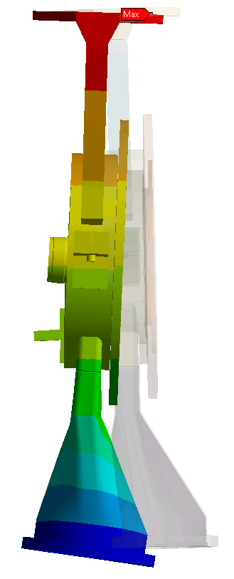
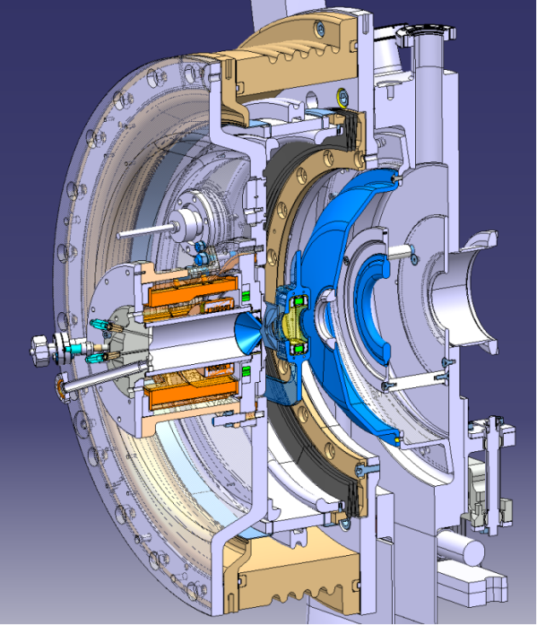
IS ENGINEERING
Linac4 Ion Source Review - 14.11.2013
M. Garlaschè; A. Dallocchio; D. Steyaert on behalf of L4 IS Team

Slide 2
Summary
Integrated mechanical design and engineering:
analytical/Finite Element analyses
experimental tests
From conceptual design to product engineering...
Courtesy J. Lettry

Slide 3
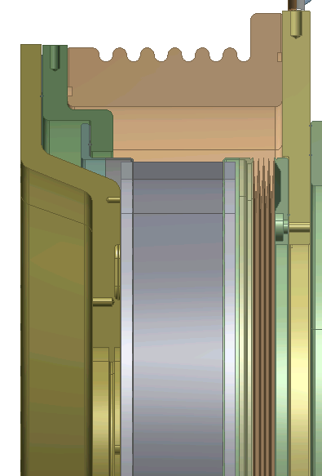
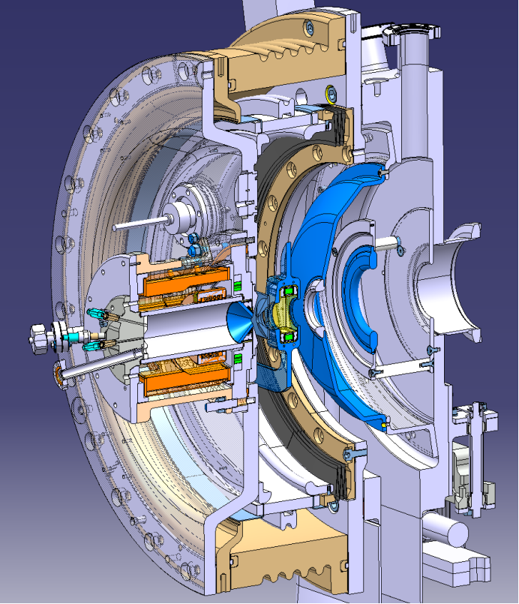
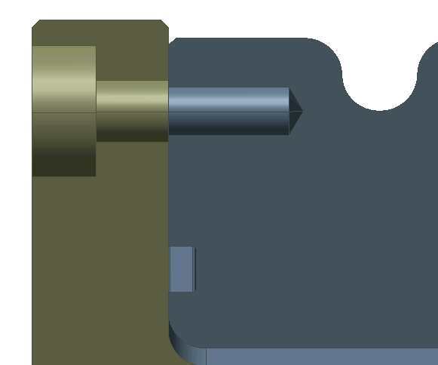
IS01 - Front End
EPGM
Insulator
Main Loads
Plasma Generator
1^{ary} vacuum
2^{ary} vacuum
O-Ring Seal
Main Insulator
Ti Insert
Glued Steel Insert
Preloaded Screw
EPGM
Insulator
Steel Flange
O-Ring Seal
Goal
Structural analysis of IS Front End
Assess performance of EPGM External Insulator

Slide 4
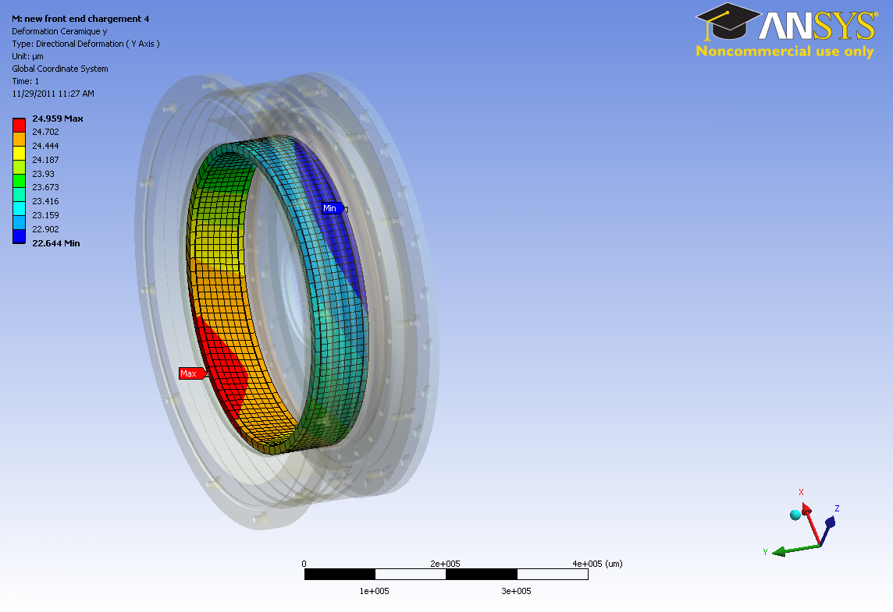
IS01 - Front End
Results
Worst case loading condition identified
Resistance of structure confirmed
Deformation of components negligible
Loss of primary vacuum
Max: 20MPa on generator flange
Few μm axial displacement on ceramic Main Insulator and Generator Flange
Axial deformation (mm)
24 μm
Ceramic Insulator
(Al₂O₃)
22 μm
What is max stress of perp. EPGM?
Courtesy M. Devoldere
Notes:
Worst case loading condition:loss of primary vacuum
No real design changes following FE results

Slide 5
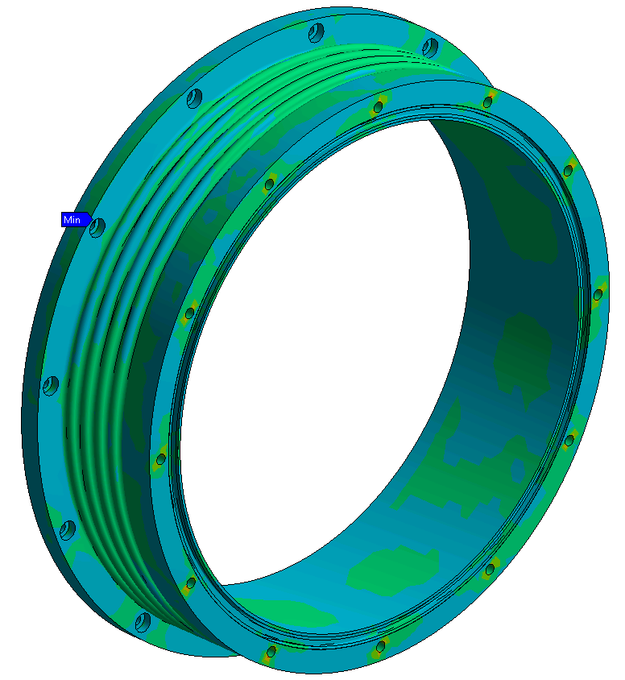
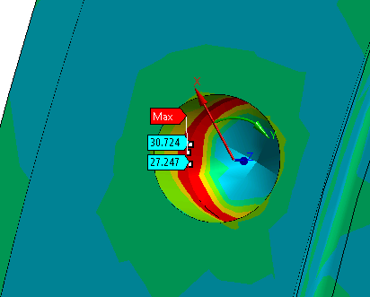

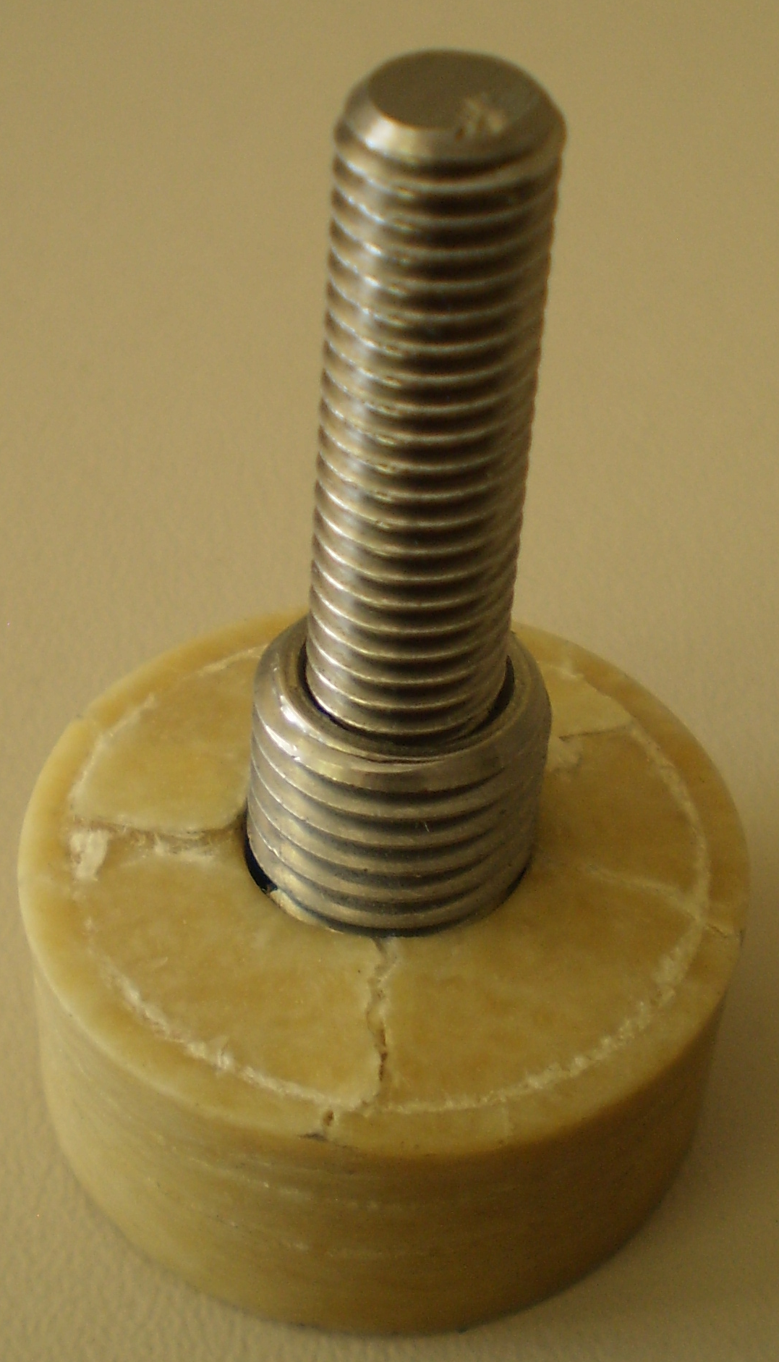
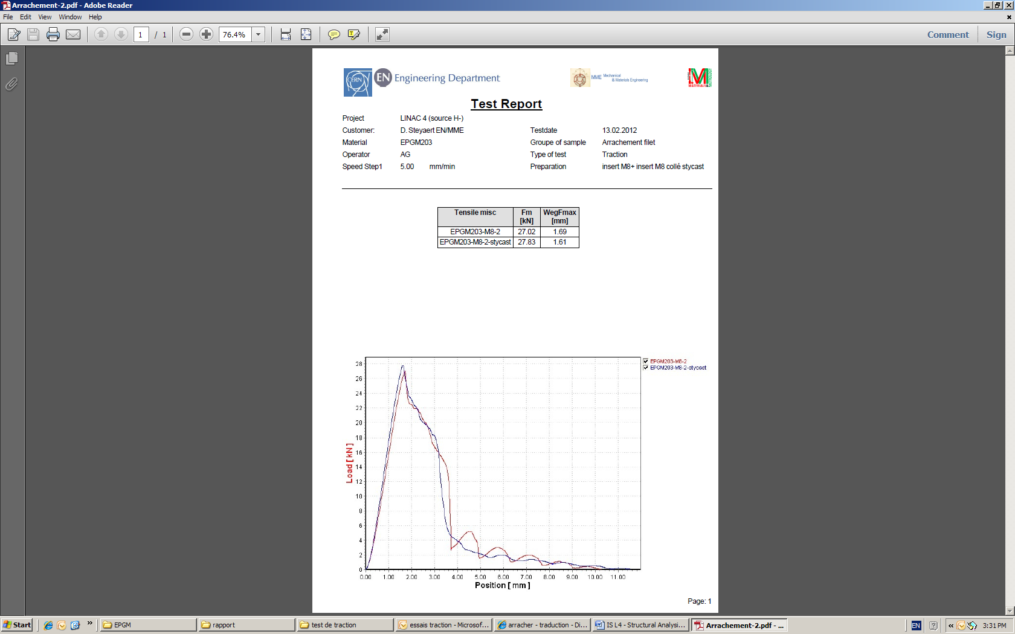
IS01 - Front End
EPGM Insulator Results
Eq. Stress (MPa)
Global stresses OK
Peak stress in correspondance of inserts..
Pull-out Test
Pull-out load VS. stroke
Rupture: 27 kN
What is max stress of perp. EPGM?
Validation of resistance to screws tightening force
Choice of Insulator fiber orientation
IS Assembly: 7 kN
EPGM
Notes:
Worst case loading condition:loss of primary vacuum
No real design changes following FE results

Slide 6
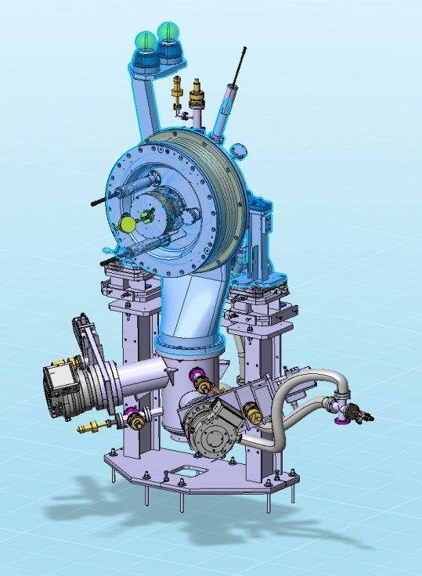
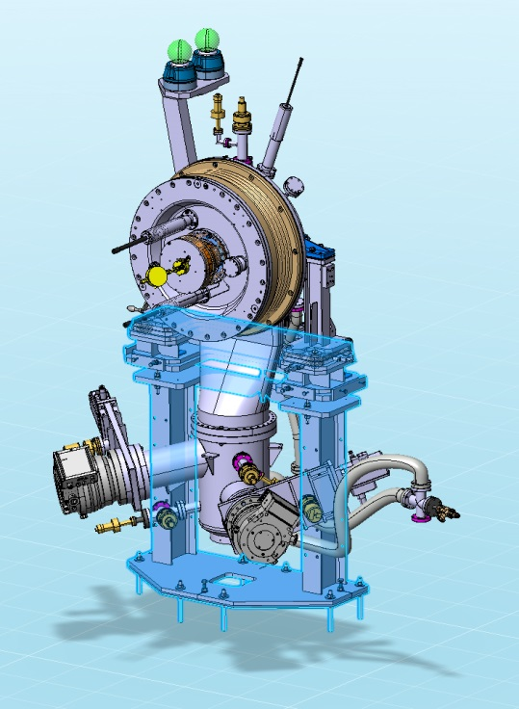
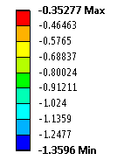
IS01 - Support
Axial displacement (mm)
Goal
Assess resistance of components
Minimize Front End displacements (beam axis)
Results
Stresses negligible
Improved Support stiffness to obtain acceptable deformations

Slide 7
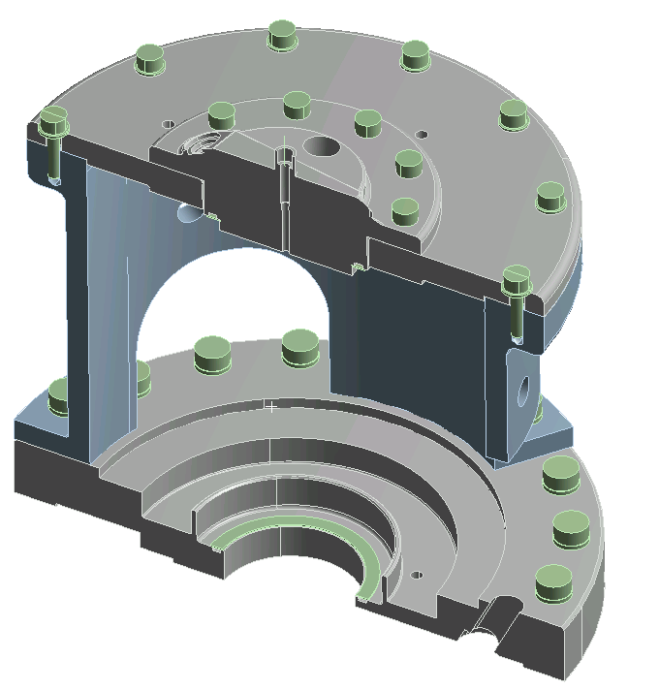
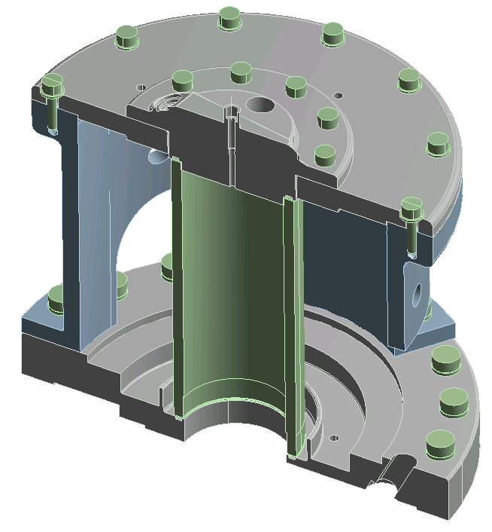
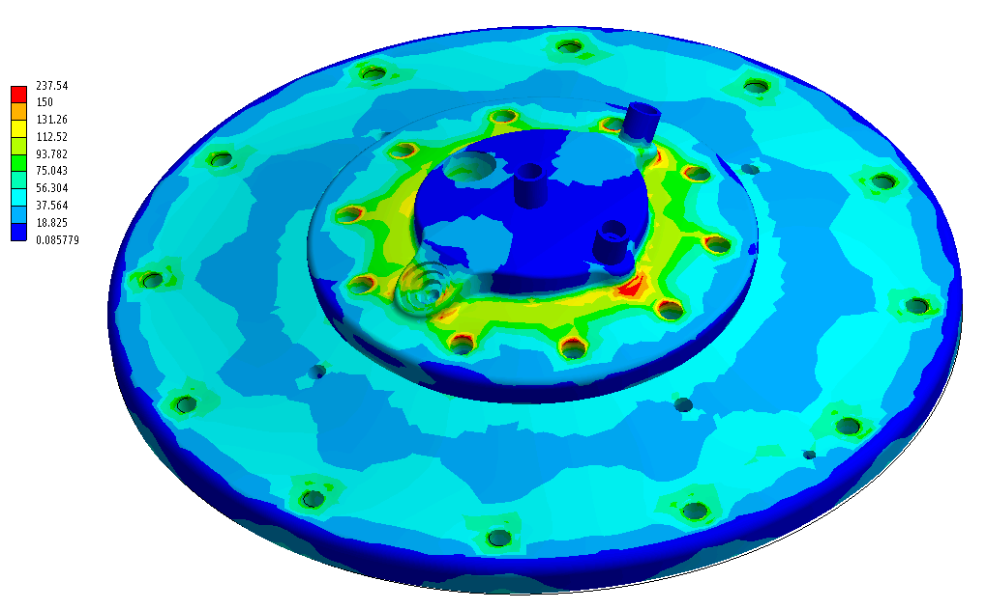
IS02 – Plasma Generator
Helicoflex seals
Goal
Design towards UHV standard by implementing metallic seals
Results
Stresses: design optimized
Assembly procedure: vacuum tightness guaranteed by using special metallic seals (HNRV helicoflex)
240
0
7
Tresca equivalent stress (MPa)
Notes:
Benchmark w.r.t. Stresses, elastic recovery during assembly procedure

Slide 8
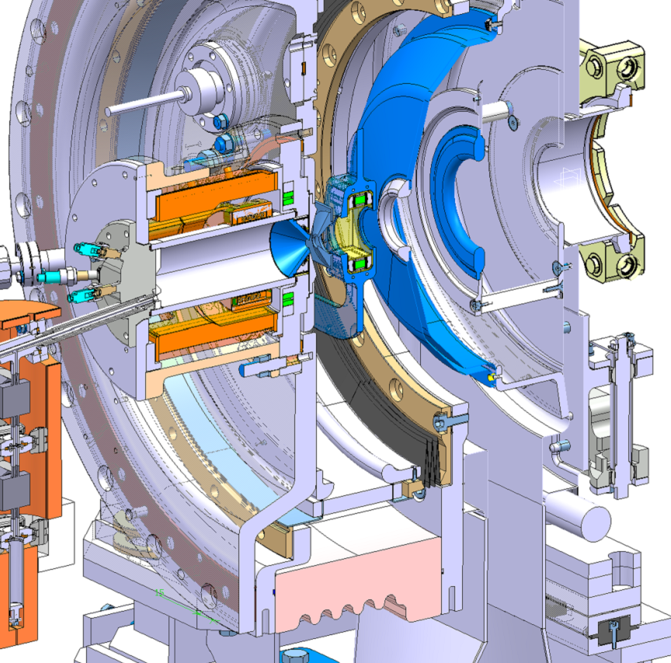
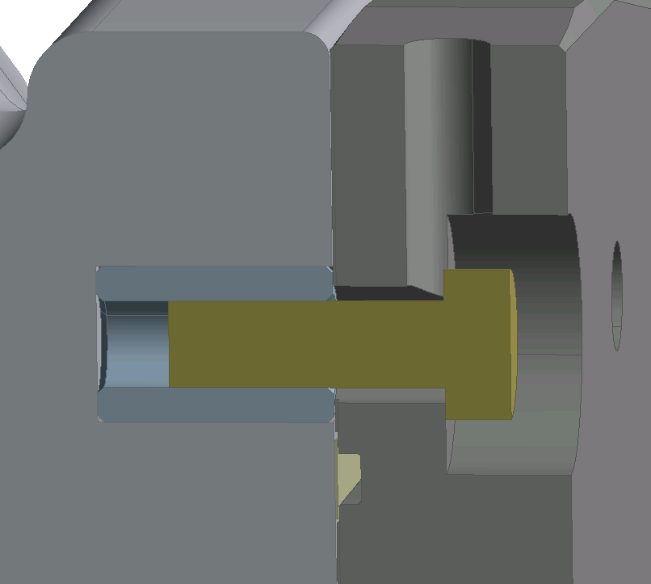
IS02/03 v1– Ext. Insulator
Goal
Improved UHV reliability with metallic seals
EPGM→Al₂O₃
Complex brazing of Titanium Inserts with Insulator
Al₂O₃ Insulator
Steel Flange
32xM8 Preloaded
Brazed Ti Insert
Ti Disc (H.flex seat)
H.Flex seal
Notes:
Stresses intensifications also linked to machining of holes

Slide 9
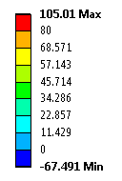
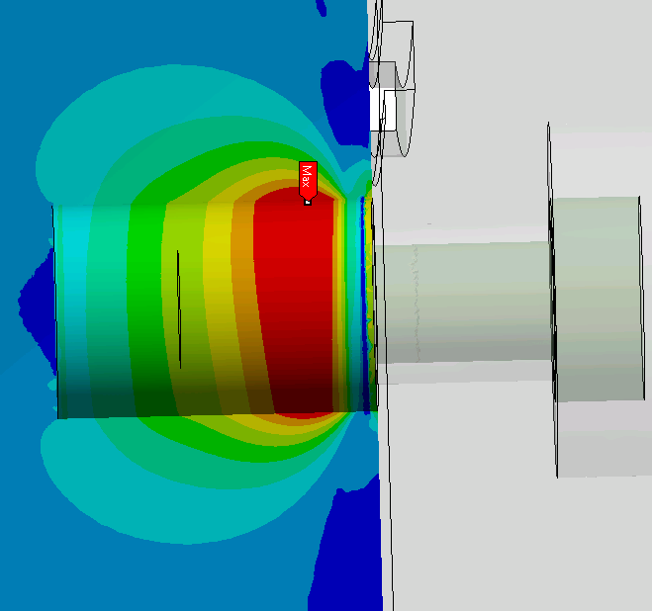
IS02/03 v1– Ext. Insulator
Goal
Improved UHV reliability with metallic seals
EPGM→Al₂O₃
Outcome
High stress in ceramic
Test campaign launched for
  Checking brazing procedure
  Mastering bolts preload
  Understanding Al₂O₃ struct. behaviour
Complex brazing of Titanium Inserts with Insulator
Al₂O₃ Insulator
Steel Flange
Principal stress (MPa)
32xM8 Preloaded
Brazed Ti Insert
Al₂O₃
Safety factor = 1.4
→ CRITICAL!
Ti Disc (H.flex seat)
H.Flex seal
Notes:
Stresses intensifications also linked to machining of holes

Slide 10
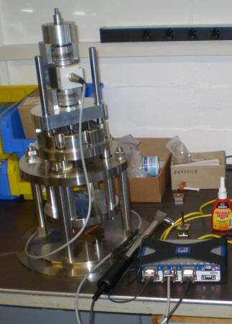
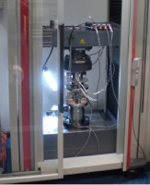
IS02/03 v1 – Ext. Insulator
..mastering bolts preload
Influence of Ti thermal treatment on friction @ preload
Change of friction coefficient during lifetime
Friction increases after Titan thermal treatment
No measured change (NOTE: to be ideally assembled once)
Courtesy EN/MME-ES
..understanding Al₂O₃ properties
Tests foreseen
Rupture properties
Tightening brazed insert
Pull-out
Ongoing – needed for brazing & struct. assessment
Notes:
Treated Titan: Coefficient of friction increases

Slide 11
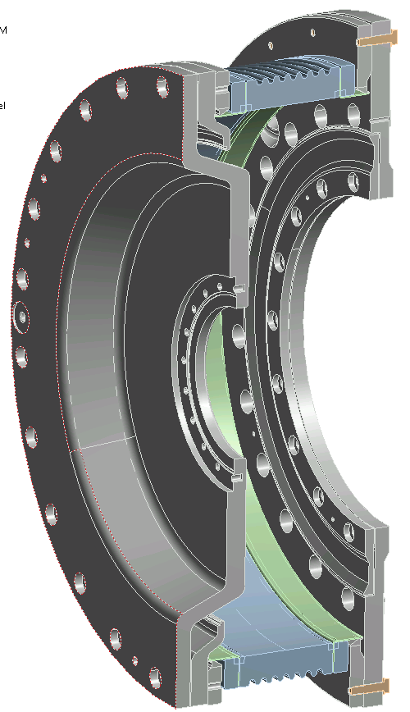
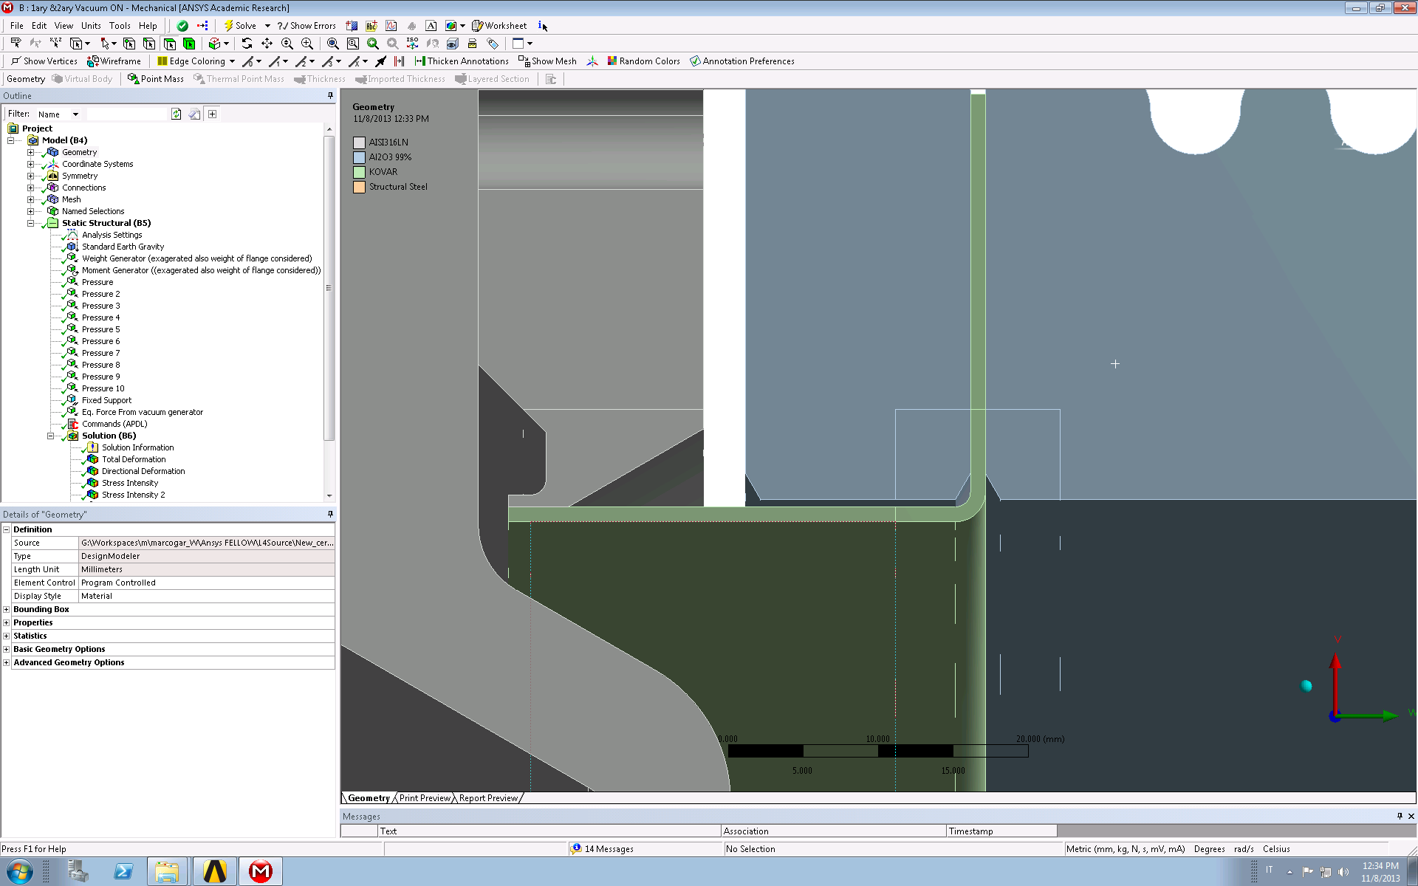
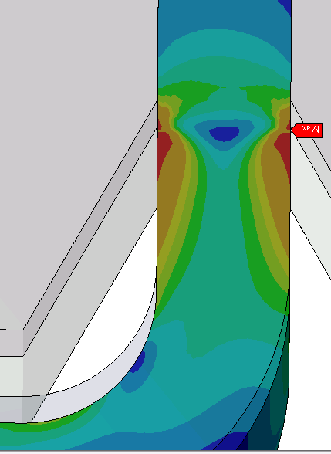
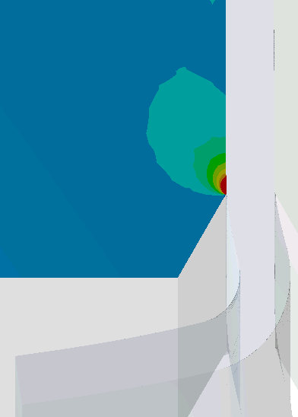
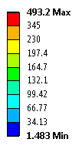
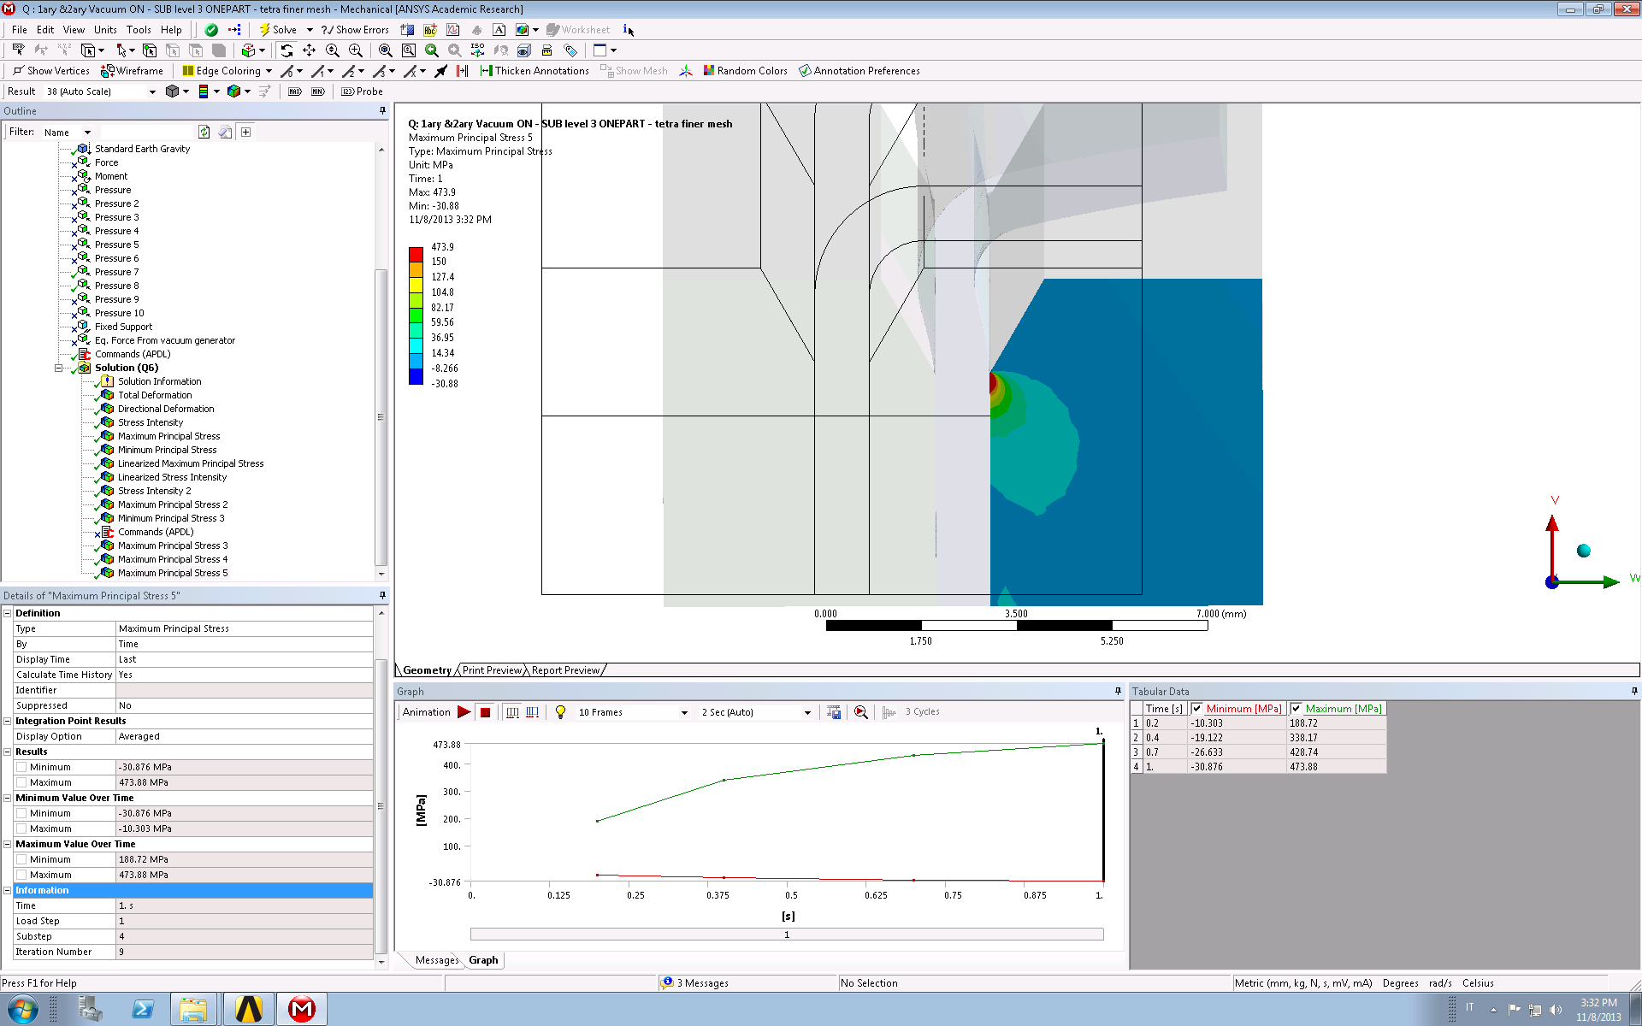
IS02/03 – Ext. Insulator
Goal
Alternative design with
No brazed inserts
Insulator (Al₂O₃) brazed to collars (Kovar)
Outcome
Vacuum-related load transmitted solely through collar-insulator
Collar
Ext. Insulator
Eq. stress (MPa)
Principal stress (MPa)
Steel
Al₂O₃
Kovar
Plasticization
Potential
CRACK
Solution
Abandoned
Notes:
Bilinear isotropic hardening used for modelling Kovar yielding

Slide 12
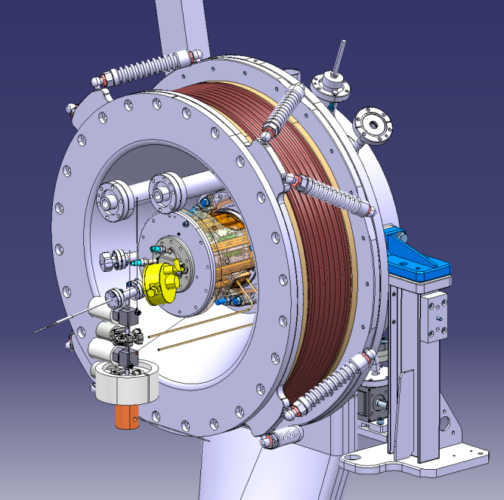
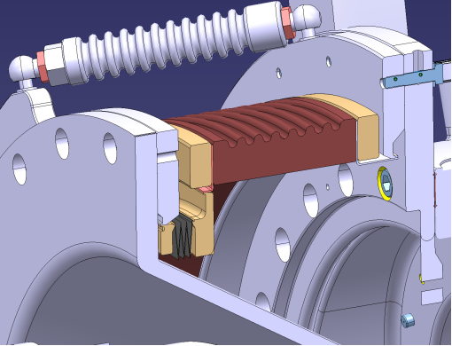
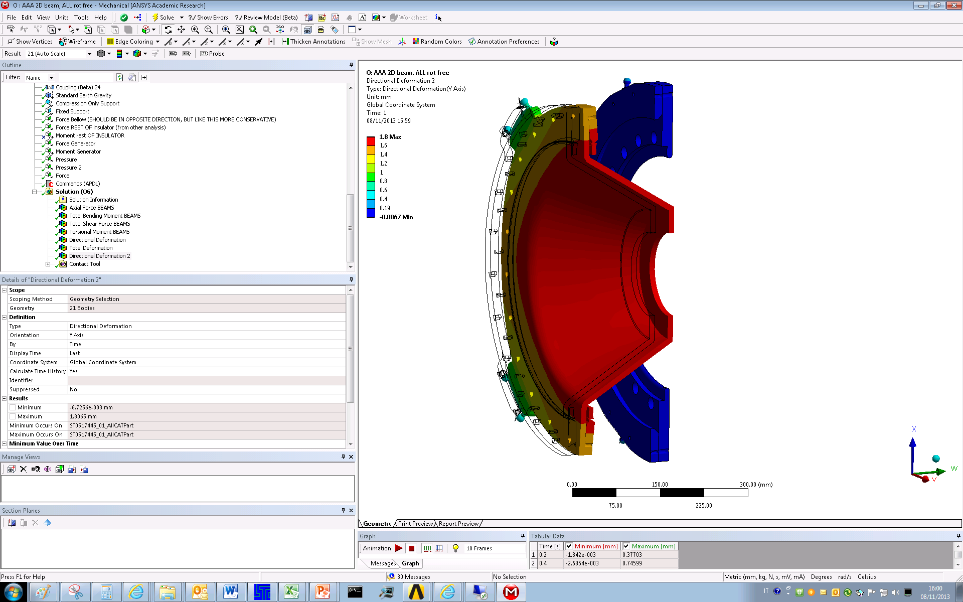
IS02/03 - Front End
Goal
Alternative design with Insulator brazed to collars
Reduce load on collar and Ext. Insulator by bellow + support rods
New Requests:
  improve optics → no 2ary vacuum
Results
Stresses: negligible
Displacements
support rod
Axial displ. (mm)
..elastic, predictable
BASELINE
Optimization ongoing for reducing displacements
bellow

Slide 13
Conclusions and future outlook
June 2011 → Present:
Engineering activities required ≈ 3 FTE
(2 Fellows working 50% on the L4 IS)
Present → future...
Estimate for future engineering activities ≈ 1,5 FTE
(1 Fellow working 50% on the L4 IS)
What’s Next (IS02 / IS03):
Design finalization of Front-End and Ext. Insulator:
structural analysis and experimental validation
Cesium Oven – thermo-mechanical calculations
Structural analysis to integrate IS03 Plasma Generator
Cold Cs Trap: thermal analysis
Notes:
Remind that eng. Supp. Comes free with design

Slide 14
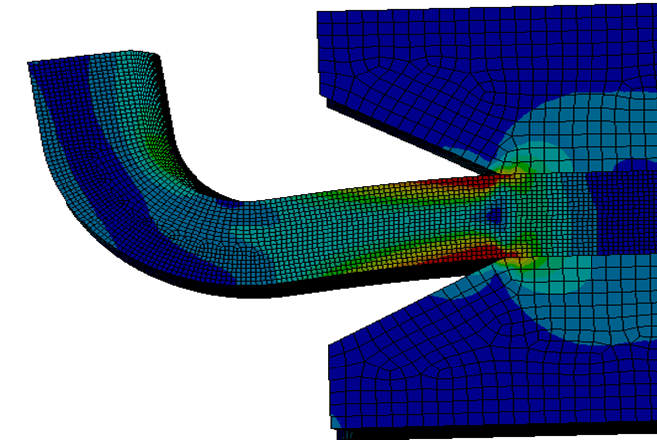
Thank you for your Attention!

