Slide 1
RF fields simulations
Alexej Grudiev, BE-RF
14/11/2013
Linac4 Ion Source Review, CERN

Slide 2
Outline
RF field simulations setup
Plasma model as a conductor
Surface electric field enhancement
EM field distribution in plasma chamber
Ion source Impedance
Comparison with measurements
Variation of the ion source geometry
Conclusions

Slide 3
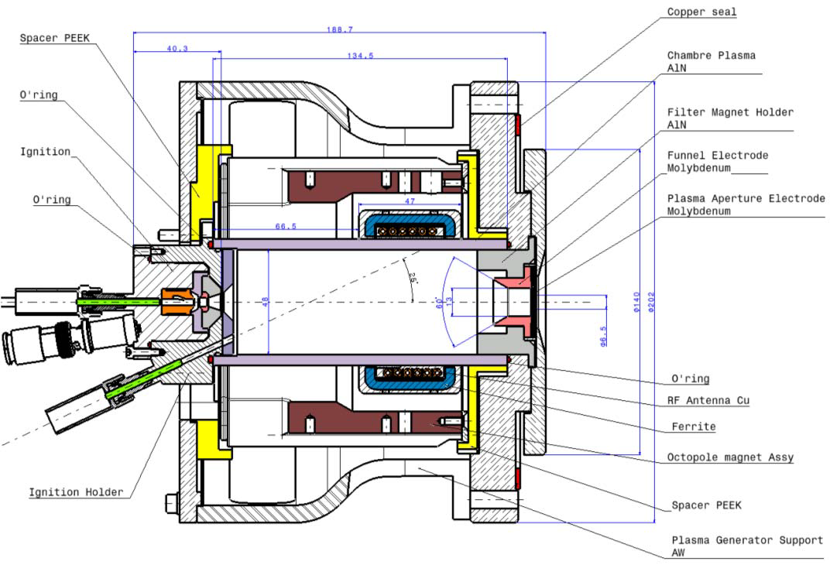
CAD 3D model of IS-01
Didier Steyaert

Slide 4
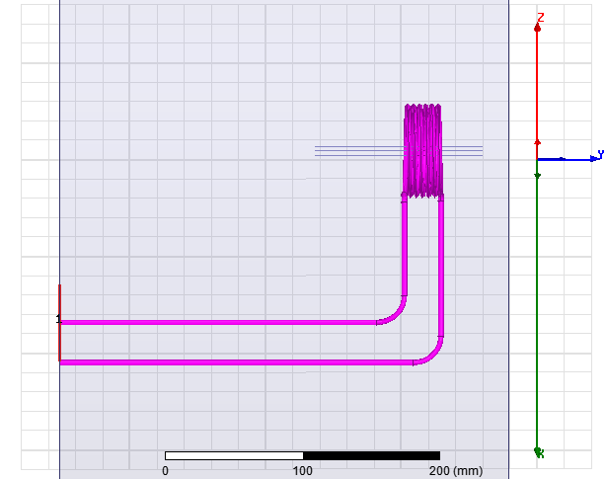
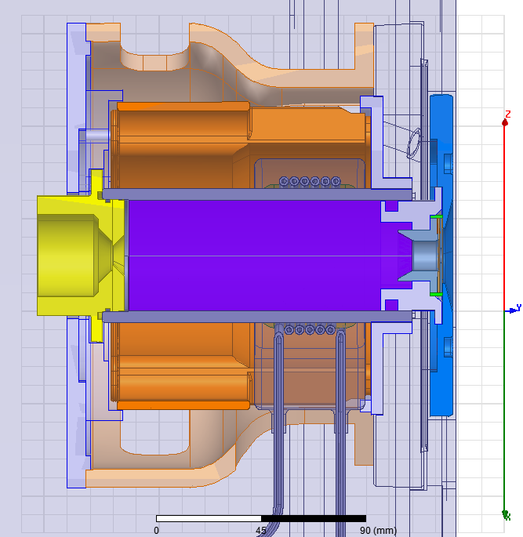

RF simulation setup (HFSS)
Coax port
Full 3D RF simulations
P_{in}
P_{out}
“Plasma” = conductor
10⁻⁴ < σ < 10⁵ [S/m]
σ/ω > ε₀ δ > 1mm
ε = ε₀+jσ/ω; δ = (2/σωµ₀)^{1/2}
Z_{c}=Zo
Z_{IS}=Z:1:1
Z_{IS}
P_{in} = 1W => I_{in} = sqrt(2P_{in}/Z_{c}) = 0.11A
I=2I_{in} = 2*0.11A = 0.22 A
To scale the EM fields presented later, multiply by the current ratio

Slide 5
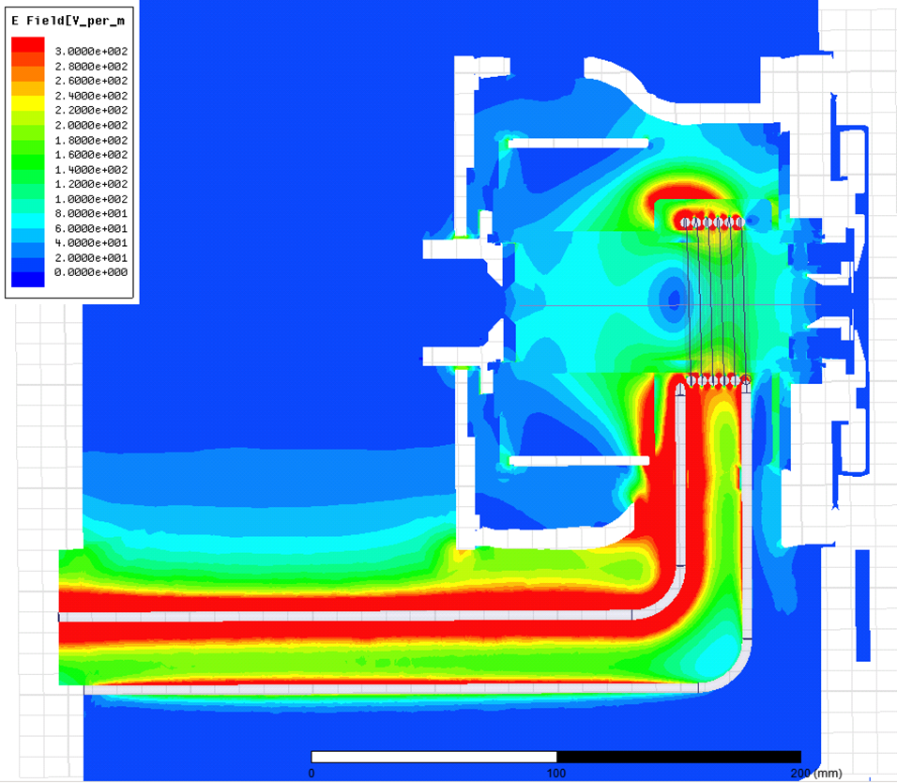
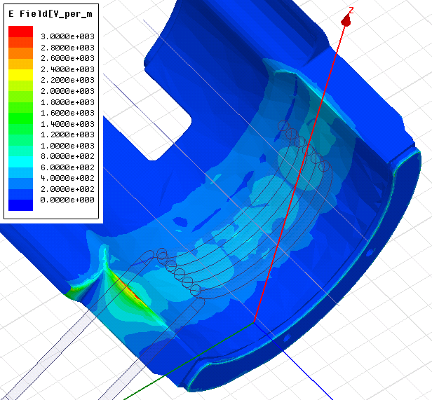
Surface electric field enhancement
Max E-field on the surface of the Cu octupole envelop for 220 A coil current is about 3 MV/m, same as air discharge threshold. This due to sharp edge close to the coil.

Slide 6
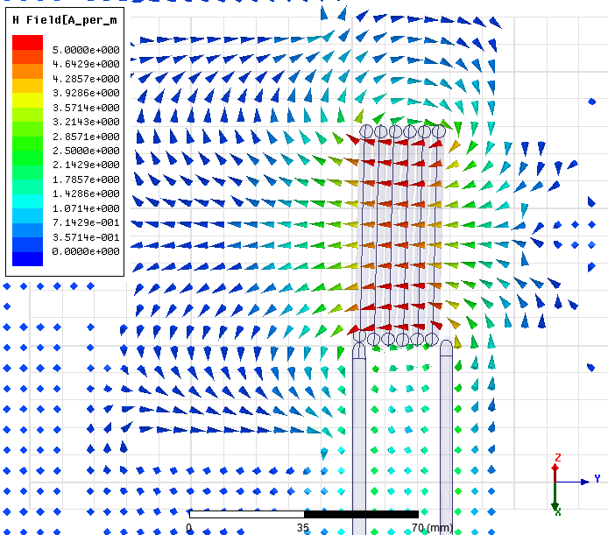
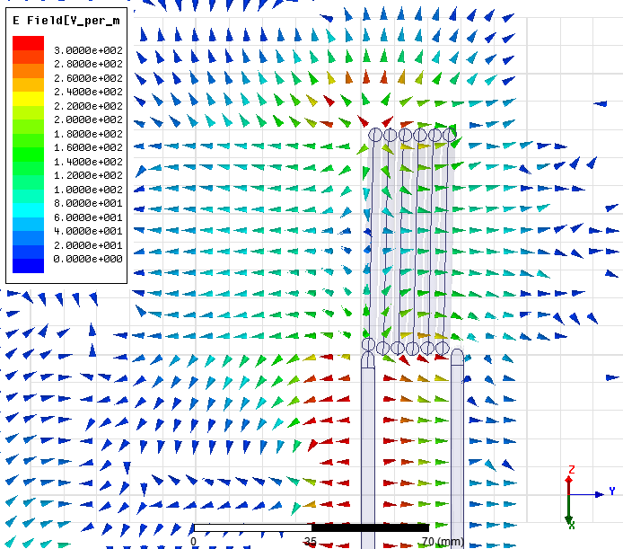
EM field distribution in plasma chamber region, σ=0
Magnetic field
Electric field
H-field is similar to the one of a solenoid
E-field is dominated by R,Z components.
It is mainly capacitive

Slide 7
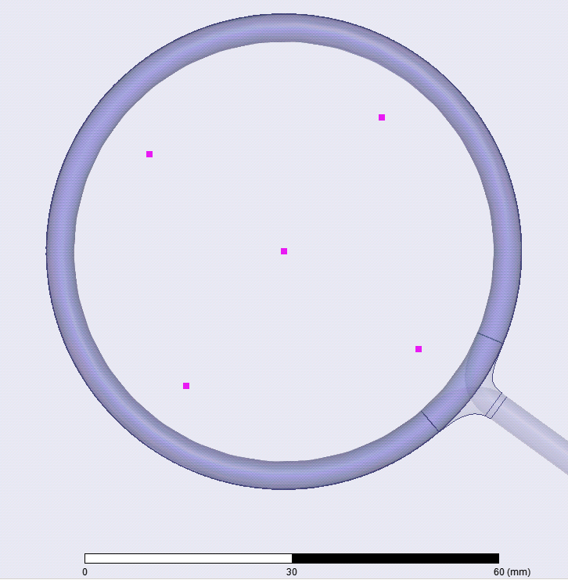
Field map for plasma simulations
Averaging the field over 4 meshes remove radial and azimuthal components on axis r=0 and make the distribution quasi 2D.
To be used in the plasma simulation code with 2D field representation.
Field = 1/4*[ field(mesh_0)+field(mesh_1)+ field(mesh_2)+field(mesh_3)]
mesh_2
mesh_3
mesh_1
mesh_0

Slide 8
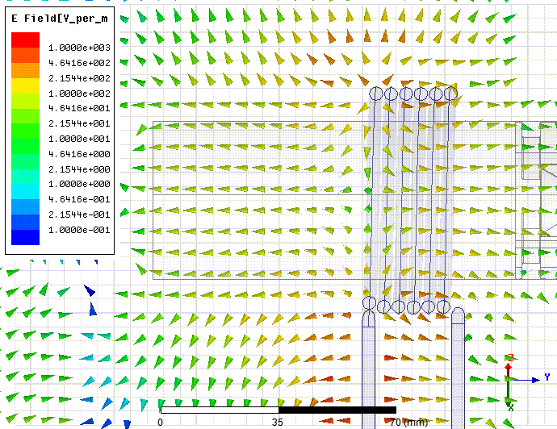
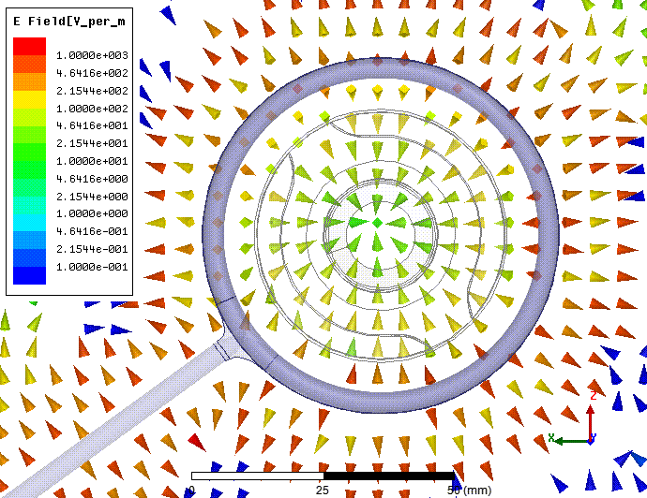
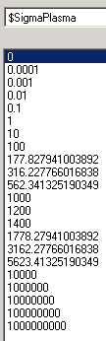
E-field distribution in plasma chamber. σ > 0

Slide 9
Ion source impedance
R_{ANT}
L_{ANT}
Model used in the RF measurements
Z_{Plasma} = Z_{Ant+Plasma}(σ>0) - Z_{Ant}(σ=0)
Z_{Ant} = R_{Ant} +jω₀L_{Ant}
Z_{Plasma} = R_{Plasma} +jω₀L_{Plasma}
R_{Plasma}
L_{Plasma}
RF Measurements IS-01:
R_{Ant} = 0.4 Ω
L_{Ant} = 3.2 µH
R_{plasma} = 4.3 Ω
L_{plasma} = -0.05 µH
M. Paoluzzi
Simulations IS-01:
R_{Ant} = 0.263 Ω
L_{Ant} = 3.02 µH
σ = 300 - 500 [S/m]
Plasma measurements (SPL-IS): H₂ pressure ~ 20 mTorr, n_{e} ~ 10¹⁸ - 10¹⁹ m⁻³ and T_{e} ~ 10 eV. =>
It gives an estimate of the conductivity of 730 - 6600 S/m for the above given density range
R. Scrivens

Slide 10
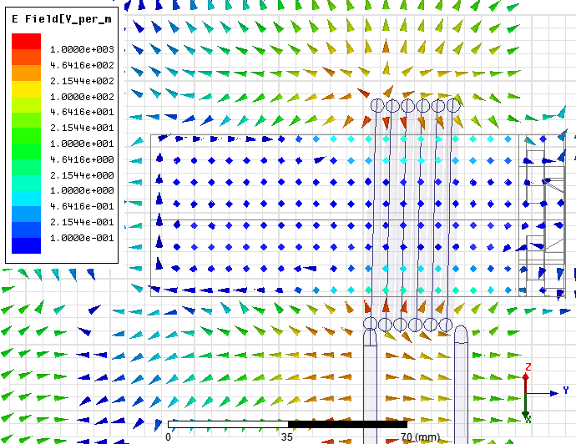
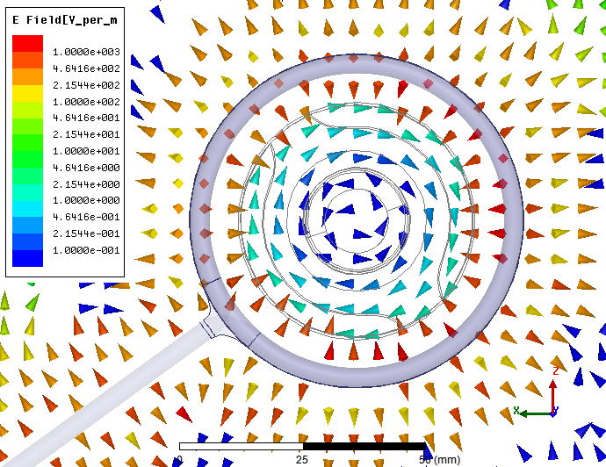
E-field distribution in plasma chamber, σ = 1000 S/m

Slide 11
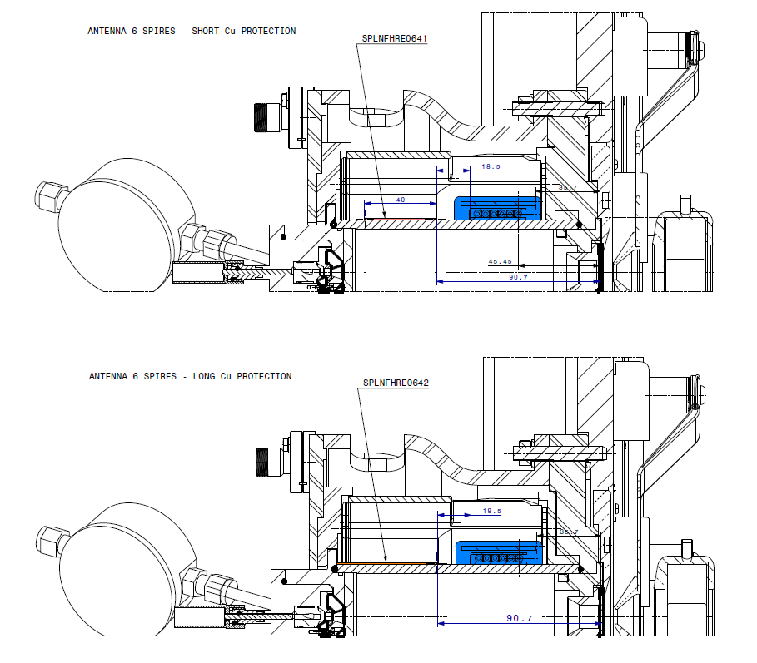
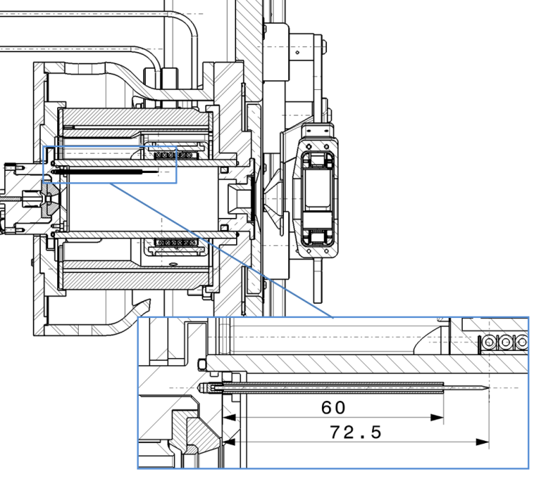
Variations: SET 1
No Cu octupole holder
Long Cu protection
Short Cu protection
W-electrode

Slide 12
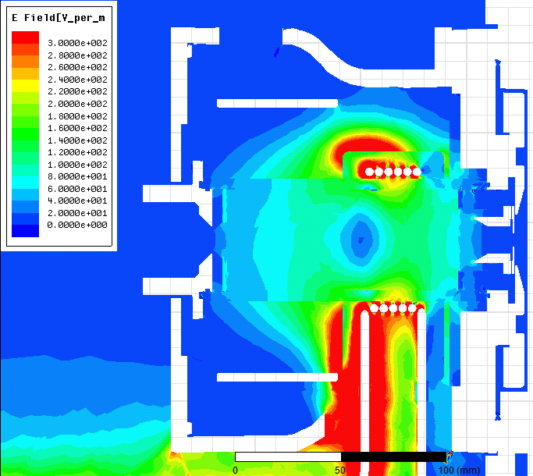
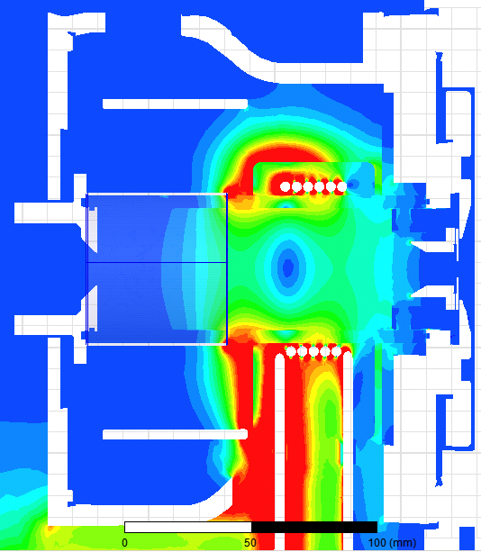
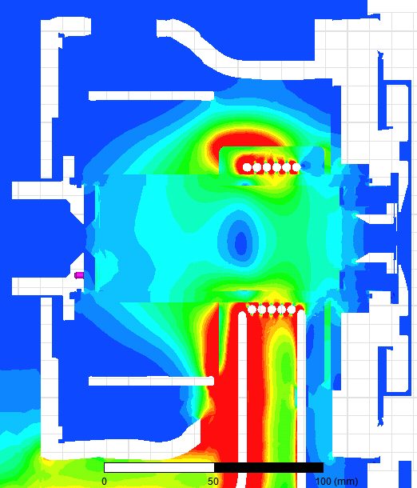
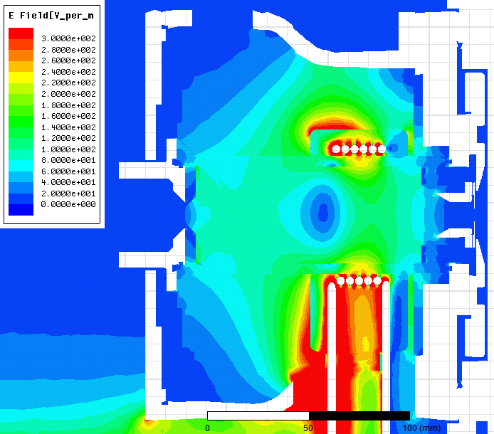
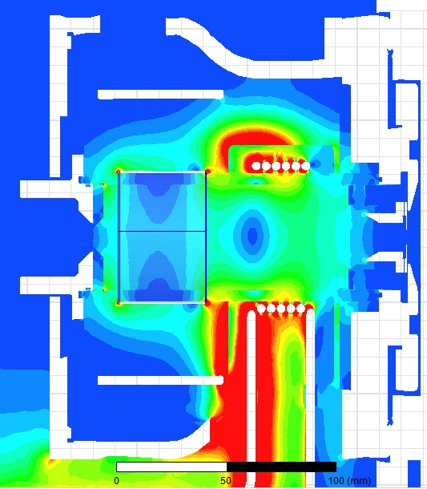
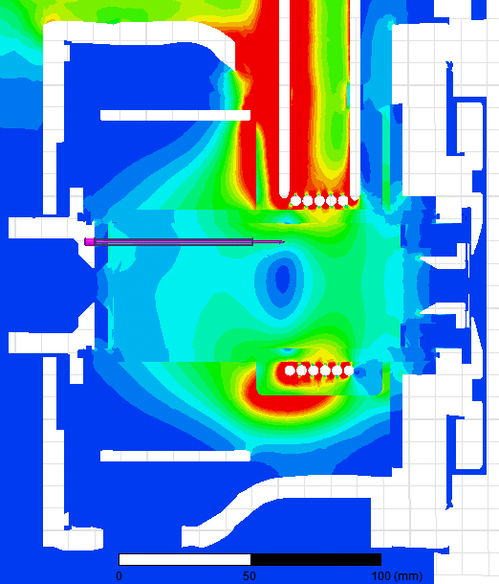
Variations SET 1: E-field distribution
Nominal
Long Cu protection
W-electrode
No Cu Octupole holder
Short Cu protection

Slide 13
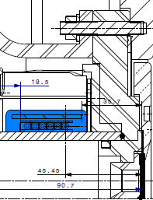
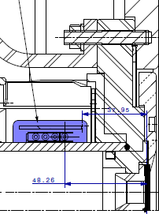
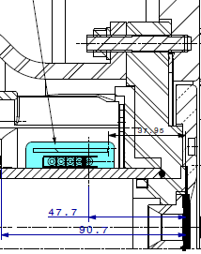
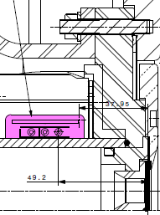
Variation of number of antenna turns
6 turns
4 turns
Nominal, 6 turns
5 turns
4 turns
3 turns
N.B. for 5,4,3 turns the size of epoxy and ferrites are a bit smaller. The same materials are used
5 turns
3 turns

Slide 14
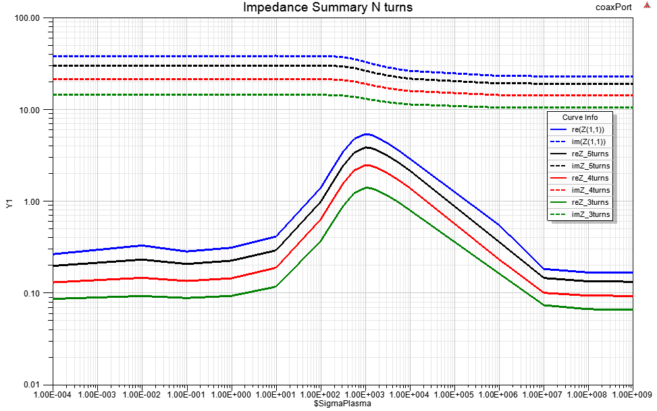
Variation of number of turns: impedance
~N²

Slide 15
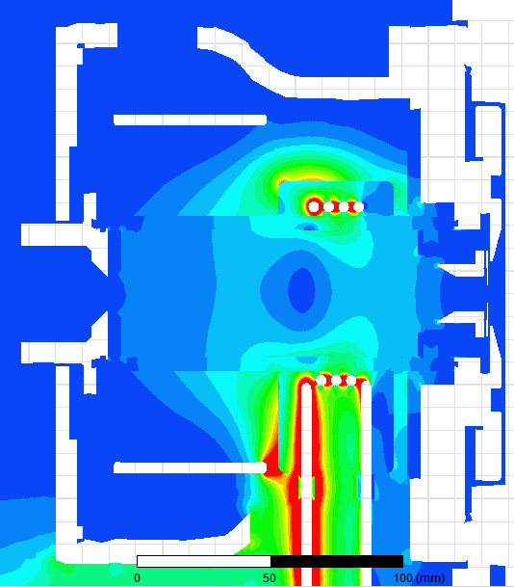
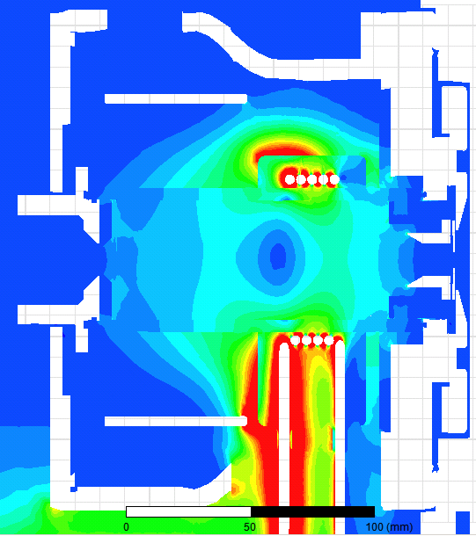
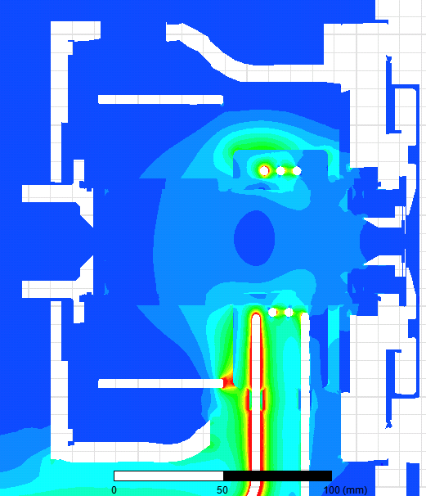
Variation of N turns: E-field distribution
6 turns
4 turns
Plasma
code
5 turns
3 turns

Slide 16
Conclusions
Full 3D model with realistic material parameters is implemented and simulated using RF code HFSS
Plasma is modelled as a conductor
Surface electric field is calculated and compared to discharge limited values
Without plasma electric field distribution in the plasma chamber is dominated by R,Z components, capacitive electric field
EM field maps has been calculated for the plasma simulation code
Impedance of the ion source as a function of “plasma” conductivity is calculated and compared to the RF measurements results
Matching simulated and measured impedance values gives plasma conductivity which agrees with the one calculated from measured plasma parameters
Several variations of the IS-01 has been simulated

Slide 17
Spare slides

Slide 18
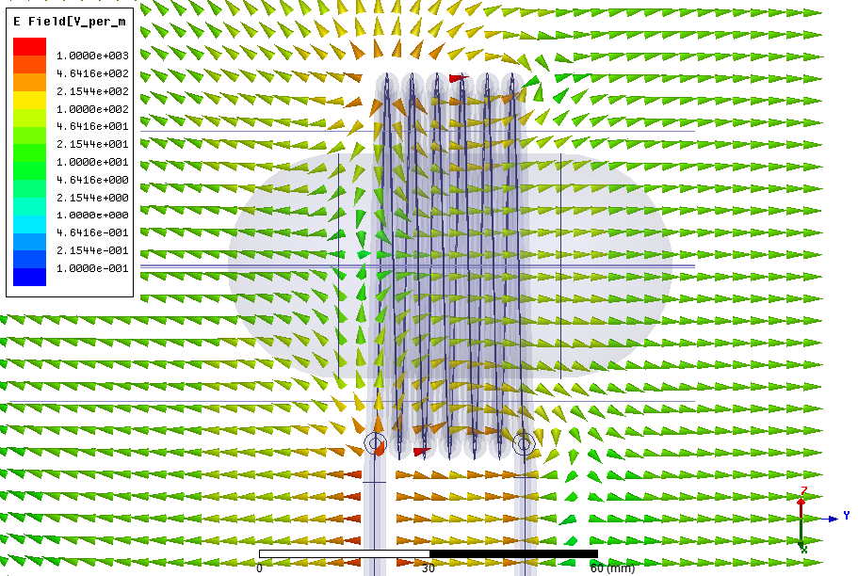
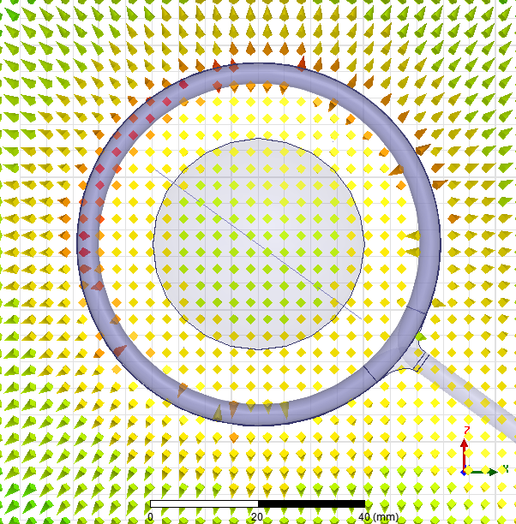
E-field: antenna + “plasma” (σ = 0 S/m)

Slide 19


E-field: antenna + “plasma” (σ = 1e-4 S/m)

Slide 20
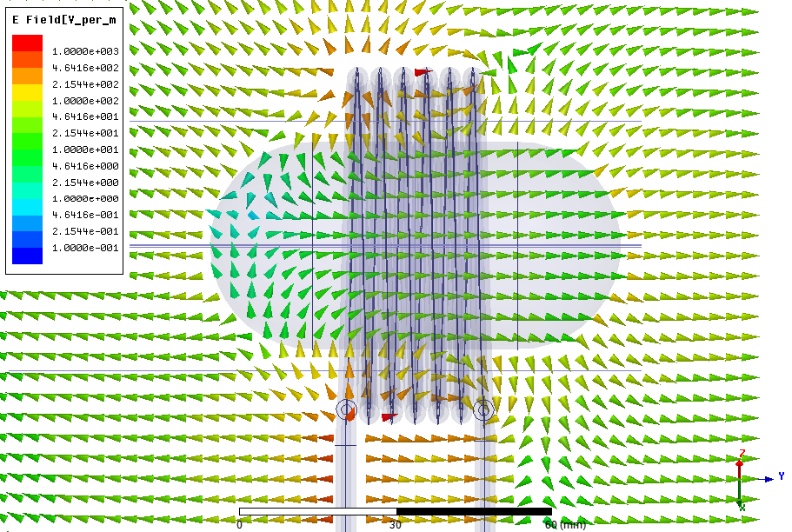
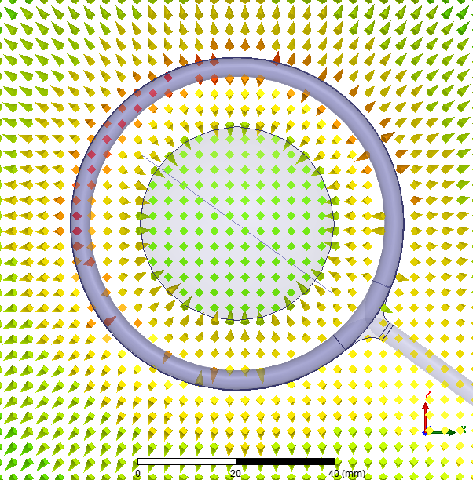
E-field: antenna + “plasma” (σ = 1e-3 S/m)

Slide 21
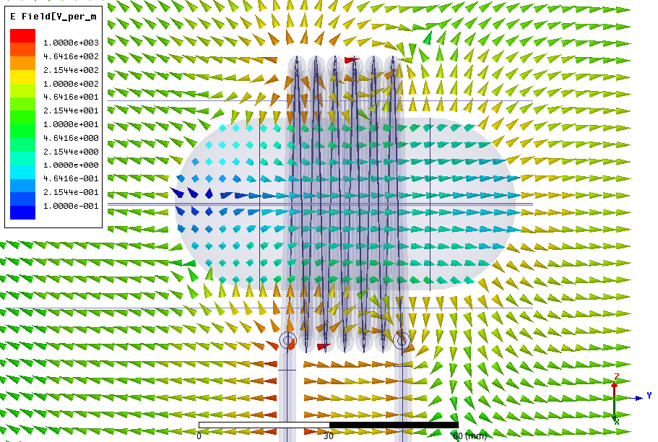
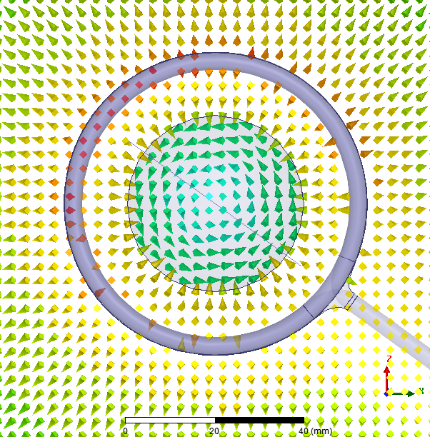
E-field: antenna + “plasma” (σ = 1e-2 S/m)

Slide 22
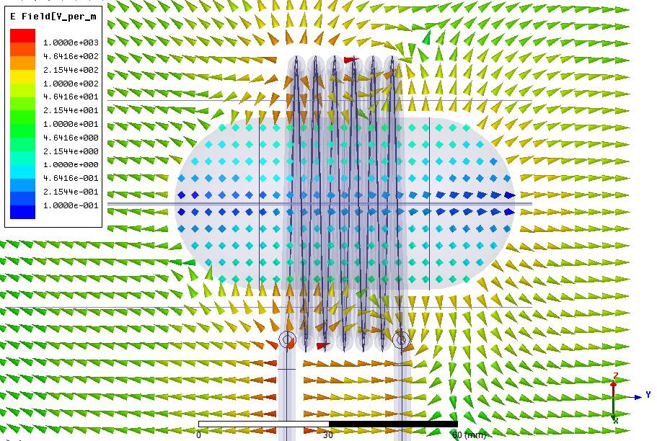
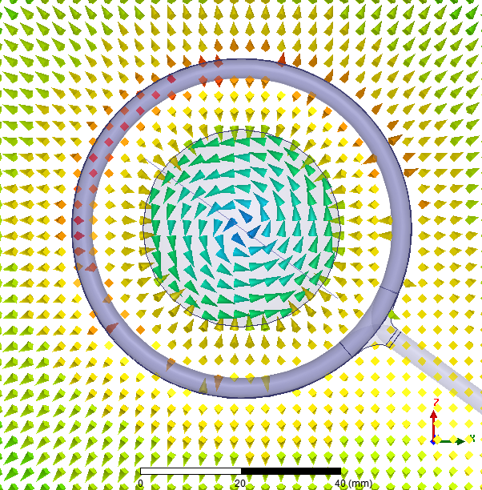
E-field: antenna + “plasma” (σ = 1e-1 S/m)

Slide 23


E-field: antenna + “plasma” (σ = 1e-0 S/m)

Slide 24
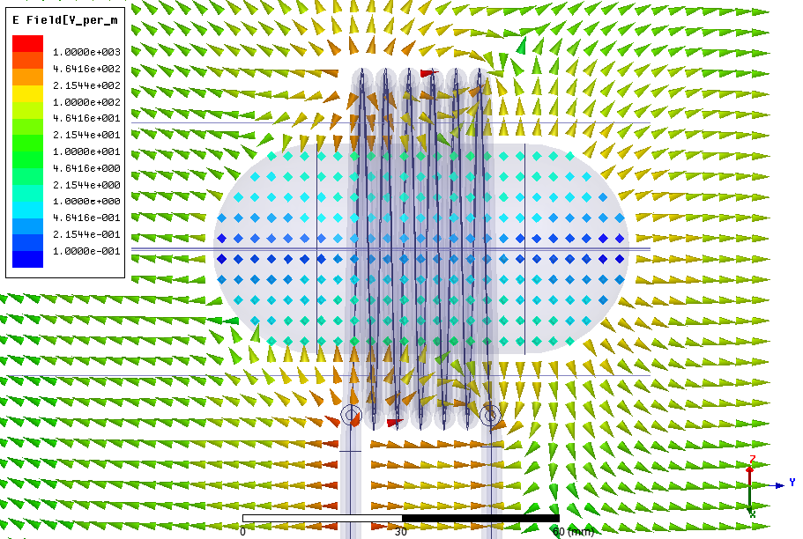

E-field: antenna + “plasma” (σ = 1e+1 S/m)

Slide 25


E-field: antenna + “plasma” (σ = 1e+2 S/m)

Slide 26
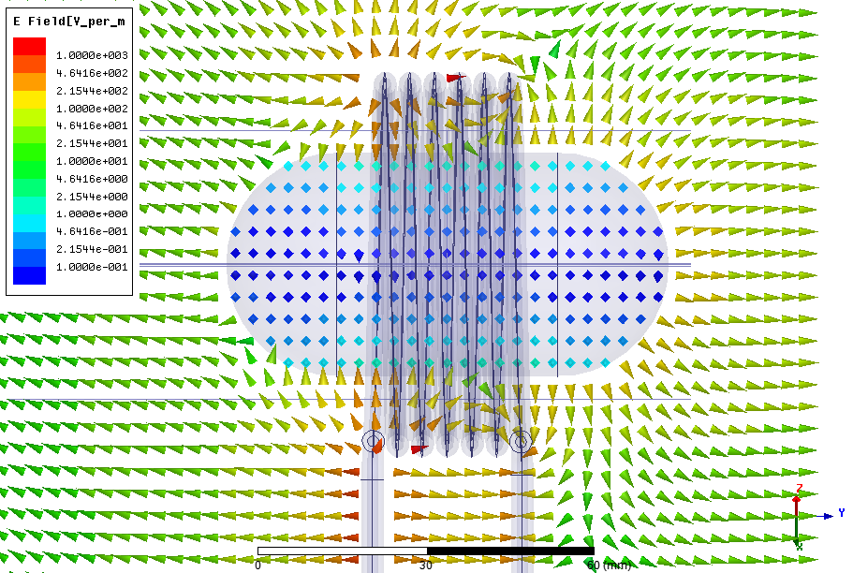
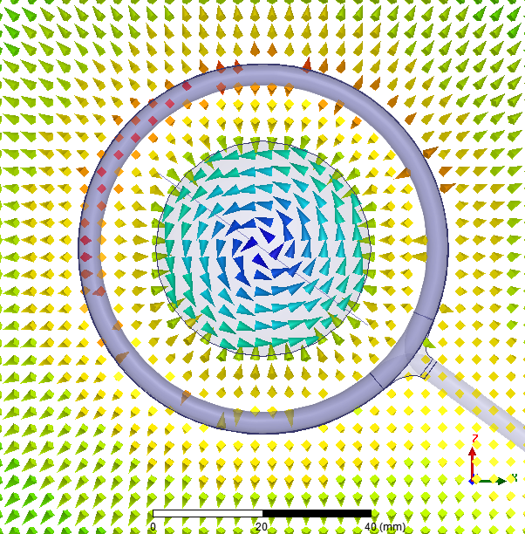
E-field: antenna + “plasma” (σ = 1e+3 S/m)

Slide 27
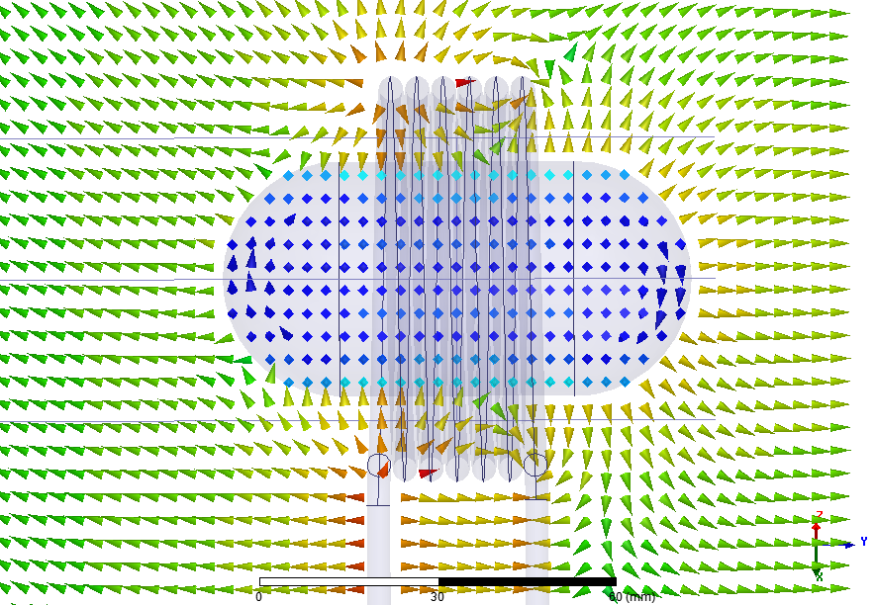
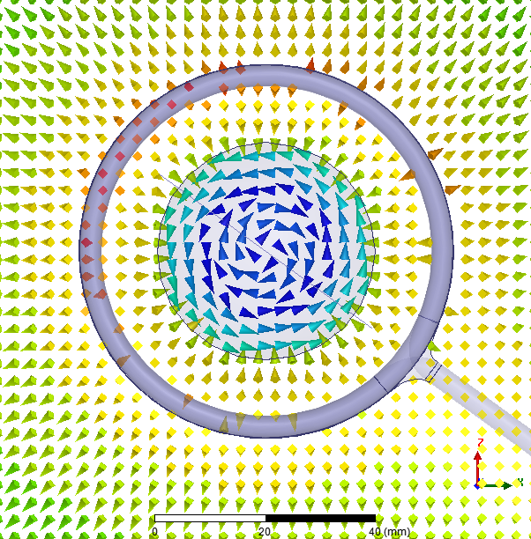
E-field: antenna + “plasma” (σ = 2e+3 S/m)

Slide 28
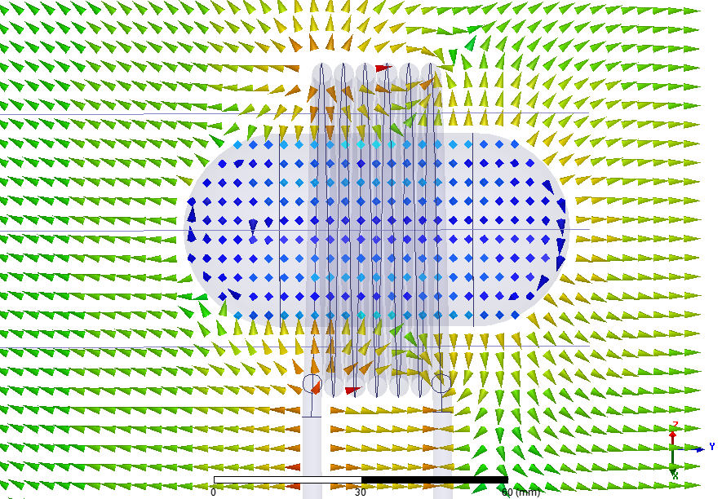
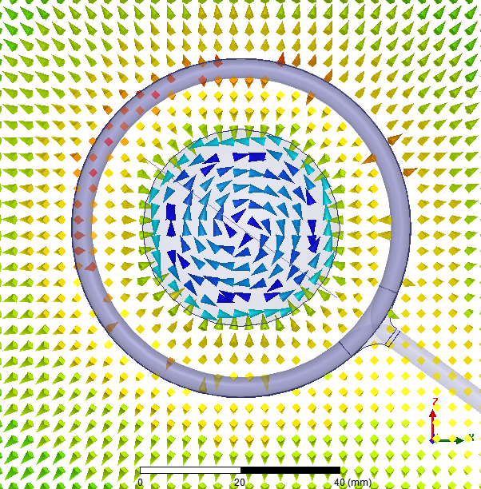
E-field: antenna + “plasma” (σ = 3e+3 S/m)

Slide 29
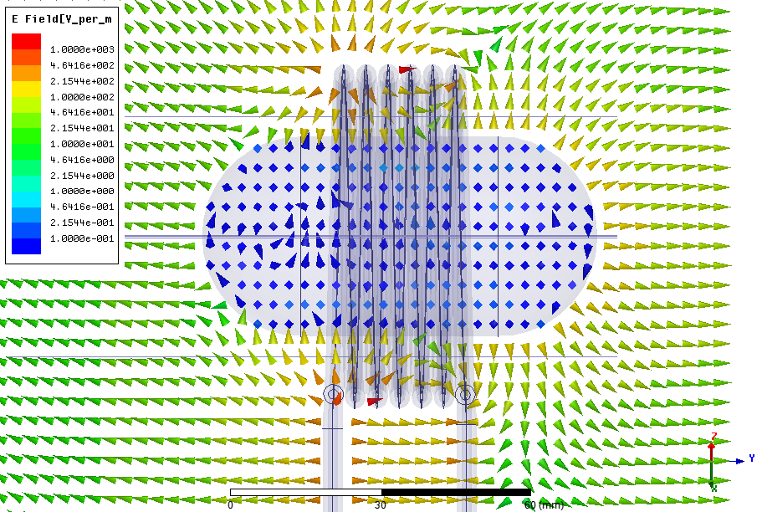
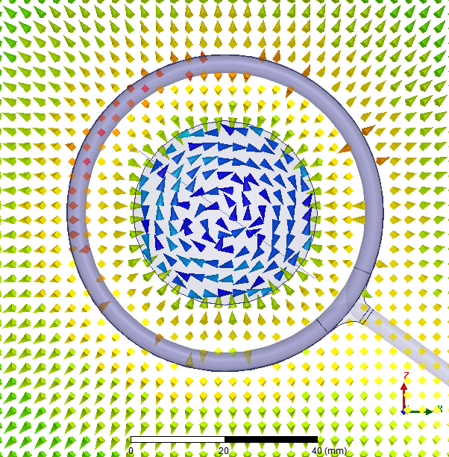
E-field: antenna + “plasma” (σ = 1e+4 S/m)

