Slide 1
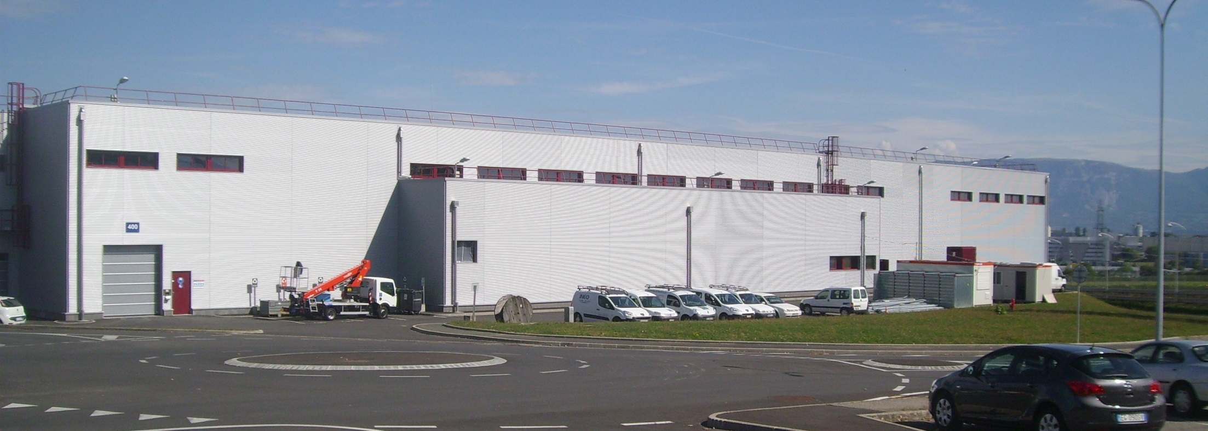
Status of Linac4
Ion Source Review, 14 November 2013
M. Vretenar, CERN

Slide 2
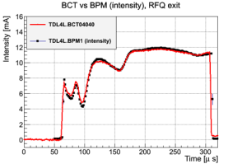
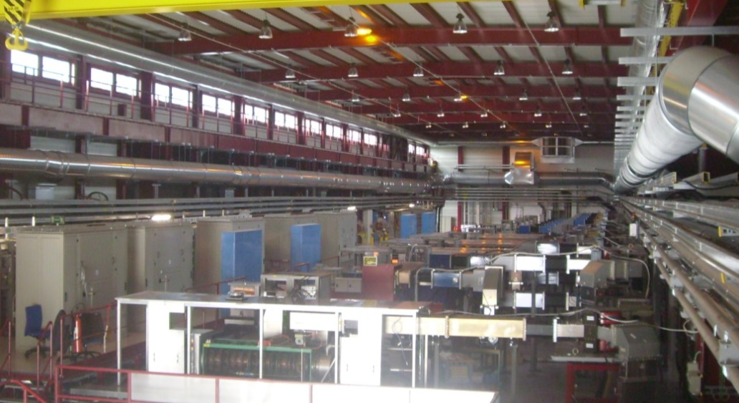
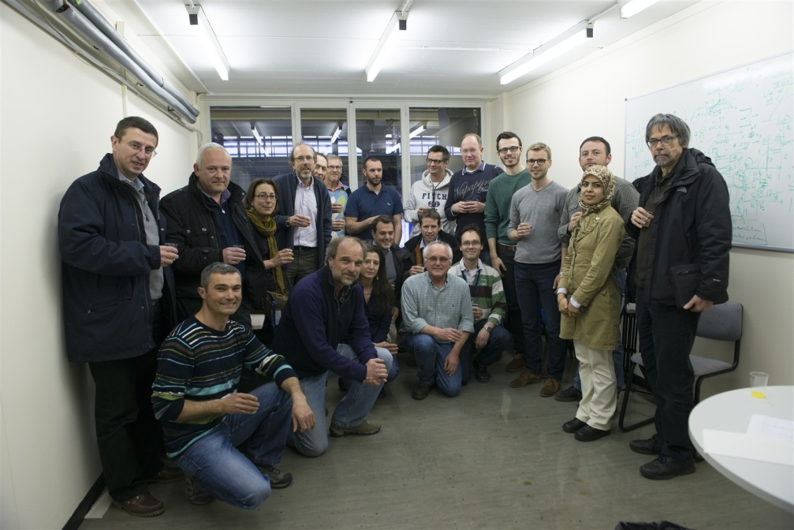
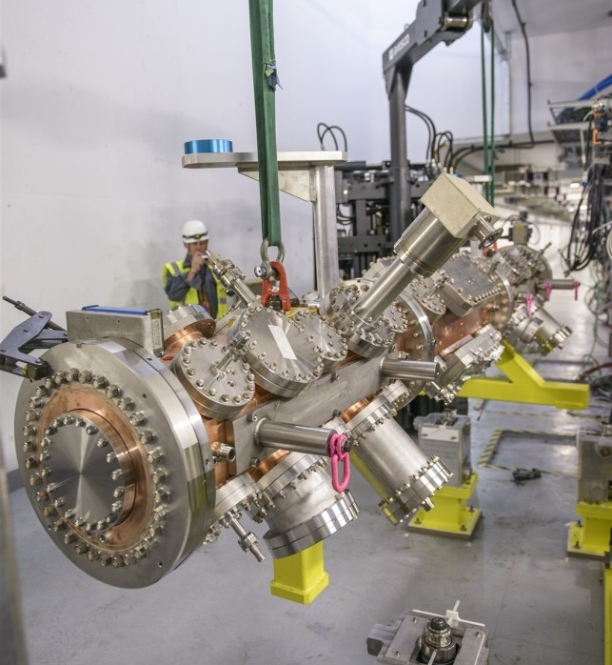
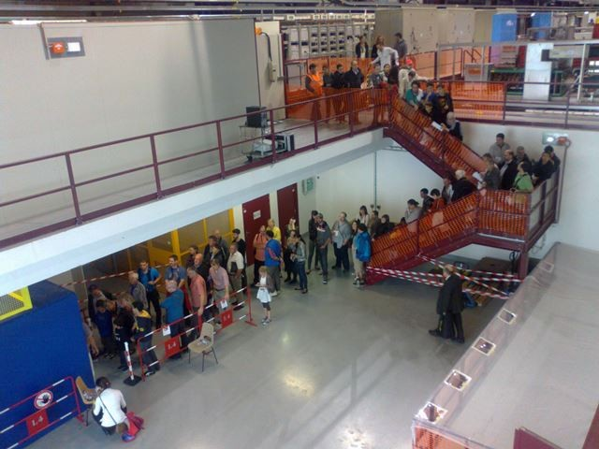
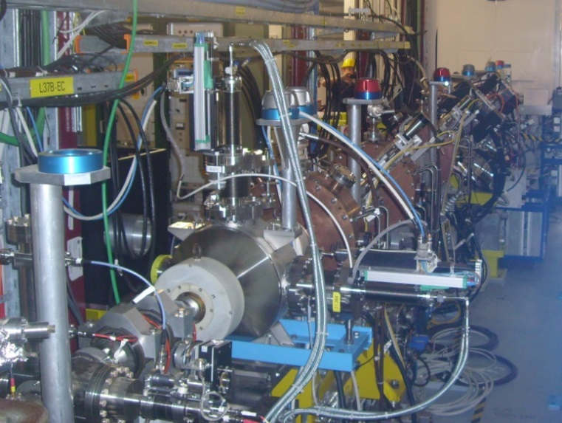
2013 : a memorable year !
A cheering crowd celebrating the first beam accelerated by the RFQ, 13.3.2013
Klystrons and modulators installed in the Linac4 Hall
The RFQ installed in its final location in the tunnel, 25.6.13
7.11.2013: ready for 3 MeV beam tests in the tunnel!
Open Days 2013: 2’500 visitors!

Slide 3
Linac4 layout
Pre-injector (source, magnetic LEBT, 3 MeV RFQ, chopper line)
Three types of accelerating structures, all at 352 MHz (standardization of components).
Beam dump at linac end, switching magnet towards transfer line to PSB.
Ion species H⁻
Output Energy 160 MeV
Bunch Frequency 352.2 MHz
Max. Rep. Frequency 2 Hz
Max. Beam Pulse Length 0.4 ms
Max. Beam Duty Cycle 0.08 %
Chopper Beam-on Factor 65 %
Chopping scheme: 222 transmitted /133 empty buckets
Source current 80 mA
RFQ output current 70 mA
Linac pulse current 40 mA
Tr. emittance (source) 0.25 π mm mrad
Tr. emittance (linac exit) 0.4 π mm mrad
 | Energy [MeV] | Length [m] | RF Power [MW] | Focusing
RFQ | 0.045 - 3 | 3 | 0.6 | RF
DTL | 3 - 50 | 19 | 5 | 112 PMQs
CCDTL | 50 - 102 | 25 | 7 | 14 PMQ, 7 EMQs
PIMS | 102 - 160 | 22 | 6 | 12 EMQs

Slide 4
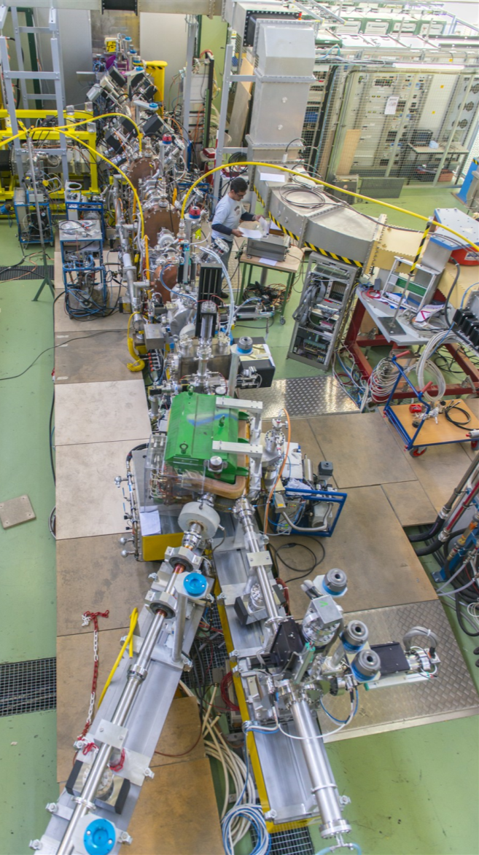
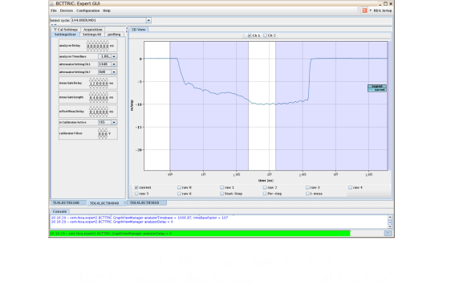
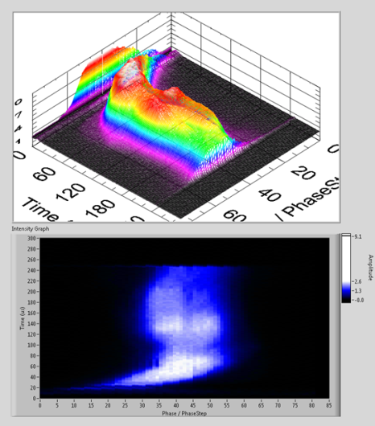
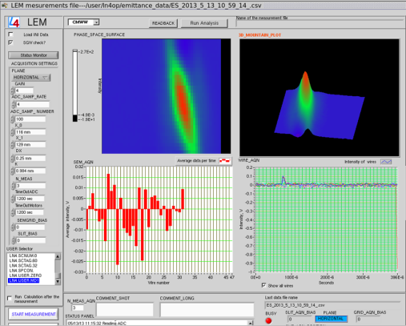
Commissioning 3 MeV
The 3 MeV injector (ion source, LEBT, RFQ, chopper line) has been commissioned with beam in March-May 2013 on a test Stand
  19.2.2013 First usable H- beam (45 keV)
  13.3.2013 Beam through RFQ
  16.4.2013 Beam through chopper line
  21.5.2013 Switch to protons (for higher intensity)
  31.5.2013 End of the beam tests, start transfer to tunnel
ion source
RFQ
chopper line
Diagnostics line
spectrometer
First 3 MeV beam on transformer: 10mA H- accelerated through the RFQ at first shot!
beam dump
Bunch Shape Monitor: phase profile of the bunch along the pulse
Hard time to get there, but commissioning completed in just 3 months!
Emittance scan

Slide 5
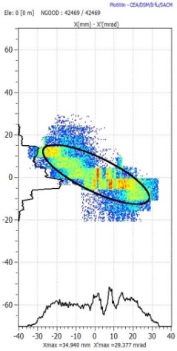
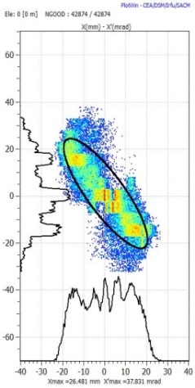
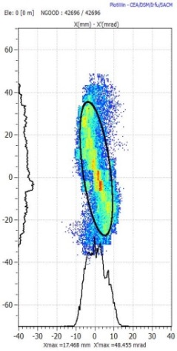
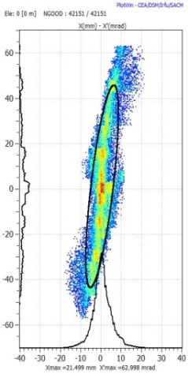
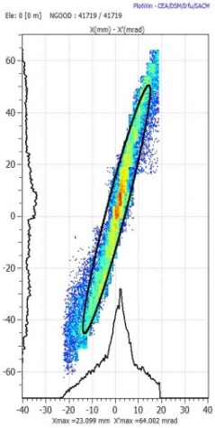
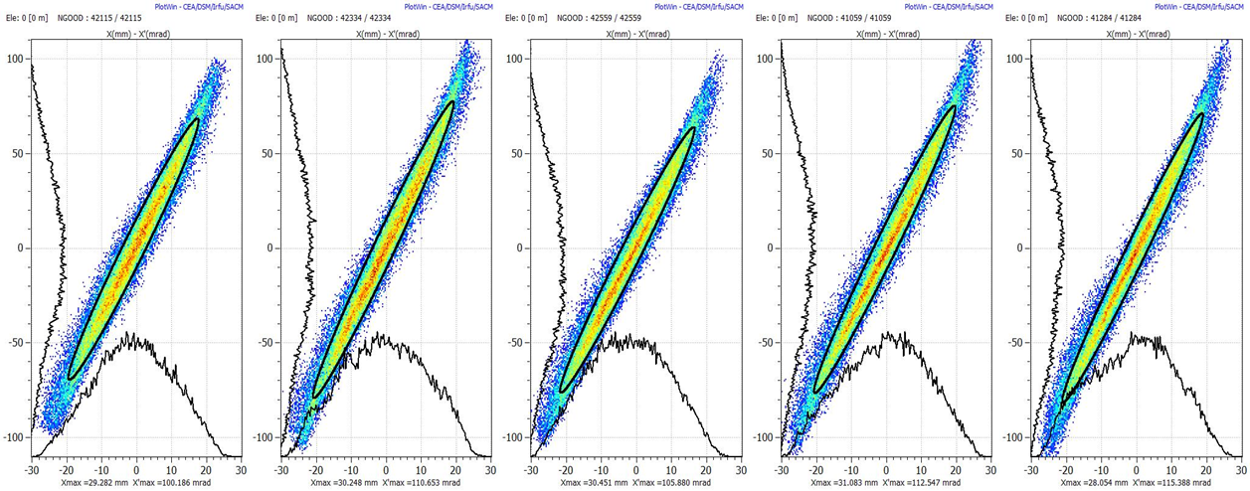
Emittance from the source
Source
Sol
ε measurement
Sol
Transverse emittance measured for different solenoid settings.
Beam reconstructed at source output and effective space charge estimate.
16-20 mA current
0.7-0.8 mm.mrad

Slide 6
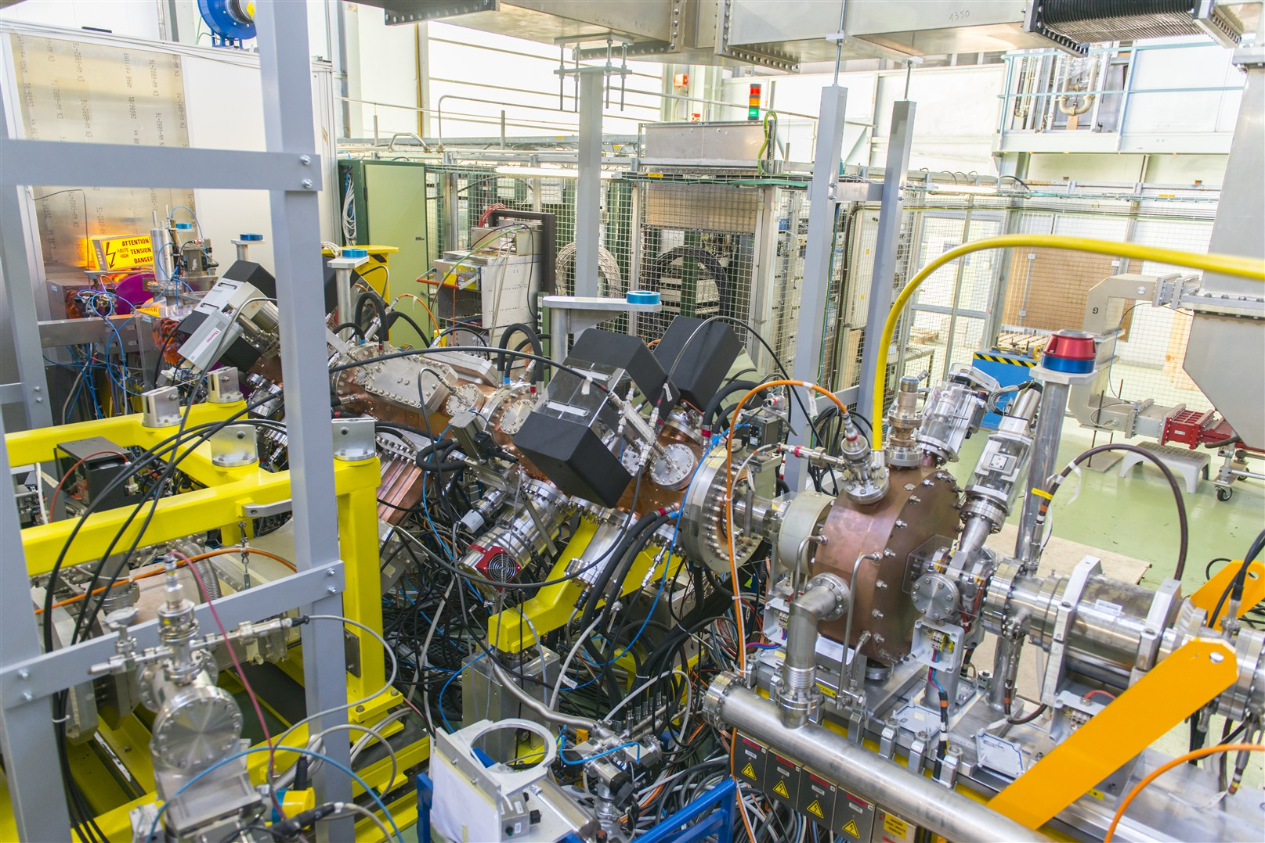

The Linac4 RFQ
Completed in September 2012 (some delays in design, machining, brazing).
RF conditioning in less than a week, commissioning with beam started on 13.3.2013 and completed on 28.3.
Compact and solid design, aiming at high reliability.
The Linac4 RFQ not only focuses and accelerates the beam as required, but so far it does it in a stable, reliable and reproducible way!

Slide 7
RFQ transmission vs RFQ RF power
measurements and simulation
March 2013
V Dimov
70-75% RFQ transmission achieved at nominal settings (<94% design value, but as expected and confirmed by simulations because of the bigger input beam emittance)
LEBT H2 gas pressure was changed to study experimentally the effect of neutralisation

Slide 8
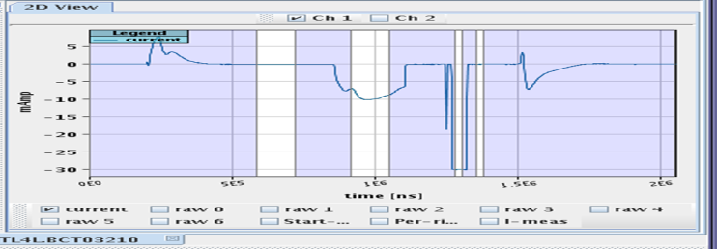
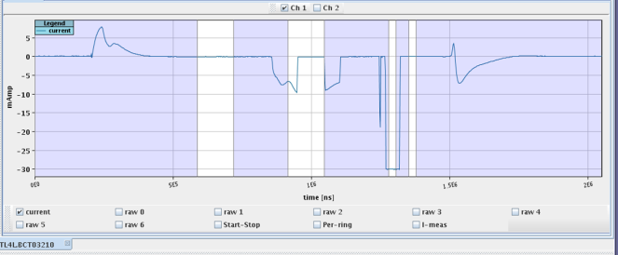
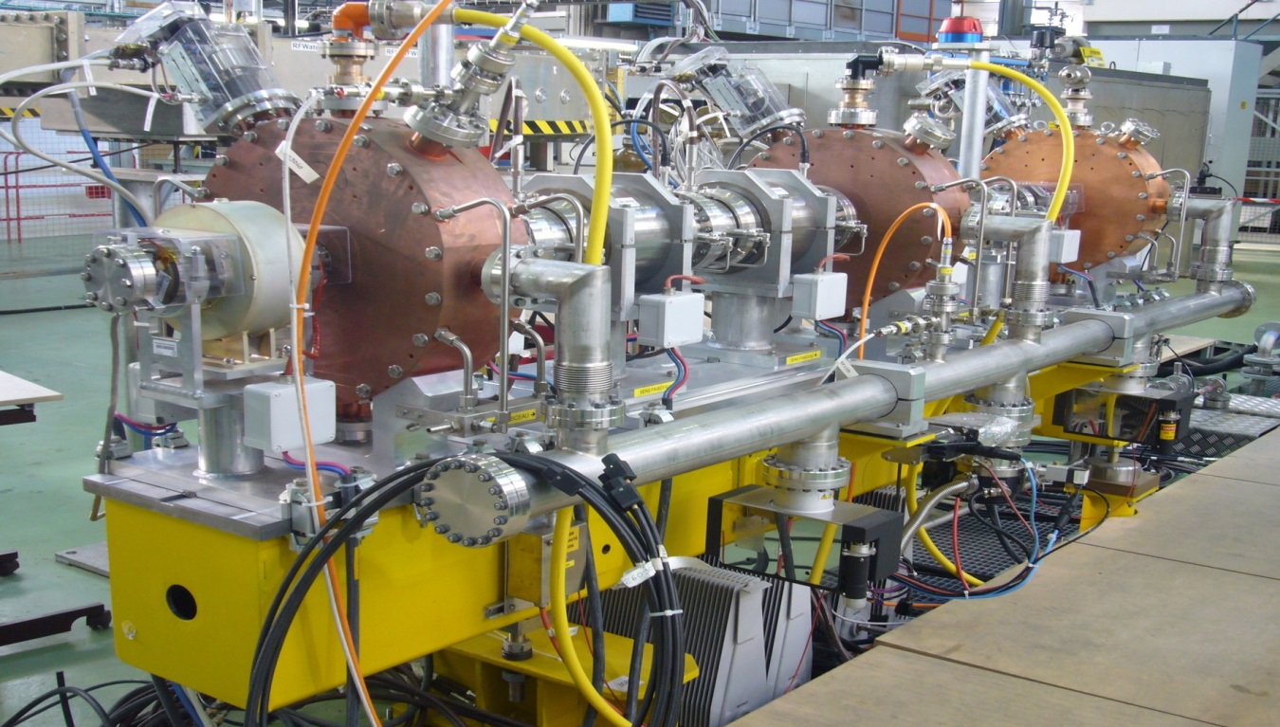
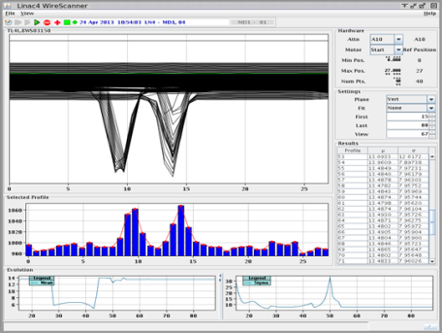
Chopper and MEBT
Chopper line (MEBT), 3.6 m:
2 choppers (double meander lines on ceramic substrate) inside quads;
3 bunching cavities;
5 quadrupoles;
Steerers and diagnostics.
Chopper dump (conical)
Quadrupoles used to increase separation chopped/unchopped beam reducing the required chopper voltage (600 V).
Worked perfectly, rise time (to avoid beam loss) measured by the transfos <10 ns (waiting for more accurate time resolved measurement).
“hole” in the beam pulse produced by the chopper
Separation of chopped and unchopped beam measured by the Wire Scanner

Slide 9
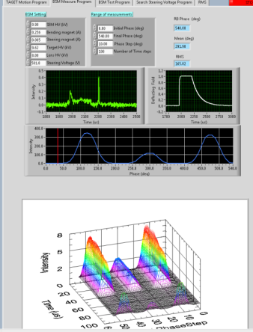
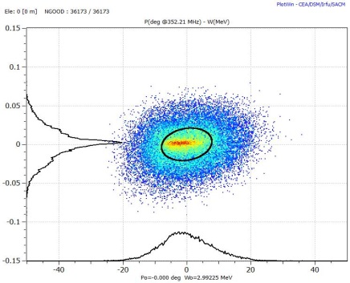
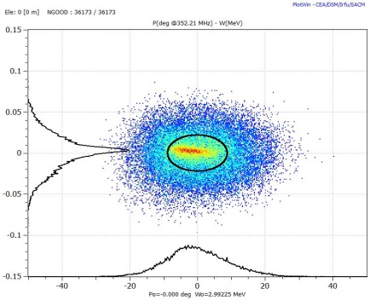
Longitudinal emittance reconstruction
RFQ
BSM
Reconstruction
BU.1 fixed
BU.2 varying
BU.3 OFF
Measurement
 | Expected | Recons.
ΔE (keV) | 21 | 22
Δφ (°) | 7.8 | 8.8

Slide 10
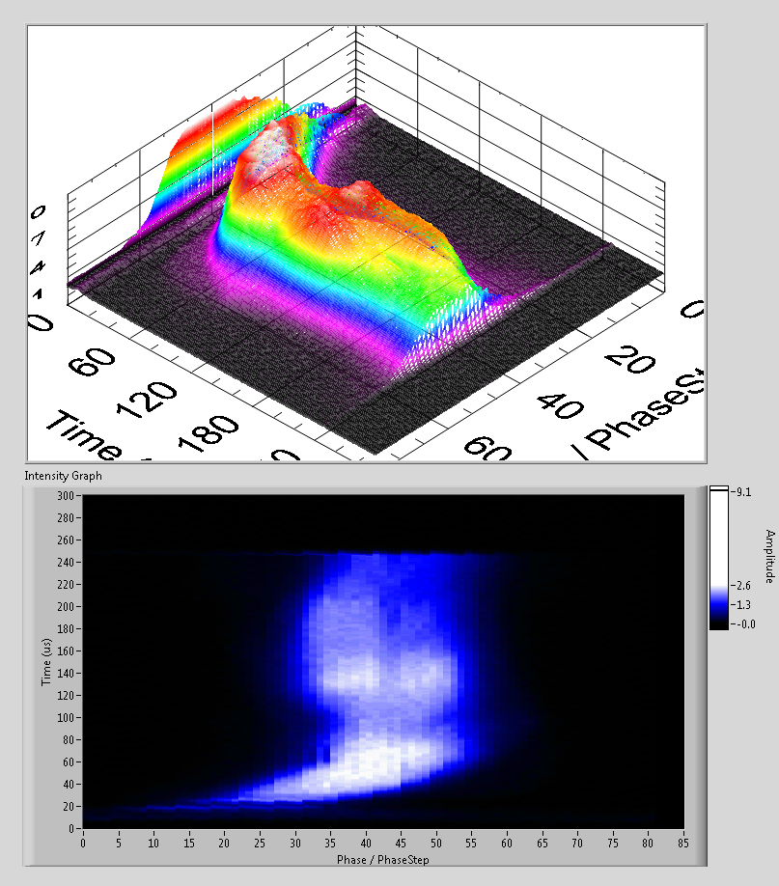
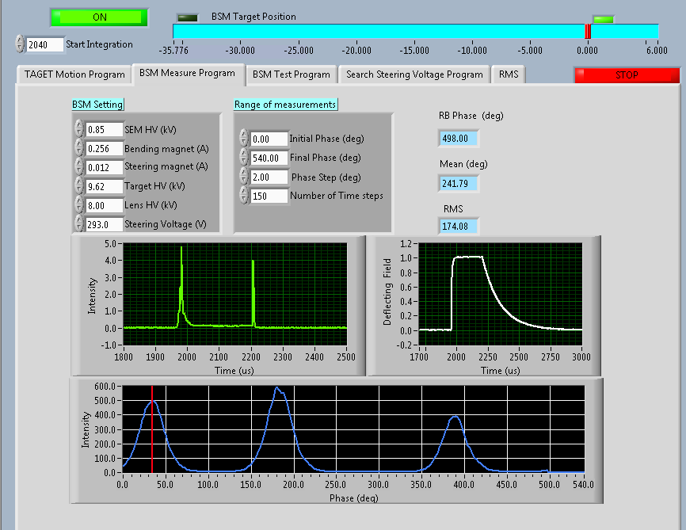
BSM / Feschenko monitor
First commissioning completed by INR team
BSM measurements

Slide 11
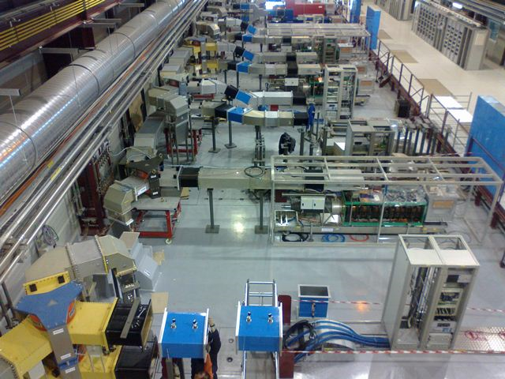
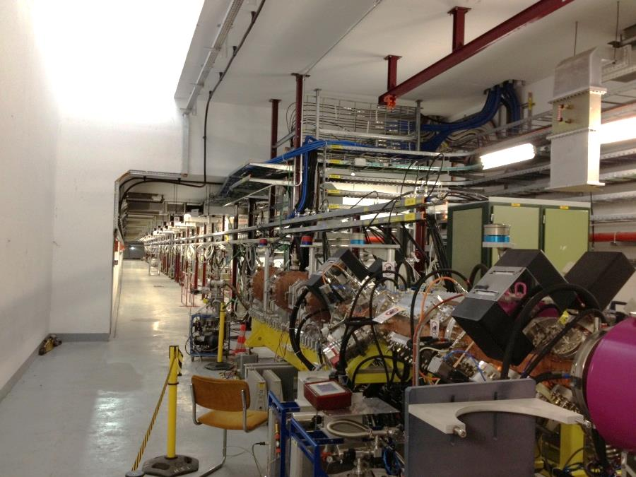
Installation in B.400
- Infrastructure (Electrical, cooling, ventilation, all cabling) completed
Waveguides and circulators installed
12 klystrons /17 installed
6 modulators /14 installed
Ion source, RFQ, MEBT line installed, HW tests completed
All safety clearances passed on 8.11.13, beam tests starting…

Slide 12
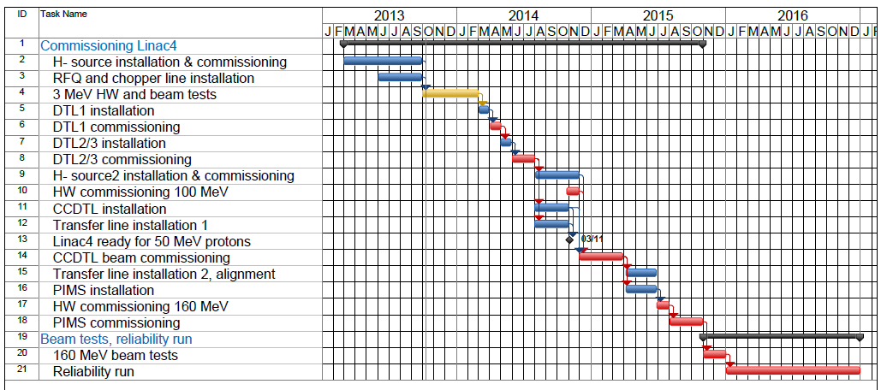
Commissioning schedule
3 MeV test stand completed
3 MeV from Oct. 2013
12 MeV, 50 MeV from April 2014
100 MeV from Dec. 2014
160 MeV from mid 2015
Reliability run 2016

Slide 13
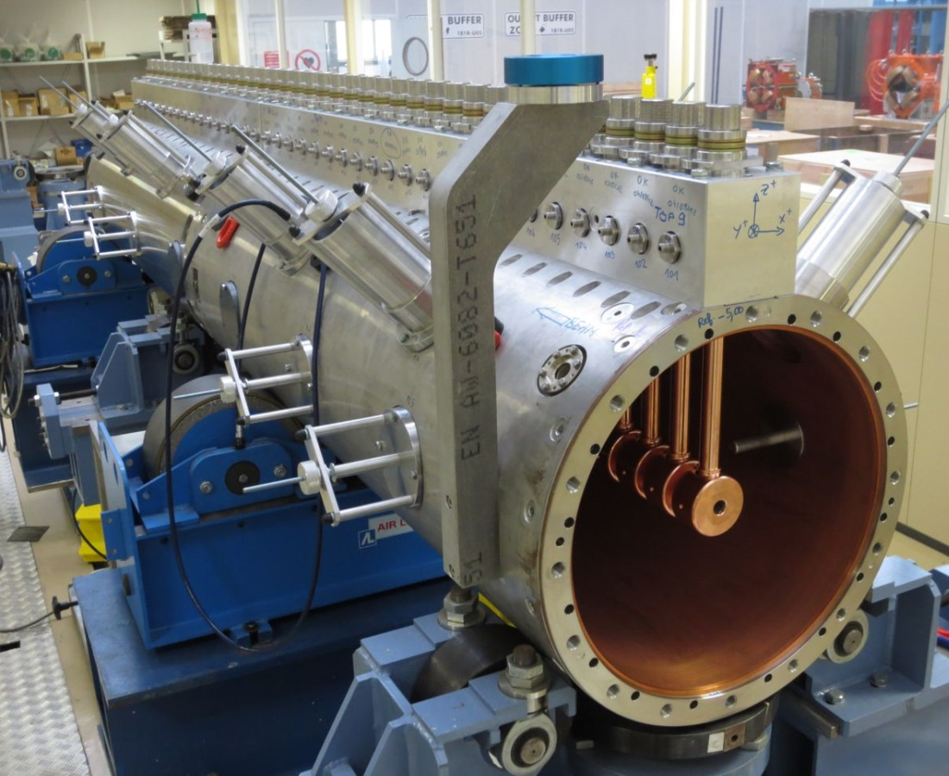
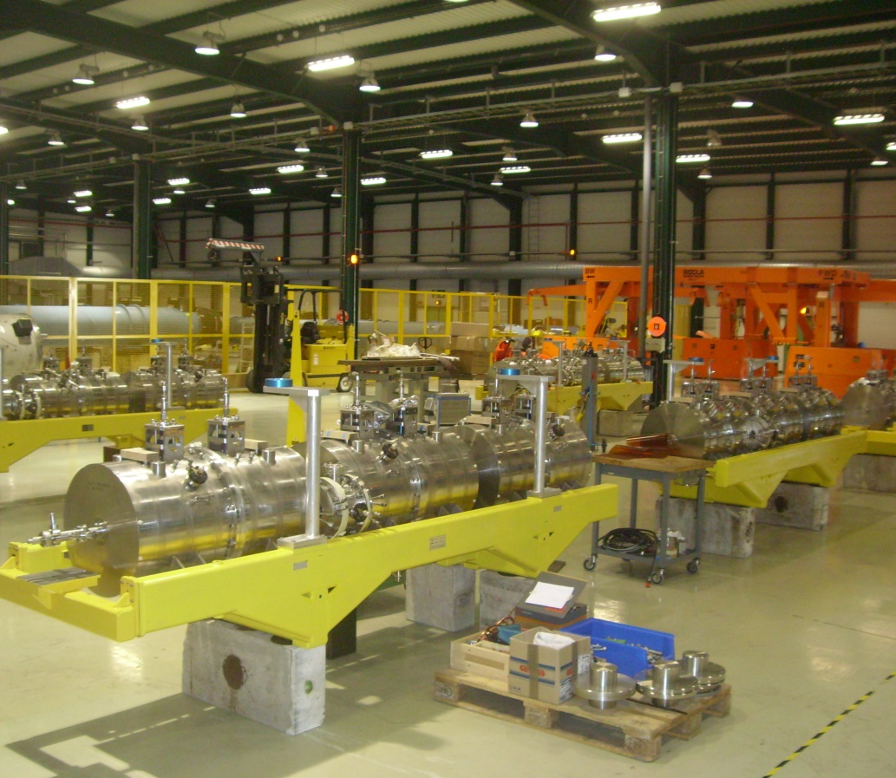
Next steps: DTL and CCDTL
DTL Tank 1 assembled, under RF tests.
DTL Tanks 2 and 3 in construction and assembly.
All 7 CCDTL modules (50-100 MeV) delivered, stored and progressively under HP tests.

Slide 14


The future ?
When are we going to connect Linac4
to the booster and with what particle?
Linac4 will be completed at end 2016.
Converting to H- the PS Booster injection takes 9.2 months (incl. 2 months cool-down and renewed cabling).
LHC will restart in 2015 and run for 3-4 years: it is very difficult to obtain an intermediate stop for Linac4 connection (although physics has plans for a 4.5 months interruption at end 2016).
Options:
(favored): connect with H- at end 2016 (intermediate shut-down for physics) or at end 2017 (early Long Shut-down).
(back-up): use Linac4 as 50 MeV proton injector replacing or in parallel with Linac2 between end 2016 (intermediate physics shutdown) and end 2018 (maximum for long Shutdown start), increasing (proton) current to 80 mA (half current and half emittance than Linac2).

