Slide 1
2nd Linac4
Ion Source Review
- Introduction -
R. Garoby
14/11/2013

Slide 2
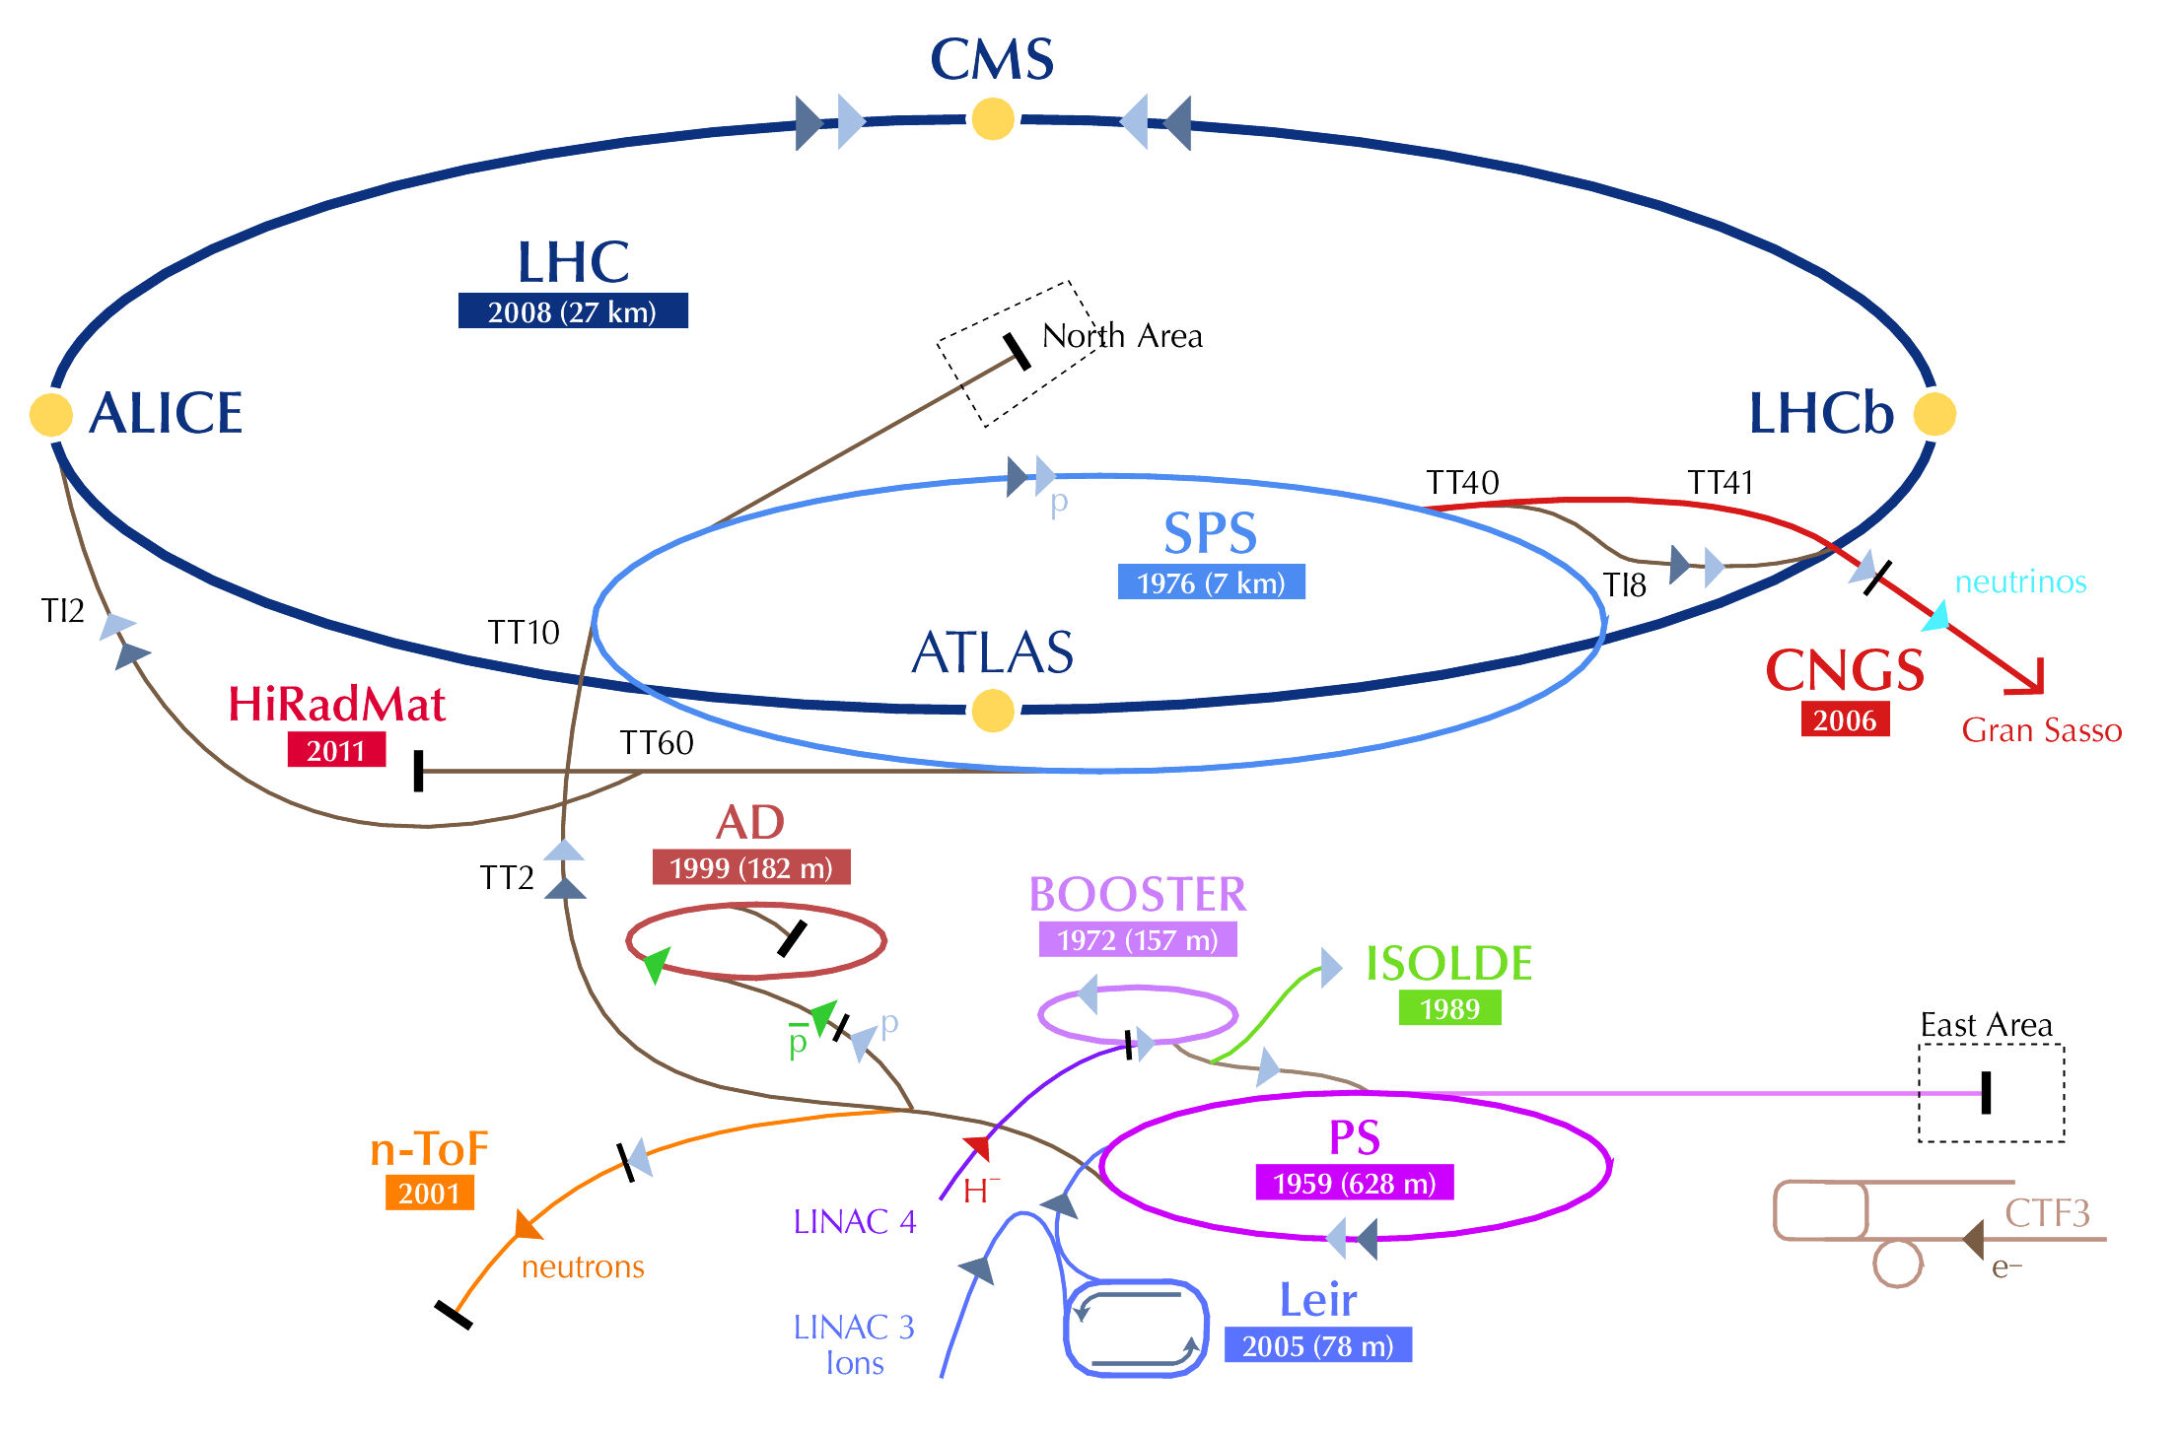
Linac4 mission
Once connected to the PSB, Linac4 will be the source of all protons at CERN, for all experimental facilities (ISOLDE, AD, nToF, East Area, SPS North Area and LHC).
In addition to beam characteristics, availability & stability of performance are crucial requirements (e.g. for the future HL-LHC, where robust injectors are key to minimize turnaround time).

Slide 3
Outcome of the Review of LHC and Injectors Upgrade Plans («RLIUP» – 29-31 Oct. 2013)
https://indico.cern.ch/conferenceDisplay.py?ovw=True&confId=260492
No experiment supported our proposal of connecting Linac4 to the PSB with H⁻ injection at 160 MeV during LS1 and LS2 because of the 4.5 months of additional interruption of proton physics.
⇓
It is likely that the new baseline schedule of LHC will foresee the connection of Linac4 to the PSB (160 MeV H⁻) during LS2. The start of LS2 itself is probably going to be in the second half of 2018.
The planning of the Linac4 project will however not change, to preserve a working alternative to Linac2, in case of failure.
Hence the goal for the H⁻ ion source is to be of nominal characteristics at the latest in February 2016, when the reliability run will start.

Slide 4
Updated plan for Linac4 to PSB Connection
Baseline start of installation in the PSB: beginning of LS2 (mid-2018?)
Start of Linac4 reliability run
LS1 for injectors
LS2 for injectors
2012
2013
2014
2015
2016
2017
2018
2019
01/2016 Stripping foil and instrumentation test stand during L4 beam reliability run
07/2016 Start complete H⁻ injection region “montage à blanc” assembly .
12/2016 all injection hardware components “ready for PSB installation”

Slide 5
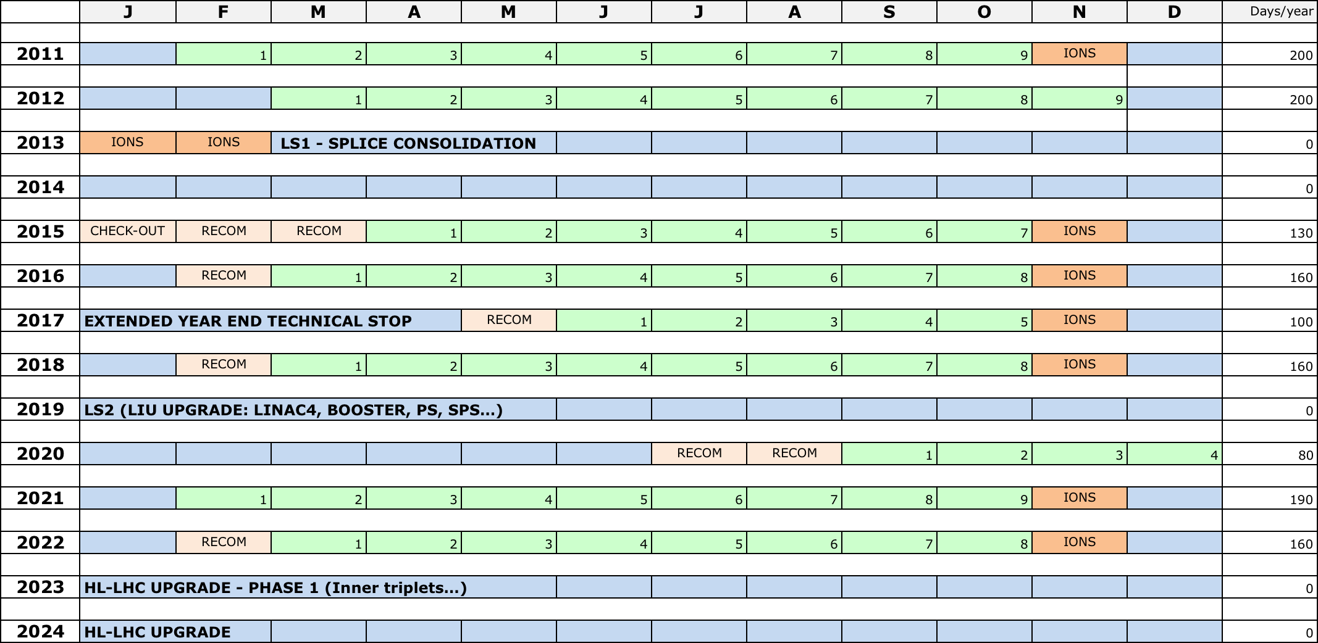
LHC slipped baseline (typical example)

Slide 6
Mandate of the Review Committee
Review of the linac4 ion source Work Package; Compare what has been achieved with respect to what was planned and review what is foreseen. Lessons?
Estimate the probability of having a sufficient beam current (40, 60, 80 mA) within the right emittance (0.25 mm.mrad) and the right duration (100 + 400 μs) in time for the final commissioning (February 2016).
Is it still necessary to pursue an alternative solution, and is the magnetron source still considered as the most appropriate option? When a decision has to be made and what has to be prepared to make such a source available on-time for the final commissioning of Linac4?

Slide 7
Thank you in advance for your help and support!

