Slide 1
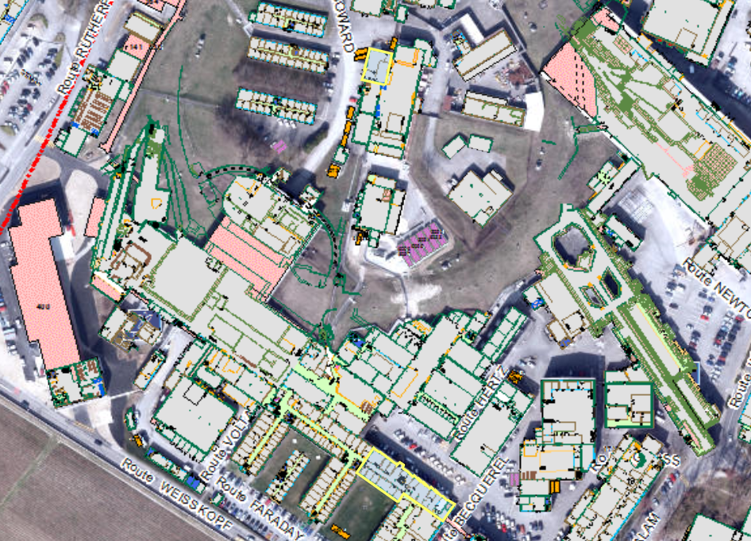
Cs-Laboratory
357
72
Production
Metrology
Welcome to CERN
102
Linac4 ion source
400
6
Cleaning
Controls
Magnets
Ion source test stand
152
9
Assembly PG
169
Leak test

Slide 2
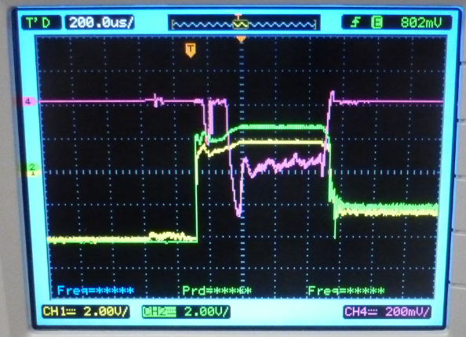
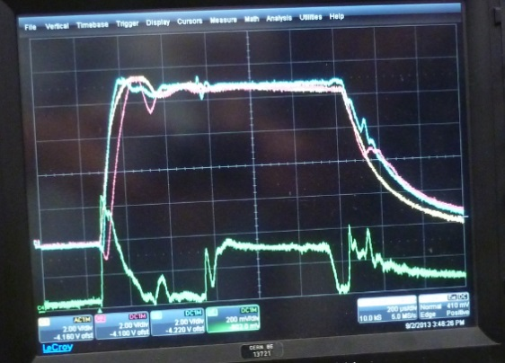
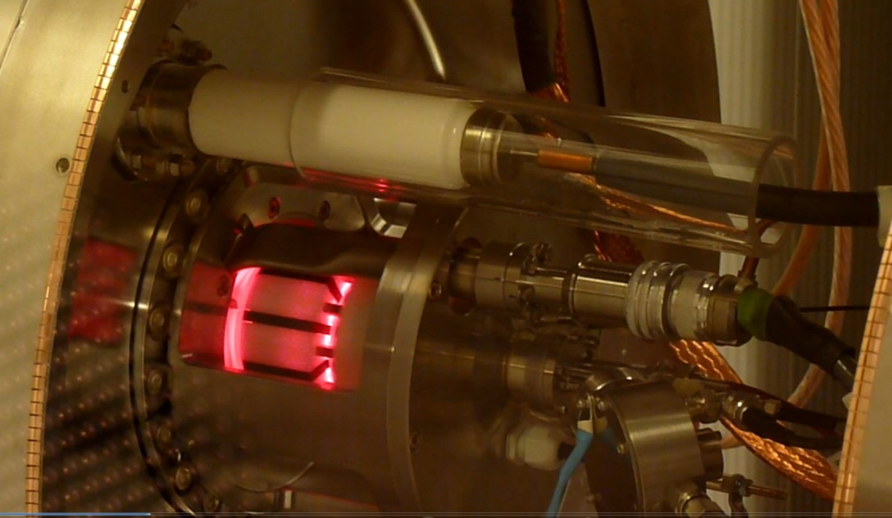
Linac4 ISWP review, Nov. 14th 2013
Overview and status
FC-LEBT
Short introduction
  Deliverables as defined in the June 2010 Review
  Modification to the ISWP boundary conditions
Status
  Ancillary equipment, adaptability in the design
  Challenges / findings
  Ion source prototypes test results
  Simulation / Publications / reports
Outlook
  From project WP to operation
    Towards 98% reliability …
Sept. 2nd 2013 1st H⁻ beam in linac4
Log RF
Pulsed HVs + I(e-dump)
HV e-dump
Plasma
Ferrites
Magnets

Slide 3
Linac4 IS Collaborations
IPP Garching | U. Fantz
University of Jyvaskyla | O. Tarvainen, T. Kalvas
SNS | M. Stockli
KEIO University | A. Hatayama 畑山明聖
IPGP Orsay | T. Minea
ISIS | D. Faircloth
BNL | J. Alessi
J-PARC | A. Hueno
Thank you all ☺
Students & Fellows
Matthias | Kronberger | SLHC-Fell. | CERN
Claus | Schmitzer | SLHC-PhD.
Oystein | Midttun | PhD.
Stefano | Mattei | Tech-Fell.
Hugo | Pereira | Fell
Jose | Sanchez | Dipl, Tech-Fell.
Jaime | Gil Flores | Tech-Fell.
Chiara | Pasquino | Tech-Fell.
Cristhian | Valerio | PhD.
Sylvia | Izquierdo | Tech-Fell.
Mahel | Devoldere | Tech-Fell.
Marco | Garlasche | Fell.
Serhiy | Mochalsky | Fell. | LPGP Orsay
Taneli | Kalvas | PhD. | Jyvaskyla Univ.
Masatoshi | Ohta | 太田雅俊 | Keio Univ.
Masatoshi | Yasumoto | 安元雅俊
Kenjiro | Nishida | 西田健治朗
Takanori | Shibata | 柴田崇統
Takashi | Yamamoto | 山本尚史
CERN
J.P. Corso, J. Coupard, M. Wilhelmsson, F. Fayet, D. Steyeart, E. Chaudet, Y. Coutron, A. Dallocchio, P. Moyret, S. Mathot, Y. Body, R. Guida, P. Carriè, A. Wasem, J. Rochez, D. Aguglia, D. Nisbet, C. Machado, N. David, S. Joffe, P. Thonet, J. Hansen, N. Thaus, P. Chigggiato, A. Michet, S. Blanchard, H. Vertergard, M. Paoluzzi, M. Haase, A. Butterworth, A. Grudiev, R. Scrivens, M. O'Neil, P. Andersson, S. Bertolo, C. Mastrostefano, E. Mahner, J. Sanchez, I. Koszar, U. Raich, F. Roncarlo, F. Zocca, D. Gerard, A. Foreste, J. Gulley, C. Rossi, G. Bellodi, J.B. Lallement, M. Vretenar, A. Lombardi
8+19+50=77

Slide 4
L4IS-historical Introduction
2005: Decision to copy the DESY RF volume source (reliable, no Caesium)
2008: SLHC: EU-project towards a plasma generator upgrade from Desy to 50 Hz, 100 kW 2MHz RF driven 5% duty factor.
2009: DESY-type source completed, equipped with CERN power supplies and RF generator.
May 2010: tests show that it cannot operate at 45 kV nominal voltage. The 45 keV co-extracted electron beam is focussed; it vaporizes the electron dump and induces HV-sparks.
End 2010: launched crash programme to build an improved source of CERN design operating in volume mode but upgradable to surface (Cs-based) production.
March 2011 completion of the SLHC WP.
June 2011 Linac4 IS-review https://indico.cern.ch/conferenceDisplay.py?confId=129870
The Linac4 Ion source work package (ISWP-2011) was tailored to meet:
The 3 MeV test dead line
The commissioning with beam in the tunnel
Implies: Parallelized design-simulation-purchase of raw material

Slide 5
WPIS Time table
2011 Review
Date | L4-IS 3 MeV test stand | L4-IS -tunnel Bldg. 400 | L4-IS upgrades | sLHC Plasma Generator test stand | H- IS test stand | Cs Laboratory
2010 |  |  | Minimal dump, protons | RF and plasma diagnostics |  | Design
2011 | protons, mini H- pulse |  | Rev. world’s IS Rev. WPIS June | Gas Dynamics, Upgrade to HT | Design, production
2012 |  |  | Multistage and e- dump |  | Test and commissioning
2013 | Move to L4-building 400 | Commissioning in L4 building | New HT-supply & extraction |  | Operation | Surface source Proto.
2014 |  | Operation, Upgrade, control | Spare parts |  | Operation | Test of prototype
2015 |  |  |  |  | Move test stand to 152

Slide 6
3MeV & L4 milestones vs. ISWP actions
2011 Review
 | date | L4-milestone | ISWP action
3MeV | April 2012 | 3MeV test Protons | Protons
 | May-Aug 2012 | LEBT June 2012 H⁻ beam July 2012 | New front-end installation and commissioning Installation of proto #1 at the 3MeV test stand
 | Sept-Dec | 3MeV test H⁻ | H⁻ 30 mA
IS-test stand | Oct-Dec 2012 |  | Ion source test stand commissioning
Linac4 | Jan 2013 |  | Installation source in L4
 | Tbc. |  | Test IS exchange procedure (proto #1)
 | Dec 2013 | Decision to connect
 | Feb 2014 |  | Installation of proto #2 in linac4
 | April 2014 | L4-160 MeV commissioning completed | 20 mA required at the end of the linac4 (40 mA at the source)
 | … 2015 | LSS2 or long MD | Installation of proto #3

Slide 7
WPIS H⁻ Ion source: staged approach, 2 units each + spare
2011 Review
 | #1 Volume source | #2 Surface source | #3 Magnetron
Operational experience Achieved H⁻ current | DESY 30 mA | SNS 50 mA | BNL 80 mA
Plasma Heating process | 2 MHz RF Ext. antenna | 2 MHz RF Int. & Ext. antenna | Arc discharge
Cesiation |  | Cs-chromate Single deposition: | Cs metal Constant flow
Cs-Oven test stand |  | Nov. 2011 | Nov. 2011
Electron / H⁻ ratio | 10-100 | 10 | 0.5 - 1
357 Plasma test stand (operational) | → Sept. 2012 | 2013 | 2014-2015
3MeV test stand (until Dec-2012) (operational, Bldg. 152) | Jul. 2012- Dec-2012
IS test stand (Bldg. 357) |  | 2013 | 2014
Linac4, building 400 | Jan 2013 | Oct 2013 | 2015

Slide 8
Summary of the L4-WPIS changes
Delayed move into the tunnel, RFQ tests in 152 until June 2013.
Cancellation of the DESY source 45 kV proton commissioning of the RFQ
Decision to not build an ion source test stand in building 357.
  Should allows commissioning of the source and LEBT equipment in the tunnel before moving the RFQ
  Saves the 2015-foreseen move of the test stand from 357 to 152
  The tunnel is not the best place for IS-R&D: effectively no IS-test-stand between January and July 2013 but beam delivery to RFQ commissioning.
Decision to consider IS-03 (Magnetron) as an option “to be confirmed at a later stage”.
  To minimize delays if the option would be selected, decision to maintain a minimal task with the following deliverables:
    Insource BNL’s drawings and produce a 3D Cathia model and production drawings
    Produce a magnetron plasma generator and test it at BNL

Slide 9
Status
14th November 2013
Repaired insulator + 1 bar SF6
Mount backup option (DESY plasma generator) on IS01 Front end + extraction & e-dumping system
12 mA 45 kV H⁻ beam available:
@ IS-TS Nov. 12th 2013
IS02 before cesiation tbc.
15 mA 45 kV H⁻ beam available:
@ 3MeV TS since February 2013
@ Linac4 since September 2nd 2013
IS01 + DESY PG

Slide 10
Organization of the ISWP
Simulation - Measurements
Bi-Weekly meeting
Beam-optics IBSimu
Pulsed H₂ injection
High voltage, B-field (Opera)
Thermal equilibrium
RF-field (ANSYS HFSS)
Photo- Spectrometry
Assembly / leak test
IS, Production, Design & Vacuum -teams
Weekly
Presentation
Discussion
Decision
IS-team
Design
Production
Vacuum
Engineering
RF-HV
Specialists
Simplified
3D models
Analysis
Simulation Plasma
Bi-Weekly video meeting with KEIO university
Plasma heating
Light emission
Collaborations
BNL, IPP, SNS, RAL, J-PARC, Uni. Orsay, Uni. Jyvaskyla
BE- ABP, CO, OP, RF
EN- MME, MEF, HE, ICE, STI
GS-SE, PH-DT
TE- EPC, VSC,
UHV-Cleaning

Slide 11
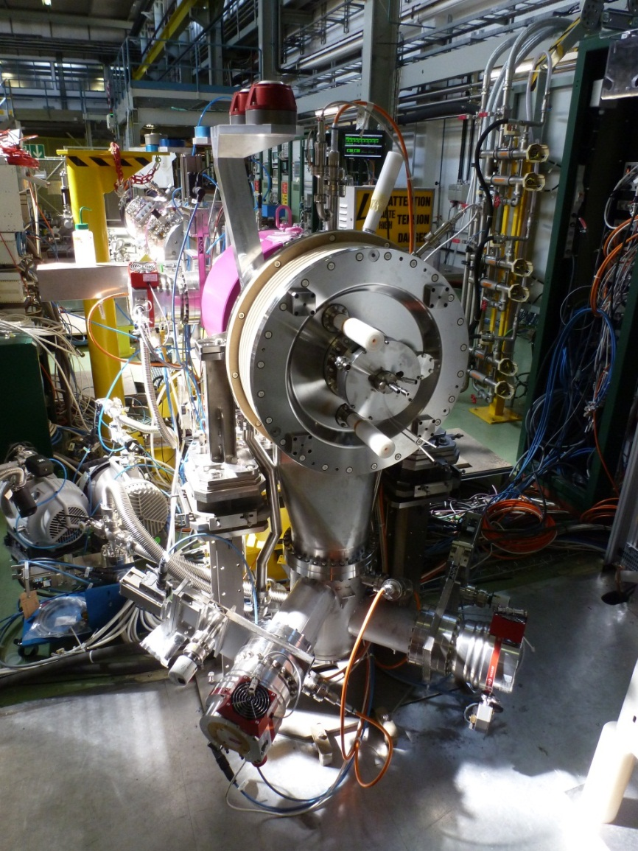
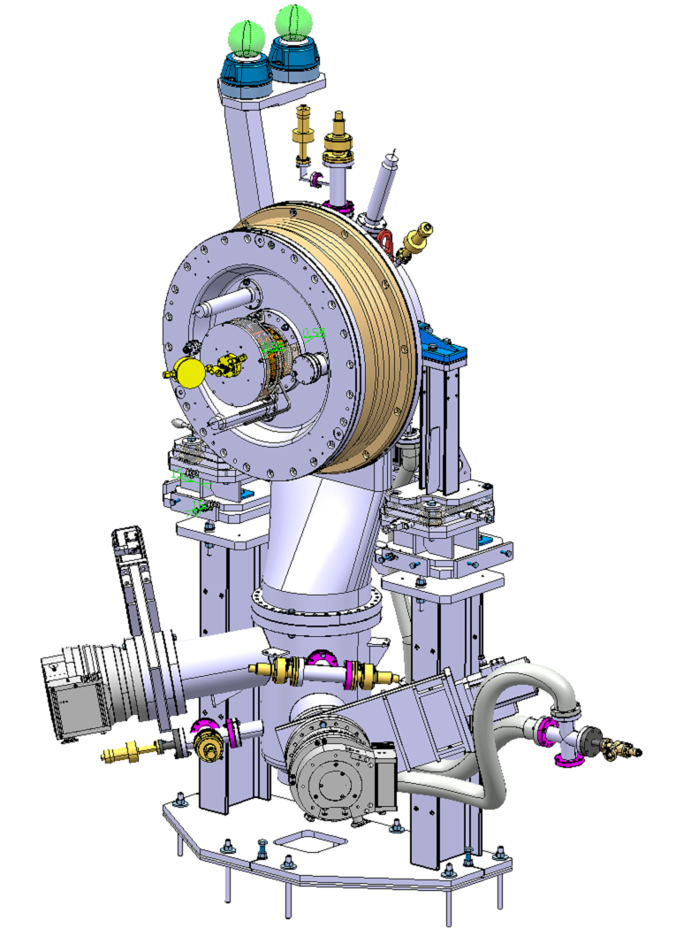
IS front end
±3°
Survey targets
Y
X
Z
o
Plasma Generator
o
Front End
H2 injection
±3°
XYZ Support table
±15mm
Alignment
±3mm
Pumping Unit
Alignment table (Survey)
Beam based alignment options: Horiz. displacement & dφ, dω
Quick exchange in case of failure:
Pumping port
Front end

Slide 12
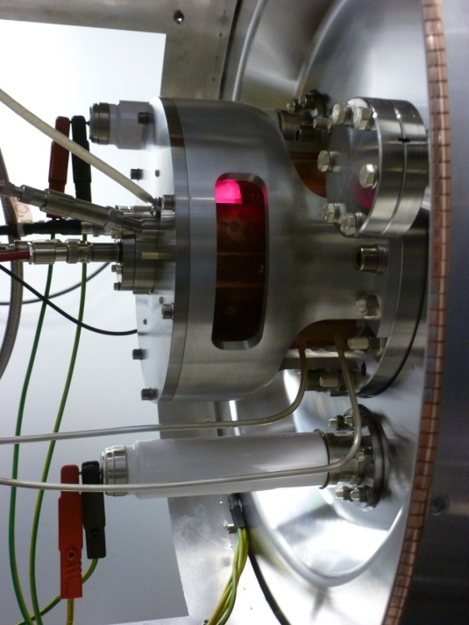
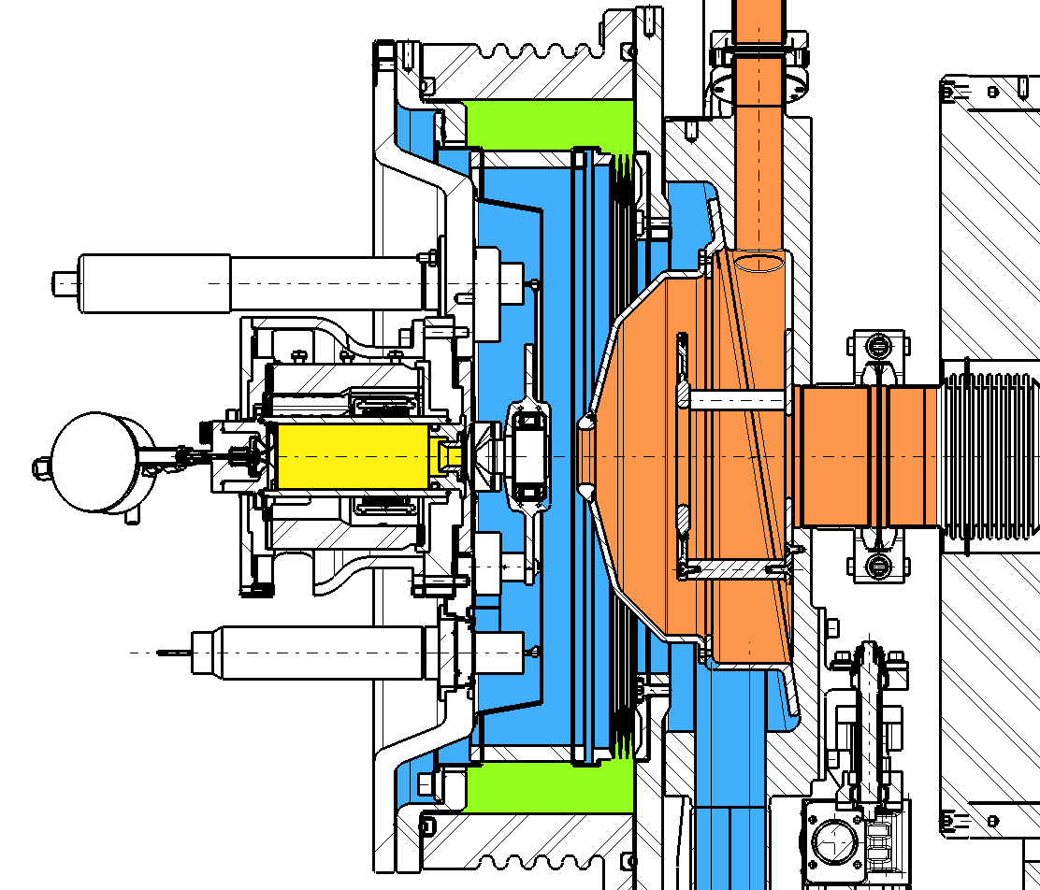
“Plug & play” Plasma Generator and beam formation region
Pumping port
60 l/min TMP
Secondary Vacuum
IS01
Extraction region
±25kV Puller
H2 Piezo Injection
H_{α} light diffusing through
The Al₂O₃ Chamber
Ignition chamber
Exchangeable:
Plasma Generator
Flange + Extraction Optics
Ground electrode
Einzel lens
Insulators
Plasma chamber
±10kV e-dump
Einzel lens region
Al₂O₃ insulator
EPGM insulator
Pumping port
2×700 l/min TMP

Slide 13
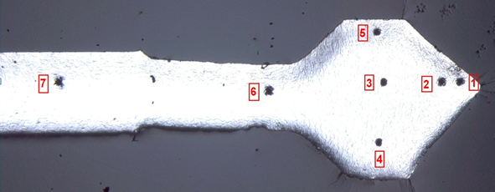
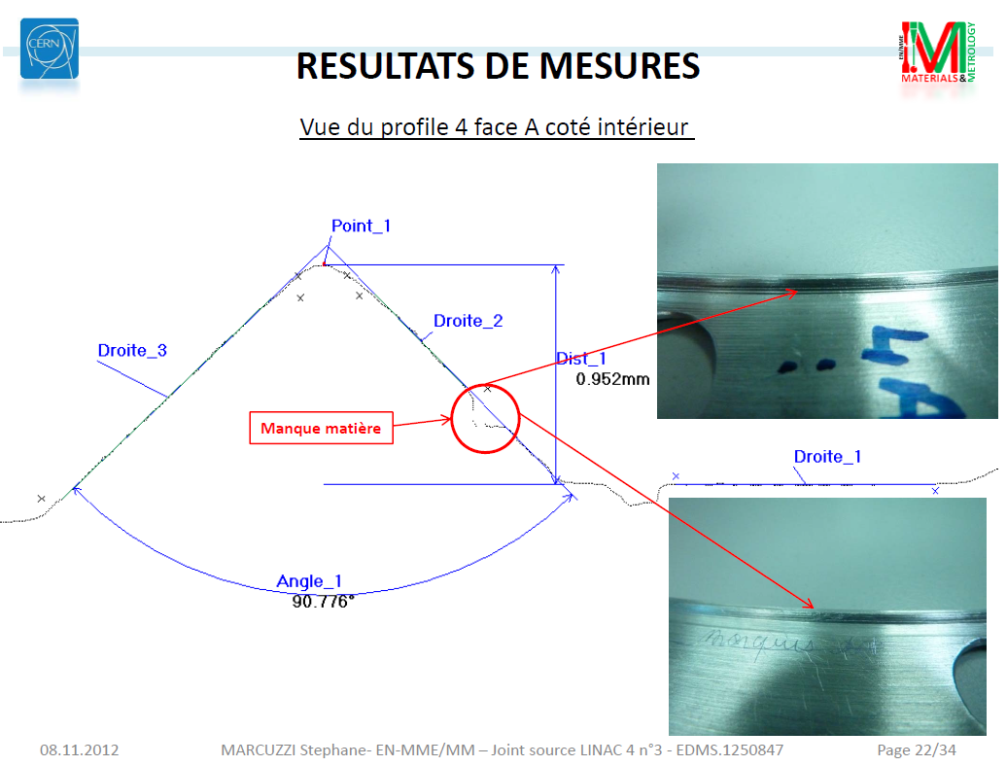
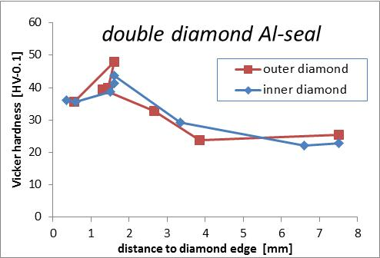
Al-2-diamond sealing issue
Apart from 2 units all other are non conform.
Other producer failed → Successfully achieved by CERN’s central workshop
Test with double helicoflex under way
Investigation of Front end modification
  Double knifes for Cu excluded (2×400 N/mm)
  Groove for helicoflex or O-ring + knife edge Al

Slide 14
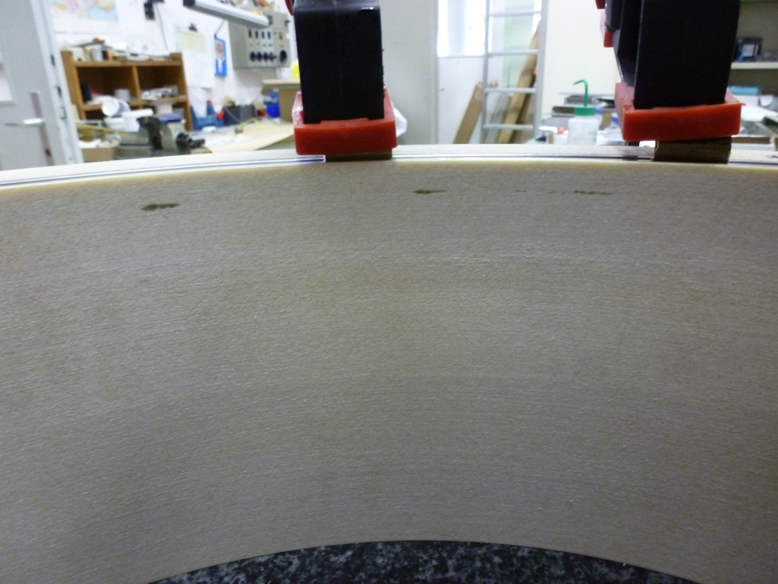
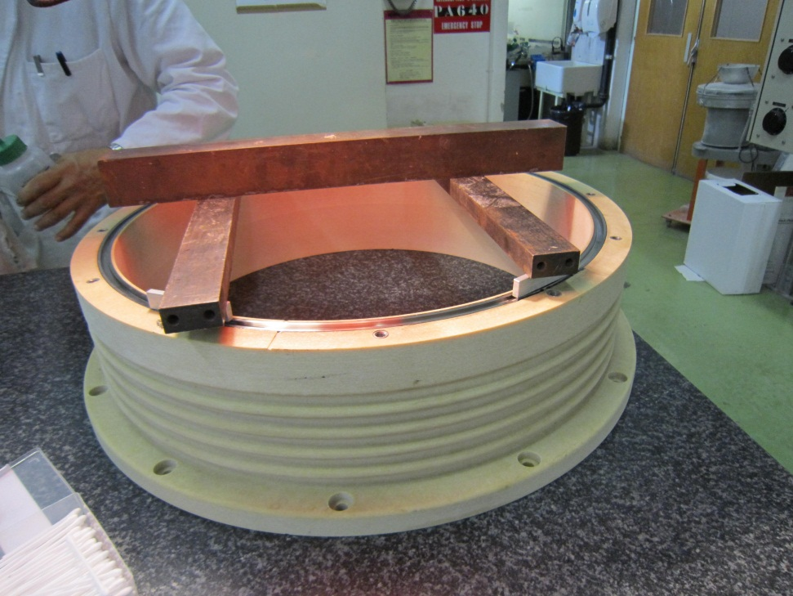
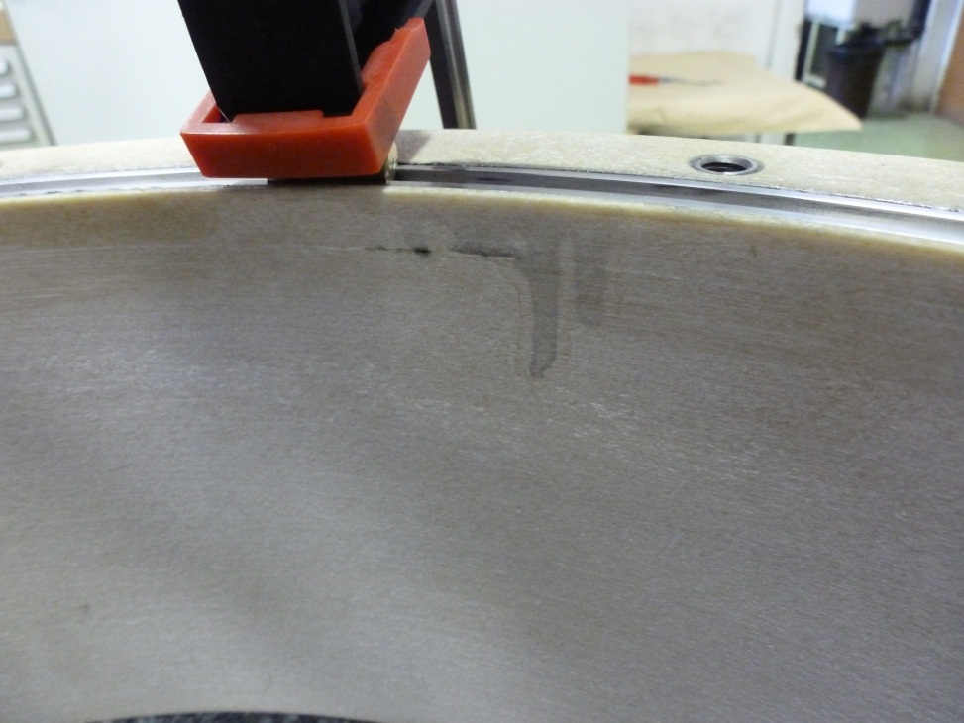
Epoxy-Glass fibre (EPGM) Insulator
Lessive NGL 17.40 spec. ALU III avec ultrasons pendant 5 h
Rinçage avec eau déminéralisée + alcool
Séchage à l’air comprimé
Etuvage à 60 °C.
Outgassing & limited pumping speed:
Received leaky, was sent back for removal of the SS-groove.
Very crude repair generated cracks in epoxy glued at the factory.
SS-grooved tightly glued in house.
2.1 10⁻² mbar in the secondary vacuum instead of ~10⁻⁵
Paschen criteria checked before HT tests,
Outgassing rate: O(2 10⁻²) mbar l/s >> RGA measurement needed

Slide 15
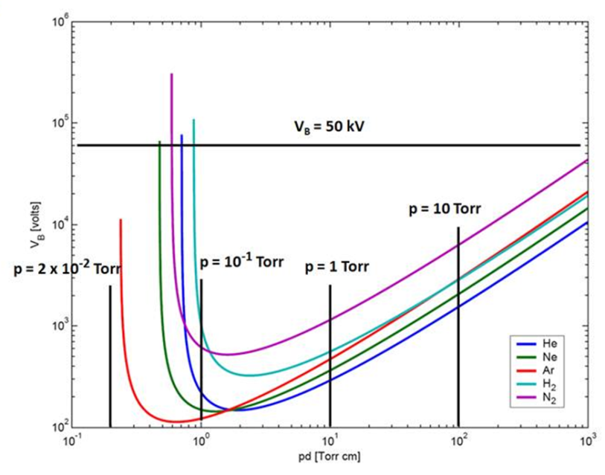
Secondary pumping:
RGA on EPGM samples
Pashen curves from representative gases
! Very Close to H₂O breakdown conditions
→ Successfully solved via 1 bara SF₆
pd (sum of all gases)

Slide 16
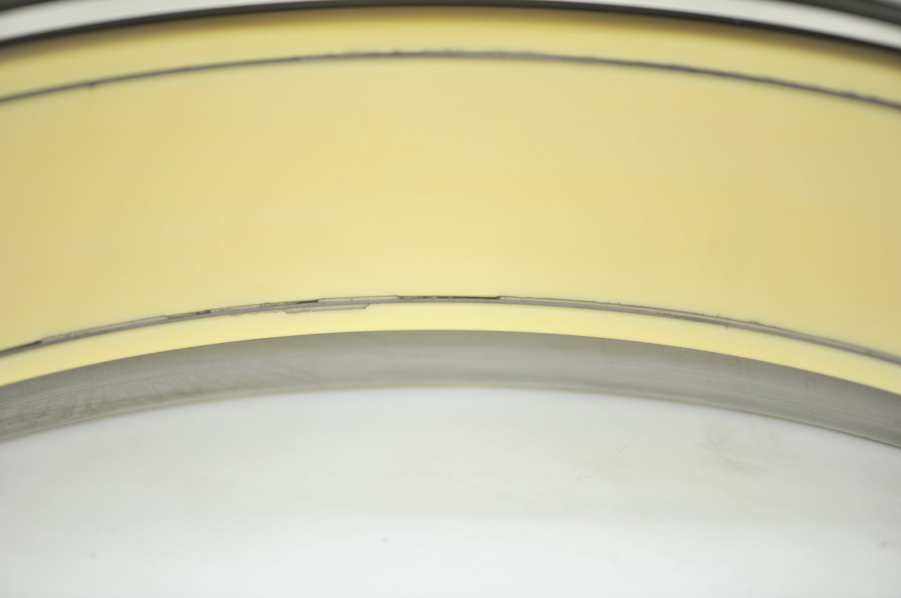
Al2O3 main (45 kV) insulator

Slide 17
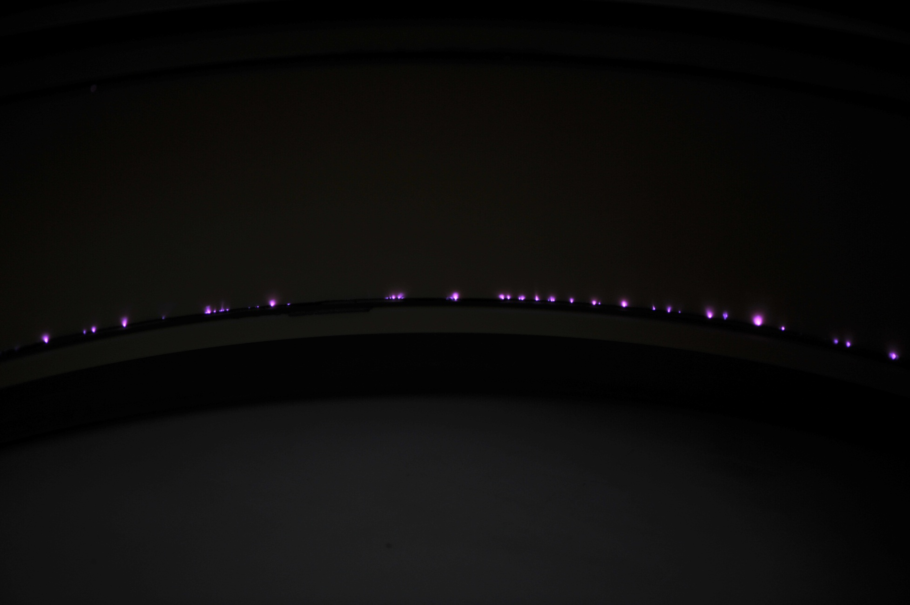
H⁻ source polarity
5 kV/cm

Slide 18
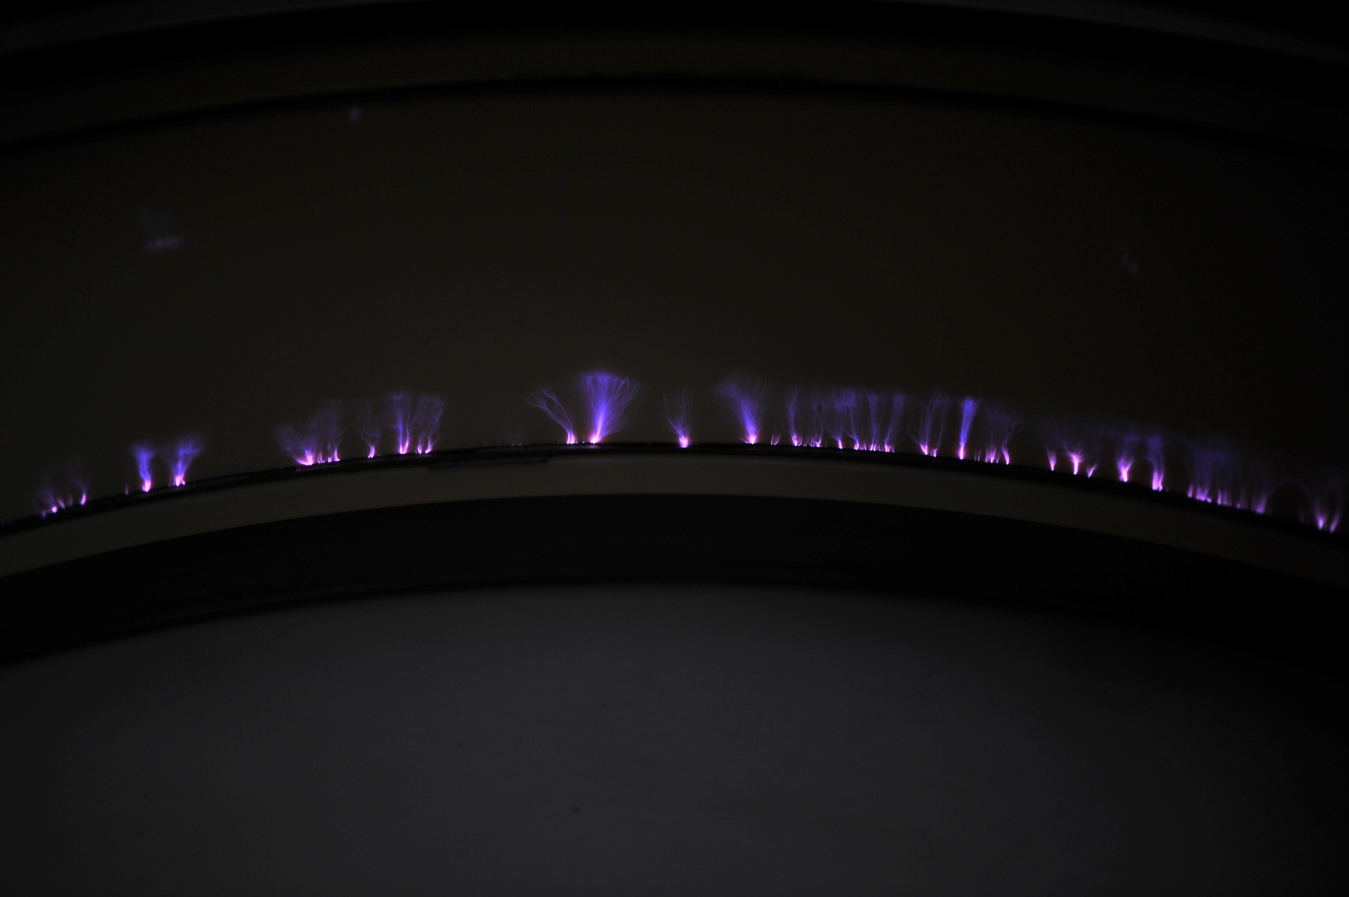
Proton source polarity
5 kV/cm

Slide 19
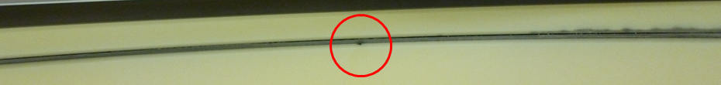
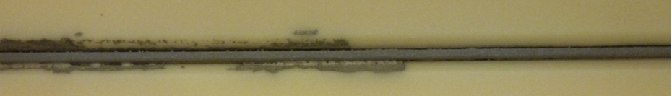
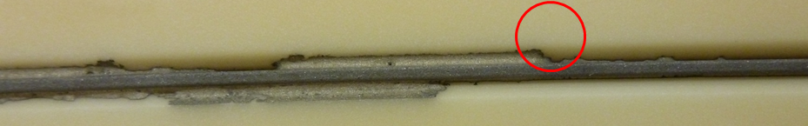
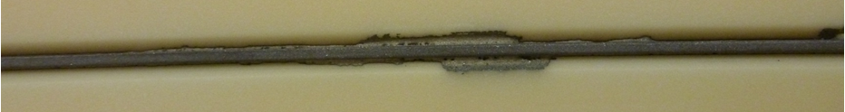
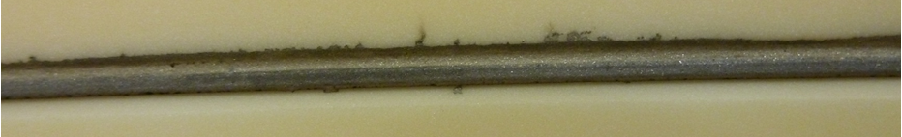
Active brazing Al2O3 insulator
Bellow Int.
Bellow
ext.

Slide 20
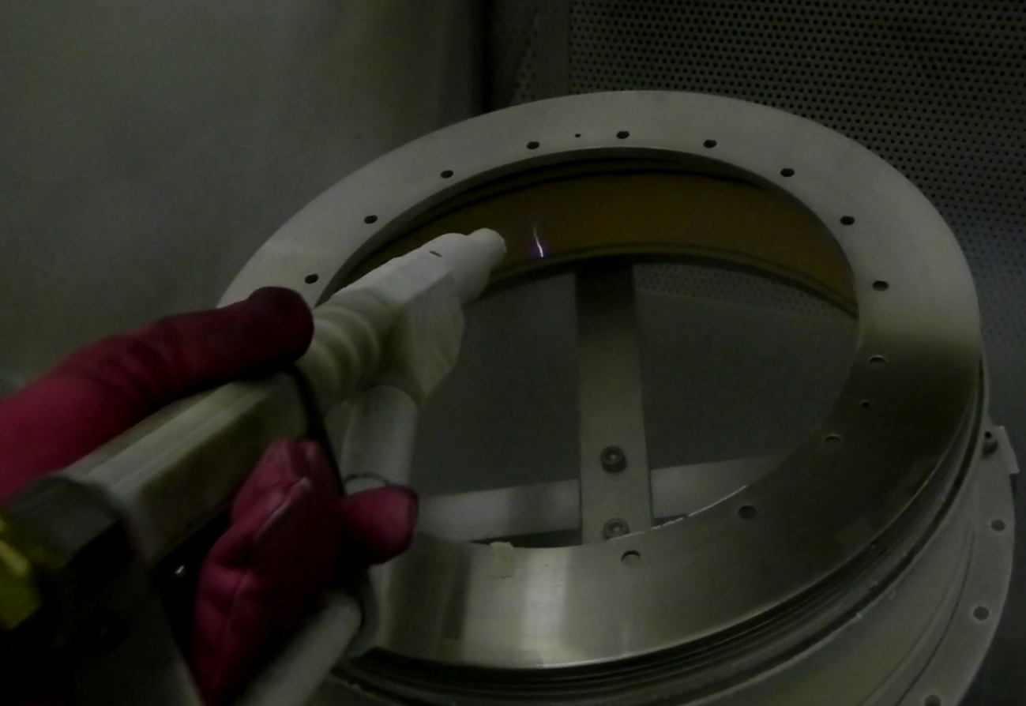
Dry ice cleaning of Al2O3 insulator
Time evolution of the HT drain current could be related to air reactive contamination.
Cleaning with alcohol reduced drain current
CO₂ dry ice (3mm beads) blasting under Nitrogen followed by drying at 60 deg.C.
The 30 kV HV tests then showed a non-measurable current drain (<0.1μA).
Surface contamination existed and is likely removed

Slide 21
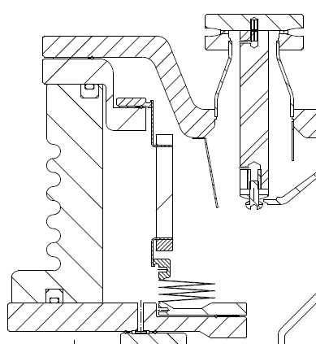
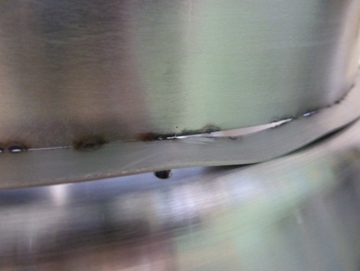
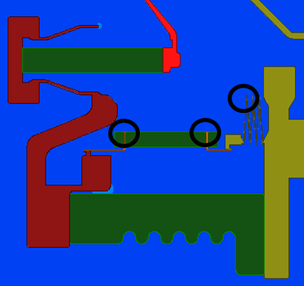
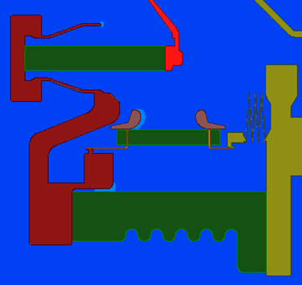
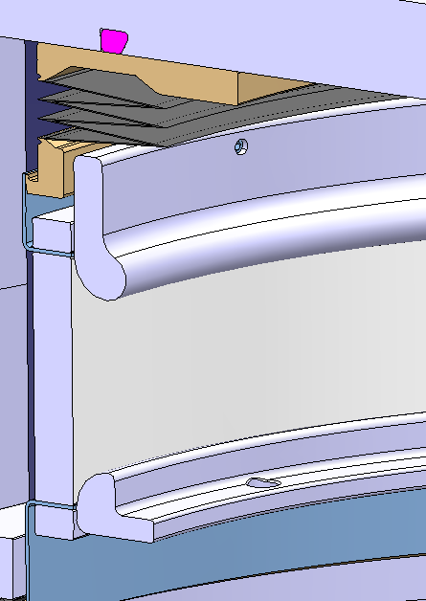


2D Electrostatic Simulation of FE-Insulation
Screen shielding form Cs-vapour
→ Removed
Protrusions induced field emission spots and
cracks lead to high fields
→ Successfully shielded
1 ceramic was sent back to remove protrusions by grinding
→ Successfully passed HV tests

Slide 22
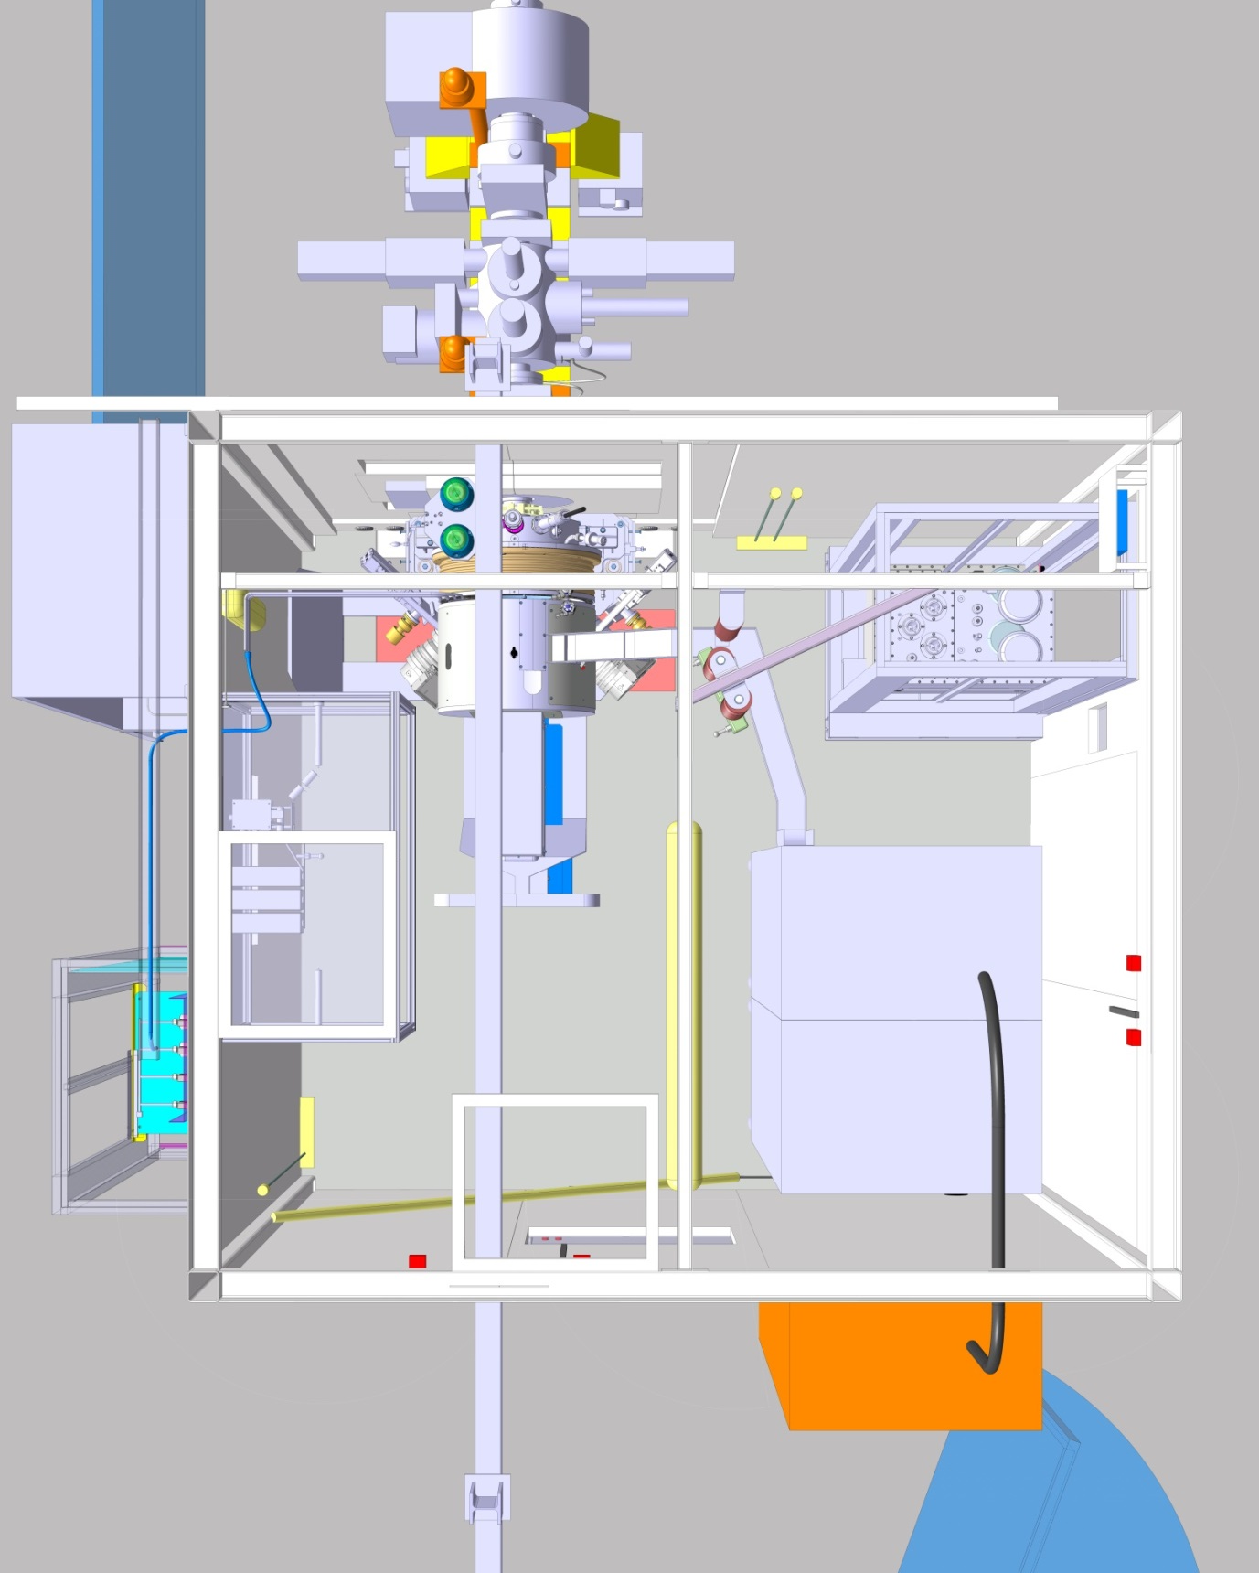
FC-400
Service Door
Vacuum
control
H₂ system
Pulsed HV
Transformers
HV-Einzel
RF-Maching
network
Service Door
HV-racks
H₂ control
2x Ventilation
Access Door
Hoist
Access

Slide 23
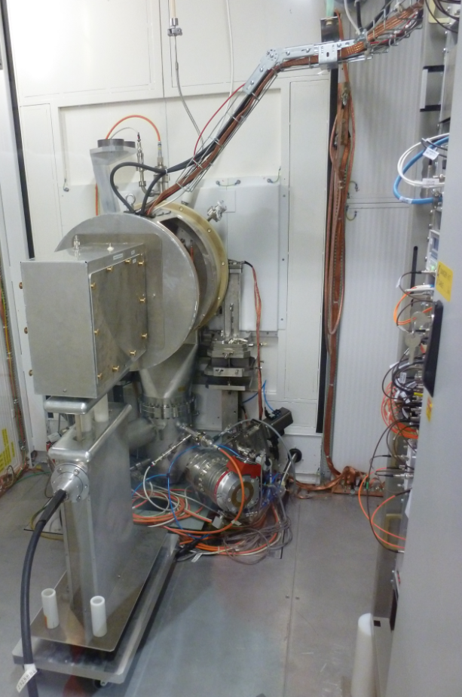
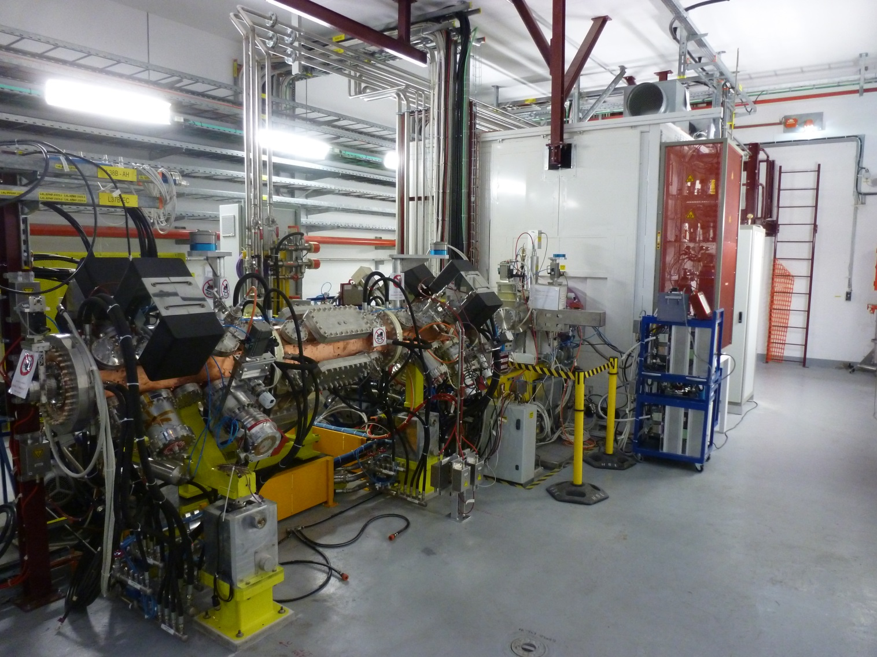
Linac4 tunnel Sept. 2013
Installation of the LEBT, RFQ and Chopper line
Commissioning with a 45 kV 20 mA class volume source based on the DESY plasma Generator)
H2 distribution
RF-Matching network
45 kV LEBT
2 MHz RF transformer
IS01: Volume 20 mA
a) 60-100 kW plasma Generator
b) DESY Plasma Generator
IS02: Cesiated surface 40-50 mA
IS03: BNL’s Magnetron (tbc.)
3 MeV RFQ

Slide 24
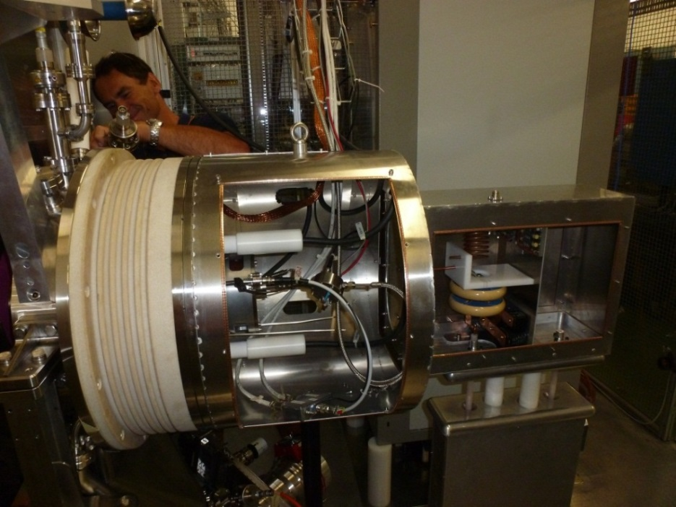
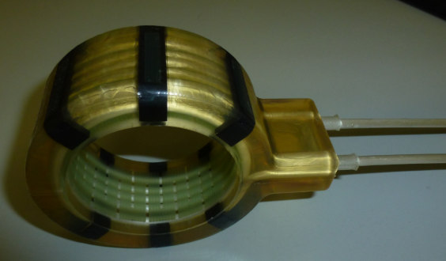
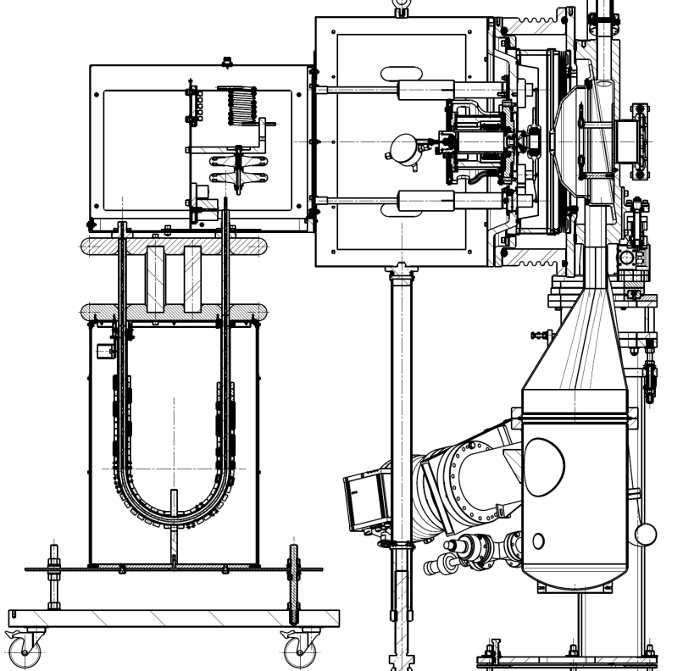
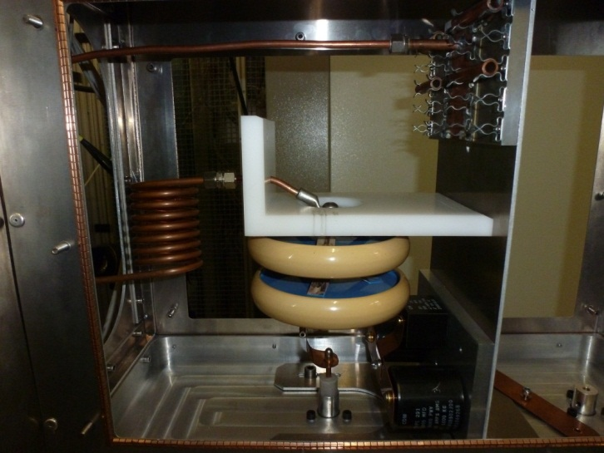
RF-Insulation transformer &
Matching Network
Exchangeable:
C_{p}, C_{s}, L_{s} measured for each Plasma Generator or solenoid antenna (3-6 turn) → f_{o} at 1.95 MHz
Pole fixed to -45 kV potential (HV-flange) either close to extraction hole of at the middle of the plasma chamber
Inductance solenoid L_{s}
6 turn solenoid
45 kV RF shield
Plasma Chamber
Matching network
Beam extraction
RF-connection
2MHz HV insulation transformer
Pumping system
Capacity C_{s}
Capacity C_{p}

Slide 25
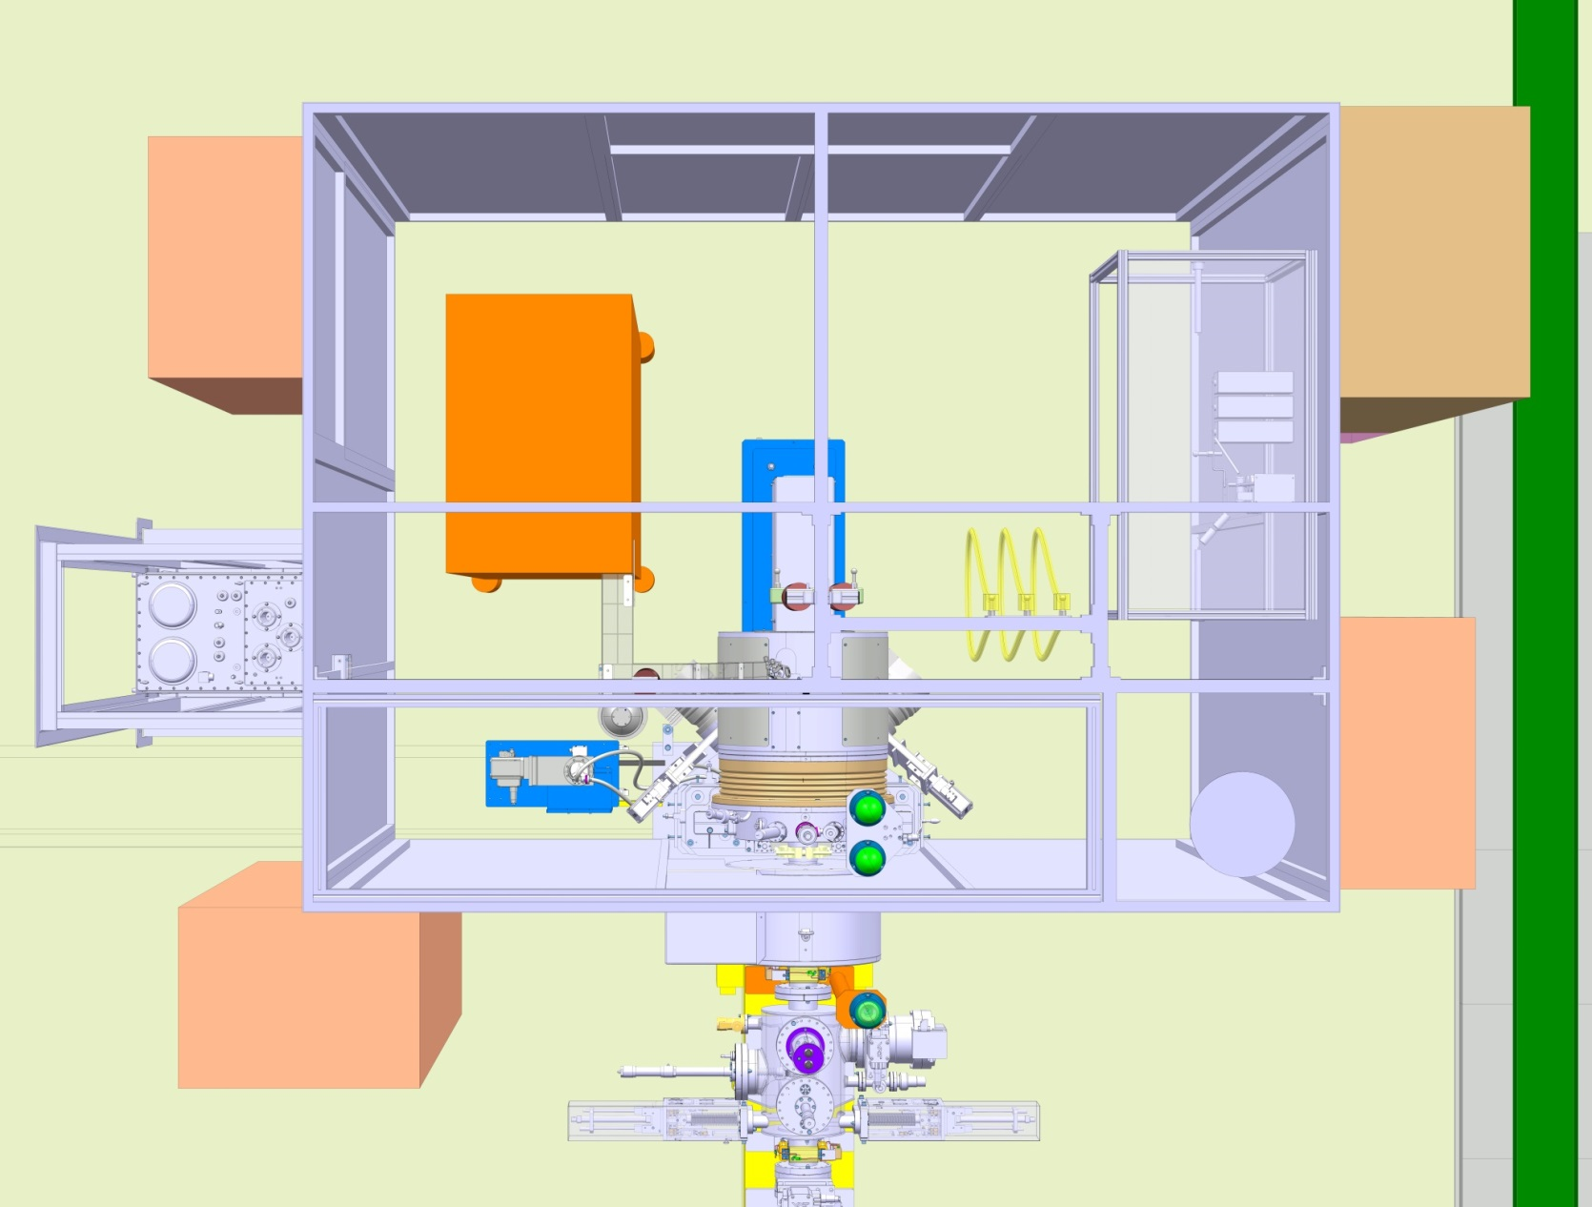
FC-152
Vacuum
control
ventilation
Mobile roof
H₂ system
Pulsed HV
Transformers
RF-Maching
network
HV-rack
HV-Einzel
H₂ control
Access Door

Slide 26
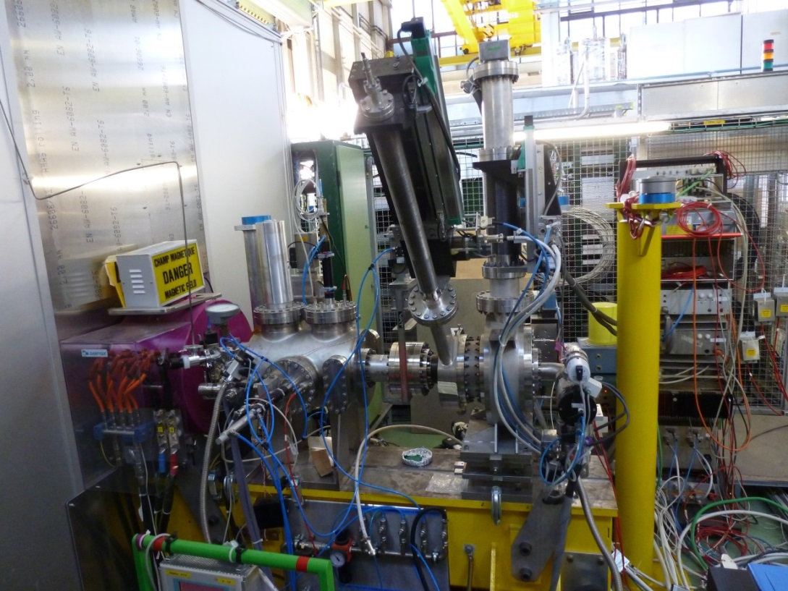
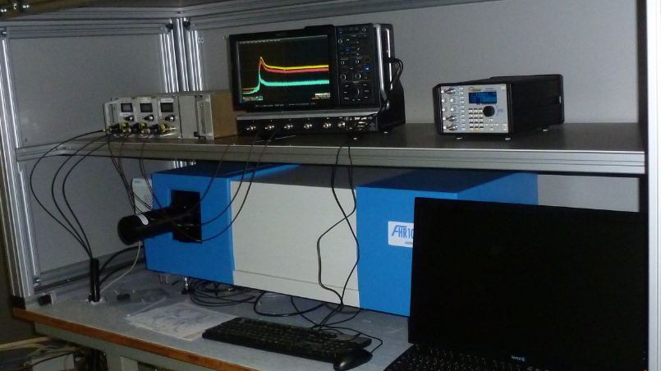
IS-test stand
Equipped identically to the first half of Linac4’s LEBT :
Solenoid
Faraday cup
H-V grids
Beam current transformer
Gas-density regulation
Plasma and beam diagnostics :
Optical photometry
Spectrometer
Emittance meter
3 Hamamatsu
10 MHz PMts
FHR 1000, 2-Gratings 100 and 2400 lines/mm

Slide 27
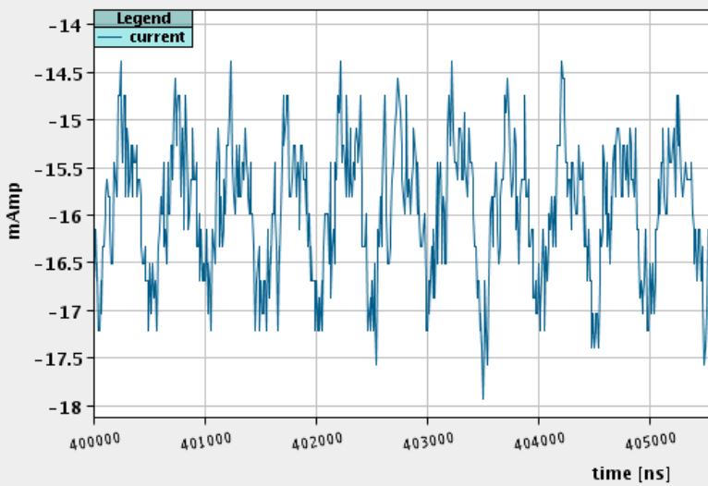
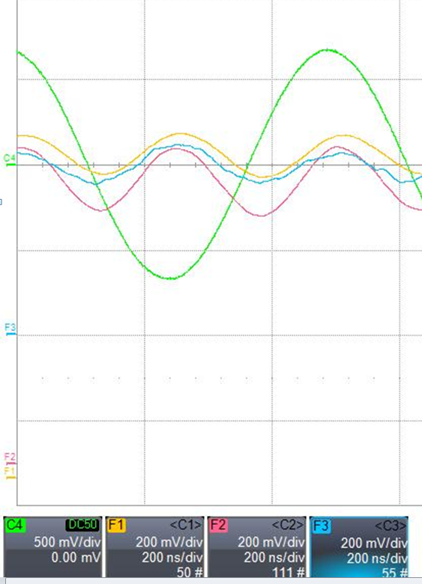
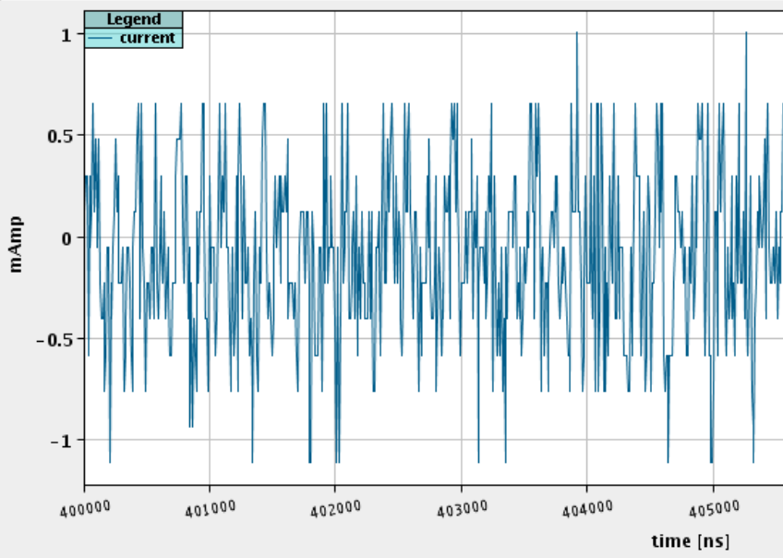
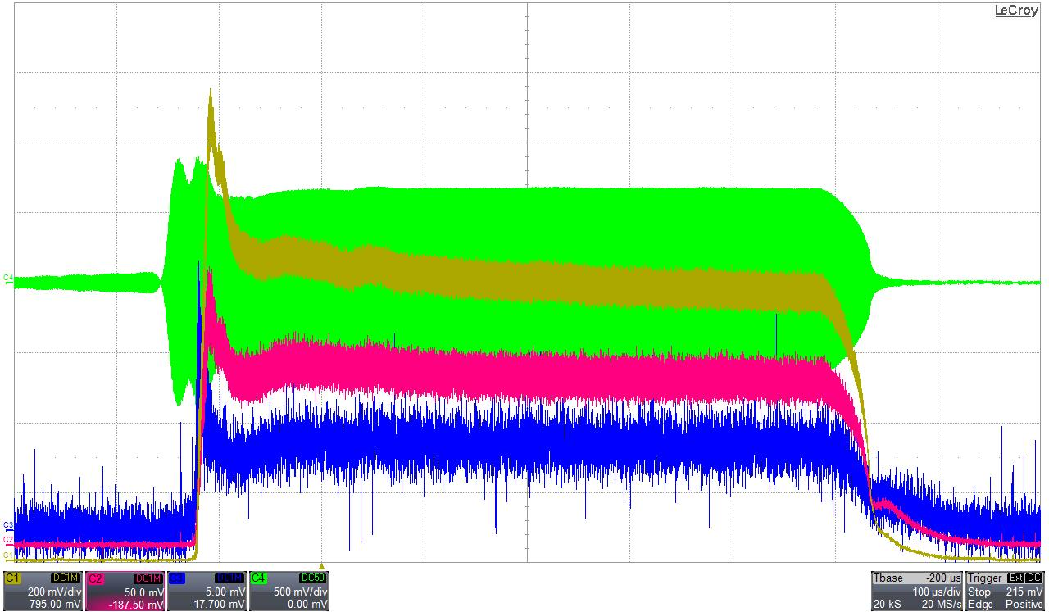
Plasma light & H⁻ beam
2MHz ripple observed by M. Sordet, J. Tan BPM-ToF system
4 MHz fine structure observed in the plasma light emission, O(10-15%) peak to peak .
2 MHz H⁻ beam fine structure observed in the Volume source equipped with the DESY PG:
O(20%) peak to peak fluctuation of the H⁻ beam intensity
(Av.: 16 mA)
I(RF+dt)
H_{α}, H_{β}, H_{γ}
LEBT BCT
0.2 μs/div
Plasma ignition, stable beam region
I(RF)
Hα
Hβ
Hγ
LEBT FC intercepting the H⁻ beam
Courtesy: U. Raich 27/3/13
100 μs/div

Slide 28
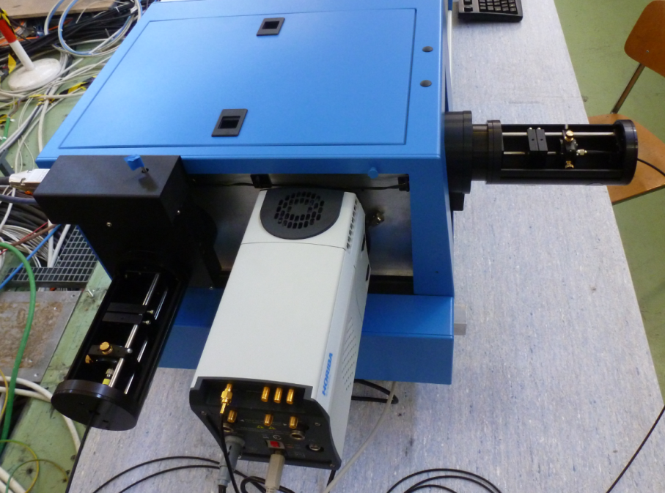
Optical Emission Spectrometry
H_{β}
H_{α}
Extraction
port
100 lines/mm
ICCD camera
Optical fibre light in
Operational & eagerly awaiting plasmas
2400 lines/mm grid

Slide 29
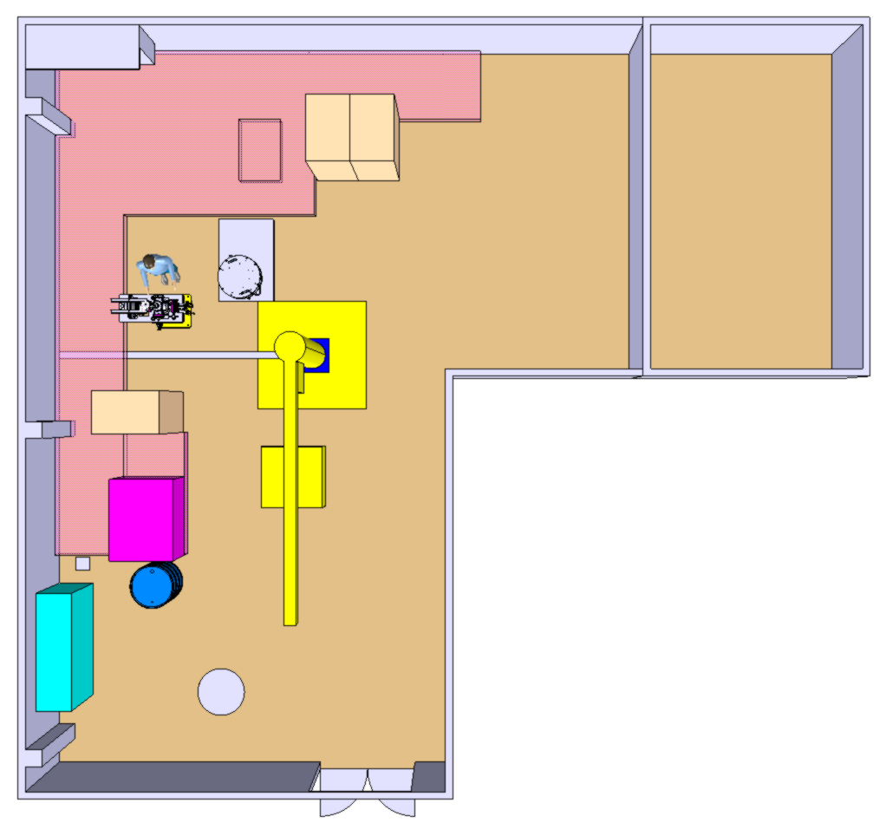
Linac4 IS: 357 test stand
357-R-005
357-R-011
Piezo
Glove Box
HV
Pulsed gas injection test bench
Cs-Oven test bench
Cs
Flammable
Controls’ Rack
Optics
Cs-Washing
High voltage
Cs-Ovens test stand
Piezo valves
Optics calibration
Cesiated water
disposal tank 200 lt

Slide 30
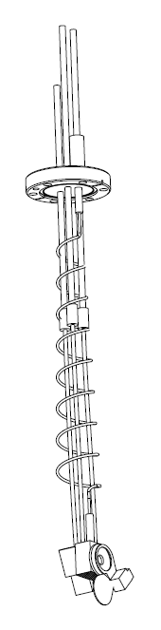
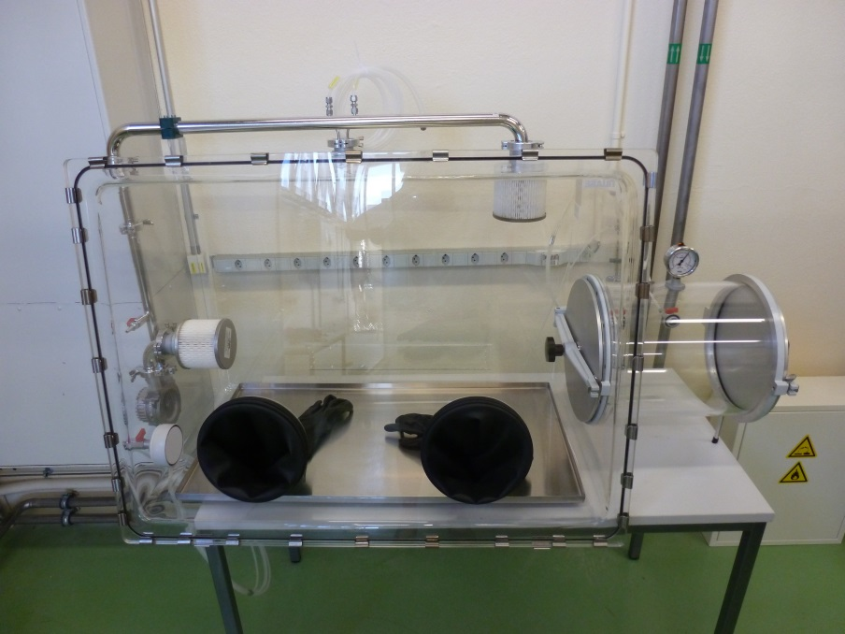
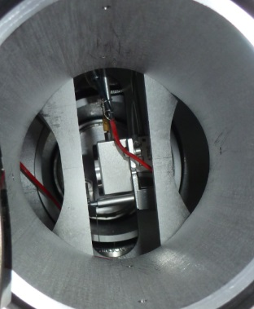
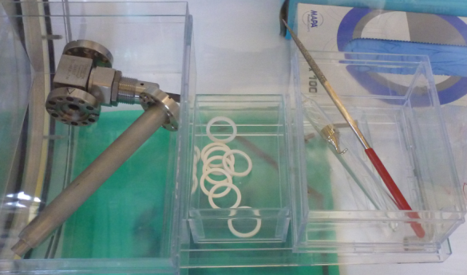
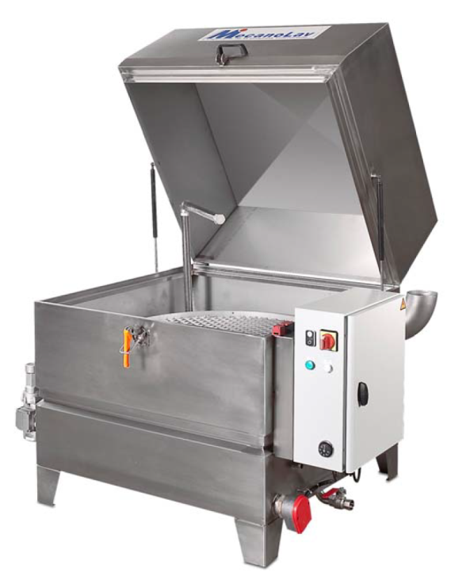

Cs-test stand 357
Cs-Oven filling
Flow and angular distribution of the Cs-atomic beam
Cleaning of cesiated components
Inert gas glove box
& antechamber
Vertical actuator
Inficon Quartz sensor
Industrial washing system

Slide 31

IS02 plasma Generator
Einzel lens
electron dump
Filter field
3 to 6 turns solenoid antenna
Plasma view ports:
on-axis, 19° & 26°
25 kV puller
T-regulated
Cesiated
Mo-surface
Permanent magnet
Octupole cusp in
offset Halbach config.
Cs-transfer line

Slide 32



Plasma Generator design: IS01 vs. IS02
Cesiated surface:
Heater design
Temperature regulation
Beam formation region (ONIX)
Cs
Cs-surface
IS-02 Plasma Surface H⁻ production
collar
Puller
IS-01 Volume H⁻ production
Filter magnet
Beam optics:
Dumping of coextracted electrons
Minimize emittance
Ignition
Cusp magnet
Caesium:
Oven production
Test stand commissioning
Flow calibration
Cleaning procedure (mg range)

Slide 33

Mounting the DESY PG on IS01-2 flange
IS01-2
SS-coupling
flange
Macor

Slide 34





Permanent magnets configuration IS01-02
8×Halbach magnets
Ferrites
Viewports
Mo Collar
electrode
Mo Plasma
electrode
Ignition
Piezo valve
Filter Magnets
e-loss lines
SLHC-3kW Av.

Slide 35







Temperature control of the Cesiated Mo-surface
3D-printing of the solenoid Epoxy mould
Implementation of the
on-axis, 19° & 26°
Optical view ports
Brazed sapphire + Quartz lens
4 fibers (600μm core, 660μm clad, 710μm polyimide coating) inside of a SMA connector

Slide 36



Cs-Oven
Cs-transfer line
Co axial heating
Valves & collars
Cs-Oven 1-5 g
Heating Jackets
Two valves allow refilling without breaking the vacuum

Slide 37
List of all tests at ISTS-152 and operation in L4-400
3MeV Test Stand → Ion Source Test Stand (July 2013)
DESY source in 35kV H⁻ and protons → mid 2012
    Emittance measurements
IS01 6-turns 2 polarities 45 kV H⁻ and protons → end 2012 and June 2013
  Variation of all parameters: RF-frequency & power, Gas pressure, collar and plasma electrode potentials, Filter field strength, Macor instead of Al²O³, short circuit of the plasma electrode
    IS01+DESY-PG 45 kV H⁻ and protons Feb-June 2012 (OM presentation)
      One Emittance measurement
    IS02 uncesiated 4-turn 45 kV H⁻ from Oct. 2013 (OM presentation)
L4-Tunnel
IS01+DESY-PG 45 kV H⁻ Sept 2nd 2013 …

Slide 38


IS-01 PG vs. Desy PG
Plasma Generator: IS01 6-turn Desy + IS-01 Optics & e-dump
RF-coupling Excellent Good
45 kV H⁻ beam current 3 mA & stops after 40 μs 16-22 mA
Electron-dump current 1.5-3 A 0.6 A
Plasma Light Normal Normal
Electron dumping operational up to 3A !,
Higher e-current when fixing the potential of the solenoid at the middle of the plasma chamber
→ 3-5 turns solenoid & mobile antennas

Slide 39

Response of the Pulsed HV under dynamic load:
0.6 A electrons & 16 mA H⁻
Pulsed HV system:
  Beam energy fluctuation meets Specification, further improvement expected with new controls electronics (end 2013)
  ± 0.5 kV stability throughout the beam pulse
  Detects over-currents and stops discharges. No traces of arcs on the electrodes
  Up to 3 A electron current successfully dumped at 10 keV on the e-dump, detailed analysis in O. Midttun’s presentation

Slide 40





IS01+DESY PG: after 1 year integrated operation time (no maintenance)
→ RF-induced arcing in air
H₂-Plasma light
RF-air arcing
Burned wire insulator and molten magnet housing
Repaired and now operated below 20 kW RF

Slide 41




Mock-up pressure meas.
The pressure in the plasma chamber during ignition and H⁻ pulse depends on 5 piezo valve operation parameters:
P₀, delay, bias, pulse voltage and duration
These partial derivatives are measured.
RF-power profile ramp minimizes AVC’s overshoot
Rf-inductive plasma ignition (No spark-gap) operational
SEJ
RF-coupling (20,40,60 kW)
All gas pulse shapes
P₀ piezo

Slide 42
Simulations & benchmarking of measurement
The Linac4 ion source team produced 24 conference papers, all published or accepted for publication from 2010 to 2013. Improving our basic understanding of H⁻ ion source physical processes and developing measurement techniques of predictable observables is mandatory to address technical challenges and to identify the direction of development towards 98% reliability
H₂-injection dynamics → 1) Neutrals at ignition ↔ P-meas.
RF-field & Plasma conductivity → 2) E and B fields
1+2 → PIC Plasma heating Keio → 3) e-density and EEDF
3 → CR-model → 4) H₀ density … flux
5) Light emission ↔ OES-P observable
4 → Beam formation ONIX → 6) electron & H⁻ beam, emittance
6 → Beam transport IBSimu → 7) emittance ↔ OES observable
7 → Beam neutralization

Slide 43
NIBS 2010 Takayama
J. Lettry, S. Bertolo, A. Castel, E. Chaudet, J.-F. Ecarnot, G. Favre, F. Fayet, J.-M. Geisser, M. Haase, A. Habert, J. Hansen, S. Joffe, M. Kronberger, D. Lombard, A. Marmillon, J. Marques Balula, S. Mathot, O. Midttun, P. Moyret, D. Nisbet, M. O’Neil, M. Paoluzzi, L. Prever-Loiri, J. Sanchez Arias, C. Schmitzer, R. Scrivens D. Steyaert, H. Vestergard, M. Wilhelmsson, Measurement of optical emission from the hydrogen plasma of the Linac4 ion source and the SPL plasma generator, AIP Conf. Proc. 1390 (2011) pp.245-254.
M. Paoluzzi, M. Haase, J. Marques Balula, D. Nisbet, CERN LINAC4 H- Source and SPL plasma generator RF systems, RF power coupling and impedance measurements, AIP Conf. Proc. 1390 (2011) pp.265-271.
M. Kronberger, E. Chaudet, G. Favre, J. Lettry, D. Küchler, P. Moyret, M. Paoluzzi, L. Prever-Loiri, C. Schmitzer, R. Scrivens, and D. Steyaert, Magnetic Cusp Configuration of the SPL Plasma Generator, AIP Conf. Proc. 1390 (2011) pp. 255-264.

Slide 44
ICIS 2011 Giardini Naxos
J. Lettry, J. Alessi, D. Faircloth, A. Gerardin, T. Kalvas, H. Pereira, and S. Sgobba, Investigation of ISIS and BNL ion source electrodes after extended operation, Review of Scientific Instruments 83, 02A728 (2012).
Ø. Midttun, T. Kalvas, M. Kronberger, J. Lettry, H. Pereira, C. Schmitzer, and R. Scrivens, A New extraction system for the Linac4 H- ion source, Review of Scientific Instruments 83, 02B710 (2012).
C. Schmitzer, M. Kronberger, J. Lettry, J. Sanchez-Arias, and H. Störi, Plasma characterization of the SPL plasma chamber using a 2 MHz compensated Langmuir Probe, Review of Scientific Instruments 83, 02A715 (2012).
J. Lettry, U. Fantz, M. Kronberger, T. Kalvas, H. Koivisto, J. Komppula, E. Mahner, C. Schmitzer, J. Sanchez, R. Scrivens, O. Midttun, P. Myllyperkiö, M. O’Neil, H. Pereira, M. Paoluzzi, O. Tarvainen, D. Wünderlich, Optical Emission Spectroscopy of the Linac4 and SPL Plasma Generators, Review of Scientific Instruments 83, 02A729 (2012).

Slide 45
NIBS 2012 Jyvaskyla
H. Pereira, J. Lettry, J. Alessi and T. Kalvas, Estimation of Sputtering Damages on a Magnetron H⁻ Ion Source Induced by Cs⁺ and H⁺ Ions, AIP Conf. Proc. 1515 (2013) pp.81-88.
H. Pereira, D. Faircloth and J. Lettry, Operation and thermal modeling of the ISIS H- source from 50 to 2 Hz repetition rates, AIP Conf. Proc. 1515 (2013) pp.114-120.
S. Mochalskyy, J. Lettry, T. Minea, A. F. Lifschitz, C. Schmitzer, O. Midttun, D. Steyaert, Numerical modeling of the Linac4 negative ion source extraction region by 3D PIC-MCC code ONIX, AIP Conf. Proc. 1515 (2013) pp.31-40.
J. Lettry, D. Aguglia, Y. Coutron, A. Dallochio, H. Perreira, E. Chaudet, J. Hansen, E. Mahner, S. Mathot, S. Mattei, O. Midttun, P. Moyret, D. Nisbet, M. O’Neil, M. Paoluzzi, C. Pasquino, J. Sanchez Arias, C. Schmitzer, R. Scrivens, D. Steyaert, J. Gil Flores, H⁻ Ion Sources For CERN’s Linac4, AIP Conf. Proc. 1515 (2013) pp.302-311.
C. Pasquino, P. Chiggiato, A. Michet, J. Hansen, J. Lettry, Vacuum simulation and characterisation for the LINAC4 H⁻ source, AIP Conf. Proc. 1515 (2013) pp.401-408.
E. Mahner, J. Lettry, S. Mattei, M. O'Neil, C. Pasquino, C. Schmitzer, Gas injection and fast-pressure-rise measurements for the Linac 4 H− source, AIP Conf. Proc. 1515 (2013) pp.425-432.
S. Mattei, M. Ohta, A. Hatayama, J. Lettry, Y. Kawamura, M. Yasumoto, and C. Schmitzer, RF Plasma modeling of the Linac4 H- ion source, AIP Conf. Proc. 1515 (2013) pp.386-393.
Ø. Midttun, T. Kalvas, M. Kronberger, J. Lettry, R. Scrivens, A magnetized Einzel-lens electron dump for the Linac4 H- ion source, AIP Conf. Proc. 1515 (2013) pp.481-490.

Slide 46
ICIS 2013 Chiba accepted for publication in AIP Conf. Proc.
J. Lettry, D. Aguglia, P. Andersson, S. Bertolo, A. Butterworth, Y. Coutron, A. Dallocchio, E. Chaudet, J. Gil-Flores, R. Guida, J. Hansen, A. Hatayama, I. Koszar, E. Mahner, C. Mastrostefano, S. Mathot, S. Mattei, Ø. Midttun, P. Moyret, D. Nisbet, K. Nishida, M. O’Neil, M. Otha, M. Paoluzzi, C. Pasquino, H. Pereira, J. Rochez, J. Sanchez Alvarez, J. Sanchez Arias, R. Scrivens, T. Shibata, D. Steyaert, T. Yamamoto, Status and Operation of the Linac4 Ion Source Prototypes.
Ø. Midttun, J. Lettry, and R. Scrivens, Measurements of Linac4 H- Ion Source Beam with a Magnetized Einzel Lens Electron Dump.
R. Scrivens, G. Bellodi, O. Crettiez, V. Atanasov Dimov, D. Gerard, E. Graneman Souza, R. Guida, J. Hansen, J.-B. Lallement, J. Lettry, A. Lombardi, Ø. Midttun, C. Pasquino, U. Raich, B. Riffaud, F. Roncarolo, C. A. Valerio-Lizarraga, J. Wallner, T. Zickler, Linac4 Low Energy Beam Measurements with Negative Hydrogen Ions.
C. A. Valerio-Lizarraga, J.-B. Lallement, I. Leon-Monzon, J. Lettry, Ø. Midttun, R. Scrivens, Space Charge Compensation in the Linac4 Low Energy Beam Transport Line with Negative Hydrogen Ions.
A. Grudiev, J. Lettry, S. Mattei, M. Paoluzzi, and R. Scrivens, Numerical Simulation of Electromagnetic Fields and Impedance of CERN LINAC4 H- Source taking into Account the Effect of the Plasma.
S. Mattei, M. Ohta, M. Yasumoto, A. Hatayama, J. Lettry, A. Grudiev, Plasma ignition and steady state simulations of the Linac4 H- Ion Source.
M. Ohta, S. Mattei, M. Yasumoto, A. Hatayama and J. Lettry, Numerical Study of the Inductive RF-discharge Initiation for the Linac4 H- Ion Source.
T. Yamamoto, T. Shibata, M. Ohta, M. Yasumoto, K. Nishida, A. Hatayama, S. Mattei, J. Lettry, K. Sawada and U. Fantz, Modeling of Neutrals in the Linac4 H- Ion Source Plasma; Hydrogen Atom Production Density Profile and H_{a} Intensity by CR Model.
K. Nishida, S. Mochizuki, M. Yasumoto, M. Ohta, J. Lettry, S. Mattei, and A. Hatayama, Equivalent Circuit of RF-Plasma with The Transformer Model.

Slide 47




ONIX PIC-simulation of the plasma-beam formation:
P-density: O(10¹⁸) m⁻³
IS01 & IS02 steady state H⁺ density
IS02 No-Cs
Tested Nov.12th
13 runs @ 2weeks & 20 cpus:
IS01, (volume production), IS02, Vol. & Surface
Sensibility study: H⁻ prod. Rate (1-7 kA/m²), filter field strength, Super particles density, plasma density (5×10¹⁷-2×10¹⁸ m⁻³) and electron to H⁻ ion ratio (5:5-1:10)
positive and negative ion extraction
S. Mochalskiy, Collaboration with LPGP Orsay France

Slide 48
Conclusion outlook
The ISWP could meet RFQ driven deadlines, a 15 mA, 45 kV H⁻ commissioning beam is available in the linac4.
However, the intensity and beam emittance are not met. The IS01 optics emittance is limited by volume source e/H ratio requiring design of high current low energy e-dumping.
Two sets of prototypes were produced, more time is required to conclude on their performances and potential.
All ancillary systems are operational, all of them require improvements in reliability, controls (GUI) and monitoring.
The availability of the test stand was O(20%) over the last 4 month… many valid explanations, but 98% is very far. Numerous specialist needed, all of them very busy, all found a slot within the next few days.
Simulation of the key processes (i.e. H₂-injection, RF, plasma heating) are at a level where engineering and optimization could start.
Thank to all contributors, great motivated IS-team

Slide 49

Major contributions from IS-team students and fellows

