Slide 1


Linac4
H₂ injection system
P. Carrié, F. Fayet, R. Guida, S. Izquierdo Rosas, J. Rochez,
A. Wasem, M. Wilhelmsson
J. Lettry, R. Scrivens, E. Mahner
Roberto Guida PH-DT-DI
Linac4 Ion Source Review November 14th, 2013

Slide 2
Outlook
Introduction
H2 supply systems: description
Software Controls and User Interface
Performances
Budget analysis
Conclusions
Outlook

Slide 3
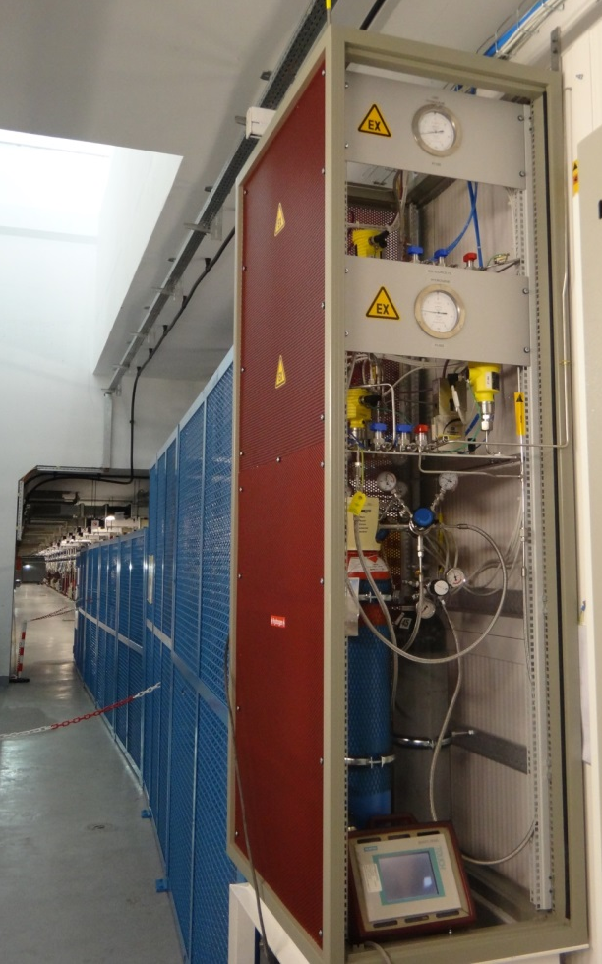
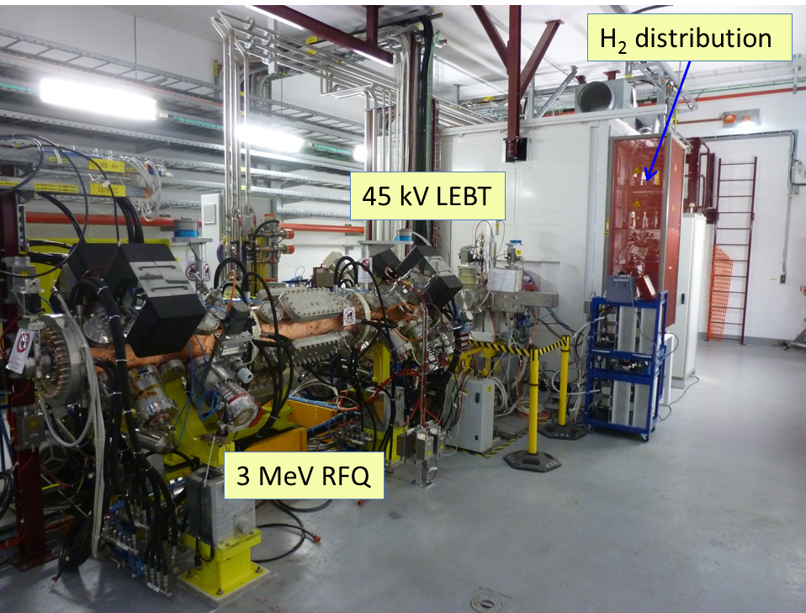
Linac4 H₂ supply system
Two identical systems: 3 MeV Test Stand and Bldg400:
Each system contains H₂ gas supply for Ion Source and LEBT
H₂ supply at 3 MeV Test Stand operational since August 2012
H₂ supply at Linac4 Bldg400 operational since August 2013
LEBT
Introduction
Ion Source

Slide 4
The team involved
PH-DT-DI/GasService….. Patrick Carrié, Roberto Guida, Albin Wasem
EN-MEF………………… Fabrice Fayet, Mats Wilhelmsson
EN-ICE…………………. Silvia M. Izquierdo Rosas, Jacques Rochez
Linac4…………………… Jacques, Richard, Edgar, Michael
Introduction

Slide 5
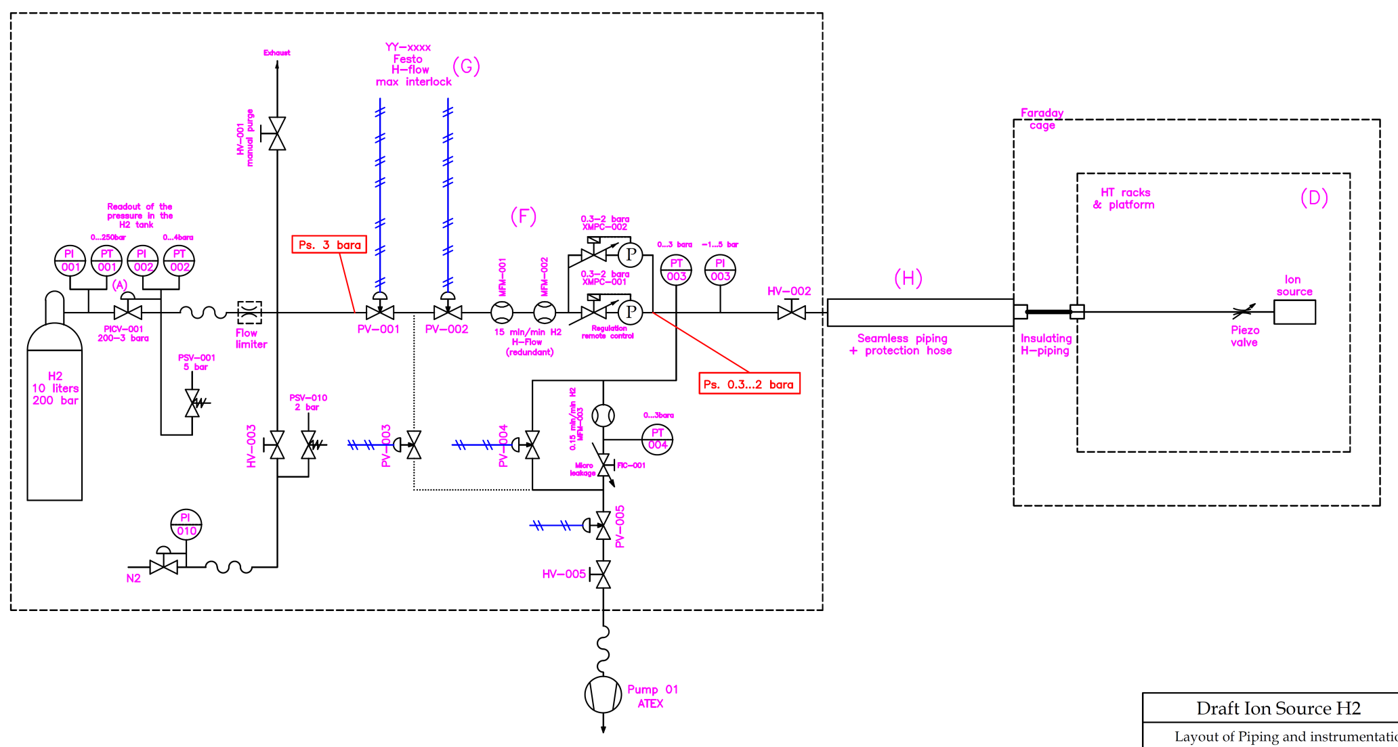
Ion Source H₂ supply
MFM mass-flow meters:
Monitoring H₂ flow
Ion Source temperature
for H₂ density regulation
Monitoring of
primary supply
and line pressure
XMPC: pressure controllers
Two for redundancy
H₂ supply systems
Independent P sensors
for monitoring/alarms
Pump unit for better P regulation
and working point below Patm
N₂ purge

Slide 6
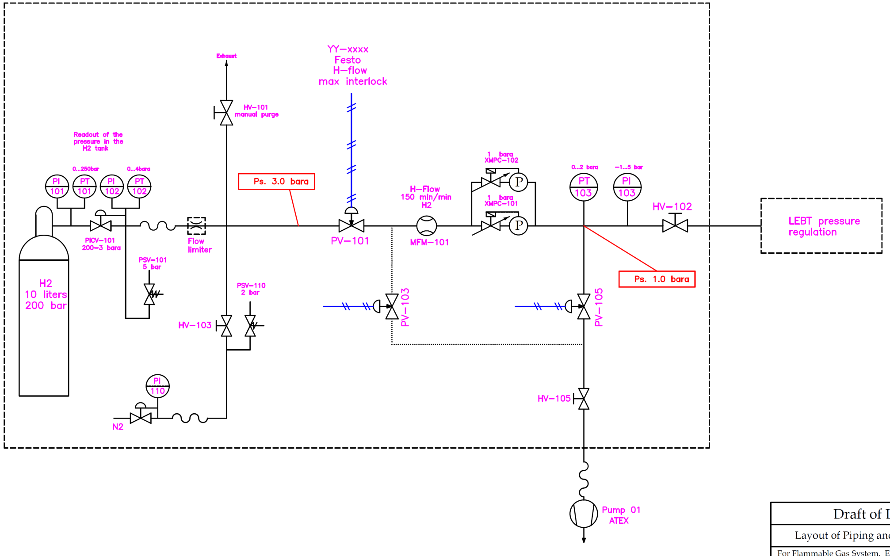
LEBT H₂ supply
MFM mass-flow meters:
Monitoring H₂ flow
Monitoring of
primary supply
and line pressure
XMPC: pressure controllers
Two for redundancy
H₂ supply systems
Independent P sensors
for monitoring/alarms
N₂ purge
Pump unit for better P regulation
and working point below Patm

Slide 7
Software controls
Remote monitoring and control
Application running on PLC with remote interface in PVSS
Local touch screen is available
Alarms propagated via email/sms
Prepared following the standard used for gas systems at LHC experiments
Operational States
Stop – (maintenance, modifications)–all the actuators in their fail-safe positions. H₂ has been evacuated from the system.
Stand-by – (allows interventions on other systems) –The gas system is stopped with all the actuators in their fail-safe positions, H₂ has not been evacuated.
Evacuate – (improve gas purity at H₂ filling) – H₂ is evacuated from the gas system until a certain pressure threshold is reached.
Run – (normal gas system operational state): The gas system is running and all the parameters are stable and within the defined limits for this operational state.
Controls and Interface

Slide 8
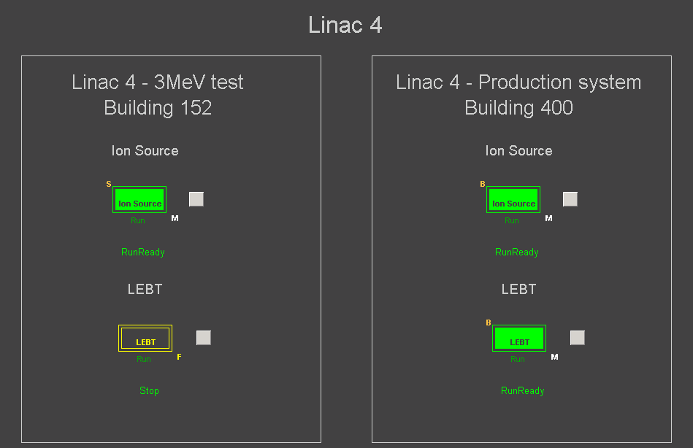
Software controls - Interface
User interface
Controls and Interface

Slide 9
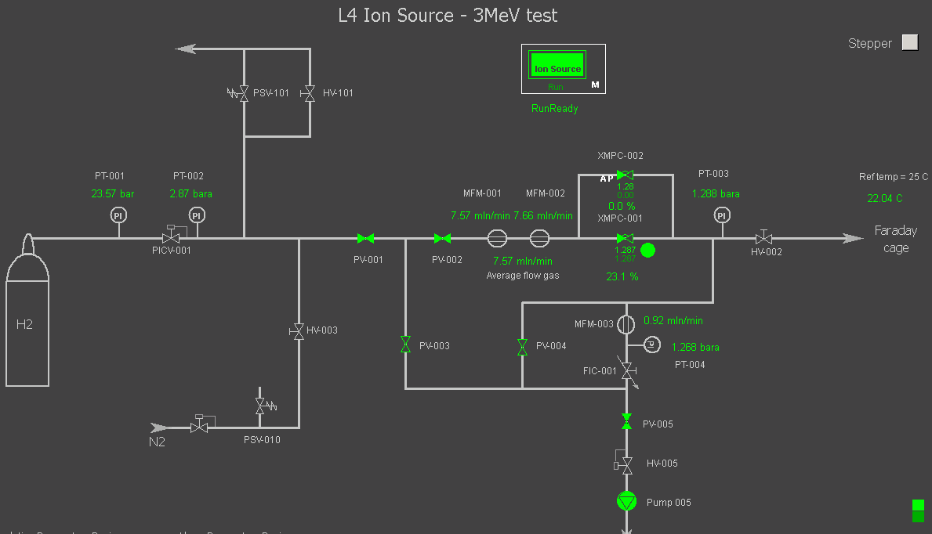
Software controls - Interface
On-line values and immediate access to one year data
Values published on DIP for other users (i.e. Linac4 control system)
Controls and Interface

Slide 10
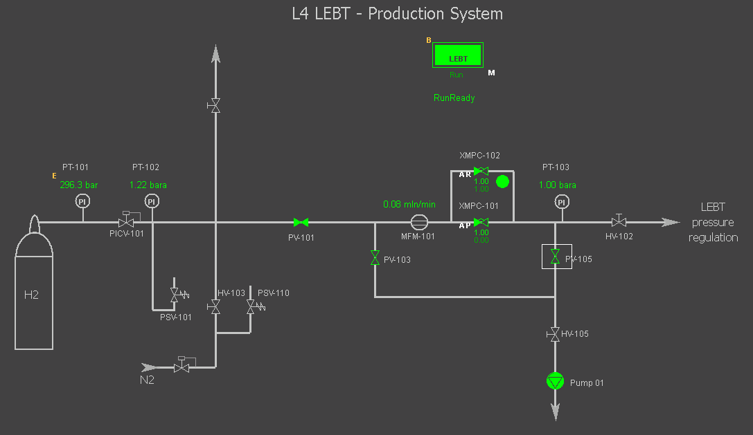
Software controls - Interface
Controls and Interface

Slide 11
Controls and Performances
Safety and Alarms:
Detection of abnormal consumption:
  At supply level → pressure drop in H₂ cylinder
  At P regulation level → H₂ flow monitoring
Several alarms implemented for system stop, unstable regulation, failure of components, measurements out of range, …
Performances:
Stable operation (the system at the 3 MeV Test Stand is operational since one year)
Gas density regulation is better than 0.5 mbar at 25 °C
System tested with Pressure set-point for operation from 100 mbara to 1800 mbara
About 15 minutes for achieving set-point with standard regulation from vacuum to 1300 mbara (room for improvement)
System performances

Slide 12
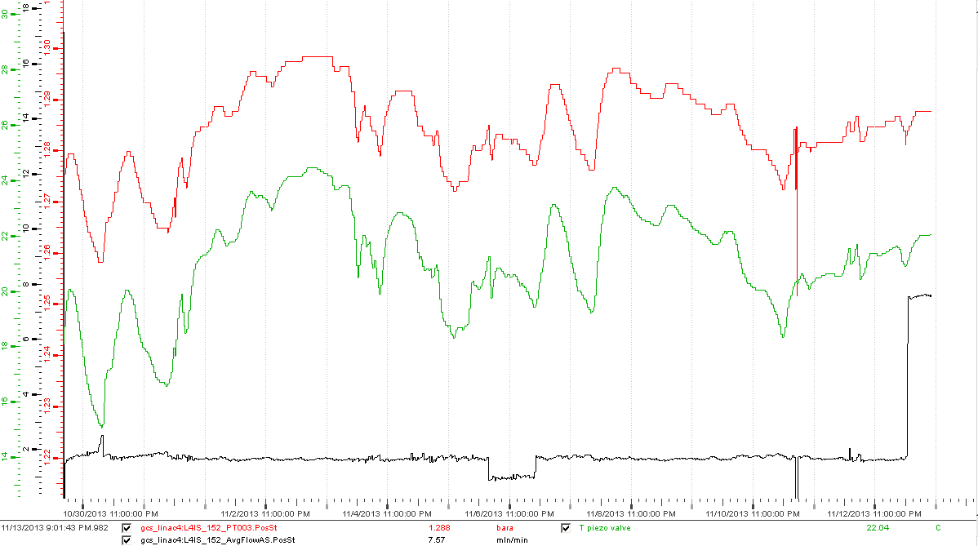
Performances – gas density regulation
Pressure regulation for the Ion Source H₂ supply
System performances
Temperature piezo-valve
H₂ supply flow measured by MFM

Slide 13
Budget analysis
 | Price (CHF) | Team
Ion source | 20 k | PH-DT-DI/gas team
LEBT | 12 k | PH-DT-DI/gas team
Pipes/connectors | 4 k | PH-DT-DI/gas team
Pressure regulators | 5 k | EN-MEF-SI
manpower (mechanical and electrical) | 7 k (165 hours) | PH-DT-DI/gas team
Functional analysis | - | PH-DT-DI/gas team
PLC and I/O modules | 4 k | EN-ICE-PLC
Software PLC and PVSS | - | EN-ICE-PLC
Budget for construction
About 55 kCHF (including manpower) per rack

Slide 14
Conclusions
Two H₂ (or other gases) supply racks have been built for 3 MeV Test Stand and final Linac4 system at Bldg400
Each rack contains fully independent H₂ supplies for Ion Source and LEBT
Fundamental to study/record the stability of the 4 systems over the coming months/year
Construction based on experience from gas systems for the LHC experiments which demonstrated extremely high availability (>99.9% power cuts excluded) over the last years
Spare parts, maintenance, manpower, … needed for operation to be reviewed in few months
Each system has already an on-site redundancy to cope with unexpected failures
Conclusions

