Slide 1
Instrumentation for the new
H⁻ Source Test Bench
Linac-4 Ion Source Review 2013
Uli Raich for the
CERN BE/BI team

Slide 2
Instruments for new test stand
SEMGrid
  Same mechanism as current device
  Wires can be polarized in addition to polarizing the frame
  New analogue electronics (foreseen for Linac-4) (done)
Faraday Cup
  Possibility to polarize up to 46 kV (variable) to measure energy spread
  Alternative: spectrometer which will not be used for Linac-4 any more (Faraday Cup is not polarized, only usable to measure beam intensity but not beam energy)
Chinese copy of LEBT transformer (done)

Slide 3
Instruments for new test stand (2)
New emittance meter
  Mechanical changes foreseen (2 independant slits?)
  Software was designed for commissioning only
  either needs to be maintained or replaced by standard CO Java application (4-5 months of work)
  (We now have 1 emittance meter for 45 keV and
  1 emittance meter for 3 MeV)
Diagnostics of electrons from source to be specified and not counted
(not done)
To my best knowledge this has been done within the budget and within the foreseen delays

Slide 4
What has been done
Copied the instrumentation we have in the LEBT at Linac-4 (Faraday Cup and wire grid)
Kept the 45 keV emittance meter, now installed on the test stand
Built a new slit & grid device working at 3 MeV installed in the Linac-4 tunnel
Chinese copy of the LEBT transformer

Slide 5
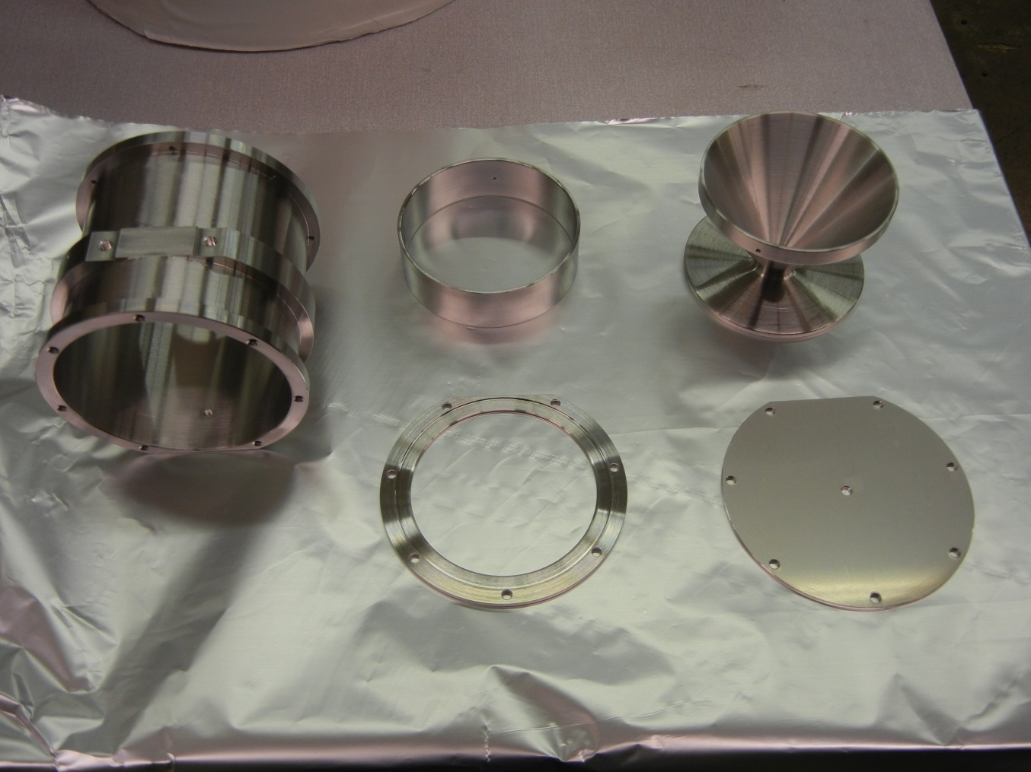
Faraday Cup

Slide 6
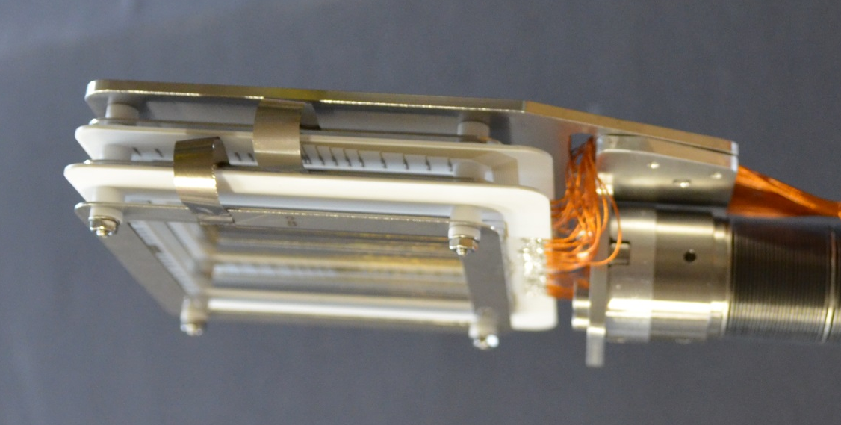
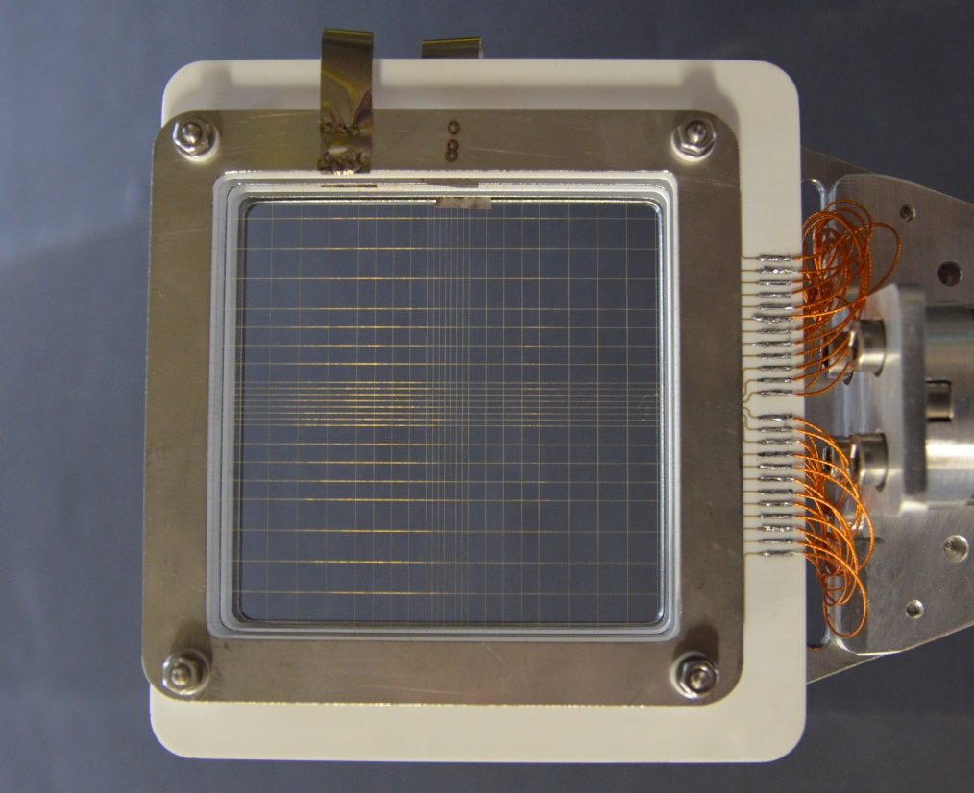
LEBT wire grids
Analogue electronics has been updated to latest
version
Sandwich of horizontal and vertical plane
24 wires with increasing wire spacing towards
the outside

Slide 7
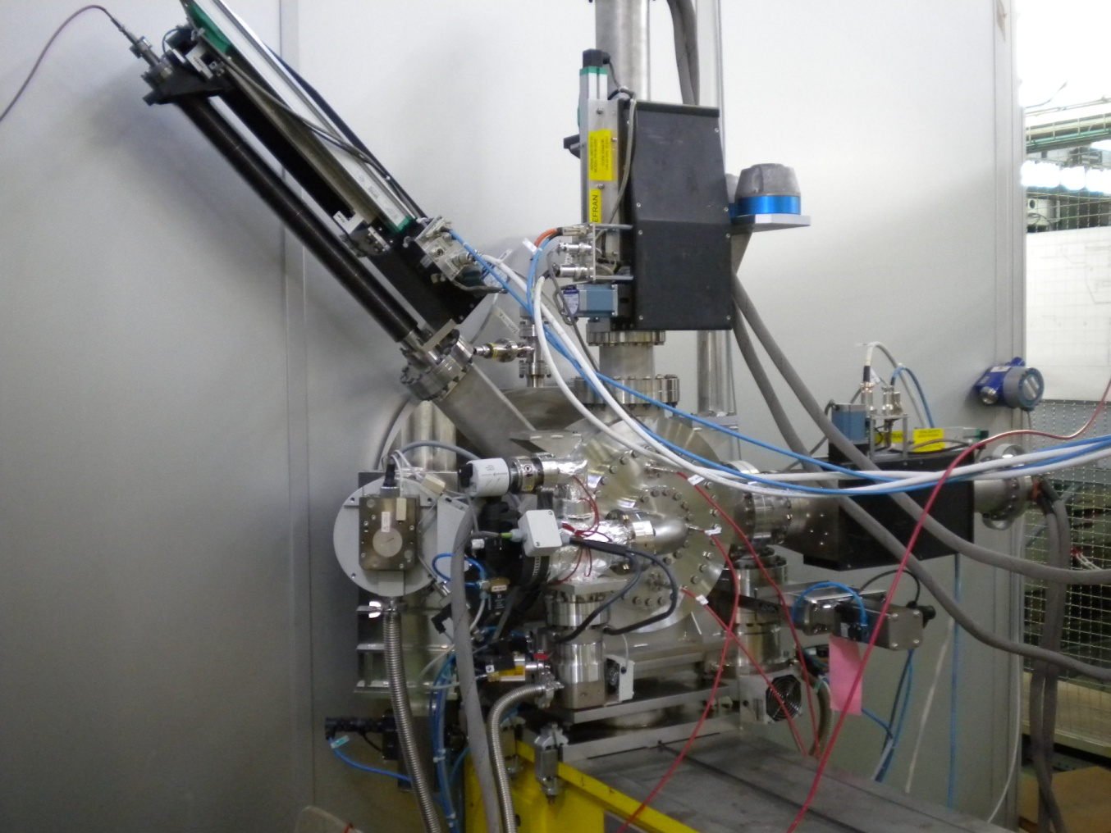
Transverse Emittance Measurement
Slit and grid phase space scanner
L-shaped 0.1mm slit moves under
45 degrees
Slit and grids move independently
Positioning precision: 50 µm
Movement PLC controlled
Slit and grids mounted in
2 independent vacuum boxes which
can be separated
Horizontal and vertical SEMGrid
wire distance .75 mm
30 signal wires
readout with home built 36 channel
250 kHz ADC
time resolved profiles

Slide 8
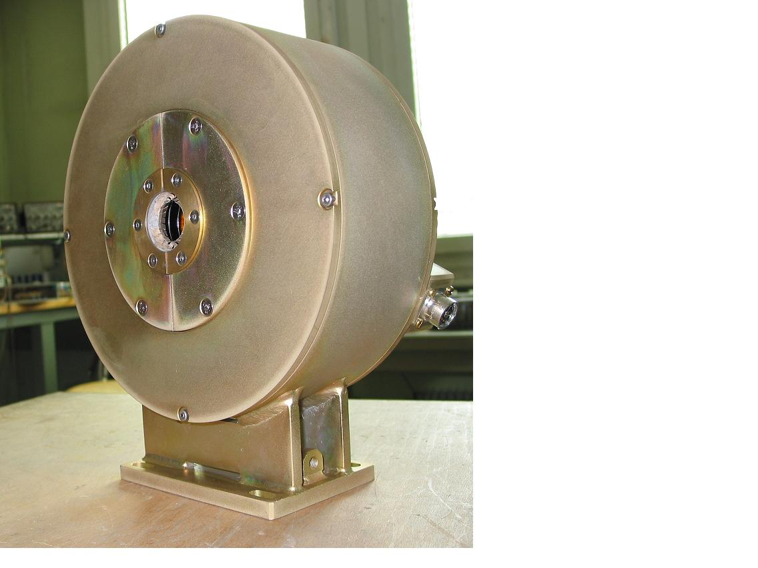
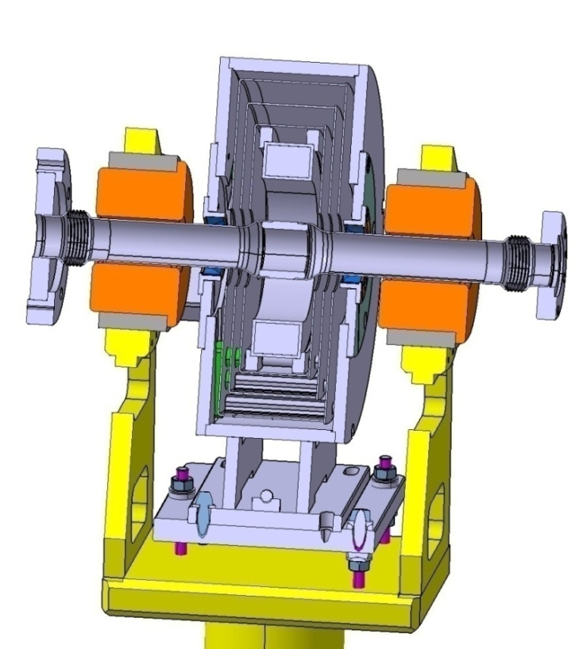
Current Transformers
Good magnetic shielding
avoids interference from
nearby pulsing quads
Shielding simulation and
test measurements have
been done
New electronics and software
has been developed for L4
Needs no additional work

Slide 9
Maintainance manpower
1 month FTE per year for
Small changes
Maintaining mechanisms
Keep electronics + software running

