Slide 1
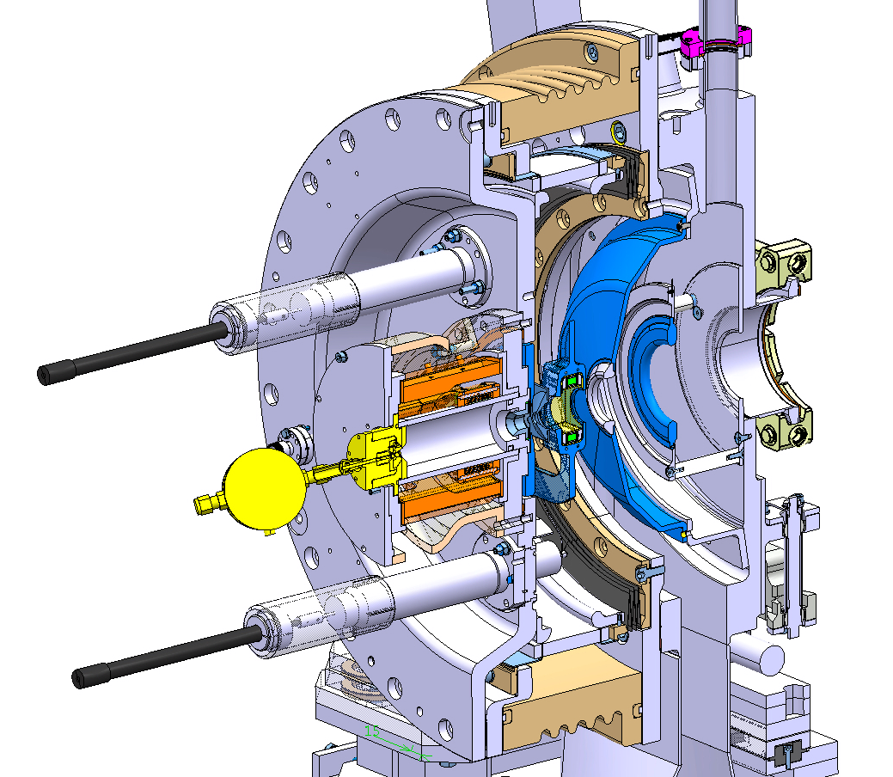


Linac4 ion source review
Beam optics simulations and measurements
Øystein Midttun
European Organization for Nuclear Research
University of Oslo
14.11.2013

Slide 2
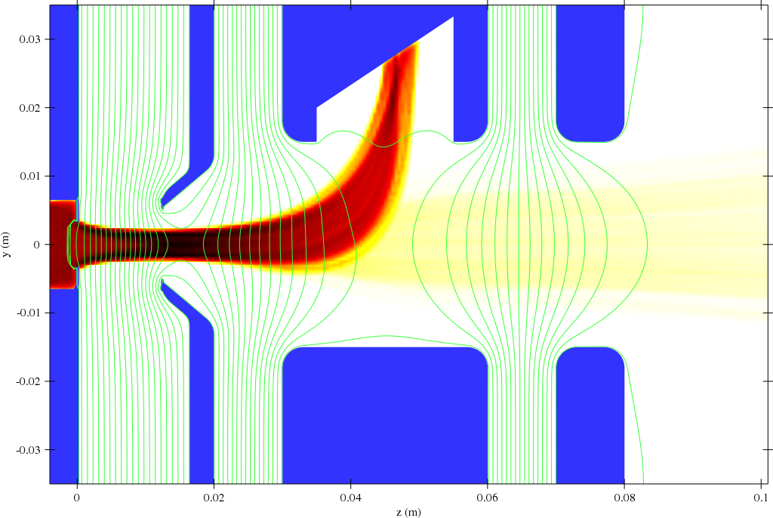
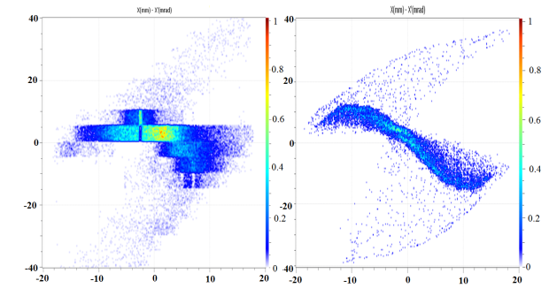
This presentations compares H⁻ beam simulations and measurements, and proposes improvements
Ion beam extraction system
Benchmarking of simulations
Emittance improvements

Slide 3
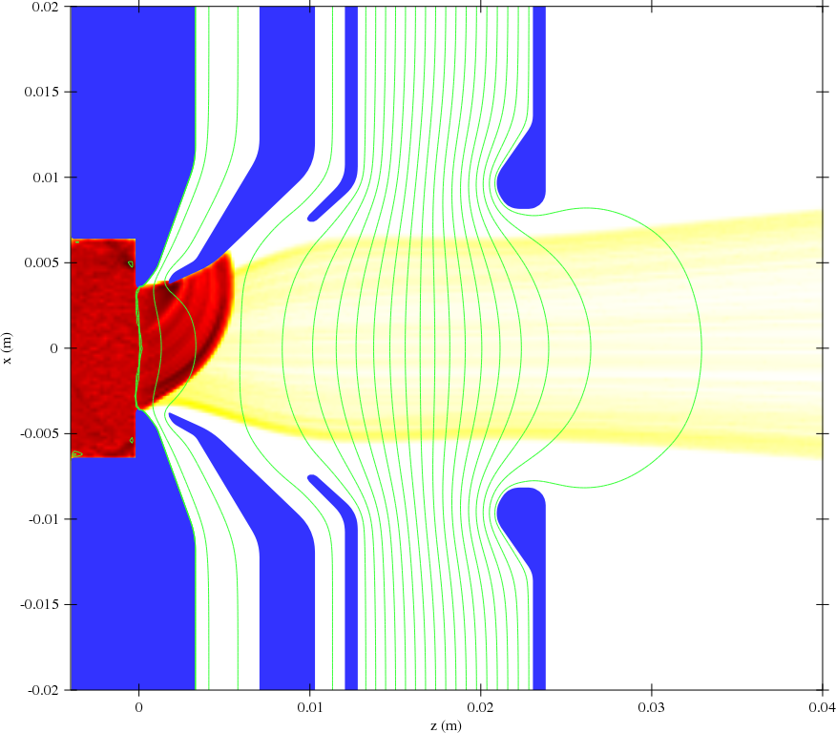
Two extraction systems were compared with emphasis on low electron power density and low H⁻ beam divergence
1. e⁻ dump in magnetized Einzel lens
2. e⁻ dump in intermediate electrode

Slide 4
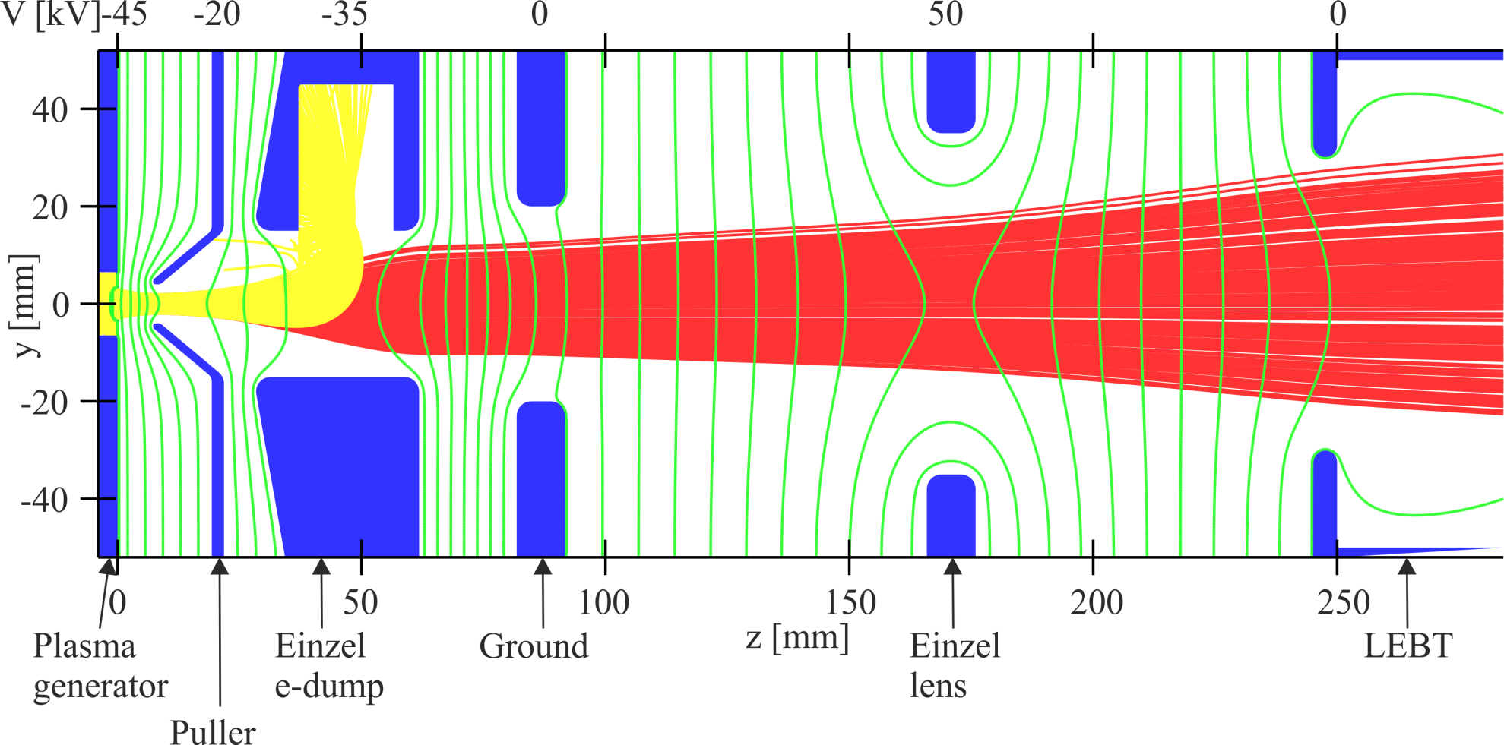
The new extraction system uses a magnetized Einzel lens to dump co-extracted electrons
Electron beam
H⁻ beam
The electrons are dumped with an energy of 10 keV,
and spread over a large surface to reduce the power density

Slide 5
Ion beam extraction system
Benchmarking of simulations
Emittance improvements

Slide 6
The comparison to simulations has been made
by using the currents measured on four electrodes
Plasma generator
Electron dump
Faraday cup
Puller

Slide 7
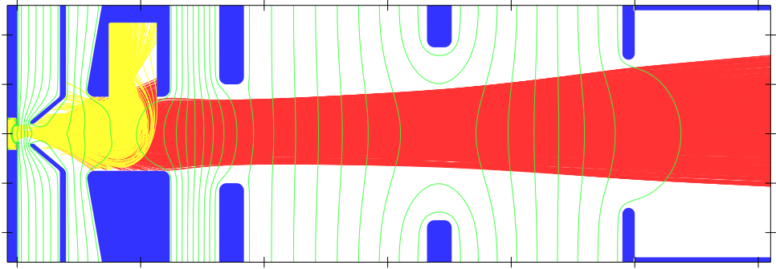
RF-power changes the H⁻ density in the plasma,
thus the extracted beam current
-45
-22
-36
0
+35
0
V (kV)
Plasma
generator
Einzel
e-dump
Ground
Einzel
lens
LEBT
Faraday
cup
Puller
Linear scaling between
RF-power (measurement)
H⁻ density (simulation)

Slide 8
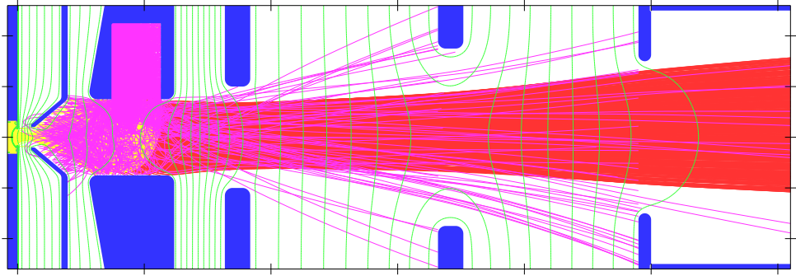
The simulations of the puller and electron dump current
do not correspond to the measured values
-45
-22
-36
0
+35
0
V (kV)
Plasma
generator
Einzel
e-dump
Ground
Einzel
lens
LEBT
Faraday
cup
Puller
Secondary electrons emitted from the electron dump
Reduce the current measured on the electron dump
Increase the current on the puller

Slide 9
The simulations fit the measurement data when secondary electron emission from the electron dump is considered
-45
-22
-36
0
+35
0
V (kV)
Plasma
generator
Einzel
e-dump
Ground
Einzel
lens
LEBT
Faraday
cup
Puller
Secondary electrons emitted from the electron dump
Reduce the current measured on the electron dump
Increase the current on the puller

Slide 10
The H⁻ beam extraction has been reproduced for a varying RF-power, with secondary electron emission included in the simulations
-45
-22
-36
0
+35
0
V (kV)
Plasma
generator
Einzel
e-dump
Ground
Einzel
lens
LEBT
Faraday
cup
Puller
Linear scaling between
RF-power (measurement)
H⁻ density (simulation)

Slide 11
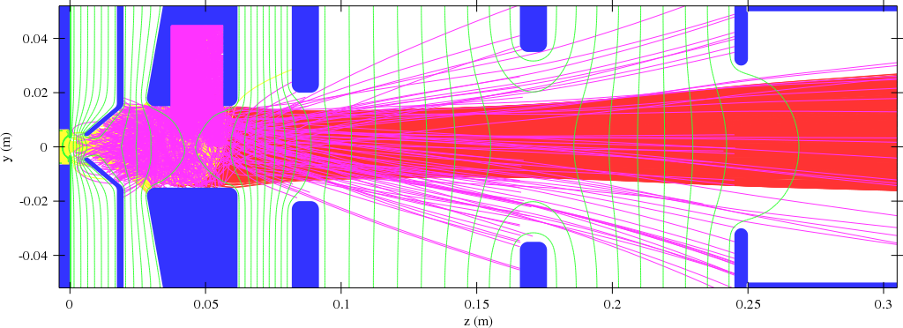
The puller voltage defines the electric extraction field,
and can be used to tune the beam optics
-45
-18
-36
0
+35
0
V (kV)
Plasma
generator
Einzel
e-dump
Ground
Einzel
lens
LEBT
Faraday
cup
Puller
Plasma generator current increases with higher extraction voltage
Increased plasma meniscus surface
Measured current increases slightly more than the simulated one
Density varies as a function of the depth of the plasma

Slide 12
The puller voltage defines the electric extraction field,
and can be used to tune the beam optics
-45
-18
-36
0
+35
0
V (kV)
Plasma
generator
Einzel
e-dump
Ground
Einzel
lens
LEBT
Faraday
cup
Puller

Slide 13
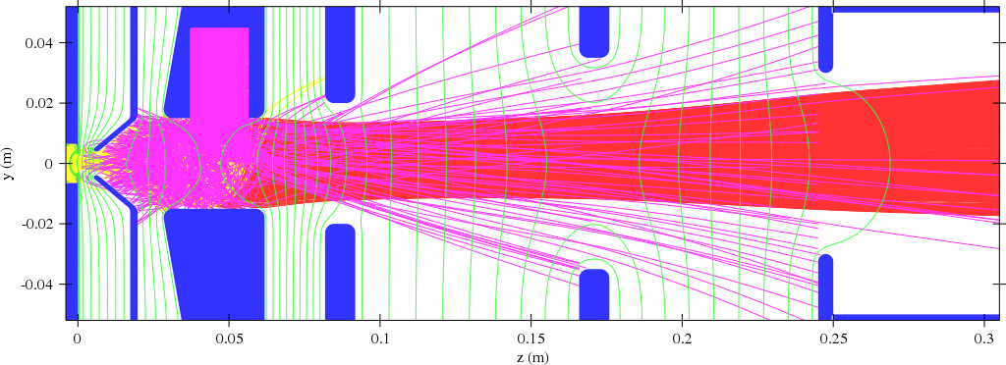
The puller voltage defines the electric extraction field,
and can be used to tune the beam optics
-45
-20
-36
0
+35
0
V (kV)
Plasma
generator
Einzel
e-dump
Ground
Einzel
lens
LEBT
Faraday
cup
Puller

Slide 14

The puller voltage defines the electric extraction field,
and can be used to tune the beam optics
-45
-22
-36
0
+35
0
V (kV)
Plasma
generator
Einzel
e-dump
Ground
Einzel
lens
LEBT
Faraday
cup
Puller

Slide 15
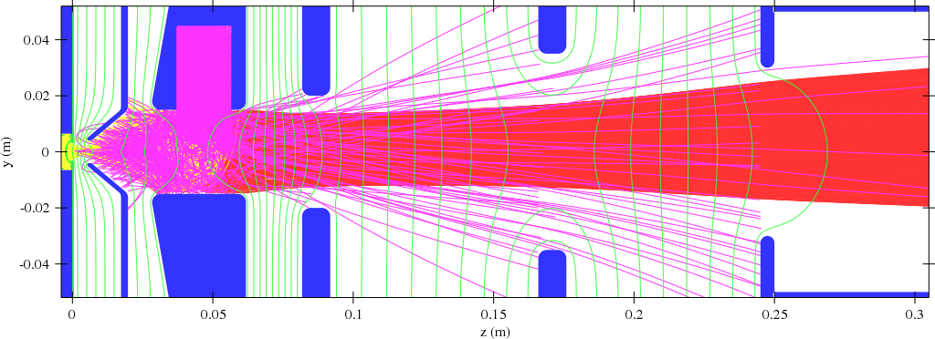
The puller voltage defines the electric extraction field,
and can be used to tune the beam optics
-45
-24
-36
0
+35
0
V (kV)
Plasma
generator
Einzel
e-dump
Ground
Einzel
lens
LEBT
Faraday
cup
Puller

Slide 16
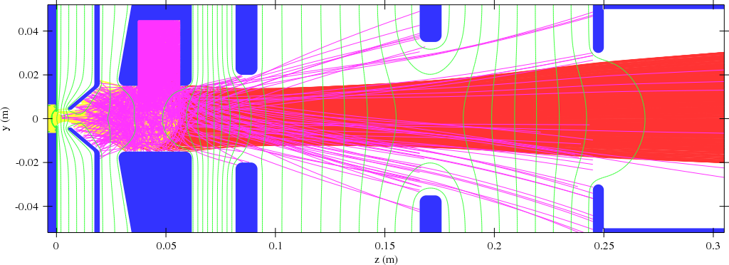
The puller voltage defines the electric extraction field,
and can be used to tune the beam optics
-45
-26
-36
0
+35
0
V (kV)
Plasma
generator
Einzel
e-dump
Ground
Einzel
lens
LEBT
Faraday
cup
Puller

Slide 17
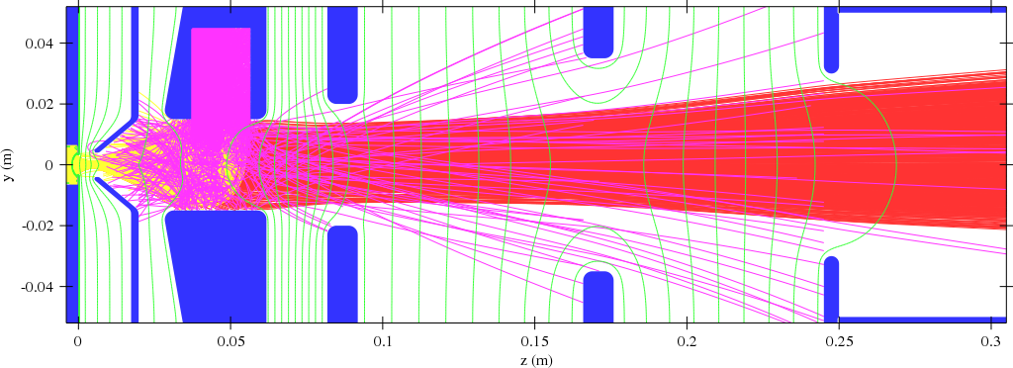
The puller voltage defines the electric extraction field,
and can be used to tune the beam optics
-45
-28
-36
0
+35
0
V (kV)
Plasma
generator
Einzel
e-dump
Ground
Einzel
lens
LEBT
Faraday
cup
Puller

Slide 18
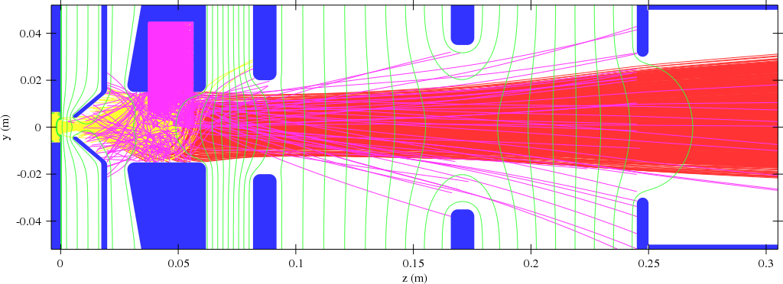
The puller voltage defines the electric extraction field,
and can be used to tune the beam optics
-45
-30
-36
0
+35
0
V (kV)
Plasma
generator
Einzel
e-dump
Ground
Einzel
lens
LEBT
Faraday
cup
Puller

Slide 19

The measured beam emittance is similar to what we expect from simulation
Measurement
Simulation
ε_{NORM, 1 RMS} = 0.5 µm
ε_{NORM, 1 RMS} = 0.5 µm
The emittance should be improved since the RFQ acceptance is 0.25 µm

Slide 20
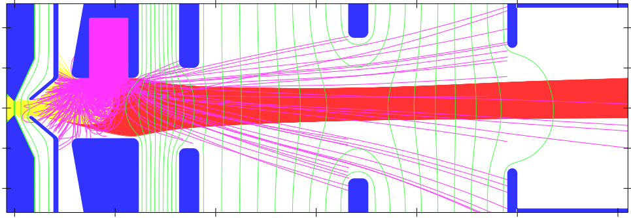
Preliminary comparison of the first measured beam from IS02 (12.11.2013) with a simulation
Simulation input: 12 mA H⁻, e/H⁻ = 30
-45
-37
-38
0
+35
0
V [kV]
 | Source [A] | Puller [A] | E-dump [A] | Faraday cup [mA] | Emittance [µm]
Measurement | 0.35 | 0.15 | 0.031 | 13
Simulation | 0.38 | 0.065 | 0.030 | 12 | < 0.6

Slide 21
Ion beam extraction system
Benchmarking of simulations
Emittance improvements

Slide 22
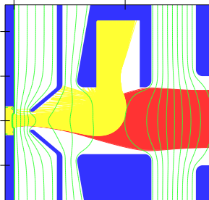
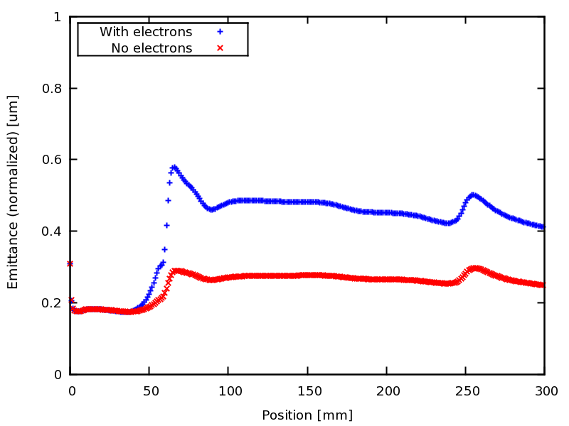
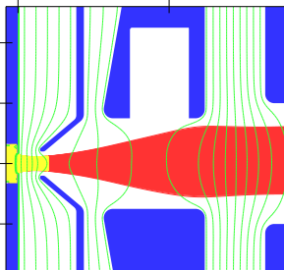
Reducing the number of co-extracted electrons, reduces the emittance growth in the electron dump
V [kV]
-45
-25
-36
0
Simulation input: 30 mA H⁻, e/H⁻ = 30
Artificial removing of electrons

Slide 23
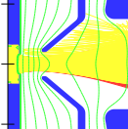
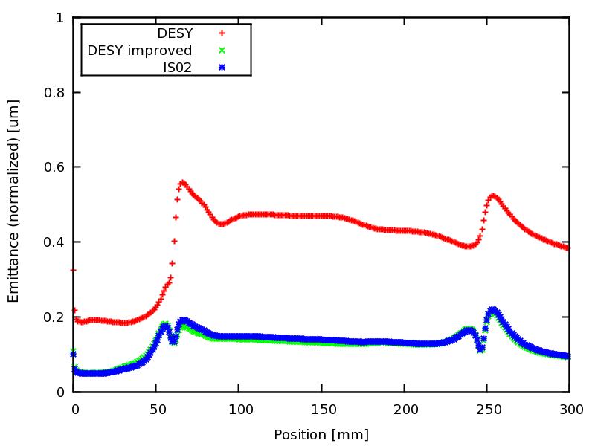


The shape of the plasma electrode improves the emittance
V [kV]
-45
-25
-36
Simulation input: 40 mA H⁻, e/H⁻ = 10
DESY
DESY imp
IS02

Slide 24
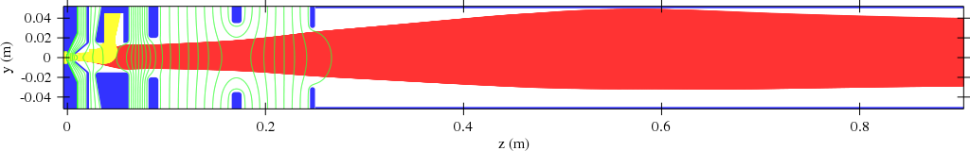
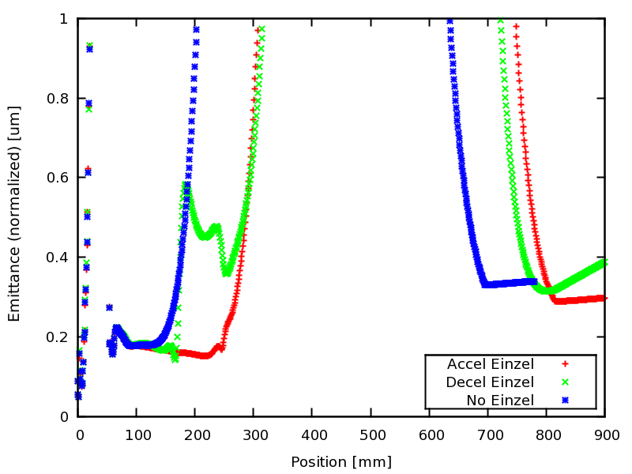
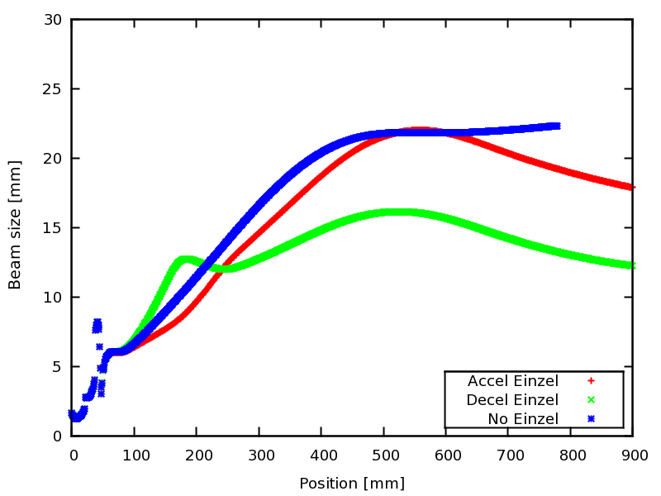
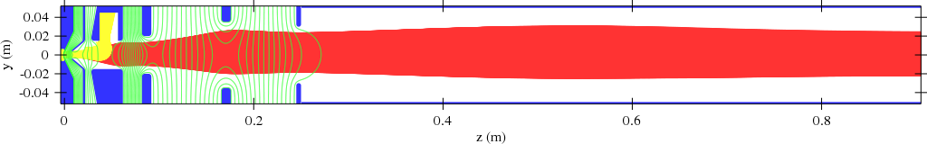
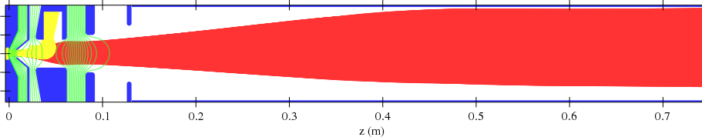
Comparison of different Einzel lens configurations with beam transport through the first solenoid
Acceleration Einzel lens
Deceleration Einzel lens
No Einzel lens (not optimized at the LEBT entry)
Simulation input: 30 mA H⁻, e/H⁻ = 30

Slide 25


With the current extraction system, it is feasible
to transport an 80 mA H⁻ beam
Simulation input: 80 mA H⁻, e/H⁻ = 1
DESY
H⁻ transmission = 79 %
ε_{NORM, 1 RMS} = 0.6 µm
IS02
H⁻ transmission = 99 %
ε_{NORM, 1 RMS} = 0.6 µm
A redesign should be made to not hit the inside of the electrodes with the H⁻ beam, and to collect all electrons in the dump

Slide 26

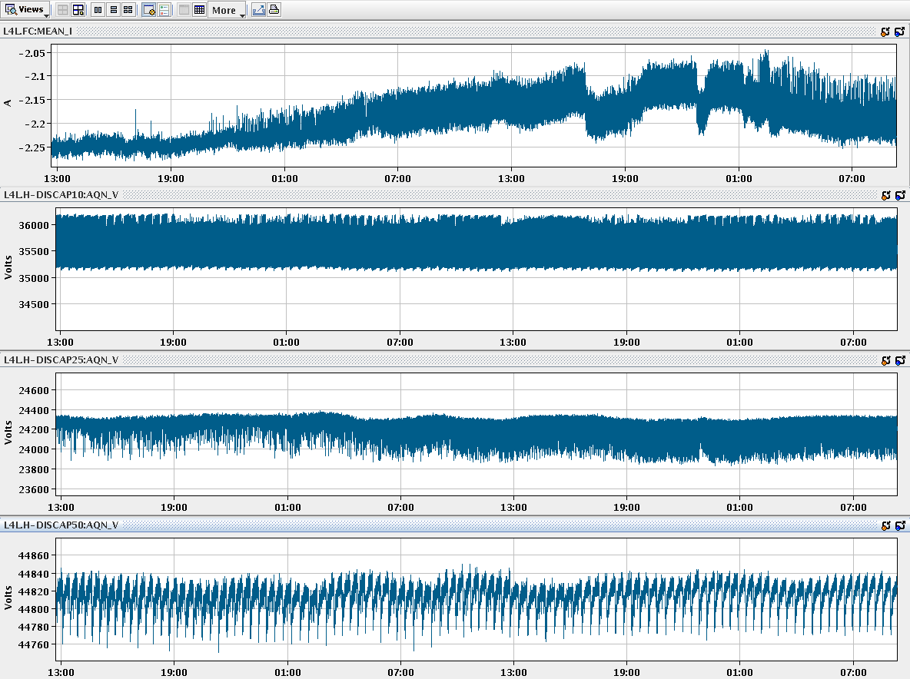
The new extraction system has been commissioned,
and verified with simulations
Stable ion beam extraction with few high voltage breakdowns
Few resources required for operation
  1 expert during start-up
  1 expert on call during operation
Room for improvement of beam current transportation and emittance
Improving the extraction system (simulations, design, production)
  Modifying existing: 6-9 months
  Complete redesign: 9-12 months
Measurements over week-end
I Faraday cup
V e-dump
V puller
V source

