Slide 1
Ion source RF system
Andy Butterworth BE/RF
Mauro Paoluzzi BE/RF

Slide 2
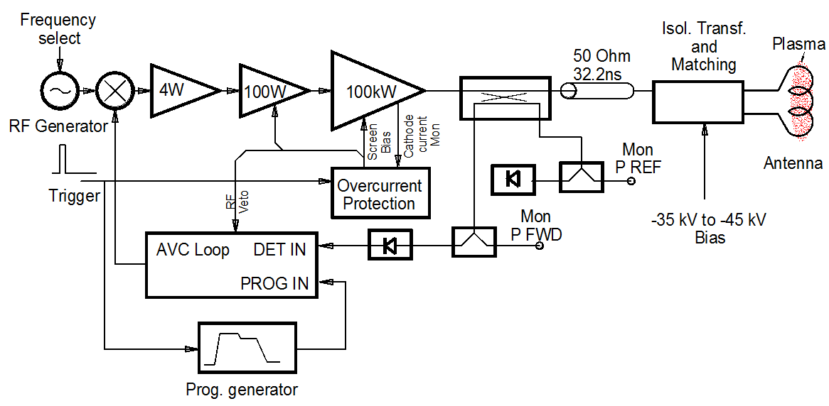
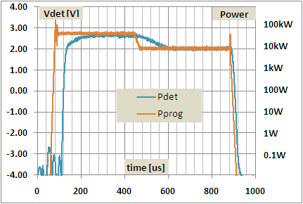
System description
Wideband solid-state drivers
2 MHz ±200 kHz, 100 kW final stage
  2 ms burst at 2 Hz or 50 Hz
  50Hz requires power supply upgrade
Wideband 1÷1 isolation transformer
Capacitive matching network
PLC control and interlock system
Forward power controlled by AVC servo system
Frequency agile operation compensates plasma detuning effects
High directivity (30dB) directional coupler for plasma electrical characteristics on line measurement

Slide 3
Present status
Two RF systems installed:
  Production source in operation in Linac4
  Development source in operation in the 3MeV test stand.
Spares of all critical items are available (custom built or long lead time)
  screen pulsers, HV capacitors etc.
Integrated in the control system
  interlock, ON/OFF controls, etc.
Integrated in Beam Interlock System
  veto from BIS can cut source RF
New low-level control system:
  RF reference signal generation
  function generation for forward power programming
Remote data acquisition and treatment in control system:
  acquisition of RF forward, reflected and plasma light signals
  amplitude and phase detection
  on-line signal processing and calculation of plasma electrical characteristics (R_{Plasma} L_{Plasma} and P_{Plasma})

Slide 4
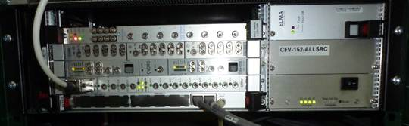
RF low-level control
A system for RF signal generation and acquisition has been implemented
Uses standard CERN VME controls hardware:
  2-channel arbitrary waveform generator for RF frequency reference and amplitude control function
  high speed digitizer for signal acquisition at 50 Msample/s
  timing receiver for synchronization with the control system
  CPU board running Linux
  custom FESA software for signal generation and processing

Slide 5
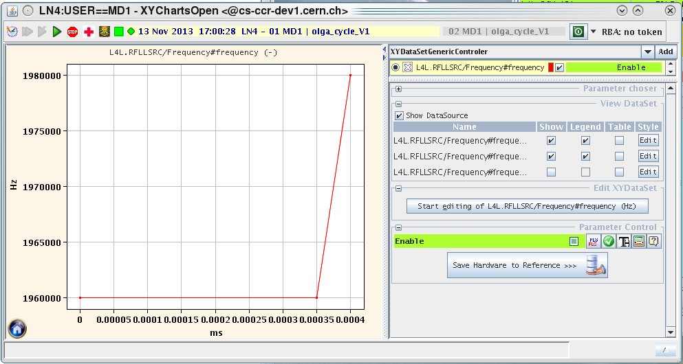
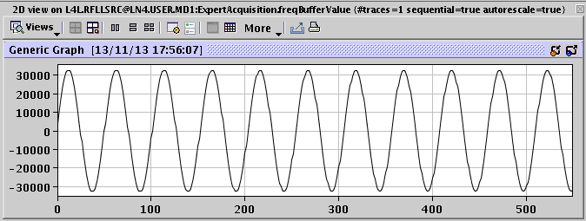
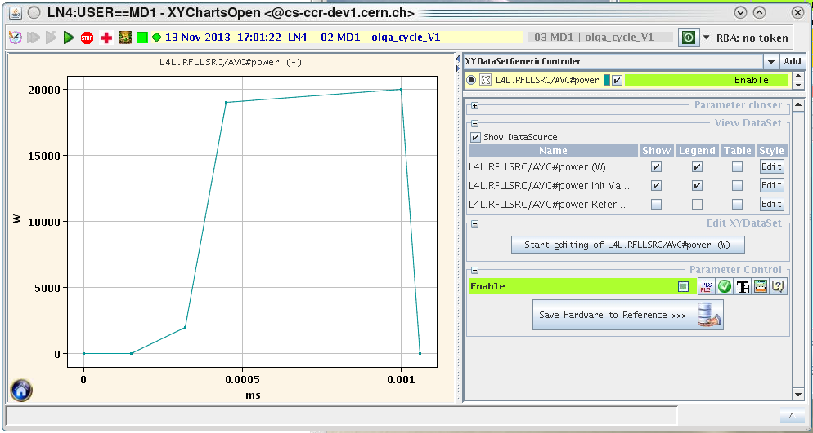
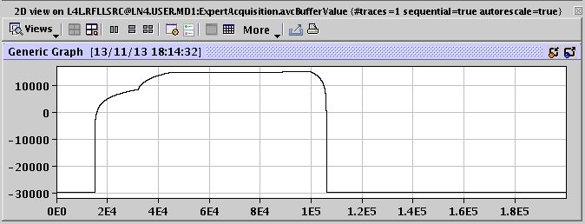
RF signal generation
Freely programmable frequency and amplitude functions edited using control system (InCA)
Fine-tuning of frequency and amplitude along the pulse allows compensation of plasma detuning effects
Settings management (history etc.) via control system
Waveforms calculated in the front-end computer FESA software
Programmed into 100 Msample/s arbitrary waveform generator
Frequency reference signal
Frequency
AVC reference function (logarithmic)
Amplitude

Slide 6
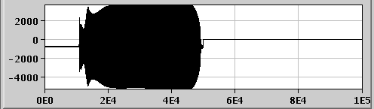
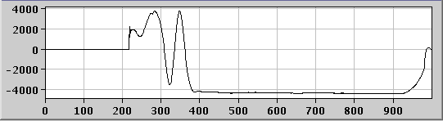
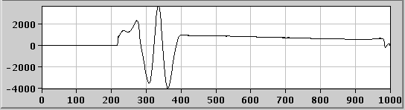
Signal acquisition and processing
Direct sampling of signals at 50 Msamples/s (pulse by pulse):
  directional coupler forward
  directional coupler reflected
  plasma light signal
Forward & reflected signals are demodulated in software into I (in-phase) and Q (quadrature):
Coupler fwd
Samples
Mixer
Coupler signal
Notch
filter
Baseband I signal
fwd I
Local oscillator
(generated RF signal)
μs
90 deg phase shift
Coupler signal
Notch
filter
Baseband Q signal
fwd Q
μs

Slide 7
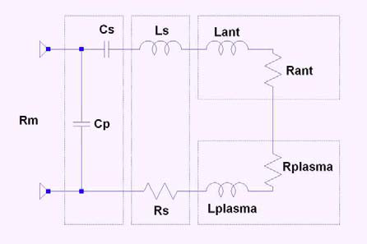
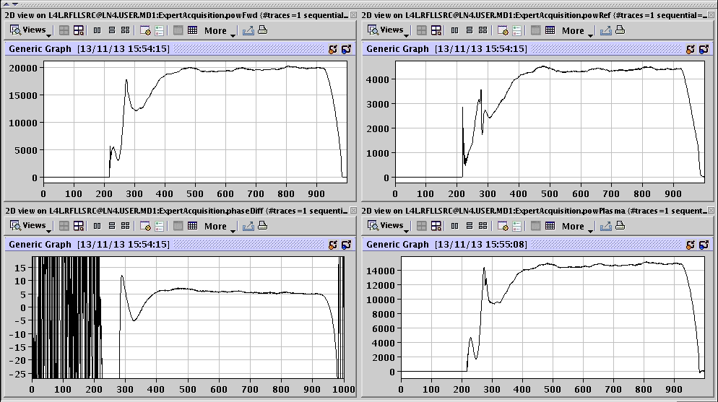
Signal acquisition and processing
From I and Q signals of coupler forward/reflected, derive:
  forward/reflected power
  phase difference forward/reflected
Using equivalent circuit model (M. Paoluzzi) estimate:
  plasma impedance
  plasma power
  power loss
  …
W
P_{fwd}
P_{ref}
deg
φ_{fwd/ref}
P_{plasma}
μs
μs

Slide 8
Remaining work for low level RF controls
Make selected signal acquisitions available in standard CERN framework (OASIS) – few days, in progress
Validate online calculation of plasma parameters and calibrate – few days, in progress
Clean up some control system details (function timebase units, device names etc.) – at suitable opportunity
Provide comprehensive user documentation – in progress

Slide 9
Resources needed for source operation
Operation of the two sources for:
  Stable production for the Linac4
  Components development for the 3MeV test stand.
Each component is to be validated in the development source before installation in the production one. This requires a number of iterations for matching network design, construction and overall characterization.
Parts installed in Linac4 have limited lifetime and spares must be prepared. They probably also include dedicated matching network parts fitting the specific antenna coil.
For each iteration two days from RF engineer/technician are required.

Slide 10
Summary
High level RF system:
  development is complete
  installed in Linac4 as well as in 3MeV test stand
  spares of all critical items available
  resources still needed to support the ongoing development of the source
“Final” Linac 4 RF generation and measurement system has been implemented
  uses standard BE/CO hardware components and software framework
  flexible control of RF frequency and amplitude
  remote RF signal measurements and parameter calculation
  small amount of additional functionality still being implemented
All RF equipment integrated into the control and Beam Interlock systems

