Slide 1
DPM Italian sites and
EPEL testbed in Italy
Alessandro De Salvo (INFN, Roma1), Alessandra Doria (INFN, Napoli),
Elisabetta Vilucchi (INFN, Laboratori Nazionali di Frascati)
Outline of the talk:
DPM in Italy
Setup at the DPM TIER2 sites
Setup of the EPEL testbed
EPEL testing activity
Other activities related to storage access in Italy
Notes:
The people involved in this work are Alessandro De Salvo from Roma , Elisabetta Vilucchi from INFN National Laboratories of Frascati and myself from INFN Napoli, we’ll have a quick look to other activities related to storage systems that we carry on in Italy.

Slide 2
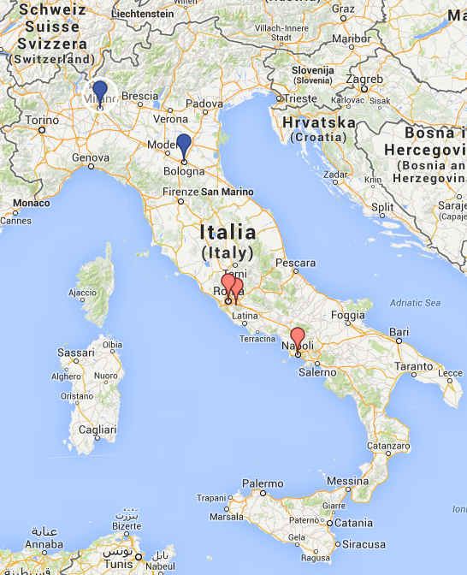
Italy in the DPM collaboration
Milano
Storage systems at ATLAS italian sites:
  DPM at Frascati, Napoli, and Roma Tier2.
  STORM at CNAF Tier1 and at Milano Tier2.
The 3 people involved in the DPM collaboration are the Site Managers of the 3 DPM Tier2s.
Alessandro D.S. is the ATLAS Italian Computing Coordinator.
Some smaller sites also use DPM.
CNAF T1
Roma
Frascati
Napoli

Slide 3
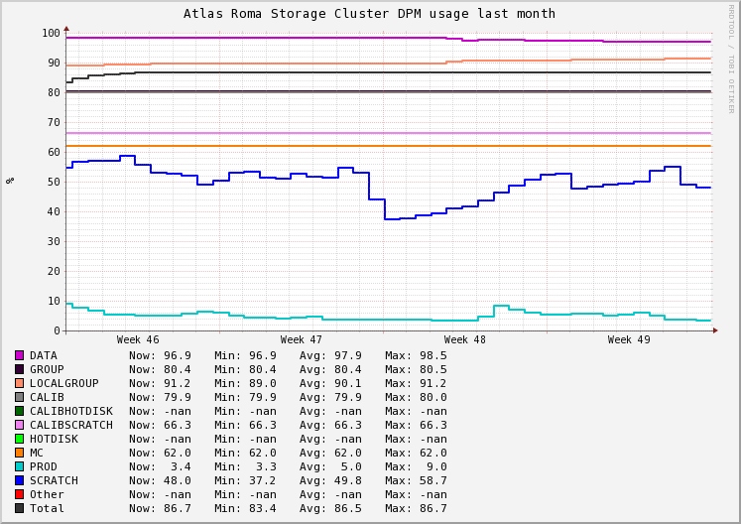
DPM setup at INFN-Roma1
> 1 PB of disk space
  18 disk servers, attached to 7 SAN systems (used in direct attach mode) via 4/8 Gbps Fibre Channels
  All servers equipped with 10 Gbps Ethernet connection to a central switch
  WAN connection via LHCONE at 10 Gbps
Installation
  Supervised by Puppet (some machines already using Foreman + Puppet)
  Currently using a custom puppet module executing yaim
  Will move to full puppetized configuration soon, the infrastructure is ready
Backup Policy
  MySQL main replica in the DPM head node
  Slave replica on a different node
  Backup, daily snapshots from the slave node
  Currently evaluating the possibility to move the database to our Percona XtraDB cluster (6 DB machines on-line), already used for the ATLAS global Installation System, hosted in Roma.
Monitoring
  Ganglia/nagios via custom plugins
  Will add the DPM standard plugins soon
Notes:
Come si pronuncia nagios?

Slide 4
DPM setup at INFN-Napoli
1.2 PB of disk space
  22 disk servers, attached to 9 SAN systems (used in direct attach mode) via 4/8 Gbps Fibre Channels.
  All servers connected to a central switch with 10 Gbps Ethernet FC .
  WAN connection via LHCONE at 10 Gbps.
Setup
  DPM release 1.8.7-3 on SL5, yaim configuration
  MySQL DB (rel. 5.0.95) is on the same server as the DPM head node.
Backup policy
  MySQL DB daily backups, with Percona xtrabackup, are saved for 7 days.
  Full backup of the the whole head node (DB included) is done by rsync twice a day on a secondary disk of another server. In case of hw failure, the other server can boot from this disk, starting an exact copy of DPM head node, not older then 12 h.
Monitoring
  Ganglia/nagios via custom plugins

Slide 5
DPM setup at INFN-FRASCATI
(production site)
700 TB of disk space
  7 disk servers, attached to 7 SAN systems (used in direct attach mode) via 4/8 Gbps Fibre Channels
  All servers equipped with 10 Gbps Ethernet connection to a central switch
  WAN connection via LHCONE at 10 Gbps soon (by the end of Feb ‘14)
Setup:
  DPM release 1.8.6. Upgrade to 1.8.7 by the end of the year
  DPM DB on a separated server: MySQL 5.0.95
Backup
  DPM DB replication with MySQL master/slave configuration;
  If MySQL server crashes it’s enough to change the DPM_HOST variable in the DPM head node with the MySQL slave hostname and run yaim configuration;
  Slave DB daily backup with mysqldump;
Monitoring
  Ganglia/Nagios custom plugins
Notes:
In case the master DB is corrupted and stops working the DPm server can be reconfigured to point to the slave replica

Slide 6
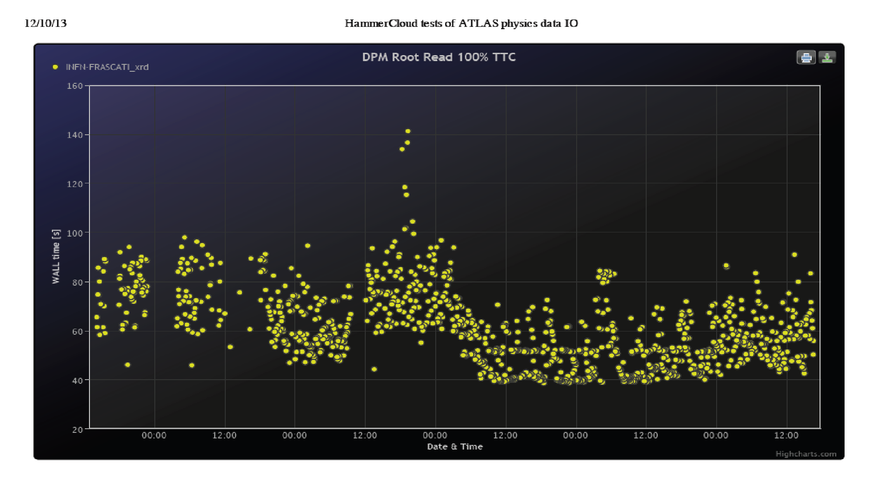
EPEL testbed setup at INFN-Frascati
Setup
  DPM head node: atlasdisk1.lnf.infn.it
  The head node is installed on a VM (2 cores, RAM 4GB)
  the MySQL server is on the physical server (8 cores, RAM 16GB) .
  Only one disk server with 500GB of disk space.
  1Gbps links for LAN and WAN connections.
Installation
  SL6.4 , DPM 1.8.7-3
  yaim configuration, to be moved to puppet a.s.a.p.
  XRootD, WebDAV/https enabled
Added to Wahid Hammercloud test page .

Slide 7
EPEL testing activity
Installed at end of summer 2013 for the first time, too late for the first EPEL release validation !
Re-installed again in November ’13 from EPEL +EMI3 SL6 repos:
  EPEL-testing repo enabled, no autoupdate.
  Installation guide followed step by step https://svnweb.cern.ch/trac/lcgdm/wiki/Dpm/Admin/Install to check its consistency.
  Very easy, no problem found: only a reference to XRootD setup could be useful.
Ready to test upgrades or reinstallation of new releases from scratch , according to the collaboration needs.
The HW is quite old and Ethernet connection is 1Gbps:
  testbed tailrored for functionality tests
  HW improvements for performance tests could be planned if needed.
We are planning to test a High Availability setup.

Slide 8
DPM in HA
The DPM head node is virtualized
  Need to evaluate the performance impact on this
Two different ways of virtualization possible
  Standard virtualization (KVM) over a shared filesystem (GlusterFS or Ceph)
  OpenStack-based virtualization
Both solutions are possible, more experience in Italy with the first option
  Will try to use either GlusterFS with GFAPI or Ceph for performance reasons, need very recent versions of QEMU and libvirt
  We also have an OpenStack Havana testbed in Roma, we will experience on that (it is also GlusterFS GFAPI enabled)
Database in HA mode via Percona XtraDB cluster
  Using (multiple instances of) HAproxy as load balancer
Head node HA
  Pacemaker/Corosync if standard virtualization
  Still have to be discussed for the Cloud option
Pool nodes
  May want to experience with GlusterFS or Ceph for the testbed
Configuration operated via Foreman/Puppet
Notes:
GFAPI ????T QEMU and libvirt????
his is a proposal based on the experience in Rome with a HA cluster.

Slide 9
ATLAS data access at DPM sites
Different access modes can be set for the queues in Panda, the ATLAS workload management system for production and distributed analysis.
For DPM sites the usual configuration is:
  Analysis jobs access directly local input files via XRootD
  MC production at DPM sites copies input files to WNs.
The 3 DPM Italian Tier2s and the Tier1 are part of FAX
  Federated ATLAS storage systems using XRootD.
  FAX uses redirection technology to access data in the federated systems.
The use of FAX can be enabled in Panda, with ad-hoc configuration of the Panda queues.
FAX redirection allows the failover to storage systems in different sites in case a required file is not found locally.
The FAX redirection in Panda is not yet enabled for the Italian sites.
Some tests with FAX will be showed .
Notes:
ATLAS uses Panda as a workload management system and for each panda queue a different data access mode con be set.

Slide 10
PROOF on Demand (PoD) and tests with FAX in the ATLAS IT cloud
“PROOF-based analysis on the ATLAS Grid facilities: first experience with the PoD/PanDa plugin”, E. Vilucchi, et al.
We presented this work at CHEP2013 about the use of PoD, a tool enabling users to allocate a PROOF cluster on Grid resources to run their analysis.
  We tested the new Panda plugin for PoD, using real analysis examples, in the ATLAS Italian cloud and at CERN.
  We also run performance tests over the DPM, StoRM/GPFS and EOS storage systems and with different access protocols:
    XRootD both on LAN and WAN;
    file protocol over StoRM/GPFS;
    XRootD on Storm/GPFS and EOS over WAN;
    FAX infrastructure was tested for XRootD access;
    Few tests of root access with HTTP for DPM.
Notes:
This is a work that we presented at CHEP, where we tested in several ways the use of PoD.
In collaboration with the developers, the Panda plugin was tested with real user analisys
Also Data Access performance tests were done, in different ways, I will just show some of these tests

Slide 11
Results of local data access tests
Calibration tool performs only data access (no computation load):
  It’s a PROOF job reading the whole content of each entry of the TTrees from the files.
  To check the site efficiency before to run analysis with PoD;
  To obtain an upper limit on the performance in terms of MB/s as a function of number of used worker nodes.
Sample datasets of real analysis used as input with PoD
  DS1 (100 files), DS2 (300 files): standard D3PD dataset (~100KB per event).
STORM/GPFS and EOS have comparable performance.
EOS and GPFS file access perform better, but the difference with DPM XRootD is only about 25%;
Calibration and DS1 at CNAF
Calibration and DS2 at CNAF
Calibration and DS1 at Roma1
Calibration and DS2 at Roma1
Calibration and DS1 at CERN
Max MB/s in function of number of workers

Slide 12
Analysis tests
Analysis tests with three real analyses,
  on different input datasets (D3PD, user-defined ntuples)
  with different event processing load.
I/O performance scalability at CERN, CNAF, Roma1
Compared with the results of the calibration, in this analysis the weight of the additional event processing is about 16%.
The performance scales linearly in a cluster up to 100 WNs, no bottleneck found due to data access.
Some preliminary tests with http protocol gave slightly lower performance, but comparable with XRootD.
Analysis 1 and DS1 at CERN
Analysis 1 and DS1 at CNAF
Analysis 1 and DS1 at Roma1
Max MB/s versus number of workers running analysis 1

Slide 13
Remote XRootD access over WAN and FAX infrastructure
We run analyses with PROOF cluster and input datasets in different sites.
  Direct XRootD access (without FAX);
  FAX redirection.
FAX works smoothly. Accessing, through a central FAX redirector, to an input container distributed across different sites, the request is forwarded to the appropriate storage elements, selecting the local Storage when possible
the mechanism is transparent for the user.
Performance depends on network connections.
Analysis 1 at CNAF and DS1 at Napoli
Analysis 1 at CNAF, DS1 at Roma1
Analysis 1 at Roma1, DS1 at CNAF
Max MB/s in function of # of WNs
for analysis 1 with DS1 over WAN

Slide 14
WebDAV/http Federation
An http(s) redirector has been installed at CNAF.
Deployed with Storm on a test endpoint
  http(s) in Storm now supports WebDAV
With DPM the http(s) access has already been tested and it works without problems.
The LFC interface has been enabled for the http redirector
  Which LFC is addressed? CERN or CNAF?
When ATLAS will switch from LFC to Rucio, a plugin interface for Rucio will be needed .
Shortly the redirector will use the production endpoint at CNAF.
  DPM sites will be ready to join the http(s) federation.
No monitoring yet
To be tested with ROOT
  the ROOT support is limited until now for https, TDavixFile needed .

Slide 15
Conclusions
We are happy with our DPM systems and with the latest DPM developments.
A ot of interesting work can be done in testing new solutions with DPM.
Thanks to the DPM collaboration!

