Slide 1
Hybrid or Monolithic ?
Pixel detectors for future LHC experiments
PH-ESE electronics seminar, CERN 17th December 2013
Tomasz Hemperek

Slide 2




The Bonn Team
Design Team:
  Hans Krueger
  Tomasz Hemperek
  Tetsuichi Kishishita
  Miroslav Havranek
  Yunan Fu
  Piotr Rymaszwski
  Xiaochao Fang
  Marcus Gronewald
Our main projects:
Thanks to our close collaborators!

Slide 3
Overview
Current status and futere of Hybrid Pixel Sensors
Current status and futuer of Monolitic Pixle Sensors
Conclusions

Slide 4
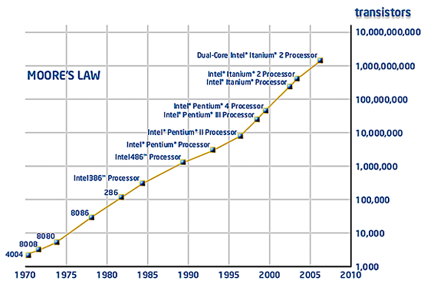
Moore's law in HEP
Name | D-OMEGA Ion | LHC1 | FE-I3 | FE-I4 | FE-I5
Year | 1991 | ~1996 | ~2005 | ~2011 | ???
Technology Node | 3 µm | 1µ | 0.25 µm | 0.13 µm | 65 nm??
Chip size | 8.3x6.6 mm² | 8x6.35 mm² | 10.8x7.6 mm² | 10.2x19 mm² | ???
Pixel size | 75x500 µm² | 50x500 µm² | 50x400 µm² | 50x250 µm² | 25x100 µm^{2 ??}
Pixel array | 16x63 | 16x127 | 18x160 | 80x336 | ???
Transistor count | ??? | 800k | 3.5M | 80M | ???

Slide 5
Price/Scaling
Technology node | 130nm | 65nm | 40nm
6T SRAM cell (um²) | 2.4 | 0.52 | 0.24
bit size in memory (um²) | ~ 3.2 | ~ 0.7 | ~ 0.32
10bit words in 100x100um | ~ 310 | ~ 1430 | ~ 3120
NRI* (um²) | $2000-$3000 | $6000-$7000 | $8000-$9000
* based on MPW prices for bigger (>25um²) designs

Slide 6
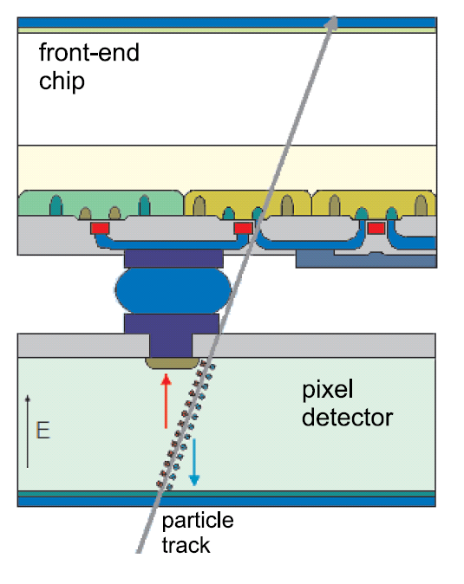
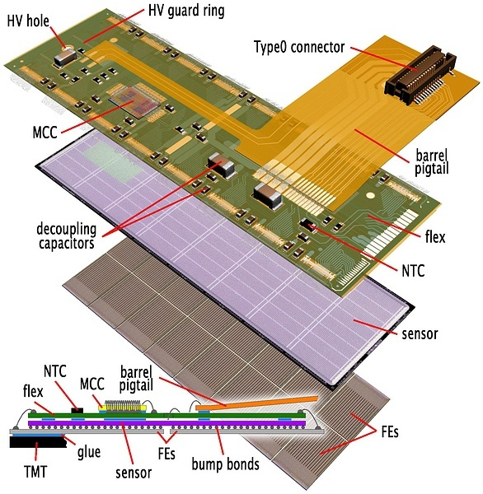
Hybrid Pixel Detectors
ATLAS Pixel Module (FE-I3)
Parameters
-fine pitch flip-chip assembly of:
  CMOS r/o chips (CSA + DSP per pixel)
  Si (planar or 3D) or Diamond detectors
- high density electronics
- moderate - good SNR
- high material budget
- expensive assembly

Slide 7
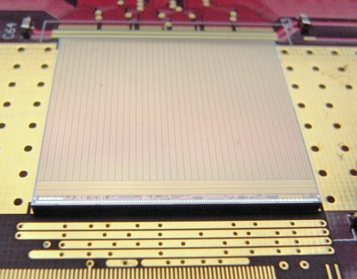
Current state of art implementations - FE-I4
Overview
Analog Channel

Slide 8
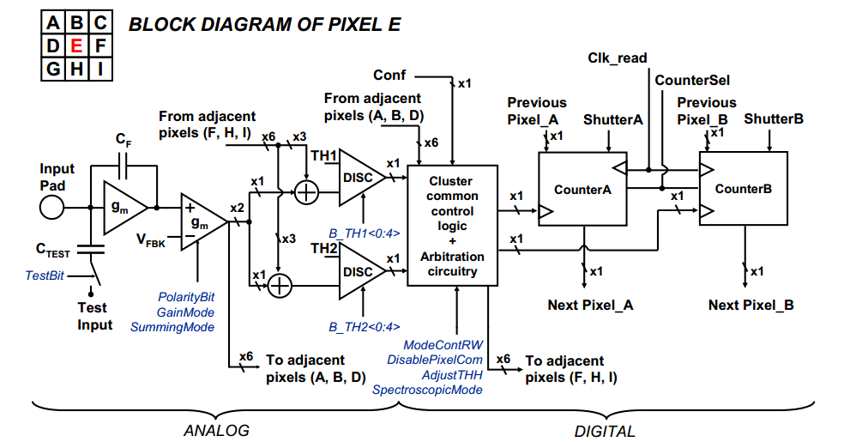
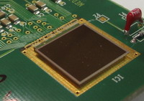
Current state of art implementations - Medipix 3
Other hybrids in 130nm:
Timpix 3
VeloPix
DosePix
…

Slide 9
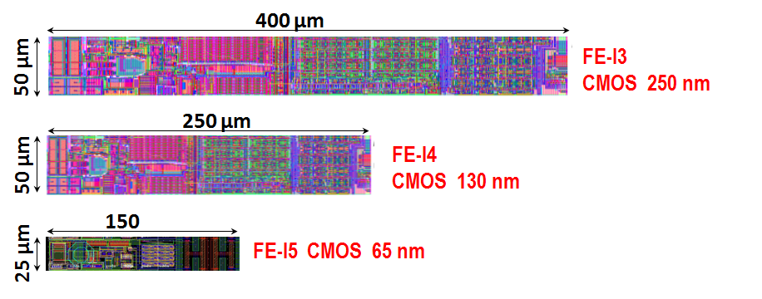
Hybrid Pixels Future
?
125 μm
FE-X5 CMOS 65 nm
FE-X5 CMOS 130 nm 3D

Slide 10
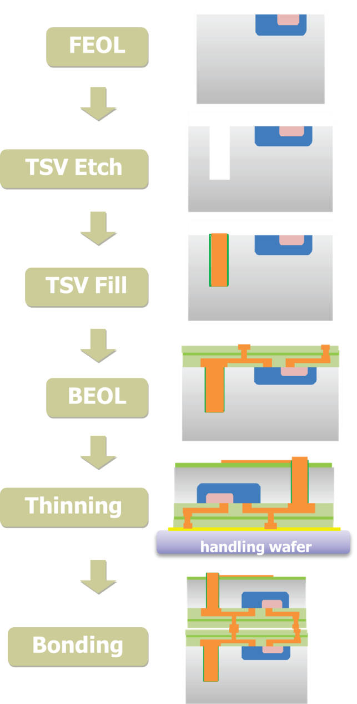
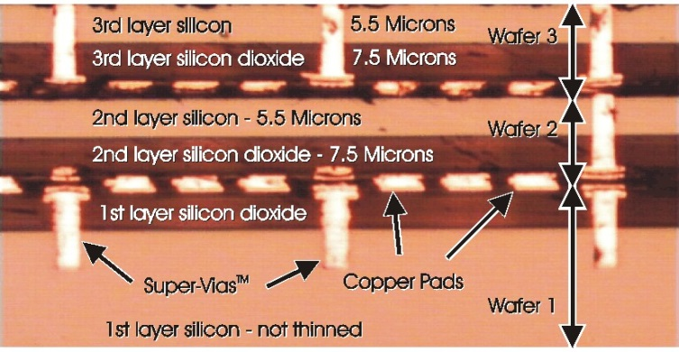
3D Integration

Slide 11
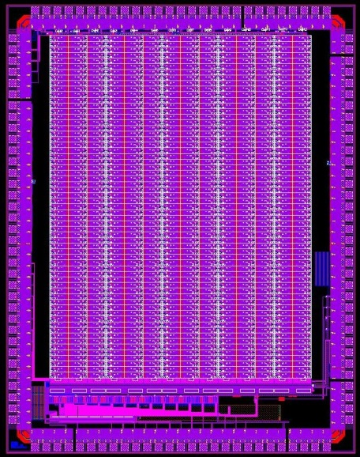
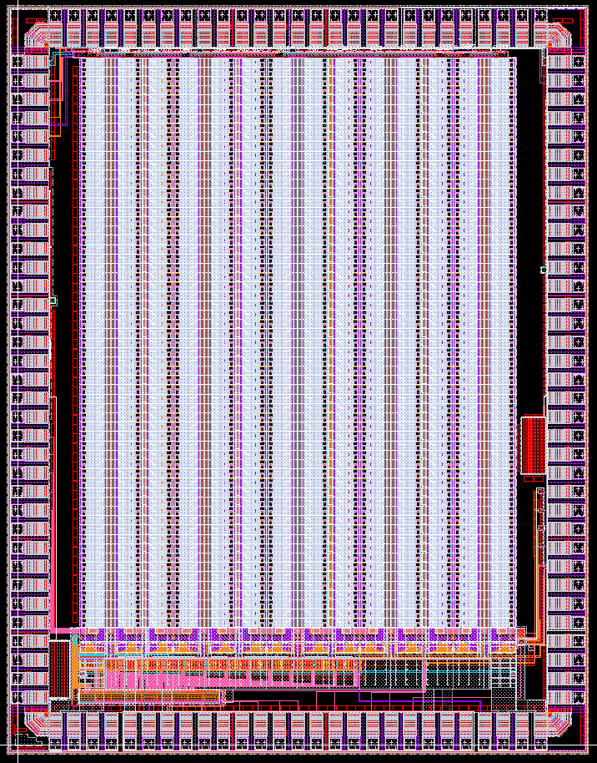
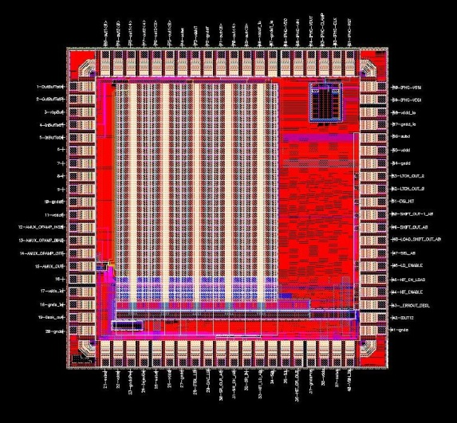
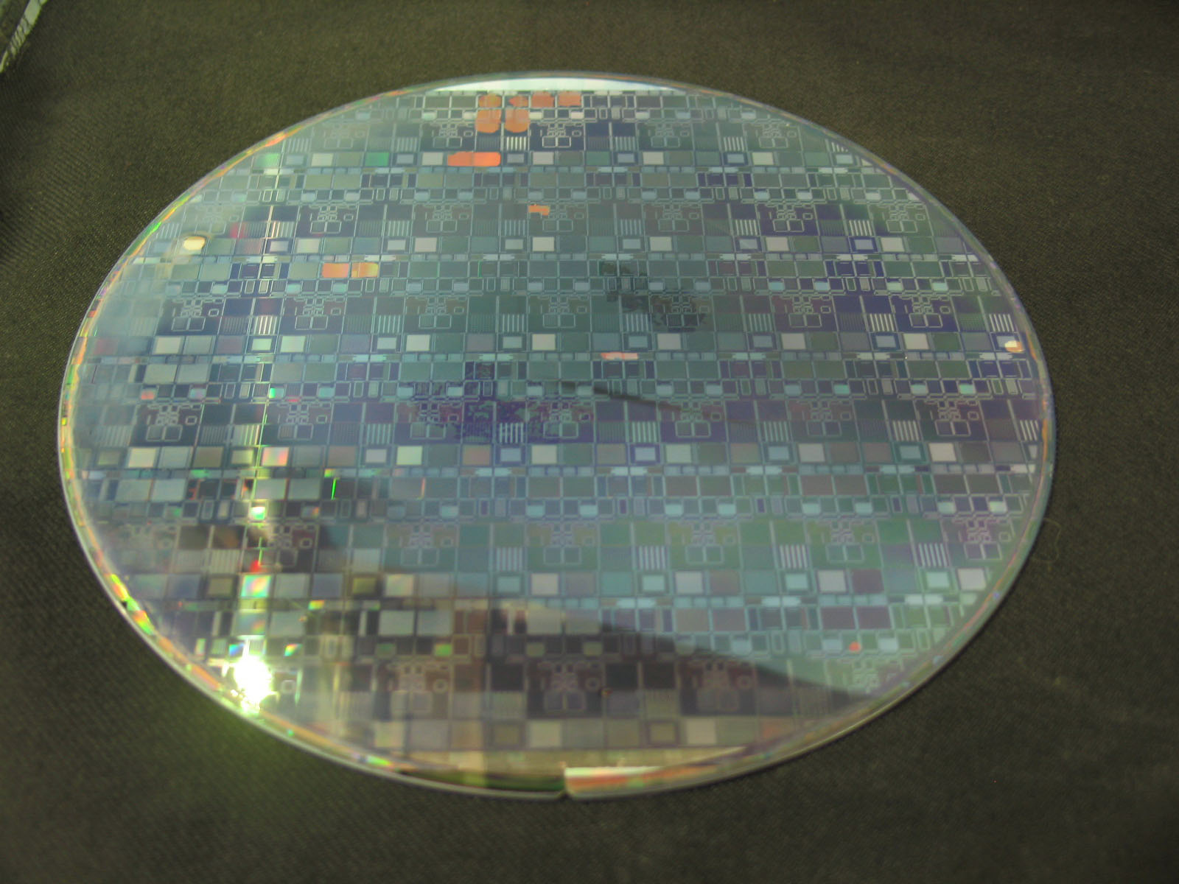
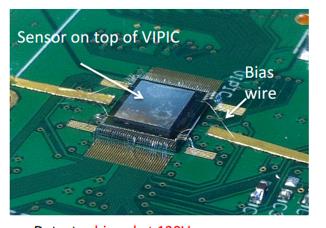
3D Integration
61x14 array
61x14 array
30x10 array
FE-I4-P1
4x3mm size
IBM 0.13µm LVT 8LM
FE-C4-P1
4x3mm size
CHRT 0.13µm LP 8LM
FE-C4-P2
4x3mm size
CHRT 0.13µm LP 8LM
FE-C4-P3
2.5x2.5mm size
CHRT 0.13µm LP 8LM
4 years later ........
CPPM, UniBonn, LBNL

Slide 12
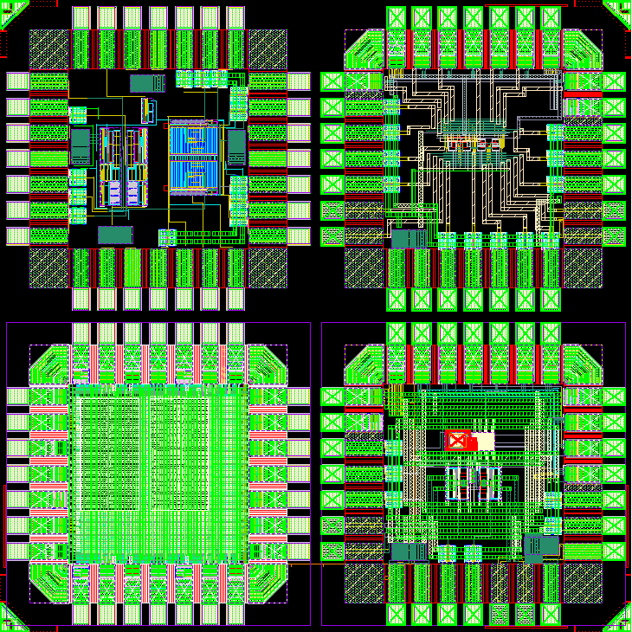
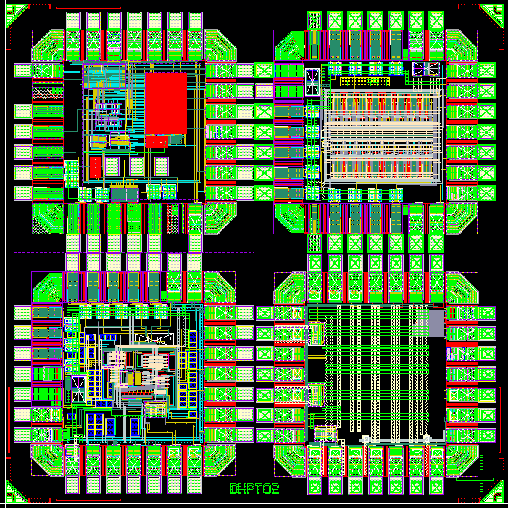
65 nm prototypes designed in Bonn
Our goal:
  design Data handling Processor (DHP) chip for Bell2
  explore potential of 65 nm technology
Design of test-chips to study analog performance of 65 nm technology
Analog FE-prototypes: FE-T65-0, FE-T65-1
Other prototypes: SAR-ADC, PLL, LVDS, SEU tests
DHPT0.1 (subm.10/2011)
DHPT0.2 (subm. 03/2012)
FE-T65-0
FE-T65-1
SAR-ADC
Chip size: 1.96×1.96 mm²

Slide 13
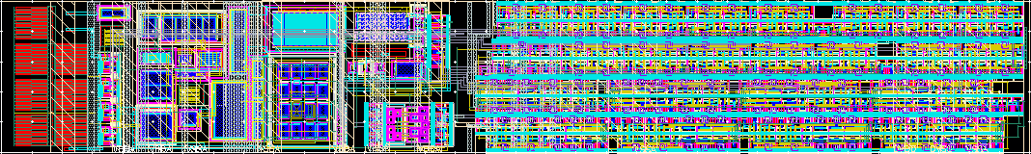
FE-T65-1 – single pixel
Analog - 50 µm
25 µm
180 µm
Analog part :
- CSA tunable input capacitance
- programmable charge injection
- FDAC – tunable feedback current
- TDAC – tunable threshold
- comparator
Digital part (custom and big std. cells):
- identical for every pixel
- configuration register 15-bits
- 8-bit shift register-counter
- mask-bit
- HitOr

Slide 14
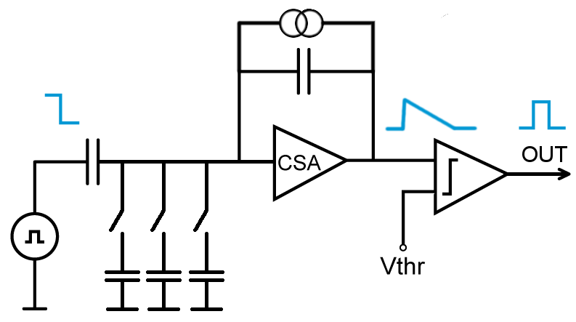
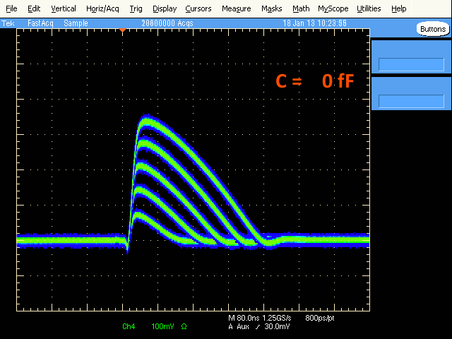
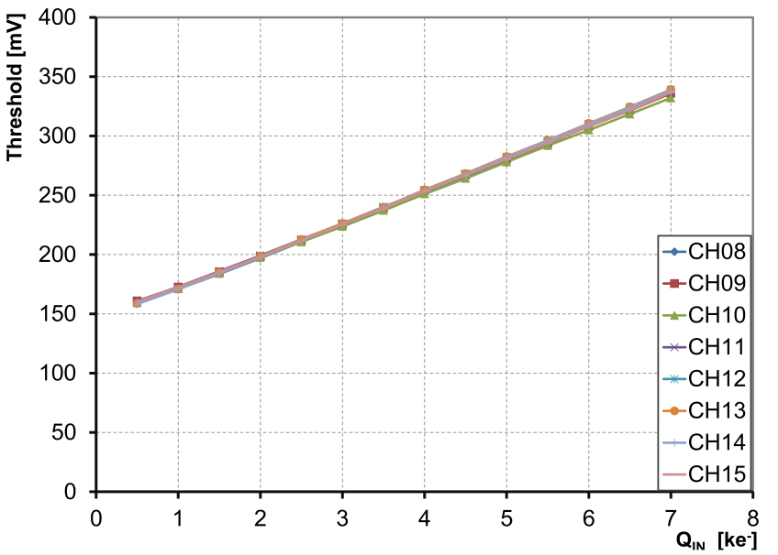
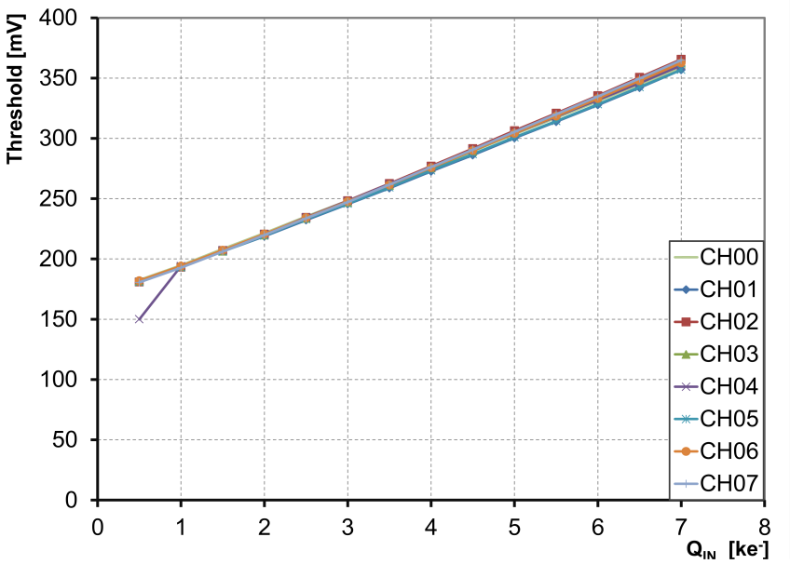
Charge sensitive amplifier with continuous reset
Version with continuous comparator
Version with dynamic comparator

Slide 15
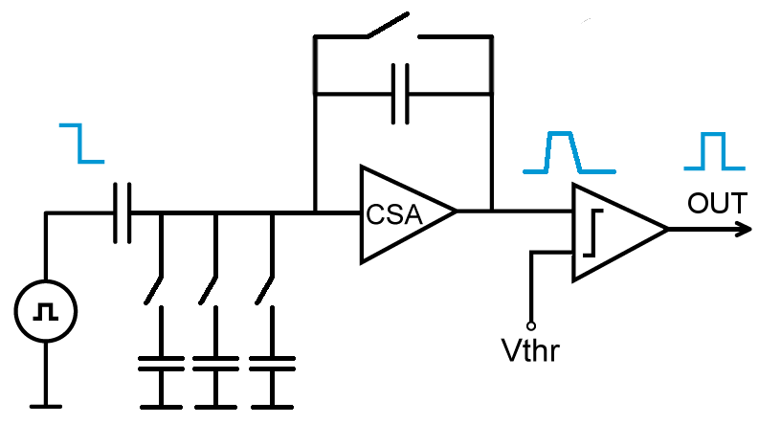
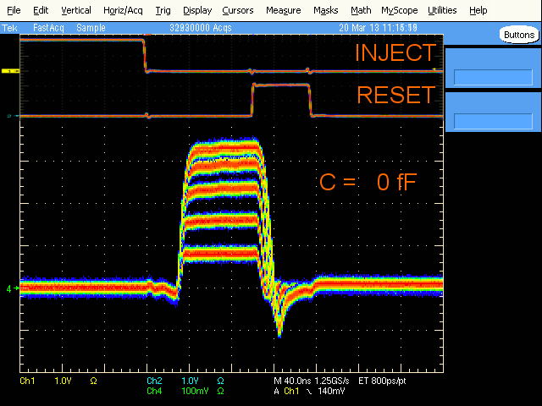
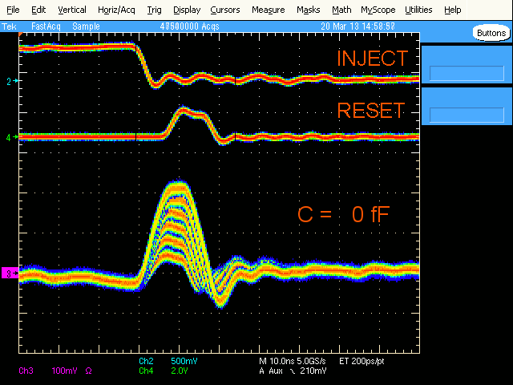
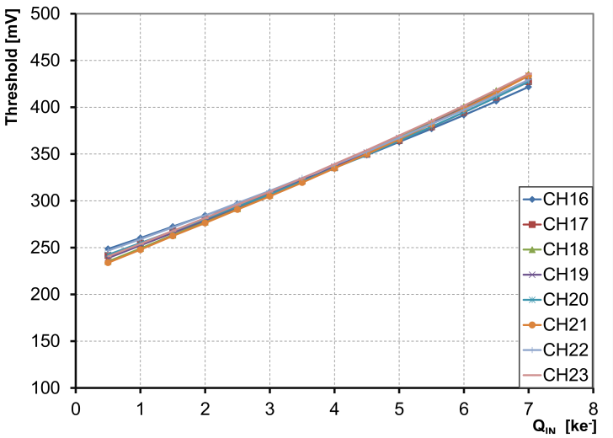
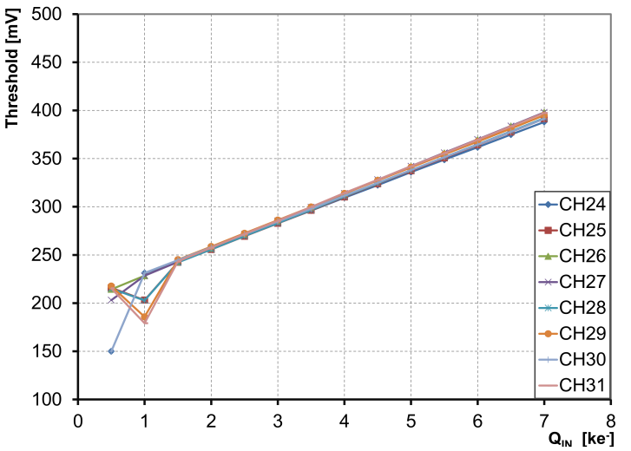
Charge sensitive amplifier with switched reset
FE – with switched CSA
Slow mode (6.25 MHz)
LHC Mode (40 MHz)
2ke – 12ke; step 2ke
Version with continuous comparator
Properties of switched CSA:
- no ballistic deficit
- higher gain
- fast reset
- requires synchronous
operation
Version with dynamic comparator

Slide 16
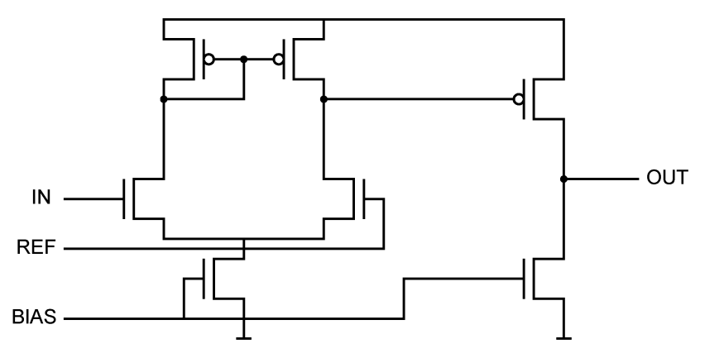
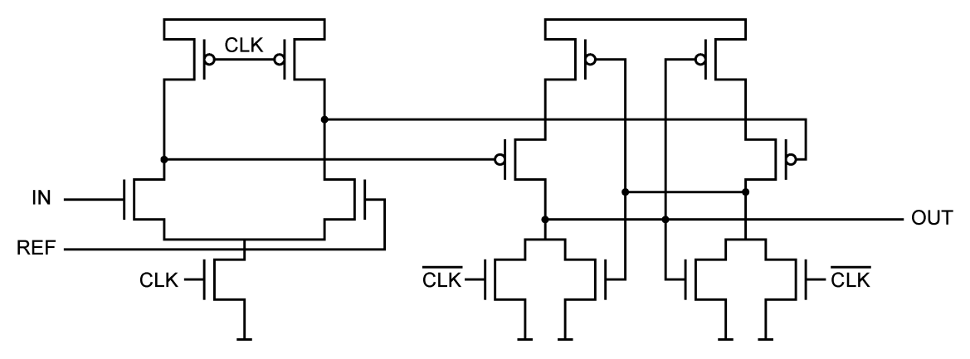
Continuous vs dynamic comparator
Continuous comparator
Popular 2 stage architecture
Asynchronous operation
Consumes power even idle state
Differential stage
CS Stage
Dynamic comparator
Based on latch in metastable state
Does not consume power in idle state
Active only when CLK edge comes
Power proportional to CLK frequency
Differential stage
Latch

Slide 17
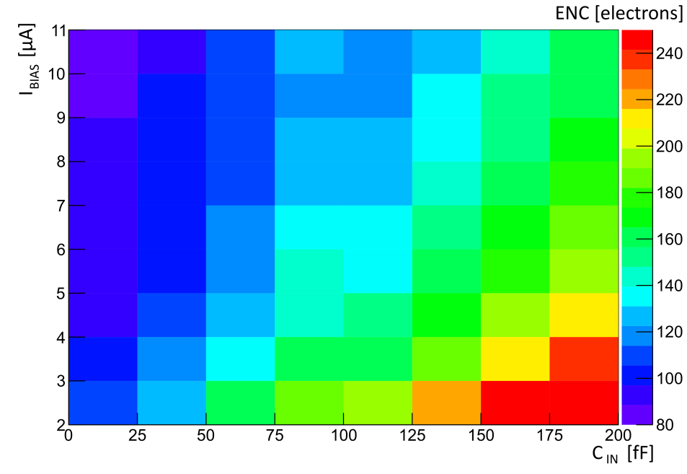
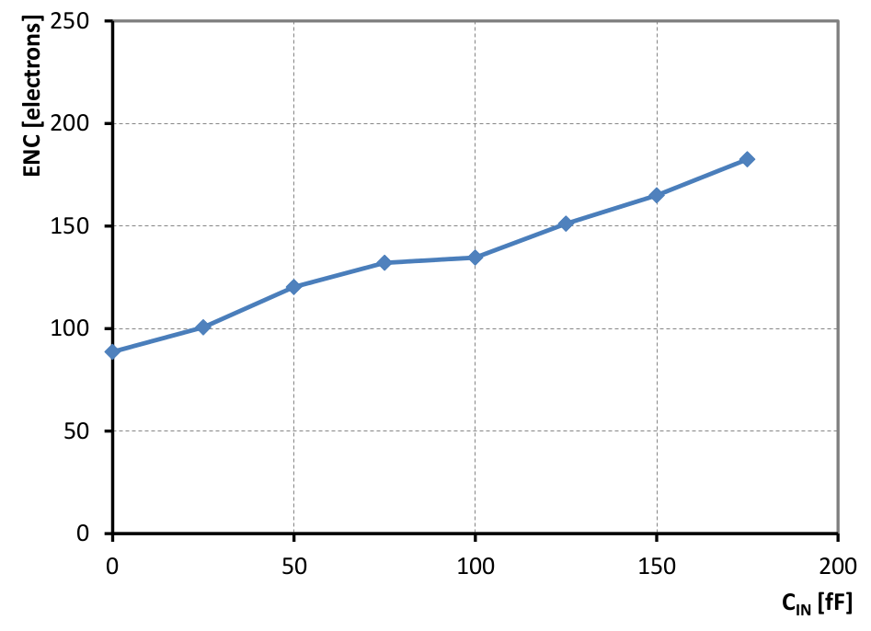
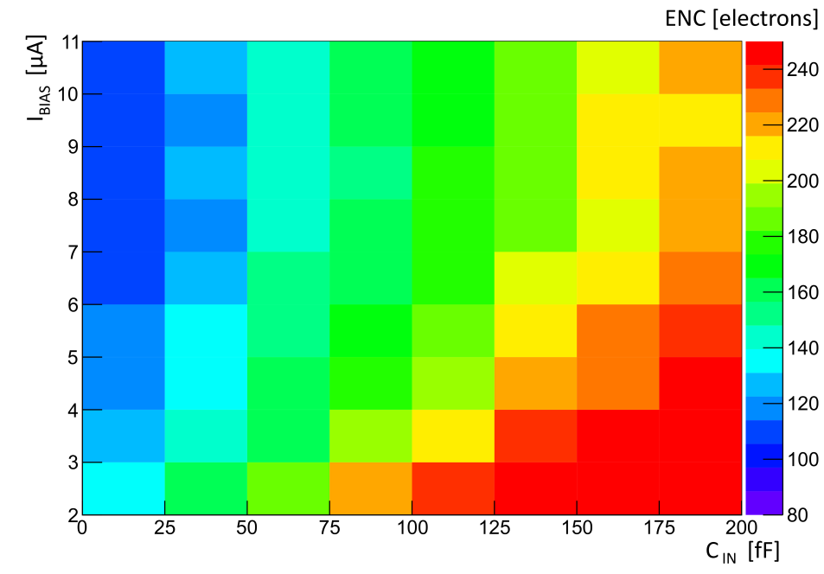
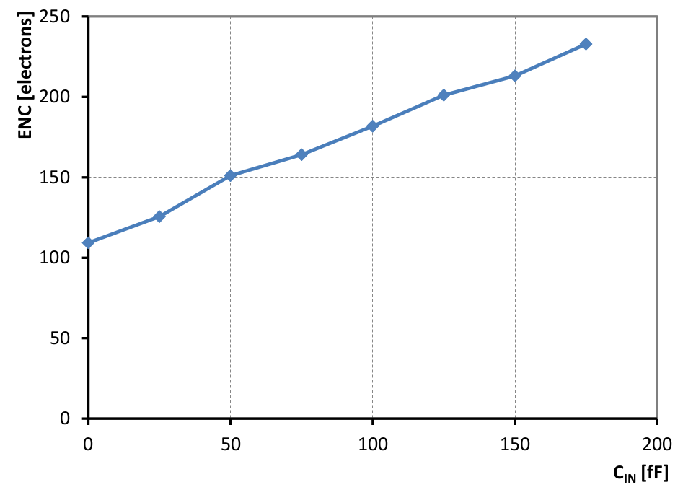
Noise – continuous CSA
Continuous CSA + continuous comparator
Continuous CSA + dynamic comparator

Slide 18
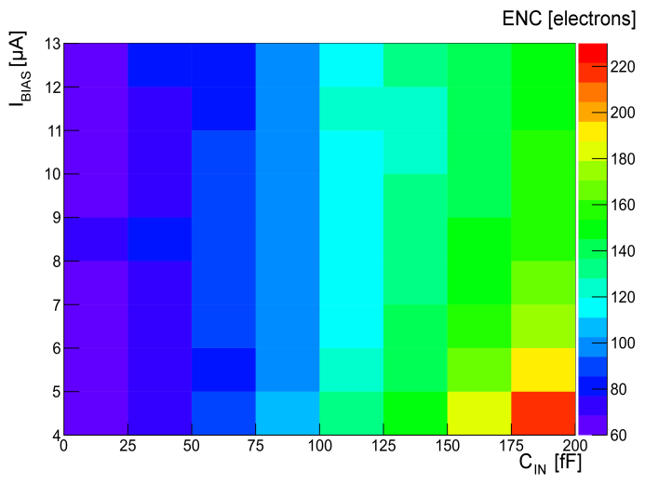
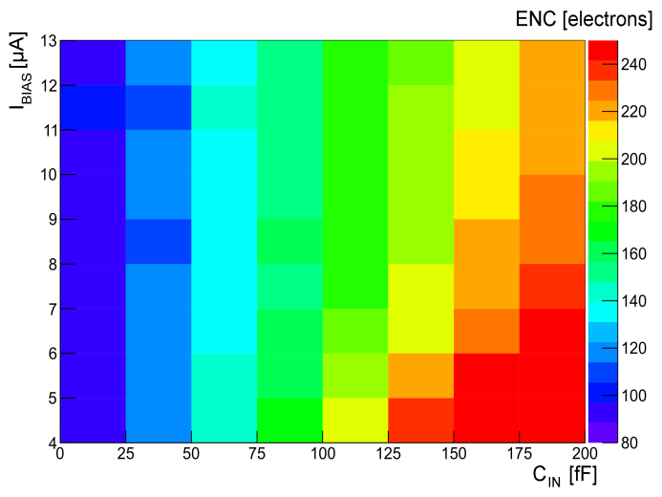
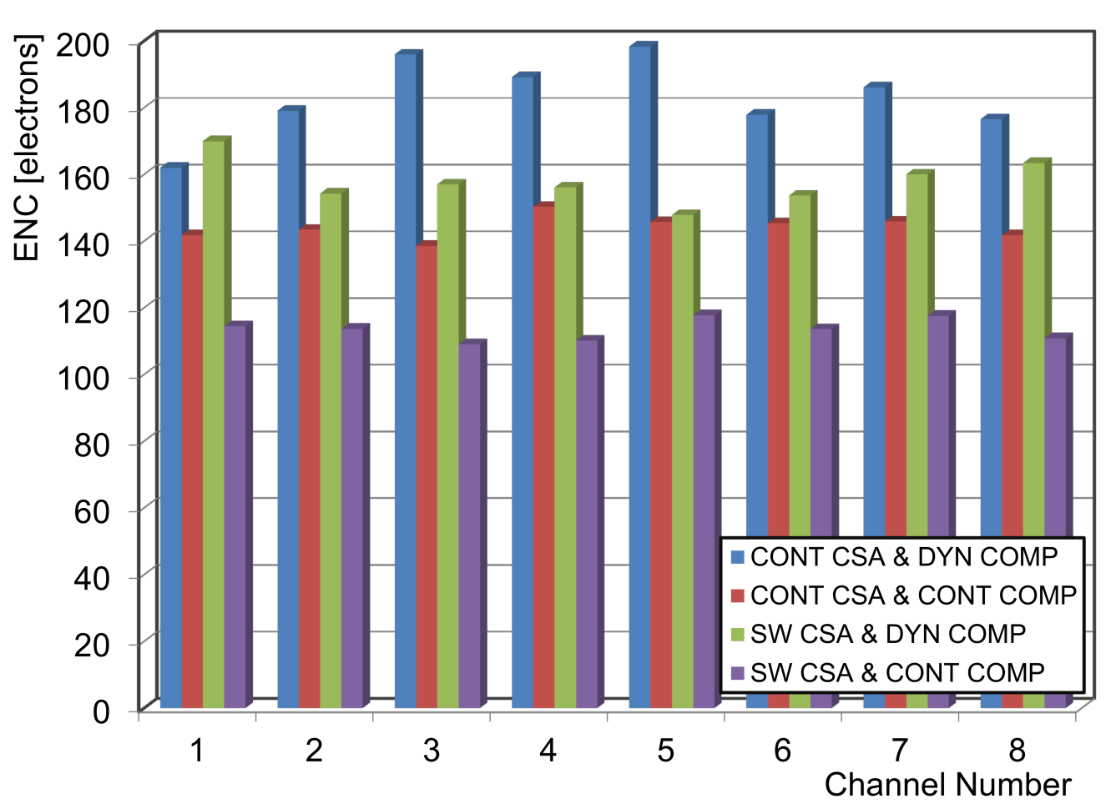
Noise – switched CSA, comparison of all versions
Switched CSA + continuous comparator
Switched CSA + dynamic comparator
CSA | Comparator | <ENC> [e⁻] | P [µW]
Continuous | Continuous | 144 | 10.4
Continuous | Dynamic | 183 | 10.6
Switched | Continuous | 113 | 14.6
Switched | Dynamic | 157 | 14.8
Cin = 75 μF, 40 MHz

Slide 19
FE-I4 vs FE-T65-1 (analog part)
 | FE-I4 | FE-T65-1
Technology | 130 nm | 65 nm
Dimensions of analog part | 156 × 50 µm² | 59 × 25 µm²
Charge sensitive amplifier | 2 stages | 1 stage
Comparator | continuous | continuous /dynamic
Analog power consumption | 12.6 + 5.4 + 3.9 = 21.9 µW / pixel | 6.8 + 3.8 = 10.6 µW (18 µW) / pixel
Analog power density | 1.75 mW / mm² | 2.36 mW / mm² (4 mW / mm²)
65 nm – what we have learned:
- shrinking pixel size down to 125 × 25 µm² is possible
- dynamic comparator saves power but has larger threshold dispersion
- ENC is comparable with FE-I4
- power density has to be optimized

Slide 20
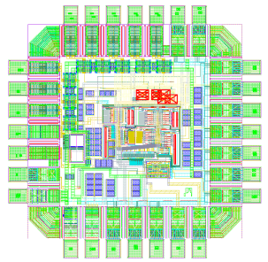
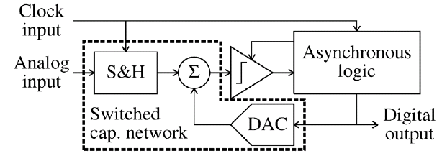
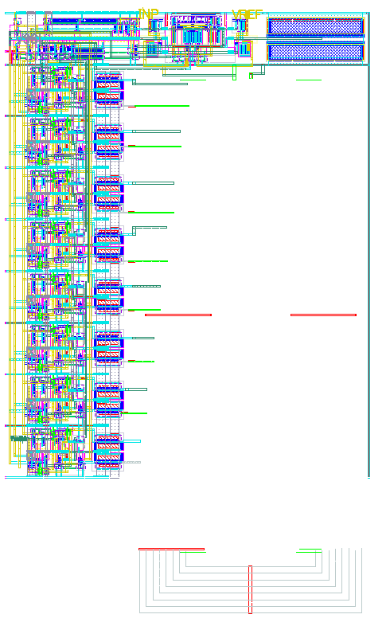
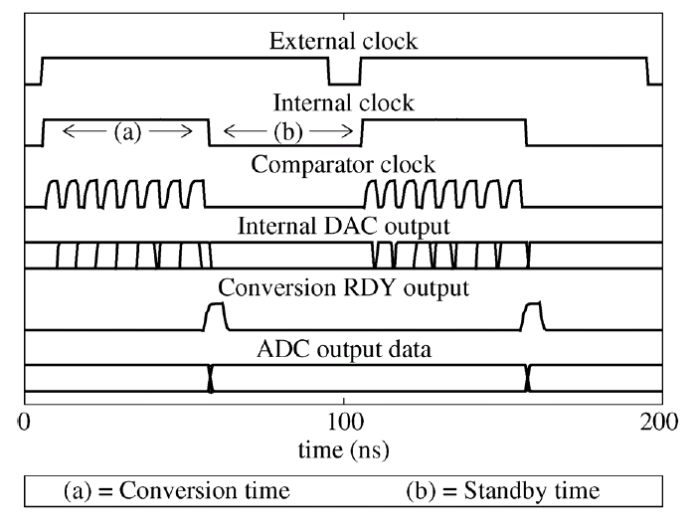
SAR ADC IN 65nm - Layout
40 um
DAC
70um
Layout is not area optimal
Possible de-cup under DAC?
Only external sample signal needed!

Slide 21
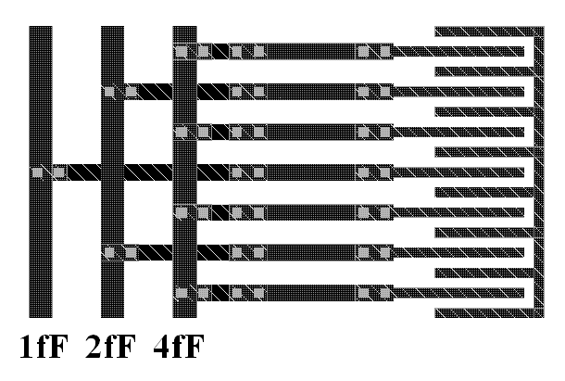
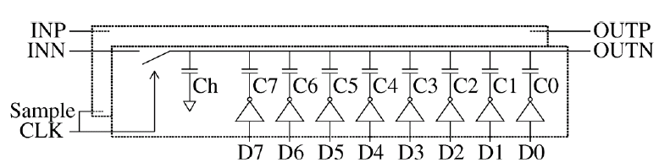
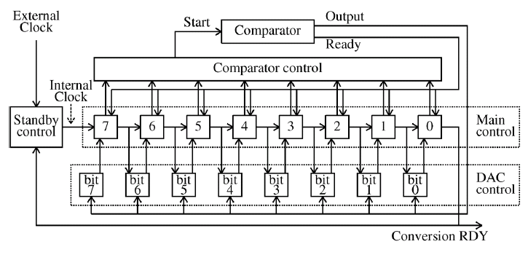
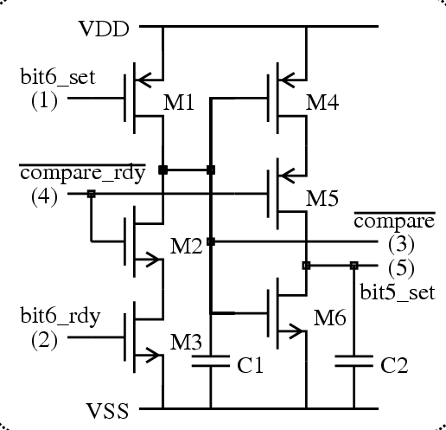
SAR ADC
DAC
DAC Layout
Control
Main Control Logic

Slide 22
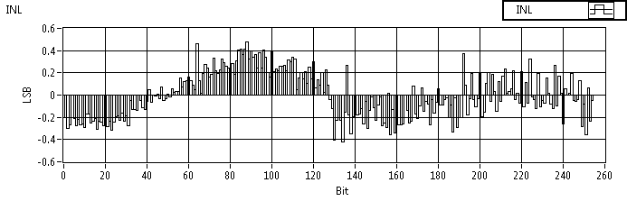
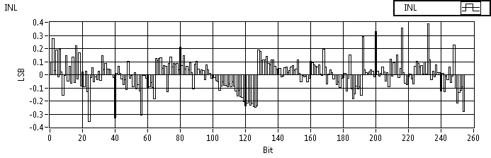
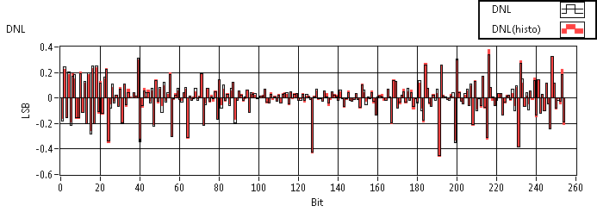
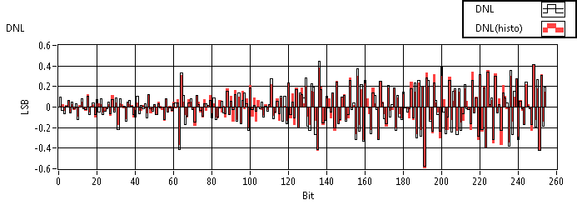
Asynchronous ADC Measurements @ 10MS/s
Single Ended Mode
Differential Mode
Power consumption: ~40uW @1.2V
Works up to 12.5 MS/s
Dynamic Range: 0.8V

Slide 23
Some possibilities in 65nm (for imaging applications)
200 um
100 um
ADC
SRAM 3072x40 bits
368x231
um
ADC
SRAM 384x40 bits
100x198
um
200 um
ADC
ADC
100 um
ADC
ADC
ADC
ADC
Fast full frame storage
In pixel histograming

Slide 24
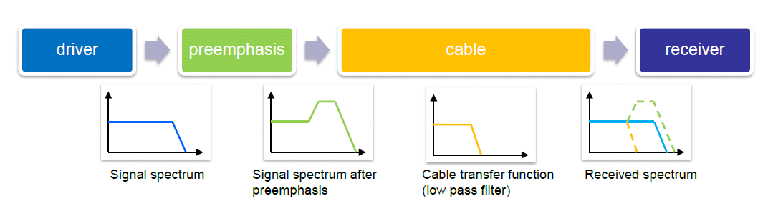
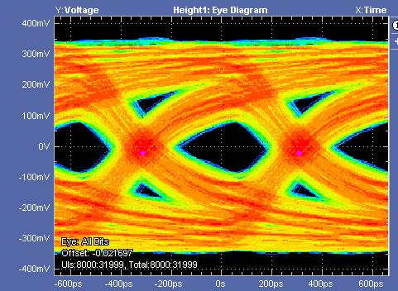
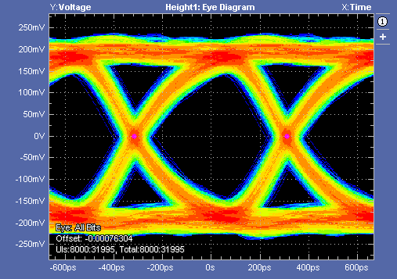
Preemphasis
Preemphasis Off
Preemphasis On

Slide 25



DHPT 0.1 - High Speed Link in 65nm
20m of Infiniband cable @1.6Gbps of random data

Slide 26



65nm in Bonn
Test chips for custom IP verification
  Two mini@sic submissions in 2011 and 2012
  1.6GHz PLL
  Gigabit link driver
  LVDS transmitter & receiver
  Pixel matrices with analog front-ends (CSA + comp.)
  In pixel ADCs
DHPT 1.0, first production version
  MPW submission in Aug. 2013
  12 mm² area, C4 bumps (SAC 305), 200µm pitch
  >300k Gates, >3MB SRAM
  PLL, 1.6Gb/s serial link, CML preamhasis
  Reference
  LVDS and HSTL IO
  DACs, ADC
  ...
DHPT 0.1 and DHPT 0.2 test chips
4 mm
3 mm
Data handling processor DHPT 1.0

Slide 27
65nm conclusions
Possible great improvement in functionality on smaller area
Good analog performance
Good radiation tolerance*
Higher submission cost
More digital chip
Technology available on MPW with bumps/full wafers
BUT what about sensor?

Slide 28



Traditional MAPS
Parameters
- Better resolution (small pixels)
- Low(er) power
- Can be only NMOS in pixel
- Slow

Slide 29


State of the art MIMOSA-26

Slide 30

Now
Future ?
  more volume → higher SNR
  collection by drift → faster charge collection → less trapping
  lower cost (no hybridization)

Slide 31

Charge Collection in Depletion Layer
Depletion width d $∝\sqrt{U_{bias}∙r_{substrate} }$
  Q_{MIP} $∝d$
  C_{parallel} _{plate} $∝ \frac{1}{d}$
  High voltage on the r/o node → HV CMOS process
  High resistive substrate material → CMOS on high resistive substrate (“HR CMOS”)
  Something in-between

Slide 32
Options for n-on-p Read-out
CMOS with twin or triple wells
Charge signal
Charge signal
Electronics (NMOS only)
Electronics (NMOS only)
p-substrate
P+
Deep n-well
p-substrate
p-well
P+
n+
p-well
n+
“MAPS” like
CCPD (HVCMOS)
DMAPS-A
CMOS with additional implants
Charge signal
Charge signal
Electronics (full CMOS)
Electronics (full CMOS)
nw
p-substrate
P+
Deep n-well
p-substrate
p-well
P+
n+
p-well
n+
nw
deep p-well
Electronics outside charge collection well
Very small sensor capacitance → low power
Potentially less rad. hard (longer drift lengths)
Full CMOS with additional deep-p implant
Electronics inside charge collection well
Collection node with large fill factor → rad. hard
Large sensor capacitance (DNW/PW junction!) → x-talk, noise & speed (power) penalties
Full CMOS with isolation between NW and DNW

Slide 33

Monolithic Pixel Sensors on HV-CMOS process
Parameters
Depletion (small)
Low leakage
Possible high resolution
Limited use of PMOS
I. Peric

Slide 34

CCPD + FE-I4 (HV2FEI4)
An active sensor!

Slide 35


3T MAPS on standard CMOS process
Parameters
Depletion (small)
Low leakage
Possible high resolution
Full CMOS
High capacitance
Low breakdown
A. Mekkaoui

Slide 36
Monolithic technology requirements for LHC
High-resistive substrate (>1kOhm-cm)
Isolated PMOS and NMOS transistors (deep n-well/p-well)
Good breakdown performance
Thinning
Backside implantation and implant activation
Backside metallization (if needed)

Slide 37

Simple device cross-section
Pros
Cons
High signal (full depletion possible)
Fast (collection by drift)
Small pixels
Only NMOS in active area
Input capacitnce dominated by deep-nwell tp pwell capacitance

Slide 38


Electrostatic Potential (HV)

Slide 39



Charge Collections
Current on collecting electrode @200V
Electron Density @ 200V (no radiation)

Slide 40

Charge Collections Efficiency
Fluence (N_{eq}/cm²) | Back Voltage [V] | CCE [%]
0 | 100/200 | 100
1e14 | 100 | 96
1e14 | 200 | 97
1e15 | 100 | 75
1e15 | 200 | 80

Slide 41

ESPROS Photonic CMOS™ Process
There is more to this in this technology ☺

Slide 42

EPCB01 - overview
DMAPS pixels
Deep N-well pixels
Transistor array for parameter extraction
Chip size: 1.4×1.4 mm²
First 50um, back side processed, full CMOS, “fully depleted”
(>2kOhm-cm substrate).

Slide 43
EPCB01 - Functional Blocks
Deep N-well pixels
  3T readout
  Analog Output
DMAPS pixels
  Pixel Charge Sensitive Amplifier (CSA)
    continuous discharge
    reset
  Pixel Comparator
    asynchronous
    dynamic
  Tuning DAC
  Digital Sift Register Readout
Custom Pads
Transistors

Slide 44



EPCB01 - Test system
FPGA Multi-IO (MIO) board
General Purpose Analog Card
- universality → can be used for other DUTs
- provides bias voltages and currents for DUT
- provides power supply for the DUT
- distributes digital signals from MIO to DUT
Board carrying DUT
MIO
GPAC
DUT
EPCB01
EPCB01

Slide 45


EPCB01 - Pixel Array Readout
CSA- switched reset
dynamic comparator
CSA – continuous discharge asynchronous comparator

Slide 46


EPCB01 - Pixel Array
Pixel size: 40×40 µm²
Sensing area: 20×20 µm²
SENSOR
RESISTOR
CSA
CDS
PIXEL
Q-INJ.
COMP
TDAC
HIT OR

Slide 47



EPCB01 - Pixel Array Bias Configurations
AC coupled
resistor bias
AC coupled
self bias
DC coupled

Slide 48


EPCB01

Slide 49

EPCB01 – more measurements

Slide 50


Pegasus
Parameters:
  180nm CMOS (TowerJazz)
  Different wafer materials
    18µm HR epi
    40µm HR epi
    HR bulk
  50 x 50 µm² and 25 x 25µm² pixels
thanks to W. Dulinski, M. Kachel (IPHC)

Slide 51


Pegasus - Electrostatic Potential (TCAD example)

Slide 52


PEGASUS - First signs of life
Sr⁹⁰ and Fe⁵⁵ Spectra for 18µm epi
Fe⁵⁵ Spectra for 18µm epi
M. Kachel (IPHC)

Slide 53


FD-SOI
Parameters
Almost perfect technology but due to back gate effect not radiation hard.

Slide 54



HV-SOI
Concept
First signs of life
Layout

Slide 55
More to come
150nm – submitted Q4 2012
  full CMOS
  n-type > 2kOhm-cm substrate
  thinned
  back implanted
180nm – submitted Q1 2013
  full CMOS
  p-type > 1kOhm-cm substrate
  full wafers -> thinning/back implanting possible
180nm - submitted Q1 2013
  full CMOS
  p-type - initially 100 Ohm-cm
  very HV isolation guaranteed
130nm – submission Q4 2013
  HV-CMOS(CCPD)/full CMOS
  p-type >3kOhm-cm
  full wafers -> thinning/back implanting possible
150nm - submission Q1 2014
  HV-CMOS(CCPD)/full CMOS/ possibly T3
  p-type >2kOhm-cm (~4-5k Ohm-cm)
  thinned
  back implanted
  full wafers

Slide 56
Possible scenarios for Monolithic Sensors
Hybrid Pixels with “smart” diodes:
  HR- or HV-CMOS as a sensor (8”)
  Standard FE chip
  CCPD (HVCMOS) on FE-I4
CMOS Active Sensor + Digital R/O chip
  HR- or HV-CMOS sensor + CSA
  (+Discriminator)
  Dedicated “digital only” FE chip
Monolithic Active Pixel Sensor
  MAPS usually on epi substrate
  → diffusion signal, not suited for HL-LHC
  HR- material (charge collection by drift) ➔ Fully depleted MAPS (DMAPS)
Diode + preamp
FE chip
Diode + full analog processing
Digital only FE chip
Wafer to wafer
bonding
Diode + Amp + Digital

Slide 57
Conclusions
Hybrid Pixel Detectors:
- minitaruzation 65nm and below
- smaller pixel
- smarter pixels
- more digital chips
- 3D, diamond or active CMOS sesors for ultra high radiation
Depleted Monolitic Detectors:
- more radiation tolerance
- will take space of hybrids/strips for less dymanding application
- as a accitve sensor layer for ultra fast enviroments

Slide 58
Thank you!
Question, comments, suggestions:
hemperek@uni-bonn.de

