Slide 1
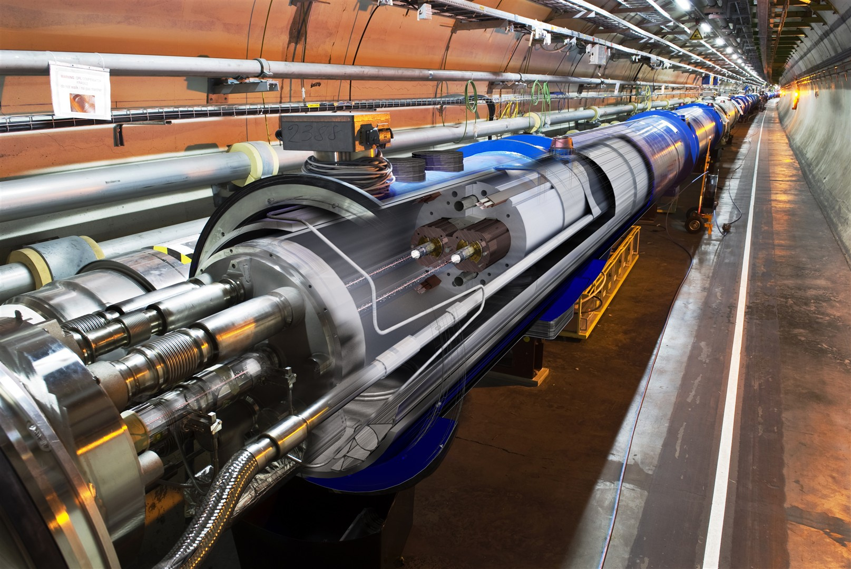
The LHC Control System
CERN Accelerator Control System
Roman Gorbonosov on behalf of the
Beams Department Controls Group
Based on the input from M.Arruat, V.Baggiolini,
JC.Bau, M.Buttner, P.Charrue, S.Deghaye, E.Hatziangeli, G.Kruk, M.Lamont, A.Radeva, U.Raich, C.Roderick, J.Serrano, W.Sliwinski, J.Wozniak
CERN – Geneva - Switzerland
Accelerators and Technology Sector
Beams Department - Controls Group
Notes:
Welcome to the second lecture about LHC Control System.

Slide 2
Contents
LHC control system requirements
Philosophy of development
Overview of the architecture
Key components
Quality Assurance (QA)
Outlook towards the Future
Notes:
Here is what we covered so far.

Slide 3






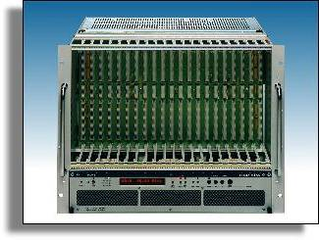
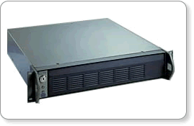
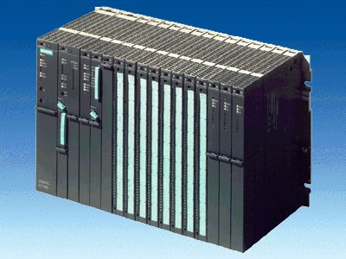
Key components
Presentation
Layer
PUBLIC ETHERNET NETWORK
Core Control GUIs
Fixed Displays
DB access
Core Control GUIs
Fixed Displays
DB access
OPERATOR
CONSOLES
FIXED
DISPLAYS
OPERATOR
CONSOLES
Core Control GUIs
Fixed Displays
DB access
TCP/IP communication services
Java RMI, JMS
Role Based Access (RBAC)
Business
Layer
LHC
Software
Architecture
Sequencer
Diagnostics
Monitoring
(DIAMON)
&
Alarms
Software
Interlock
System
Logging
DB
Settings &
Logging
FILE SERVERS
APPLICATION SERVERS
SCADA SERVERS
CERN GIGABIT ETHERNET TECHNICAL NETWORK
CTRL
CTRL
DB
Settings &
Logging
DB
Settings &
Logging
Oasis
Post
Mortem
TCP/IP communication services
TIMING GENERATION
T
T
T
T
Timing
System
Controls MiddleWare (CMW)
RT Lynx/OS
VME Front Ends
WORLDFIP
Front Ends
PLC
Role Based Access (RBAC) – Critical Settings Management
TCP/IP communication services
Front End
Layer
FESA servers
PVSS
FESA servers
PVSS
T
PVSS
FESA servers
T
T
T
T
Notes:
And yesterday we finished looking at the first diagnostics application = OASIS.

Slide 4
Key components
Presentation
Layer
PUBLIC ETHERNET NETWORK
Core Control GUIs
Fixed Displays
DB access
Core Control GUIs
Fixed Displays
DB access
OPERATOR
CONSOLES
FIXED
DISPLAYS
OPERATOR
CONSOLES
Core Control GUIs
Fixed Displays
DB access
TCP/IP communication services
Java RMI, JMS
Role Based Access (RBAC)
Business
Layer
LHC
Software
Architecture
Sequencer
Diagnostics
Monitoring
(DIAMON)
&
Alarms
Software
Interlock
System
Logging
DB
Settings &
Logging
FILE SERVERS
APPLICATION SERVERS
SCADA SERVERS
CERN GIGABIT ETHERNET TECHNICAL NETWORK
CTRL
CTRL
DB
Settings &
Logging
DB
Settings &
Logging
Oasis
Post
Mortem
TCP/IP communication services
TIMING GENERATION
T
T
T
T
Timing
System
Controls MiddleWare (CMW)
RT Lynx/OS
VME Front Ends
WORLDFIP
Front Ends
PLC
Role Based Access (RBAC) – Critical Settings Management
TCP/IP communication services
Front End
Layer
FESA servers
PVSS
FESA servers
PVSS
T
PVSS
FESA servers
T
T
T
T
Notes:
Let’s now look at “Diagnostic Monitoring and Alarms”. These are 2 components which are closely related that’s why we will look at them together.

Slide 5
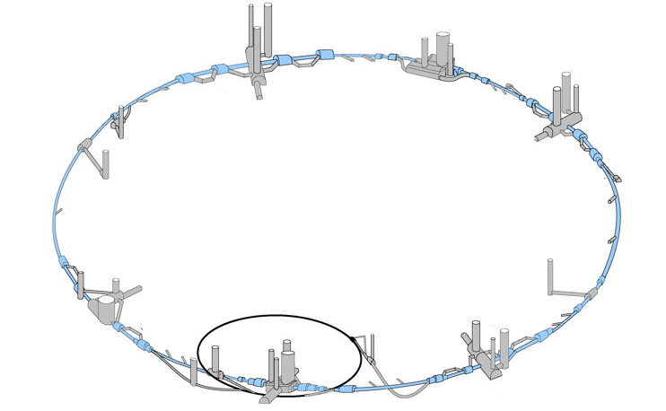
Diagnostic Monitoring and Alarms
Alarms
Summary of problems in single place
Huge number of SW processes
Diagnostics Monitoring
Huge number of devices
Notes:
Why do we need Diagnostic Monitoring and Alarms?
LHC has huge number of devices, huge number of software processes which potentially could fail. In order to detect those failures early enough it is necessary to have the summary on a single screen.
The Diagnostic Monitoring component is responsible to constantly monitor the state of all the devices and all the software processes in the control system. While Alarms component takes care of showing all the problems in a single place and in informative way.

Slide 6
DIAgnostic MONitoring
Monitors controls infrastructure
  Computers (front-ends, servers, consoles)
  Network
  Software applications
Provides overview of infrastructure state
Notes:
It’s main purpose is to monitor the controls infrastructure. By infrastructure I mean all the computers, the network, software applications, etc. And to provide the overview of infrastructure state at any moment in time.

Slide 7
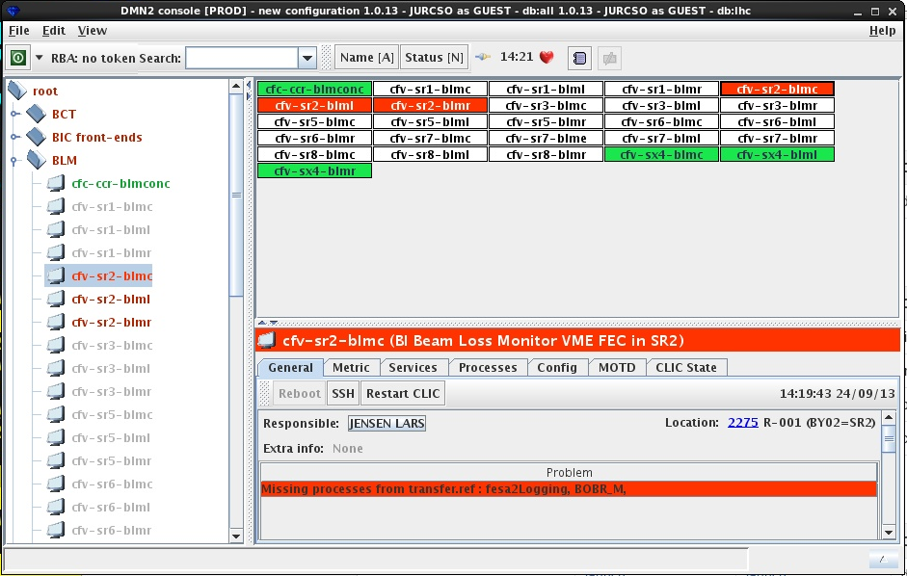
DIAgnostic MONitoring GUI
Notes:
This is how it looks like for the clients. In this screenshot we see the overview of the infrastructure related to the LHC Beam Loss Monitors. Since we’re in shutdown most of the front-ends are not reachable and marked with white. At the same time we have some front-ends in a good shape, the green ones, and some others which are up but have some problems – the red ones. For those front-ends which have a problem we can see all the detailed information: who is responsible for it, what is the actual problem, and a lot more. During normal operations this all should be green.

Slide 8
DiaMon: architecture
DiaMon
GUI
DiaMon
Server
JMS
JMS
DiaMon
DAQ
JMX
DAQ
SNMP
DAQ
JMS
Consoles
Front-Ends
DiaMon
agent
DiaMon
agent
Servers
DiaMon
agent
Processes
JMX
HW
SNMP
Notes:
Let’s have a brief look at the architecture of DiaMon. So, let’s start with different types of computers we want to monitor: front-ends, servers, operational consoles. In CERN they are all instrumented with a software agent which sends all the metrics, CPU load, memory utilization, etc. to a data acquisition module. The module does some filtering of data and forwards it to the central DiaMon server which makes the information available through a dedicated GUI.
Now, in addition we would like to monitor Java processes, for example, LSA. LSA exposes its metrics through Java Management Extension API – the Java standard. No problem, there is a JMX data acquisition module which is plugged into the DiaMon.
OK, but we have a piece of hardware which exposes its metrics through Simple Network Management Protocol. No problem – we have a DAQ for it as well.
So you see that the architecture is very extensible.

Slide 9
DiaMon: features
Helps finding the root cause of the problem
Provides evolution history
Allows certain actions
  restart system
  restart process
Notes:
DiaMon helps to find the root cause of detected problems. For example, a computer is not reachable anymore: there are plenty of reasons. If other computers in the same network segment are still reachable, most probably the problem is related to that particular computer. If all the computers of a network segment lost connection then the problem could be related to a network switch.
It provides a history of information evolution, so we always can look back and see what happened a week ago.
And also it allow certain basic actions, for example, restart a process or a machine.

Slide 10
Alarms
Software alarms system
  Problem => notification
Does not deal with human/equipment safety
Notifies about problems requiring human intervention
Notes:
Let’s leave Diagnostic Monitoring aside for a moment and look at the Alarms.
Alarms is essentially a software alarms system – so when something wrong happens it displays the notification on the alarm console.
It doesn’t deal with human or equipment safety. The fire alarms go directly to the fire brigade. But it deals, for example, with equipment being down. And the main purpose of alarms is to notify operators or experts about arising problems requiring human interaction.

Slide 11
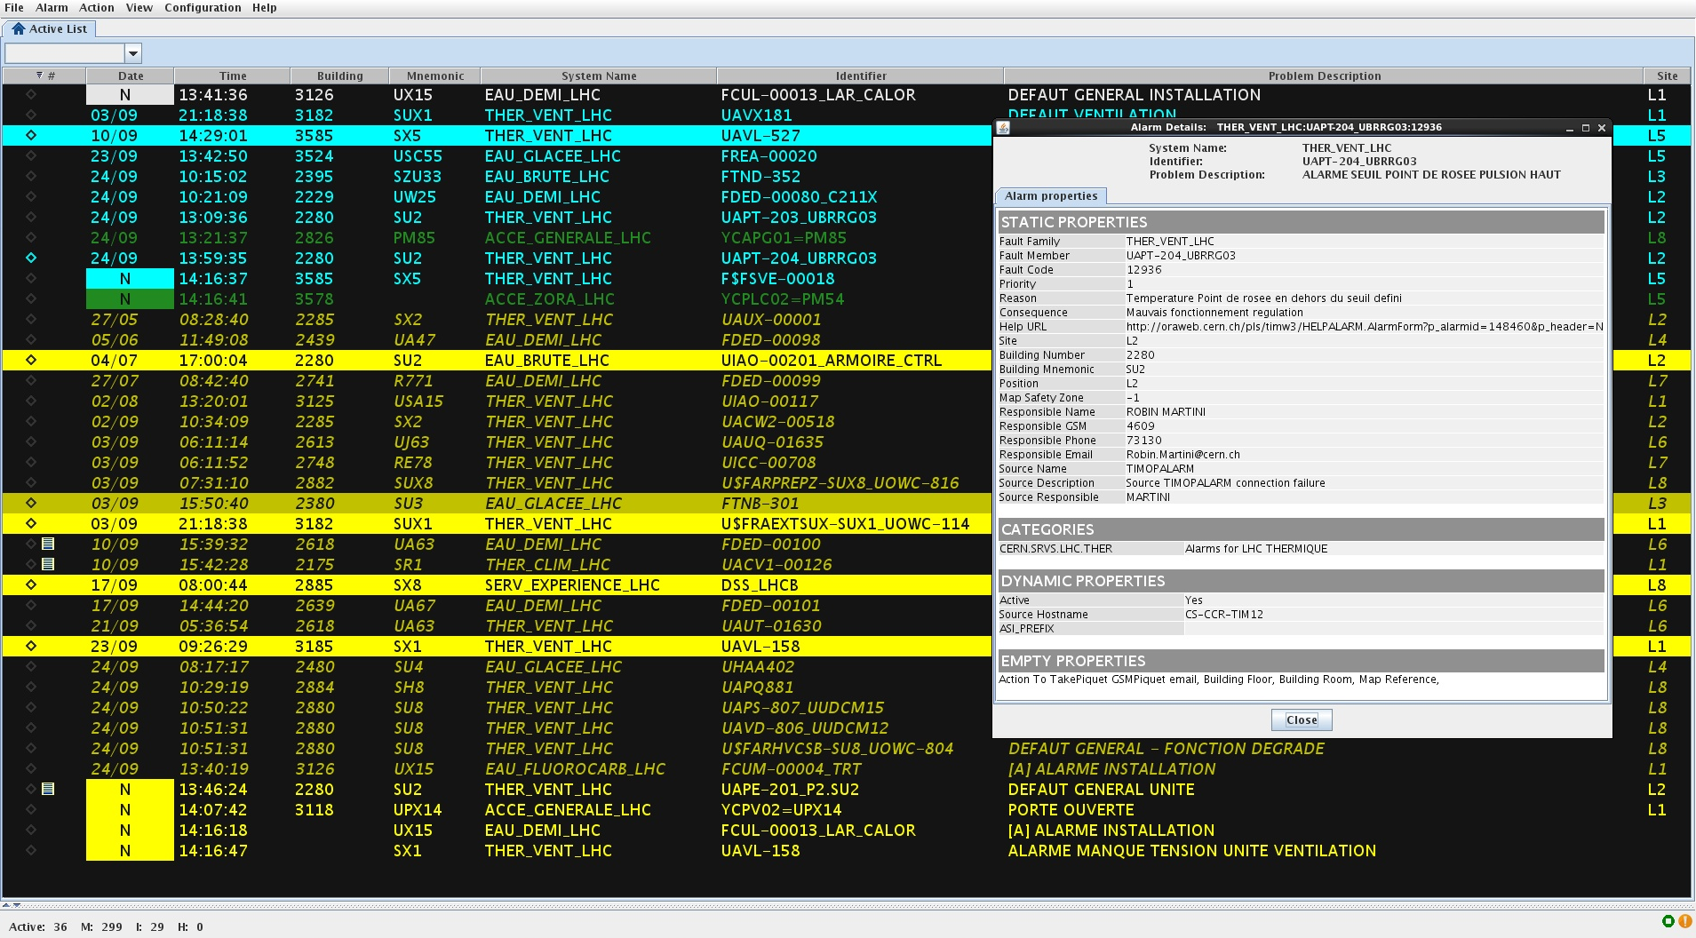
Alarms Console
Notes:
This is how it looks like. Every line is an alarm. The color of the alarm corresponds to its priority. The alarms which have just appeared have background color. We can get additional information about alarms, for example, description, the contact person.

Slide 12
DiaMon & Alarms: architecture
DiaMon
GUI
Alarms
Console X
Alarms
Console Y
Alarms
Server
JMS
DiaMon
Server
JMS
JMS
JMS
DiaMon
DAQ
JMX
DAQ
SNMP
DAQ
JMS
Consoles
Front-Ends
DiaMon
agent
DiaMon
agent
Servers
DiaMon
agent
Processes
JMX
HW
Alarms
API
SNMP
…
Notes:
This is how it fits into the overall diagram.
Imagine DiaMon server has got some bad news and wants to raise an alarm, so it communicates with Alarms server which displays all the alarms on the alarms consoles depending on alarm category.
While Diagnostic Monitoring is one of the main alarm sources any equipment or software can raise an alarm directly if necessary.

Slide 13
Alarms: features
Relevant alarms only
threshold
Alarm?
time
Notes:
Let’s have a brief look at the features of our alarms system. First of all it notifies about relevant alarms only. What do I mean by relevant? Well, here we have a certain signal, for example CPU load, and the idea is that this signal should not overpass a threshold otherwise an expert should be called. And we see here that for a short time the CPU load was over the threshold. Is this an alarm? It depends of course, depends on the system, depends on the value we monitor, depends on the requirements. But in general case we see that immediately after the CPU load came back to the normal value. So, probably in the most of the cases such an event should not raise an alarm – otherwise we will just see alarms blinking: appearing and disappearing.

Slide 14
Alarms: features
Relevant alarms only
threshold
Alarm?
time
Notes:
Here is another example? Is this an alarm? Definitely yes – it stays quite long over the threshold. And even later on when it goes below the threshold it doesn’t come to the normal value.
There are different technics to distinguish one case from another. Let’s go through them briefly so you have an idea.

Slide 15
Alarms: features
Relevant alarms only
ON delay
threshold
time
Notes:
“ON delays” – meaning that alarm should not be raised until the value is bad long enough.

Slide 16
Alarms: features
Relevant alarms only
OFF delay
threshold
time
Notes:
Symmetrically there are “OFF delays” – meaning the alarm doesn’t disappear immediately, but after certain time only to avoid flickering.

Slide 17
Alarms: features
Relevant alarms only
threshold
Dead band
time
Notes:
“Dead bands” used to not raise/remove alarms while the value is in the “dead band”. Meaning that an alarm is raised when value exceeds upper limit, and is terminated when value is again below lower limit. So in this example the alarm corresponding to the red signal should stay.

Slide 18
Alarms: features
Relevant alarms only
Context
threshold
time
Notes:
And of course context is very important. During beam operations a switched off power converter will raise an alarm, while during the shutdown – noone cares.

Slide 19
Alarms: features
Relevant alarms only
  Quality of raised alarms
  Dependent on clients: ex. different accelerators
Alarms history
Maps alarms to people and possible actions
Alarms priority
Notes:
So, there is a certain quality of raised alarms.
The alarms are shown to relevant people. For example, operators of one accelerator should not see the alarms of another accelerator.
The system provides the alarm history – it allows to look back and see how often the alarms is raised.
It maps the alarms to the people to contact and also provides some instructions of possible actions.
As you saw in the screenshot it support alarms priorities as well.

Slide 20
DiaMon & Alarms: today
Diagnostic Monitoring
  Metrics from >2000 computers
  ~10 M updates / day
Alarms
  ~200 K alarm definitions (80’000 for LHC)
  ~150 alarm events / minute
Notes:
Ok, today DiaMon processes metrics from more than 2000 computers, what makes it receiving and processing about 10 millions updates per day. There are around 200 thousands alarm definitions. And every minute about 150 alarm events are received. By “alarm event” I mean alarm raising, alarm termination, or update of alarm state.

Slide 21
DiaMon & Alarms: future
Extend monitoring to process internals
  JMX metrics
  Periodic sanity checks
Automatic alarms analysis
  Frequent, oscillating alarms => contact expert
  Long-standing alarms => reconsider alarm
Notes:
Talking about future developments we plan to extend the monitoring capabilities of the system from OS level to process level. I mean that today we can monitor the presence of a process, its memory usage or CPU load, basically metrics provided by the OS. Our goal is to be able to monitor the specific metrics of the processes, for example the number of active threads or some buffer sizes, etc. Plus it would be nice to trigger some sanity checks on the processes from time to time, ask to execute some action to ensure the process is not stuck.
We also plan to invest efforts in the automatic alarms analysis. For people it is difficult to keep track of all those 200’000 alarms definitions, but the software can detect those alarms which are raised often or which flicker, so the expert can be contacted. Or alarms which just stay active for long time and noone cares – probably such alarms don’t make sense. There could be other alarm categories worth considering.

Slide 22
Key components: SIS
Presentation
Layer
PUBLIC ETHERNET NETWORK
Core Control GUIs
Fixed Displays
DB access
Core Control GUIs
Fixed Displays
DB access
OPERATOR
CONSOLES
FIXED
DISPLAYS
OPERATOR
CONSOLES
Core Control GUIs
Fixed Displays
DB access
TCP/IP communication services
Java RMI, JMS
Role Based Access (RBAC)
Business
Layer
LHC
Software
Architecture
Sequencer
Diagnostics
Monitoring
(DIAMON)
&
Alarms
Software
Interlock
System
Logging
DB
Settings &
Logging
FILE SERVERS
APPLICATION SERVERS
SCADA SERVERS
CERN GIGABIT ETHERNET TECHNICAL NETWORK
CTRL
CTRL
DB
Settings &
Logging
DB
Settings &
Logging
Oasis
Post
Mortem
TCP/IP communication services
TIMING GENERATION
T
T
T
T
Timing
System
Controls MiddleWare (CMW)
RT Lynx/OS
VME Front Ends
WORLDFIP
Front Ends
PLC
Role Based Access (RBAC) – Critical Settings Management
TCP/IP communication services
Front End
Layer
FESA servers
PVSS
FESA servers
PVSS
T
PVSS
FESA servers
T
T
T
T
Notes:
So the Diagnostics Monitoring and Alarms deal with the situation when a human intervention is necessary.
What about the situations where an automatic action is needed. LHC is working with dangerous beam, so if a problem is detected we need components which react fast and trigger the beam extraction from the accelerator automatically.
We have a component dealing with those cases - “Software Interlock System”.

Slide 23
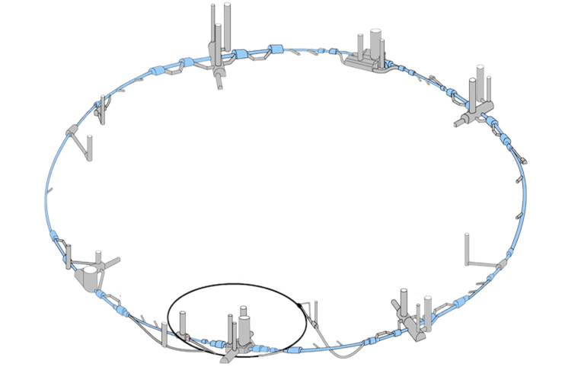
Machine Protection: birds-eye view
Software Interlock System
Hardware Machine Protection
Notes:
Before we start talking about Software Interlock System I should provide you with basic information about Machine Protection of LHC.
And the basic information is: for such a crucial task as Machine Protection we don’t trust software. Therefore the most of the Machine Protection is actually implemented in the hardware which guarantees that if the situation is really critical the beam will be extracted from the machine. For example if to high beam losses are detected the beam is dumped. You can look at the Hardware Machine Protection as an “emergency stop” – it is extremely reliable and at the same time very rigid.
And normally it is better to not let the situation to become that bad that we need to use an emergency stop. It is better to react before.
And this is where the Software Interlock System comes into play as a more flexible, more user-friendly and in a certain sense more “accelerator-firendly” way to provide machine protection besides strict and rigorous hardware machine protection.

Slide 24
Software Interlock System (SIS)
Surveys the state of key LHC components
Acts if necessary
  abnormal situation ⇒ beam dump
Part of overall Machine Protection
Notes:
The main goal of Software Interlock System is to survey the state of key components and act on the machines if necessary. The main use-case is to dump the beam if an abnormal situation is detected.
Providing such functionality SIS is a part of the overall Machine Protection.

Slide 25





SIS: architecture
Data Processing
External
Systems
Beam Interlock
Timing
Alarms
etc.
1Hz
Data Acquisition
Controls MiddleWare
Front End
Layer
Notes:
Sis-core is divided into two separate parts:
- data acquisition,
- data processing.
The data acquisition part is based on the subscriptions – the data is stored in the buffers for the future evaluations.
Data processing starts with a trigger which comes periodically, once a second in the case of LHC. So the data (arrived or missing) are taken from the acquisition part, evaluated according to the definition of conditions.
And then the system acts accordingly, for example it can request Beam Interlock System to dump the beam, raise an alarm, etc.

Slide 26
SIS: implementation
Data Processing
Permit
nodes
G
AND
Logical
nodes
E
F
OR
AND
Alarm
Elementary
nodes
Ignore/mask
A
B
C
D
Notes:
The data processing is based on the boolean tree evaluation.
The tree consists of:
- elementary nodes – leaf nodes representing low level information. For example the state of LHC magnets.
- logical nodes– logical expressions on the elementary channels
- permit nodes – top one, special logical nodes. The SIS acts based on the values of the permit nodes and provides their values to external systems. In the main use-case the permit node represents the permission for the beam to be in the machine.
So, in this example we base the calculation on 4 elementary nodes, let’s say power converter states. And we see that one power converter is in a bad state, so the whole tree is evaluated to be a problem.
Still we have a possibility for a human intervention here. The operators could be aware of the problem, however they could consider the problem not critical enough to block the LHC operations. In this case operator can ignore a node by masking it.
When the tree gets evaluated again the true state is propagated up the tree and permit is now valid.
Alarm is sent to the alarm system to warn about masked (ignored) nodes which might be dangerous for the equipment when someone forgets to unmask.

Slide 27
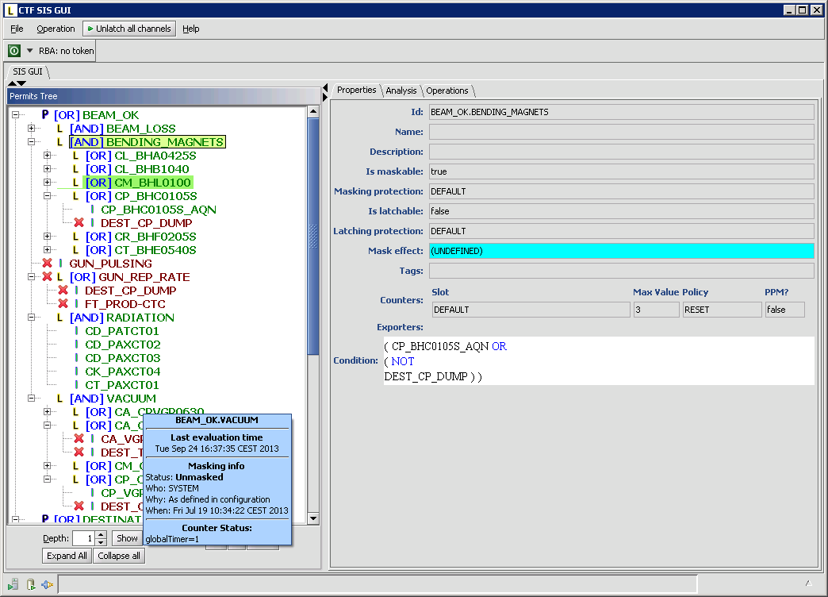
SIS: features
Notes:
And this is how the SIS GUI looks like: on one side we have the evaluation trees: so you see that this tree is quite complex. The color represents the result of the evaluation. And on the other side we have detailed information about the selected node. If it is maskable or not, etc.

Slide 28
SIS: features
Domain conditions representation
Complex condition logic
Provides the operations with condition calculation diagnostics
Extensible
Deterministic and highly reliable
Notes:
So the Software Interlock system provides a way to describe the domain conditions to react on.
Those conditions can have quite a complex logic: if the injection request is present and the injection kicker is not armed or LHC is in shutdown ... and … or … etc.
It provides diagnostics regarding the condition calculation. If the condition is complex then it could be not obvious why it was evaluated to a certain value.
The system must be easily extensible, meaning that the operators should be able to add/modify/remove conditions and reactions as they want without us involved.
It is deterministic and highly reliable. It ensures the trees evaluation within certain time limits, for example it doesn’t wait forever for the missing data. And its reliability has been proven by experience – this application became very popular for LHC and other accelerators in the complex.

Slide 29
SIS: today
Deployed practically for all accelerators
SIS for LHC has
  ~2700 subscriptions
  ~5200 elementary / ~800 logical / 8 permits
SIS for SPS is used to save energy
  Up to 200’000 euro/year
Notes:
As I already mentioned we normally don’t develop specific applications for 1 accelerator only but rather keep in mind other facilities. SIS is not an exception since the idea is not LHC-specific. Today it is deployed practically for all our accelerators.
For LHC the current deployment of SIS has about 2700 subscriptions. From those subscriptions about 5200 values are used to calculate about 800 logical channels contributing to 8 global permits.
In SPS it is used to save energy. When there is no beam expected SIS prevents (via timing system) magnet from powering. This allows to save up to 200’000 euro per year.

Slide 30
Key components: Post-Mortem
Presentation
Layer
PUBLIC ETHERNET NETWORK
Core Control GUIs
Fixed Displays
DB access
Core Control GUIs
Fixed Displays
DB access
OPERATOR
CONSOLES
FIXED
DISPLAYS
OPERATOR
CONSOLES
Core Control GUIs
Fixed Displays
DB access
TCP/IP communication services
Java RMI, JMS
Role Based Access (RBAC)
Business
Layer
LHC
Software
Architecture
Sequencer
Diagnostics
Monitoring
(DIAMON)
&
Alarms
Software
Interlock
System
Logging
DB
Settings &
Logging
FILE SERVERS
APPLICATION SERVERS
SCADA SERVERS
CERN GIGABIT ETHERNET TECHNICAL NETWORK
CTRL
CTRL
DB
Settings &
Logging
DB
Settings &
Logging
Oasis
Post
Mortem
TCP/IP communication services
TIMING GENERATION
T
T
T
T
Timing
System
Controls MiddleWare (CMW)
RT Lynx/OS
VME Front Ends
WORLDFIP
Front Ends
PLC
Role Based Access (RBAC) – Critical Settings Management
TCP/IP communication services
Front End
Layer
FESA servers
PVSS
FESA servers
PVSS
T
PVSS
FESA servers
T
T
T
T
Notes:
SIS is an online analysis tool, and since it takes decisions online it is limited in time for processing and therefore can’t process big amounts of data. At the same time in case of a beam dump (especially unexpected) it is necessary to understand the reason of the dump. And for this it is necessary to analyze the information from thousands devices around LHC ring to answer the question: what exactly happened to each device around the beam dump moment. And we have a framework dedicated to such exhaustive analysis: Post-Mortem Analysis.

Slide 31
Post-Mortem Analysis (PMA)
Detects the cause of the beam dump
Checks if all the protection equipment behaved as expected
Decides if it safe to continue the operations
Blocks the next injection otherwise
Part of overall Machine Protection
Notes:
The main purpose of PMA is to detect the cause of the beam dump (beam losses, quench, etc.), check if all the protection equipment of LHC behaved as expected, to decide if it safe to continue the operations with the next injection and block the next injection otherwise. So the PMA is a part of the overall Machine Protection for LHC.

Slide 32


PMA: workflow
External Systems
GUI
Sequencer
Fixed Displays
SIS
Injection Permit
Interact
Check
Result
Publish
Lock
Unlock
PM Analysis System
PM Analysis
Data Collection
Push
Data
Push
Data
Push
Data
Beam dump
LHC
Notes:
Let’s look how it works. On this picture we have LHC with all the possible equipment at the bottom, the PMA in the middle and clients at the top. You see that Sequencer and SIS which we already talked about before collaborate with PMA.
So, LHC is working, colliding the beams and suddenly a beam dump happens. The first thing PMA does is removing the injection permit via SIS.
At the same time all the equipment around LHC start pushing the data about themselves to the data collection part of PMA. This data contain very detailed information about what the equipment was doing around the beam dump moment.
Once the data is collected it is given to the analysis part which processes the data and makes the outcome available for all the clients: it provides all the results to the PMA GUI, it returns the injection permit via SIS if the analysis outcome is good, it provides the information for the fixed displays, for the Sequencer, and any other external system which is interested.

Slide 33
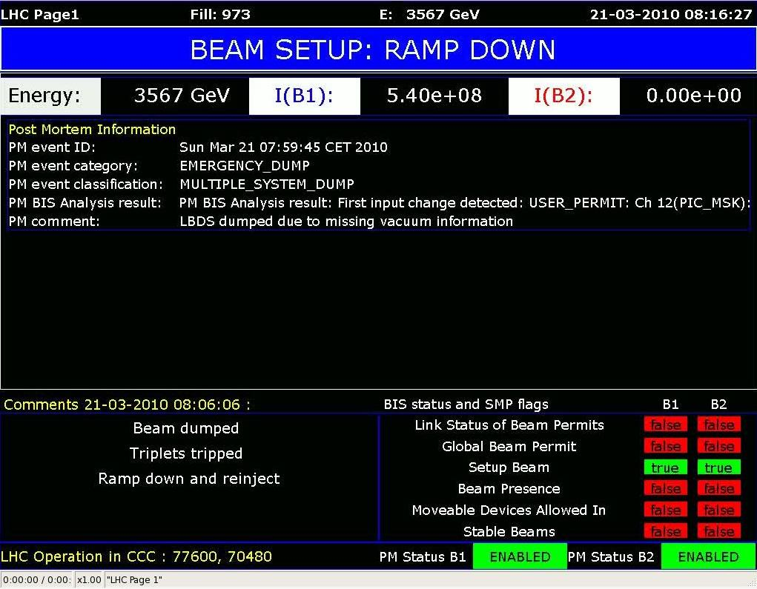
PMA: LHC Page 1
Notes:
For example, here is LHC Page 1 Fixed Display which you can see in many places in CERN, even in restaurants. And the information in the red box is coming from the PMA.

Slide 34
PMA: implementation
Analysis is based on a graph of analysis modules
PMA Framework
Beam Interlock
Controller check
Cross
domain
Beam Loss
Monitor check
Overall
result
Power Interlock
Controller check
Beam Position
Monitors check
Notes:
In terms of implementation the analysis is actually based on a graph of analysis modules which provide the data for each other. The left-most modules focus on a single domain (BLMs, BPMs, etc.). The main purpose of these modules is to filter out all the normal data since such data is not interesting for problem detection. The modules in the middle represent some additional analysis logic or cross-domain analysis. These modules consume the results of single-domain analysis and perform data correlation in order to find discrepancies. And at the right there are one or several modules producing overall analysis result. Here for simplicity we have just 3 levels of analysis modules, but in reality we could have any number of levels and any number of modules on each level.

Slide 35


PMA: implementation
Analysis is based on a graph of analysis modules
PMA Framework
Beam Interlock
Controller check
Cross
domain
Beam Loss
Monitor check
Overall
result
Power Interlock
Controller check
Beam Position
Monitors check
Notes:
So, once the data is collected it is distributed over the single-domain analysis modules, which start processing the data.

Slide 36
PMA: implementation
Analysis is based on a graph of analysis modules
PMA Framework
Beam Interlock
Controller check
Cross
domain
Beam Loss
Monitor check
Overall
result
Power Interlock
Controller check
Beam Position
Monitors check
Notes:
In terms of implementation the analysis is actually based on a graph of analysis modules which provide the data for each other. The left-most modules focus on a single domain (BLMs, BPMs, etc.). The main purpose of these modules is to filter out all the normal data since such data is not interesting for problem detection. The modules in the middle represent some additional analysis logic or cross-domain analysis. These modules consume the results of single-domain analysis and perform data correlation in order to find discrepancies. And at the right there are one or several modules producing overall analysis result. Here for simplicity we have just 3 levels of analysis modules, but in reality we could have any number of levels and any number of modules on each level.

Slide 37

PMA: implementation
Analysis is based on a graph of analysis modules
PMA Framework
Beam Interlock
Controller check
Beam Interlock
Controller check
Cross
domain
Cross
domain
Cross
domain
Beam Loss
Monitor check
Beam Loss
Monitor check
Overall
result
Power Interlock
Controller check
Power Interlock
Controller check
Beam Position
Monitors check
Beam Position
Monitors check
Notes:
In a certain moment some modules finish and their result is provided to the dependent modules which in turn start processing. In the meanwhile other modules finish analysis, some modules found some problems in the data. And finally all the data is ready for the final analysis module which processes those intermediate results…

Slide 38
PMA: implementation
Analysis is based on a graph of analysis modules
PMA Framework
Beam Interlock
Controller check
Cross
domain
Beam Loss
Monitor check
Overall
result
Overall
result
Overall
result
Power Interlock
Controller check
Modules implemented
by domain experts
Beam Position
Monitors check
Notes:
… and calculates the overall result which is a failure in our example since one of the domain-specific analysis has detected problems related to Beam Position Monitors.
What is very important to mention here is that analysis modules are normally not written by us – they are written by domain experts. The analysis is exhaustive, multilateral and very detailed for all the systems involved. There is no single team possessing sufficient expertise about all the LHC components. So the PMA is designed to accept analysis logic from all the dedicated teams. So each equipment group contributes its bit in a form of analysis modules.

Slide 39
PMA: today
4 mission critical LHC applications
  LHC Beam Dump Analysis
  eXternal Post-Operational Check (XPOC)
  Injection Quality Check (IQC)
  Powering Event Analysis
45 analysis modules
10 module developers from different teams
2 GB per LHC Beam Dump
Notes:
Today the LHC Control System contains 4 mission-critical applications based on PMA framework. It is the LHC beam dump analysis which we were talking about so far. It is eXternal Post-Operational Check which is also triggered by beam dumps but is focused on the beam dump system of LHC only. It is Injection Quality Check which is triggered every time the beam is injected into LHC. And powering event analysis which looks at problems related to power converters and magnets.
We have 45 analysis modules in total developed by a dozen of developers from different teams.
And just to give you the idea of data volumes: 1 LHC beam dump triggers about 2GB of data being collected and analyzed.

Slide 40
Key components: Logging
Presentation
Layer
PUBLIC ETHERNET NETWORK
Core Control GUIs
Fixed Displays
DB access
Core Control GUIs
Fixed Displays
DB access
OPERATOR
CONSOLES
FIXED
DISPLAYS
OPERATOR
CONSOLES
Core Control GUIs
Fixed Displays
DB access
TCP/IP communication services
Java RMI, JMS
Role Based Access (RBAC)
Business
Layer
LHC
Software
Architecture
Sequencer
Diagnostics
Monitoring
(DIAMON)
&
Alarms
Software
Interlock
System
Logging
DB
Settings &
Logging
FILE SERVERS
APPLICATION SERVERS
SCADA SERVERS
CERN GIGABIT ETHERNET TECHNICAL NETWORK
CTRL
CTRL
DB
Settings &
Logging
DB
Settings &
Logging
Oasis
Post
Mortem
TCP/IP communication services
TIMING GENERATION
T
T
T
T
Timing
System
Controls MiddleWare (CMW)
RT Lynx/OS
VME Front Ends
WORLDFIP
Front Ends
PLC
Role Based Access (RBAC) – Critical Settings Management
TCP/IP communication services
Front End
Layer
FESA servers
PVSS
FESA servers
PVSS
T
PVSS
FESA servers
T
T
T
T
Notes:
So with the tools we looked at we can understand what is going on with LHC right now.
But what if we want to look at the past? Imagine we want to compare the behavior of LHC today with its behavior a year ago? For such cases we need a kind of long-term memory. And we have component which is our long-term memory – Logging.

Slide 41
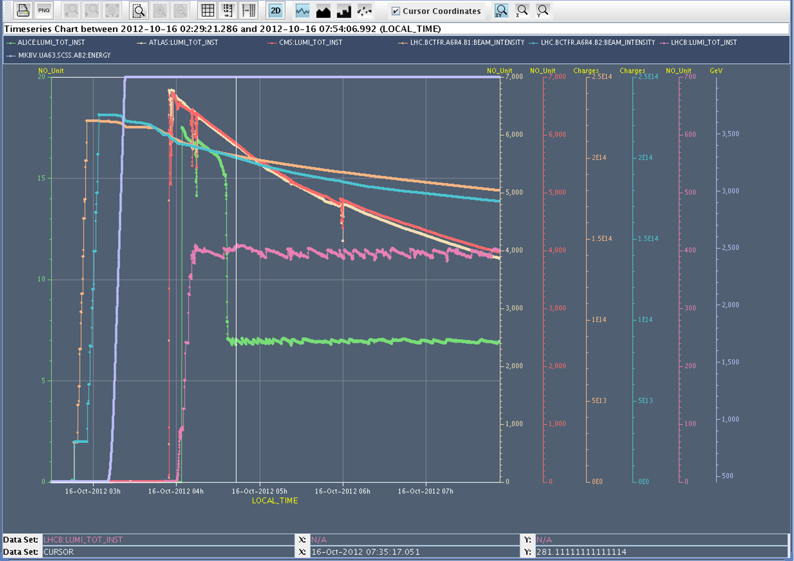
Logging Service
1’000’000 device properties recorded
6 billions of records per day
2TB/week throughput (~400 DVDs)
Notes:
The Logging service constantly monitors and records the values of 1M of device properties, receiving about 6 billions records per day, or with other words having 2 TB of throughput per week. This is roughly 400 DVDs per week. Most of this information will not be looked at but it must be stored to provide enough data for analysis later on if necessary.
All this data is reliably stored providing flexible means of data extraction, visualization and correlation. For example on this plot you see roughly 6 hours of LHC lifetime. The orange and the blue lines represent the intensity of both beams in LHC. The grey line is the energy of the particles in the beams. And 4 other lines show the luminosity of collisions detected by the LHC experiments.

Slide 42
Logging Service
Storage for beam & equipment data beyond LHC lifetime (>20 years)
  Does not store experiments’ data
Online storage (Oracle DB, RAC-based)
Allows analysis of accelerator behaviour over long periods of time
Notes:
Logging provides a storage for accelerator beam & equipment data beyond the LHC lifetime, let’s say for 20 years. It is important to note that Logging service have nothing to do with the data collected by experiments. Experiments have their own storage and analysis facilities.
All the data stored online, meaning any data can be accessed at any moment, no tapes are used to “archive” old data, etc.
Since Logging has a lot of data from all the moments of LHC life it allows the analysis of accelerator behaviour over long periods of time.
Logging was considered a mission critical project since LHC Hardware Commissioning in 2008.

Slide 43

Logging: architecture
Clients
Logging Data Extraction API
Measurement DB
7 days of raw data
Logging DB
>20 years of filtered data
PL/SQL
filter
Logging
Processes
Controls MiddleWare
PVSS
Industrial Control
Front End
Layer
Notes:
Now coming to the architecture, it is quite obvious that the data is coming from the equipment, so the system receives the data from Controls MiddleWare, no surprise here. And it is stored to a Logging DB which keeps the data for very long time.
In fact it is not stored to Logging DB directly – the data first get into another database - Measurement DB. Measurement DB is a kind of rolling buffer which stores the data for a week. Yes, in fact not all the data should be stored forever, for some data 7 days is just enough.
Since those 2 databases have different requirements to the data lifetime – they tuned in a different way.
Measurement database contains all the received data. If the source sends 0s with 100Hz – all those 0s are stored into the Measurement DB.
The Logging DB in contrast doesn’t store such data. So in order to get into Logging DB the data go through a sophisticated PL/SQL filter.
Now the data gets into the Measurement DB? Well, we have several “Logging Processes” which actually receive the data from the equipment and push the requested data into the Measurement DB.
In addition to this there other systems, namely industrial control systems like vacuum or cryogenics, which perform the filtering themselves and push the data directly to the long-term database.
For the data extraction we provide Logging Data Extraction API which makes transparent this distinction between Measurement and Logging databases.
This API is used by both standard GUI of Logging called “Timber” and any external client applications. Timber allows to extract the data by lots of criteria, visualize the data, export the data, etc.

Slide 44
Logging: today
~ 1000 clients
~ 5 million extraction requests / day
Clients
Logging Data Extraction API
~ 95 % data reduction
Millions of recs / min
Measurement DB
7 days of raw data
Logging DB
>20 years of filtered data
PL/SQL
filter
~ 250’000 device properties
~ 5.5 billion records / day
~ 2 TB / week throughput
Logging
Processes
~ 1 million device properties
~ 4 billion records / day
~ 1 TB / week stored
~ 170 TB stored now
Controls MiddleWare
PVSS
Industrial Control
Front End
Layer
Notes:
Now I will try to impress you with some numbers.
So, on the level of the Measurement DB which keeps raw data for 7 days we have 250’000 signals registered, with 5.5 billions records per day and 2 TB per week throughput.
95% of the data is filtered before coming to the Logging DB.
And in Logging DB we have about 1 million signals defined, 4 billions records or 1 TB of data stored per week. Today there is about 170 TB of data stored in our long-term database. (You can wonder how after filtering the number of signals can be more – but it is just because there are quite some systems (namely PVSS) which push the data through another mechanism – it will be replaced with the mechanism similar to the one on the picture after LS1.)
Then on the level of Data Extraction API we have about 1000 of clients (SW and people) providing ~5 millions extraction requests per day, what is quite impressive.
In fact the Logging service is one of the most often used components of LHC Control System.

Slide 45
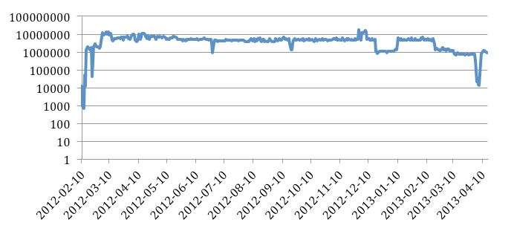
Logging: daily extraction requests
LHC Workshop
TS
Christmas
Notes:
Here is the diagram showing the daily extraction requests rate.
From this diagram it is obvious the Logging service is used all the time, regardless of Technical Stops or Christmas breaks.
By the way on this picture it is nice to see different events, for example here is the time just before the Evian workshop when a lot of people suddenly start preparing their presentations.

Slide 46
Key components: RBAC - MCS
Presentation
Layer
PUBLIC ETHERNET NETWORK
Core Control GUIs
Fixed Displays
DB access
Core Control GUIs
Fixed Displays
DB access
OPERATOR
CONSOLES
FIXED
DISPLAYS
OPERATOR
CONSOLES
Core Control GUIs
Fixed Displays
DB access
TCP/IP communication services
Java RMI, JMS
Role Based Access (RBAC)
Business
Layer
LHC
Software
Architecture
Sequencer
Diagnostics
Monitoring
(DIAMON)
&
Alarms
Software
Interlock
System
Logging
DB
Settings &
Logging
FILE SERVERS
APPLICATION SERVERS
SCADA SERVERS
CERN GIGABIT ETHERNET TECHNICAL NETWORK
CTRL
CTRL
DB
Settings &
Logging
DB
Settings &
Logging
Oasis
Post
Mortem
TCP/IP communication services
TIMING GENERATION
T
T
T
T
Timing
System
Controls MiddleWare (CMW)
RT Lynx/OS
VME Front Ends
WORLDFIP
Front Ends
PLC
Role Based Access (RBAC) – Critical Settings Management
TCP/IP communication services
Front End
Layer
FESA servers
PVSS
FESA servers
PVSS
T
PVSS
FESA servers
T
T
T
T
Notes:
The control system would not be complete without an access control implementation. And we have 2 component responsible for this: Role Based Access Control and the Management of Critical Settings.

Slide 47
Role Based Access Control (RBAC)
Protect against unauthorized access
Access audit
Integrated with all 3 layers
  front-end, business, presentation
Notes:
The goal of this component is to protect the equipment and software applications against unauthorized access. It also performs access audit, so we can always look back in the history and see who did what and when.
And it is well integrated with all 3 layers of the Control System.

Slide 48
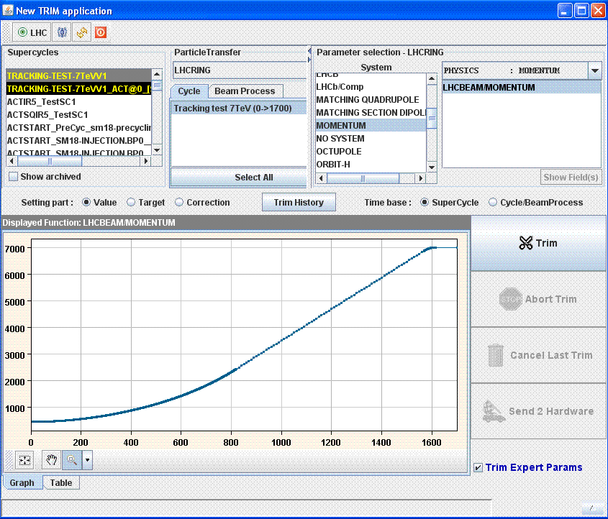


RBAC: HW and SW protection
1. credentials: name, password, location
2. token with roles
RBAC
Server
3. token
Central
Configuration
DB
CERN
NICE
CMW
RBAC
Access
Map
FESA
server
Notes:
Let’s look at how it works. So here we have a client, Front-end server which controls a certain equipment and the RBAC server which uses CERN Authentication Service and the information from Central Configuration Database. And the client wants to access the equipment.
The first thing a client does it provides the information about itself (name, password, location) to the RBAC server and if RBAC server is satisfied it issues an authentication token representing the user identity. Like this the authentication is done.
Then the user accesses the equipment with the token and the Role Based Access Control part of FESA server verifies if the access is allowed for this user. How the FESA server knows: in fact it has a part of the permission configuration called access map in its disposal. Access map is basically mapping of user roles to the properties which this role is allowed to access.

Slide 49
RBAC: HW and SW protection
1. credentials: name, password, location
2. token with roles
3. token
Application
Server
(ex. LSA)
RBAC
Server
4b. token
Permission?
4a. token
Central
Configuration
DB
CERN
NICE
CMW
RBAC
Access
Map
FESA
server
Notes:
Let’s look at another scenario: the client wants to work with a middle-tier server – in this case it accesses the application server with the token. Then the server can just propagate the action to the equipment – so it is the same case as we have just seen. Or the server itself can be protected. In this case before the action is executed on the server side the RBAC service is consulted in order to verify the permission.

Slide 50
RBAC: features
Authentication
Authorization
  Business layer
  Front-End layer
Permission definitions
  Who, what, when, from where
Flexibility
  Login-by-location
  Temporary permissions
  Operational-mode dependent
Notes:
Our access control system obviously provides means of user authentication as well as authorization on both business and front-end layers.
It provides means to define the permissions: who, what, when, from where.
While usually by nature access control systems are quite strict a certain flexibility is requested for our access controls. Therefore we provide such features as login-by-location, meaning that any application in LHC part of the control room gets default LHC user privileges. We have temporary permissions which are revoked automatically after certain time. And our access control is dependent on operational mode of the LHC: the permissions during physics are different from permissions during shutdown.

Slide 51
RBAC: today
RBAC protects all the LHC equipment
~500’000 permission definitions
~500 users
Notes:
Today RBAC protects all the equipment and software components of LHC. It handles about 500’000 permission definitions for about 500 users.

Slide 52
Management of Critical Settings
Protects the value, not the action
  BLM, BPM thresholds
  Collimator thresholds
  SIS configuration
Only experts can modify the value
All the operators can use this value
Digitally signed values
100 critical value types => 1500 properties
Notes:
Now I will say a couple of words about the management of critical settings. In contrast to RBAC it doesn’t protect the actions on equipment or applications but rather protects certain critical setting values. For example the BLM thresholds are critical. Setting a wrong, too-high value, would allow to keep the beam in the machine even having high beam-losses – this is dangerous.
The idea is that only expert can modify the value while all the operators can use it and send to the equipment. The mechanism is based on digital signatures, what allows to detect any tampering of settings.
100 value types are treated as critical what makes critical about 1500 device properties.

Slide 53
Key components
Presentation
Layer
PUBLIC ETHERNET NETWORK
Core Control GUIs
Fixed Displays
DB access
Core Control GUIs
Fixed Displays
DB access
OPERATOR
CONSOLES
FIXED
DISPLAYS
OPERATOR
CONSOLES
Core Control GUIs
Fixed Displays
DB access
TCP/IP communication services
Java RMI, JMS
Role Based Access (RBAC)
Business
Layer
LHC
Software
Architecture
Sequencer
Diagnostics
Monitoring
(DIAMON)
&
Alarms
Software
Interlock
System
Logging
DB
Settings &
Logging
FILE SERVERS
APPLICATION SERVERS
SCADA SERVERS
CERN GIGABIT ETHERNET TECHNICAL NETWORK
CTRL
CTRL
DB
Settings &
Logging
DB
Settings &
Logging
Oasis
Post
Mortem
TCP/IP communication services
TIMING GENERATION
T
T
T
T
Timing
System
Controls MiddleWare (CMW)
RT Lynx/OS
VME Front Ends
WORLDFIP
Front Ends
PLC
Role Based Access (RBAC) – Critical Settings Management
TCP/IP communication services
Front End
Layer
FESA servers
PVSS
FESA servers
PVSS
T
PVSS
FESA servers
T
T
T
T
Notes:
Like this we have actually covered all the essential component of the Control System. There is not much to add about Data Concentrators. As I already mentioned these are handy applications which combine the data from several information sources. And not much to say about GUIs since the reflect the functionality of the business layer.

Slide 54
Contents
LHC control system requirements
Philosophy of development
Overview of the architecture
Key components
Quality Assurance (QA)
Outlook towards the Future
Notes:
Let’s move to the next subject – the Quality Assurance.

Slide 55
Highly modular distributed system
Big developer community
Front-End Layer (C/C++)
  85’000 devices controlled by 2000 different machines
  600 different device types (FESA, PVSS, FGC)
  Developed by 100 people from 16 different groups
Business and Presentation Layer (Java)
  400 different GUIs and 150 server applications
  Up to 600 processes on 400 machines
  Developed by ~100 people from 10 different groups
Control system performs mission-critical tasks
Control system must evolve
Quality Assurance
Notes:
Let’s briefly summarize what we know about the LHC control system.
…<slide contents>…
The system is big and performs mission-critical tasks.
And in addition the control system evolves with time: we can not just freeze the control system at a certain level of functionality: we get new requirements, we should fix the bugs, we should follow the updates of external software (OS, Java, third-party libraries, etc.)
Therefore in order to have the Control System in a good shape (stable and maintainable) we seriously consider Quality Assurance as one of the main goals in our development process and is basically a part of our development culture.

Slide 56
Quality Assurance is essential
  +
  +
Development
Process
Integration
Testing
Deployment
Strategy
Control System Quality Assurance
Notes:
And here is our formula for the Quality Assurance. There are 3 basic ingredients: our development process, so the way how we develop the components of our control system. The integration testing, so the testing of the key components of the control system together and verification that they communicate well and together do the job. And the deployment strategy, which helps us to ensure the Control System will not be broken after the new version deployment. so the upgrades which don’t break the control system.

Slide 57
Quality Assurance is essential
  +
  +
Development
Process
Integration
Testing
Deployment
Strategy
Control System Quality Assurance
Notes:
Let’s start from our development process.

Slide 58
Software Improvement Process (SIP)
Development process
    Recommended / mandatory activities and deliverables
Tools
    Support the process by automating as much as possible
Organization
    Officially allocate time
    Dedicated QA days
    Follow up progress
Process
Tools
SIP
Org.
Notes:
Several years ago in 2007 we’ve realized that we should invest more efforts into the quality of our development. At that time we have launched a “software improvement process” which was well adopted and today is at the basis of our every day development.
It is based on a set of mandatory activities and tools which I will go through on the next slide.
The third very important ingredient is that our management understands the importance of these activities and supports us. So the time for the quality assurance activities is officially allocated, we have dedicated days when we don’t implement any new functionality but focus on quality improvement, on technical debt minimization. The progress is followed up, we have so called “top-flop” lists which summarize the metrics of quality for different software components.

Slide 59
SIP: activities and tools
Common code style (Eclipse IDE)
Dependency analysis (Eclipse plugin)
Unit testing (JUnit, Mockito, Clover)
Static code analysis (FindBugs, PMD, Sonar)
Code reviews (FishEye + Crucible)
Continuous Integration (Bamboo)
Issues tracking & planning (JIRA + Greenhopper)
Documentation (Confluence Wikis)
Agile development methodologies
Notes:
And now lets briefly go through the activities and tools which help us – this is a special slide for software people.
We use common code style which is enforced by out development environment. The common code styles helps people to read the code of others.
We have a special tool which helps us discovering who and how is using our code. This knowledge is extremely important before applying modification.
Unit testing is a must – we normally use Junit, Mockito and Clover for analysis.
Static code analysis is another mandatory activity which allows to discover bugs, design flaws and other problems. Tools like FindBugs, Sonar help us a lot in this task.
We exercise code reviews with FishEye and Crucible.
Continuous integration is the must in our development. So the tests are automatically executed after every detected change in the codebase.
We centrally track the issues and plan the work using JIRA and Greenhoper. This also facilitates a lot issue reporting and monitoring for our clients.
We provide documentation on our central Wiki pages.
And many teams use agile development methodologies in their work.
So you can see that we treat the Software Quality as essential part of our job.

Slide 60
Links to project pages
Beams Department Controls Group | espace.cern.ch/be-dep/CO
Timing System | wikis.cern.ch/display/HT(/Timing+Software) www.ohwr.org(/projects/white-rabbit/wiki)
Front-End Software Architecture | wikis.cern.ch/display/FESA3
Controls MiddleWare | wikis.cern.ch/display/MW
LHC Software Architecture | wikis.cern.ch/display/LSA
Sequencer | wikis.cern.ch/display/SEQ
Open Analog Signal Information System | wikis.cern.ch/display/OASIS
Diagnostics Monitoring & Alarms | wikis.cern.ch/display/ADM laser-alarms.web.cern.ch/laser-alarms/
Software Interlock System | wikis.cern.ch/display/SIS
Post-Mortem (Analysis) | wikis.cern.ch/display/PMS(/Documentation)
Logging Service | wikis.cern.ch/display/CALS
Testbed | wikis.cern.ch/display/CSTBF

Slide 61
Quality Assurance is essential
  +
  +
Development
Process
Integration
Testing
Deployment
Strategy
Control System Quality Assurance
Notes:
Now let’s look at the integration testing...

Slide 62
Integration testing: Testbed
Test the core components of the control system together
Validate new versions of the control system before deployment
Automation
Presentation
Layer
PUBLIC ETHERNET NETWORK
Core Control GUIs
Fixed Displays
DB access
Core Control GUIs
Fixed Displays
DB access
OPERATOR
CONSOLES
FIXED
DISPLAYS
OPERATOR
CONSOLES
Core Control GUIs
Fixed Displays
DB access
TCP/IP communication services
Java RMI, JMS
Role Based Access (RBAC)
Business
Layer
LHC
Software
Architecture
Sequencer
Diagnostics
Monitoring
(DIAMON)
&
Alarms
Software
Interlock
System
Logging
DB
Settings &
Logging
FILE SERVERS
APPLICATION SERVERS
SCADA SERVERS
CERN GIGABIT ETHERNET TECHNICAL NETWORK
CTRL
CTRL
DB
Settings &
Logging
DB
Settings &
Logging
Oasis
Post
Mortem
TCP/IP communication services
TIMING GENERATION
T
T
T
T
Timing
System
Controls MiddleWare (CMW)
RT Lynx/OS
VME Front Ends
WORLDFIP
Front Ends
PLC
Role Based Access (RBAC) – Critical Settings Management
TCP/IP communication services
Front End
Layer
FESA servers
PVSS
FESA servers
PVSS
T
PVSS
FESA servers
T
T
T
T
Notes:
… which is based on the Testbed component.
Testbed is a replication essential components of the LHC Control System in the laboratory. And by essential I mean the components which is difficult to redeploy because they are widely used across the accelerator complex.
So what we have in the Testbed: the FESA framework, the Timing, the Controls Middleware and Role-Based Access.
And Testbed is intended to test all those core components together, validate new versions of the control system before deploying for real and provide the testing automation:

Slide 63
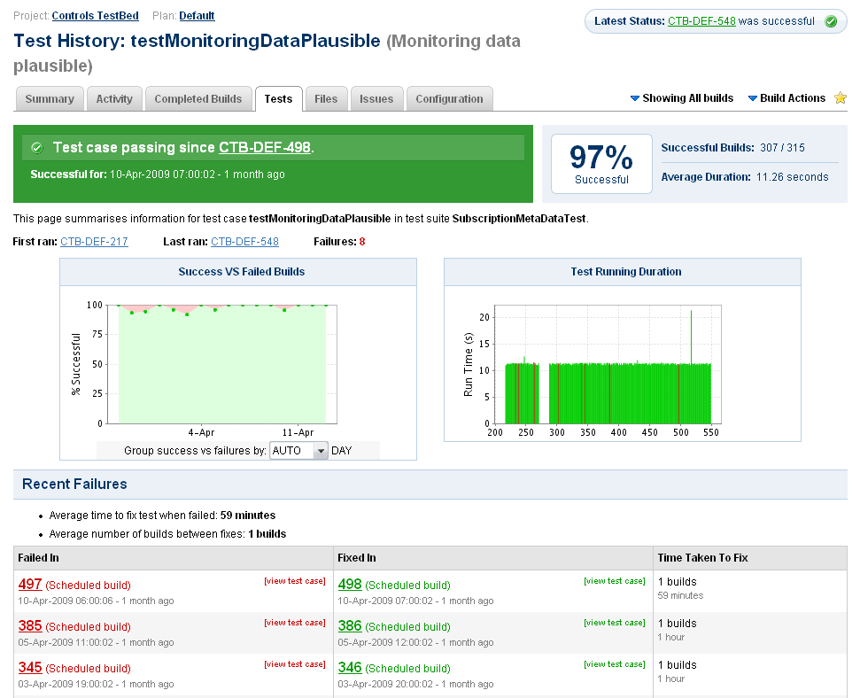
Integration testing: Testbed
Presentation
Layer
PUBLIC ETHERNET NETWORK
Core Control GUIs
Fixed Displays
DB access
Software
Versioning
Control
System
(SVN)
Core Control GUIs
Fixed Displays
DB access
OPERATOR
CONSOLES
FIXED
DISPLAYS
OPERATOR
CONSOLES
Core Control GUIs
Fixed Displays
DB access
notifies
TCP/IP communication services
Java RMI, JMS
triggers
Test
Automation
Tool
(Bamboo)
collects
Role Based Access (RBAC)
Business
Layer
LHC
Software
Architecture
Sequencer
Diagnostics
Monitoring
(DIAMON)
&
Alarms
Software
Interlock
System
Logging
DB
Settings &
Logging
FILE SERVERS
APPLICATION SERVERS
SCADA SERVERS
CERN GIGABIT ETHERNET TECHNICAL NETWORK
CTRL
CTRL
DB
Settings &
Logging
DB
Settings &
Logging
tests
Oasis
Post
Mortem
TCP/IP communication services
TIMING GENERATION
tests
tests
T
T
T
T
Timing
System
Controls MiddleWare (CMW)
RT Lynx/OS
VME Front Ends
WORLDFIP
Front Ends
PLC
Role Based Access (RBAC) – Critical Settings Management
TCP/IP communication services
Front End
Layer
FESA servers
PVSS
FESA servers
PVSS
T
PVSS
FESA servers
T
T
T
T
Notes:
Once a new version of a component is detected in our versioning system the Testbed automatically builds the new version, deploys it into the Testbed, runs the battery of tests on those components together, gathers the statistics about the tests and sends notifications to the developers about the outcome.

Slide 64
Quality Assurance is essential
  +
  +
Development
Process
Integration
Testing
Deployment
Strategy
Control System Quality Assurance
Notes:
Now let’s move to the third ingredient of our Quality Assurance – the deployment strategy.

Slide 65
Deployment: Smooth Upgrades
Official approach
  Analyze the impact of a change upfront
  Backward compatible upgrades if possible
  Non-backward compatible upgrades only with careful coordination and follow-up
  Big changes on central systems only during shutdown
Other ingredients to smooth upgrades:
  Planning before starting development work
  Quality Assurance (development + integration testing)
  Deploy upgrades first for accelerators that need them
  Means to quickly roll-back in case of problems
Notes:
Our deployment strategy is based on the concept of “smooth upgrades”, so the upgrades which are applied minimizing the risks of breaking the control system.
When a change is requested first the impact is evaluated. Backward-compatible updates a certainly preferred over the backward-incompatible ones since they allow to do the change in isolation. If a backward-compatible change is not possible then it requires thorough coordination between all the affected components. And of cause the major changes are not accepted during the physics run and could be performed during shutdowns only.
This is the main strategy. At the same time the upgrades are planned across all the different groups involved before starting development, as I already mentioned above no upgrade can bypass the Quality Assurance process. We deploy the upgrades first to the accelerators which actually require the change, thus minimizing the risk of breaking down the control system for other accelerators.
And before applying any upgrade we make sure we know how to roll back in case of problems.

Slide 66
Contents
LHC control system requirements
Philosophy of development
Overview of the architecture
Key components
Quality Assurance (QA)
Outlook towards the Future

Slide 67
Consolidation and new functionality
Control System consolidation
Common analysis framework for logged data
LHC Hardware Commissioning analysis automation
Technology replacement
  Future Front End hardware platform technology
  Investigations regarding future software technologies
  Timing => WhiteRabbit, Middleware => ZeroMQ
Notes:
We have plenty of items to work on. The first one is the consolidation of the Control System. Till recently we were focused on providing the functionality required by LHC operations. And today we have some parts of the control system which duplicate each other and need to be merged, other less critical parts of the control system were implemented in a way which should be improved, etc.
While talking about logging I mentioned that a huge amount of information about the beam and accelerator is stored for later use. At the same time we’re missing common data analysis tools which would help processing the data.
During HWC phases thousands of tests are executed on the accelerator components and the results of those tests are analyzed before considering the machine ready for operations. This phase is time consuming and therefore requires automation. While the test execution is already automated very well, the test analysis phase is not yet automated enough.
Yet another task is the technology replacement. Some technologies become deprecated and are not maintained anymore, others appear on the horizon. So we dedicate our time and efforts into the research regarding future technologies to use, for example which hardware platforms to choose. Other examples which I mentioned in the lecture and which are already on their way is switching timing to WhiteRabbit technology and moving Controls MiddleWare from CORBA to ZeroMQ.

Slide 68

LHC performance improvement
“Physics” time maximization
  LHC procedures optimization
  => provide tools
Control System fault
minimization
Access
Interventions
Physics
Preparation
Squeeze
Beam Injection
Ramp
Notes:
A big theme for CERN is the minimization of the accelerator downtime, the time without physics. I mean that before the collisions can be provided to experiments there are several steps in each LHC operational cycle. It is necessary to prepare the machine, inject the beam, accelerate it, squeeze and only then we can provide collisions for the experiments, to have physics. Since LHC time is very expensive and because CERN’s performance is measured by the number of collisions provided for experiments it is necessary to minimize the time spent outside the physics, outside the green part of the chart.
There are several directions to work:
The first is the optimization of the whole procedure: for example can we fill up the LHC with particles faster? This task is mainly done by machine physicists but we should provide good tools to support their needs.
The second direction is to minimize the contribution of the Control System itself into the downtime of the machines. In order to do this we gather statistics about which parts of the Control System block the physics the most. Once a component of the Control System is selected for optimization we elaborate a suitable way to improve the situation: for example we can invest into the quality of the component more, or may be invest into its redundancy, etc. And this process is continuous.

Slide 69
Accelerator downtime minimization
Early warning system, problem anticipations
  Monitoring
  Sanity checks
Improve first-line problem analysis
  Runtime dependency analysis
  Which expert to call
Improve smooth upgrades
  Better tools to show what has changed
  Tools to help backward-compatibility assurance
Notes:
The third direction is to improve the way we prevent problems if we can and deal with the problems if something breaks.
A good early warning system would help to anticipate the problems. Apart from monitoring all the key metrics of the components it could also periodically perform some sanity checks exercising the components functionality and ensuring the component is not stuck, for example. The team of Diagnostic Monitoring mainly focuses on this task.
A user-friendly first-line problem analysis could help. I mean when a problem happens on any layer of the control system it is visible in the top-level components only. Quite often operators don’t know what actually is broken, they don’t know which components are in use, they don’t know who to call for help. If we have means to show which components are used at runtime, then the operators could already have the first idea which components to check and expert to call.
We also need to improve our tools for smooth upgrades. As I already explained the strategy is in place, but good tools are missing. For example we need a tool which would show which changes were recently done – this would help to faster localize the problem.
Backward-compatibility assurance is not always a trivial thing. It would be nice to have tools which help us to estimate the backward-compatibility of changes. We have some: we know that the public APIs should not change, we have a set of unit and integration tests. But backward compatibility is so tricky subject that there are always cases which are not yet covered.

Slide 70

CERN Accelerator Control System
Presentation
Layer
PUBLIC ETHERNET NETWORK
150 server applications
400 different GUIs
Up to 600 processes on 400 machines
Developed by ~100 people from 10 different groups
Core Control GUIs
Fixed Displays
DB access
Core Control GUIs
Fixed Displays
DB access
OPERATOR
CONSOLES
FIXED
DISPLAYS
OPERATOR
CONSOLES
Core Control GUIs
Fixed Displays
DB access
TCP/IP communication services
Java RMI, JMS
Role Based Access (RBAC)
Business
Layer
LHC
Software
Architecture
Sequencer
Diagnostics
Monitoring
(DIAMON)
&
Alarms
Software
Interlock
System
Logging
FILE SERVERS
APPLICATION SERVERS
SCADA SERVERS
CERN GIGABIT ETHERNET TECHNICAL NETWORK
CTRL
CTRL
Configs
Settings
Logging
Oasis
Post
Mortem
TCP/IP communication services
TIMING GENERATION
85’000 devices controlled by 2000 different machines
600 different device types (FESA, PVSS, FGC)
Developed by 100 people from 16 different groups
T
T
T
T
Timing
System
C++
Controls MiddleWare (CMW)
RT Lynx/OS
VME Front Ends
WORLDFIP
Front Ends
PLC
C++
C++
Role Based Access (RBAC) – Critical Settings Management
TCP/IP communication services
Front End
Layer
FESA servers
PVSS
FESA servers
PVSS
T
PVSS
FESA servers
T
T
T
T
C++
Notes:
Like this we have actually covered all the topics of the lecture.
I would like just to show you again the numbers regarding the CERN Accelerator Control System.
Looking at the scale, at the number of people contributing to the control system I would definitely say that the control system we have today is a great success!

Slide 71

LHC Control System
Presentation
Layer
PUBLIC ETHERNET NETWORK
150 server applications
400 different GUIs
Up to 600 processes on 400 machines
Developed by ~100 people from 10 different groups
Core Control GUIs
Fixed Displays
DB access
Core Control GUIs
Fixed Displays
DB access
OPERATOR
CONSOLES
FIXED
DISPLAYS
OPERATOR
CONSOLES
Core Control GUIs
Fixed Displays
DB access
TCP/IP communication services
Java RMI, JMS
Role Based Access (RBAC)
Business
Layer
LHC
Software
Architecture
Sequencer
Diagnostics
Monitoring
(DIAMON)
&
Alarms
Software
Interlock
System
Logging
FILE SERVERS
APPLICATION SERVERS
SCADA SERVERS
CERN GIGABIT ETHERNET TECHNICAL NETWORK
CTRL
CTRL
Configs
Settings
Logging
Oasis
Post
Mortem
TCP/IP communication services
TIMING GENERATION
85’000 devices controlled by 2000 different machines
600 different device types (FESA, PVSS, FGC)
Developed by 100 people from 16 different groups
T
T
T
T
Timing
System
C++
Controls MiddleWare (CMW)
RT Lynx/OS
VME Front Ends
WORLDFIP
Front Ends
PLC
C++
C++
Role Based Access (RBAC) – Critical Settings Management
TCP/IP communication services
Front End
Layer
FESA servers
PVSS
FESA servers
PVSS
T
PVSS
FESA servers
T
T
T
T
C++

Slide 72
CERN Accelerator Control System
Strategy behind development:
  We provide extensible frameworks/tools
  Clients fill in the domain-specific knowledge
Clear guidelines
  Coherent model: device-property
  Architecture and technology choices
Thorough Quality Assurance
Successful and efficient collaboration
  with equipment groups and operators
  with other laboratories (FermiLab, GSI, ESRF, etc.)
Notes:
And such a success was possible thanks to well defined strategy behind the development and optimal work sharing: we provide all the infrastructure while clients fill in the domain knowledge. It was possible thanks to clear guidelines for the development: coherent device-property model, clear architecture and technology choices. It was possible thanks to through quality assurance which is put in place. And of course it was possible thanks to very successful and efficient collaborations with equipment groups, with machine physicists, as well as with other laboratories.

