Slide 1
Possibility of bringing TRIμP to HIE-ISOLDE
Dual magnetic Spectrometer
Olof TENGBLAD
ISCC Oct. 22nd 2013
There will be a presentation during the ISOLDE workshop 25-27 November by Lorens Willman from the TRIμP collaboration at KVI.
But as not everyone will be present I will give some background and some explanation to what the TRIμP is and how it could fit at HIE-ISOLDE.
Notes:
There will be a presentation during the ISOLDE workshop 25-27 November by Lorens Willman from the TRImuP collaboration at KVI.
But as not everyone will be present I will give some background and some explanation what the TRImP is and how it could fit at HIE-ISOLDE.

Slide 2
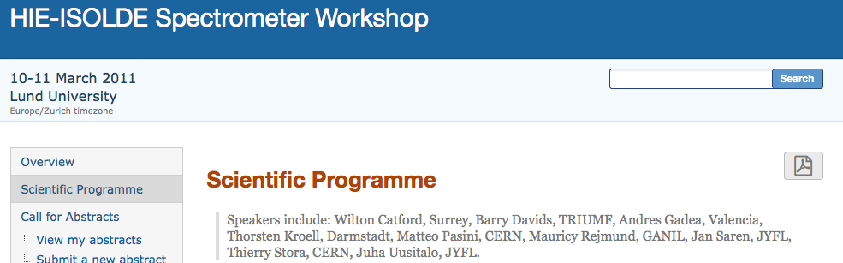
Zero-degree spectrometer @ Hie-Isolde
Workshop in LUND March 2011 where it was expressed a strong interest for having a Zero- degree spectrometer coupled to HIE-ISOLDE.
The initiative was postpone due to the rapid advance of the TSR project and two such projects on the same time was too much

Slide 3
WHY a Zero-degree spectrometer
USING RADIOACTIVE BEAMS in INVERSE KINEMATICS
transfer products on
neutron-rich side can
sequentially n-decay
(d,p)
from 180° to
forward of 80°
(d,t)
forward of 45°
INCIDENT BEAM
isobaric beams can be
identified and/or physically
separated (possibly further
stripped, e.g. ¹⁵N³⁺/²¹O⁴⁺)
(d,d)
just
forward of 90°
fusion-evaporation
products from reactions
on C in CD₂ targets
Knock-on carbons
from CD₂ targets
Wilton Catford
University of Surrey, UK

Slide 4
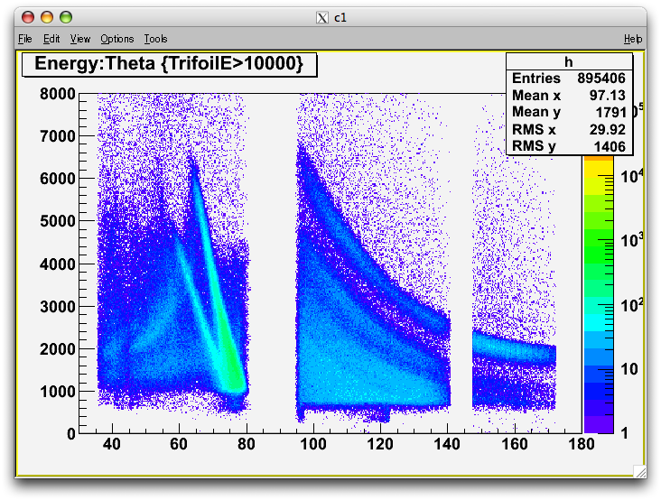
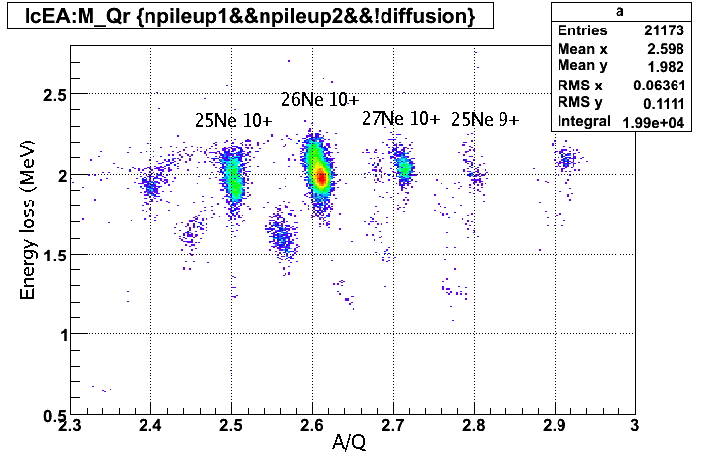
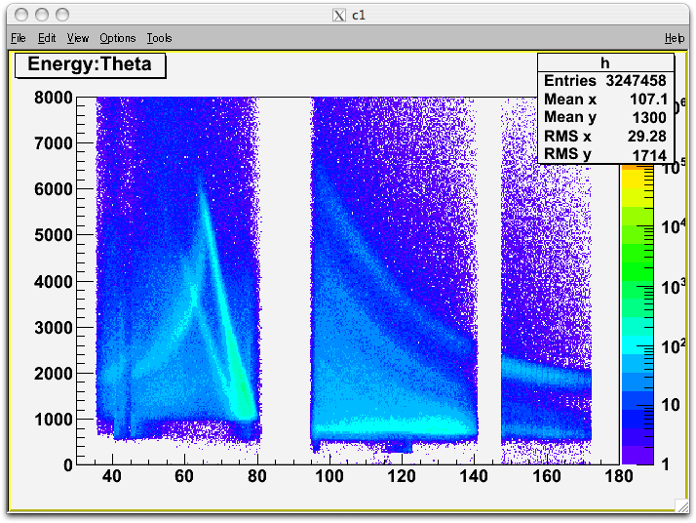
ZERO DEGREE = SPECTROMETER
ZERO DEGREE = SCINTILLATOR
Wilton Catford
University of Surrey, UK
Energy v Theta with trifoil
(d,d)
²⁶Na g.s.
²⁶Na ex. states
(p,p)
²⁵Na(d,p)²⁶Na 5 A.MeV
²⁶Ne(d,p)²⁷Ne
²⁶Ne(d,p)²⁷Ne→²⁶Ne+n
RESULTS from TIARA/MUST2 Nov2007
RESULTS from SHARC Aug2009

Slide 5
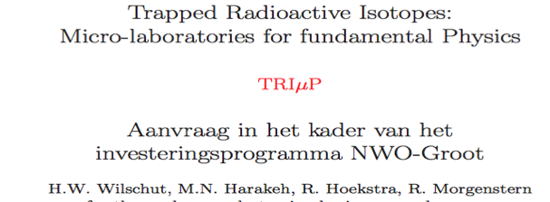
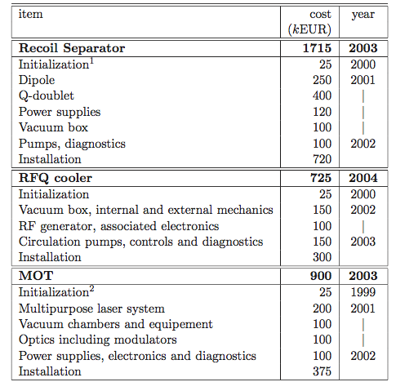
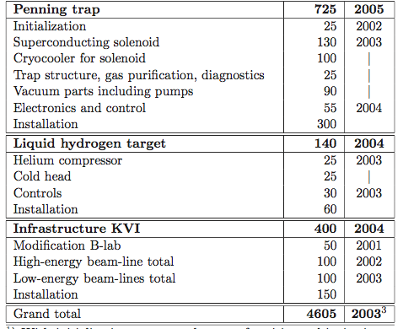
Original Proposal @ KVI
This is not some old equipment laying around.
Original proposal for funding in August 1999, to build a
“Microlaboratorie for fundamental Physics at KVI
using Trapped radioactive Isotopes”
2001 Start building – 2005 ready for Beam
4.6 M€ project, where the Recoil separatar was 1.7 M€.
27 August 1999
Notes:
These are more details from the original proposal. As you can see a 4.6 M€ project, where the Recoil separatar is 1.7 M€.
First I would like to make clear that this is not some old equipment laying arround.
You see here the original proposal for funding in August 1999, to buid a microlaboratorie for fundamental Physics at KVI
Using Trapped radioactive Isotopes

Slide 6
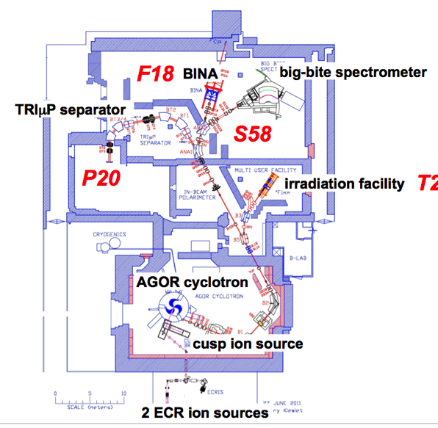
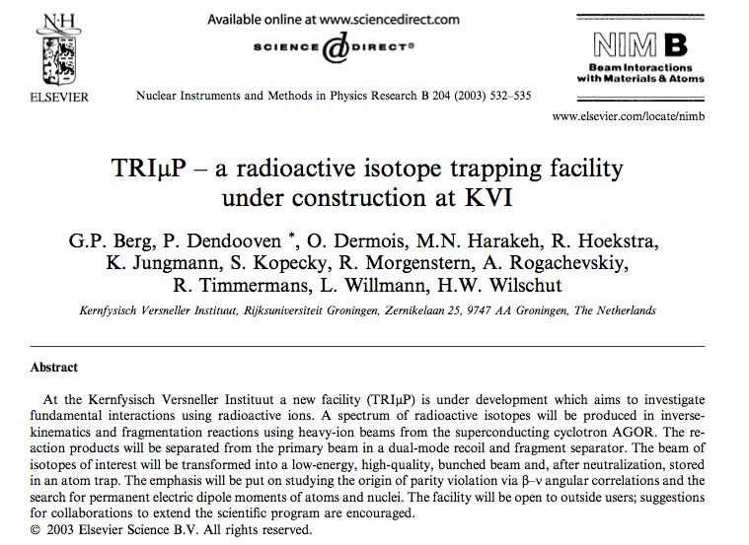
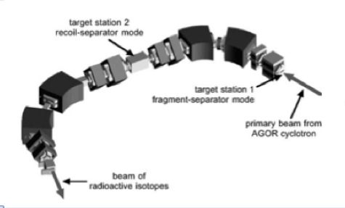
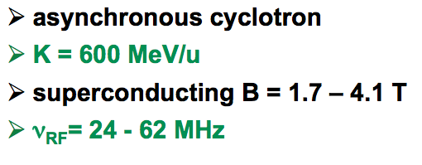
TRIμP@KVI
The radioactive nuclei are produced using beams from the superconducting cyclotron AGOR.
The high energy radioactive beam is transformed to a low-energy.
High quality bunched beam by the combined fragment and recoil-separator.

Slide 7
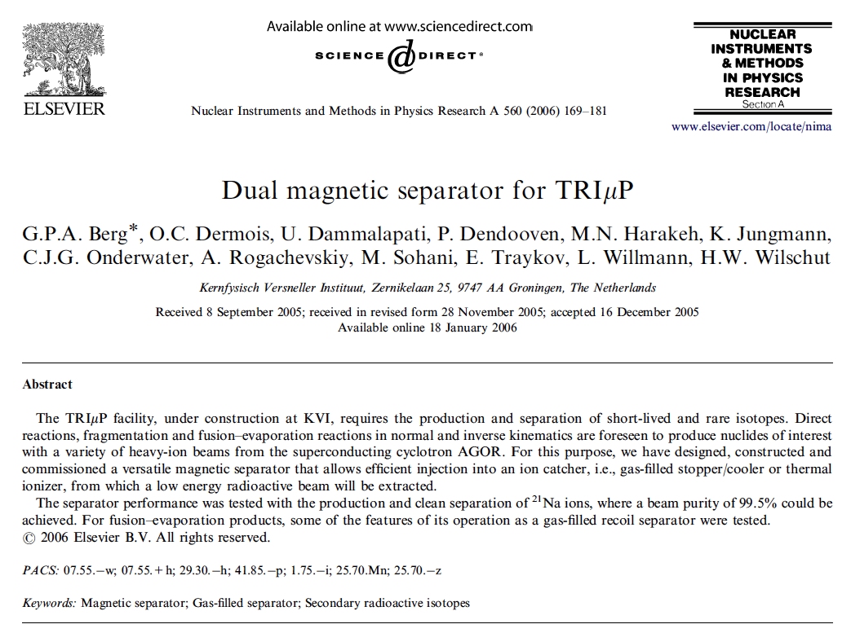
TRIμP test beam report 2006

Slide 8
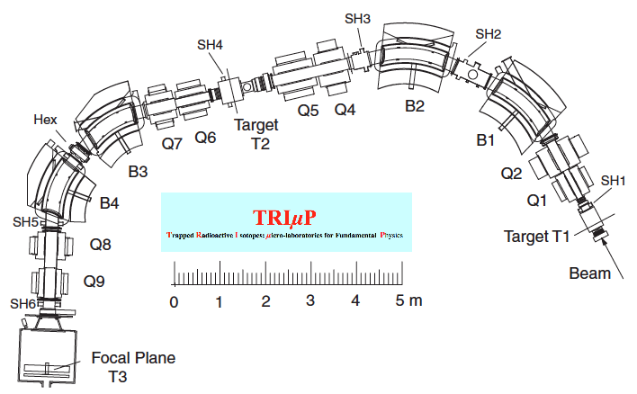
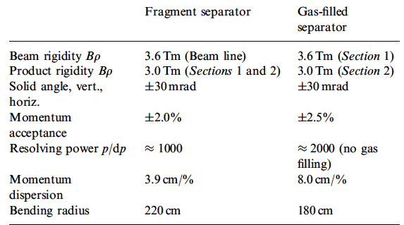
TRIμP separator
B1-B4 4 dipole- &
Q1-Q9 8 quadrupole-
magnets
Q3 was omitted in final design
Slits
Slits
Slits
Dipole magnets
H-type DANFYSIK
Sec. 1 Dispersion:
Separate isotopes of different rigidity
Slits
Sec. 2 reversed:
Achromatic image

Slide 9
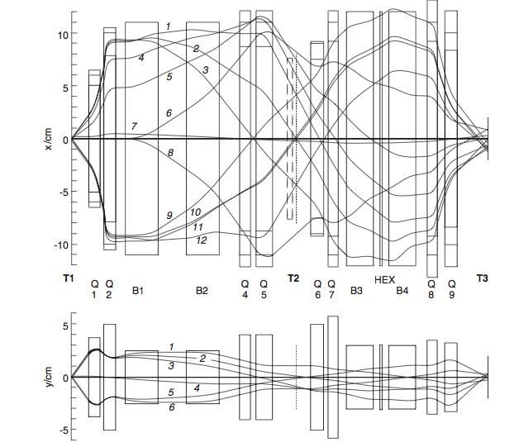
Fragmentation mode
20 mm
Target spot size
+/-2 mm horizontal
+/- 1 mm vertical
10 mm
9.82m
18.20 m

Slide 10
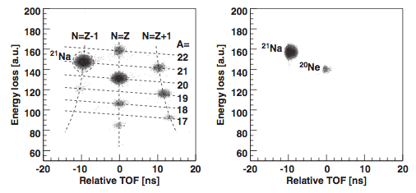
²¹Ne⁷⁺ @ 43 MeV/u on 20 mg/cm² polyethylen target
The emerging primary beam now ²¹Ne¹⁰⁺ is stopped in slits SH2
²¹Ne(p,n)²¹Na
The time of flight vs. energy loss in a 100 mm silicon detector shows various nuclides at the intermediate plane (T2).
At the final focal plane (T3) there is only ²¹Na and a small contamination of stable ²⁰Ne which could be reduced to below 0.5 %

Slide 11
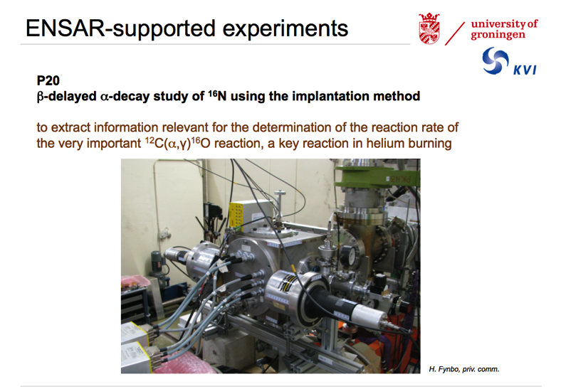
TRIμP is new equipment still in use & with an existing collaboration.
P20 ENSAR supported experiment in 2013.
¹⁵N from AGOR on Deuterated gas target @ T1 → the produced ¹⁶N was separated and transported and slowed down to be implanted in a micro strip detector to measure. ¹⁶N → β + ¹⁶O + α measure the summed deposit energy
R. Raabe & H. Fynbo
¹⁵N(d,p)¹⁶N
¹⁶N separated & implanted in a DSSSD. For beta decay study
Notes:
The machine is still in use. This is from one of the ENSAR suported experiemnts in 2013.
Where the at the target position T1 produced 16N was separated and trasnported and slowed down to be implanted in a micro strip detector to messure the
The brakup in 4 alpha partciles (beta decay to excited states in 16O via alpha to 12C via alpha to 8Be and to 2 alpha

Slide 12
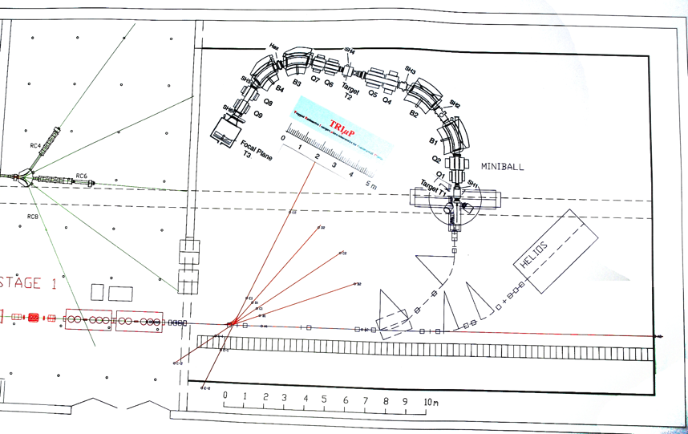
TRIμP with MiniBall
MiniBall

Slide 13
What would an ideal zero-degree device achieve?
identification of reaction products
physical separation of reaction products ←→ beam
physical separation of reaction products ←→ fusion-evaporation
physical separation of isobaric beams or other beam contaminants
large enough angular acceptance to pick up sequential decay products
excellent angular resolution to allow kinematic reconstruction – missing-p

