Slide 1


ISOLDE: Status report building 508
68th ISCC meeting
CERN, 22 October 2013
Maria Borge, Erwin Siesling

Slide 2
Outline
  Status new building 508:
  Progress on the demolishing / construction
  What has changed in terms of building and layout
  Progress on infrastructure
  Costs and timeline

Slide 3
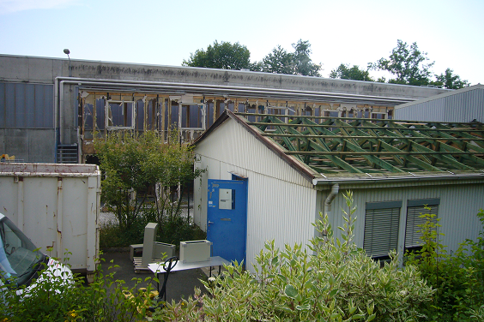
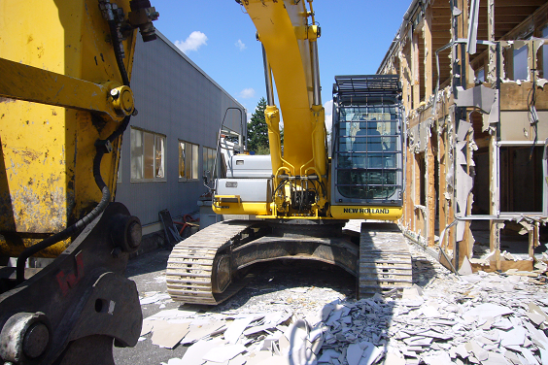
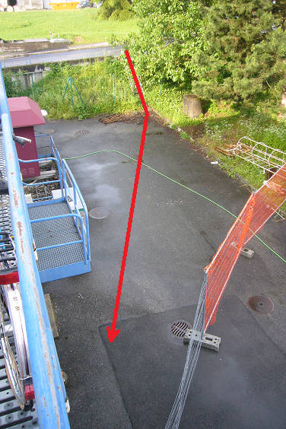
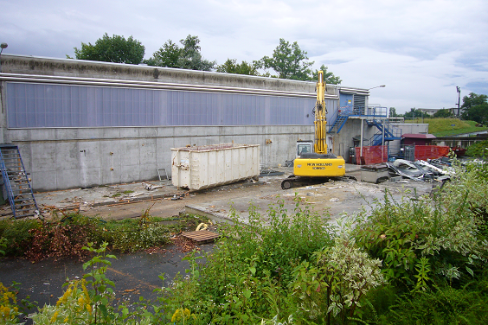
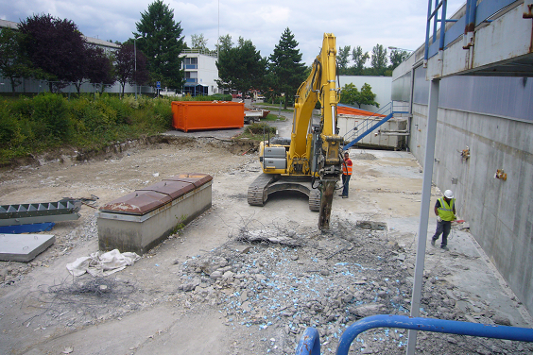
Progress
Progress during the summer after the removal of all equipment and items inside:
Desamiantage – treatment of the asbestos parts in roof and floor 115, 601
Declassification of 115 and 507
Change of the access point
Demolishing of 115, 601 and 507
Demolishing of the 507 floor

Slide 4
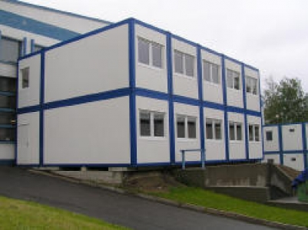
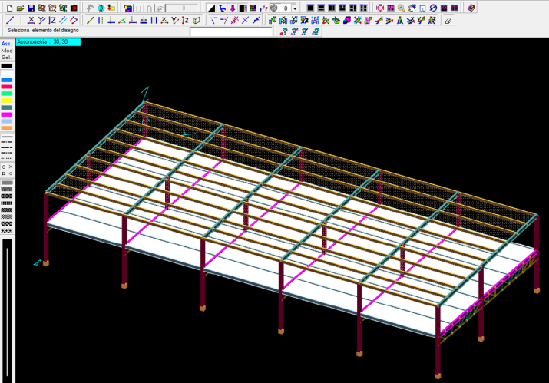
Changes
A few things have changed for the construction and layout of the new building 508:
On the first floor extra space for a new Isolde Control Room has been added (outside the classified area)
Advantages:
- Outside the classified area but still on the facility’s site
- Ergonomic: daylight, windows to the outside
- Enhances contact between users (DAQ rooms) and machine supervisors
- Next to possible future TSR storage ring (commissioning and operations)
The building will be a light structure, not modular cabins
  - Due to high pricing for non-standard cabins - Class C lab and T30 fire retarding material
    - New drawings structure done – re-designed concrete floor construction starts
    this week
Building 508 layout:
The new building 508 will be replacing the old user building 507, 601 and workshop/solid state lab 115. Light metal structure with 2 concrete floors: Total surface 864m2
Ground floor (only accessible from within the classified area): 432 m2
- Solid state, Laser labs and workshop
First floor (accessible from outside the classified area): 432m2
- Data Acquisition rooms
- Meeting room/Visitors Center
- Kitchen
- Isolde Control Room

Slide 5
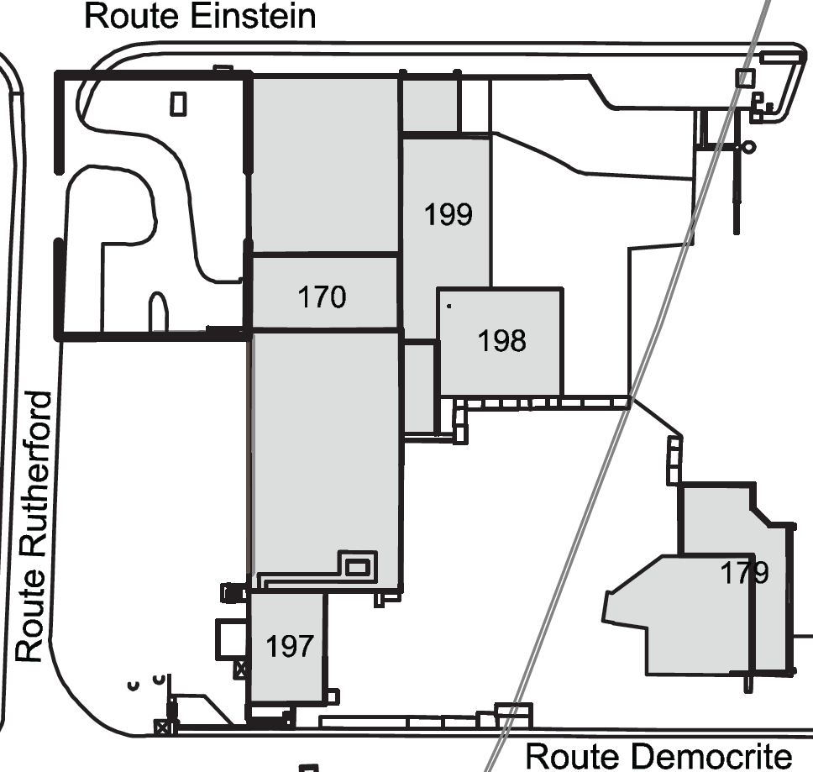
New building 508
Reserved for TSR
New user facilities building 508
(replacing 507, 115, 601)
ISOLDE experimental hall
New ISOLDE Control Room, 1st floor 508
508
Target zone and separators area
water station
Present ISOLDE Control Room, basement 197

Slide 6
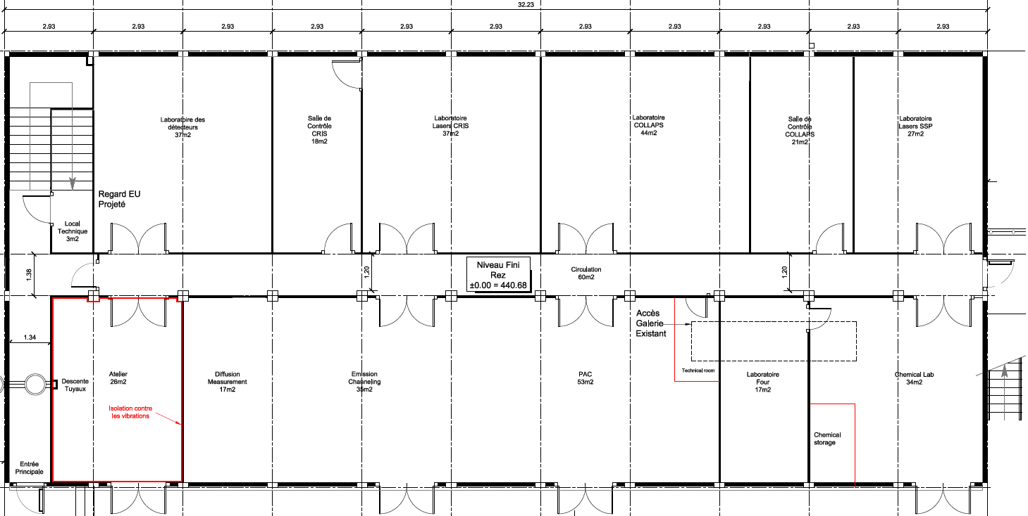













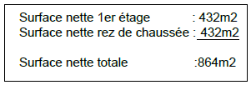
Layout 508
Ground floor B508:
Access 1st floor
Access 1st floor
Controlled Access ground floor
and Isolde hall

Slide 7
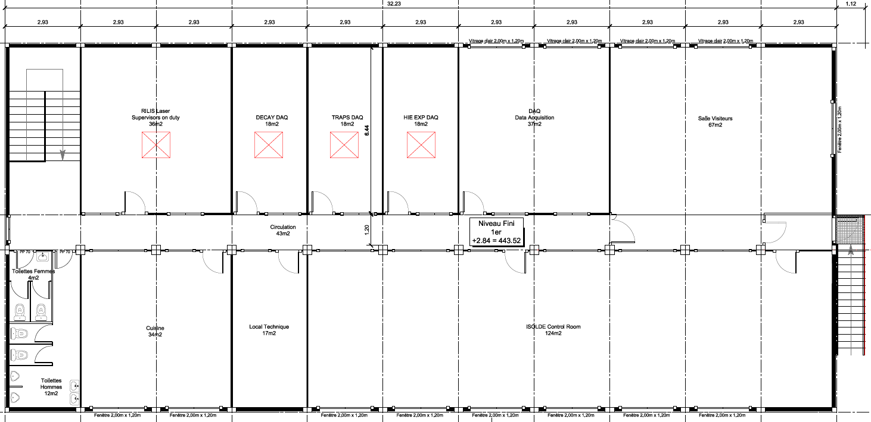









Layout 508
1st floor B508:
Access 1st floor
Access 1st floor
Courtesy Eliseo Perez-Duenas GS/SE

Slide 8
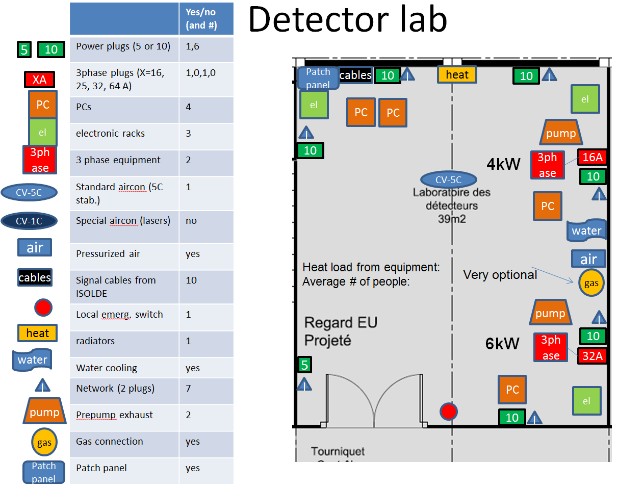
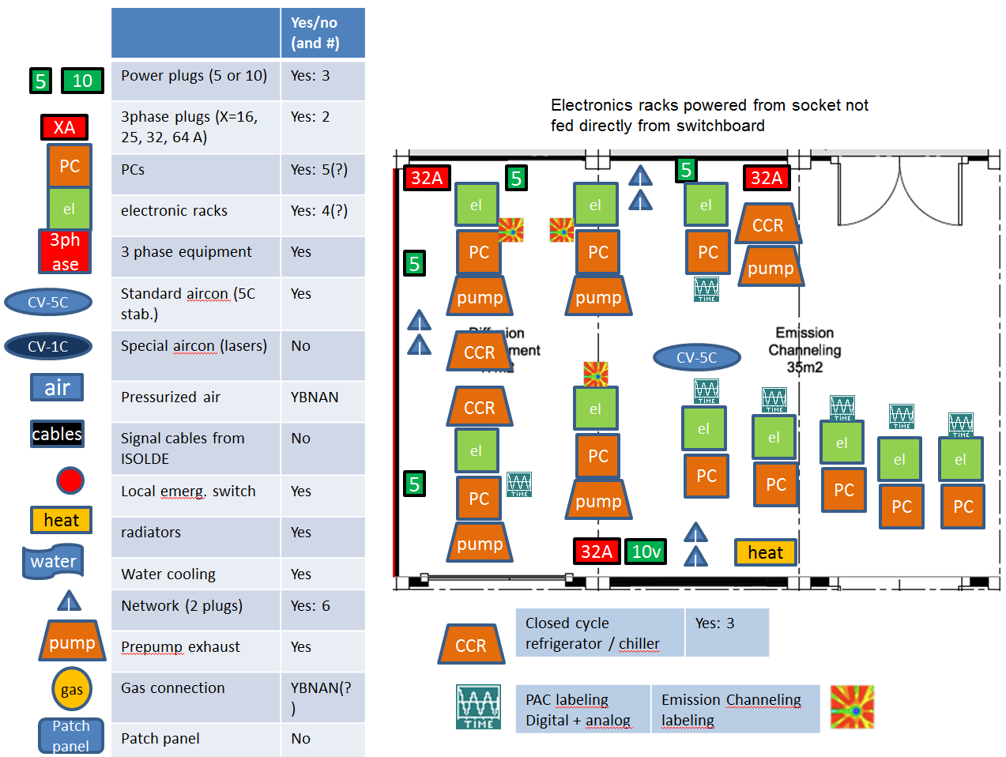
Infrastructure 508
Infrastructure:
Needs for the users have/are being collected by Magda Kowalska
Implementation by the different groups ongoing (EL, CV, IT)
Finalized plans with regard to infrastructure to be ready asap (not as urgent as for the modular cabin solution)
Courtesy Magda Kowalska

Slide 9
Costs and Timeline
Costs:
Total costs light structure building 508 (incl. ICR & services):
1.8MCHF
Includes Infrastructure: Cooling & Ventilation 300kCHF (estimate)
Electrical: <200kCHF
Approved budget:
600kCHF for consolidation
350kCHF for LS1
400kCHF by PH dept.
1.35MCHF (without control room)
Covered:
New Isolde Control room: 185 kCHF by BE dept.
Extra costs light structure building: 200kCHF by GS dept.(to be confirmed)
385kCHF
To obtain: 1800-1350-385=65kCHF
Timeline:
Concrete floor as of end October till end November2013
Building ready end February 2014
Infrastructure ready end March 2014
Installations users as of April 2014
Milestone: Protons to Isolde .. July 2014 (?)

