Slide 1


HIE-ISOLDE
Status Report Installation works
ISOLDE Hall 170
68th ISCC meeting
CERN, 22 October 2013
Erwin Siesling on behalf of the HIE integration team

Slide 2
Outline
  Status Report HIE Installation October 2013:
  Progress since the last SC meeting in April
  Have there been or are there any delays
  Are we on track with regard to the planning
  What to expect for the next 6 months

Slide 3
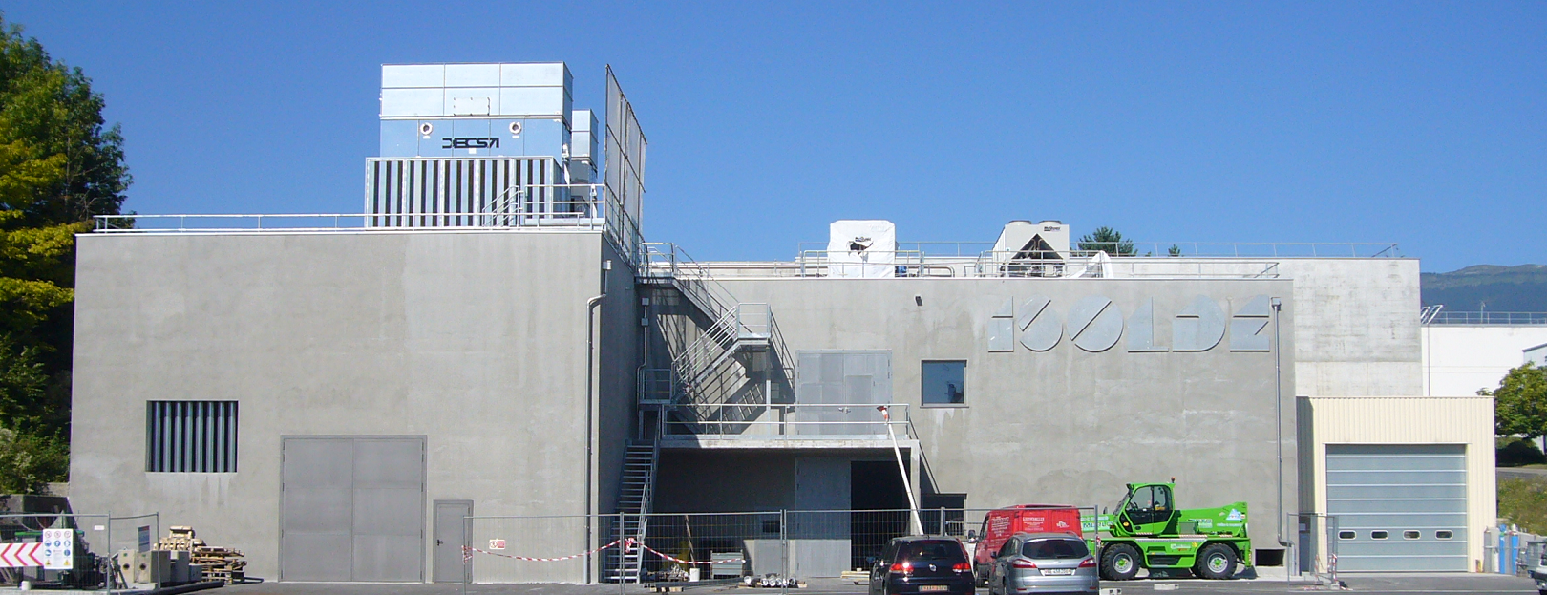
HIE ISOLDE installation progress

Slide 4
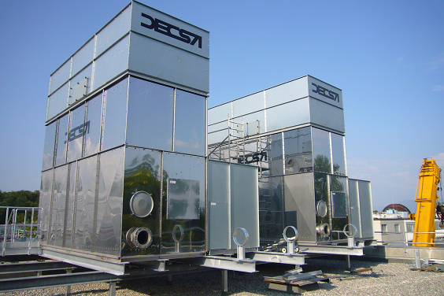
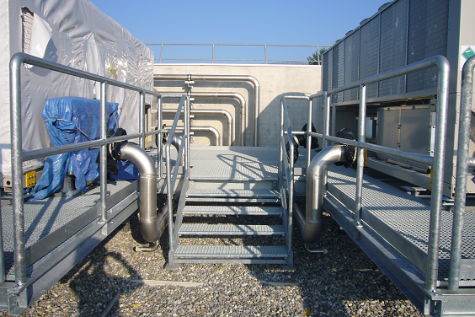
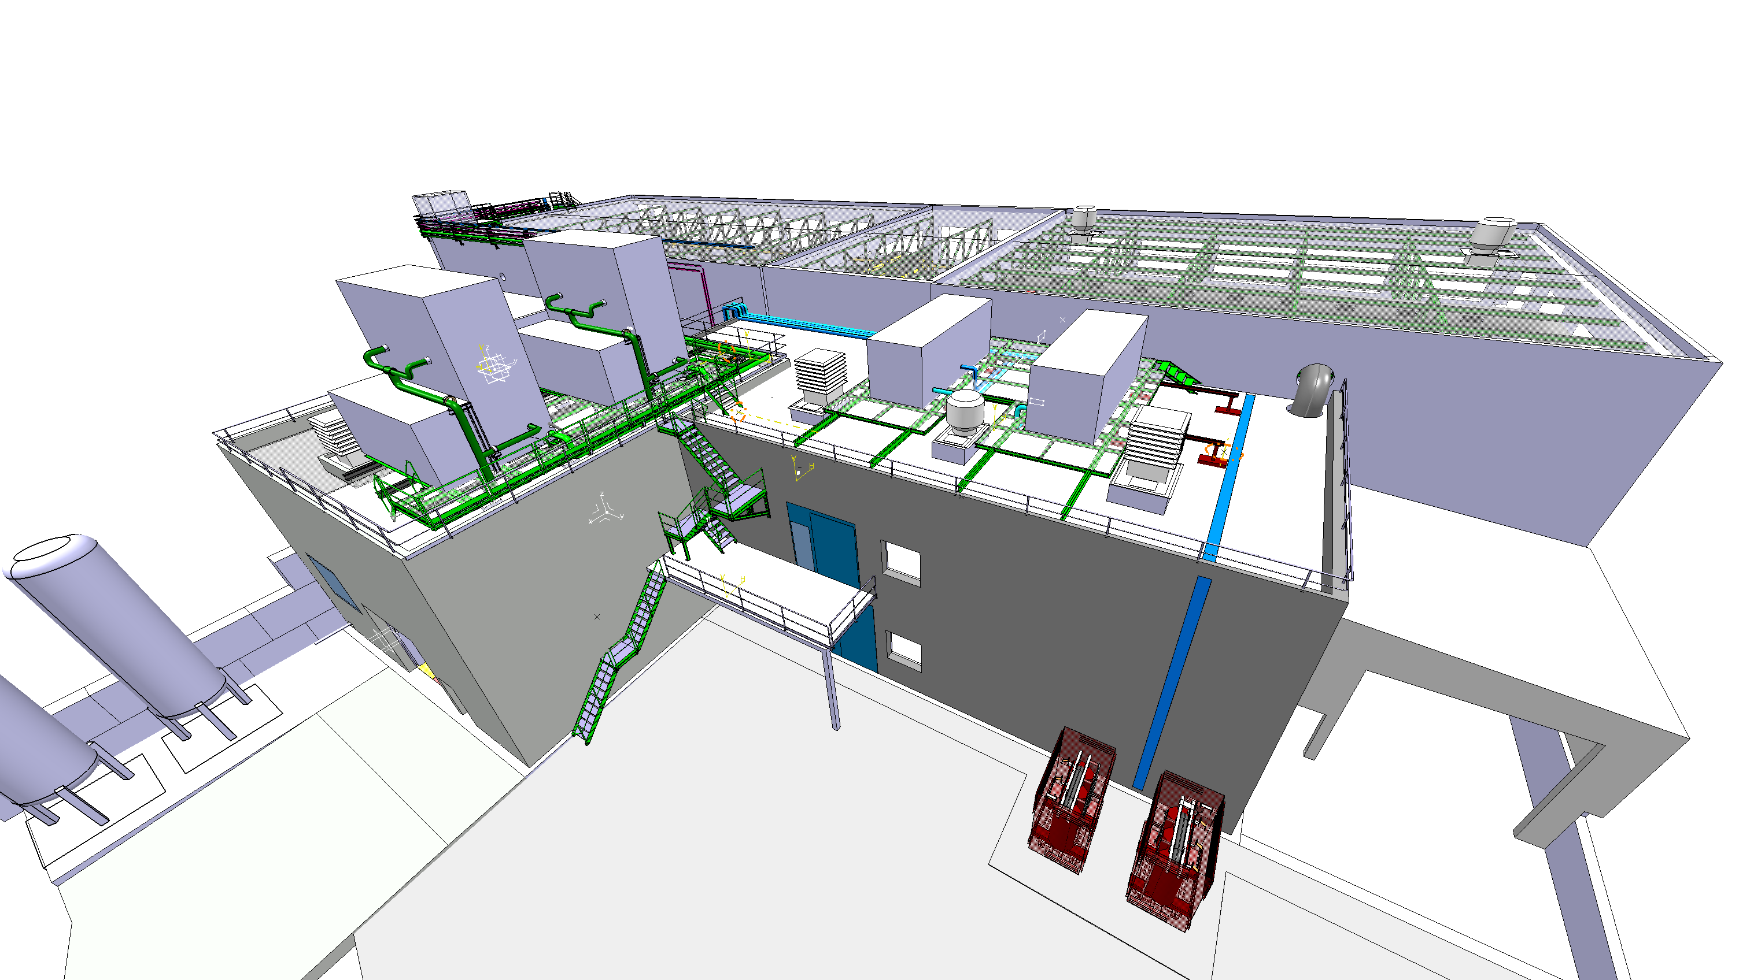
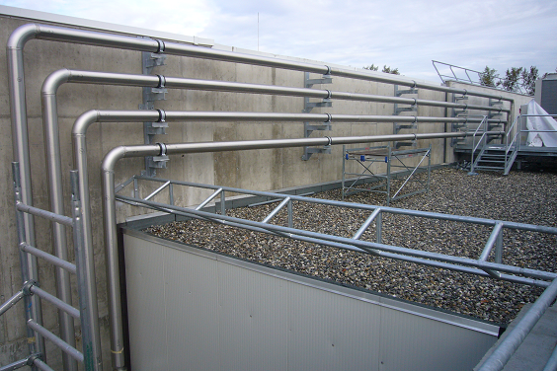
Outdoor progress
Cooling & ventilation:
Cooling towers, Chillers and a large part of the tubing is in place

Slide 5
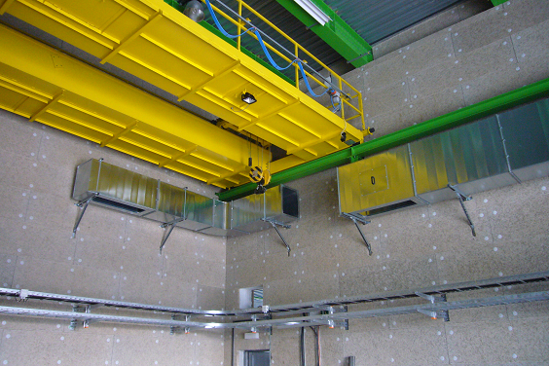
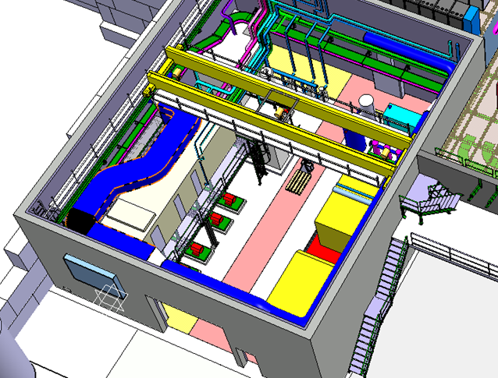
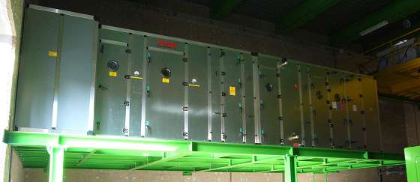
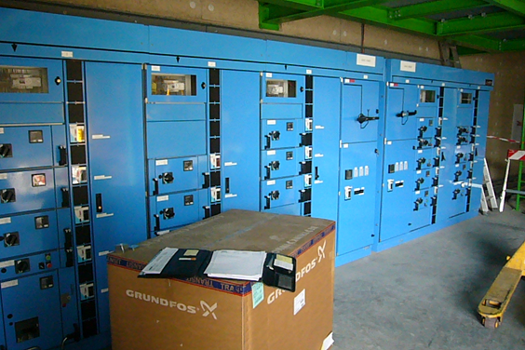
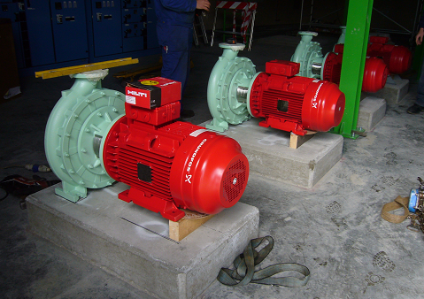
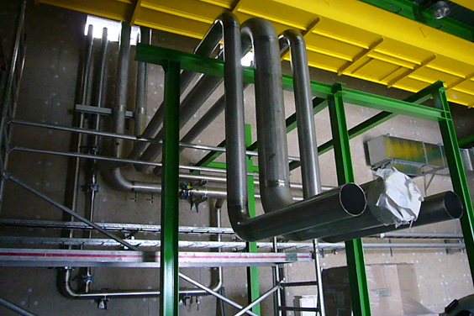
Compressor building 198
Thank you for your attention
Cooling & ventilation and EL systems:
Steel structures, Ventilation Unit, Electrical cabinets, Pumps and Piping in place as well as large parts of the ducts and cable trays

Slide 6
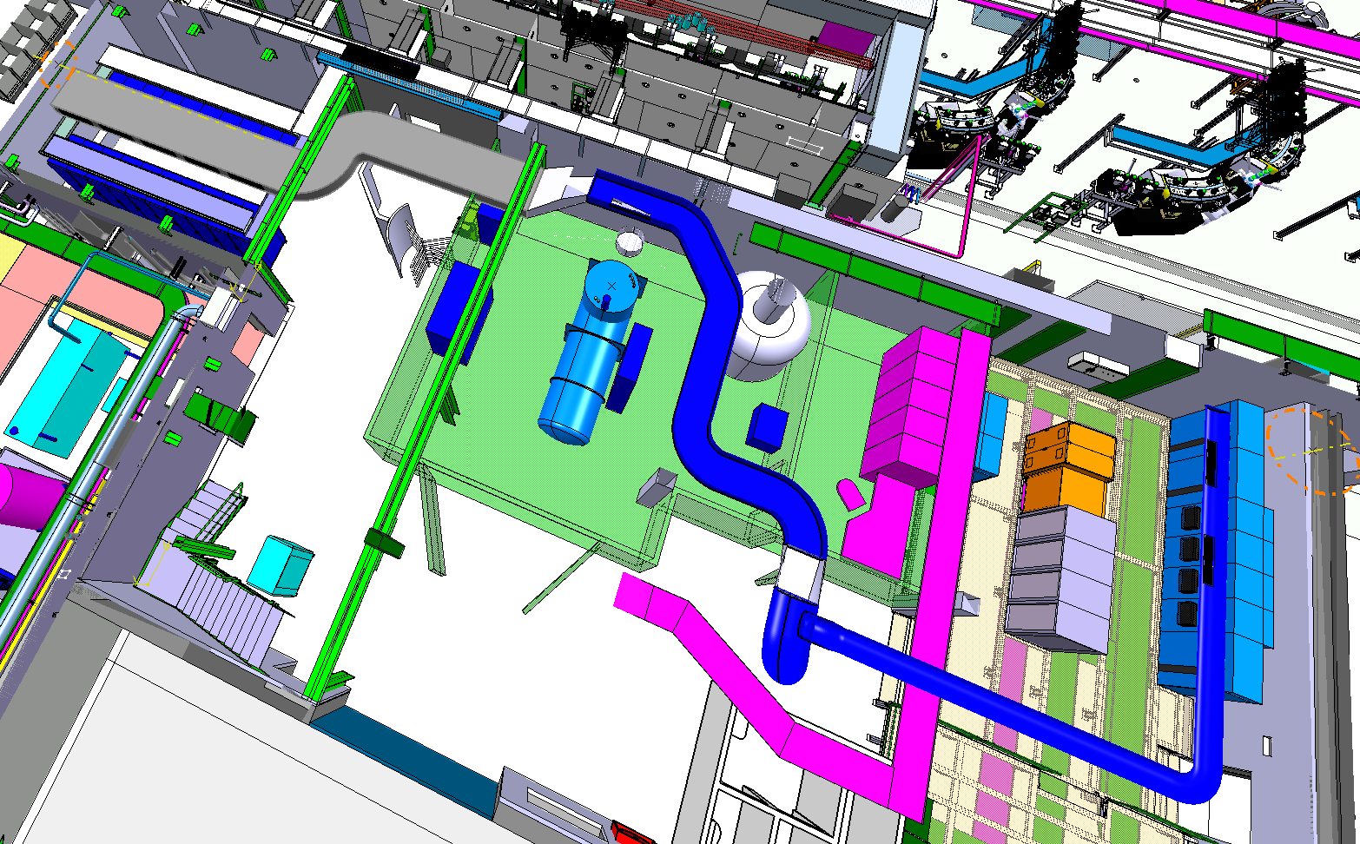
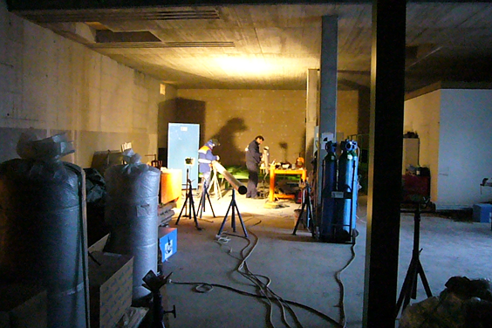
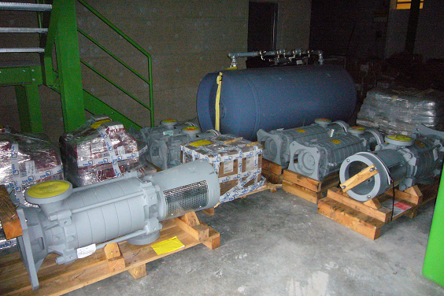
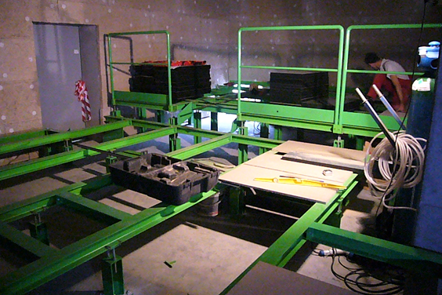
Cold Box building 199
EL systems ground floor:
False floor structure in place for the 3.3kV (Compressors power)

Slide 7
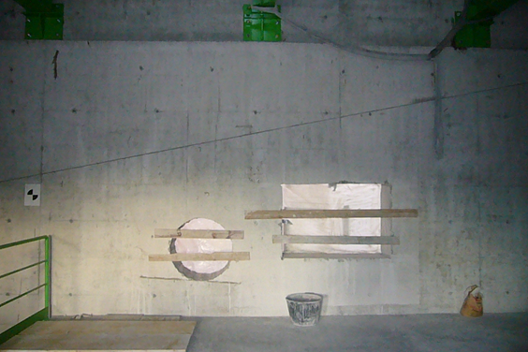
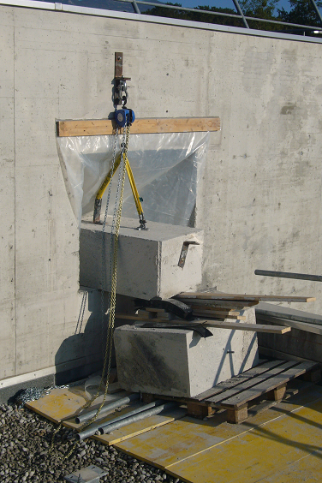
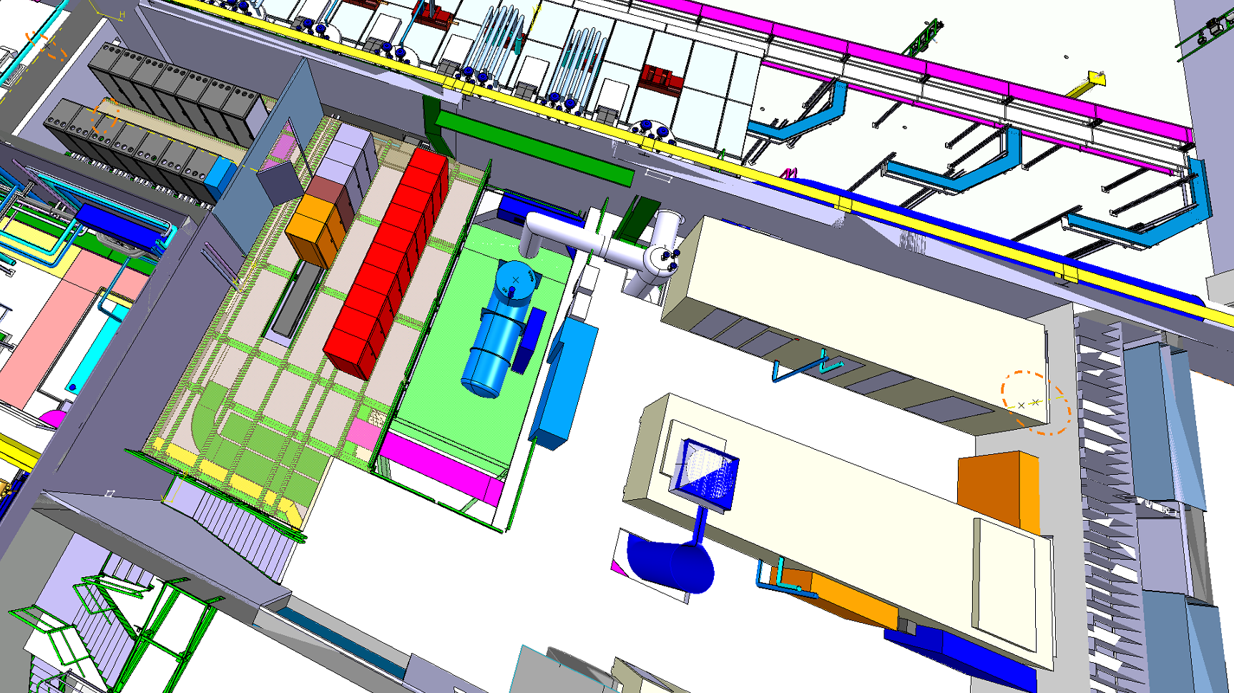
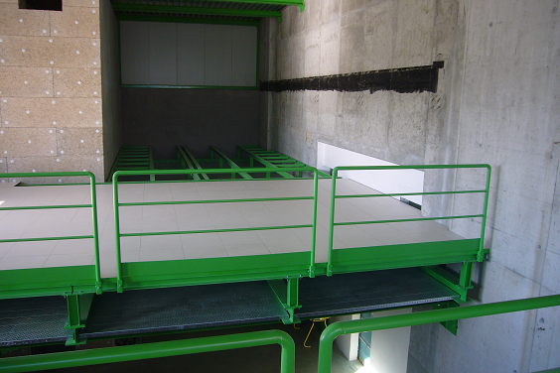
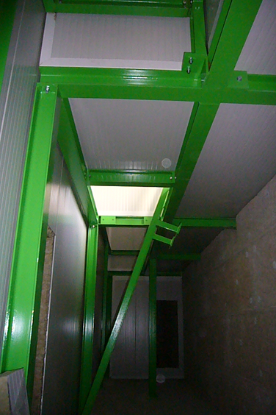
Cold Box building 199
1st floor, metal structures and Civil Engineering:
Plenum, false floor and reservations done

Slide 8
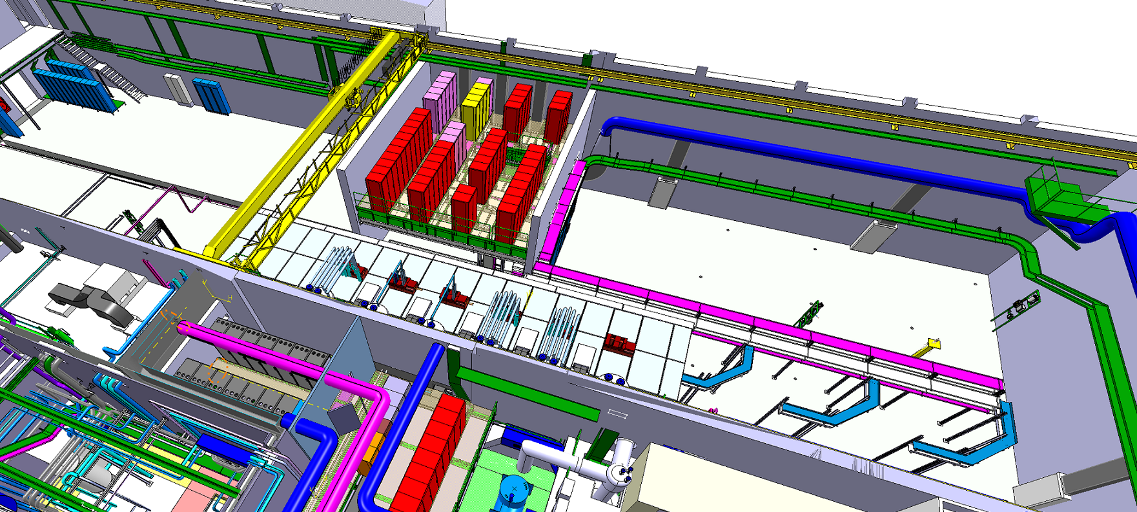
ISOLDE hall 170
ISOLDE hall 170:
Civil engineering, metal structures, cooling and ventilation

Slide 9
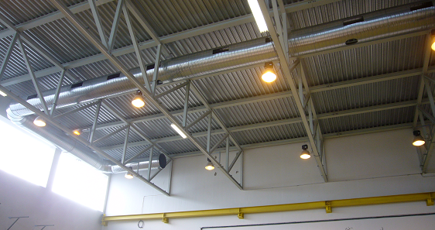
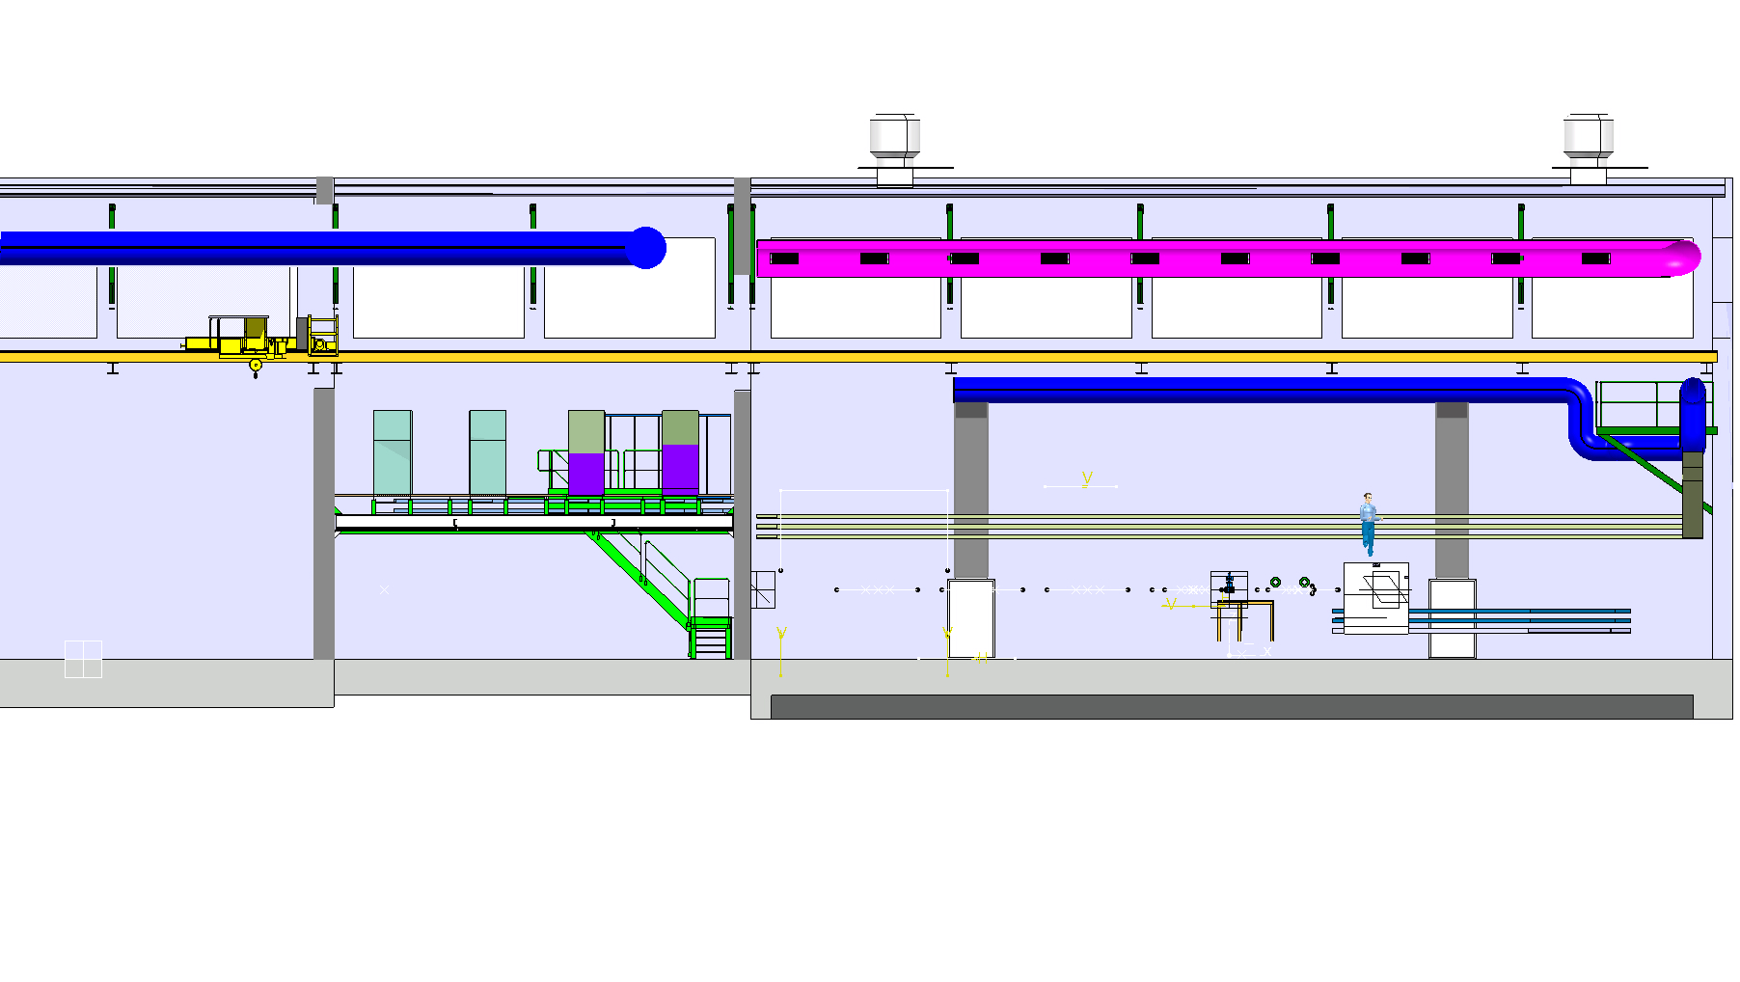
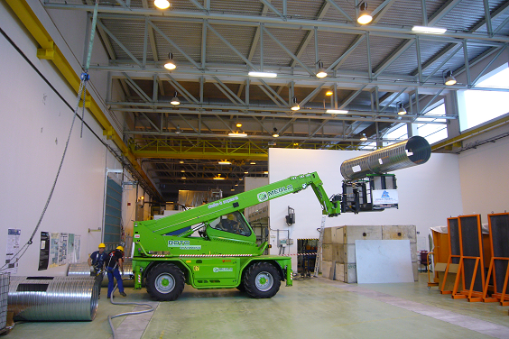
Hall 170 ventilation systems
New ducts
platform
New diffusers
1st extension
2nd extension
ISOLDE hall 170: Ventilation ducts put in place

Slide 10
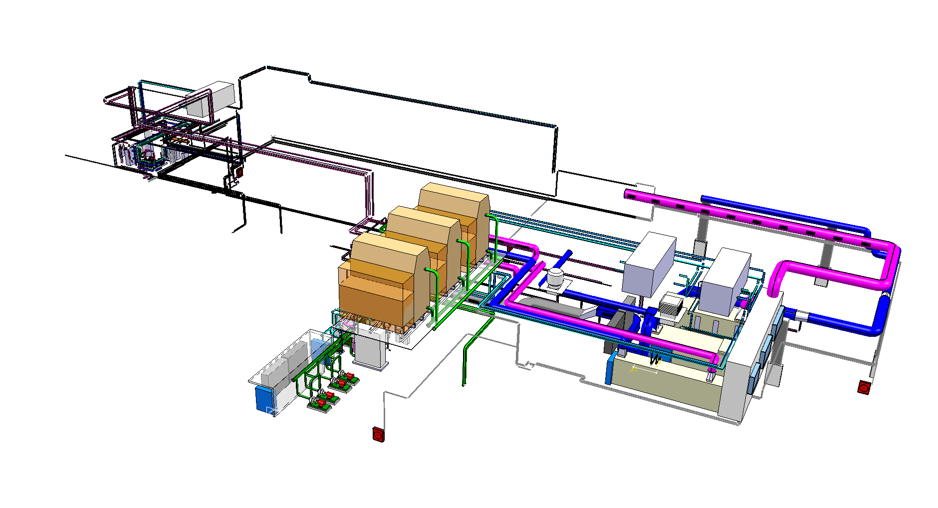
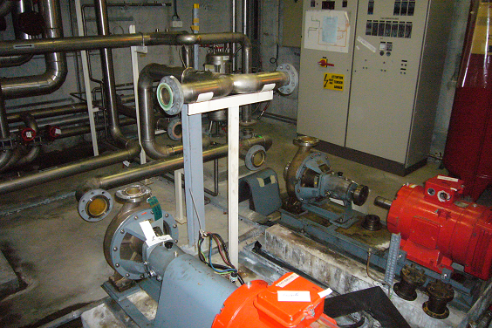
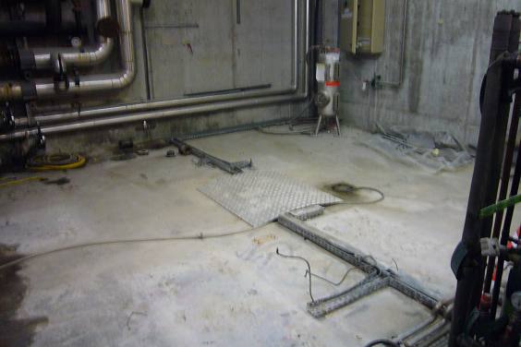
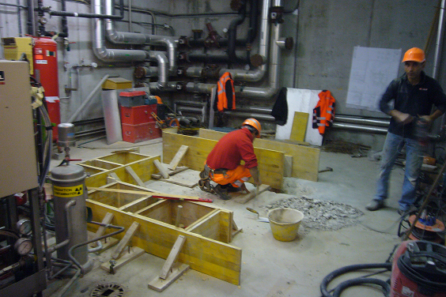
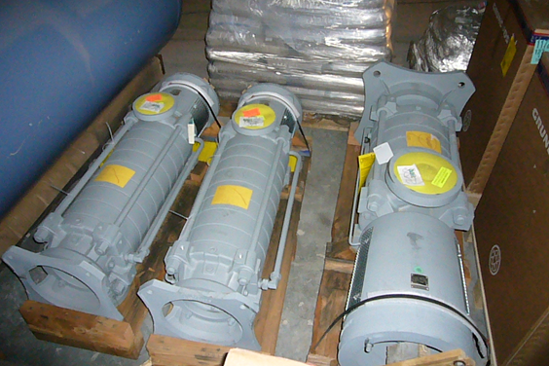
Cooling and ventilation systems
Experimental hall 170
B. 198 compressor building
B. 199 cold box building
ISOLDE water station:
Old equipment removed, installation new pumps and piping started

Slide 11
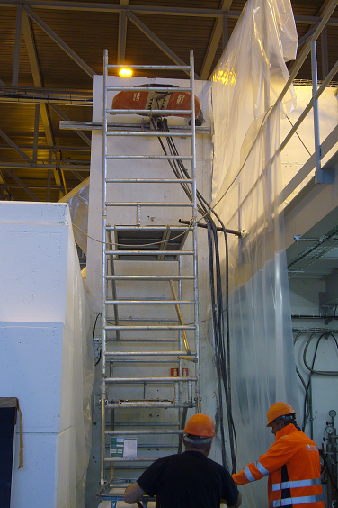
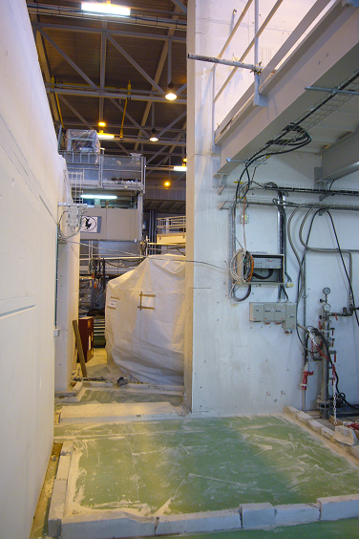
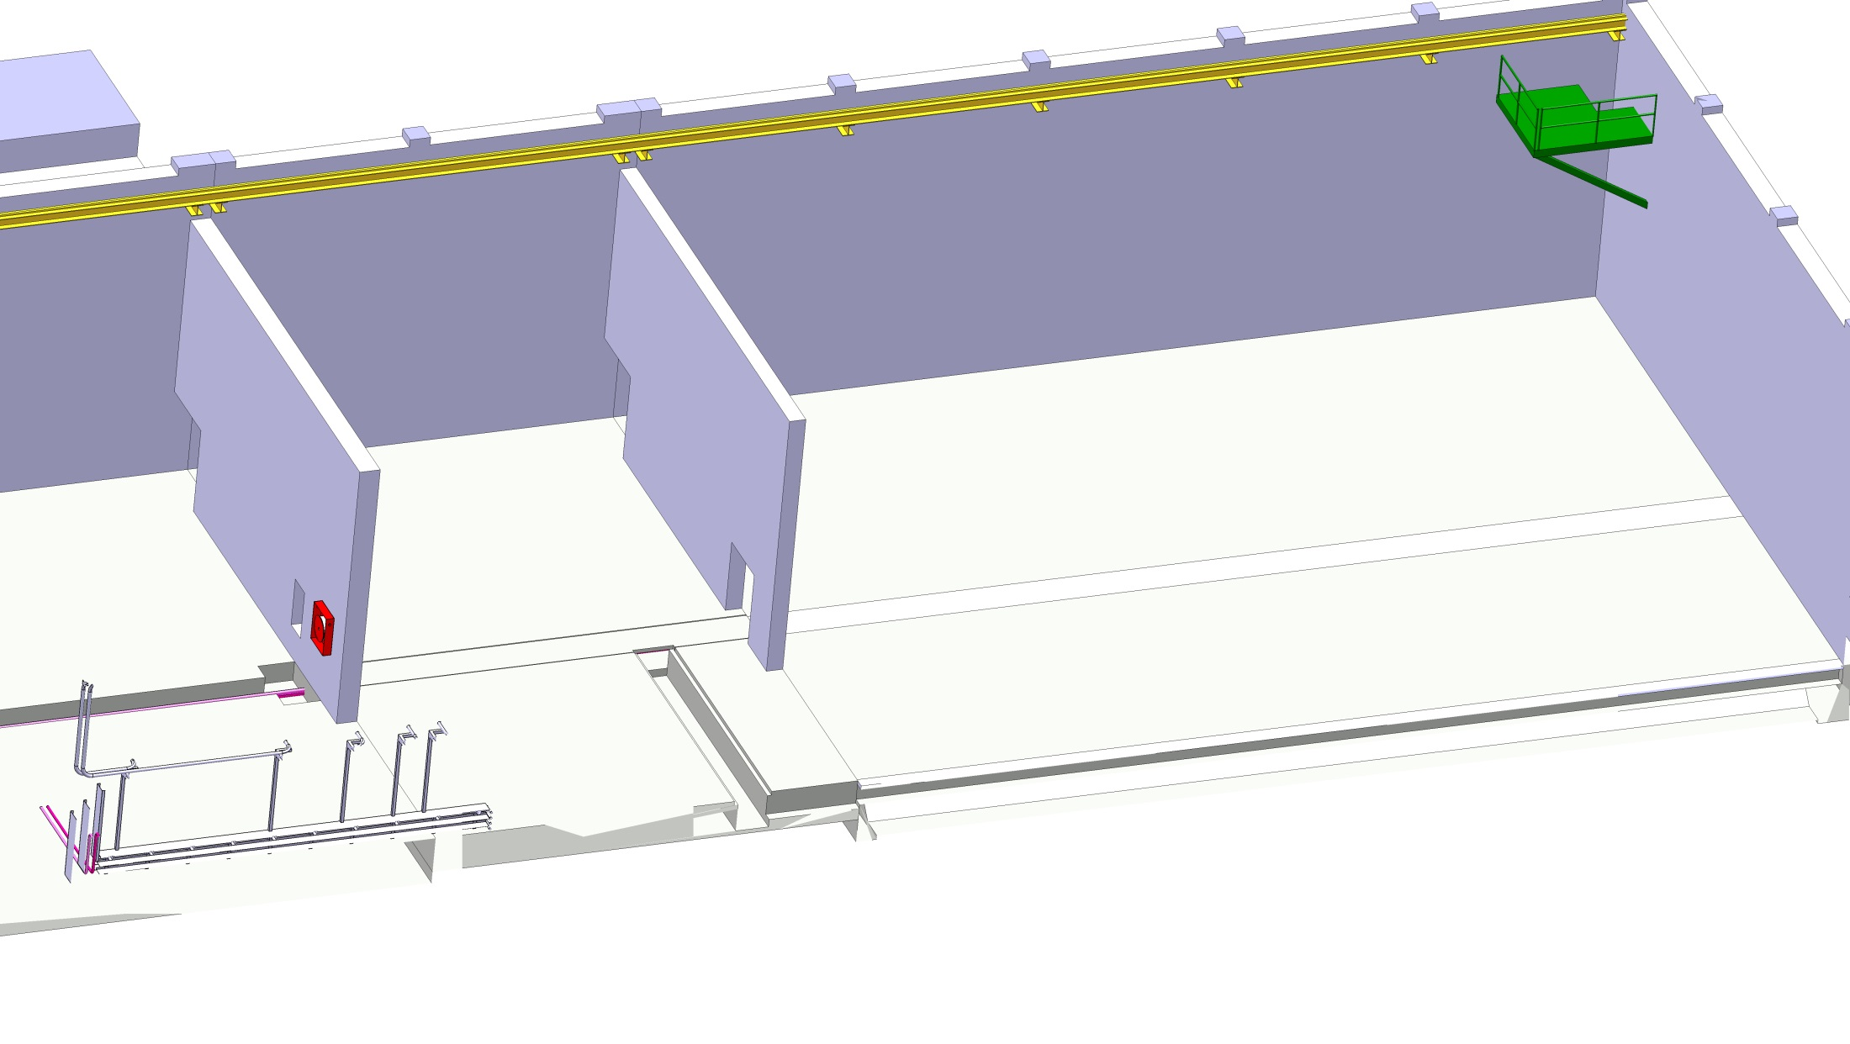
Civil Engineering in Hall 170
Wall to be cut
New trench to add
Platform wall has been cut to provide free passage/access cryo modules: Cleaning campagne was organised to undust equipment

Slide 12
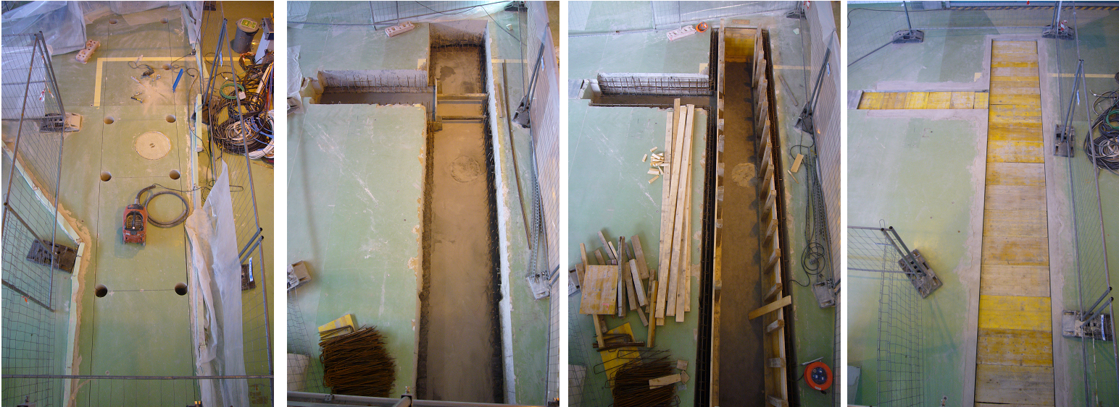
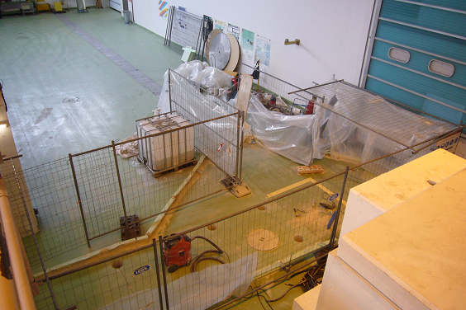
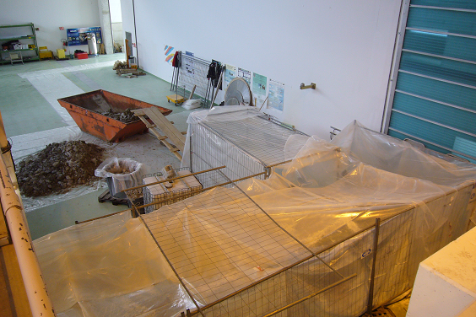
Civil Engineering in Hall 170
Wall to be cut
New trench to add
New trench in place for cabling into the new shielding tunnel:
Covering tent for dust protection

Slide 13
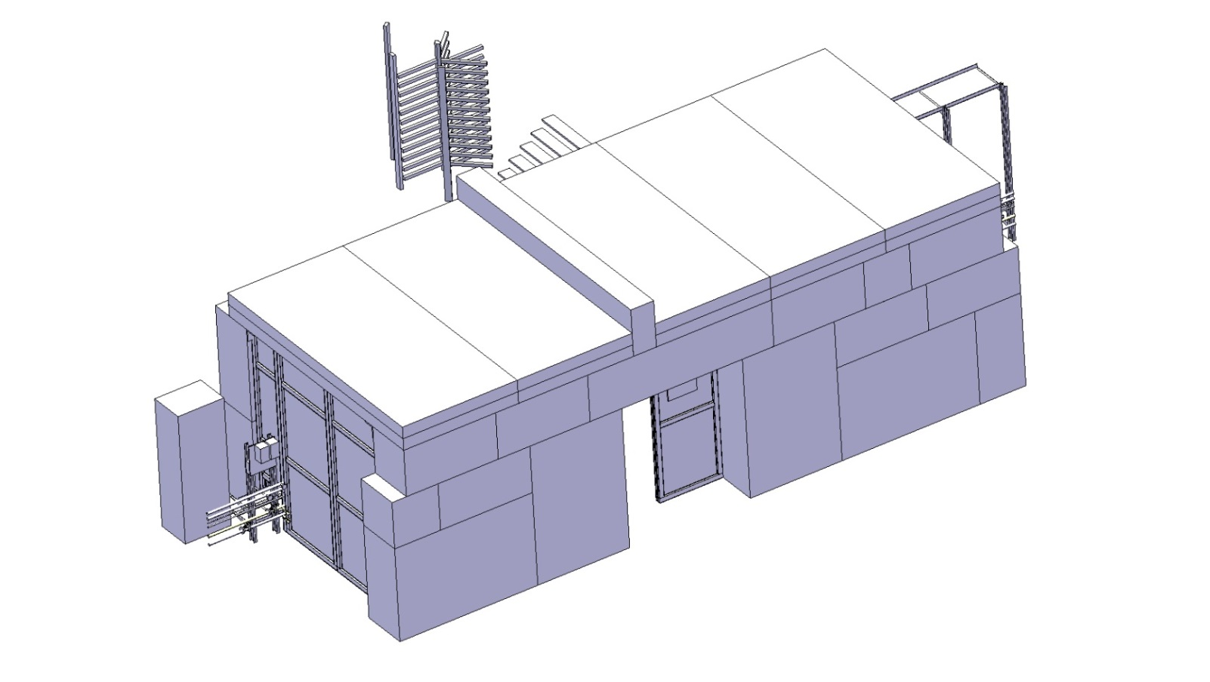
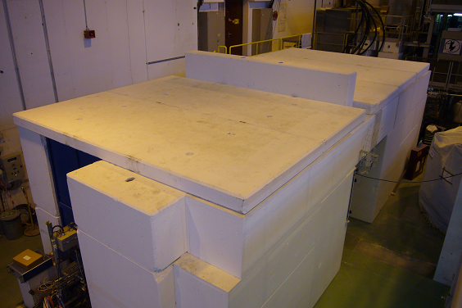
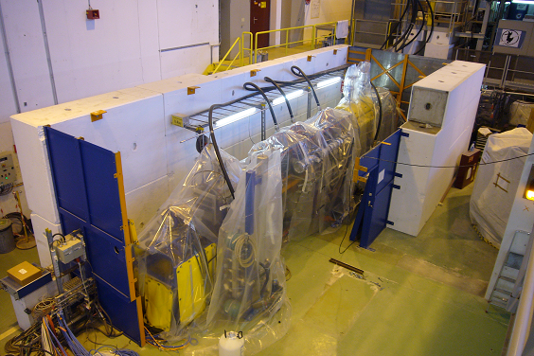
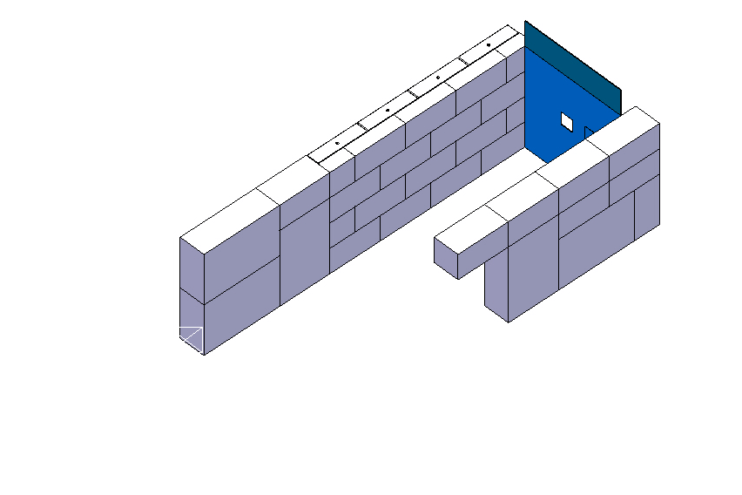
Shielding tunnel Hall 170
ISOLDE hall 170: Civil engineering
Installation of the new shielding tunnel walls

Slide 14
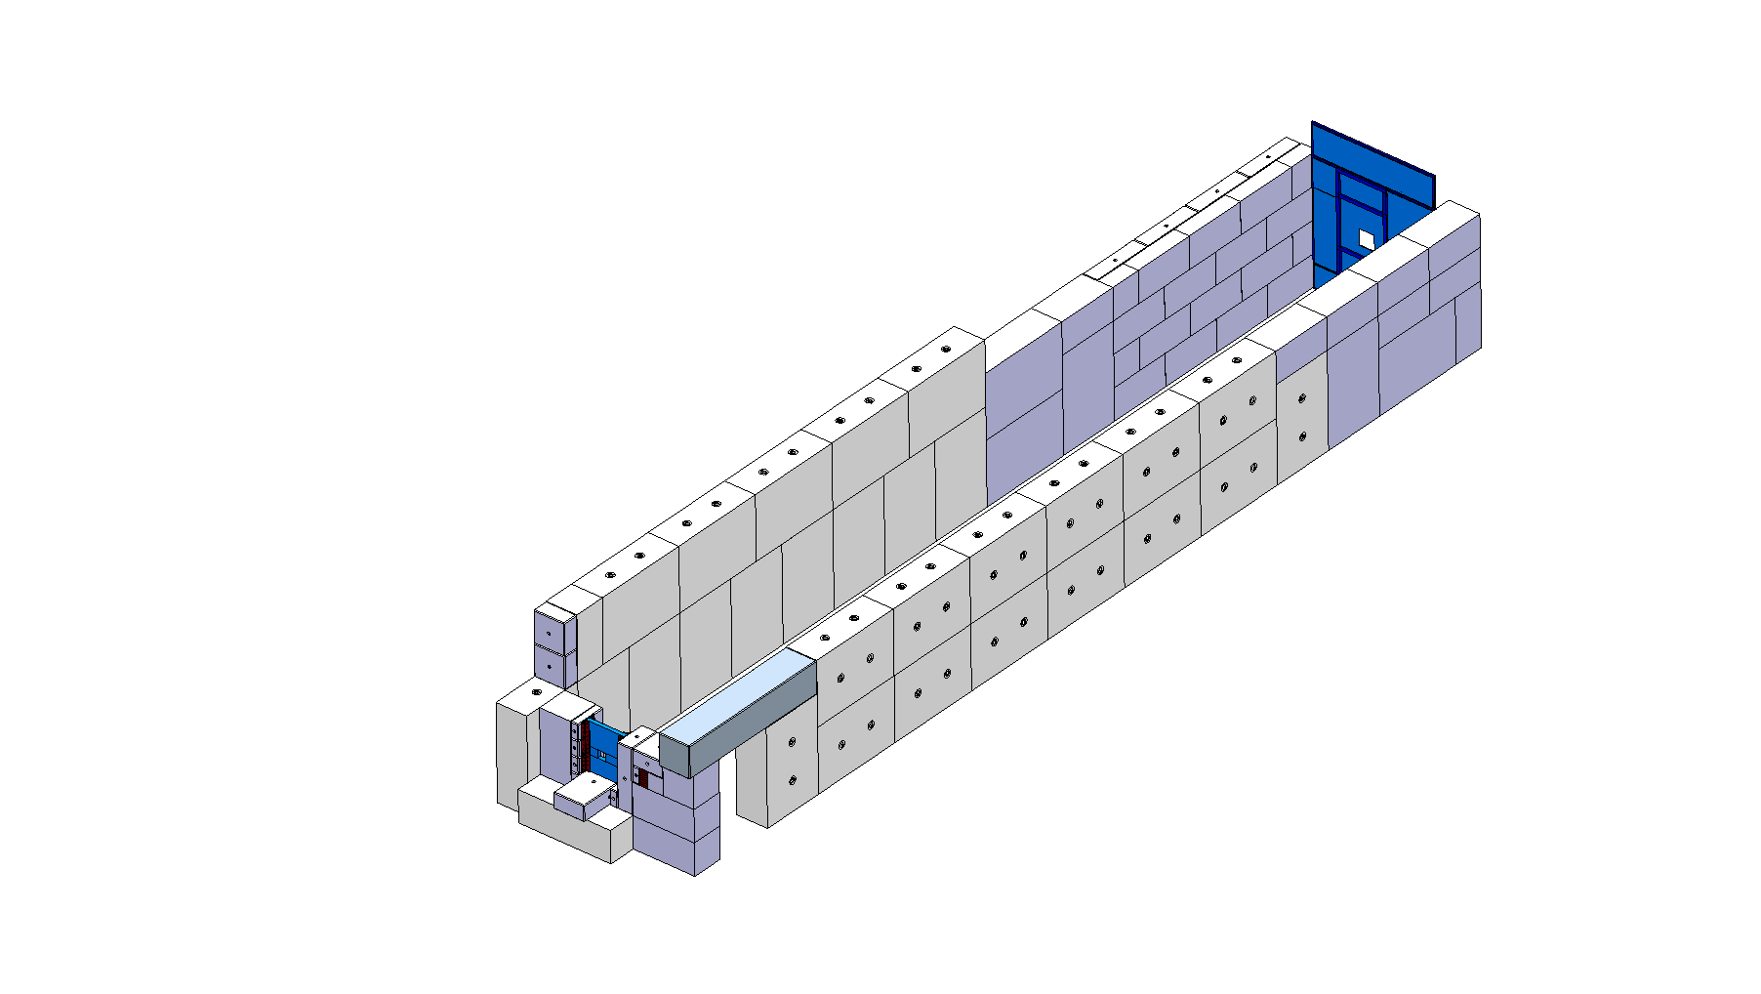
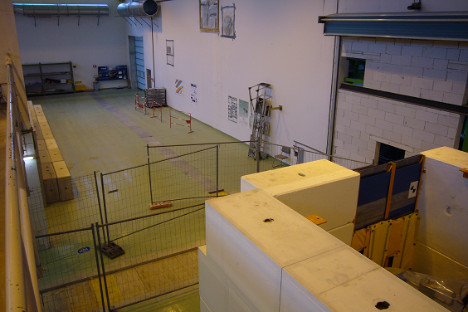
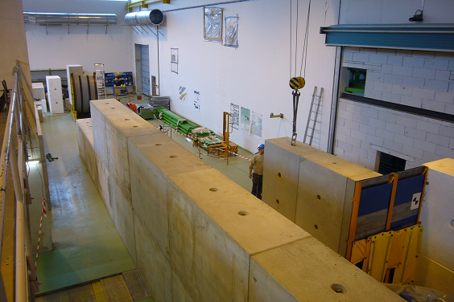
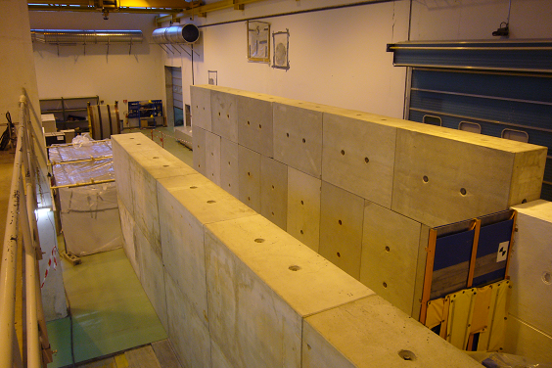
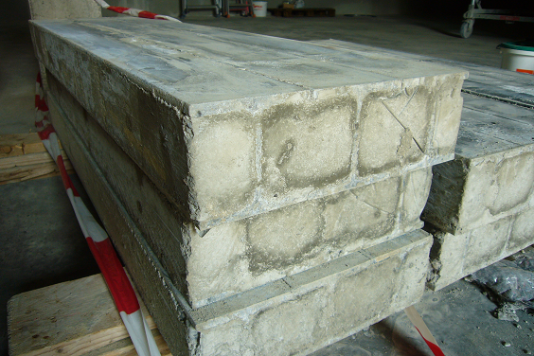
Shielding tunnel Hall 170
ISOLDE hall 170: Civil engineering
Installation of the new shielding tunnel walls

Slide 15
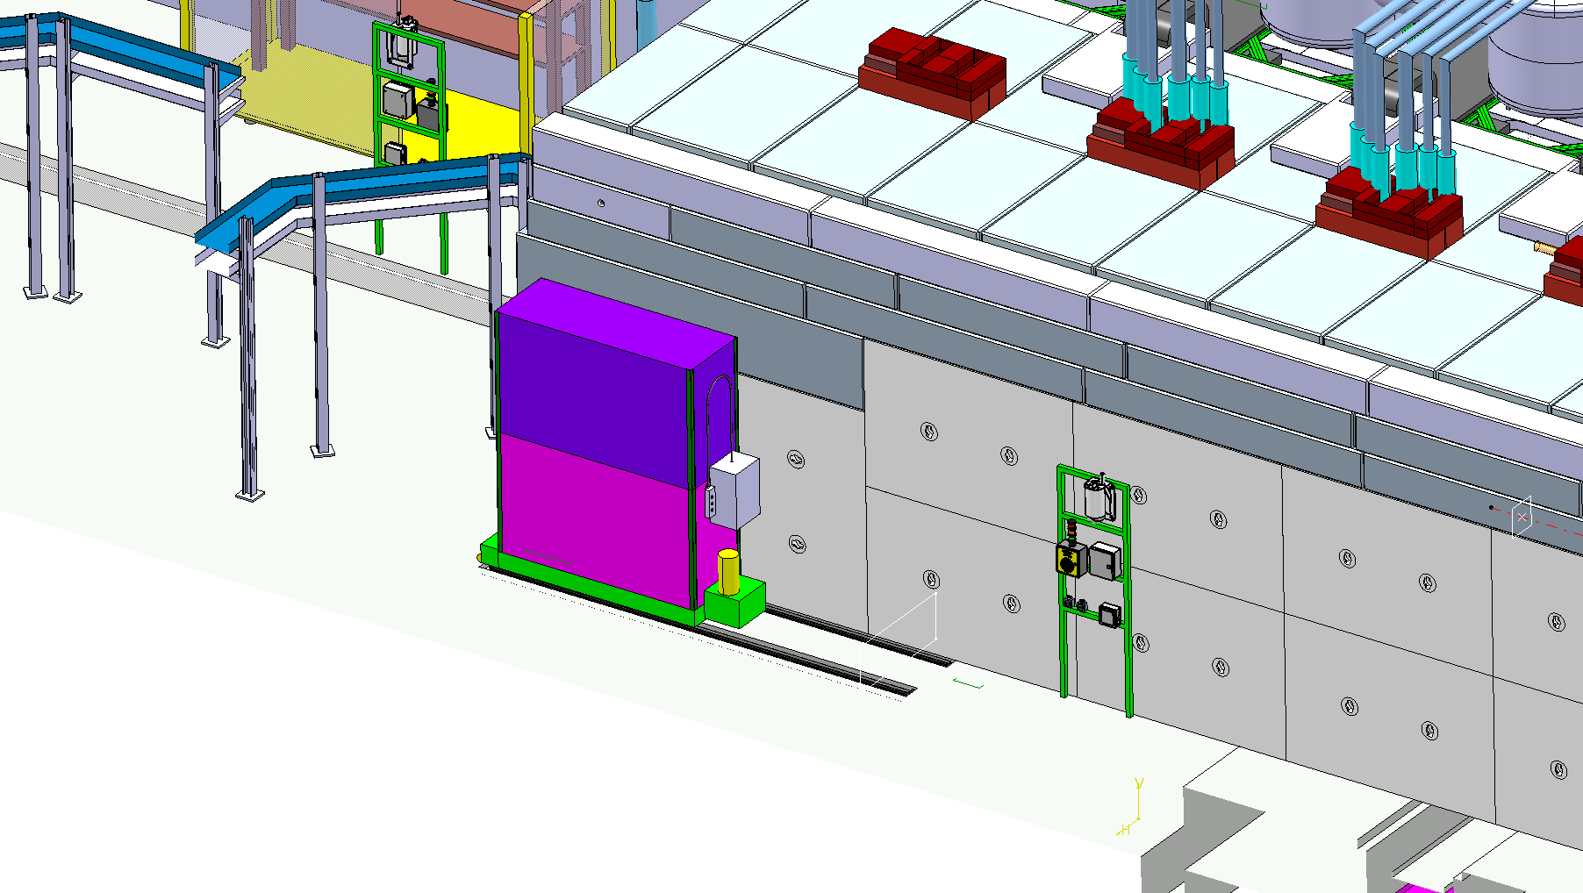
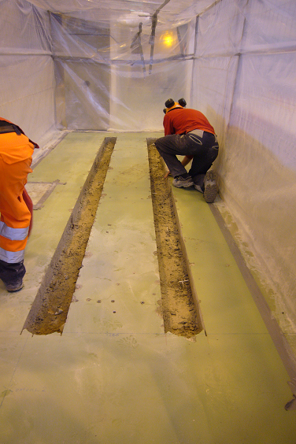
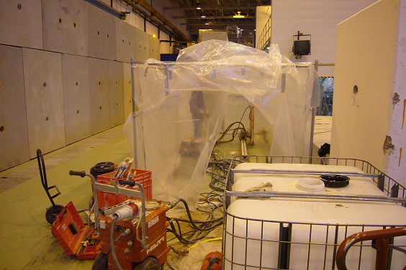
Shielding tunnel Hall 170
ISOLDE hall 170: Civil engineering
Installation of the shielding door rails

Slide 16
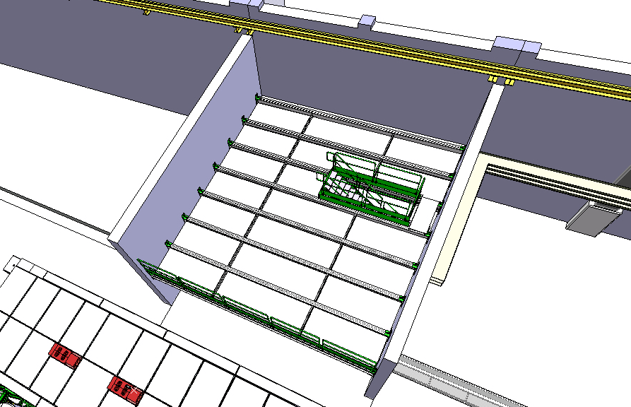
Metal structures Hall 170
ISOLDE hall 170: Metal structures
Modification of the future rack platform ongoing

Slide 17
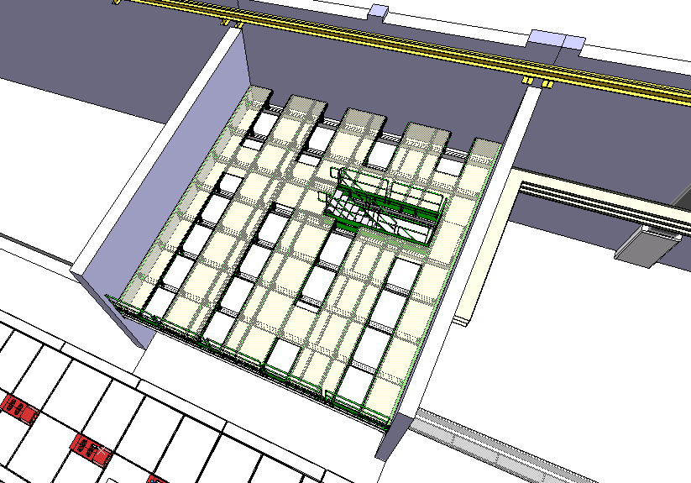
Metal structures Hall 170
ISOLDE hall 170: Metal structures
Modification of the future rack platform ongoing

Slide 18
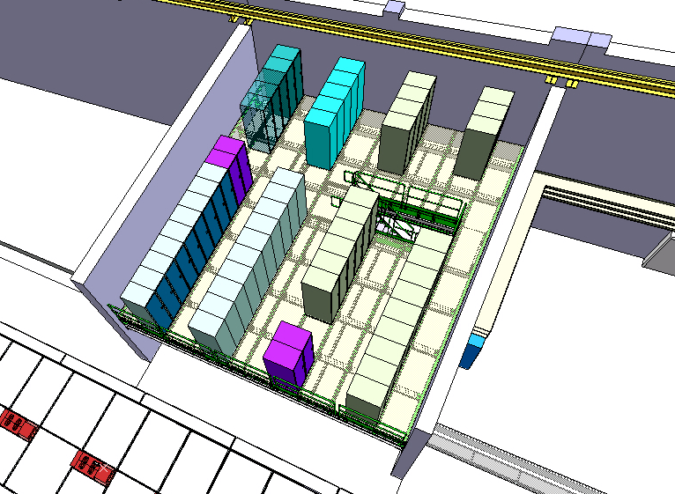




Metal structures Hall 170
Access to Nicole
ISOLDE hall 170: Metal structures
Modification of the future rack platform ongoing

Slide 19
HIE Simplified Planning
Start Isolde shutdown
17 dec 2012
We are here:
Oct 2013
End LS1:Start Low E physics
July 2014
HIE physics at 5.5MeV/u
October 2015
2011
2012
2013
2014
2015
2016
Q1
Q2
Q3
Q4
Q1
Q2
Q3
Q4
Q1
Q2
Q3
Q4
Q1
Q2
Q3
Q4
Q1
Q2
Q3
Q4
Q1
Q2
Q3
Q4
Civil
HEBT
Civil hall
Cryo
Main services
RF
Ventilation
Demi water
5.5MeV/u
Electrical syst.s
CM 1&2
Timeline:
Cabling
sd
sd
LS1
sd
sd
17 Dec 2012 - Q3 2014
Beam commissioning
3 months
shutdown
Isolde Ops
HIE installations and tests (Isolde normal operations)
Machine Check-Out
(Isolde normal operations)
Beam Commissioning
(Isolde normal operations)

Slide 20
Planning: delays and critical
Activities | Delay with regard to baseline April 2013 |  | building | On track present planning | Critical
Cooling & ventilation: Installation units and piping | 4 months | Introduced by the contractor. New planning in place | 198, 199, 170 | Yes | No 14 March ready for Isolde Low Energy startup
Electrical systems: service buildings | 2 months | Due to CV contractor delay | 198,199 | Yes | No
Integration tunnel infrastructure | - | Open actions on metal structure, vacuum and water piping routing, He shielding, CM supports | 170 | Yes | Yes Critical: tunnel infrastructure + cable trays need structure in place by end Jan’14
Metal Structures: rack platform | 2 months | Due to LS1 load | 170 | Yes | No
Metal Structures: jumper boxes platform | 4 months | Design needs finishing: Data missing from Cryo due to late Cryo Line procurement | 170 | Yes | Yes Critical: cable trays need platform in place end Jan’14
Civil Engineering: trench | 2 months | Unforeseen difficulties with trench cutting | 170 | Yes | No
Civil Engineering: tunnel | 2 months | Due to trench delay | 170 | Yes | No
Cabling: trays and cables | 3 months | Due to late modif rack platform + service buildings CV installations delayed | 199, 170 | Yes | No
Cryogenics: late cryo distribution line | - | Late installation dewar, distribution line & jumper boxes (sept ’14) | 199, 170 | Yes | Yes Critical: very tight with commissioning plan & physics oct’15

Slide 21

Metal structures
Platforms Cryo Jumper Boxes: To be in place early 2014

Slide 22

Tunnel Infrastructure
Tunnel structure and infrastrucure installation to start early 2014

Slide 23

Coming up:
CV units 199, air ducts (remaining 170), diffusers and smoke extractors B198, 199 and 170: Oct-Nov-Dec 2013

Slide 24

Coming up:
Installation top walls shielding tunnel: Dec 2013

Slide 25

Coming up:
Cable trays buildings, tunnel and HEBT: Nov 2013 – March 2014

Slide 26
Conclusions
  Status Report HIE Installation October 2013:
  Progress since the last SC meeting in April
  High activity in the hall and service buildings
  Have there been or are there any delays
  Yes. Indicated and co-activities planning adapted
  Are we on track with regard to the planning
  Yes. Despite delays we are still in line with the overall schedule which aims for low energy physics during 2014 and HIE physics as of Oct 2015. Critical paths for some activities are being addressed

Slide 27
HIE ISOLDE Integration
GS/SE : DANIEL PARCHET, ELISEO PERES-DUENAZ
EN/MEF : STEPHANE MARIDOR, ELEFTHERIOS ZOGRAFOS
BE/ABP : FREDERIK WENANDER
BE/OP : DIDIER VOULOT
PH/SME : MARIA BORGE, MAGDA KOWALSKA
EN/HDO : YACINE KADI
BE/RF : MATTEO PASINI, MATTHEW FRASER, DANIEL VALUCH, WALTER VENTURINI, LUCA ARNAUDON
EN/CV : PAUL PEPINSTER, BENOIT LACARELLE, FREDRIC BORRALHO
EN/EL : RENE NECCA, JEAN-CLAUDE GUILLAUME, GEORGI GEORGIEV, JEAN-PIERRE BILLON-GRAND EN/EL
TE/CRG : NICOLAS DELRUELLE, JOS METSELAAR
EN/STI : RICHARD CATHERALL, ANA-PAULA BERNARDES
GS/DI : CYRILLE BEDEL
TE/MSC : YANN LECLERCQ, LLOYD WILLIAMS
DSG/RP : JOACHIM VOLLAIRE, SANDRA GIRON, ALEXANDRE DORSIVAL
TE/ABT : BRENNAN GODDARD

Slide 28
Co-activities planning HIE ISOLDE installation:

Slide 29

Co-Activities B198

Slide 30

Co-Activities B198

Slide 31

Co-Activities B199

Slide 32

Co-Activities B199 & Safety

Slide 33

Co-Activities B170

Slide 34

Co-Activities B170

Slide 35

Co-Activities B170

Slide 36

Co-Activities B170

Slide 37

Co-Activities B170

Slide 38

Co-Activities B170

Slide 39

Co-Activities B170

