Slide 1
HIE-ISOLDE Project
Status Report
Y. Kadi for the HIE-ISOLDE Project Team
68th ISOLDE Collaboration Committee
CERN, 22 October 2013

Slide 2
OUTLINE
Financial Situation
  Identification of the extra costs
  Review of the expenditures on the external funds
  Future expenses
Technical Advances
  SC Linac
  HEBT
Installation works
Schedule
Conclusions
Acknowledgment:
W. Venturini Delsolaro; E. Siesling, A.P. Bernardes and R. Catherall

Slide 3
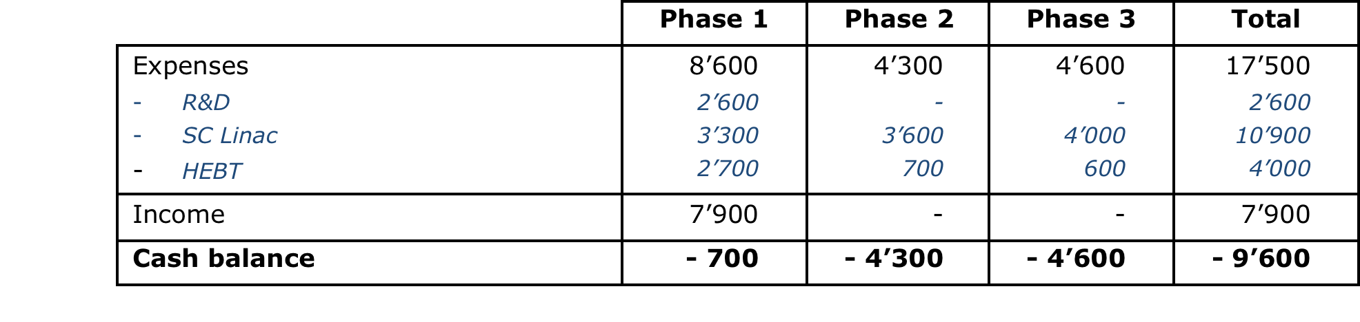
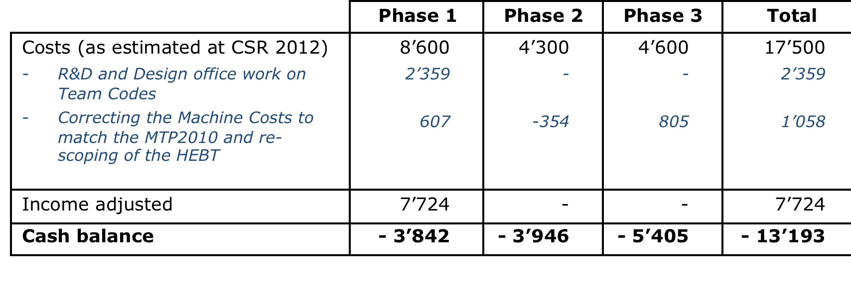
Financial Situation 2012
Cost of the Machine Part as presented at the Cost & Schedule Review in 2012
The following elements should have been incorporated:
    R&D expenditures on Team account
    Correcting the Machine costs to match the MTP2010
    Adjustment of the income

Slide 4
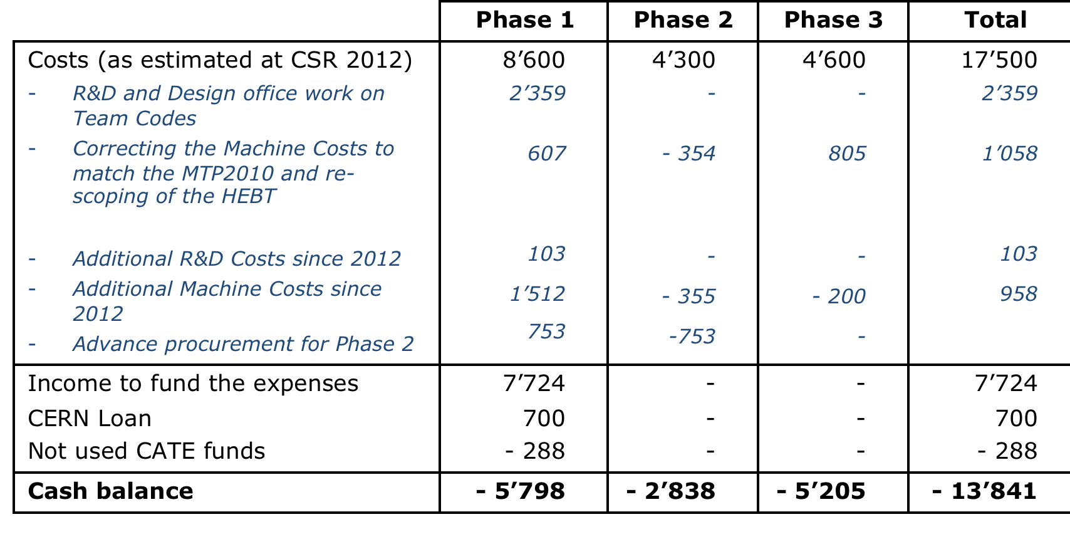
Financial Situation 2013
Since CSR 2012, the following elements have to be considered:
    Additional R&D Costs
    Additional Machine Costs
    Adjustment of the income: not used CATE funds
    Advance procurement of Phase 2 components

Slide 5
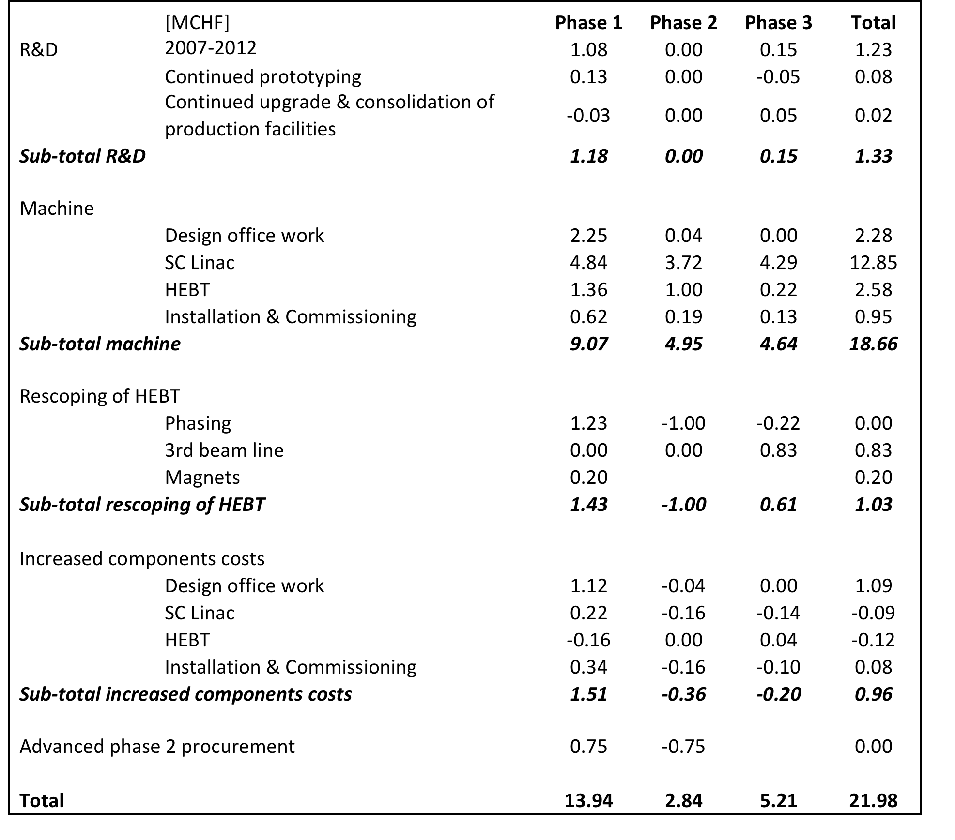
Actual Cost
Cost of the Machine Part of the HIE-ISOLDE Project as assessed in September 2013

Slide 6
Summary of the evolution
[MCHF] | CERN | HIE-ISOLDE Collaboration | Total | CERN Contribution
Approval of the Project | 17.5 | 17.5 | 35.0 | 50%
MTP 2012 | 19.0 | 17.5 | 36.5 | 52%
MTP 2013 | 21.2 | 17.5 | 38.7 | 55%
Present Situation Total | 21.2 | 22.0 | 43.2 | 49%
The current income of the collaboration is
7.44 MCHF + 0.7 MCHF loan

Slide 7
Expenses on Team Codes
Only material and Design Office hours
RF Engineers:
M. Pasini (2007-2010
A. D’Elia (2012-2013)
BE/RF: 1 PhD; 1 RF engineer; 1 tech. student; 1 accel. Phys
BE/BI: 1 tech. student
EN/MME: 1 mech. Engineer
EN/STI: 1 RP expert
TE/MSC: 1 mech. Engineer + 1 Designer
EN/MME: 1. mech. Engineer
BE/RF: 1 tech student
TE/MSC: 1 designer

Slide 8
Status of Expenditures
Machine part

Slide 9
Technical Advances
SC Linac
      Cavity series production started
      RF coupler and tuner systems are being validated
      LLRF prototype successfully tested => series production underway
      SC solenoid design approved=> fabrication starting
      Cryomodule design finalized => procurement underway for long-lead items
High-Energy Beam Transfer lines
      Layout frozen => tracing on the floor
      Dipole and quadrupole Magnets + supports ordered
      H/V corrector magnets by end of November
      vacuum chambers design to be finalized soon
      Diagnostic boxes under procurement
Installation works @ ISOLDE
Design Study for the Intensity Upgrade well underway
      Target + Front-end (FE8 and 9)
      Offline separator test bench
      HVAC + Cooling => nuclearization
      Charge Breeder => assembly of electron gun, test at BNL (US)

Slide 10
Latest sputtering developments
Remaining issues with cavity performance were solved in Spring 2013:
  Sputtering configuration modified to achieve higher deposition rate on the cavity top
  Poor surface quality in the peak E field region fixed
  Sputtering protocol for production defined and validated on 2 test cavities (proof of principle but no statistics)

Slide 11
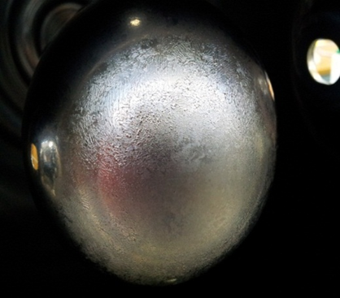
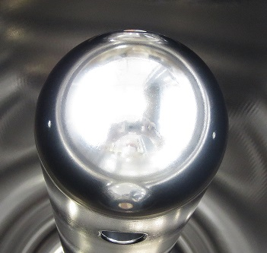
Surface quality of the inner conductor tip
→ source of field emission
Central electrode: 20 mm diameter, at earth potential
No central electrode

Slide 12
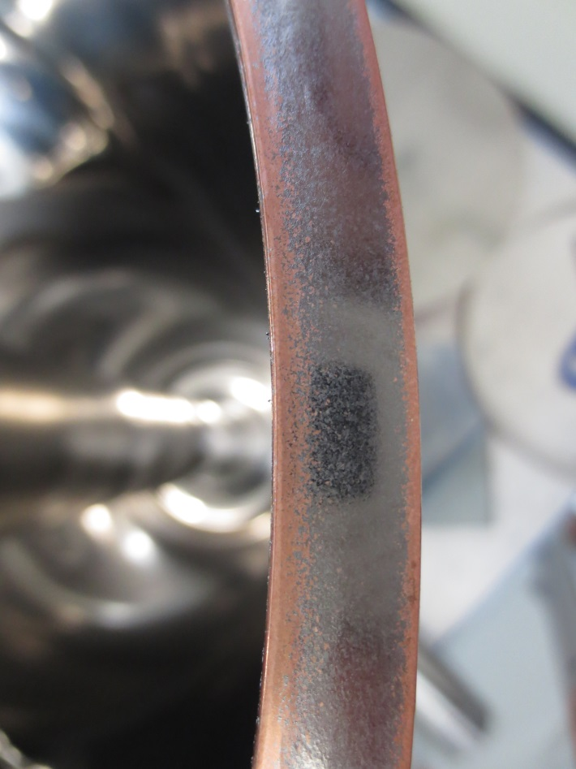
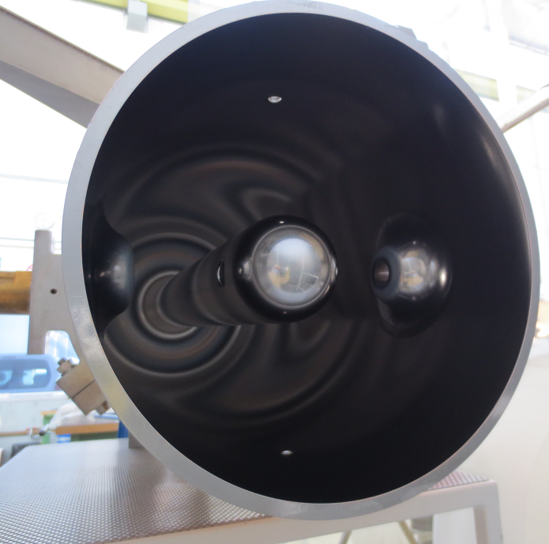
Adhesion on the lower edge (RF contact) was improved using a longer cathode
with 840 mm cathode
length increased to 870 mm

Slide 13
Ready to start series cavity production

Slide 14
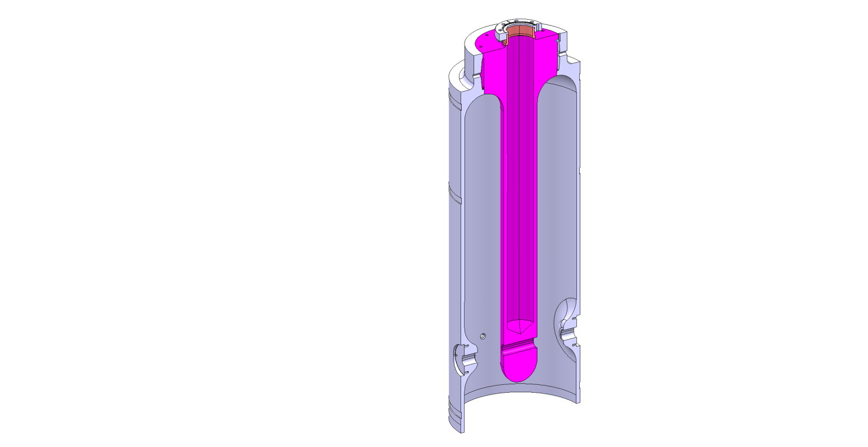
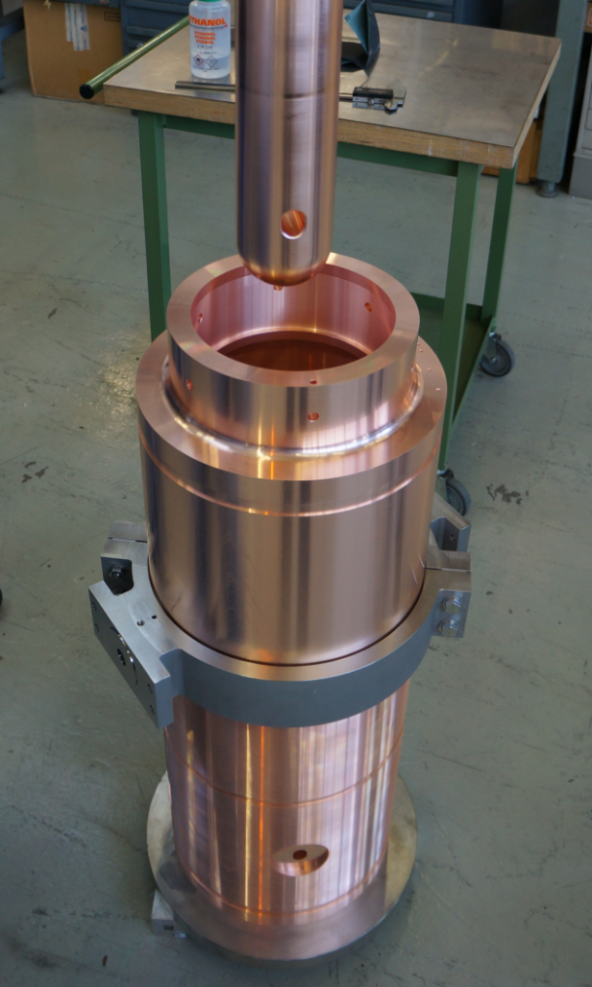
High beta cavity procurement
Version 2
Two series cavities (QP2 and QP3) ready at CERN to start series coating
Contract attributed to industry for production
Few welding issues still being finalized: parameters of the welding machine to be set in collaboration with CERN
Kick-off meeting pending
Delivery of first series unit before the end of the year

Slide 15
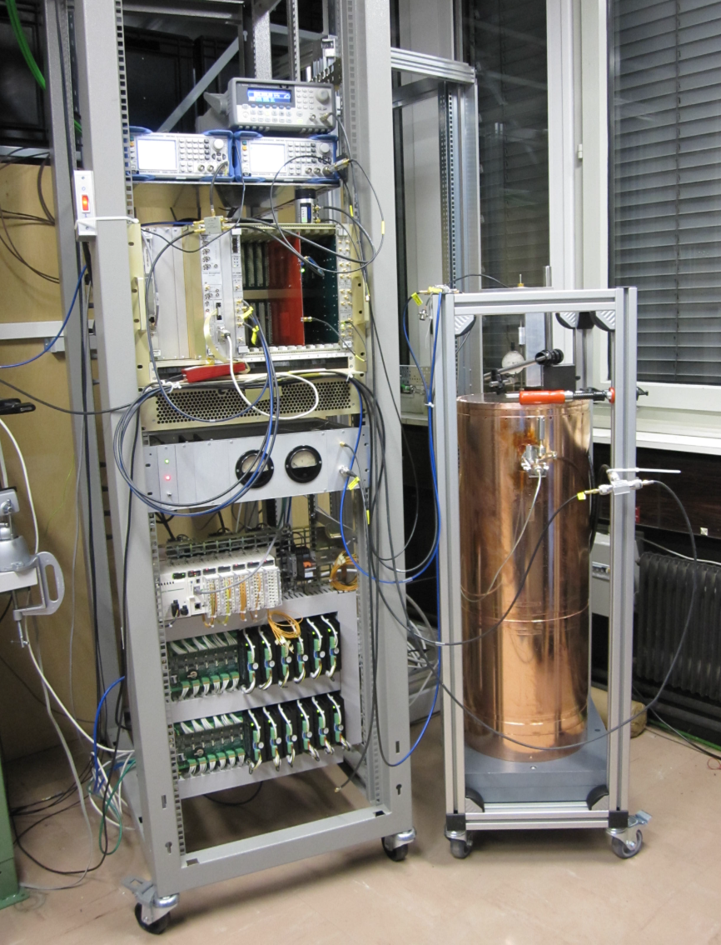
Low Level RF status
First prototype LLRF controller commissioned in SM18
Monitoring of RF signals, locking in Self Excited Loop mode, control of Coupling and Tuning
FESA class operational, high level software to be developed
Manufacturing on-going of 3 LLRF controllers for SM18 cryomodule test
Components for 10 controllers already in house, will start assembly early 2014

Slide 16
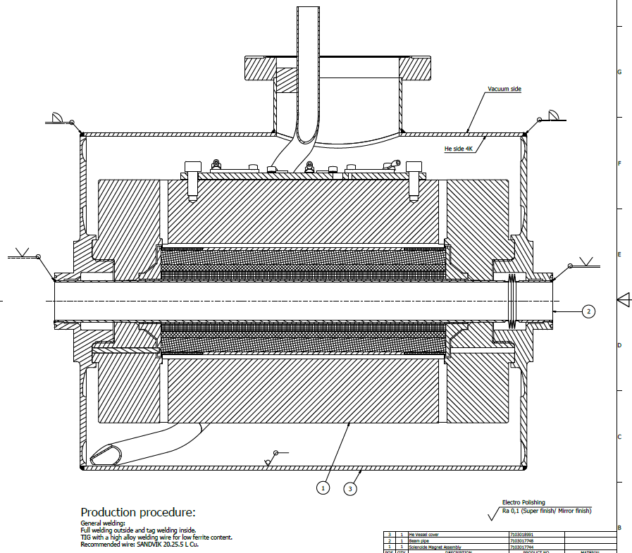
Superconducting Solenoid
Design was revised in June to cope with differential thermal contractions during cool down transients
Final Design Report
Company working on manufacturing drawings and tooling (mandrel, etc.)
Winding scheduled to start in November
First solenoid delivery foreseen end February 2014
Second end March 2014

Slide 17
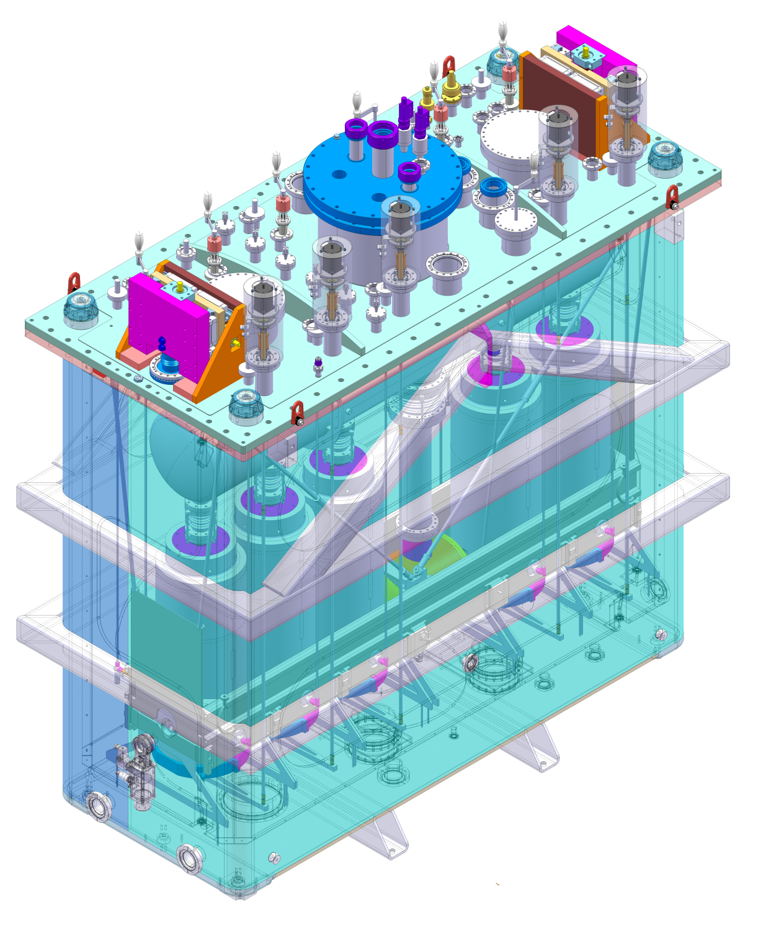
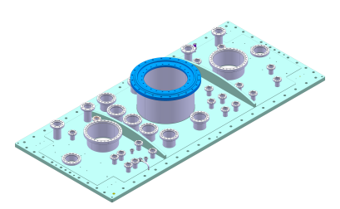
Cryomodule assembly
Vacuum vessel (leading item): tendering process is complete. On 21/10/2013 visiting the (lowest bidder) company. If OK, place contract; delivery: T₀+ 6 months (end April 2014)
Helium vessel: same stage as vacuum vessel, shorter manufacturing times
Thermal shield: detailed drawings being produced→ price inquiry by end November
Suspension system: design complete; final review 6 November. Detailed design and specification by the end of year; price inquiry. Present plan to sign contract in February 2014 for a just in time delivery in May
Support adjusters: two systems passed acceptance tests, will be delivered at CERN next month.

Slide 18
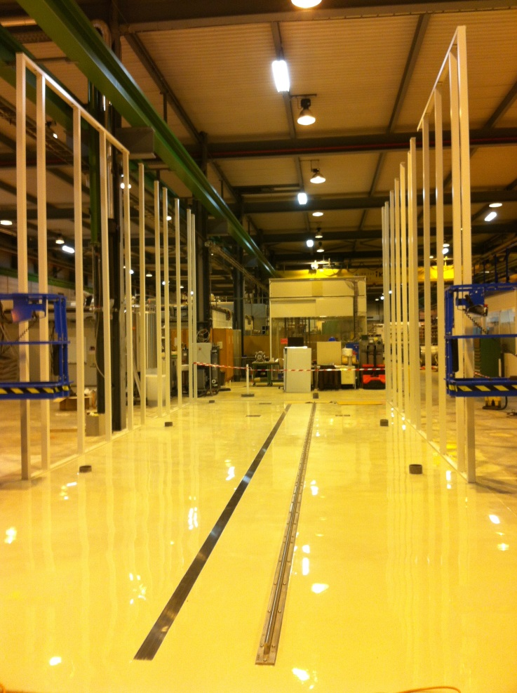
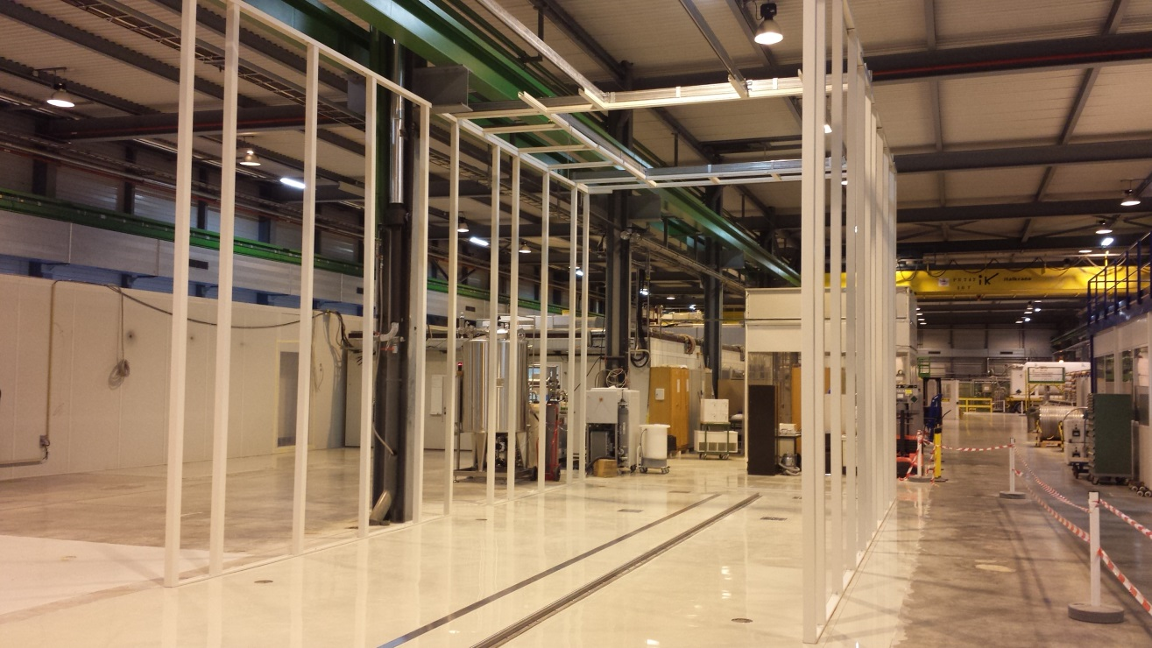
SM18 infrastructure: clean room
Status of clean room:
  Rail installed and precisely positioned
  Ground prepared
  Clean room mounting started last week

Slide 19
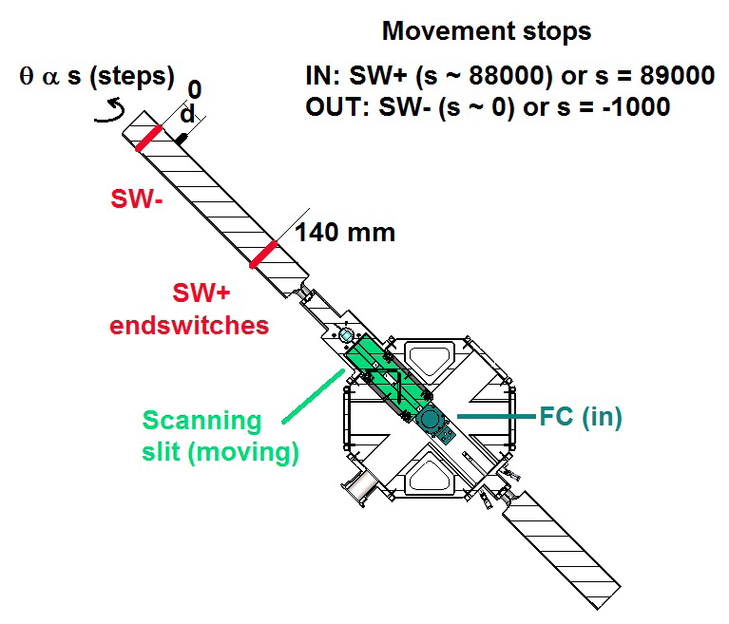
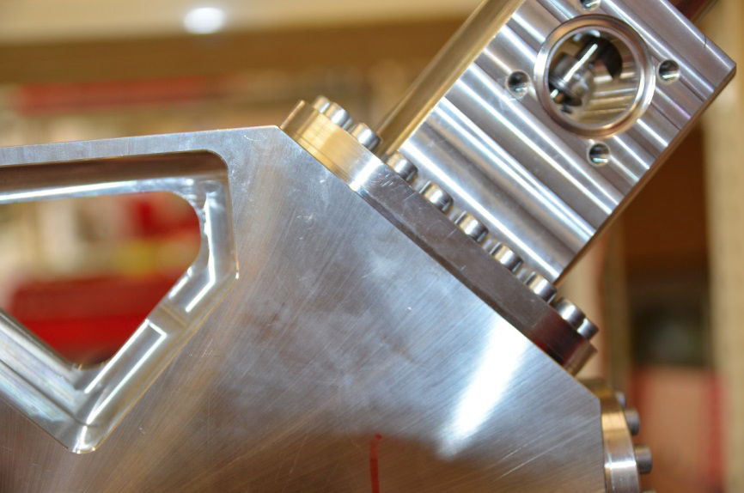
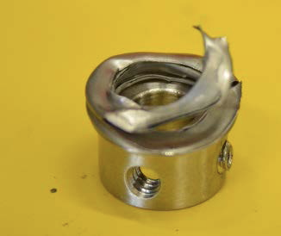
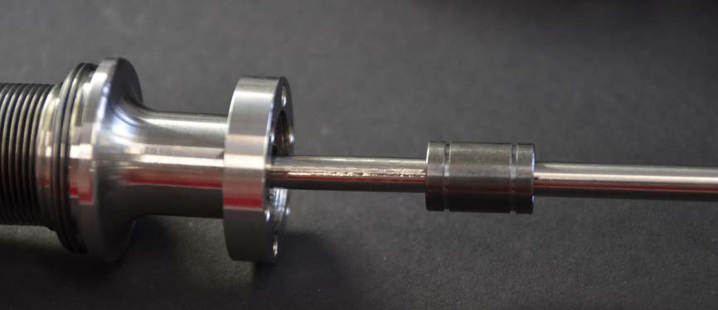
Failure of the prototype short DB
History log of the experimental test done with the HIE DB:
– 20 August 2012: Installation of HIE DB in REX-ISOLDE Hall
– From 20 August 2012 to 5 February 2013: Experimental measurements with stable beams (A/q = 4 and A/q = 3.5); mainly Faraday cup test but also beam profile measurement including movement of the scanning slit (during this period, about 100 IN-OUT scans of the scanning slit were performed).
– 8-9 April 2013: Tests of the scanning slit software, approx. 350 IN-OUT cycles.
– 10-15 April 2013: Stress test of the scanning slit mechanism (run of 1340)
Total number of IN-OUT cycles of the scanning slit mechanism: approx. 1800.
HIE-BDB-TN-0001 (edms# 1284254)

Slide 20
Beam Instrumentation
New design with external actuators
The concept of an external actuator was tested successfully at CERN
Contract with AVS is about to be signed for Short Diagnostic Boxes → 6 SDB boxes by August 2014
Supply T0=contract date. T1=Slit prototype acceptance | Latest Delivery dates
Revised manufacturing drawings | 8 November 2013
Test of the scanning slit linear motion at AVS | T0+9 weeks (15 January 2014)
Batch of prototype short diagnostic box | T1+7 weeks (5 March 2014)
Batch of three series short diagnostic boxes | T1+31 weeks (6 August 2014)
Batch of two optional series short diagnostic boxes, if option taken up by CERN | T1+31 weeks (6 August 2014)
Batch of two optional spare short diagnostic boxes, if option taken up by CERN | To be advised
Tendering for Long boxes (LDB) needed in the transfer lines will start by end of this year as soon as CERN has recuperated the intellectual property of the drawings

Slide 21
HIE Simplified Planning
Start Isolde shutdown
17 dec 2012
We are here:
Oct 2013
End LS1:Start Low E physics
July 2014
HIE physics at 5.5MeV/u
October 2015
2011
2012
2013
2014
2015
2016
Q1
Q2
Q3
Q4
Q1
Q2
Q3
Q4
Q1
Q2
Q3
Q4
Q1
Q2
Q3
Q4
Q1
Q2
Q3
Q4
Q1
Q2
Q3
Q4
Civil
HEBT
Civil hall
Cryo
Main services
RF
Ventilation
Demi water
5.5MeV/u
Electrical syst.s
CM 1&2
Timeline:
Cabling
sd
sd
LS1
sd
sd
17 Dec 2012 - Q3 2014
Beam commissioning
3 months
shutdown
Isolde Ops
HIE installations and tests (Isolde normal operations)
Machine Check-Out
(Isolde normal operations)
Beam Commissioning
(Isolde normal operations)

Slide 22

Conclusions (1/2)
Technical Activities: progress is tangible on most of the machine parts => however one has to carefully monitor the following items:
      Series cavity production
      Tuning system procurement
      Procurement of CM parts and instrumentation
      Tooling for clean room assembly
      Cryogenics for SM18 test
      Transport solutions
      Reliability issues
      Safety
  Installation Works: High activity in the hall and service buildings; Despite delays we are still in line with the overall schedule which aims for low energy physics during 2014 and HIE physics as of Oct 2015. Critical paths for some activities are being addressed (cryogenics & cryomodule installation)

Slide 23
Conclusions (2/2)
Safety:
      Shielding study finished – Report under preparation
      Beam losses and dump study to be finished
      CFD simulations of He leaks done by EN/CV have helped to discuss the access to the tunnel during steady state
      Safety folder => Demonstrative part to be finished
      Safety review planned for November 2013
Budget and Resources:
      Financial situation analysed in-depth:
          5.8 MCHF shortfall for the completion of Phase 1 (5.5 MeV/u)
          8.6 MCHF shortfall in total up to Phase 2 (10 MeV/u)
          13.8 MCHF shortfall including Phase 3 (10 MeV/u + Low-Beta)
      Staffing of clean room assembly is an issue
      Extension of CATHI fellows beyond 31st Oct. 2014 => no funding available
Planning: consolidation ongoing

