Slide 1

Status of the activities for LS1 and HIE-ISOLDE Design Study
Alignment
VITO Beam line modification
Richard Catherall
EN-STI-RBS
ISOLDE Collaboration Committee
22nd October 2013

Slide 2

LS1 Activities
Target area
  Robots
  PAD/MAD
  Medicis
  Hot Cell
Hall
  REX
  TSR@ISOLDE
  RILIS

Slide 3
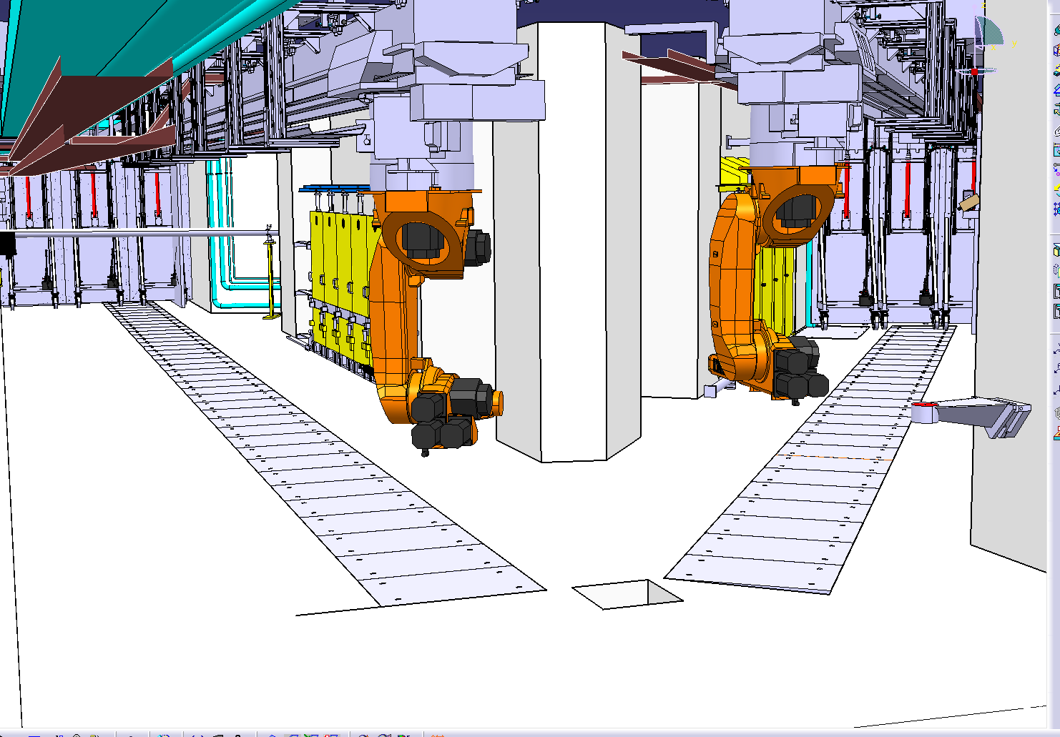
Robots
Over 260 cycles performed during the CERN open days demonstration
  ~7 years of operation
  No faults
  But…
M. Vagnoni, J-L Grenard

Slide 4
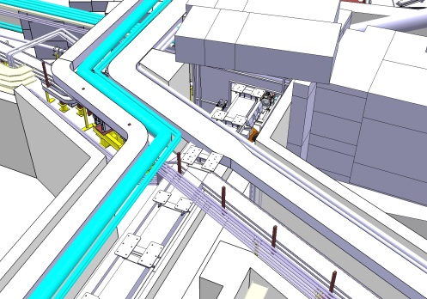
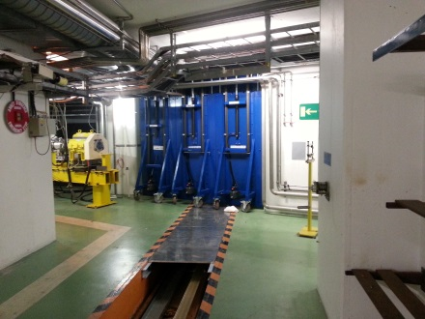
Phase III – Services modification
Overview of the situation
MAIN TASKS TO BE CARRIED OUT
Dismantling and installation of new CV pipes and ducts
Dismantling and installation of new electrical cables and cable trays
RADIOPROTECTION ASPECT
Higher collective and individual doses than expected
Main reason for higher dose rates in the area:
  Activation of certain equipment and material near the Faraday Cages on both GPS and HRS sides
    Ducts, pipes
    Concrete walls
    Cable trays
CONSEQUENCES
Major increase of the collective dose concerning phase 3 near the GPS Faraday cage
2313 H.µSv
ALARA Committee
March 2013
7181 H.µSv
New estimation
September 2013
Factor 3
Duc Duy Phan

Slide 5
Phase III – Services modification
Overview of the situation
ADDITIONAL CONTROL MEASURES IMPLEMENTED
Use of a saber saw to reduce the time of intervention and to maintain a safe distance from the cutting points
Installation of a lift truck to allow the mechanical support of the ducts and pipes during cutting work, thus avoiding human intervention for the handling
Phasing of the work in order to dismantle the hot points first
Limitation of the individual dose to 600 μSv
Duc Duy Phan

Slide 6
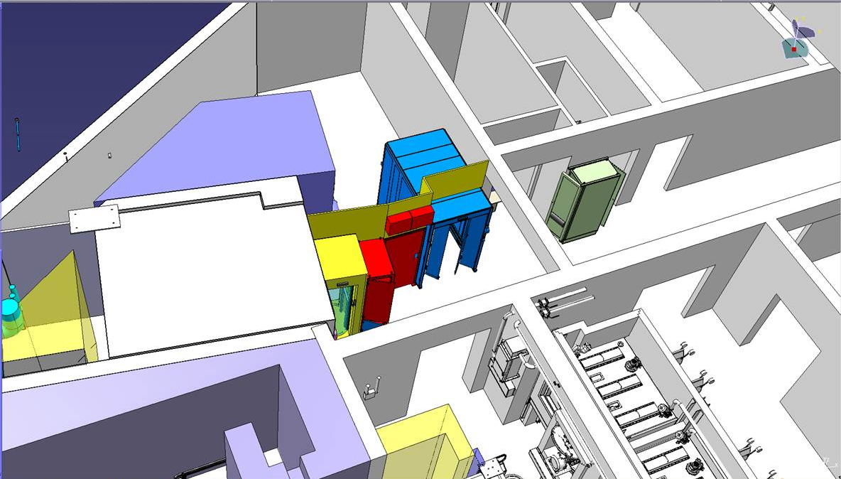
PAD/MAD Installation
Will be installed in January
  Gives more time for installation of robots
  Allows for the modification of the corridor for future hot cell
  Safety chain checks start in February

Slide 7

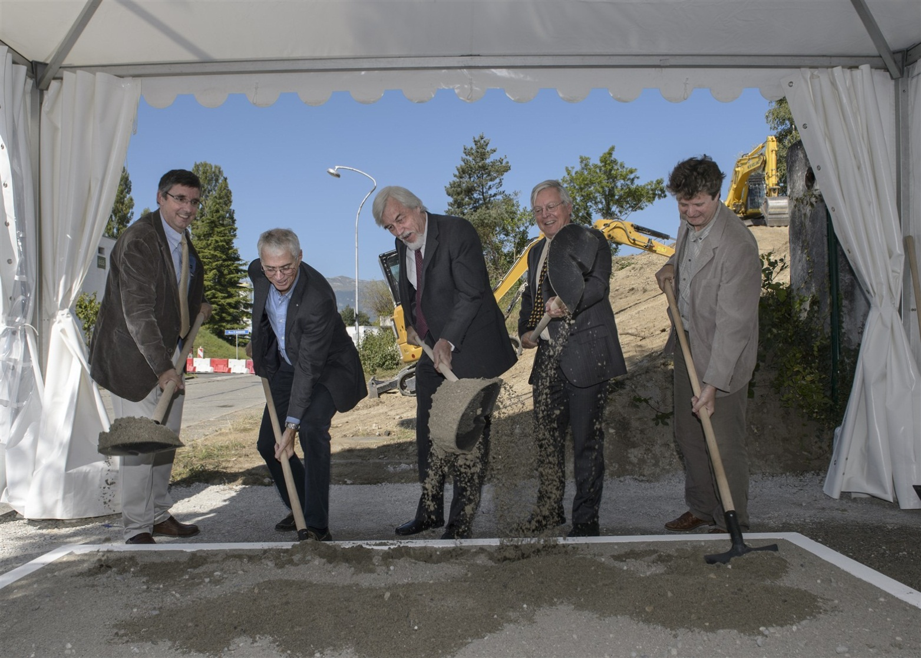





Groundbreaking
September 4th 2013
T. Stora

Slide 8
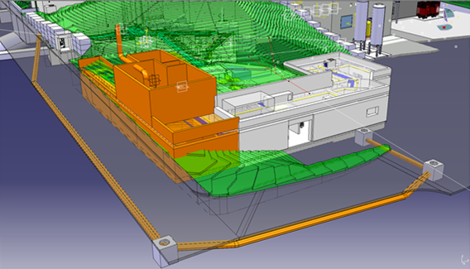
Building
New services for Bld 179 done.
Earth removal started.
“cold building” finished in Feb 2014 (1 month shift).
T. Stora

Slide 9
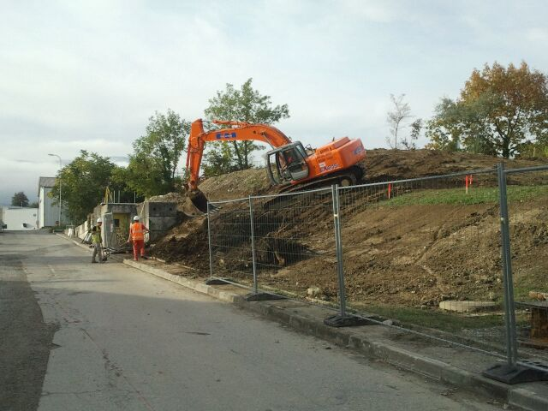
Earth Removal
T. Stora

Slide 10
External partners
External partners :
Dr. Forni (Clin. Carouge)
L. Vouga, Prof. P. Morel, Prof. L. Buehler, Prof. Y. Seimbille, Prof. O. Ratib (HUG, Geneva), Prof. D. Hanahan (ISREC-EPFL, Lausanne)
Prof. J. Prior, Dr. F. Buchegger (CHUV, Lausanne)
Prof. M. Huyse, Prof. P. van Duppen (Univ. Leuven)
Prof. S. Lahiri (SINP, Kolkata)
Prof. Piperkova (Nat’l oncology hospital, Sofia)
Prof. Dos Santos (FCUL, Lisbon)
Budget so far : (CERN+external+in-kind) : 3.2 MiCHF
New in-kind + grant requests underway
PHASE I Commissioning : No beam (end 2015)
PHASE II Start up with light targets for retour d’experience (2016)
PHASE II B Production with light targets (mid 2016)
PHASE III Extending to heavy targets up to Tantalum (tentative end 2016)
PHASE IV Collection of short lived alpha emitters (149Tb) (tentative 2017)
PHASE IVB Operation with Lasers
PHASE V Operation with Uranium targets/possible proton beam upgrade (tentative 2018)
T. Stora

Slide 11
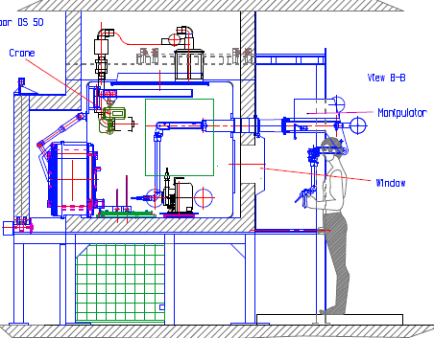
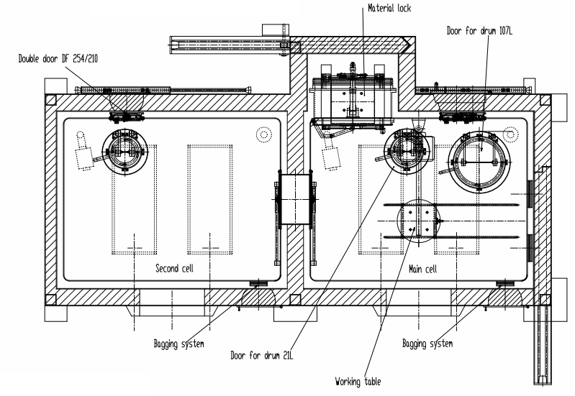
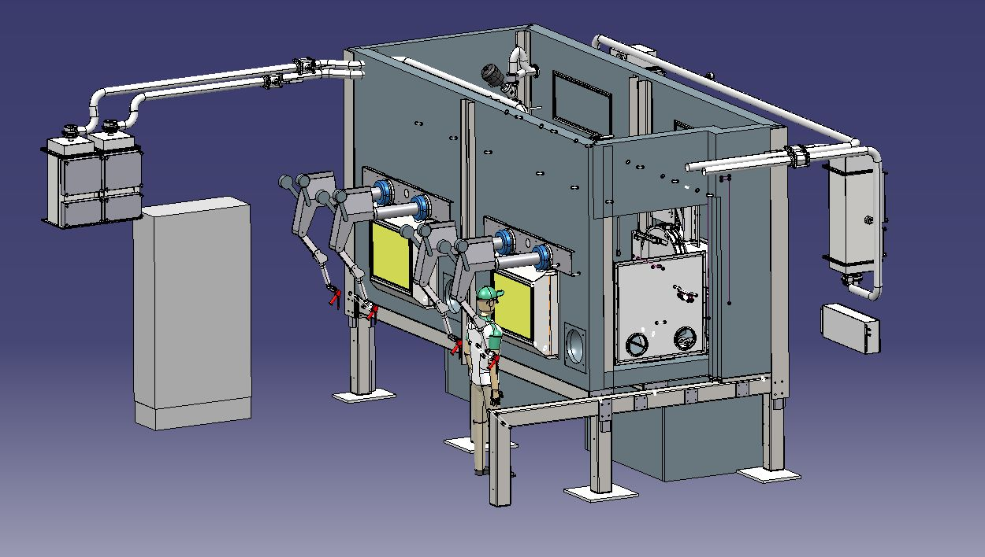
Hot cell layout
Production on schedule
Factory acceptance tests planned for December 2013
Modification of building 179 to start in next few weeks
A. Stadler

Slide 12
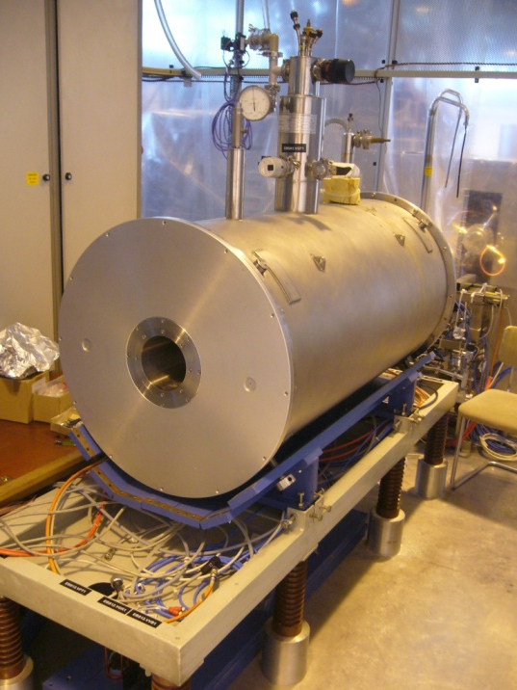
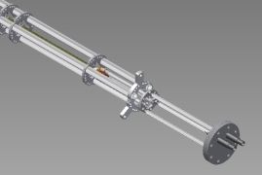
REXEBIS and REXTRAP
1. Scheduled electron cathode tests for autumn 2013 postponed to spring 2014
  Due to lacking infrastructure (water, LHe, controls etc).
2. Repair of REXEBIS magnet cryostat initialized
Present LHe holding time 6 days and could fall abruptly (nominal 14 days).
  Last repaired 2005 by external firm Ice Oxford; this time in-house repair.
Major and risky job; complete EBIS needs to be dismantled.
Goal: EBIS re-assembled by March 2014.
3a. Incomplete and incorrect drawings of REXEBIS now redone in 3D
b. Production of spare collector (critical EBIS part), gun and inner structure
Spin-off from TwinEBIS
4. Modification of injection FC for REXTRAP
Inherent design error mitigated; new version being evaluated.
F. Wenander

Slide 13
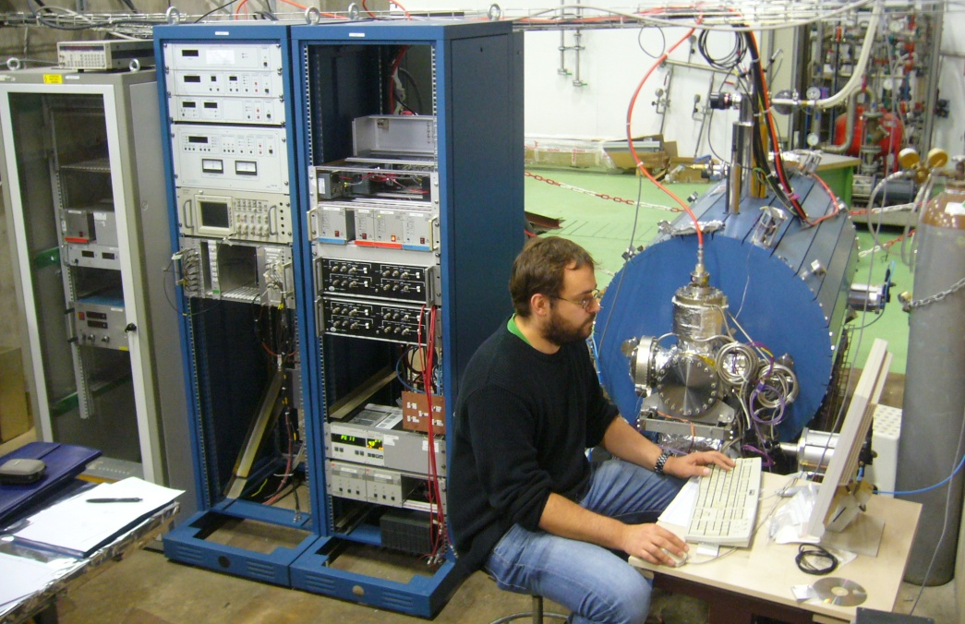
TwinEBIS test setup
* Labview system for DC control and vacuum readout finished.
* Bakeout system, power supplies, HV gun rack installed.
* Remaining mechanical internal parts in production.
(act as spares for REXEBIS)
* Vacuum control system (FPGA) in production. Assistance P. Fernier.
* M. Breitenfeldt COAS during autumn 2013 => major push!
Long-term goals:
0. Spare for REXEBIS
Higher electron current
Better cathode lifetimes
Test-bench for EMILIE project
Optimization of extracted ion pulse
EBIS team: M. Breitenfeldt, J. Thiboud

Slide 14
Funding of EBIS development activities
Good progress thanks to excellent members at the team!
1. Struggling to extend A. Shornikov’s presence at CERN. His CATHI fellowship is ending 30/6-2014.
2. Can only fund M. Breitenfeldt to Feb 2014. TwinEBIS activities
will thereafter be reduced.
* ENSAR-2 application submitted for continuation of the charge-breeder upgrade development. Approval, granted funding and starting date unknown.
* Open for external contributions and suggestions how to prolong 1 and 2 above.
F. Wenander

Slide 15

integration study
* Preliminary results presented at IEFC 31/7-2013
* Final report submitted to Director of accelerators and department leaders 28/8-2013
* Full presentation and executive summary can be obtained upon request (F. Wenander)
TSR elements evaluated by CERN specialists
In general a positive response and supportive response from the CERN groups
Two approaches 1. CERN homologation (full-fledged ‘standardization’)
2. Keep-system-as-is (low-budget option with minimal changes)
Next steps
* Awaiting feedback from CERN management
* workshop at CERN 14 Feb 2014
E. Piselli, E. Siesling, F. Wenander

Slide 16
integration study
* The radiological concern of importing the ring is minimal.
* Well advanced civil engineering plan with associated infrastructure exists.
* No technical show stoppers for the implementation – standard solutions identified.
CERN integration proposal
Keep-system-as-is
a. The first cost and manpower estimate, should cover most/all parts of the move and are believed to be conservative. The CERN support groups claim that the cost of some WPs can be reduced if the allocated budget so requires. However, no contingency included.
b. Most CERN groups have insisted on hardware changes and CERN standardization and discourage a 3 years transition period with temporary solution as that would inflate the costs.
Total cost and manpower for transfer and integration into a CERN facility:
15.2 MCHF 27.5 FTE (man year)
a. Would need to keep all subsystems as they are since many are interlinked with the control system.
b. Would have limited or in some cases no support by CERN groups; longer dependence on MPIK Heidelberg.
c. Power converters, vacuum, magnets, RF and e-cooler
could in principle be imported as such.
d. Improved electrical ring safety is mandatory if the ring
is imported as is.
The approximate cost and manpower need for the
Keep-system-as-is scenario are:
11.8 MCHF 17.1 FTE (man year)
The cost saving might appear low but it should be kept in mind that:
* The main cost drivers for a TSR at ISOLDE are the injection line, buildings and infrastructure.
* Some spares, complementing parts and replacement parts are absolutely necessary.
* Includes the mandatory electrical protection of magnets connections.
* Includes sensitivity improvement of the beam diagnostics.

Slide 17
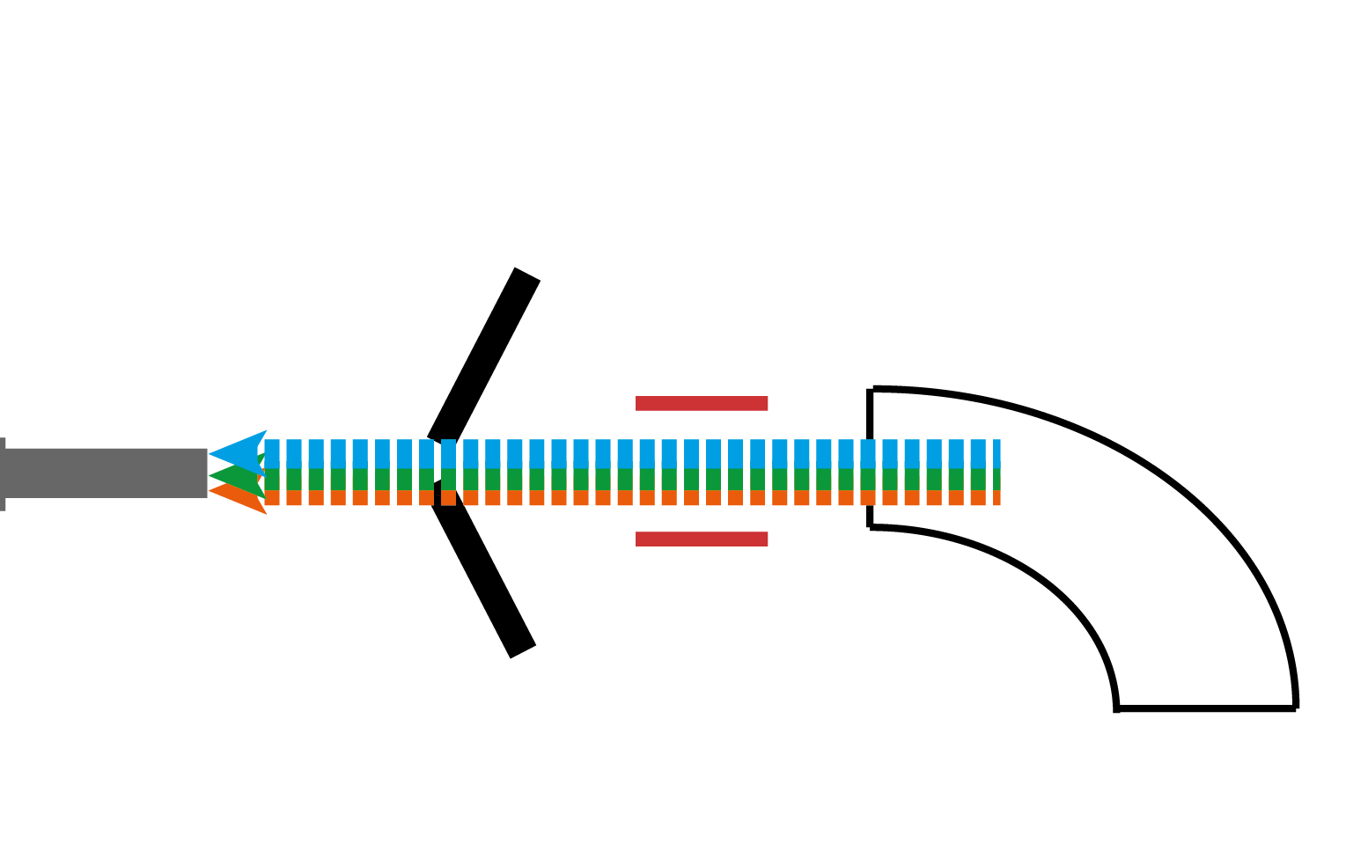
5 μs beam gating test
Narrow laser-ion bunch width + micro beam gate tests
Ga mass
marker
Solid-state switch
~ 500 V @ 10 kHz
RILIS
ionization
scheme
High Ω cavities:
Thin graphite ☑
Pyrolytic graphite ☑
Sigradur ‘glassy’ graphite ☐
Pulsed heating for higher voltage ☐
Ga
1 μs beam gate
is possible!
= 100 x
Surface ion suppression!
Laser-ion
time structure:
5 μS FWHM!
B. Marsh, V. Fedosseev

Slide 18
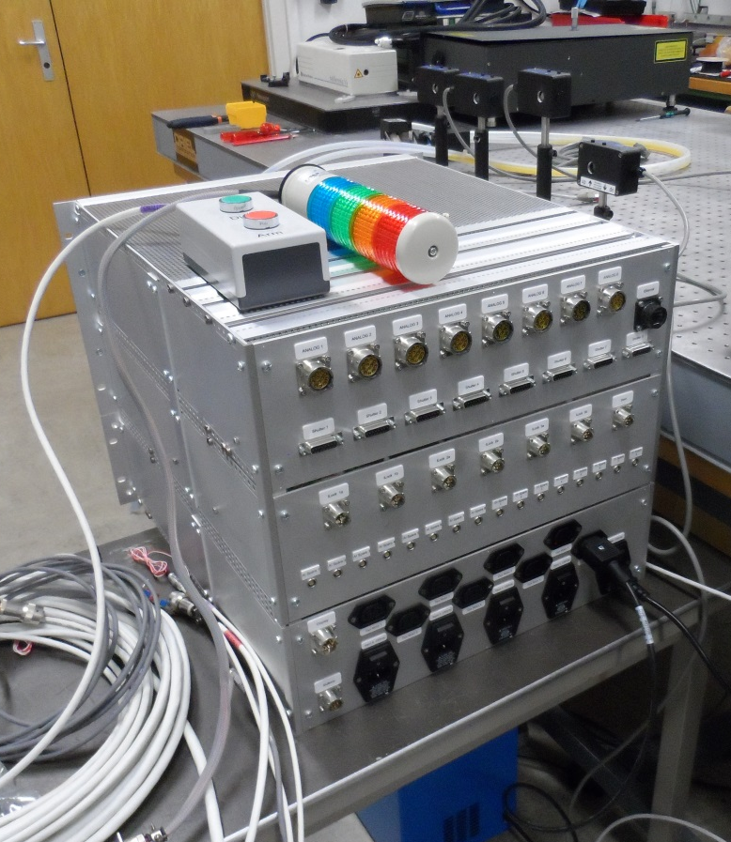

RILIS machine protection: built and being tested
  Hardware to control multiple laser interlocks and shutters is assembled by STI-ECE
  Laser dye leak detection
  Offline testing has begun
  Installation in January 2014
Preparation for
‘on-call’
RILIS operation
B. Marsh, V. Fedosseev

Slide 19


Overview
Different Technical Advances
  Targets
  Front End
  Beam Quality
    REX EBIS
    Off-line
    HRS
  Infrastructure
    Ventilation
Time line
  The Design Study report
  REX-EBIS planning
  Implementation
HIE-ISOLDE workshop: The Technical Aspects

Slide 20
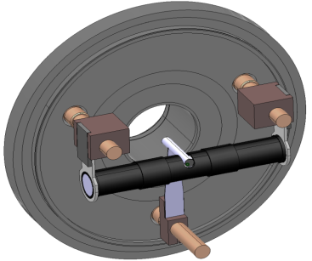
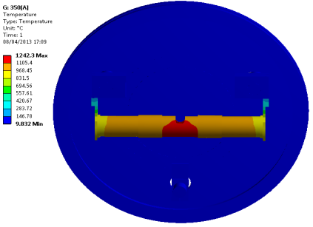
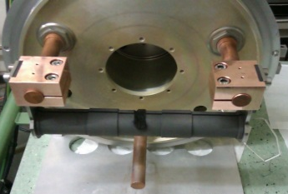
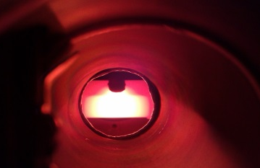
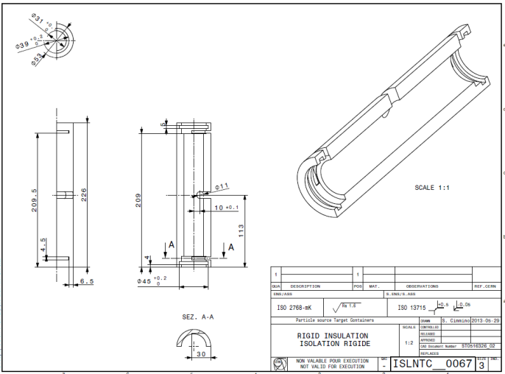
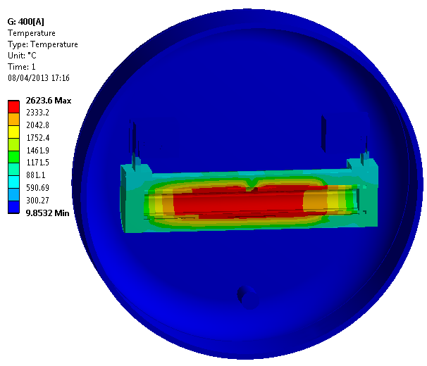
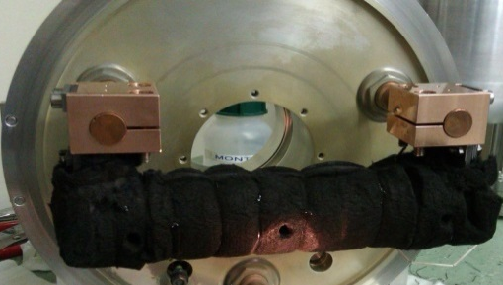
Targets: RIB Intensity Increase
Separated heating and containing design: electro-thermal study, prototype and experimental tests
Bare Graphite heater
CATIA model
Graphite container simulations
CATIA model
Graphite heater with Sigratherm screen
Sigratherm screen simulations
Notes:
One of the major problems connected with the actual target heater is the presence of cold spot on the extremity which cause re-condensation of the nuclei affecting the in target production. A new design has been tested: the containing and the heating functions are separated allowing a design optimized for the thermal issue. This concept was, at first tested via numerical analyses and then, prototyped and validated via experimental tests. Numerical and experimental data showed good agreement and proved the design to be successful for thermal uniformity.
The second step was the test of the new concept wrapped in a graphite solid mousse. The results proved to be even better for the thermal point of view but the assembly is challenging therefore a new rigid graphite screen has been designed and purchased.
Soon this soultion will be tested.
The use of graphite is important also in term of waster reduction considered the future increase of proton intensity.

Slide 21
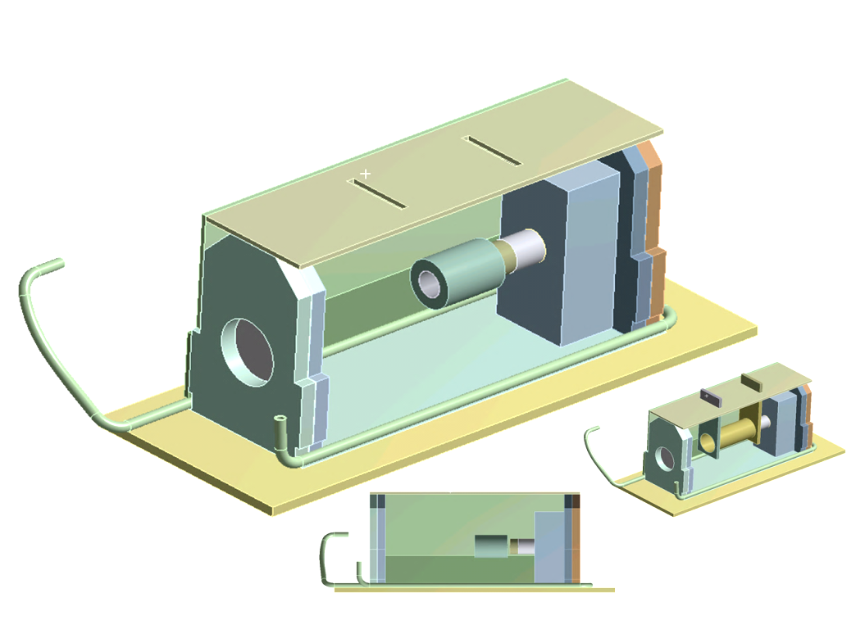
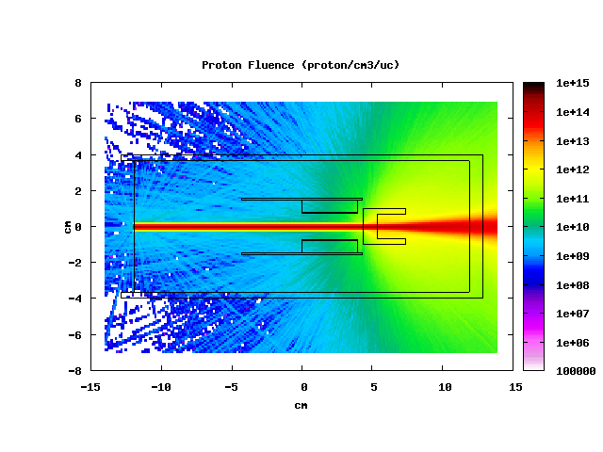
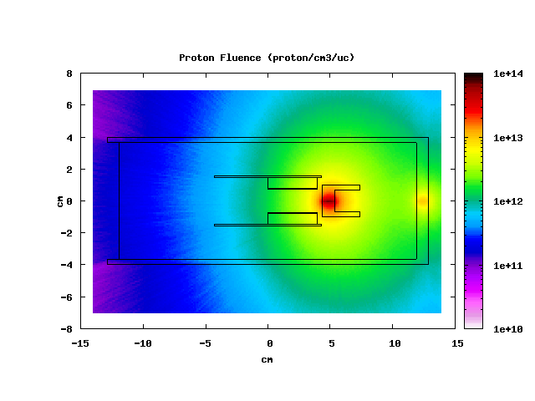
Targets: RIB Purification
Neutron spallation source design study:
Heat Shield
Cooling
Pipe
UCx
Converter
Container
Graphite Block
Online tests at TRIUMF in 2014.
Energy: 500 MeV;
Intensity: 100uA.
Notes:
A new neutron converter design study is on going. It is forseen to be tested on line at TRIUMF in order to have higher power (in view of HIE ISOLDE).
The aim of this device is to have beam purification from neutron-deficient isobaric contamination. A neutron-converter uranium target largely excludes the production of these contaminants.
The main issue, for the moment, is the space constraint imposed by TRIUMF which doesn’t allow great results.
Discussion are undergoing about possible constraint release or eventual delay of the project.

Slide 22
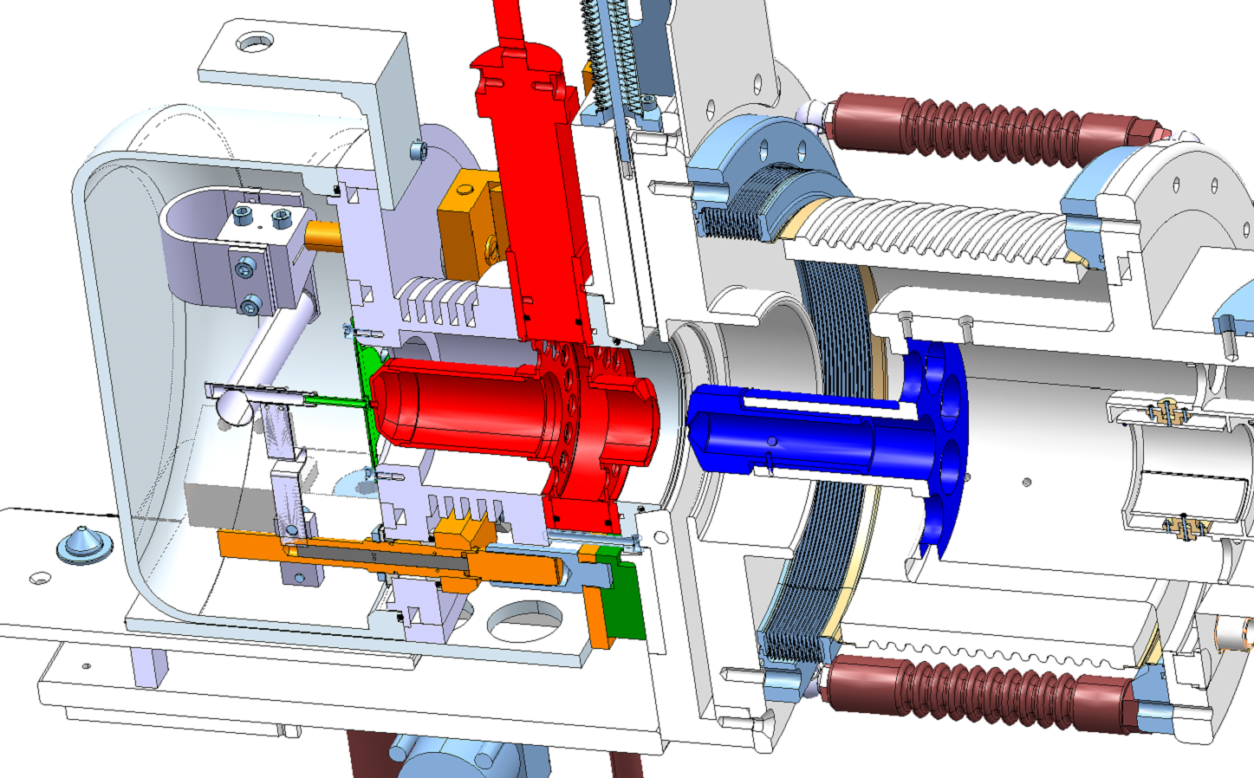
Front End: Pre extraction prototype
- Without electrode movement mechanism
- Electrode head exchanged with target unit without human intervention
- Intermediate voltage works as focalization lens
- Intermediate electrode customizable for each target unit
60 kV
57 kV
Ground
J. Montano

Slide 23
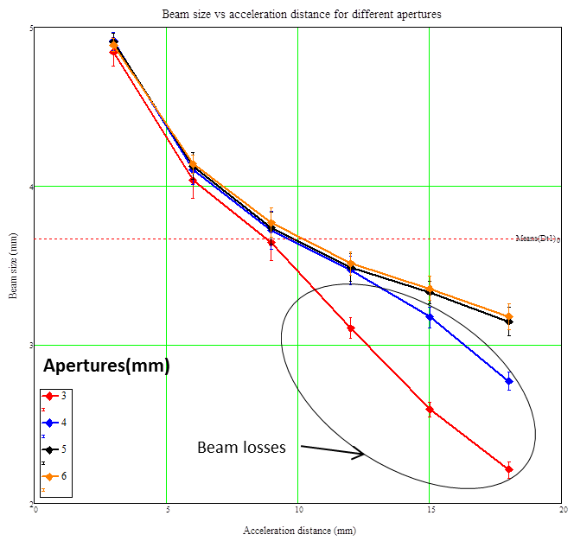
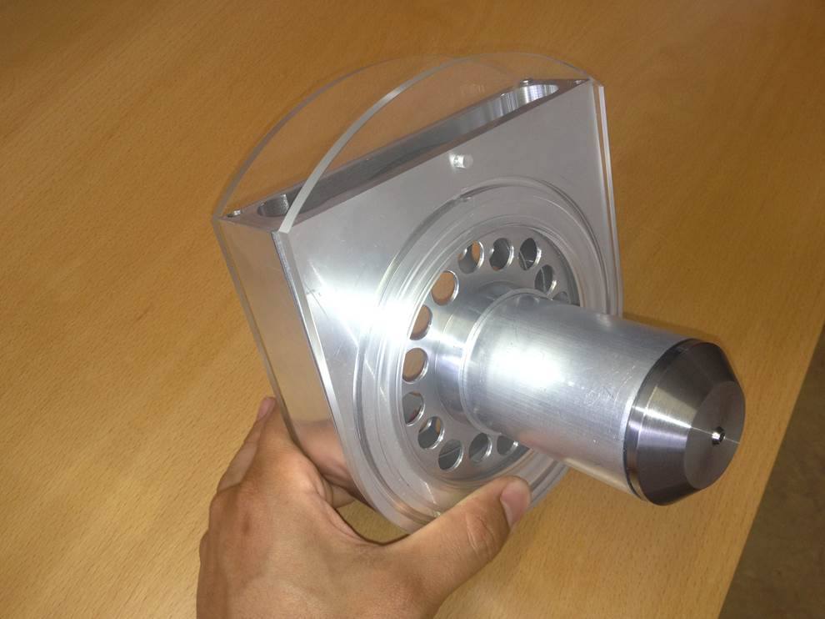
Front End: Geometrical optimization
… A numerical optimization of the geometry has been performed. The criteria were mostly based on extracted beam quality and minimum losses
… prototypes have been constructed and are under experimental tests to validate the results
J. Montano

Slide 24
Charge breeder upgrade for HIE-ISOLDE
Design parameters
 | HIE-ISOLDE / TSR@ISOLDE charge breeder | REXEBIS
Electron energy [kV] | 150 | 5
Electron current [A] | 2-5 | 0.2
Electron current density [A/cm²] | 1-2x10⁴ | 100
New EBIS – High Energy Compression and Current (HEC²) EBIS
Main challenge – produce the high compression electron beam
Goal – have a reliable design of the HEC² electron gun at earliest possible stage
Realization – in a joint effort with BNL, based on BNL design and infrastructure
(BNL Test-EBIS), partly funded and manned by CERN
EBIS team: CATHI fellow A. Shornikov

Slide 25
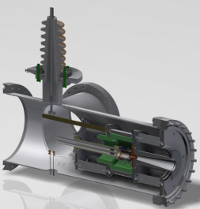
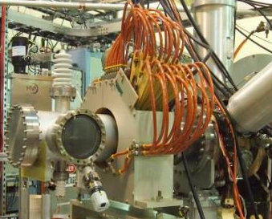
Charge breeder upgrade for HIE-ISOLDE
HEC2 gun at TestEBIS
HEC2 gun
Cathode
Anode
Progress since April
HEC2 gun
chamber
Magnetic
shielding
BNL TestEBIS
Apr
May
Jun
Jul
Aug
Sep
Oct
The gun manufactured at CERN
Gun mounted on Test EBIS
Preparing for tests
Gun shipped to BNL
Conditioning EBIS
Work at BNL
First complete EBIS simulation with high compression beam
EBIS team: CATHI fellow A. Shornikov

Slide 26
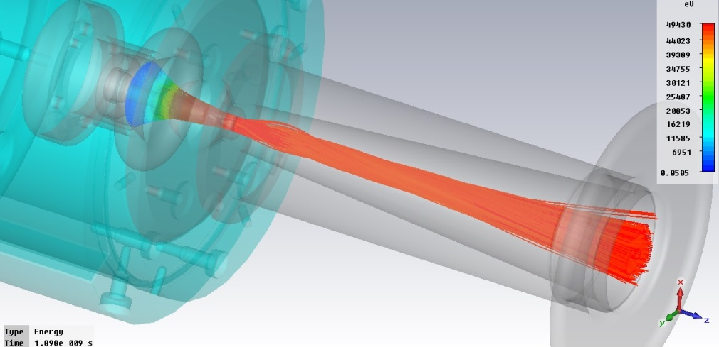
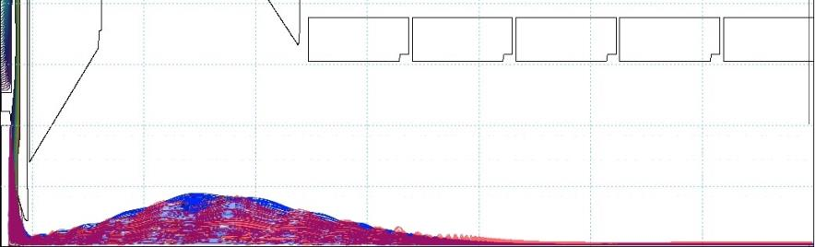
Electron beam simulations
*Major effort benefiting: HEC2 gun design and verification
            REXEBIS current increase
* So far mainly 2D results using Field Precision software
* Complete BNL TestEBIS with HEC2 gun simulated – major feat!
* Preliminary 3D simulation results using CST Microwave Studio obtained
* Cluster simulations using up 128 cores and 1 TB memory in the pipeline
Allows to break the symmetry (e.g. misalignments)
Cathode
Anode
Drift tube
Simulation and optimization of a 10A electron gun with electrostatic compression for the HEC2 gun
Classical approach
Relativistic approach
Electron trajectories
4
mm
Results: Limited beam scalloping
>2E4 A/cm² in full field
optimization of collector potential and geometry in process
EBIS team: PhD R. Mertzig

Slide 27
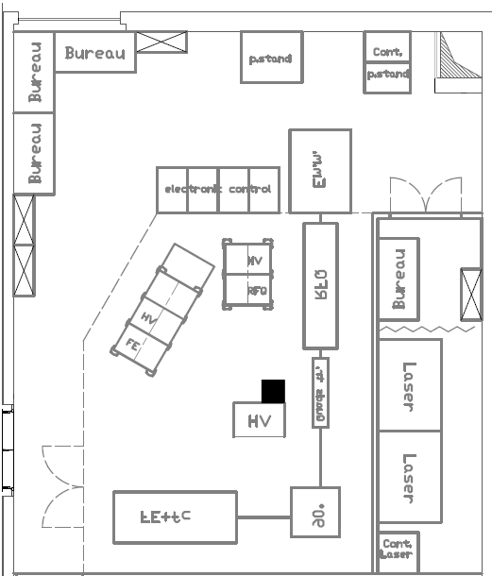
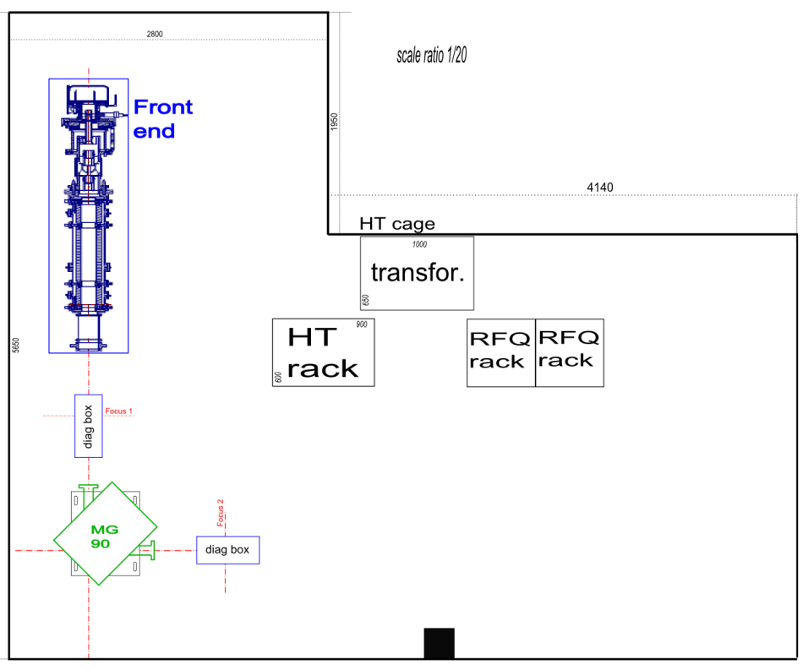
ISOLDE offline separator #2
Purpose: testbench for the validation of principles
regarding the High Resolution Separator upgrade
Courtesy of Stefano Marzari
ISOLDE offline #2 (current status)
Foreseen layout of ISOLDE offline #2
Detailed definition of experimental setup
Dipole characterization
Magnetic field mapping
Ion source characterization
Separation test
RFQCB test
Status on 11/10/2013 : FE and MG90 operational, RFQ under assembly
M. Augustin

Slide 28
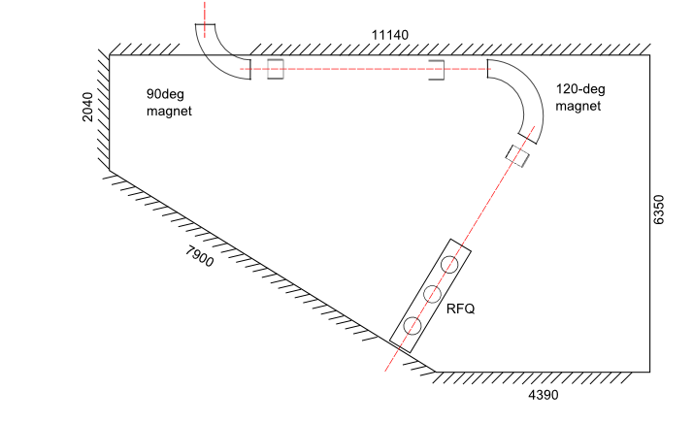
High Resolution Separator (HRS) upgrade design study
Moving of Radio Frequency Beam Cooler (RFQBC) foreseen more upstream of beamline, in the separator room.
➔ Constraints regarding the available space in separator room and regarding the positioning of already existing beamlines upstream and downstream
Existing beamline
Low beam emittance at exit of RFQBC
Beam shaping before magnetic stages with quadrupoles
120º dipolar separator magnet (including quadrupolar and sextupolar components)
90º dipolar separator magnet
quad.
Existing beamline
Layout proposal schematic
M. Augustin

Slide 29
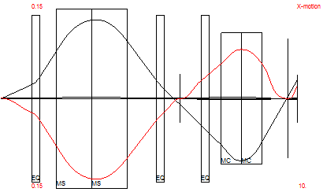
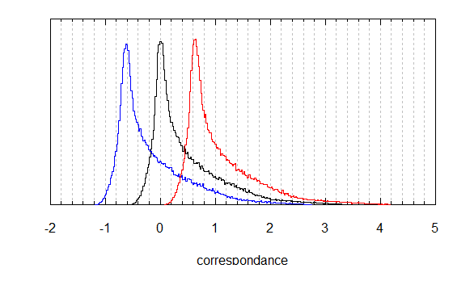
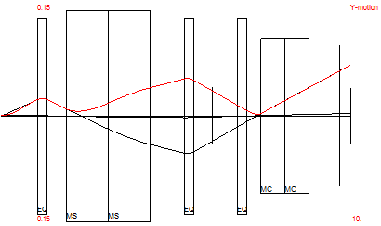
High Resolution Separator (HRS) upgrade design study
© COSY simulation of HRS proposed layout : x-axis
Separation power computation with © Octave
Considered mass M=100
ΔM/M=2.10⁻⁴
Computation performed at 3rd order
Next steps :
Tuning for compensation of aberrations at 3rd order on MG120
Tuning of quadrupole and sextupole components on MG90 °
© Opera simulations of MG120°
© COSY simulation of HRS proposed layout : y-axis
M. Augustin

Slide 30
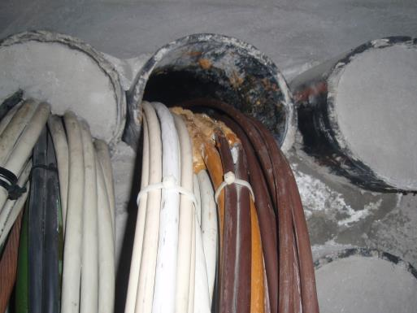
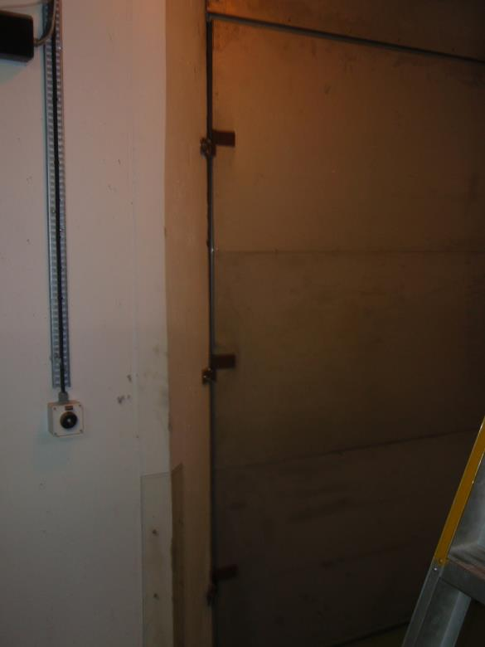
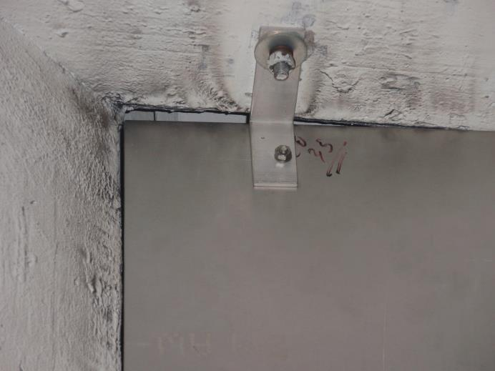
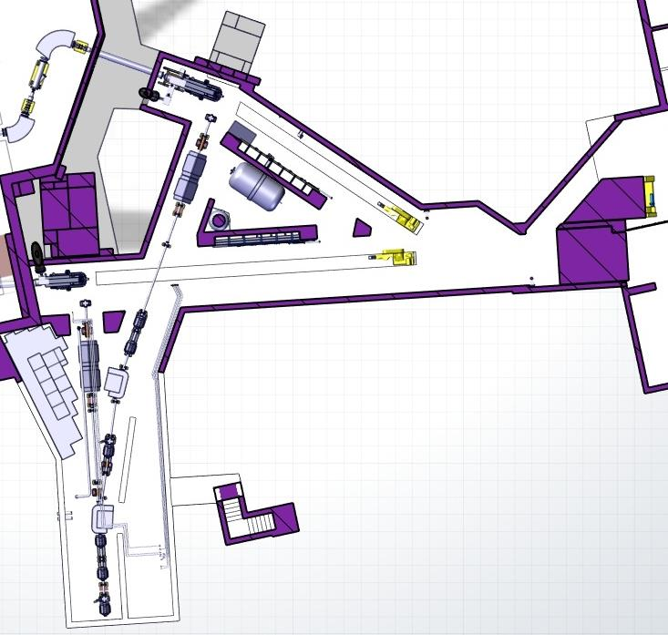
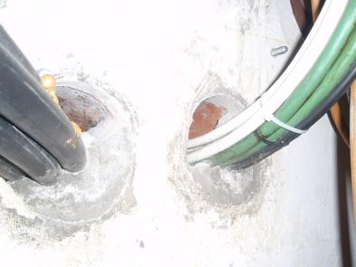
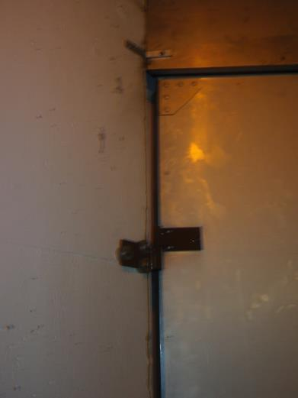
Ventilation
Tunnel and HT Room surveys to measure existing air Leaks
On-field activity to measure the entities and positions of the main sources of air leaks present inside the ISOLDE tunnel. Results in terms of dimensions and air speed
50 mm
2.2 m/s
Access Door
7 m/s
6 m/s
200 mm
10
÷
30 mm
0.4 ÷2.5 m/s
Cable trenches
The measures show the non optimized leak tightness of the Tunnel.
As a conclusion: an accurate activity of gaps sealing is amended as necessary. This measure together with the:
  Stop of the air supply during beam mode
  Installation of access airlocks
  ΔP optimization
  will move in the sense of reducing the activity released in in atmosphere
150 mm
1 m/s
Cable trenches
A. Polato

Slide 31
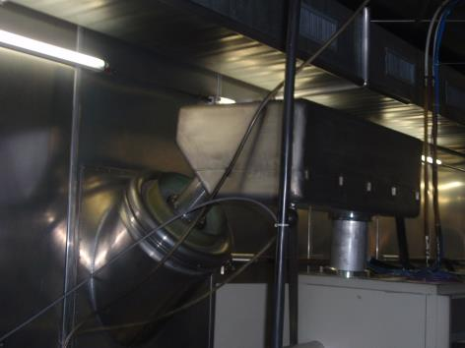
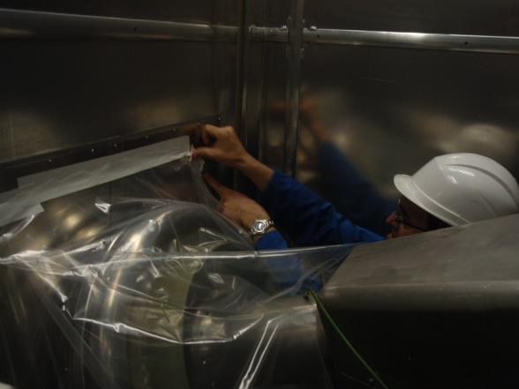
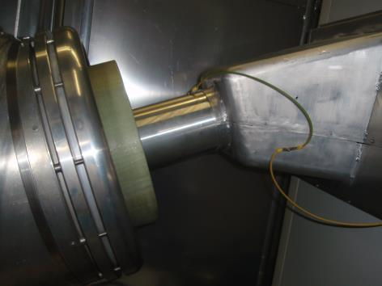

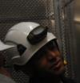
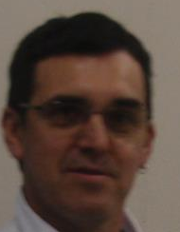
Ventilation
Tunnel and HT Room surveys to measure existing air Leaks
Verification of the correct pressure cascade between HT room and ISOLDE Tunnel, to confirm that the traces of activation in the HT Room are not caused by an air backflow (but most probably by direct radiations in the room)
Boris Tube towards GPS Faraday Cage
Temporary Confinement of the HRS Boris tube. A tracing element (smoke) has been injected in it to see the direction of the flow
SMOKE TEST MOVIE
(INTERNET CONNECTION AND MOVIE PLAYER NEEDED)
Boris Tube towards HRS Faraday Cage
The test showed that the tracing element was flowing towards the Faraday Cage, hence no air backflows are present (in accordance with the initial evaluations)
As a conclusion: due to the contamination present in the room, a confinement system of the HT room vs. the Instrumental hall will be proposed in the Design Study
Precious help from:
H. Sabri
A. Garcia

Slide 32
The Design Study Report
Document describing all the issues addressed throughout the design study period
High Intensity
  Targets; thermal analysis, design and materials
  Front ends
  High voltage
  Operation
Infrastructure
  Beam dumps
  Radiation protection
  Ventilation and cooling
  Vacuum
Beam Quality
  HRS magnet design
  RFQ Cooler
  New REX-EBIS
Cost Summary and Planning
Report: Deliverable for the Autumn 2014

Slide 33
Tentative tasks and timeline for breeder upgrade
 | Phase | Part | Task
A | Gun gen1 | Gun | Demonstrate >1.5E4 A/cm² in trapping region.
B | Gun gen1 | Collector | Suppress backscattered electrons.
C | Gun gen1 | Trap | Detect low level RF that will inhibit cryogenic operation.
D | Gun gen2 | Gun | Suppress discharges at gun to allow for cw operation.
E | Gun gen2 | Collector | Extract the ion beam.
F | Gun gen2 | Collector | Suppress backscattered electrons for cw beam.
G | Gun gen2 HV | Gun | Allow e-beam acceleration to 150 keV.
G | Concept | Surroundings | Shield 5 T magnet stray field.
H | Concept | Vacuum | Attain vacuum performance with either warm or cryogenic concept.
2013-2014
2015-2016
2015
Conditions for above: 1. Continued collaboration with BNL
2. A. Shornikov following the project
3. ENSAR2 application granted and fully funded
By end of 2016 all critical items could be verified -> solid foundation for design.
Thereafter a 2 years realization phase would follow (manpower and cost tbd).
F. Wenander

Slide 34
Implementation
2014 Final Report
2014/2015
Separation of ventilation systems.
Installation of airlocks
LS2 (2018)?
New FE’s
Beam dumps
Shielding
New HRS
…
New EBIS??
Vacuum systems
Targets
2016/2017?
New HT power supplies/modulator

Slide 35
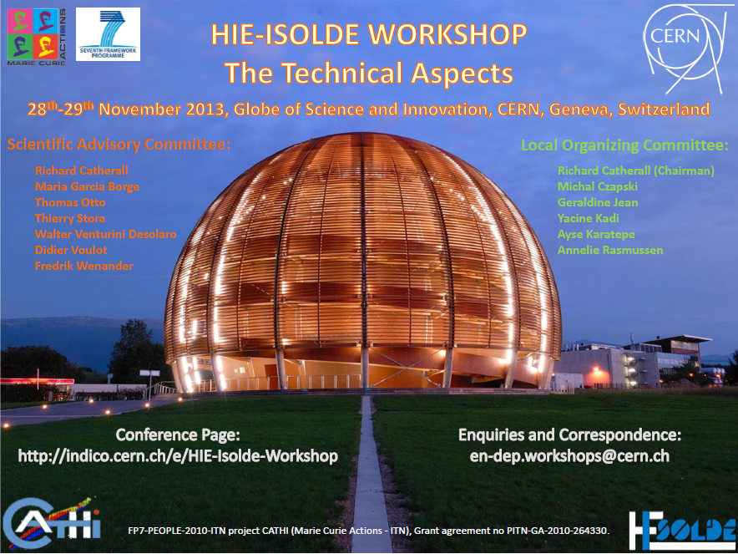

Slide 36


Range of the measurement done by SU-EXP –
quadroples and switchyards
Quadruples
Switchyards

Slide 37

Range of the measurement done by SU-EXP –
levelling travers
GPS/HRS area
Target Zone
Parking in front of the 198, 199, 170 buildings

Slide 38

Results: Central Line - graphs
~10mm step – already existing in 2007
See next slide

Slide 39
Results: Central Line - numbers
Horizontal and vertical offsets are given to the theoretical beam line. Positive sign of the horizontal offset means that, the measured point is on the right from the theoretical beam line (looking downstream). Positive sign of the vertical offset means that, the measured point is above the theoretical beam line. Nominal position in XYccs of each line has been taken from the autocad drawing of Isolde/Hie-Isolde provided by Didier VOULOT. Nominal position in H has been determined according to the same drawing as well as the calculated slopes.
REMARK: Final values of the offsets might change slightly after recalculation according to the optic files which will be provided by Isolde Team
Name | Horizontal offset | Vertical offset | Name | Horizontal offset | Vertical offset
 | [mm] | [mm] |  | [mm] | [mm]
HRS.MAG90.E | --- | 1.0 | CB0.QP20-30.E | 2.5 | 6.0
HRS.MAG90.S | --- | 2.2 | CB0.QP20-30.S | 2.6 | 6.6
HRS.DB470-490.E | --- | 1.4 | CB0.QP40-50.E | 3.7 | 15.3
HRS.DB470-490.S | --- | 0.8 | CB0.QP40-50.S | 2.9 | 15.9
HRS.MAG60.E | --- | 1.2 | CB0.SW.E | 2.1 | 16.1
GPS.MAG70.E | --- | 1.5 | CB0.SW.SC | 2.4 | 17.2
GPS.MAG70.E | --- | 2.2 | CC0.QP20-30.E | 1.9 | 17.5
GPS.QP520-530.E | --- | 2.1 | CC0.QP20-30.S | 2.7 | 17.4
HRS.MSW.E | -0.6 | 4.3 | CC0.QP40-50.E | 1.3 | 17.7
GPS.MSW.E | 3.8 | 5.1 | CC0.QP40-50.S | 0.5 | 17.5
GPS/HRS.MSW.S | 3.6 | 5.8 | CA0.SW.E | 0.5 | 6.2
CA0.QP40-50.E | 2.9 | 5.3 | CA0.SW.SC | 0.5 | 5.7
CA0.QP40-50.S | 1.8 | 5.1 | CD0.QP20-30.E | 0.5 | 17.6
CA0.SW.E | 0.5 | 6.2 | CD0.QP20-30.S | -0.4 | 16.1
CA0.SW.SC | 0.5 | 5.7

Slide 40
Results: Left Lines – numbers
LA1, LA2, LC0
LA0, LA3
Name | Horizontal offset | Vertical offset
 | [mm] | [mm]
LA0.SW.SGG | -3.8 | 6.9
LA1.QP20-30.E | -1.9 | 7.6
LA1.QP20-30.S | -1.0 | 7.8
LA1.QP40-60.E | 0.6 | 8.2
LA1.QP40-60.S | 0.7 | 8.2
LA0.SW.SG | -0.7 | 7.1
LA2.QP20-40.E | -0.8 | 7.6
LA2.QP20-40.S | -0.1 | 8.6
CC0.SW.SG | 1.9 | 17.5
LC0.QP20-30.E | 1.6 | 15.4
LC0.QP20-30.S | 1.4 | 17.0
Name | Horizontal offset | Vertical offset
 | [mm] | [mm]
CA0.SW.SG | -0.7 | 5.5
LA0.QP20-40.E | -0.9 | 6.2
LA0.QP20-40.S | -0.3 | 6.6
LA0.SW.E | -0.7 | 7.9
LA0.SW.SC | 0.3 | 6.8
LA3.QP20-30.E | -1.9 | 6.7
LA3.QP20-30.S | -2.6 | 8.3

Slide 41
Alignment
The following reasons contributed to the decision not to re-align the beam line during the LS1 period:
  Consecutive delays:
    Cleaning had to be done, Absence of J. Thiboud
  The current workload on-going at ISOLDE is already a cause for concern with respect to the start up next year.
  The clash with HIE-ISOLDE work in the hall
    Especially near the platform
  The uncertainty in improvement of beam transport
  REX
Counter measures
  Will open 1 or 2 switchyards to better understand their alignment
  Implement automatic beam tuning
    Resources

Slide 42
Technical and Safety Review of the RB0 upgrade (VITO line) held on September 3, 2013.
  Technical review panel:
Tim Giles (optics and beam lines)
Gerrit Jan Focker (beam instrumantation)
Ana Paula Bernardes (safety)
Jean Christophe Gayde (survey)
Erwin Siesling (integration)
Didier Voulot (TSO and REX compatibility)
Giovanna Vandoni (vacuum)
Joachim Vollaire (radiation protection)
Maria Garcia Borge (physics)
Richard Catherall (chairman, ISOLDE technical coordination)
Upgrade approved by the Technical committee
  INTC committee:
Physics cases endorsed (26 June 2013)
3 proposals, 2 LoIs submitted in September 2013
Physics endorsed by the INTC committee
M. Stachura

Slide 43


ASPIC → VITO (upgrade, not a new beam line!)
ASPIC
ViTO
M. Stachura

Slide 44

Space around the experiment
Access and escape routes (all dimensions respected)
35°
377
30°
1429
376
690
1598
401
3070
1128
1199
930
M. Stachura

Slide 45
Radiation
  From Joachim Vollaire:
“RP requests to be present when the first manipulation of the beamline takes place, in particular when the vacuum beam pipe will be opened. The standard safety file, as it is known from other ISOLDE beamlines needs to be filled in and submitted but other than that no additional steps are required before the physical start of work at the beamline. I don’t see an impact from a radiation protection standpoint in a slight modification of the beam line optics. “
  FLUKA simulations done for:
⁸Li, ²¹Na, ²³Mg, ³¹Mg, ³³Mg, ³³Na, ³⁵Ar, ⁵⁸Cu, ⁷³Se, ⁷⁴Cu, ⁷⁷Br, ⁸⁰Br, ¹¹¹Ag, ¹¹¹Cd, ¹¹¹In, ¹⁴⁰La, ¹⁴⁷Ga, ¹⁷²Lu
(with and without shielding and for 1ms and 1wk of cooling period).
Whenever listed in SR 814.501, accumulated amount is below 1LA.
The new monitoring system will cover more precisely this part of the hall.
Most of the accumulated activity will be removed during / after irradiation.
Very small quantities of radioactivity will be handled.
The requested isotopes and their isobaric contaminants – mostly short-lived.
M. Stachura

Slide 46
Magnetic Field
Minimal influence on HIE-ISOLDE, REX, TAS, WITCH and ISOLTRAP
Local field of Max. 0.3 T
Magnetic field of WITCH: members of WITCH in VITO collaboration, willing to switch off the magnet for the time of β-NMR experiments
Magnetic field of REX: not an issue for beam transport at VITO
Based on WITCH 9T Stray Field
(provided by M. Breitenfeldt)
9T – max magnetic field
6T – magnetic field during experiments
3T – when WITCH on standby
VITO pumping zone: 10⁻⁴ T
B _{total}[T]
R [cm]
Z [cm]
M. Stachura
46

Slide 47

Alternative location of the VITO beam line
  Alternative location:
RC lines (behind NICOLE or RC2 → switchyard → VITO line) – possible conflict with on-going works
  Disadvantages:
Setting up a new line
Large budget required
At least 8.5 m of free space required
Problems with lasers: smaller focusing on larger distances, lower laser power due to larger amount of optics, bigger vibration of the laser beam, considerable additional budget
Beam tuning more difficult ( ideally 4 mm beam at the entrance of the β-NMR setup)
RC region is currently space for low background experiments (permanent decay station), which is not compatible with PAC type of ion implantations
If moving becomes necessary then rather upstream (GLM, GHM), old control room access less critical, zone of higher background
M. Stachura

Slide 48
VITO Beam line
SUMMARY
The panel would like to congratulate the VITO Collaboration on their excellent preparation in anticipation of this review and the quality of their presentations. It is clear that the proponents have thoroughly investigated both the installation and integration of this modified beam line. From a technical point of view, no justified objections to this installation were raised. The availability of a dedicated beam line for laser-induced nuclear orientation along with ASPIC and B-NMR set-ups can only be of benefit to the physics program at ISOLDE. The panel recommends that the ISCC and INTC support this initiative by the VITO Collaboration.

Slide 49
Only 38 weeks to go before protons to ISOLDE!
Thank you for your attention

