Slide 1
News of the ISOLDE Group
Maria J. G. Borge

Slide 2
Outline
Fellows Associates and students
Courses and activities during 2013
Workshops 2013
ENSAR 1
ENSAR 2
Financial situation of the collaboration
Experiments

Slide 3

Fellows, Associates & Students
Alfredo Poves January - June 2014
CAS: Olof Tengblad (Jul-Dec 2013)
Fellows: Present status
    Susanne Kreim, Dec2014
    Elisa Rapisarda, Sept 2014
    Monika Stachura, starting April 2013- March 2015
    Jan Kurcewicz,Nov 2013 (ENSAR, 5 months prolongation, EU)
    Doctoral student: Next deadline 19th of November.
    Assigned 1 NEW DOCTORAL STUDENT For FIXED DECAY STATION starting January 2014
    Edoardo Bizotti (IT)
    Doctoral Program with Greece for life sciences (50% GR, 50% CERN)
Technical student: No technical student
Technicien: Julien Thiboud, August 2014 (Col + EU support (?))
User support: Jennifer Wetterings (50% Col + 50% PH)
Notes:
discussion with Ph to get a Limited term contract 50% collaboration + 50% PH

Slide 4
Fellows, Associates & Students (future)
Fellows & Assocites deadline 3rd of September 2013
One very good candidate for the IDS + Miniball
Well externally evaluated.
No Associate request or technical student.
Future Deadlines
• ASSOCIATES AND FELLOWS COMMITTEE
20 May 2014 ‐ deadline for applications* Fellows, 3 March 2014 (one more)
  ‐ deadline for applications* Associates, 13 March 2014
11 November 2014 ‐ deadline for applications* Fellows, 3 September 2014
  ‐ deadline for applications* Associates, 13 September 2014
• TECHNICAL STUDENTS COMMITTEE
28 January 2014 ‐ deadline for applications,* 19 November 2013
24 June 2014 ‐ deadline for applications,* 6 May 2014
• SUMMER STUDENTS
March 2014 ‐ deadline for applications,* 31 January 2014

Slide 5
Courses 2013
Statistical Methods for Nuclear Physics
Karsten Riisager
18-20 of March
Great Success more than 25 attendants.
Physics courses for Summer students: 3 lecturers 17-19 July 2013
  Magda Kowalska:
  Magda Kowalska: ISOLDE facility
  Magda Kowalska: ISOLDE Physics
Three Lectures by Rick Casten 23 – 25 July 2013
-The new Frontier of exotic Nuclei—shattering cherished paradigms and building a new synthesis
Emergent collectivity, phase transitions and cosmological consecuences.
Shell model for non Practicioners 14 – 18 of October
By Frederick Nowacki , E. Courrier, G. Martinez-Pinedo, A. Poves, K. Sieja
Reaction course in April 2014
Separator courses in May 2014

Slide 6
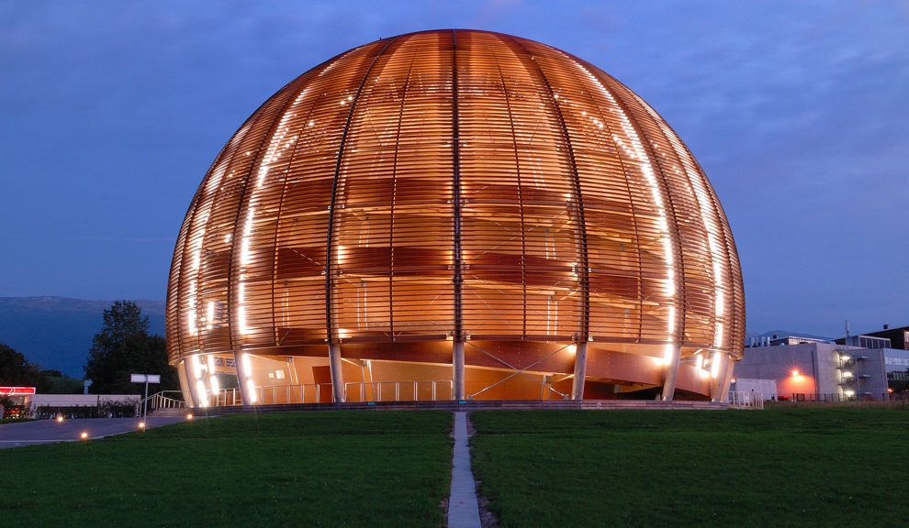
Workshops 2013
1 Day workshop on ASPIC 6 of September
2 days Workshop by Miniball (24-25 oct)
ISOLDE Workshop 25 – 27 October 2013
    40 contributions
Session of Poster call for submissions
Sponsor by CATHI program
HIE-ISOLDE Workshop 28-29 November 2013
  Registration still open

Slide 7
ENSAR (European Nuclear Structure and Application Research)
The aim of Integrated Activities in FP7 is to improve the access of European Researchers to facilities which are not in their country of Origin and to increase the output of these facilities. This is done through 3 types of work packages:
  Trans-national access (TNA)
  Networks (NA):
    The EURISOL-NET Network in ENSAR (NA3,WP3, Y. Blumenfeld leader)
      Task 1 : Coordination of R&D (Y. Kadi leader): First workshop at CERN 27-28 June 2011
      Task 2: Physics and Instrumentation (A. Bonaccorso leader)
  Joint research activities (JRA) :
    ACTILAB (JRA2/WP8, Thierry Stora (EN) Leader).
    Improvement of Actinide target technology for ISOL facilities.
    PREMASS (JRA3/WP9) coordinated by Ari Jokinen (JYFL Finland)
    Task. Improvement of beam purity and emittance in ISOL facilities.
    Valentin Fedosseev (EN) leads a task
ENSAR started on Sept. 1, till August 31st, 2014.
Discussion of prolongation due to the late start of FP8, Horizon 2020
Y.B.<<>> M.J.G. Borge is the CERN representative

Slide 8
STATISTICS Until April, 2013
Number of beam hours-Full Contract | 5200
provided as of 31/12/12 | 6946,4
Number of users- full contract | 400
Supported as of 31/12/12 | 352 (User counted 1 per IS-exp)
Number of days support- full contract | 2800
Supported as of 31/12/12 | 2244
Number of projects – full contract | 60
Supported as of 31/12/12 | 75 (different experiments)
T&S – full contract (EUR) | 252000
Distributed as of 31/12/12 | 256947 (309672CHF)
Number Experiments / researchers | 75 / 352
Rate of days per experiment | 4.69 researcher / exp
Access costs – full contract (EUR) | 291408
Access costs up to 31/12/12 | 389276 (= 6946,4 x 56,04)
Remining 33.000 CHF for 2014

Slide 9

Meeting Padova 16-18 /10
K. Blaum as chair of the INTC participated in the FCC
Magda went for the TNA meeting and General Assembly
Financial report was approved as it was presented with the remark that reports from some laboratories will come later.
Mushin got the mandate to discuss with EU officers the prolongation of ENSAR until ENSAR2 starts.
  it means that in January/February he will discuss 6-7 month extension in order to gap the bridge to ENSAR2
  They agreed that in about 6 months, once we know the EU decision on the prolongation,
  The FCC and Ensar steering committee (i.e. facility representatives) will prepare a proposal for fund redistribution. This proposal will be sent to GA members for vote via email.
Next GA will be in October 2014 or in April 2015 (probably in Vienna), depending on the prolongation decision,

Slide 10
ENSAR 2 / Town Meeting
Call for NA, JRA, until 15th of April
Presentations in Warsaw June 19-20
14 proposals for NA
27 proposals for JRA
Presentations in Warsaw under the title BEYOND ENSAR
TNA Krakow + Warsaw
TNA KVI
TNA ELI-NP
Merging of several JRA before Warsaw
  ECOS (F. Azaiez)
  AGATA: TNA or JRA (B. Cederwall)
  EURISOL (Piet Van Duppen)
  DEMARCOS (P. Haensel)
  Beamlab (C. Lau)
  PASPAG (O. Tengblad)
  AHEAD ( A. Drouart)
  RESIST (I. Moore)
  Separator Control (S. Pietri, GSI)
  MIDAS (Koivisto, JYFL)
  Gas filled detectors (Grinyer)
  Nuclear tools for Medical aplications
  Sinurse2
  Neutron Detectors (D. Cano-Ott)
  Gamma Tracking (D. Napoli)
  ASTARTE (P. Thirolf)
  DEMARCOS (P. Haensel)
  NucApp (S. Leray)
  Phys & Instr for new generation of High Flux
  High Complexity Nuclear Structure (S. Lenzi)
  UNITHERI (D. Lacroix)
  NUSTAR (C.Scheidenberger)
  Fundamental Interaction (A. Jokinen)
  FULN (M. Freer)
  Theory Network in Reactions (A. Moro)
  ENSAF (Harissopulos)
Meeting 10th of September Paris

Slide 11
News of ENSAR2 / 10 sept 2013
Members of SSC: R. Alba, F. Azaiez, M.J.G. Borge, D. Cortina Gil, M. Freer, J. Gerl, H. Goutte (substituting for W. Korten), M. N. Harakeh (Chair), P-H. Heenen, R.D. Herzberg, : R. Julin, M. Lewitowicz, A. Maj, N. Pietralla, K. Riisager, K. Rusek, S. Szilner, L. Trache, K. Turzó, W. Weise
TNA for ENSAR2
    GANIL (France)
    GSI (Germany)
    LNL / LNS (Italy)
    JYFL (Finland)
    ISOLDE – CERN (Switzerland)
    ALTO – CNRS (France)
    KVI (The Netherlands)
    SLCJ-HIL / IFJ PAN (Poland)
    ELI-NP / IFIN-HH (Romania)
    ECT* (Italy)
Budget < 50 % of ENSAR2

Slide 12
JRA / NA
All Integrating Activity (IA) should be for the benefit of the Research Infrastructures (RIs) within the IA. The TransNational Access Activities (TNAs) are to serve the community by offering access to the advanced unique RIs of an IA.
NAs @ ENSAR2
FISCO: Management NA
    ASTARTE: advancement of radiation therapy detectors
    NucApp: nuclear applications (medical applications, e.g., hadrontherapy?)
    FULN: Fundamental Understanding of Light Nuclei
    ENSAF: small scale accelerator facilities
    HiCONS: High Complexity nuclear structure
    GDS: Active targets (TPC gaseous detectors)
    MIDAS: ECR ion sources
    Precision tests of FIS
    Advanced electronics network
The JRAs @ ENSAR2
    Theory (Nuclear Structure & Reactions)
    AGATA detector + applications
    ECOS: stable ion beams + medical isotopes
    EURISOL facility (all stages)
    RESIST: resonant ionisation techniques for separators
    PASPAG-SEE: particle and gamma detection
    SiNuRSE2: simulations
Call for H2020 Sept 2014
Draft for each Initiative end of Nov 2013

Slide 13
PUBLICATIONS
YEAR | N. PUBLICATIONS | PH. D thesis
2010 | 67 | V. Bilstein T.E. Cocoolios R. Domínguez Reyes D. Fink S. Naimi D. Neidherr K. Wimmer A. Meaney
2011 | 49 | M. Albers J. Lommen O. Müller M. Thürauf M. Zboril
2012 | 62 | Ch. Borgmann E. Estevez J.G. Johansen T. E. Mølholt A.B. Perez Cerdán M. Seidlitz M. Stachura
2013 | 17…… | P. Kessler B. Siebeck T.J. Procter D. Di Julio J. Cullen K. Kreim K Lynch J.A. Briz B. Olaizola
Please send us the reference and if possible a copy of the thesis done based in data from ISOLDE

Slide 14
Collaboration Matters

Slide 15
Income of the collaboration
Country | Amount per year (CHF) | 2013 contribution Received
Belgium | 60.000 | ✔
CERN | 60.000 | ✔
Denmark | 60.000 | ✔
Finland | 60.000
France | 60.000
Germany | 60.000 | ✔
Greece
India | 40.000
Ireland | 10.000
Italy | 60.000 | ✔
Norway | 60.000 | ✔
Romania | 60.000 | ✔
Spain | 60.000
Sweden | 60.000 | ✔
United Kingdom | 60.000 | ✔
Discussion with Greece on going
Notes:
The committee agrees that until Greece signs the updated MoU and has paid its outstanding fees it will no longer be considered a member of the ISOLDE collaboration.

Slide 16
Budget for 2013
Foreseen Budget for 2013
Man Power :
  Experts 35000
  Target & Ion source 8000 (A. Gottberg Jan-April)
  RILIS 3400 (Seliverstov Jan-Feb)
  Rex-Operation 83792 (Thibaud)
  Student support 25000
  ISOLDE Seminars 6000
        161192
Administration 35000
Consumables 40000
Conferences & schools 10000
TOTAL 250.000
Expenditure 2013 208.101,86 (January-Sep)
Contribution 2013 to HIE-ISOLDE of 500.000 pending
Minimum Expenditure foreseen for 2014 250.00 – 300.000
Present balance 983. 925
Contributions 2013 70 % received
Remining electronic pool rental charged to the Phys Group Account

Slide 17
Experiments
ASPIC ➔ VITO
Technical Review (Chair R. Catherall) 3rd September
“The proponents have thoroughly investigated both the installation and integration of this new beam line.
From a technical point of view, no justified objections to this installation were raised
The panel recommends that the ISCC and INTC supports this initiative by the VITO Collaboration
NICOLE: Fridge repaired
      A new proposal submitted in October 2013
      Ask for a new setting at the ISOLDE Hall
      New Collaboration lead by: Taka Ohtsubo & Miroslav Veskovic
HELICOIDAL spectrometer ➔ Large Grant submitted to STFC to develop advanced detection systems for TSR

