Slide 1
Beam Lines for HIE-ISOLDE
Maria J. G. Borge

Slide 2

Status of Physics @ HIE-ISOLDE
May 2010: 34 LoI submitted
1 Nov 2012: INTC endorsed the increase of 2 GeV-proton energy for ISOLDE
31 Oct 2012: 30 proposals for HIE-ISOLDE defended
  800 shifts requested
  440 shifts approved
June 2013: 5 HIE-ISOLDE Proposals submitted with 85 shifts. Approved 37 shifts
  2 Letts of Clarification approved with 58 shifts

Slide 3
Instrumentation
Miniball + T-ReX (upgrade planned) : COULEX + Transfer (18)
Multipurpose reaction chamber (5)
SPEDE, one experiment approved Jun2013
Helios type device: transfer(5)
ACTAR: resonant scattering + transfer. (2)
For 2016: TSR storage ring, approved, Integration study till Q3-2013

Slide 4
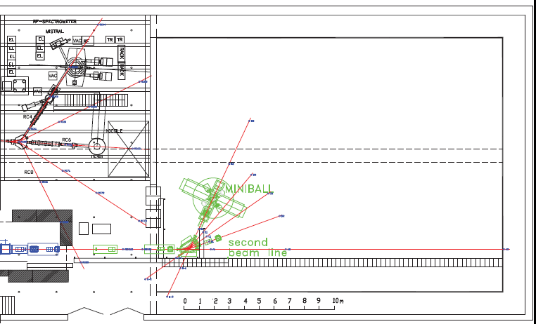
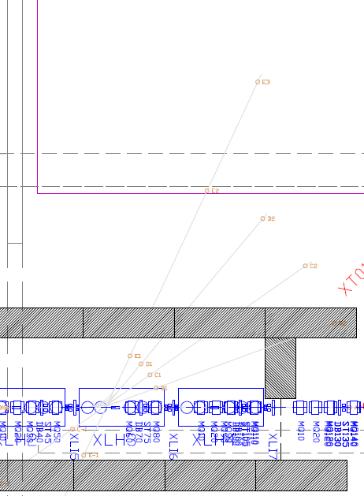
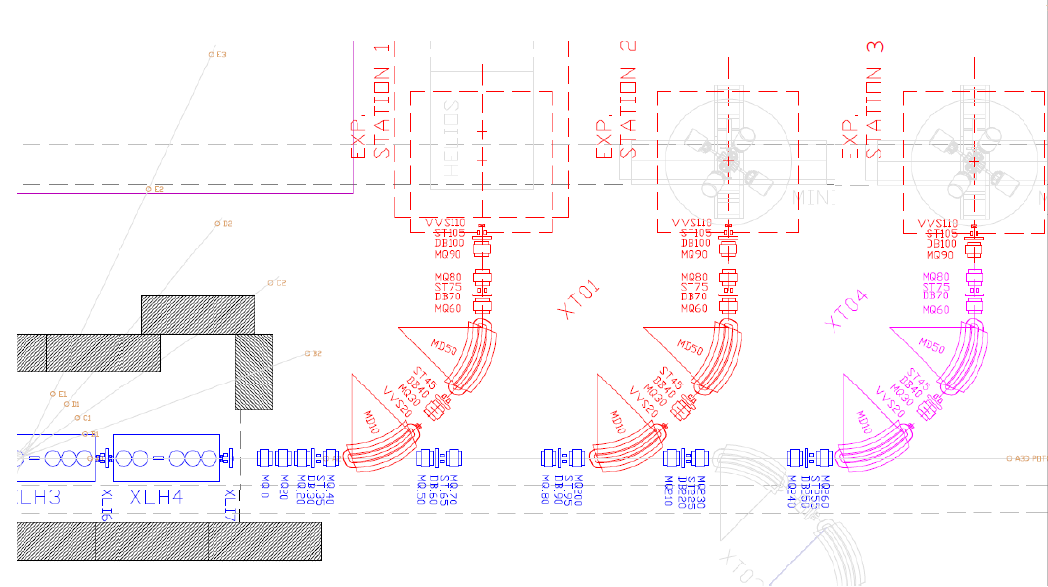
WALL
Passage space
HIE-ISOLDE
Beam lines
5.2m
Request from HEBT & integration to decide where the experiments will be placed,
1m
3.3m
1.7m left for other setups
(1.3m, if passage counted from the open frame)
Electronics?
2.7m – open frame
Small
removable
2.3m -rails
1m – common passage/dewars
1m – common passage/dewars
MINIBALL
WALL
Passage space
WALL

Slide 5
WALL
Passage space
Request from Mini-ball to be in the first beam line
5.2m
5m
5.2m
1m
3.3m
Electronics?
Electronics?
Small
removable
2.3m -rails
1m – common passage/dewars
1m – common passage/dewars
MINIBALL
WALL
Passage space
WALL

Slide 6
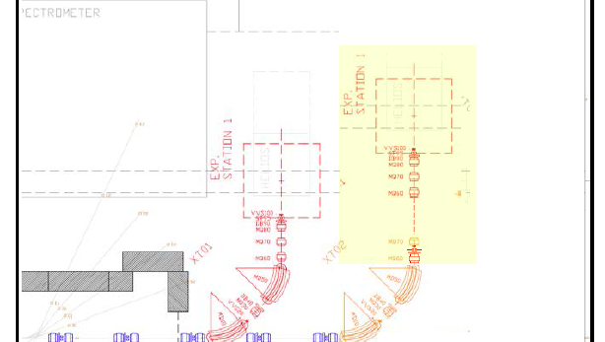
Study of extension of beam line
Due to modular design the extension will have no negative impact in the beam optics or performance
Natural extension 1 standard doublet period = 2, 62 m
  2 quadrupoles + long Diagnostic Box + 1 steerer
  COST = 82 kCHF (infrastructure) + 192 kCHF project and material
  Optics calculations (M. Fraser) Courtesy of Brennan Goddard

Slide 7
HELIOS (update D. Jenkins 17/10)
In 2012, a 3-T MRI magnet (in fact, the first ever full body MRI magnet) was recovered from the University of Nottingham and transported to the STFC Daresbury Laboratory .
The magnet had been inspected by Graham Gilgrass, who was originally the engineer responsible for its construction in 1991.
Cooldown and testing of the magnet took place in February 2013. The work was supervised by Shrikant Pattalwar .
The magnet was successfully powered and operated at 1.5 T. At the full current (the 3-T setting), the magnet quenched.
There was insufficient helium remaining to recool the magnet or complete the mapping of the field within and outside the solenoid .
The magnet is undamaged and the quench was attributed to the thermal cycling of the magnet. During the Summer of 2013, a vacuum chamber which fits inside the solenoid has been ordered along with a large turbo pump
The Nottingham magnet does not have active shielding like modern MRI magnets and so the stray field is appreciable.
A shielding simulation carried out by Ben Shepherd (STFC Daresbury) indicates that at the distances proposed by the ISOLDE technical team, an enclosing box would have to contain a very substantial amount of steel of the order 100 tons.
UK collaboration (Daresbury Laboratory, the Cockcroft Institute, and the universities of Edinburgh, Liverpool, Manchester, Surrey, West of Scotland and York) has submitted to STFC application to develop and construct an advanced, innovative detector system for experiments on the TSR. The main goal of the project is to build a spectrometer for the measurement of charged-particle reaction products both in-ring and external to the ring, each employing high granularity silicon-detector systems. If succesful (January 2014) they plan to install the magnet in the TSR during the 2nd major shutdown.

