Slide 1
Conservative Beam Emittances for CLIC Damping rings
Y. Papaphilippou
Thanks to H. Braun, J.-P. Delahaye and D. Schulte
February 19th, 2008

Slide 2
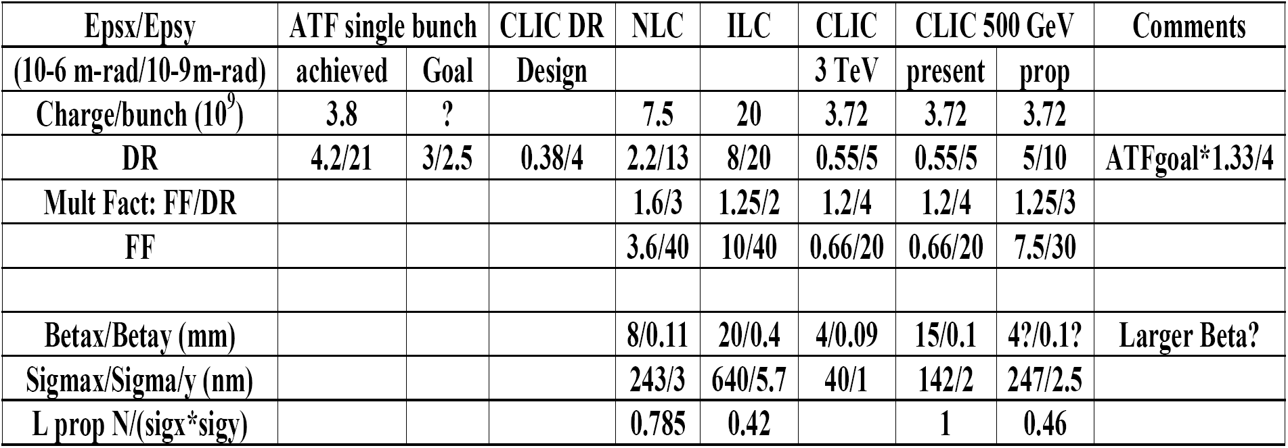
Parameters for CLIC @ 500GeV
J.-P. Delahaye, CLIC PWG, 06/11/07
What is a reasonable set of “conservative” emittances for the CLIC damping rings
Instead of using scaling based on ATF experience or other linear colliders, consider present or future synchrotron light sources
2
Notes:
2

Slide 3
Vertical emittance
Swiss Light Source achieved 2.8pm, the lowest geometrical vertical emittance, at 2.4 GeV, corresponding to ~10nm of normalised emittance
Below 2pm, necessitates challenging alignment tolerances and low emittance tuning (coupling + vertical dispersion correction)
Seems a “safe” target vertical emittance for CLIC damping rings
Notes:
3

Slide 4
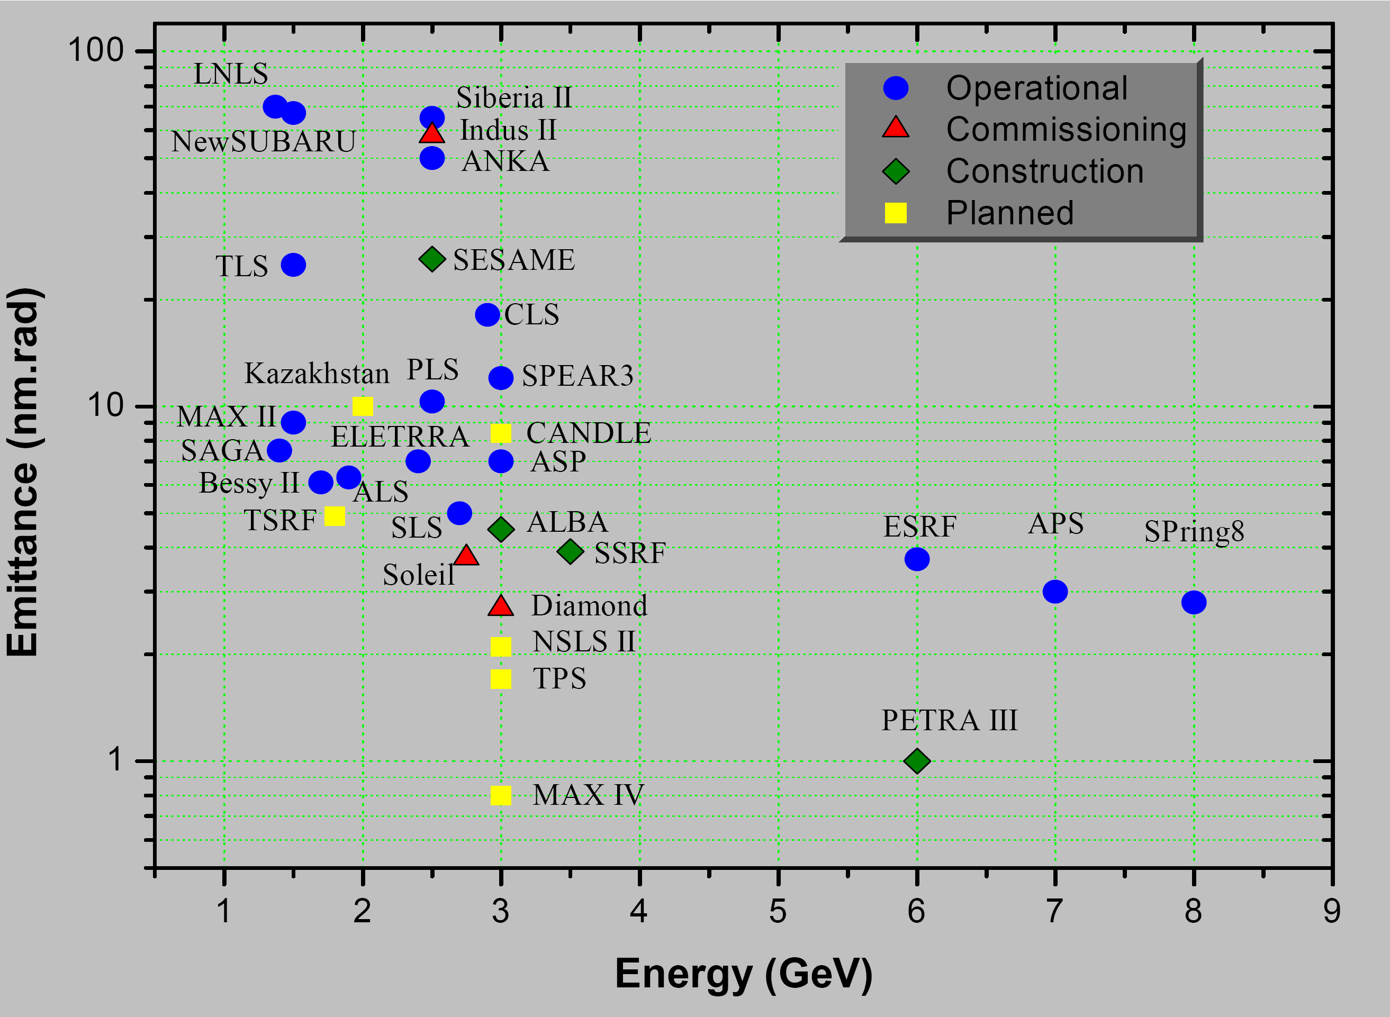
Horizontal emittance vs. energy
NLC
NSLS II
ILC
CLIC
Z. Zhao, PAC’07
0.6nm @ 3GeV, including damping wigglers and IBS
Notes:
4

Slide 5
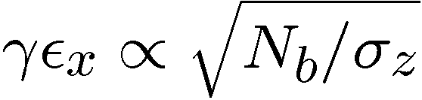
Scaling of NSLS II parameters
Assuming constant dipole bending angle (i.e. increasing dipole length with bending radius), horizontal normalized emittance proportional to γ³
The “zero-current” equilibrium emittance scaled to CLIC DRs energy is 1.6µm
Under previous assumptions, bunch length is energy independent and rms energy spread scales with γ^{1/2} to give longitudinal emittance of 6256eV.m @ 2.424 GeV
Taking into account scaling of horizontal emittance with bunch population and
longitudinal emittance
the hor. norm. emittance for CLIC DR parameters (4.1x10⁹p/bunch and 5000eV.m) is 1.3µm
This is an optimistic value as the IBS growth was not scaled with energy
PARAMETER | Values
energy [GeV] | 3
circumference [m] | 791.5
bunch population [10⁹] | 7.9
bunch spacing [ns] | 1.9
number of bunches | 1056
rms bunch length [mm] | 2.9
rms momentum spread [%] | 0.1
hor. normalized emittance [µm] | 2.99
ver. normalized emittance [nm] | 47
lon. normalized emittance [eV.m] | 10395
coupling [%] | 0.64
wiggler field [T] | 1.8
wiggler period [cm] | 10
RF frequency [GHz] | 0.5

Slide 6
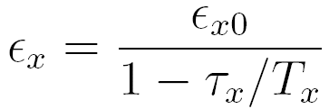



Scaling of IBS growth with energy
At equilibrium, the emittance under the influence of IBS is
Considering a beam which is not IBS dominated
The horizontal damping rate versus the IBS growth rate can be estimated taking Bane’s approximation and will provide a complicated scaling with the transverse emittances and the energy
The final horizontal emittance after scaling the IBS growth with the energy and the vertical emittance, is 2.5µm
This is a pessimistic estimate due to various considerations in the previous approximations
In this respect the final value may lie around 2µm providing a safe compromise
≈
6
Notes:
6

Slide 7
Concluding remarks
Using scaling from existing and future light sources, conservative normalised emittances of 2µm horizontal and 10nm vertical were estimated for the CLIC damping rings
These emittances are very close to the normalised emittances of NLC damping rings (~10% lower)
They can be further reduced by relaxing the longitudinal emittance
They provide some margin to relax the final focus beam size requirements, and still achieve luminosities close to the ones of ILC
Next steps
  Verify the numerically the IBS growth scaling with energy
  Relax the damping ring design in order to achieve such output emittances

