Slide 1
BNL RACF Site Report
Ofer Rind
HEPiX, Annecy
May 19, 2014
A summary of updates since the Ann Arbor meeting...

Slide 2
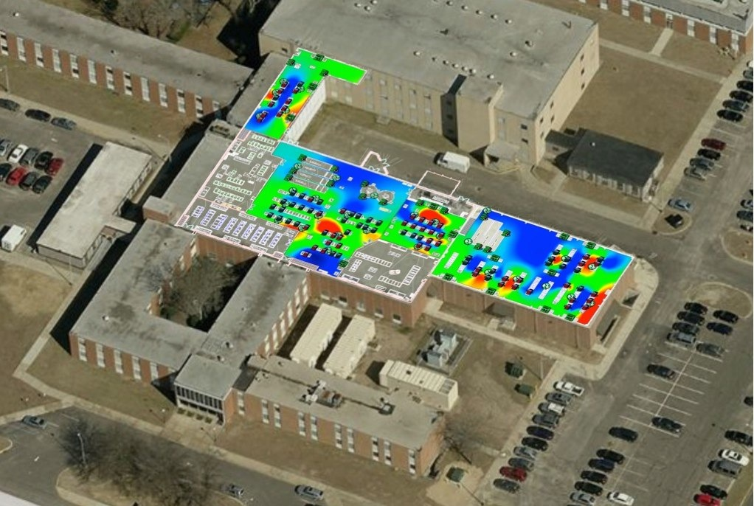
BNL RACF Overview
Located at Brookhaven National Lab on Long Island, NY, the RACF provides full service computing for the two RHIC experiments — STAR, PHENIX — and for ATLAS (US Tier1)
Sigma-7
BCF
CDCE
RHIC Run 14 (Au-Au) in progress (to July)
Support for additional smaller BNL groups: LSST, Daya Bay, LBNE, EIC, etc.
O. Rind - BNL RACF Site Report - HEPiX, Annecy - May 19, 2014

Slide 3
Processor Farm
Hardware evaluation for FY14 purchase completed (see T. Wong presentation on Wednesday for details)
  ~200 servers for RHIC, ~100 for ATLAS
  32-40 computing cores per server (depending on architecture)
  Onboard storage for RHIC will grow to 48 TB/server
Moving to fiber-based 10 GbE on FY14 RHIC servers
  6% add’l cost per server (not including external network infrastructure)
  ATLAS farm will remain at 1 GbE for next several years
Migration of all farm systems to SL6.4 completed in November.
  Awaiting decision on possible SL7 ➜ CentOS transition (hoping distros remain separate)
Discussing consolidation of support for Intensity Frontier (IF) programs at RACF, e.g. LBNE. Similar to support model for cosmology programs implemented in 2011.
O. Rind - BNL RACF Site Report - HEPiX, Annecy - May 19, 2014

Slide 4
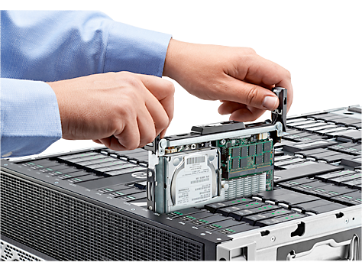
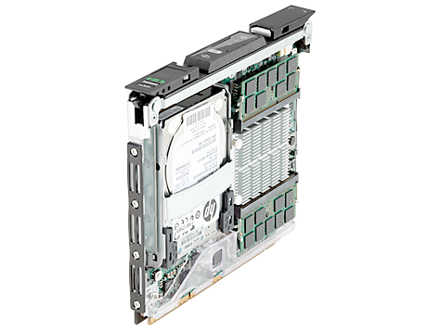
Moonshot Benchmarking (brief summary)
Evaluating HP Moonshot (8 core Intel Atom C2750 in ProLiant m300 cartridge)
  240-360 cores in 4U
  High density potential for Tier3 use
HepSpec06 (vs. 2.2 Gz E5-2660, 8 x 1TB)
  Ivy Bridge 41% better per core, but Moonshot provides 59% more performance in 4U space with up to 40% increase in spindle count
Other tests performed using ATLAS simulation and reconstruction show promising results
O. Rind - BNL RACF Site Report - HEPiX, Annecy - May 19, 2014
Notes:
Ivy Bridge is Intel E5-2660v2 2.2 Gz (40 logical cores in 1U with HT on), 8 x 1 TB drives

Slide 5
Processor Farm Infrastructure
Replacement of end-of-life Liebert XD racktop cooling systems with traditional CRAC units is ongoing (repeated failures, high maintenance cost)
  Two units replaced in FY13, two more to replace in FY14, one more to replace after that
CRAC units in Sigma-7 (ATLAS storage) connected to flywheel/generator backup. Project underway to outfit same units with domestic cold water backup.
Live test of flywheel/generator system conducted on May 6 during a network maintenance window
  System functioned as expected under 40% (400 KW) of max load
O. Rind - BNL RACF Site Report - HEPiX, Annecy - May 19, 2014
Notes:
Racktop cooling replacement program was mentioned in Ann Arbor

Slide 6
Operations
In the wake of last Fall’s rack tipping incident, a revised, BNL-approved, audit-able process was implemented for moving racks on a raised floor. Required updated training and documentation.
Ongoing effort to implement integrated suite of infrastructure monitoring tools.
  Summer project to unify existing UPS monitoring system in BCF with Sensaphone system in CDCE/Sigma-7.
O. Rind - BNL RACF Site Report - HEPiX, Annecy - May 19, 2014

Slide 7
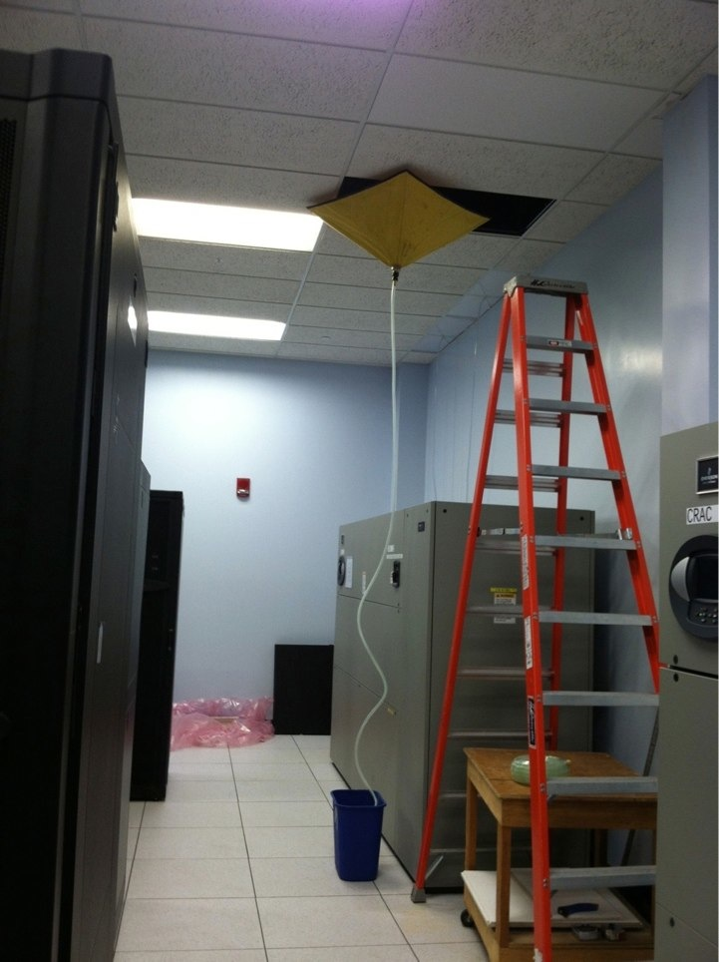
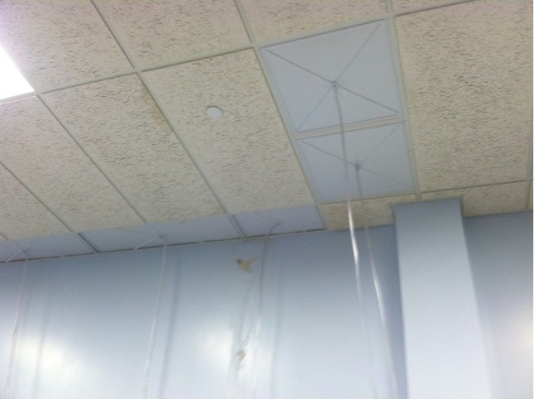
Sometimes Mother Nature Comes Calling….
Inclement weather over the past six months lead to development of some roof leaks
“Cowbags" used to protect elec. equipment while roof is being repaired
Considering “hats” for protection of PDU and CRAC units?
O. Rind - BNL RACF Site Report - HEPiX, Annecy - May 19, 2014

Slide 8
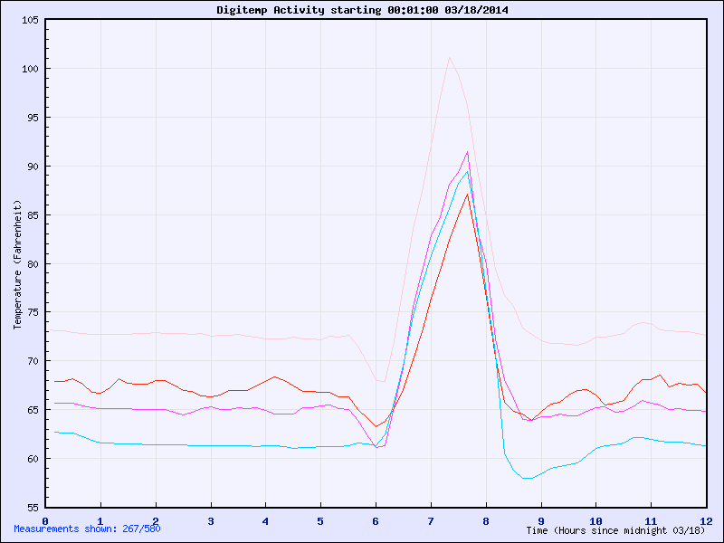
…and sometimes it’s simply human
RACF staff not present during planned cooling outage on March 18th due to mis-communicated start time.
  Overheating in BCF triggered emergency handling system.
RACF staff manually disabled system five minutes before automatic shutdown at completion of cooling work.
Indication of elevated disk failure rate in affected systems since.
O. Rind - BNL RACF Site Report - HEPiX, Annecy - May 19, 2014

Slide 9
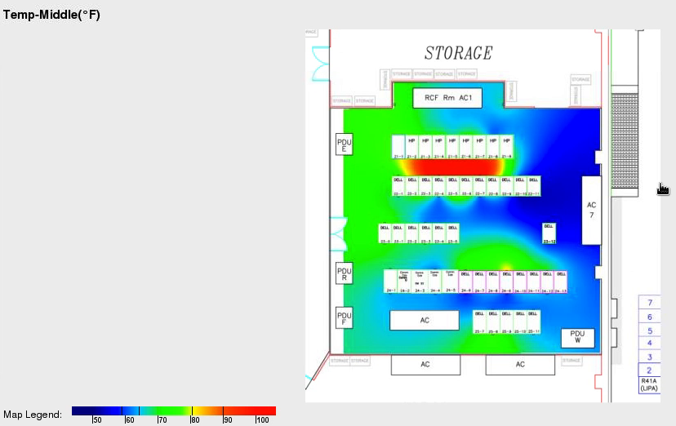
Capturing The Moment With Synapsense
O. Rind - BNL RACF Site Report - HEPiX, Annecy - May 19, 2014

Slide 10
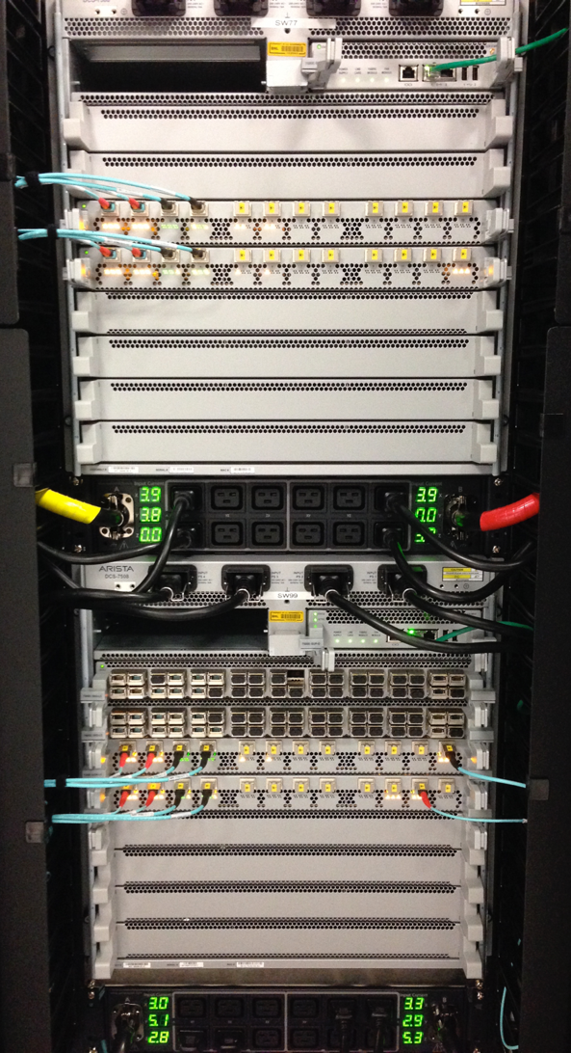
Network - ATLAS
Two more Arista Networks 7508E switches purchased, bringing total to three.
  One used for dCache storage node connectivity (replacing two Dell Z9000 switches).
  One used to replace Atlas routers with a pair of Arista switches.
Installation of large amount of new optical fiber to accommodate upgraded network topology.
Extensive use of Arista's MLAG (Multi-Chassis Link Aggregation) capabilities for load balancing and failover of inter-switch and server links.
100 GbE ports on switch used to connect to 100 GbE Juniper perimeter router for 100 Gb/s WAN testing
  Expect to move to 100 Gb/s WAN connectivity when BNL purchases second Juniper perimeter router (FY14?)
O. Rind - BNL RACF Site Report - HEPiX, Annecy - May 19, 2014
Notes:
MLAG will allow real multi-pathing

Slide 11
Network - RHIC
Just took delivery of 3 Arista Networks 7508E switches, two for routing, one for 10 GbE farm connectivity ➜ expect to upgrade in mid-July
  All new optical fiber being installed for these switches
  Expect extensive use of MLAG
All future Linux Farm nodes, starting with FY14, will be line rate optical 10 GbE-SR connected
Given Phenix/Star Linux Farm node counts and 7508E port densities, expect one 7508E for Phenix and one for Star when transition to 10 GbE is completed (4 to 5 year farm node life time)
O. Rind - BNL RACF Site Report - HEPiX, Annecy - May 19, 2014

Slide 12
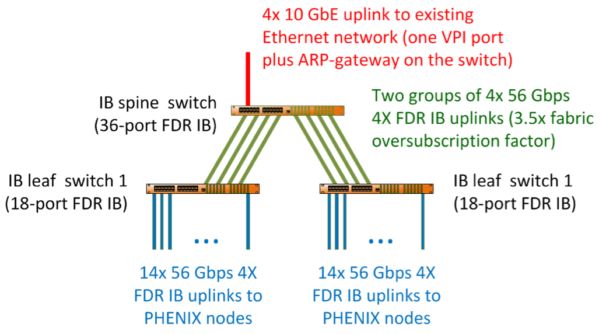
Infiniband vs. 10 GbE
Conducted a comprehensive evaluation of Infiniband networking solution
  Focused on Mellanox 4X FDR IB (56 Gbps/port), IPoIB, two-level over-subscribed tree topology (racktop switches) ➜ transparent to end users
  Tests were run utilizing two PHENIX racks (28 servers)
Results imply that IB solution gives 50% better performance for the cost (endpoint bandwidth normalized, w/o locality) compared to optical 10 GbE (non-blocking central core), with at least 2X lower latency
  Oversubscribed IB fabric shows efficient performance under existing RHIC workloads
O. Rind - BNL RACF Site Report - HEPiX, Annecy - May 19, 2014
Notes:
There was concern about contention on the spine switches in this topology.
Full 4X intra-rack connectivity

Slide 13
File Locality In Condor
Motivated by investigation of Infiniband network with tree-topology + PHENIX use of local farm storage
  Exploit advantage of intra-rack network connectivity
dCache File locality map (PNFS ID) harvested node-by-node, stored in separate db
  Client-side name to ID translation
Host rack-group locality advertised to Condor via STARTD_CRON
Job RANK statement built to steer jobs preferentially to host or rack
  Slight increase in negotiation time
  Several thousand matches per hour with possibly unique RANK statements
O. Rind - BNL RACF Site Report - HEPiX, Annecy - May 19, 2014

Slide 14
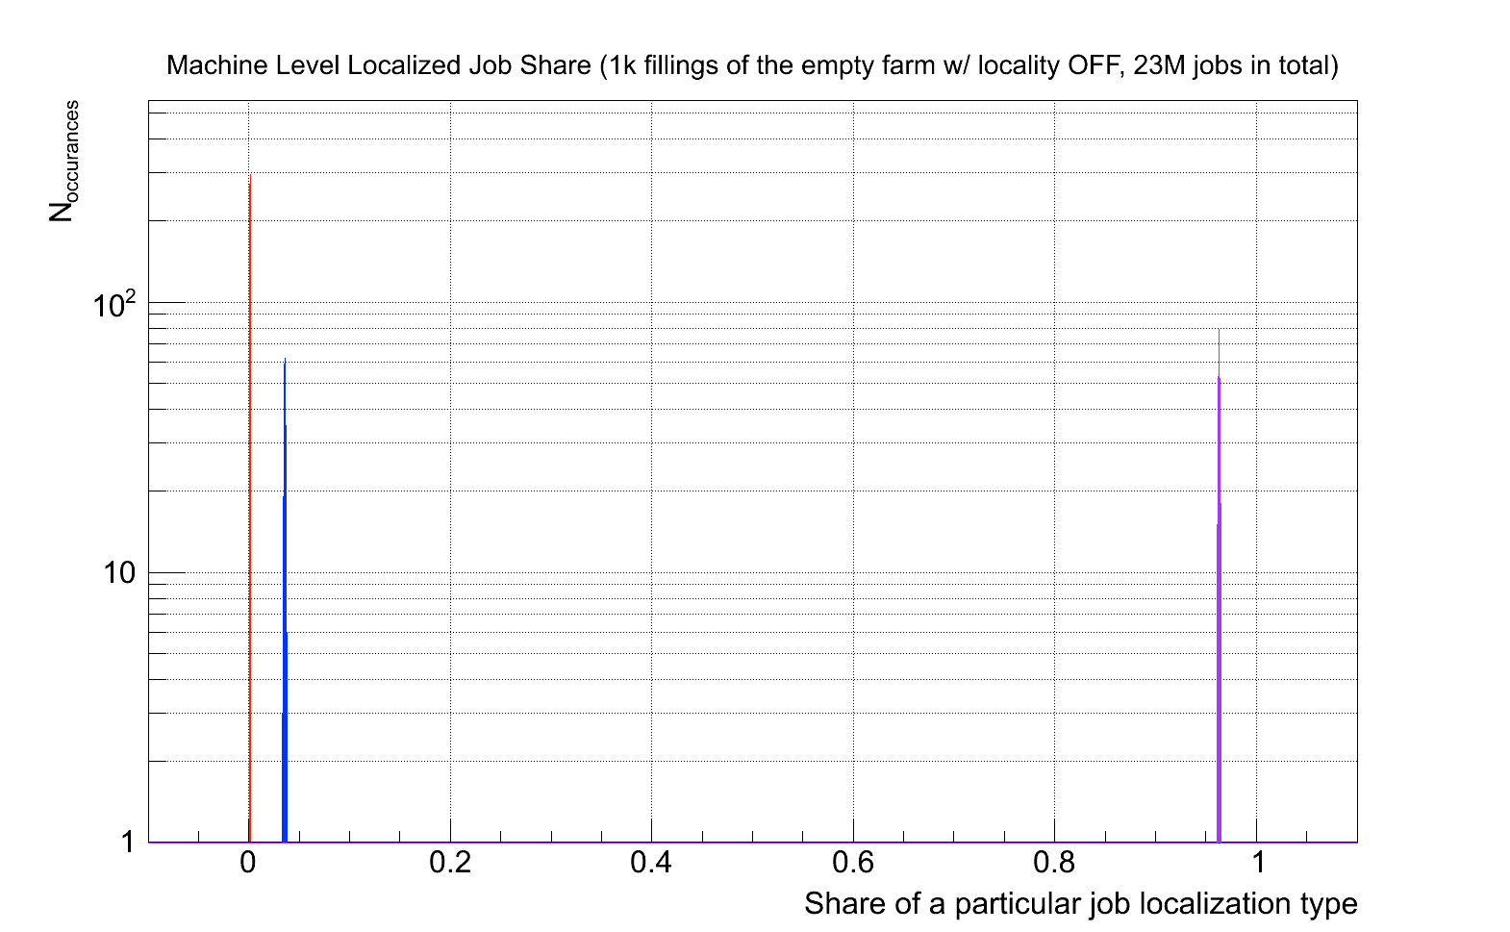
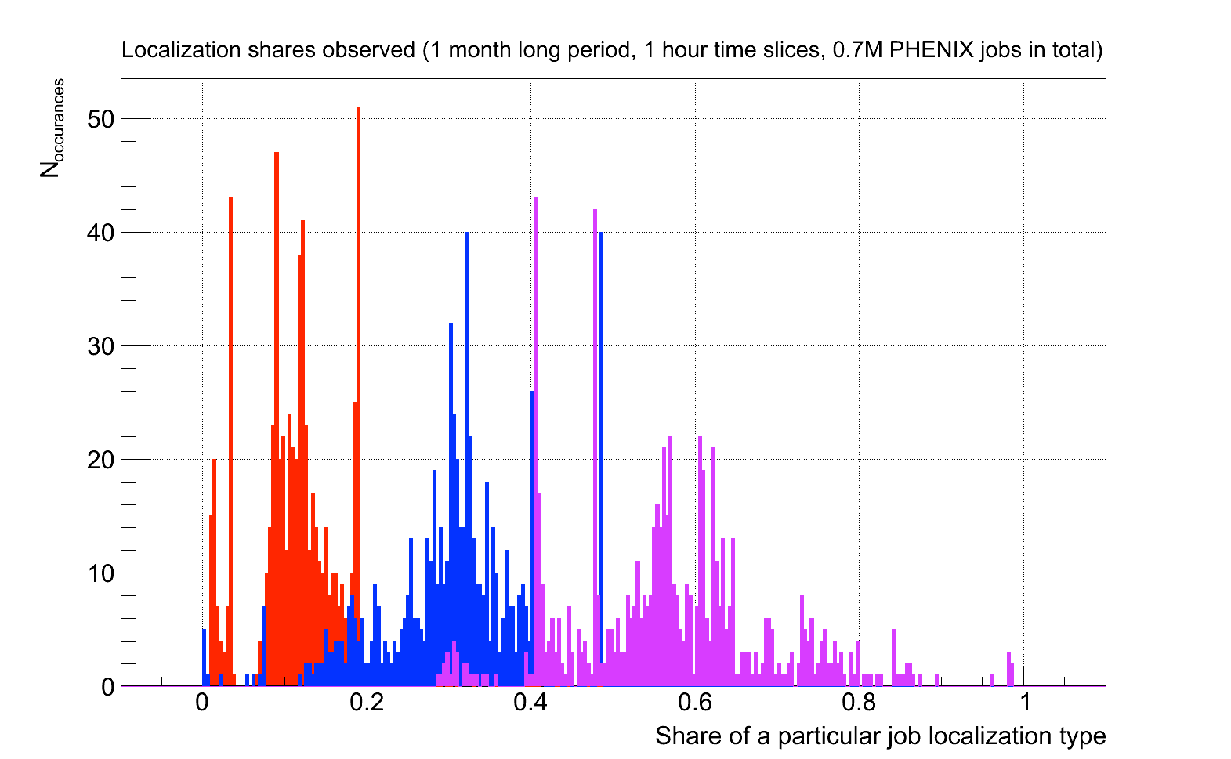
File Locality Scheduling Results
No Localization (Simulated)
Localized Job Scheduling (Real Jobs)
Machine-Local
Rack-Local (exclusive of Machine-Local)
Non-Local
~10% machine local + ~30% rack group local on average for these runs, but highly dependent on initial conditions
➜ Greatest benefit within non-flat network
O. Rind - BNL RACF Site Report - HEPiX, Annecy - May 19, 2014
Notes:
These are (correlated) snapshots
On empty farm, can get 90% rack group local

Slide 15
Mass Storage
HPSS now at 7.4.1p2
  Original release created a serious drive performance issue ➜ needed to push IBM to acknowledge software problem and provide patch in time for RHIC run
~45 PB on 52K tapes
Moving to LTO-6 in FY15
8-year “master plan” developed to account for library capacity issues
  Migration of data from lower capacity cartridges
  “Dual-copy” archive, with primary copy on LTO-6, secondary on T10KD
O. Rind - BNL RACF Site Report - HEPiX, Annecy - May 19, 2014
Notes:
Drive performance was reduced by 70%
There was a contingency to roll back HPSS before RHIC run if patch had not been provided
T10KD secondary storage is strictly backup - only accessed if primary becomes unreadable

Slide 16
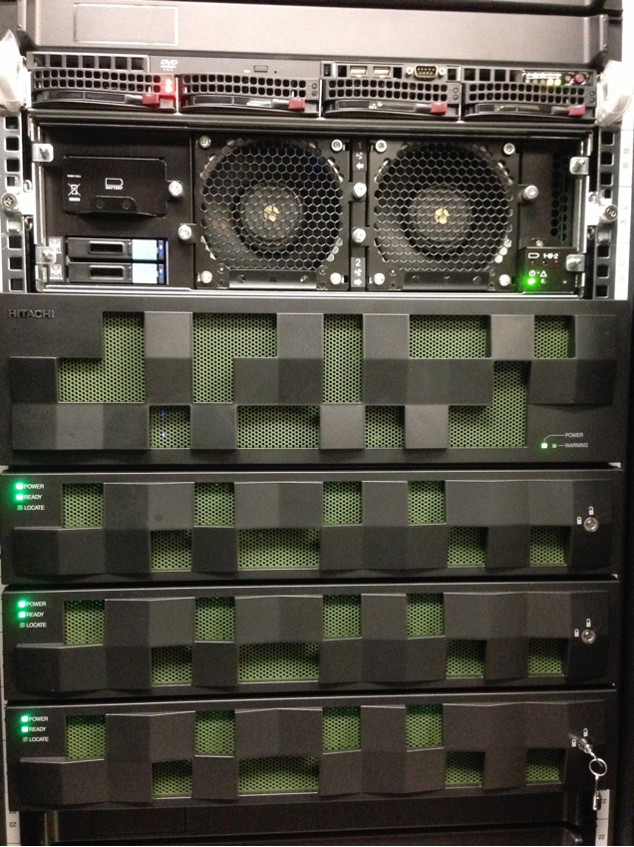
NFS Storage
Previously reported BlueArc performance problems tracked down to a change in RHEL 6.3: sunrpc.tcp_max_slot_table_entries dynamically allocating RPC slots up to the maximum (65536).
  Reverting to previous limit of 128 recovered system stability.
Tested two new Hitachi HNAS 4100 heads ➜ production deployment in one month
Exploring alternatives for some applications….
O. Rind - BNL RACF Site Report - HEPiX, Annecy - May 19, 2014
Notes:
Mentioned in Ann Arbor studies of NFS alternatives

Slide 17
GPFS
Small installation currently in production: 5x IBM M4 servers, 5 JBODs, 300 drives (30x SW RAID6)
  Observed performance: 10 GB/s writes, 10 GB/s reads
Future addition: 5x HUS130, 5x IBM M4 servers, 600 drives (60x HW RAID6), bringing total to ~3.1 PB
  Projected performance 20 GB/s
Two client clusters implemented on RHIC farm
  Mix of 3.5.0-13 and 3.5.0-16 clients
  Puppet can manage reinstallation of client cluster hosts, but initial client installation requires manual operation on cluster manager ➜ hope IBM fixes this in future release (possible solution using Puppet exported resources?)
O. Rind - BNL RACF Site Report - HEPiX, Annecy - May 19, 2014

Slide 18
CEPH
Two large scale tests (v0.72) conducted in the last year:
  Using 26 farm nodes, 312 disks, IPoIB, 26 MONs, 26 OSDs ➜ observed up to 6 GB/s write (internal replication)
  Dedicated storage 3xHUS130, 6 farm servers, 720 disks (2.2 PB), 6 MONs, 48 OSDs ➜ up to 2.4 GB/s write (internal replication), RAID controller bw limited (62% of theoretical max)
Best performance using low latency interconnect with dedicated SSD storage for OSD journals
Further tests
  Plan for comprehensive CephFS evaluation under RHEL 7
  Investigating use of fully striped RBD objects (v2) as mounted raw volumes for dCache
  Scale test beyond 2.2 PB
O. Rind - BNL RACF Site Report - HEPiX, Annecy - May 19, 2014

Slide 19
Distributed Storage
All HP servers in most recent PHENIX purchase dedicated to “raw” dCache pool (2 PB) for fast turnaround production ➜ daily transfer direct from HPSS cache working well
ATLAS dCache now at 2.6.18 (evaluating 2.6.26), ~12 PB
  Multiple access protocols including XRootd and WebDAV (with Metalink and davfs); NFS 4.1 available and in testing
  Transatlantic network test achieved 50 Gb to BNL (disk-to-disk, limited by source bandwidth)
Federated ATLAS XRootd (FAX) access
  Updated topology:
    Two RHEV VMs serving as redundant, load-balanced North American redirector
    Three North American Regional redirectors (3*2 VM)
    dCache interface via one XRootd proxy master and five proxy servers (5*10 gb)
  Upcoming 100 Gb FAX test (BNL to T2)
O. Rind - BNL RACF Site Report - HEPiX, Annecy - May 19, 2014

Slide 20
North American FAX Redirector Topology
US T3
Atlas-xrd-eu
Atlas-xrd-us
Atlas-xrd-west
Atlas-xrd-central
Atlas-xrd-east
Bnl-fax-proxy
WT2
MWT2
SWT2
AGLT2
NET2
O. Rind - BNL RACF Site Report - HEPiX, Annecy - May 19, 2014

Slide 21
Other Efforts
Grid Services
OpenStack Grizzly Cluster with Neutron/Open vSwitch network framework; 200 ~ 300 instances capacity
  In use for ATLAS Panda production
  Moving to latest Icehouse release
Oracle infrastructure moving to 11.2.0.4 by end of 2014.
Configuration Management
Upgraded all managed systems to Puppet 3.4.3 in March
  No performance issues using single Puppet master/PuppetDB server managing 500+ hosts checking in hourly, with additional 2500 hosts running on demand
Foreman 1.4.2 now in use
  Ongoing effort to migrate PXE build templates from Cobbler
O. Rind - BNL RACF Site Report - HEPiX, Annecy - May 19, 2014

Slide 22
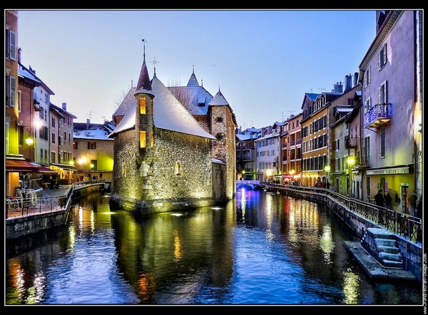
Questions?
Many thanks to Carlos Gamboa, Chris Hollowell, Hiro Ito, Shigeki Misawa, Tejas Rao, Jason Smith, Will Strecker-Kellogg, Tony Wong, David Yu, Alex Zaytsev and Xin Zhao for their contributions to this presentation.
O. Rind - BNL Site Report - HEPiX, Ann Arbor - October 28th, 2013

