Slide 1


WP2 (Detector development) Summary
Gabriella Pugliese INFN – Politecnico of Bari

Slide 2
Objective
Description of the WP2 work:
Study innovate particle detectors (with gaseous and silicon technologies) to cope with future high background experiments. Important R&D is still necessary to bring the detector technology at the required level of sustainability for this challenge.
Task 2.1: New gaseous detectors for high rate environment
Task 2.2: New high radiation tolerance silicon detectors (no news since last meeting. I will not cover this task on this talk)
Task 2.3: Set up of a gas-detector laboratory at HELWAN

Slide 3
2.1: New gaseous detectors for high rate environment
Delivering date: March 2014 (month 15)
Deliverables: Assembly and test of MRPC/GEM detectors
Assembly of large size MRPC/GEM prototypes
Beam-test measurements to study the detector performance in an LHC similar background environment will be pursued and completed.
Milestones:
March 2014: First small size MRPC and GEM prototypes validated. Performance measurements with cosmic rays of first small size MRPC and GEM prototypes
Secondments:
Early-Stage Researcher from Helwan to Poliba, May 2013 - Feb 2014 (10 month)
Early-Stage Researcher from Helwan to Poliba, July 2013 - April 2014 (10 month)
Sheeren and Ahmed arrived in Bari on 3th of Sep ‘13.
Plan to go at Cern middle of October and stay there until 3th of March ‘14.
NEWS

Slide 4
2.3: Set up of a gas-detector laboratory at HELWAN
Deliverables: Detector laboratory infrastructure at Helwan
Delivering date: August 2016 (month 44)
Milestones:
Dec 2014: Advancement on infra-structure preparation for the gas lab at HELWAN: Installation of power system and gas system for gaseous detector test.
Sept. 2016: Completion of HELWAN infrastructure and test of large size MRPC/GEM: HELWAN gas lab ready and fully functioning. Validation with cosmic rays of the large size gas detector.
Secondments:
TECH from Poliba to Helwan:
Jan- Feb 2014 & Jan- Feb 2015 & Jan- Feb 2016 (6 months)
Early-Stage Researcher from Poliba to Helwan:
May - June 2014 & Oct – Nov 2015 & Jun – Jul 2016 (6 month)

Slide 5
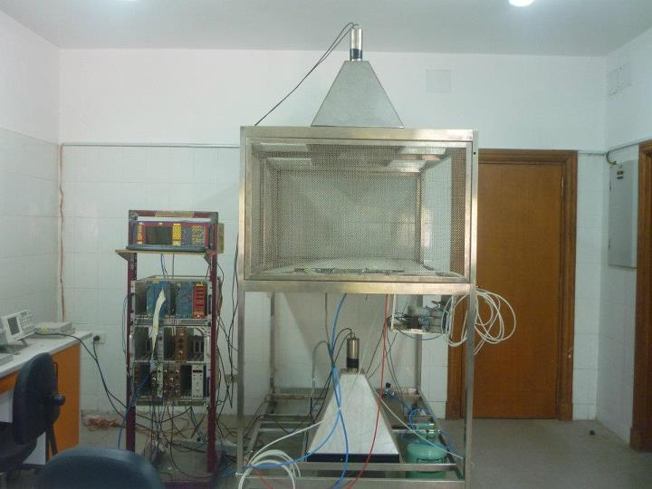
Cosmic Test laboratory status..
Activity started (as planned): end of April.
Weekly meetings (until 2 months ago for the known reasons)
Twiky page will all materials: https://twiki.cern.ch/twiki/bin/view/CMSPublic/EEPN2.
What is missing….
GAS system: the present system is only partially working.
DAQ system: plan to develop it at cern and then bring it in Egypt.
Data Base tool to store the data
Data Analysis tools

Slide 6
Proposal for activities @ CERN
Sheeren: study of the muon trigger and reconstruction capability in the high eta region (Delphes fast simulation..see Sheeren’s talk) vs detector performance
Ahmed: 904 activities (construction and test of RE4) and analysis tool development for cosmic test data
Yasser: DAQ system developed?

