Slide 1
Operations in RussianDataIntensiveGrid
Andrey Zarochentsev
SPbSU, St. Petersburg
Gleb Stiforov
JINR, Dubna
ALICE T1/T2 workshop in Tsukuba, Japan, 3-7 march 2014

Slide 2
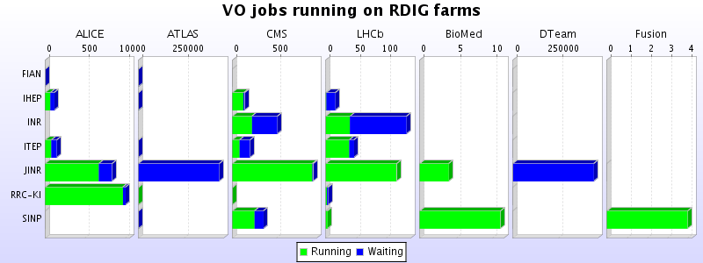

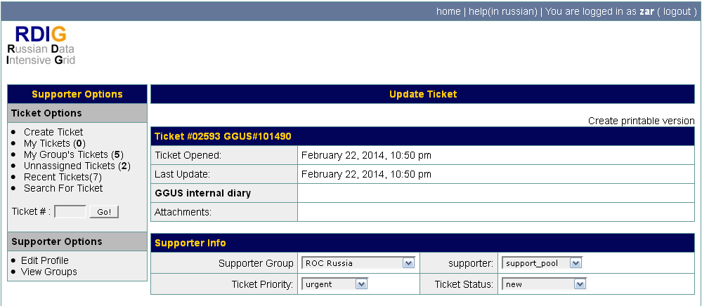
Structure of Russian sites 2013
8 Tier2 sites by 8 institutes of RDIG, involved into ALICE activity:
IHEP , JINR, RRC-KI, ITEP, Troitsk, PNPI, SPbSU
+ MEPHI
Services for all Russian sites

Slide 3
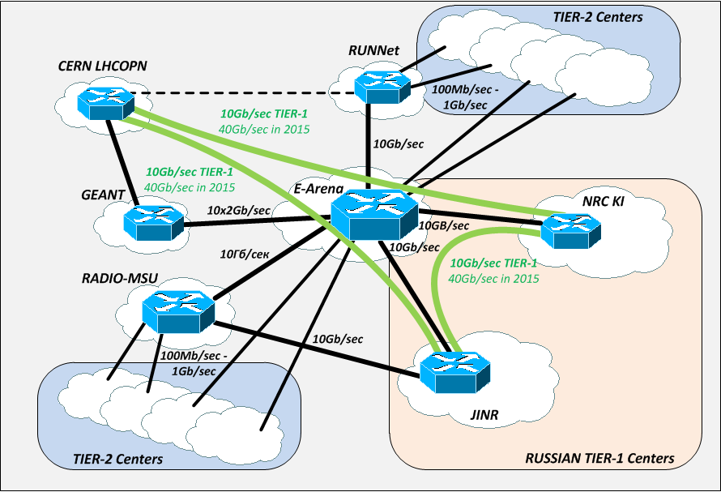
Network Structure 2013
All sites, (except SPbSU), worked via one provider to GEANT - via E-ARENA

Slide 4
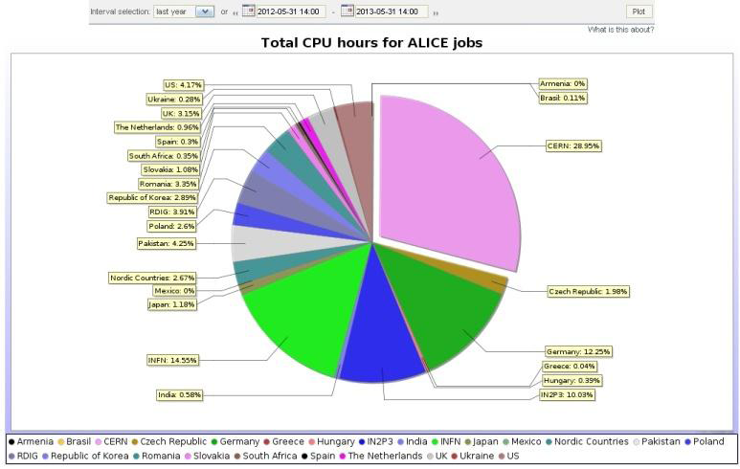
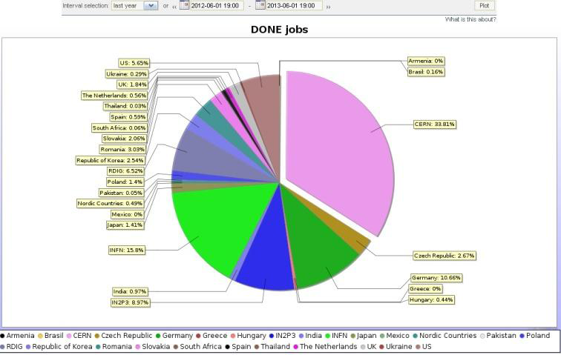
Results of Russian sites on 1 June 2013 (workshop in Lion)
Resources usage 3,91%
Done jobs6.5%

Slide 5
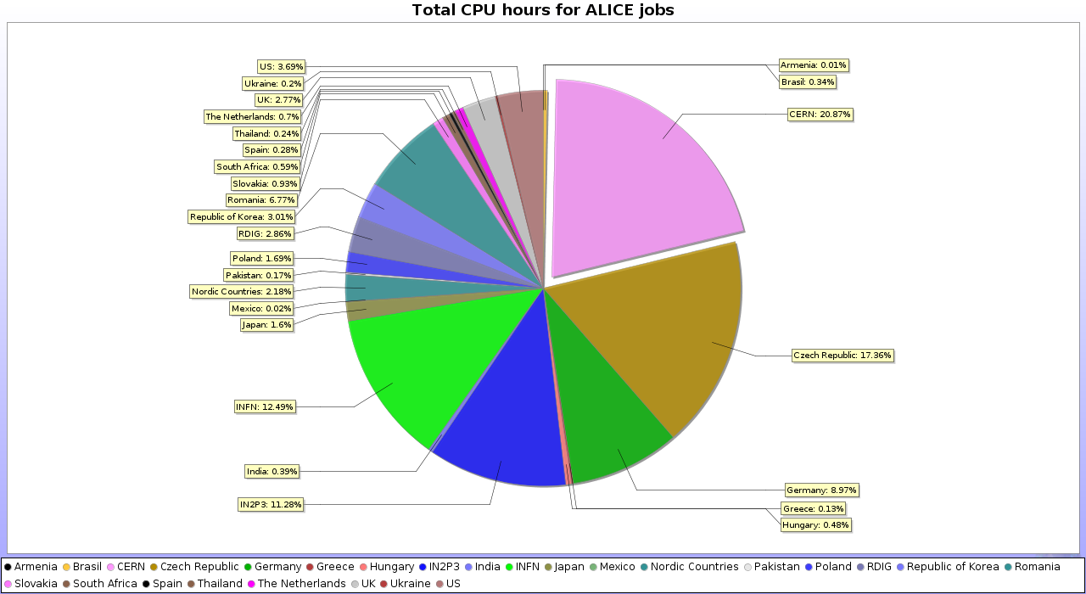
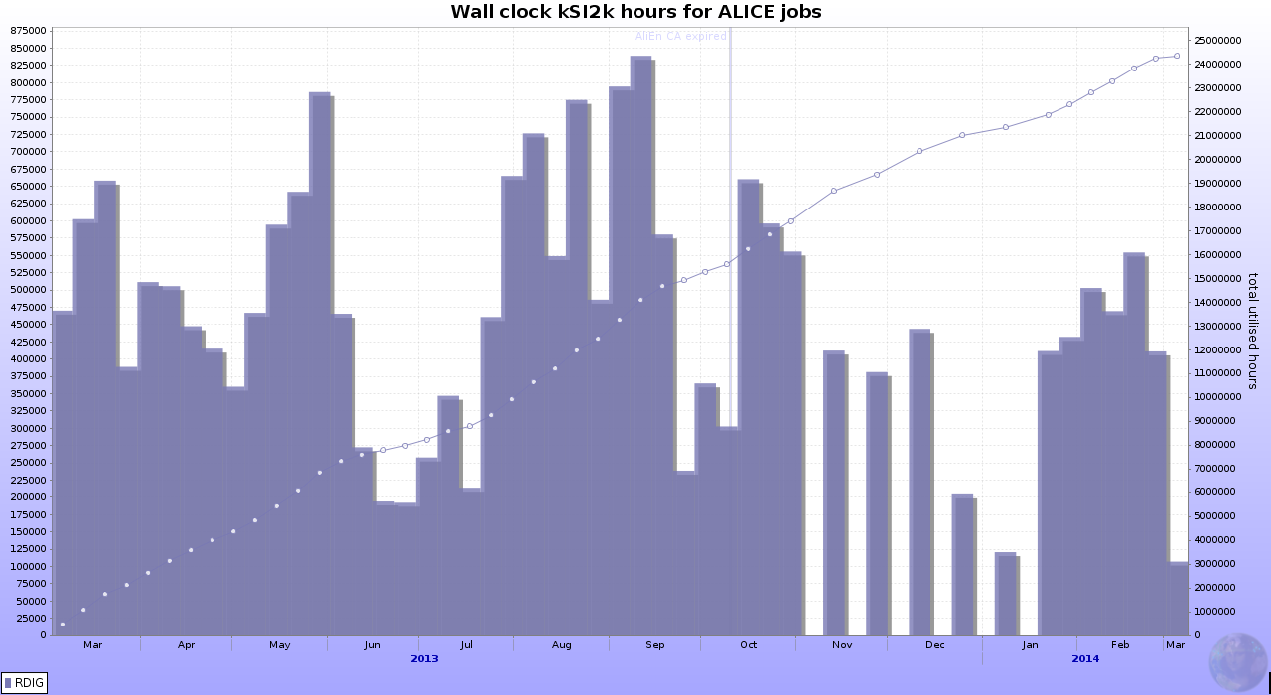
Changes in 2013!!!
In the Autumn of 2013 E-Arena terminated connection of Russian institutes with GEANT.
Sites were forced to create new network infrastructure .
Some loss of production happend as result
01/06/2013-01/01/2014 usage 2,86%

Slide 6
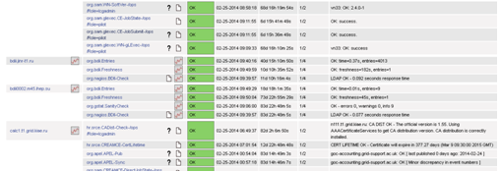
New Structure of Russian T2 sites 2014
Institutes
4 sites are unified to Regional Research Center Kurchatov Ints. (KI):
RRC-KI, IHEP, ITEP, PNPI
3 independent Rusian sites:
SPbSU, Troitsk, MEPHI
International site:
JINR
Services for all russian sites - ok

Slide 7
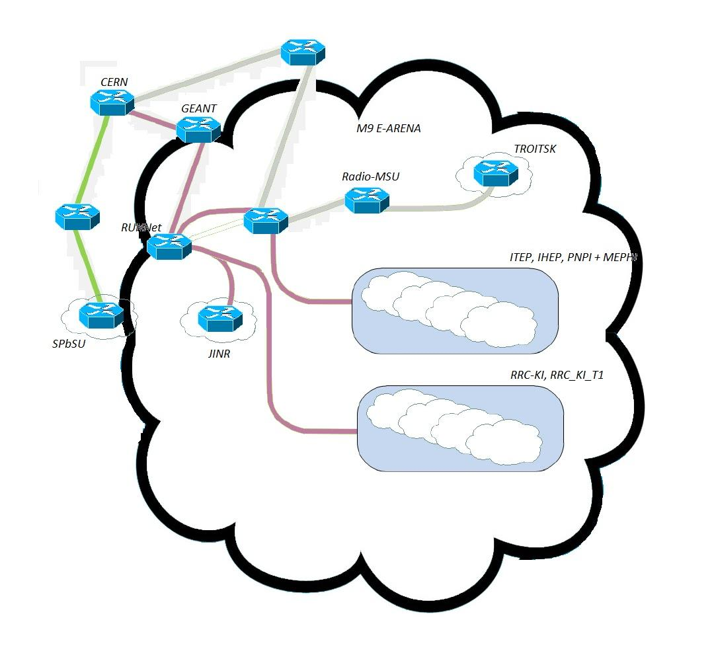
Network Structure in 2014
Russian sites have different paths to CERN:
(1) some via GEANT)
(2) some sites - without GEANT
All sites have local connections with each other

Slide 8
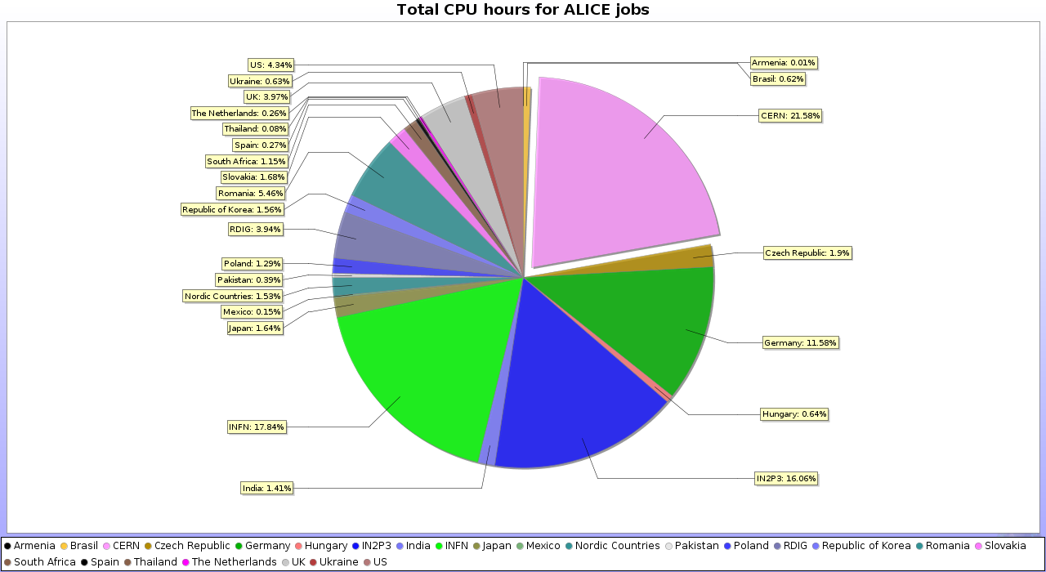
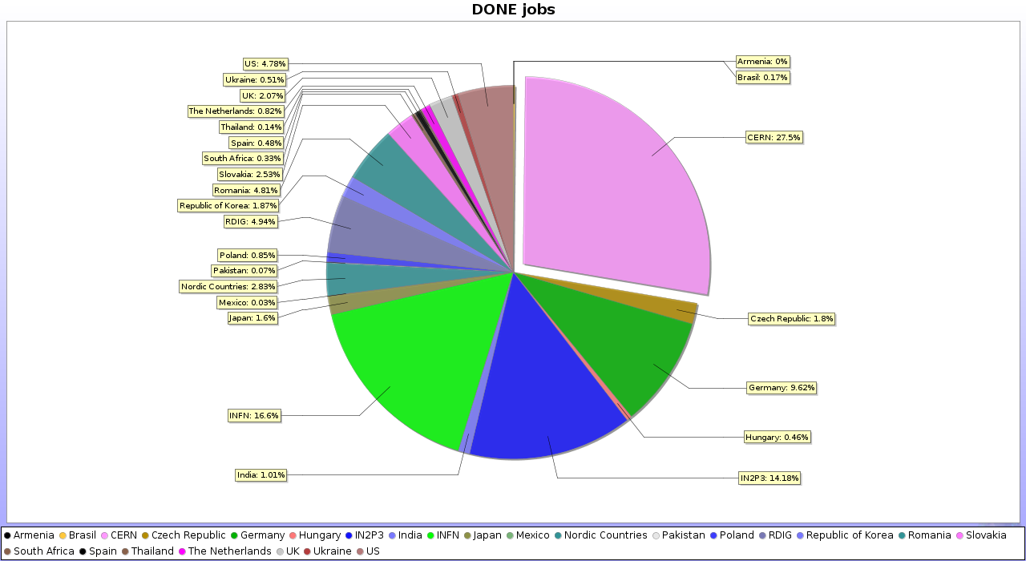
First Results in new structure result from the last month
Resources usage 3,94%
Done jobs 4,94%

Slide 9
Resources of Russian sites 2013 (CPU)
Site name | Resource (CPU) | HEP-SPEC2006/slot | HEPSPEC2006/VO | SE (TB)
SPbSU | 128 | 10,13 | 648,32 | 43
PNPI | 224 | 10,8 | 604,8 | 40
JINR | 2400 | 10,76 | 6456 | 350
RRC-KI | 1272 | 11,81 | 3755,58 | 339
Troitsk | 114 | 9,59 | 273,315 | 95
ITEP | 180 | 10,26 | 461,7 | 140
IHEP | 2828 | 10,33 | 7303,31 | 270
SUM | 7146 |  | 19503,03 (106,8%) | 1238 (95,2 %)
need by rebus |  |  | 18256 | 1301

Slide 10
New resources of Russian sites 2014
Requested by REBUS (http://wlcg-rebus.cern.ch/apps/pledges/resources/): (T2 only) DISK = 1645 TB , CE = 20467 HEPSPEC2006
information on 28 February 2014 year:
SPbSU: + 20 TB (old server)+ 66 TB (New), +96 Cores (new) (11.53 HS2006)
MEPHI: + 40 TB + 112 Cores (10.41 HS2006)
JINR: +0
Troitsk: +0
RRC-KIAE (ITEP only): +0
Sum: DISK=1238+ 126=1364TB (82 %) ,
CE~19503+1107+1166 =21775 HEPSPEC2006 (106 %)

Slide 11
Alice requirements to Russian sites on middleware: all ok in 2014.
Site name | cvmfs version | OS version | EMI (UMD) version | xrootd version
SPbSU | 2.1.15 | 6.4 | 2 | v3.2.6
PNPI | 2.1.15 | 6.5 | 2 | v3.3.4 (rpm)
JINR | 2.1.15 | 6.5 | 3 | v3.3.4
RRC-KI | 2.1.15 | 5.9 | 2 | 20100510-1509_dbg
Troitsk | 2.1.15 | 6.4 | 2 | 20100510-1509_dbg
ITEP | 2.1.15 | 6.5 | 2 | v3.2.6
IHEP | 2.1.15 | 6.4 | 3 | v3.2.4
MEPHI | 2.1.15 | 6.5 | 3 | -------------------------------

Slide 12
Questions from site admins:
1) Xrootd from RPM - instruction?
We have the expirience with installation of xrootd from rpm (PNPI) from EOS repository, but eos-apmon is not working for xrootd. We created a new package, but may be sombody has a normal package??
2) Migration of xrootd to EOS (with saved data)?
Some sites think about migration to EOS , but we have no instruction how to save data.
3) Future alice computing (network) model. What is more important: the internal connection or relationship with CERN provided for each individual site?
What is more important – high connection to CERN (or GEANT) or high interconnections between sites in one group (maybe in one cloud)?

Slide 13
Additional computing activity for ALICE:
1) Proof cluster at JINR - JRAF
Master PC
8 cores with RAM = 32Gb
Slaves PCs
48 cores summary.
Disk space for data is equal 14.13TB
2) Setting cloudstack for mCVM at SPbSU
Patching cloudstack for work EC2-API through ssl, running test tasks, etc.

Slide 14
Conclusions
1) Change of Structure of Russian sites and network
2) ALICE requirements to RDIG in 2013 for middleware are ok
3) Russian pledges for ALICE for 2013 are satisfied 107% for CPU and 95% for SE.
4) We expect to be ok in 2014 for SE…..
5) Questions from site admins - it would be nice to discuss here...

Slide 15
Thank for support to administrators of Russian Tier-2 sites:
IHEP V.Kotlyar, JINR V.Mitsyn,
RRC-KI E. Ryabinkin, ITEP Y.Lyublev,
PNPI A.Kiryanov, MEPHI S. Smirnov,
Troitsk L.Stepanova

Slide 16
Thank you!

