Slide 1
WLCG Monitoring Consolidation
ALICE Physics Analysis and T1-T2 Workshop
6th March 2014
Pablo Saiz
IT/SDC
Presented by Maarten Litmaath
IT/SDC

Slide 2
Table of contents
WLCG Monitoring consolidation:
  Definition of the project
  How to do it
  Current status
  Impact on the experiments
  Summary

Slide 3
WLCG monitoring consolidation group
Main goals:
  Reduce complexity, modular design
  Simplify operations, support and service
  Common development and deployment
  Unify, where possible, components
We know we can monitor with the current system:
  How can we do it with less resources?
http://go.cern.ch/B6NS
Already presented at Sep. GDB http://cern.ch/go/XZ8t
Notes:
The goal of the project is the consolidation of the WLCG monitoring
This includes critical analysis of
what is monitored,
technology used
deployment and support model
Wherever reasonable, the effort should be aligned with the activities of the Agile Infrastructure Monitoring team at CERN.
As a result by autumn 2014 the monitoring services should be operated and modified (when required) with at least twice smaller team, compared to spring 2013

Slide 4
Organization of work
Small core team:
  Monitoring development teams
  LHC experiment representatives
  WLCG operations representative
  Agile Infrastructure Monitoring representative
Even smaller taskforces on dedicated subjects
Mailing list: wlcg-mon-consolidation@cern.ch
Fortnightly meetings with summary reports
  http://go.cern.ch/6XQQ

Slide 5
Timeline
Review
Proof of concept
Deployment
Jul 13
Oct 13
Jan 14
Sep14
Notes:
The project is split in three stages:
First one which should be accomplished by the end of September:
Review of the current systems and metrics used for WLCG monitoring
Collecting and summarizing requirements from the LHC computing community to understand the changes needed in monitoring.
Highlight areas that are expected to be problematic
Propose a revised strategy and architecture for WLCG monitoring
Suggest implementation technologies and approaches for the transitions
Second stage: A first prototype should be ready by the end of 2013.
Third stage: Implementation and deployment All monitoring should have transitioned to the new approach by summer 2014.

Slide 6
Table of contents
WLCG Monitoring consolidation:
  Definition of the project
  How to do it
  Current status
  Impact on the experiments
  Summary

Slide 7
How to reduce complexity
Remove applications/functionality
Reduce scope
Modular design
Take existing solutions
Merging applications

Slide 8
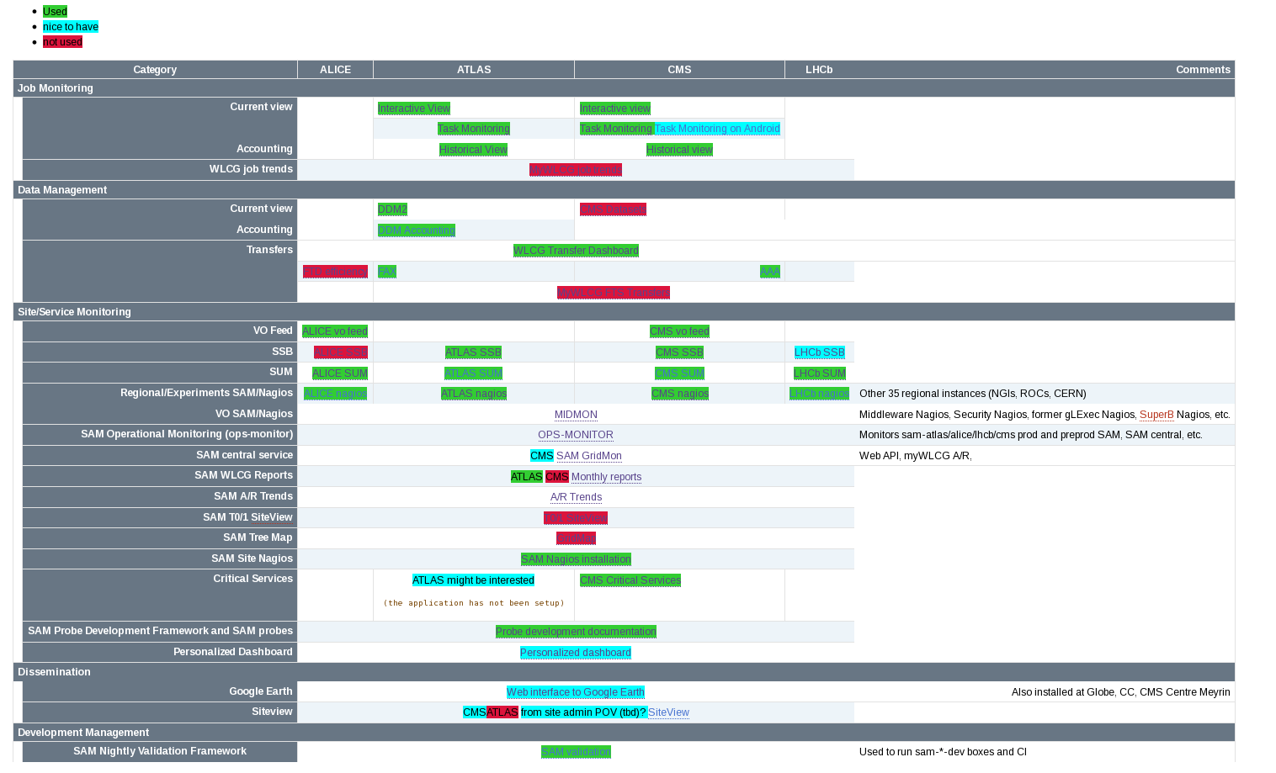
1. Identify applications no longer needed
Notes:
Monitoring applications currently provided by the WLCG monitoring team can be split in 4 groups:
Monitoring and accounting of the job processing activity
Monitoring and accounting of data access and data transfers
Remote testing and monitoring of the distributed infrastructure
Tools for dissemination purposes
Both experiments and sites were asked to provide input regarding usefulness of the existing applications, possible improvements and missing functionality (if any). Input from sites was provided through the WLCG operations team which sent a questionnaire to the sites. The review did not include VO-specific monitoring systems developed inside the experiments
Input we received was consistent with Google Analytics which is used for monitoring usage of our applications. SAM and most of the Dashboard applications are considered to be useful or essential by the experiments ( at least ATLAS and CMS) and by the WLCG operations team. No important gaps in the monitoring functionality were identified.
Stop support for applications which were reported not used by the experiments

Slide 9
2. Reduce scope
Concentrate on WLCG
  From distributed to centralized deployment
  Moving SAM central service to France/Greece/Croatia
Removing ‘OPS’ Virtual Organization
  From January, WLCG reports based on experiment metrics
  Experiments do not depend on OPS test

Slide 10
3. Modular design
Collect
information
Transport
Storage
Visualize
Aggregate
Recurrent Tasks
Documentation
Deployment
Notes:
First, we split the applications based on different layers. For each of the layers:
Check if we are doing things consistently within all our applications
If not, check if there is a good reason for that
Check if there are any solutions out there that would help us.
A very similar model is used also in the AI Monitoring team
It would be great if any of the layers could be changed without impact on the other layers…
In general, all applications have common functional blocks like data publishers, transfer layer, data collectors, data repository, data processing engines, web service and UIs. SAM in addition has a test submission framework based on Nagios.

Slide 11
4a. Deployment
Collect
information
Transport
Storage
Visualize
Using openstack, puppet, hiera, foreman
  Quota of 100 nodes, 240 cores
  28 hostgroups already created
    Development machine (8 nodes)
    Web servers (SSB, xrootd, WLCG transfers, Job: 40 nodes)
    Elastic Search (6 nodes), Hadoop (4 nodes)
    Nagios with info from vofeed.
Migrating machines from quattor to AI
Koji and Bamboo for build system and continuous integration
Aggregate
Recurrent Tasks
For details on other layers, see:
http://cern.ch/go/Bp9j
Documentation
Deployment
Deployment

Slide 12
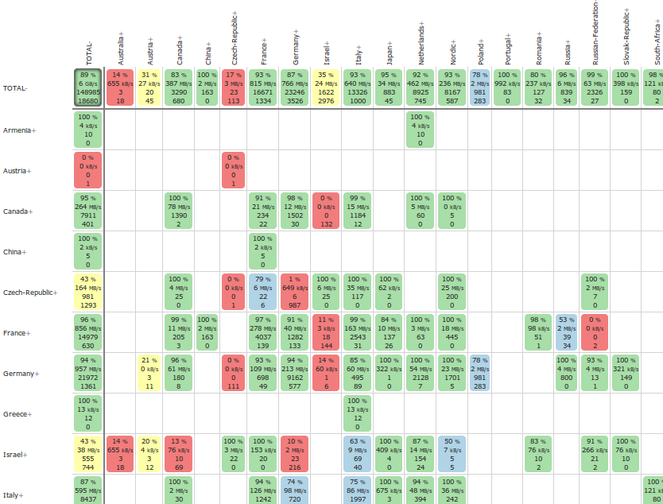
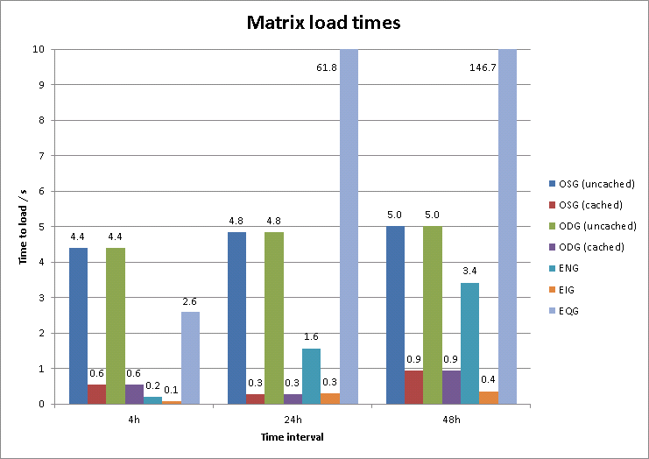
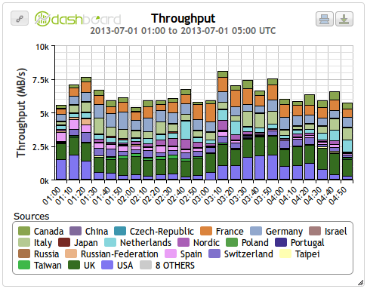
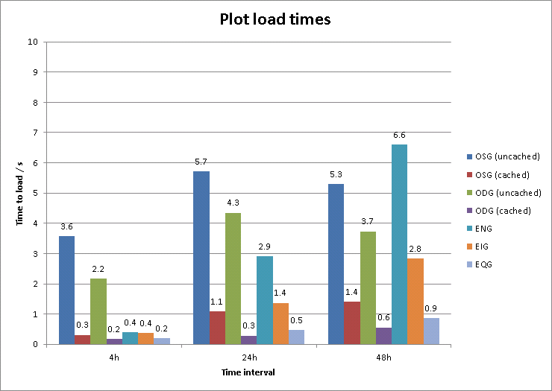

4b. Storage evaluation: Elasticsearch
For details on other layers, see:
http://cern.ch/go/pw7F
Notes:
Elasticsearch 0.90.3 does not support grouping by terms of multiple fields for statistical aggregations.
Using Elasticsearch 0.90.3 for WLCG Transfer Monitoring we could achieve similar performance to 2nd hit, i.e. cached, Oracle performance but this means using diverse workarounds for multi-field grouping.
Elasticsearch 1.0 includes a new Aggregation Module that will support grouping by terms of multiple fields for statistical aggregations
Recommend re-evaluating ElasticSearch for WLCG Transfer Monitoring when 1.0 is available.

Slide 13
5. Merging applications
Categories:
  Job Monitoring
  Data Management /Transfers
  Infrastructure Monitoring
  Dissemination
Infrastructure monitoring is currently the area with more applications
  And where we can benefit the most from common components

Slide 14
Infrastructure monitoring (Current state)
Experiment-defined metrics
HTTP
SSB
SSB WEB service
Experiment-specific processing
MyWLCG
Derived metrics
Primary metrics
ACE
Nagios
Nagios SAM probes
Message queue
MRS
WEB service
POEM
ATP
SUM
Hammer Cloud jobs
Hammer
Cloud
server
WEB interface
Hammer Cloud DB
Notes:
Multiple different schemas for metric repositories
Multiple different processing engines
Different implementation of data collectors
Different implementation of APIs and visualization layers
Not all components provide enough flexibility for introducing new metrics, for combining metrics , for custom processing algorithms
While functional testing (Nagios) and stress testing (Hammer Cloud) by its nature might dictate different implementation of the test submission mechanism, the following part of the chain looks very similar : collecting metrics, processing them (with generic or custom algorithm) in order to produce derived metrics out of the primary ones, providing access to data through APIs and UIs
Can data flow be unified without loosing (even improving) functionality?
Does our infrastructure monitoring currently provide realistic view of what experiments are doing?
SAM tests are submitted through WMS which LHC experiments do not use (or do not intend to use) for their workflows
SAM tests are pretty static and in general check only basic functionality of the services
Not all experiments are interested in using SAM/Nagios (ALICE is not).
One of the possibilities would be to perform inside experiment pilots the checks similar to ones handled by functional tests
All experiments would like to be able to provide their own metrics which would be taken into account for evaluation of site usability and performance in a way similar to the results of the functional tests.
The monitoring system should allow to handle all monitoring flows in a similar way without much difference in the monitoring workflow

Slide 15

Infrastructure monitoring (Goal)
T
R
A
N
S
P
O
R
T
Metric store
SAM Nagios tests
Primary
and derived
metrics
Hammer Cloud metrics
UI
Profile
Metrics defined by experiments
Topology
Pledges
Built-in/External processing
engine
Downtime

Slide 16
Table of contents
WLCG Monitoring consolidation:
  Definition of the project
  How to do it
  Current status
  Impact on the experiments
  Summary

Slide 17
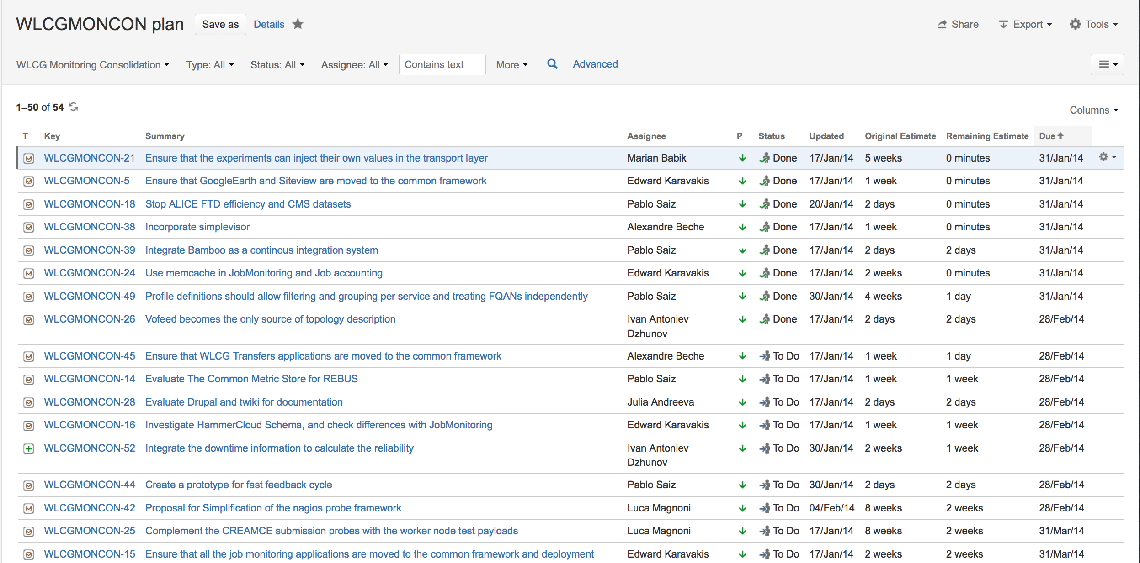
Project plan
Report with the evaluation created.
Tasks identified and inserted in JIRA
https://its.cern.ch/jira/browse/WLCGMON

Slide 18
Different set of tasks
1. Application support
  Job, Transfer, Infrastructure, GoogleEarth
2. Running the services
  Moving to AI, EGI transition, Koji, SLC6, …
3. Merging applications
  SSB and SAM, SSB and REBUS, HammerCloud and Nagios (still under discussion)
4. Technology evaluation
  ElasticSearch, Testing framework (see Luca’s Feb GDB presentation), PostgreSQL, Django, Drupal…

Slide 19
1. Application support
Support the current system
Multiple applications identified by users/developers as under control
  Already modular design
  Hit the spot
Introduce some new functionality
  Not covered by the consolidation project
  Example: Alexandre’s Feb GDB talk ‘The new WLCG Transfer dashboard’

Slide 20
2. Running the services
Most of the machines moved already to openstack, puppet, SLC6
  More will be done before end of March
  Thanks to the Agile Infrastructure Team
Transition of SAM EGI to consortium GRNET, SRCE and CNRS
  Coordinated by Marian
  See his Feb 14 Mon Consolidation talk

Slide 21
3. Merging applications
Goal: reduce number of applications to maintain.
Infrastructure monitoring:
  Testing framework
    Can the Nagios tests and HC Functional tests be combined
  SAM & SSB:
    storage and visualization already done
  REBUS & SSB
    Prototype ready. Still to investigate how to populate

Slide 22
4. Technology evaluation
Most of the work done during the review & prototype phase
  Effort still necessary to keep up to date
Close collaboration with AI Monitoring

Slide 23
Table of contents
WLCG Monitoring consolidation:
  Definition of the project
  How to do it
  Current status
  Impact on the experiments
  Summary

Slide 24
Impact on the experiments
Main impact on Infrastructure monitoring
  Transition for other applications should be transparent
Consistent data across all system
Reduced number of UI

Slide 25
Topology
Vofeed becomes single authority of topology
  Any service, any instance
    Also “meta” services, like the AliEn CE, CM, …
  No cross-check with GOCDB/BDII
Content and format will be revised

Slide 26
Collecting information
Nagios
  Optional component
    If experiment wants it, there will be a Nagios
  CREAM CE probe with payload
  CondorG probe
  Each FQAN treated as a different metric
Injecting metrics
  Any metric published in the transport with the correct format will be collected
  Dynamic definition of metrics
  Metrics could be anything:
    Status, # successful jobs, downtime info, # transfer errors

Slide 27
Metric store
Solution already existing (SSB)
Access to current state and historical data
Stores only status changes
Combining metrics into views
Used for operations by ATLAS and CMS
  Deployed for LHCb and ALICE
A common metric store:
  Simplifies current architecture
  Allows evaluation of new technologies
  Allows concept of usability (Site Readiness)
Notes:
SSB looks to be generic enough to be used as a common metric store.
Provides access to the snapshot and historical data
Provides data compaction and archiving
Has a built in mechanism for calculating status of a given instance over a given time range (similar to availability calculation)
It has necessary concepts for combining metrics which can be of interest for a particular task (SSB views)
Was successfully used for operations by ATLAS and CMS
Having a common implementation for metric store would
simplify a lot the current architecture
allow to easily evaluate and apply new technologies (for data storage and processing)

Slide 28
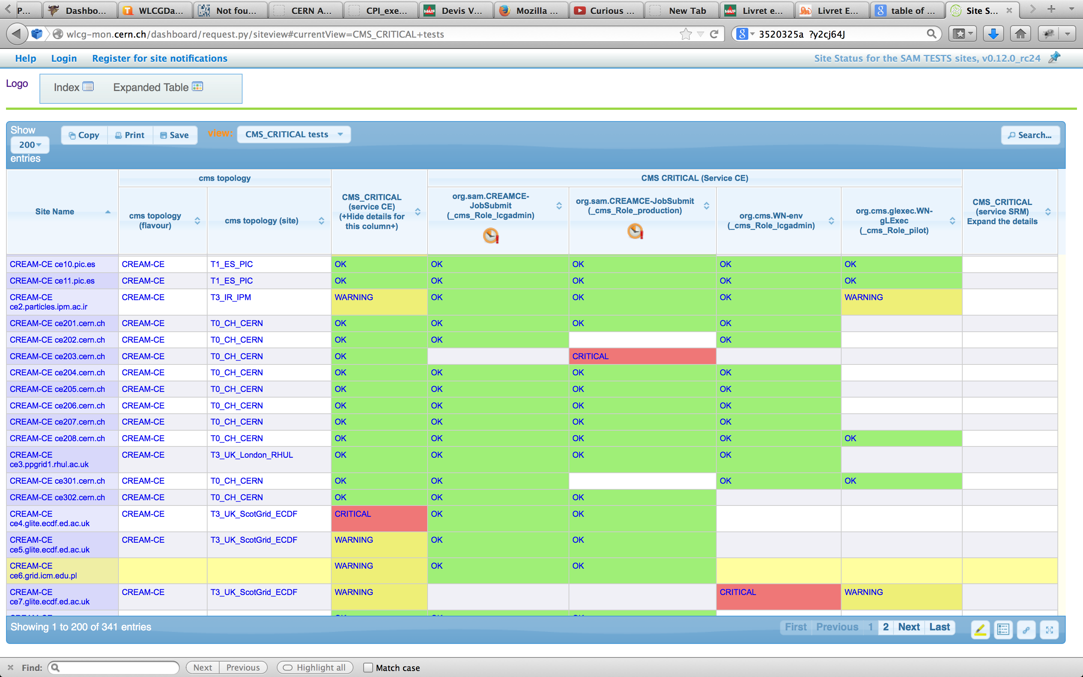
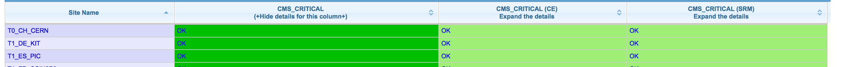
Aggregation of metrics
Horizontal
Vertical
And another horizontal

Slide 29
More options for aggregation
Filtering:
  Combine metrics depending on the value of another metric:
    Use different profile for T1 sites
    Take values only for one service
Other base algorithms:
  Currently: AND, OR
  Still to be developed: SUM, AVG, downtime, sliding window
Multiple levels of aggregation:
  Queue Name → CE → Site → VO

Slide 30
Definition of profiles
Experiments can define multiple profiles
  Include list of metrics
  Filtering
  Topology
  Algorithm

Slide 31
Site readiness
Define status of the site, defining if the site ‘can be used by the experiment’
  Different from Site Availability
  Issues might be experiment specific
    Or from a different site
Current approach of ATLAS and CMS:
  Read data from SSB
  Apply their own algorithm (sliding window, depending on tier structure, granularity)
  Inject a new metric in SSB

Slide 32
Table of contents
WLCG Monitoring consolidation:
  Definition of the project
  How to do it
  Current status
  Impact on the experiments
  Summary

Slide 33
WLCG Monitoring Consolidation Group
Simplify scope/tools/maintenance to support it with half of the resources
Prototype already deployed
  Now, ‘just’ evolve it production
Very good progress on moving to common infrastructure, and merging applications
And plenty of work still ahead of us…
less than half

