Slide 1
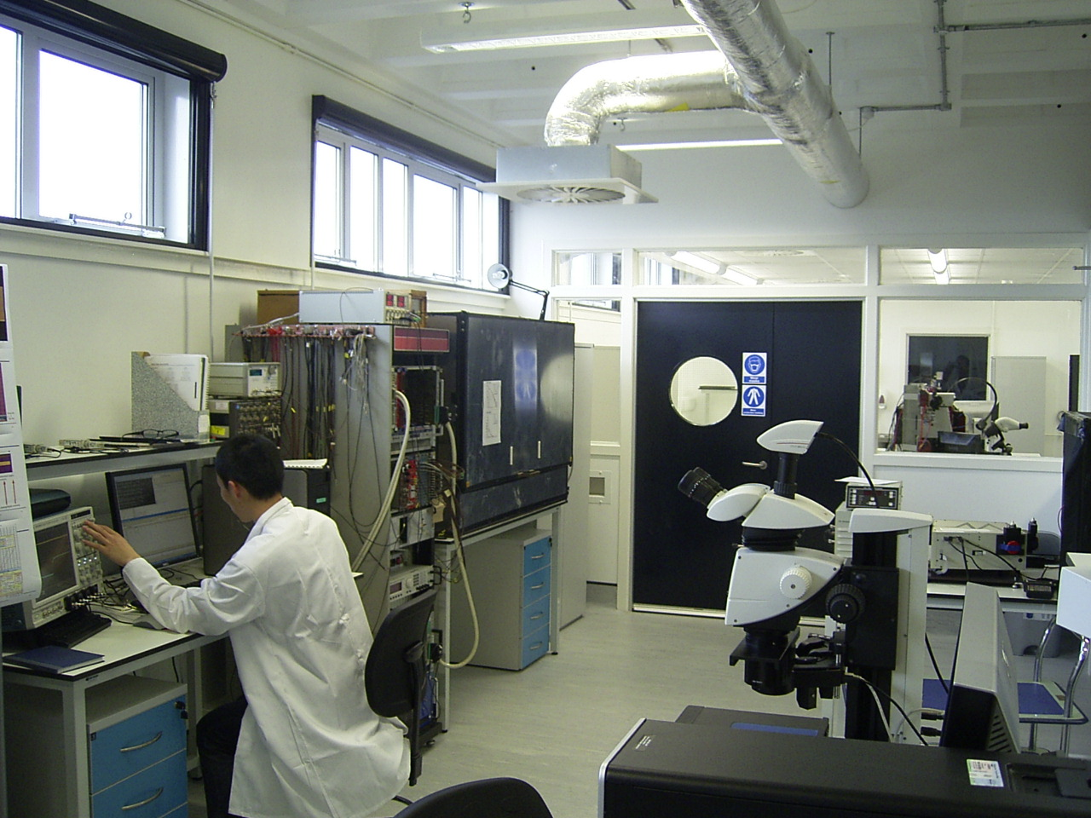

Edinburgh Hardware Activities
Projects:
  LHCb M&O
  LHCb Upgrade
  ATLAS Upgrade
  Sensor Studies
Technologies:
  Photon Detectors
  Silicon Pixel Detectors
Laboratory Infrastructure:
Manpower:
I will present mainly in order of projects,
summarising achievements and plans,
interleaved with information on technologies,
laboratory infrastructure and manpower.
all PPE meeting, 22.10.2013
Stephan Eisenhardt
University of Edinburgh

Slide 2
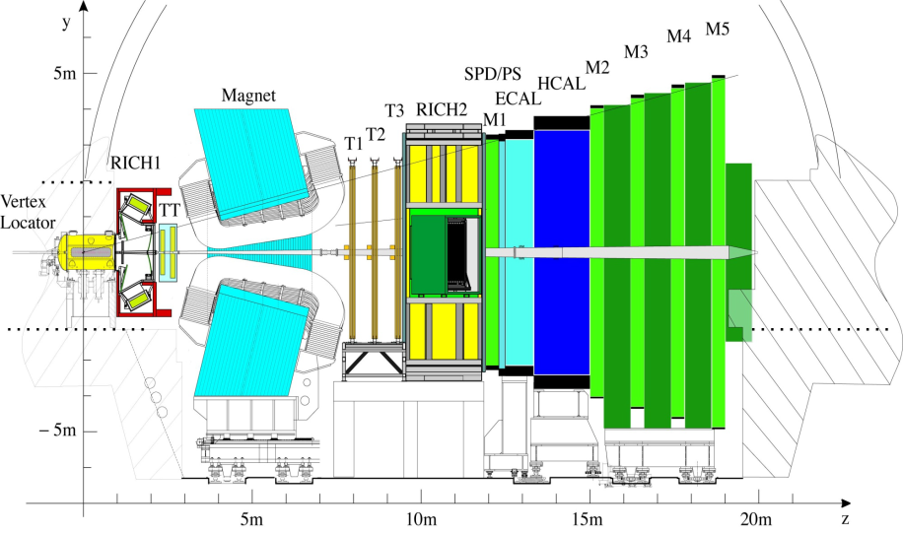
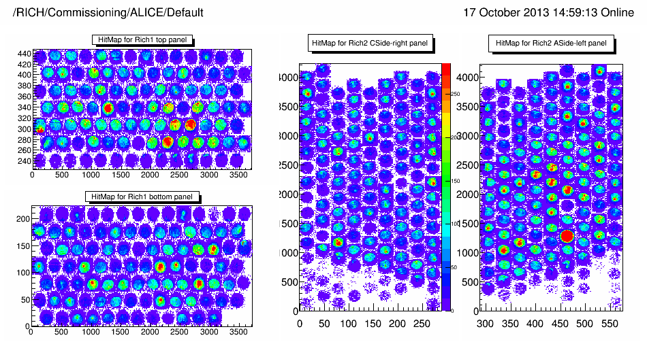
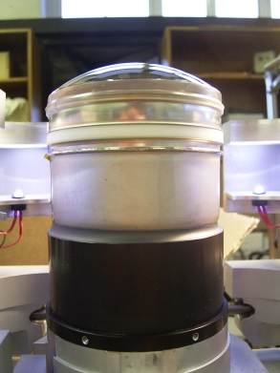
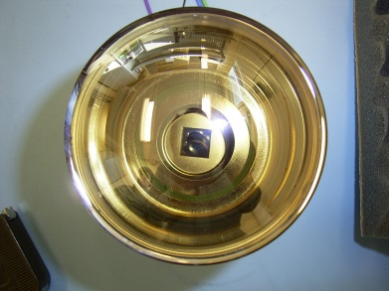
LHCb M&O – Project
Edinburgh committed to maintain the RICH photon detectors (HPD)
  until LS2 when the RICH photon detectors need to be upgraded to 40MHz readout
LHCb
RICH1
RICH2
RICH 1 photon detector panels RICH 2
Hybrid Photon Detector (HPD)

Slide 3
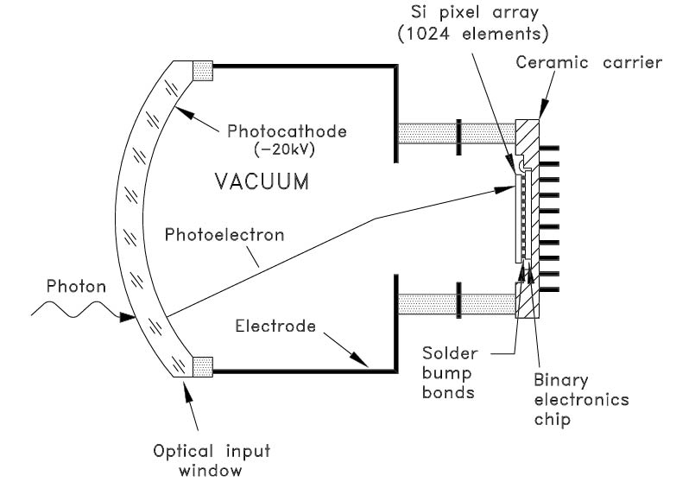
LHCb M&O – Project
HPDs do an excellent job (high photon efficiency, low noise), but suffer from degradation of vacuum
  visible in increase of Ion Feedback:
    ionisation of residual gas atoms
    drift of ions to photocathode: O(200-300ns)
    secondary electron production: O(10-40 e⁻)
  ranging: 0.01%/yr <= ΔIFB <= 2.0%/yr
  HPDs become unusable when: P(IFB)*(e⁻ multiplicity)>=1 (typically @ 5%*20e⁻)
this made a continuous repair programme necessary  vital for RICH
  monitor IFB of RICH HPDs in situ
  schedule exchange when they approach the critical point
  refurbish (rebuild) HPDs at Photonis & retest at Edinburgh
  plan exchange campaigns and HPD placement
Anode
ion
Vacuum
photon detector

Slide 4
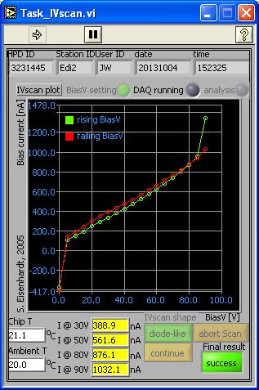
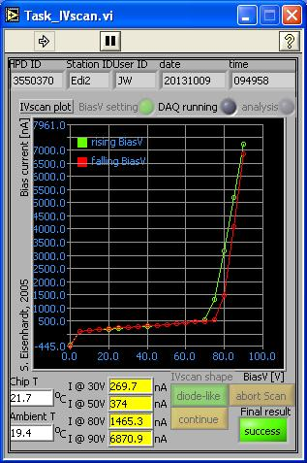
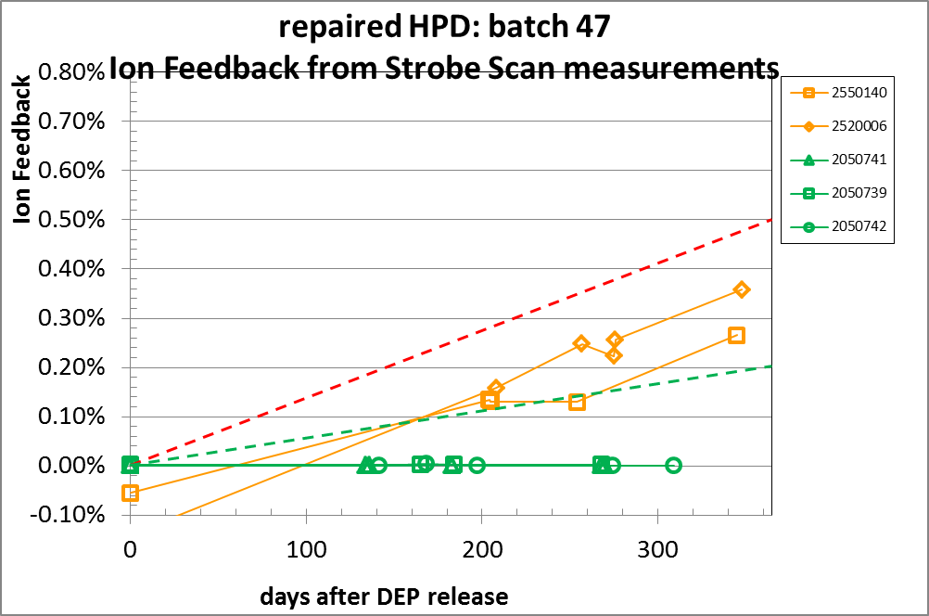
LHCb M&O – Recent Developments
Developed and qualified new HPD production procedure
  old bake-out profile: 300°C, 3hrs dwell time
  new bake-out profile: 310°C, 7hrs dwell time, 12 getter strips
  at the very limit of profile parameters (increased risk of high leakage current)
  introduction of getters very successful: IFB ~ 0.01, ΔIFB < 0.01%/yr
Thierry Gys
Photonis
  0.5%/yr
  0.2%/yr
bias current can change after back-out
the getter strips are very effective

Slide 5
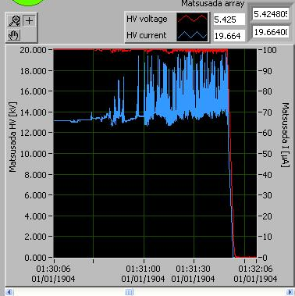
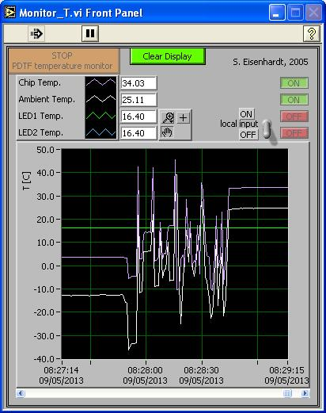
LHCb M&O – Recent Developments
Had to overcome significant HW problems at PDTF
  triggered by badly discharging HPD
    EMP damaged HW & spoiled SW configuration
Jon Webster
discharges visible as noise in the HV current and in the current sources for the T sensors

Slide 6
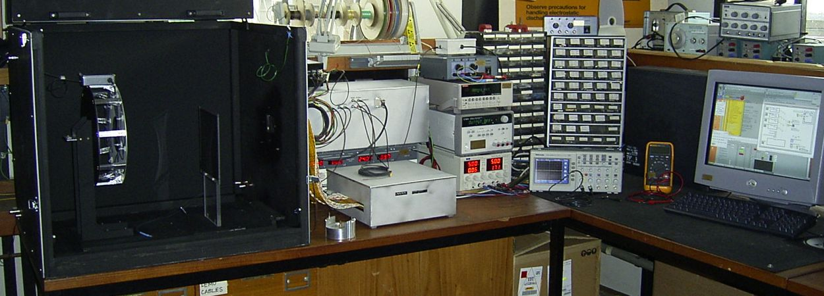
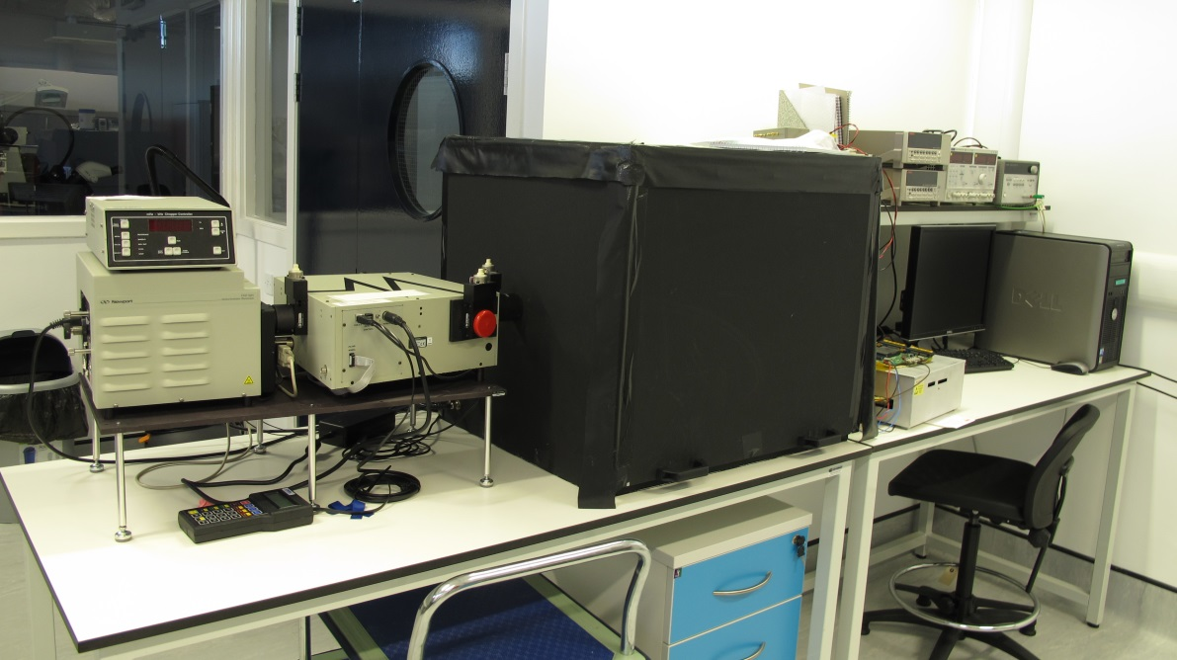
LHCb M&O – Recent Developments
Redeveloped PDTF DAQ on new Win7(64-bit) platform
  95% done, still needs:
    another SW component from CERN (WinDriver)
    final cross check of first station
    setup of second station from documented
    recipe
Automation of QE measurement
  90% done, still needs:
    setup of test recipes
    tuning of steering parameters
    cross-calibration with old setup
Cameron Dean
needs follow-up
PDTF setup
Ross McKenzie
needs follow-up
new QE setup

Slide 7
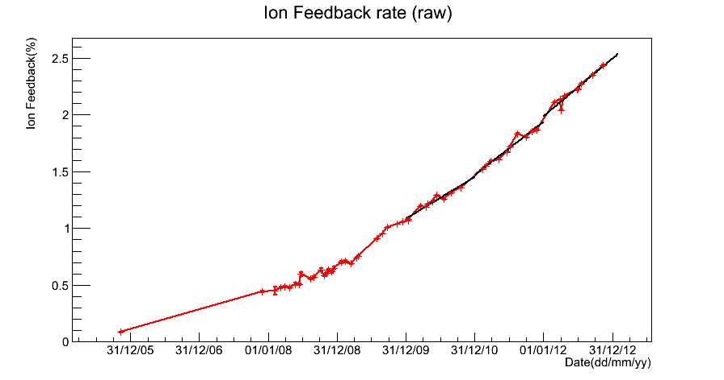
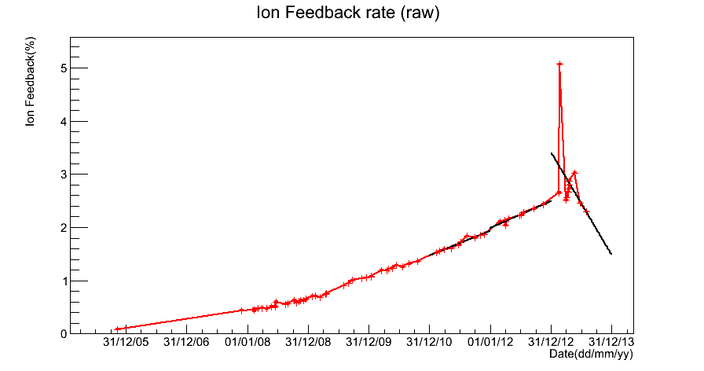
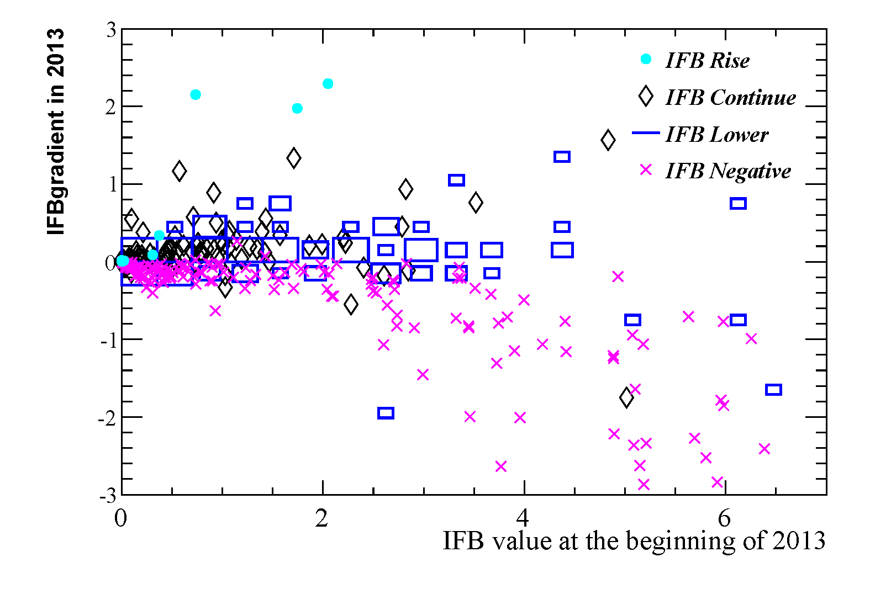
LHCb M&O – Recent Developments
Haofei Luo
Developed new strategy to judge IFB status of HPDs
  needed due to different operation conditions to hibernate HPDs during LS1
  moved from linear extrapolation of ΔIFB to 2-dim method: ΔIFB vs. IFB
extrapolation by year
up to LS1
H525004 A0_6
12/2012
breakdown of extrapolation
during LS1
new approach
ΔIFB vs. IFB
H525004 A0_6
07/2013
[%/yr]
[%]

Slide 8
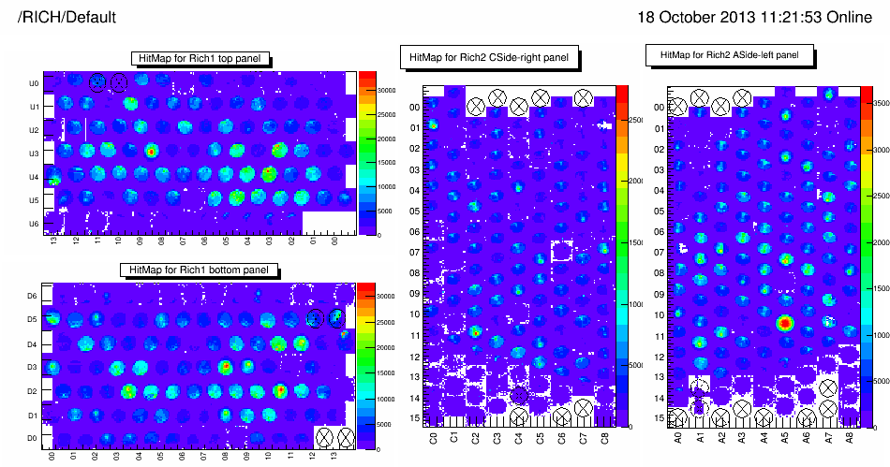
LHCb M&O – Plans
Laurence to be trained up to lead this effort
  topic-by-topic take over
    oversee online IFB monitoring & HPD life-time prediction
    run the test facility (planning, trouble shooting)
    compile & judge test results (incl. bookkeeping & presenting)
    plan HPD placement in RICH
    develop test facilities (finalise WinXPWin7 transition, QE automation & analysis SW)
2014 exchange campaign – big push to get to 2017/18
  provisional planning:
    02/2014: RICH2 A-side, exchange ~20 HPD
    04/2014: RICH2 A-side, exchange ~20 HPD
    06/2014: RICH2 C-side, exchange ~20 HPD
    10/2014: RICH1 U & D, exchange ~15 HPD
  currently have: 12+2 HPDs in hand, 4+4 at Photonis, ~20 old HPD @ Photonis
  this is a tight schedule, almost half of the 2005/07 production pace, but now only one test centre
Present RICH & HPD performance at RICH2013 (talk)
people:
Laurence Carson
Jon Webster
Haofei Luo

Slide 9
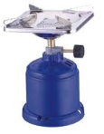


LHCb Upgrade – Project
we contribute to the upgrade of the photon detectors of the RICH
  need to be replaced to upgrade readout: 1MHz  40MHz
all efforts so far (since ~2008) w/o funding
  ‘on the side’ in our spare time, cooking on small flame…
  and employing students (PhD, MPhys, summer students)
currently we are bidding (again) for proper funding
  2008 no bid submitted due to STFC funding crisis
  2011 bid was ‘shelved’, i.e. not looked at, due to funding problems
  2013 bid was encouraged and LHCb Upgrade case is rated in highest category
    but is treated badly:
    LoI plans were asked to ‘cut to the bone’ with the indication that this would be funded
    so we did cut O(40%) and submitted
    now we are asked to develop further cut options to 70% and 50% level of submission
    we are fighting this, but don’t know what will happen …
LoI
submitted
PPRP
requested scales

Slide 10
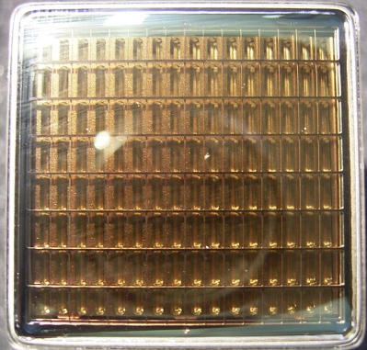
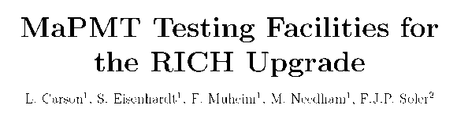
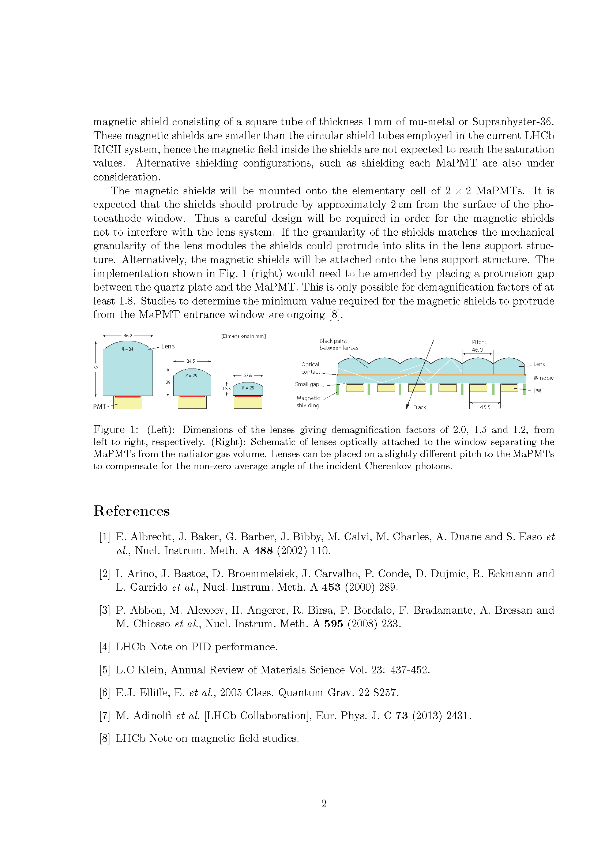
LHCb Upgrade – Project
what we are bidding for (only the Edinburgh hardware part)
  WP 1.2 Photon Detectors
  WP 1.2.1 Qualify Photon Detectors
    finalise R&D on MaPMT R11265
      basic tube characteristics
      behaviour in magnetic field
      QE of new Super BiAlkali photocathodes (SBA)
      ageing
  WP 1.2.2 MaPMT Test Facilities and QA
    develop, commission and run two test facilities (Edinburgh & Glasgow)
    custom DAQ and Quality Assurance procedures
    QE measurements
    tube selection (to mount groups of similar gain)
  WP 1.2.3 MaPMT Module Assembly
    plan and conduct assembly of Elementary Cells at test facilities
  WP 1.2.4 MaPMT Monitoring
  WP 1.3.2 Lenses & Magnetic Shields
    design lens system and mu-metal shields (fabrication by industry)
led by:
S.E.
Matt Needham
R11265
entry
window
S.E. & Paul Soler
Matt Needham
Gla (Edi supports)
Franz Muheim

Slide 11
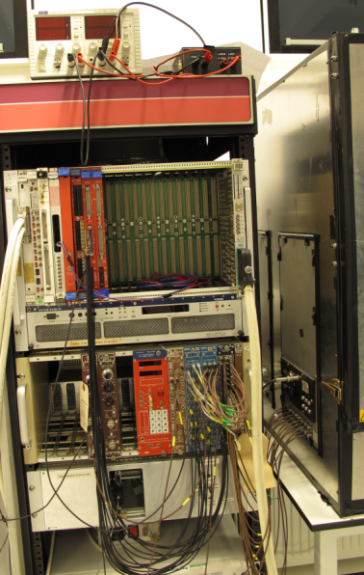
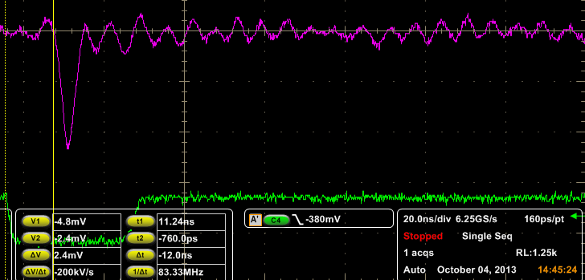
LHCb Upgrade – Recent Developments
Development of reference DAQ system at Edinburgh
to readout MaPMT
  using commercial components (16-ch readout, limited by available amplifiers)
    VME based QDCs (CAEN V792), with well understood behaviour
  developing fast (linear) 64-channel amplifier (prototype works)
MPhys students
Haofei Luo
Matt Needham
Yiorgos Sidiropoulos
Pulse generator
LED box
Black box
MaPMT R&D setup
Pulse
Pulse
2nd pulse generator &delay
Delay/Gate generator
LED voltage
TTL
Gate
QDC CAEN V792
LED light source
Delay/Gate Ortec 416A & 934
single photon pulse
amplified x100
Optical
fibre
VME 32ch QDC
GRIN lens
Light
Signal
VME BUS
MaPMT on xy-stage
Signal
2 cascaded X10 linear amplifiers
HV
HV
Stepper motor
Serial
PC
port
Stepper motor controller
X10 amps: x1 PS 776 (16ch)
& x2 Lecroy 612A (2X12ch)

Slide 12
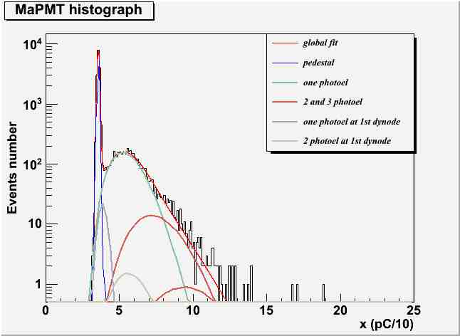
LHCb Upgrade – Recent Developments
Characterisation of basic MaPMT R11265 and R7600 parameters
  absolute gain, pixel-to-pixel gain variation, gain dependence on HV
  cross-talk between pixels
  fit to signal shape & signal efficiency / signal loss calculations
Haofei Luo
pixel gain map
Correlation of 1 phe Signal Size
5 sigma
R7600
5 sigma
Stray light events
R11265
R11265
cross talk
study
Pedestal
R11265
signal loss
study

Slide 13
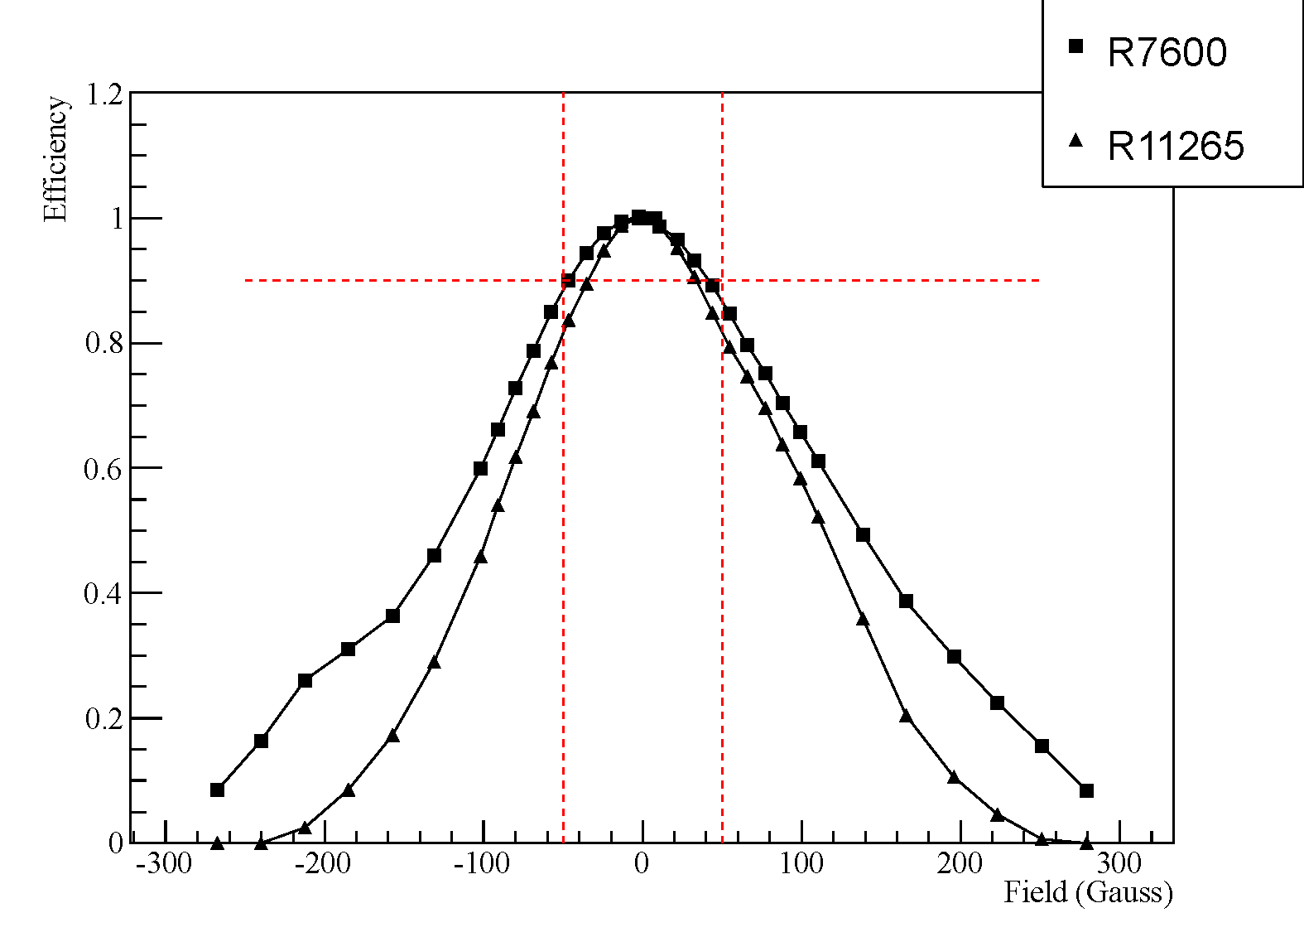
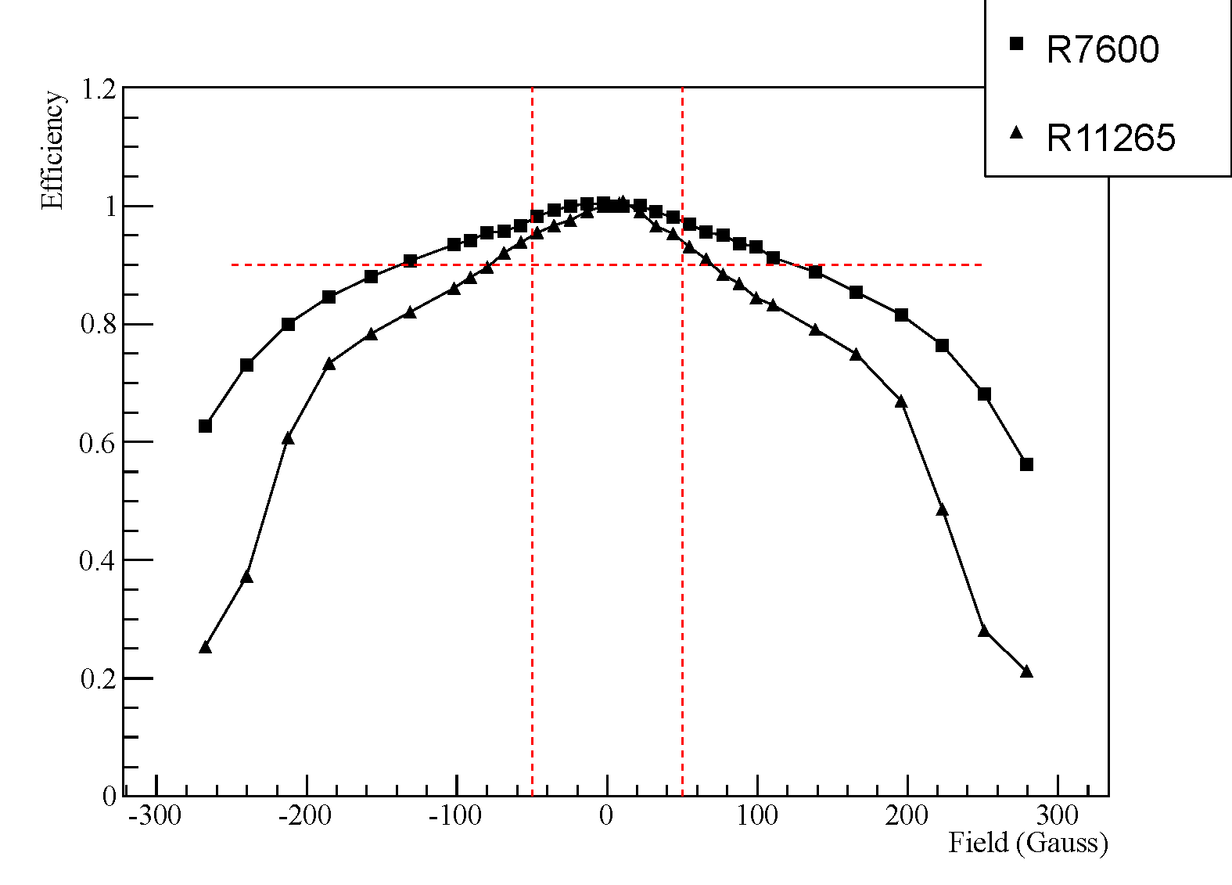
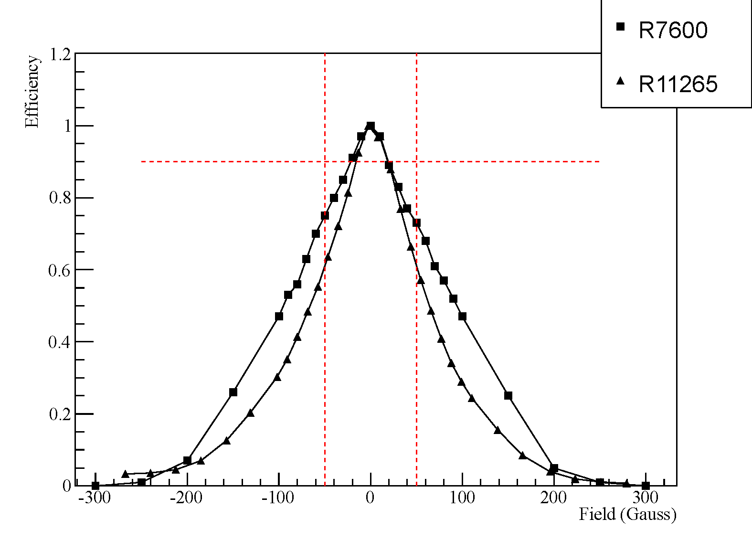
LHCb Upgrade – Recent Developments
Matt Needham
MaPMT behaviour in magnetic fields (still ongoing)
  revived setup in magnet providing up to 500 Gauss (50mT)
    tedious fight for stability and reliability: now under control
  2001 study only for y-axis of MaPMT R5900 and z-axis of R7600
    was due to geometrical limitations
    and oversight that x-direction is different
  now taking data for x-, y- and z-axis
Reuben Taylor
Adam Morris
Josh Neill
hot of the press!
2013: R7600
2013: R7600
2001: R7600
R11265
R11265
R11265
x-axis
y-axis
z-axis

Slide 14

LHCb Upgrade – Plans
Finalise characterisation of MaPMT performance in magnetic fields
  take reference data with R7600
    with current setup
    behaviour in x- and z-axis of MaPMT never been measured
  test for changes in cross-talk due to magnetic fields
  improve analysis: photon counting  fits of signal spectra
    allows to disentangle
      loss of photoelectrons between photocathode and entry window
      loss of gain in electron multiplication along the dynode chain
  commission 64-ch amplifier
present results at
  12/2013
Josh Neill
Josh Neill
Adam Morris
Matt Needham
Yiorgos Sidiropoulos

Slide 15
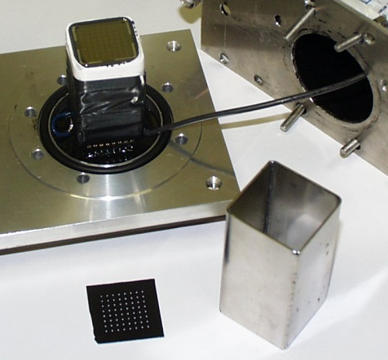
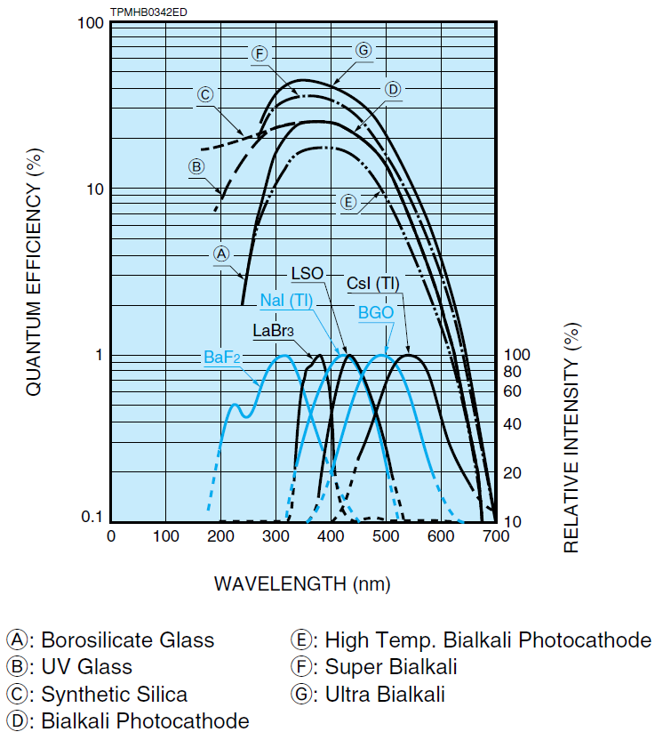
LHCb Upgrade – Plans
Further MaPMT characterisation
  test with mu-metal shield
    hard: adapt current setup to existing mu-metal shield
    time consuming: get new shield
not yet assigned
QE from Hamamatsu data sheet
single
μ-metal
shield
  Quantum Efficiency:
    verify Hamamatsu claim of improved QE of SBA over
    bialkali
    test for stability of QE while ageing
    “Is the observed 35% gain loss over 1500hrs
    due to changes in the QE?”
vacancy to fill

Slide 16
LHCb Upgrade – Plans
Develop MAROC3 based MaPMT readout (for test facilities)
  MAROC3 characteristics
    64-ch ASIC, purpose built chip to read out MaPMT
    pixel-to-pixel gain adjustment up to factor 3
    slow analog readout (O(100kHz))
    fast (40MHz) binary readout (caveat: 75ns return-to-baseline)
  get 1-2 MAROC3 boards from Cambridge & commission new DAQ chain(s)
    compare analog readout option with QDC based readout
    compare digital readout option with analog readout/QDC based readout
not yet assigned
Cambridge
MAROC3
board
prototype

Slide 17
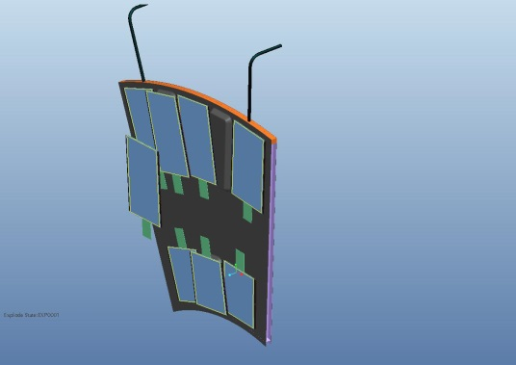
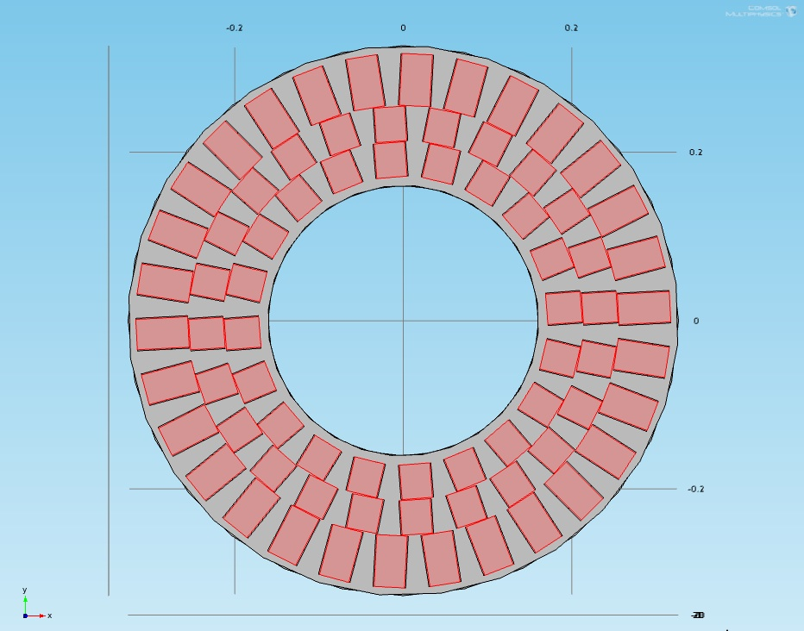
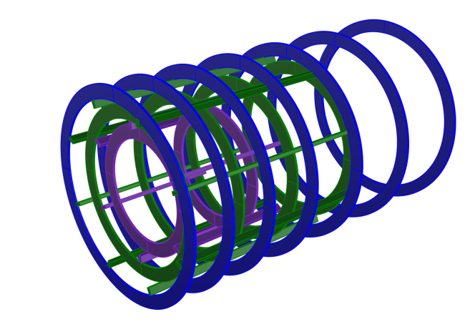
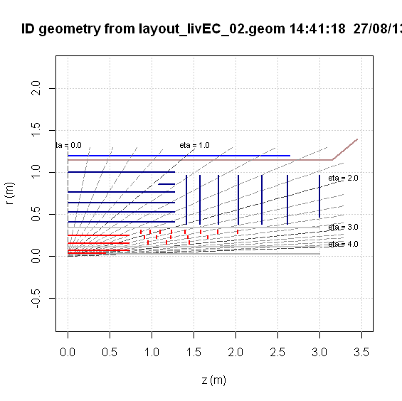
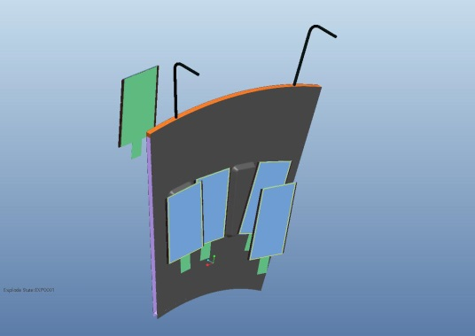
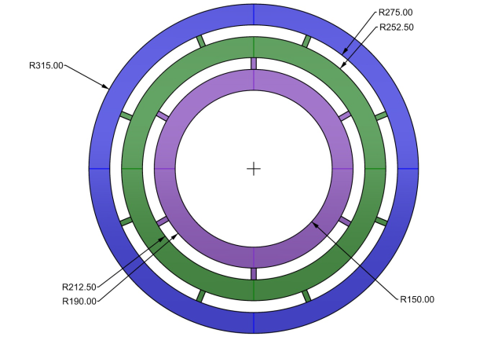
ATLAS Upgrade – Project
we are part of the Forward Pixel Disk project for the Phase II upgrade of the Inner Tracking (ITK) detectors (to be operational 2022)
  Forward Pixel Disk detector:
    O(150M) readout pixels of 250μm*50μm pixels, O(8m² silicon)
stepped
geometry
LoI
layout
diskettes
ITK in LoI

Slide 18
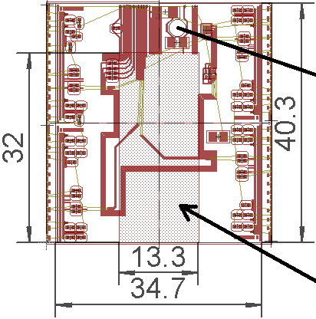
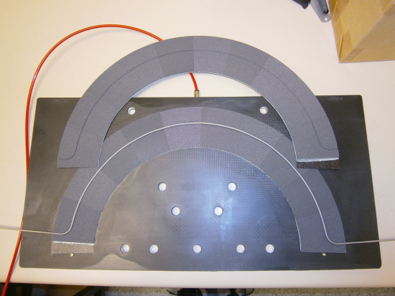
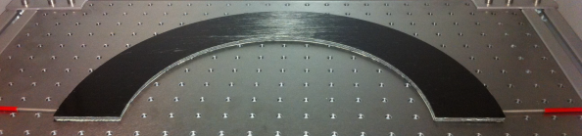
ATLAS Upgrade – Project
we contribute to the HW R&D (and plan to take part in construction) via
  WP 1: forward pixel disks module design and building
    layout and design effort
    front-end chip testing (FE-Ix)
    module building
  WP 2: forward pixel disks mechanics and services
    leading pixel disk services
    layout and design effort
    module mounting
  WP 6: ITK integration (pixel barrels, pixel disks, strip barrels, strip petals)
    ex officio (WP 2 services): interfaces for pixel disk services
    ex officio (WP 2 services): common solutions for ITK services
Quad Module
Liverpool
prototype flex
diskette
Manchester
thermal prototype

Slide 19
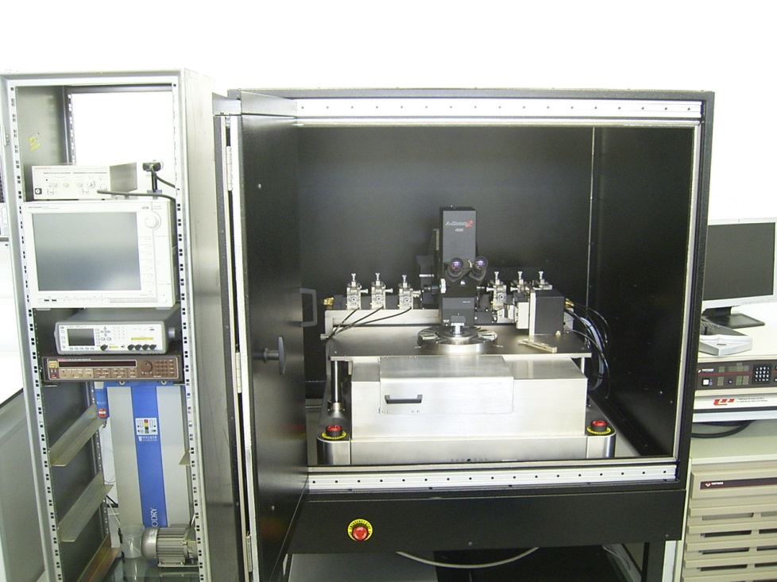
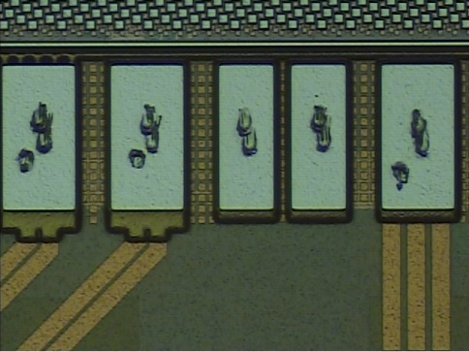
ATLAS Upgrade – Recent Developments
WP 1: development of FE-I4A wafer probing capabilities
  commissioning of B1500 Si-characterisation system
  and remote control from probing PC
  commissioning of USBpix readout on Win7 64-bit architecture
  commissioning of Wentworth prober operation
  development of library of functions to remote control Wentworth prober
  integration of Wentworth prober control into STcontrol
  optimising probing procedures and quality of data
Paul Glaysher
Francisca Garay
Andreas Korn
Corrinne Mills
Jon Webster
probe station
FE-I4A chip with 3D sensor
probe marks on FE-I4A pads

Slide 20
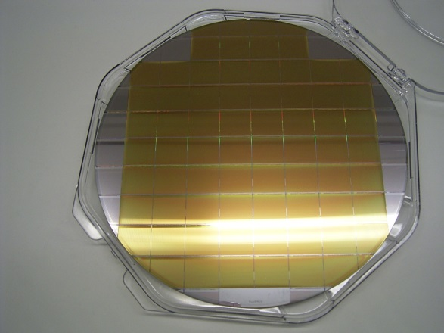
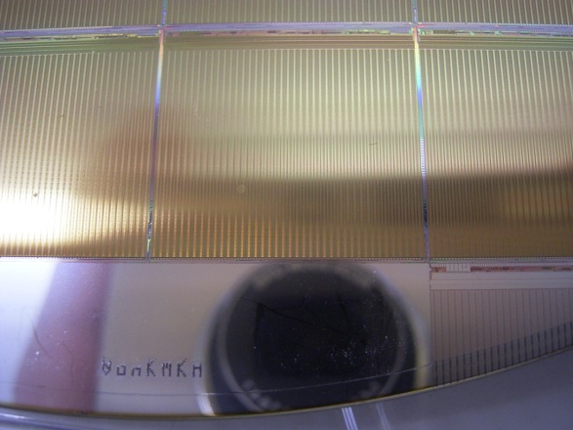
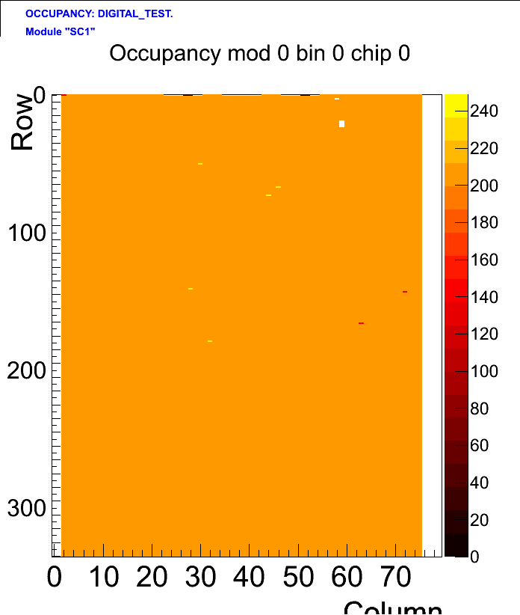
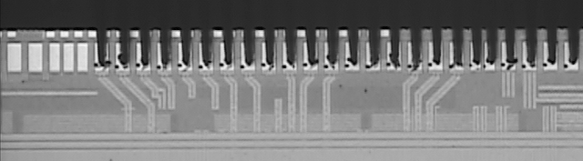
ATLAS Upgrade – Plans
WP 1: FE-I4A wafer probing
  finalise commissioning and vetting of our test procedures
    test first wafer and let experts (Glasgow/RAL) check our results
    test Glasgow wafer and compare with Glasgow results
  put Edinburgh capabilities on international agenda (Bonn/LBL)
    private chats at AUW
  test remaining FE-I4A wafers, as service for the UK pixel project
    <=10 wafers will arrive in UK ~November, need to be tested asap
Corrinne Mills
Jon Webster
FE-I4A wafer
V8KMKT
good digital scan
good analog scan
FE-I4A chip probing
FE-I4A chip with 3D sensor

Slide 21
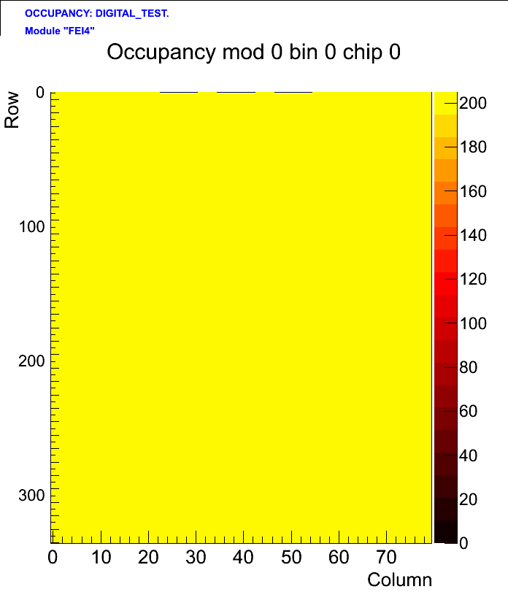
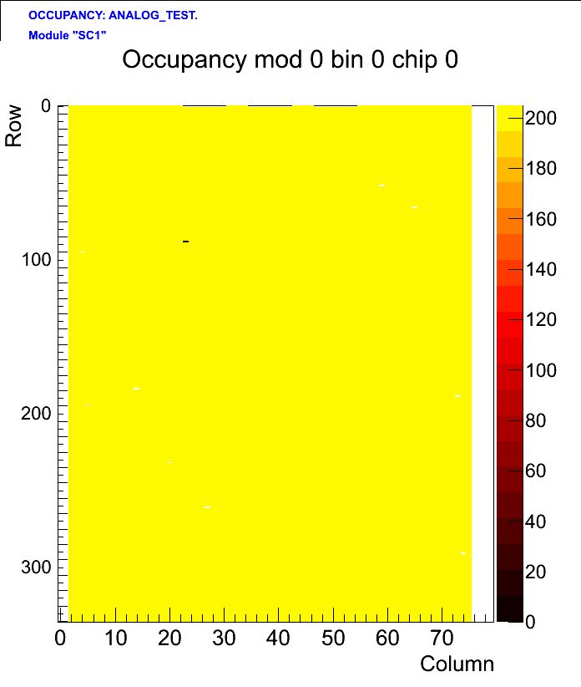
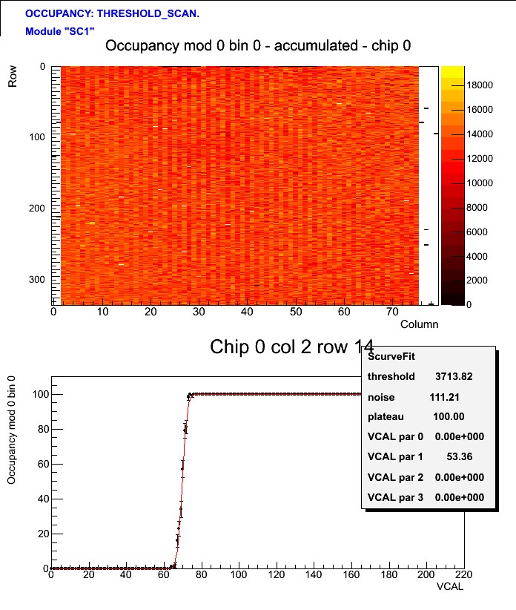
ATLAS Upgrade – Hot of the Press!
WP 1: FE-I4A wafer probing
  22.10.2013: first excellent probing results from wafer
    V8KMKT - chip 8<=10 wafers will arrive in UK ~November, need to be tested asap
Corrinne Mills
Jon Webster
Andreas Korn
digital scan
analog scan
threshold scan
(with tuning for
another chip!)

Slide 22
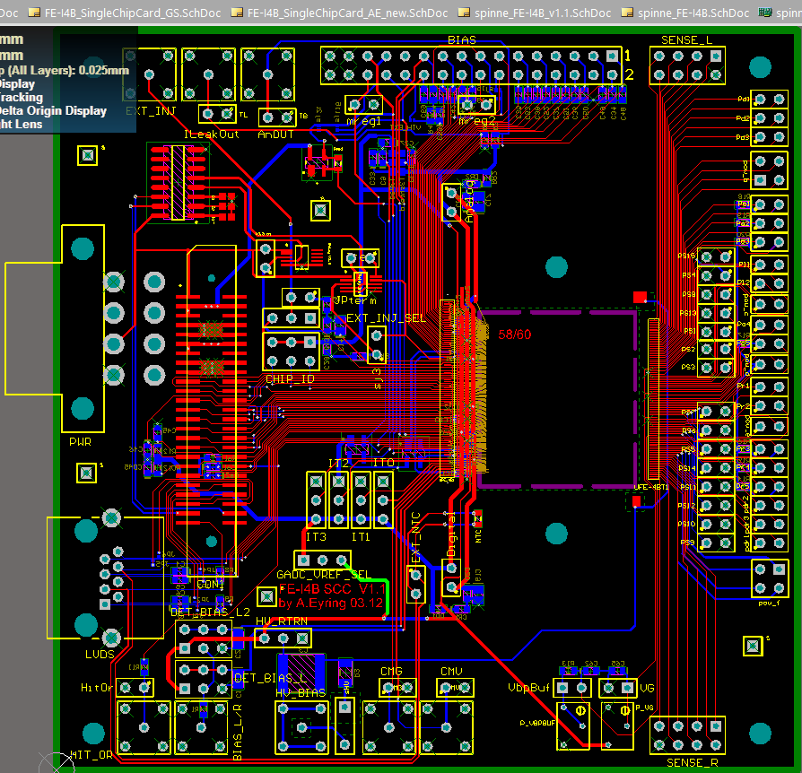
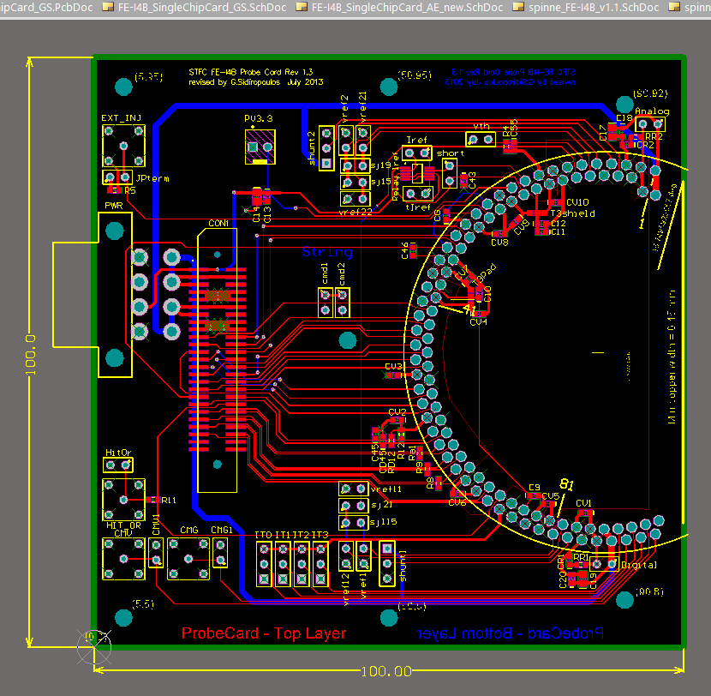
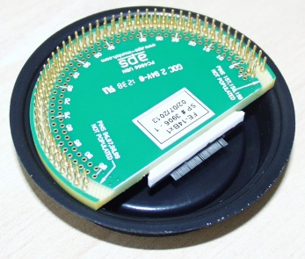

ATLAS Upgrade – Recent Developments
WP 1: PCB design adaptations for UK front-end chip probing
  Single Chip Card (SCC) used for FE-I4B chips
  probe card for FE-I4B chips
Yiorgos Sidiropoulos
FE-I4B
probe
card
FE-I4B
SSC
RAL

Slide 23

ATLAS Upgrade – Plans
WP 1: FE-I4B wafer probing
  join the Glasgow/RAL effort on testing O(60) FE-I4B wafers
    additional functionality and I/O  additional test electronics
    minimise additional commissioning effort: use same HW setup as other labs
Jon Webster
Corrinne Mills
(Francisca Garay)
Bonn
FE-I4B
setup

Slide 24


ATLAS Upgrade – Recent Developments
WP 2: design flex tapes for pixel disk prototypes
  half-crescent tape to serve 9(7) Quad modules
  on ‘thermal’ prototype
  and in lab setups
  high-speed prototype series
    various layouts, thicknesses,
    lengths
Yiorgos Sidiropoulos
half-crescent
flex
high-speed
flex
tap to serve
quad & hex modules

Slide 25



ATLAS Upgrade – Plans
WP 2: flex tape studies
  study signal transmission up to 4.8Gb/s and 9.6Gb/s
  study limits due to tape length and bending
  study serendipitous capacities idea
Yiorgos Sidiropoulos
support desirable
vacancy to fill
6MHz, 10Gs/s
arbitrary
waveform
generator
6MHz, 25Gs/s
oscilloscope
option:
FPGA
evaluation kit
serendipitous capacities:
using Kapton of flex tape
as dielectric

Slide 26
ATLAS Upgrade – Recent Developments
WP 2: forward pixel services
  overview of internal services on disk
  understand requirements for external services and DCS proposals
  identification of open issues and links to other projects
  review of GBTx capabilities and plans
Yiorgos Sidiropoulos
Quad Module
with DCS infrastructure:
regulator, I2C slave, ADC,
Shunt, NTC
(humidity sensor?)
Vreg
NTC
ADC
LV Shunt
I2C
FE-I4
FE-I4
FE-I4
FE-I4
GBTx
radiation tolerant
bi-directional Gigabit serialiser

Slide 27





ATLAS Upgrade – Plans
WP 2: develop plan for external pixel disk services
  understand requirements on cable diameters
  understand Twin-Ax cables
  prepare detailed options (default, worst case)
  work out multiplexing options
  initiate int. working group on pixel services
Paul Glaysher
vacancy to fill
QMUL
diskettes: exploded view
clam-shell mounting of
Forward Pixel Disks
half-disk options
diskettes: mounting study

Slide 28



ATLAS Upgrade – Recent Developments
WP 2: commissioning of Finetech Si-placement system
  commissioning of basic functionality
  (placement, heating, glue dispensing)
  addition of ultrasonic bonding
Jon Webster
Corrinne Mills
(Yiorgos Sidiropoulos)
(Paul Glaysher)
≤10μm accuracy
Si-placement
system
ultrasonic arm
3D-microscope

Slide 29

ATLAS Upgrade – Plans
WP 2: gain experience in micro-placement and bonding
  run trials & gain security in operations
  iron out issues with SW of setup
  learn about glues and bonding techniques
Jon Webster
(Corrinne Mills)
ultrasonic
Cu-Al
bonding
vacancy to fill
manual dispensing trials
LBL
stepped geometry
module building
150μm R/O chip
20μm bumps
150μm sensor
100μm TPG
200μm glue
200μm carbon fibre skin
Allcom Foam
Berlin
UV curing
glue thickness control

Slide 30

Sensor Studies – Project
Transient Current Technique (TCT) measurements on new diode materials
  study n-type magnetic Czochralski diodes for irradiation up to 10¹⁶/cm² n_{eq} & p
  compare to standard Float Zone (FZ) diodes
  deduct if the mag.Cz indeed show compensating of ageing under mixed irradiation
    expected not to type inverting under p irradiation
    expected to type invert under n irradiation
Option on joining the 3D sensor development
  study sensor efficiencies across area
    using our through-the-lens ps-laser pulser
MPhys
Rebecca Carney
other Si: n-irradiation
p-irradiation
mag.Cz: n-irradiation
p-irradiation
change of doping in silicon
due to irradiation
RD48 irradiation study
Hamburg
vacancy to fill

Slide 31





Sensor Studies – Recent Developments
Lab Developments
  commissioned ps-laser pulser on probe station
    three laser heads (473nm, 655nm, 980nm)
    through the microscope lens focusing (diameter not yet optinised)
    interlock
  commissioned HV SMU (Keithley 237)
  established dry-air supply to probe chamber
    to facilitate measurements at -10…-15°C for irradiated diodes
Rebecca Carney
(Jon Webster)
air dryer &
vacuum system
ps-laser pulser
laser light feed at microscope

Slide 32


Sensor Studies – Recent Developments
TCT study
  support by Daniel Münstermann (RD50) & Uni Dordmund
  FZ diode samples diced up and send to KEK for irradiation
  review of techniques and previous studies
  planned PCB design to mount diodes (need further info)
Rebecca Carney
Yiorgos Sidiropoulos
shard with
FZ diodes
FZ diode
with guard rings

Slide 33

Sensor Studies – Plans
TCT study
  commission cold operation of chuck
  optimise operation of ps-laser (focus size)
  solve diode PCB mounting and storage (deep freezer) questions
  establish TCT measurement with FZ diodes (known behaviour)
  possibly arrange for a TCT training session at Dortmund
  irradiate mag.Cz diodes with p and n beams
    options: Ljubljana, KEK, Karlsruhe, Birmingham (to be organised)
    irradiation cost: covered by RD50
  differential study of different irradiations of mag.Cz diodes
  on time scale until 04/2014 (MPhys limit)
Rebecca Carney
ball & wedge wire bonder
pull & shear tester

Slide 34



Further Lab Development
Next investments
  planned purchase: test electronics for FE-I4B tests
    Keithley 2614B (2-ch SMU)
    Keithley 2001 DMM
    TTi QL335TP power supply
  bid for:
    Atmospheric plasma cleaning system
    Si-placement upgrades:
      die pick-up and flipping modules
      formic acid module
      3μm adjustment set
    Low leakage switching matrix
On the to-do list
  lab fixes (doors & over-pressure in 5203b, water and drain at vent)
  improve clean room standards
  finalise commissioning (QE setup, Win7 DAQ for PDTF)
  commission climate chamber
atmospheric
plasma cleaner
climate chamber &
fume extraction

Slide 35


Further Lab Development
Long-term plans: dream on…
  upgrade lab space
    more clean room space
  upgrade workforce
    mech. engineer
    technician
  upgrade capabilities
    Metrology: Coordinate Measuring Machine (CMM)
  upgrade capacities
    Probing:
  clone myself and get more sleep…
  make the day 48 hours…
  and did I already say that I am bad in multi-tasking…
  … yep, I do have too many dinners on my plate
typical
clean room
floor space
utilisation
CMM
system

Slide 36
Conclusions

Slide 37
Spare Slides

Slide 39
End Of Structure card
Pixel Bus Tape: 5x quad shown, 5x hex will be default

