Slide 1


Etudes et essais de matériaux: présentation de la section Matériaux et Métrologie dans le contexte du groupe EN-MME
DT Training Seminar, 3 Oct. 2013
Introduction to EN-MME group
Mandate and expertise
Equipment
Examples of material studies and tests
Perspectives
Stefano Sgobba
EN-MME-MM

Slide 2
Mandate of the EN-MME group
know-how on specific material for accelerator construction ⇓
Provide to the CERN community specific engineering solutions combining mechanical design, production facilities and material sciences. This group owns, maintains and develops the 30 years old know-how on the mechanical construction of beam accelerators and physics detectors.
MME involves a large spectrum of highly specialized activities like : mechanical calculations, metallurgical analysis, destructive and non destructive material testing, micrometric 3D metrology, mechanical dynamic and static measurements, precision CNC machining, all welding and vacuum brazing techniques and sheet metal forming.
Prototyping and feasibility developments are the main role of the MME group. For less demanding work or for larger scale mechanical production, subcontracting in the Member States is always preferred. And to adapt to the changing volume of demands, flexible industrial contracts are placed to support the mechanical workshop and the design office.
MME is a unique reference capable of responding rapidly with professionalism to the complex demands from other CERN groups, and managing the process from the start to the end, in close collaboration with the project engineers.
⇐ qualifications, destructive tests and NDT involved
⇑ material selection and characterization
Courtesy F. Bertinelli
2/26

Slide 3
EN-MME Structure and Activities
Engineering & Design D. Perini | Fabrication F. Bertinelli |  | Materials & Metrology
A. Bertarelli O. Capatina T. Renaglia | Machining & Subcontracting M. Polini | Assembly & Forming G. Favre | S. Sgobba
Engineering analysis and calculations Design studies and draughting Support with norms and certifications Mechanical measurements CLIC nano-stabilisation | Job preparation Precision CNC milling (3, 4 and 5 axes) and turning ED (spark erosion) machining Mechanical assembly and site interventions CERN-wide machine tool maintenance and conformity Free Access Workshop Radiation workshop Subcontracting | Job preparation Sheet metal forming Welding (TIG, MIG/MAG, plasma) Site interventions Electron-beam welding Laser welding, cutting, drilling Vacuum brazing & heat treatments Welding engineering CERN-wide welder certification | Materials selection Materials analysis and testing / Metallurgy NDT Metrology and surface measurements Metrology site interventions
Courtesy F. Bertinelli
3/26

Slide 4
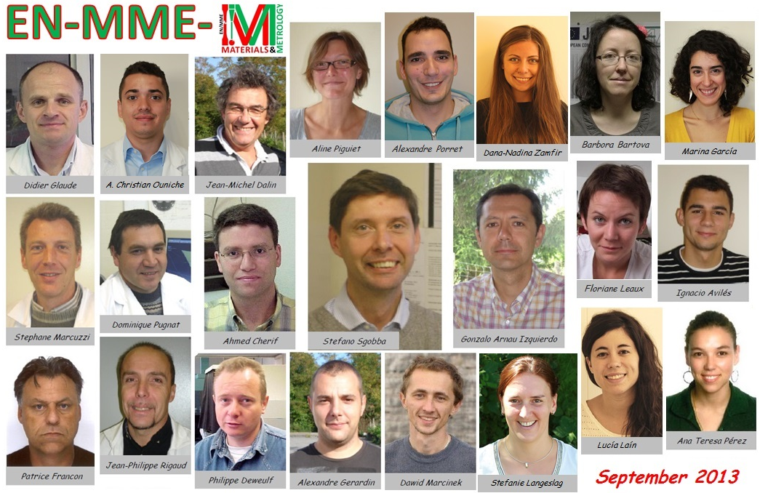

Slide 5
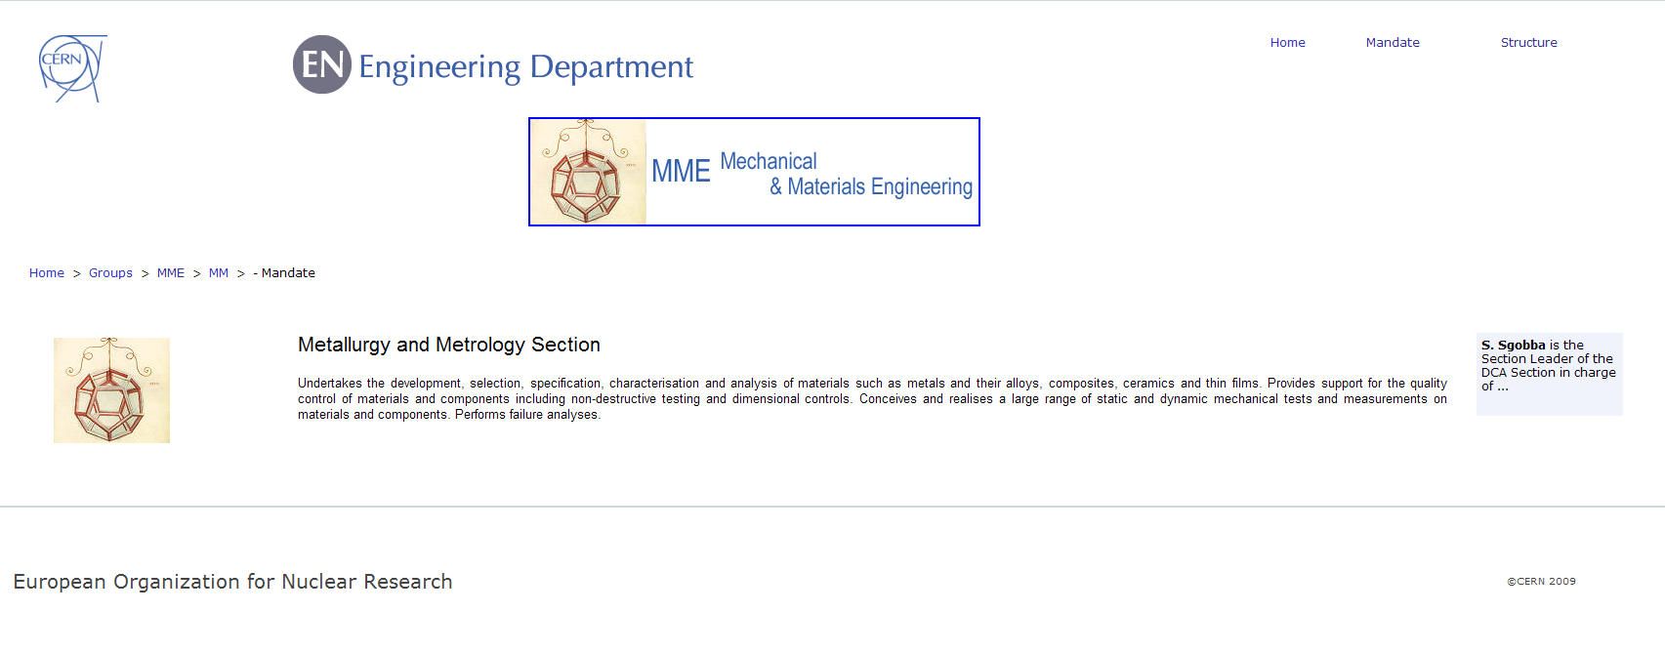
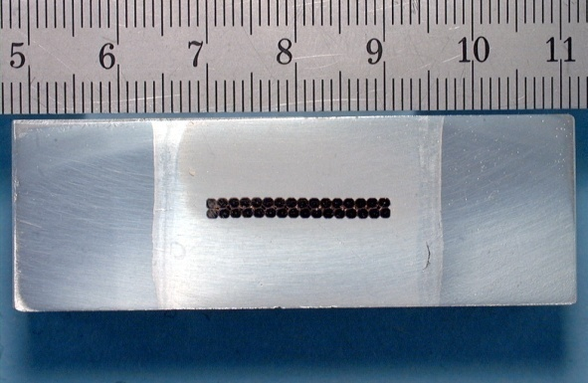
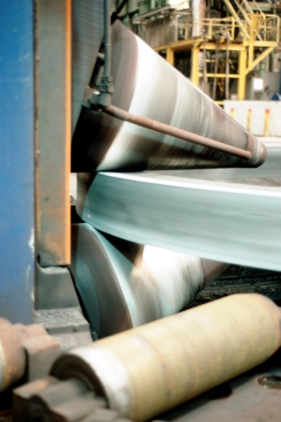
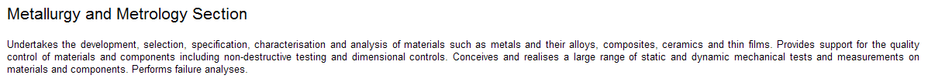
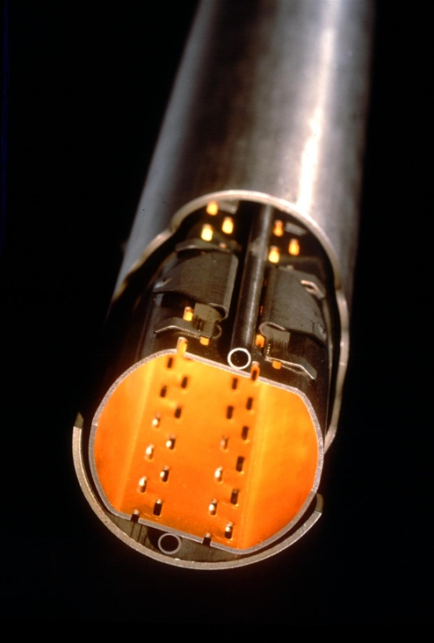
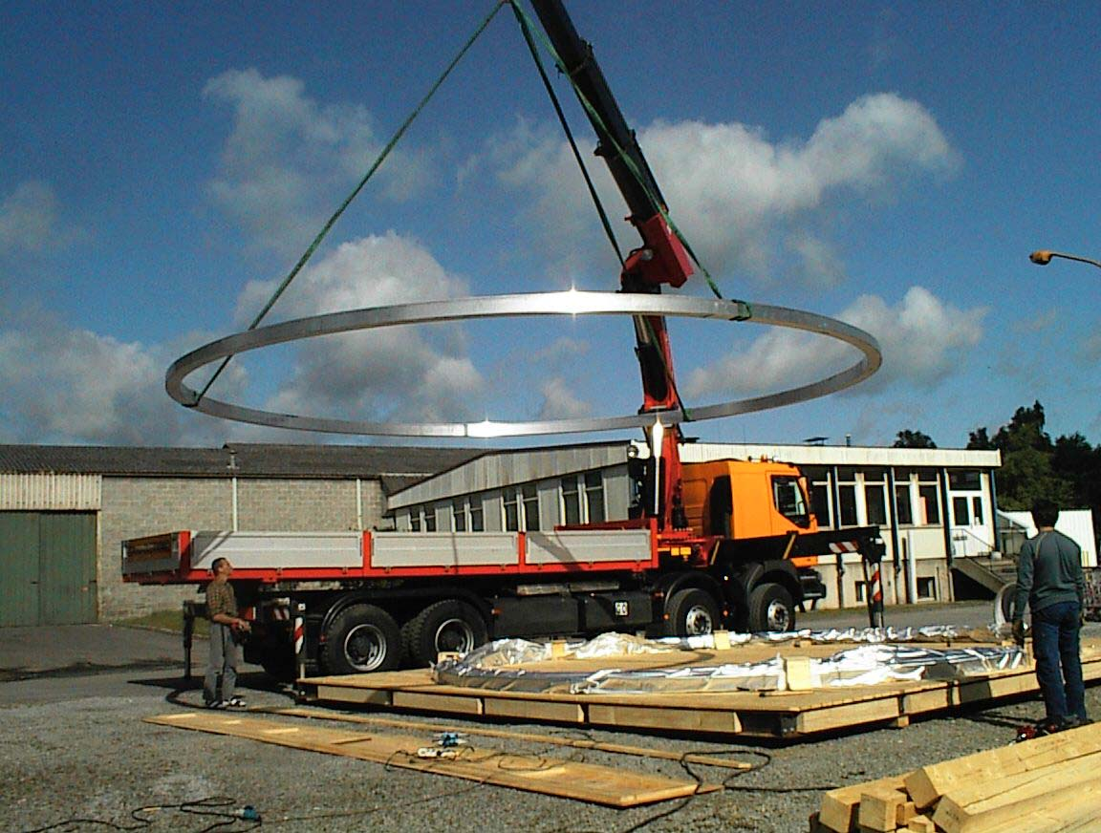
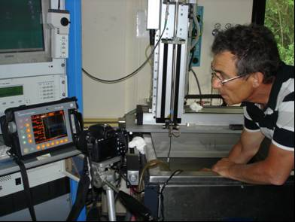
5/26

Slide 6
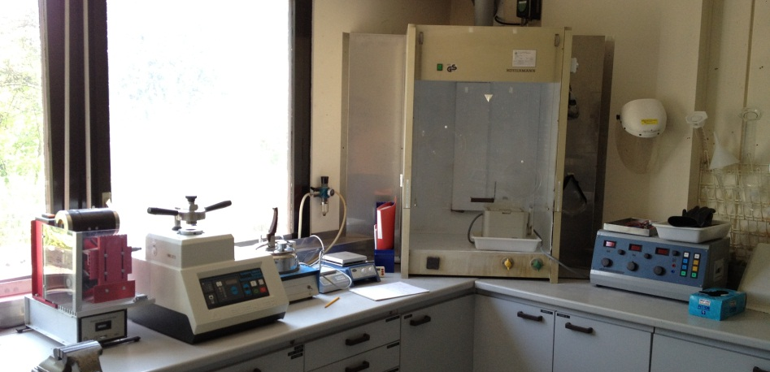
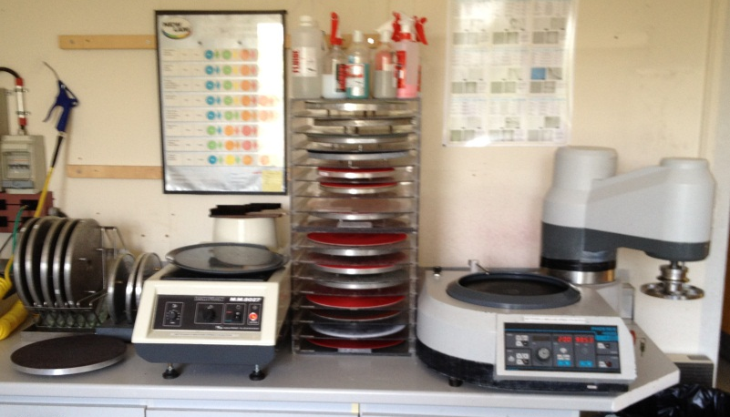
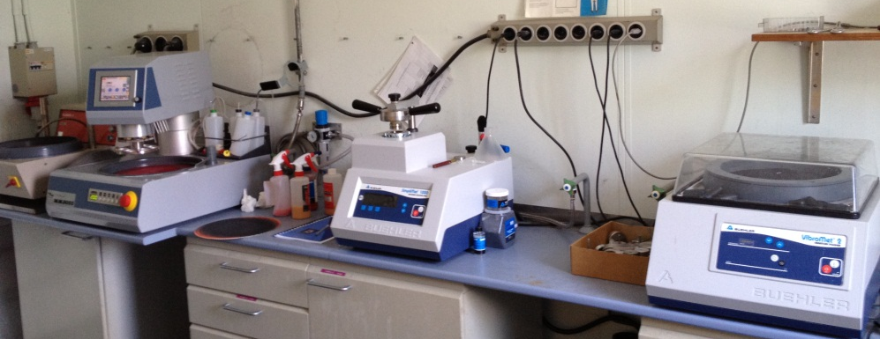
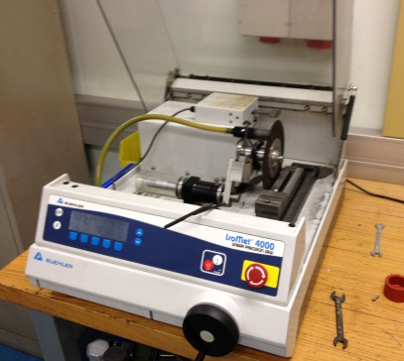
Microstructural characterization. Specimen preparation
Sectioning
Linear precision Saw. Buehler IsoMet 4000
Precision diamond wire saws. Well 3242 and 3241
Mounting
Hot mounting presses. Buehler Simplimet 1000 and 2000
Cold mounting pressure chamber. LamPlan M.M. 806
Grinding & polishing
Manual polishing machines. LamPlan M.M. 8027 S. and Plamopol 2
Automatic polishing machines. Buehler Phoenix 4000 and LamPlan M.M. 8055
Vibratory polishing machine. Buehler vibromet 2
Automatic electrolytic polishing-etching. ATM Kristall 620 with electrolytic cell
6/26

Slide 7
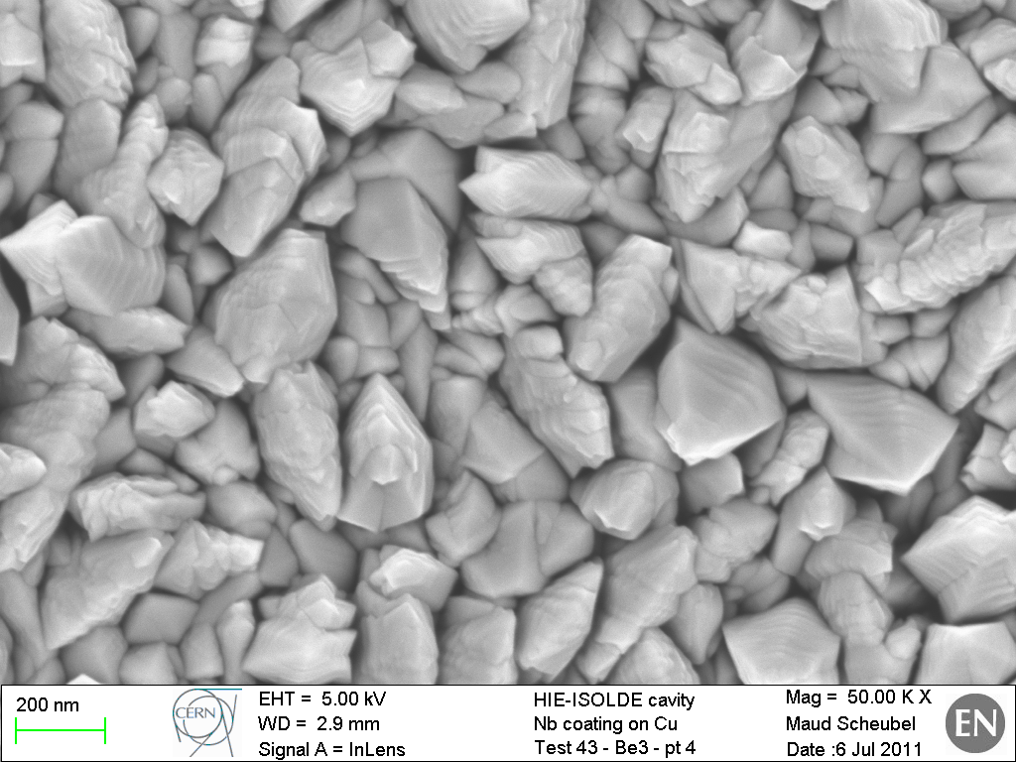
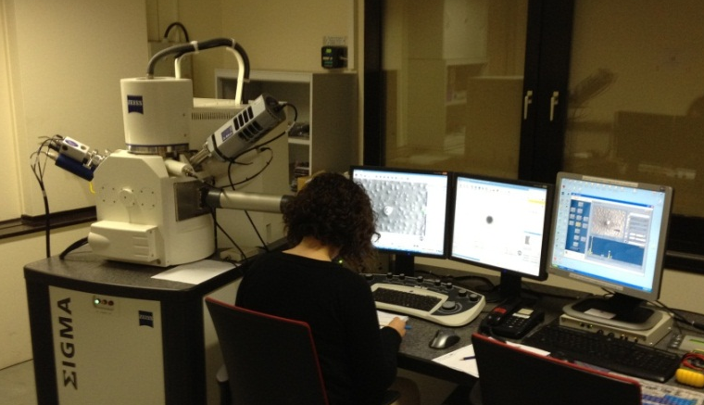
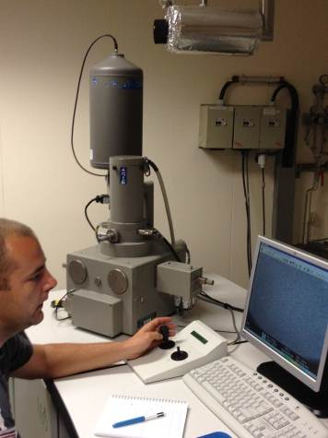
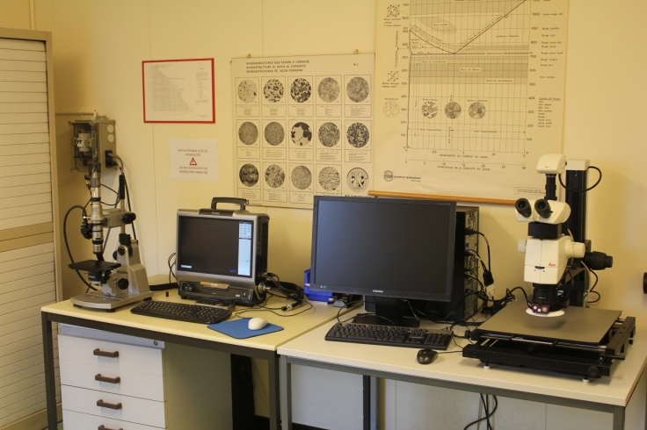
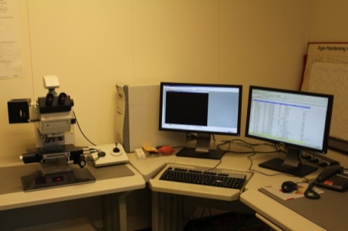
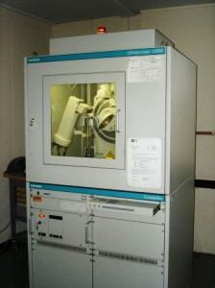
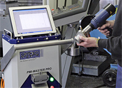
Microstructural characterization. Observation and analysis
Optical microscopy
Various stereo microscopes.
Metallographic microscope. Leica DMRM
Objectives for magnifications from x16 to x1500
Image analysis system
Digital portable microscope. Keyence VHX-1000
Resolution max 54 MPixel
Objectives 0 - x50, x20 - x200 and x100 - x1000
Morphology of a Nb coating on Cu structure, original magnification 50000 x
Electron microscopy
SEM. Leo 430i
Chamber 190 mm x 300 mm x 265 mm
SE and BSE imaging detectors. Max resolution 4 nm
Beam 0.5 to 30 kV, 1pA to 500 nA
EDS analyser Oxford Isis.
FE-SEM. Zeiss Σigma
Chamber ø365 mm x 275 mm
SE, BSE, in-lens SE imaging detectors. Max resolution 1.5 nm
Beam 0.1 to 30 kV, 4 pA to 20 nA
EDS analysis Oxford Inca with 30 mm² SDD detector
EBSD analysis HKL Chanel 5
New optical microscope being purchased in 2013
Spectroscopy and X ray diffraction
Powder XR diffraction. Siemens D5000
Cu and Cr X-ray sources
Vertical and horizontal goniometers
Portable OES analyser. Oxford Instruments PMI MasterPro
Calibrations for steels, Al, Ni, Cu and Ti alloys
UV probe for S and P
New SEM (replacement LEO) in 2015
7/26

Slide 8
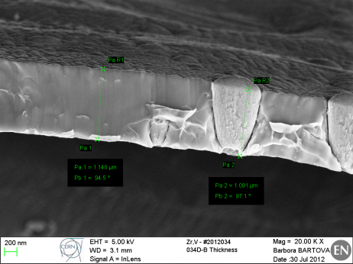
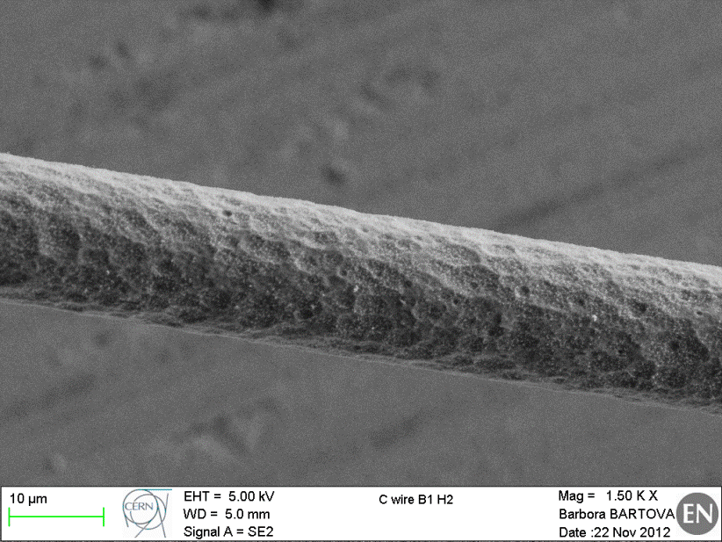
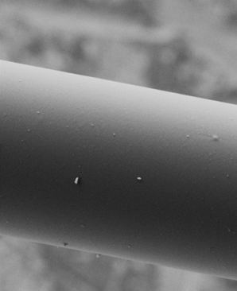
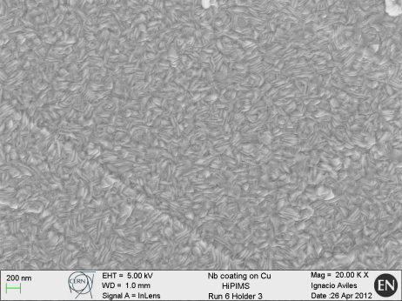
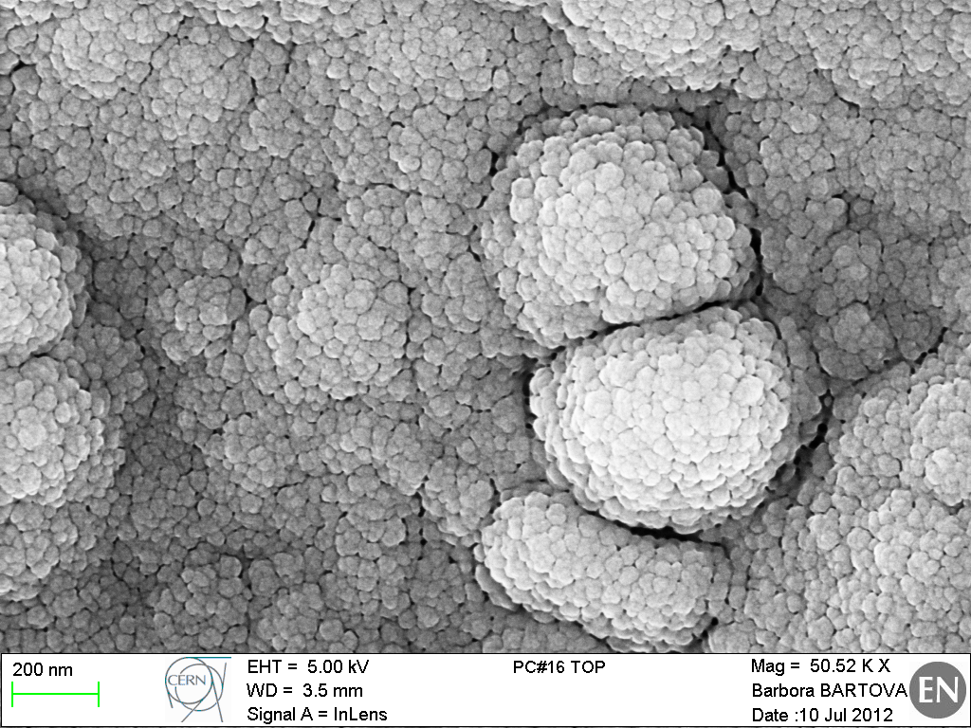
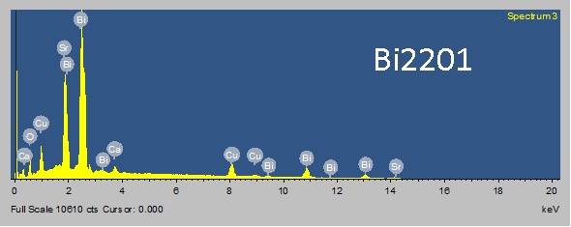
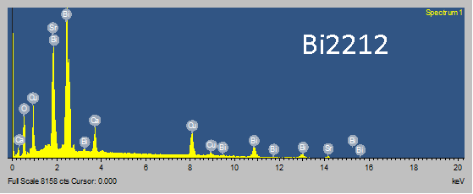
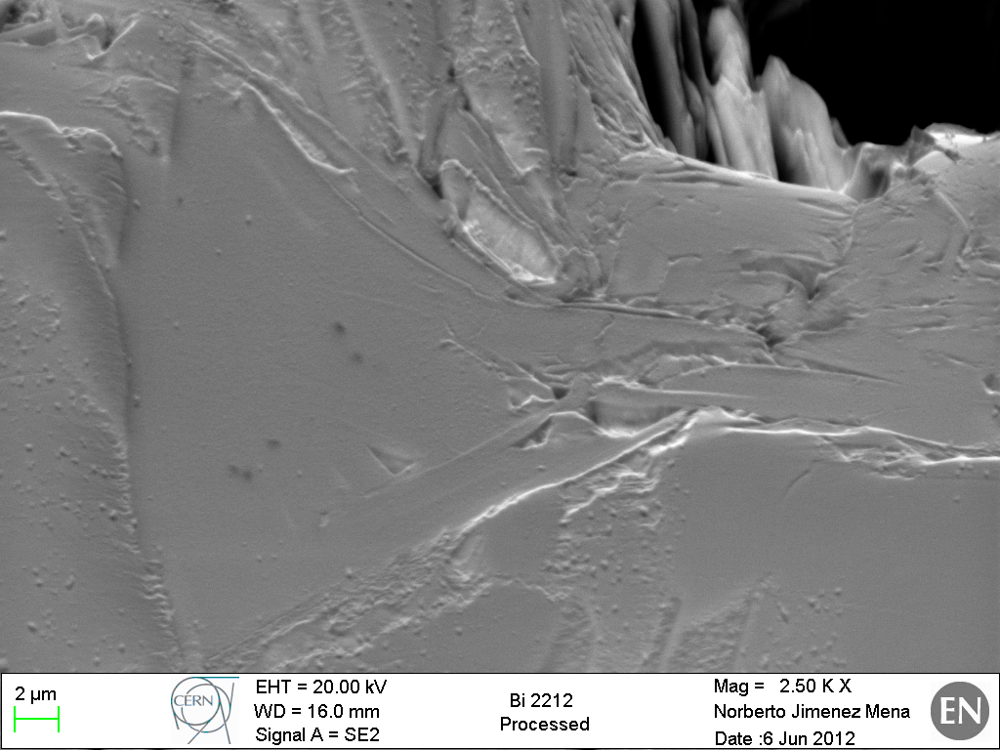
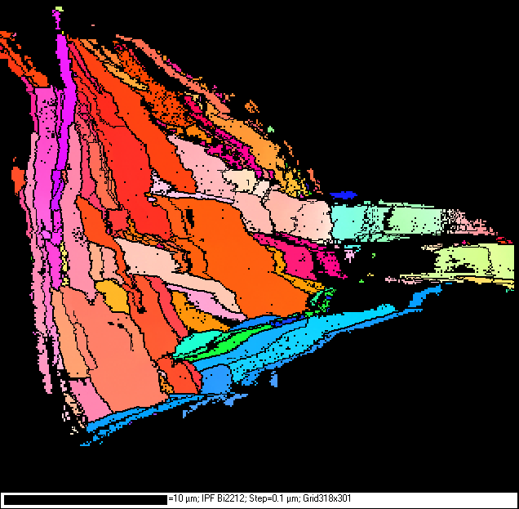
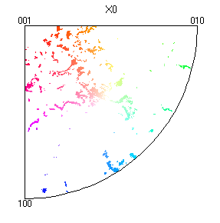
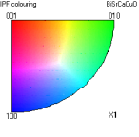
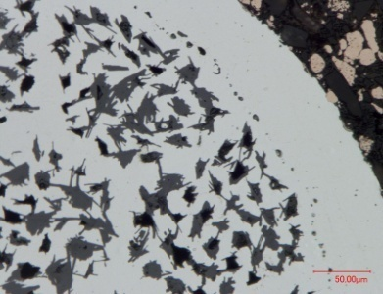
Scanning Electron Microscopy and microanalysis support
Carbon wires from SPS beam scan: region degraded by the beam (left) and unused reference (right, same scale)
NEG coatings
Thin films
Nb-coatings,
HIE-Isolde cavities
C-coatings for SPS upgrade
Microstructural characterisation by EBSD of Bi2212 wire
orientation map
inverse pole figure

Slide 9
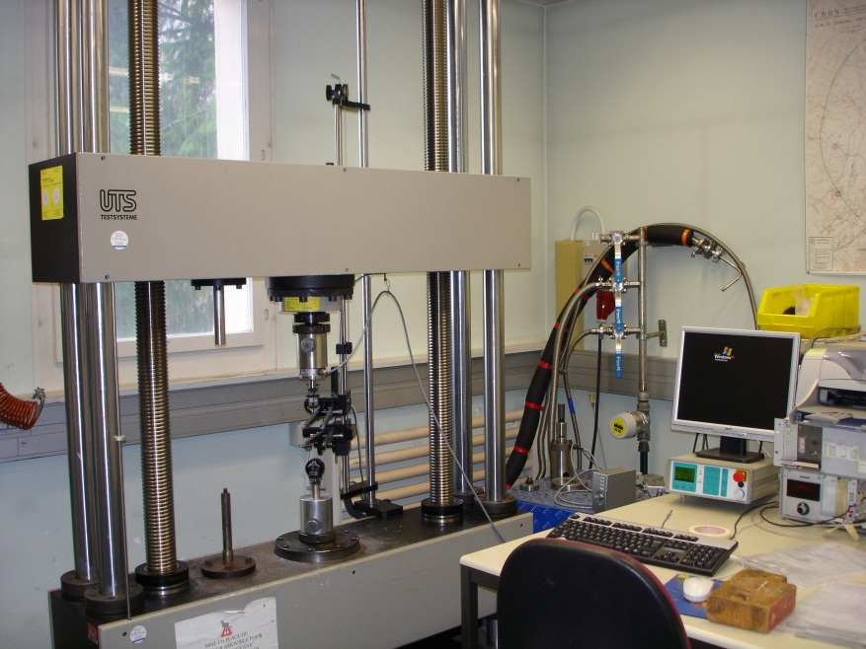
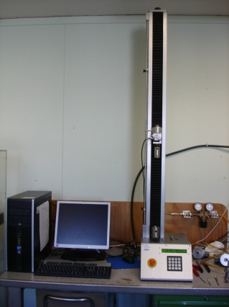
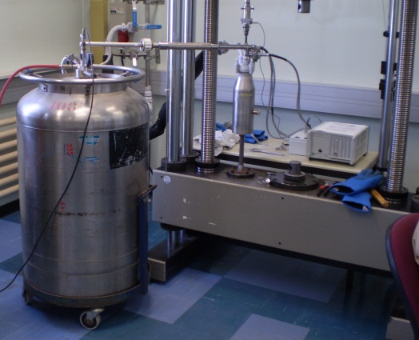
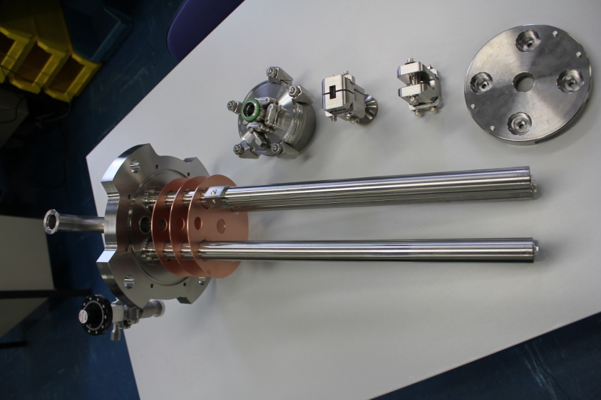
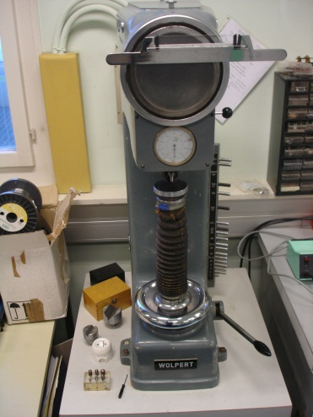
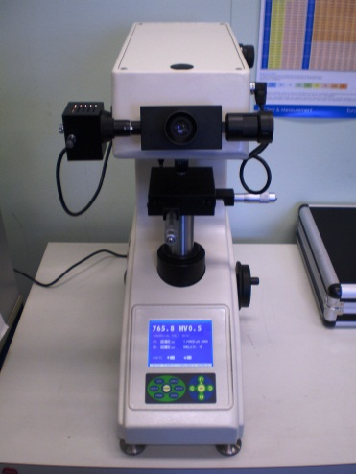
100 kN cryostat for tensile testing and eventually fracture mechanics at 4.2 K in construction (2013)
Mechanical testing
Tensile testing machines
Two column electromechanical universal testing machine UTS 200
Load cells 1 kN, 20 kN and 200 kN, stroke 800 mm
Knives and clip-on extensometers
Tensile grips, compression plates, bending tools
System for tests at 77 K and 4.2 K, 25 kN load cell
Single column press ZPM 1000-500. Load cell 1 kN, stroke 500 mm
New dynamic mechanical testing unit in 2014
Hardness
Hardness. Wolpert 2RC testor
Load 1 to 250 kg
Brinell, Vickers and Rockwell indenters
Micro hardness automatic tester Wilson Hardness 402MVD
Load 10 g to 2 kg, Vickers indenter
9/26

Slide 10
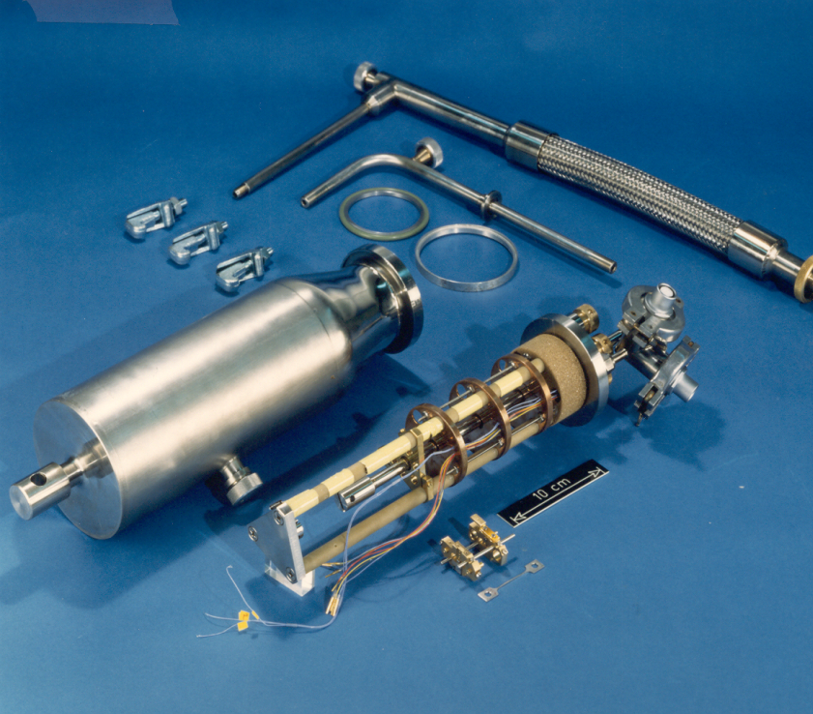
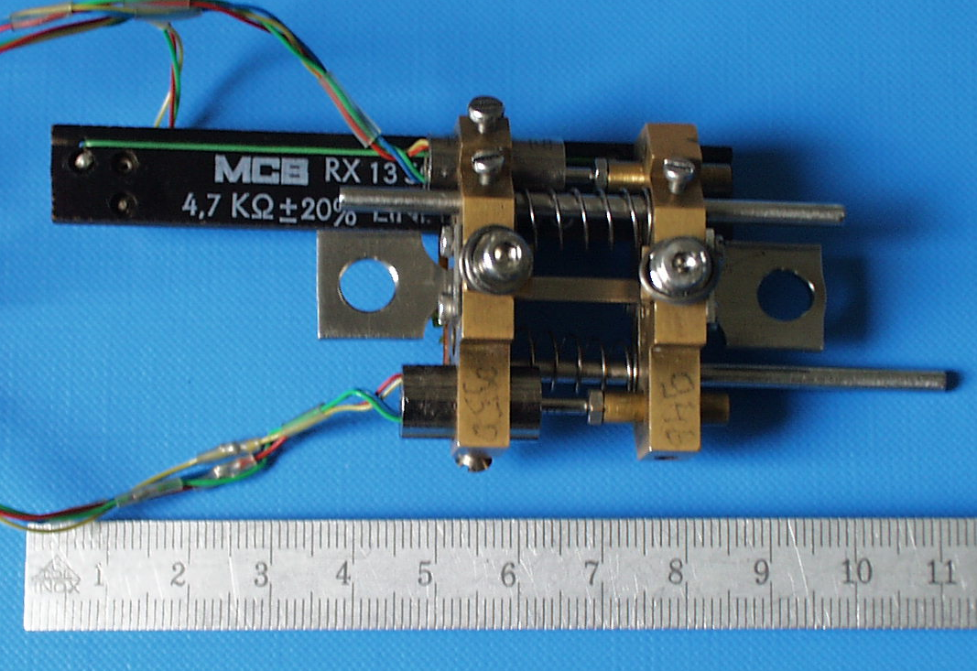
Mechanical testing at 4.2 K, the past…
10/26

Slide 11
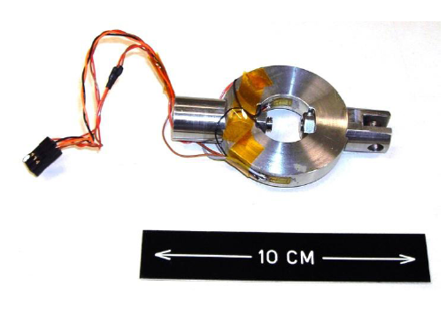
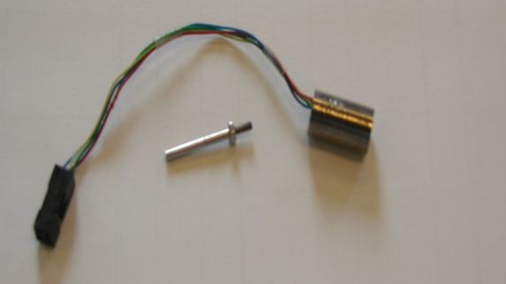
Evolution of the equipment
Internal load cell:
immersed in liquid He, based on a deformable 316LN ring equipped by strain gauges
conditioner: MVD2555 of HMB
coil
LVDT:
range: up to 3 mm
resolution: 0.5 µm
core
Temperature probe, CERNOX CX-1050-SD-30 (Lakeshore Cryotronics):
thermal response time: 15 ms at 4 K
resolution: ± 15 mK
Carbon potentiometer: range: up to 50 mm resolution: 0.1 mm
11/26

Slide 12
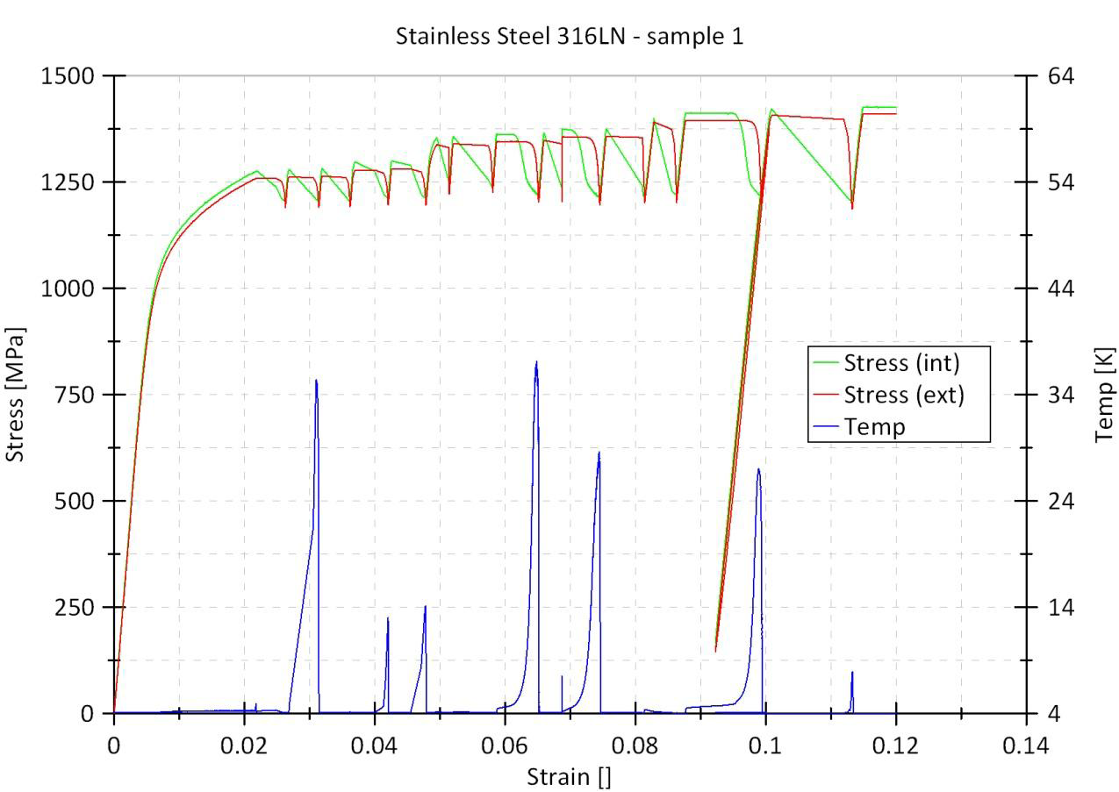
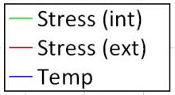
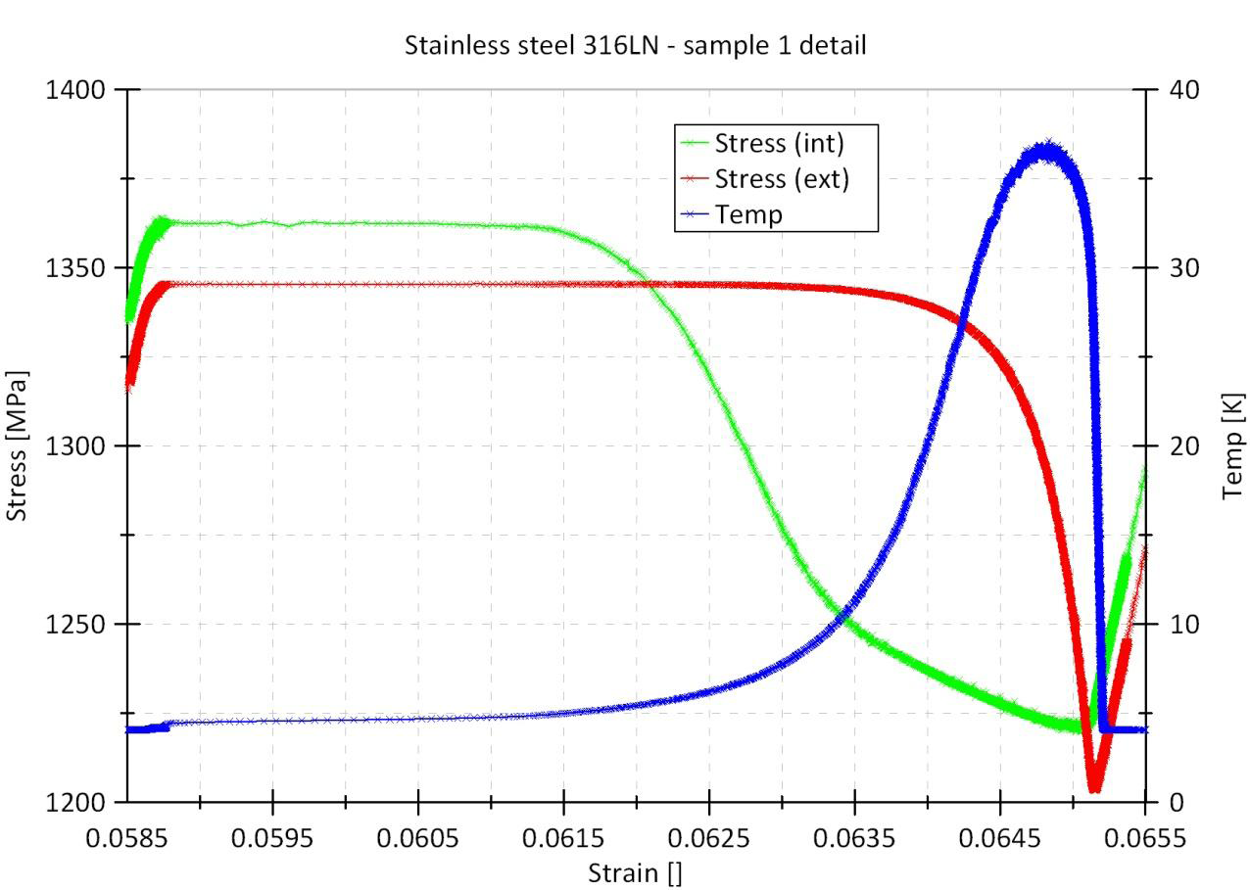
Evolution of the equipment
D. J. Marcinek, Experimental Study of Discontinuous Plastic Flow, Phase Transformation and Micro-damage Evolution in Ductile Materials at Cryogenic Temperatures, Master of Science Thesis, CERN and CUT, 2009
Sampling frequency up to 20 kHz!
B. Skoczen, J. Bielski , S. Sgobba , D. Marcinek , Constitutive model of discontinuous plastic flow at cryogenic temperatures, International journal of plasticity, 26 (2010) 1659-1679
12/26

Slide 13
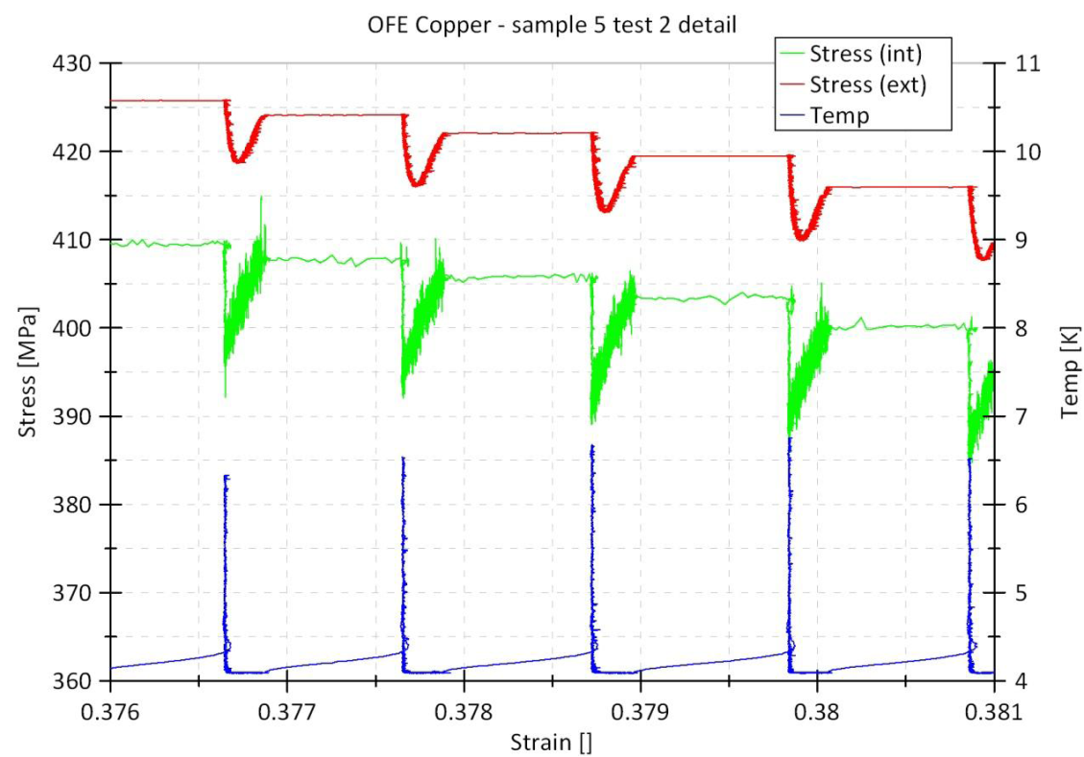
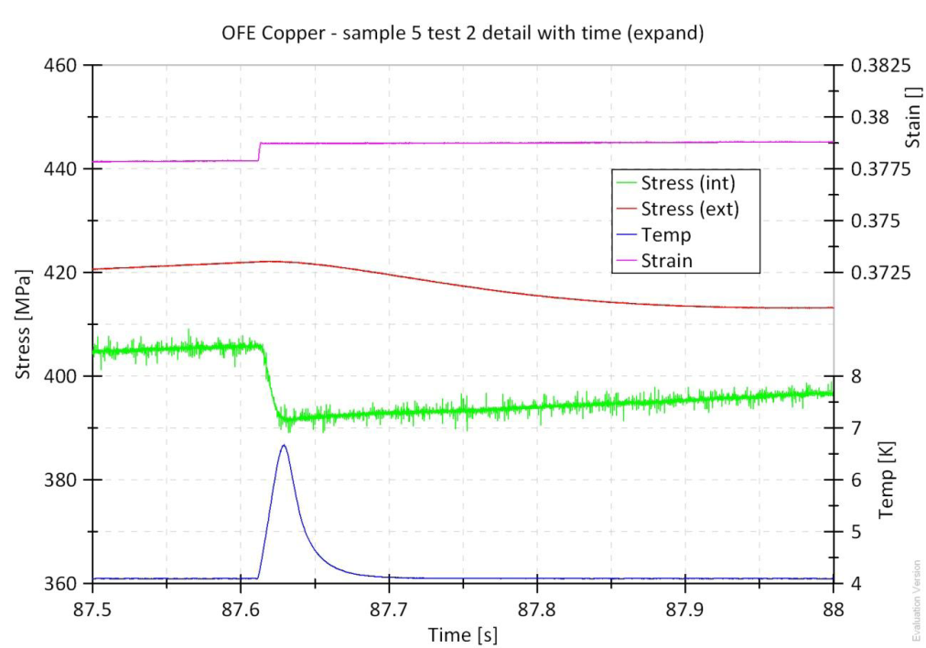
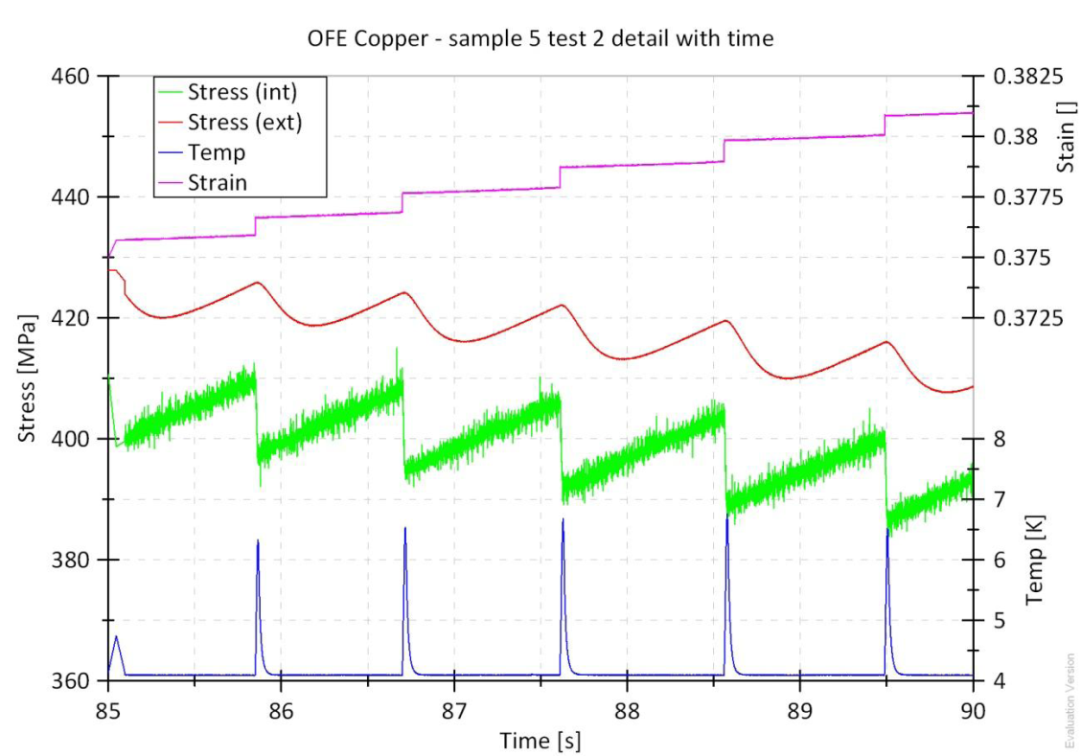
OFE Cu, serrated yielding recorded during necking (engineering stress-engineering strain plot)
D. J. Marcinek, Experimental Study of Discontinuous Plastic Flow, Phase Transformation and Micro-damage Evolution in Ductile Materials at Cryogenic Temperatures, Master of Science Thesis, CERN and CUT, 2009
13/26

Slide 14
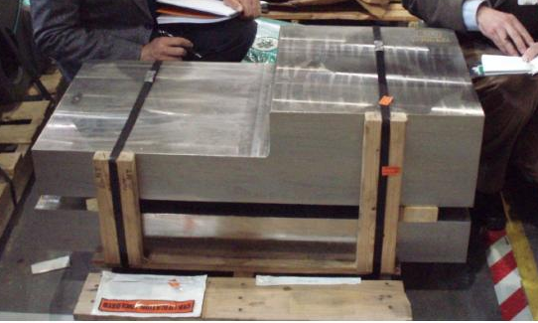
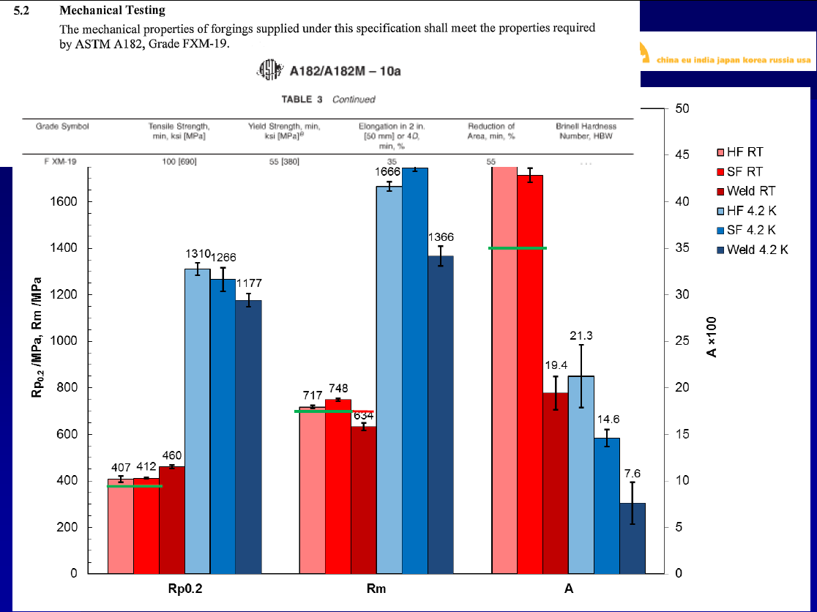
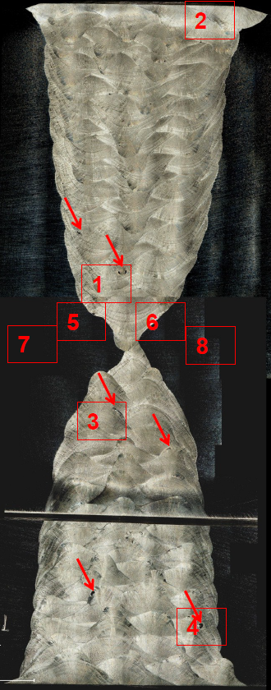


Major Tool and Machines, 11/04/2012, Indianapolis, IN (USA). ITER CS magnets,, precompression structure
CERN
Mechanical testing at 4.2 K, the present and future
CERN + CEME

Slide 15





Courtesy of Kind
CS Nitronic 50 single piece, 15 m forged precompression tie plate, G & G Steel Inc., Russellville, AL /US
Present involvements
15/26

Slide 16




Non destructive testing
Visual testing, VT, two level 2 certified
Penetrant testing, PT, two level 2 certified
Ultrasonic testing, UT
Portable flaw detectors. Krautkramer USN 60
    Gain 0 dB to 110 dB, probe from 0.25 MHz to 25 MHz,
Portable flaw detector with Phased Array mode. GE Phasor XS
    Gain 0 dB to 40 dB, probe from 0.5 MHz to 10 MHz,
    Various sectorial or linear transducers
Immersion tank scanner
    Scan-surface: 500 mm x 500 mm, 0.1 MHz to 150 MHz
Level 3 and 2 certified operators
Radiographic testing, RT
Mobile X-ray computed tomography system. RayScan Mobile
Mini-focus x-ray source focal spot size 0.4/1.0 mm, 225 kV, 3.6 – 8 mA,
Flat panel detector, active area 410x410 mm, 4 MPixel
Software for 3D reconstruction and visualization
X-ray sources. Philips 160 kV, 0. 10 – 160 kV, 4 and 10 mA
Sieffert isovolt 160 kV, 1 to 10 mA (mobile device)
Computer radiography system
High definition scanner Duerr HD-CR35NDT, spatial resolution 40 µm
High resolution monitor 3 MP
Controlled area (bunker) of 30 m²
Level 2 certified operators
16/26
LHC warm modules, spring of the module VMTSA-4L2-3259-left side

Slide 17








Non destructive testing
⇐ Computed Radiography Testing (RT) of LSS warm modules. Completion of the radiography campaigns during LHC technical stops. 1767 modules examined, 107 non-conformities identified to be repaired during LS_1, 46 nights.
⇓ Computed RT of CMS RF modules
set-up in the tunnel
courtesy of RX-Solutions
X-Ray tomography of ITER CC He-inlets: thin defects precisely identified and confirmed by metallography
7 5
He-inlets
⇐ Computed RT of ATLAS RF modules
17/26

Slide 18



Delivery and
test description
ITER CC He Inlets samples delivered to CERN by ASIPP in March 2013
Two welded with buttering (B-L and B-S) and two without buttering (WB-L and WB-S)
Laminography (planar tomography) of all four samples performed by RX Solutions /FR, allowing to access defects in the whole weld volume with higher resolution than through computed RT
Classification following ISO 6520-1 and judged with respect to EN ISO 5817 - level B
B-S B-L
WB-S WB-L
X-ray source
He inlet sample
detector
Laminography of WB-S sample

Slide 19


Slide 20




3D tomography
Technique description
Specimens placed on a mobile and rotatable stage
Motorized zoom
Full inspection of samples up to 240 mm length
Sealed microfocus source, max. tension 150 kV
HR area image sensor, 1920 pixels x 1536 pixels
Detection surface: 200 mm x 250 mm
14 bits – 16000 gray levels
1-30 images /s
2nd sample of the VPI
11 separate 360° scans
were combined to compile a final single 3D object reconstruction while avoiding shadows due to steel conduits

Slide 21





Microstructural and dimensional investigations
?
⇐ lack of resin in the cross-section
300 μm
areas of pure resin ⇒

Slide 22

X-Ray
Computed Tomography (CT)

Slide 23


X-Ray
Computed Tomography (CT)
Slices extracted from the CT inspection confirming presence of voids along the fibers consistent with metallurgical cross sectional observations
Elongated voids in resin along glass ropes between the steel conduits

Slide 24











DFBAA-1L
Divisional seminar, 01/02/2006
Pitting
⇐ Complex failure analysis of DFBA flexible metal hoses,
TE-TM, 01/09/2009
Progression of stress corrosion cracking
QRL: corrosion leaks on the tube F close to the fix point ⇒
G. Stachowiak, A.W. Batchelor, Engineering Tribology, 3rd ed., Elsevier Butterworth-Heinemann, Amsterdam (2005)
Final separation by overload (microvoid coalescence)
24/26

Slide 25


2008-2009, material selection and corrosion studies for n_TOF
23 days
S. Sgobba, L. Marques Antunes Ferreira, Material Selection and Corrosion Studies for a High Energy Physics Experiment: the Neutron Time-of-Flight Facility at CERN, NACE Conference Papers, March 01, 2011, pages: 1 – 15
28 days
100 °C
erosion and impingement quantified by 3D metrology
RT
117 days
92 days, Pb 99.99%+, erosion-corrosion, impingement
25/26
a
b
25/26

Slide 26
Conclusions
CERN-wide (and beyond) activity
Limited but selected and highly specialized equipment
Covers a wide range of materials, welds and components
Provides support to CERN stores (specifications, identification of suppliers, audit…)
Several decades of experience, including audit and follow-up of industrial production
In house expertise completed by an extensive network
Prone to intervene in or pilot activities with a strong emphasis on materials or controls (quality control for LS_1 weld activities; RIAC; ITER…)
Section very exposed to international exchanges and contacts:
  Industrial partners
  - National labs, academy
  CERN-ITER cooperation agreement (IO, DAs via IO)
- Training of students and fellows, hosted a large (3 digit) number of trainees since the creation of the section in the early 90ies
26/26

