Slide 1
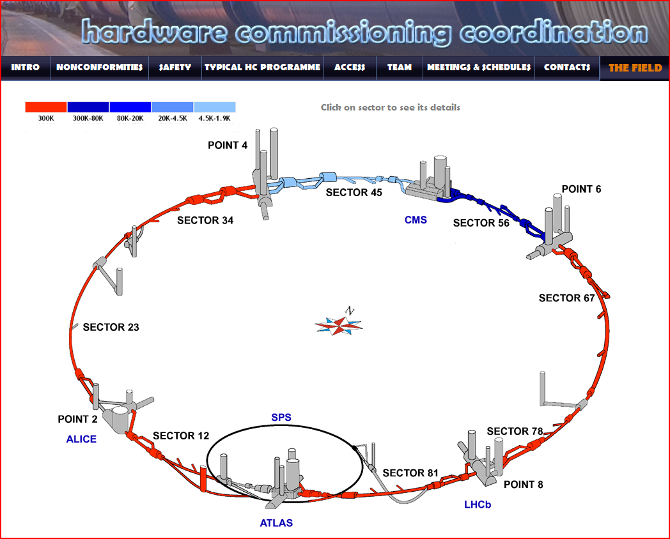
Hardware Commissioning

Slide 2
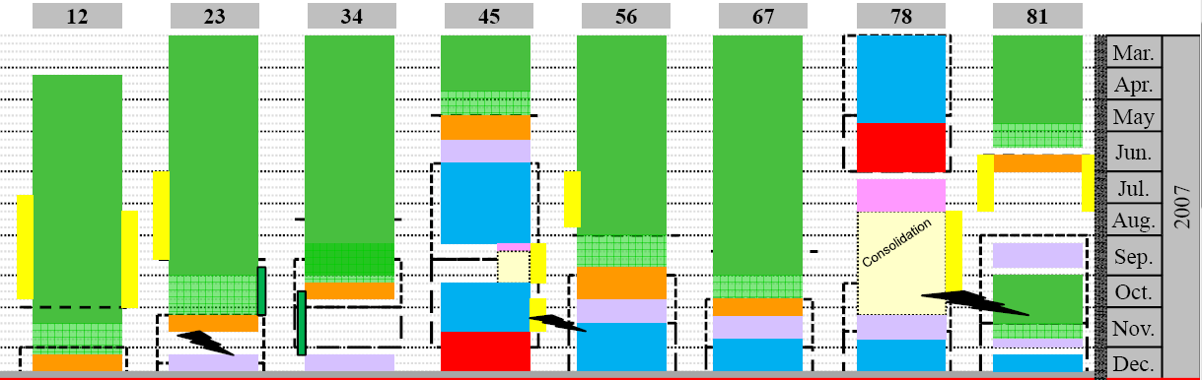
… a quick look at last year
Powering Tests
Consolidation
Powering Tests
Installation
Cool down
Installation
Installation
Installation
Installation
Installation
Reconnection of the inner triplet left of Point 8
Exchange of a dipole
Shortening of main bus bars in some short straight sections
Repair of a few known cold mass to insulation vacuum leaks
Repair of two short circuits
Repair of line Y in the heat exchanger tube
Replacement of some plug in modules
Interconnection of the continuous cryostat
Cool down
Leak tests of the last sub-sectors
Powering tests
Global pressure test & consolidation
Warm up

Slide 3
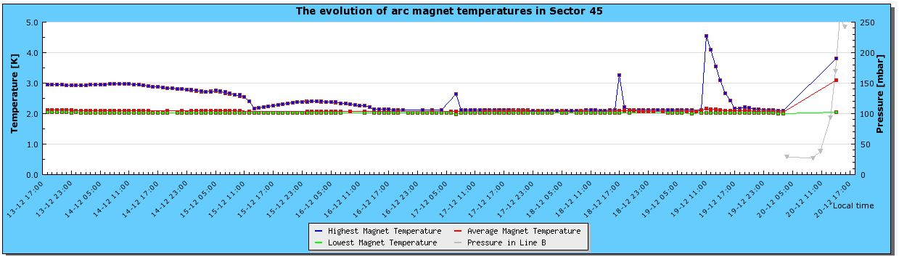
Powering Tests

Slide 4
First cool down of Sector 45
Stops required to repair the flexibles: one one side of the sector, then on the side
… about 9 weeks + the time required to stabilize

Slide 5
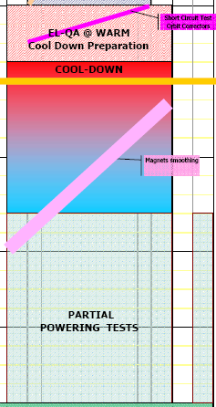

Slide 6
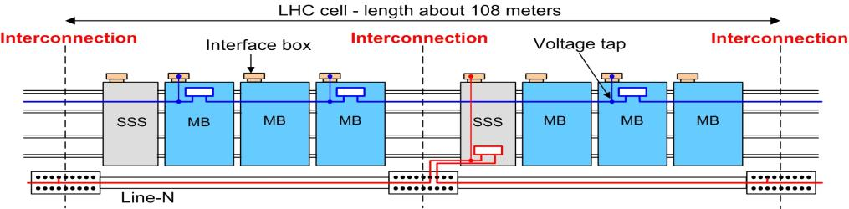
The superconducting circuits
1.9K
4.5K

Slide 7
The superconducting circuits
Circuit Type | Sector |  |  |  |  |  |  |  | LHC
 | 1-2 | 2-3 | 3-4 | 4-5 | 5-6 | 6-7 | 7-8 | 8-1
13 kA | 3 | 3 | 3 | 3 | 3 | 3 | 3 | 3 | 24
Indipendently Powered Dipoles | 3 | 2 | 2 | 3 | 1 | 0 | 2 | 3 | 16
Indipendently Powered Quadrupoles | 14 | 7 | 6 | 13 | 12 | 5 | 7 | 14 | 78
600A with Energy Extraction | 23 | 27 | 28 | 24 | 23 | 27 | 27 | 23 | 202
600A Energy Extraction in Converter | 14 | 20 | 20 | 14 | 14 | 20 | 20 | 14 | 136
600A no Energy Extraction | 16 | 9 | 2 | 9 | 9 | 2 | 9 | 16 | 72
80-120A Correctors | 50 | 37 | 22 | 33 | 33 | 22 | 37 | 50 | 284
TOTAL | 123 | 105 | 83 | 99 | 95 | 79 | 105 | 123 | 812
Circuit Type | Sector |  |  |  |  |  |  |  | LHC
 | 1-2 | 2-3 | 3-4 | 4-5 | 5-6 | 6-7 | 7-8 | 8-1
60A Closed Orbit Correctors | 94 | 94 | 94 | 94 | 94 | 94 | 94 | 94 | 752

Slide 8
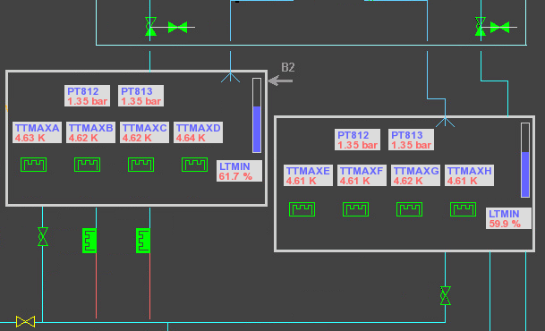
RF cavities in Point 4
Already achieved is the parallel conditioning of eight cavities up to:
    ~150kW (1MV/cavity) with Q_{L} = 20’000
Started on four cavities:
    ~200kW intermediate position of movable Main Coupler nominal field (2MV/cavity with Q_{L} = 60’000)
Continuing the conditioning of the cavities & the main couplers
Setting up of
  the Tuner Loop
  the RF feedback
  the Klystron Polar Loop
  the one-turn feedback
Goal: set-up of the first three loops on one cavity before warm-up
LEMIC, January 29, 2008 - Roberto Saban
Courtesy O.Brunner

Slide 9
Test of the Access Control System
The LHC access system was nearly completely commissioned during the first week of January 2008 by a joint AB-TS team in collaboration with the supplier's team.
Access is presently (from Monday 14/1) possible again with the CERN access card. No major issues encountered during the 7 days of intense tests.
From early April access to the LHC will be made with dosimeter and biometric control.
Test the Access System when doing a patrol of all the LHC points
In « Access Mode », test the correct system behaviour when one or more EIS-beam becomes unsafe
In « Beam Mode », test the triggering of all the « EIS-BEAM» and external interfaces (BI, LBDS) in case of intrusion, door opening inside the LHC or Emergency stop.
Objectives

Slide 10
Status of the sectors
Sector | Temperature | Status
12 | warm | Leak test
23 | warm | Preparation for cool down
34 | warm | Preparation for cool down
45 | cold | Powering tests
56 | cold | Stand by
67 | warm | Preparation for cool down
78 | warm | Cool down next week
81 | warm | Cool down to start in week 6
– short to ground

Slide 11
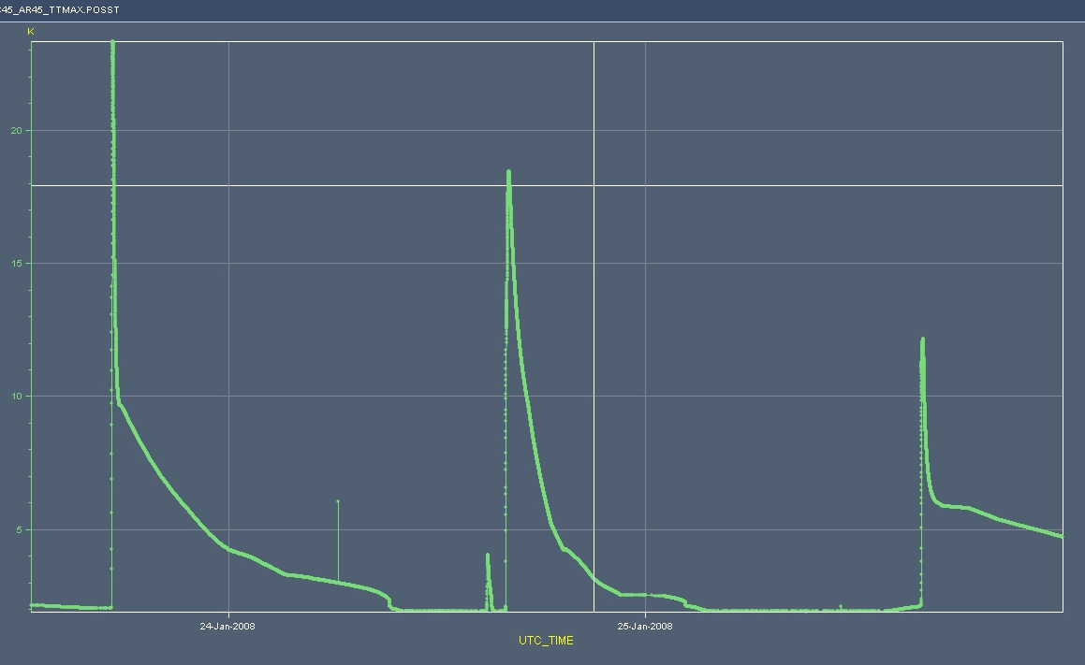
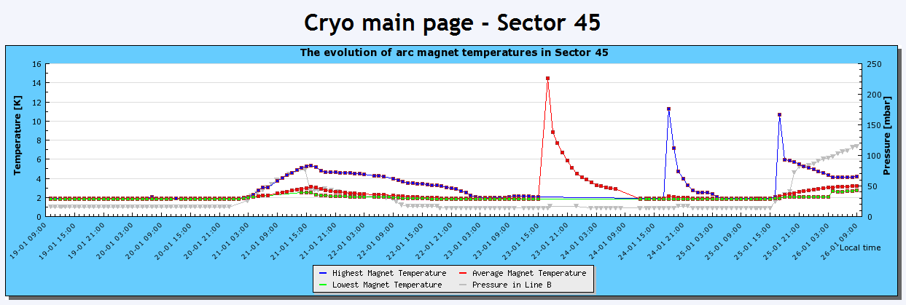
Provoked and Natural quenches in RB circuit
@9500A
17R4-B
@9789 A
27L5 (C-B-A)
@9857A
22R4 (A-B-C) then 21R4 (C)

Slide 12
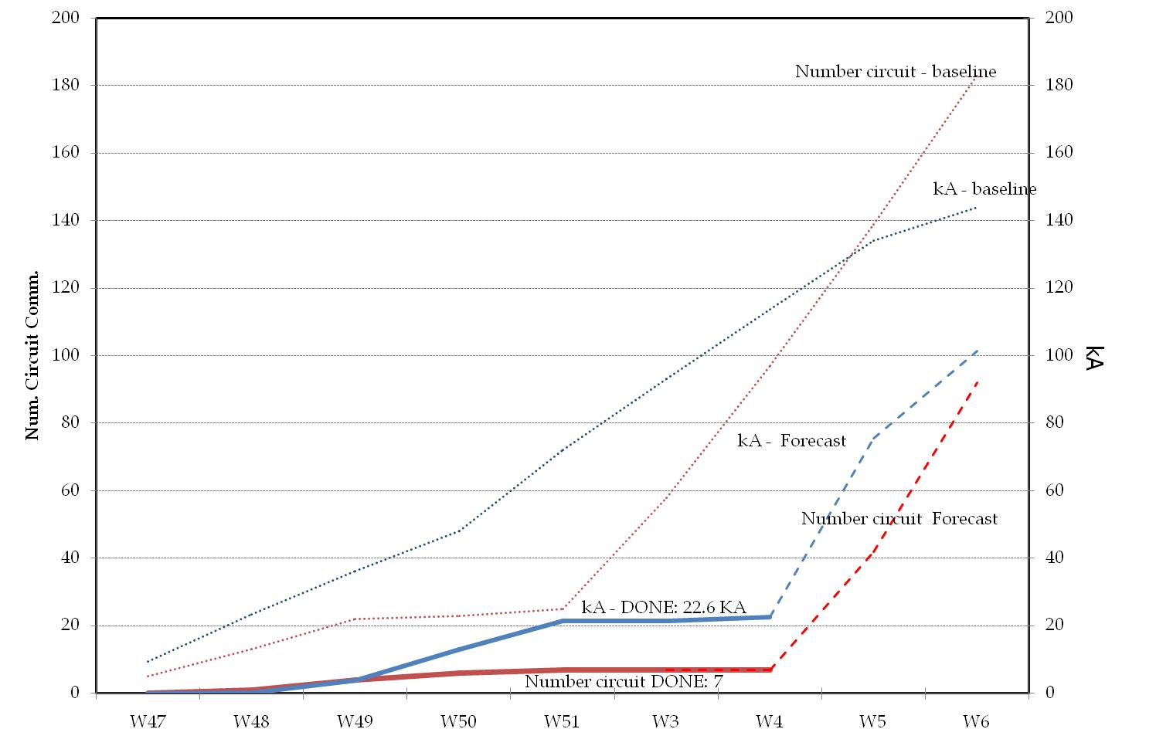
Progress chart
182
92 circuits commissionable if :
If Stand alone of LL5 released (level gauges) (4 IPQD + 10 DOC)
If good conditions for the DOC circuits are met (~120 circuits)
No major contingencies for QPS/Interlocks (last ISTs before powering)
92

Slide 13
LHC General schedule
The engineering run originally foreseen at end 2007 is precluded by delays in installation and equipment commissioning.
450 GeV operation is part of normal setting up procedure for beam commissioning to high-energy
The general schedule being reassessed, accounting for inner triplet repairs and their impact on sector commissioning
  Machine closed April 2008
  Beam commissioning starts May 2008
  First collisions at 14 TeV c.m. July 2008
  Pilot run pushed to 156 bunches for reaching 10³²cm⁻²·s⁻¹as soon as possible
No provision for major mishaps, e.g. additional warm-up/cooldown of sector: a success-oriented schedule !
Courtesy R.Aymar

