Slide 1

Υ Suppression in Hot and Cold Nuclear Matter at STAR or:
Yield Extraction with Low Statistics
Anthony Kesich
University of California, Davis

Slide 2
Outline
Current Status
Chi² Fitting
Bias Correction
Likelihood Fitting
Composite Signals
Mismatched line shapes
The Future

Slide 3

Current status of Upsilon results
Our paper was submitted in December
Now in referee stage
While responding, we found a critical error
Now corrected. Back on publication track
Let’s discuss fitting methods
  Others can learn from my
  mistake

Slide 4
FITTING!
So without further ado…

Slide 5
Example : Yield from a Gaussian pdf
Suppose we are performing a counting experiment
  Measuring a particle’s mass in the absence of background
    e.g. time of flight of anti-alpha particle in the STAR detector
  Distribution is Gaussian, with some mean mass and width given by the detector resolution
    For simplicity, assume we can make this into a Normal Standard distribution
      e.g. if the resolution is known, and if the mass of the alpha particle is equal to the mass of the anti-alpha particle.
  Suppose you want to obtain yield using a fit to the data
    How would you do it?

Slide 6
Example : Continued
One possibility
  Construct a Gaussian pdf (2 parameters: μ, σ)
  Add one parameter as normalization (counts)
Is this a good way?

Slide 7
Simple Extraction
Signal only; no background
Signal is a simple Gaussian
Throw a known number, extract result from chi² fit
  0.1% error

Slide 8
Simple Extraction (lower statistics)
Only 2% of previous sample
5.6% error

Slide 9
Simple Extraction (even lower statistics)
20% of previous sample
10.5% error

Slide 10
Least squares with binned data
Least squares: minimize χ² with
  assumes Poisson statistics, i.e.: mean = variance
  here, λ is PDF which we assume (hope?) is parent distribution.
Modified least-squares method: minimize χ² with
  Easier computationally: use data, instead of assumed PDF
  Can lead to problems if a bin contains no entries

Slide 11
Adjustable normalization: careful!
If we add an arbitrary normalization:
  Here, ν is the arbitrary normalization constant.
    Suitably normalized, it can be used to estimate the yield.
  Minimizing χ² leads to an estimator of the normalization:
    For least squares:
    For modified least squares:
  In our example of 1,000 events: N =944.2 +/- 30.9
    What method do you think ROOT is using by default?

Slide 12
…and this isn’t a fluctuation

Slide 13
But it can be corrected (somewhat)
1000 thrown per event
Yield corrected by adding chi²
0.71% bias vs -5.8%

Slide 14
Until you go back to low statistics
200 thrown per event
Yield corrected by adding chi²
8.6% bias vs -12.7% → Not a huge improvement
  Empty-bin effect

Slide 15
But really, just use Likelihood

Slide 16
But the world isn’t that simple

Slide 17
Extracting yields from composite signals
Signal is a Gaussian
Background is an exponential

Slide 18
Extracting yields from composite signals
1) Extraction via fit parameters
2) Integrate data and subtract background (green dashed curve)

Slide 19
Extracting yields from composite signals
300 thrown
Extraction from fit outperforms subtraction
But we know the lineshape here….

Slide 20
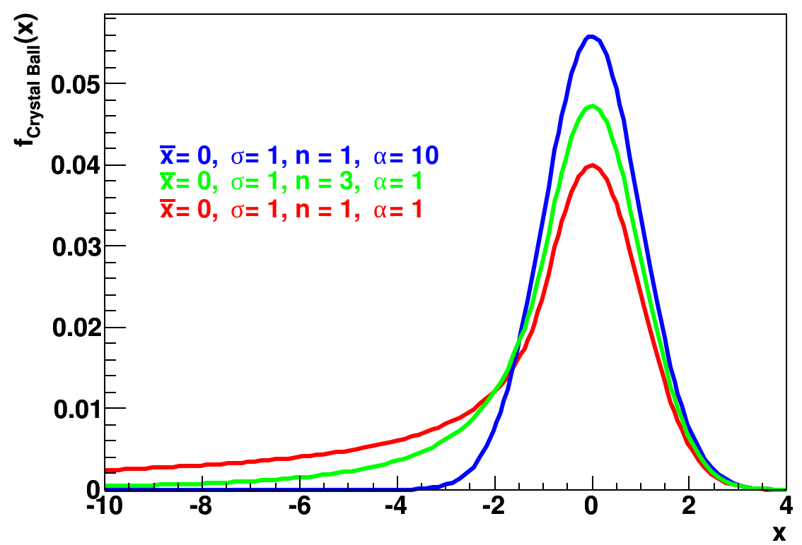

The Crystal Ball function
Gaussian paired with power law
Models “lossy” functions

Slide 21
Chi² vs Likelihood with incorrect line shapes
Chi²
Likelihood
Threw 300 events with a Crystal Ball function and fit it to a Gaussian
Chi² gets the shape right (somewhat)
Likelihood gets the yield right

Slide 22
Still holds at high statistics
Chi²
Likelihood
Threw 50,000 events with a Crystal Ball function and fit it to a Gaussian

Slide 23
Composite signals with incorrect line shapes
Signal is Crystal Ball with exponential bkg
Fit to Gaussian with exponential bkg

Slide 24
Composite signals with incorrect line shapes
Signal is Crystal Ball with exponential bkg
Fit to Gaussian with exponential bkg

Slide 25
Results of many “incorrect” fits

Slide 26
Results of many “incorrect” fits

Slide 27
</talk>
STAR Upsilon results are in the publication process
Chi² fitting is biased at low statistics
  Use likelihood.
Be wary of line shape assumptions
  Integrating data help remove biases
Keep learning
Keep sharing

