Slide 1



Energy Density, Pressure and Flow
At Early Times
Rainer J. Fries
Texas A&M University
WWND XXX
Galveston, April 9, 2014

Slide 2
Overview
Classical Gluon Fields and MV Model
Analytic Solutions for Early Times
Phenomenology
Beyond Boost-Invariance
Work in collaboration with
  Guangyao Chen (Texas A&M)
  Joe Kapusta (Minnesota)
  Sener Ozonder (INT/Seattle, Minnesota)

Slide 3
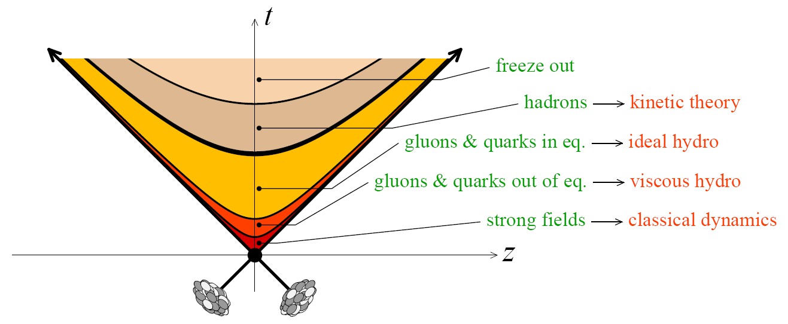
A “Standard Model” of URHICs
Bulk evolution: Local thermal equilibrium with small (?) dissipative corrections after time 0.2-1 fm/c.
Expansion and cooling via viscous hydrodynamics, maybe augmented by transport.
Pre-equilibrium: strong classical gluon fields (CGC) → rapid (?) thermalization

Slide 4
Motivation
The simplest classical gluon field model (MV) can be solved analytically for small times (near-field approximation).
Typical time scale: 1/Q_{s}.
Notable results to hope fore:
Analytic expressions for early energy density and pressure.
Analytic expressions for initial flow [see talk by G. Chen on Saturday]
“New” phenomena? Global energy-momentum map of the early-time collision!
classical
gluons (MV)
hydro
p
T
L
τ
~1/Q_{s}
τ_{th}

Slide 5
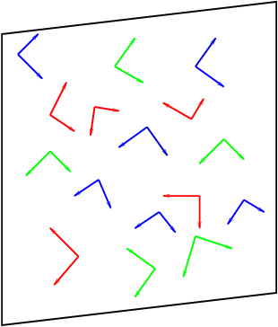
MV Model: Classical YM Dynamics
Nuclei/hadrons at asymptotically high energy:
  Saturated gluon density ~ Q_{s}⁻² → scale Q_{s} >> Λ_{QCD}, classical fields.
Single nucleus: solve Yang-Mills equations for gluon field A^{μ}(ρ).
  Source = light cone current J (given by SU(3) charge distribution ρ ).
  Calculate observables O(ρ ) from the gluon field A^{μ}(ρ).
  ρ from random Gaussian color fluctuations of a color-neutral nucleus.
[L. McLerran, R. Venugopalan]

Slide 6
MV Model: Classical YM Dynamics
Two nuclei: intersecting currents J₁, J₂ (given by ρ ₁, ρ₂), calculate gluon field A^{μ}(ρ ₁, ρ₂) from YM.
Equations of motion
Boundary conditions
[A. Kovner, L. McLerran, H. Weigert]

Slide 7
Analytic Solution: Small Time Expansion
Numerical solutions available
Here: analytic solution using small-time expansion for gauge field
Recursive solution for gluon field:
  0th order = boundary conditions
[Krasnitz, Venugopalan][Lappi][Schenke et al.]
…
[RJF, J. Kapusta, Y. Li, 2006]
[Fujii, Fukushima, Hidaka, 2009]

Slide 8
Fields: Before Collision
Before the collision: color glass = pulse of strictly transverse (color) electric and magnetic fields, mutually orthogonal, with random color orientations, in each nucleus.

Slide 9
Fields: At Collision
Before the collision: color glass = pulse of strictly transverse (color) electric and magnetic fields, mutually orthogonal, with random color orientations, in each nucleus.
Immediately after overlap (forward light cone, τ → 0): strong longitudinal electric & magnetic fields E₀, B₀. Non-abelian effect.
E₀
B₀
[L. McLerran, T. Lappi, 2006]
[RJF, J.I. Kapusta, Y. Li, 2006]

Slide 10
Fields: Into the Forward Light Cone
Once the longitudinal fields E₀, B₀ are seeded, the next step in the time evolution can be understood in terms of the QCD versions of Ampere’s, Faraday’s and Gauss’ Law.
Transverse fields with rapidity-even and -odd contributions
Longitudinal fields up to O(τ²)
[G. Chen, RJF, PLB 723 (2013)]

Slide 11
Analytic Solution: Small Time Expansion
Convergence for weak field limit: recover analytic solution for all times.
Convergence for strong fields: convergence radius ~ 1/Q_{s} for averaged quantities like energy density.

Slide 12

Energy Momentum Tensor
Initial (τ = 0) structure of the energy-momentum tensor from purely londitudinal fields
$$ε_{0}=\frac{1}{2}\left(E_{0}^{2}+B_{0}^{2}\right)$$
Transverse pressure
P_{T} = ε₀
Longitudinal pressure
P_{L} = –ε₀

Slide 13
Energy Momentum Tensor
Flow emerges from pressure at order τ¹:
Transverse Poynting vector gives transverse flow.
[RJF, J.I. Kapusta, Y. Li, (2006)]
[G. Chen, RJF, PLB 723 (2013)]
Like hydrodynamic flow, determined by gradient of
transverse pressure P_{T} = ε₀; even in rapidity.
Non-hydro like; odd in rapidity ??
[see talk by G. Chen on Saturday]

Slide 14
Energy Momentum Tensor
Corrections to energy density and pressure at second order in time
Example: energy density and pressure
New terms:
Depletion/increase of energy density due to transverse flow
New term

Slide 15
Modelling Color Charges
So far color charge densities ρ ₁, ρ₂ fixed.
MV: Gaussian distribution around color-neutral average
Sample distribution to obtain event-by-event observables.
Next: analytic calculation of expectation values (as function of average color charge densities μ₁, μ₂).
Transverse flow comes from gradients in nuclear profiles.
Original MV model μ = const.
Here: relaxed condition, μ constant on length scales 1/Q_{s} , allow variations on larger length scales 1/m where m << Q_{s}.
[G. Chen, RJF, PLB 723 (2013)]
[G. Chen et al., in preparation]

Slide 16
Calculating Expectation Values
Example:
Need to evaluate “higher twist” expectation values.
Number of terms increases rapidly with order in time (~ 600 for τ⁴).
[Fujii, Fukushima, Hidaka, PRC 79 (2009)]
[G. Chen et al., in preparation]

Slide 17
Averaged Density and Flow
Energy density ~ product of nuclear gluon distributions ~ product of color source densities
“Hydro” flow:
“Odd“ flow term:
  With we have
[T. Lappi, 2006]
[RJF, Kapusta, Li, 2006]
[Fujii, Fukushima, Hidaka, 2009]
[G. Chen, RJF, PLB 723 (2013)]
[G. Chen et al., in preparation]

Slide 18

Higher Orders in Time
Generally: powers of τ go with factors of Q or factors of transverse gradients:
  ${\sim τμ}^{−1}∇^{i}μ$
  $\sim τQ$
Example for order τ ² term:
Rather simple pocket formulas if gradients and logs are neglected:

Slide 19
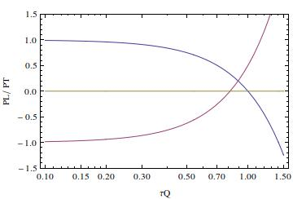
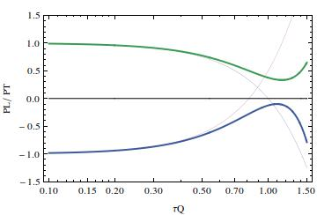



Comparison with Numerical Solutions
CGC in a box
[F. Gelis, T. Epelbaum, arxiv:1307.2214]
$$O\left(τ^{4}\right)$$
$$\frac{P}{ε_{0}}$$
$$\frac{τ}{Q}$$

Slide 20
Comparison with Numerical Solutions
CGC in a box
4th order in time: preliminary
[F. Gelis, T. Epelbaum, arxiv:1307.2214]
$$O\left(τ^{4}\right)$$
$$\frac{P}{ε_{0}}$$
$$\frac{τ}{Q}$$

Slide 21
Comparison with Numerical Solutions
Caveat: only a qualitative comparison at this point.
Qualitative features for pressure and energy density up to 1/Q recovered.
Classical theory sufficient up to 1/Q.

Slide 22
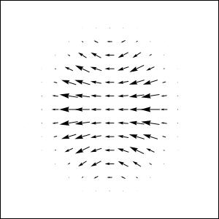
Can We Do It Event-By-Event?
Yes, MC sampling of time-expansion coefficients.
Example: “odd” vector β ^{i} in Au+Au (b=4 fm).
Averaging over events: recover analytic result.
Energy density N=1
Analytic expectation value
PRELIMINARY

Slide 23
Classical QCD Beyond Boost Invariance
Real nuclei are slightly off the light cone.
Classical gluon distributions calculated by Lam and Mahlon.
Nuclear collisions off the light cone?
Here: two simplifying assumptions when passing time R_{A}/γ << internal time 1/Q_{s}:
  dε/dτ = 0 ⇒ put a light-cone like hypersurface on which to “measure” the energy density just after nuclear overlap
  New (transverse) field components Lorentz suppressed → only count longitudinal fields in initial energy density.
Calculate on this “τ”=0
hypersurface
[C.S. Lam, G. Mahlon, PRD 62 (2000)]
[S. Ozonder, RJF, PRC 89 (2014)]

Slide 24
Classical QCD Beyond Boost Invariance
Strategy: use Lam-Mahlon gluon distributions in the “old” light cone formula for ε₀.
Obtain rapidity profiles with plateau around the center (approximate boost-invariance), rapid fall-off towards beam rapidity.
Well fitted by Woods-Saxon (see for parameters).
[S. Ozonder, RJF, PRC 89 (2014)]

Slide 25
Summary
Fields and energy momentum tensor for τ < 1/Q_{s} can be calculated analytically in the appropriate limit of QCD.
Simple predictions for homogeneous nuclei.
Transverse energy flow shows interesting and unique features: directed flow, A+B asymmetries, etc.
First results for energy density at finite sqrt(s).

Slide 26
Transverse Flow: Visualization
Transverse Poynting vector for randomly seeded A₁, A₂ fields (abelian case).
η = 0: “Hydro-like” flow from large to small energy density
η ≠ 0: Quenching/amplification of flow due to the underlying field structure.

Slide 27
Matching to Hydrodynamics
No equilibration here; see other talks at this workshop.
Pragmatic solution: extrapolate from both sides (r(τ) = interpolating fct.)
Here: fast equilibration assumption:
Matching: enforce
(and other conservation laws).
Analytic solution possible for matching to ideal hydro.
  4 equations + EOS to determine 5 fields in ideal hydro. Up to second order in time:
  Odd flow β drops out: we are missing angular momentum!
p
T
τ
L

