Slide 1


Future Heavy Ion Physics at the CMS
Michael Northup (On behalf of CMS)
Rice University
Winter Workshop for Nuclear Dynamics
Galveston, Texas
April 12, 2014
Notes:
At venue, date, on behalf of cms. Add CMS logo

Slide 2
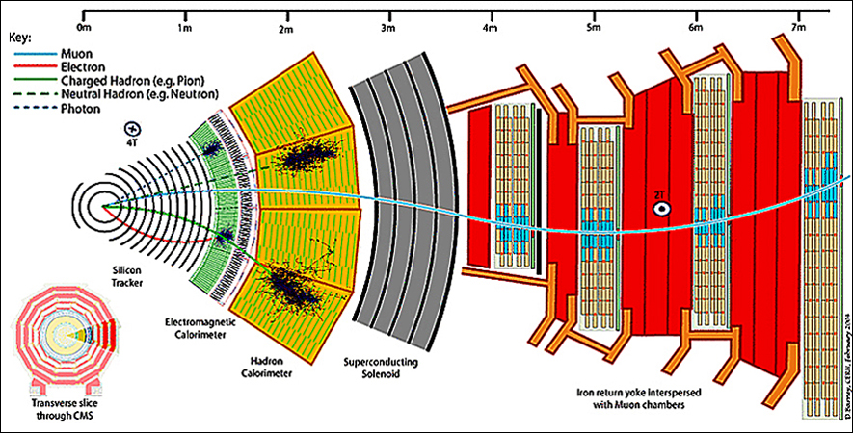
Basic CMS Anatomy
Notes:
----- Meeting Notes (4/11/14 16:45) -----
Not 10 layers

Slide 3
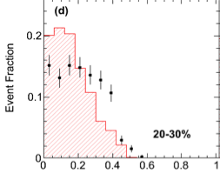

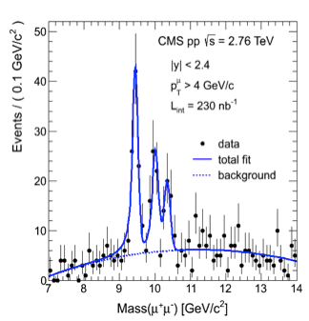
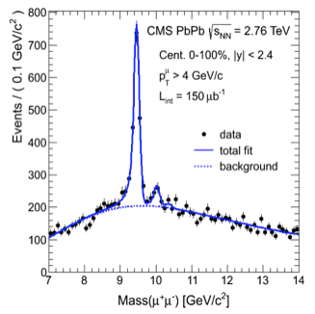
Run 1 Results
Dijet Imbalance in PbPb
Run 1 of the CMS was a resounding success for HI Physics with many exciting results reported.
Υ Supression in PbPb
PRC 84 (2011) 024906, PRL 109 (2012) 222301
Notes:
Try and compress this and Y results onto one slide
----- Meeting Notes (4/11/14 16:45) -----
Add references for plots. Call imbalance the whole time.

Slide 4
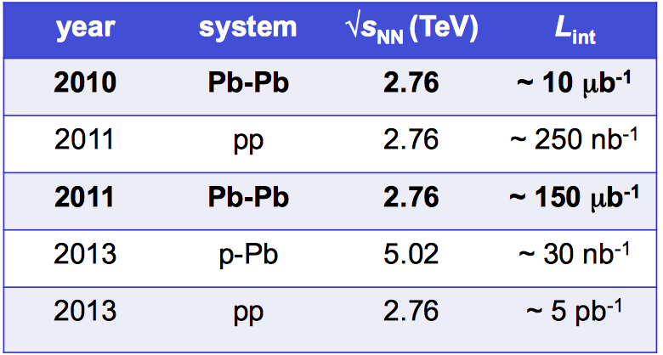
LHC Heavy Ion Run 1
First very successful pPb run.
Two very short pp reference runs at PbPb √s.
Sampled Events
~1 Billion
Notes:
----- Meeting Notes (4/11/14 17:36) -----
Double check nominal luminosity. Are we really above nominal. Put number of events next to luminosity.

Slide 5
Schedule of LHC and CMS
Upcoming runs will prove to be even more exciting with the CMS receiving much needed upgrades to the L1 trigger, pixel tracker, and other sub detectors.
HL-LHC
pp 13-14 TeV
pPb 8 TeV
PbPb 5 TeV
pp 13-14 TeV
pPb 8 TeV
PbPb 5 TeV
(10 nb⁻¹)
LHC
pp 13-14 TeV
pPb 8 TeV
PbPb 5 TeV
(1.5 nb⁻¹)
We are here
LS1
LS2
LS3
2012 | 2013 | 2014 | 2015 | 2016 | 2017 | 2018 | 2019 | 2020 | 2021 | 2022 | 2023 | 2024 | 2025
CMS
New pixel and strip tracker
L1 track trigger
Possible forward tracker and muon
L1 calorimeter
trigger upgrade
Pixel tracker upgrade
Notes:
What is the expected luminosity for HI in next stages?
Make L1 Up stand out
Add HL-LHC
----- Meeting Notes (4/11/14 17:36) -----
Add as transition slide between L1 and HL-LHC.

Slide 6
L1 Upgrade Motivation
CMS possesses a novel two level trigger design, the purely hardware based level 1 trigger (L1), and the purely processor based high level trigger (HLT).
During LS1 the collision energy will increase to around √s_{NN} = 5.0 TeV and the PbPb collision rate will increase to as high as 30 kHz, up from 3 kHz, which will increase the production rate of hard probes by more than a factor 10.
Significant rejection factors will have to be reached at L1.
This necessitates the use of background subtraction on single track and jet triggers.
Notes:
Figures for rates. Eta phi “map” of CMS.
----- Meeting Notes (4/11/14 17:36) -----
Add that now is 3 kHz but is increasing to 30 kHz because of pixel detector. Fix typos and implement max's fixes.

Slide 7
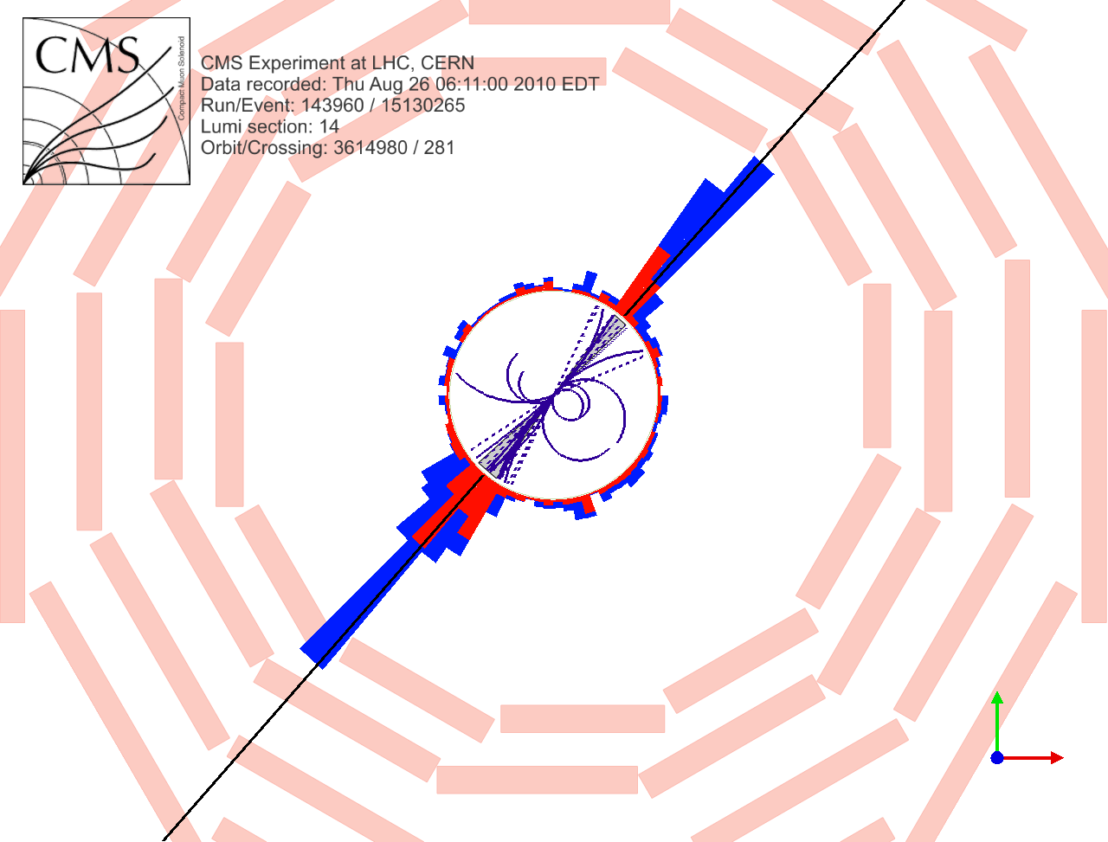
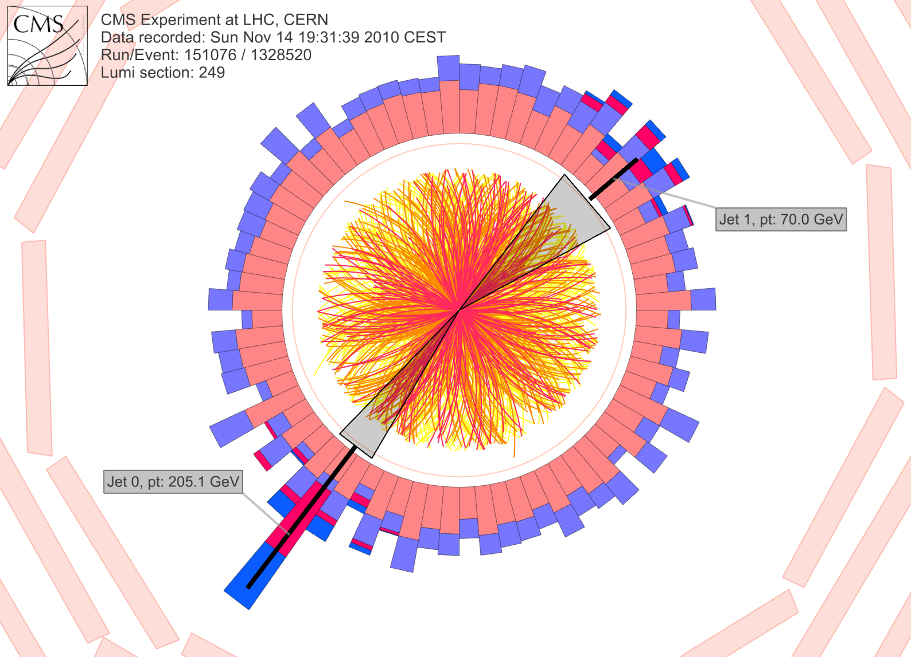
PP-PbPb Background Comparison
Background in PbPb will push L1 trigger rate up to unacceptable levels.
pp
PbPb
Notes:
----- Meeting Notes (4/11/14 17:36) -----
Say "L1 trigger" rate

Slide 8
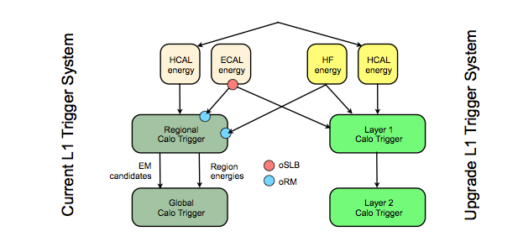
L1 Background Subtraction
New Layer 2 allows us to form Et sums over a ϕ-ring at constant η for the purpose of subtracting the background.
Schematic of L1 calorimeter
trigger upgrade
JET
ϕ
η
Old L1
New L1
Notes:
Box layer 2
----- Meeting Notes (4/11/14 17:36) -----
Say "to perform background subtarction".
Possibly remove orange and emphasize difference between old and new.

Slide 9
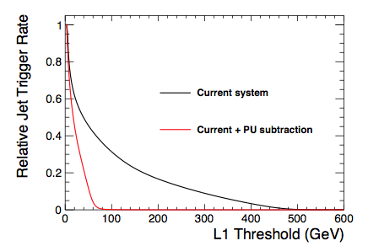
L1 Jet Rate Comparison
Does the new background subtraction algorithm give a sufficiently reduced rate?
YES!
2011 PbPb minbias at √s_{NN =} 2.76 TeV
Backg. Subt.
CMS-TDR-12
Notes:
Describe the jet algorithm and by the background subtraction is so crucial. Rate at Jet energy of 100 GeV. Accept rate of 5% is required.
Change PU to background subt.
----- Meeting Notes (4/11/14 17:36) -----
Check data centrality and type (PbPb).

Slide 10
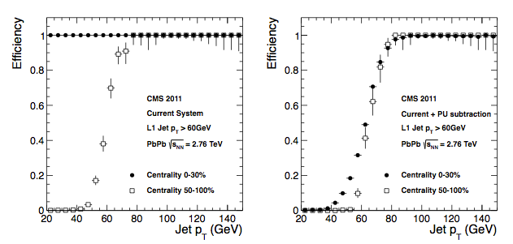
L1 Jet Efficiency Comparison
We have shown low rate but what about efficiency?
Trigger efficiency is less dependent on collision centrality.
Without Backg. Subt.
With Backg. Subt.
CMS-TDR-12
Notes:
Change PU to Bs
----- Meeting Notes (4/11/14 17:36) -----
error bars go high-low-high due to pt distribution of jet sample.

Slide 11
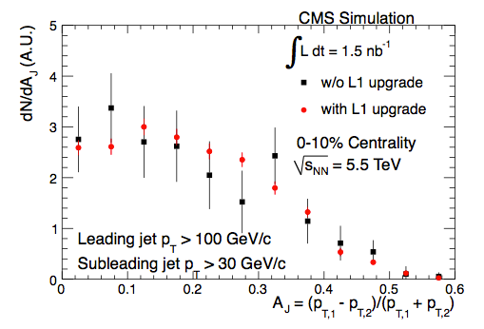
Dijet Imbalance Comparison
We expect substantial improvement in measurement of A_{J}.
CMS-TDR-12
Notes:
Data or MC? Why aren’t the red and black centered the same but with different error bars?
----- Meeting Notes (4/11/14 17:36) -----
emphasize simulation not dat. Say "imbalance" instead of asymmetry.

Slide 12
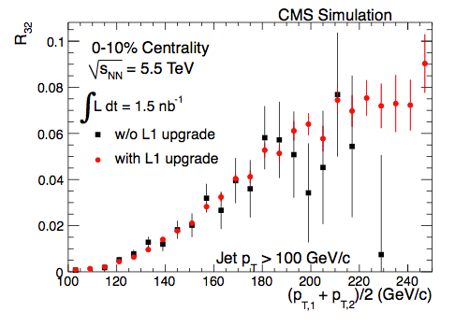
Inclusive 3-jet to 2-jet Cross Section Ratio
Excellent testing ground for pQCD and possible modification of parton shower and gluon jet quenching in QGP.
CMS-TDR-12
Notes:
The expected number of 3-jet events at 5.5 TeV is estimated based on the observed statistics in the 2011 data sample, in which we recorded about 106 3-jet events and 8225 dijet events, with all jets having pT > 100 GeV/c. The ratio from PYTHIA events, with uncertainties scaled to the expected 2015 statistics, is shown in Figure 3. With the upgrade L1 system, R32 measurements as a function of the average pT of the two leading jets are made possible.
----- Meeting Notes (4/11/14 17:36) -----
1.5 nb^-1 at the nd of run 2

Slide 13
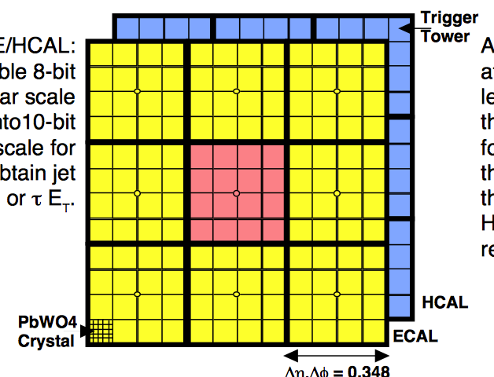
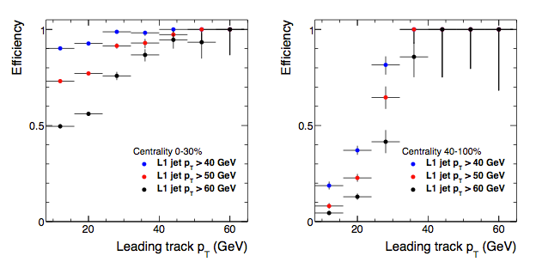
Single-Track Trigger
Single track trigger can give CMS a
tremendous advantage.
Work underway to optimize region size.
CMS-TDR-12
Notes:
Be sure to mention that this is using 12x12 regions, the old system. Currently working to improve the algo by shrinking the region size.
----- Meeting Notes (4/11/14 17:36) -----
include eta phi granularity.
Emphasize that these plots are only for background subtractionfor 12x12 regions.

Slide 14
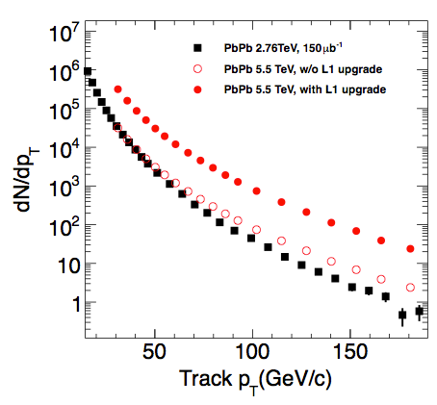
High-Pt Statistics Comparison
At high pt, we experience at least a factor 10 increase in statistics.
Must have high pt track trigger to exploit these new data.
CMS-TDR-12
Notes:
Use high pt v3 data as proof of pudding
Want to lead into the HL-LHC upgrade. What real advantages do we get from the increased luminosity? More Statistics. Demonstrate.
Add text that emphasizes the gain in stat at high pt.
----- Meeting Notes (4/11/14 17:36) -----
In order to take advantage of this factor 10 increase, we must have a single track trigger.

Slide 15
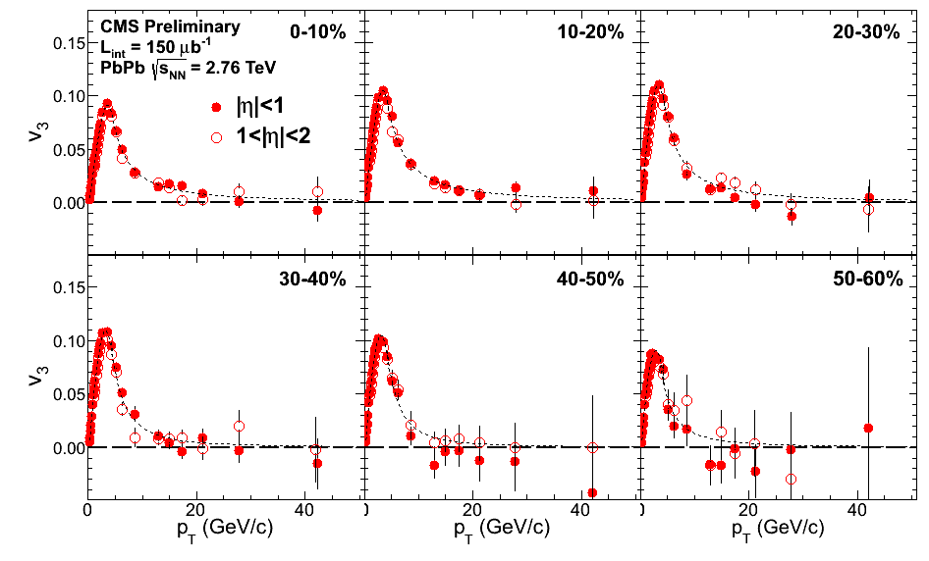
Charged particle v3 at high Pt
Can more precisely study path length dependence of jet quenching
CMS-HIN-12-010
Notes:
Can study path length dependence of jet quenching.

Slide 16
Schedule of LHC and CMS
Upcoming runs will prove to be even more exciting with the CMS receiving much needed upgrades to the L1 trigger, pixel tracker, and other sub detectors.
HL-LHC
pp 13-14 TeV
pPb 8 TeV
PbPb 5 TeV
(1.5 nb⁻¹)
pp 13-14 TeV
pPb 8 TeV
PbPb 5 TeV
(10 nb⁻¹)
LHC
pp 13-14 TeV
pPb 8 TeV
PbPb 5 TeV
We are here
LS1
LS2
LS3
2012 | 2013 | 2014 | 2015 | 2016 | 2017 | 2018 | 2019 | 2020 | 2021 | 2022 | 2023 | 2024 | 2025
CMS
New pixel and strip tracker
L1 track trigger
Possible forward tracker and muon
L1 calorimeter
trigger upgrade
Pixel tracker upgrade
Notes:
What is the expected luminosity for HI in next stages?
Make L1 Up stand out
Add HL-LHC
----- Meeting Notes (4/11/14 17:36) -----
Add as transition slide between L1 and HL-LHC.

Slide 17
HL-LHC Upgrade
Much greater statistics will be possible (factor of 20 increase in luminosity, > 10 nb⁻¹).
Additional upgrades to cope with higher luminosity:
  New Tracker
  New L1 Tracking Trigger
  ZDC upgrade
Dramatic improvement in the measurement of parton energy loss, e.g.,:
  Detailed studies of b-tagged jets
  Measurements of Z+jet correlations
Notes:
----- Meeting Notes (4/11/14 17:36) -----
Before put schedule.
Put L1 "tracking" trigger.

Slide 18
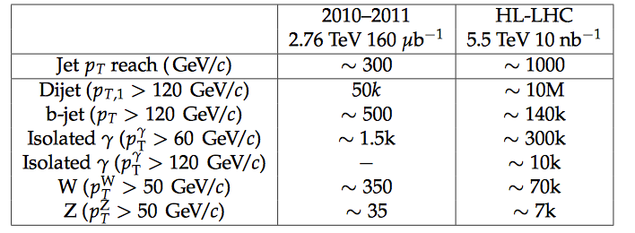
Hard Probe Event Rates
Notes:
----- Meeting Notes (4/11/14 17:36) -----
Expect asymmetry in W plus and W minus. More U quarks than D quarks.

Slide 19
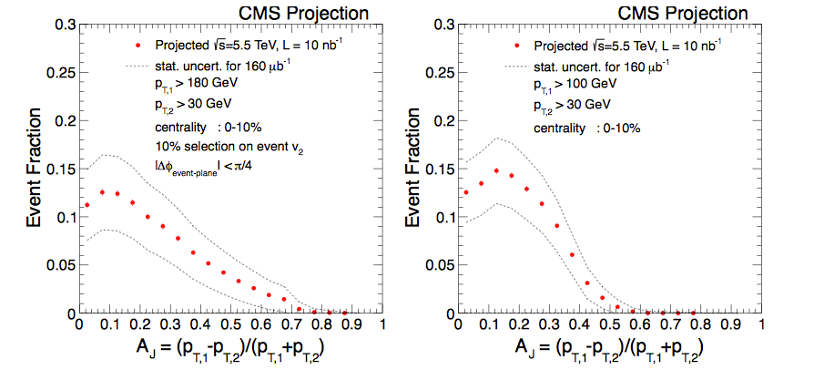
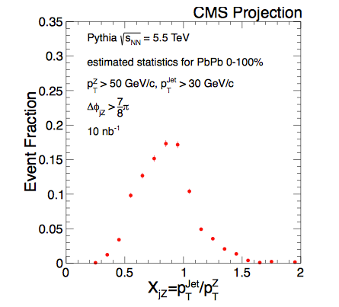
Z + Jet and b-Tagged Dijet Projections
Z + Jet
b-tagged dijets
  ∼ 7000 Z bosons with p_{T} > 50 GeV/c.
CMS PAS FTR-13-025
Notes:
2nd plot id b-di-jets. Nicely demonsatrates higher luminosity capability. Clearly label b-tagged jets.
Naturaly leads into pixel tracker. See pixel TDR for high pileup pt data.
----- Meeting Notes (4/11/14 17:36) -----
Say "z + jet".
Say "Improved precision in Z + jet carries over into all jet quenching meauremtn."

Slide 20
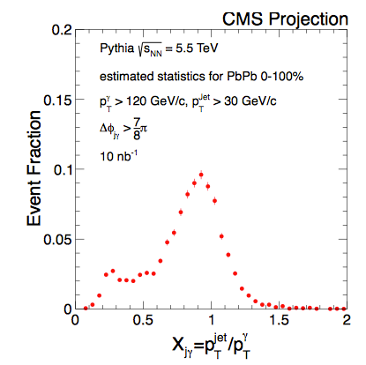
Gamma + Jet Projection
CMS PAS FTR-13-025
Notes:
----- Meeting Notes (4/11/14 17:36) -----
gamma + jet.
No physics here, just say improved precision.

Slide 21
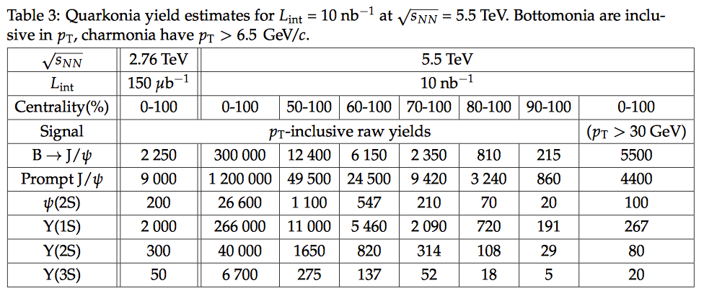
Quarkonia Yield Estimates
CMS PAS FTR-13-025
Notes:
From Projections for Heavy Ions with HL-LHC

Slide 22
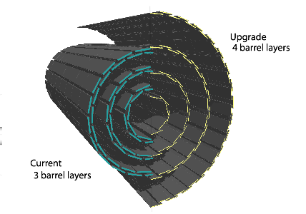
Pixel Detector Upgrade
Up till the end of LS2, we expect luminosities for pp collisions to exceed 2 x 10³⁴ cm⁻² s⁻¹ and average pileup to exceed 50.
To cope with this new high luminosity, high pileup environment, a new pixel detector is needed.
Notes:
Goal of the CMS Upgrade program:
To maintain detector performance with good reconstruction efficiency at relatively low transverse energy even with pileup several times higher than original design.
What does high pileup do?
-Increased Fake rates in tracking
-Reduced resolution in calorimetry with contamination due to overlaping signals.
----- Meeting Notes (4/11/14 17:36) -----
find longitudinal picture.

Slide 23
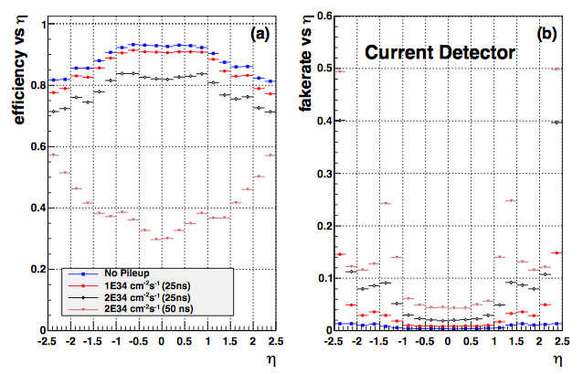
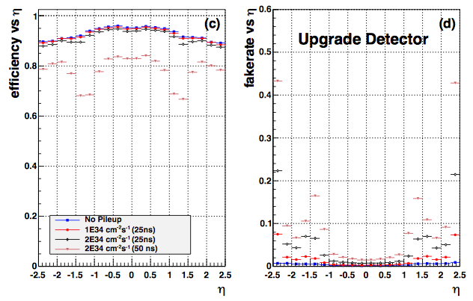
Performance of New Pixel Detector
The new pixel detector maintains high efficiency and low fake rate even in a high pileup (heavy ion like) environment.
CMS-TDR-11
Notes:
----- Meeting Notes (4/11/14 17:36) -----
Make clear that you mean high occupancy in both high pileup pp and PbPb.

Slide 24
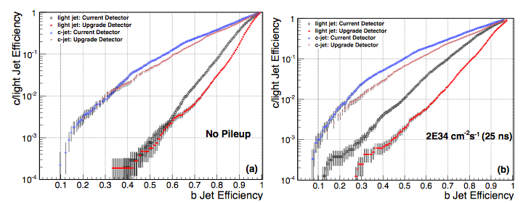
B-tagging Performance
New pixel detector substantially outperforms the current detector even without pileup.
Average Pileup = 50
CMS-TDR-11
Notes:
Performance of the Combined Secondary Vertex b-tagging algorithm for jets with pT > 30 GeV in a tt ̄ sample with (a) zero pileup, and (b) an average pileup of 50. The perfor- mance for the current detector are shown by the open points while the solid points are for the upgrade detector. The triangular points are for c-jets while the circle and square points are for light quark jets.
----- Meeting Notes (4/11/14 17:36) -----
Make plot bigger. See color

Slide 25
Closing Remarks
Run 1 of the CMS yielded spectacular results for heavy ion physics.
Future runs will require substantial upgrades to the L1 trigger, pixel tracker, and other sub detectors in order to exploit the full capabilities of the detector.
With background subtraction, sufficient rate reduction can be achieved at L1.
With the boost in statistics from the HL-LHC upgrade, we expect fantastic improvements to our ability to measure Z-jet, b-tagged dijets, and quarkonia.

Slide 26
Backup

Slide 27
Z-jet
Notes:
Use z-jet plot. Also good demonstration of high lum cap.

Slide 28
LS1 Upgrade to the L1 Cal Trig
Beam energy will increase by a factor 2 while luminosity will increase by a factor 10.
Primary concern for HI is the L1 Calorimeter Trigger.
Notes:
Jet algorithm will require a background subtraction (Absolutely essential to the upgrade). This was impossible in the previous system. Motivate from physics first.

Slide 29
Notes:
Probably not

Slide 30
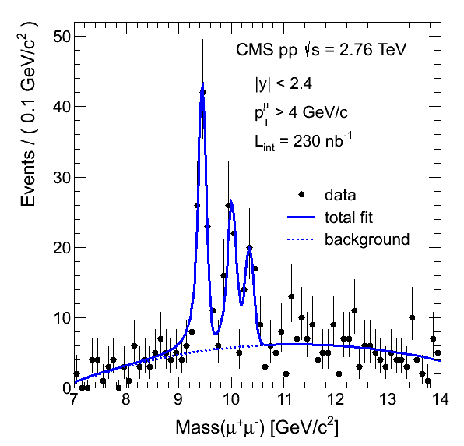
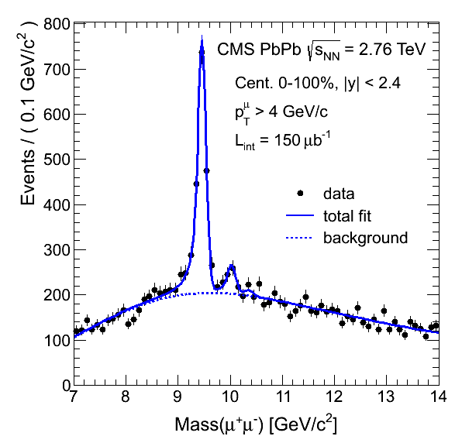
Y Excited State Suppression

Slide 31
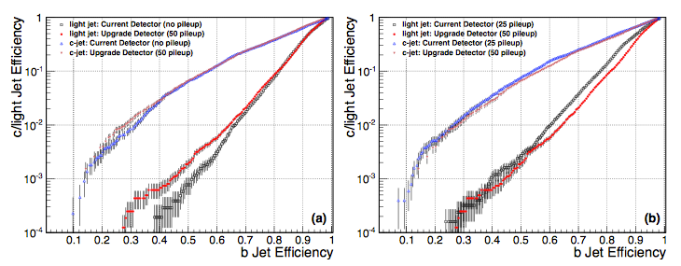
B-tagging performance 2

Slide 32
Outline
CMS 101
Current Findings (CMS HI Current results)
  Di jet
  Quarkonium supression
Schedule (Projections)
L1 Upgrade plans and performance
  Basic Goal for L1
  Rate Plot
Physics Performance (HL-LHC)
  Jet Quenching
    Di-Jets (b-Di Jets)
    Z Jet
    Gamma jet
  Quarkonium Supression
    Low pt charmonium
Conclusions/Summary

