Slide 1


Recent results on event-by-event fluctuations from rhic beam energy scan program at star experiment
Nihar R. Sahoo
(for the STAR Collaboration)
Texas A&M University,
USA

Slide 2
Outline
RHIC Beam Energy Scan Program
  Search for QCD Critical Point
    Higher moments of conserved charge distribution
    Other observables
Signature of QGP
Signature of Disoriented Chiral Condensate
Future perspective for BES-II and upgrades
Summary

Slide 3
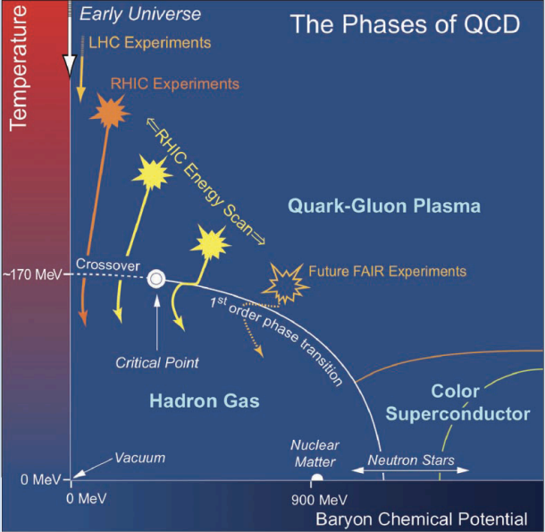
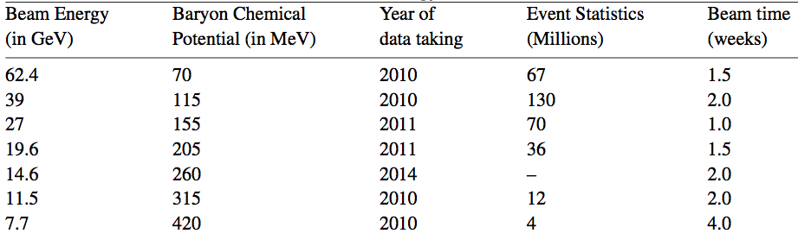
RHIC Beam Energy Scan program (BES)
Main Goal
  Search for the QCD Critical Point
  Evidence of 1st order phase transition in the QCD Phase diagram
  Understand the properties of the QGP as a function of μ_{B}
20
BES-I
http://www.agsrhichome.bnl.gov/RHIC/Runs/
3

Slide 4
BES E-by-E fluctuation analysis
Physics Phenomena | Observables
QCD Critical Point | Higher moments of conserved charge distribution like, Net-charge Net-proton (proxy of net-baryon) Net-kaon (proxy of net strangeness) (Skewness, Kurtosis, etc) p_{T} fluctuation ( two particle p_{T} correlation) Particle Ratio fluctuation (ν_{k/π} , ν_{p/π} , ν_{k/p})
Signature of QGP | Dynamical charge fluctuation (ν_{+/-} )
DCC signature | Charged particles-ϒ correlation (r_{m,n})

Slide 5
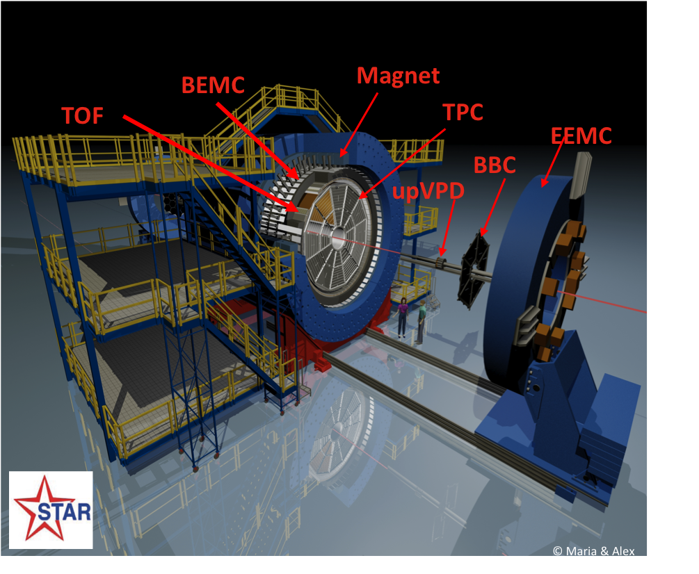
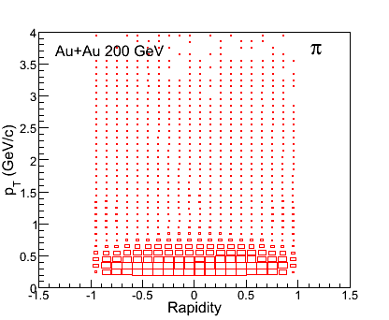
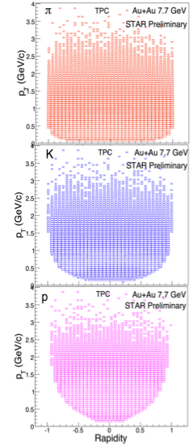
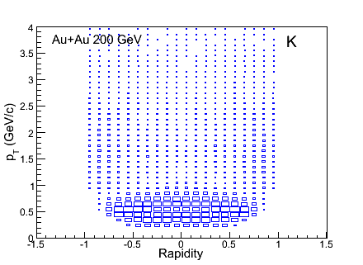
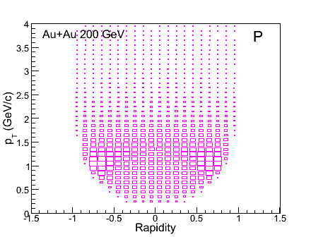
STAR Experiment at RHIC
AuAu 200 GeV
7.7 GeV
Pion
Kaon
Transverse momentum
Proton
Rapidity
Uniform p_{T} and rapidity acceptance
Full 2π coverage
Very good particle identification capabilities
(TOF and TPC)
Important tools
for any fluctuation
analysis

Slide 6
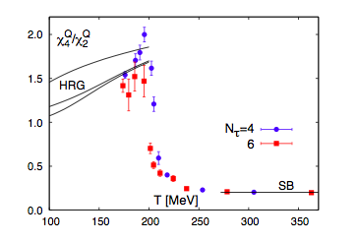

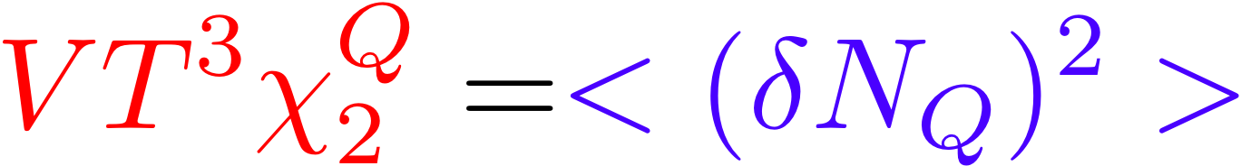

QCD Critical Point
Signature of Critical Point
M. Cheng et al, PRD 79, 074505 (2009)
(Lattice QCD results)
Divergence of the correlation
Divergence of the thermodynamic susceptibility
μ_{B} = 0
(QCD based calculation)
Bridge between
Theory and Experiment
(σ)
(S)
(κ)
Thermodynamic ⬅➔ Moments of the conserved
susceptibility quantities distribution
net-charge, net-baryon and
net-strangeness
Various baseline measurements (Like, Poisson dist., NBD, etc.)
Caveats: finite size and time effect, critical slowing down etc.
Higher moments of the distribution of conserved quantities as a function of beam energy may give signature of Critical Point.

Slide 7
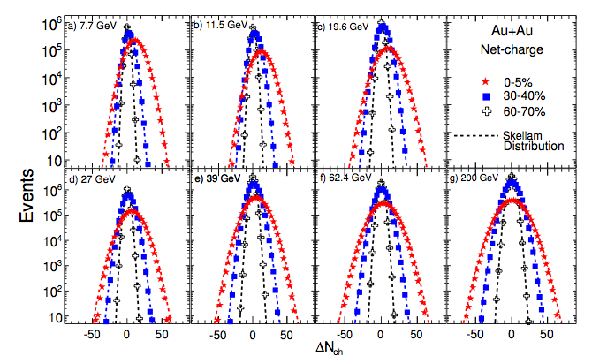
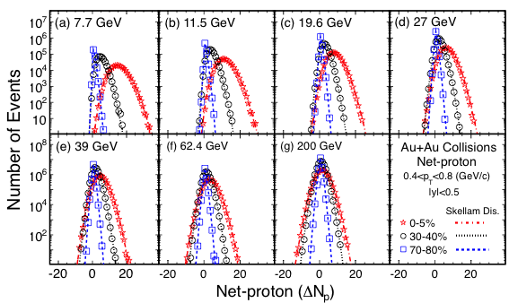
Higher moments analysis: Experimental techniques
Net-proton distribution
Net-charge distribution
PRL 112, 032302 (2014).
Various sophisticated analysis techniques are used
  Extensive event quality assurance
  Centrality Bin width effect
  Efficiency correction of higher moments
Various effects have been studied
  Auto-correlation effect
  Centrality resolution effect
Various baseline measurements including different MC model simulations
Acta Phys.Polon.Supp. 6 (2013) 437-444
Critical Analysis
for Critical Point

Slide 8
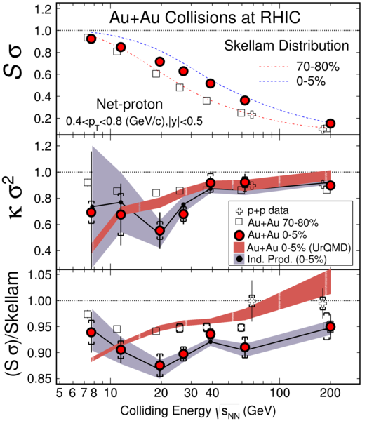
BES Results of Higher moments : Net-Proton
Deviations for both κσ² and Sσ from HRG and Skellam expectations are observed for √s_{NN} ≤ 27 GeV
At low energies, large statistical
error
Various model estimations are compared
  Independent Production
  (no correlation between proton and
  anti-proton)
  UrQMD
PRL 112, 032302 (2014).

Slide 9
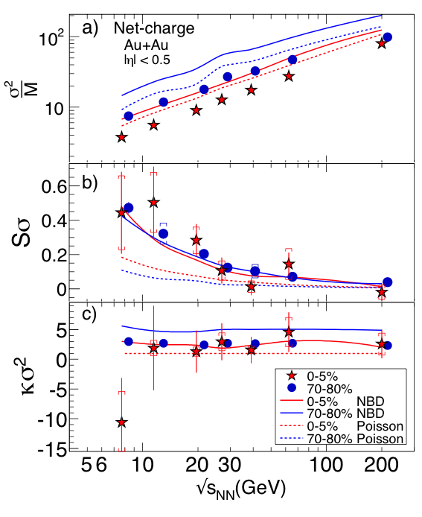
BES Results of Higher moments: Net-Charge
Within the present uncertainty, no non-monotonic behavior is observed as a function of beam energy
More statistics at low energies is needed for better understanding
Baseline measurements have been compared
  Poisson ( input: mean of Pos. and Neg. dist)
  NBD
  ( input: mean and width of Pos. and Neg. dist)
These results can be used to extract the freeze-out parameters by comparing with lattice results
arXiv:1402.1558

Slide 10
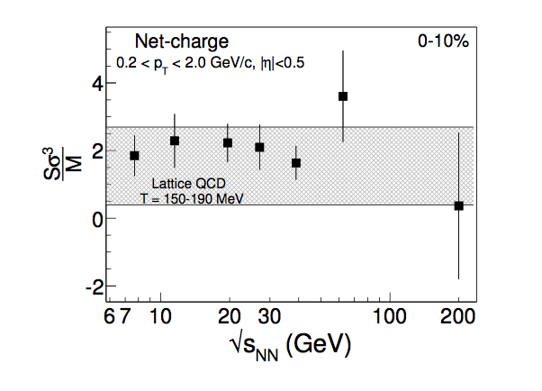
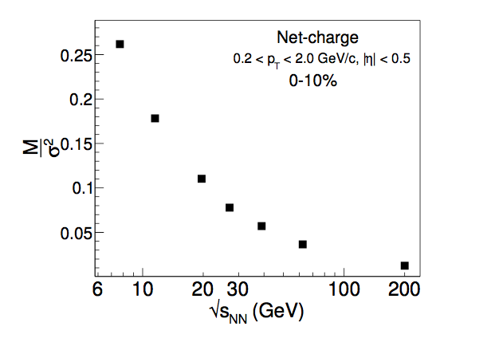
Extraction of Freeze-out parameter
Lattice QCD calculation and Experiment
Thermometer
Baryometer
Recent lattice measurements
  Estimation of T_{f} and μ_{B_f} : comparing experimentally measured
higher moments of Net-charge distribution
( A. Bazavov, et al., PRL 109, 192302 (2012), S. Borsanyi et al., PRL 111, 062005 (2013) , arXiv:1403.4576 )
Exploring more about QCD phase diagram
Sσ³/M : T_{f} lies between 150-190 MeV (with uncertainty)
M/σ² decreases with increased beam energy as μ_{B}

Slide 11
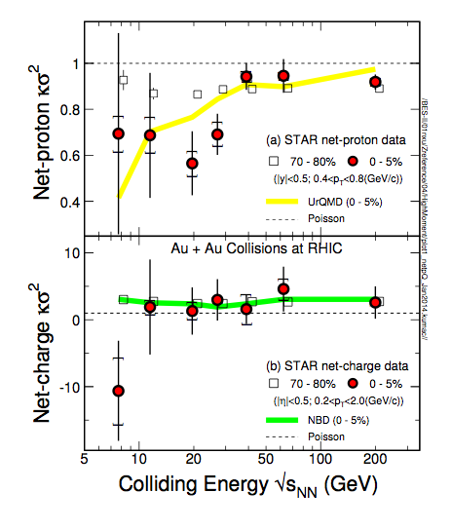
QCD Critical Point vs BES program
Within large stat. uncertainty,
Net-proton
Deviations for κσ² from UrQMD and Poisson expectations for √s_{NN} ≤ 27 GeV
Net-charge
No deviation is observed for κσ²
from NBD and Poisson
Net-kaon (ongoing analysis)
Large statistics is required at low energies
Besides expt. challenges, required more
understanding on
  Various final state effects
  (Resonance decay, diffusion of charge fluct. etc)
  Finite volume and time effect
  Effect of baryon stopping at low energies
  …, etc
STAR white paper on BES-I
Other Observables for Critical Point search ?

Slide 12
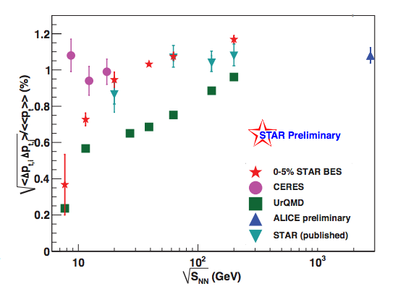

Transverse momentum fluctuation
Two-particle transverse momentum correlation
Related to specific heat of the system
No non-monotonic behavior is observed as a function of collision energy
Two particles p_{T} correlation decreases with decreased collision energy
Rapid increase of p_{T} correlation below 39 GeV and a plateau above it

Slide 13
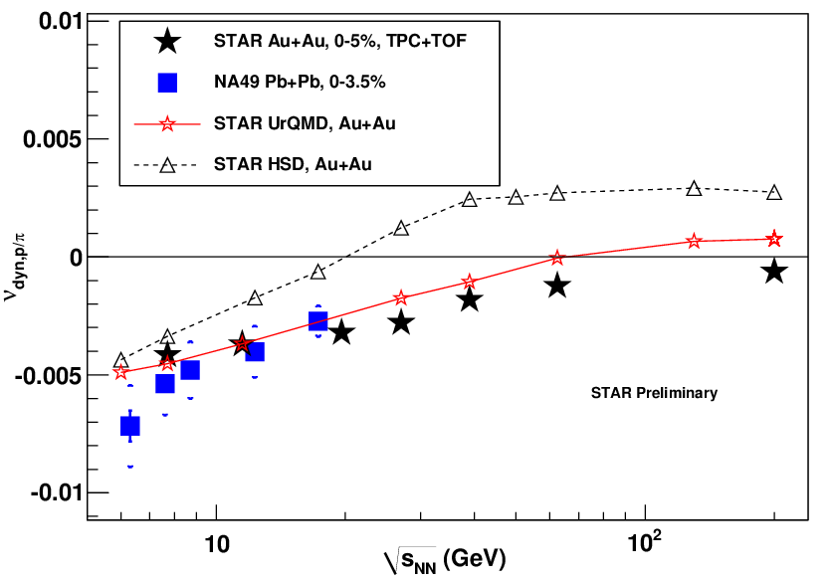
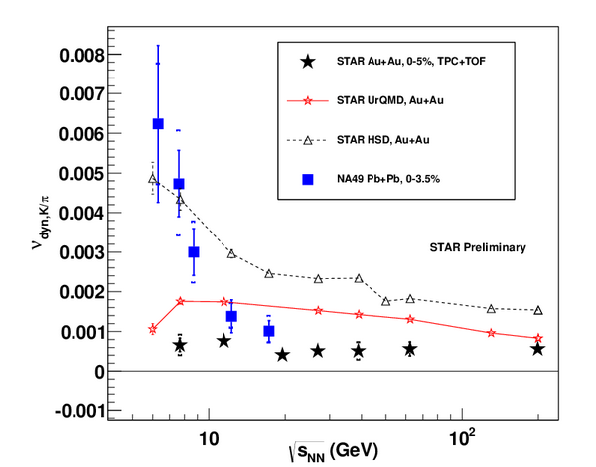
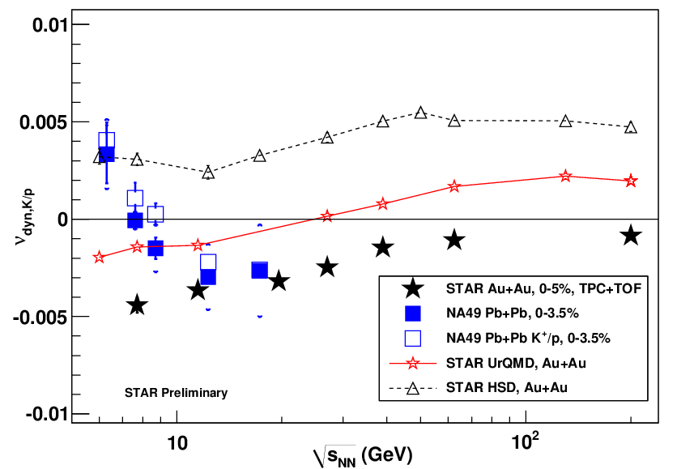
Particle Ratio Fluctuations
ν_{p/π}
ν_{k/π}
ν_{k/p}
Dynamical p/π and k/p fluctuation are negative and decreases with decreased collision energy
Dynamical K/π fluctuation remains independent of collision energy.
No non-monotonic behavior is observed as a function of collisions energy

Slide 14
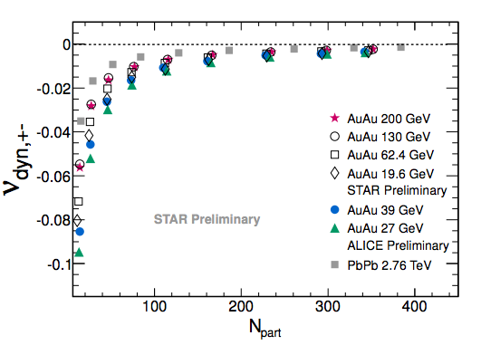
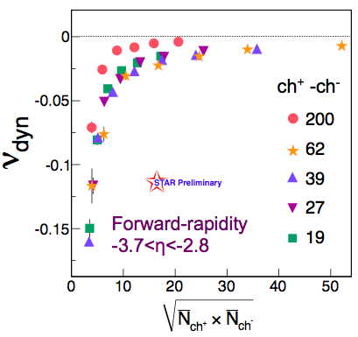
Dynamical charge fluctuation
Mid rapidity: -0.5 < η < 0.5
Forward rapidity: -3.7 < η < -2.8
With decrease in collision energy, dynamical charge fluctuation decreases and becomes more negative
  Correlation between positive and negative charged particles increases with decreased beam energy

Slide 15
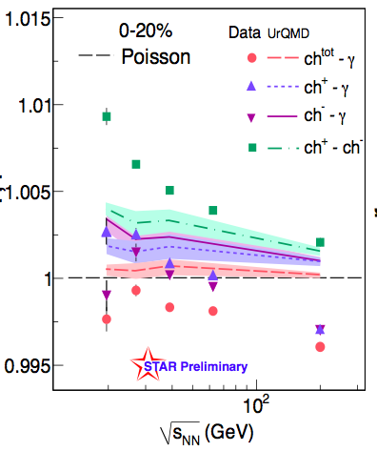
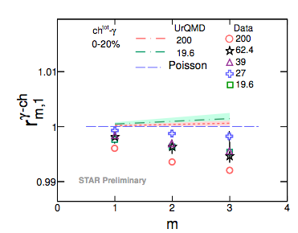
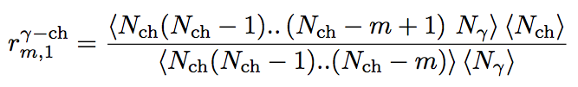
DCC signature
Photons are counted at forward detector PMD
r_{1,1}
DCC signature: presence of very large e-by-e flut. in fraction of π⁰ production
  Photons (ϒ) mostly from π⁰ decay
Anomalous pion production as signature of DCC domain formation
r_{1,1}^{Υ-ch} is a robust variable for DCC search
More systematic study is needed ( on going work)

Slide 16
Where do we stand, so far ?
Observables | Signature of | Observation | Remarks
Net-proton higher moments | QCD Critical Point | Deviation below 27 GeV | Large Statistical Error
Net-charge higher moments |  | No clear deviation | Large Statistical Error
Particle ratio Fluctuation |  | No Deviation | Statistically sound
Two particle pT fluctuation |  | No Deviation | Statistically sound
ν-dynamic : positive-neg. charged particles | QGP | Systematically decrease of dyn. fluc. | Ongoing analysis
ν-dynamic : charge-neutral particles | DCC | No conclusive signature | Ongoing analysis
More statistics is required for the higher moment analysis to close the chapter on Critical Point at STAR Experiment.
(Let’s give one more try!)

Slide 17
Future BES-II program
Collision Energy (GeV) | 7.7 | 9.1 | 11.5 | 14.6 | 19.6
µB (MeV) 0-5% central collisions | 420 | 370 | 315 | 260 | 205
BES-I (10⁶ Events) | 4 | - | 12 | 20 (y2014) | 36
BES-II (10⁶ Events) | 100 | 160 | 230 | 300 | 400
Expected 2018-2019
Detector Upgrades
            iTPC (Rebuilding of inner-sector of STAR TPC)
              Improve dE/dX,
              η coverage (from 1.0 to 1.7)
              accessible for low p_{T}.
            EPD (Event Plane and centrality Detector)
            End-cap Time-Of-Flight (ETOF)
future E-by-E
fluct. Analysis will improve

Slide 18
Summary
STAR experiment has successfully completed BES-I program
With large stat. uncertainty
  Net-proton higher moments show deviation below 27 GeV from
  UrQMD and Poisson baseline
  No clear deviation is observed from Net-charge higher moments
More statistics and energy points are needed for final conclusion on Critical Point
BES-II program with large statistics and detector upgrade
may resolve the clear existence of Critical point in
QCD phase Diagram

Slide 19
Back Up

Slide 20


nu-dynamic
Where M and N are multiplicity of different particles species.
Two particle p_{T} correlation

Slide 21
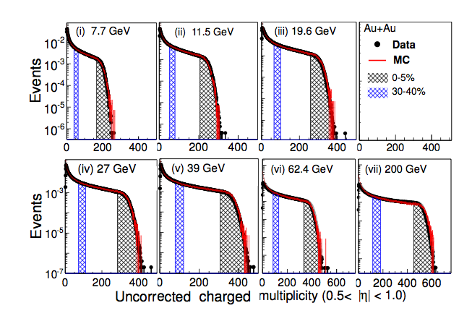
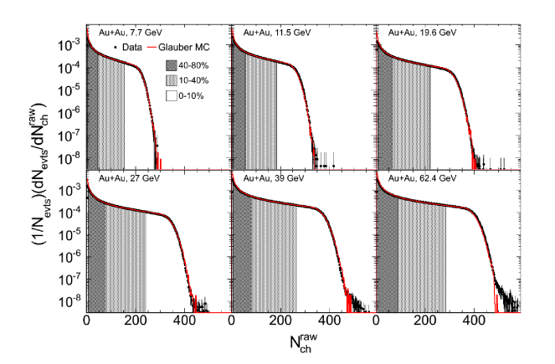

Slide 22
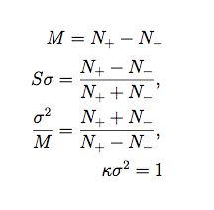

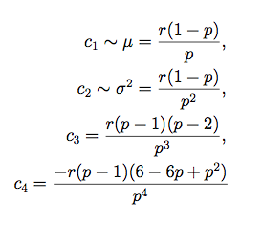

Baseline measurement for Net-charge higher moments
Poisson Dist.
Negative Binomial Dist.
(Mean of the dist. as input)
(Mean and width of the dist. as input)
Assuming Positive and Negative charged particles distribution are independently Poisson NB distribution
Poisson distribution: Statistical distribution no physics
NB distribution: mean and width give information about the
correlation between the multiplicity

