Slide 1
PLT DAQ
W. Johns for the Lumi DAQ workshop
Oct 15, 2013

Slide 2
System Readout overview
VME
Detector:
16 “pixel” chnls
48 Fast-Or chnls
(Fast-Or prop to # hits)
Standard pxlFED
Slink
Up to 70 kHz
SLC-5 (SC1425) Fedstreamer
(10 kHz is our usual Max)
pltFED
pltFED
-Histogram Readout via VME every
4096 orbits to disk
-Same histo system was used for
the BRM electrical pltFED
-Provides integrated hit coincidence
BX by BX integrated 4096 orbits
-Other VME info readout less often and with much less size (~GB/day)
Data Rates:
Histograms:(about 60GB/day uncompressed)
-> 640 kB/s (compress 320 kB/s)
Slink: ~2MB/s for every 10kHZ (50 GB/day)
Scaler info: 30 GB/year
Status info: 10 GB/year
Transparent Histo Data: 1TB/year

Slide 3
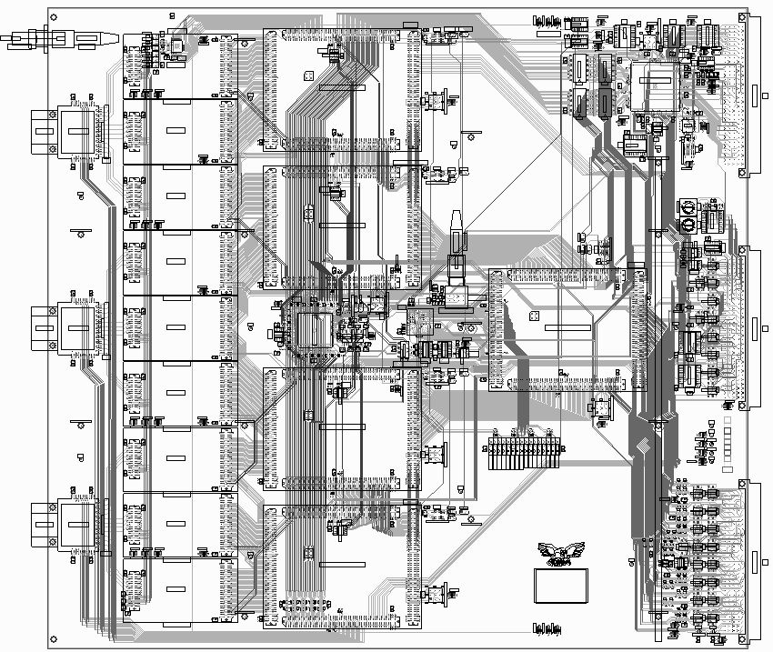
PLT FED
Vienna Pixel FED
9U VME card
36 input channels
24 used for PLT
ADC every BX
Continuous Histogram
Fast Trigger
(BRM uses electrical version (no opto input)
Internal self tester with video DAC

Slide 4
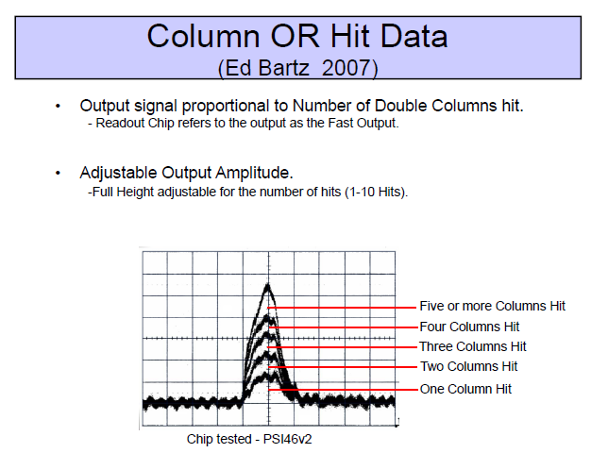
Input to PLT FED
Only consider
these

Slide 5
PLT Cell of 3 channels (TELESCOPE) (PLT Telescope coincidence 8/FED)
VME
DC, Phase
& Timing
adjustment
a
3964 BX x 14 bit
X12 optical receiver
(some DC
adjust)
ADC
Baseline
Adj
Level Det
(0,1,2)
DC, Phase
& Timing
adjustment
b
Coincidence:
Minimum of (a,b,c)
Baseline
Adj
Level Det
(0,1,2)
Swap every
4096 Orbits
ADC
DC, Phase
& Timing
adjustment
c
ADC
Baseline
Adj
Level Det
(0,1,2)
3964 BX x 14 bit
Fast trigger
Fifos for calibrating
inputs, spy capture
TTCrx: L1A, Resync,
BX, OC0
Can get Clock, orbit and start from TTCci or VME Aux backplane

Slide 6
2012 Developments etc.
(BRM) operation was to restart at Prepare Ramp and Flat Top
  Send start signal via TTCci
    also reconfigure TTCci 1st (had problems if we didn’t)
  Histogram memory is read from VME to files
    4096 swaps of 4096 orbits (except new file at midnight)
    Orbit, time marker in data
    PLT uses trigger to alignment data from Histo and Pixel FEDs
  Sync to HF BGO for Start (not tested, hardware @P5)
    Resets counters -> Creates new files for Lumi (flag in data to mark new start)
    “new” module took HF signal and transmited it to pltFEDs
      Will a Start/Restart signal work in the new Lumi-DAQ?
      Any instance where the start nibble ! = 0?

Slide 7
2012 BRM Histo Data Format
File name has human readable filename time
  E.g. Data_Histogram_20131014.225124.dat
  Each 4096 orbits:
    milliseconds since midnight
    #orbits since start (32 bits)
      Histogram Ch #, BX Data payload:3664 words x 32 bits
        Can reduce the payload to 14 bits/word
Should be easy to modify for the new format
  Fill, Run, Nibble, section, time
  Retask dedicated board for new words
    PLTFeds can stay the same

Slide 8
PLT Fast Trigger Setup for data
V1495
OR
Of
Triples
- Use TTCci software triggers
for calibration
- Can also use TTCci to trigger on specific BX(s)
E
Fast-Or
Fast-Or
Fast Or
Triple
Coincidences
Ribbon Cable
Pixel
Pixel FED sets TTs signals Based
On its state: fifo’s almost full?
Events in sync? Also, TTs state
can be set in VME
SLINK
TTs
RJ45
TRIG(IN)
TTCci
TRIG(OUT)
L1A 0
Trigger will be transmitted
Only in READY state (but switch
Settable)
TTs
RJ45
BUSY
READY
WARN
OOS

Slide 9
2013?
Global coincidence info in the 1476
  Have all 16 channels of 3-fold fast-or coincidences
  Can do zero-counting by BX (D.S. suggestion)
  Can do lots of checks with scalers
  No firmware exists at present
  “zeros” histogram -> 20 kB/s
Global coincidence info in the PLTFed
  Have 8 channels of 3-fold fast-or coincidences
  Can do zero-counting by BX (D.S. suggestion)
  Can do lots of checks with scalers
  No firmware exists at present
  “zeros” histogram -> 40 kB/s

Slide 10
Wrap Up
PLT DAQ used well proven and “simple” setup to take data
  Pixel system REALLY tested well
    SEU etc. are rare compared to pixels (much fewer channels) and ok for us to stop triggers longer
    Longer term FedStreamer problem due to RAM blocks not released
      Fixed in next OS?, we rebooted to fix it
  pltFED system tested in BRM application
    Ran for weeks without intervention
      Just need to move the data
      Good to have clear restart procedures in place
    Emphasis is on simplicity and primary local storage

