Slide 1
Drive Beam injector front end developments
DB injector introduction
Status of Hardware design,
Klystron, SHB-buncher,Pre-buncher, Gun
Gun Test Facility

Slide 2
CLIC DB front end,
Post CDR Project
Modulator-klystrons, 1 GHz, 15 MW
500 MHz
Diagnostics
Gun
SHB 1-2-3
PB
Buncher
Acc. Structures
~ 140 keV
~ 3 MeV
~ 12 MeV
For time being only major component development:
GUN, SHB, high bandwidth 500 MHz source, 1 GHZ MBK, modulator and fully loaded accelerating structure

Slide 3
CLIC DB injector specifications
Parameter | Nominal value | Unit
Beam Energy | 50 | MeV
Pulse Length | 140.3 / 243.7 | μs / ns
Beam current | 4.2 | A
Bunch charge | 8.4 | nC
Number of bunches | 70128
Total charge per pulse | 590 | μC
Bunch spacing | 1.992 | ns
Emittance at 50 MeV | 100 | mm mrad
Repetition rate | 100 | Hz
Energy spread at 50 MeV | 1 | % FWHM
Bunch length at 50 MeV | 3 | mm rms
Charge variation shot to shot | 0.1 | %
Charge flatness on flat top | 0.1 | %
Allowed satellite charge | < 7 | %
Allowed switching time | 5 | ns

Slide 4

CLIC drive beam injector layout
Solenoids
Thermionic gun
SHB
Prebuncher
Buncher
Accelerating cavity
140 KeV
6 MeV
Slit
26 MeV
53 MeV
Quadrupole
Bend

Slide 5
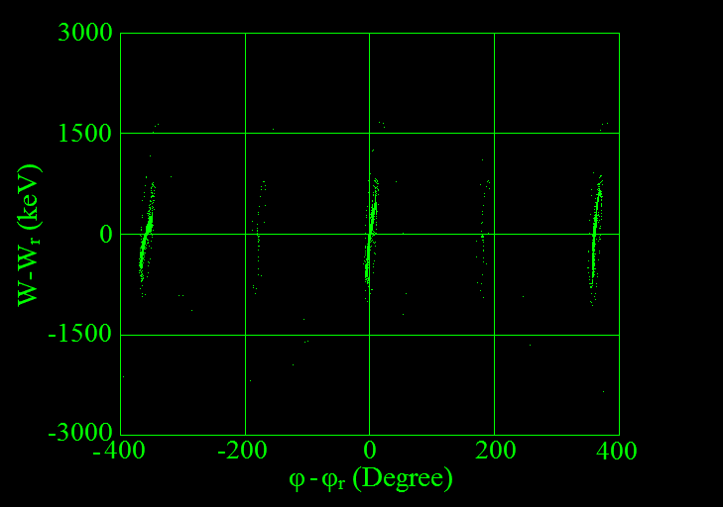
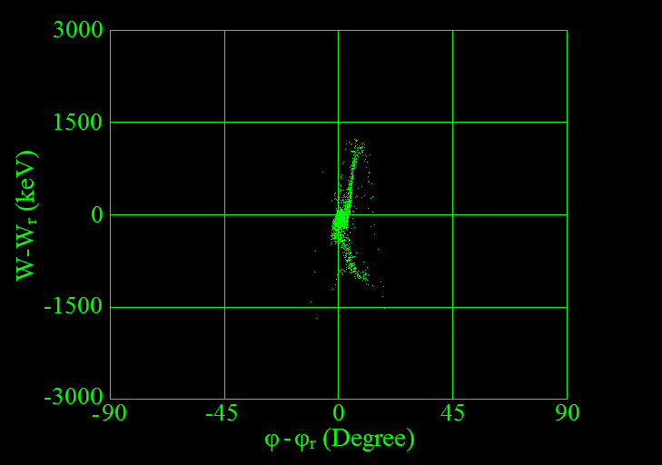
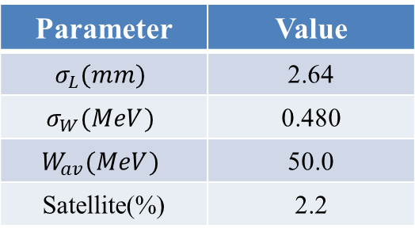
DB injector optimization
phase space after TW buncher
Final phase space at 50 MeV
Parameter | Value
$$σ_{L}(mm)$$ | 2.64
$$σ_{W}(MeV)$$ | 0.480
$$W_{av}(MeV)$$ | 50.0
Satellite(%) | 2.2
Satellites and total losses significantly reduced !
Shahin Sanaye Hajari, IPM

Slide 6
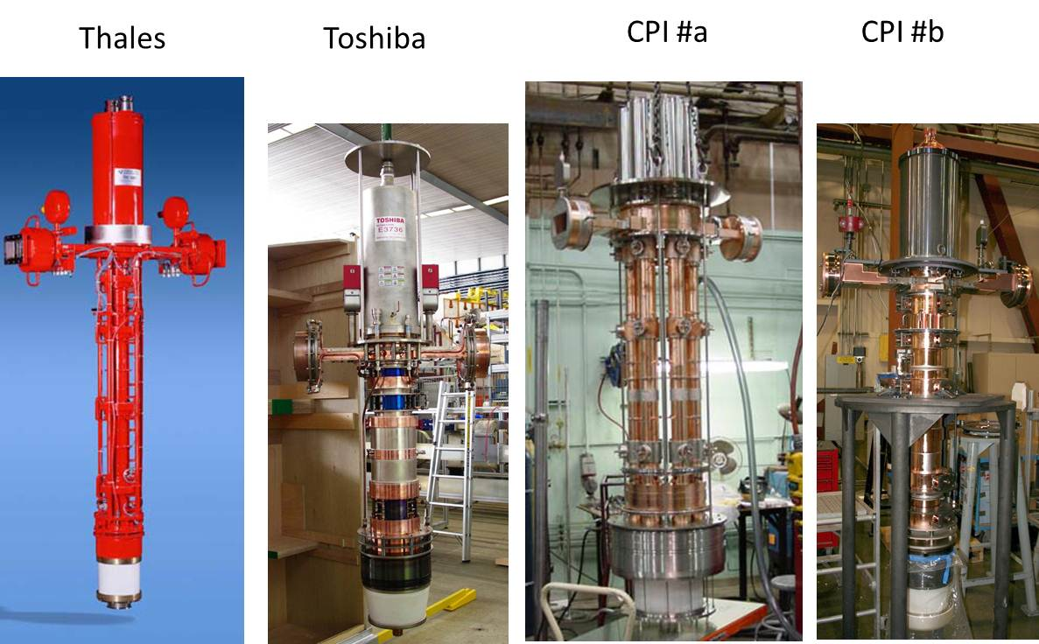
Tentative klystron
parameters
PARAMETER | VALUE | UNITS
RF Frequency Bandwidth at -1dB RF Power: Peak Power Average Power RF Pulse width (at -3dB) HV pulse width (at full width half height) Repetition Rate High Voltage applied to the cathode Tolerable peak reverse voltage Efficiency at peak power RF gain at peak power Perveance Stability of RF output signal at nominal working point RF phase ripple [*] RF amplitude ripple Pulse failures (arcs etc.) during 14 hour continuous test period Matching load, fundamental and 2nd harmonic Average radiation at 0.1m distance from klystron Output waveguide type, | 999.516 ≥ 1 ≥ 20 150 150 165 50 tbd, ≤ 180 tbd 67 ≤ 70 tbd, > 48 tbd ±1 (max) ±1 (max) < 1-2 tbd < 1 WR975 pressurised | MHz MHz MW kW μs μs Hz kV kV % dB μA/V^{1.5} RF deg % VSWR μSv/h 2-3 bar
Status: First Contract under negotiation with Thales

Slide 7
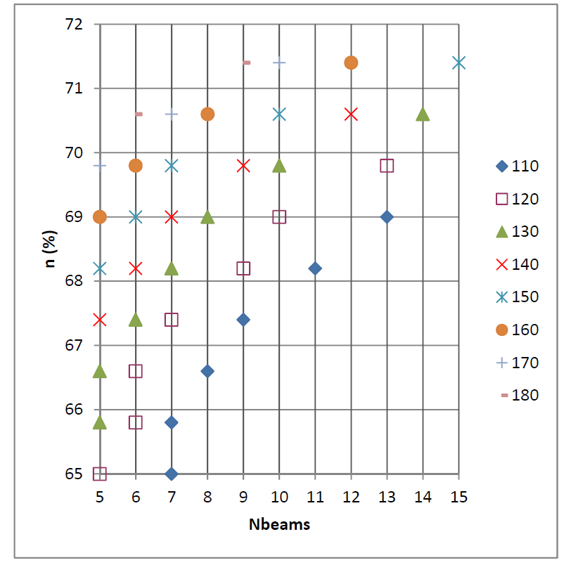
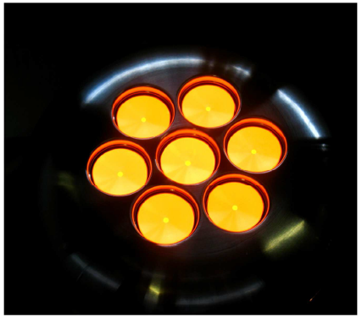
Tentative klystron
parameters
Efficiency for 20 MW for different voltages (Thales study)

Slide 8
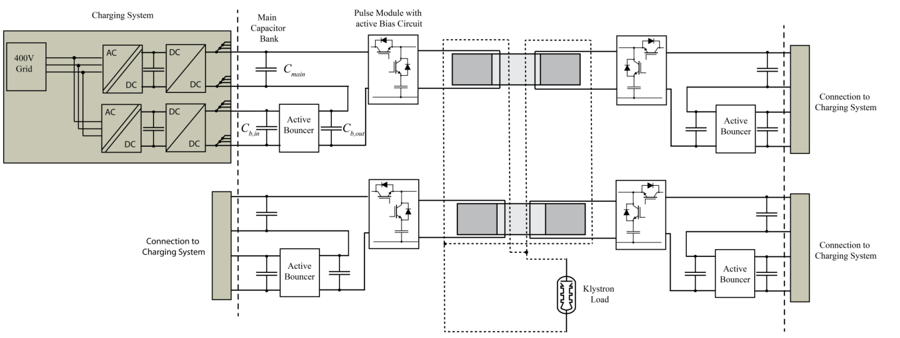
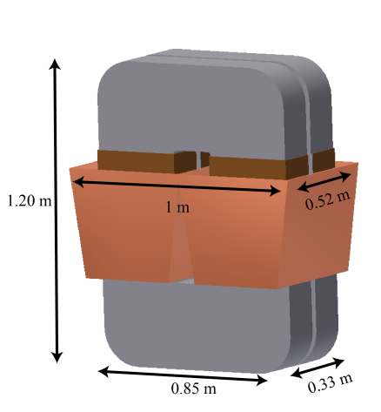
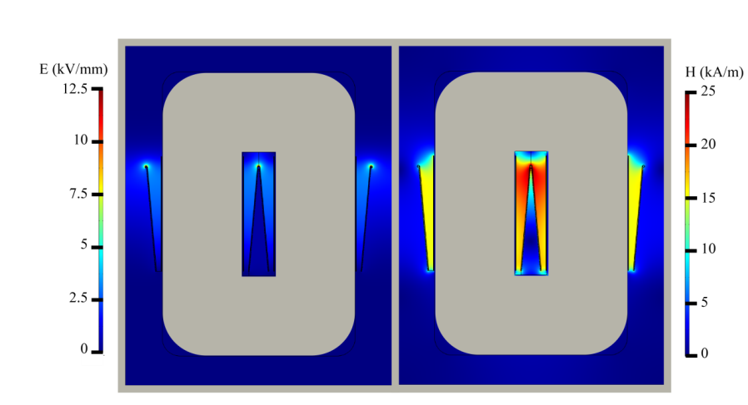
Modulator design advancing well
ETH: Topology defined-matrix transformer based
Pulse transformer design almost finished
Expected prototype beginning 2014
Active bouncer theoretical design almost finished – construction in 2014
Davide Aguglia

Slide 9
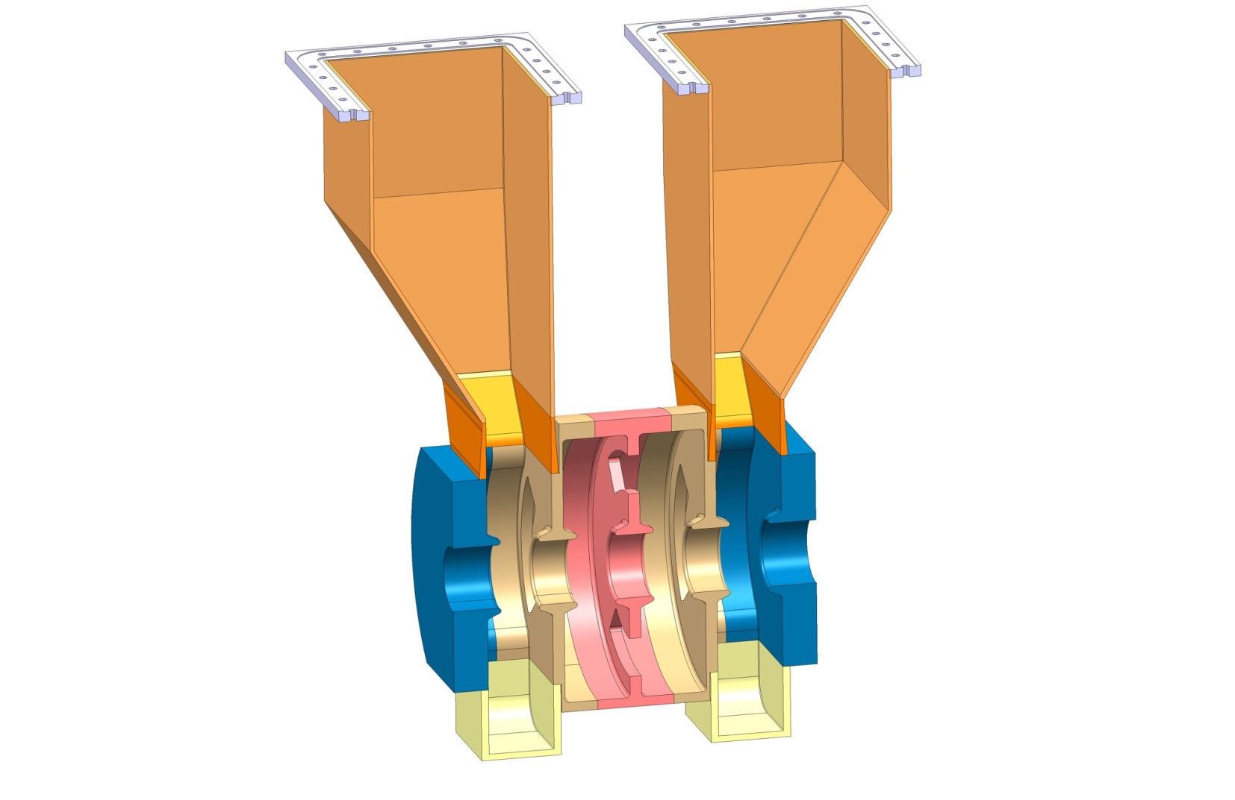
Sub-harmonic bunching system
Status:
RF design existing, mechanical design advanced,
Discussion with CERN work shop on realization
Power source:
500 MHz, 15-115 kW, wide band (60 MHz) sources needed for fast phase switching.
Solid state favored
Started to discuss with industry and collaborations.
 | SHB 1 | SHB 2 | SHB 3
Beam velocity | 0.62 c | 0.62 c | 0.62 c
Current | 5 A | 5 A | 5 A
Voltage | 15 kV | 30 kV | 45 kV
Bunch form factor | 0.058 | 0.57 | 0.73
Detuning | 1.6 MHz | 12.1 MHz | 12.7 MHz
Hamed Shaker, IPM

Slide 10
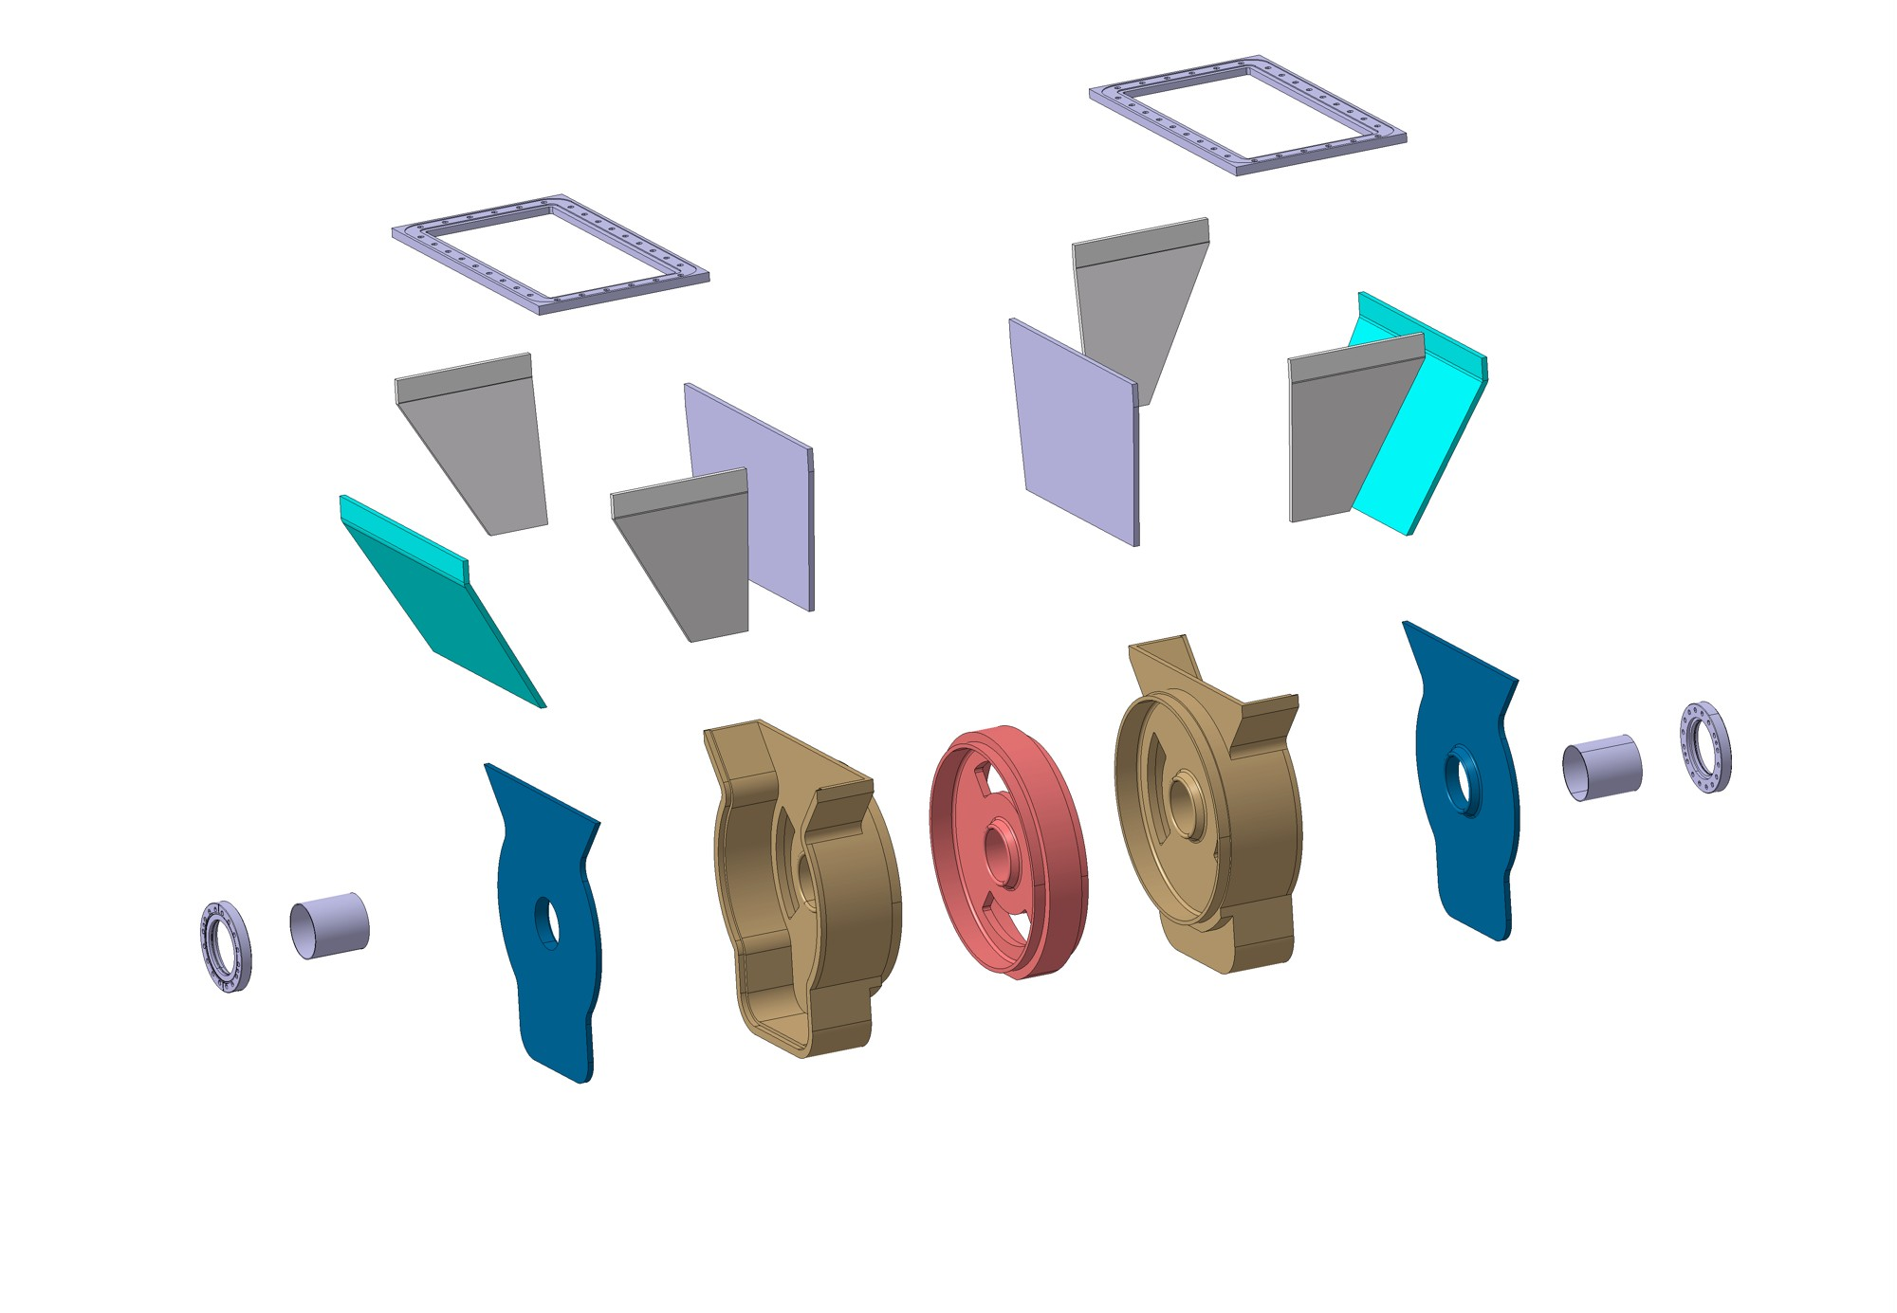
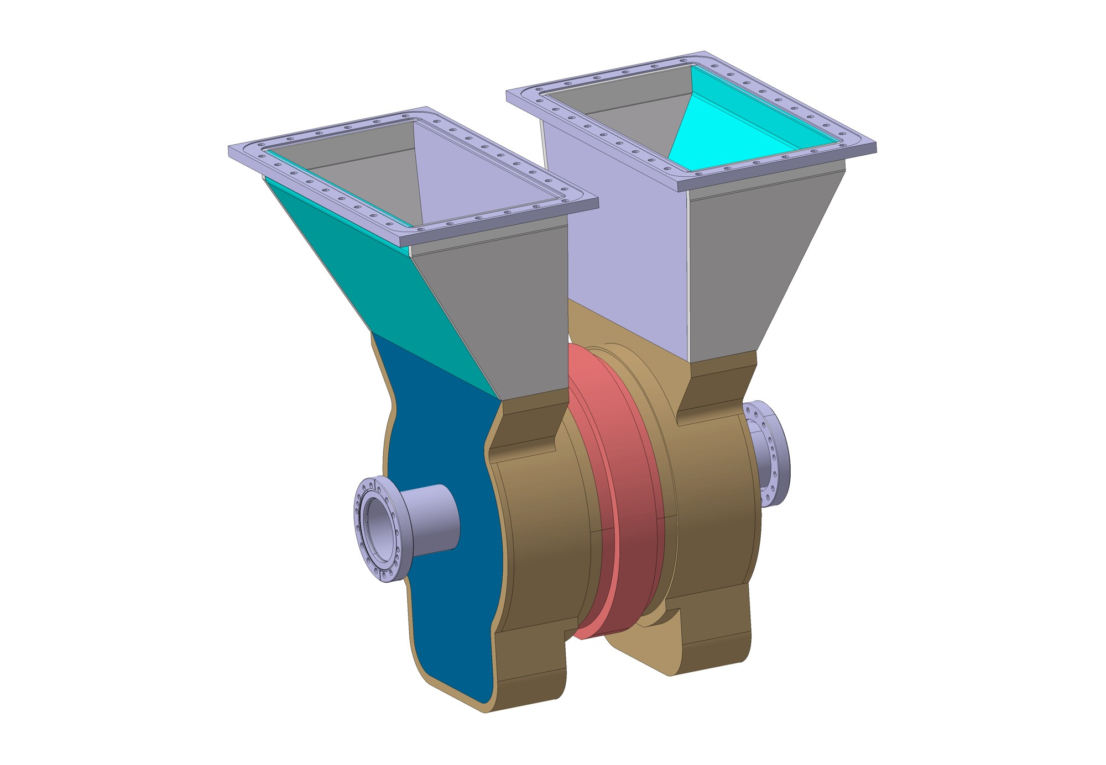
Sub-harmonic buncher design
Raphael Leuxe

Slide 11
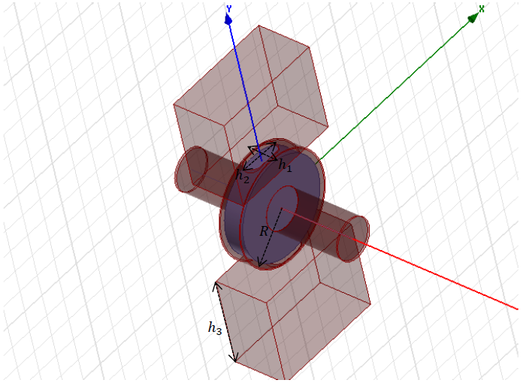
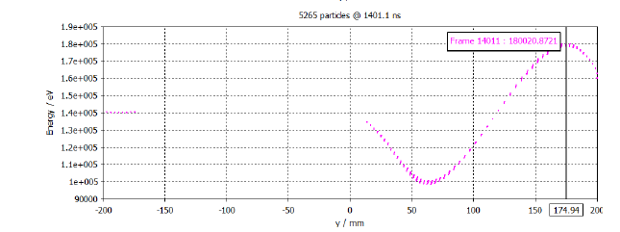
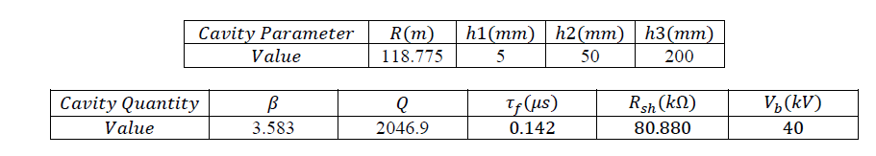
Pre-buncher design
About 100 kW of power needed for the pre-buncher with beam loading
Mohsen Dayyani Kelisani, IPM

Slide 12
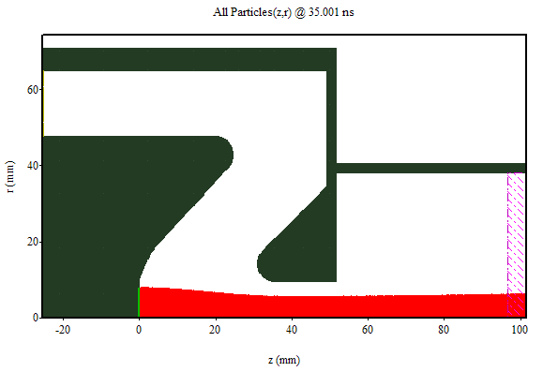
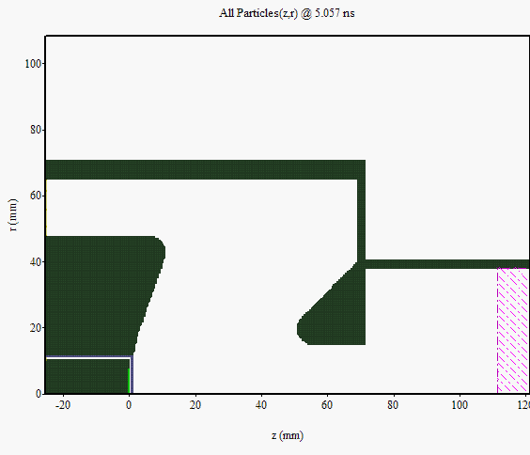
DB gun simulations
Contour plots of field components at t=35ns
Typical MAGIC snapshot: particle positions in r-z
Jacques Gardelle, CEA-CESTA

Slide 13
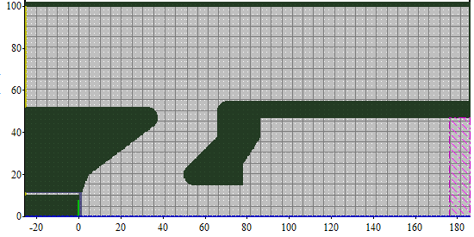
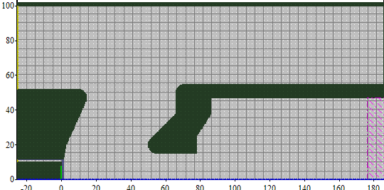
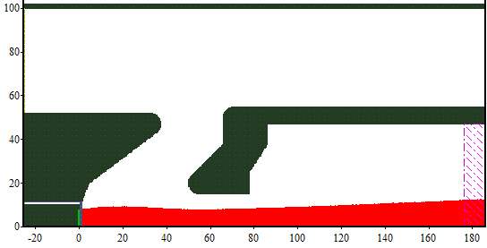
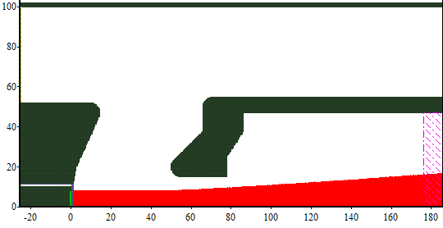
DB gun simulations
Small cathode
new geometry dak 50mm
r_{rms} = 8 mm
ε_{x,rms} = 14 mm.mrad
r_{rms} = 10,5 mm
ε_{x,rms} = 10 mm.mrad
α₁ = 62,5 °
α₂ = 35°
α₁ = 67,5 °
α₂ = 65°
Jacques Gardelle, CEA-CESTA

Slide 14

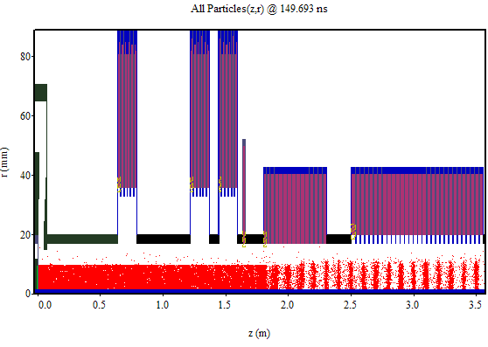
CTF 3 benchmark simulations
using MAGIC
« Front-end Drive beam injector » CTF3
Jacques Gardelle, CEA-CESTA

Slide 15
CTF 3 benchmark simulations
Jacques Gardelle, CEA-CESTA

Slide 16
Drive Beam gun simulations
Large cathode: 140 kV, 10 mm cathode, 5 A, 50 mm
Comparism with MAGIC (blue)
Emittance: Magic: 14.5; EGUN : 20-27 (depending on number of rays)
Same result after changing the anode aperture to 15 mm

Slide 17
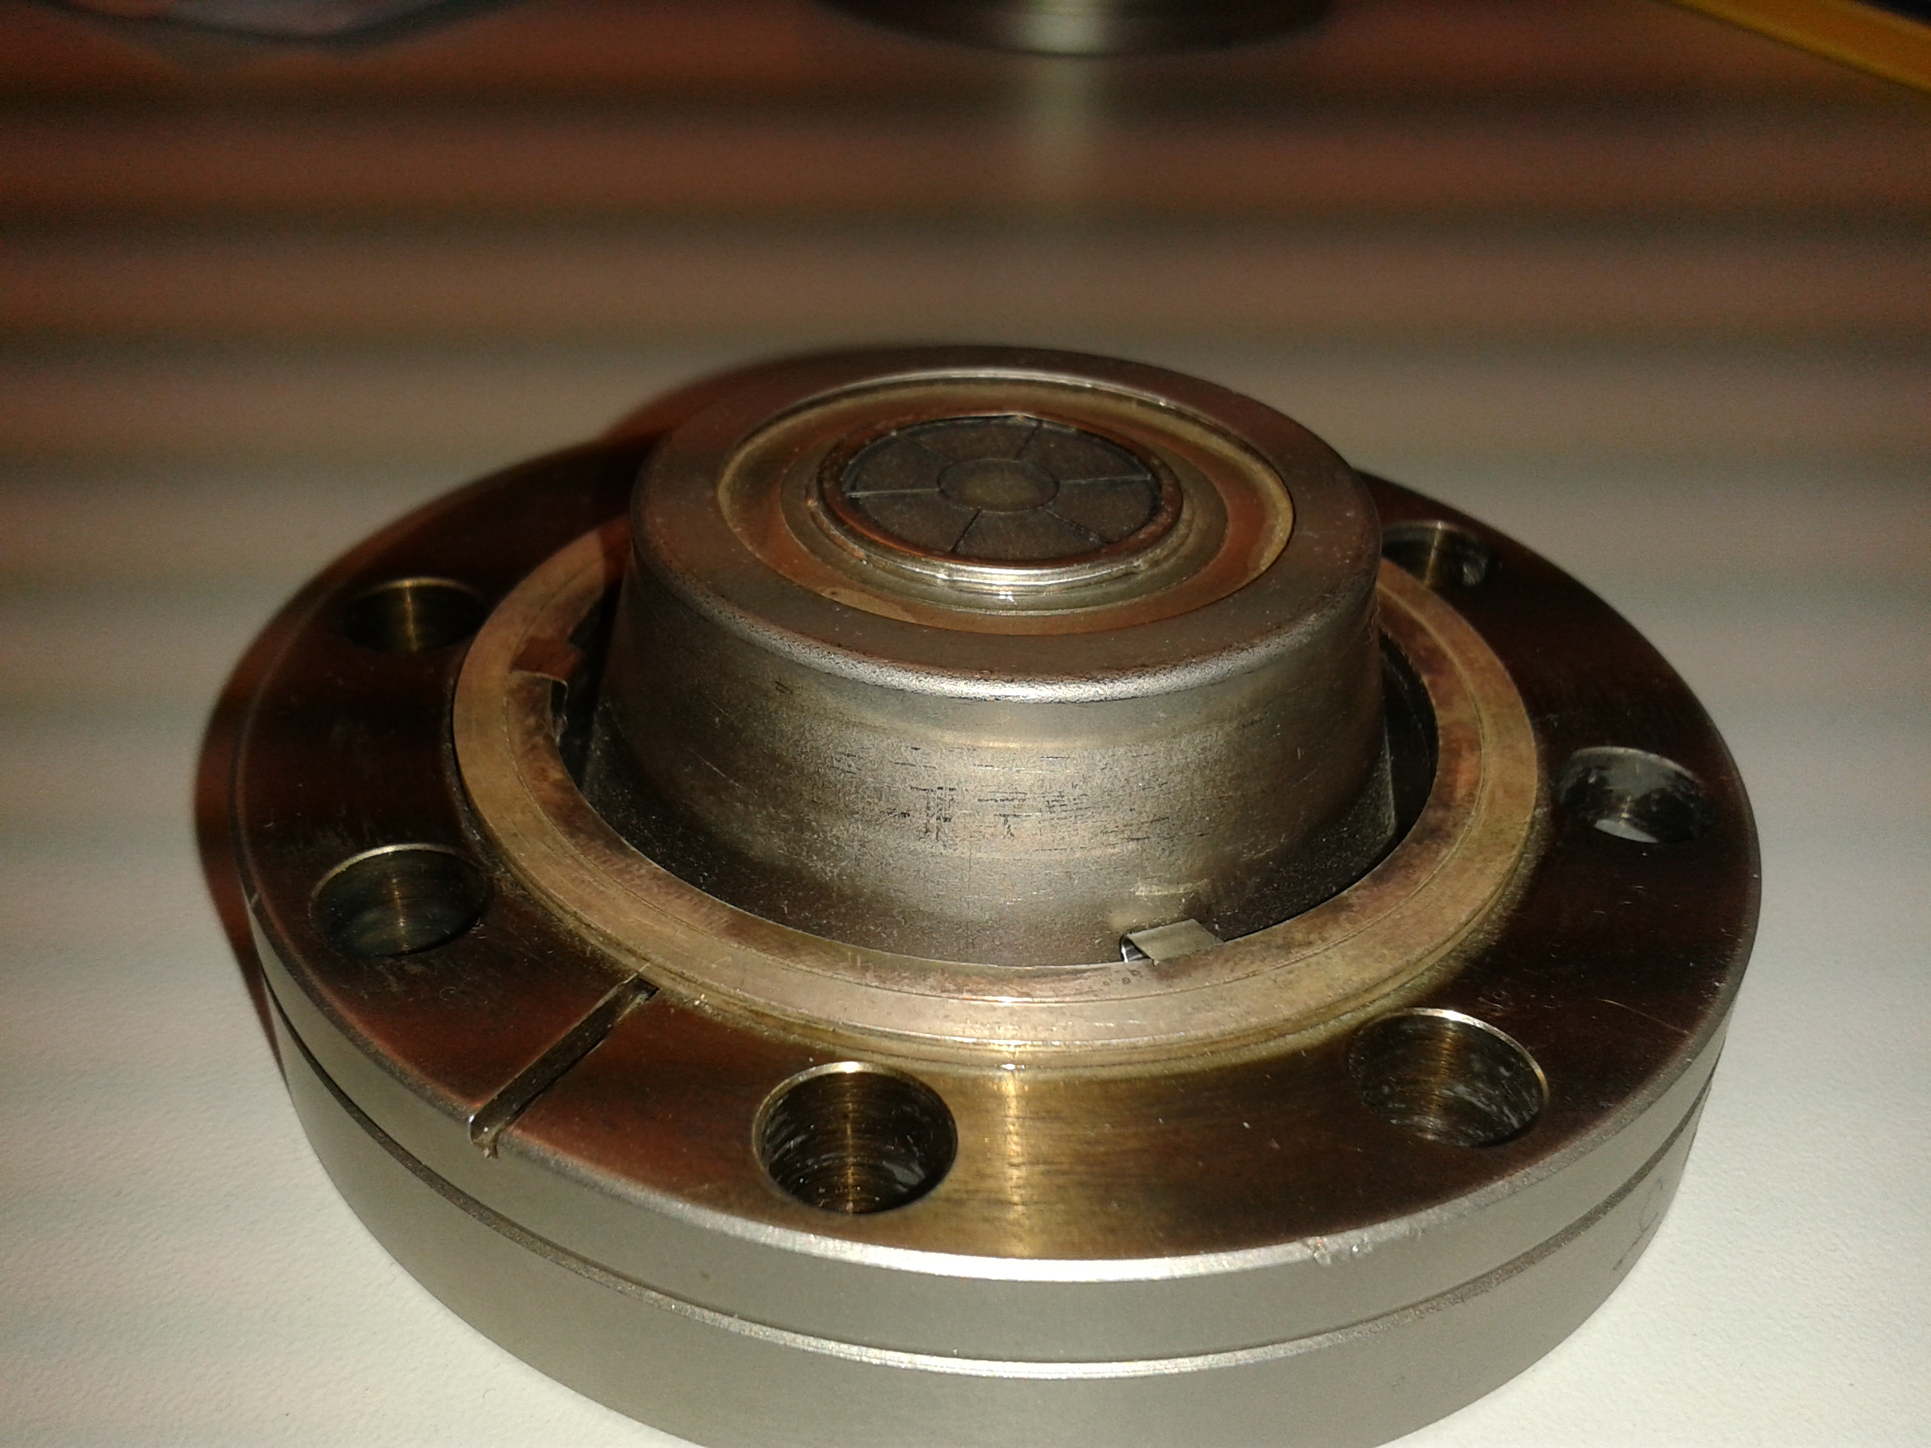
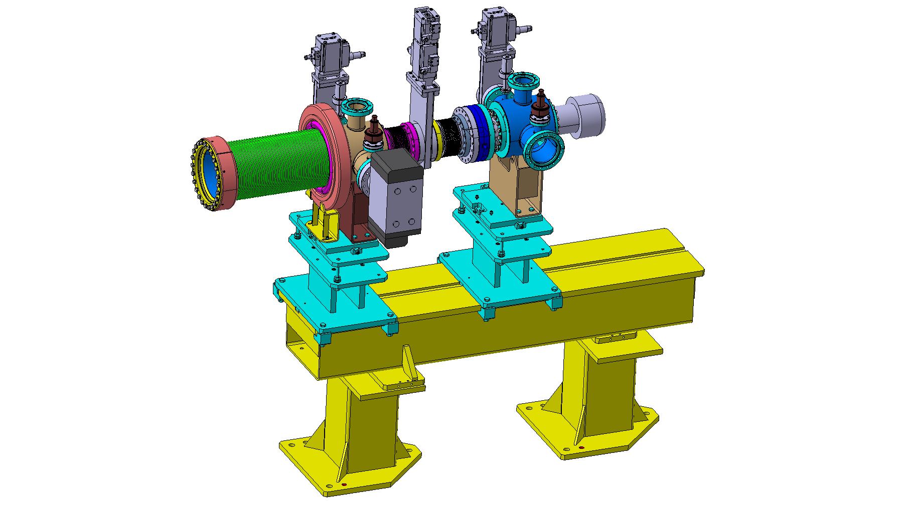
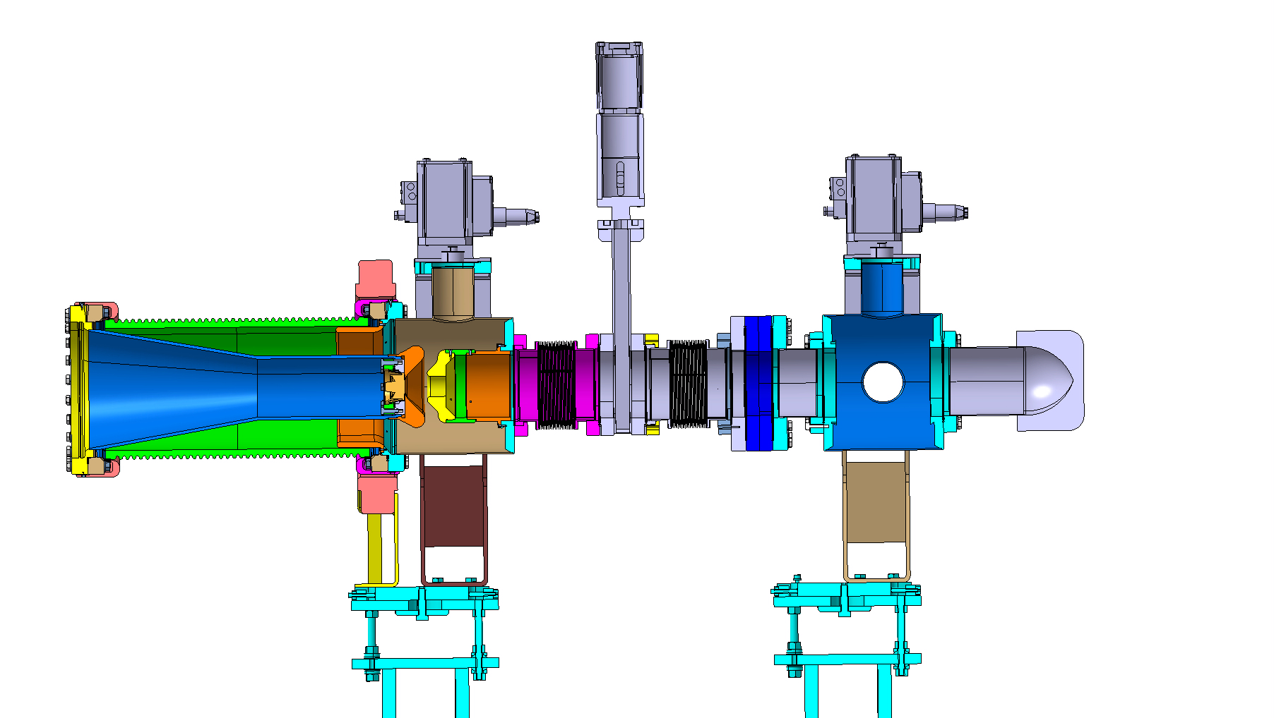
Thermionic Gun design

Slide 18
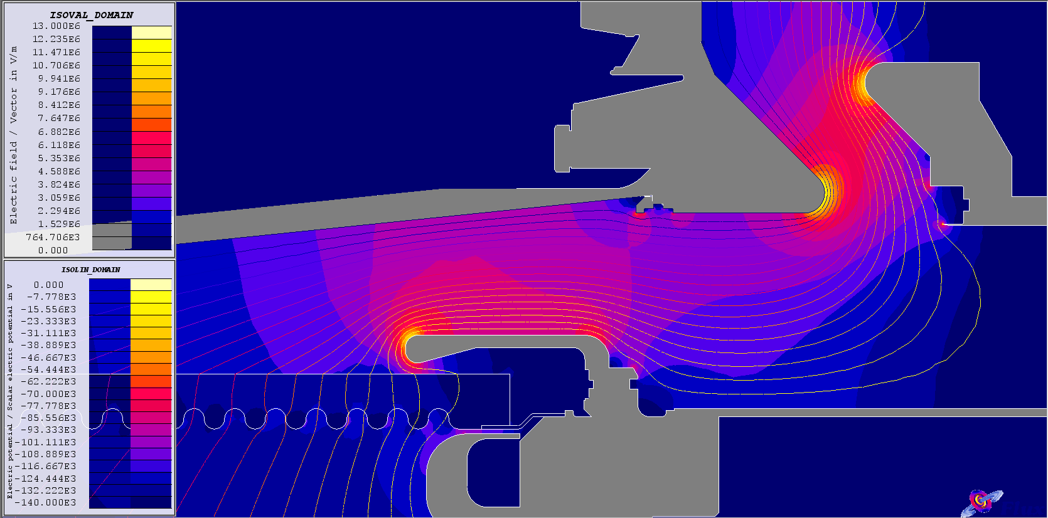
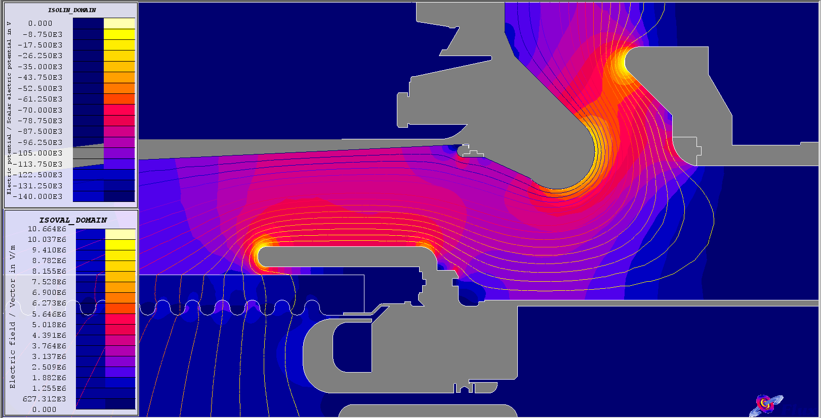
Thermionic Gun design
B. Cadilhon,
CEA-CESTA

Slide 19
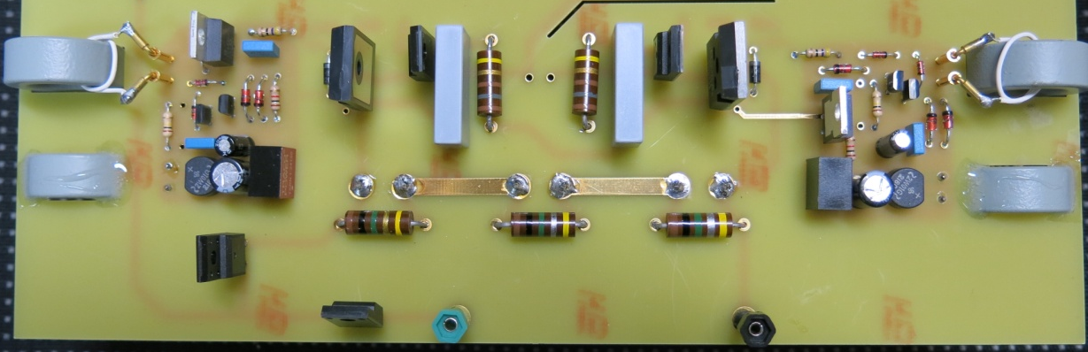
HV Modulator status
CEA/CESTA
Modulator based on a Marx structure with two 1700V IGBTs/cell
First prototype performances objective (for summer 2014)
    Output voltage range : 0 to -30kV
    Output current range : 0 to 10A
    Pulse width (on top) : 150µs
    Flatness of the top : ~ 1-2%
    Rep. rate : 10Hz
One of the key points of the modulator is the IGBTs driving circuit :
→ first we decided not to use fiber optics to trigger the IGBTs
→ technical solution with ferrite cores seems to be robust (under tests)
Schematic of a Marx cell
Photography of a 1.5kV Marx cell prototype
First experimental tests
on a 4 cells Marx prototype
Bruno Cassany, CEA-CESTA

Slide 20
Energy deposition in a beam dump
by the 140 keV beam
Material | Max. Energy to stay solid
Aluminium | 836 J.g⁻¹
Cuivre | 522 J.g⁻¹
Titane | 1023 J.g⁻¹
Graphite | 2715 J.g⁻¹
Kevin Pepitone, CEA-CESTA

Slide 21
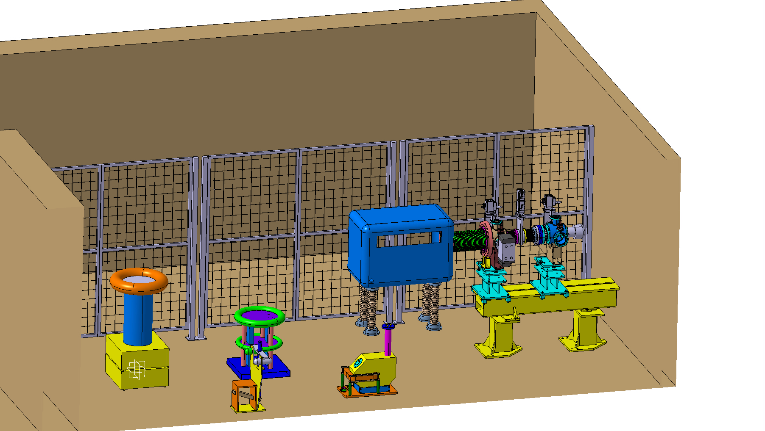
Gun Test Facility

Slide 22
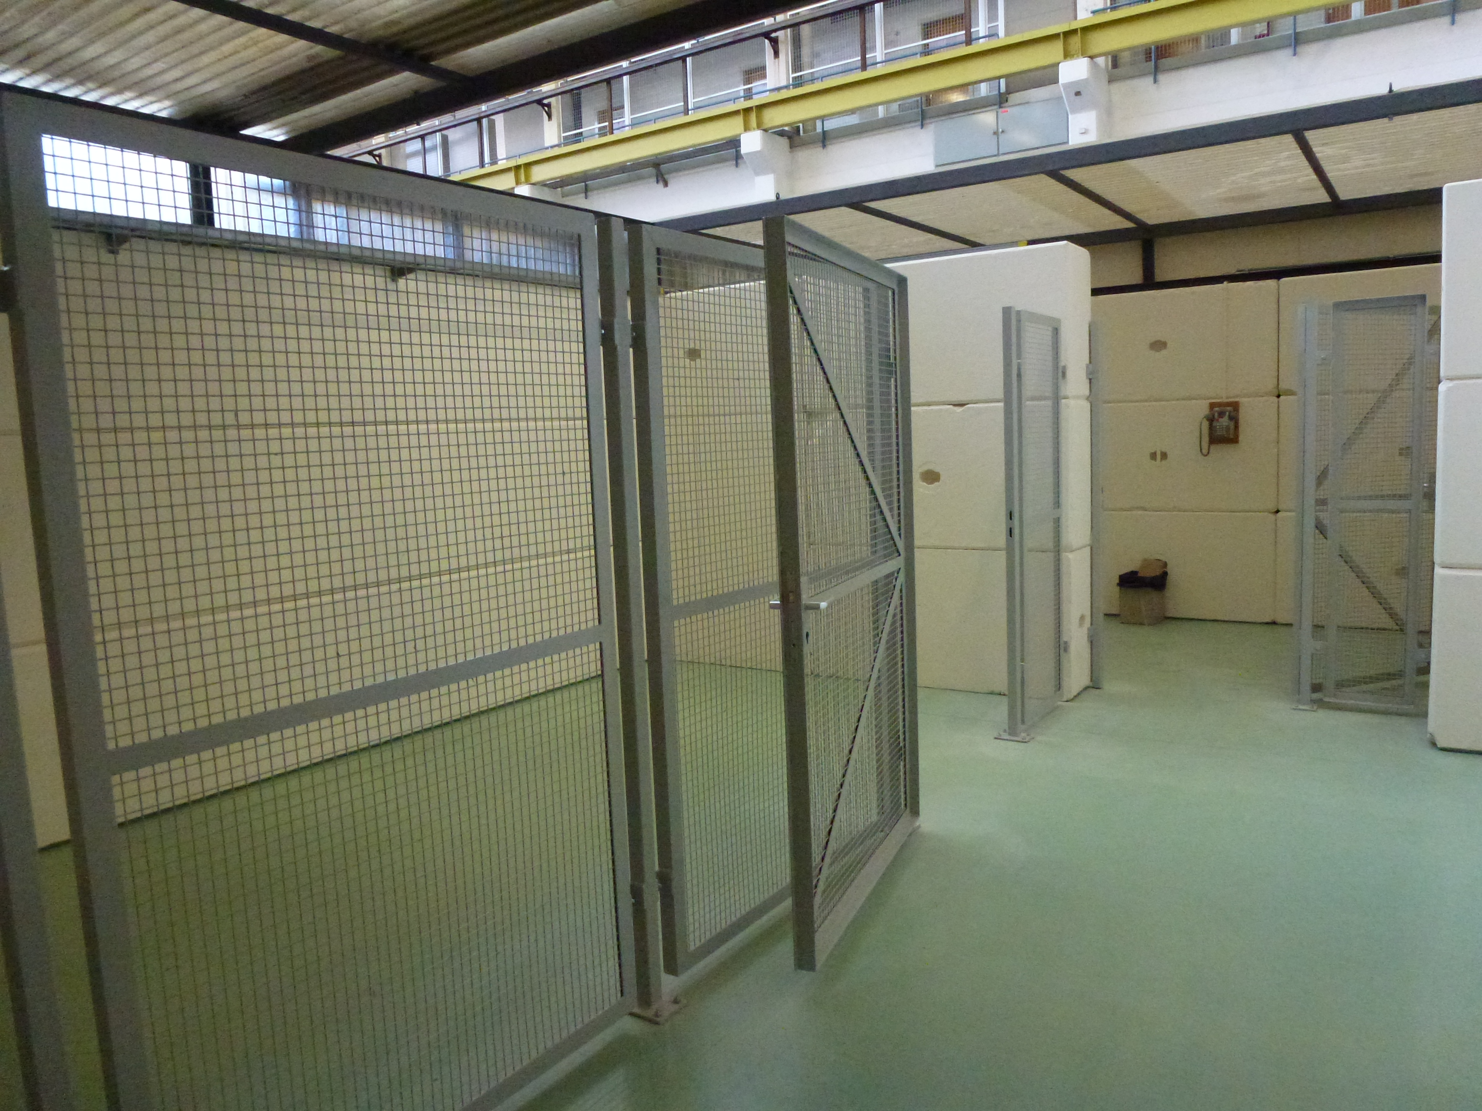
Gun test facility

Slide 23
Conclusion and Outlook
Challenging Drive beam frond project
Key elements under design or manufacturing ,
nice progress
Large collaborative effort
Hope to get some ‘real’ CLIC drive beam hardware to test in 2014

Slide 24
End

Slide 25
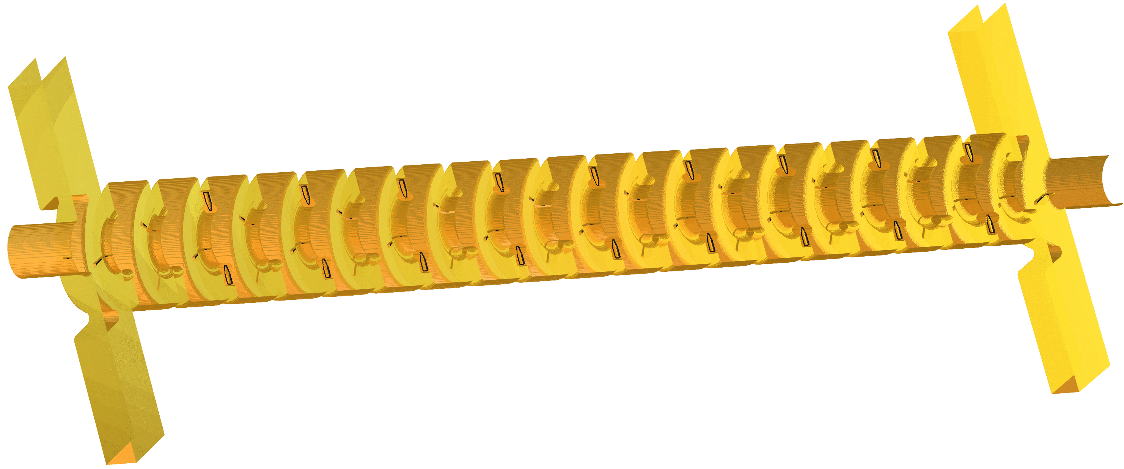
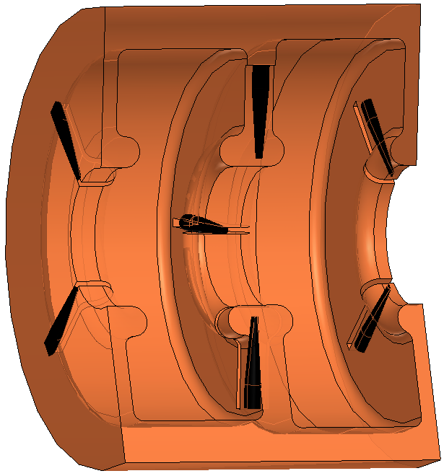
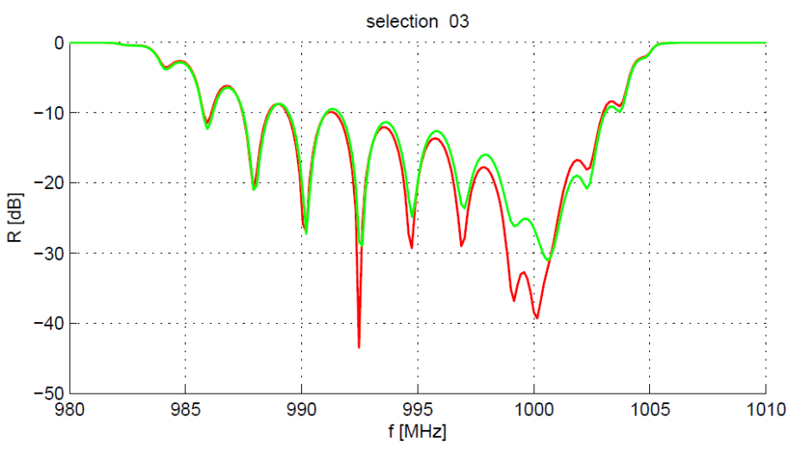
DB-accelerator structure
RF-design existing,
next steps: mechanical design and prototype
Input and output coupler design finished
Correct match, input reflection < 30 dB.
(red and green: two different geometries; red is final)
Rolf Wegener

Slide 26
Calculs du canon proptotype CLIC0/ADELE
géométrie SLAC

Slide 27
Large cathode
new geometry dak 50mm
α₁ = 52, 5°
α₁ = 67,5 °
α₁ = 90 °
black squares α₂ = 30°; red circles α₂ = 50°; blue up-triangles α₂ = 70°;

