Slide 2
Monolithic transformer-based Klystron Modulator for the CLIC Drive Beam
CLIC Workshop 2014
Francisco Cabaleiro
LEEPCI – Laval University (Canada)
CERN – European Organization for Nuclear Research

Slide 3
Outline
Introduction
Objectives
R&D Status
  Methodology
  Topology Selection
  Power & Droop Compensators
  Monolithic Pulse Transformer
Schedule

Slide 4

Introduction
Pulse Requirements
Nominal pulse voltage | V_{kn} | 150 - 180 KV
Nominal pulse current | I_{kn} | 160 - 195 A
Rise & Fall Times | t_{rise,} t_{fall} | 3 μs
Settling time | t_{set} | 5 μs
Pulse Length | t_{flat} | 140 μs
Repetition Rate | REPR | 50 Hz
Voltage overshoot | V_{ovs} | 1 %
Flat-top stability | FTS | 0.85 %
Pulse to pulse repeatability | PPR | 10 ppm
Pulse efficiency | ŋ_{pulse} | 95 %
PFS electrical efficiency | ŋ_{pfs} | 98 %
Modulator global efficiency | ŋ_{mod_global} | 90 %
    ~1300 modulators of 29MW
    Total peak power: ~40 GW
    Average power consumption:
    ~300 MW
4
CLIC Workshop 2014

Slide 5
Objectives
Optimal Design of a Klystron Modulator for CLIC-DB, based on a monolithic transformer based topology, capable of:
    Respecting the challenging pulse and efficiency specifications.
    Operating at constant power consumption

Slide 6
R&D Status
Influence of several modulator parameters on active bouncer requirements
  Examples:
  HV charger bandwidth
  Transformer droop
  Main capacitor bank size

Slide 7
R&D Status
Influence of several modulator parameters on active bouncer requirements
  Need for an integrated system approach
  Constrained nonlinear optimization

Slide 8
R&D Status
Methodology

Slide 9
R&D Status
Topology Selection
a)
b)

Slide 10
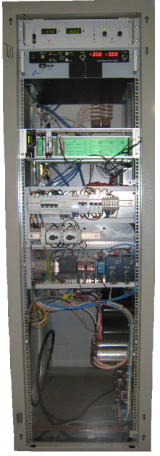
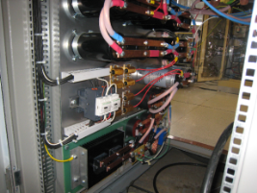
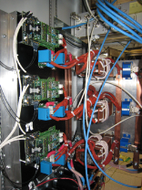
R&D Status
Power & Droop Compensators:
    300 kW prototype (1kV, 300A).
Validation & Correction of Mathematical Models
and Control Strategies

Slide 11
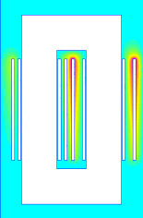
R&D Status
Monolithic Pulse Transformer
3D
FEA
Analytical Dimensioning
Model Correction
by 3D FEA
Klystron Rated
Operation Point
0.3 m
2D FEA
Identification
Equivalent Circuit
Output Voltage
Pulse simulation
Objective
&
Contraints
Functions
Evaluation
State Variables
Vector
Thermal
Modelling
0.8 m
Mechanical
Modelling
Dimensioning Model using 2D FEA
Non Linear Constrained
Optimization Procedure

Slide 12
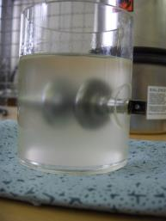
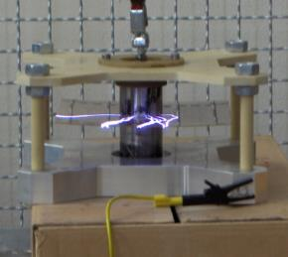
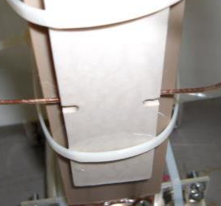
R&D Status
Monolithic Pulse Transformer
  HV Tests: Determination of expert coefficients
MIDEL & Silicon
Oil tests
PEEK test
Insulation system test

Slide 13
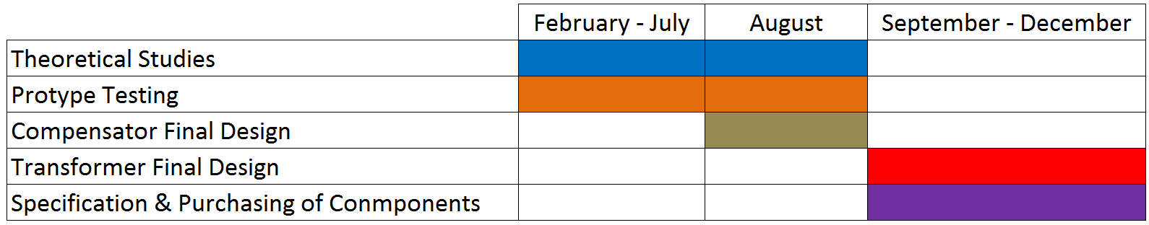
Schedule
2014:
Beginning of full scale construction: December 2014
Full Power Testing & Validation: 2015

