Slide 1
Development of Two-Klystron Modulator Topologies for the CLIC Drive Beam / ETH Modulator
by Sebastian Blume
ETH Zürich

Slide 2
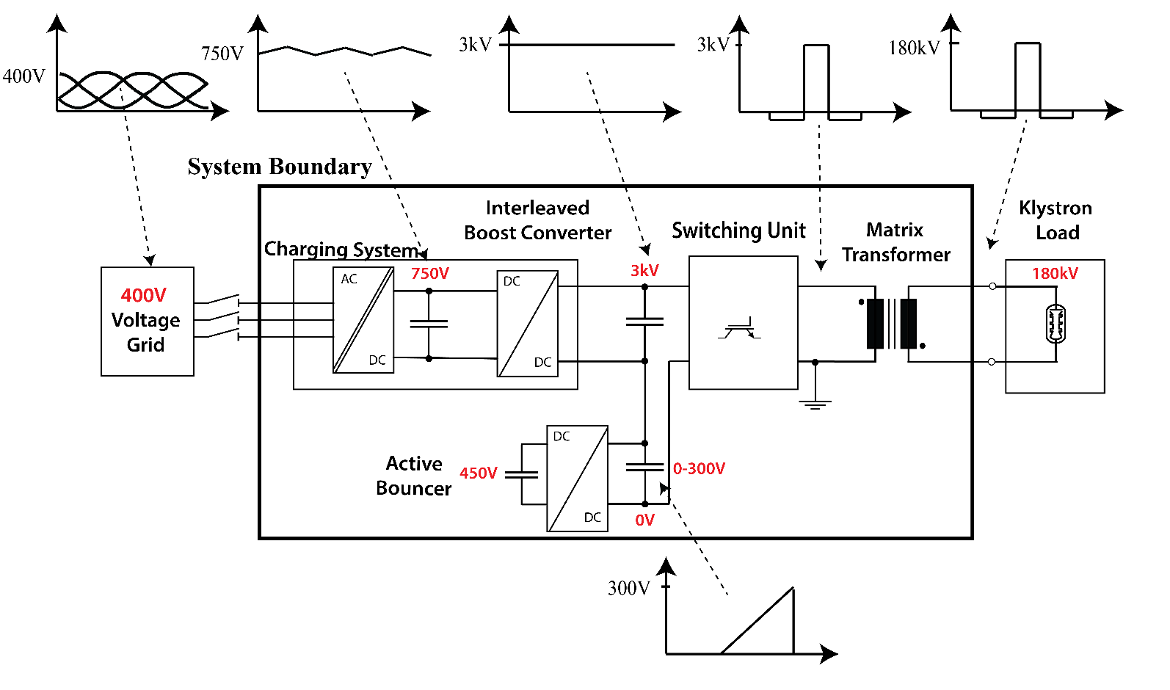
Topology
Modulator main specifications
Pulse voltage | V_{kn} | 180 | kV
Pulse current | I_{kn} | 195 | A
Peak power | P_{out} | 29 | MW
Rise + settling time | t_{rise} | 8 | μs
Flat-top length | t_{flat} | 140 | μs
Repetition rate | Rep_{r} | 50 | Hz
Total efficiency | η_{ges} | >90 | %
Pulse repeatability | PPR | ~50 | ppm

Slide 3
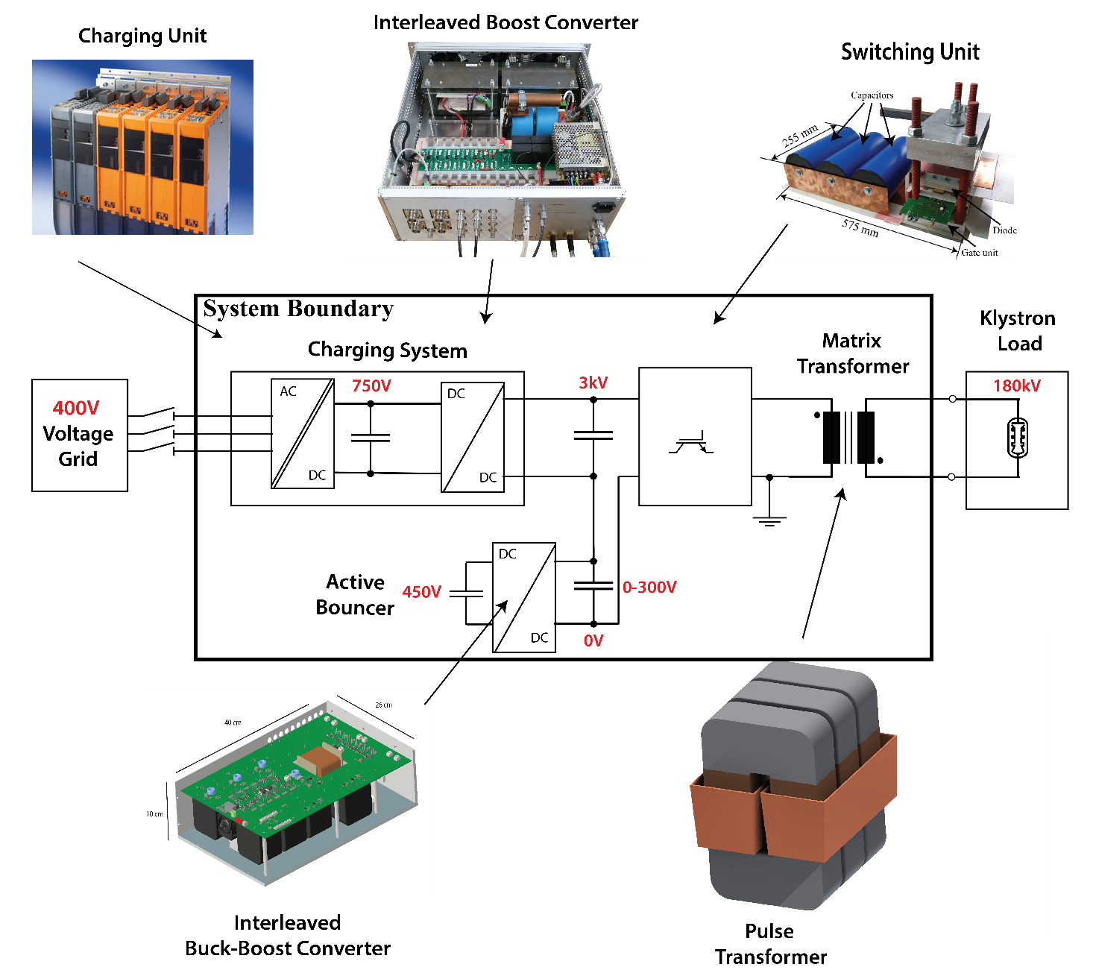
Topology

Slide 4
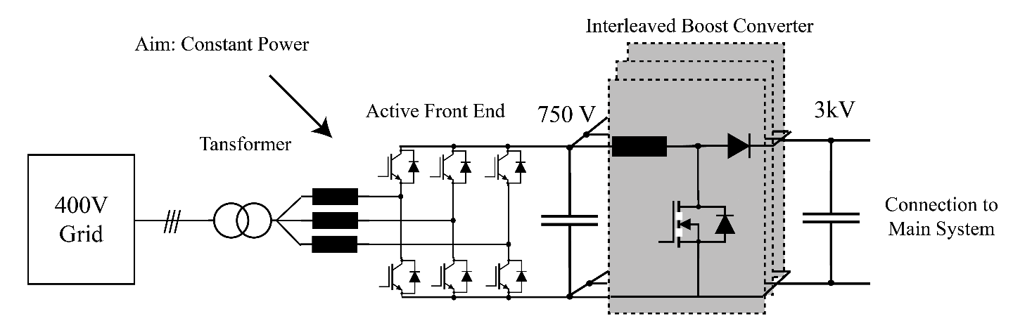
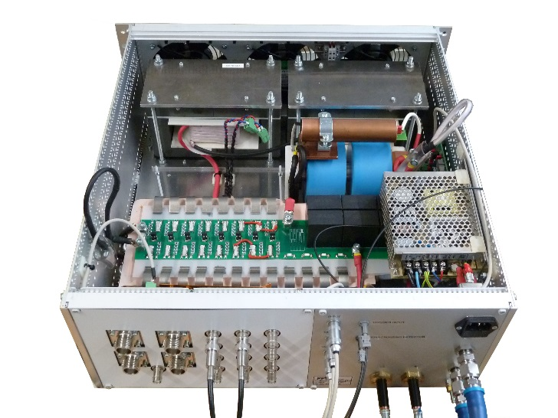
Charging System
Features
  AC/DC stage available on market
  Parallel redundancy
  Constant power consumption
Challenges:
  Ultra precise charging voltage Interleaving,
  precise voltage measurement
  High efficiency Optimization procedure
  High grid power quality Constant power, unity power factor

Slide 5
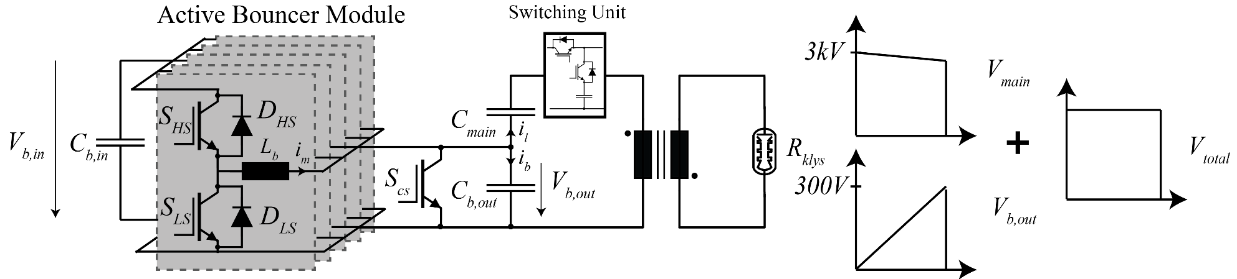
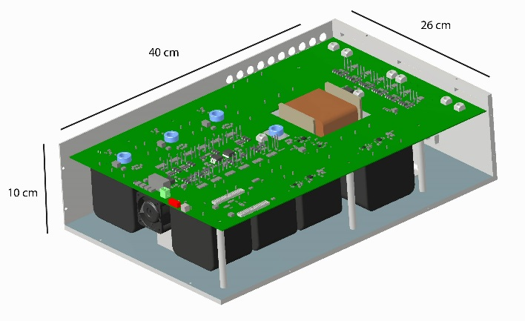
Bouncer Topology
Interleaved buck-boost converter with short circuit switch
Features:
  Output switching frequency up to 2.4 MHz
  High repeatability
  Parallel redundancy
Challenges:
  High switching frequency 24-fold interleaving
  High pulsed currents Parallelization of switches
Notes:
erklären: Repeatability ➔ ersetzt durch Rippelanforderung, um Anforderung an Control/Jitter, etc. zu reduzieren
(Influence jitter on repeatability neglected)

Slide 6
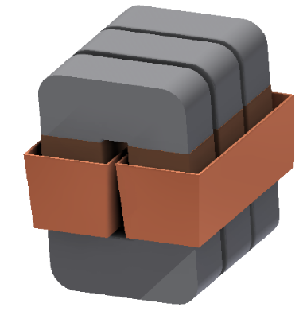
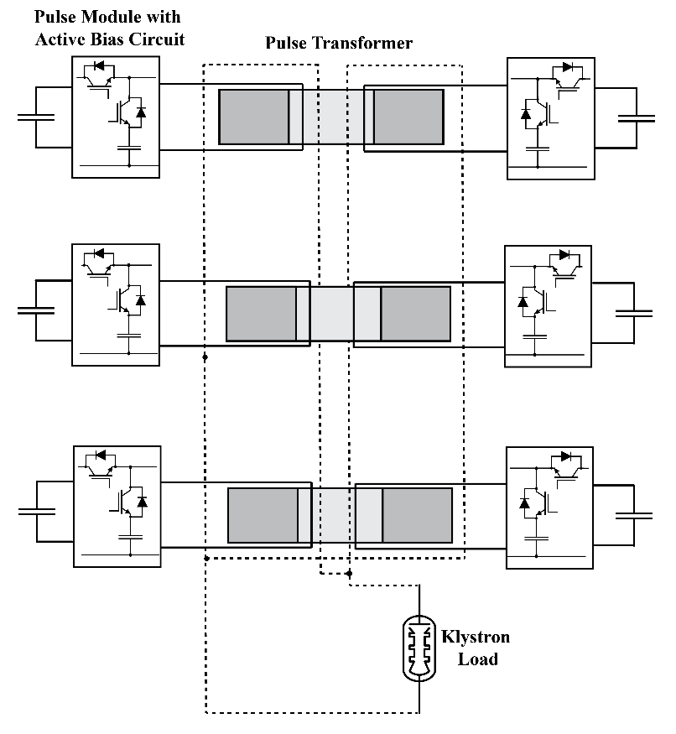
Split Core Transformer with Cone Winding
Split core transformer (Matrix transformer) with cone winding
  Secondary winding encloses all cores
  Advantages: Higher dynamics (rise time)
Challenges
  Long pulse length
  Fast rise time
  High efficiency
Global optimization procedure

Slide 7
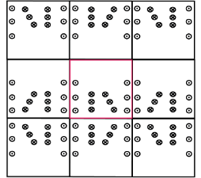
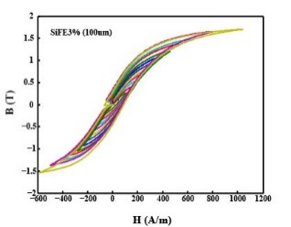
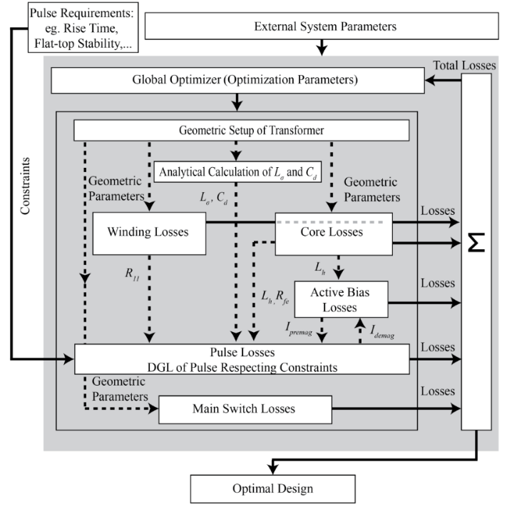
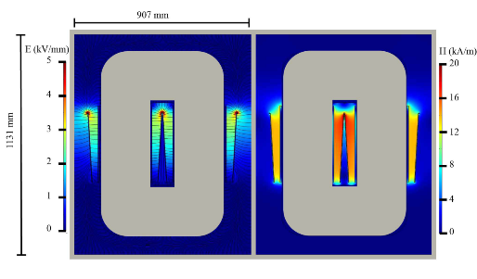
Optimization Procedure for Matrix Transformer
Optimization Procedure
  8 optim variables
  Loss components included
  Core loss measurements integrated
  Analytical approximations for parasitics with FEM verification
  Pulse shape analyzed in time domain
Optimal design
Analytical approximations
Core loss measurements
FEM verification

Slide 8

Project Status
Status
  Overall topology selected
  Transformer optimization procedure & design models ready
  Bouncer optimization procedure & design models ready
  Design models under experimental validation
Challenges Timeline
Modulator main specifications - today
Pulse voltage | V_{kn} | 180 | kV
Pulse current | I_{kn} | 195 | A
Peak power | P_{out} | 29 | MW
Rise + settling time | t_{rise} | 8 | μs
Flat-top length | t_{flat} | 140 | μs
Repetition rate | Rep_{r} | 50 | Hz
Total efficiency | η_{ges} | >90 | %
Pulse repeatability | PPR | ~50 | ppm
Component | Time
Charging Unit | Q4 2014
Active Bouncer | Q2 2015
Pulse Transformer | Q3 2015
Entire System Test | Q4 2015
Final delivery | Q1 2016
η
Rise time
Grid distortion
Repeatability

