Slide 1


Beam Dynamics Studies of
CLIC DB Injector
Shahin Sanaye Hajari
Institute For Research in Fundamental Science (IPM), Tehran, Iran
CERN, Geneva, Switzerland

Slide 2
Contents
Introduction
Results of the Longitudinal Dynamics
Transverse Beam Dynamics Studies
  3.1 Envelop Equation
  3.2 Emittance Growth
  3.3 Simulations

Slide 3
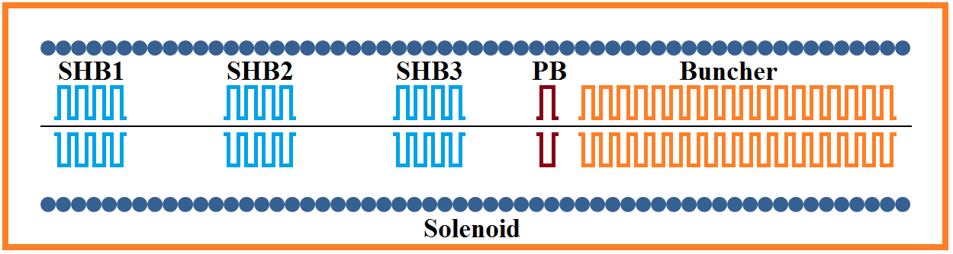
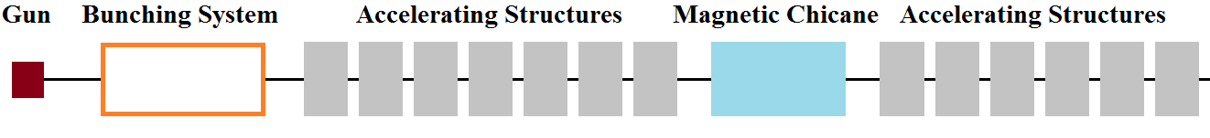
1. Introduction 1
Introduction
1.1 Injector Layout

Slide 4
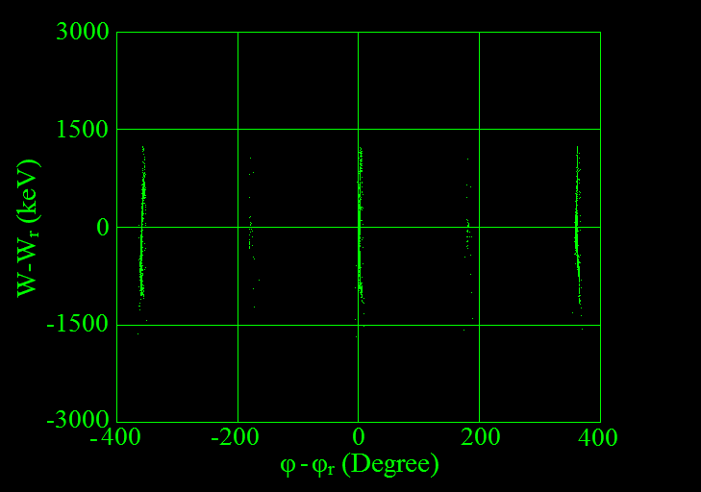
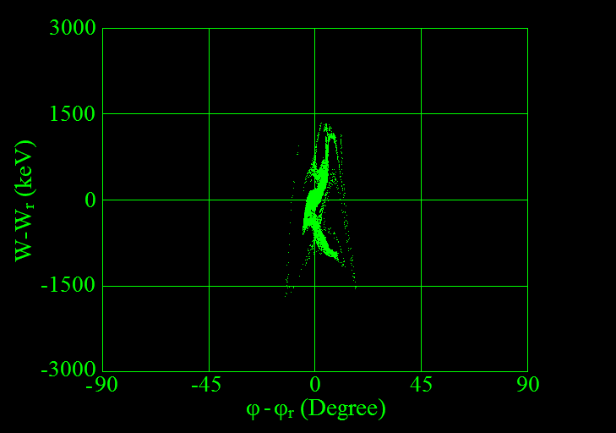
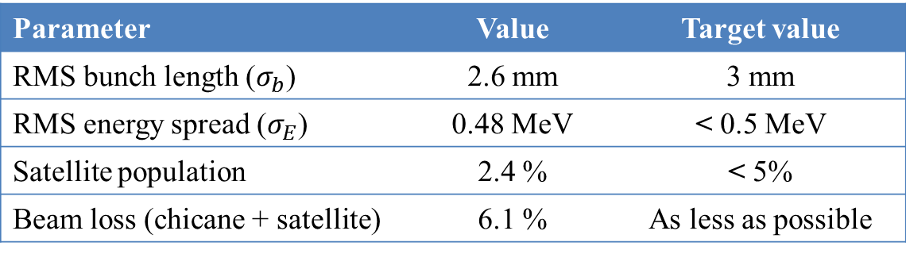
2. Review of The Longitudinal Results 2
2. Review of The Longitudinal Results
Parameter | Value | Target value
RMS bunch length ($σ_{b}$) | 2.6 mm | 3 mm
RMS energy spread ($σ_{E}$) | 0.48 MeV | < 0.5 MeV
Satellite population | 2.4 % | < 5%
Beam loss (chicane + satellite) | 6.1 % | As less as possible

Slide 5




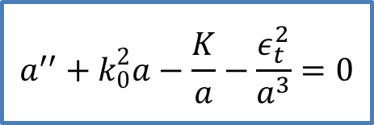
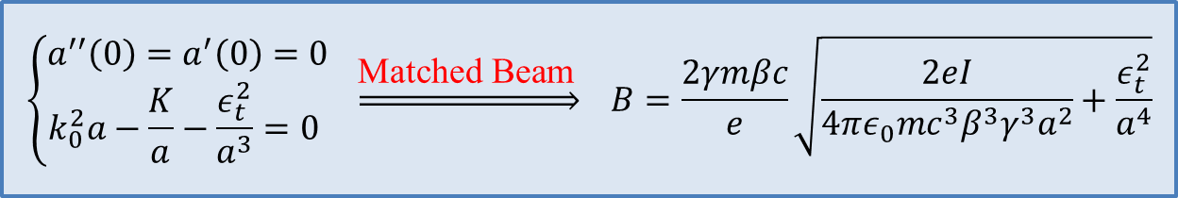
3. Transverse beam dynamics studies 3
3. Transverse Beam Dynamics Studies
3.1 Envelop Equation
Focusing term $\left(k_{0}=\frac{eB}{2γmβc}\right)$
$$a^{′′}+k_{0}^{2}a−\frac{K}{a}−\frac{ε_{t}^{2}}{a^{3}}=0$$
$$a=2x_{rms}$$
Emittance term $\left(ε_{t}=4ε_{rms}\right)$
Space charge term $\left(K=\frac{2eI}{4πε_{0}mc^{3}β^{3}γ^{3}} \right)$
$$\left\{\begin{aligned}a^{′′}\left(0\right)=a^{′}\left(0\right)=0 \\ k_{0}^{2}a−\frac{K}{a}−\frac{ε_{t}^{2}}{a^{3}}=0 \end{aligned} \underset{⇒}{\text{Matched} \text{Beam} }\right. B=\frac{2γmβc}{e}\sqrt{\frac{2eI}{4πε_{0}mc^{3}β^{3}γ^{3}a^{2}}+\frac{ε_{t}^{2}}{a^{4}}}$$

Slide 6
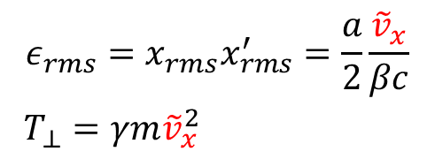
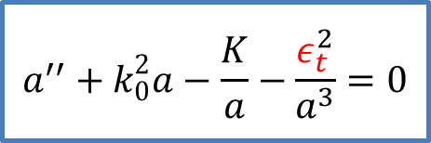
3. Transverse beam dynamics studies 4
3. Transverse Beam Dynamics Studies
3.2 Emittance Growth
$$a^{′′}+k_{0}^{2}a−\frac{K}{a}−\frac{ε_{t}^{2}}{a^{3}}=0$$
$$\begin{aligned}ε_{rms}=x_{rms}x_{rms}^{′}=\frac{a}{2}\frac{{\tilde{v}}_{x}}{βc} \\ T_{⊥}=γm{\tilde{v}}_{x}^{2} \end{aligned}$$
Sources of the emittance growth
Non-stationary initial distribution
Beam mismatching

Slide 7
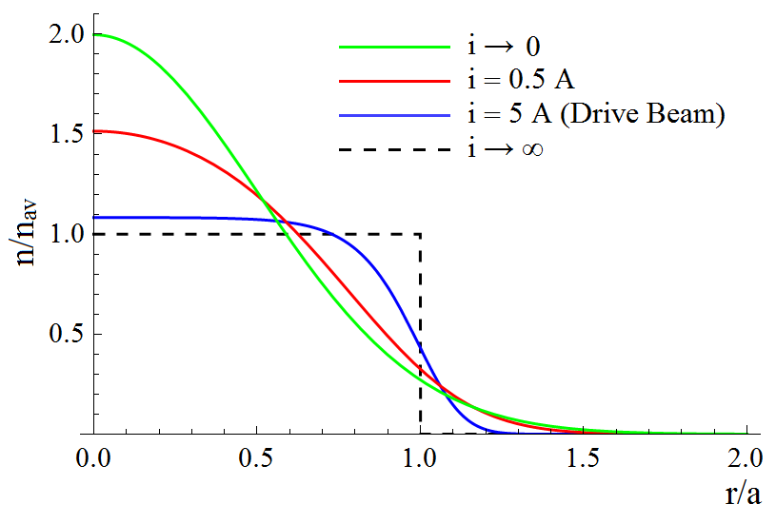
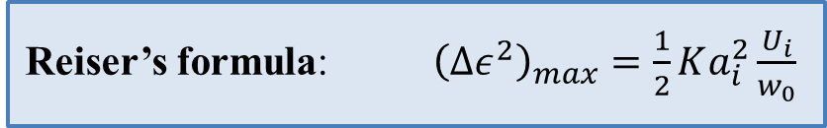
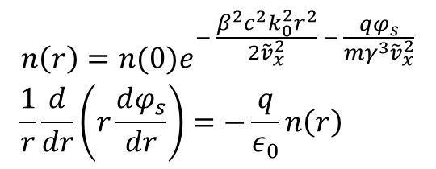
3. Transverse beam dynamics studies 5
3. Transverse Beam Dynamics Studies
3.2.1 Non-Stationary Initial Distributions
$$\begin{matrix}n\left(r\right)=n(0)e^{− \frac{β^{2}c^{2}k_{0}^{2}r^{2}}{2{\tilde{v}}_{x}^{2}} − \frac{qφ_{s}}{mγ^{3}{\tilde{v}}_{x}^{2}}} \\ \frac{1}{r}\frac{d}{dr}\left(r\frac{dφ_{s}}{dr}\right)=−\frac{q}{ε_{0}}n\left(r\right) \end{matrix}$$
Radial profile
Reiser’s formula: ${\left(∆ε^{2}\right)}_{max}=\frac{1}{2}Ka_{i}^{2}\frac{U_{i}}{w_{0}}$

Slide 8
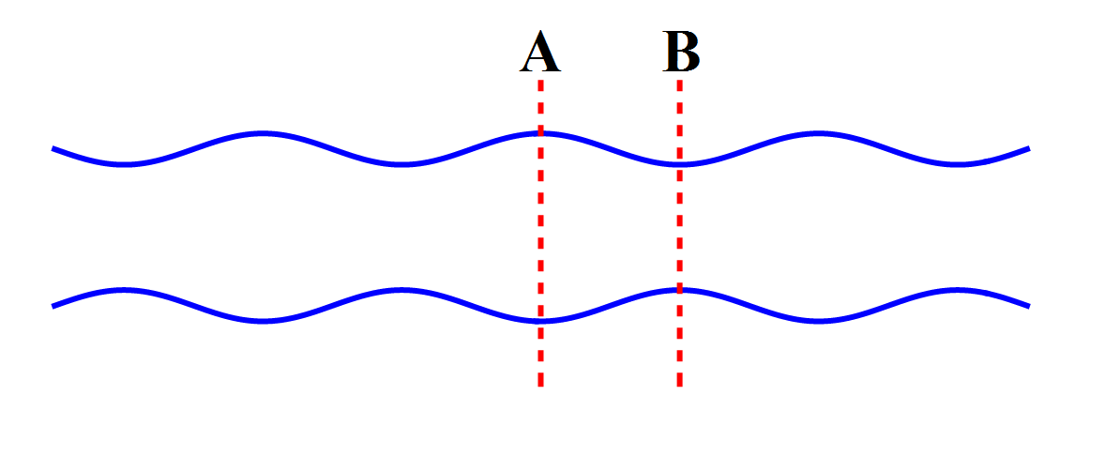
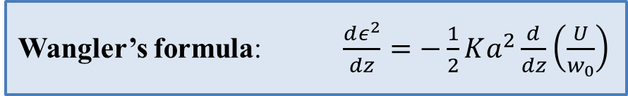
3. Transverse beam dynamics studies 6
3. Transverse Beam Dynamics Studies
3.2.2 Beam Mismatching
Wangler’s formula: $\frac{dε^{2}}{dz}=−\frac{1}{2}Ka^{2}\frac{d}{dz}\left(\frac{U}{w_{0}}\right)$

Slide 9

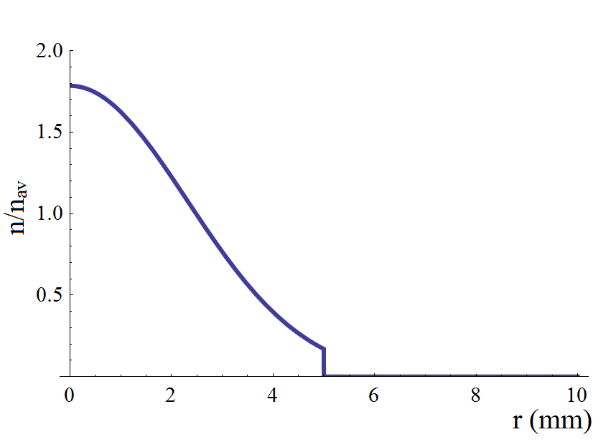
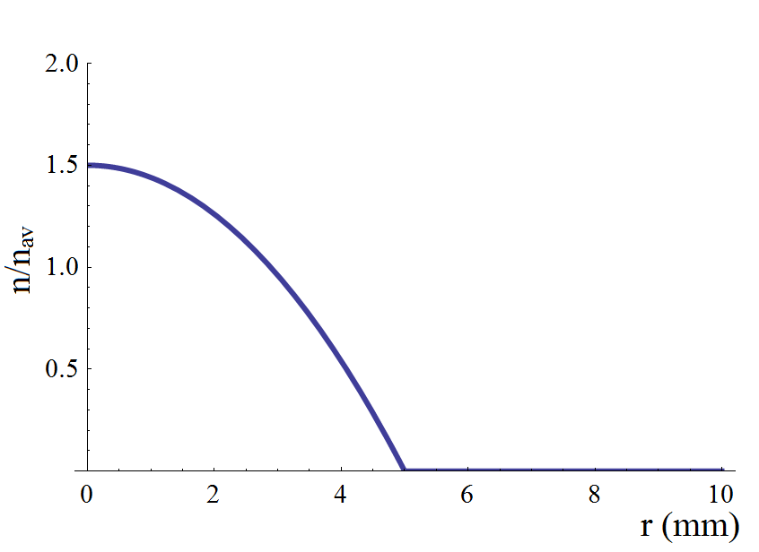
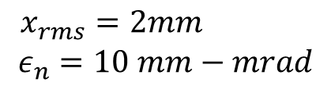
3. Transverse beam dynamics studies 7
3. Transverse Beam Dynamics Studies
3.3 Simulations
3.3.1 Beam Initial Conditions
$$\begin{matrix}x_{rms}=2mm \\ ε_{n}=10 mm−mrad\end{matrix}$$
PARMELA

Slide 10
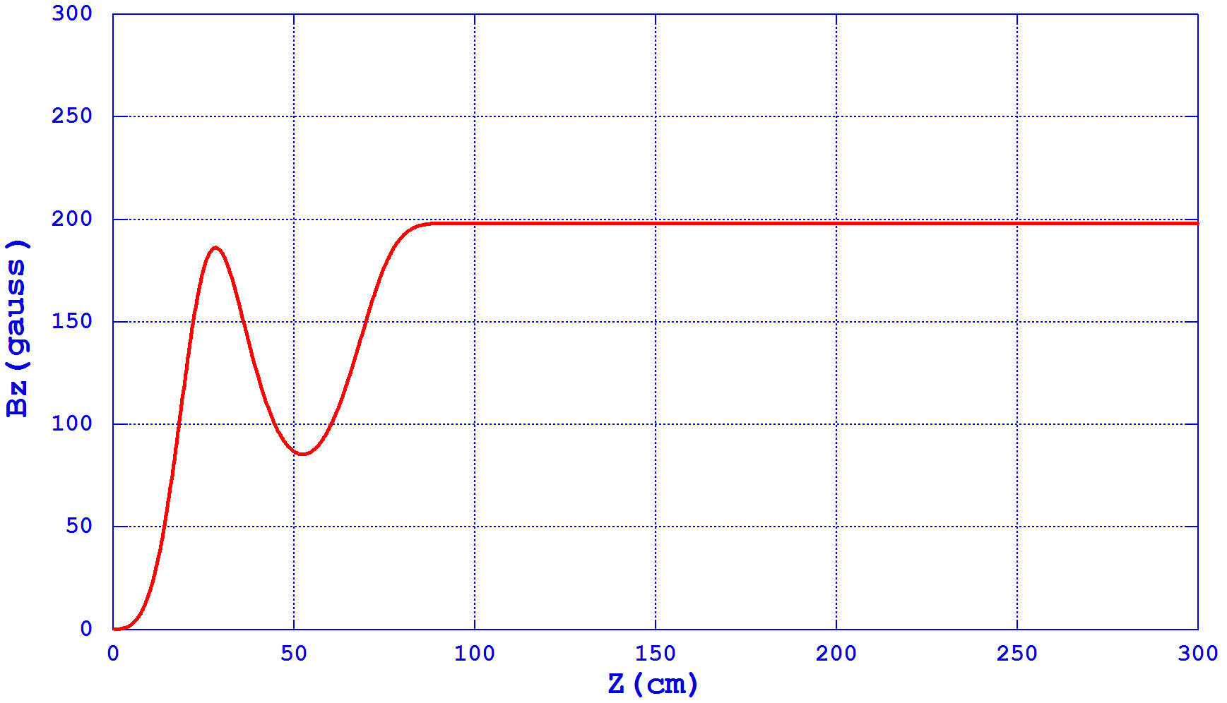
3. Transverse beam dynamics studies 8
3. Transverse Beam Dynamics Studies
3.3 Simulations
3.3.2 Matched Beam
Magnetic field map

Slide 11
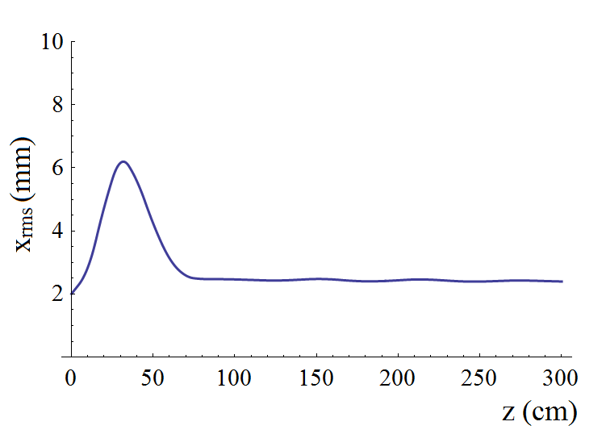
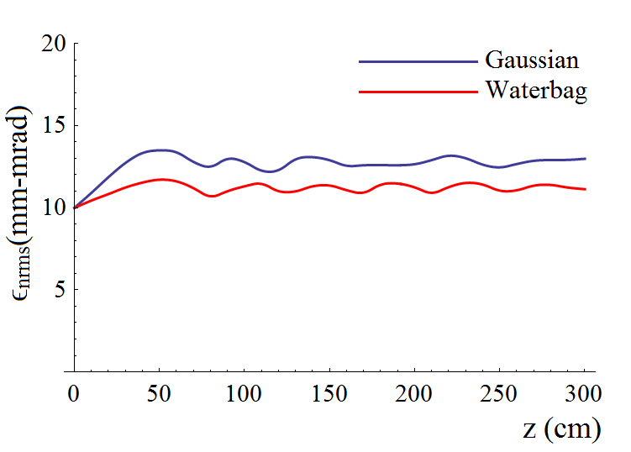
3. Transverse beam dynamics studies 9
3. Transverse Beam Dynamics Studies
3.3 Simulations
3.3.2 Matched Beam
RMS Beam Size RMS Normalised Emittance

Slide 12
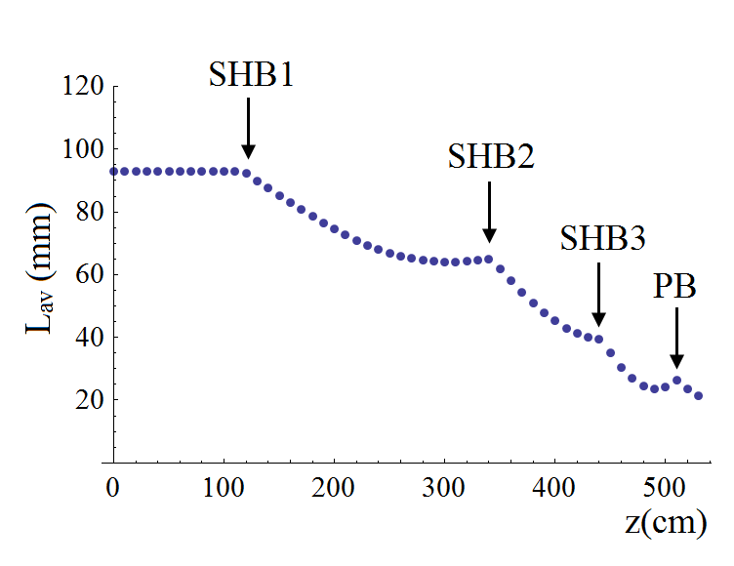
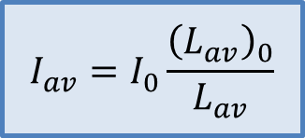
3. Transverse beam dynamics studies 10
3. Transverse Beam Dynamics Studies
3.3 Simulations
3.3.2 Bunching Effect
$$I_{av}=I_{0}\frac{{\left(L_{av}\right)}_{0}}{L_{av}}$$
Average bunch length

Slide 13
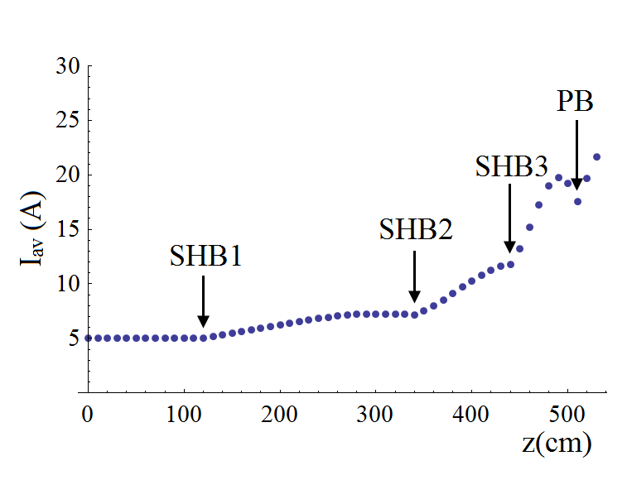
3. Transverse beam dynamics studies 11
3. Transverse Beam Dynamics Studies
3.3 Simulations
3.3.2 Bunching Effect
$$I_{av}=I_{0}\frac{{\left(L_{av}\right)}_{0}}{L_{av}}$$
Average bunch current

Slide 14
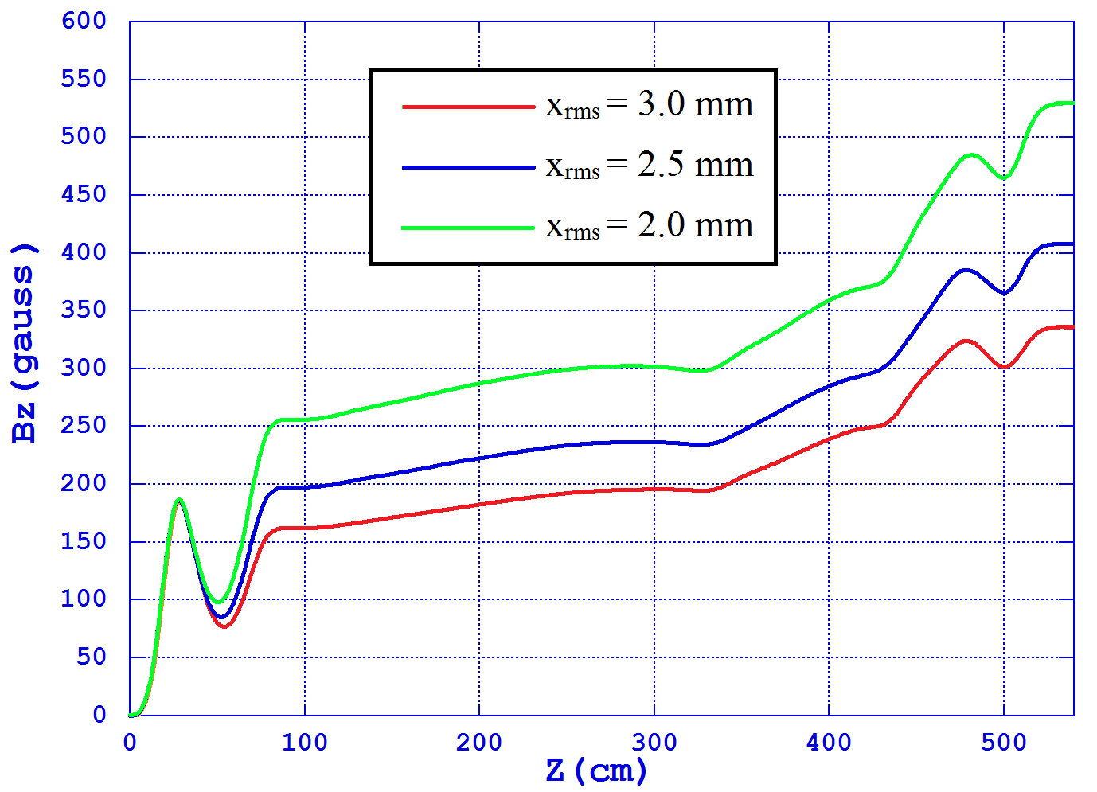
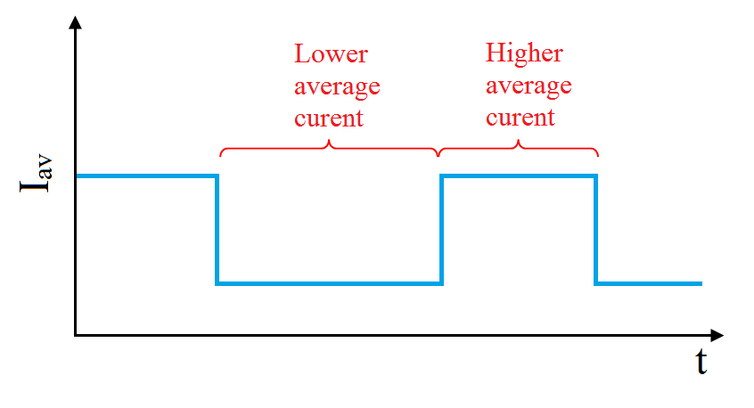
3. Transverse beam dynamics studies 12
3. Transverse Beam Dynamics Studies
3.3 Simulations
3.3.2 Bunching Effect
Average current profile
Magnetic field map

Slide 15
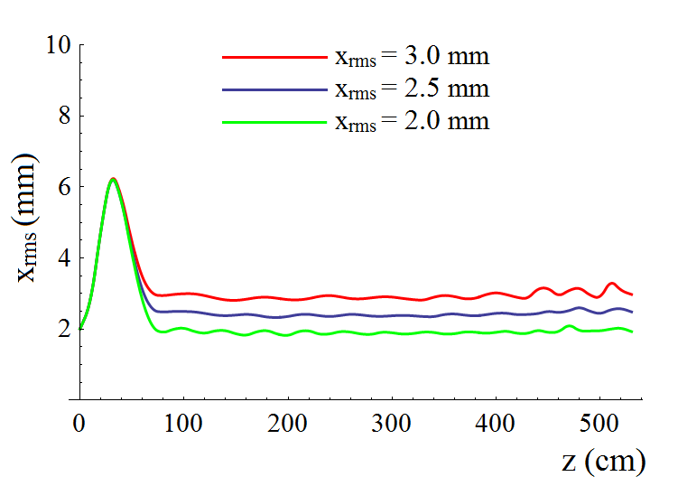
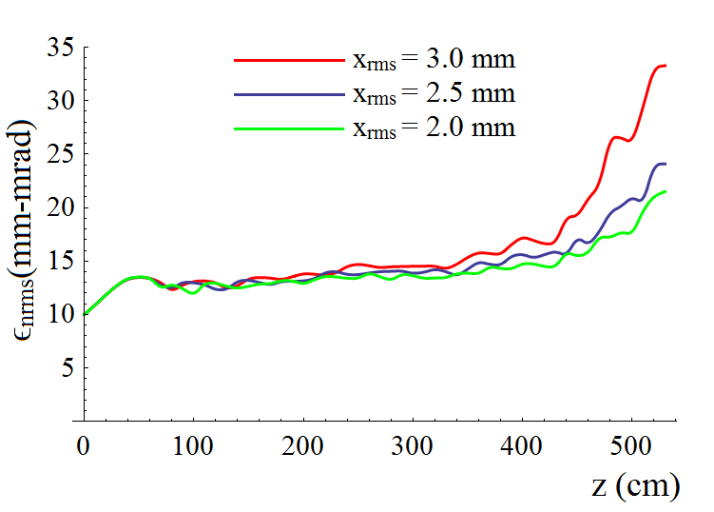
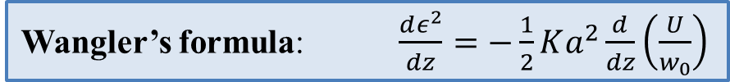
3. Transverse beam dynamics studies 13
3. Transverse Beam Dynamics Studies
3.3 Simulations
3.3.2 Bunching Effect
RMS Beam Size RMS Normalised Emittance
Wangler’s formula: $\frac{dε^{2}}{dz}=−\frac{1}{2}Ka^{2}\frac{d}{dz}\left(\frac{U}{w_{0}}\right)$

Slide 16
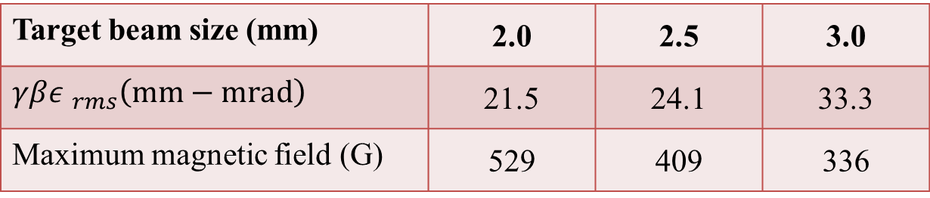
3. Transverse beam dynamics studies 14
3. Transverse Beam Dynamics Studies
3.3 Simulations
3.3.2 Bunching Effect
Target beam size (mm) | 2.0 | 2.5 | 3.0
$γβ{ε }_{rms}\left(mm−mrad\right)$ | 21.5 | 24.1 | 33.3
Maximum magnetic field (G) | 529 | 409 | 336
The larger the focusing field the smaller the beam size and the lower the emittance growth

Slide 17
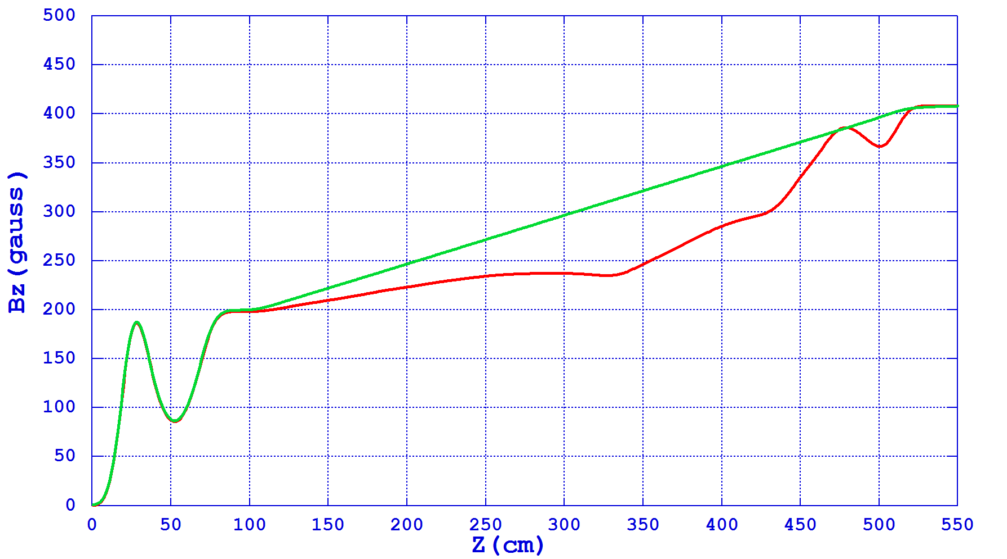
3. Transverse beam dynamics studies 15
3. Transverse Beam Dynamics Studies
3.3 Simulations
3.3.3 Sensitivity to The Ideal Filed

Slide 18
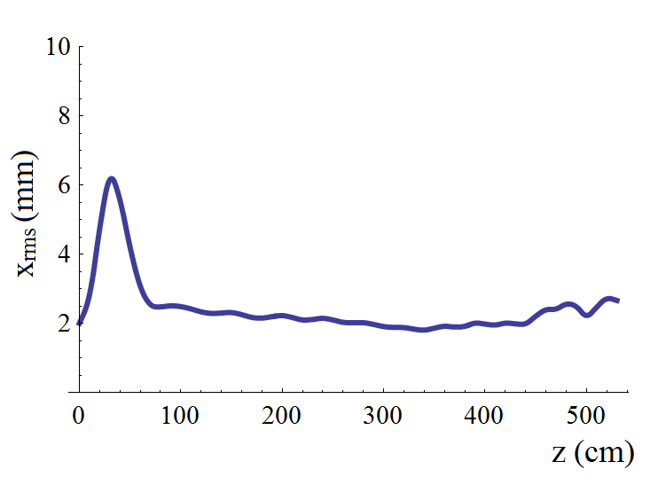
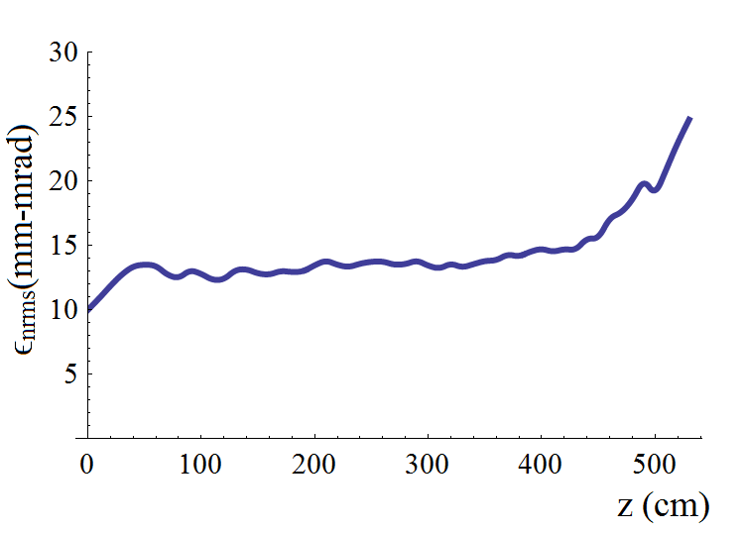

3. Transverse beam dynamics studies 16
3. Transverse Beam Dynamics Studies
3.3 Simulations
3.3.3 Sensitivity to The Ideal Filed
RMS Beam Size RMS Normalised Emittance
$$γβ {ε }_{rms}\left(mm−mrad\right): 24.1⟶24.8$$

Slide 19
Thanks for your attention

