Slide 1



DC Spark Experiments
Nick Shipman, Sergio Calatroni, Roger Jones, Anders Korsbeck, Tomoko Murunaka, Iaroslava Profatilova, Kyrre Sjobaek, Walter Wuensch

Slide 2
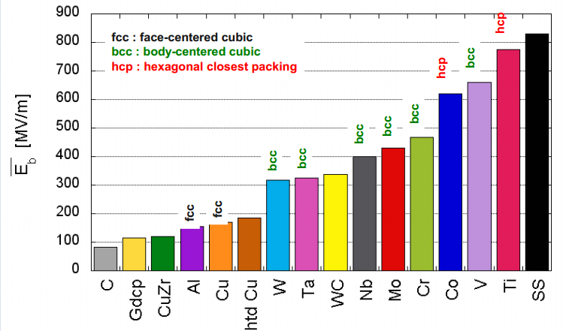
Why study breakdown in a DC System for CLIC
RF tests are expensive and time consuming. DC tests allow many more tests to be carried out.
The physics in DC tests is also simpler, no pulse surface heating, pre-breakdown magnetic fields etc. In order to understand the physics of RF breakdown, DC breakdown must be understood first!
For example it would never have been practically possible to get this lovely plot using only RF tests.

Slide 3
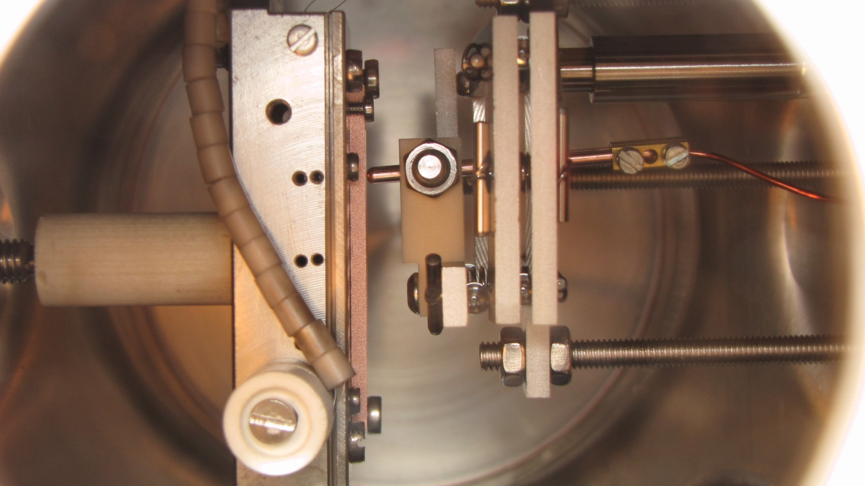
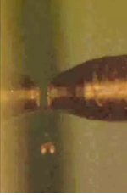
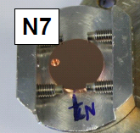
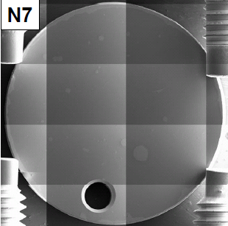
What are the CERN DC spark systems?
The CERN DC spark systems consist of an anode and cathode in a rod-plane geometry in ultrahigh vacuum. I will be talking about system I which is powered by the High-Rep-Rate circuit.
The gap size can be varied from 0-100um by using a stepper motor. It is possible to monitor and actively control the gap with an accuracy of ~1.5um.
The diameter of the anode is 2.3mm and has a hemispherical tip.
The cathodes have a good surface quality.
High voltage is applied across the electrodes and the resulting current and voltage waveforms are analysed (largely automatically) and recorded.
From these we can tell whether a BD occurred and measure several properties of the BD such as the turn on time, the position of the BD within the pulse, the burning voltage and even the gap distance!
We are not currently able to measure the field enhancement factor β, with this setup however.

Slide 4
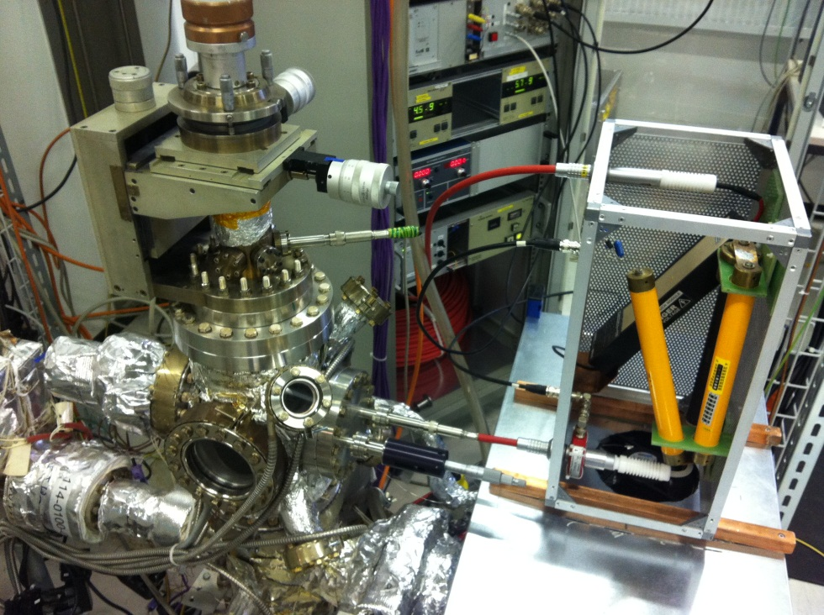
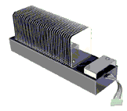
What is the High Rep Rate Circuit?
The HRR circuit uses a solid state switch to supply high voltage pulses (up to 10kV) at a rep rate of up to 1kHz. The energy is stored on a 200m/1us long coaxial cable.
The picture above shows the HRR circuit. The metal box housing the switch is placed as close as possible to the vacuum chamber to minimise stray capacitance.

Slide 5
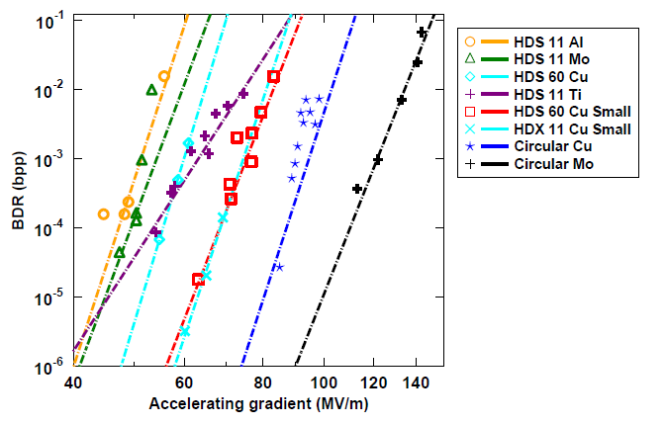
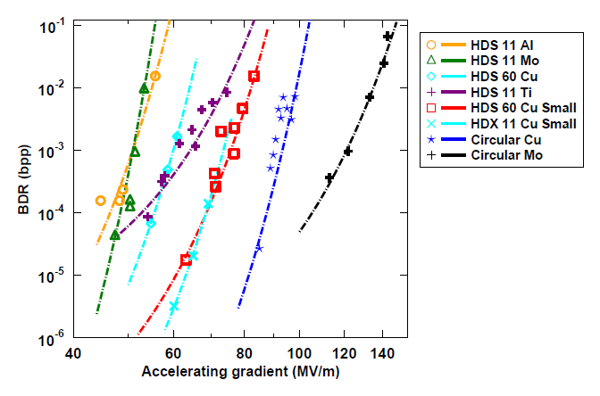
Motivation behind the HRR system
CLIC is interested in the low breakdown regime ~10^-7 BDs/pulse/m.
With the older mechanical relay the maximum operating frequency is only 0.5Hz.
  10^7/0.5Hz ~ 7.7months
By using a solid state switch the HRR system can operate at 1kHz
  10^7/10^3Hz ~ 3 hours
We should also be able to test the BDR vs. E stress model scaling theory proposed by Fluyra Djurabekova .

Slide 6
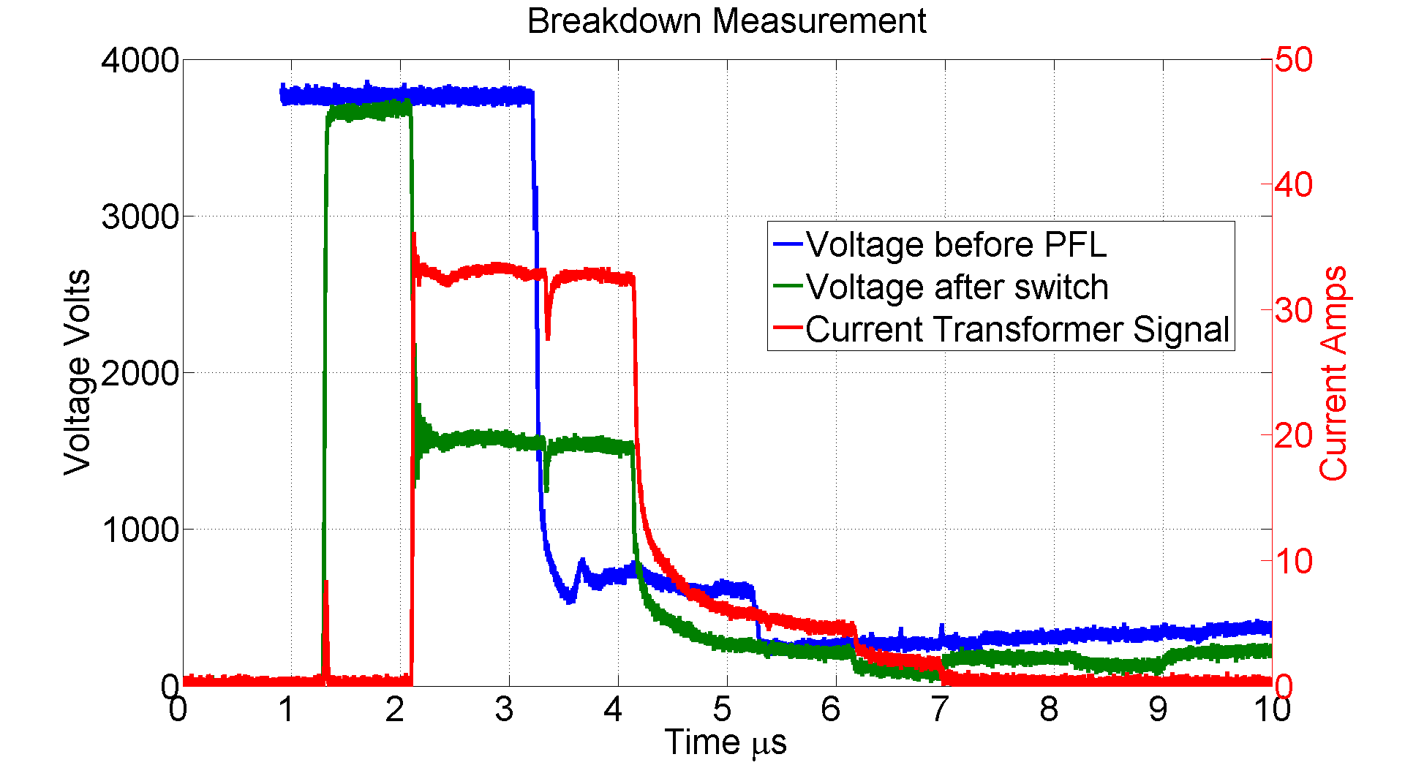
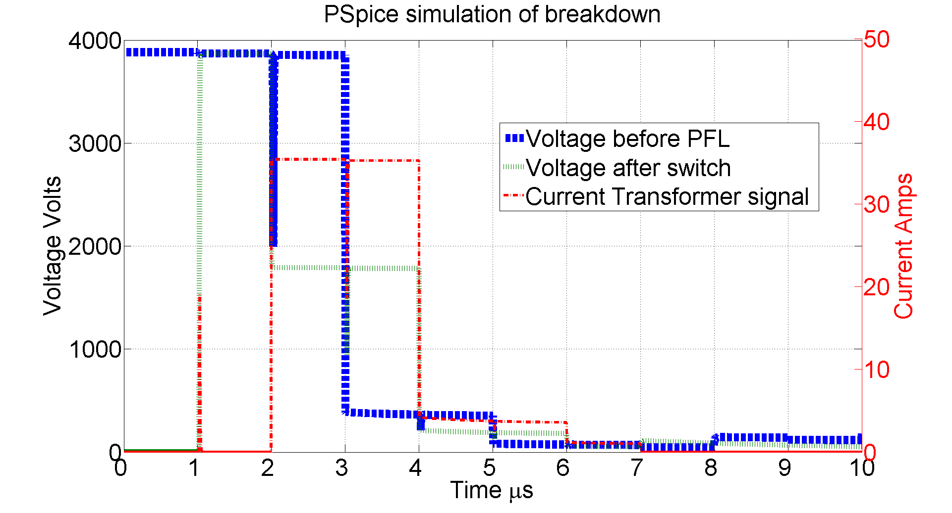
The High Rep Rate System
Measured voltage and current signals in the HRR circuit during a breakdown. The switch is closed at 1us and the breakdown occurs at 2us.
PSpice simulation of the HRR circuit during a breakdown. The switch is closed at 1us and the breakdown occurs at 2us.

Slide 7
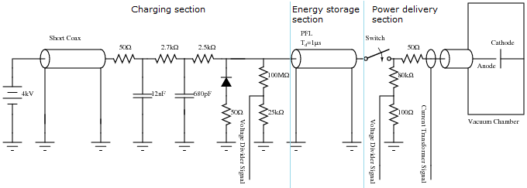
The High Rep Rate System

Slide 8
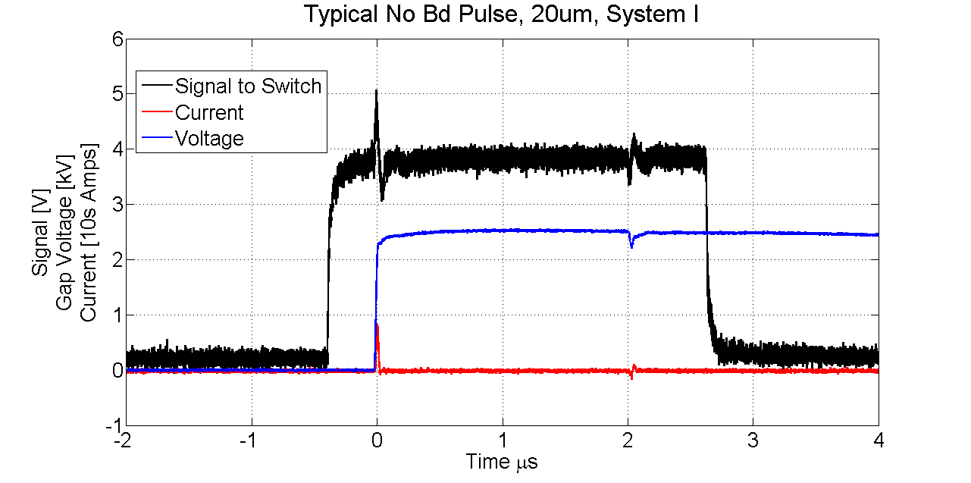
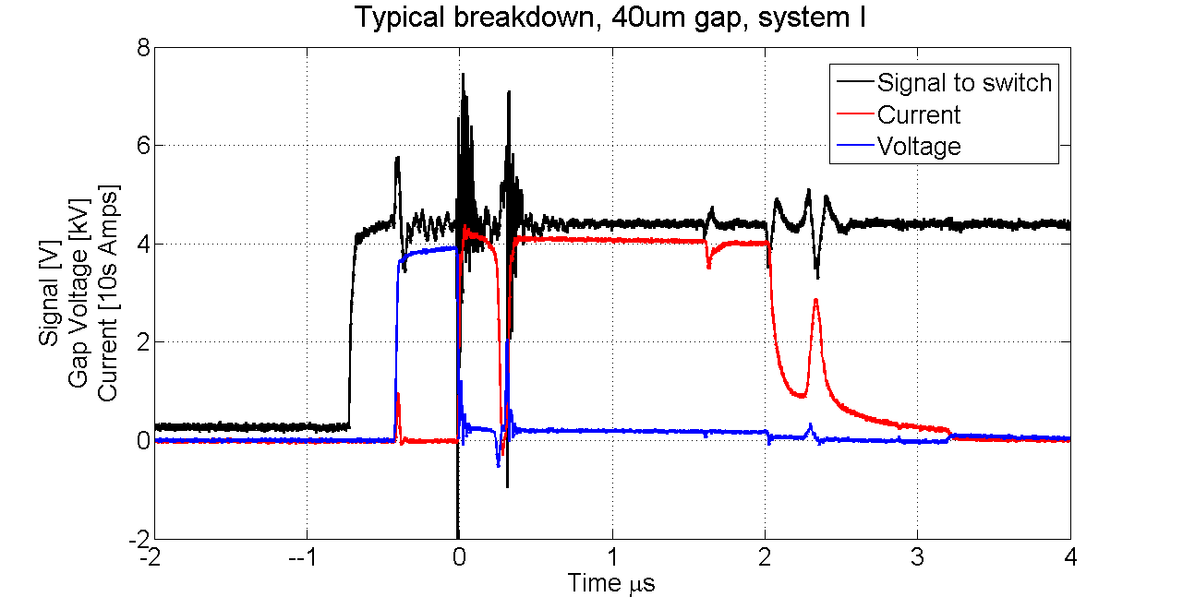
Measured traces
Fast voltage rise, but slow voltage fall time
Pulse length adjustments not useful
Small and brief initial charging current
The turn on time is how quickly the voltage drops after a BD.
The BD position is the position or time the BD occurs within the pulse.
An estimation of the burning voltage can be obtained by averaging the voltage fluctuations after the BD.

Slide 9
Monitoring of electrode gap

Slide 10
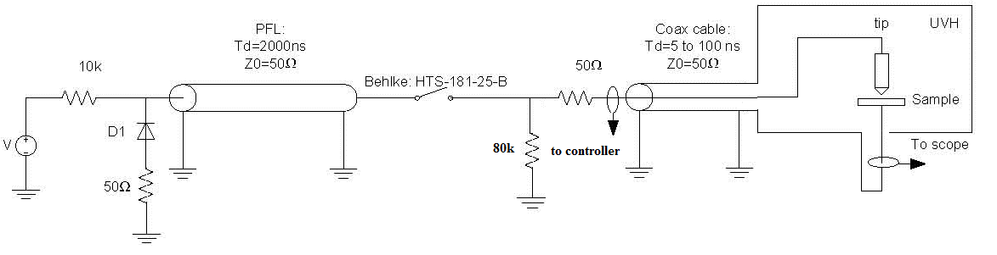
Pulse Integration Method
The pulse integration method is used to monitor the gap distance.
Current transformer 2 as shown in the circuit diagram is used to measure the transient current flow when the switch is closed. The area of this current pulse is dependent on the gap capacitance.
In this position the current transformer is insensitive to as much stray capacitance as possible
CT 2
The measurement used is an average of many pulses.
5ns/div
1μs/div

Slide 11
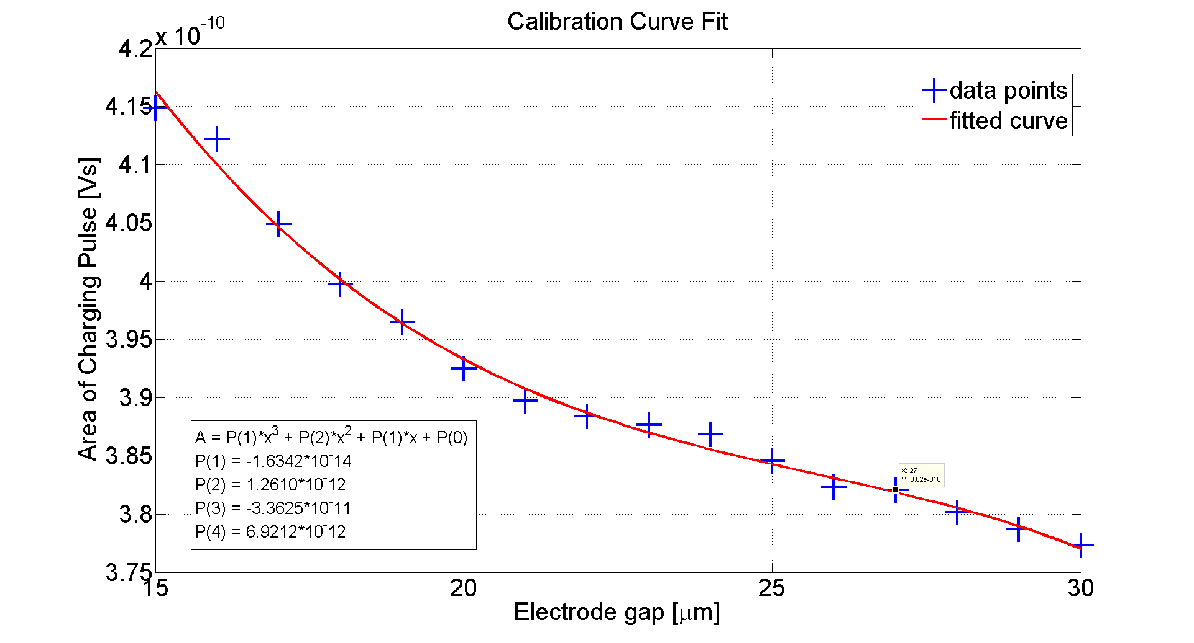
Calibration Curve
A cubic function is fitted to the calibration data and used to convert subsequent integral measurements to a gap distance.
How good is the measurement?
We are able to measure the gap to +-1.5um, as yet it hasn’t been determined if this is a limit on the gap measurement or the gap tends to actually vary by this amount.
The error introduced when going into contact is of the order of 1um, but this only introduces a fixed offset.

Slide 12
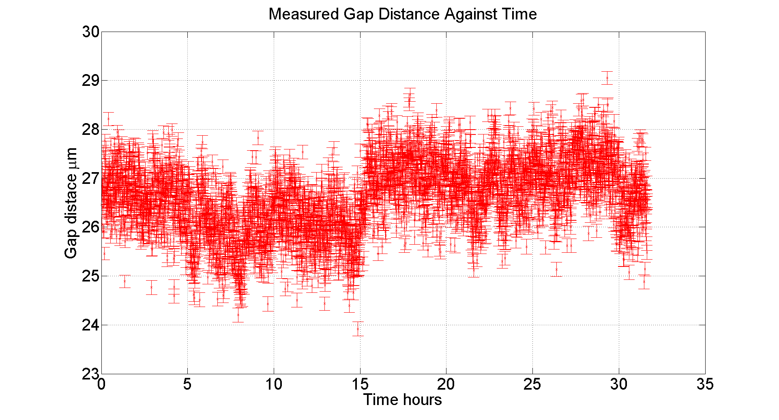
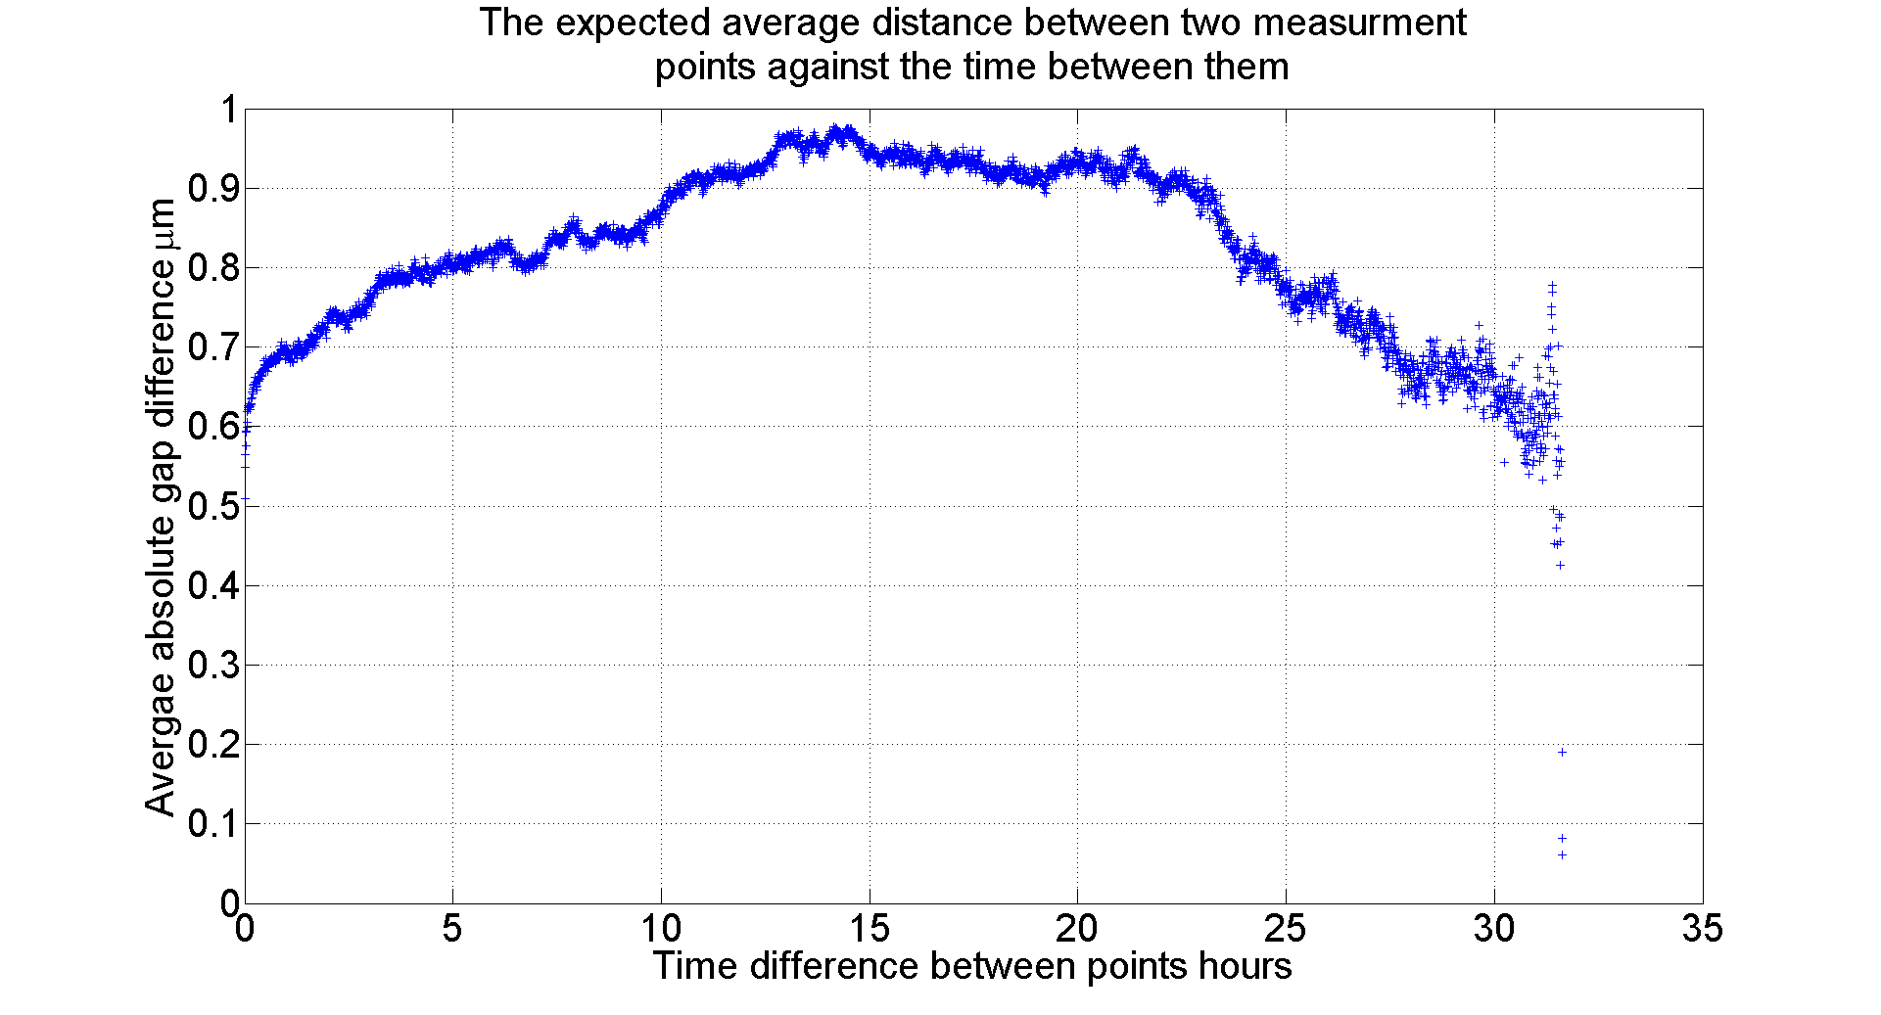
Change in Gap without BDs
The system was left pulsing at 100Hz 2000V for a day in order to measure the gap variation with no BDs over time.
This plot was generated from the data in the previous plot it shows ΔX against ΔT, where:-
ΔX(ΔT) = mean(abs(d(t) – d(t+ ΔT)), over all t
And d(t) is the measured gap distance at time t

Slide 13
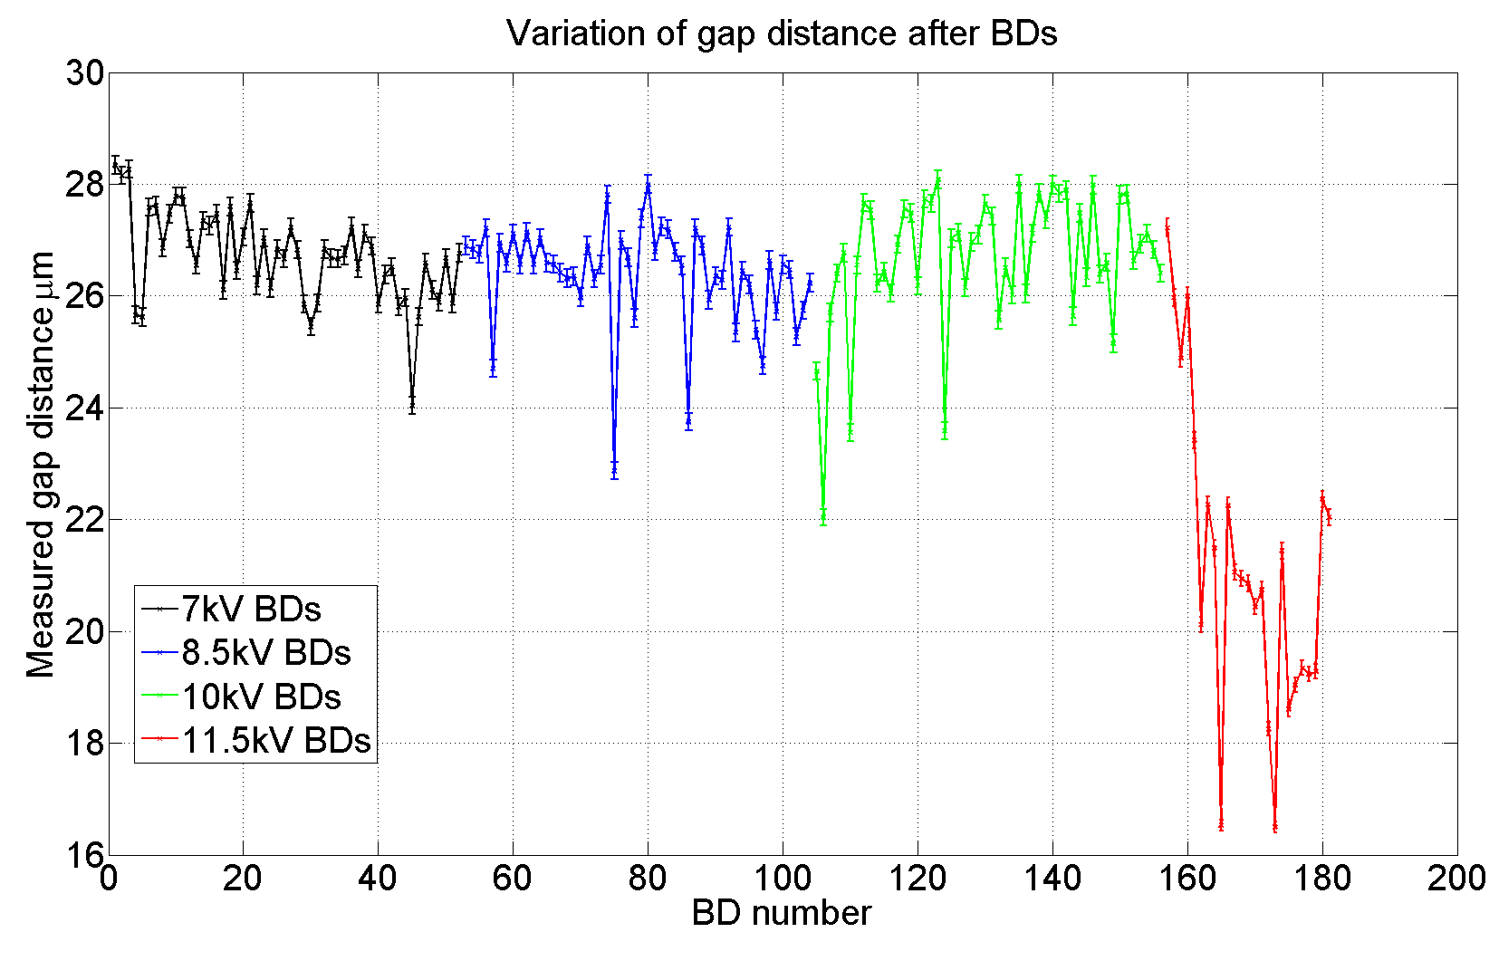
Change in Gap with BDs
V | Std
7kV | 0.82um
8.5kV | 0.92um
10kV | 1.22um
11.5kV | 2.75um
Interestingly although it is not obvious by eye the change in gap after BD does appear to be correlated to the BD voltage.
In this plot each point represents a gap measurement @2000V after a single BD was forced to occur at a higher voltage indicated in the legend. The gap was not reset by going into contact after each series.
Oddly the gap appears to suddenly get smaller at 11.5kV.

Slide 14
BD statistics at fixed voltage

Slide 15
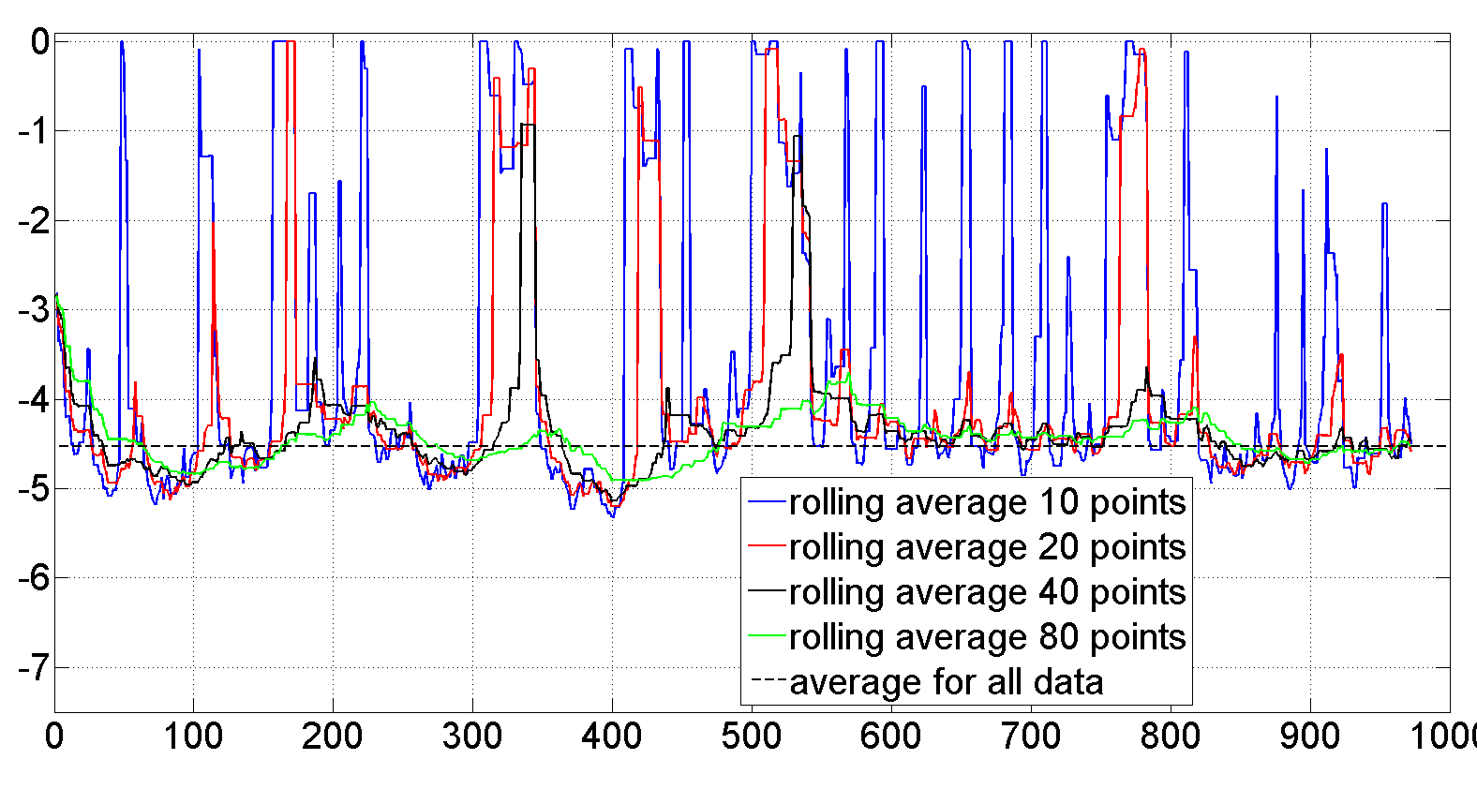
Rolling average
Bigger voltage steps more BDs per voltage level.
Clusters mean the calculated BDR for 20 BDs may not reflect the underlying BDR.
Gap seems to be changing once stepper motor arrives this will not be such a problem.
Total #BDs | 972
Average BDR | 2.95*10^-5 BDs/pulse
Std(pulses between BD) | 8.54*10^4
Ratio(immediate BDs/Total BDs) | 0.64

Slide 16
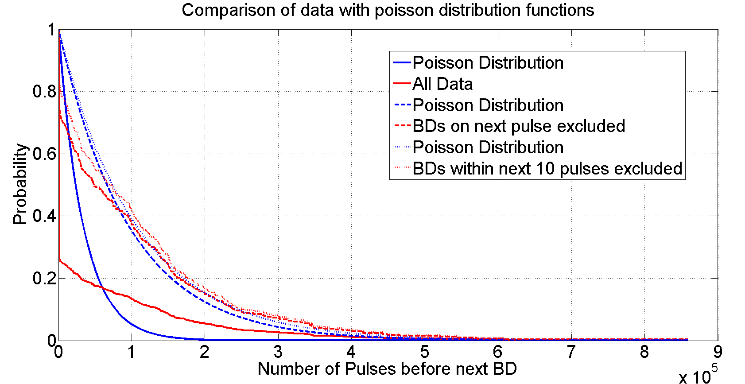
BDR Analysis of long run experiment
This experiment was performed at a surface electric field of 170MV/m and a gap size of 20um. The large number of BDs which occur immediately following a previous BD cause the data to deviate significantly from the Poisson distribution that might otherwise be expected. Even when BDs on the next pulse or within the next 10 pulses are excluded the distribution is still not Poissonian.

Slide 17
BDR vs E

Slide 18
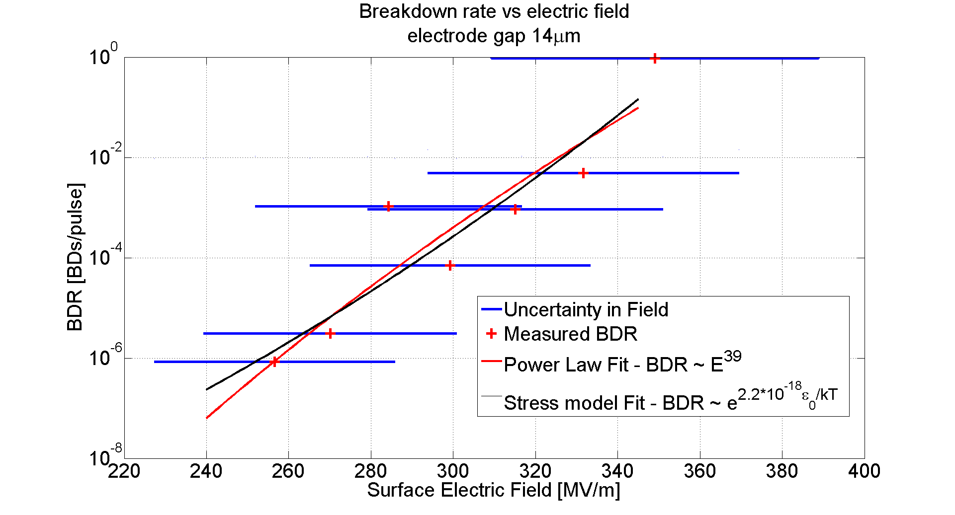
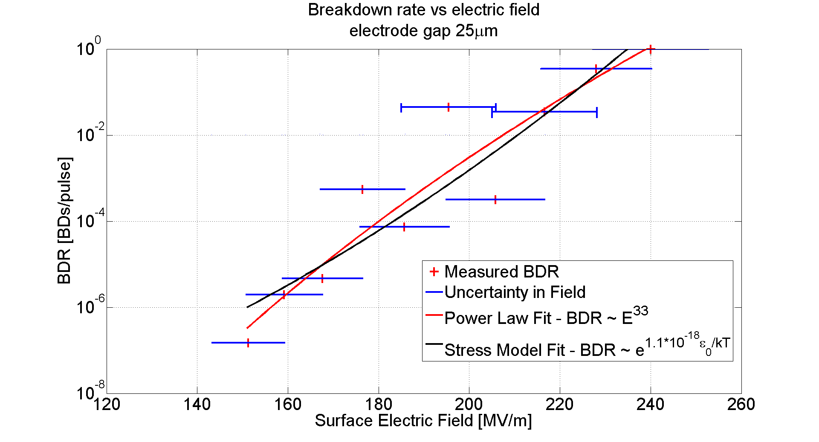
BDR vs E 14um and 25um gap
For each experiment the gap is first set to the required distance. Then the voltage is set at the highest value and the HRR circuit begins pulsing at 1000Hz.
After 100BDs have been recorded or 10^7 pulses and at least 10BDs the voltage is reduced by 5%.
Every 10mins if no BD has occurred the HRR circuit is made to pulse at a predetermined voltage too low for a BD to occur, so the gap can be measured and automatically corrected.
As the uncertainty in the gap is always around 2um the error in the field is much larger at smaller gap sizes.

Slide 19
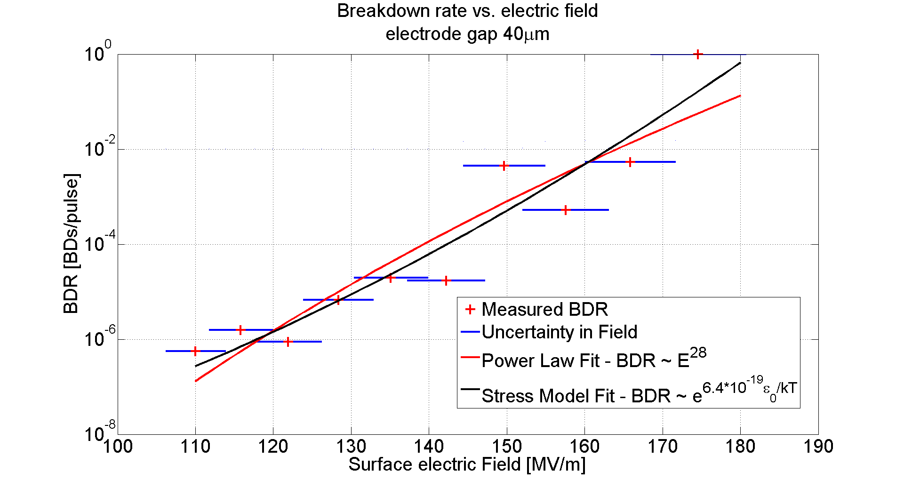
BDR vs E 40um gap
Both the power law model and the stress model fit the data well. Going to a lower BDR in the future should help distinguish between them. The exponents obtained for the power law model are very similar to those obtained in high power RF tests of accelerating cavities.
The fitted exponent tends to decrease for a larger gap.

Slide 20
BD position

Slide 21
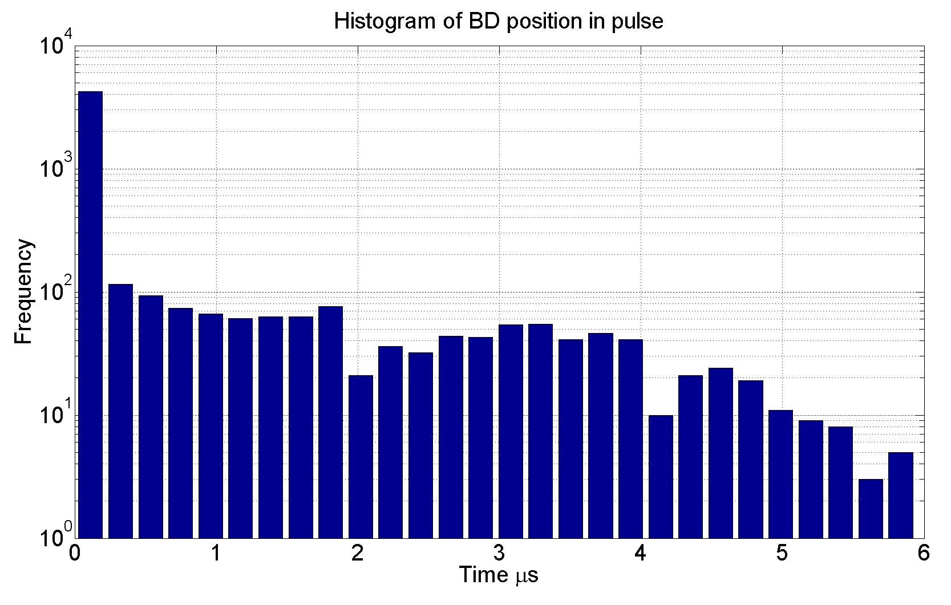
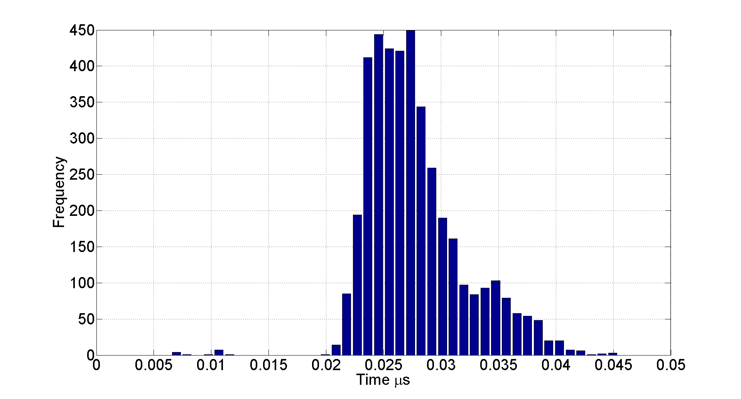
Distribution in BD position
Almost all BDs occur at the beginning of the pulse. The distribution of non immediate BDs is quite flat up to 3us at which point the voltage across the gap begins to fall. A small drop in voltage due to a reflection from the end of the PFL results in fewer BDs at 2us.

Slide 22
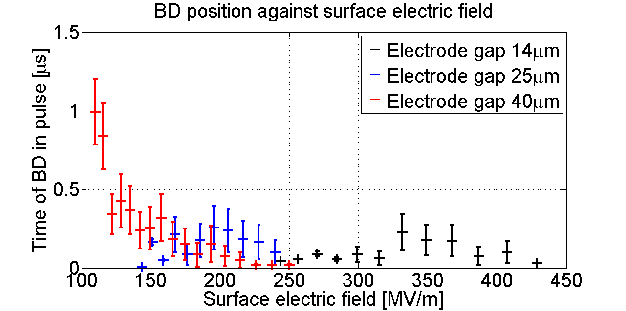
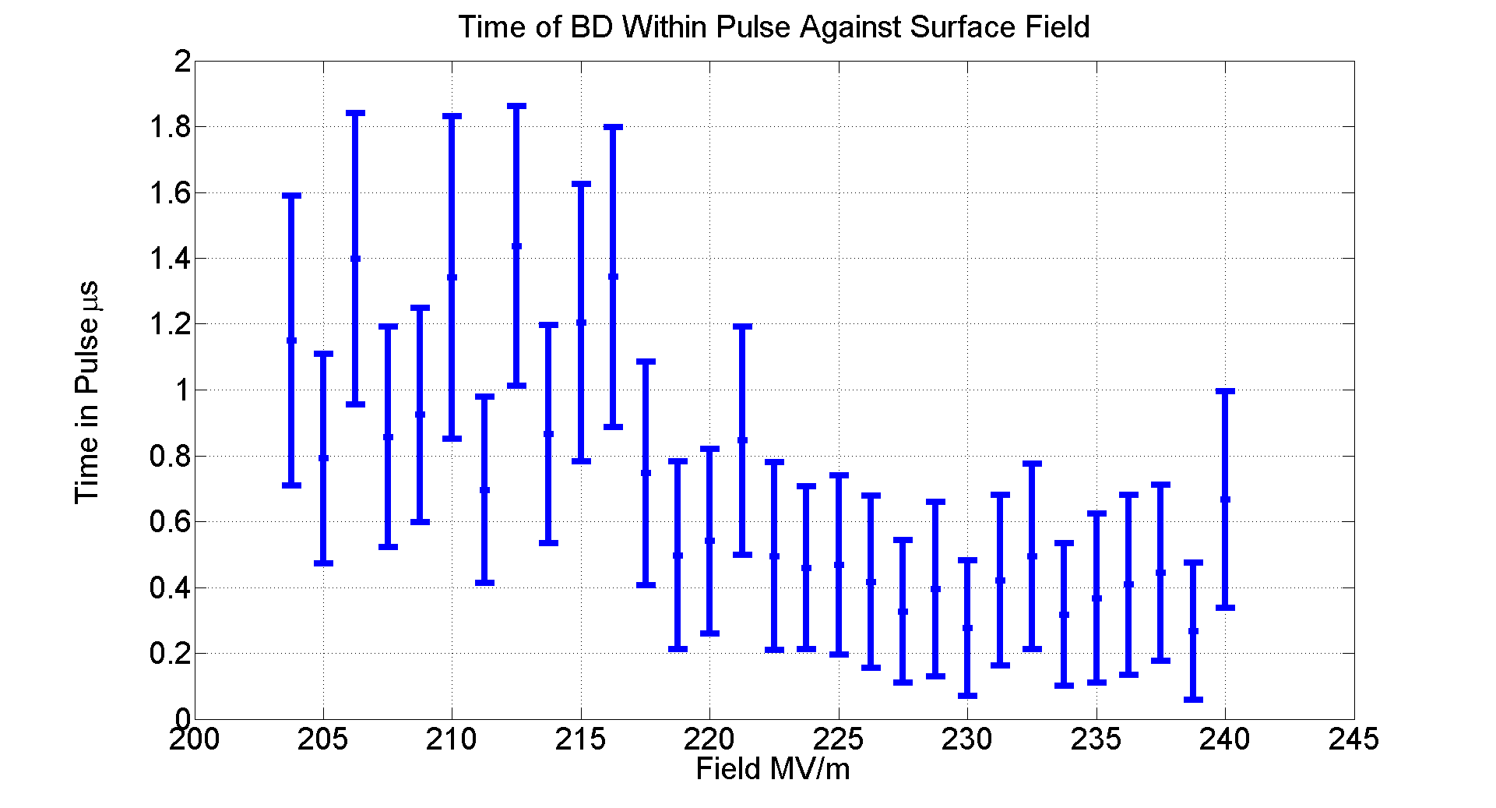
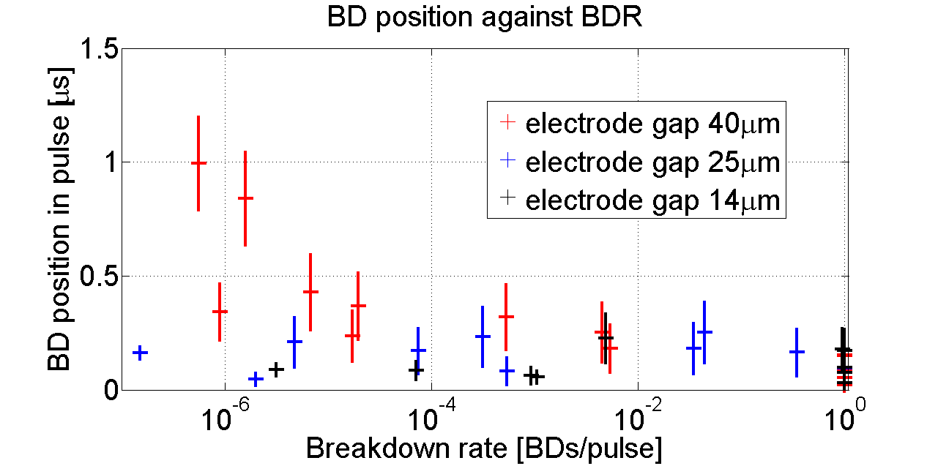
BD position dependencies
The position of the BD within the pulse, in some experiments, is seen to occur later for lower fields and BDRs.
The graph below shows some old data taken at a gap of 20um but before gap monitoring was possible.

Slide 23
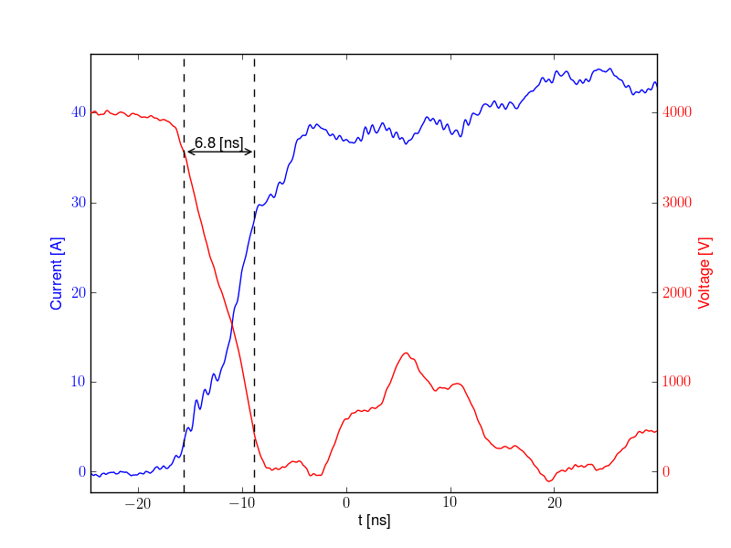
Measured Turn on Times

Slide 24
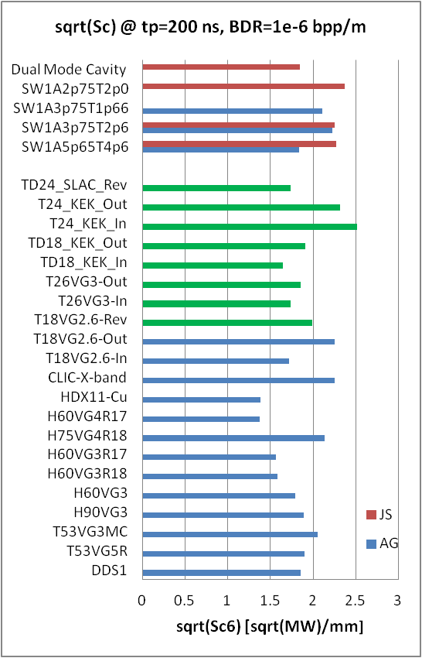
Firstly - why are we interested in turn on time?
RF tests indicate that low group velocity, and consequently narrow bandwidth structures are able to sustain much higher surface fields than high group velocity, large bandwidth, structures.
Further study has led to the idea that the process which governs the turn on time is the instantaneous power flow available to feed the breakdown during its onset.
In other words a high group velocity structure could more quickly replenish local energy density absorbed by a growing breakdown leading to faster turn on times.
An accurate measure of the rise time of breakdowns in the DC systems under electrostatic conditions is an essential precursor to understanding whether the transient response of RF systems to the breakdown currents determine breakdown limits.
For more background see references below
[1] C. Adolphsen 2005, “Advances in Normal Conducting Accelerator Technology from the X-Band Linear Collider Program”, PAC 2005 pp.204-8.
[2] A. Grudiev, S. Calatroni and W. Wuensch 2009, “New local field quantity describing the high gradient limit of accelerating structures”, PRSTAB, vol. 12, no. 10, pp.102001-1 -102001-9.

Slide 25
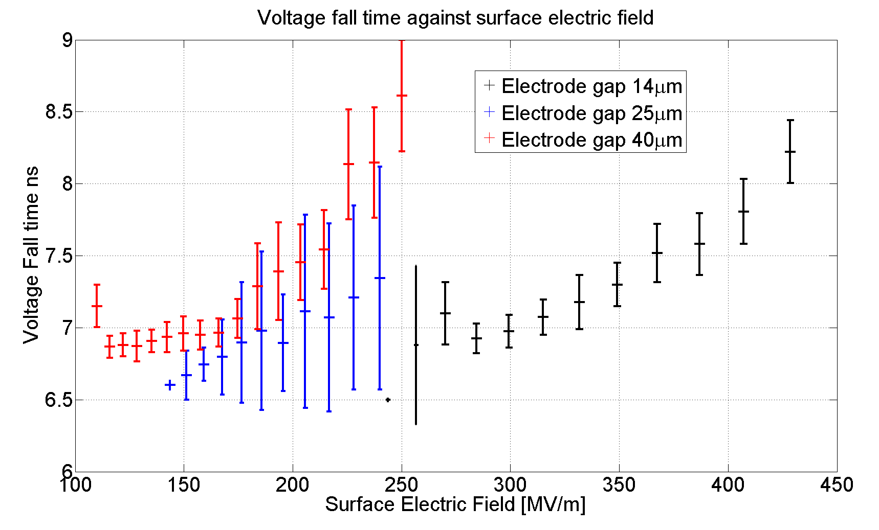
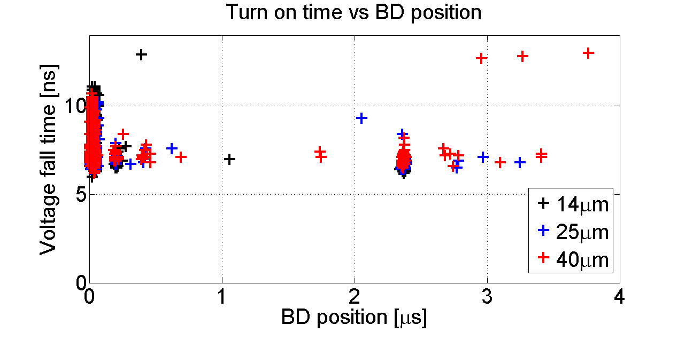
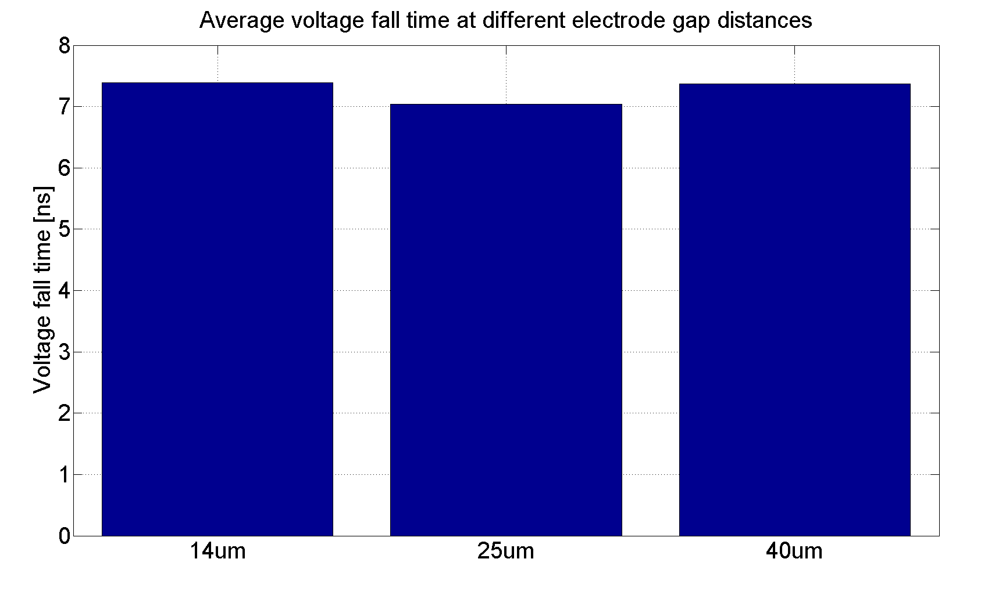
Turn on time measured in the DC Spark system
The turn on time appears uncorrelated with gap size or BD position, but is generally higher at higher surface fields.

Slide 26
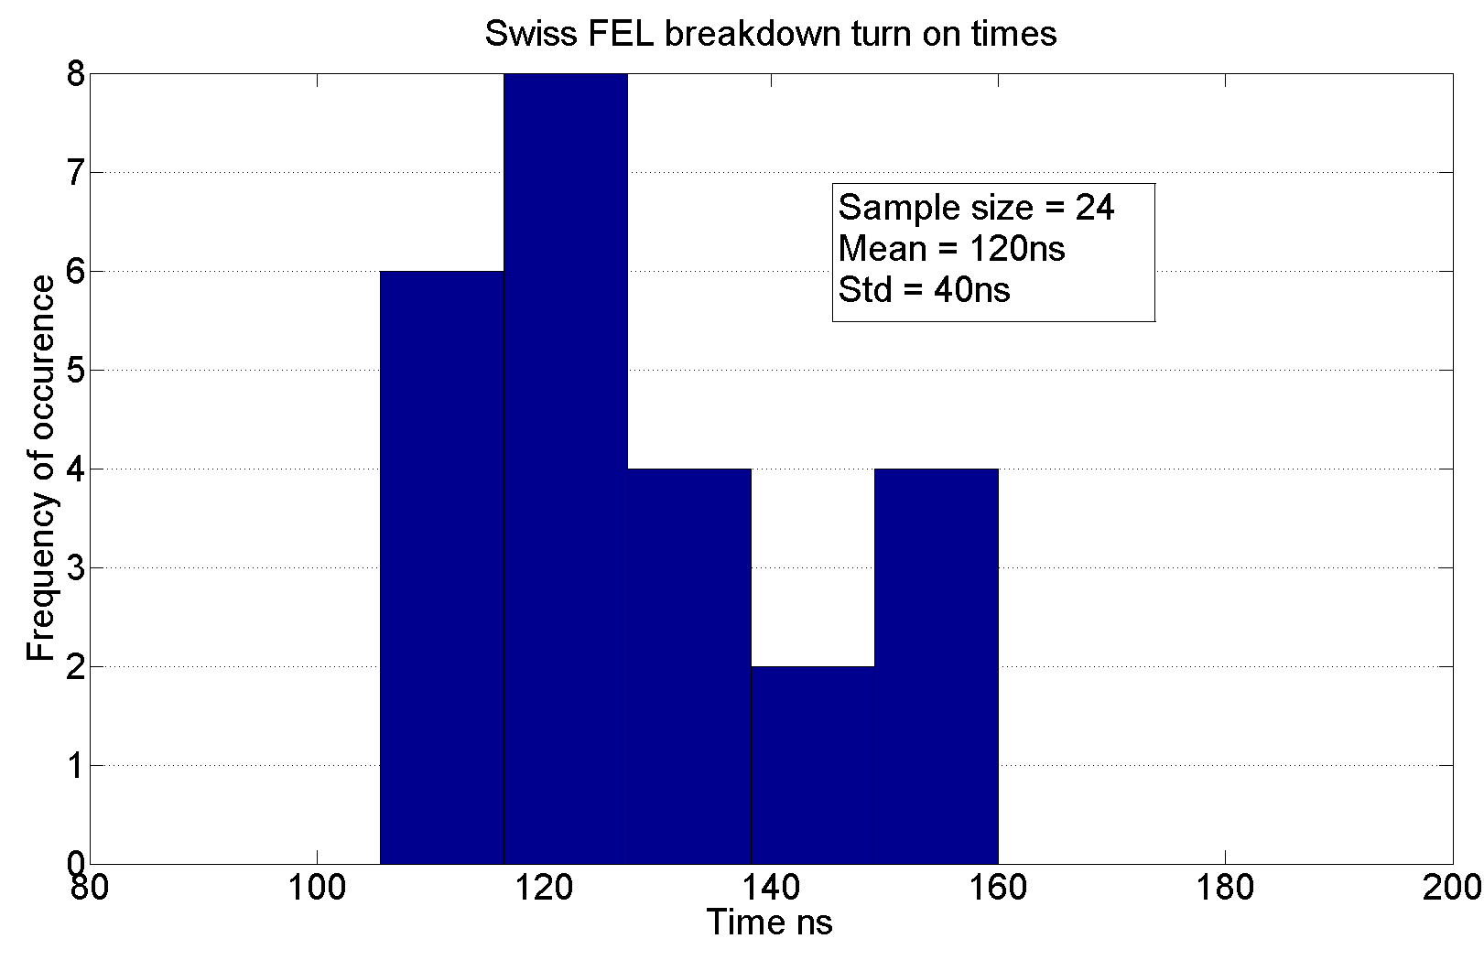
Comparison of falling edge duration
The Swiss FEL turn on times are much longer than in the DC case and the variation is much greater, this is keeping with other RF breakdown turn on time measurements.
Test | Measurement | Result
Simulation |  | ~0.25ns… maybe
New DC System | Voltage Fall Time | ~7ns
TBTS (X-Band) | Transmitted Power Fall Time | 20-40ns
KEK (X-Band) | Transmitted Power Fall Time | 20-40ns
Swiss FEL (C-Band) | Transmitted Power Fall Time | 110-140ns
The summary table on the right suggests the characteristic size of the system breaking down may govern the turn on time.

Slide 27
Measured Burning Voltages

Slide 28
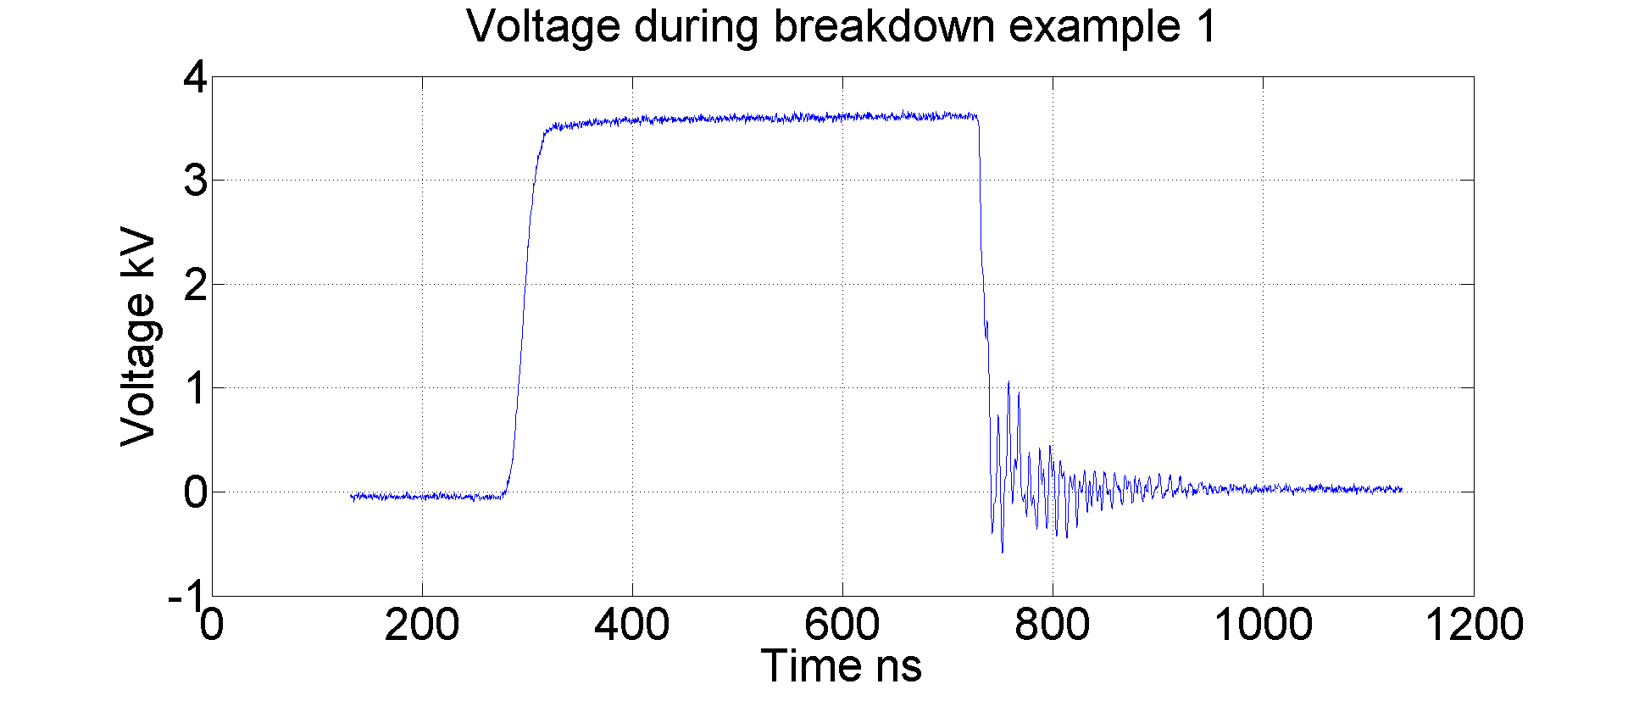
Measured Burning Voltages
The burning voltage was measured across here.
It is the “steady state” voltage across the plasma of a spark during a breakdown at which point most of the voltage is dropped across the 50 Ohm resistor. It is a property of the material.
Subtract average voltage with switch closed from
Average voltage during breakdown after initial voltage fall.

Slide 29
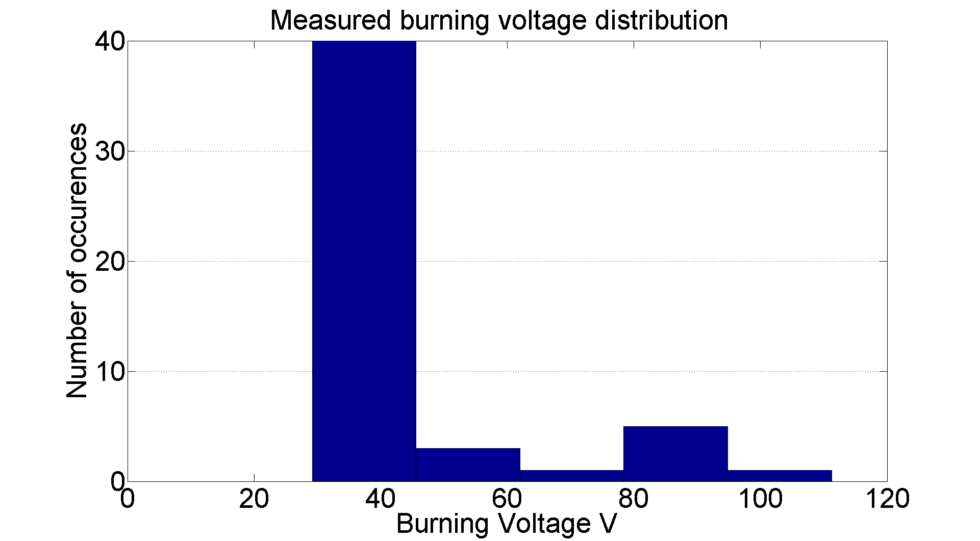
Measured Burning Voltages
The literature gives a value for the burning voltage of clean copper of ~23V. This is lower than what I have measure so far in the DC spark system. But I have not measured or corrected for the short circuit resistance of cables etc.

Slide 30
The Fixed Gap System

Slide 31
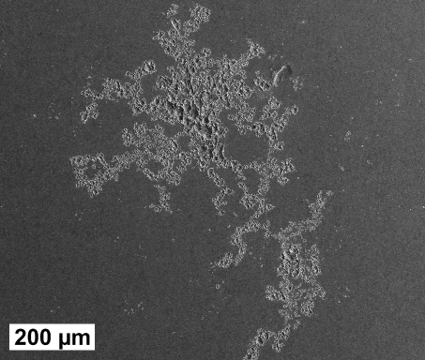
Motivation behind the fixed gap system
This fixed gap system solves two key issues…
There is no need to measure the electrode gap, it is fixed.
The surface area is very much larger, so hopefully breakdown will usually occur on “virgin” surface which hasn’t seen a breakdown yet.
Also the system is very compact 30cm x 30cm. This will allow the whole system to be placed inside a 2T magnet we have at CERN, enabling us to study the effect an external magnetic field has on the BDR.
These SEM pictures well illustrate the difference in experimental conditions in RF tests (Right) which even after 100s of hours of testing shows minimal surface modification compared to just 5 breakdowns in the present DC spark system (Left).

Slide 32
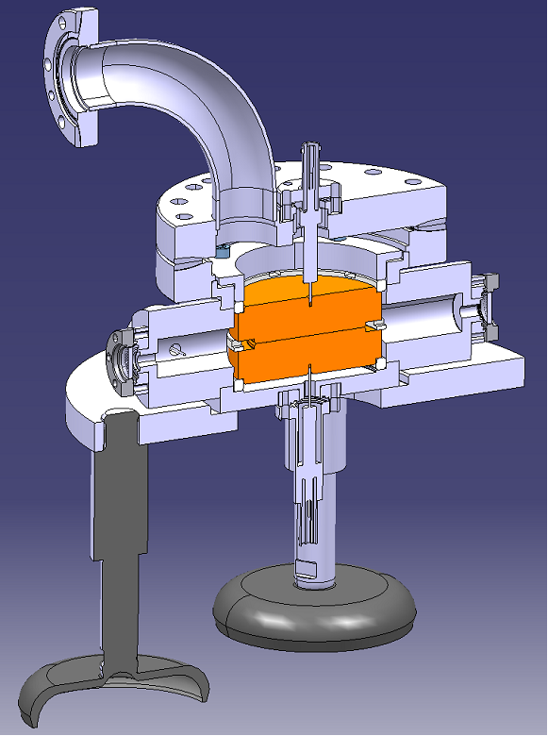
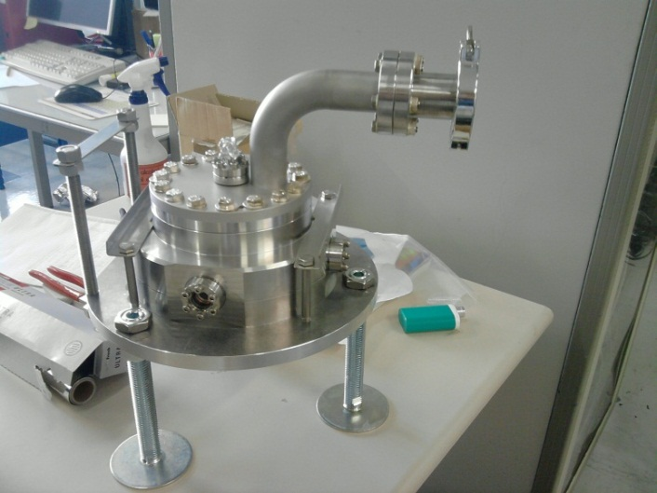
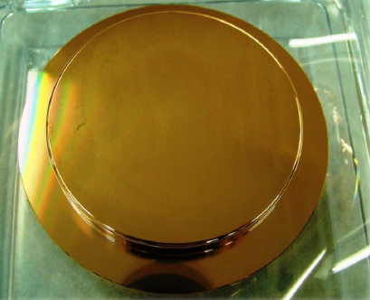
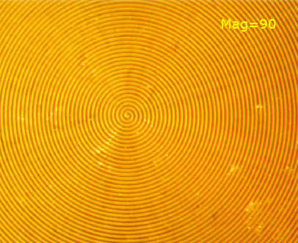
The Fixed Gap System
Despite the comparatively large size of the anodes, the system is very compact. Four antennas are included in the design to pick up the radiation from breakdowns.
The surface of the electrodes are 80mm in diameter and have a surface tolerance of <1um. The picture on the right shows the high precision turning.

Slide 33
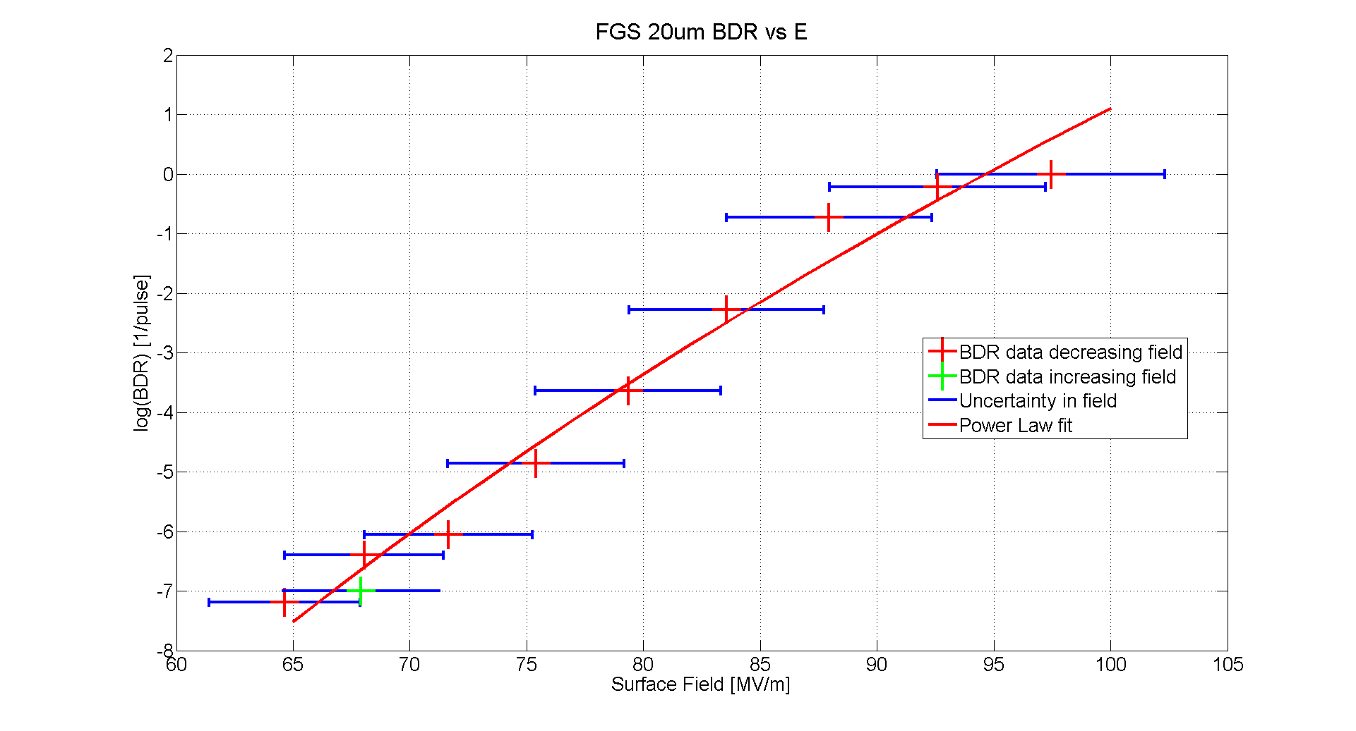
The Fixed Gap System
BDR ~ E⁴⁵
First voltage was decreased in steps of 5% (red). Once a BDR of ~5*10^-8 was achieved the voltage was increased in steps of 5% (green). The experiment is still running. We expect the electrodes have conditioned so the BDR data in green will always be consistently lower than the BDR data in red.

Slide 34
Future Plans
Probe lower BDRs and try to improve error on field (better gap measurement).
Study the effect of the magnetic field on the BDR for the fixed gap system.
Study pulse length dependence.
Study dependence on temperature.

