Slide 1
Roadmap for CLIC high-efficiency klystron development
I. Syratchev, CERN

Slide 2
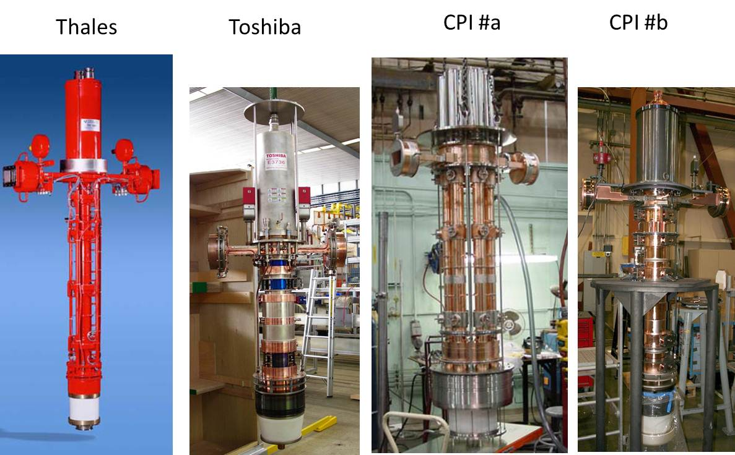
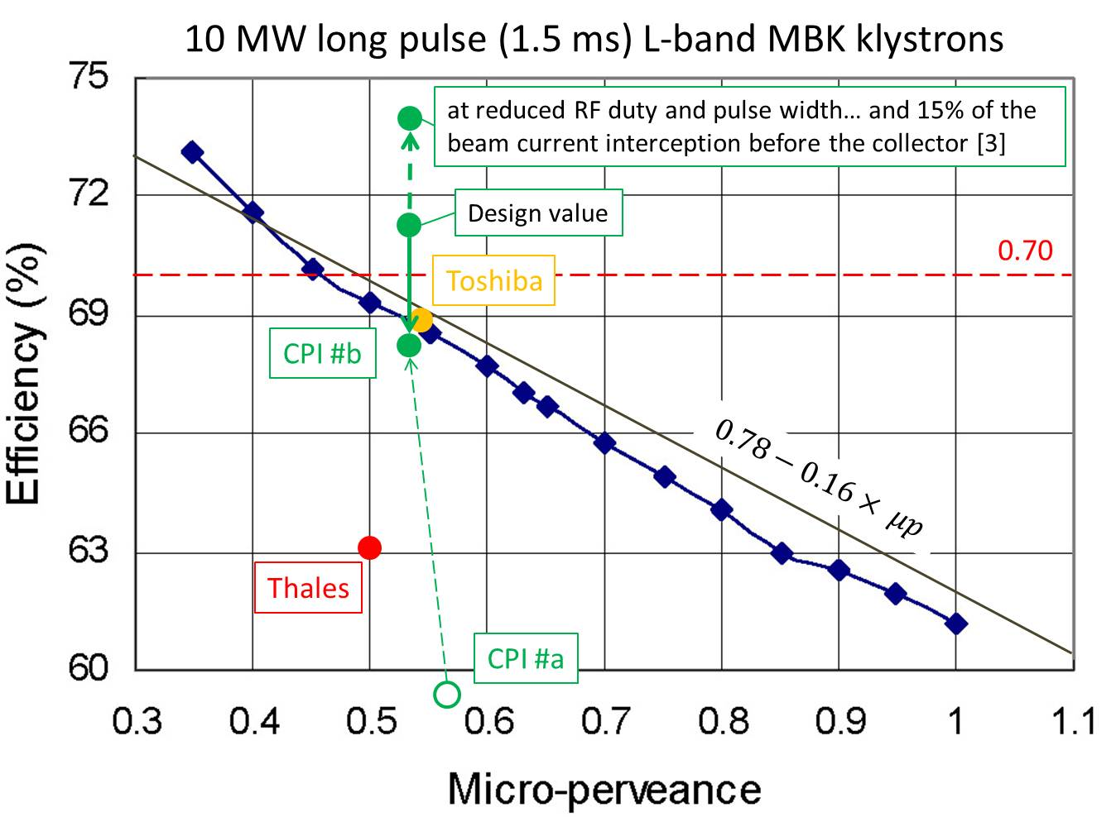
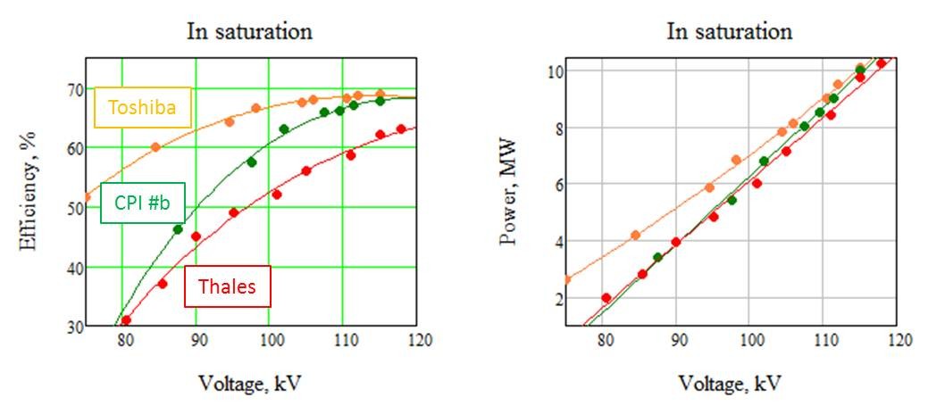
State of art: L-band 10 MW MBK klystrons for ILC.
In terms of achieved efficiency at 10 MW peak RF power level, the existing MBK klystrons provides values very close to the 70%, as is specified in CLIC CDR.

Slide 3
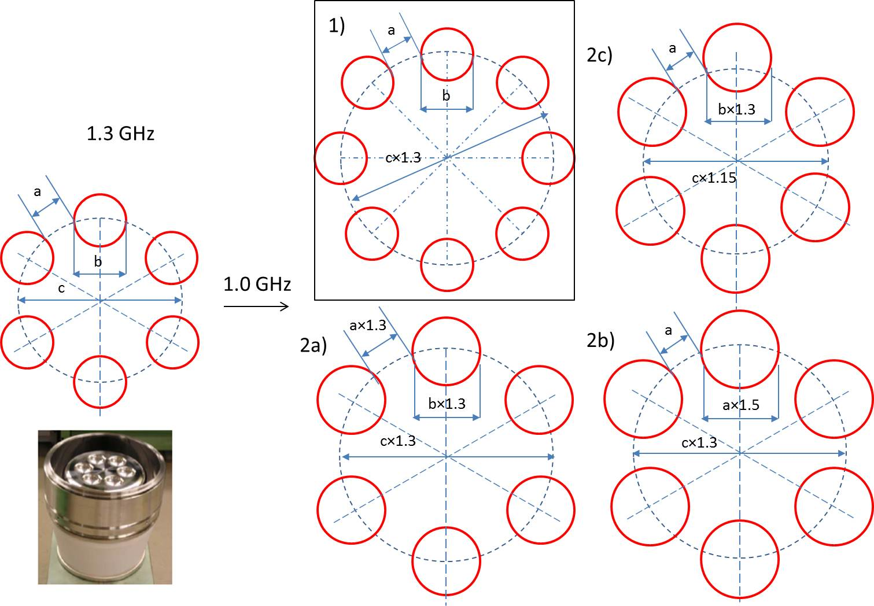
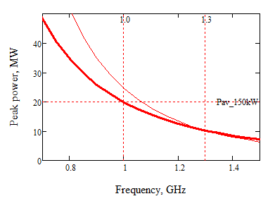
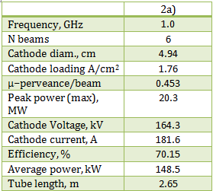
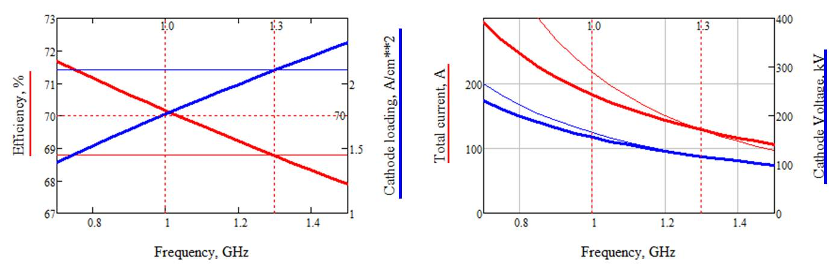
Extending technology: L-band 20 MW MBK klystron for CLIC.
We made a study which indicates that the scaling of existing tubes down in frequency may end up in rather powerful (>20 MW) and efficient (>70%) MBK.
Currently we are in process of ordering such a tube(s). See Steffen Doebert presentation for more details.

Slide 4
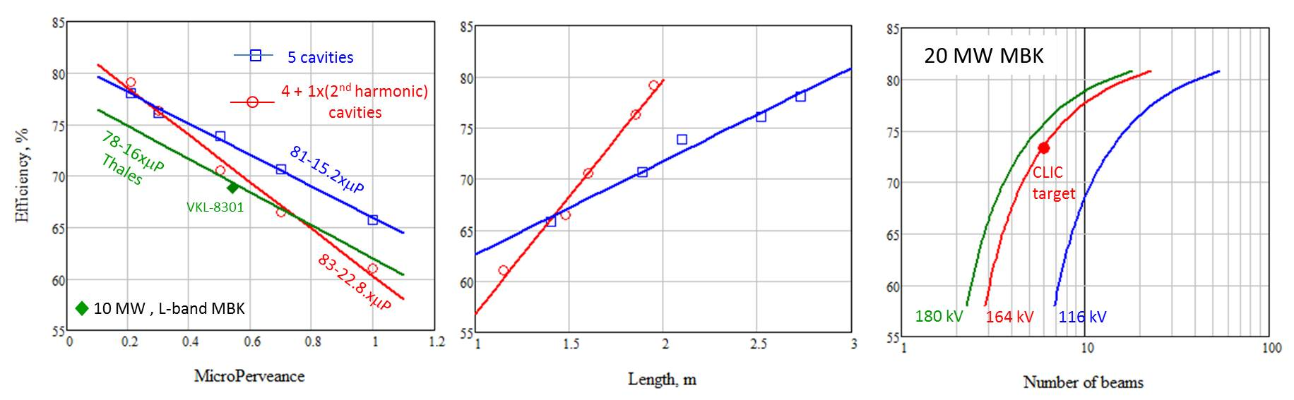
Scaling of the klystron parameters
Dedicated campaign to make parametric study of the high efficiency klystrons was conducted by Chiara Marrelli (Manchester/CERN) using 1D klystron computer code AJDISK:
The extension of existing technology above 20 MW RF power and 75% efficiency looks very challenging. One will need to increase substantially the number of beamlets in MBK and/or cathode voltage (soon limited for the long RF pulses at ~200 kV).
All these might be rather expensive (complicated cathode unit and long tube length).

Slide 5
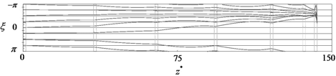
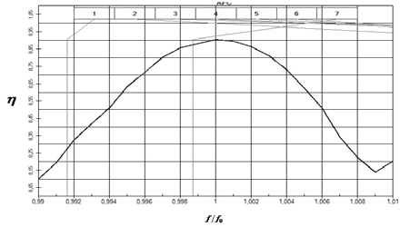
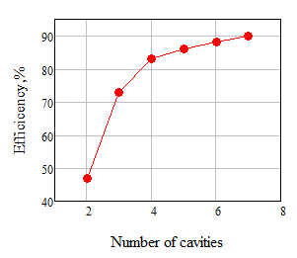
90% efficient klystrons ?!
Courtesy of A. Baikov.
Moscow University of Finance and Law.
Russia
For the highest efficiency, the velocities of electrons within the bunch at the klystron exit should be almost identical. It can be achieved with significant lengthening of the tube, when core of the bunch experiences few ‘oscillations’, thus averaging the electrons velocities within the bunch due to space charge forces.
Lengthening the klystron allows as well to collect the electrons with least modulation (outside the bunch core).
Increasing the number of bunching cavities and arranging the drift tube lengths and cavities frequencies along the tube under very specific rules, will allow to minimize the phase length of the bunches at the output cavity and to reduce the tube length.

Slide 6
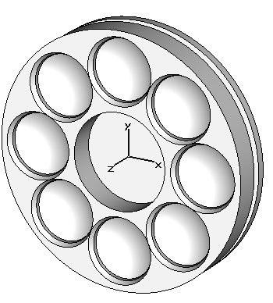
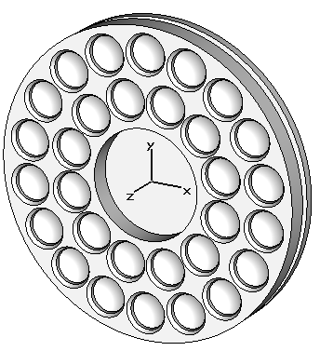
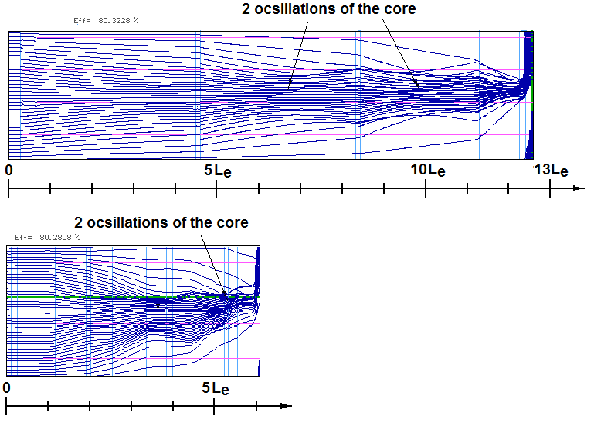
Very high (80%) efficiency MBK. Proposed by I. Guzilov
(JSC “Basic Technology of Vacuum Devices”, Moscow, Russia)
Step 1. From 8 to 30 beams.
Lowering perveance and voltage.
CLIC/20 MW BTVD/20 MW
Voltage, kV 164 116
Beams # 6-8 30
Total current, A 181 233
Perveance x10⁻⁶ 0.45 0.2
Efficiency 72 80
Length, m 1.7 1.2
Step 2. Design “conventional” efficient klystron (8 beams).
Step 3. Implement the novel bunching technique (30 beams).
Bunch core oscillations
Collecting outside electrons
Tube length 3.0 m; 164kV; 80%
Tube length reduced to 1.2 m; 116 kV; 80%
For more details see presentation by Igor Guzilov

Slide 7

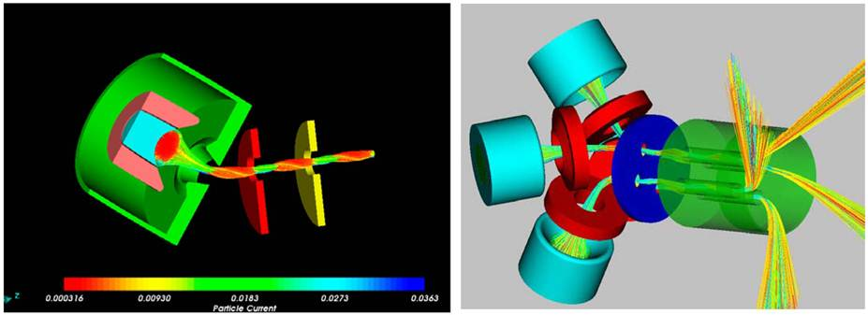
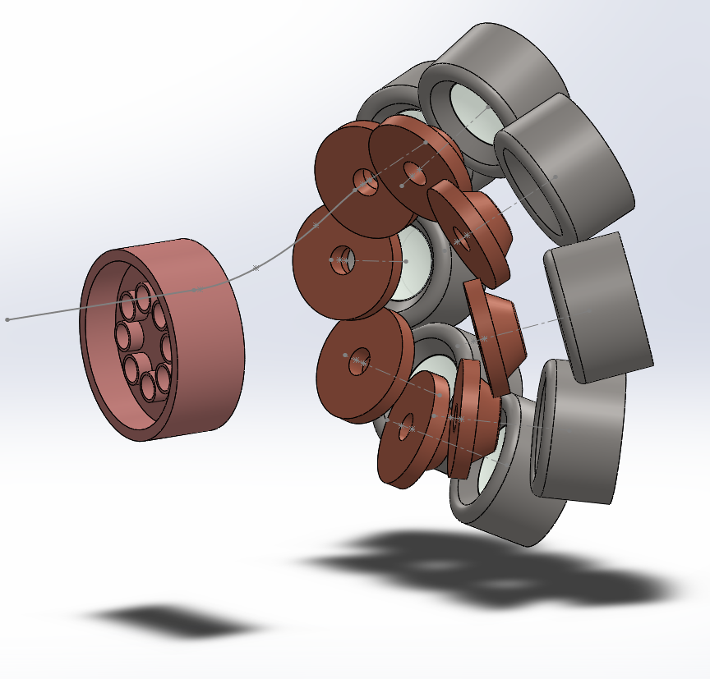
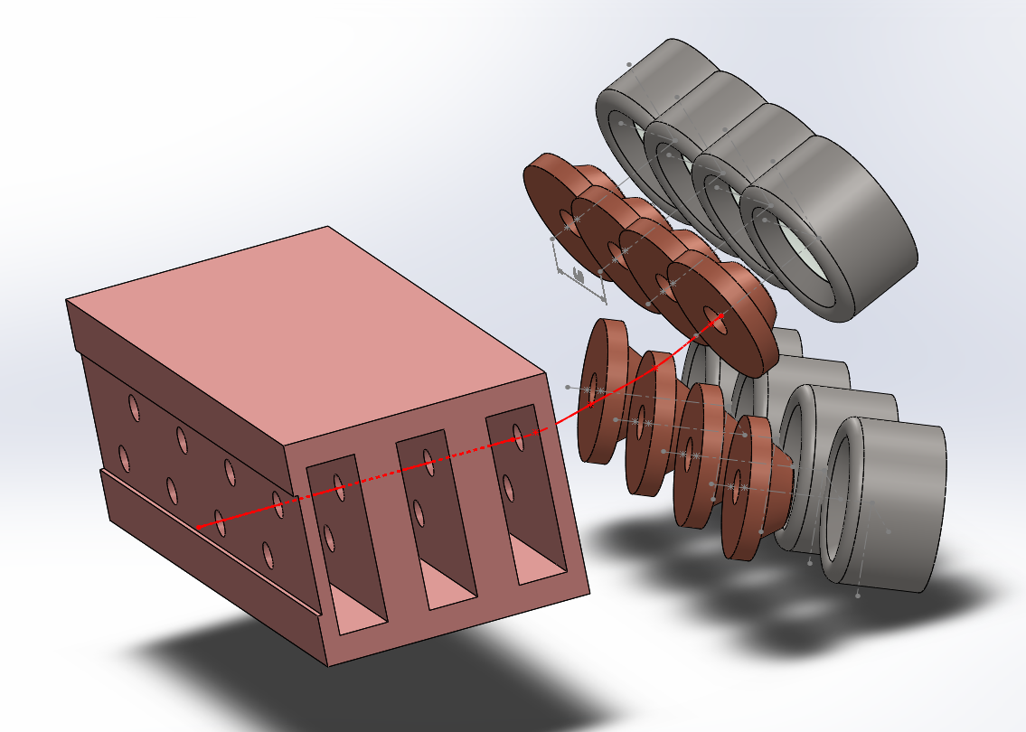
New cathode topology
Doubly Convergent Multiple-Beam Electron Guns
The multiple beam guns with two stages of compression allows to de-couple the gun and RF circuit topologies and opens the way towards very high power efficient klystrons.
+ PPM focusing

Slide 8
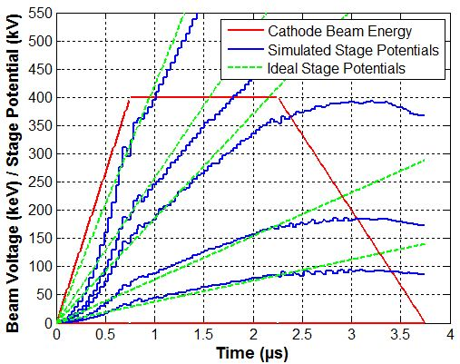

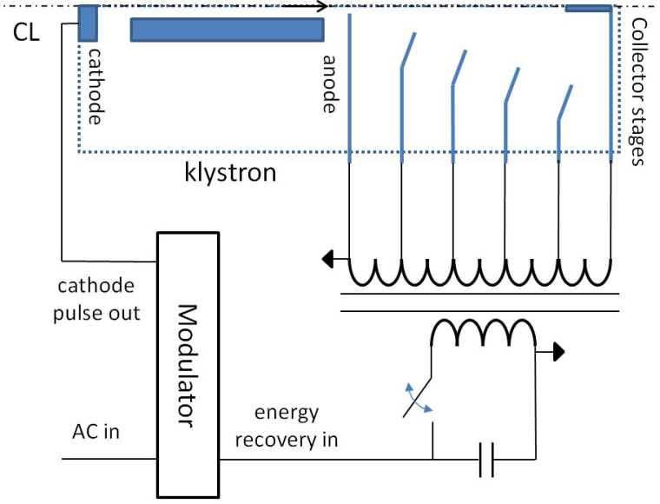
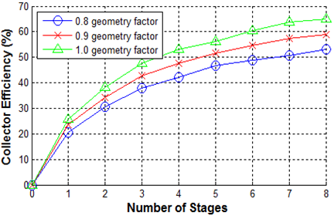
System efficiency and depressed collector
IVEC 2013
A pulsed depressed collector which uses a novel feed-forward energy recovery scheme. It also allows to recover the rise and fall time of the modulator pulse (opens a potential to reduce modulator price).
Projected Performance for SLAC 5045 Klystron
“…For the highest efficiency, the velocities of electrons within the bunch at the klystron exit should be almost identical…” – single stage compression?

Slide 9
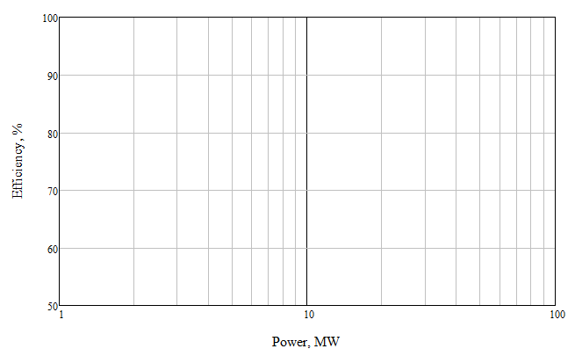
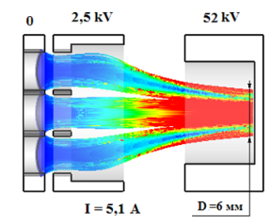
Strategy for high-efficiency high RF power klystron development
L-band
CW (TLEP, proton linac)
>30 beams; <30 kV?
??? years
4 years
L-band
CLIC
30 beams; 116 kV
2/gun+3years
L-band
CLIC/Double C. Gun
12 beams; 164 kV
2 years
Optionally – gun with controlled electrode (2.5 kV)
S-band Demonstrator
30 beams; 52 kV
L-band
CLIC
6-8 beams; 164 kV
Exploring X-band MBK
L-band
ILC
6 beams; 116 kV
2 years
Exists
2
6
20
40

