Slide 1


Measurement of H→ WW* fully hadronic in HZ at 350 GeV
Measurement of H to ZZ* at 1.4 TeV
status reports
M. Pandurović G. Milutinović-Dumbelović
I. Božović-Jelisavčić, S. Lukić, P. Roloff

Slide 2
Common points
We are measuring BF of H→VV (V=W,Z) to extract Higgs couplings
Multijet final states
Full analysis chain
The status of both analysis after the preselection will be presented

Slide 3
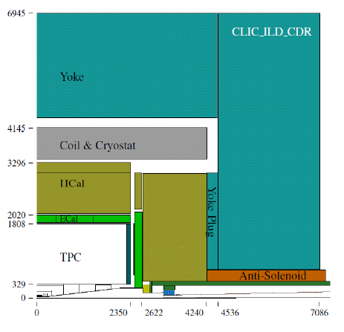
Common points
Simulation and Reconstruction
Fully simulated events:
Event generation with WHIZARD v.1.95
including ISR and BS
Beamspectrum generated with
GUINEAPIG
Hadronization with PYTHIA
Assuming m_{H}=126 GeV
CLIC_ILD detector
Particle reconstruction
and identication using
PandoraPFA

Slide 4
Measurement of H→ WW* fully hadronic in HZ at 350 GeV
Mila Pandurović

Slide 5
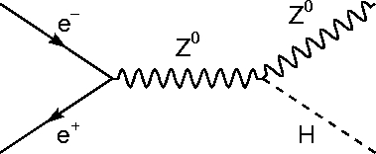
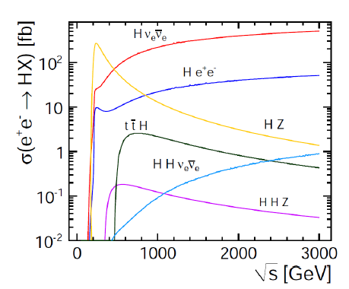
Introduction
HZ @350GeV σ(e⁺e⁻ →HZ)=134 fb
H→WW→qqqq , Z →ff, f=e,μ,q
Favourable BF:
BF(H→WW)~23% BF(WW→qqqq )~45%
BF(Z→ll )~10%
BF(Z→qq )~70%

Slide 6
Signal and background processes
Signal HZ, H→WW→qqqq | σ [fb]
Z→ee | 0.48
Z→μμ | 0.48
Z→qq | 9.7
Background
HZ, other H decays, Z vis. d. | 92.02
e⁺e⁻ →qqqq | 5847
e⁺e⁻ →qqll | 1704
e⁺e⁻ →qqlν | 5914
e⁺e⁻ →qqνν | 324.6

Slide 7
Analysis chain H→WW→qqqq , Z →ll
Semileptonic FS: H→WW→qqqq , Z →ll , l=e, μ
Isolated lepton finder !
FastJet Finder: Kt exclusive algorithm - 4 jet FS
Hadronic FS: H→WW→qqqq , Z →qq
FastJet Finder: Kt exclusive algorithm - 6 jet FS
Lepton finding
Jet Clustering
Preselection optimization
  mH , mW1, mW2, mZ, pT jet , Evis, jet transitions, (Θ_{el})
Flavour tagging (b,c) LCFIPlus to reduce H->bb background
MVA analysis

Slide 8
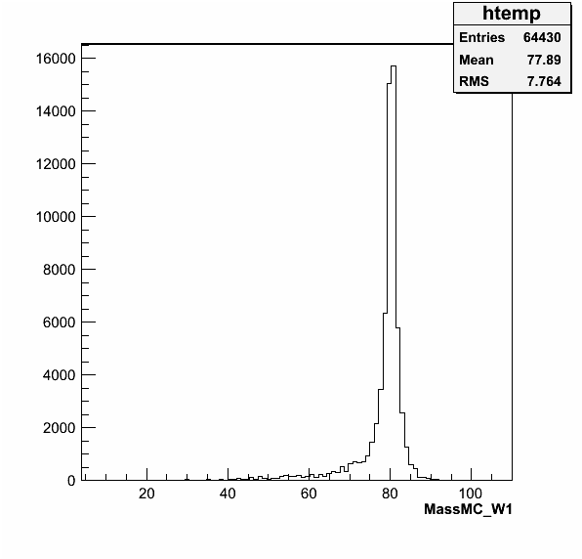
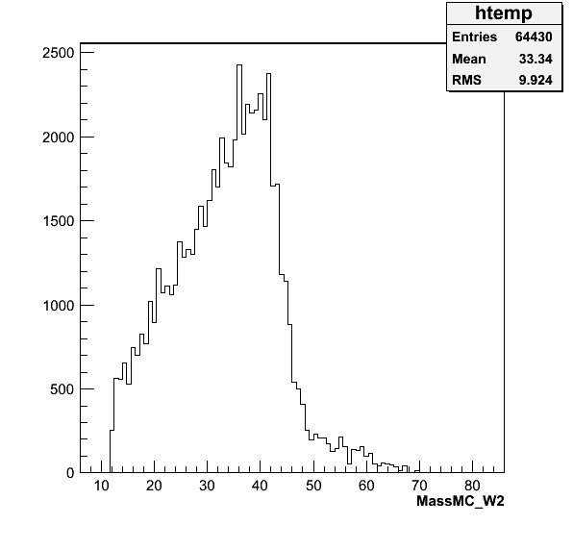
Signal Monte Carlo H→WW→qqqq , Z →ll
WW decaying into four jets: real and off-shell W.
The reconstruction is based on the pari of jets with the mass closest to the mass of real W.
m_{W1} [GeV]
m_{W2} [GeV]

Slide 9
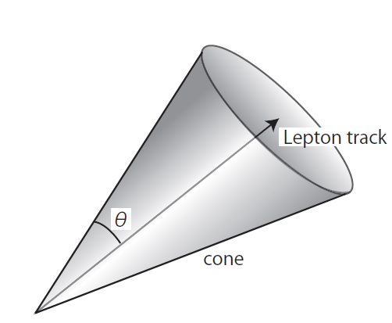
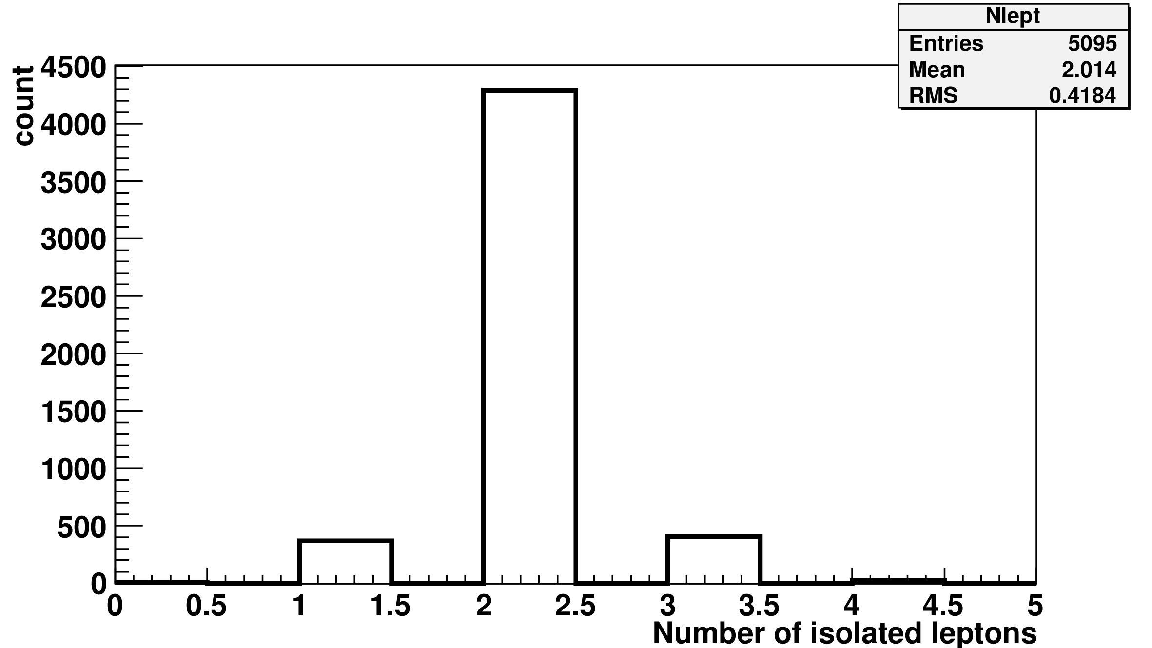
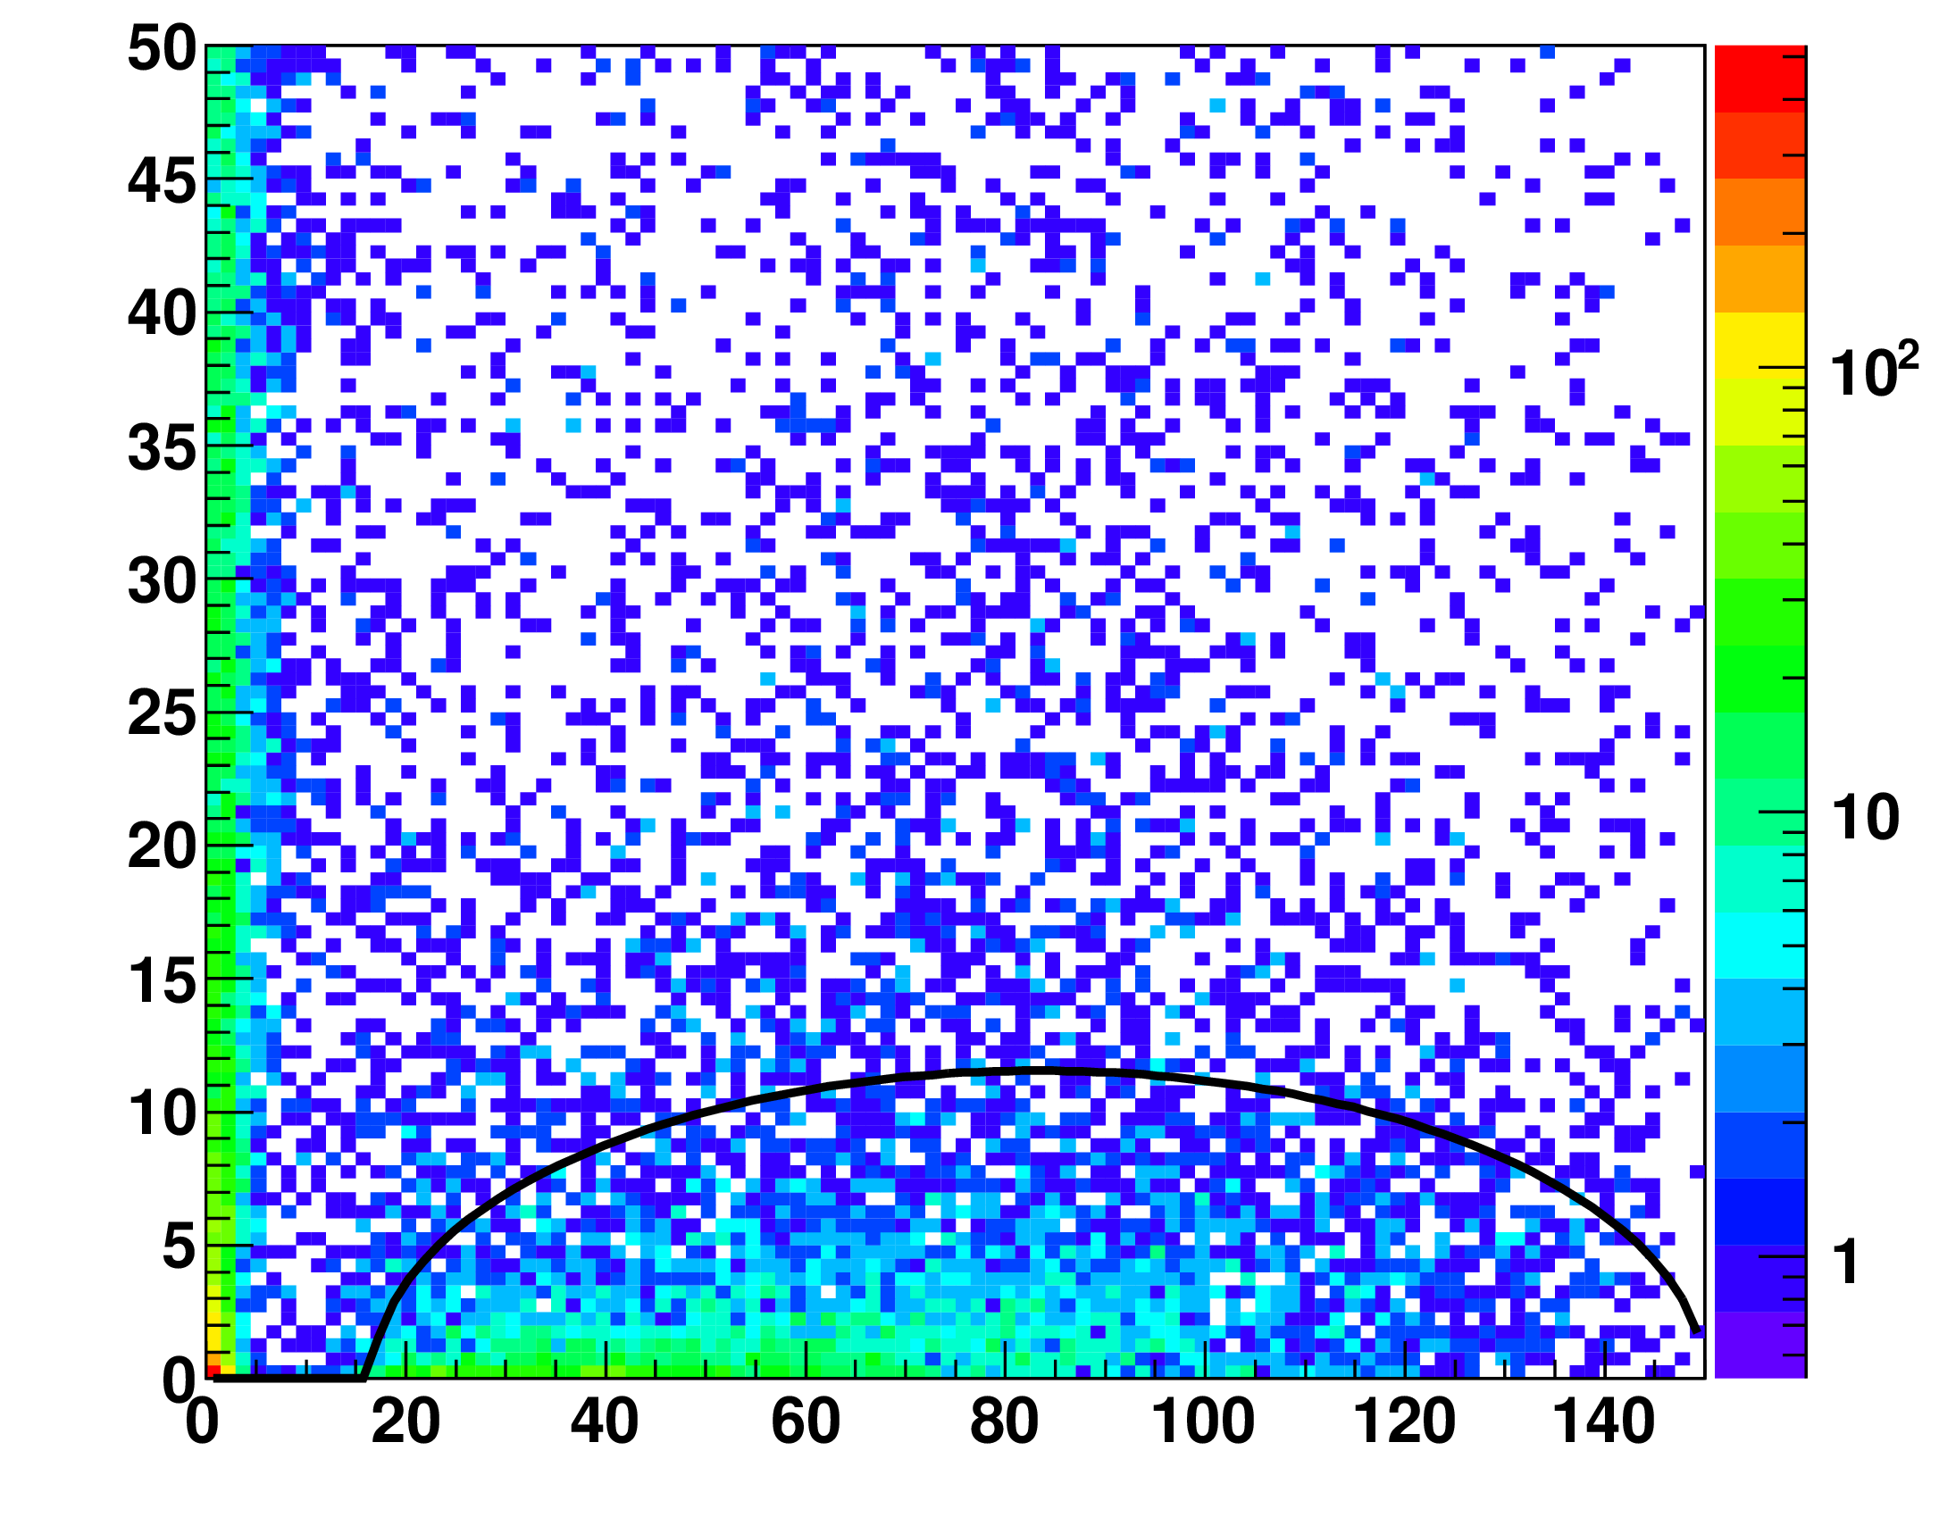
Isolation of lepton H→WW→qqqq , Z →ll
Based on the track energy of a lepton candidate and calorimeter depositions within a cone of size cos θ=0.995 around lepton candidate track.
Etrack = 12 GeV
Econe [GeV]
85% efficiency in reconstruction of the ‘pure’ lepton pair
Etrack [GeV]

Slide 10
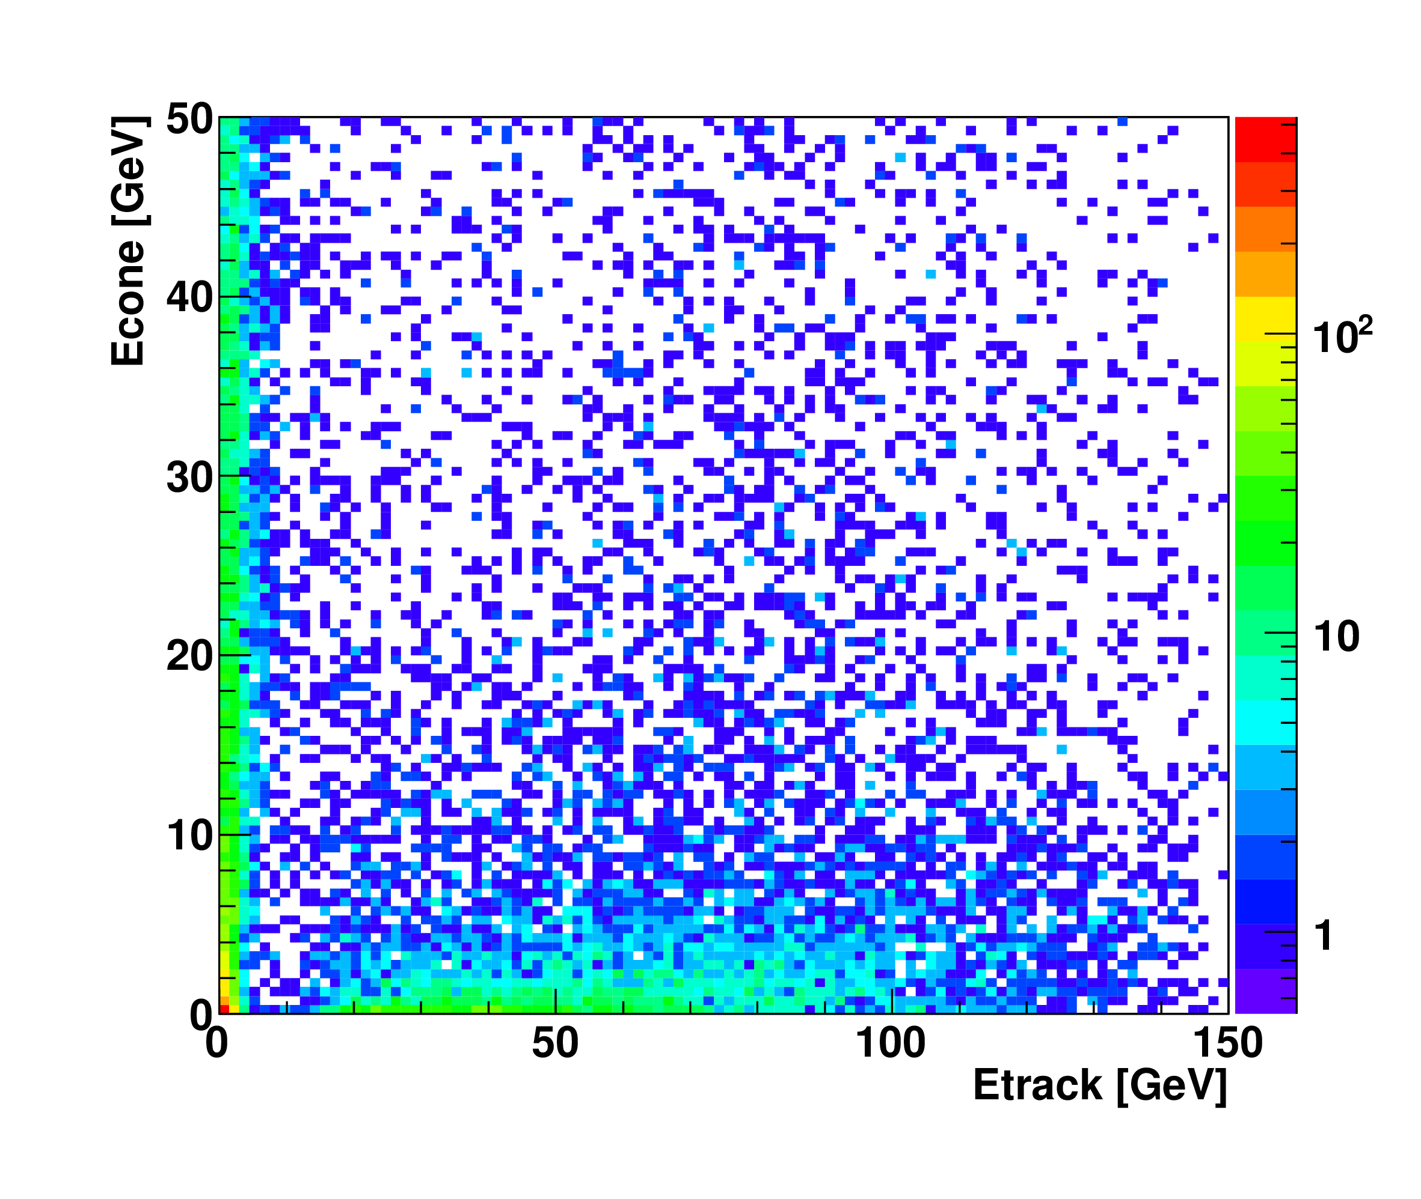
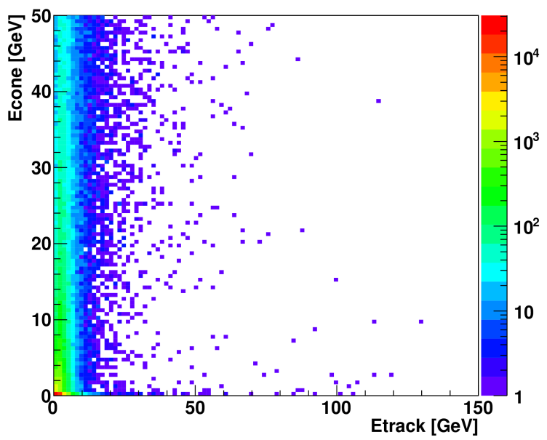
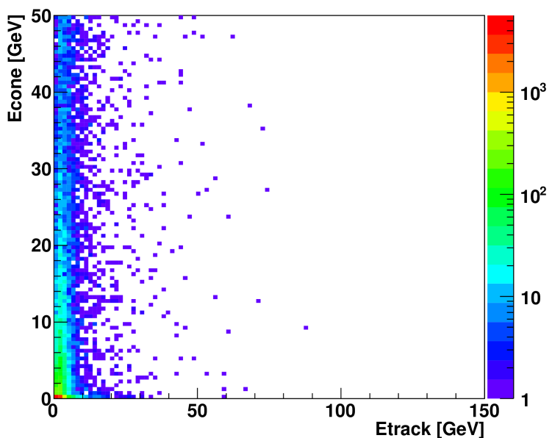
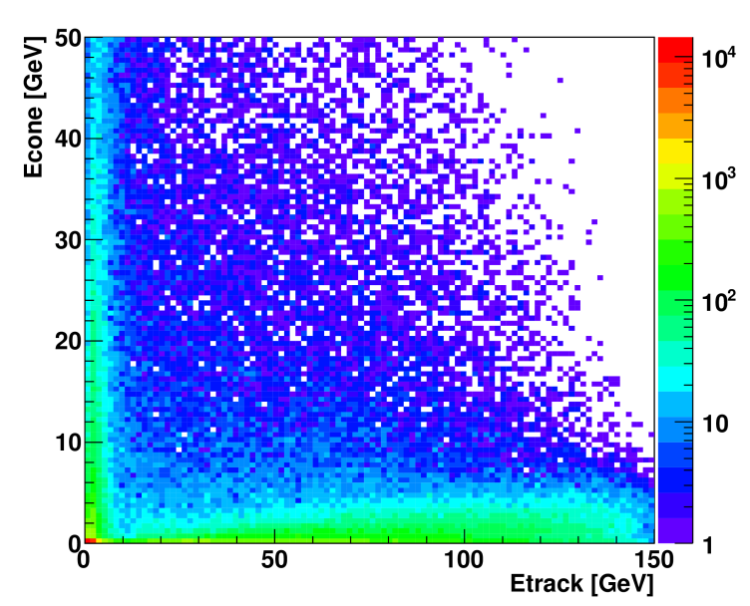
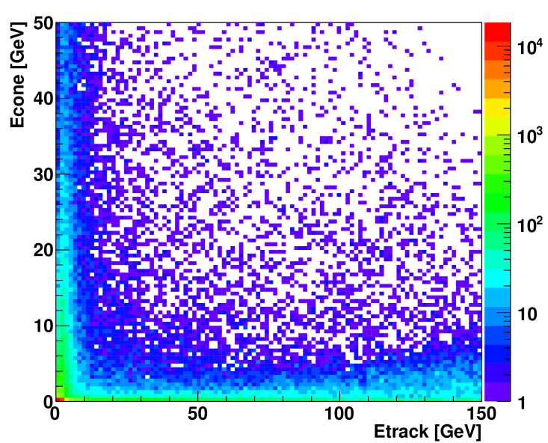
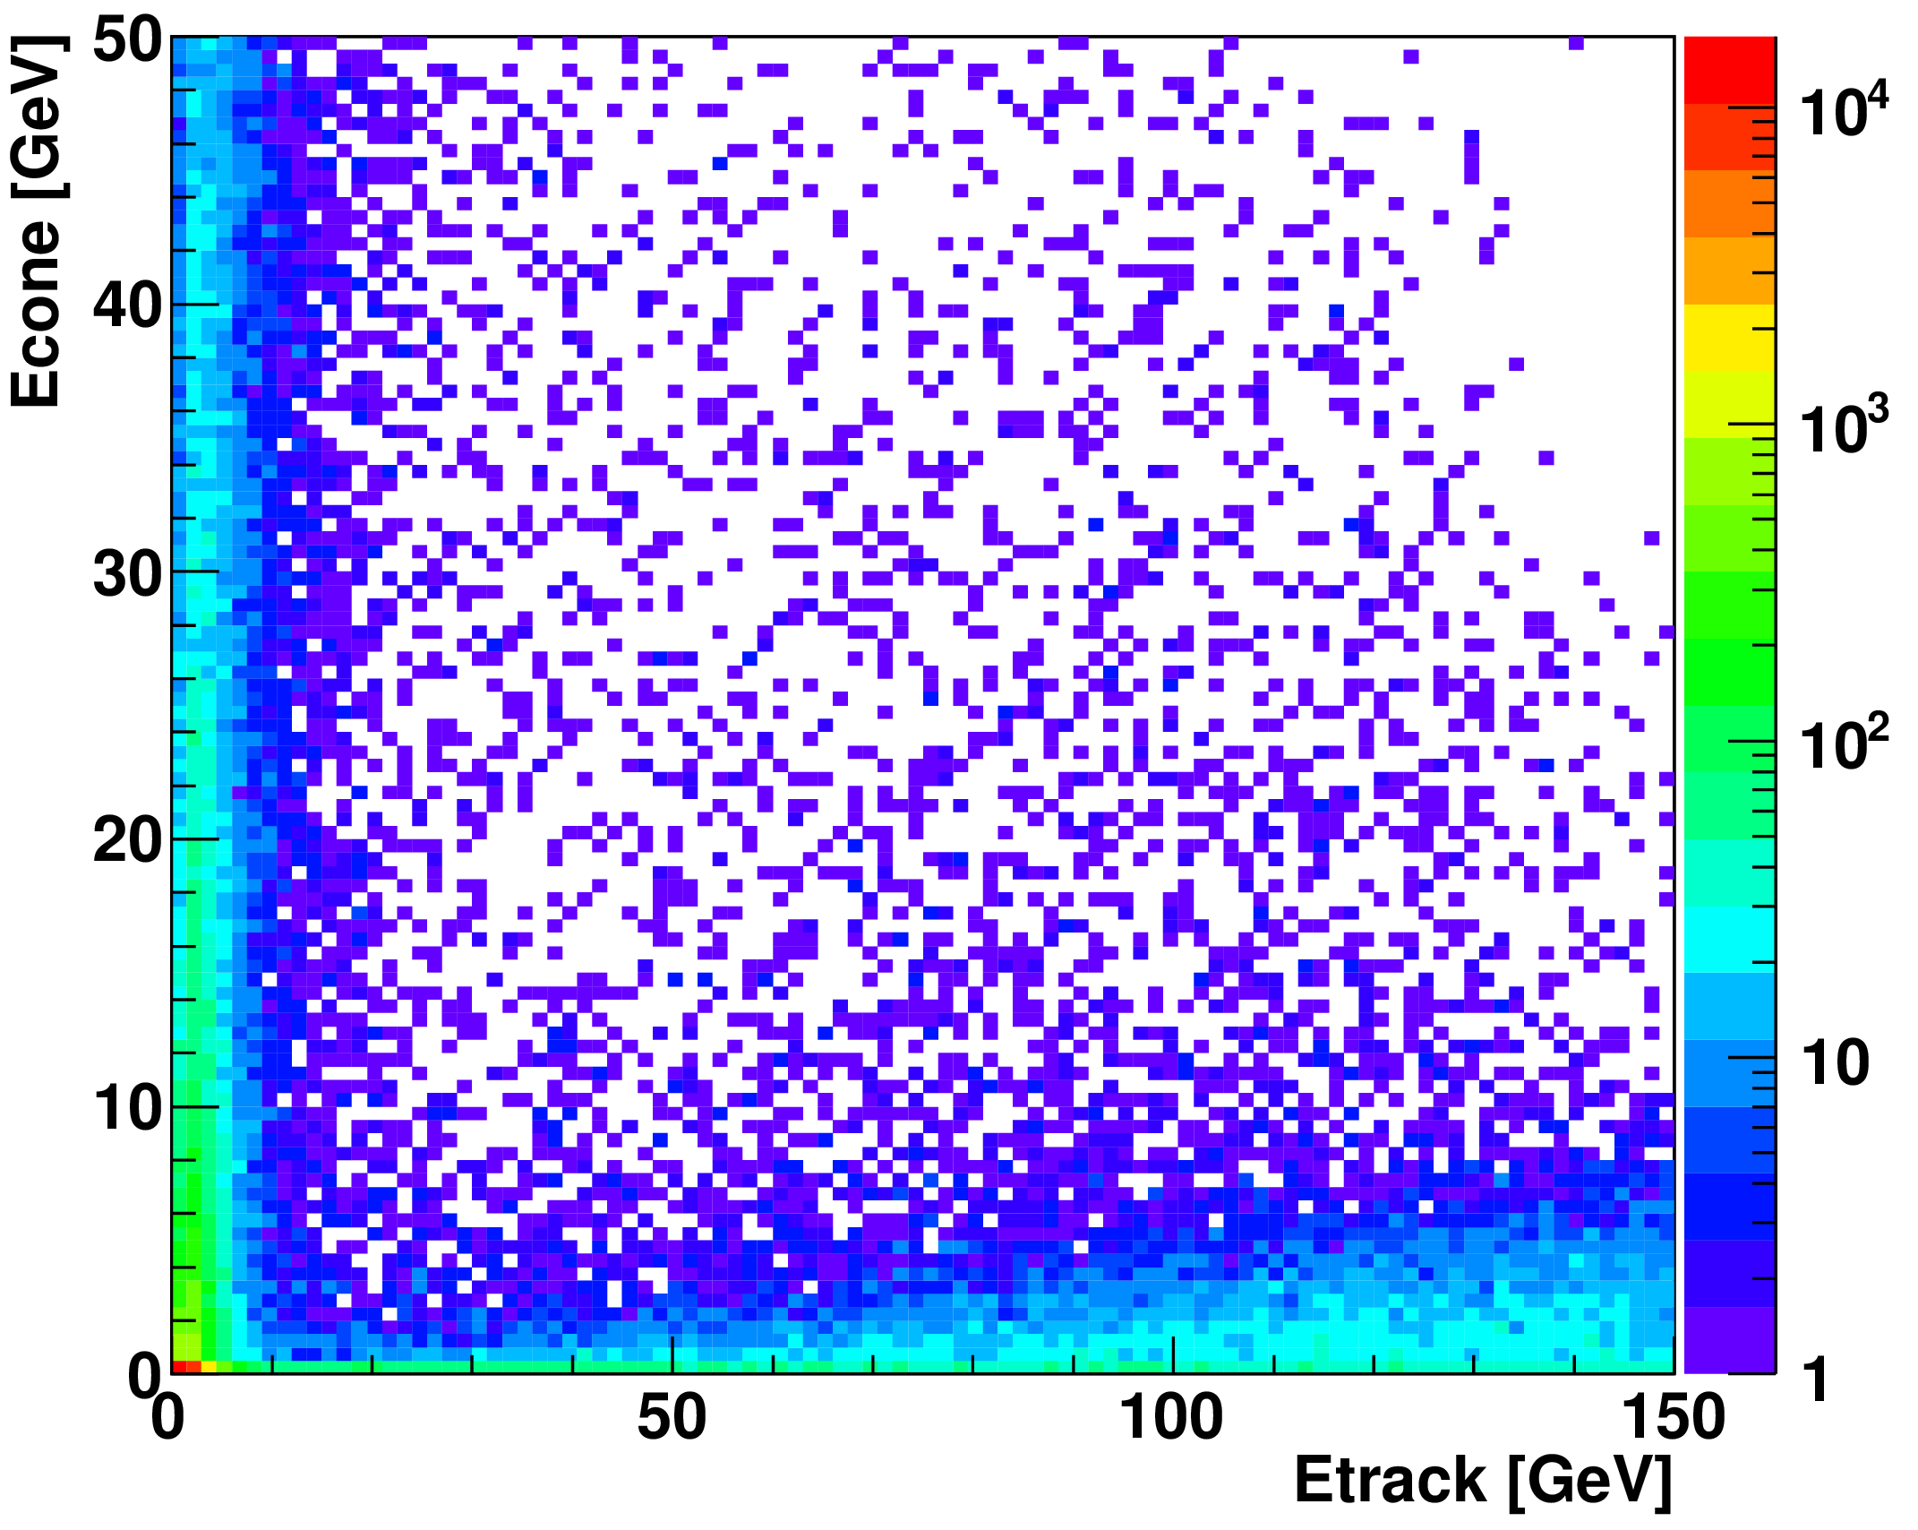
Lepton isolation H→WW→qqqq , Z →ll
signal
e⁺e⁻→qqqq
e⁺e⁻→qqνν
e⁺e⁻→H→ all other decays
e⁺e⁻→qqll
e⁺e⁻→qqlν

Slide 11
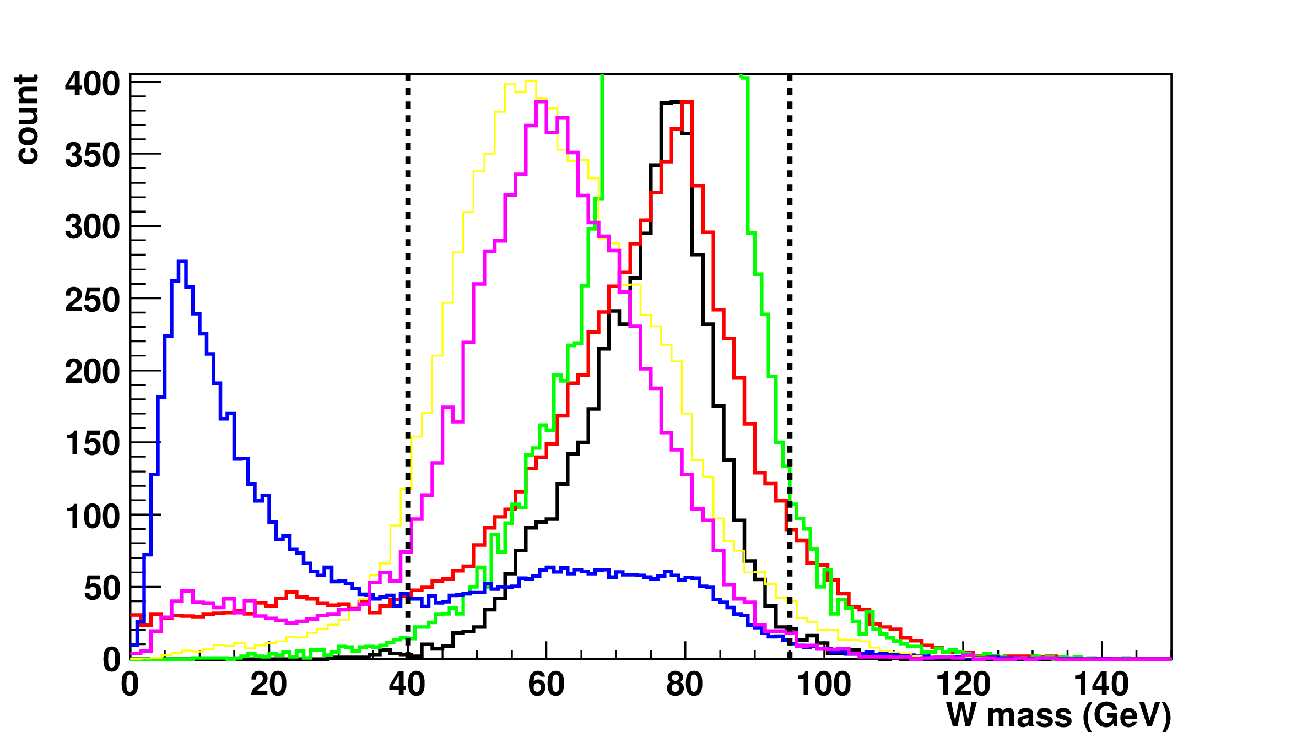
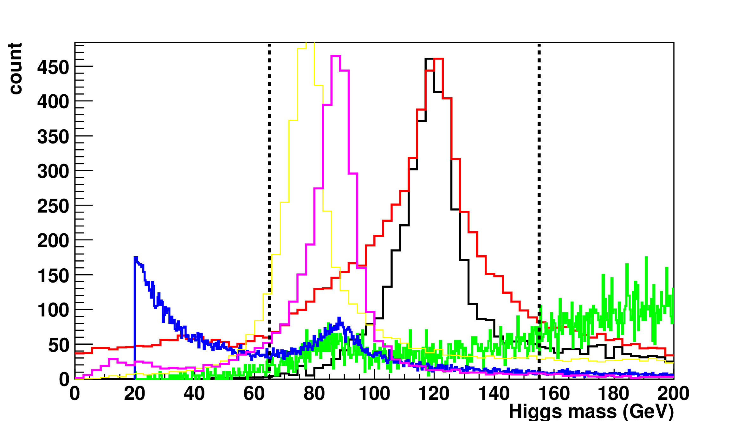
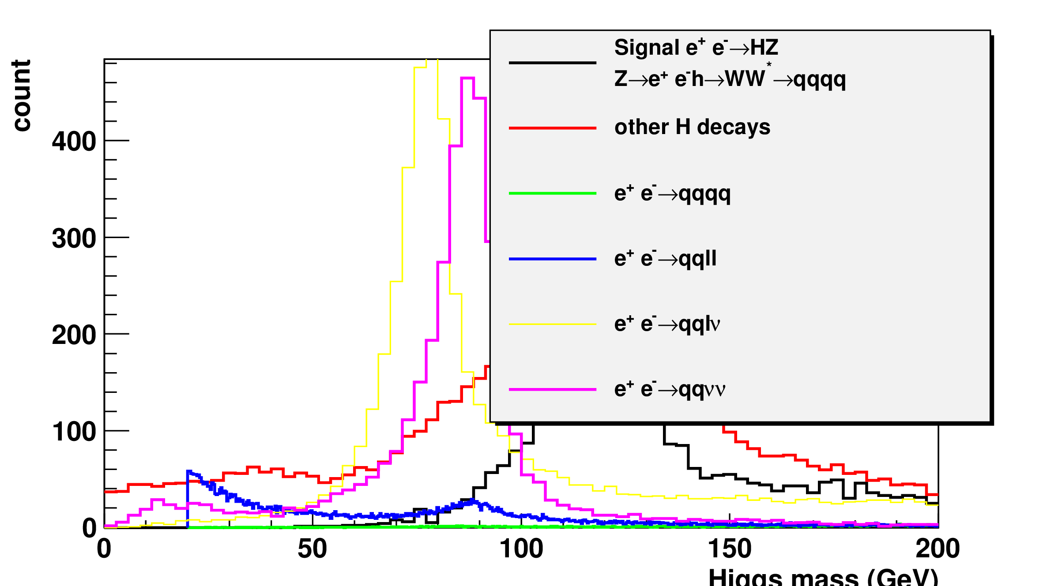
Preselection variables H→WW→qqqq , Z →ll
reconstruction focuses on a real W: jet pair with the mass closest to the W mass is chosen as a W candidate
45 GeV < m_{W} < 95 GeV
65GeV < m_{H} < 155 GeV

Slide 12
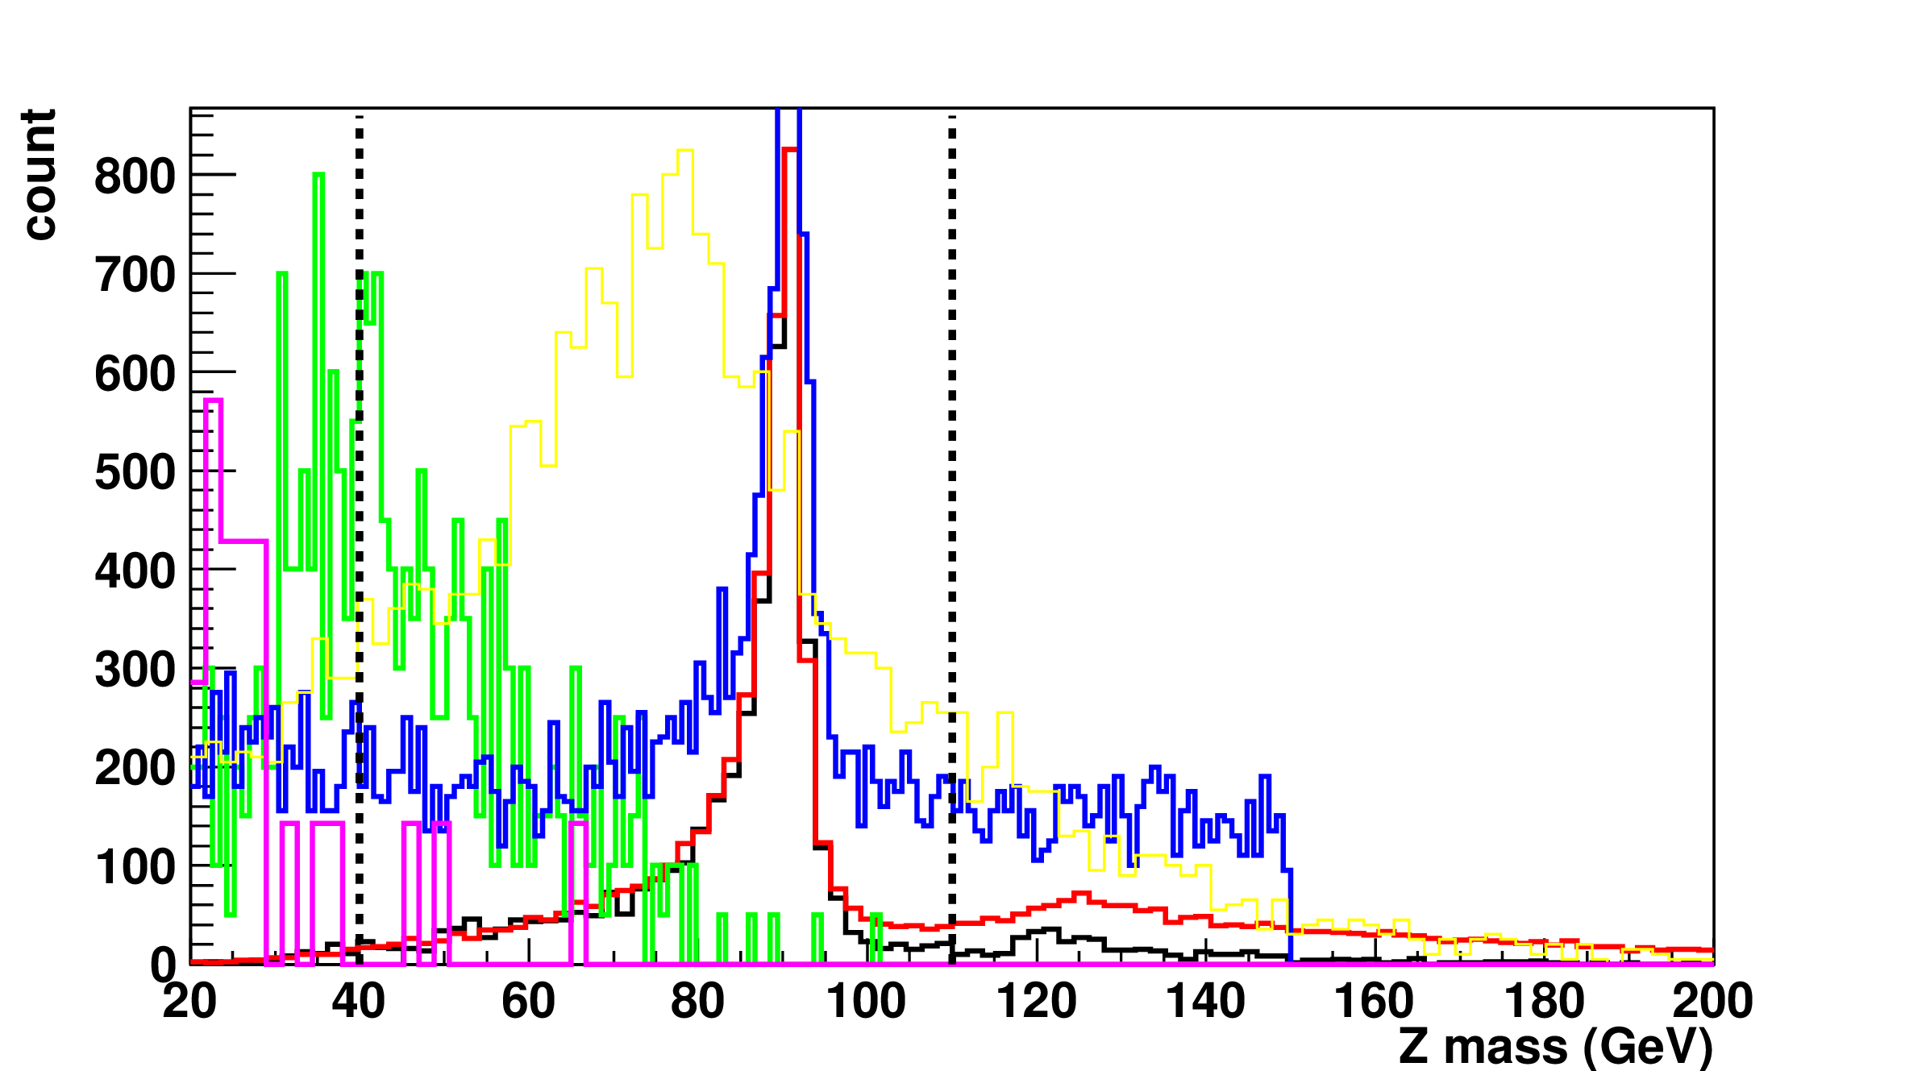
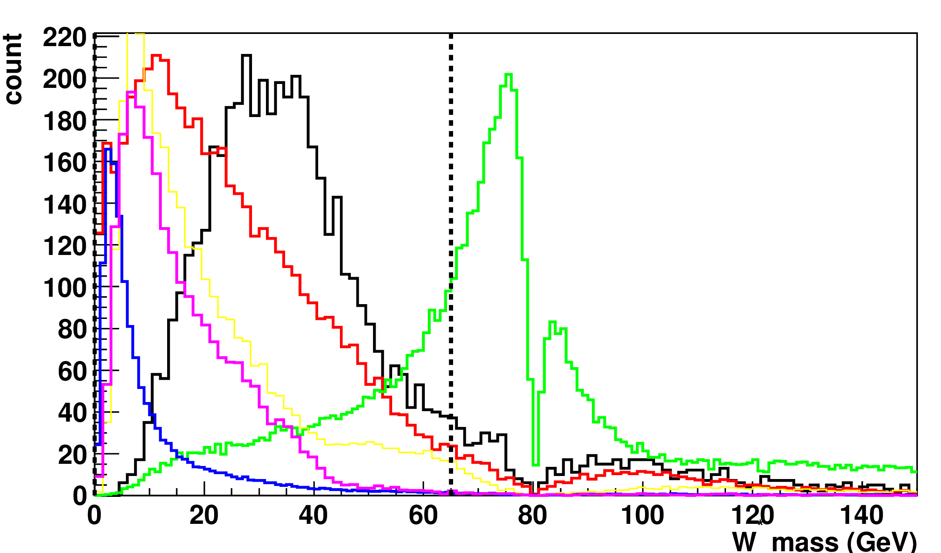
Preselection variables H→WW→qqqq , Z →ll
Invariant masses of jet pair and lepton pair to reconstruct
W* candidate Z candidate
m_{W*} < 65 GeV
40 GeV < m_{z} < 110 GeV

Slide 13
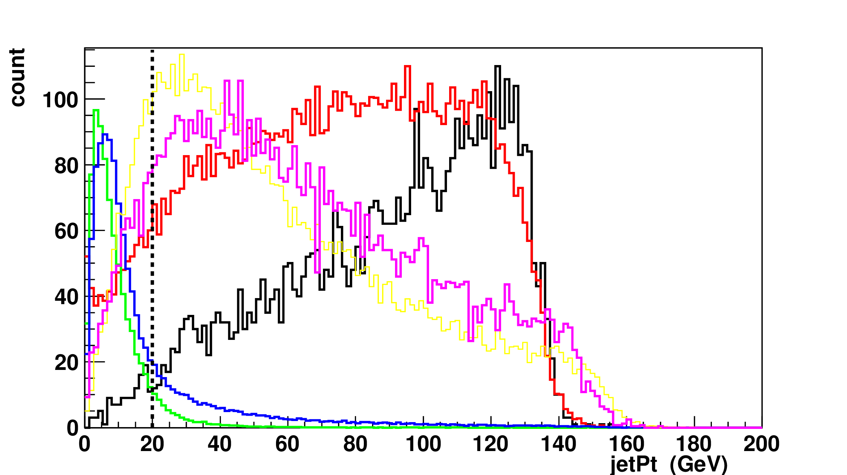
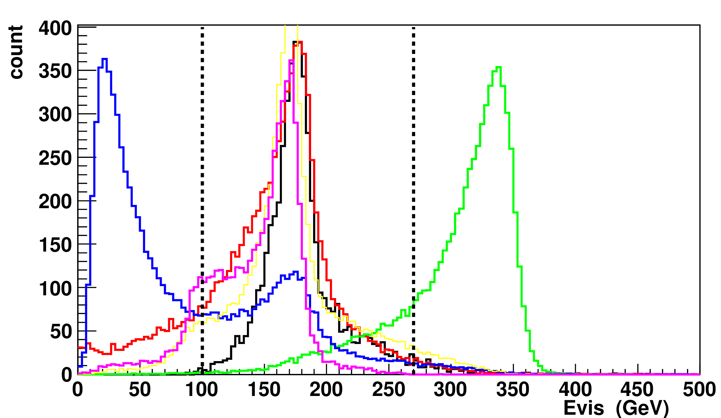
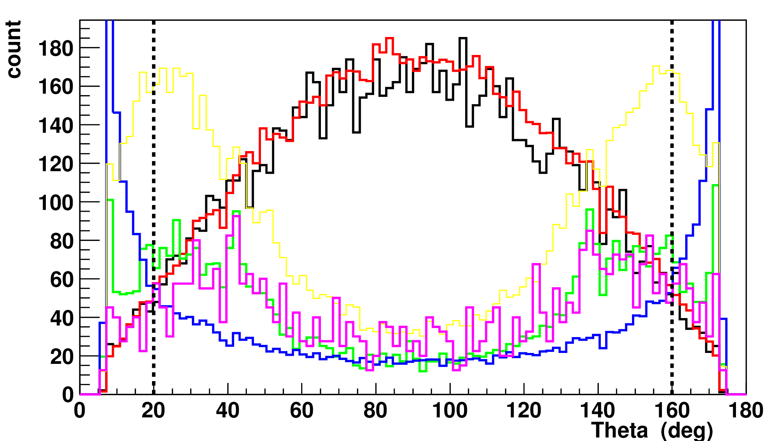
Preselection variables H→WW→qqqq , Z →ll
JetPt >20 GeV
100 GeV<Evis <300 GeV
20⁰ <θ_{el}<160⁰

Slide 14
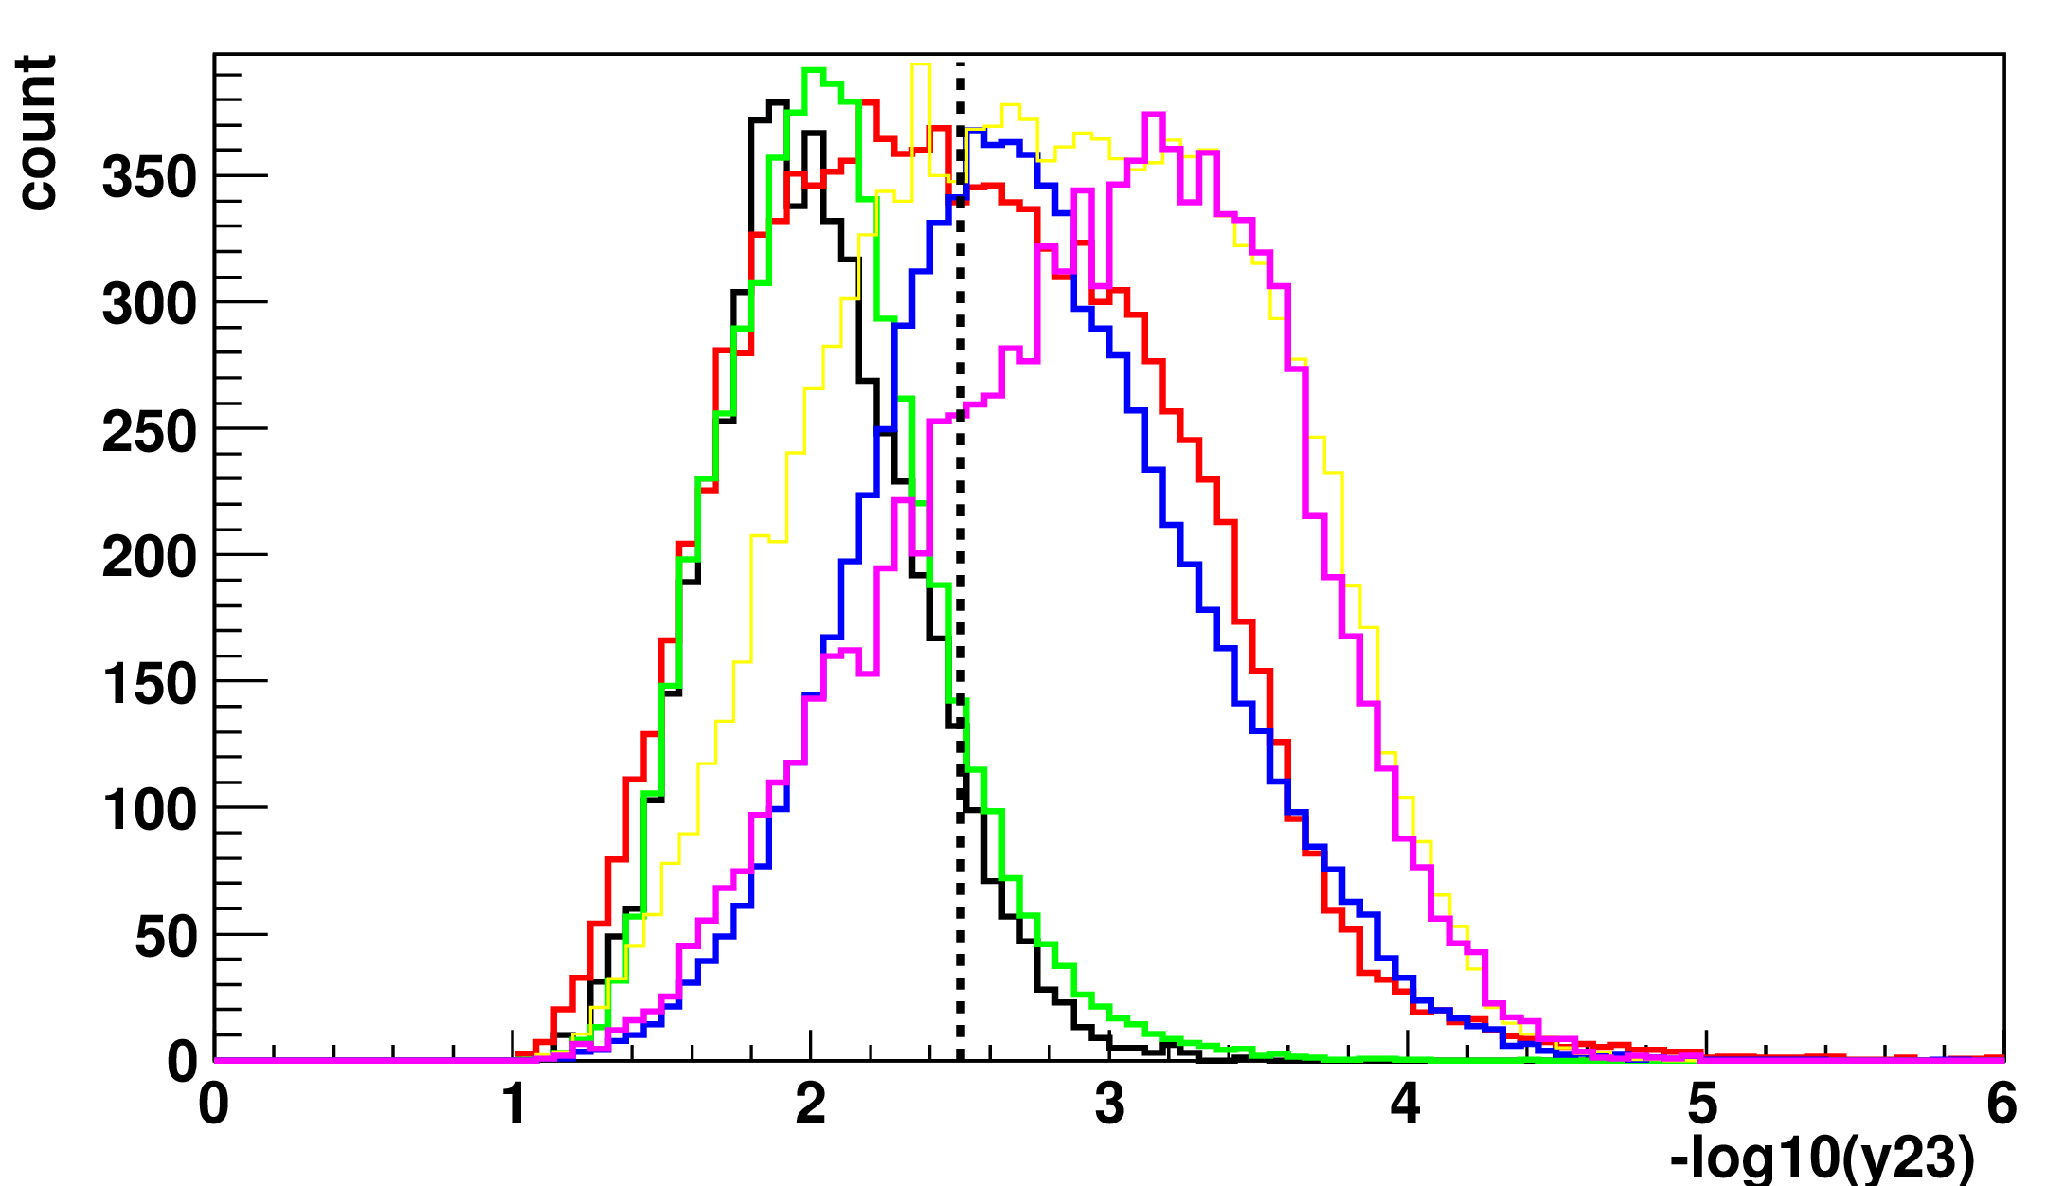
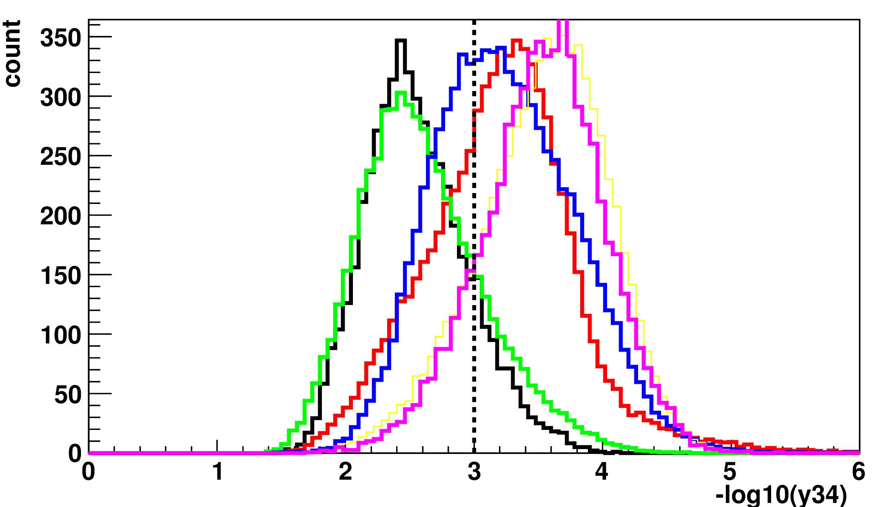
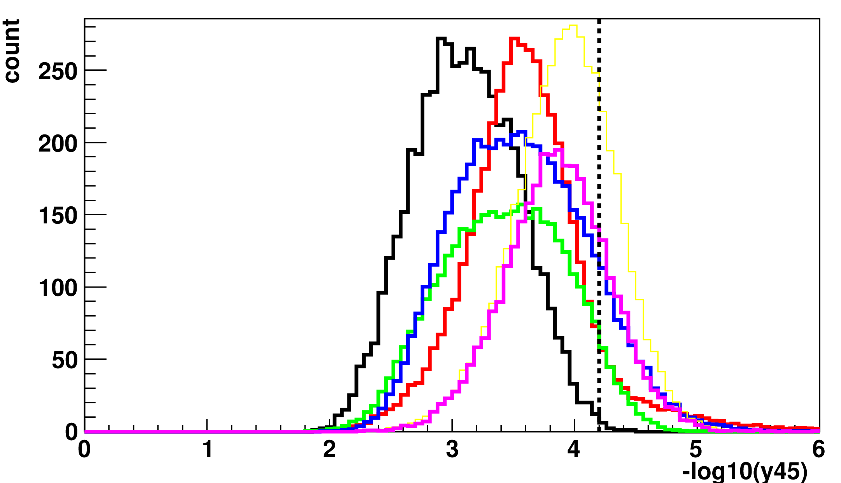
Preselection variables H→WW→qqqq , Z →ll
Jet transitions

Slide 15
Preselection H→WW→qqqq , Z →ll
 | m_{Z} | m_{H} | Jet transitions | Total preselection | σ[fb] | σ[fb] after pres.
Signal eff. | 84.2% | 76.6% | 63.3% | 52.0% | 0.48 | 0.25
Background eff.
Other H decays from HZ→ee | 45.5% | 30% | 81.2% | 8.0% | 4. 14 | 0.33
qqqq | 0.0053% | 3.5% | 32.3% | 0.005% | 5847 | 0.29
qqll | 5.5% | 26.8% | 12.9% | 0.22% | 1704 | 3.78
qqlν | 4.5% | 69.0% | 4.4% | 0.08% | 5914 | 4.73
qqνν | 0.4 % | 83.0% | 5.8% | 0.02% | 324.6 | 0.06
The phase space that is being cut-off by the separate variables are overlaping ⇒the total efficiencies ≠ multiplication of separate ones

Slide 16
Summary H→WW→qqqq , Z →ll
The status of the H→WW→qqqq , Z →ll at 350 GeV is being presented
Preselection cuts are being optimized to maximize background suppresion and preserve signal efficiency
After preselecion S/B is ~ 3/100 (not final)
Precise lepton isolation important for good reconstruction of invariant Z mass which is the most effective preselection variable

Slide 17
Current status of the H to ZZ* analysis at 1.4 TeV
G. Milutinović - Dumbelović

Slide 18
Signal
Signal : 4 jets + missing energy
Three possible ZZ decay topologies:
- qqqq~48%
- qqll~42%
- llll~10%
Only fully-hadronic final state considered

Slide 19
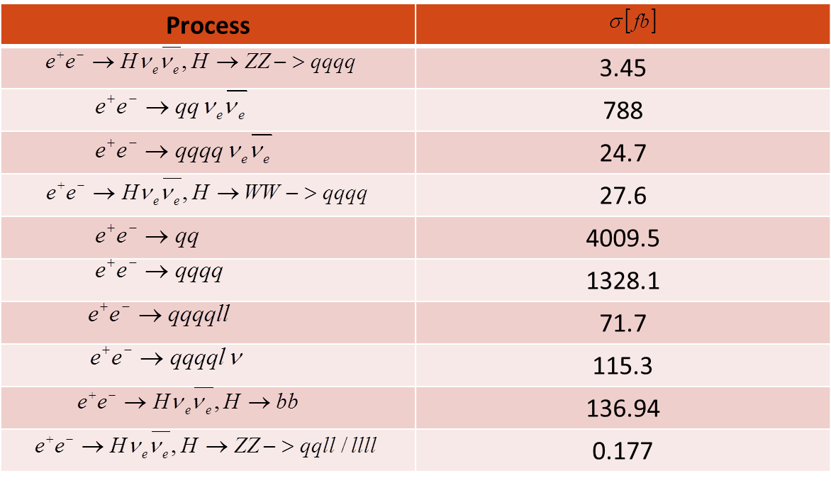
Signal and bck cross-sections
The most dominant and backgrounds will be rejected by the E_{vis} based preselection.
backgound has been overlade before the digitization phase.

Slide 20
Preselection
40GeV<InvMassZ1<110GeV
InvMassZ2<65GeV
80GeV<InvMassHiggs<180GeV
-log₁₀y₃₄<3.5
-log₁₀y₂₃<3.0
150GeV<Evis<650GeV
P(b)jet₁<0.95
P(b)jet₂<0.95
2 jet topologies

Slide 21
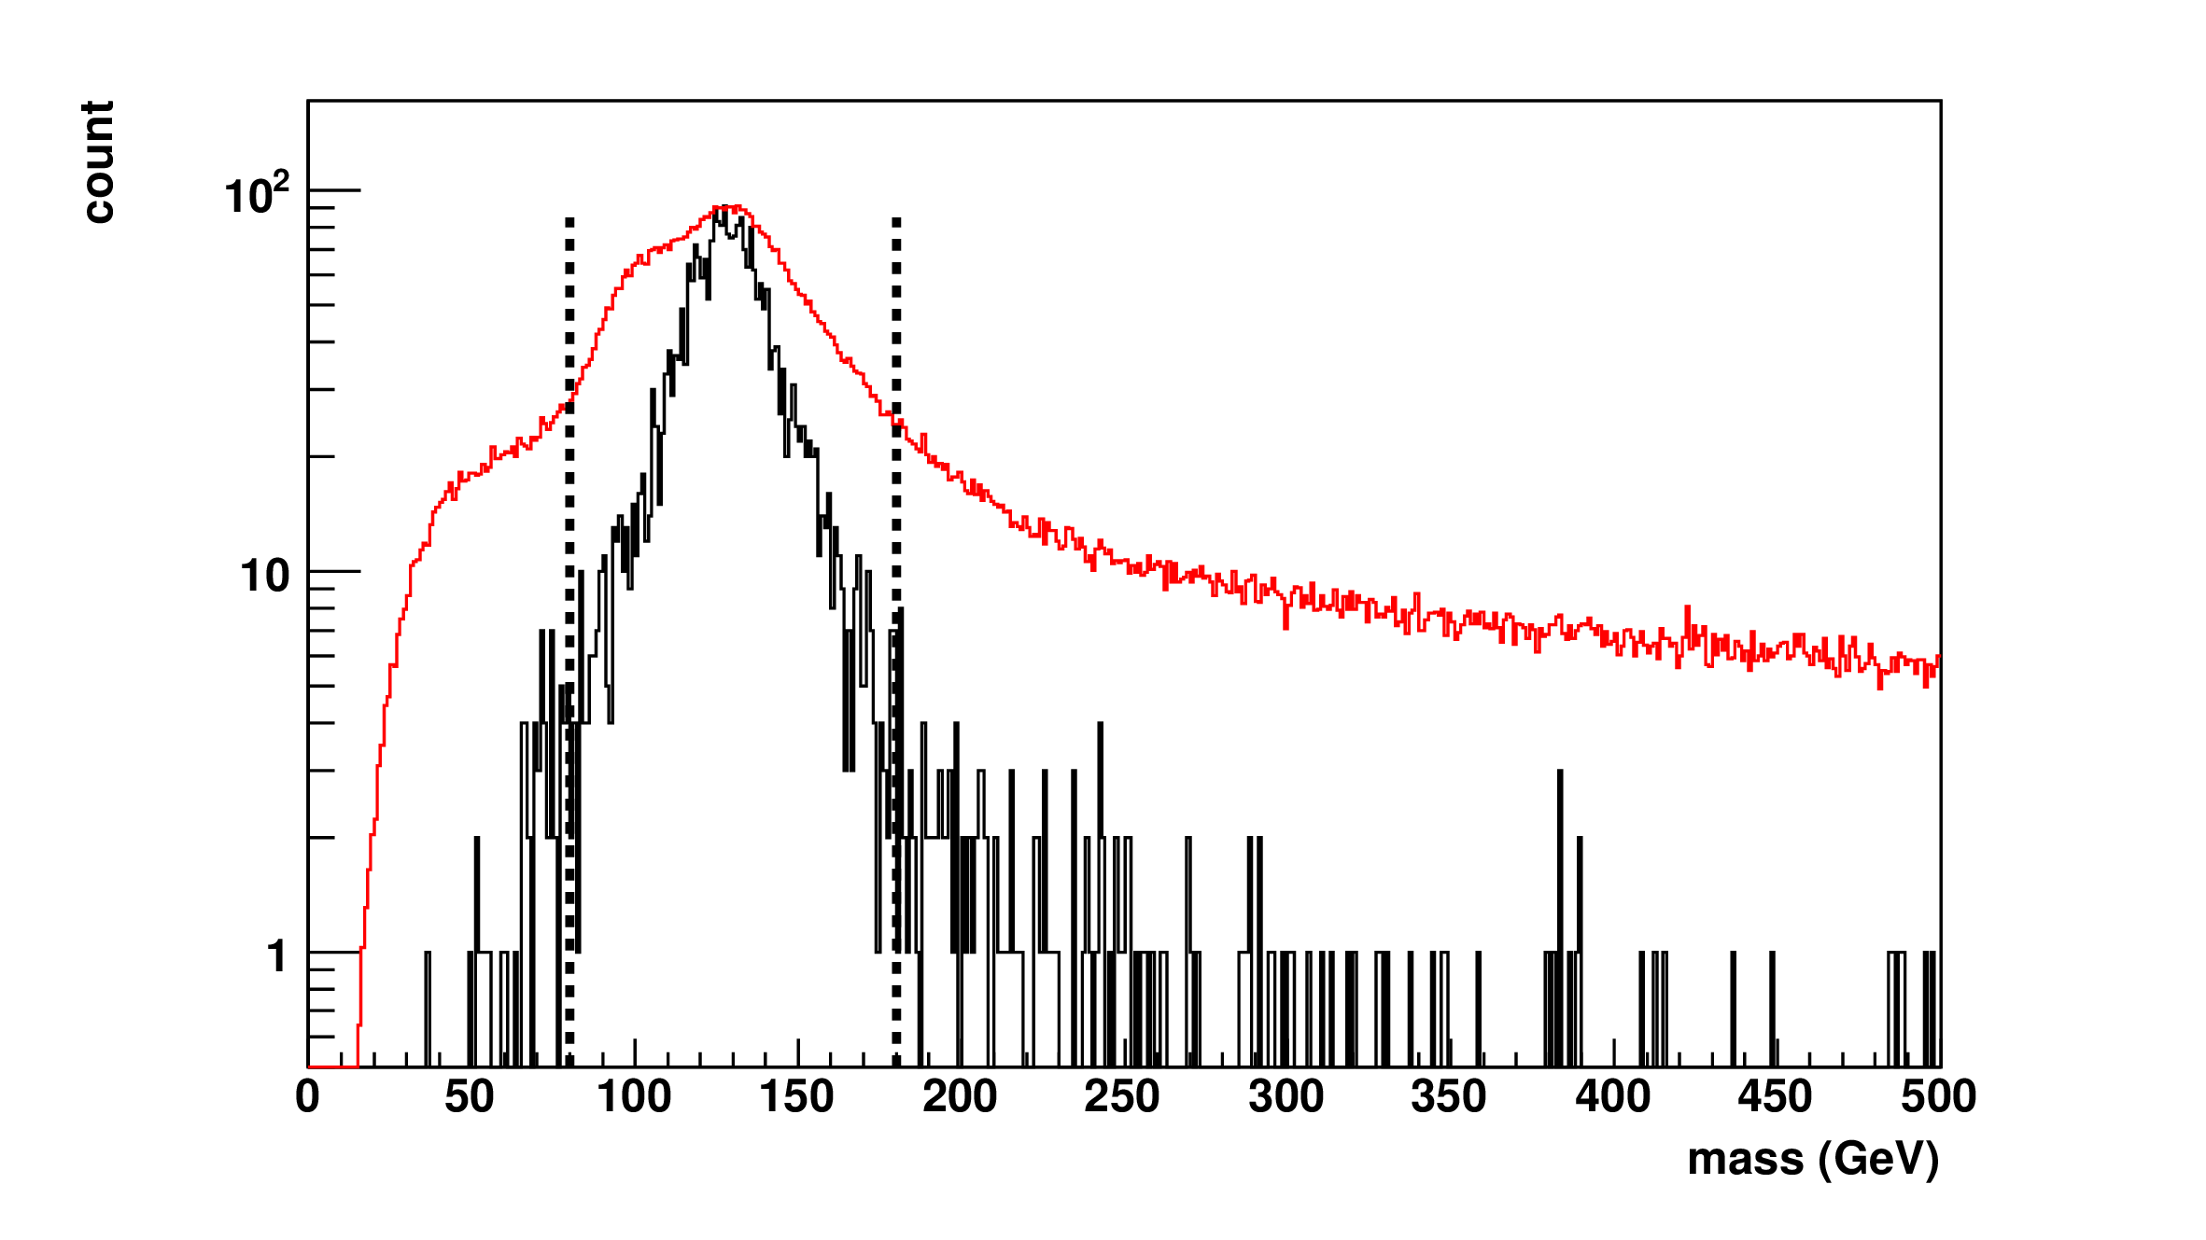
Higgs Invariant Mass
Background
Signal
80GeV < InvMassHiggs < 180GeV

Slide 22
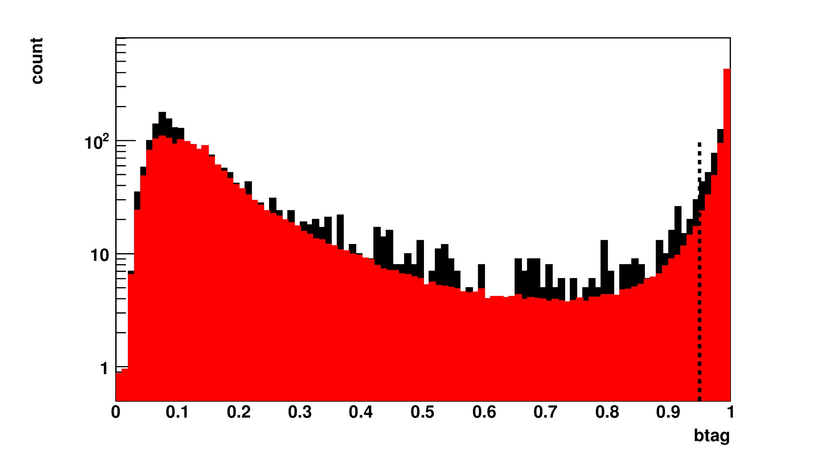
P(b)jet₁
Background
Signal
P(b)jet₁<0.95

Slide 23
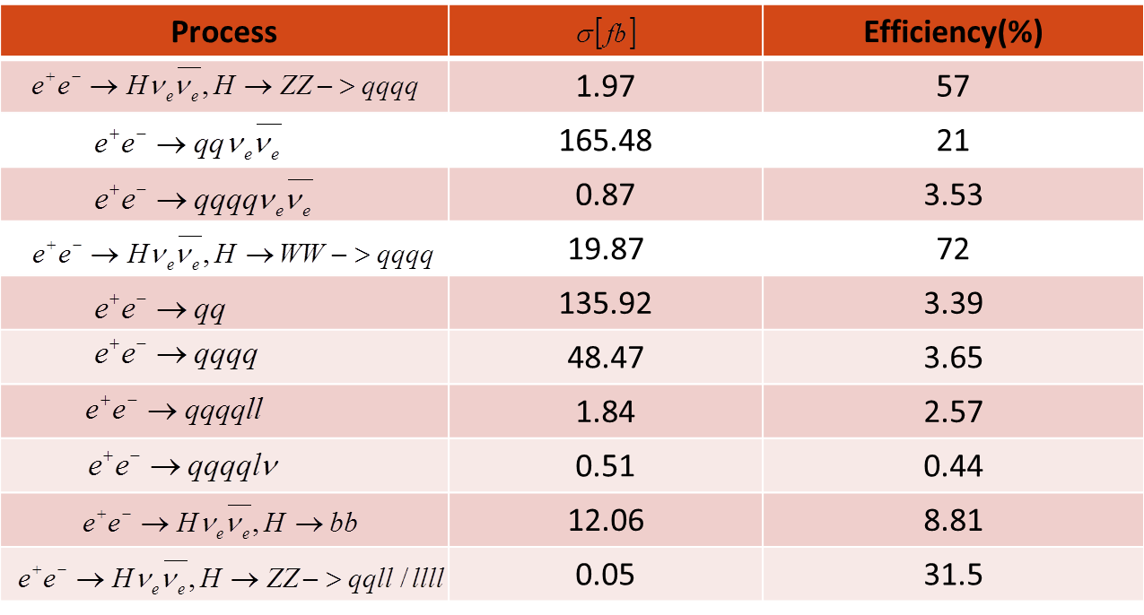
Signal and bck. after preselection
- Z is decaying more frequently to b quarks than W what results in enlarged selection efficiency.

Slide 24
Conclusion
Preselection completed to reduce the most dominant backgrounds.
Reasonably high rejection rate for bck. processes, except for WW fully hadronic decay.
An attempt to optimize further preselection will be made before MVA analysis.

Slide 25
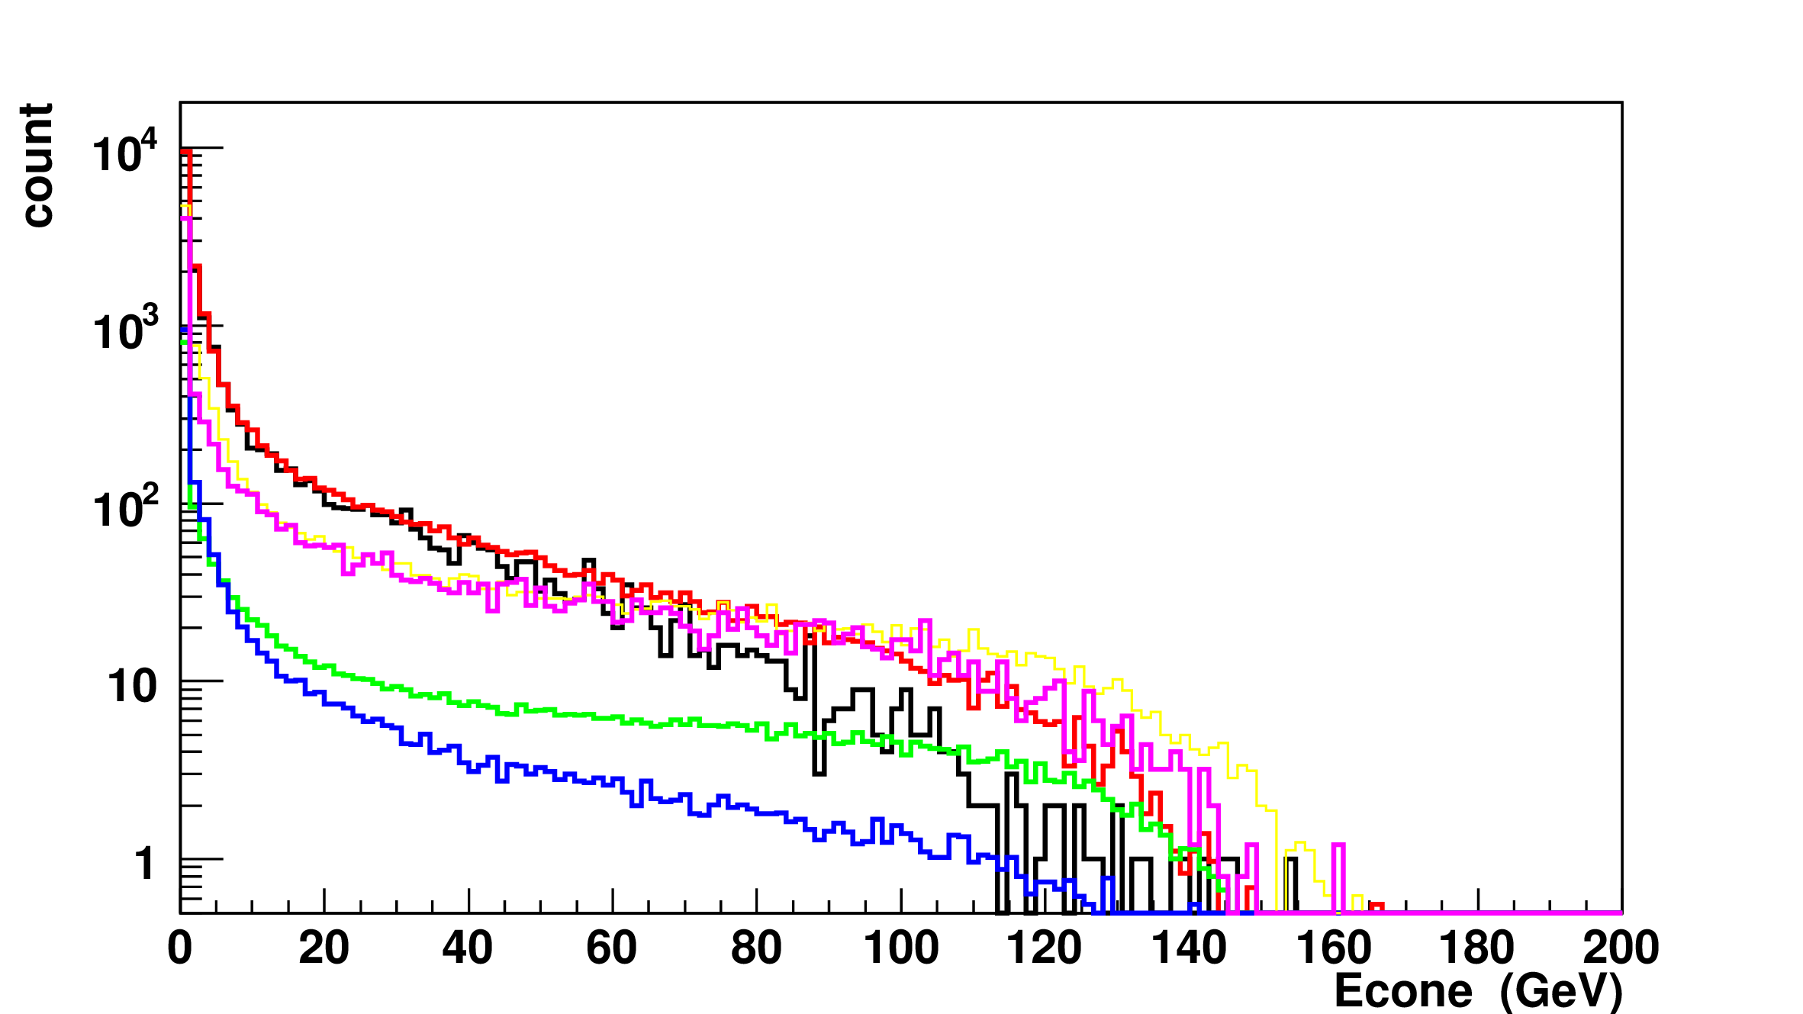
Backup
PFO
Leptons

Slide 26
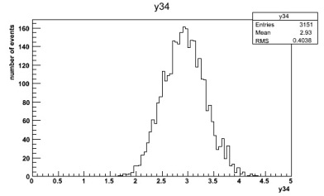
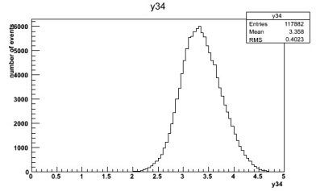
Jet transitions
Signal
-log₁₀(y34) < 3.5
- Require event to be 4-jet like: use y₃₄ (the k_{T} value at which the event transit from 3 jets to 4 jets)

Slide 27
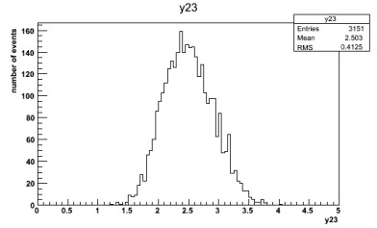
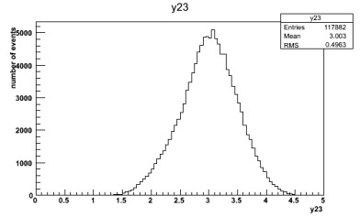
Jet transitions
Signal
-log₁₀(y23) < 3.

