Slide 1


Update on scintillator studies
CLIC Workshop 2014
3 – 7 February 2014, CERN
Samir Arfaoui, Chrisitan Joram, Damiano Celeste
on behalf of the CLIC Detector and Physics Study

Slide 2
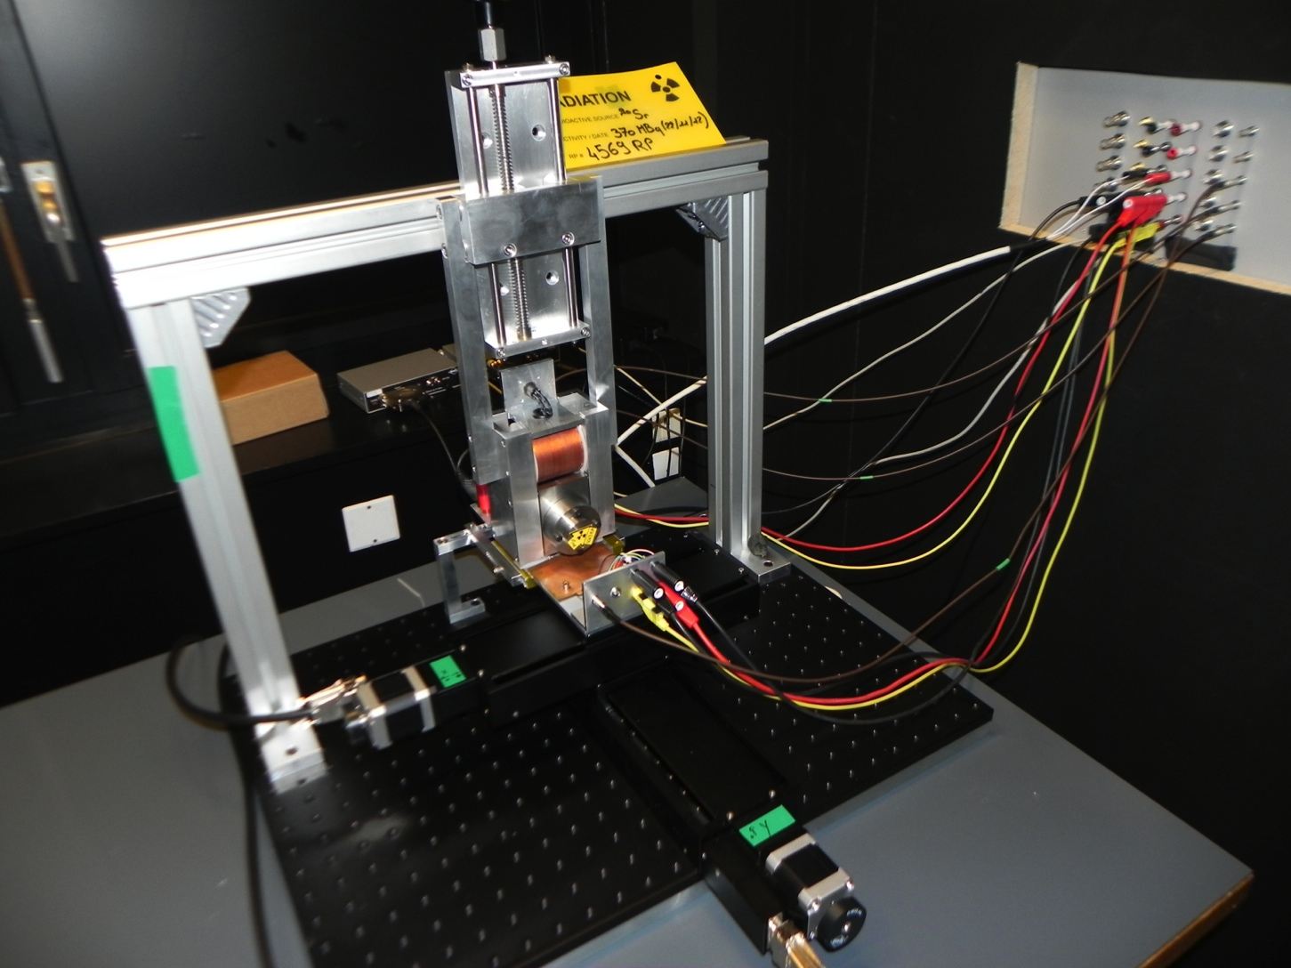
Setup
Electron gun
Inside AC regulated dark room
Feedthrough to lab next door
DUT
Translation axes

Slide 3
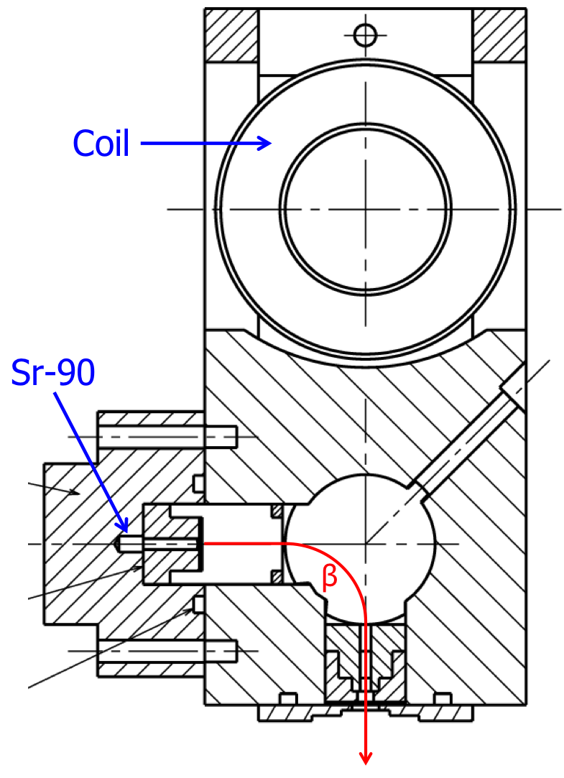
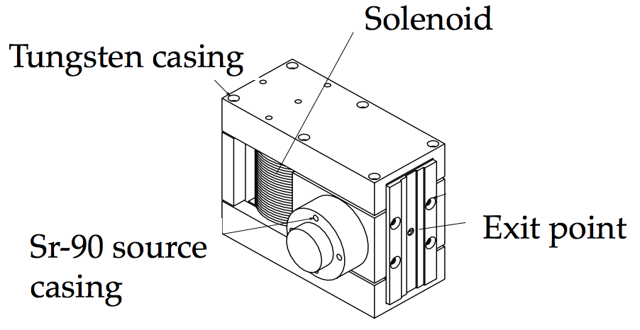
Electron gun
~350 MBq Sr-90 source
Double beta emission
Selectable energy up to ~2.2 MeV

Slide 4
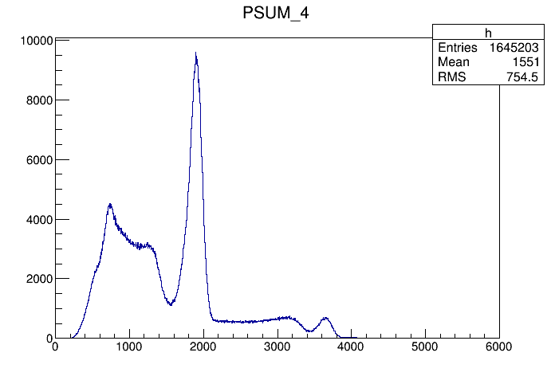
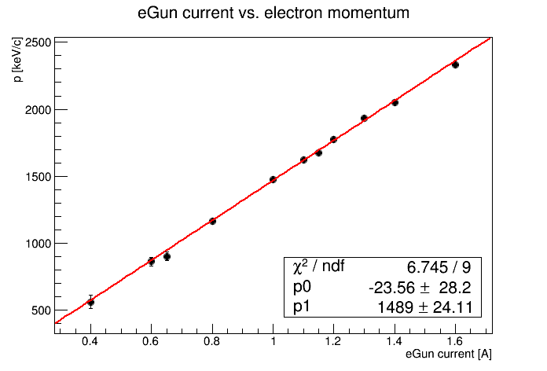
eGun calibration
(Many thanks to C. Joram and C. Casella!)
eGun
Calibration with Na22 source
Na22
LYSO
LYSO
DSiPM
DSiPM
511 keV
1270 keV
DSiPM light yield

Slide 5
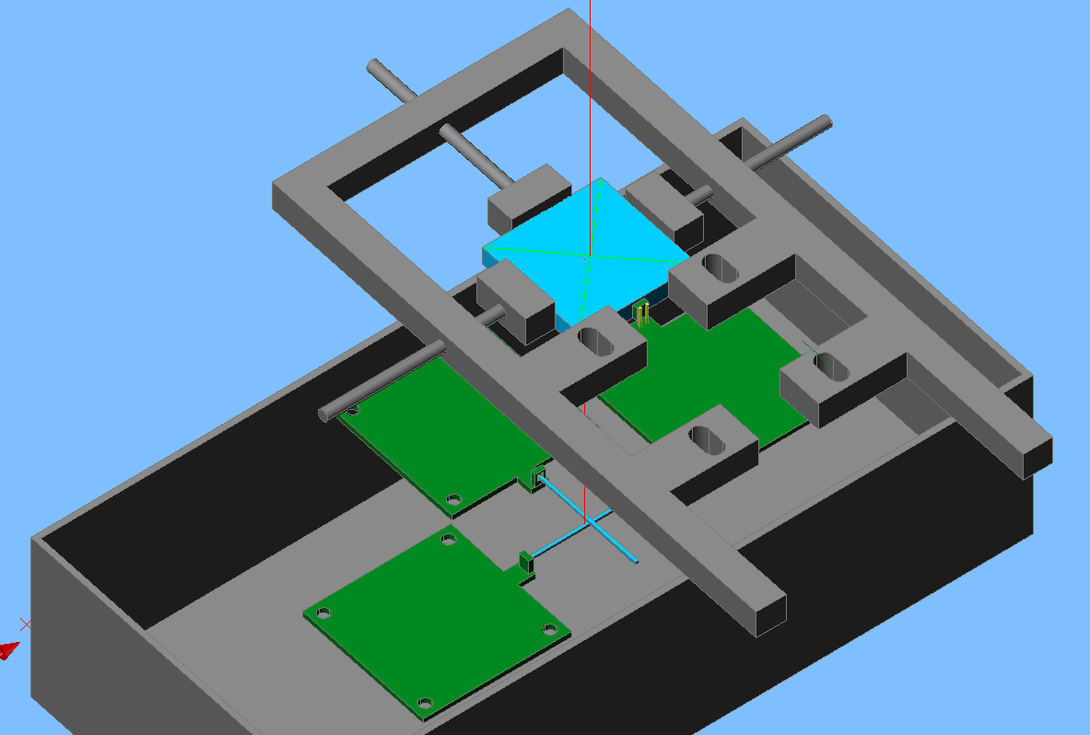
Trigger and Readout
R. Dumps
SiPM connection
Bias V
Signal
5V
Same as MPI board, with Infineon BGA 614 amplifier, redesigned to 25x22 mm²
(S. Veneziano)
  Crossed scintillating fibers (20x1x1 mm³) as trigger, fixed underneath DUT.
Positioned Hamamatsu MPPC (50 μm pitch) on a nose, sticking out 2 mm beyond the edge, for readout of tiles with dimples
Including surface-mounted Pt1000 probe near SiPM.

Slide 6
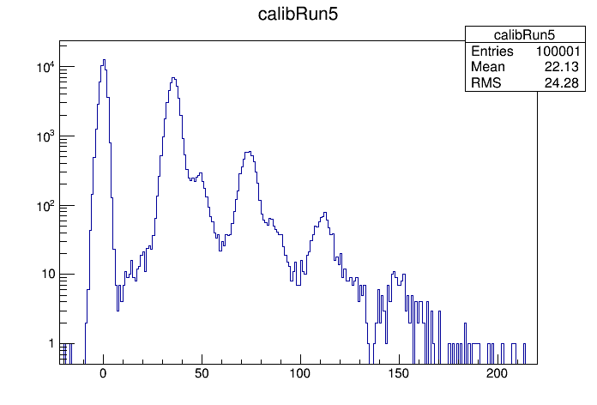
DAQ and Calibration
Data acquisition:
  Digital oscilloscope: 4 GHz 4-channel picoscope
  LabView VI → readout trigger by trigger
    Rate is limited by electron gun & tile thickness: up to O(20) Hz.
Calibration:
With the gun off, acquire Single
Photon spectrum run
At the center of tile, define gain
at nominal temperature
First tile scanned: 30x30x3 mm³ →
Waveform integral [pVs]

Slide 7
Measurement and analysis procedures
Measurement
  Place selected tile in setup, coupled to the SiPM by direct contact to side face using optical grease
  Perform self-triggered calibration run to measure gain at reference temperature
  Switch electron gun ON (1.4 A, MIP regime), start automated tile scan with pre-selected positions
  At each scan step (~60-120 sec):
    Measure temperature (surface-mounted PT1000)
    Record DUT SiPM waveform integral for each crossed-fibres coincidence signal
Analysis
  Correct each waveform integral by relative temperature offset w.r.t. calibration run (-3.4% / K)
  Convert waveform integral into #p.e.
  Define tile area at the centre to calculate average response
  For each scan position, compute deviation from <#p.e.>
  Estimate effective tile areas within ± 5, 10, and 20% of the average response to assess non-uniformity

Slide 8
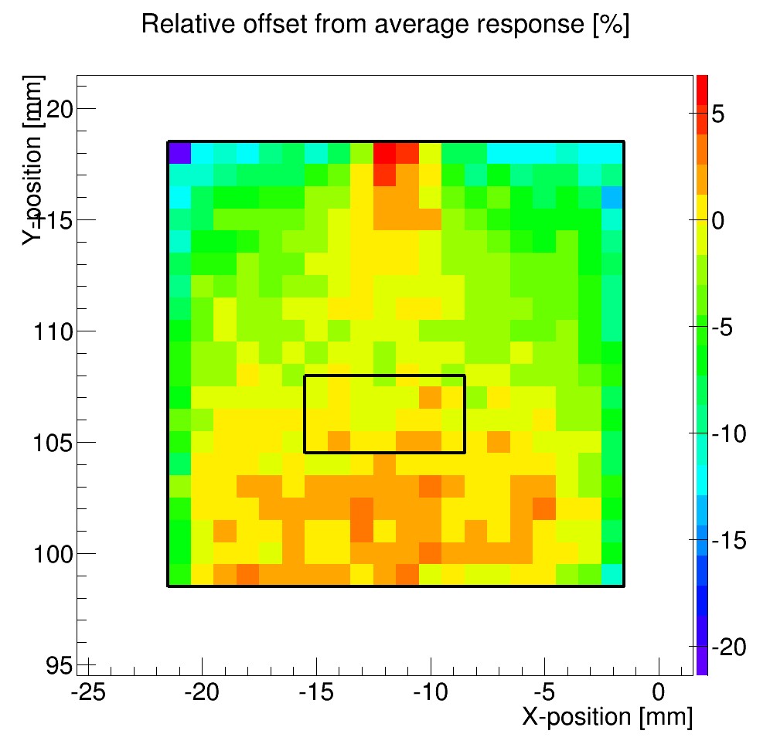
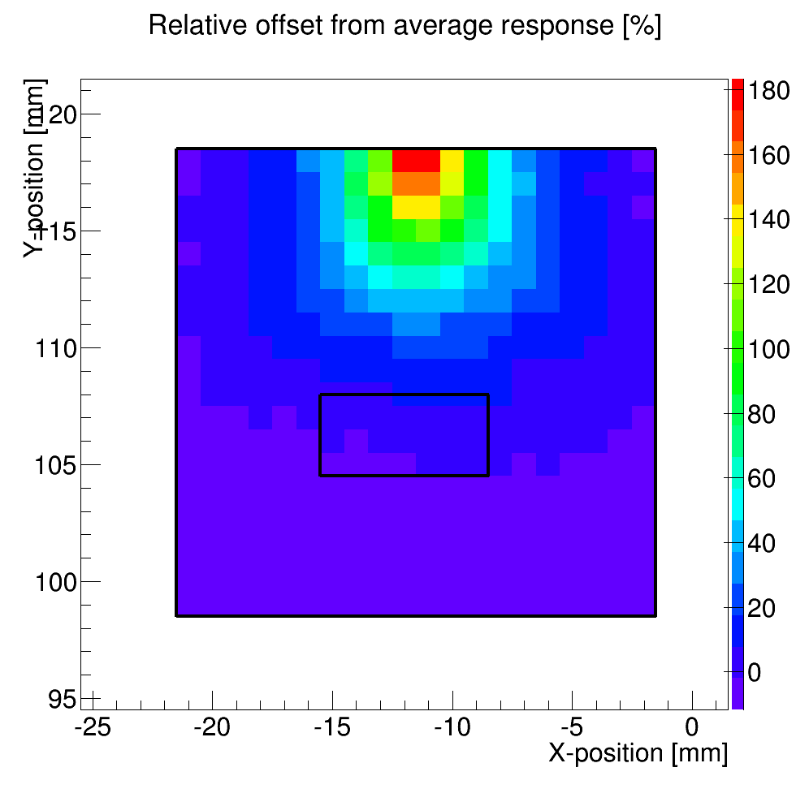
What we learned so far: ESR vs. Paint
Size [mm] | Packaging | <#p.e.> | ± 5 % [%] | ± 10 % [%] | ± 20 % [%]
20x20x2 | 3M ESR¹ | 68 | 77.5 | 94.8 | 99.8
20x20x2 | Paint² | 15 | 31.5 | 67.0 | 79.5
pre-folded around scintillator, held by Teflon tape
Saint-Gobain BC-620 diffusive paint

Slide 9
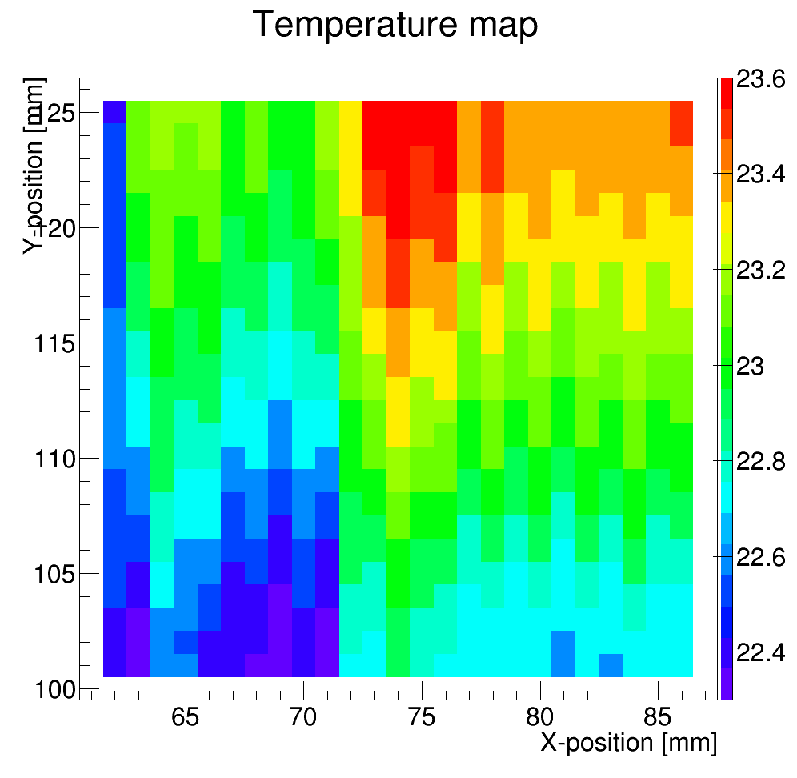
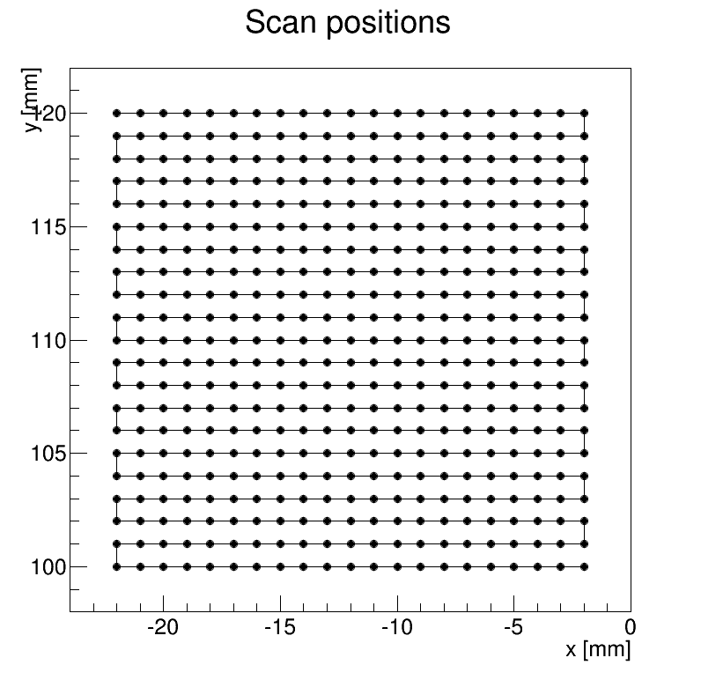
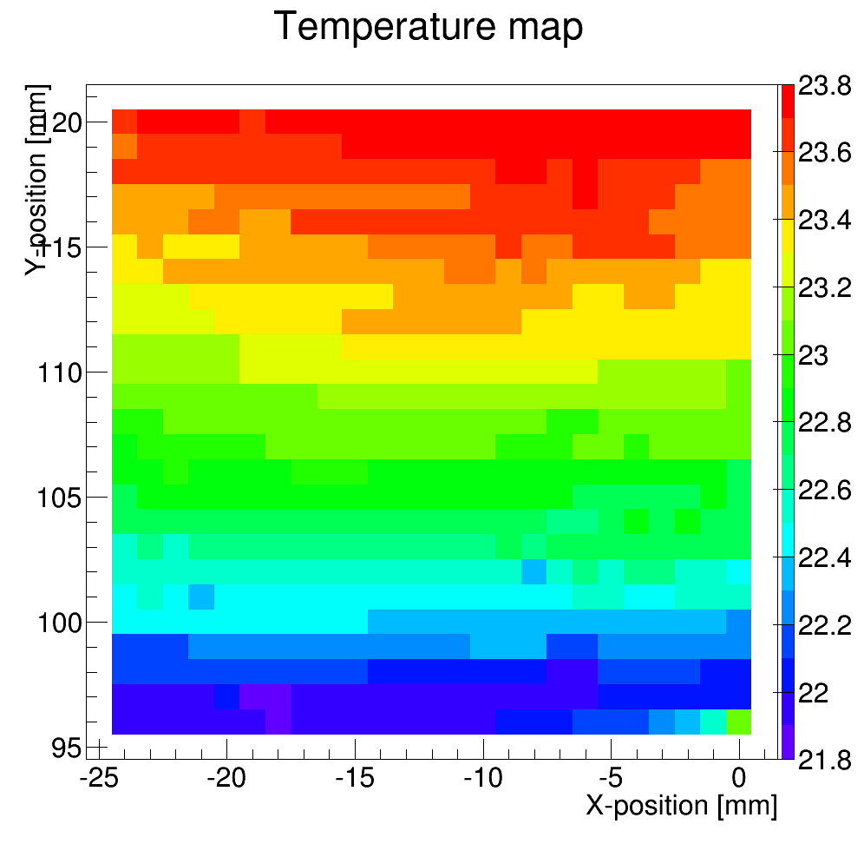
What’s new
Plastic block glued to PCB behind MPPC in order to improve mechanical stability
Replaced LV and Bias banana-pairs with mini-coax to improve noise
Changed scan direction to homogenise temperature fluctuations during scan and limit left-right asymmetry
More scintillators tested, 2 identical batches of 4 tiles:
  painted 20x20x2 + 15x15x2 and 3M wrapped 20x20x2 + 15x15x2
after
before

Slide 10
Scans performed
Two identical batches.
Same MPPC, same bias voltage, same electron gun current (MIPs).
Batch | Run | Size [mm³] | Packaging | MPPC | Bias [V] | I (eGun) [A]
1 | 14 | 20x20x2 | 3M ESR | 50μm pitch | 71.3 | 1.4
1 | 13 | 20x20x2 | Paint | 50μm pitch | 71.3 | 1.4
1 | 15,28 | 15x15x2 | 3M ESR | 50μm pitch | 71.3 | 1.4
1 | 16 | 15x15x2 | Paint | 50μm pitch | 71.3 | 1.4
2 | 25,26 | 20x20x2 | 3M ESR | 50μm pitch | 71.3 | 1.4
2 | 27 | 20x20x2 | Paint | 50μm pitch | 71.3 | 1.4
2 | 17,29 | 15x15x2 | 3M ESR | 50μm pitch | 71.3 | 1.4
2 | 18 | 15x15x2 | Paint | 50μm pitch | 71.3 | 1.4

Slide 11
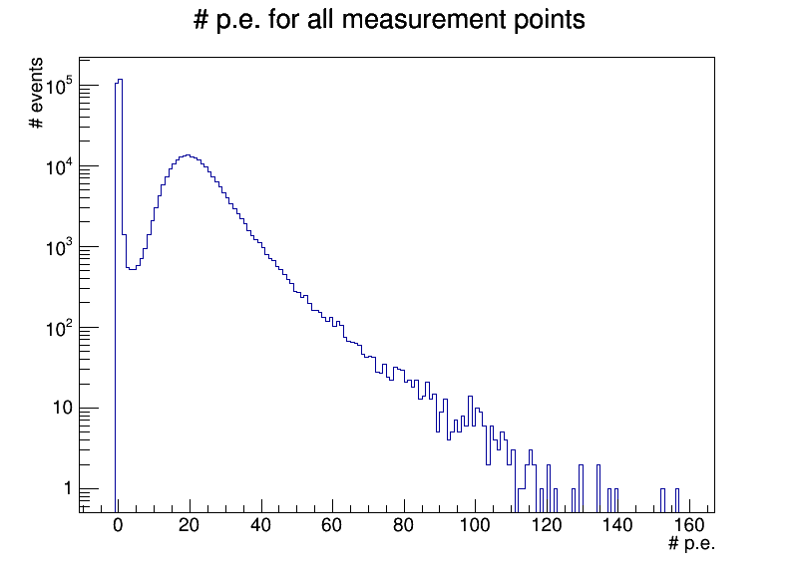
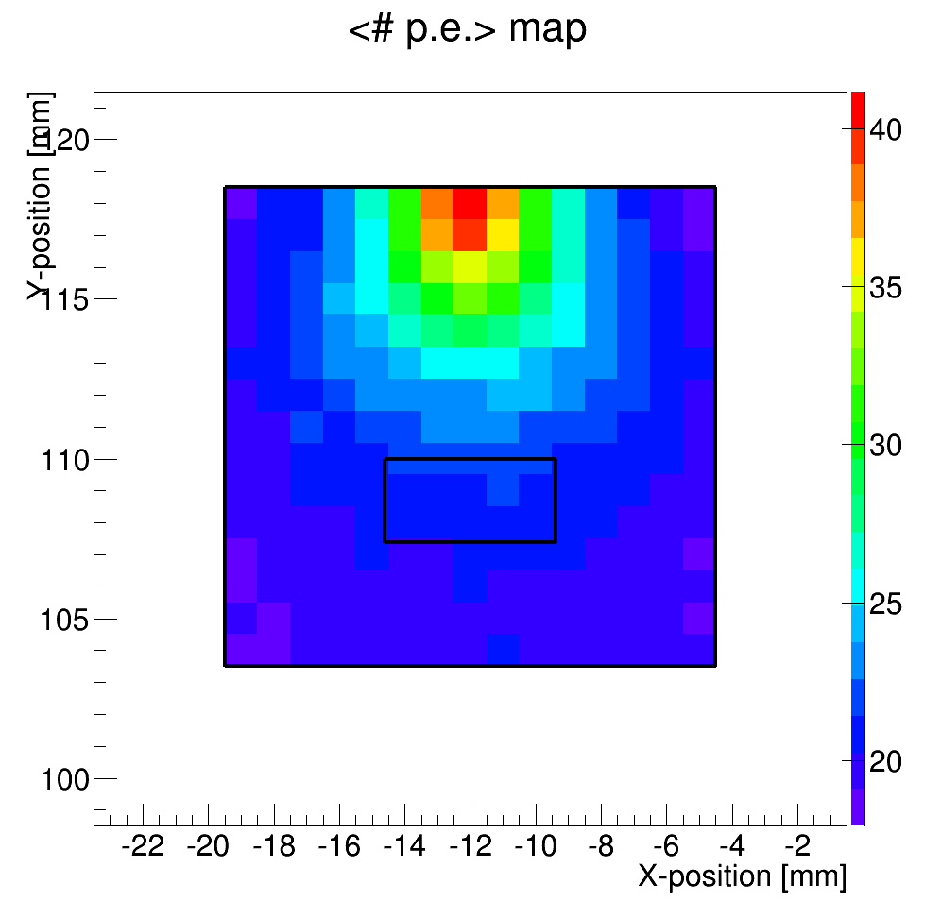
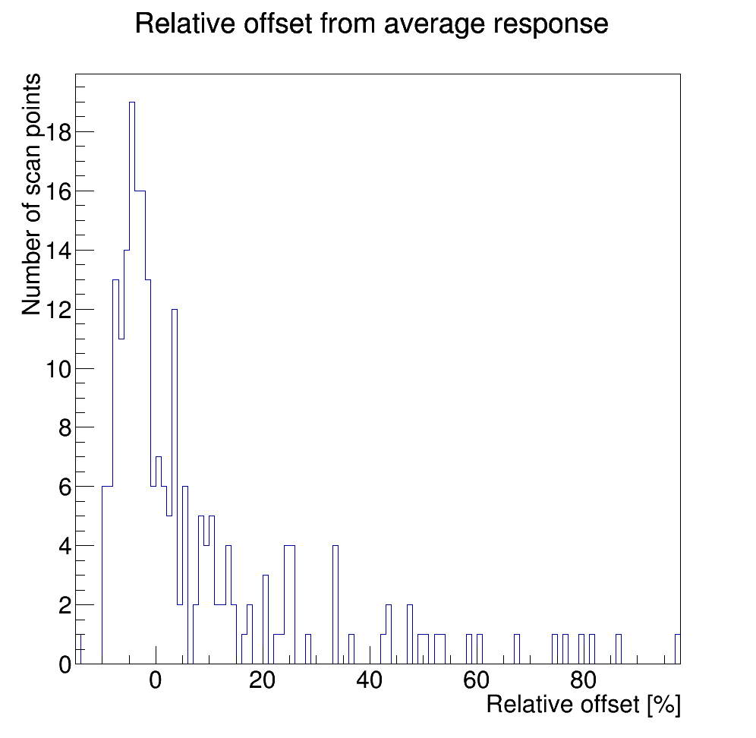
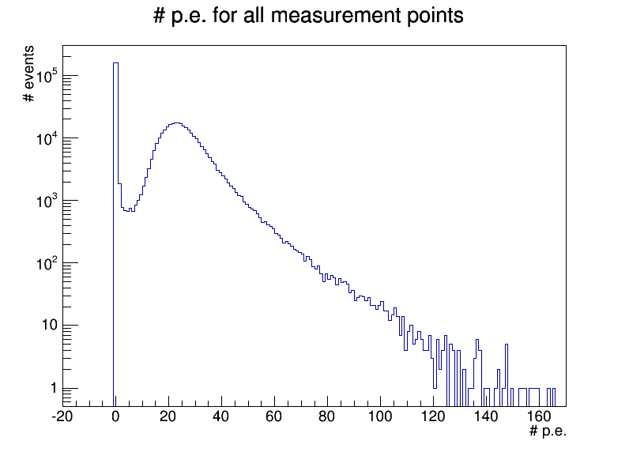
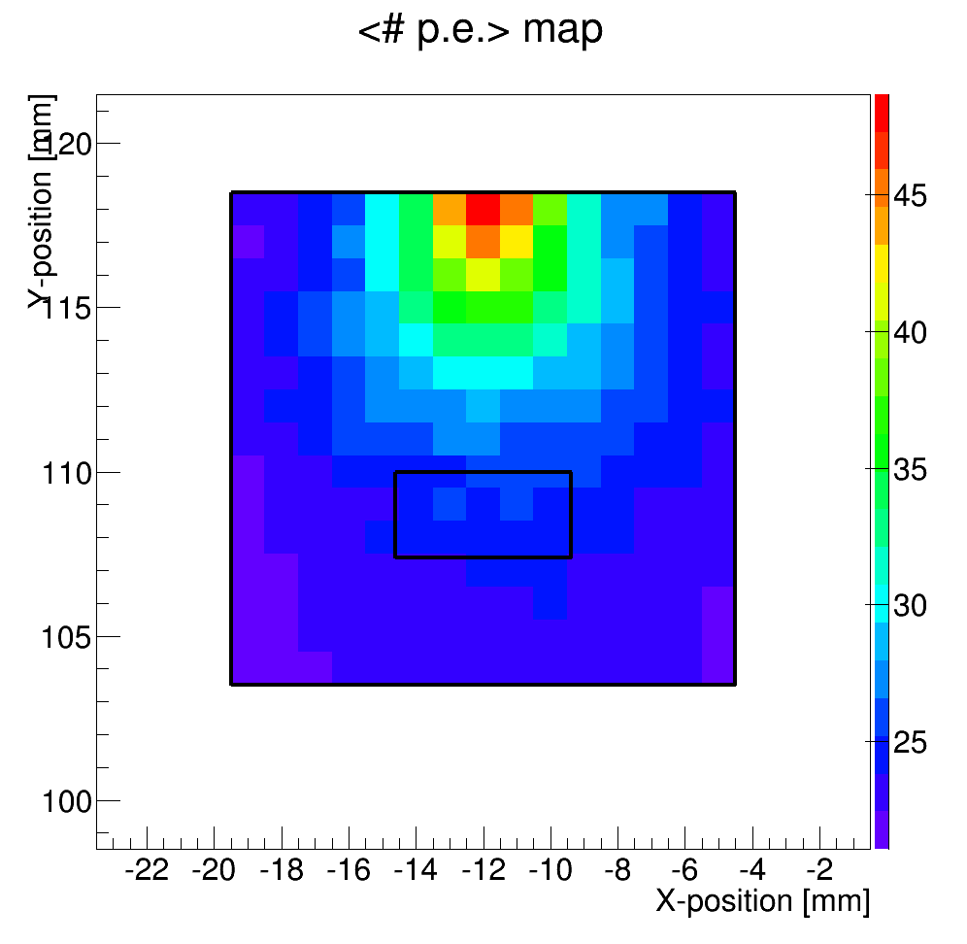
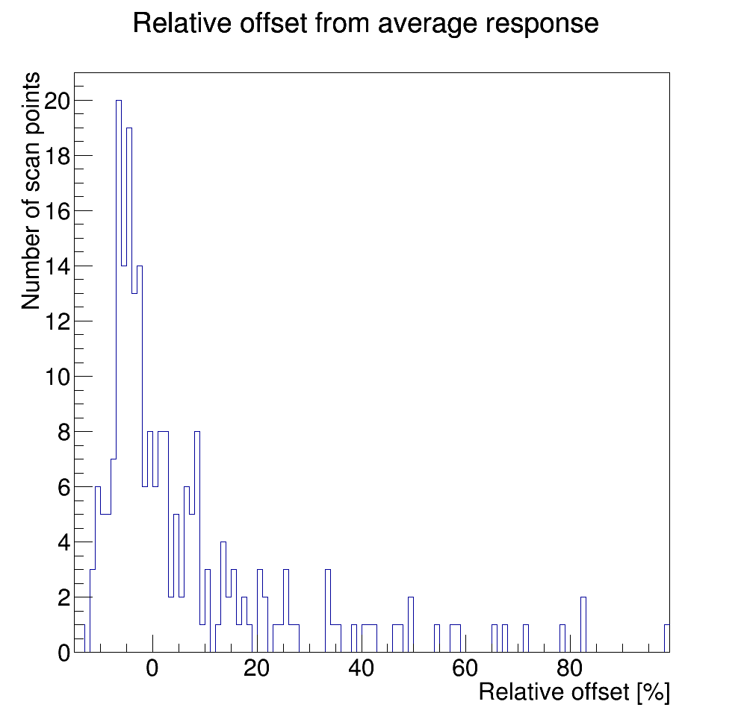
Painted 15x15x2 mm3
batch 1
batch 2

Slide 12
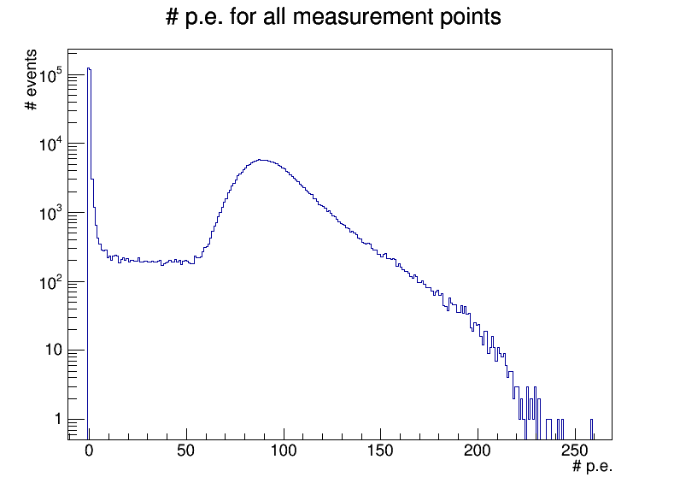
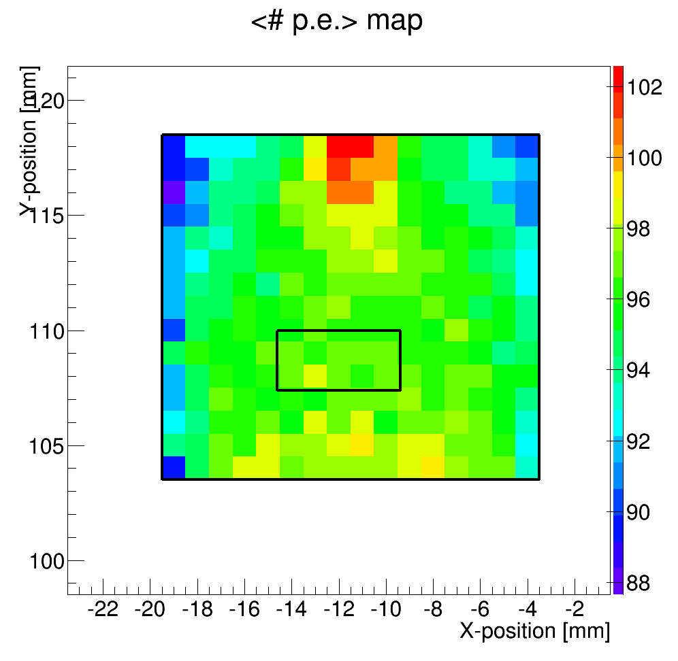
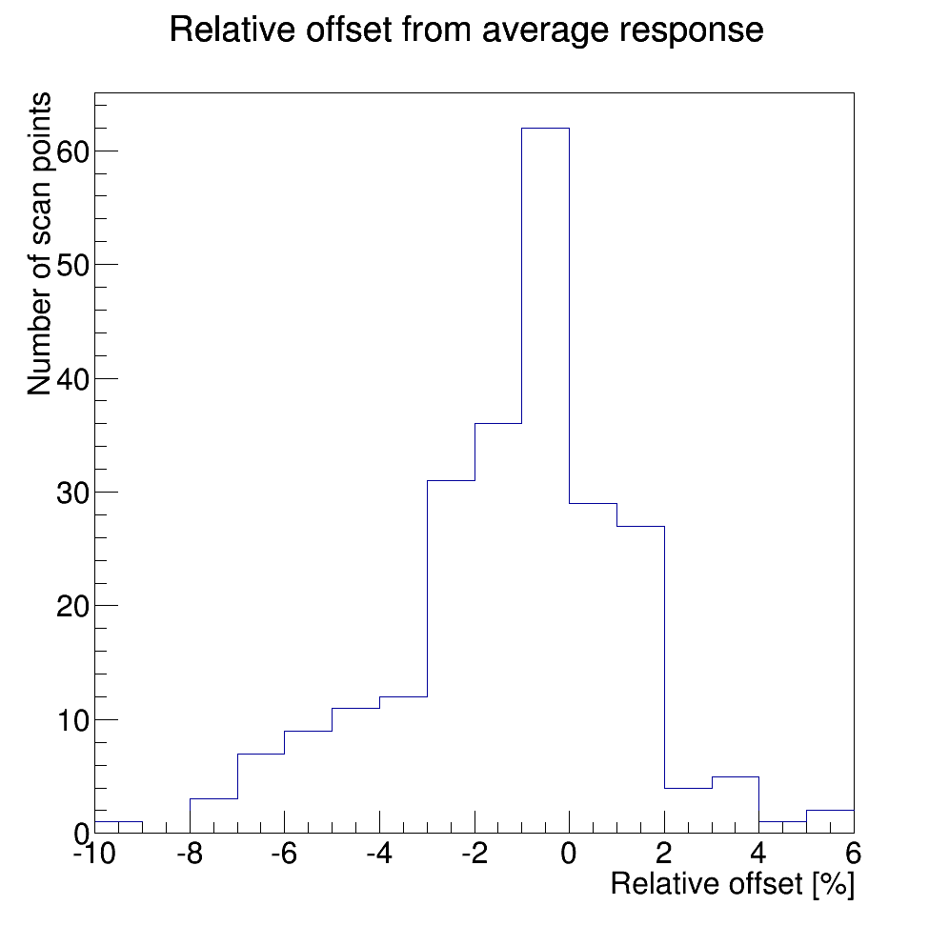
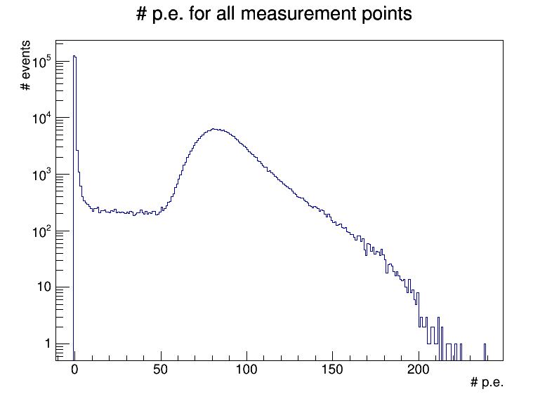
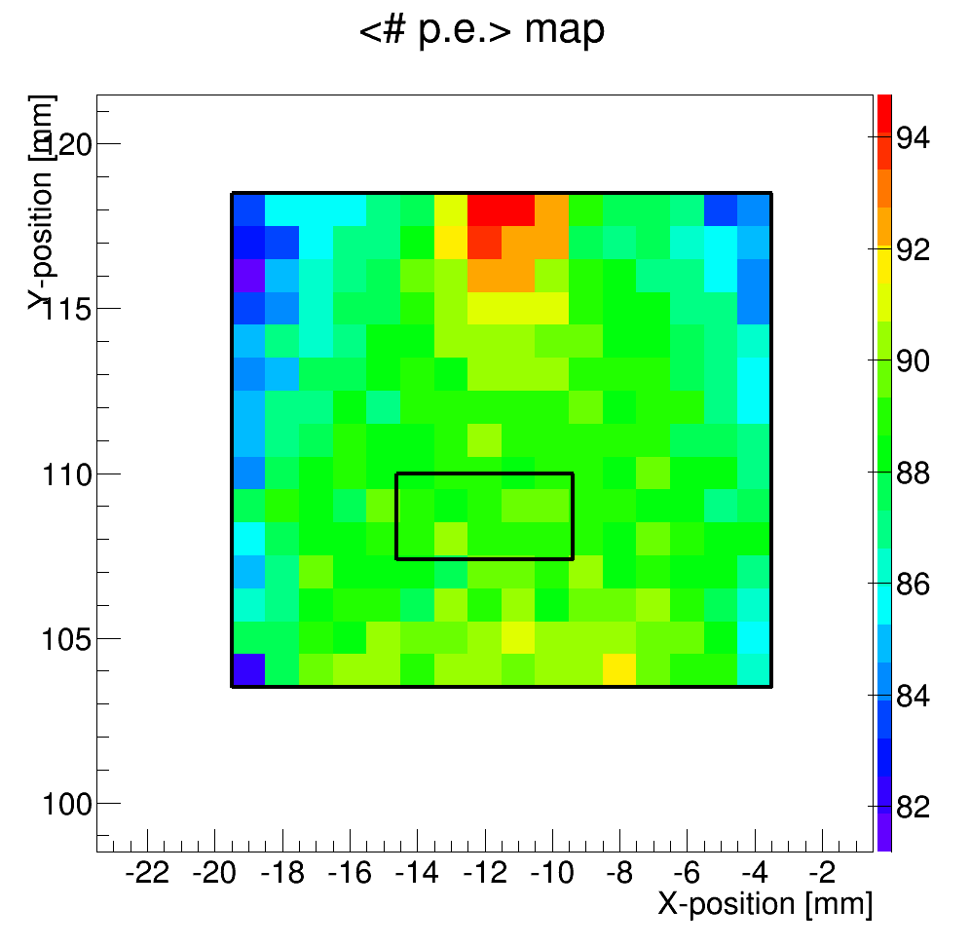
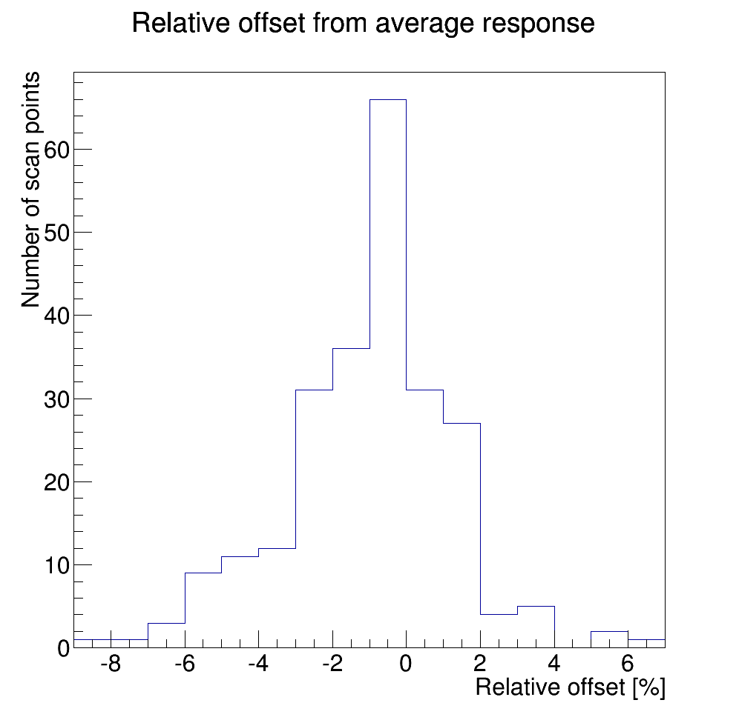
Wrapped 15x15x2 mm3
batch 1
batch 2

Slide 13
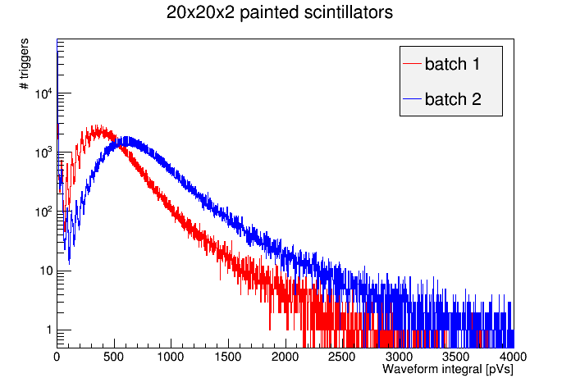
A look at the charge (1/4)
Waveform integrals collected for all scan points.
Two painted scintillators, same size.

Slide 14
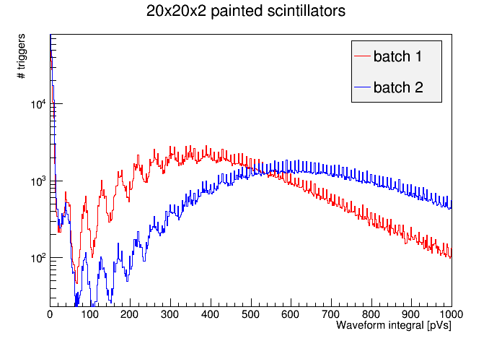
A look at the charge (2/4)
Zoom

Slide 15
A look at the charge (3/4)
Peaks are aligned
same gain
same temp. conditions

Slide 16
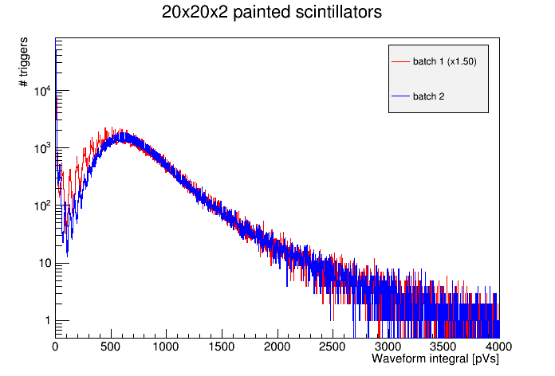
A look at the charge (4/4)
Red waveforms integrals x 1.5
there’s 50% more light
reaching the MPPC in batch 2 scan

Slide 17
Results
Summary of all scintillator scans taken so far (more to come!):
Batch | Run | Size [mm³] | Packaging | <#p.e.> | ± 5 % [%] | ± 10 % [%] | ± 20 % [%]
1 | 14 | 20x20x2 | 3M ESR | 31 | 70.5 | 95 | 100
1 | 13 | 20x20x2 | Paint | 11 | 22.9 | 59.5 | 85.4
1 | 15 28 | 15x15x2 | 3M ESR | 50 97 | 83.1 90.8 | 99.6 100 | 100 100
1 | 16 | 15x15x2 | Paint | 21 | 45.3 | 75.1 | 83.6
2 | 25 26 | 20x20x2 | 3M ESR | 77 68 | 77.0 77.5 | 95.2 94.8 | 100 99.8
2 | 27 | 20x20x2 | Paint | 15 | 31.5 | 67.0 | 79.5
2 | 17 29 | 15x15x2 | 3M ESR | 67 89 | 68.4 92.9 | 91.1 100 | 100 100
2 | 18 | 15x15x2 | Paint | 25 | 39.6 | 72.0 | 84.4

Slide 18
Results
C. Joram

Slide 19
Summary and outlook
Scintillator samples of various sizes have been scanned, their uniformity assessed
  with reflective foil and paint
  with direct SiPM coupling to side face
MIP response is lower with paint, but much less uniform
MIP response is difficult to reproduce
Questions:
  How does wrapping affect light yield?
  Is wrapping by hand reproducible? --> do we need dedicated tooling?
  Reproducibiity of side coupling? Grease or no grease?
Next steps:
  Continue investigating wrapping issues
  New approach to coupling: glue the MPPC to the side of the scintillator
  Alternative light containement solution?
  Better look at tile edges (e.g. scan two tiles side-by-side)
  Test new readout with designed for new 10μm pitch MPPCs

Slide 20
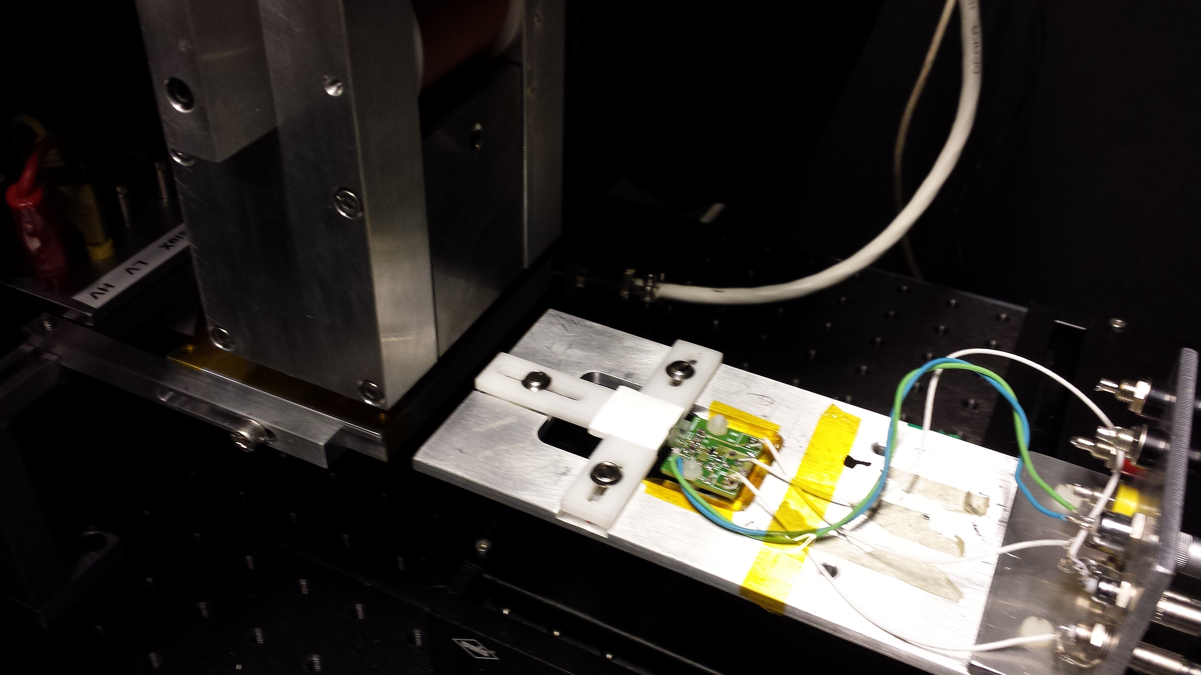
Setup

