Slide 1

Beam instrumentation developments at CTF3
E. Bravin, A. Goldblatt, T. Lefevre, S. Mazzoni, A. B. Morell, E. Nebot del Busto, R. Pan, J. R. Towler, M. Wendt,

Slide 2
Introduction
BPM: cavity and stripline
BLM status
Longitudinal profile: Electro Optical and streak upgrade
Spectrometry: recent and future installations
OTR/ODR tests

Slide 3
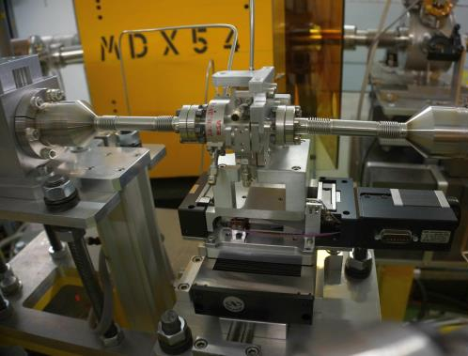
Main Beam Cavity BPM: Setup and Sensitivity
BPM required to measure orbit with 50 nm and 50 ns resolutions.
15 GHz stainless steel prototype cavity BPM installed in CALIFES.
Two cavities: Position (dipole) and reference (monopole).
Beam tests last spring.
No motor control to vary beam position, used corrector magnets.
Reference cavity charge sensitivity: 130 V nC⁻¹.
Predicted 117 V nC⁻¹.
Dipole cavity position sensitivity: 16.5 V nC⁻¹mm⁻¹.
Predicted 17.1 V nC⁻¹mm⁻¹.

Slide 4
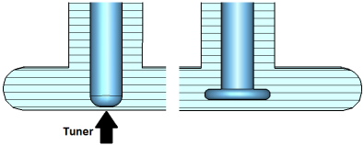
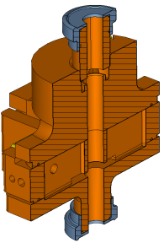
Main Beam Cavity BPM: Calibration and Plans
Calibration using corrector magnets.
13 μm horizontal beam jitter measured with focused beam.
Measurements will be repeated during next run using translation stages.
Redesigned
Reference
Cavity
Prototype design has been adapted based on beam tests.
  Copper to give higher internal Q: reducing time resolution, improving spatial resolution
  New feedthrough coupler design to remove tuners on opposite waveguide wall.
  Monopole cavity dimensions altered to restore frequency and Q after changing feedthroughs
New redesigned prototype should be manufactured from copper and ready for bench testing in March.
A three BPM system is foreseen later in the year to demonstrate the combined spatial and temporal resolution.
Position Cavity

Slide 5
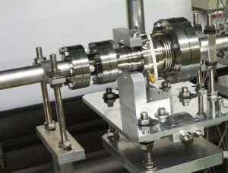
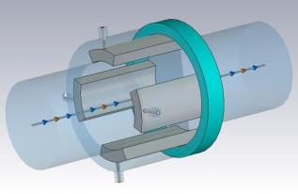
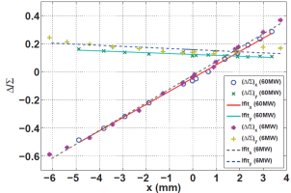
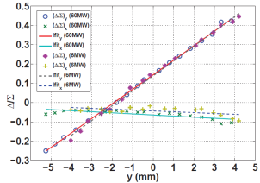
Stripline BPM development for CLIC drive beam
BEAM
Stripline prototype with short-circuited electrodes installed in TBL at CTF3 and successfully tested with beam (2013)
FESA class developed for synchronous data acquisition with the rest of TBL BPMs (Fall 2013)
Resolution tests to be performed using MIA-SVD analysis (First run of 2014)
STRIPLINE BPM
TBL Beam sweep in horizontal and vertical planes

Slide 6
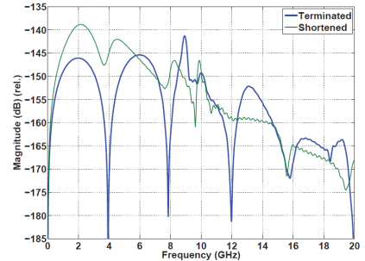
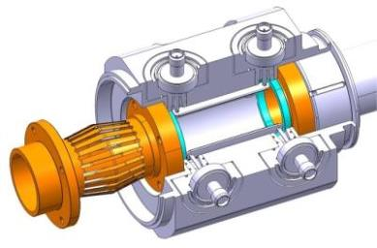
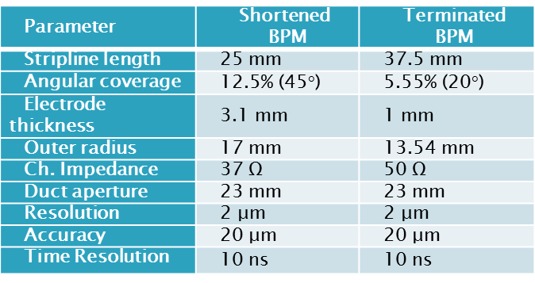
Stripline BPM development for CLIC drive beam
(*)
2 Stripline prototypes with 50Ω-terminated electrodes developed for CLIC Module, currently under fabrication (to be received in spring 2014).
8-port design for increased notch tunability and loop-through calibration.
Enhanced PETS interference suppression at 12 GHz (*).
Cold tests planned for summer 2014.
Beam tests planned for autumn 2014.
D. Gudkov BE-RF

Slide 7
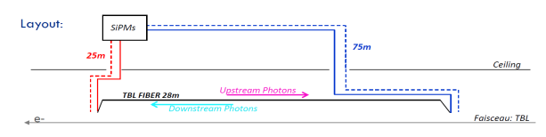
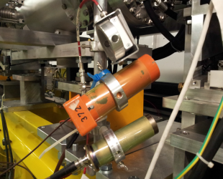
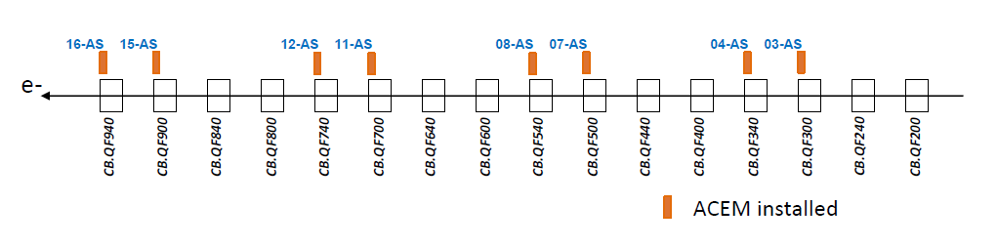
BLM investigations at TBL
Diamond pCVD
ACEM
PEP-II
Ionization Chambers
Fibre based BLM (200 um pure silica core + MPPC readout)
    RIA~200-300dB/km for 10kGy@0.22Gy/s (with Co60 and 445nm)
Ionization Chambers: They fulfill CLIC requirements
    Test response against low energy (< 150 MeV) particles
ACEM (Al Cathode +PMT)
    Simulations estimate sensitivity to beam losses of ~10mA. Consistent with observation
PEP-II (Cherenkov crystal + PMT) and diamond (pCVD)
    Fast time response. They disentangle losses within 150 ns pulse

Slide 8
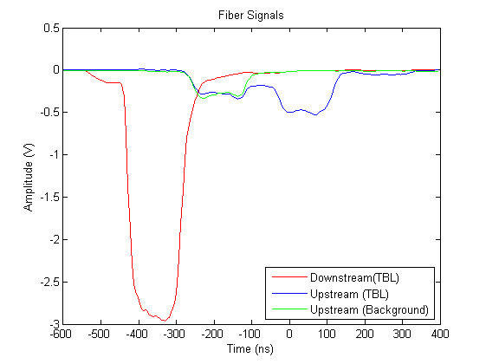
BLM investigations: work plan
RF structures as source of BLM background
    Cherenkov fibre + MPPC and pCVD detectors at Xbox 1
    Observation of X-rays and electrons escaping the structure
    Limit to sensitivity of BLM system?
Fiber based system improvements
    Signal deconvolution and position resolution with long pulses
    Extra fiber for H/V disentangling
    Choice of photodetector (optimization for CLIC-like conditions)
    Background subtraction (minimize contributions from fibre section not covering the beam line)
Measurement of beam losses at nominal TBM
    X-talk of beam losses from drive and main beam (and extrapolations at high energy)

Slide 9
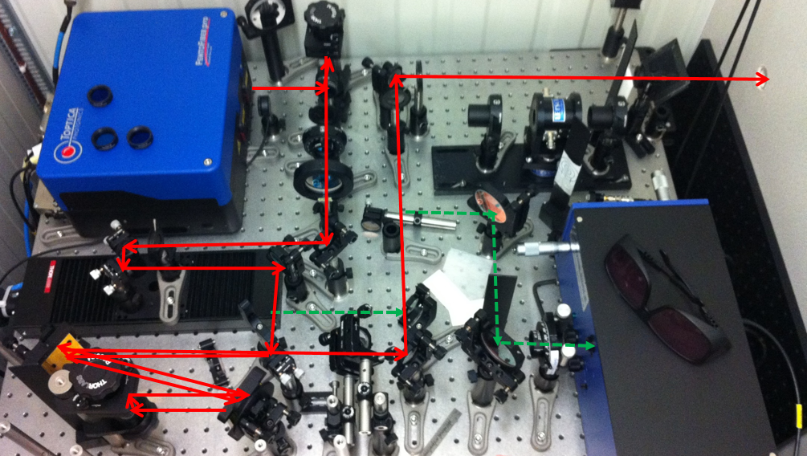
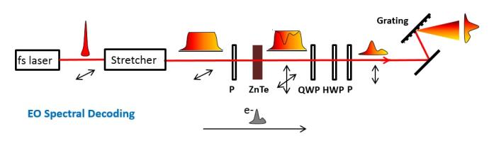
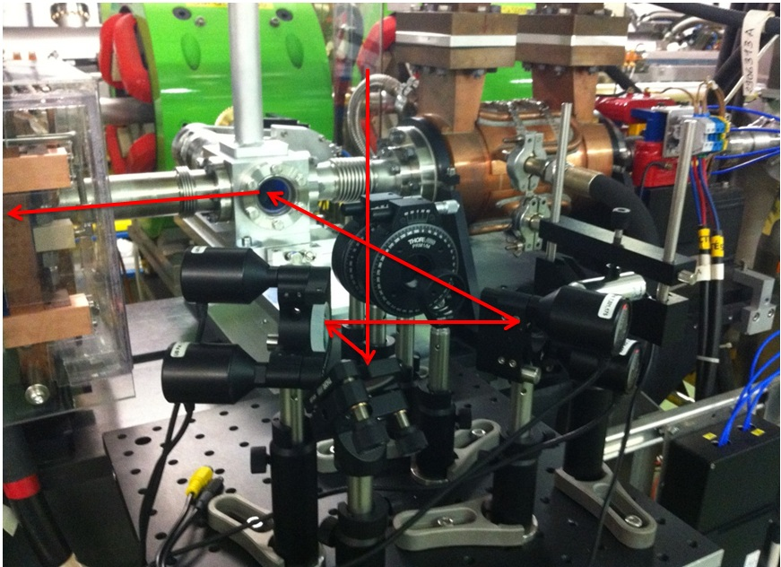
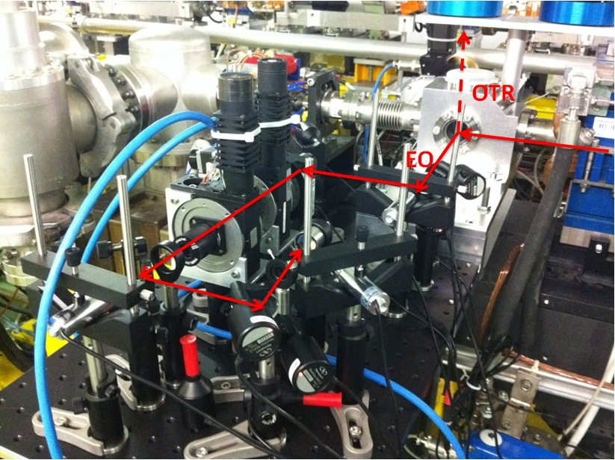
Electro-Optic bunch length monitor
Hardware and software: ready to use.
New 4mm thickness crystal installed instead of 1mm. Signal expected 11 times stronger
New stretcher: laser pulse can be chirped to 8 ps from 110 fs.
Added two detachable mirrors in the laser lab. Switching between single-shot and step scanning is possible now.
Principle of the monitor is tested by real e-beam.

Slide 10
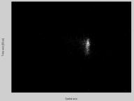
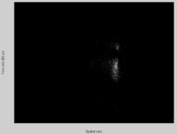
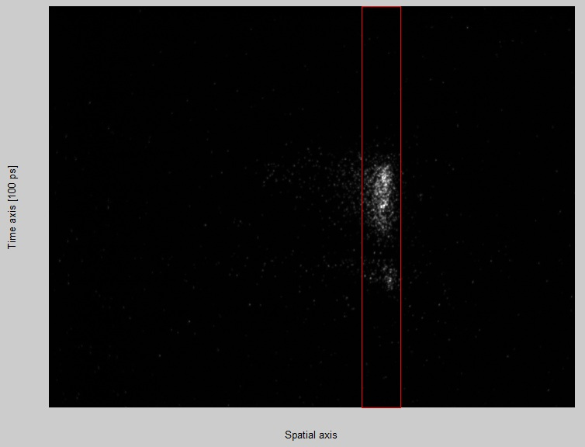
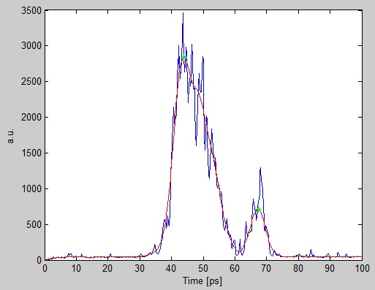
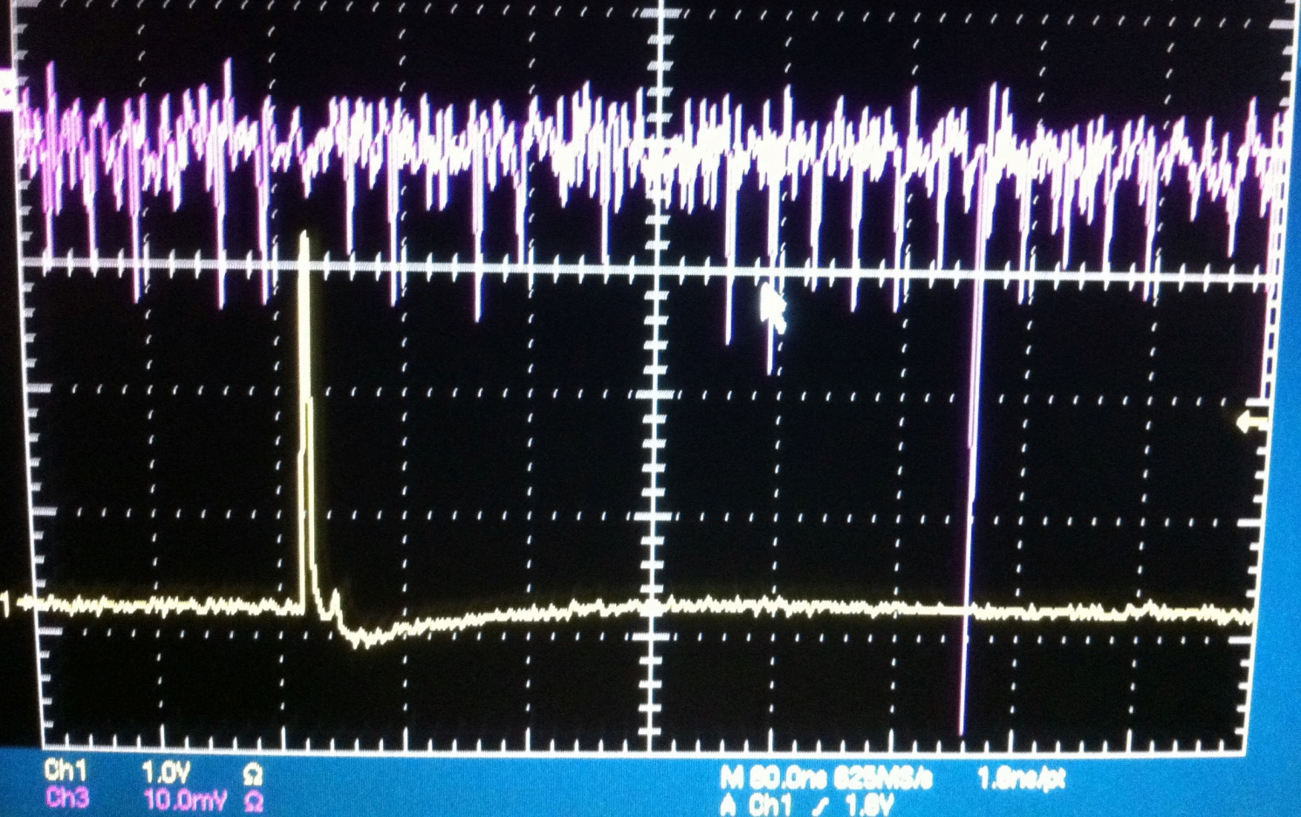
Electro-Optic bunch length monitor
Beam measurements: synchronisation between e-bunch and laser pulse
First E-O signal measured by a photomultiplier
Next steps: bunch length measurements, resolution improvement
100 ps
A laser pulse (top trace) is visible 420ns after the trigger signal (RF), bottom trace. Evidence for a depolarisation induced by the E-O crystal

Slide 11
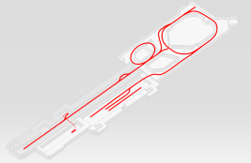
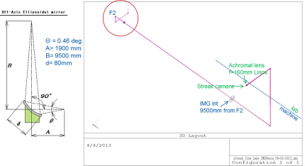
Bunch Length monitor: streak cameras
Synch light
Delay Loop OTR line upgrade (Jan 2014): from 6 achromats down to 1 (f = 5000 mm).
OTR
CLEX line upgrade (planned): installation of elliptical mirror (less chromatic dispersion and aberrations)
New software interface (allows remote operation)

Slide 12
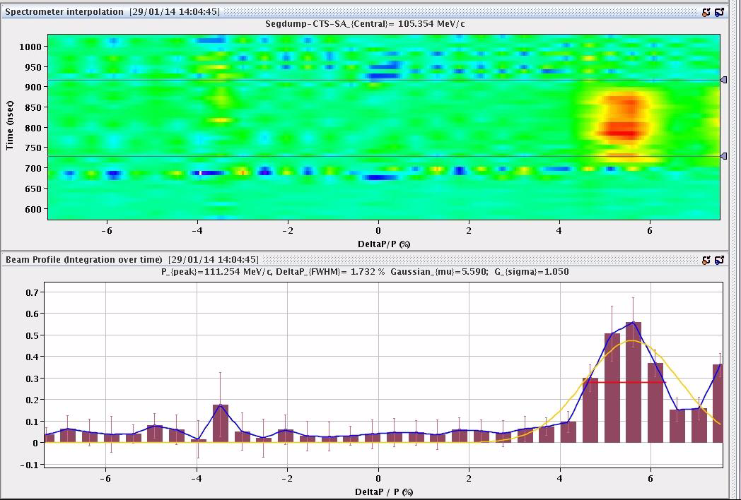
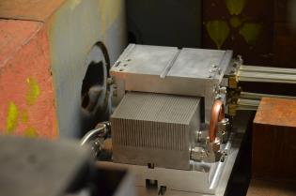
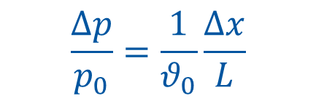
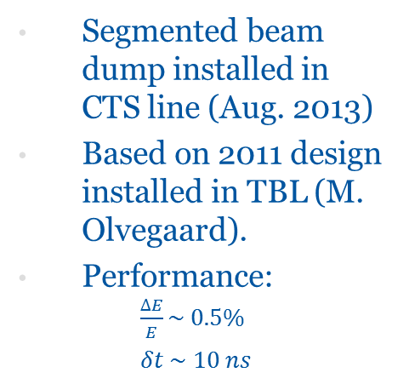
Spectrometers: segmented dump
Segmented beam dump installed in CTS line (Aug. 2013)
Based on 2011 design installed in TBL (M. Olvegaard).
Performance: $\frac{∆E}{E}\sim 0.5\%$
  $δt \sim 10 ns$
SW: D. Gamba
$$\frac{Δp}{p_{0}}=\frac{1}{θ_{0}}\frac{Δx}{L}$$
(zero-length approximation)

Slide 13
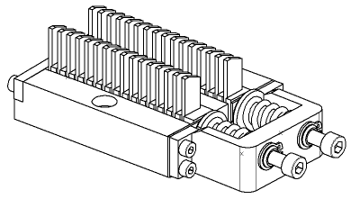
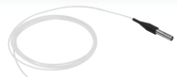
Spectrometers: Cherenkov crystals
Planned installation in Califes line towards future high charge beams:
32 silica crystals
each coupled to a GRIN collimator (dia 1.8 mm, acc, angle 0.15 deg)
GEANT simulations by A. Apyan
To sensor
Requirements tuned for CALIFES. BI test of light transmission (light yield, dispersion, coupling etc.)
Requirement | Min | Typ | Max
Temporal resolution [ps] |  | 100 | 600
Measurement duration [ns] |  | 100 | 150
Repetition rate [Hz] | 0.8 |  | 5
Energy resolution [%] |  | 0.5
Energy range [%] |  | 10
Central beam energy [MeV] | 200 |  | 250
Number of bunches | 1 |  | 200

Slide 14
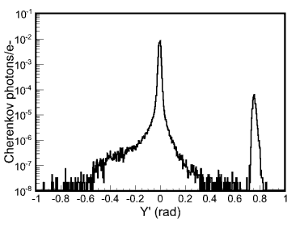
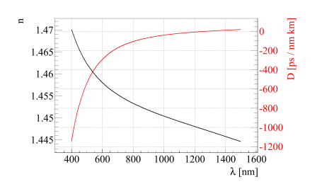
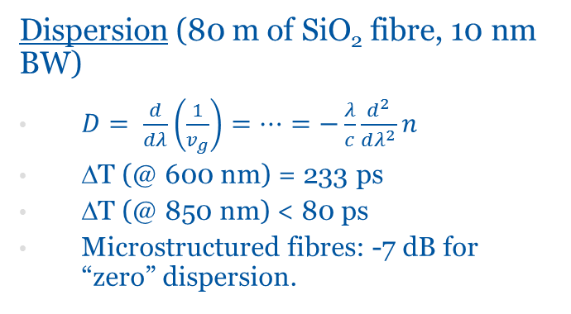
Spectrometers: Cherenkov crystals
Light yield (@ 400 nm):
From GEANT simulations: 2.5 x 10⁻⁴ ph/e- collected
-5 dB attenuation (insertion and transmission)
-> 7.5 x 10⁻⁵ photons/e- at the sensor -> 10²-10⁴ ph/bunch
@ 850 nm: 10-10³ ph/bunch
Energy 200 MeV
σ_{x} = 1 cm, σ_{y} =2 mm
σ_{θx} = 0 rad, σ_{θy} =0 μrad
Dispersion (80 m of SiO₂ fibre, 10 nm BW)
$D= \frac{d}{dλ}\left(\frac{1}{v_{g}}\right)=…=−\frac{λ}{c}\frac{d^{2}}{dλ^{2}}n$
ΔT (@ 600 nm) = 233 ps
ΔT (@ 850 nm) < 80 ps
Microstructured fibres: -7 dB for “zero” dispersion.

Slide 15
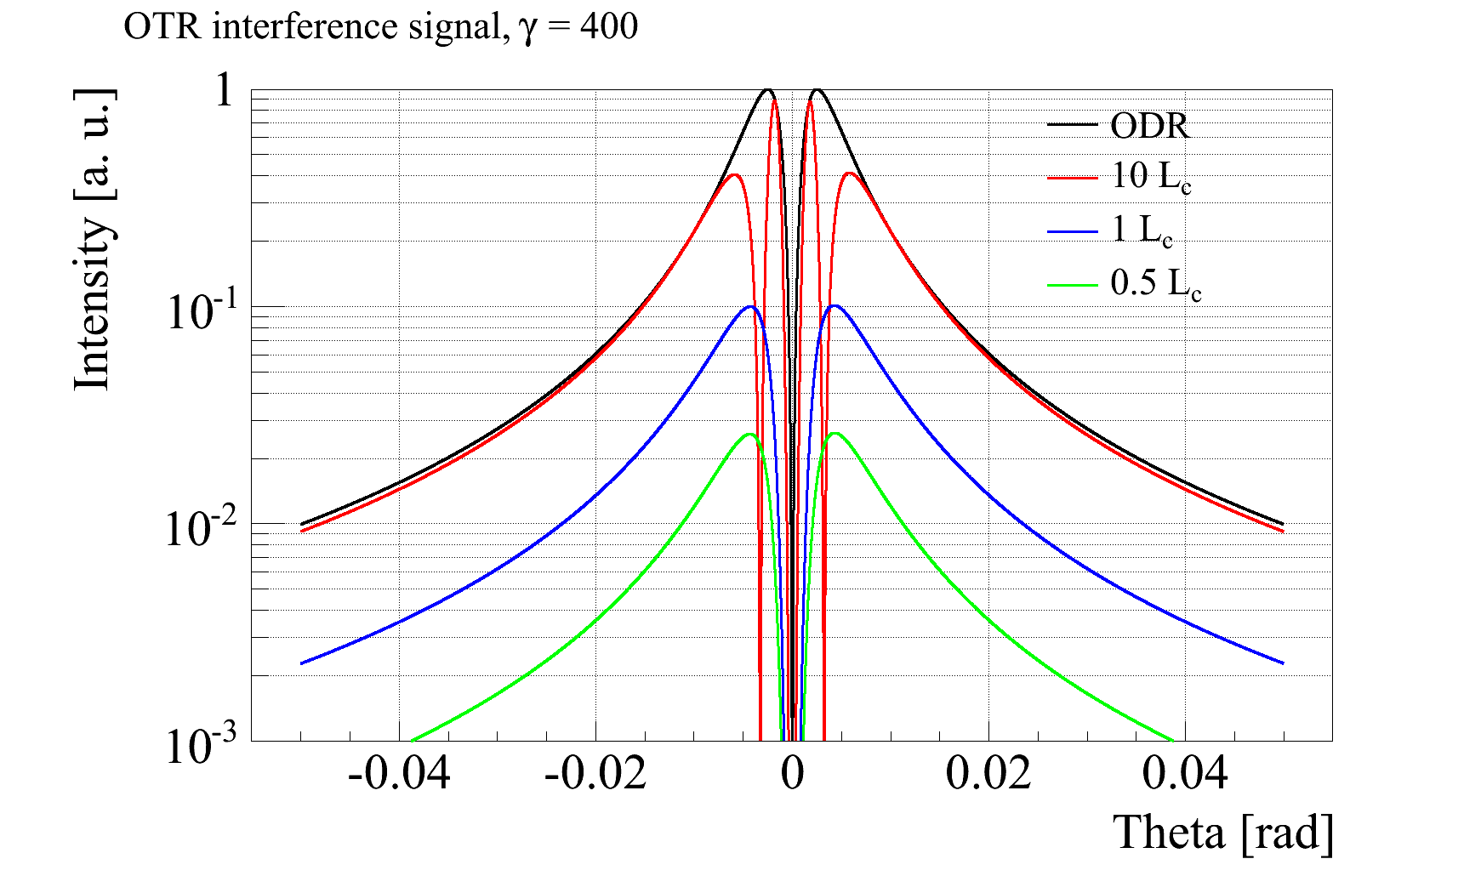
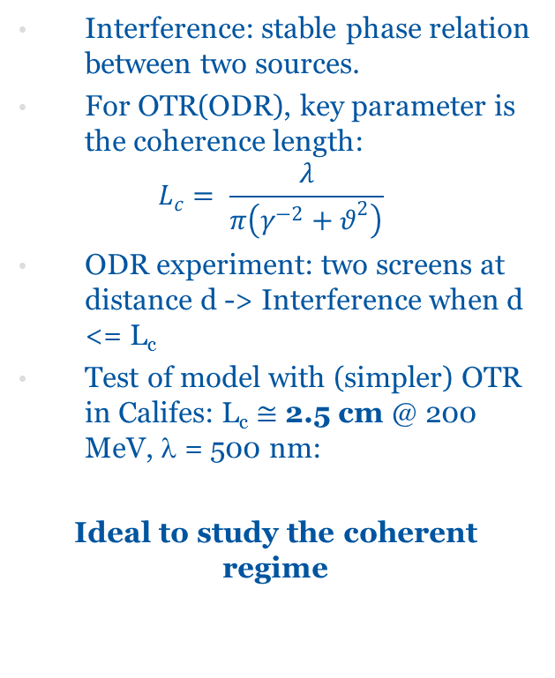
Coherence length test
SR mask
Interference: stable phase relation between two sources.
For OTR(ODR), key parameter is the coherence length:
$$L_{c}= \frac{λ}{π\left(γ^{−2}+θ^{2}\right)}$$
ODR experiment: two screens at distance d -> Interference when d <= L_{c}
Test of model with (simpler) OTR in Califes: L_{c} ≅ 2.5 cm @ 200 MeV, λ = 500 nm:
Ideal to study the coherent regime
target
optics
Warstki 1975

Slide 16
Summary
Continued involvement of BI team for CLIC studies
Maintenance (screen replacement, alignment, etc. )
Post-2016: possible utilisation of Califes line for BI tests (see presentation of W. Farabolini Wed, 9:00)

