Slide 1
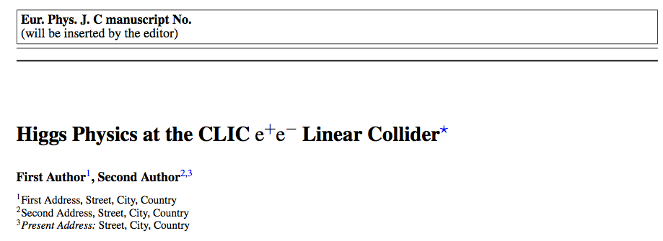
Brief report on
Status of CLIC Higgs Paper
Mark Thomson
for the editorial team

Slide 2

Status
  Things are progressing:
  enthusiastic agreement from editor that
  paper should be submitted to EPJC
  paper structure decided
  a very early draft exists
  sections are being filled as analyses are
  completed
  now need to fill in gaps
  + editing, more editing, …

Slide 3
Structure
  1) Introduction
  2) Simulation and Reconstruction tools
  3) Overview of Higgs Production at CLIC
  4) Higgsstrahling at 350 GeV
  5) WW Fusion – all energies: 350, 1.4, 3.0
  6) ZZ Fusion – 1.4 TeV
  7) Top Yukawa Coupling
  8) Higgs Self-Coupling
  9) Higgs Mass
  10) Combined Fits
  11) Summary and Conclusions

Slide 4
Status
  1) Introduction
  2) Simulation and Reconstruction tools
  3) Overview of Higgs Production at CLIC
  4) Higgsstrahling at 350 GeV (some gaps)
  5) WW Fusion (some content)
  6) ZZ Fusion (introductory text)
  7) Top Yukawa Coupling
  8) Higgs Self-Coupling (1.4 TeV to be finalised)
  9) Higgs Mass
  10) Combined Fits (need all final numbers)
  11) Summary and Conclusions

Slide 5
Structure
  1) Introduction
  2) Simulation and Reconstruction tools
  3) Overview of Higgs Production at CLIC
  4) Higgsstrahling at 350 GeV (some gaps)
  5) WW Fusion (some content)
  6) ZZ Fusion (introductory text)
  7) Top Yukawa Coupling
  8) Higgs Self-Coupling (1.4 TeV to be finalised)
  9) Higgs Mass
  10) Combined Fits
  11) Summary and Conclusions
  3) Overview of Higgs Production at CLIC
    3.1: Motivation for 350 GeV
    3.2: Impact of Beam Polarisation
    3.3: Overview of measurements at 350 GeV
      3.3.1: Extraction of couplings
    3.4: Overview of measurements at > 1 TeV

Slide 6
Structure
  1) Introduction
  2) Simulation and Reconstruction tools
  3) Overview of Higgs Production at CLIC
  4) Higgsstrahling at 350 GeV (some gaps)
  5) WW Fusion (some content)
  6) ZZ Fusion (introductory text)
  7) Top Yukawa Coupling
  8) Higgs Self-Coupling (1.4 TeV to be finalised)
  9) Higgs Mass
  10) Combined Fits
  11) Summary and Conclusions
  4) Higgsstrahling at 350 GeV
    4.1: Recoil mass
    4.1.1: Z → μμ, ee
    4.1.2: Z → qq
    4.1.3: Z → invis
    4.1.4: ZH cross section
    4.2: Branching ratios
    4.2.1: H → bb, cc, gg
    4.2.2: H → ττ, bb, cc, gg
    4.2.3: H → WW*
    4.2.4: H → ZZ*

Slide 7
Structure
  1) Introduction
  2) Simulation and Reconstruction tools
  3) Overview of Higgs Production at CLIC
  4) Higgsstrahling at 350 GeV (some gaps)
  5) WW Fusion (some content)
  6) ZZ Fusion (introductory text)
  7) Top Yukawa Coupling
  8) Higgs Self-Coupling (1.4 TeV to be finalised)
  9) Higgs Mass
  10) Combined Fits
  11) Summary and Conclusions
  5) WW Fusion
    5.1: Higgs to fermions
    5.1.1: H → bb, cc, gg
    5.1.2: H → ττ
    5.2: Higgs to WW and ZZ
    5.2.1: H → WW* at 350 GeV
    5.2.2: H → WW*
    5.2.3: H → ZZ*
    5.3: Rare Higgs Decays
    5.3.1: H → γγ
    5.3.2: H → Zγ
    5.3.3: H → μμ

Slide 8
Structure
  1) Introduction
  2) Simulation and Reconstruction tools
  3) Overview of Higgs Production at CLIC
  4) Higgsstrahling at 350 GeV
  5) WW Fusion
  6) ZZ Fusion
  7) Top Yukawa Coupling
  8) Higgs Self-Coupling
  9) Higgs Mass
  10) Combined Fits
  11) Summary and Conclusions
Monolithic
sections

Slide 9
Structure
  1) Introduction
  2) Simulation and Reconstruction tools
  3) Overview of Higgs Production at CLIC
  4) Higgsstrahling at 350 GeV
  5) WW Fusion
  6) ZZ Fusion
  7) Top Yukawa Coupling
  8) Higgs Self-Coupling
  9) Higgs Mass
  10) Combined Fits
  11) Summary and Conclusions
Some thoughts required on
BSM sensitivity?

Slide 10
What next?
  Timescales
  desire to bring to conclusion asap
  lots of progress, but still a lot to do…
  Highest priorities
  finish remaining analyses – lots of progress
  presented at this meetings
  fill in the missing sections (analyses + …)
  edit into a consistent style

