Slide 1

Magnet Studies
(CLIC QD0 and BDS, ILC QD0, ATF2)
M. Modena CERN
Acknowledgments:
CERN CLIC Magnets Studies Team: A. Aloev, A. Bartalesi, E. Solodko, P. Thonet, A. Vorozhtsov

Slide 2
Outline:
STATUS and PLANS for the different MDI & Co R&D activities:
CLIC QD0
CLIC antisolenoid
CLIC SD0
QD0 for ILC
Magnets for ATF: QD0 and Octupoles
2

Slide 3
Outline:
STATUS and PLANS for the different MDI & Co R&D activities:
CLIC QD0
CLIC antisolenoid
CLIC SD0
QD0 for ILC
Magnets for ATF: QD0 and Octupoles
3

Slide 4
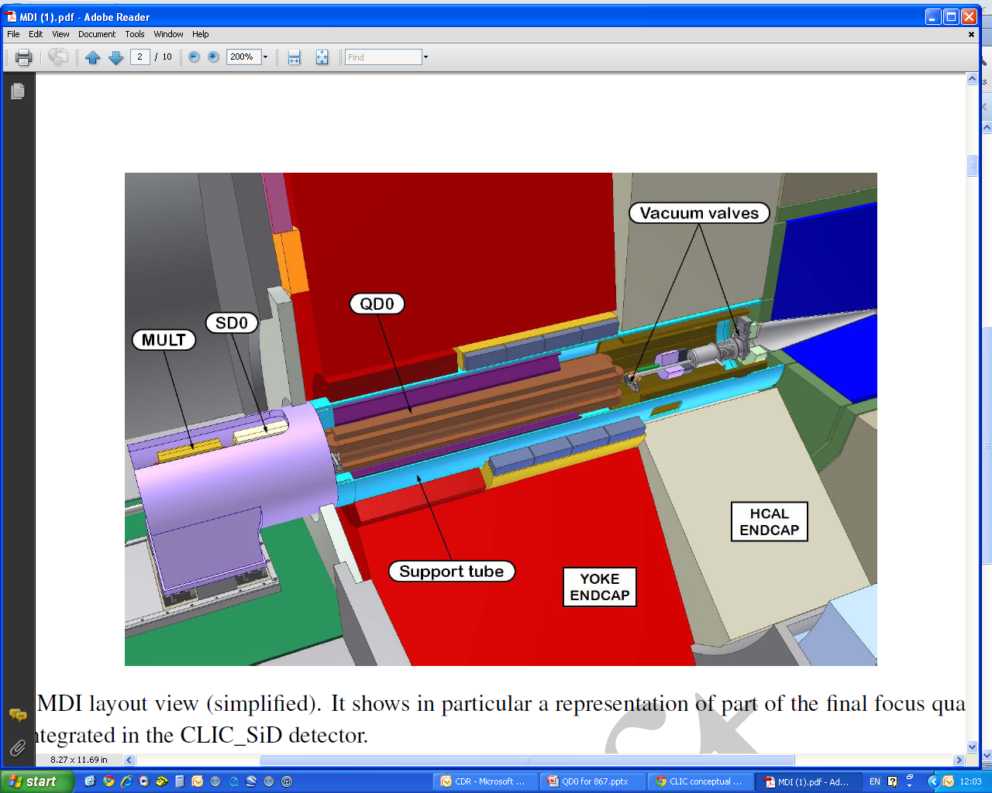
CLIC QD0 layout&integration
CLIC 3 TeV MDI conceptual design for L*=3.5 m layout (as in CLIC CDR baseline)
REMIND: for CLIC QD0 we proposed an hybrid design solution since we think it more stable (no active cooling) and easy to be fiducialized and aligned respect to a superconducting design (only alternative for such high gradient).
4

Slide 5
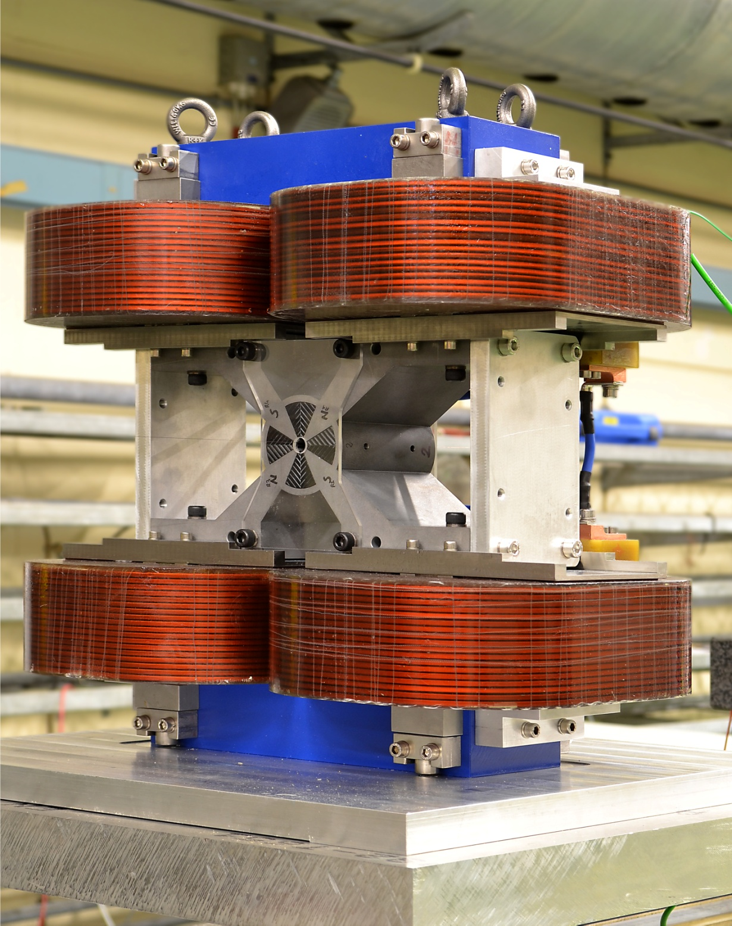
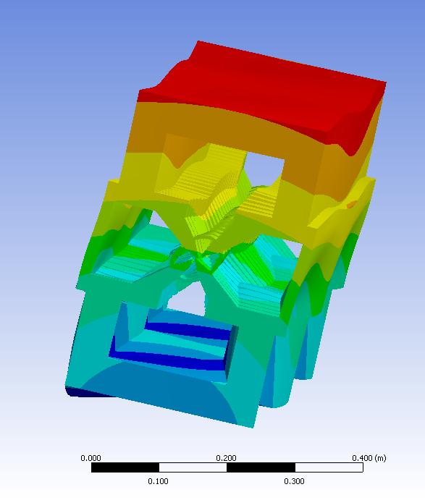
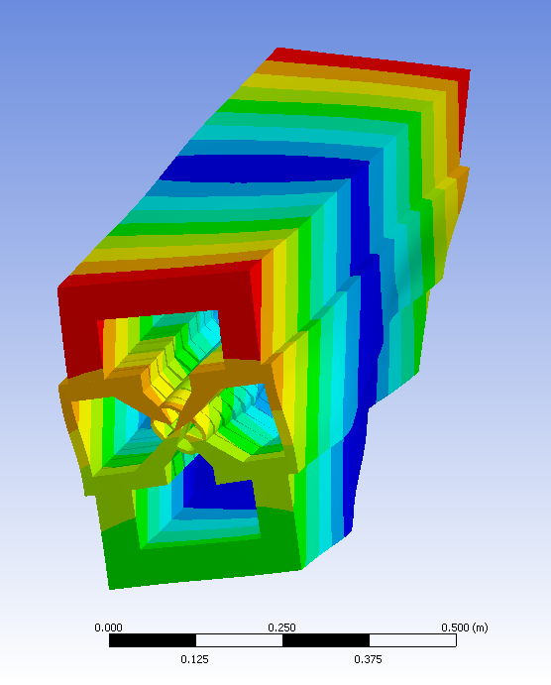
CLIC QD0 Prototype Status
CLIC QD0 Short Prototype (built in 2011 and measured in 2012):
STATUS: Coils are under dismounting in order to:
Permit LAPP (Annecy)
to do vibration and mechanical
measurements
Perform magnetic measurements in a simpler configuration (with coils only) to assess the field quality contributions due to Permendur and PM.
Investigate (at CERN and at Supplier site) the quality of the NdFeB blocks.
Main Parameter | Value
Required field gradient G | 575 T/m
Prototype gradient expected/measured | 503/504 (SmCo) 547/514(NdFeB); T/m
Magnetic length (full size QD0) | 2.73 m
Magnet aperture (required for beam) | 7.6 mm
Magnet bore diameter (assuming a 0.30 mm vacuum pipe thickness) | 8.25 mm
Good field region(GFR) radius | 1 mm
Integrated field gradient error inside GFR | < 0.1%
Gradient adjustment required | +0 to -20%
5

Slide 6
Outline:
STATUS and PLANS for the different MDI & Co R&D activities:
CLIC QD0
CLIC antisolenoid
CLIC SD0
QD0 for ILC
Magnets for ATF: QD0 and Octupoles
6

Slide 7
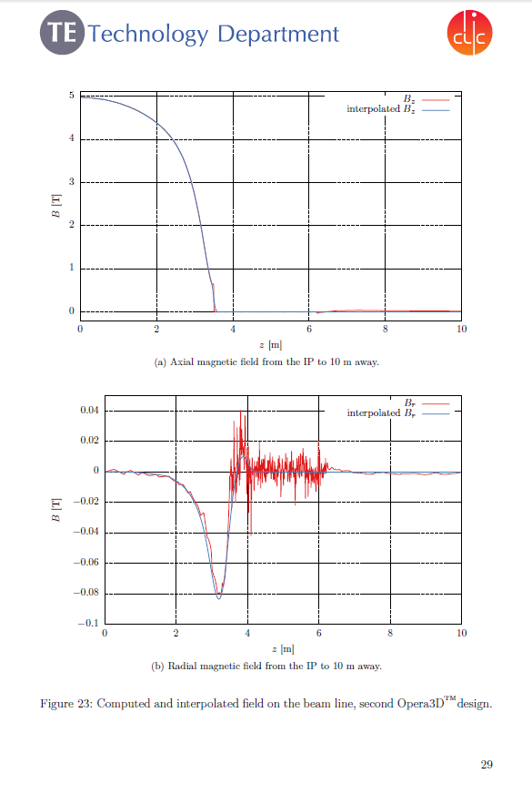
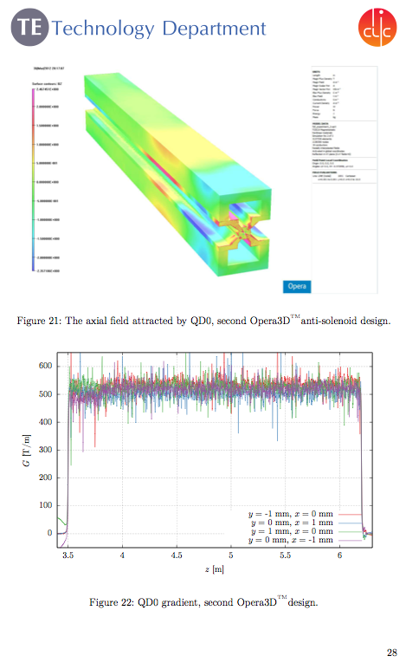
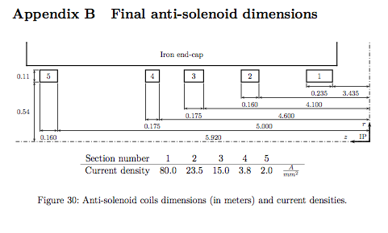
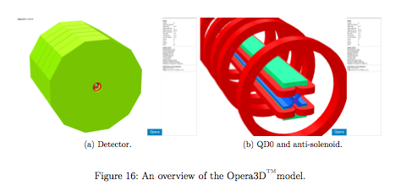
ANTISOLENOID studies:
Forces:
- The most relevant is the axial force: Fz of 7.0·10⁶ N acting
on the first coil of the anti-solenoid, pushing it away from the IP.
- The magnetic forces acting on QD0 are estimated as:
Fz ≃−5.7kN; Fx ≃8.3kN; Ty ≃5.6·10³ Nm.
Note: If a new study for an antisolenoid system for L* = 6 m, A. Aloev is available to continue the work started by A.Bartalesi
Ref: CLIC Note 944: A. Bartalesi, M. Modena: “DESIGN OF THE ANTI-SOLENOID SYSTEM FOR THE CLIC SID EXPERIMENT”
7

Slide 8
Outline:
STATUS and PLANS for the different MDI & Co R&D activities:
CLIC QD0
CLIC antisolenoid
CLIC SD0
QD0 for ILC
Magnets for ATF: QD0 and Octupoles
8

Slide 9
CLIC SD0 Status
CLIC 3 TeV MDI conceptual design for L*=3.5 m layout (as in CLIC CDR baseline)
SDO is also considered a BDS critical magnet as it is requested with the stronger as possible gradient.
The magnet is the last placed in the tunnel, just at the border with the experimental Hall
Being much shorter and not placed inside the Detector, the magnet has less tight geometric boundary conditions.
As all BDS magnets it also needs an active stabilization.
Parameter | Value
Inner radius | 4.3 mm
Nom. Sext. Gradient | 219403 T/m2
Magnetic Length | Lm: 0.248 m
9

Slide 10
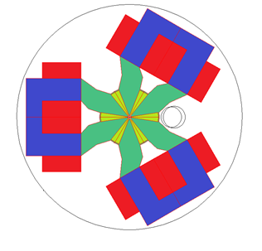
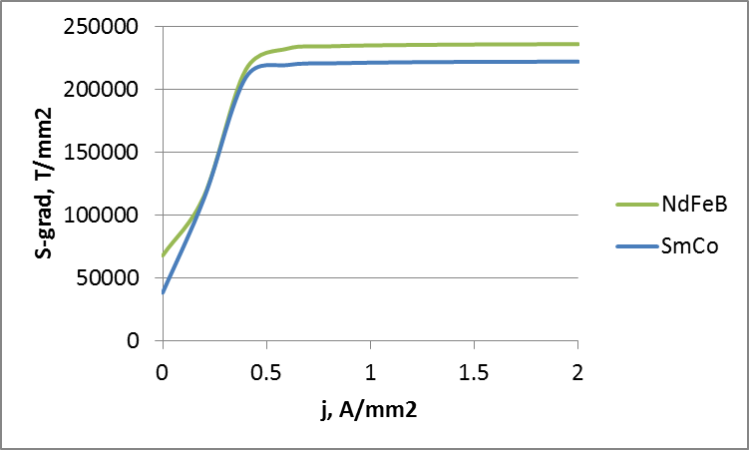
CLIC SD0 Status
Main requirements & boundary conditions:
- Tunability of ~ -20 %
Minimized vibrations
Integration (Post Collision vacuum pipe).
Compactness (but less critical respect to QD0).
Prototype key aspects:
- It provide a wide tunability (nominally -80%)
It permit to test the assembly of the sectors (individual and global assembly procedure: magnetic forces between blocks impact? PM blocks are very fragile!)
It needs high precision manufacturing of Permendur sector, PM insert, “C” shape return yokes (assembly references)
Measuring, assembly and sorting of PM blocks
Magnetic measurements
Alignment studies
10

Slide 11
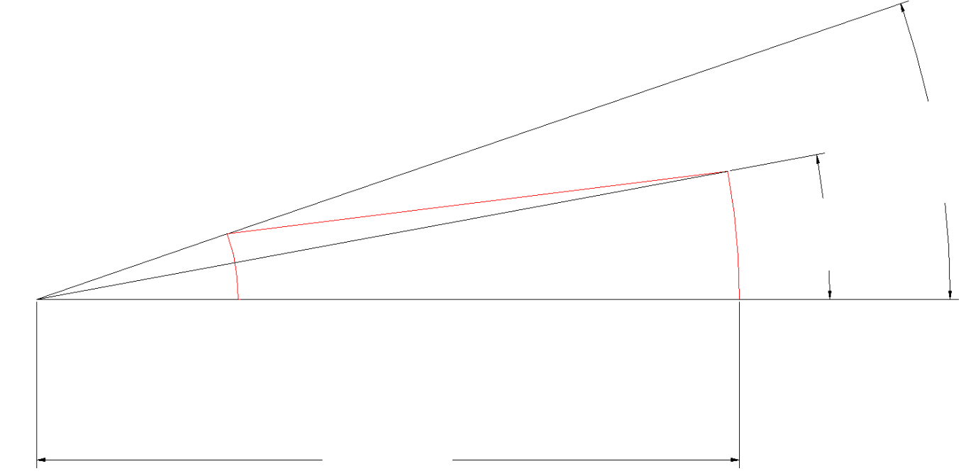
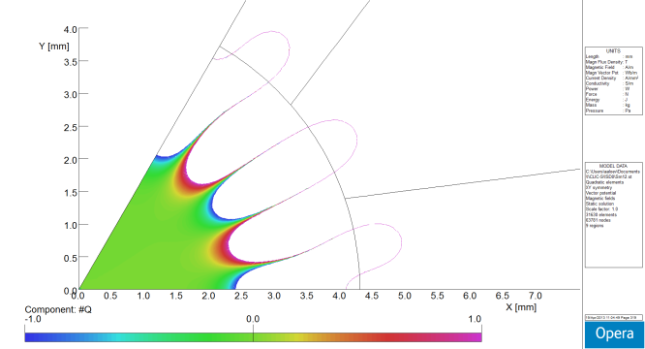
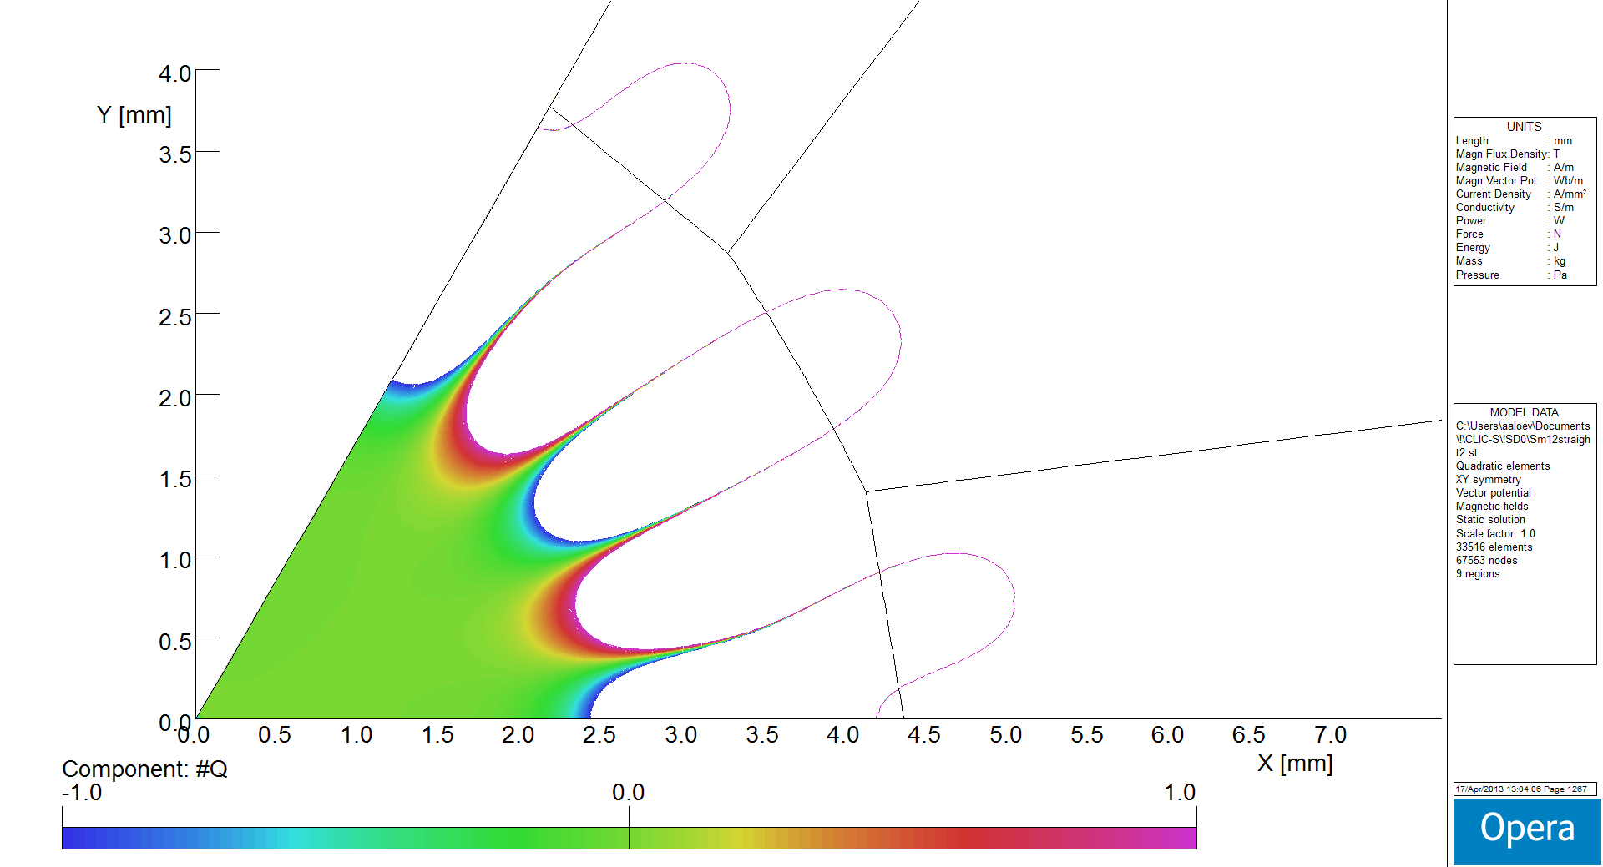

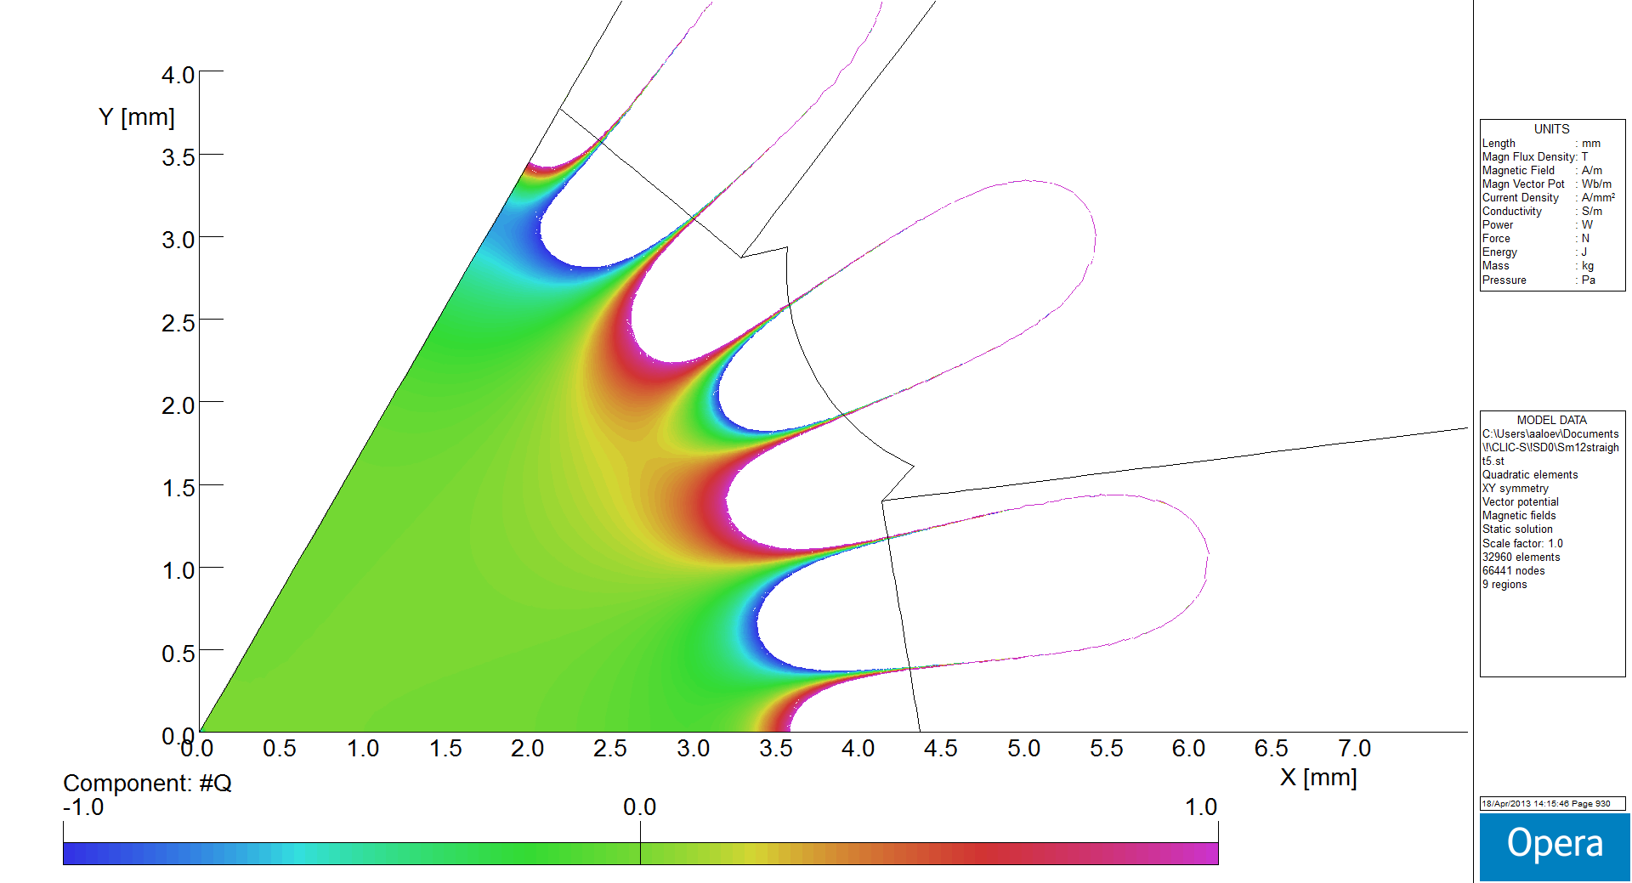
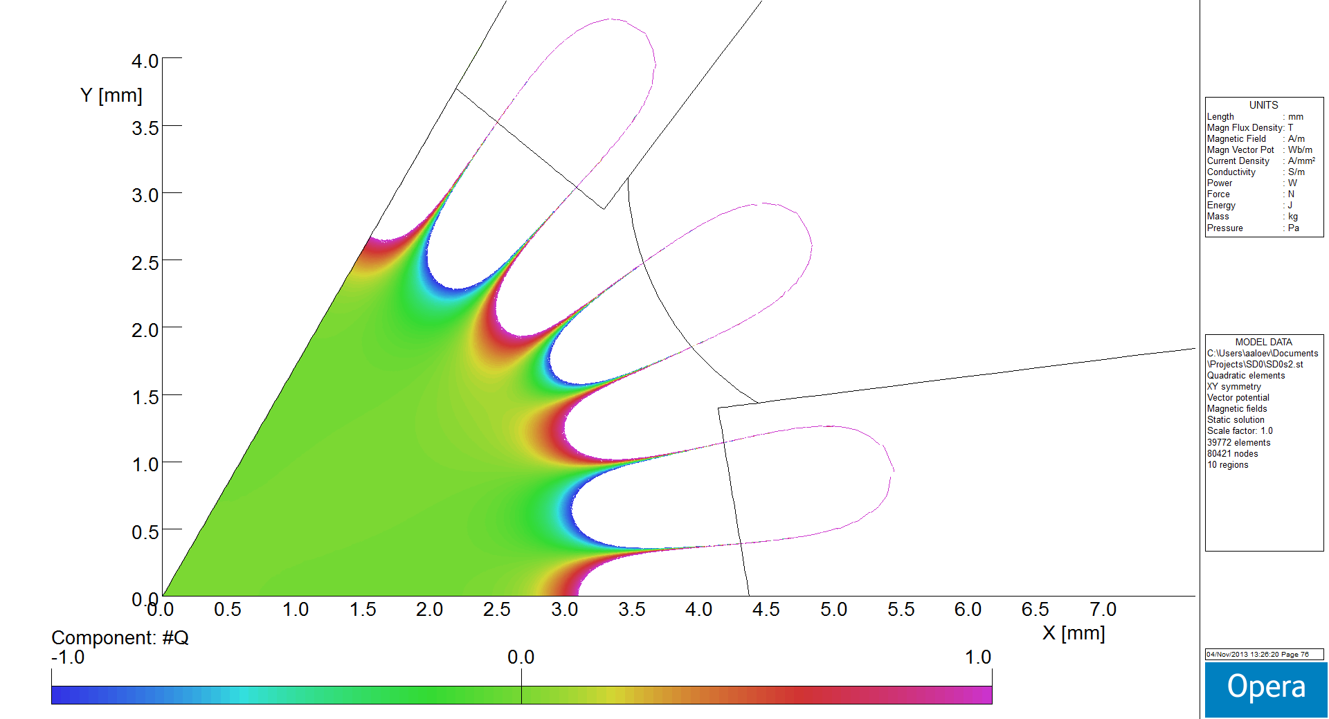
SD0: Field quality tuning
Optimization process provides the following values : α_{in} = 18.9° α_{out} = 8.4 ° R_{out} = 40 mm
α_{in}
α_{out}
PM “Easy direction”
R_{out}
Opt.1 S-grad 222020 T/m²
Opt.2 S-grad 220349 T/m²
Opt.3 S-grad 221247 T/m²
Opt.4 S-grad 215785 T/m²
Opt.5 S-grad 216013 T/m²
11

Slide 12
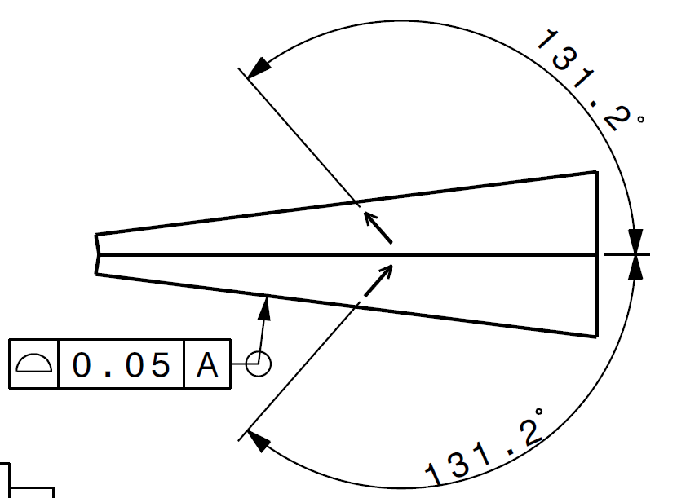
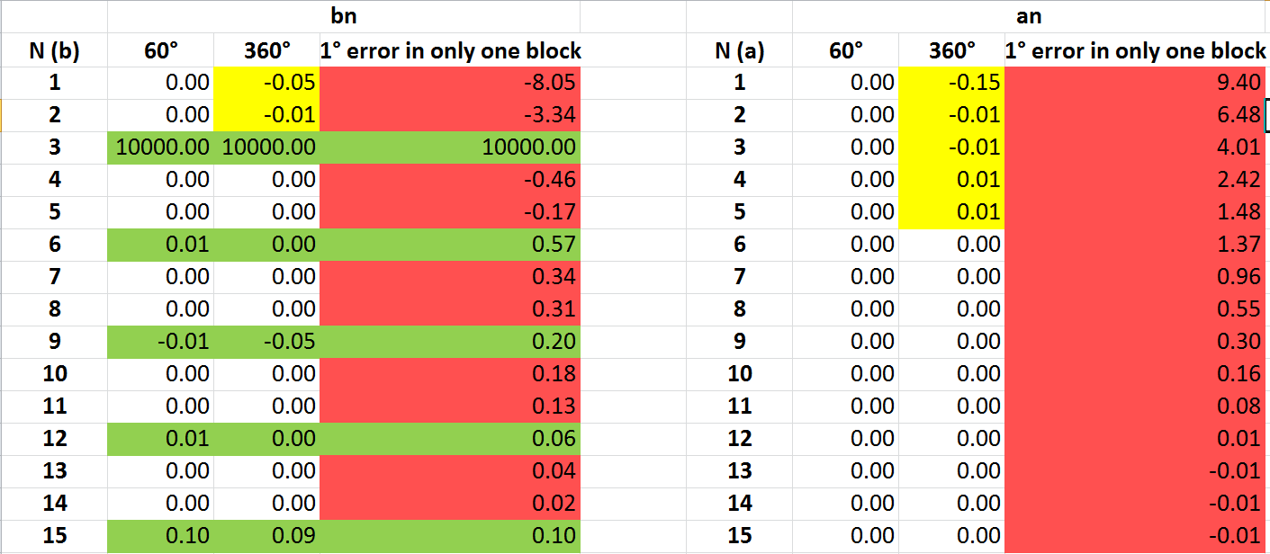
Field quality tuning: SD0
A sensitivity study of the the field quality versus error in the magnetization angle was also initiated:
The table below shows the appearance of undesiderable multipole components when an error of 1 degree in the magnetization angle appears in ONE block.
(NOTE: this case is much worse than the case where the same error appear in 6 symmetrically positioned blocks)
12

Slide 13
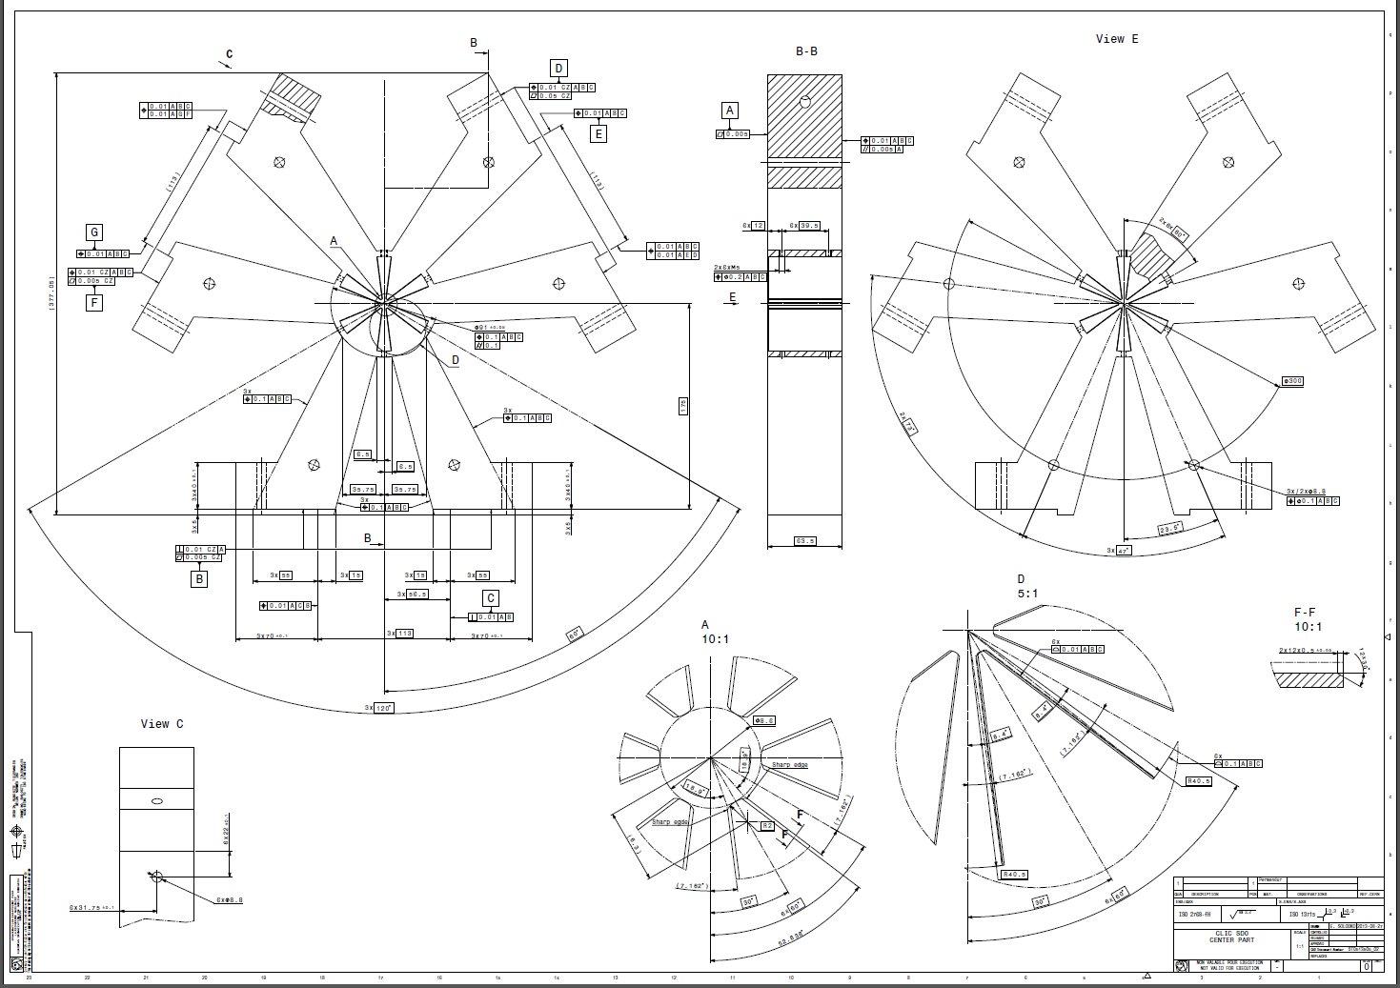
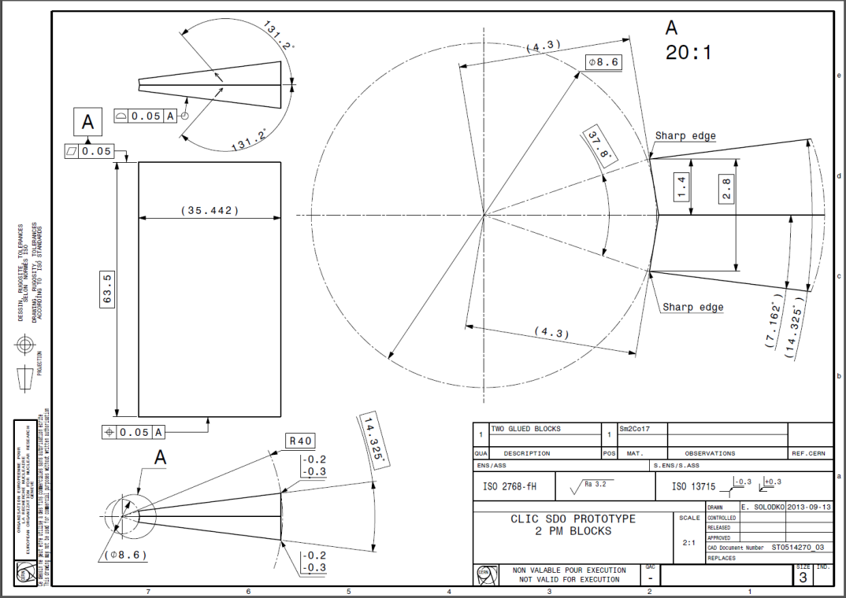
13

Slide 14
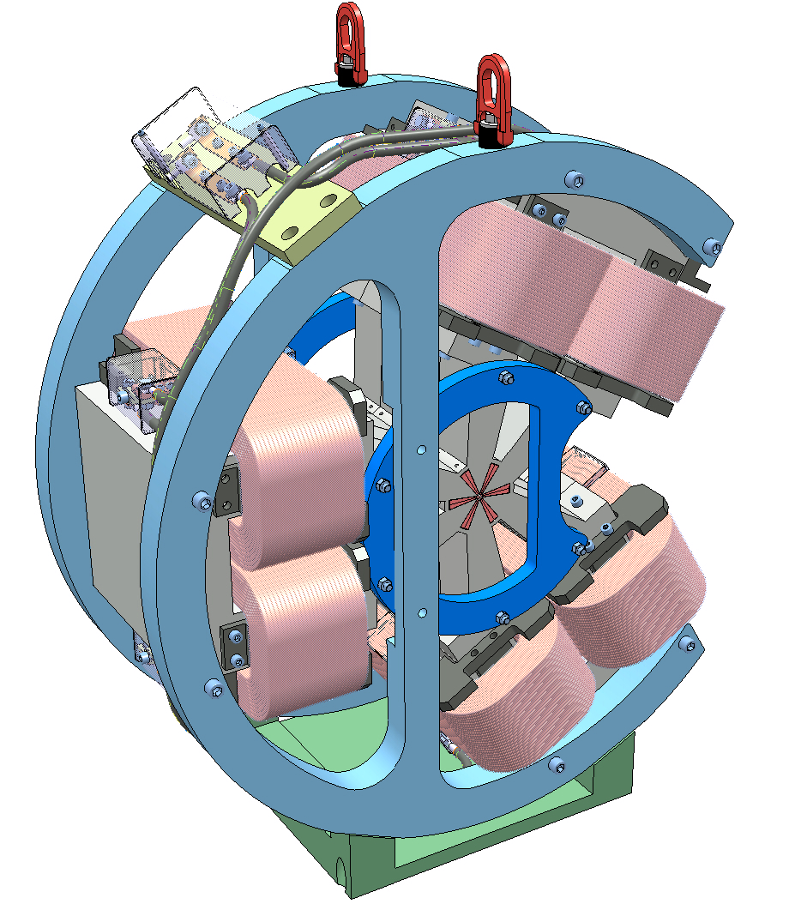
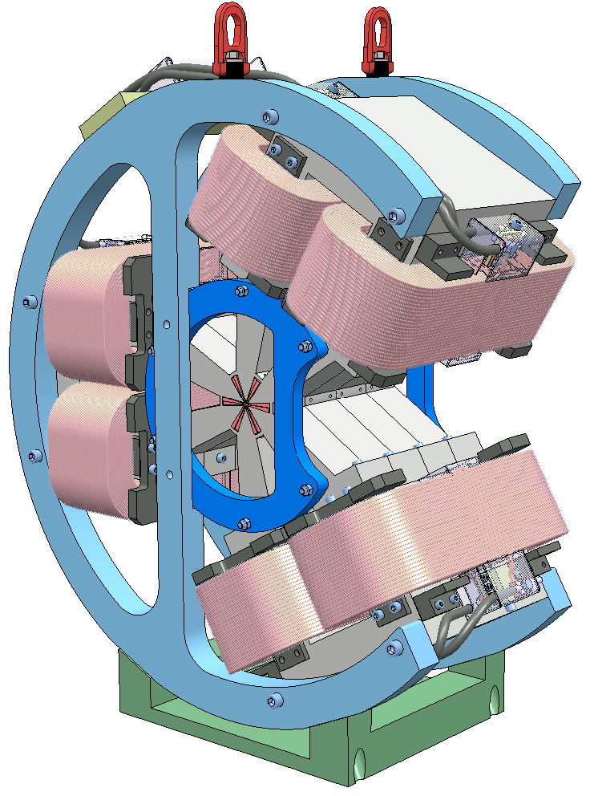
Technical design in progress;
we are discussion with potentials components manufacturers on components and assembly details to complete the design and start the procurement.
14

Slide 15
Outline:
STATUS and PLANS for the different MDI & Co R&D activities:
CLIC QD0
CLIC antisolenoid
CLIC SD0
QD0 for ILC
Magnets for ATF: QD0 and Octupoles
15

Slide 16
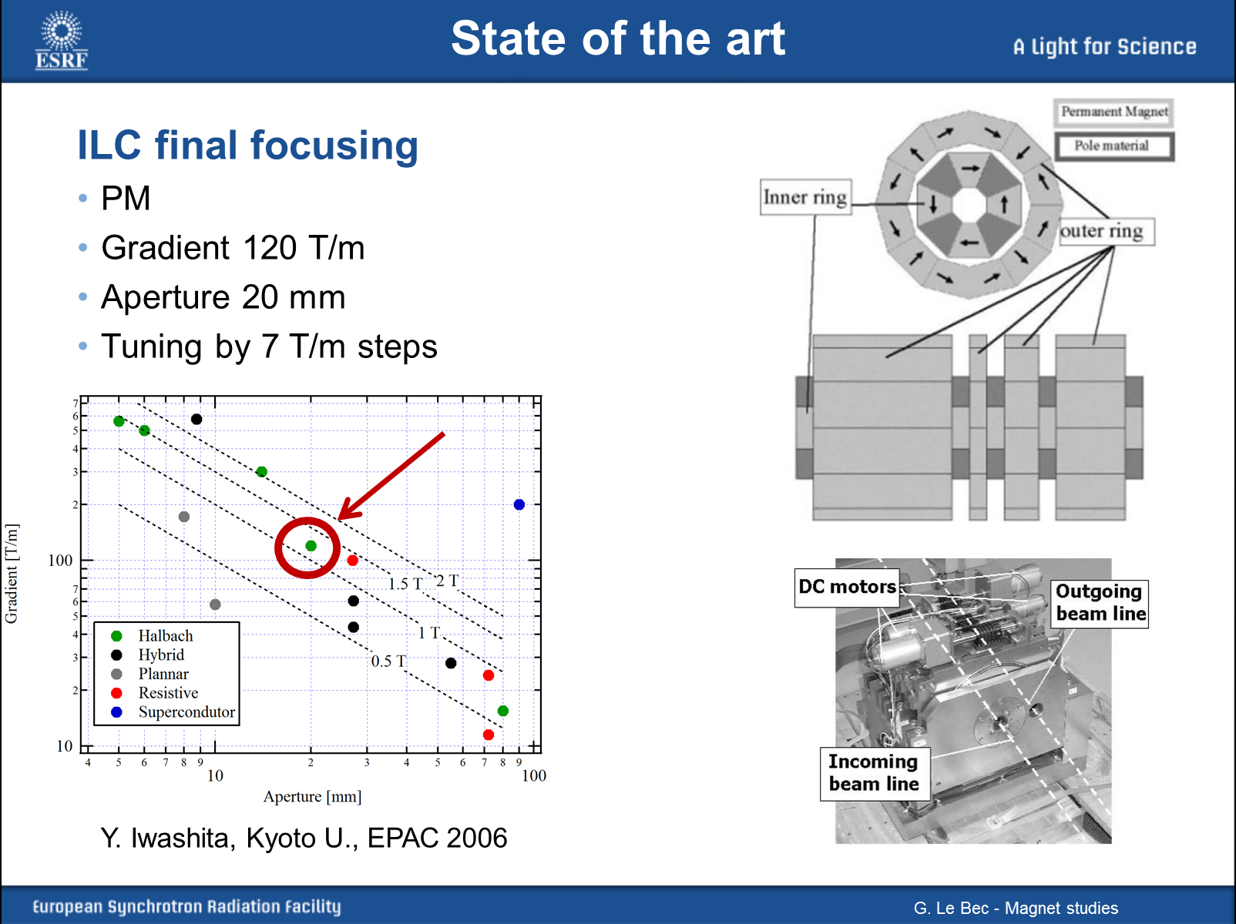
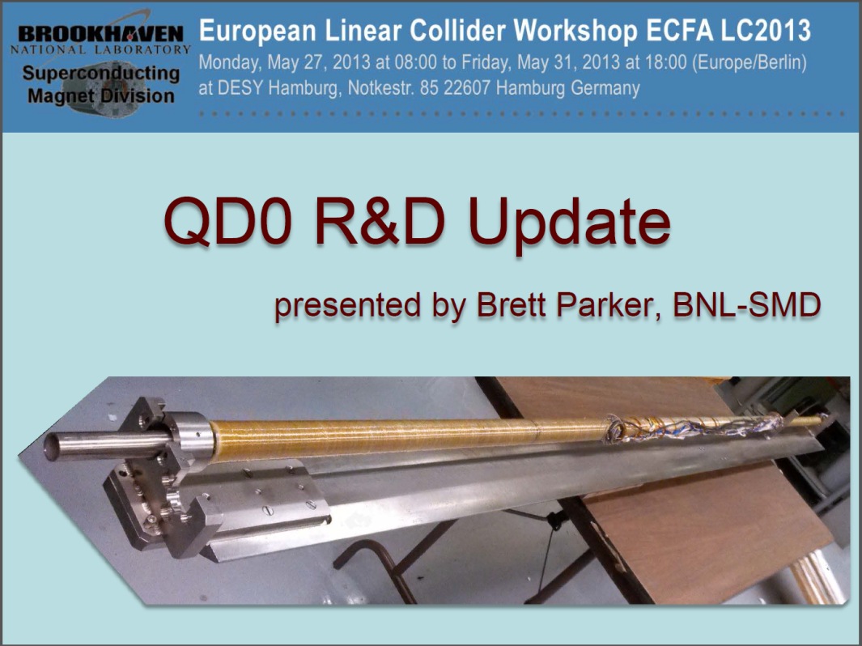
A hybrid QD0 for ILC ?
16

Slide 17
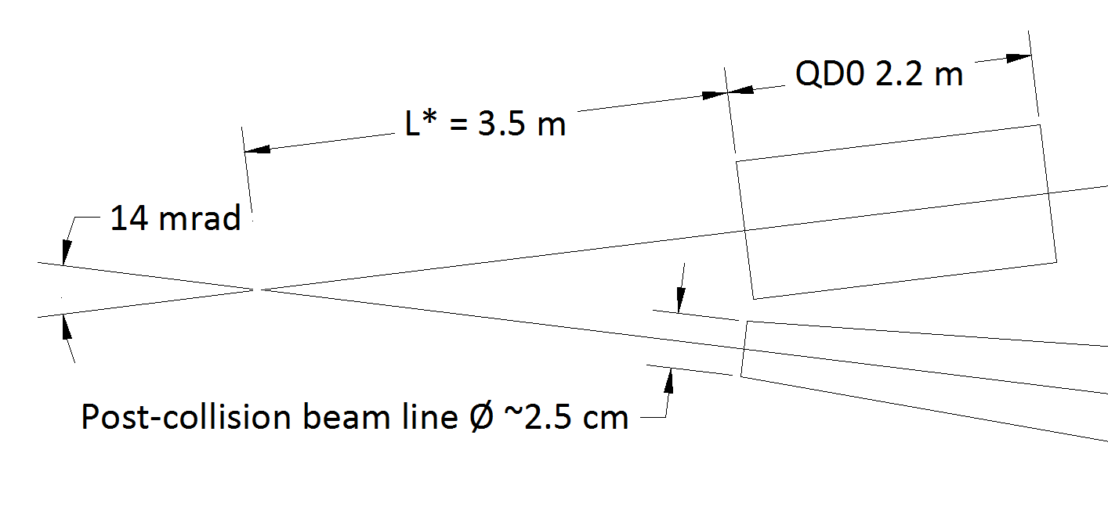
- Crossing angle: 14 mrad
- L* = 3.5 m
- QD0 full aperture: 2 cm
- QD0 total length: 2.2 m
- QD0 gradient: 124 T/m
- Post Collision Line vacuum pipe radius at 3.5 m: ~ 12.5 mm
A hybrid QD0 for ILC ?
Basic ILC QD0 parameters (R. Tomas : private communication, May 2013):
17

Slide 18
Examples of an optimization done on 3 parameters (α_{in}, α_{out}, ↑_{easy dir;}) (R_{out} =30 mm):
-The field quality is optimized by: 32° for both α_{in}, α_{out}, and 55° for the easy dir. (1st table)
-The gradient is maximized with: α_{in}=33°, α_{out}=13° and 32° for the easy dir. (2nd table)
A hybrid QD0 for ILC ?
α_{in}
α_{out}
PM “Easy direction”
R_{out}
18

Slide 19
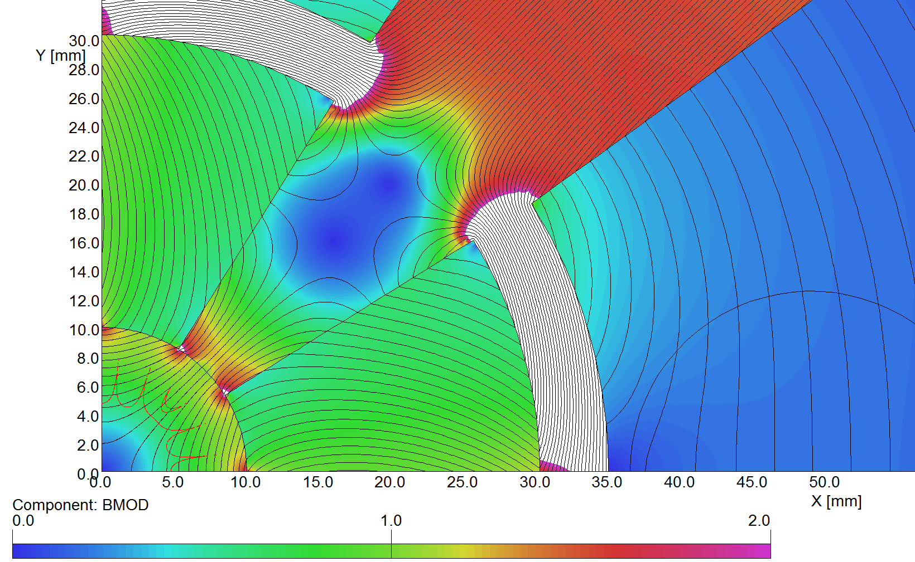
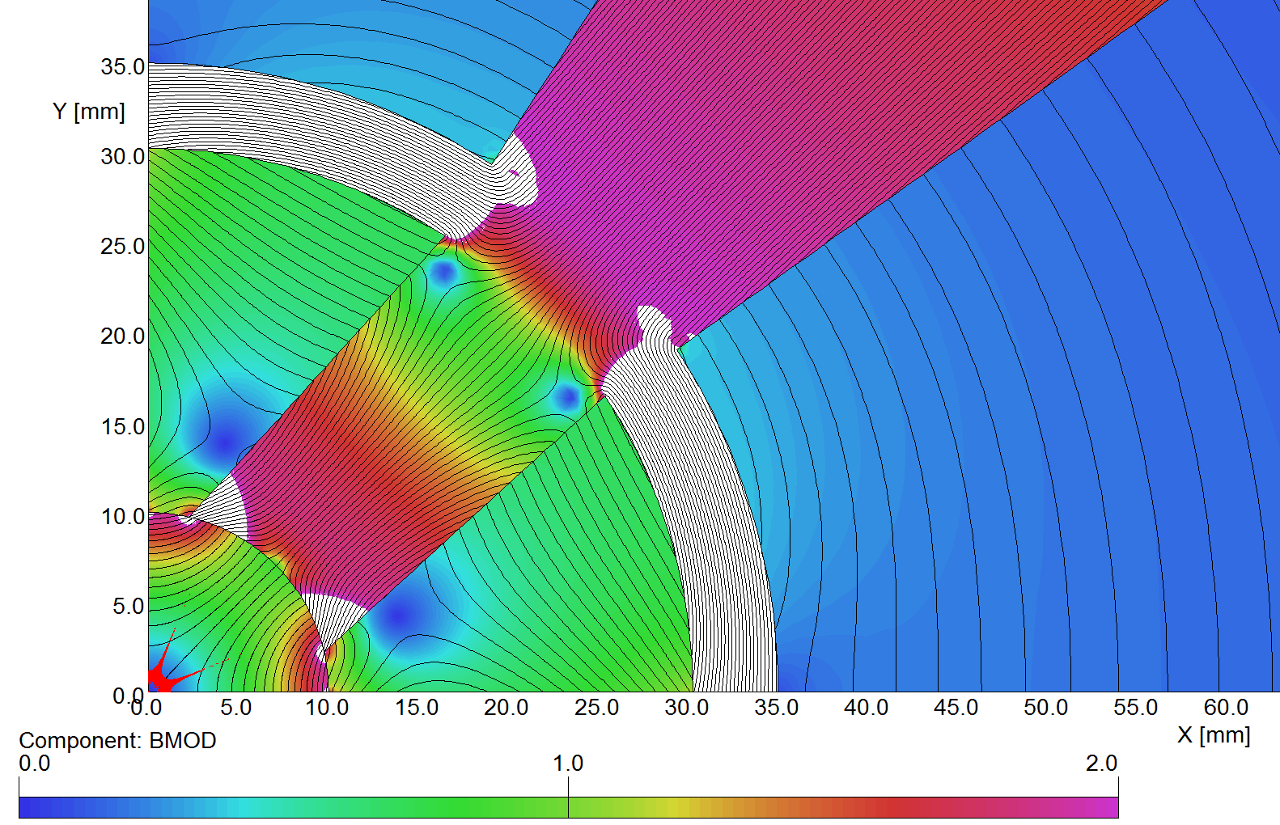
LEFT: ILC QD0 design optimized for nominal Gradient required and best field quality.
RIGHT: a configuration for a MAX Gradient (142 T/m). Saturation appears and filed quality is much lower
A hybrid QD0 for ILC ?
“red line” inside the aperture: area where ΔG/G ≤1 unit (good field region)
Main multipoles estimation at r = 3 mm; 5000 NI is the nominal working point (G:125 T/m)
19

Slide 20
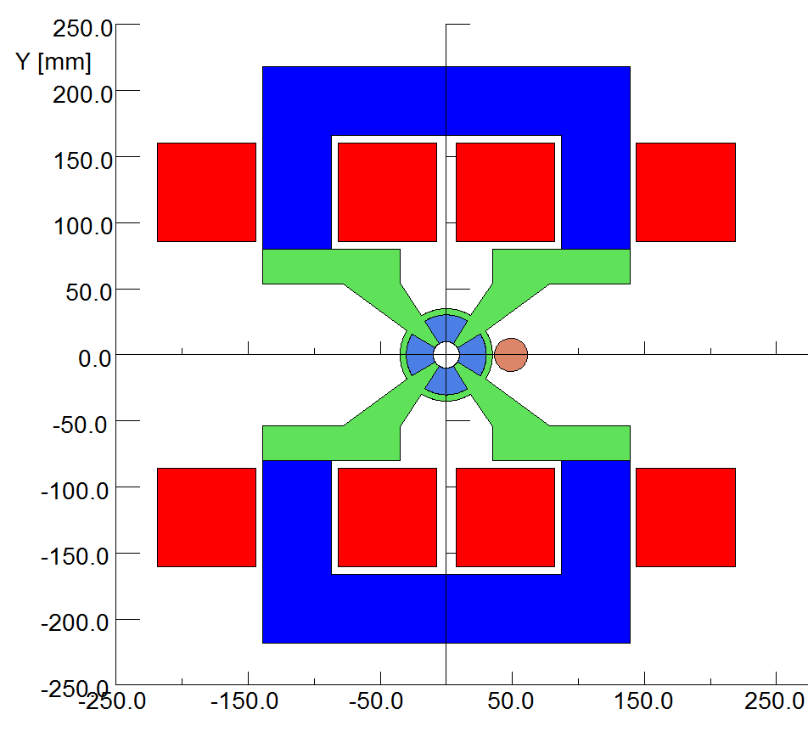
A basic sketch for the hybrid QD0 (CLIC concept) adapted to the ILC parameters:
- As for CLIC case, this solution minimises vibrations; coils are sized for a current density J ~ 0.9 A/mm (→ no water cooling).
- Overall dimension are in the range of 500 x 500 mm.
A hybrid QD0 for ILC ?
Other solutions to minimise the cross-section:
A coils cooling system could be added if not detrimental to magnet stability (micro-vibration)
Even more interesting; a “superferric” solution could be envisaged; (discussed this option with Akira Yamamoto, it could become an interesting line to be investigated…)
20

Slide 21
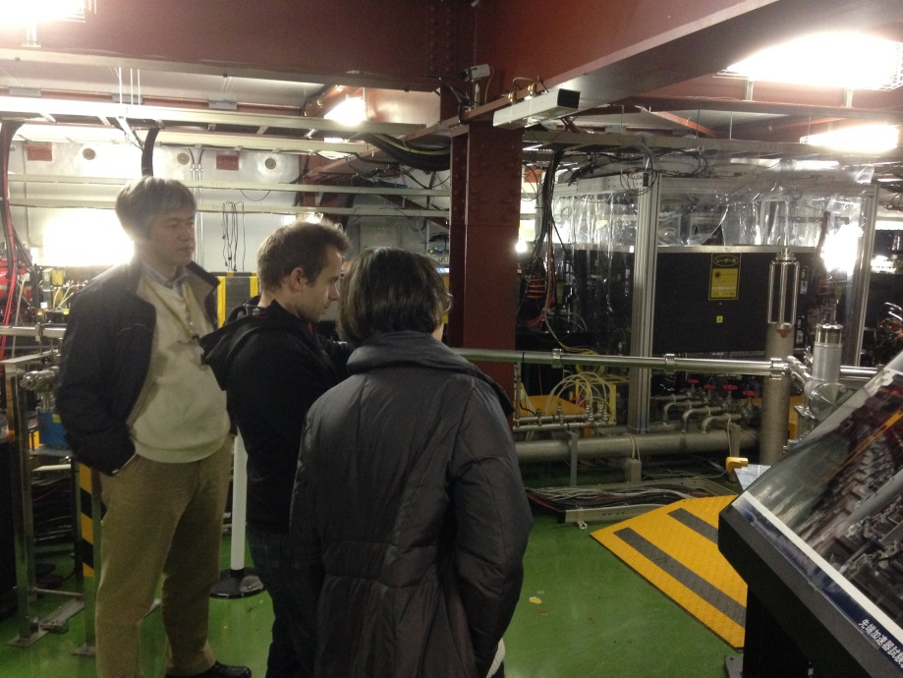
Outline:
STATUS and PLANS for the different MDI & Co R&D activities:
CLIC QD0
CLIC antisolenoid
CLIC SD0
QD0 for ILC
Magnets for ATF: QD0 and Octupoles
21

Slide 22
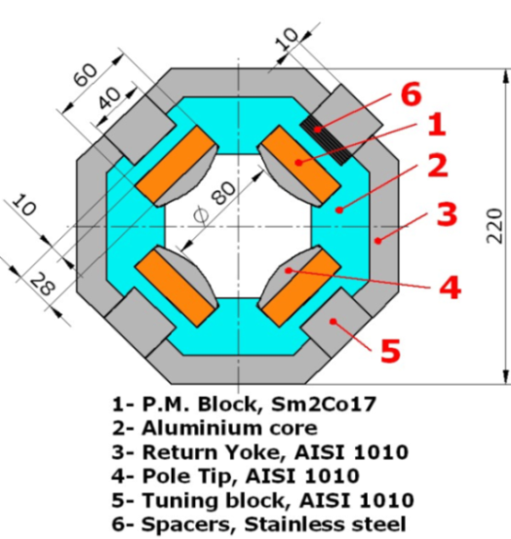
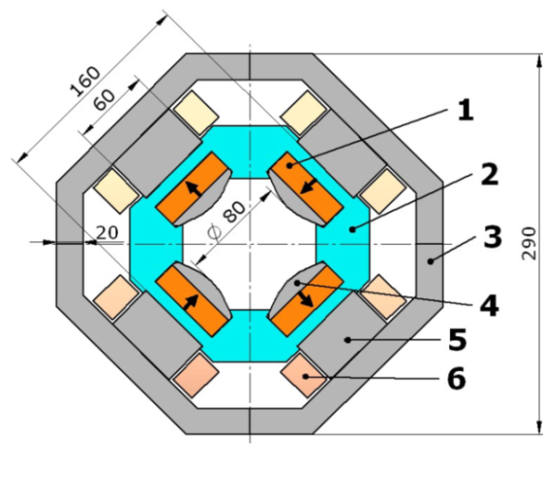
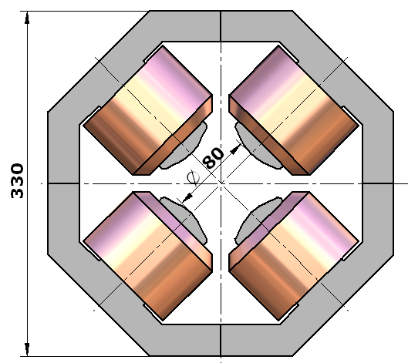
Requirements for new QF1 and QD0* (for Ultra-low β* studies at ATF2)
Upgrade of QD0 for ATF
Magnet Name | QF1FF | QD0FF | Units
Gradient Nom. / Ultra low | 6.772 / 6.791 | 12.45 / 12.46 | T/m
Magnetic length | 475 |  | mm
Nom. Integrated gradient | 3.226 | 5.919 | T
Tuning range | ±5 |  | %
Aperture radius | > 35 |  | mm
Good Field Region radius | 20 |  | mm
Constrains | Top half of the magnet has to be dismountable
Field quality requirements
Harmonic №: | Skew an=An/B2 | Normal bn=Bn/B2
3 | 0.124 | 0.748 | units@r_{GFR}
4 | 0.344 | 4.12 | units@r_{GFR}
5 | 0.665 | 2.76 | units@r_{GFR}
6 | 1.57 | 9.82 | units@r_{GFR}
(*H. Garcia, E. Marin. R. Tomas. “ATF2 QD0FF and QF1FF specifications”, CERN, 26/07/2011).
1) EM quadrupole: 2) PMQ 3) Hybrid (based on PMQ)

Slide 23
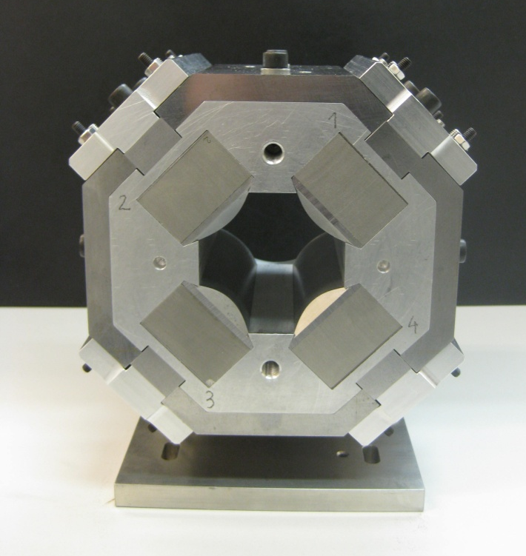
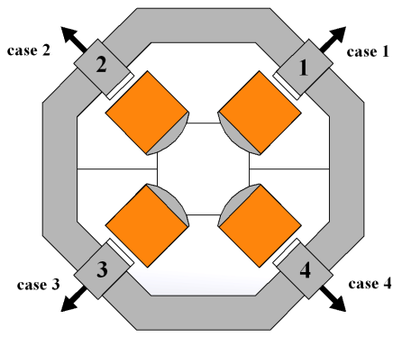
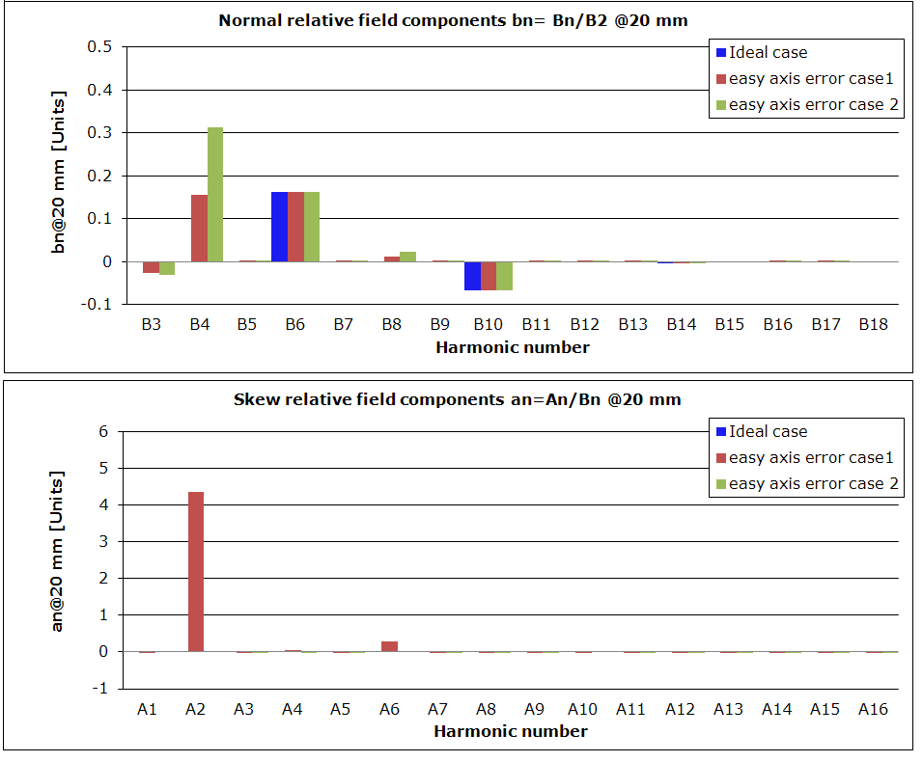
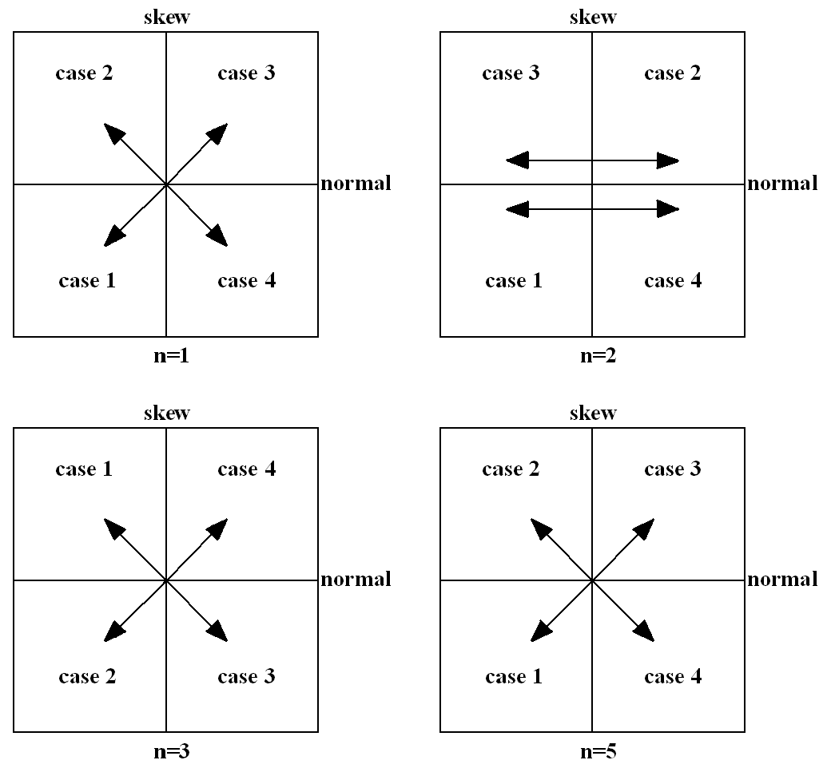
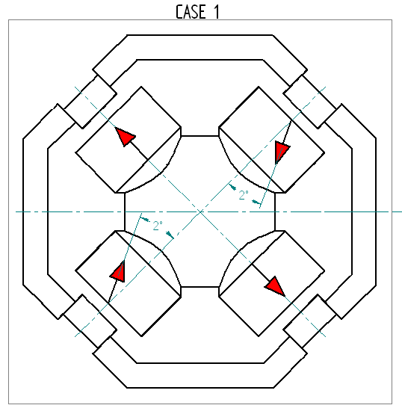
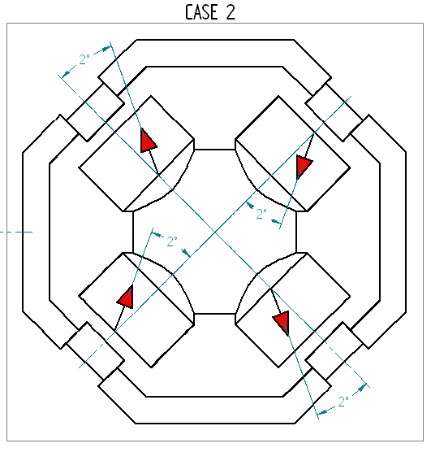
Field quality aspects:
Upgrade of QD0 for ATF
1. Field components suppression: field components can be suppressed by tuning of magnetic reluctance on each individual pole performed by radial offset of the tuning blocks (at 45⁰, 135⁰, 225⁰, and 315⁰) .
2. P.M. easy axis orientation errors: The effects of possible permanent blocks inequalities due to the easy axis orientation errors are studied
Ex. A prototype built for LINAC4:
Aperture: 45 mm
Gradient: 16 T/m

Slide 24
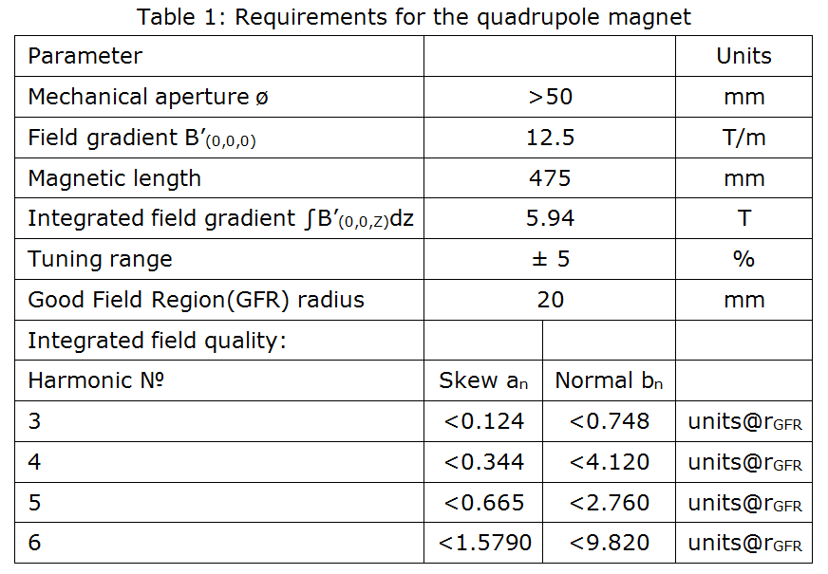
Upgrade of QD0 for ATF
ATF evolution:
in 2012 a solution for a new ATF QF1 was found recovering a quadrupole of the PEP B-Factory at SLAC.
For QD0, we revised the specification (private discussion with R. Tomas) mainly looking at the magnet aperture and field quality requirements and we agreed on the following revised specification table:

Slide 25
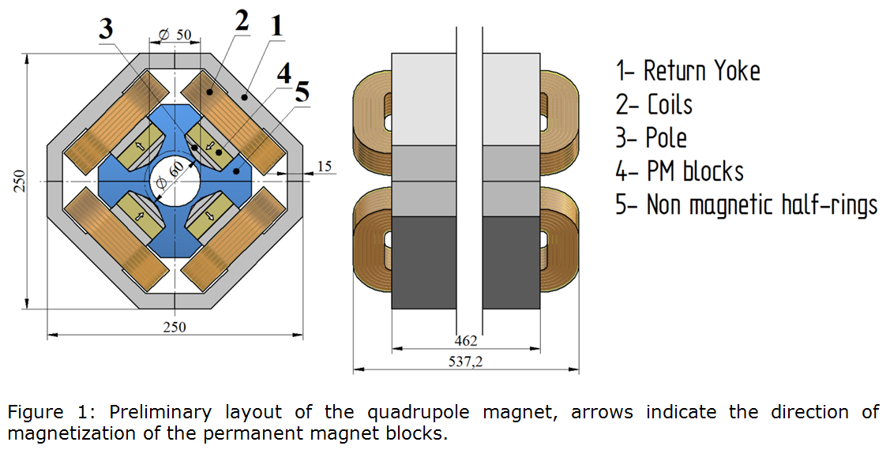
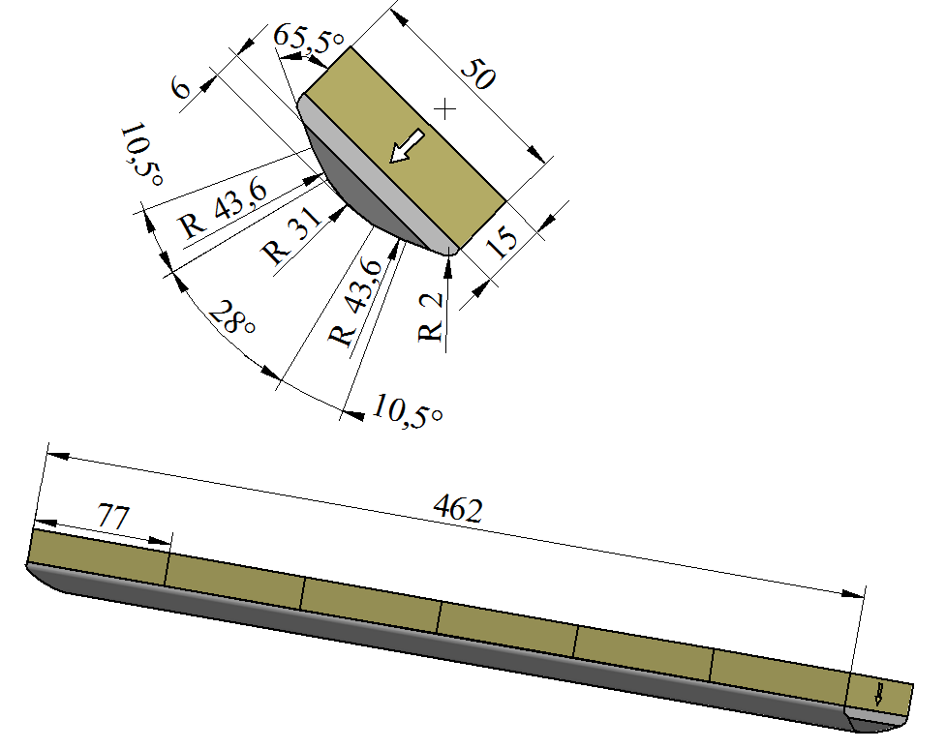
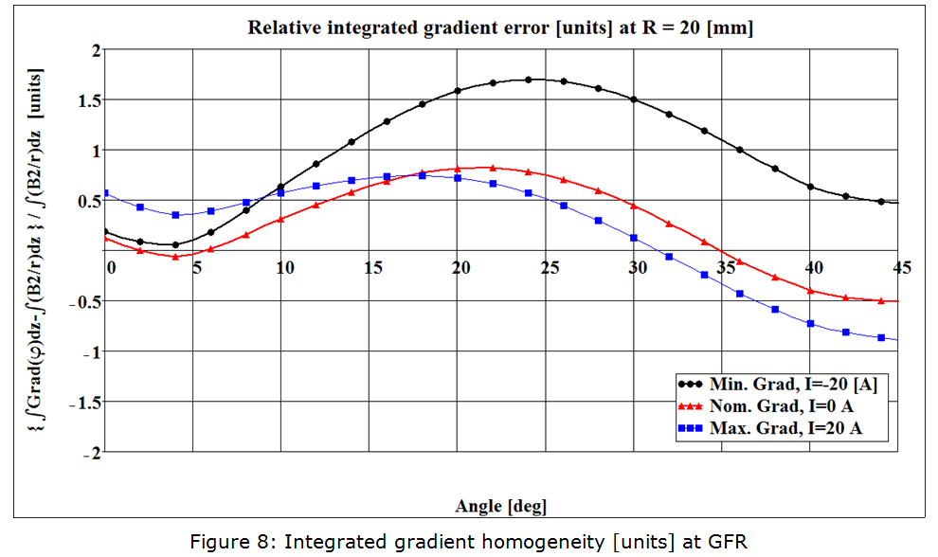
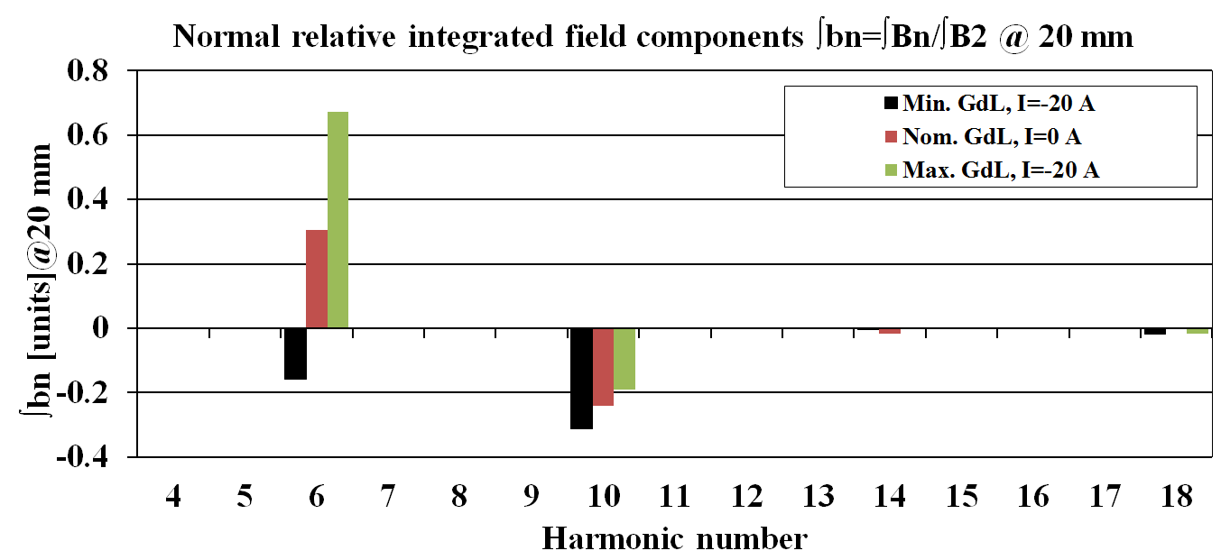
Upgrade of QD0 for ATF
Following the confirmation on major interest for a EASILY and REMOTELY tunable magnet, we finally converged on an HYBRID solution (PM blocks + electromagnetic coils for tunability):

Slide 26
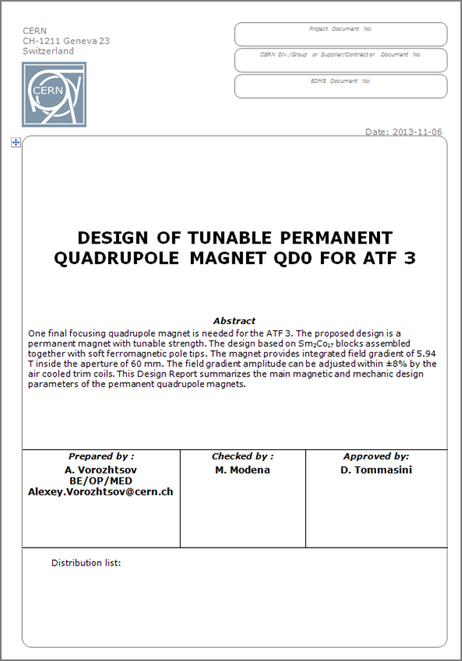
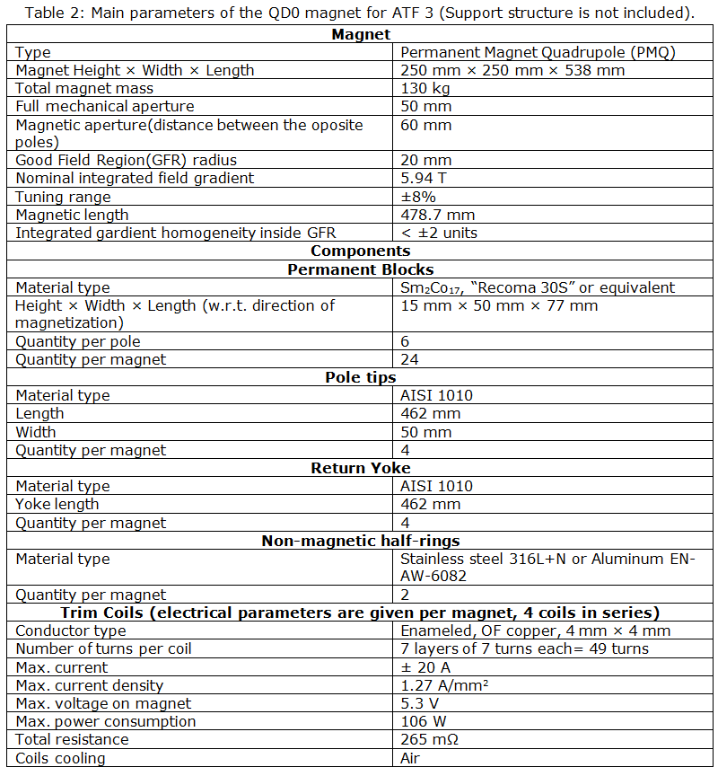
Upgrade of QD0 for ATF
A full set of design and working parameters is available for the preliminary design.
Draft

Slide 27
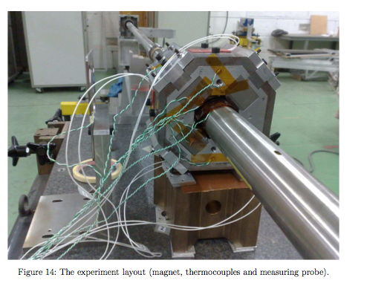
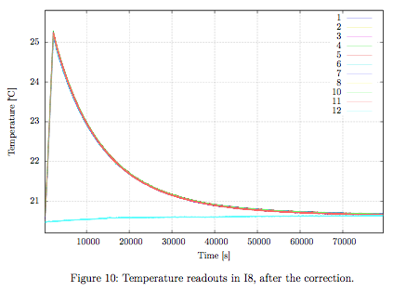
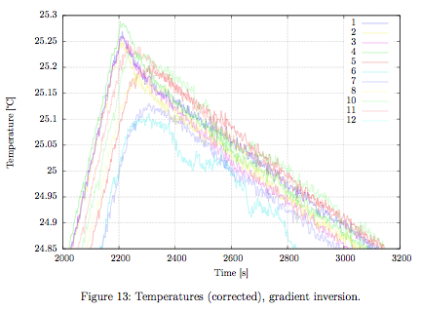
Magnet stability (temperature dependence) for such type of designs:
Questions about this point were raised in some occasions (ex. at “FJPPL-FKPPL Workshop on ATF2 Accelerator R&D” , Paris, March 2012):
Upgrade of QD0 for ATF
Temperature in ATF estimated at T=26 ⁰C, Temperature variation: ∆T = 0.3 ⁰C
Permanent magnet material: Sm2Co17 RECOMA® 30S
  Reversible temperature coefficient of induction α(Br) provided (α(Br = -0.035%/⁰C but declared for a range of 20-150 ⁰C (!)
  Br=1.12 [Tesla] @ 20 ⁰C => ∆Br ≈ 1.2×10⁻⁴ Tesla
Anyway, we decided to perform a dedicated test on this aspect (Summer 2012):

Slide 28
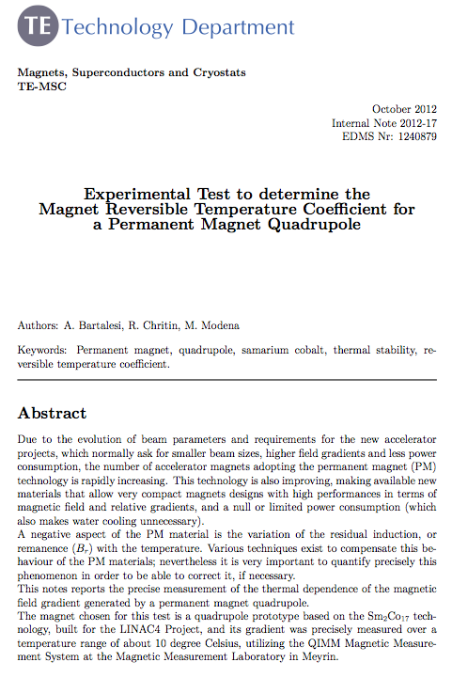
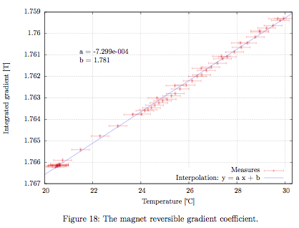
Upgrade of QD0 for ATF
Conclusions of the work:
A “magnet reversible temperature coefficient” was measured with value: −0.041 % per °C
(respect to the “reversible temperature coefficient of induction” of the PM material this coefficient is 17% higher)
The effect is linear and no measurable effects due to the hysteresis on the ferromagnetic elements was observed.

Slide 29
OCTUPOLES for ATF
For Ultra-low β* studies at ATF2, alternatively to a new QD0, it is proposed to insert in the lattice two octupoles (see ICFA Beam Dynamics Newsletter N. 62, December 2013).
A first draft of specification and requirement was provided (R. Tomas)
PARAMETER | UNITS | VALUE
Nominal Gradient, | T/m³ | 5284
Required tunability | % | -75, +20
Integrated gradient | T/m² | 560
Aperture radius | mm | 50
Iron length | m | 0.100
Magnetic length | m | 0.106
Coil number of turns |  | 61
Conductor size | mm x mm | 5 x 5
Ampere-turns | A | 1200
Current | A | 19.7
Resistance (per coil) | mΩ | 14
Conductor length (per coil) | m | 19.9
Conductor mass (per coil) | kg | 4.5
Yoke mass | kg | 56
Total mass | kg | 92
Our proposed design is focusing on these aspects:
To get the best field quality the number of yokes part is a minimum (possibly two half-yokes).
The magnet aperture will be relatively big for the following reasons:
  To avoid working with too low saturation (when working at -75% of nominal)
  Assembly reasons (insertion of the coils in the two half-yokes).
  To improve the field quality at 20 mm radius.
Coils are designed for a very low current density value.

Slide 30
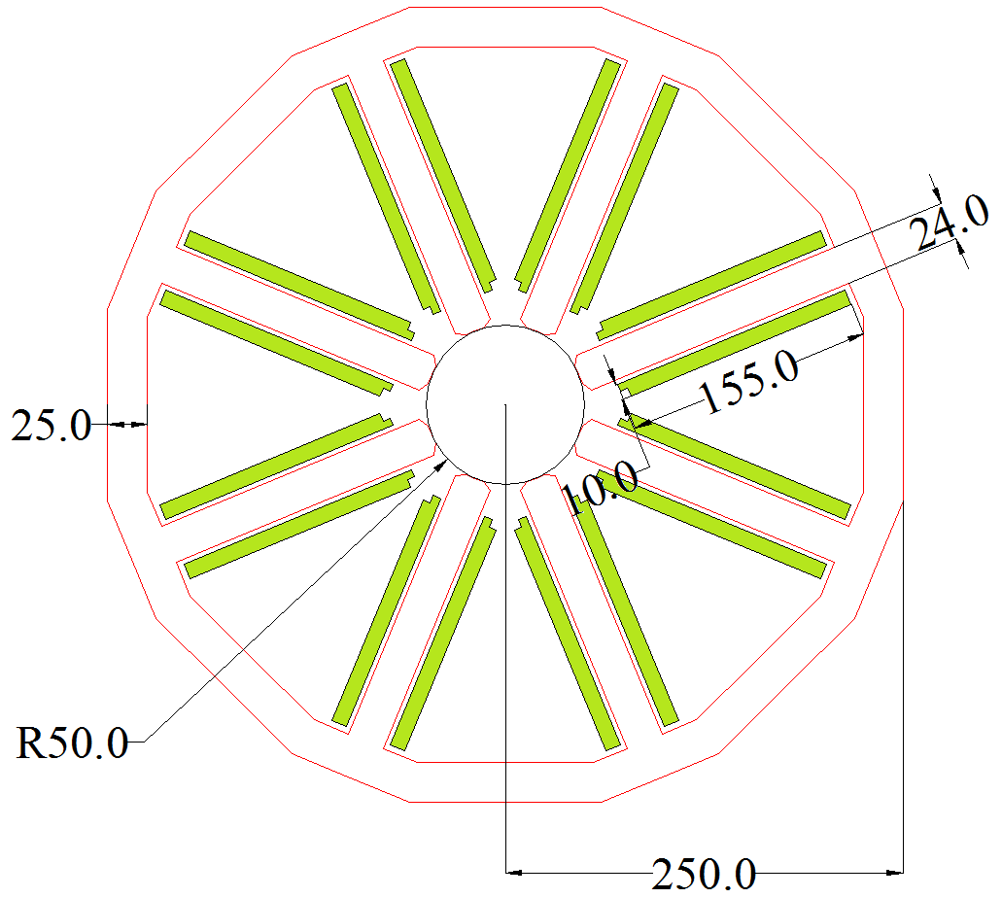


OCTUPOLES for ATF
The achievable field quality is good (computed is less of 1 unit for permitted harmonics).
Similarly as done for the PM and hybrid magnets, we plan to procure the main components and do at CERN the coils and the final assembly.

Slide 31
Conclusions:
QD0:
We plan detailed magnetic measurements to better understand the magnetic field quality contributions
The QD0 prototype will be tested mechanically (vibrations studies) at LAPP.
Antisolenoid:
An antisolenoid was successfully studied and dimensioned (magnetic design) for the L* 3.5 m. In case of a L* of 6 m this design can be revised.
SD0:
Conceptual design is completed and technical design under completion.
We are in contact with components Manufacturers to discuss the procurement and technical details.
QD0 for ILC:
We have studied the possible application of the CLIC QD0 hybrid concept to ILC.
We start to discuss at LCWS2013 about the other boundary conditions imposed by the ILC experiments and accelerator layouts. Evolution of the design (superferric solution, etc.) is expected.
Magnets for ATF:
QD0 and Octupoles proposal:
- Conceptual magnetic and mechanical designs available.
  For both magnets:
- In order to finalize the designs, we are now waiting comments and better definition of requirements from the ATF Community.
- Some official statement between parties (CERN and ATF) will be required.
THANKS
31

