Slide 1
Neutron source at JIPNR-SOSNY for electronics qualification of radiation hardness.
Sergey Sadovich
Joint Institute for Power and Nuclear Research - SOSNY
Minsk, Belarus

Slide 2
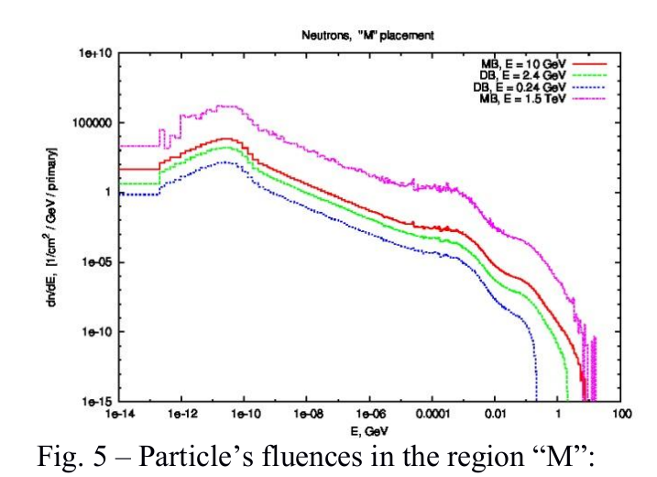
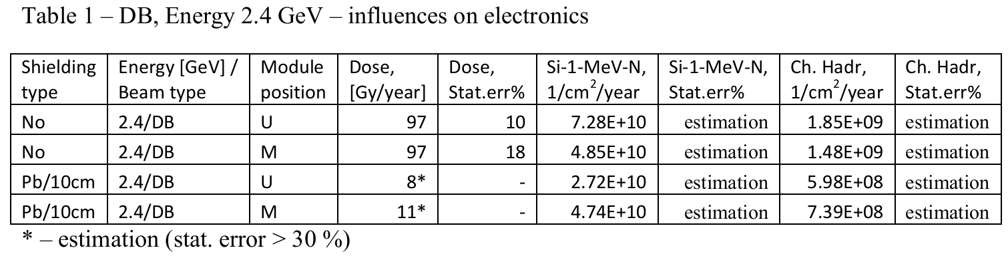
Technical requirements
(information is taken from presentation of Andrei Patapenka)

Slide 3
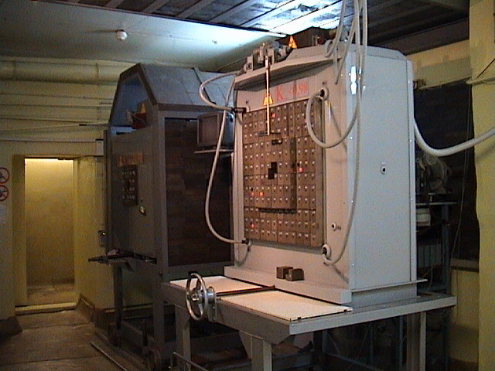
Yalina facility
Investigations of physics of subcritical systems
Testing and development methods for on-line reactivity measurements

Slide 4
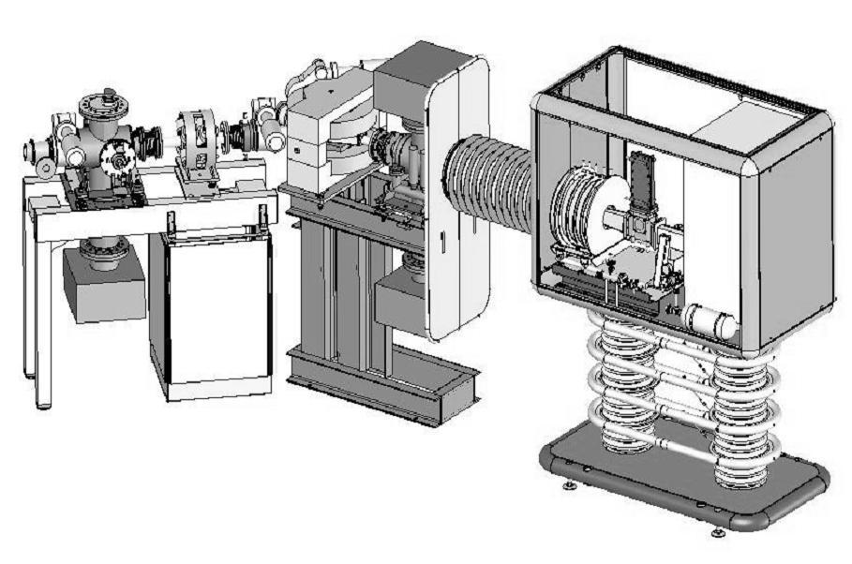
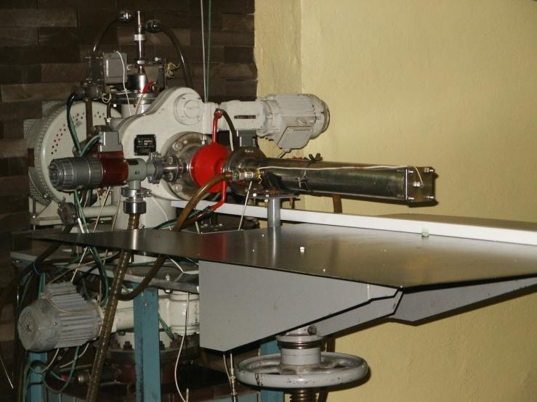
Neutron generator “NG-12”
240 kV Acceleration voltage
DD target:
  2.5 MeV
  5E+9 n/s (total)
DT target:
  14.1 MeV
  2E+11 n/s (total)

Slide 5
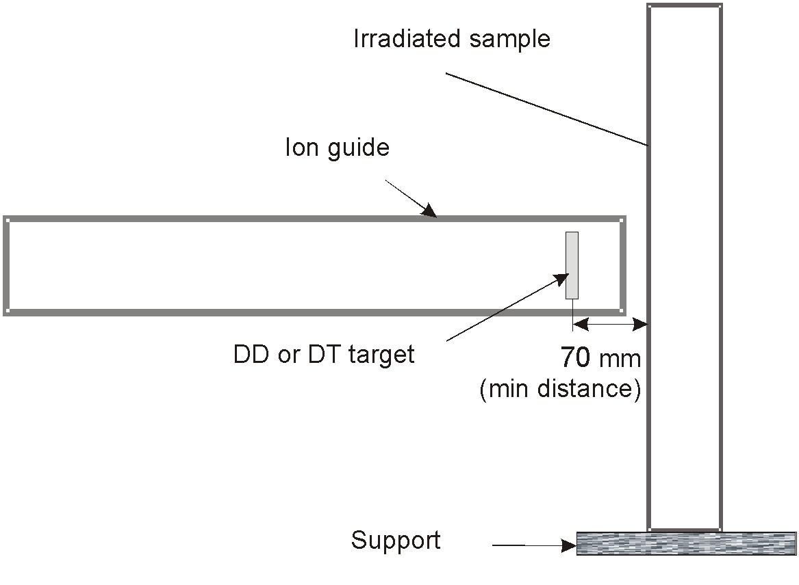
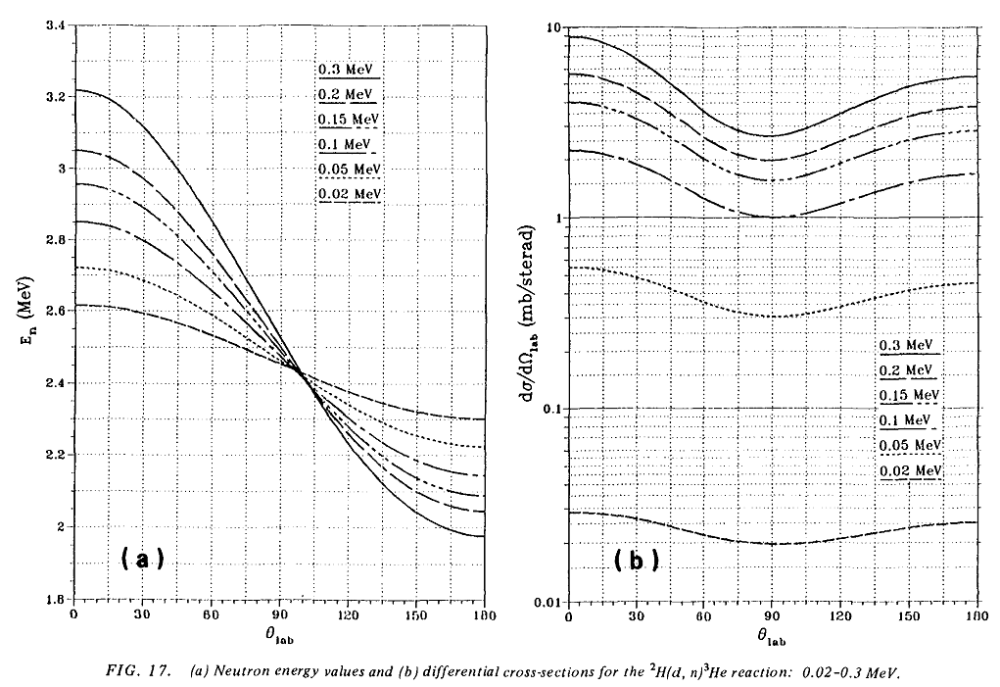
NG neutron’s yield - 1

Slide 6
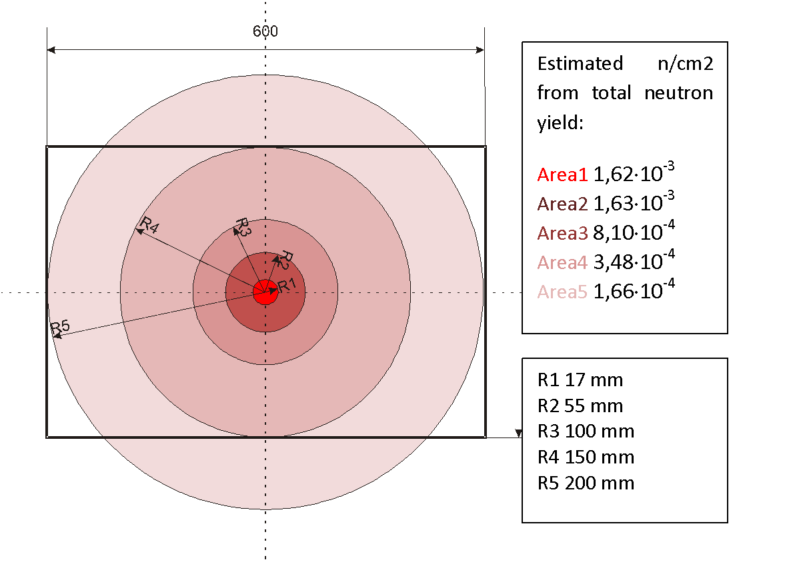
NG neutron’s yield - 2
The maximum neutron flux is:
  8.1E+6 n/s cm² for DD
  3.2E+8 n/s cm² for DT
The area with maximum neutron flux is:
  150 cm²

Slide 7
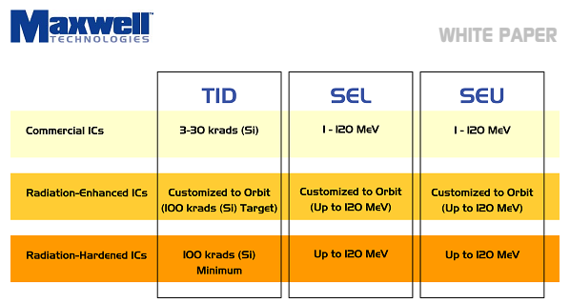
Type of IC
Radiation resistance depends on:
IC’s line (commercial, rad-hard)
Manufacturer
Type of chip (IC, FPGA, CPU, Memory, etc)
Size and type of memory
...

Slide 8
Conclusion
NG-12 in JIPNR-SOSNY can be used for electronics qualification of radiation hardness
  value of neutron flux allows to provide estimated year dose in one week;
  neutron spectra can be adjusted using moderator (polyethylene for example);
  in one month of irradiation errors for commercial IC can be detected, for rad hard line - year of irradiation is needed (impossible).
Type and lines of IC should be chosen for testing procedure

