Slide 1
ATF2 Status and Plan
K. Kubo
20014.02.04

Slide 2
ATF2, Final Focus Test for LC
Achievement of 37 nm beam size (Goal 1)
  Demonstration of a compact final focus system based on local chromaticity correction
Control of beam position (Goal 2)
  Demonstration of beam orbit stabilization with nano-meter precision at the IP
    Establishment of beam jitter controlling techniques at the nano-meter level with an ILC-like beam

Slide 3
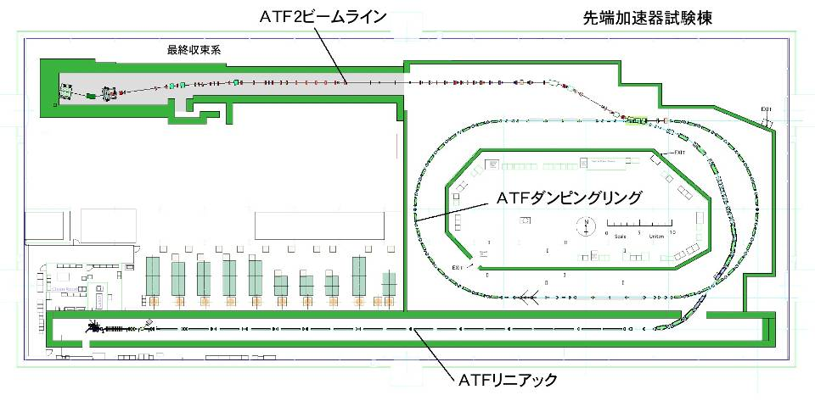
Accelerator Test Facility (ATF) at KEK
Focal Point
IP; ~40 nm beam
Extraction Line
Final Focus Test Line
ATF Damping Ring (140 m)
Photo-cathode RF Gun
ATF Linac (1.3 GeV)

Slide 4
Status of Goal 1
History of measured beam size
Goal
Modulation
With 30 deg. mode
Modulation
With 2~8 deg. mode
Modulation
With 174 deg. mode
No significant improvement in the period from autumn 2013 to Jan. 2014,
which was mostly for IPBPM commissioning.

Slide 5
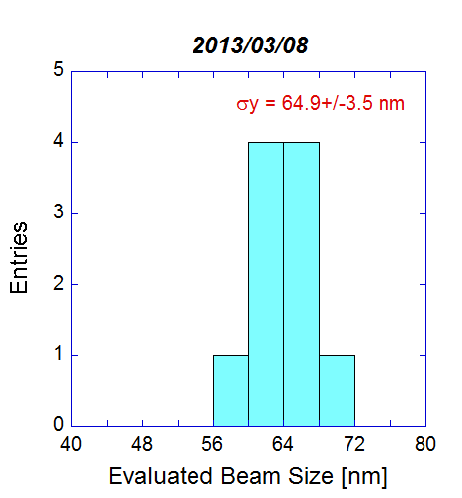
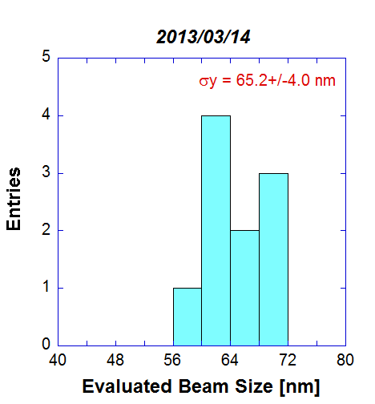
December 2012: first observation of fringe with 174 deg mode （<70 nm）
2013 winter - spring: Establish tuning procedure, better result (60-65 nm）
(Only with low bunch intensity)
Results of 10 consecutive measurements after tuning
2012 Dec. 2013 March
2012/12/21
These histograms do not consider systematic error of the beam size monitor.

Slide 6
Intensity Dependence
example
Different in different weeks. (?)
Cannot be explained by intra-beam scattering in DR, etc..
Fitted lines:

Slide 7
Intensity dependence
Transverse wakefield ?
Cavity BPM, Bellows may have some effects, but calculations predict not so serious
Experimental tests performed : Larger than calculation by factor 1.5 - 2. (?)
Longitudinal wakefield
Calculations show the effect should be very small.
→ Report by Jochem Snuberink
Other possibilities have not been excluded ?
（intra-beam scattering + Chromatic aberration, Geometrical aberration）
More studies needed. New ideas?

Slide 8
What made beam size ~60 nm, not 37 nm
(at low intensity)
Non linear magnetic field ?
  Tuning knobs cannot correct
    Higher order than sextupole ?
Wake field
  So string even at low intensity ?????
Beam position jitter
Systematic error of the beam size monitor
Any of above may be important.
Data analysis
Simulations
Experiments
  IPBPM for beam jitter
  IPBSM system improvement
Increase apparent beam size
Need new ideas
Need manpower

Slide 9
Plan of Goal 1
Achieving small beam size is the First Priority of ATF
Confirm Final Focus Optics, Tuning method
  37 nm beam size
  Maintain small beam for a long time
  Nominal optics (horizontal beta*), including horizontal beam size tuning
Understand Intensity dependence
  Wakefield study, reduction of wakefield, , , etc.
Improvement of beam size monitor is important
    Stability of laser: reduction of angle jitter, etc.

Slide 10
Goal-2 status
Preparation before 2013 summer
  Design and construction of Cavity BPM for IP. Beam test in LINAC(KNU, KEK)
  BPM mover and vacuum chamber design and construction (LAL)
  Intra-train feedback (FONT) test in EXT line（Oxford, KEK)
2013 summer shutdown： IP region modification
  3 low-Q cavity BPM installed
  Beam size monitor disassembled and reassembled
2013 Nov.-Dec.：IPBPM Commissioning
  IPBPM（electronics, mover） beam test
  Alignment （position and angle of 3 BPMs）
  Test using FONT feedback electronics board

Slide 11
Intra-train feedback (ATF-EXT)
latency ~133 ns
Slide from Terunuma

Slide 12
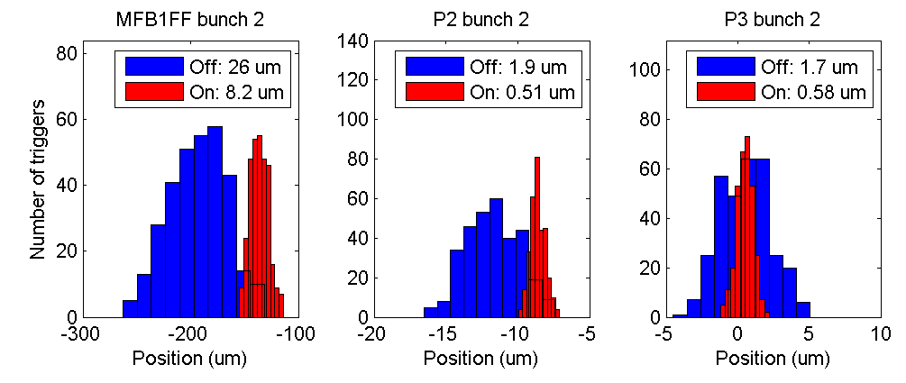
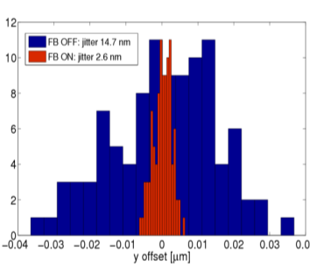
Beam Stabilization at ATF-EXT
ー Intra-train Fast Feedbackー
FONT
feedback
IP-FONT
by IP Cavity BPM
EXT-FONT by stripline BPM, result 2014/Jan
- latency ~133 ns
expected (from results in EXT）
FB OFF: jitter 14.7 nm
FB ON: jitter 2.6 nm
?
Slide from Terunuma
FONT group, slide from Terunuma

Slide 13
IP nm beam position stabilize system
IP-FONT
  Monitor: Cavity BPM（designed resolution 2 nm）
  Stlipline BPMs (resolution 0.4 um) were used for the beam test in EXT
Slide from Terunuma

Slide 14
In vacuum IP-BPMs and piezo movers
BPM A&B
BPMs
  Bolted aluminum plates, no brazing because of In-vacuum.
  BPM A&B bolted together.
  BPM C is independent.
Piezo mover
  BPM units are mounted on the base with three piezo movers.
  Dynamic range of each mover is +/- 150 um.
BPM C
IP
Piezo Movers
(Cedrat)
Piezo Movers
(PI)
Initial alignment need to be better than this.
Slide from Terunuma

Slide 15
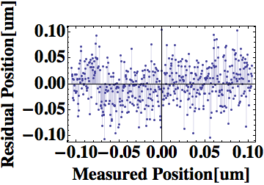
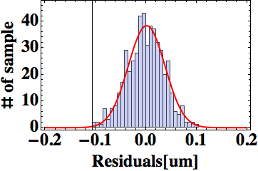
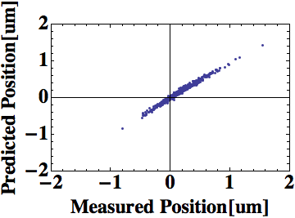
by Siwon Jang (KNU)
Simple resolution test by using Low-Q IP-BPM
X
X
X
Convert to
residual
Beam position prediction
Residual value
= measured position – predicted position
X
X
X
Residual Gaussian fitting
Beam position measurement
1σ=36.35nm
Slide from Terunuma

Slide 16
Goal-2 near future plan
Improve IPBPM body
  Relative displacement of BPM-A and BPM-B (one block) is too large compare with dynamic range for small resolution.
  Consider remaking. May be Replaced in summer.
BPM front-end electronics performance study
FONT feedback board
  First beam test of front-end electronics using FONT digitizer in November 2013. Additional FONT feedback board(digitizer) is being prepared.
  Experiment in upstream (EXT line) is also on going, in addition to preparation of IP feedback.
Start IP feedback test in Feb.
Future
  Achieving 2nm resolution will need iteration of beam test and modifications of equipment. May need 3 to 6 months.
  Final goal, nm beam stability , may need 2-3 years.
Slide from Terunuma

Slide 17
Proposals for Future ATF2
Proposed by CERN group, related to CLIC
Ground motion to orbit feed-forward (→ Report by Juergen Pfingstner)
  Measure ground motion and correct orbit to correct the effects
Ultra low beta* (20 nm beam size)
  Development of hybrid QD0
  Octupole magnet (tail folding, multipole field correction)
  Can be useful for Goal 1 too
R&D of Extraction Kicker for CLIC DR
Other proposals
R&D for γ−γ collider
High EM field experiment (fundamental physics)
These have not approved yet.

Slide 18
SUMMARY
Modification of the IP region in last year made it possible to study for both small beam (G1) and orbit stabilization (G2).
Goal-1（37 nm small beam）
  First Priority of ATF
  Improvement of the beam size monitor is essential
  Establish optics and tuning method
    Achieve 37 nm beam size and maintain for a long time
  Understand intensity dependence
Goal-2（Beam position stability in nm）
  Start IP feedback test in Feb.
  Achieving 2nm resolution will need iteration of beam test and modifications of equipment. May need 3 to 6 months.
  Final goal, nm beam stability , may need 2-3 years.
Good proposals of future plans. But have not been approved.

