Slide 1

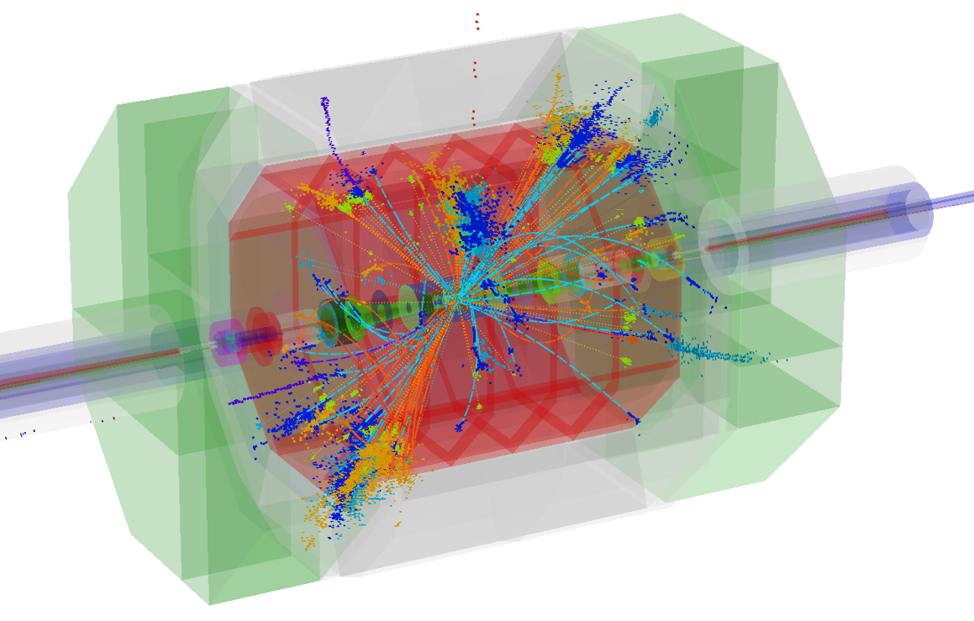
detector R&D challenges for energy frontier physics
Lucie Linssen, CERN

Slide 2
Outline
Detector requirements at hadron and lepton colliders
Challenges/technologies in vertex/tracking detectors
Challenges/technologies in calorimetry
Possible common development areas
Outlook
In ~20 minutes:
Impossible to pay justice to the broad spectrum of detector R&D;
Impossible, also, to cover pp en e+e- options in a balanced way;
My apologies

Slide 3
Sources
Material used for this talk was taken from:
ECFA High Luminosity LHC experiments workshop, Aix-les-Bains, 2013
http://indico.cern.ch/conferenceDisplay.py?confId=252045
FHC Hadron Collider physics and experiments, indico
https://indico.cern.ch/categoryDisplay.py?categId=5258
In particular detector talks by D. Fournier and W. Riegler
LCWS13, linear collider workshop, Tokyo, 2013
http://www.icepp.s.u-tokyo.ac.jp/lcws13/
CLIC CDR (vol 2), Physics and Detectors at CLIC,
CERN-2012-003, arXiv:1202.5940
CLIC CDR (vol 3), The CLIC Programme: towards a staged e⁺e⁻ Linear Collider exploring the Terascale, CERN-2012-005, http://arxiv.org/abs/1209.2543
With apologies for not having asked individual permissions

Slide 4
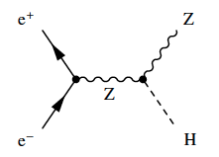
hadron vs. lepton colliders
p-p collisions | e⁺e⁻ collisions
Proton is compound object Initial state not known event-by-event Limits achievable precision | e⁺/e⁻ are point-like Initial state well defined (√s / polarization) High-precision measurements
Circular colliders feasible | Linear Colliders (avoid synchrotron rad.)
High rates of QCD backgrounds Complex triggering schemes High levels of radiation | Cleaner experimental environment trigger-less readout Low radiation levels
High cross-sections for colored-states | Superior sensitivity for electro-weak states

Slide 5
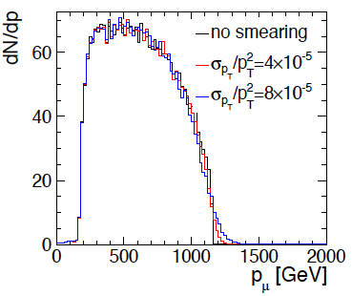
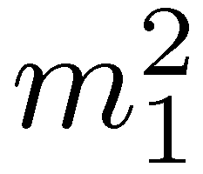
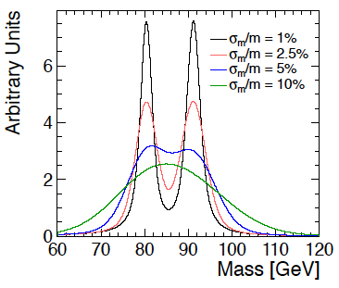
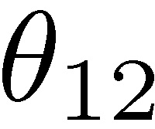
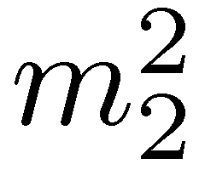
CLIC physics aims => detector needs
momentum resolution:
e.g. Smuon endpoint
Higgs recoil mass, Higgs coupling to muons
smuon
end point
jet energy resolution:
e.g. W/Z/h di-jet mass separation
(for high-E jets)
impact parameter resolution:
e.g. c/b-tagging, Higgs BR
W-Z
jet reco
angular coverage, very forward electron tagging
+ requirements from CLIC beam structure and beam-induced background

Slide 6
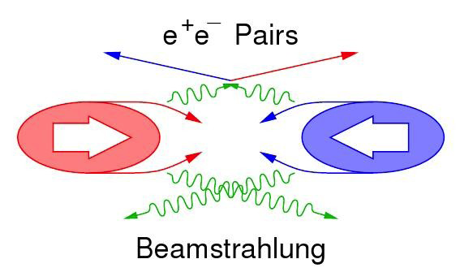
CLIC machine environment
CLIC machine environment
 | CLIC at 3 TeV
L (cm⁻²s⁻¹) | 5.9×10³⁴
BX separation | 0.5 ns
#BX / train | 312
Train duration (ns) | 156
Rep. rate | 50 Hz
σ_{x} / σ_{y} (nm) | ≈ 45 / 1
σ_{z} (μm) | 44
Drives timing
requirements
for CLIC detector
very small beam size
Beam related background:
Small beam profile at IP leads very high E-field
  Beamstrahlung
    Pair-background
      High occupancies
    γγ to hadrons
      Energy deposits

Slide 7
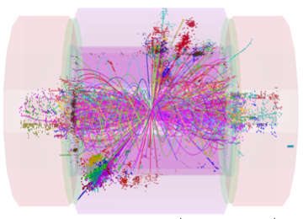
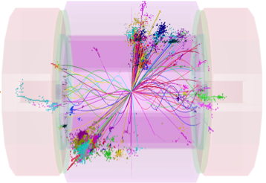
CLIC conditions => impact on detector
CLIC conditions => impact on detector technologies:
High tracker occupancies => need small cell sizes
(beyond what is needed for resolution)
    Small vertex pixels
    Large pixels in intermediate regions
    Limited strip length in tracker
Bkg energy => need high-granularity calorimetry
Bkg suppression => overall need for precise hit timing
    ~10 ns hit time-stamping in tracking
    1 ns accuracy for calorimeter hits
Low duty cycle
    Triggerless readout
    Allows for power pulsing
      => less mass and high precision in tracking
      => high density for calorimetry

Slide 8
Challenges in LC detector R&D
Combined requirements lead to the following challenges:
Vertex and tracker
Very high granularity
Dense integration of functionalities
Including ~10 ns time-stamping
Super-light materials
Low-power design + power pulsing
Air cooling
Calorimetry
Fine segmentation in R, phi, Z
Time resolution ~1 ns
Ultra – compact active layers
Pushing integration to limits
Power pulsing
ultra – light
ultra – heavy
and compact

Slide 9
detector requirements HL-LHC
Maintain performance at full sensitivity for discovery and
precision measurements at low p_{T}, under severe pile-up conditions
Pileup
  <PU> ≈ 50 events per crossing by LS2
  <PU> ≈ 60 by LS3
  <PU> up to 140 for lumi-leveling at 5x10³⁴cm⁻²s⁻¹ at HL-LHC
  (accounting for uncertainty and bunch-to-bunch variations)
Radiation damage
  Performance longevity after 300 fb⁻¹
  Replace elements with limited lifetime
Extend performance to larger η
Profit from detector technology advances
Enhance trigger + DAQ

Slide 10
comparison CLIC ⬄ LHC detector
In a nutshell:
CLIC detector:
High precision:
  Jet energy resolution
    => fine-grained calorimetry
  Momentum resolution
  Impact parameter resolution
Overlapping beam-induced background:
  High background rates, medium energies
  High occupancies
  Cannot use vertex separation
  Need very precise timing (1ns, 10ns)
“No” issue of radiation damage (10⁻⁴ LHC)
  Except small forward calorimeters
Beam crossings “sporadic”
No trigger, read-out of full 156 ns train
LHC detector:
Medium-high precision:
  Very precise ECAL (CMS)
  Very precise muon tracking (ATLAS)
Overlapping minimum-bias events:
  High background rates, high energies
  High occupancies
  Can use vertex separation in z
  Need precise time-stamping (25 ns)
Severe challenge of radiation damage
Continuous beam crossings
Trigger has to achieve huge data reduction

Slide 11
from HL-LHC to FHC
Some very (!) first assessments about extrapolation from LHC to FHC
What are the changes the detectors have to cope with ?
Collisions with larger boost => need more forward coverage
Longer barrel ?
Increased forward η-coverage (jet coverage up to η=6?)
Cope with higher particle/jet energies for interesting physics
Larger tracker (muon system) radius and/or higher B-field
Deeper calorimetry for less leakage (~2 Λ_{i} extra)
(Muon energy loss)
Issues of background suppression and radiation levels 14 TeV => 100 TeV:
25% increase of pp cross section
Charged multiplicity will go up by ~50%
Average p_{t} will go up by ~1/3 (from 0.6 GeV to 0.8 GeV)
One can expect factor 2 increase in fluence and dose levels at first pixel layer

Slide 12
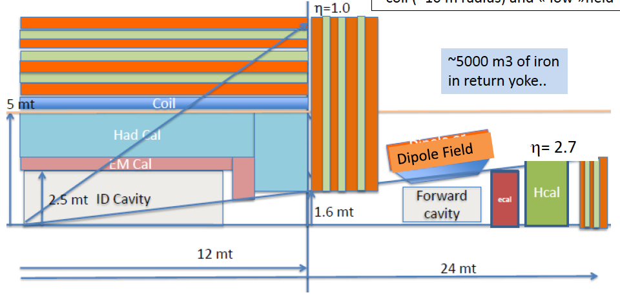
first thoughts on FHC detectors
D. Fournier et al.
⬆ a first iteration on dimensions:
To achieve physics performance for high-E objects
Increased forward coverage up to ~η=6
without extrapolation on detector technology/precision capabilities
Room for smart ideas and use of new technologies !

Slide 13
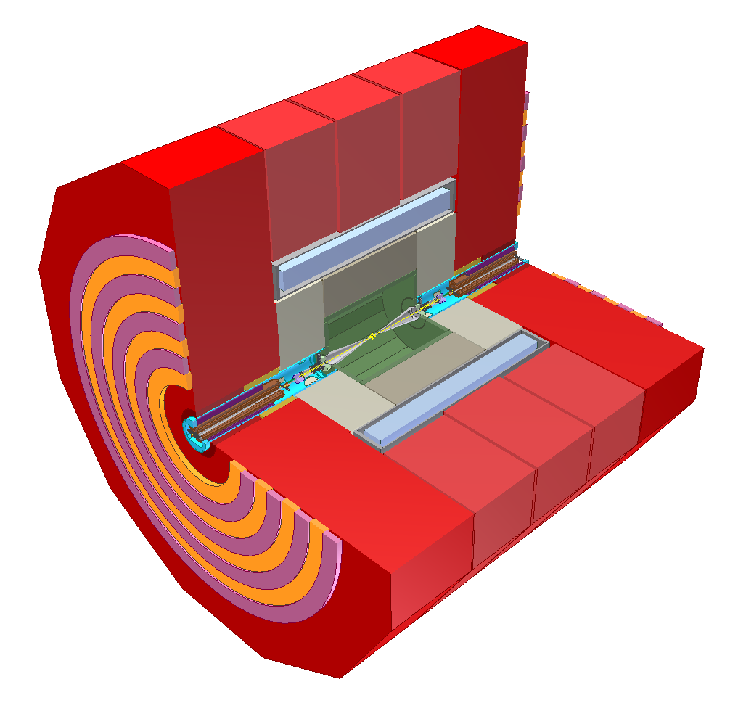
CLIC detector concept
… in a few words …
return yoke with
Instrumentation
for muon ID
complex forward region with final beam focusing
strong solenoid
4 T - 5 T
fine grained (PFA) calorimetry, 1 + 7.5 Λ_{i},
6.5 m
all-silicon tracker
ultra low-mass
vertex detector
with 25 μm pixels

Slide 14
Vertex/tracker technologies
Overall challenges:
More accuracy:
  Small cell sizes
  Low-mass
    => Low power
    => Interconnects: high-density + vertical
Integrated designs, including:
  Low-mass supports
  Cooling
  Power delivery
  Signal transmission
Manufacturability in large areas at low cost
Move away from most expensive elements (e.g. silicon sensors, bump-bonding)
Radiation hardness (for pp case)
A few technology examples on the next slides

Slide 15
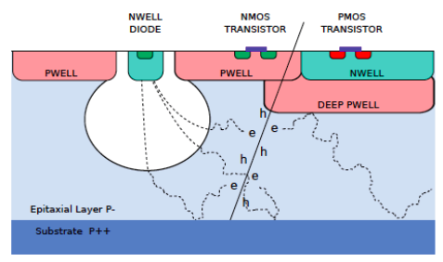
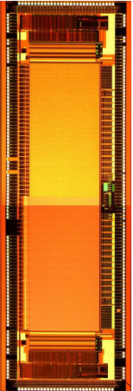
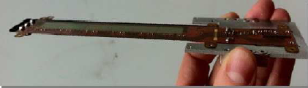
Vertex detector: monolithic CMOS (ILC)
Monolithic sensor, CMOS process
high-resistivity in thin epitaxial layer
Fast signal component (drift)
Electronics integrated in pixel
Rolling shutter read-out (coarse timing)
Analog or digital readout possible
2 types of sensors for inner and outer layers MIMOSA-30 : Dual sided readout out
1 side for spatial resolution (16x16 μm pixel),
1 side for timing (~10μs, 16x64 μm pixel)
MIMOSA-31 : Larger pixel for reduced power consumption (35x35 μm)
Functional ILC prototype 0.6% X0

Slide 16
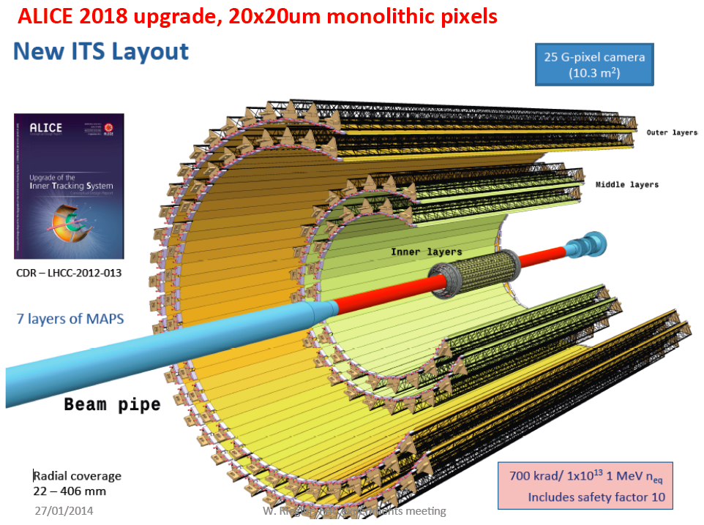
Monolithic pixels => ALICE ITS
From ILC designs + RHIC detector to ALICE upgrade for 2018
20 μm pixels
For CLIC and FHC would need increased rate and increased radiation hardness

Slide 17
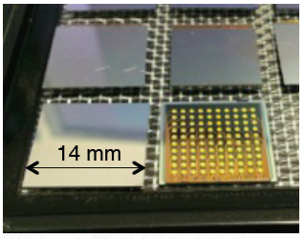
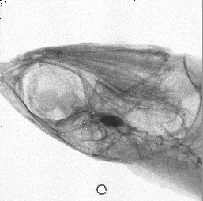
Through Silicon Vias (TSV)
Through Silicon Via (TSV)
Vertical electrical connection passing through Si wafer
  eliminates need for wirebonds
  4-side buttable chip/sensor assemblies
  large active surfaces => less material
• 240 μm TSV diameter
• wafers thinned to 120 μm
• 5 μm copper layer for TSV
E.g. Medipix TSV project (ALICE / CLIC / ACEOLE / AIDA) with CEA-Leti
130 nm IBM Medipix(RX) wafers, via-last process
successful completion of first phase: demonstrate feasibility
on-going second phase: demonstrate good yield
Next phase: with Timepix3 and thin sensors
First Medipix3 Image
taken with TSV assembly

Slide 18
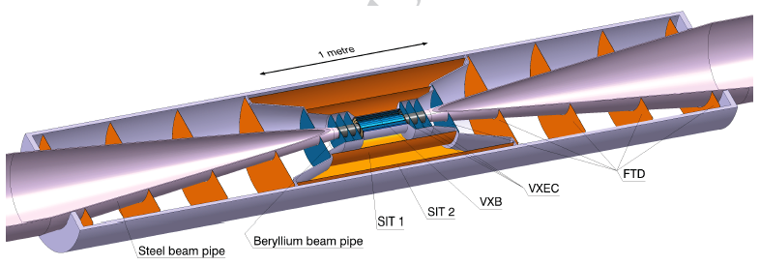
CLIC vertex detector
Vertex + forward tracking
CLIC_ILD
~25×25 μm pixel size => ~2 Giga-pixels
0.2% X₀ material per layer <= very thin !
  Very thin materials/sensors
  Low-power design, power pulsing, air cooling
  Aim: 50 mW/cm²
Time stamping 10 ns
Radiation level <10¹¹ n_{eq}cm⁻²year⁻¹ <= 10⁴ lower than LHC

Slide 19
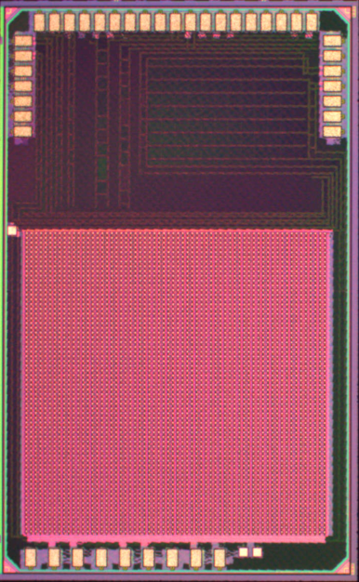
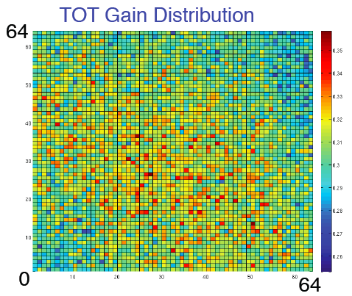
CLIC vertex detector R&D (1)
Hybrid approach pursued: (<= other options possible)
Thin (~50 μm) silicon sensors
Thinned high-density ASIC
  R&D within Medipix/Timepix effort
Low-mass interconnect
  Micro-bump-bonding (Cu-pillar option)
  Through-Silicon-Vias (R&D with CEA-Leti)
Power pulsing
Air cooling
CLICpix demonstrator
64×64 pixels, fully functional
65 nm technology
25×25 μm² pixels
4-bit ToA and ToT info
Data compression
Pulsed power: 50 mW/cm²
64×64 pixels
1.6 mm
RMS 4.2% gain variations
65 nm ASIC development
ATLAS, CMS, CLICdp => RD53

Slide 20
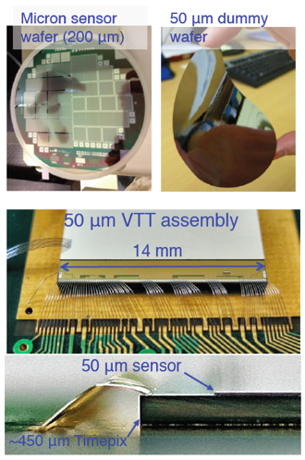
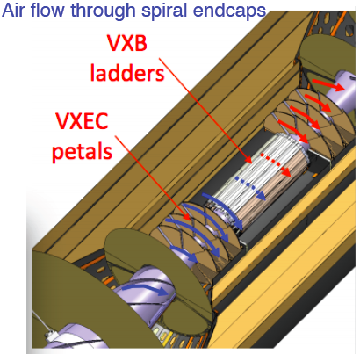
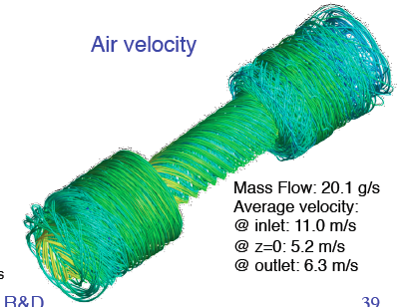
CLIC vertex detector R&D (2)
further ongoing R&D activities
thin sensors, down to 50 μm
power pulsing, air cooling, light supports
Watching other R&D, e.g. micro-channel cooling

Slide 21
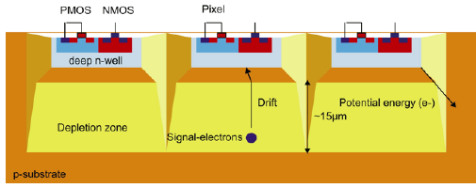
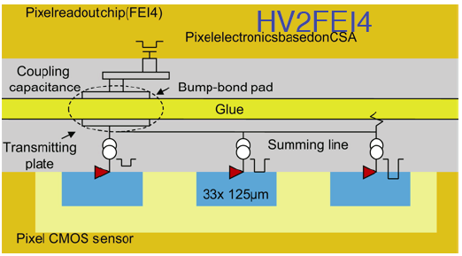
Hybrid detector with HV-CMOS
HV-CMOS MAPS:
180 nm High Voltage process
V_{bias} ~100 V, 10-20 μm depletion layer
Integrated sensors, fast signal collection
Hybrid option:
Capacitive Coupled Pixel Detector (CCPD)
HV CMOs chip as integrated sensor+ amplifier
Capacitive coupling to readout chip
through layer of glue => no bump bonding
Ongoing R&D with FEI4, Timepix, CLICpix

Slide 22
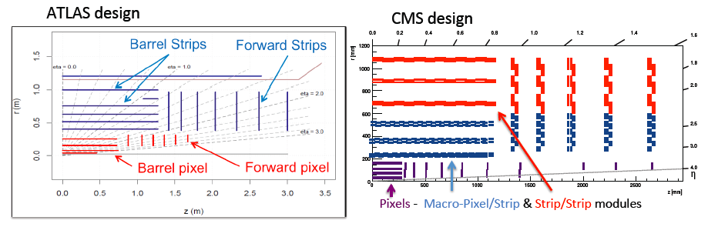
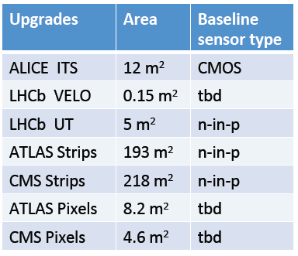
HL-LHC tracker upgrades
Macro-pixel / Strip module
“large tracker pixels” also needed for CLIC
With smaller granularity and less mass

Slide 23
Calorimeter technologies
Overall challenges:
More accuracy:
  Shower reconstruction of particles within the jet
  Need hit-time accuracy
    => ~1 ns for CLIC
    => ~25 ns for LHC (ideally <200 ps for HL-LHC and FHC)
Integrated designs, involving:
  High density => little space for active layers
    => ~2 mm in linear collider ECAL
    => <7 mm in linear collider HCAL
  High channel count
  Low-power design
  Minimal space for cooling
Manufacturability in large areas at low cost
Radiation hardness (for pp case)
A few technology examples in the next slides

Slide 24
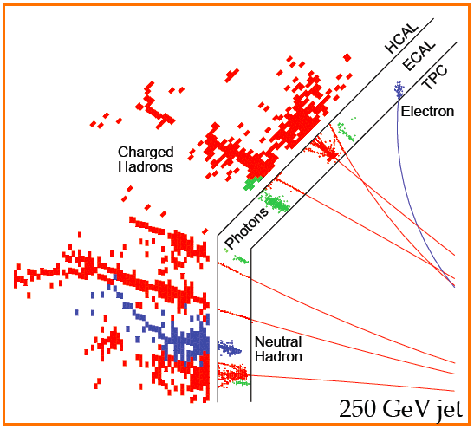
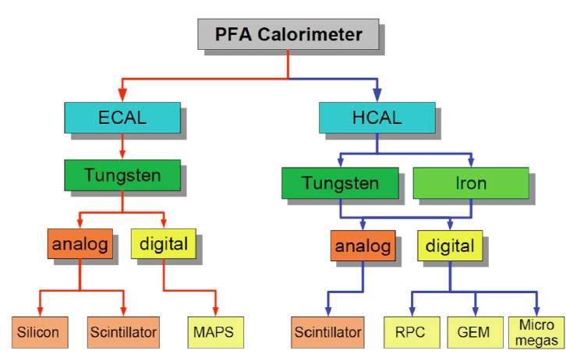

PFA calorimetry at CLIC
ECAL
Si or Scint. (active) + Tungsten (absorber)
cell sizes 13 mm² or 25 mm²
30 layers in depth
HCAL
Several technology options: scint. + gas
Tungsten (barrel), steel (endcap)
cell sizes 9 cm² (analog) or 1 cm² (digital)
60-75 layers in depth (HCAL depth ~7 Λ_{i})
many technologies pursued

Slide 25
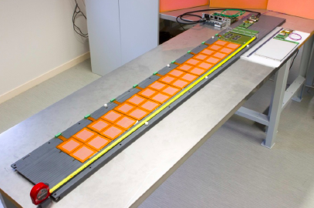
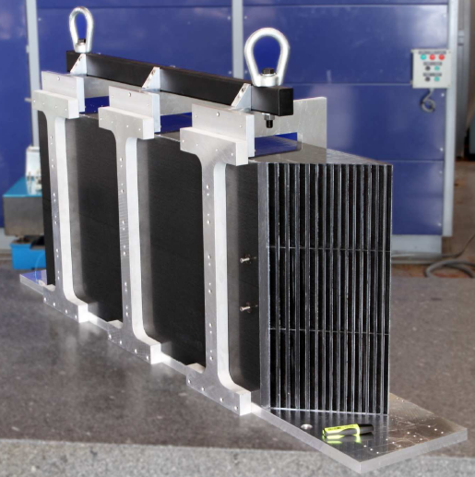
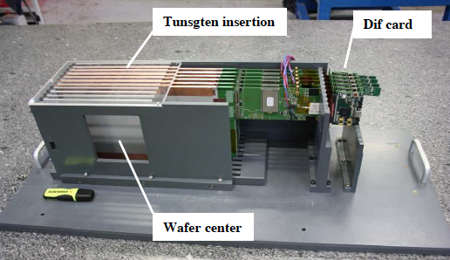
ECAL: Si-W (CALICE)
30 layers in depth
cell size 5.5x5.5mm²
~100 M ECAL channels at ILC (ILD)
~2000 m² silicon
Successful beam tests
Currently: technological Si-ECAL prototype
Real-scale detector integration model
Full-scale mechanical structure

Slide 26
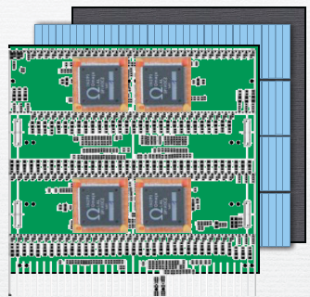
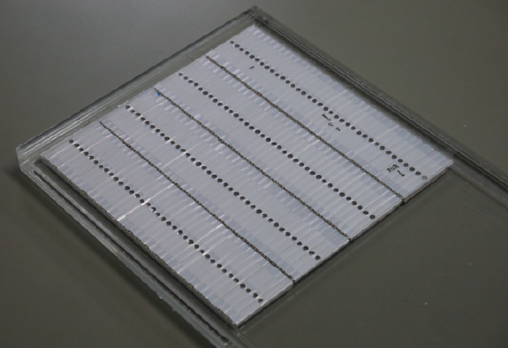
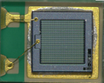
ECAL: Scint-ECAL (CALICE)
absorber
scintillator strips x,y
integrated electronics (SKIROC)
5 mm wide strips
MPPC
1600 pixels
1×1 mm²
Strips of 45*5*2 mm³, 144 channels/ plane
Fully integrated modules,
successful beam tests at DESY
currently exploring
SiPM with more pixels
1 cm
Row of MPPC (SiPM)

Slide 27
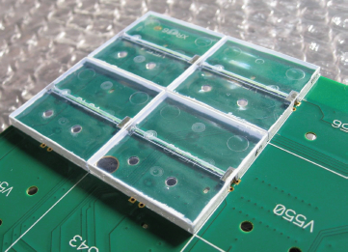
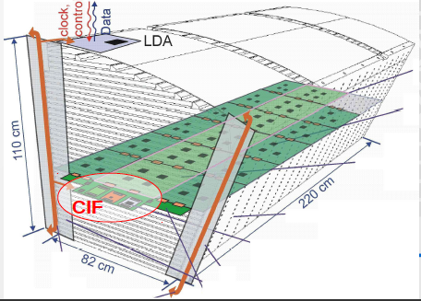
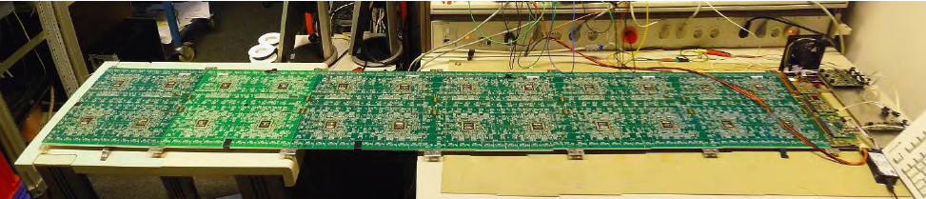
A-HCAL (CALICE)
AHCAL 2nd generation fully integrated prototype
undergoing beam tests
3 cm
3x3 cm² scintillator tiles with SiPMs
Integrated electronics (SPIROC chip)
LED SiPM calibration
Power-pulsing
220 cm long modules
Active layer thickness of 5.4 mm

Slide 28
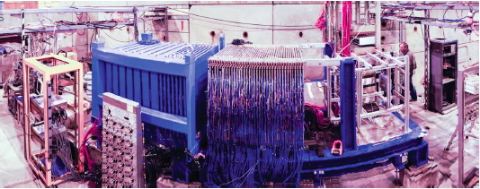
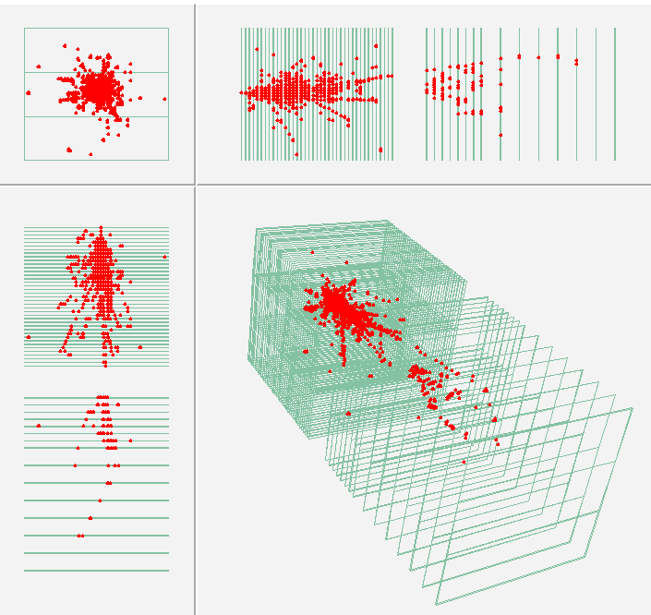
digital DHCAL glass RPC’s (CALICE)
Steel DHCAL
Tungsten DHCAL
500’000 readout channels
54 glass RPC chambers, ~1m² each
PAD size 1×1 cm²
Digital readout (1 threshold)
Fully integrated electronics
Total 500’000 readout channels
Ongoing R&D with lower-resistivity glass
for better rate dependence
Other large-scale protoypes:
1m³ semi-digital HCAL with glass RPC’s
4 large (~1m²) micromegas readout planes
W-DHCAL π⁻ at 210 GeV (SPS)

Slide 29
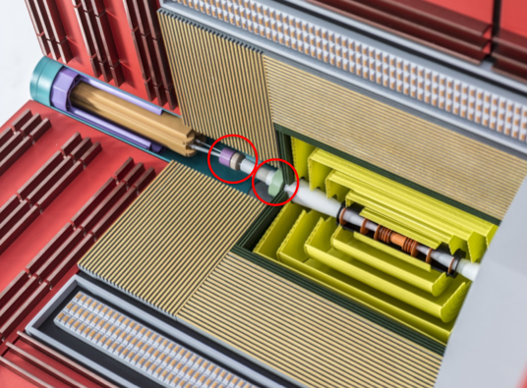
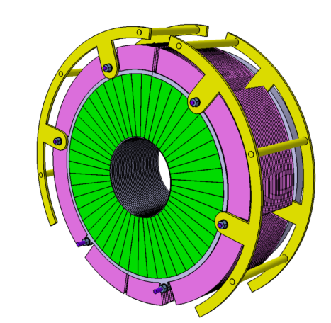
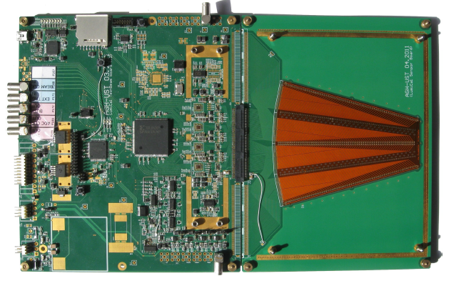
CLIC forward calorimetry
2 forward calorimeters: Lumical + Beamcal
Tungsten thickness 1 X₀, 40 layers
BeamCal sensors GaAs, 500 mm thick
LumiCal sensors silicon, 320 mm thick
Readout at the outer radius
BeamCal angular coverage 10 - 40 mrad
LumiCal coverage 38 – 110 mrad
doses up to 1 Mgy
neutron fluxes of up to 10¹⁴ per year
Very compact !
Active layer gap is 0.8 mm
Moliere radius 11 mm
high-radiation performance
=> collaboration with LHC beam monitors

Slide 30
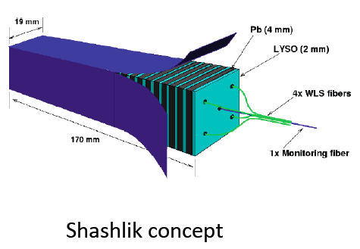
HL-LHC CMS end cap calorimetry
Potential replacement of the CMS end-cap calorimetry (EE+HE)
Main motivation:
Radiation resistance
Extension of the η-coverage (for jets from VBF)
Several detector options
They represent a nice illustration of recent technology advances
Shashlik design
  Radiation-hard scintillators (e.g. crystal scintillator for EE)
Dual fiber read-out: scintillation & Cerenkov – following work of DREAM/RD52
  using doped/crystal fibers => allows e/h correction
Fine-grained Particle Flow Calorimeter – following work of CALICE
  active layers GEM/Micromegas or Silicon => detailed jet reconstruction

Slide 31
Possible common pp/e⁺e⁻ development areas
Non-exhaustive, to be completed
Vertex+tracking detector technology
  R&D in integrated hybrid detectors (including developments with HV-CMOS)
  Advanced radiation-hard microelectronics
  Interconnect technologies
  Low-mass engineering
  Low-mass detector cooling (e.g. microcooling options)
  Detector powering
  New low-mass solutions with small strips / large pixels
Fine-grained calorimetry
  Optimisation of jet energy resolution + bkg suppression with PFA
  Compact, large area detectors
Overall detector engineering aspects and large+strong detector magnets
Simulation tools and methods
  Flexible detector geometry descriptions for simulations in detector optimisation phase
  PFA-like event reconstruction tools
  Jet clustering

Slide 32
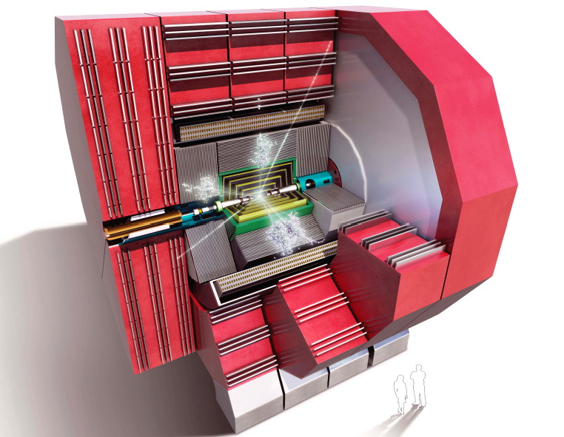
Summary/outlook
Many exciting detector R&D projects for high-energy e+e- and pp !
Collaborative efforts, creativity, perseverance and new technologies
help to overcome challenges
When comparing e+e- with pp: many challenges are common, others diverge
In most cases, basic technology advances can be carried out in common
Implementations are nearly always application-specific
thank you

Slide 33
SPARE
SLIDES

Slide 34
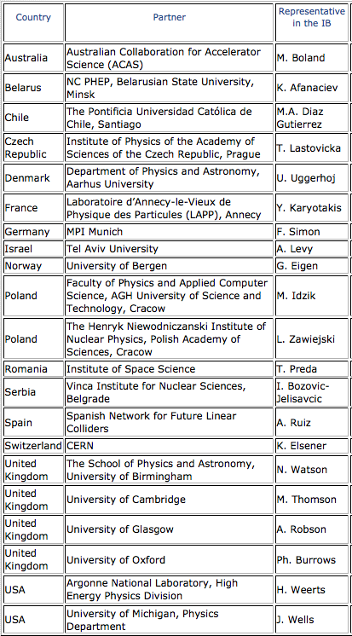

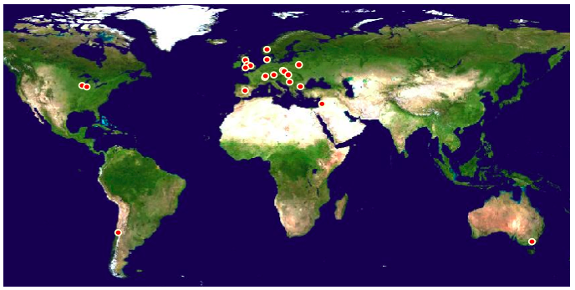
CLIC detector and physics study
Light-weight cooperation structure
No engagements, on best-effort basis
With strong collaborative links to ILC
http://lcd.web.cern.ch/LCD/Home/MoC.html
CLICdp: 21 institutes

Slide 35
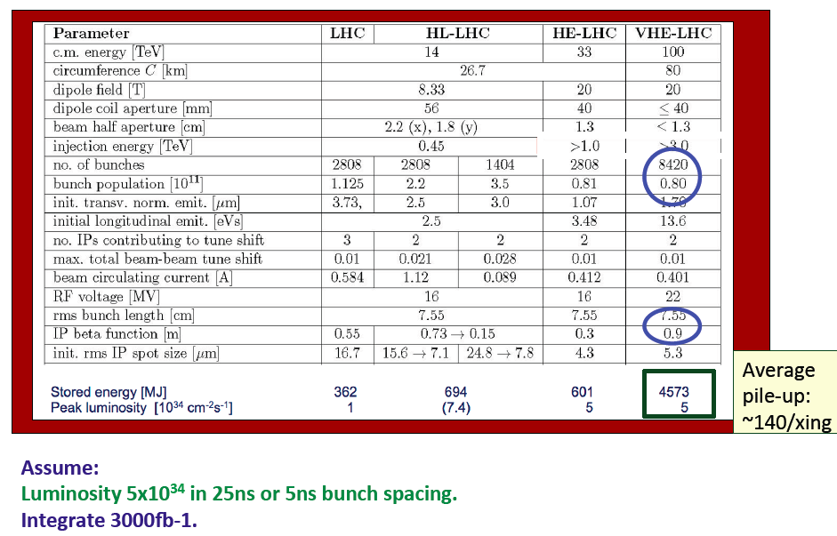
pp table of comparison

Slide 36
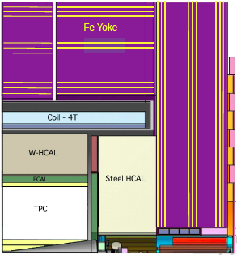

CLIC_ILD and CLIC_SiD
Two general-purpose CLIC detector concepts
Based on initial ILC concepts (ILD and SiD)
Optimised and adapted to CLIC conditions
CLIC_ILD
CLIC_SiD
7 m

Slide 37
Vertex detectors
Categories of candidate technologies
 | Monolytic CMOS | (3D) integrated | Hybrid pixel
Examples | DEPFET, FPCCD, MAPS, HV-CMOS | SOI MIT-LL, Tezzaron, Ziptronix | CLICpix (TimePix3, Smallpix)
Technology | Specialised HEP processes, r/o and sensors integrated | Customized niche industry Processes with focus on Interconnectivity | Industry standard ASIC processes; HEP-specific high-resistivity sensors
Depletion layer | Partial | Partial or full | Full => large fast signals
Granularity | Down to 5 μm pixel size | Down to 5 μm pixel size | 25 μm pixel size
Thickness | ~50 μm total thickness achievable | ~50 μm total thickness achievable | ~50 μm sensor + ~50 μm r/o
ILC
CLIC

Slide 38
Vertex detectors
Categories of candidate technologies
 | Monolytic CMOS | (3D) integrated | Hybrid pixel
Examples | DEPFET, FPCCD, MAPS, HV-CMOS | SOI MIT-LL, Tezzaron, Ziptronix | CLICpix (TimePix3, Smallpix)
Technology | Specialised HEP processes, r/o and sensors integrated | Customized niche industry Processes with focus on Interconnectivity | Industry standard ASIC processes; HEP-specific high-resistivity sensors
Depletion layer | Partial | Partial or full | Full => large fast signals
Granularity | Down to 5 μm pixel size | Down to 5 μm pixel size | 25 μm pixel size
Thickness | ~50 μm total thickness achievable | ~50 μm total thickness achievable | ~50 μm sensor + ~50 μm r/o
Smaller pixels
Thinner detectors
High level of pixel functionality
Fast time-stamping
ILC
CLIC

Slide 39

CLIC vertex R&D: power pulsing

Slide 40



Linear collider, Si-tracker R&D
Silicon tracker for the Linear Collider
=> Aim for ~1% X0 per layer
Only limited R&D ongoing
1.3 m
SiD tracker module
“chip on sensor”
1024-channel KPIX chip
Sensor with double metal-layer routing
Connectivity via Kapton pig-tail cable

Slide 41



calorimetry and PFA
Jet energy resolution and background rejection drive the overall detector design
=> => fine-grained calorimetry + Particle Flow Analysis (PFA)
What is PFA?
Typical jet composition:
60% charged particles
30% photons
10% neutrons
⬇
Always use the best info you have:
60% => tracker
30% => ECAL
10% => HCAL
Hardware + software !

Slide 42

calorimetry and PFA
Simulated image
(gives good feeling of the granularity)
FPA-based simulation
(to determine depth of tungsten HCAL)

Slide 43

time development in hadronic showers
(depends on active material)

Slide 44



Analog HCAL: scintillator/tungsten
HCAL tests with 10 mm thick Tungsten absorber plates,
Tests in 2010+2011 with scintillator active layers, 3×3 cm² cells => analog readout
longitudinal shower profile, pions
visible Energy
protons
CERN SPS 2011
good agreement with Geant4

Slide 45


HCAL: SDHCAL (CALICE)
Steel SDHCAL
500’000 readout channels
~50 glass RPC chambers, 1m² each
PAD size 1×1 cm²
Semi-digital readout (3 thresholds)
200 ns time-slicing
Fully integrated electronics
With power-pulsing !
Separate power-pulsing tests in 3T magnet
=> Stable signal response
Full SDHCAL stack successfully tested:
2012 (2011) CERN - ongoing
  Steel absorber
Colour for threshold 1, 2, 3

Slide 46




Calorimetry: Micromegas / GEM
Micromegas
Two 1 m² chambers, multi-threshold readout
Successfully tested within SDHCAL stack, 2012
50 cm
1 m
GEM foil
After successful tests with 30×30 cm GEM chambers, development towards of 1m² plane has started.

Slide 47
background suppression at CLIC
Triggerless readout of full train
 t₀ physics event (offline)
Full event reconstruction + PFA analysis with background overlaid
  => physics objects with precise p_{T} and cluster time information
  Time corrected for shower development and TOF
Then apply cluster-based timing cuts
  Cuts depend on particle-type, p_{T} and detector region
  Allows to protect high-p_{T} physics objects
tCluster
+
Use well-adapted jet clustering algorithms
  Making use of LHC experience (FastJet)

Slide 48

time window / time resolution
The event reconstruction software uses:
 t₀ physics event (offline)
Translates in precise timing requirements of the sub-detectors

Slide 49

PFO-based timing cuts

Slide 50

Software compensation
High granularity of the calorimeter can be used to distinguish between electromagnetic (dense) and hadronic (less dense) shower components
CALICE
Steel-AHCAL data
➔ Improved resolution (20% better) and linearity

Slide 51

details of forward detector region
IP at ~2 m
forward calorimeters
“FCAL”

Slide 52

CLIC strategy and objectives
2013-18 Development Phase
Develop a Project Plan for a staged implementation in agreement with LHC findings; further technical developments with industry, performance studies for accelerator parts and systems, as well as for detectors.
4-5 year Preparation Phase
Finalise implementation parameters, Drive Beam Facility and other system verifications, site authorisation and preparation for industrial procurement.
Prepare detailed Technical Proposals for the detector-systems.
Construction Phase
Stage 1 construction of CLIC, in parallel with detector construction.
Preparation for implementation of further stages.
2018-19 Decisions
On the basis of LHC data
and Project Plans (for CLIC and other potential projects), take decisions about next project(s) at the Energy Frontier.
2024-25 Construction Start
Ready for full construction
and main tunnel excavation.
Commissioning
Becoming ready for data-taking as the LHC programme reaches completion.

