Slide 1
CLIC-PACMAN:
BPM-to-Quadrupole Alignment based on EM Field Measurements
Manfred Wendt
CERN BE-BI-QP

Slide 2
PACMAN WP4 ESR4.1
PACMAN work-package 4 (WP4) covers microwave instrumentation and beam diagnostics technologies:
  Early Stage Researcher (ESR) 4.1: Alignment between a CLIC/CTF 15 GHz cavity BPM and the Main Beam quadrupole
    A stretched-wire method could be utilized to align the center of the magnetic field of the quad to the center of the dipole mode of the BPM TM110 resonator.
    A similar method has been successfully demonstrated in the μm regime on a stripline-BPM/quad combination (DESY-FLASH).
  ESR4.2: Alignment between wakefield monitors and CLIC accelerating fields
    Minimization of the transverse wakefields (beam blow-up) over several accelerating structures.
Motivation:
  Low emittance beam transport requires a beam trajectory on a “golden” orbit, i.e. well centered at the magnetic center of the quadrupoles and the EM center of the accelerating structures.

Slide 3
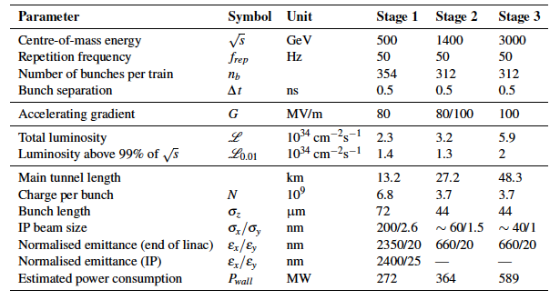
Motivation
Typical CLIC parameters (similar to other LCs, FEL drivers, etc.)
  Large scale accelerators, many km long!
  Sub-μm beam size, down to a few nm at the IP!!
    2/200 μm at LEP, 17 μm at LHC
  Emittance preservation is a key issue for any future accelerator!

Slide 4
Example: SLAC SLC DFS and WFS
Simulation. Nominal beam: q=2e10 e⁻ ; WFS test beam: q=1.6e10 e⁻
Courtesy
A. Latina

Slide 5
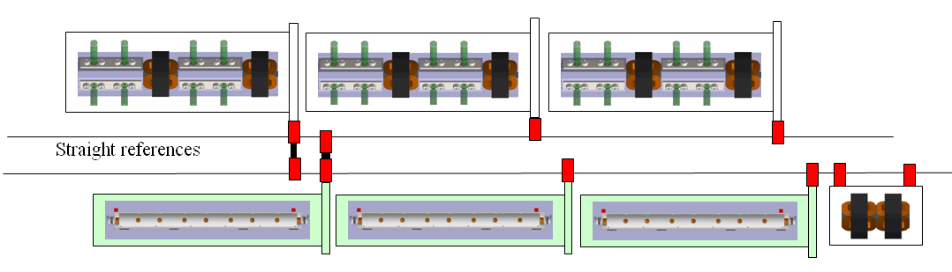
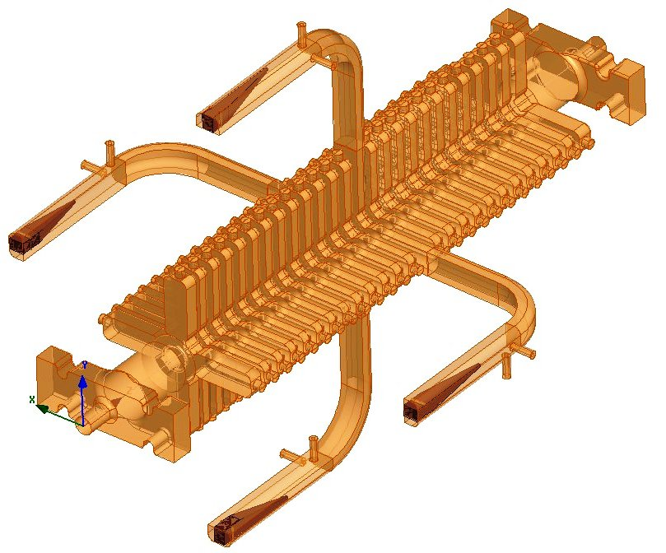
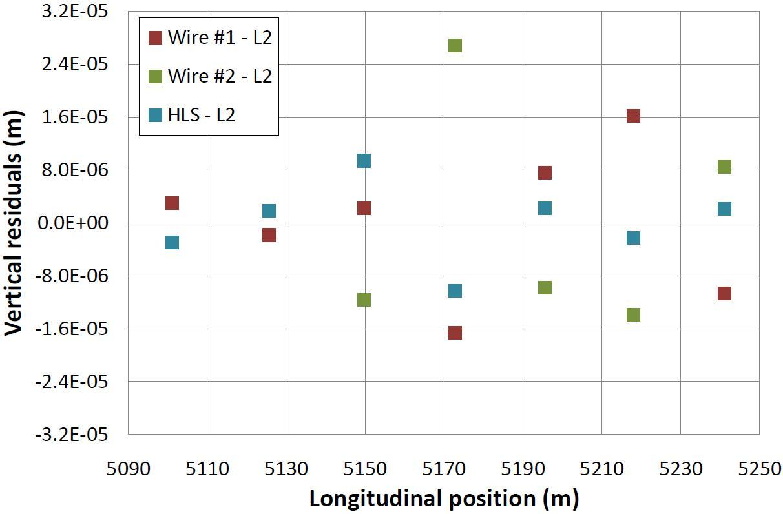
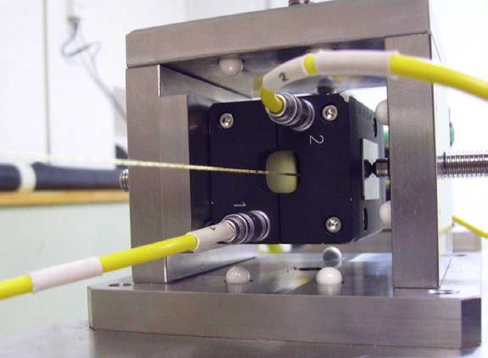
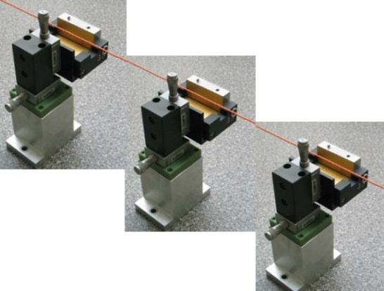
Low-Emittance Beam Transport
Stabilize quadrupole
@(1nm) @ 1Hz
Graphic User Interface:
1) Pre-align BPMs+quads
Accuracy @(10μm) over about 200m
3) Use wake-field monitors accuracy @(3.5μm) – CTF3
FACET
2) Beam-based alignment
Test of prototype shows
  vertical RMS error of 11μm
  i.e. accuracy is approx. 13.5μm

Slide 6
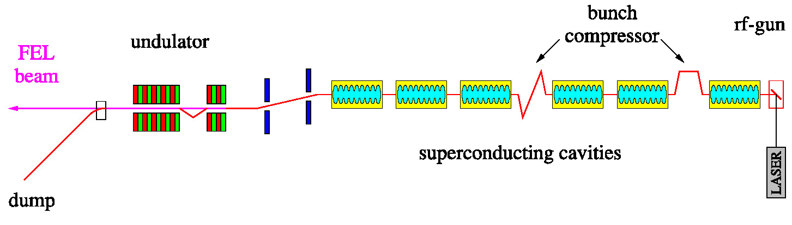
Back in the Past…
In 2003 the DESY Tesla Test Facility (TTF)
received major upgrades
  TTF phase I -> TTF phase II (later called FLASH)
  The SRF e-beam linac test facility includes ~20 warm quadrupole magnets with integrated stripline beam position monitors (BPM)
    The BPMs have been rigidly fixed in the quadrupole magnets.
  A field-based quad-BPM pre-alignment procedure was established
    Measure the offset between magnetic center of the quadrupole and electrical center of the stripline BPM. Goal: <50 μm
    The magnetic axis measurement was part of a Ms.Sc. thesis.

Slide 7
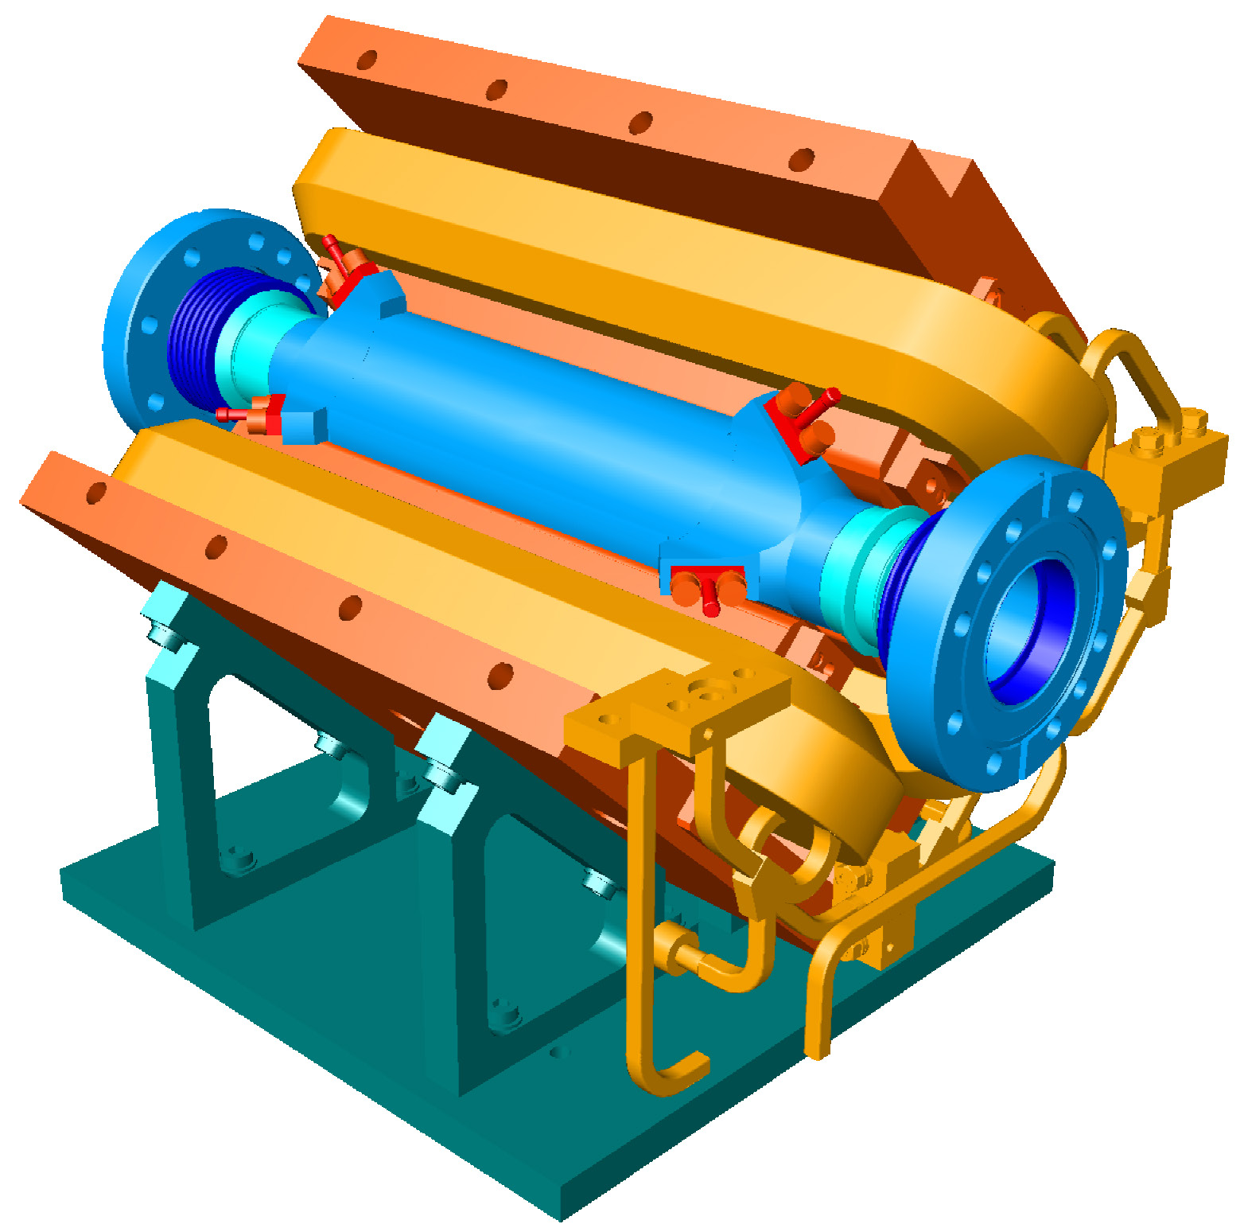
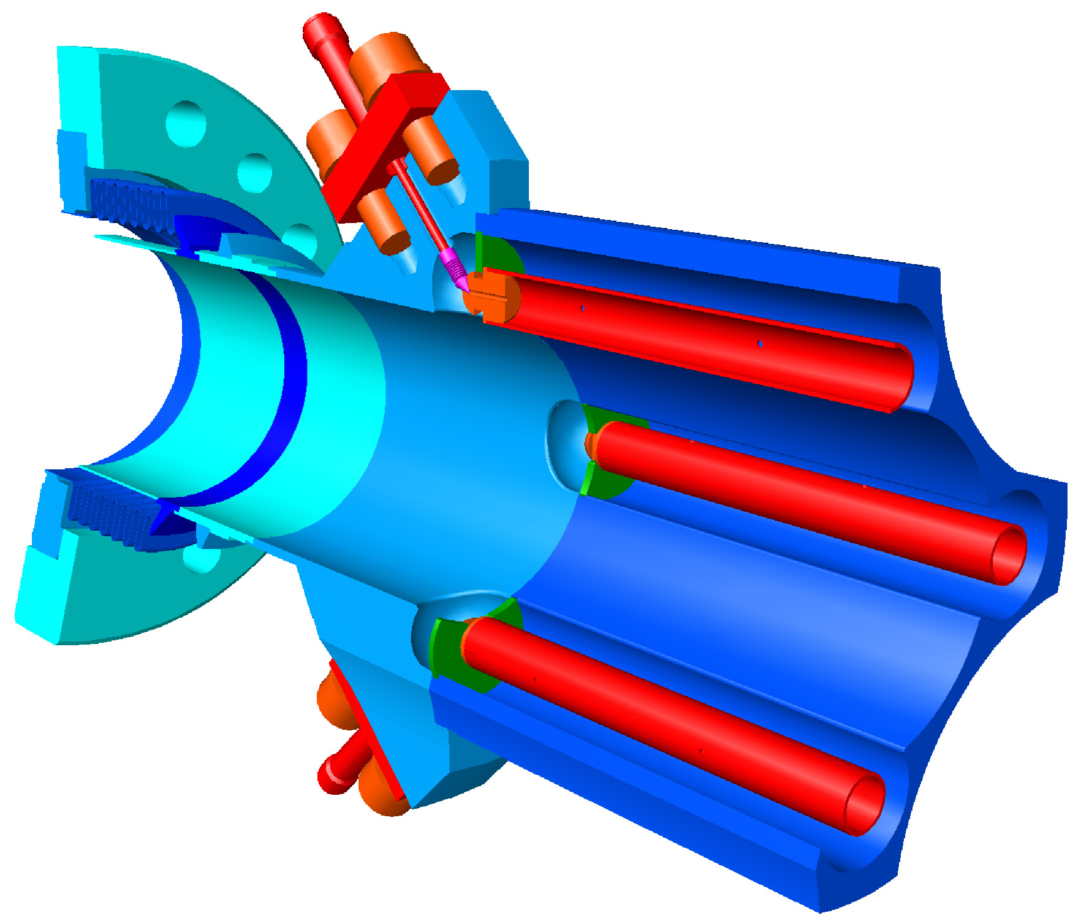
DESY FLASH BPMs and Quads
Stripline-type BPMs have a cross-section shape matched to the poles tips of the quadrupole
  The BPM is further “squeezed” into the quadrupole by shimming

Slide 8
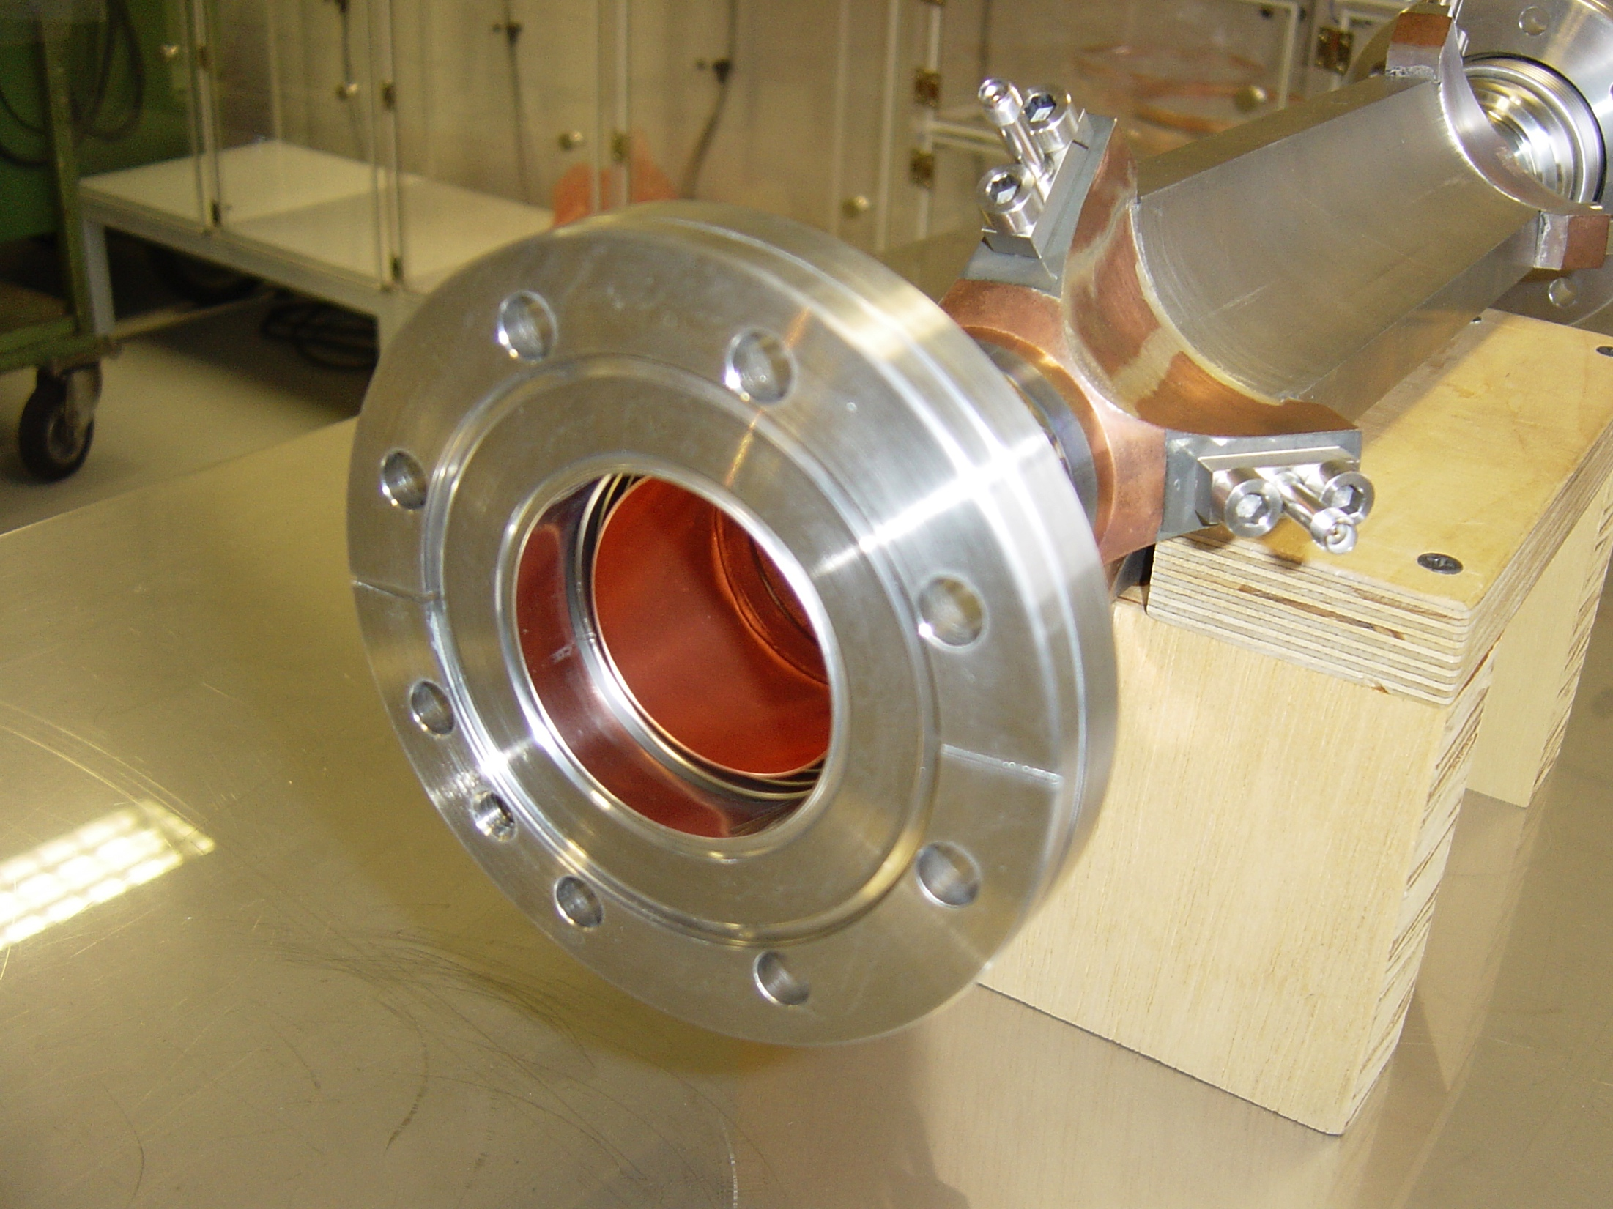
DESY FLASH Stripline BPM

Slide 9
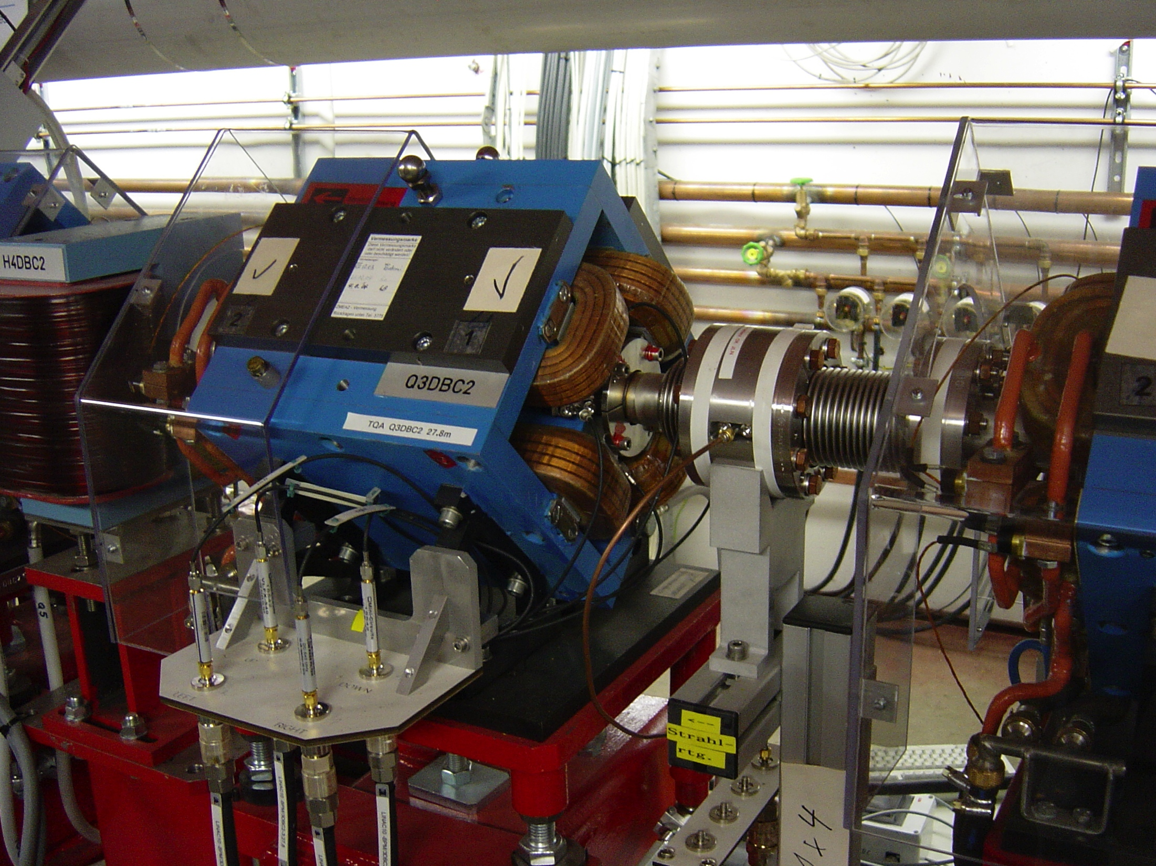
DESY FLASH Quad & BPM

Slide 10
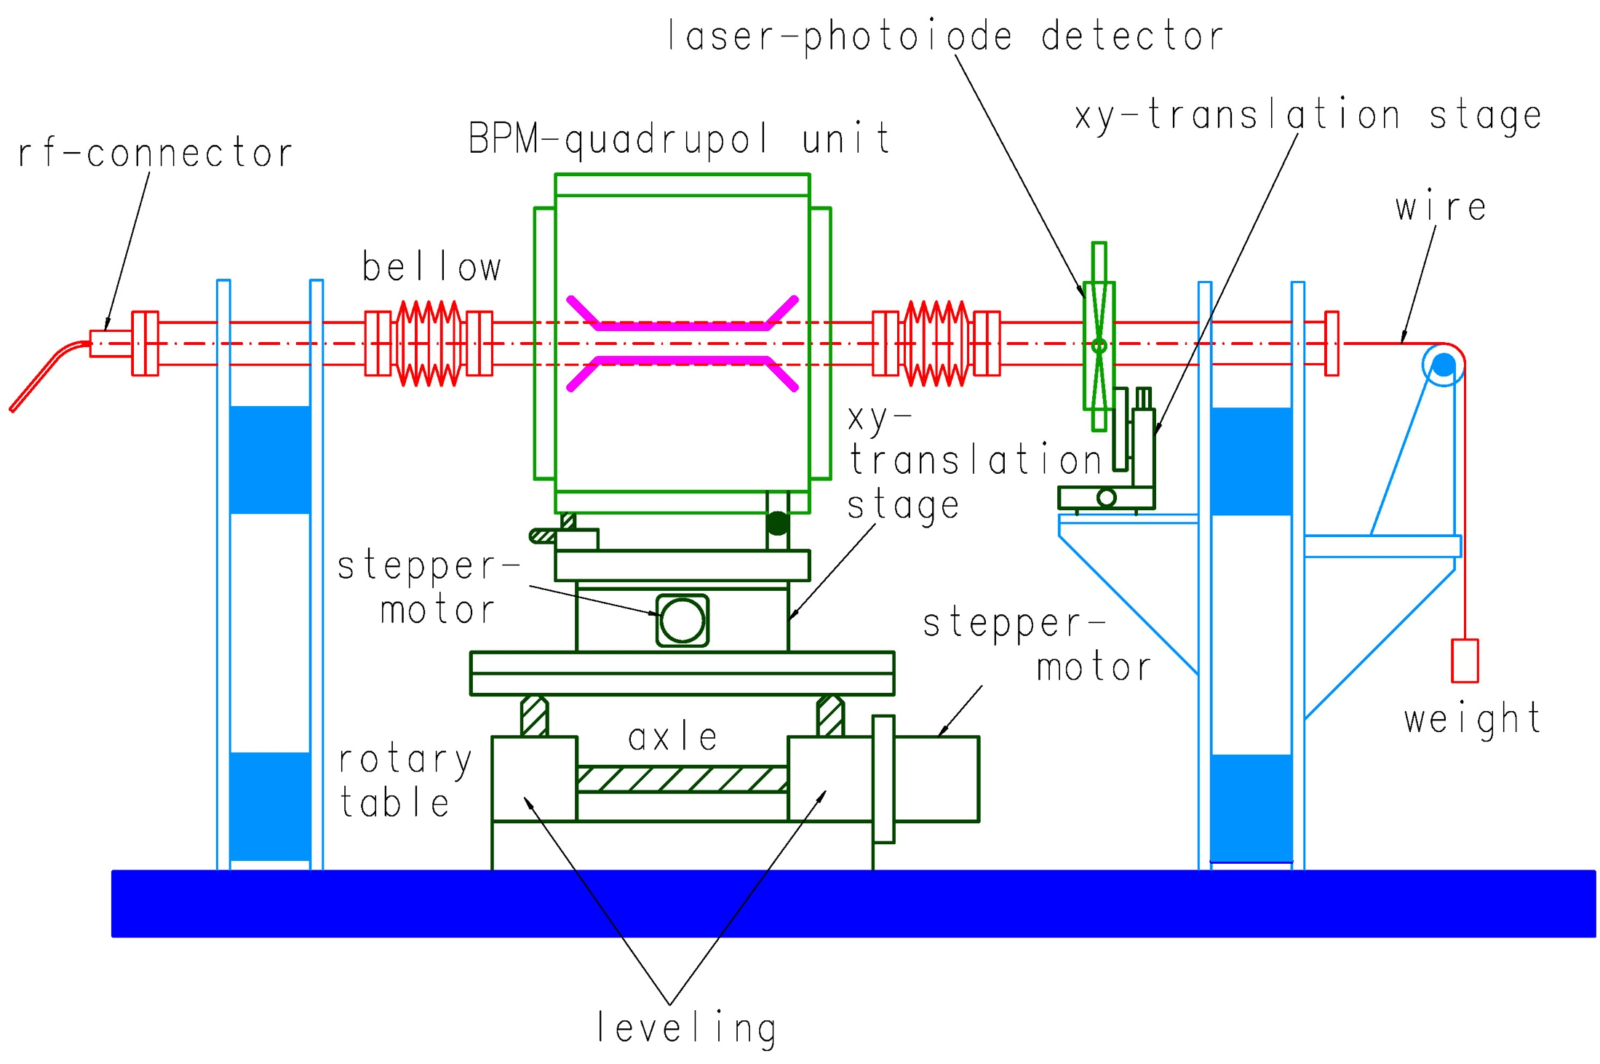
Stretched-Wire Setup
Schematic view of the calibration setup
  based on a common stretched wire
  The wire is fixed, BPM-quad is moved by step-motor controlled stages
  Two step calibration procedure:

Slide 11
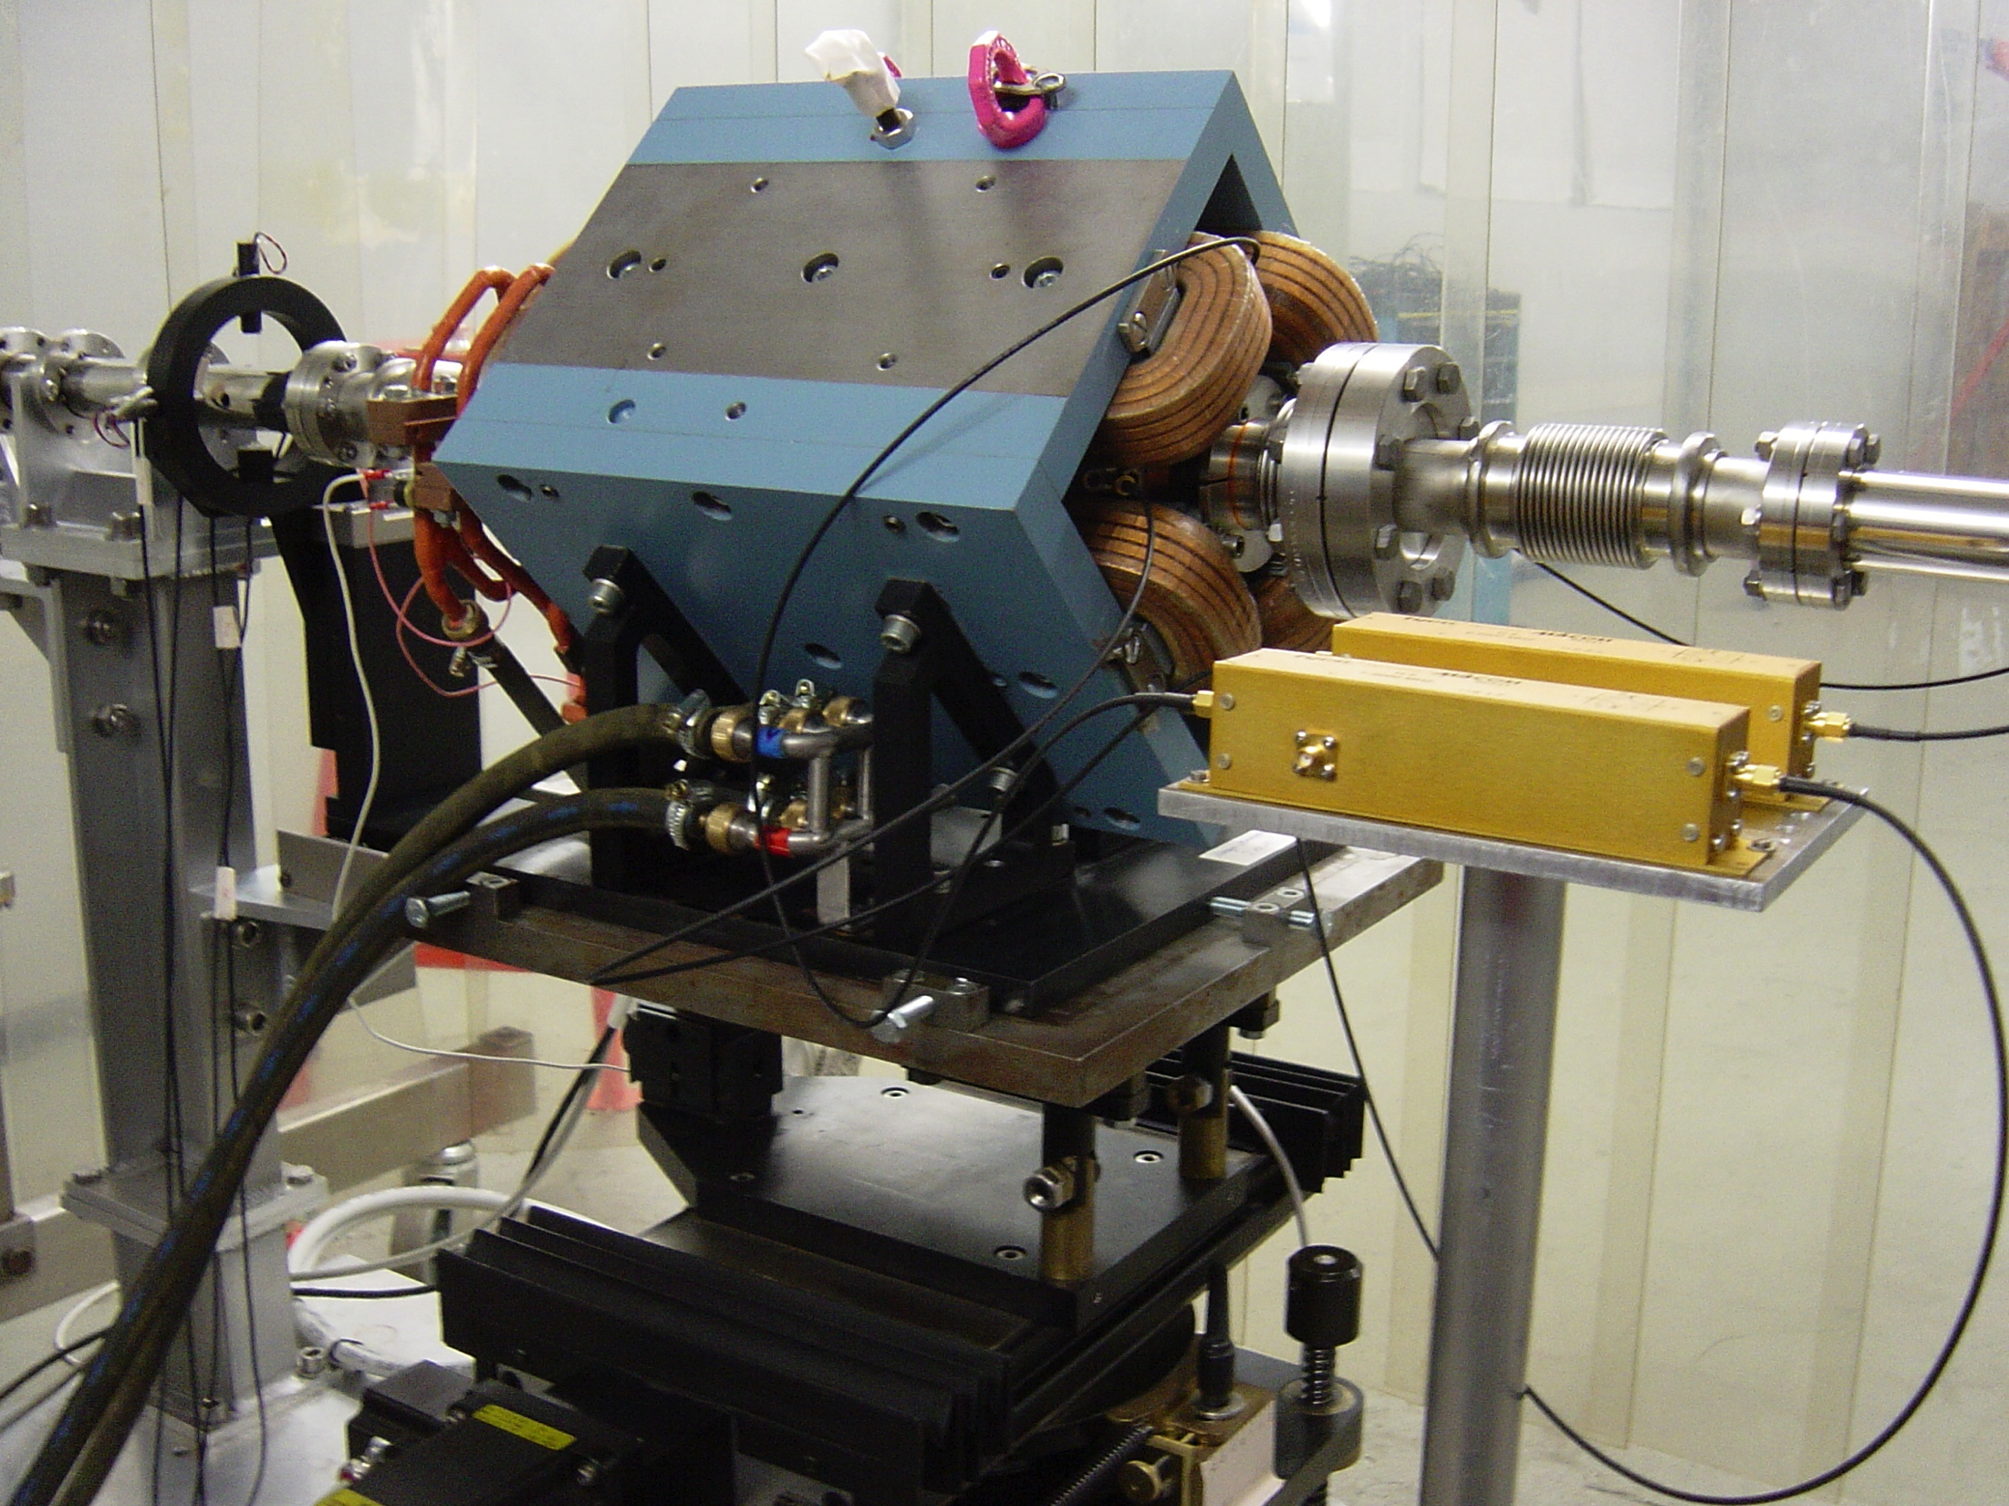
DESY FLASH Alignment Setup

Slide 12
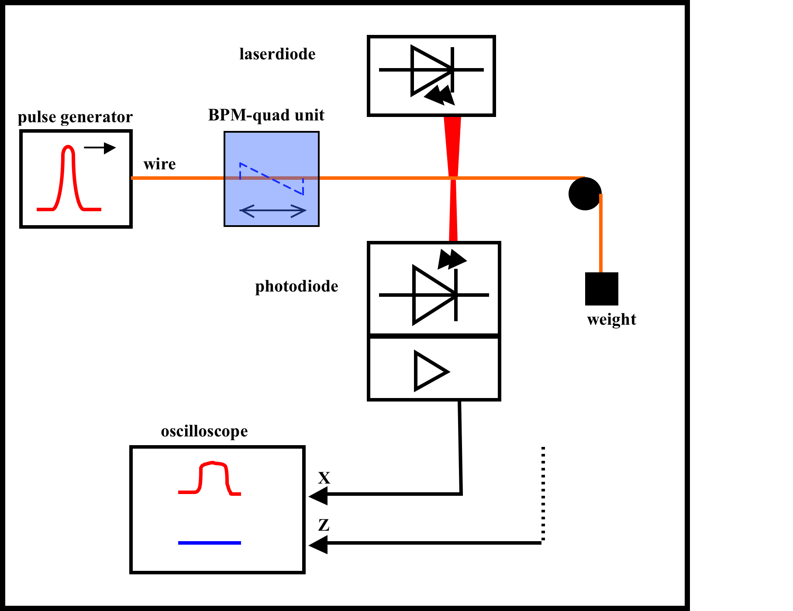
Calibration of the Magnetic Center
Magnet powered at 25 % of its nominal value (here ~100 A).
Cu-Be wire, 130 μm diameter.
Current pulse of charge Q, here 20 A, 10 μs (400V PS).
  displaces the wire in the region of the magnetic field by:
T: tensile strength of the wire
μ: weight per unit length of the wire
The excited wave runs with towards upstream and downstream fix points of the wire, were the displacement can be detected at a location z₀ behind the magnet.

Slide 13
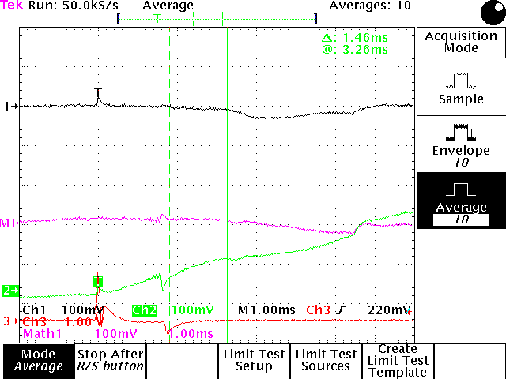
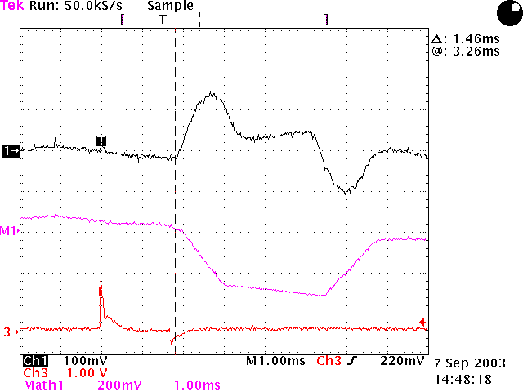
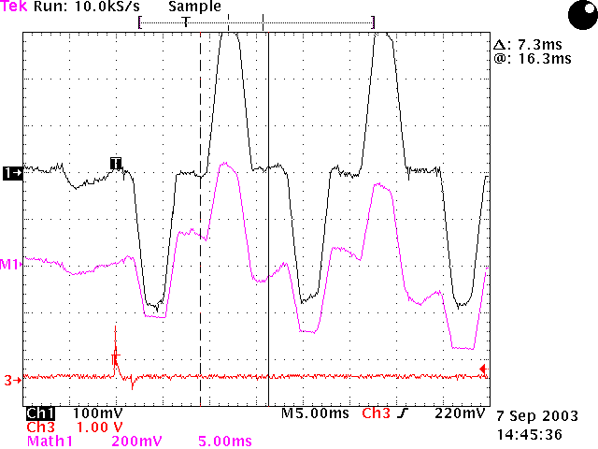
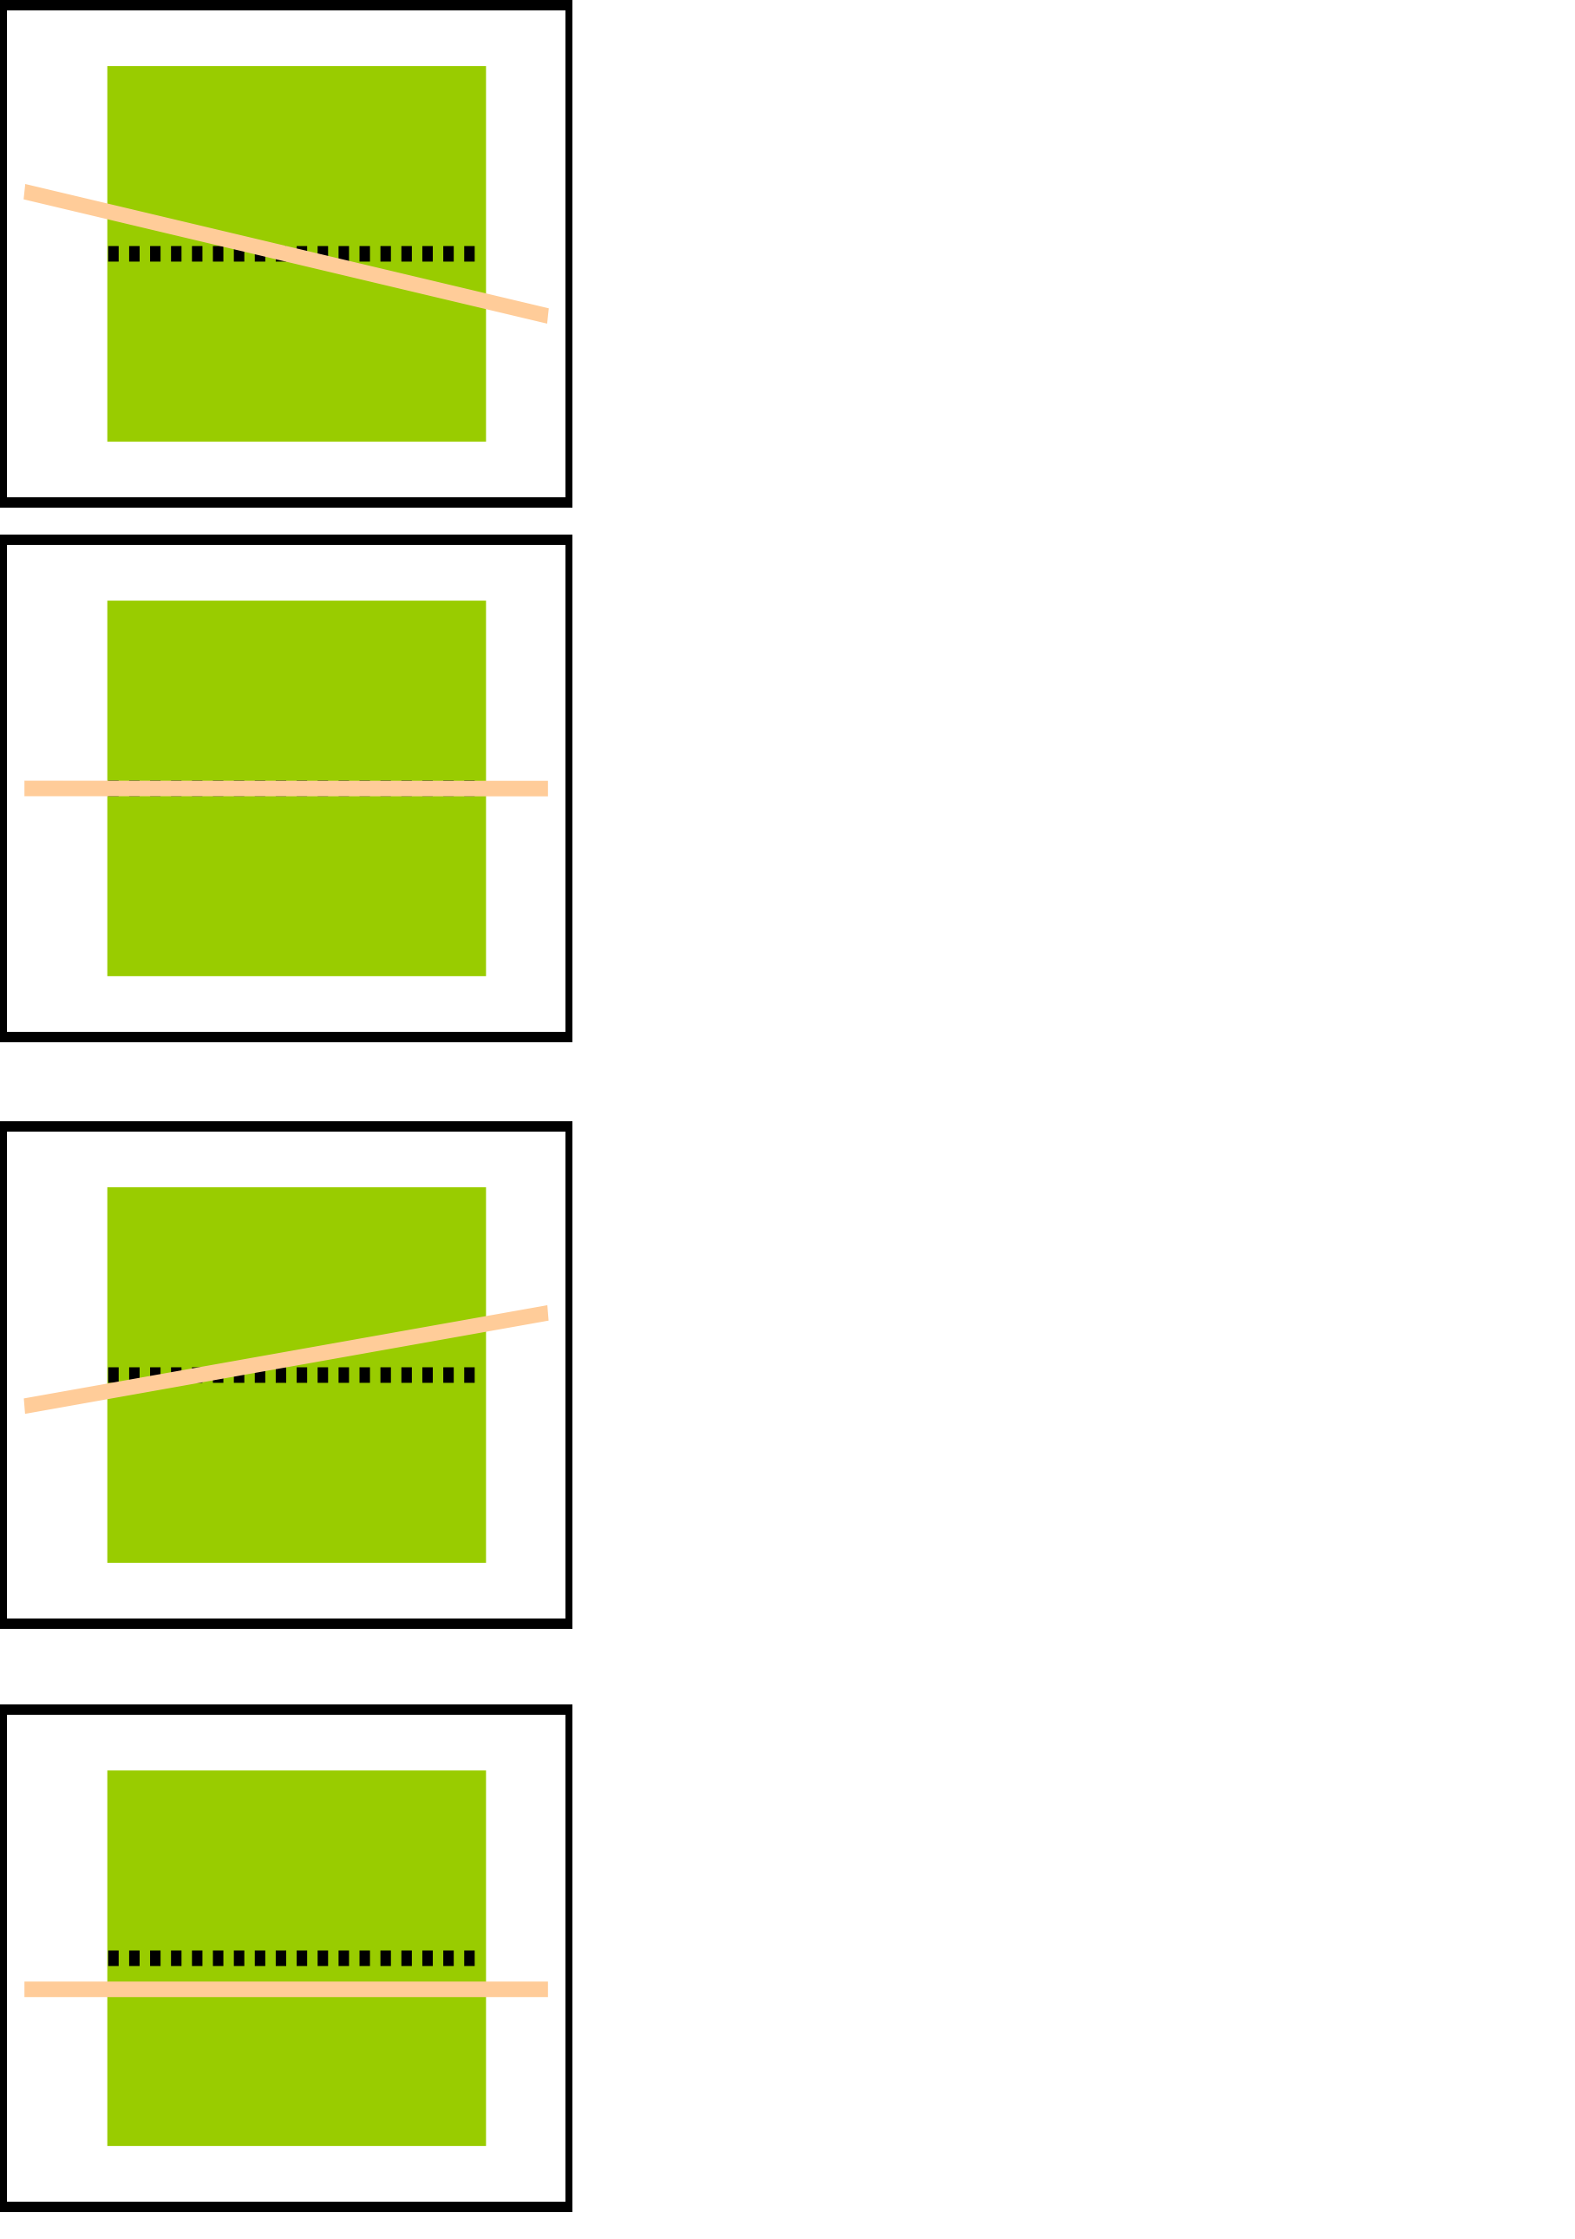
Typical Measurements
Tilt between quadrupole and wire
Quadrupole aligned to the wire!
  The BPM-quad unit was moved minimizing the oscilloscope signal:
  The wire is on the axis of the magnetic field – REFERENCE
Tilt and offset between
quadrupole and wire
Offset between quad and wire,
and the effect of the reflections

Slide 14
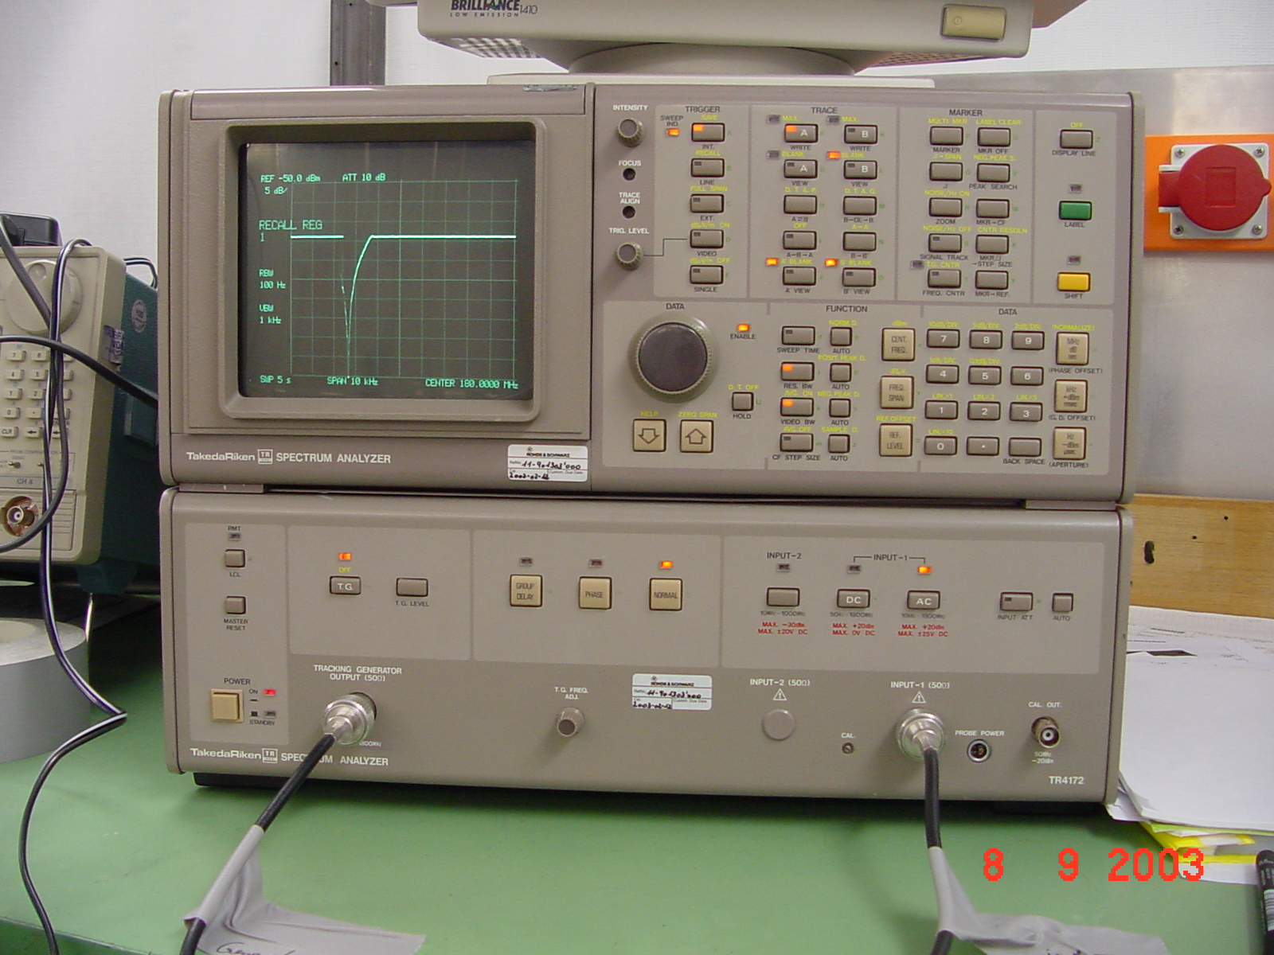
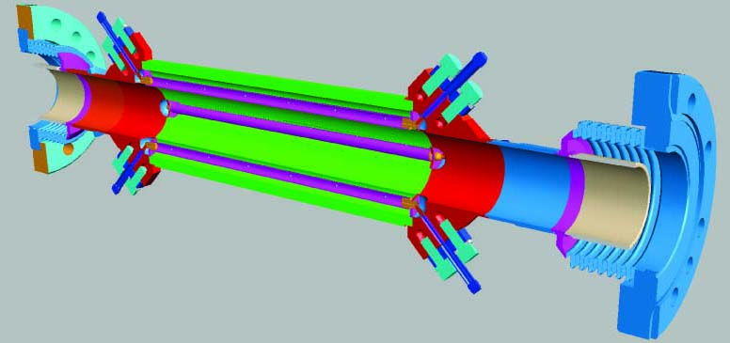
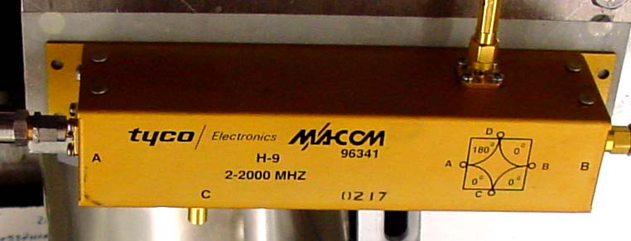
Calibration of the electrical BPM Center
VNA S21 CW setup (f = 375 MHz):
  Δ-signal from the two opposite electrodes
  Perform |S21| measurement
    Input: stretched wire (matching network)
    Output: Δ-output 180⁰ hybrid
  From the REFERENCE position the BPM-quad unit was moved until
  |S21| = min.

Slide 15
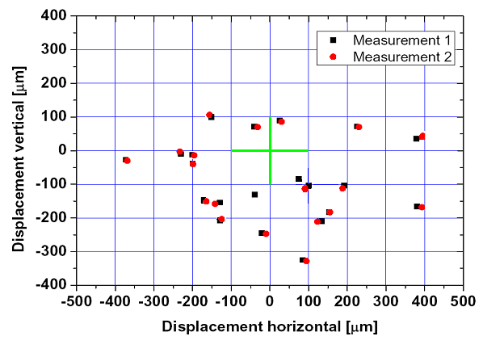
DESY FLASH Alignment Results
The xy-offset between magnetic center of the quadrupole and electrical center of the stripline BPM was evaluated by counting the driven steps, cross-checking with the readings of a micrometer gauge
23 BPM-quad units were calibrated, each measurement was performed twice.
Typical offset up to 200…300 μm were recorded.
While the resolution to identify the BPM center was 1…2 μm, the magnetic axis identification, and therefore the resolution of the entire setup, was limited to 10…20 μm.

Slide 16
PACMAN ESR4.1 Challenges…
BPM: cavity BPM operating at microwave frequencies!
  f₁₁₀ = 15 GHz, non-TEM eigenmode -> wire influence!
  Dedicated RF-front-end, plus commercial DAQ & control electronics.
Investigating of stretched-wire issues
  Understanding physical issues, e.g. wire-sag, eigenmodes, temperature behavior, etc., AND: RF signal excitation!
Read-out electronics and data acquisition
  In close collaboration with National Instruments!
  Data decimation and filtering, FPGA firmware, control of external elements (stepper motors, attenuators, etc.).
Collection and mining of measured data
  The data analysis has to be performed in team effort with the other ESRs to entangle unwanted influences, e.g. temperature effects, seismic vibrations, drift effects (magnet), EMI,…

Slide 17
…and Goals!
Reproducible calibration, i.e. alignment
between BPM and quadrupole: < 1 μm!
  What are the limiting factors
  Reproducibility questions
  Environmental studies
What is the ultimate achievable resolution
  of the stretched-wire BPM setup?!
  of the measurement of the magnetic axis?!

Slide 18
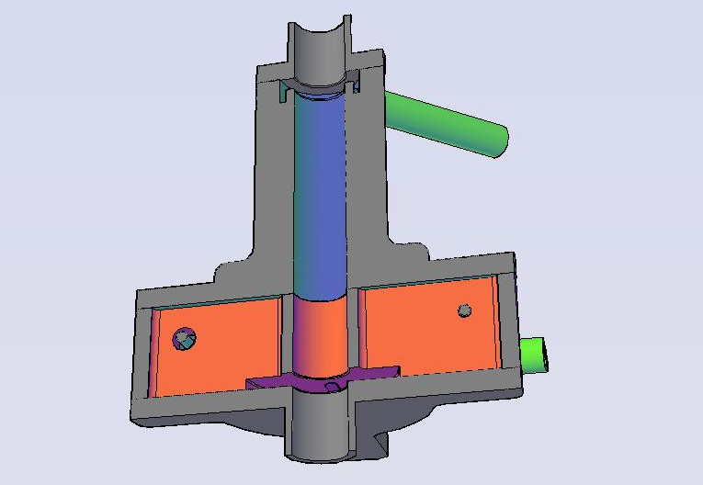
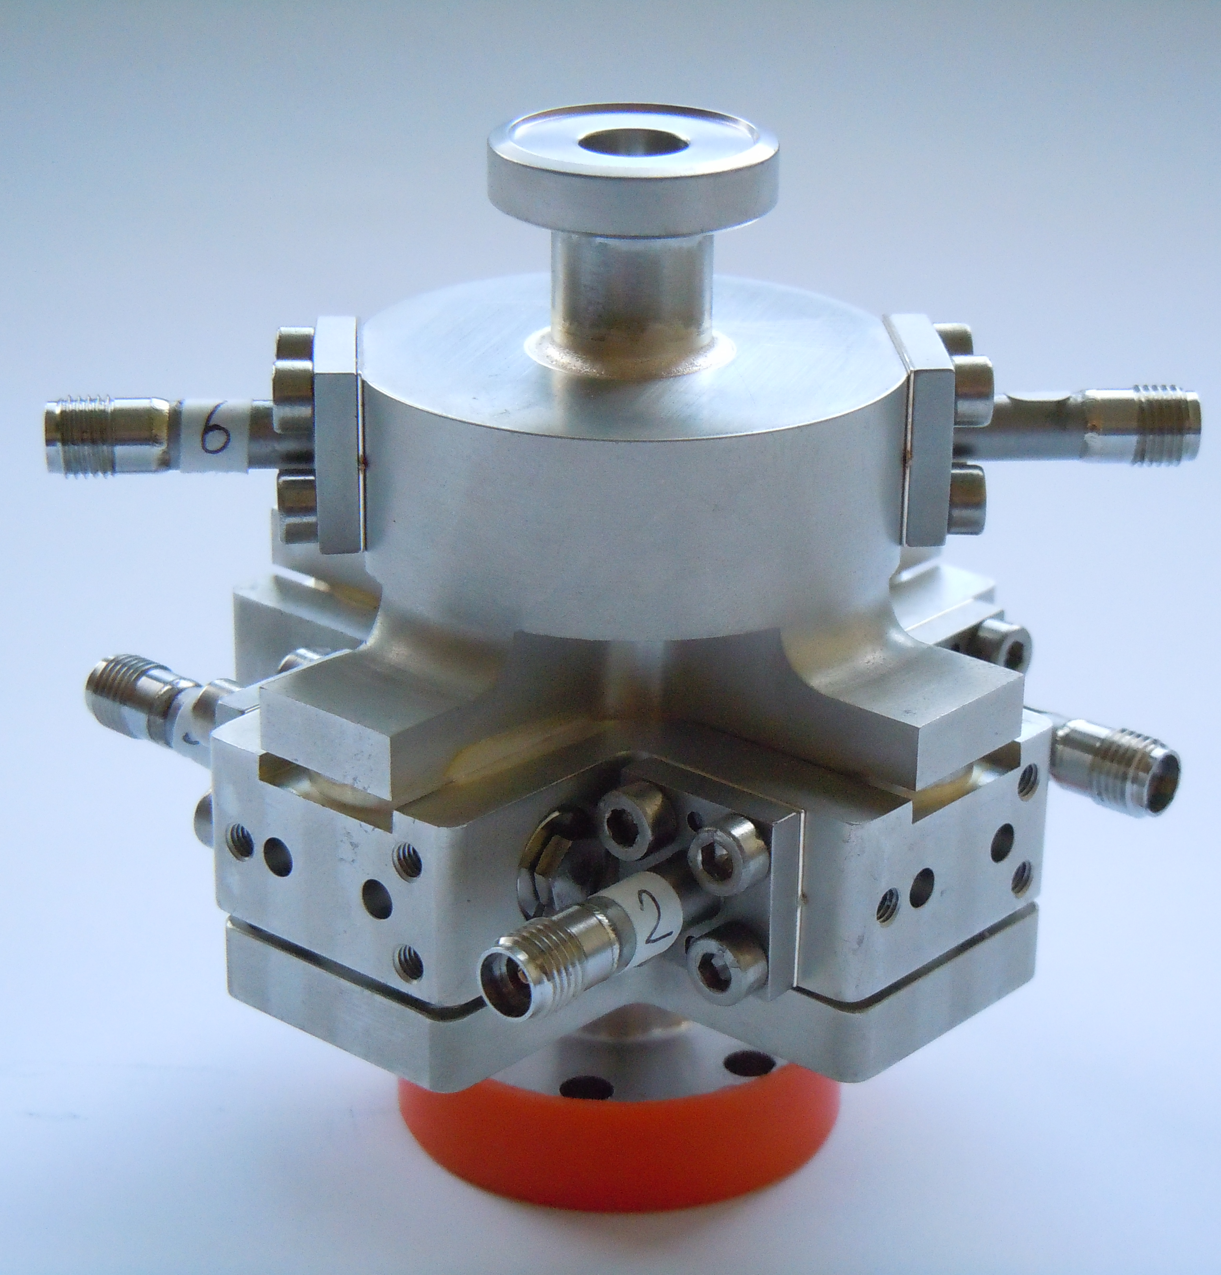
CLIC/CTF Cavity BPM (ESR 4.1)
CLIC accelerator and beam diagnostic components operate at microwave frequencies
  Example:
  The 15 GHz CTF cavity BPM
    R&D for the CLIC Main Beam
TM₀₁₀ monopole mode
reference cavity
Waveguides
TM₁₁₀ dipole mode
BPM cavity

Slide 19
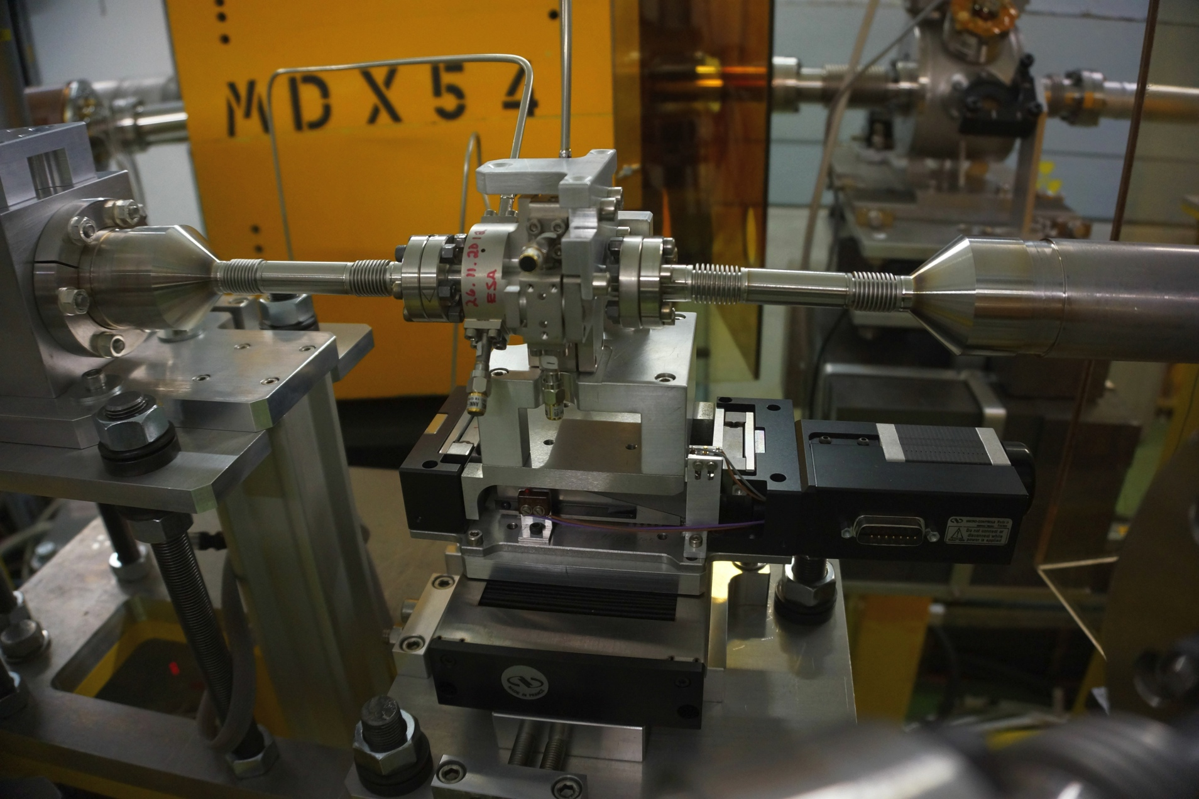
Cavity BPM on Translation Stages
BPM
Beam pipe with
bellows
Hor./vert. translation
stages (remote controlled)

