Slide 1

“Power/size trade-offs
in classical electromagnets”
M. Modena, CERN
Acknowledgments:
A. Vorozhtsov and A. Aloev that have analysed and sized the CLIC magnets for the preparation of the “CLIC Magnet Catalogue”

Slide 2
Outline:
1) Size/power optimization for electro-magnets: general considerations
2) The CLIC specificities
3) Some conclusions

Slide 3
Outline:
1) Size/power optimization for electro-magnets: general considerations
2) The CLIC specificities
3) Some conclusions

Slide 4
Size/power optimization for electro-magnets: general considerations
BASIC CONCEPTS:
An accelerator magnet system has a global cost that is composed by several main parts, ex:
Some of these cost parts are tightly link together:
Let us consider the design process of a specific magnet:
Once fixed the magnet performances (magnetic field, aperture, etc.) we obtain that:
- the costs (capital, operation and total) are normally combined in this way:
  Let us see why:
Total cost
Capital cost
Operation cost

Slide 5
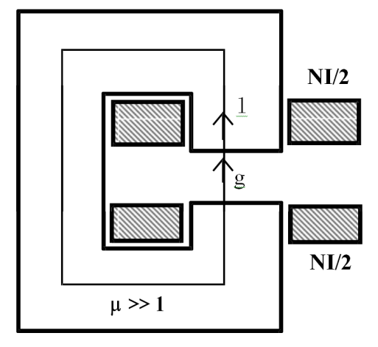
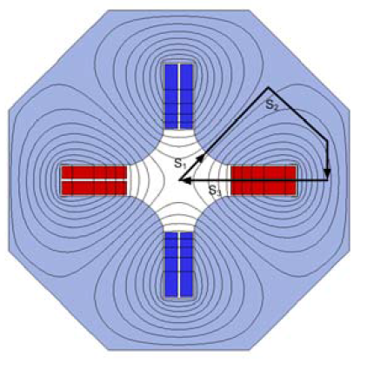
Size/power optimization for electro-magnets: general considerations
POWER COST CONSIDERATIONS:
The basic relations for magnet design are the Ampere’s and Ohm’s laws and the Joule heating effect.
Example of a C-Type dipole (non-saturated):
So, dissipated power in an electromagnet is directly proportional to the current density in the coils (Ј).

Slide 6
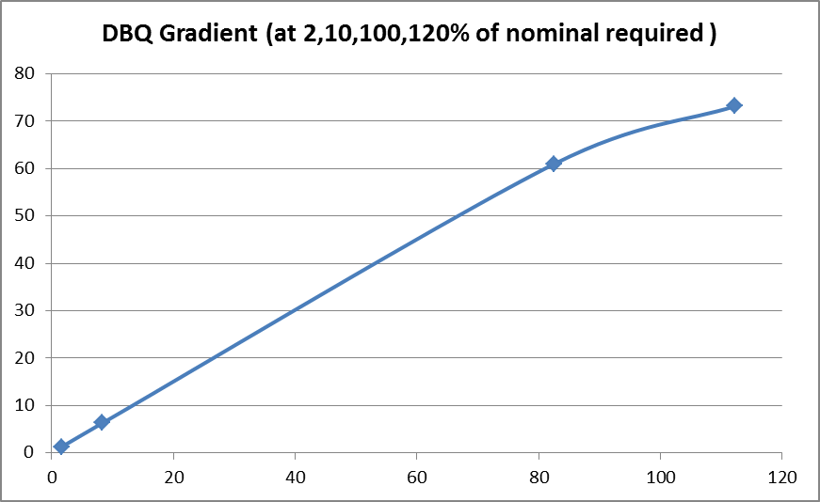
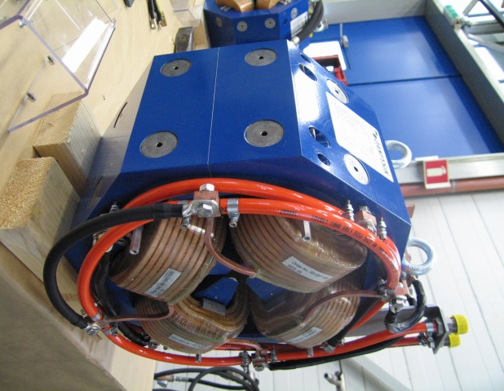
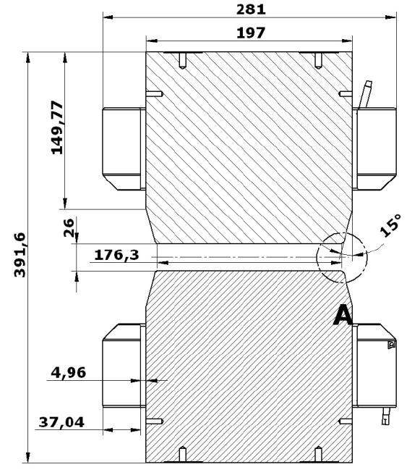
Size/power optimization for electro-magnets: general considerations
POWER COST CONSIDERATIONS:
2. Saturation of the iron has also an impact on the required power.
Magnetic design must include enough iron to work far from saturation, but in some cases (ex. of CLIC DBQ magnets) this it is not possible for (ex. space or weight limitations).
Main Parameters
 | 1st design values | Final values
Aperture Ø | 26 mm | 26 mm
Mag. Length | 194 mm | 197 mm
Nom. Grad. | 62.8 T/m | 61.8 T/m
Max. Length | 281 mm | 281 mm
Max. Width | 390 mm | 390 mm
Iron Length | 180 mm | 197 mm
Weight | ~ 149 kg | ~ 170 kg
Nom. Current | 93 | 82.5
Nom. Voltage | 9.2 | 6.74
Nom. Power | 855 W | 556 W
Cu conduct. | 6X6 mm² | 6X6 mm²
N. Of turn | 208 | 208
Nom.Water flow | 2.4 l/min | 1.8 l/min
Nom.Press. drop | 3 bar | 3 bar
Δ T | 5 °C | 5 °C
Max.Power (at 120%) | 3030 W | 1028 W
These effects are not linear so it is always good to invest time in the optimization of the magnetic and mechanical design.
Still from the CLIC DBQ example:

Slide 7
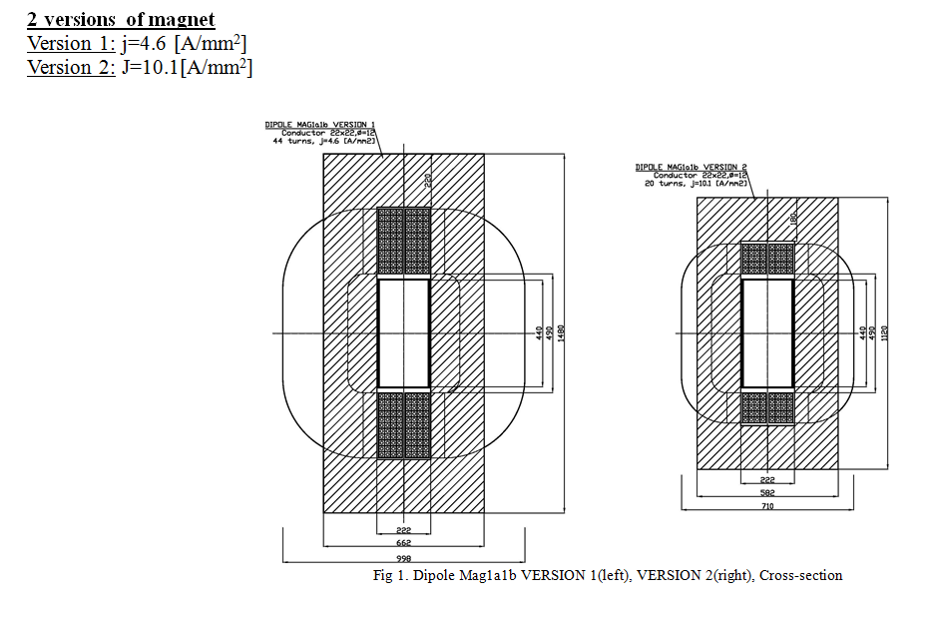
Size/power optimization for electro-magnets: general considerations
POWER COST CONSIDERATIONS:
Another example (also taken from the CLIC Magnet Catalogue) showing the impact of magnet sizing on the needed power. Mag1a1b dipole of the CLIC Post-collision line:

Slide 8
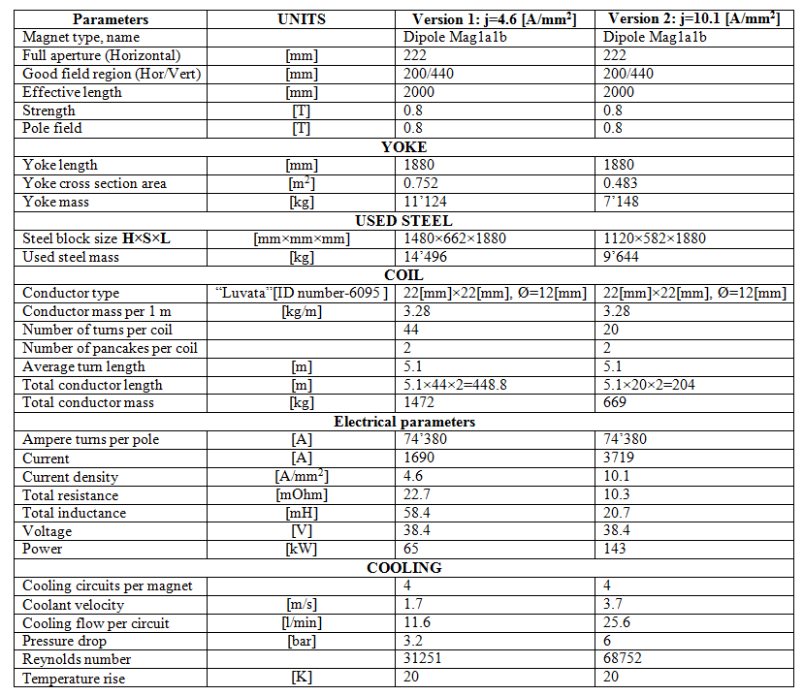
Size/power optimization for electro-magnets: general considerations

Slide 9
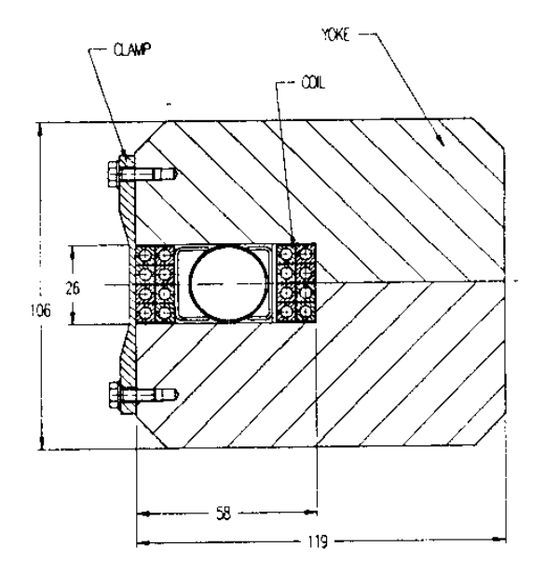
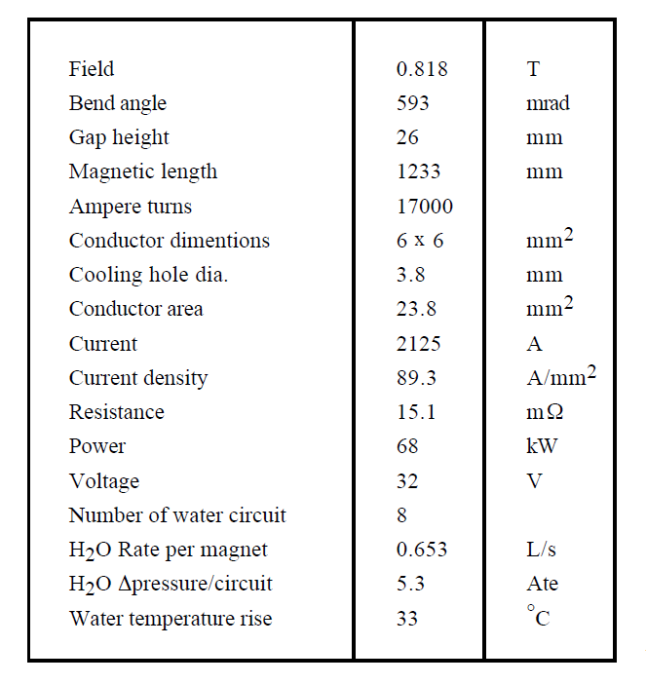
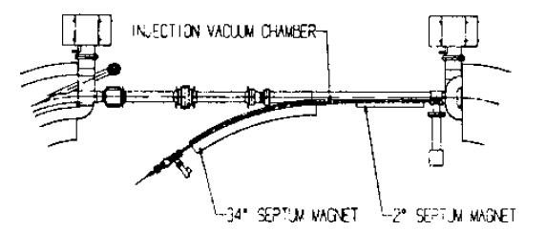
Size/power optimization for electro-magnets: general considerations
CURRENT DENSITY AND WATER FLOW CONSIDERATIONS:
In literature is frequently indicated a current density J between 5 and 10 A/mm² as a convenient value for magnet design.
(Cfr. with the very exhaustive CAS-2009 Lecture: Th. Zickler: “Basic design and engineering of normal-conducting, iron-dominated Electromagnets” available at: http://arxiv.org/ftp/arxiv/papers/1103/1103.1119.pdf; or the “historic” CERN study done in the 70s: G. Brianti and M. Gabriel: “Basic Expressions For Evaluating Iron Core Magnets, a Possible Procedure to Minimize Their Cost”, CERN/SI/Int.DL/70-10 available at: https://cdsweb.cern.ch/record/1462804/files/CERN-SI-INT-DL70-10.pdf‎ )
This suggested range for J is depending by cost optimization reasons (conjuncture and site dependent) and normally not by technical ones. Current density (and consequently water flow rates and velocity) can be much higher without causing major problems.
Ex: Injection septa (as final focus magnets), are usually “unique elements” in an accelerator so their impact on total power consumption is limited, while the compactness design is normally a critical requirement.
For these reasons is not essential to apply strict power/size considerations to their design.
As an example, a septum done for the DAΦNE Φ–Factory at LNF (INFN) Italy. (Ref: M. Modena, H. Hsieh and C. Sanelli “High Current Density Septa for DAΦNE Accumulator and Storage Rings”, LNF-92/033 (P)

Slide 10
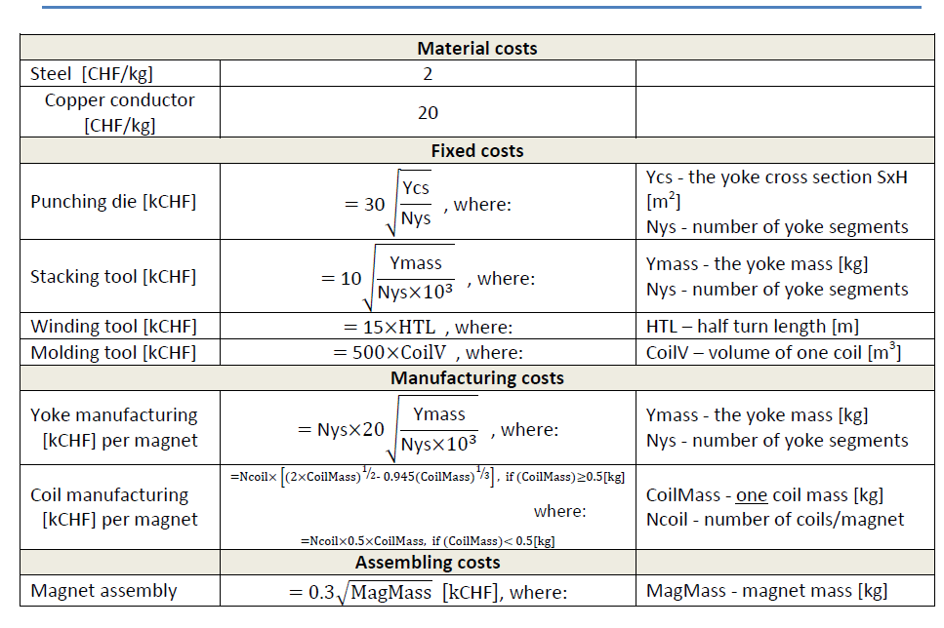
Size/power optimization for electro-magnets: general considerations
SIZE COST CONSIDERATIONS:
For a defined magnet (type and requirements), a bigger magnet will be evidently more expensive of a compact one.
Procurement cost includes: raw material, machining, main tooling, assembly, ancillary finishing components , tests, transport, etc. All this costs are proportional to the magnet size.
The classical approach for cost estimation is to develop practical formulae providing the procurement costs of the different parts in function of some key design parameters.
A set of formulae was recently revised and updated for the CLIC Magnet Catalogues release and other MSC-MNC magnets procurement:
This is a mixed analytical and pragmatic approach:
The key elements are the “coefficients” appearing in the formulae: they must be keep updated checking the validity of the formulae with as much as possible “standard” procurement cases.
(For information: these formulae were found correct inside ±20% for the MedAustron magnet system procurement done in these last years).
(Source: A.Vorozhtsov elaboration with inputs from D.Tommasini, T.Zickler and M. Modena)

Slide 11
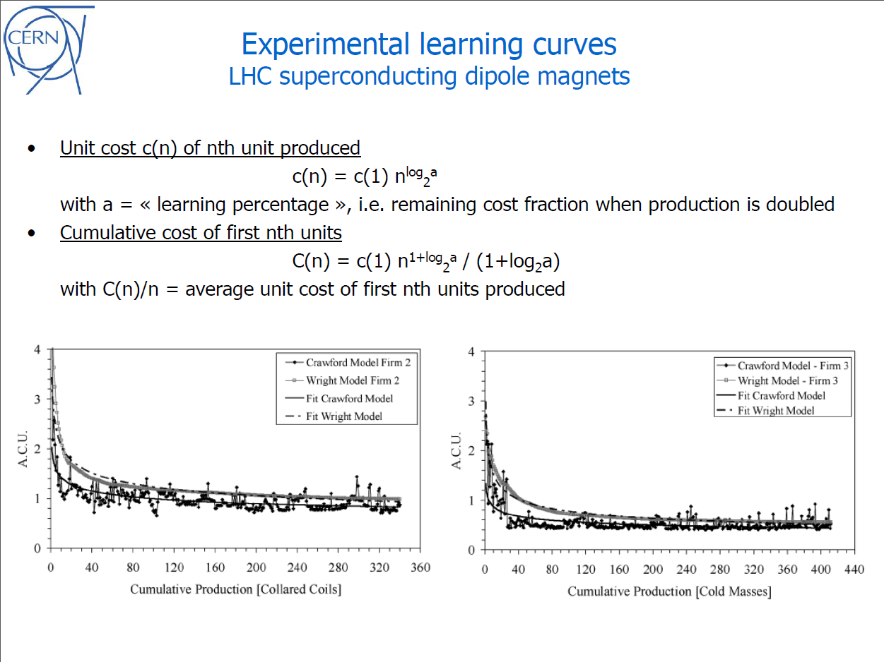
Size/power optimization for electro-magnets: general considerations
LEARNING CURVE COST CONSIDERATIONS:
With “size” of a procurement we could also mean the number of magnet units to be procured:
A cost “learning curve” will apply for a magnet series production:
(see the very comprehensive presentation of P.Lebrun “Issues, methods and organization for costing the CLIC accelerator project” EDMS:100426 from which the following 3 slides are taken).

Slide 12
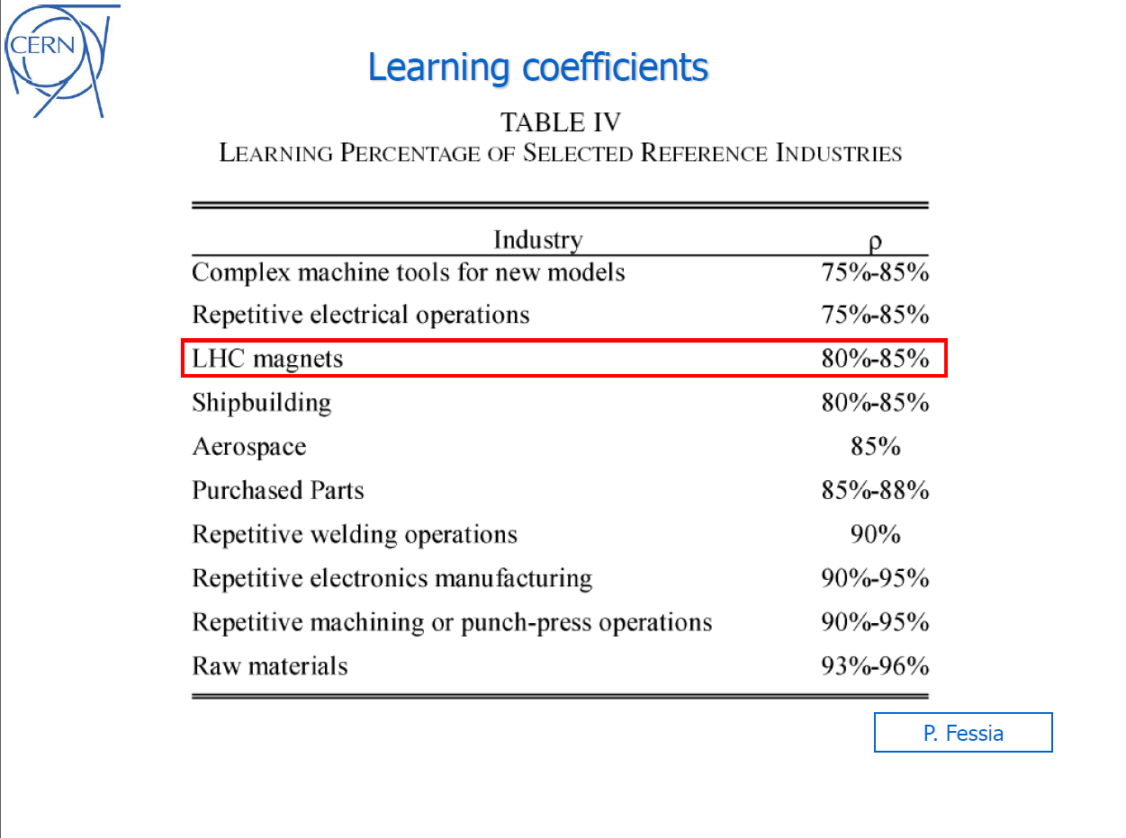
Size/power optimization for electro-magnets: general considerations

Slide 13
Outline:
1) Size/power optimization for electro-magnets: general considerations
2) The CLIC specificities
3) Some conclusions

Slide 14
The CLIC specificities
Some of the main “CLIC specificities” relevant for magnets design and optimization that I will mention here are:
1) The required compactness for the Linac structures: aspect well reflected in the “two-beam Modules” layout with geometrical and stabilization tight constraints.
2) The wide population of magnets in the different subsystems of the CLIC complex: the “CLIC Magnet Catalogue” that we realized in the past years show in details this aspect.
3) The accelerator complex power (and water) consumption: considered a very sensible and critical aspect for the feasibility of the Project.

Slide 15
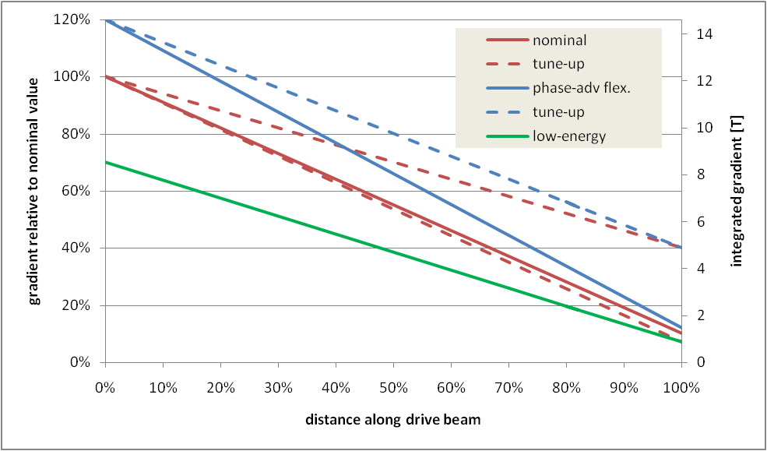

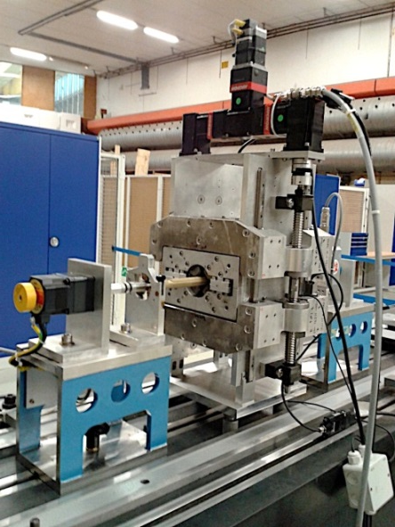
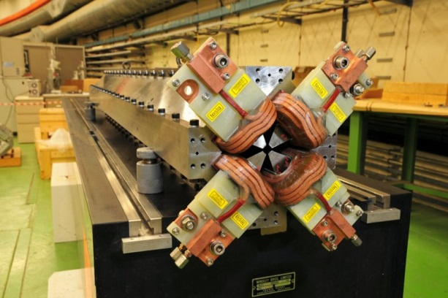
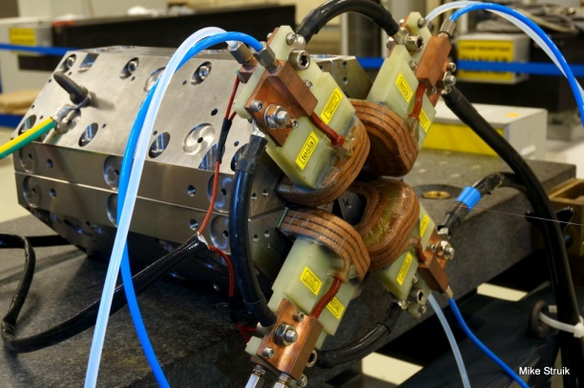
The CLIC specificities
The required compactness for the Linac structures:
The situation for the DBQ:
Very tight allowable space (longitudinally and transversally)
Wide powering scenario (10% to 120% range);
A feasible EM solution was anyhow found and verified
For substantial power saving alternative new designs like the full PM one (see presentation: B. Shepherd “Development of permanent-magnet based accelerator magnets”) are under study.
The situation for the MBQ:
- Magnet weight critical for the stabilization → minimized
- The magnet design is optimized towards performances and available space
- For power saving we also here plan to investigate an hybrid version (PM + EM)

Slide 16
The CLIC specificities
2) The wide population of magnets in the different part of the CLIC complex:
1) CLIC Drive Beam complex (turnaround, delay line, combiners rings, TL, etc.) EDMS n.1082761:
- 12096 magnets in total; divided in 14 types with population from 32 to 1872 units.
2) CLIC Main Beam Transport EDMS n. 1139561:
- 2291 magnets in total; divided in 17 types with population from 1 to 250 units.
3) CLIC Damping Rings EDMS n. 1092291:
- 4076 magnets in total; divided in 11 types with population from 76 to 1004 units.
4) CLIC Post-Collision line (CDR baseline version) EDMS n. 1097652:
- 18 magnets in total; divided in 5 types with population from 2 to 8 units.
5) CLIC Beam Delivery System EDMS n. 1250188:
- about 400 magnets in total; divided in 70 types with population from 1 to 96 units.
6) CLIC DBQ (EM design): 41848 magnets in total.
7) CLIC MBQ: 4274 magnets in total; divided in 4 types with population from 368 to 1490 units
The total procurement cost for all the above listed magnets was estimated, applying the formulae seen before (i.e. capital cost of magnets including the production learning curve as proposed in EDMS:100426 by P. Lebrun).
In agreement with the responsibles of the different CLIC subsystems, we try to unify similar magnets design in order to profit of more convenient production cost due to larger series.
POSSIBLE FUTURE ACTIONS: if/when CLIC energy scenario and machine layout will be modified or consolidated, the Catalogue could be revised looking for more efficient merging magnets types. This would need an effort from the Beam Dynamics colleagues toward an unification of magnets requirements.

Slide 17
The CLIC specificities
3) The accelerator complex power consumption:
1) CLIC Drive Beam complex: 12096 magnets in total; Total power: 45 MW (J=5 A/mm²)
2) CLIC Main Beam Transport: 2291 magnets in total; Total power: 4 MW (J=5 A/mm²)
3) CLIC Damping Rings: 4076 magnets in total; Total power: 13 MW (J=5 A/mm²)
4) CLIC Post-Collision line (CDR baseline version): 18 magnets in total; Total power: 3.3 MW (J=5 A/mm²)
5) CLIC Beam Delivery System: about 400 magnets in total; Total power: 0.3 MW (J≤5 A/mm²)
6) CLIC DBQ (EM design): 41848 magnets in total. Total power: 7.7 MW (nom. operation) ; 16.6 MW (“tune-up”, 120%)
(J ≤ 3 A/mm² ; 4 A/mm²)
7) CLIC MBQ: 4274 magnets in total; Total power: 10.8 MW (J=5.9 A/mm²)
The magnets were sized to operate with a relatively low current density (J≈5 A/mm²).
This will limit the running cost for the electrical power and cooling water consumption.
From what explain in the first part, this aspect could be even enhanced but with the consequence of increasing the capital cost.
POSSIBLE FUTURE ACTIONS:
For some specific magnets (MB RTML and DB TAL dipoles) with important population and power consumption (15 MW in total), we plan to study alternative PM or Hybrid solutions (see B. Shepherd’s presentation)
Apart the case of the DBQ powering, no specific studies done regarding the power supplies and distribution lines.
For the design we selected I/V values in agreement with the EPC colleagues. Anyway the magnet design permit a relatively easy adaptation (by the n. of turns in the coils) to other choice for these coupled parameters.

Slide 18
Outline:
1) Size/power optimization for electro-magnets: general considerations
2) The CLIC specificities
3) Some conclusions

Slide 19
Some conclusions:
The basic concept and considerations driving the design and power/size trade-off for classical electro-magnets were presented.
At CERN we keep updated sets of formulae to estimate the costs of electro-magnets, and we tests them in the on-going procurement contracts.
Methods and techniques to estimate the cost Learning Curve and cost risks analysis are developed inside the CLIC Cost & Schedule Working Group with the main task to correctly estimate the cost for the big series of components of the CLIC complex; magnets are one of these components.
CLIC SPECIFICITIES:
  Magnets for the Two-Beams Modules (DBQ and MBQ) are special cases where the boundary conditions (space, weight) are limiting the design optimization. For those cases we expect the most efficient saving coming from alternative PM or Hybrid designs.
  The 1st released “CLIC Magnet Catalogue” was a wide exercise of magnets design (1st sizing) unification/optimization. The numbers of magnets required in CLIC, their distribution in family of very different sizes, permit to apply the methods for cost evaluation mentioned.
  To limit the running cost (power required for the CLIC magnet system), the majority of the magnets were sized for a relative low coils current density (J ≤ 5 A/mm²).
  A revision of the Catalogue could be envisaged after a consolidation and optimization of the CLIC magnetic lattice, with the aim to improve the merging and reduction of magnets types present. We need an effort also from the Beam Dynamic Team toward this objective.
THANKS

