Slide 1
HL-LHC performance with the various
LIU options
G. Arduini, O. Brüning, R. De Maria with input from: H. Bartosik R. Bruce, H. Damerau, S. Fartoukh, M. Fitterer, S. Gilardoni, M. Giovanozzi, B. Gorini, M. Lamont, A. MacPherson, S. Redaelli, G. Rumolo, R. Tomas and LIU/HL-LHC teams

Slide 2
Definitions
  Scenarios:
  PIC: Integrate 1000 fb⁻¹ by 2035
  US1: Integrate 2000 fb⁻¹ by 2035
  US2: Integrate 3000 fb⁻¹ by 2035
  Assumptions for all scenarios (i.e. regardless of extent of the interventions):
  10 years operations starting from 300 fb⁻¹
  160 days of scheduled physics per year
  Performance goals: PIC 70 fb⁻¹ / year, US1 170 fb⁻¹ / year, US2 270 fb⁻¹ / year
  Benchmark:
  Performance efficiency: time fraction needed to reach the goal with a sequence of successful fills, assuming 3h turnaround time and either optimal fill length and 6h fill length (2012 run -> 50%).
  Physics efficiency: stable beam time fraction to reach the goal (2012 run -> 38%)

Slide 3
Experimental conditions
  Average pile-up limit in IP1-5:
  140 evt per crossing
  1.4 evt/mm accepted but 0.7 evt/mm should be the target
  Cross- section for pile-up 85 mb, cross s-section for intensity life: 100 mb
  Filling scheme: 48b (preliminar B. Gorini), 72b (doubling 50ns), 64b (just a guess)
  Possible optimization with no bunches w/o collisions, no 4-fold symmetry and use last injectable bucket
Filling scheme | IP1-5 Colliding bunches
48b 5 Ps inj, 12 SPS inj | 2508
48b 5 Ps inj, 13 SPS inj | 2544
48b 6 Ps inj, 12 SPS inj | 2592
64b (guess) | 2680
72b (doubling 50ns) | 2760

Slide 4
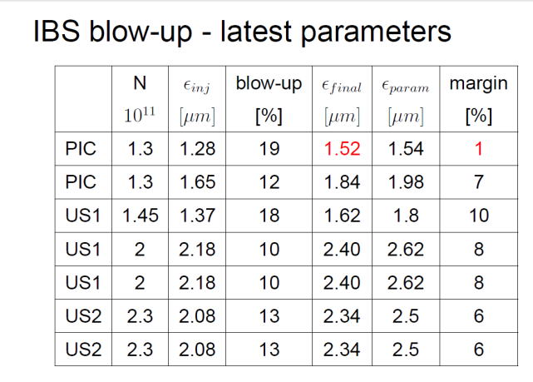
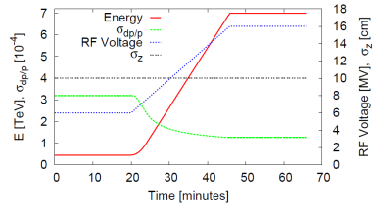
Assumed for RLIUP:
20% emittance blowup
5% intensity loss
 | N_{b inj} [10¹¹] | ε*_{inj} [μm] | N_{b coll} [10¹¹] | ε*_{coll} [μm]
PIC | 1.45 | 1.45 | 1.38 | 1.8
PIC | 1.45 | 1.85 | 1.38 | 2.22
US1 | 2.0 | 2.18 | 1.9 | 2.62
US2 | 2.32 | 2.08 | 2.2 | 2.5
US2 | 2.32 | 2.08 | 2.2 | 2.5

Slide 5
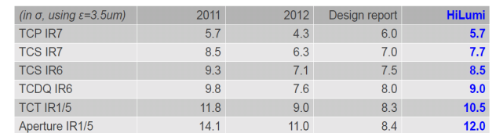
Collimation settings and beta* reach
Impedance effects and
gain from button not included
R. Bruce, 13/9/2013
SQUEEZE OPTICS (6.5 TeV) |  | APERTURE | minimum over IR1/5
β* [m] | x-angle [μrad] |  | MQX* | D1 | TAN | D2 | Q4 | Q5
0.10/0.40 | ±165 | beam size + co | 13.39 | 14.11 | 8.86 | 12.19 | 11.92 | 11.35
0.15/0.15 | ±270 | beam size + co | 12.11 | 12.87 | 9.4 | 12.38 | 11.64 | 12.09
0.20/0.40 | ±165 | beam size + co | 18.94 | 19.95 | 12.44 | 17.23 | 16.86 | 16.03
0.30/0.30 | ±190 | beam size + co | 19.1 | 20.12 | 14.4 | 18.56 | 17.33 | 17.8
M. Fitterer, 16/9/2013
Values not final, new aperture margin evaluation being formulated:
approach run-1 measurement but do not neglect very low-beta specific effects

Slide 6
Hardware changes: PIC
  PIC
  Experiment compatible with 140 pileup-ev crossing
  New TAS, 60 mm, IT, D1, 150 mm, correctors
  New collimators with buttons, new materials for robustness and impedance, new TCTs in IR1-5 for D2-Q5 for cleaning and protection
  Arc sextupoles (MS) at 600A
  SC links in IR15, QRL
  New powering with SC links at P7 (RR)
  New Cryoplant P4 for SCRF
  Cryoplants in P1,5?
  Beam pipes and Y chamber between D1 and TAN?

Slide 7
Hardware changes US1, US2
  US1
  All what it is in PIC
  BBLR in IR1 and IR5 located where effective
  US2
  All what it is in US1
  new matching section (D2, TAN, Q4, Q5) in IR1-5 with line shielding
  Stronger Q5 IR6
  Sextupoles in Q10 in Sectors 12,45,56,81
  Crab cavities
  800MHz?
  e-lens ?

Slide 8
Assumed injector upgrades / feedback for LIU
PIC:
  LINAC4 and 160 MeV PS Booster injection
  LLRF SPS upgrade allowing pulsing the RF
US1:
  In order to achieve the target luminosity we would need (although not planned, presently) in addition:
    SPS RF upgrade (power and LLRF) to increase bunch population
    No PSB energy upgrade would be strictly required at this stage

Slide 9
Assumed injector upgrades / feedback for LIU
US2:
  In addition to upgrades proposed for US1:
    PSB energy upgrade
    Further bunch population increase to 2.2x10¹¹ p/bunch (further impedance reduction in SPS?)
  In all cases considered we assumed >2500 bunches per beam (2508 for BCMS and 2760 for standard production schemes)

Slide 10
Topic under study
Impedance effect on stability and heat load
E-cloud effect on heat load
Beam – beam effects ( footprint and DA vs intensity, crossing angle, beta*, ip8 separation)
Energy deposition (scaling from nominal OK, but new triplet expose more MS)
Impact on orbit control on luminosity
Leveling strategy (proposed: collide and squeeze, IP8 separation, beta*: max->flat->low, BBLR position and current)
Iteration on scenarios (adding damping effects, luminosity evolution, evaluate sensitivity vs pile-up limit)

Slide 11
Scenarios for consideration with 140 pile-up limit (6.5 TeV)
 | N_{b inj} [10¹¹] | ε*_{inj} [μm] | N_{b coll} [10¹¹] | ε*_{coll} [μm] | B-B Sep [σ] | Min β* (xing/sep) [cm] | Xing angle [μrad] | L_{peak} [10³⁴ cm⁻²s⁻¹] | L_{lev} [10³⁴ cm⁻²s⁻¹] | τ_{lumi} [h] | Lev. time [h] | Machine eff. 6 h fills [%] | Machine eff. opt. fill length [%] | Opt. Fill length [h] | Avg. Peak-pile-up density [ev./mm] | Target int. Lumi [fb⁻¹/year]
PIC | 1.45 | 1.45 | 1.38 | 1.8¹⁾ | 12 | 40/20 | 308 | 3.8 | - | 5.1 | - | 33.9 | 33.3 | 4.7 | 1.32 | 70
PIC | 1.45 | 1.85 | 1.38 | 2.22²⁾ | 12 | 40/20 | 342 | 3.4 | - | 6.9 | - | 33.5 | 33.4 | 5.6 | 1.06 | 70
US1 | 2.0 | 2.18 | 1.9 | 2.62¹⁾ | 10⁴⁾ | 40/20 | 310 | 5.4 | 4.6 | 6.6 | 1.0 | 52.8 | 52.7 | 5.6 | 1.47 | 170
US2 | 2.32 | 2.08 | 2.2 | 2.5²⁾ | 12 | 15/15 | 590³⁾ | 20⁶⁾ | 5.1 | 6.5 | 8.8 | 57.3 | 50.1 | 10.6 | 1.16 | 270
US2 | 2.32 | 2.08 | 2.2 | 2.5²⁾ | 10⁴⁾ | 30/7.5 | 347³⁾ | 18.8⁶⁾ | 5.1 | 6.5 | 8.4 | 57.3 | 50.6 | 10.2 | <1.24⁵⁾ | 270
Using total bunch length of 1 ns and 2760 bunches where not specified differently.
Average pile-up density calculated but not included in the optimization.
BCMS scheme (2508 colliding pairs in IP1/5)
Standard PS production scheme (2760 colliding pairs in IP1/5)
Crab cavities used
BBLR used (parameters to be matched)
Crab kissing scheme could be used to reduce and the average peak pile-up density (S. Fartoukh)
Crab cavity RF curvature not included
Performance estimated at 6.5 TeV but when more restrictive (e.g. HW, beam stability control, etc. 7 TeV operation should be considered

Slide 12
Scenarios for consideration with 140 pile-up limit (7 TeV)
 | N_{b inj} [10¹¹] | ε*_{inj} [μm] | N_{b coll} [10¹¹] | ε*_{coll} [μm] | B-B Sep [σ] | Min β* (xing/sep) [cm] | Xing angle [μrad] | L_{peak} [10³⁴ cm⁻²s⁻¹] | L_{lev} [10³⁴ cm⁻²s⁻¹] | τ_{lumi} [h] | Lev. time [h] | Machine eff. 6 h fills [%] | Machine eff. opt. fill length [%] | Opt. Fill length [h] | Avg. Peak-pile-up density [ev./mm] | Target int. Lumi [fb⁻¹/year]
PIC | 1.45 | 1.45 | 1.38 | 1.8¹⁾ | 12 | 40/20 | 296 | 4.1 | - | 5.5 | - | 30.4 | 30.0 | 4.9 | 1.42 | 70
PIC | 1.45 | 1.85 | 1.38 | 2.22²⁾ | 12 | 40/20 | 330 | 3.7 | - | 7.3 | - | 30.4 | 30.4 | 5.8 | 1.15 | 70
US1 | 2.0 | 2.18 | 1.9 | 2.62¹⁾ | 10⁴⁾ | 40/20 | 298 | 5.8 | 4.6 | 7.3 | 1.7 | 48.2 | 48.2 | 6.1 | 1.47 | 170
US2 | 2.32 | 2.08 | 2.2 | 2.5²⁾ | 12 | 15/15 | 570³⁾ | 21.5⁶⁾ | 5.1 | 7.4 | 10.6 | 57.3 | 48.2 | 10.6 | 1.16 | 270
US2 | 2.32 | 2.08 | 2.2 | 2.5²⁾ | 10⁴⁾ | 30/7.5 | 335³⁾ | 20.2⁶⁾ | 5.1 | 7.4 | 10.1 | 57.3 | 48.6 | 11.9 | <1.24⁵⁾ | 270
Using total bunch length of 1 ns and 2760 bunches where not specified differently.
Average pile-up density calculated but not included in the optimization.
BCMS scheme (2508 colliding pairs in IP1/5)
Standard PS production scheme (2760 colliding pairs in IP1/5)
Crab cavities used
BBLR used (parameters to be matched)
Crab kissing scheme could be used to reduce and the average peak pile-up density (S. Fartoukh)
Crab cavity RF curvature not included
Performance estimated at 6.5 TeV but when more restrictive (e.g. HW, beam stability control, etc. 7 TeV operation should be considered

Slide 13
Reserve

Slide 14
Variations on PIC Scenarios (7 TeV)
N_{b coll} [10¹¹] | ε*_{coll} [μm] | B-B Sep [σ] | Min β* (xing/sep) [cm] | Xing angle [μrad] | L_{peak} [10³⁴ cm⁻²s⁻¹] | Colliding Bunches IP1-5 | L_{lev} [10³⁴ cm⁻²s⁻¹] | τ_{lumi} [h] | Lev. time [h] | Machine eff. 6 h fills [%] | Machine eff. opt. fill length [%] | Opt. Fill length [h] | Avg. Peak-pile-up density [ev./mm] | Target int. Lumi [fb⁻¹/year]
1.38 | 1.8¹⁾ | 12 | 40/20 | 296 | 4.1 | 2508 | - | 5.5 | - | 30.4 | 30.0 | 4.9 | 1.42 | 70
1.38 | 2.22²⁾ | 12 | 40/20 | 330 | 3.7 | 2760 | - | 7.3 | - | 30.4 | 30.4 | 5.8 | 1.15 | 70
1.24³⁾ | 1.54¹⁾ | 12 | 40/20 | 284 | 3.6 | 2508 | - | 4.5 | - | 38.2 | 37.1 | 4.3 | 1.24 | 70
1.24³⁾ | 1.98²⁾ | 12 | 40/20 | 322 | 2.8 | 2760 | - | 6.5 | - | 37.8 | 37.7 | 5.4 | 0.96 | 70
Using total bunch length of 1 ns, average pile-up density calculated but not included in the optimization.
Using 85mb for intensity lifetime, no SR, no IBS evolution.
BCMS scheme (2508 colliding pairs in IP1/5)
Standard PS production scheme (2760 colliding pairs in IP1/5)
No LLRF SPS upgrade for pulsed cavity operations

Slide 15
Variations on US1 Scenarios (7 TeV)
N_{b coll} [10¹¹] | ε*_{coll} [μm] | B-B Sep [σ] | Min β* (xing/sep) [cm] | Xing angle [μrad] | L_{peak} [10³⁴ cm⁻²s⁻¹] | Colliding Bunches IP1-5 | L_{lev} [10³⁴ cm⁻²s⁻¹] | τ_{lumi} [h] | Lev. time [h] | Machine eff. 6 h fills [%] | Machine eff. opt. fill length [%] | Opt. Fill length [h] | Avg. Peak-pile-up density [ev./mm] | Target int. Lumi [fb⁻¹/year]
1.9⁵⁾ | 2.62¹⁾ | 10⁵⁾ | 40/20 | 298 | 5.8 | 2508 | 4.64 | 7.3 | 1.7 | 48.2 | 48.2 | 6.1 | 1.47 | 170
1.9⁵⁾ | 2.62¹⁾ | 10⁵⁾ | 40/20 | 298 | 5.8 | 2592 | 4.80 | 7.3 | 1.7 | 46.6 | 46.6 | 6 | 1.47 | 170
1.9⁵⁾ | 2.26²⁾ | 10⁵⁾ | 40/20 | 277 | 7.4 | 2760 | 5.11 | 6.6 | 2.5 | 41.5 | 41.5 | 6.1 | 1.38 | 170
1.9⁵⁾ | 2.01³⁾ | 10⁵⁾ | 40/20 | 261 | 8.1 | 2680 | 4.96 | 6 | 3.0 | 41.7 | 41.7 | 6.1 | 1.51 | 170
1.9⁵⁾ | 1.65⁴⁾ | 10⁵⁾ | 40/20 | 236 | 9.3 | 2508 | 4.64 | 5 | 3.4 | 43.8 | 43.8 | 5.9 | 1.52 | 170
Using total bunch length of 1 ns, average pile-up density calculated but not included in the optimization.
Using 85mb for intensity lifetime, no SR, no IBS evolution.
BCMS scheme, no 2 GeV
Standard PS production scheme and 2 GeV
H9 scheme and 2 GeV
BCMS and 2 GeV
SPS power upgrade
Crab cavities used
BBLR used (parameters to be matched)

Slide 16
Variations on US2 Scenarios (7 TeV)
N_{b coll} [10¹¹] | ε*_{coll} [μm] | B-B Sep [σ] | Min β* (xing/sep) [cm] | Xing angle [μrad] | L_{peak} [10³⁴ cm⁻²s⁻¹] | Colliding Bunches IP1-5 | L_{lev} [10³⁴ cm⁻²s⁻¹] | τ_{lumi} [h] | Lev. time [h] | Machine eff. 6 h fills [%] | Machine eff. opt. fill length [%] | Opt. Fill length [h] | Avg. Peak-pile-up density [ev./mm] | Target int. Lumi [fb⁻¹/year]
2.2¹⁾ | 2.5¹⁾ | 12 | 15/15 | 567⁶⁾ | 21.5⁹⁾ | 2760 | 5.11 | 7.4 | 10.6 | 57.3 | 48.2 | 12.3 | 1.16 | 270
2.2¹⁾ | 2.5¹⁾ | 10⁴⁾ | 30/7.5 | 335⁶⁾ | 20.2⁹⁾ | 2760 | 5.11 | 7.4 | 10.1 | 57.3 | 48.6 | 11.9 | <1.24⁸⁾ | 270
1.9²⁾ | 2.26³⁾ | 12 | 15/15 | 450⁶⁾ | 17.7⁹⁾ | 2760 | 5.11 | 6.6 | 8.2 | 57.3 | 50.8 | 10 | 1.16 | 270
1.9²⁾ | 2.01⁴⁾ | 12 | 15/15 | 509⁶⁾ | 19.4⁹⁾ | 2680 | 4.96 | 6.0 | 8.1 | 59.0 | 52.4 | 9.9 | 1.19 | 270
1.9²⁾ | 1.65⁵⁾ | 12 | 15/15 | 461⁶⁾ | 22.8⁹⁾ | 2592 | 4.80 | 4.94 | 7.7 | 61.0 | 55.1 | 9.2 | 1.20 | 270
1.9²⁾ | 1.65⁵⁾ | 12 | 15/15 | 461⁶⁾ | 22.1⁹⁾ | 2508 | 4.64 | 4.94 | 7.7 | 63.0 | 57.1 | 9.2 | 1.20 | 270
Using total bunch length of 1 ns, average pile-up density calculated but not included in the optimization.
Using 85mb for intensity lifetime, no SR, no IBS evolution.
HL-LHC target
SPS Power Upgrade
Standard production scheme and 2 GeV
H9 Scheme and 2 GeV
BCMS Scheme and 2 GeV
Crab cavities used
BBLR used (parameters to be matched)
Crab kissing scheme could be used to reduce and the average peak pile-up density (S. Fartoukh)
Crab cavity RF curvature not included

Slide 17
Reach vs colliding bunches, pile-up, fill-time
Filling scheme | IP1-5 Colliding bunches | Max lumi [10³⁴ cm⁻²s⁻¹ ] | Integrated lumi (50%, 6h fill time) [fb ⁻¹ / year] | Integrated lumi (50%, 10h fill time) [fb ⁻¹ / year] | Integrated lumi (50%, 14h fill time) [fb ⁻¹ / year]
48b 5 Ps inj, 12 SPS inj | 2508 | 4.64 | 214 | 247 | 264
48b 5 Ps inj, 13 SPS inj | 2544 | 4.71 | 217 | 250 | 268
48b 6 Ps inj, 12 SPS inj | 2592 | 4.80 | 221 | 255 | 273
64b (guess) | 2680 | 4.96 | 228 | 264 | 282
72b (doubling 50ns) | 2760 | 5.11 | 235 | 272 | 291

Slide 18
IBS (Rogelio, Octavio)
IBS at injection and during the ramp/squeeze (Rogelio, Octavio):
  Check longitudinal/RF parameters with Elena, Philippe
    Longitudinal parameters after capture
    Longitudinal blow-up at injection/during ramp
    RF voltage during the ramp. Can we limit the voltage to 10 MV?
  Provide table with emittances in collision with IBS only

Slide 19
Aperture, Optics (Riccardo, Roderik)
Are the assumed parameters compatible with protection at 12 sigma? If not by how much we have to re-scale apertures?
Are the proposed optics compatible with the assumed upgrades? If not what are the modifications required?

Slide 20
Energy deposition and radiation (Helmut, Luigi, Francesco)
Are the considered scenarios compatible with energy deposition and radiation limits in the various stages?
E.g.: can we run with larger triplets and no modifications to the matching section for PIC?
Do we need to modify the TAN for US1? Is a movable TAN a possible solution for US1 and US2?

Slide 21
Transverse beam stability and heating (Elias, Benoit, Nicolas)
Are the above schemes compatible with transverse stability taking into account the collimator settings (assuming present jaw materials) presented by Roderik at the WP2 meeting on 13/9 and assuming operation up to 7 TeV?
At which stage do we need to have Molybdenum-Graphite jaws with Molybdenum coating for impedance reduction?
Is the octupole strength sufficient for all cases up to 7 TeV?
When heating is becoming an issue for the present hardware?

Slide 22
Beam-beam (Sasha, Tatiana)
Is there any scheme among those proposed for BCMS (see next slide) that could pose problems for beam-beam effects?
What is the required beam-beam separation for flat optics and no BBLR? What is the dependence on intensity?
BBLR position vs emittance, flat beam crossing angle with BBLR. Is it compatible with collimation?

Slide 23
Filling patterns with BCMS and max of 5 PS train per SPS extraction
 | K_{B1/B2} | k_{IP1/IP5} | k_{IP2} | k_{IP8}
Filling 1 | 2508 | 2508 | 2108 | 2204
Filling 2 | 2508 | 2472 | 2087 | 2240
Filling 3 | 2508 | 2428 | 2061 | 2284
Filling 4 | 2508 | 2384 | 2035 | 2328
Filling 5 | 2652 | 2652 | 1839 | 1859
Selected for the rest of the presentation
B. Gorini
Abort Gap Keeper at 276 bunches
Max. 5 PS train/SPS extraction (=240 bunches)
No isolated bunches to ATLAS and CMS
12 bunches intermediate injection
Over injection over pilot
Any preference from beam dynamics point of view ➔ Beam-beam team
Any counter proposal?

Slide 24
Electron cloud effects (Elias, Giovanni²)
What are the heat loads that we can expect after scrubbing for the considered scenarios? And during scrubbing?
What is the required SEY to achieve in the triplets to avoid electron cloud build-up?
What are the electron cloud effects that we can expect after scrubbing during the various phases?
Countermeasures?

Slide 25
Longitudinal parameters (Elena)
Are the above parameters consistent with longitudinal stability
What are the possible RF and longitudinal parameters at injection, after capture, during the ramp and at flat-top?
In which phases are we going to have controlled longitudinal blow-up? To which values?

Slide 26
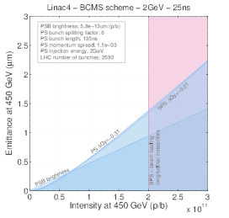
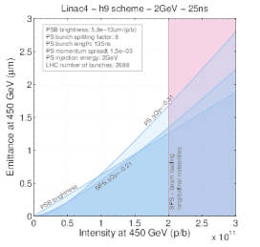
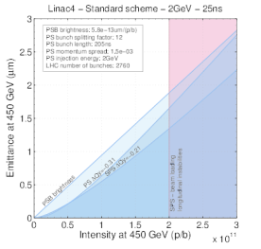
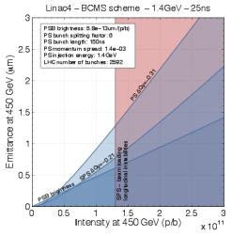
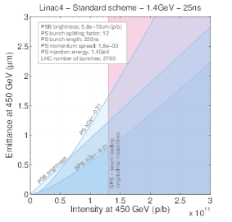
Performance of LIU schemes
H. Bartosik, G. Rumolo

Slide 27
Performance of ‘standard’ schemes
Intensity and transverse emittance at SPS extraction:
Linac2 + 1.4 GeV | 25 ns |  |  | [N_{b}] = 10¹¹, [βγε] = μm
Scheme | # | N_{b} | βγε | Limitation
Triple splitting | 72 | 1.3 | 2.5 | Brightness from Linac2 + PSB
Original ‘h=9’ | 64 |  | 1.9 | Space charge PS
BCMS | 48 |  | 1.3 | Space charge PS
Pure batch compression | 32 |  | 1.0 | Brightness from L2+PSB, space charge PS
Linac4 + 1.4 GeV | 25 ns |  |  | [N_{b}] = 10¹¹, [βγε] = μm
Scheme | # | N_{b} | βγε | Limitation
Triple splitting | 72 | 1.3 | 1.7 | Space charge PS
Original ‘h=9’ | 64 |  | 1.9 | Space charge PS, suffers from small ε_{l}
BCMS | 48 |  | 1.3 | Space charge PS
Pure batch compression | 32 |  | 1.0 | Space charge PS
\\cern.ch\dfs\Users\h\hdamerau\Public\ForRLIUP\AlternativesPerformanceAfterUpgrades_v5.xlsx

Slide 28
Performance of ‘standard’ schemes
Intensity and transverse emittance at SPS extraction:
Linac4 + 1.4 GeV + SPS RF | 25 ns |  |  | [N_{b}] = 10¹¹, [βγε] = μm
Scheme | # | N_{b} | βγε | Limitation
Triple splitting | 72 | 2.0 | 3.0 | Space charge PS
Original ‘h=9’ | 64 |  | 3.2 | Space charge PS, suffers from small ε_{l}
BCMS | 48 |  | 2.3 | Space charge PS
Pure batch compression | 32 |  | 1.6 | Space charge PS
Linac4 + 2 GeV + SPS RF | 25 ns |  |  | [N_{b}] = 10¹¹, [βγε] = μm
Scheme | # | N_{b} | βγε | Limitation
Triple splitting | 72 | 2.0 | 1.9 | Brightness from L4+PSB
Original ‘h=9’ | 64 |  | 1.71 | Space charge PS
BCMS | 48 |  | 1.4 | Space charge SPS
Pure batch compression | 32 |  | 1.4 | Space charge SPS
\\cern.ch\dfs\Users\h\hdamerau\Public\ForRLIUP\AlternativesPerformanceAfterUpgrades_v5.xlsx

Slide 29
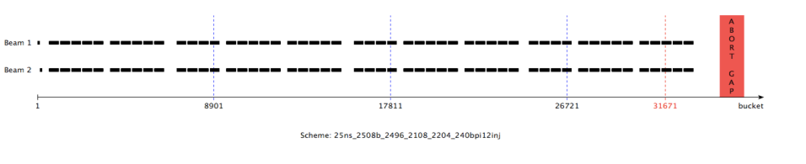
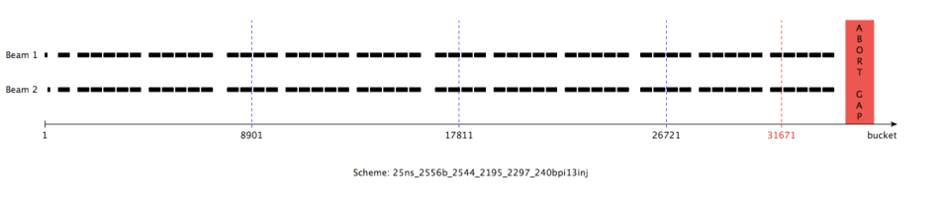
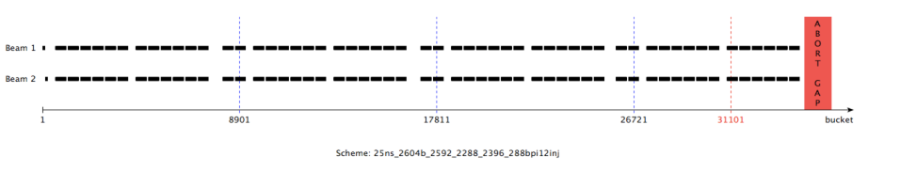
48b Filling schemes (B. Gorini)

Slide 30
Beam/Machine parameters
Momentum [TeV/c] | 6.5 / 7
Max. Number of bunches/colliding pairs IP1/5 | 2508 or 2760
Total RF Voltage | 16
ε_{L}*[eV.s] at start of fill | 2.5
Bunch length (4 σ)[ns]/ (r.m.s.) [cm] | 1/7.5
“Visible” cross-section IP1-5-8 [mb] for pile-up estimation | 85¹⁾
Pile-up limit IP1 | 140
Pile-up limit IP5 | 140
Pile-up limit IP8 | 6²⁾
Luminosity limit IP2 [10³⁴ cm⁻² s⁻¹] | 0.002³⁾
Pile-up Density can be an issue here
Need limits from experiments!
Likely 70-75 for LHCb at 6.5 TeV (R. Jacobsson)
Likely 4.5 for LHCb assuming the visible cross section above (R. Jacobsson)
Feasible?

Slide 31
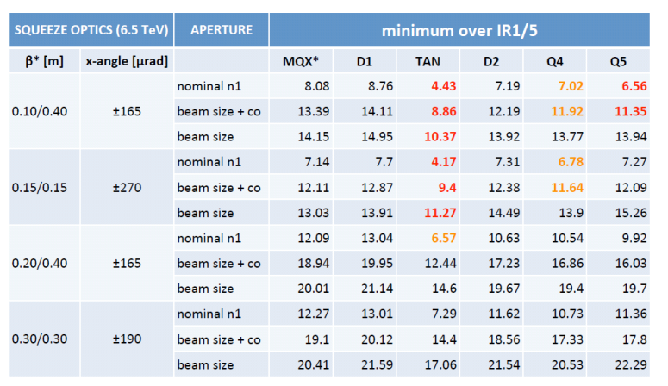
Aperture estimates for PIC layouts
Beta*<20cm needs MS in Q10 and new Q5 IR6
M. Fitterer

Slide 32
Integrated luminosity targets
Assumptions:
  Luminosity in 2015=30 fb⁻¹
  310 fb⁻¹ by the end of 2021. See M. Lamont 6th HL-LHC Coordination Group meeting 26.07.13.
 | No PIC Only gain in reduced SD | PIC | US1 | US2
Integrated luminosity by end 2021/ end 2035 | 300 | 300/1000 | 300/2000 | 300/3000
Number of years of operation after 2021 | >10 (shorter SD) | >10 (shorter SD?) | 10 | 10
Goal luminosity/year | 40-60 | 70 | 170 | 270

