Slide 1


Welcome to CERN
Accelerating Science and Innovation
Notes:
1

Slide 2
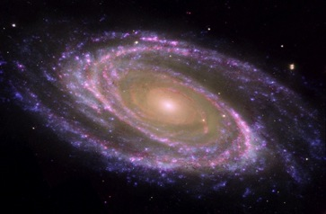
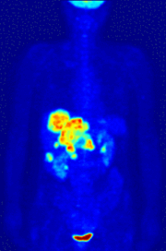
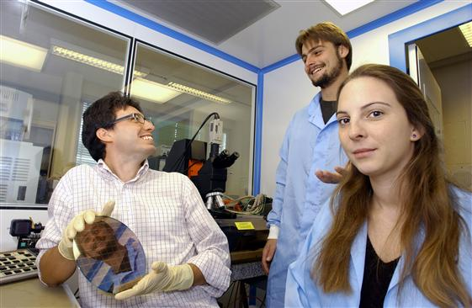
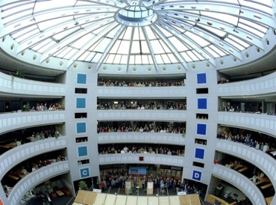
The Missions of CERN
Push forward the frontiers of knowledge
What are the constituent parts of matter? What was matter like during
the first moments of the Big Bang?
Develop new technologies
Information technologies – the Web and the Grid
Medicine – diagnostics and therapy
Train the scientists and engineers
of tomorrow
Unite people from different
countries and cultures

Slide 3
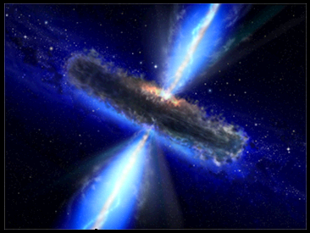
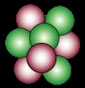
CERN searches for answers…
…to the fundamental questions
What was it like during the birth
of the Universe?
What makes up the matter we see around us?
What causes the basic phenomena that we observe, like forces and mass?

Slide 4
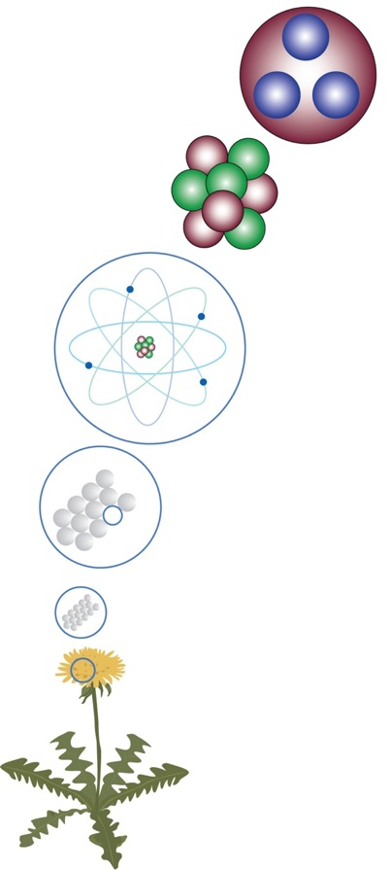
What we knew about matter before
the second World War
1808 : Confirmation of the existence of atoms
Neutrons
Protons
1897 : Discovery of the electron
Nucleus
Electrons
1911 : Discovery that atoms are made up of positively-charged nucleus and orbiting electons
Atom
1919 : Discovery of the proton
1932 : Discovery of the neutron
Molecule
All of these discoveries were
made in Europe!
Matter

Slide 5
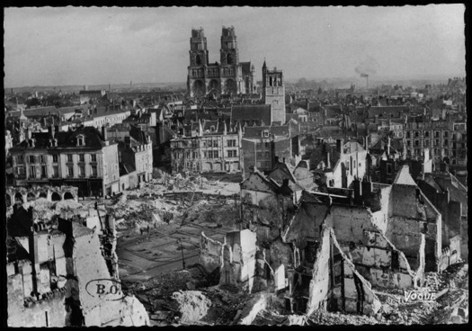
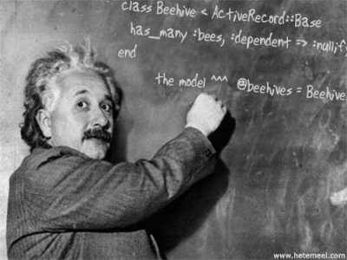
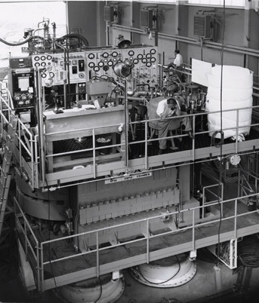
CERN was founded in the aftermath
of the second World War
Europe was devestated, as well as its means of research…
Many of the brightest European minds fled to the United States…
The US and the USSR then took the lead in scientific research

Slide 6
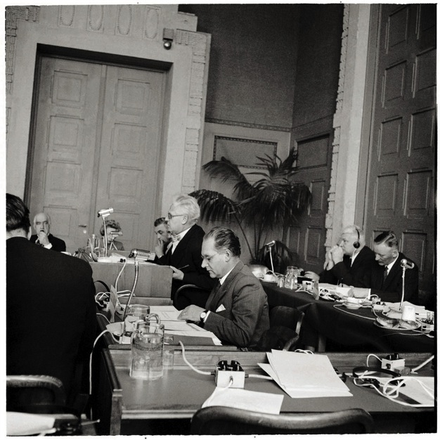
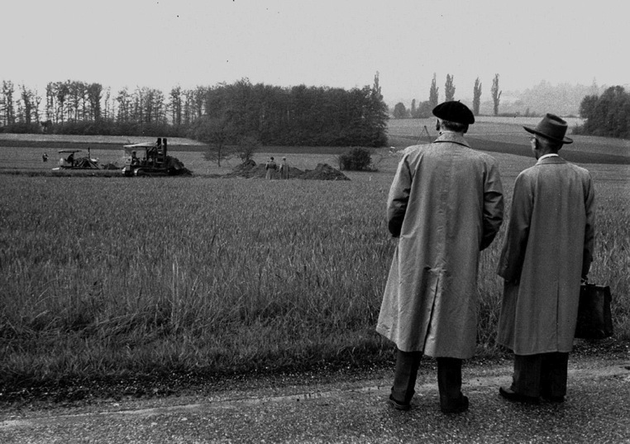
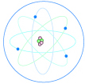
CERN was founded in the aftermath
of the second World War
CERN was founded by 12 European states on September 29, 1954
CERN: Conseil Européen pour la Recherche Nucléaire
(European Council for Nuclear Research)
Nucleus: the heart of the atom
Notes:
Les outils de recherche ne peuvent être construits par un seul pays. Il faut s’unir.
Le CERN est fondé en 1954 avec 12 Etats membres, don’t les pays qui se sont combattus. C’est le premier exemple de collaboration à l’échelle européenne, et c’est une vraie réussite.

Slide 7
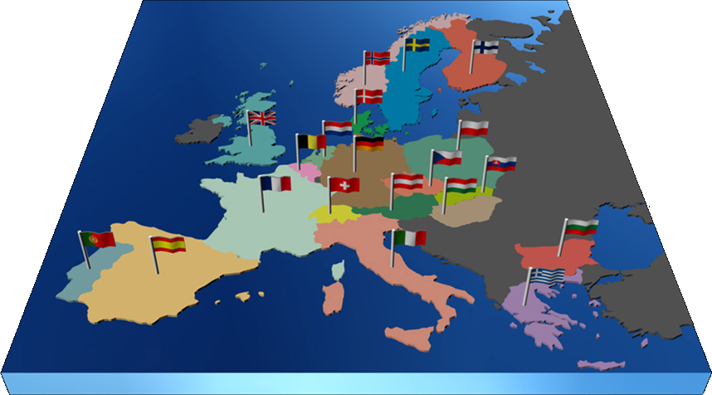

The largest particle physics laboratory in the world
Today…
Annual budget
in 2013
~ 1200 MCHF (960MEUR)
Personnel
~2500 Staff
~900 Fellows and Associates
~350 Students
~11000 Users
As of Dec 31 2012
1 Candidate for Accession:
Romania
2 Associate Members in Pre-Stage to Membership:
Israel, Serbia
7 with Applicant Status for Membership or Associate Membership:
Brazil, Cyprus (awaiting ratification), Pakistan, Russia, Slovenia, Turkey, Ukraine
7 Observers to the Council:
India, Japan, Russia, Turkey, USA, European Commission and UNESCO
20 Member States
Austria, Belgium, Bulgaria, the Czech Republic, Denmark, Finland, France, Germany, Greece, Hungary, Italy, the Netherlands, Norway, Poland, Portugal, Slovakia, Spain, Sweden, Switzerland, and the United Kingdom.

Slide 8
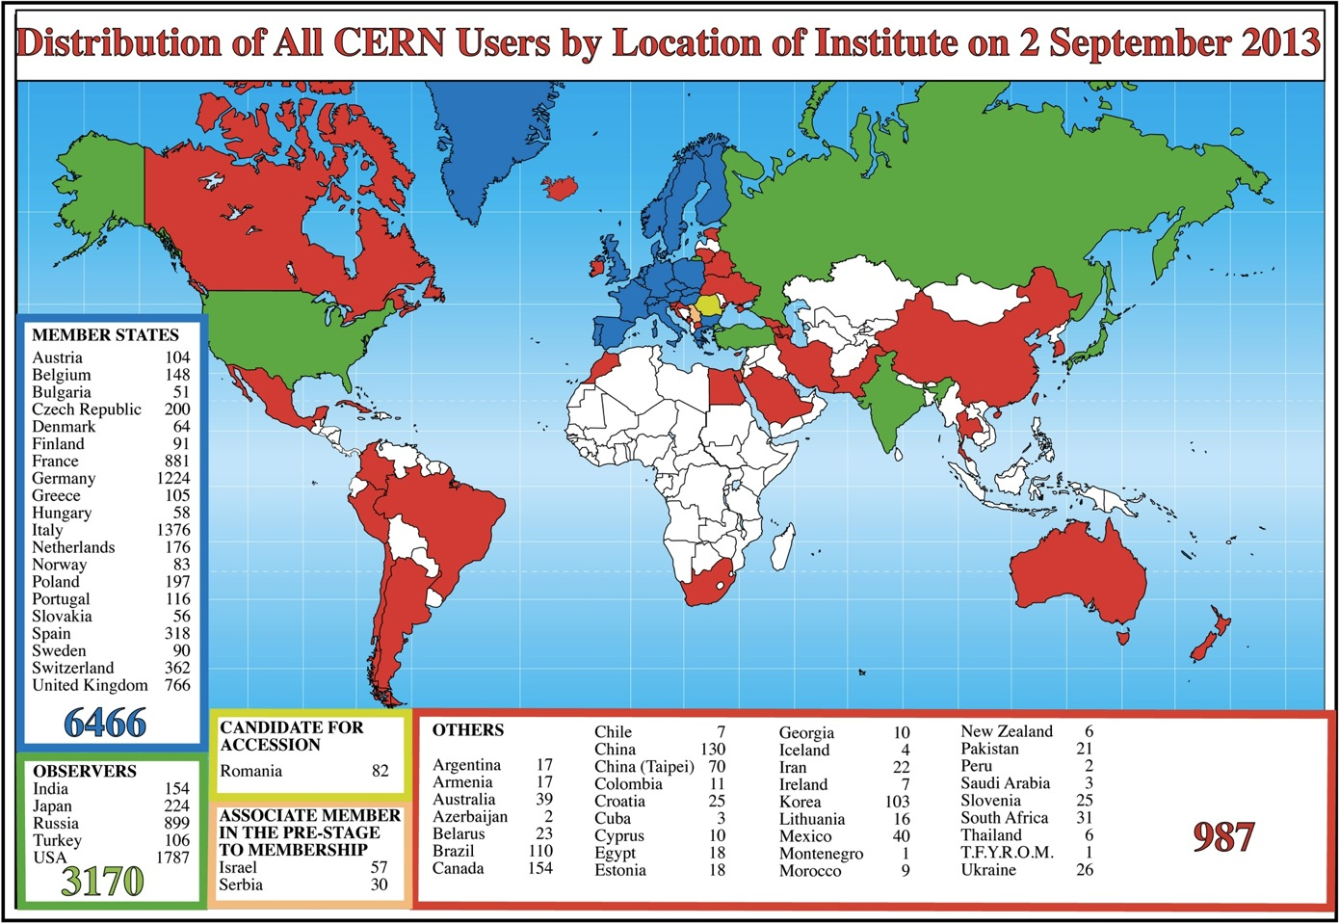

Slide 9
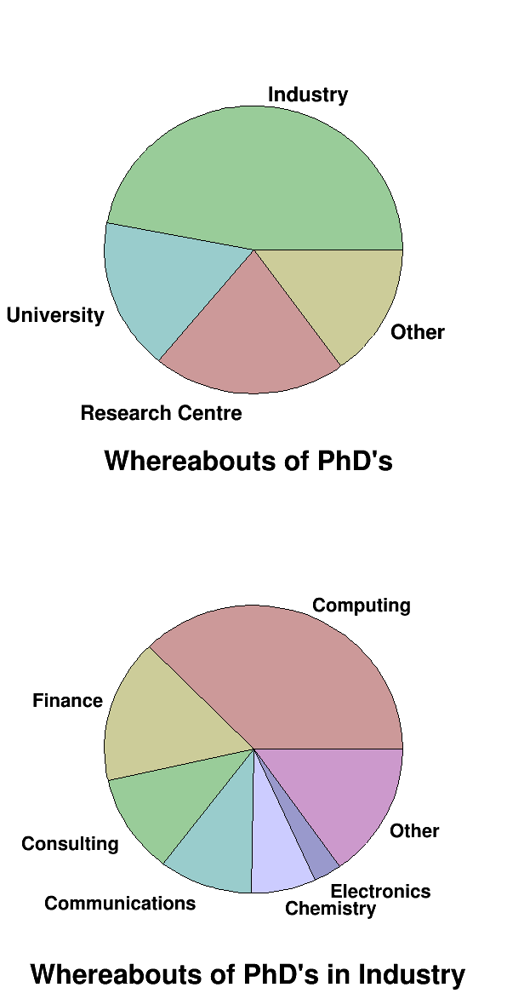
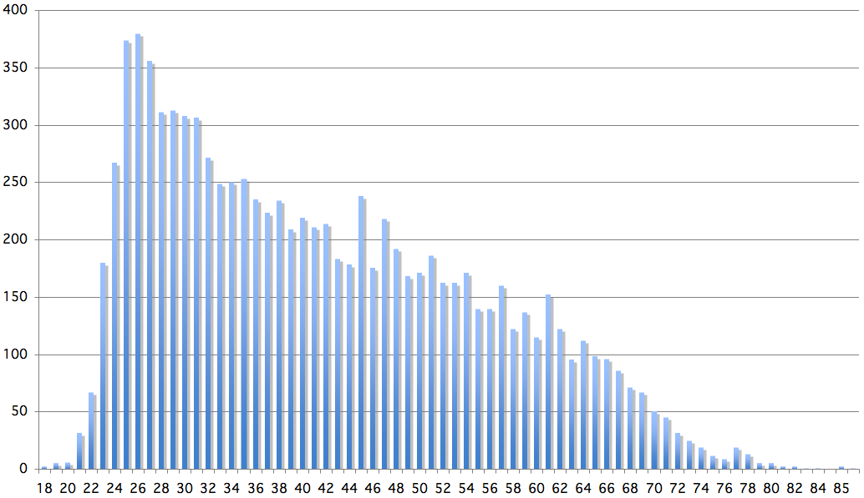
Age Distribution of Scientists
26
Today :
∼2500 PhD students
in LHC experiments
65
Age
Where do they go after CERN ?

Slide 10
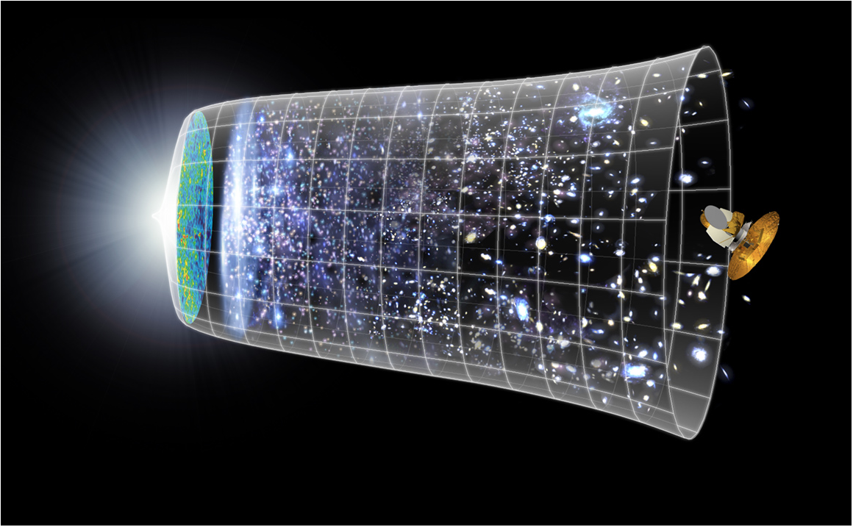


Next Scientific Challenge:
To understand the very first moment of our Universe
after the Big Bang
Big Bang
WMAP
13.8 Billion Years
Today
10²⁸ cm

Slide 11
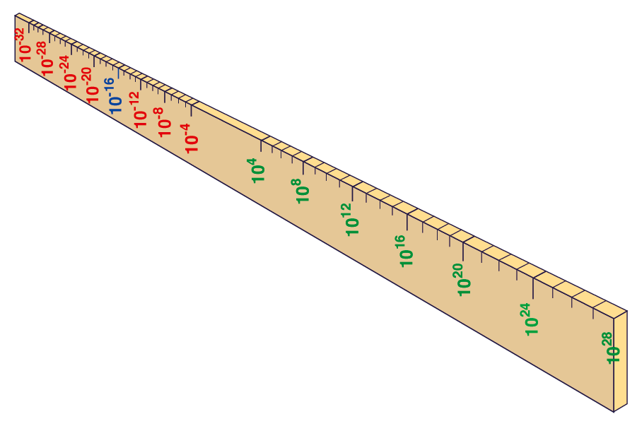
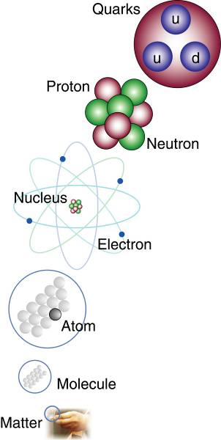
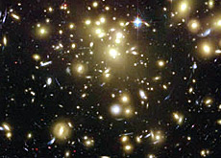
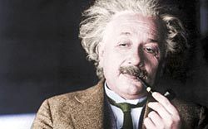


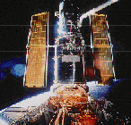
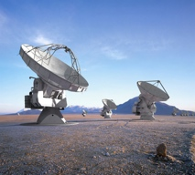
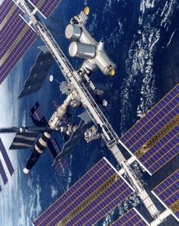
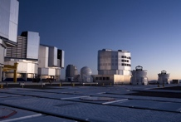
Big Bang
Proton
Atom
Radius of Earth
Earth to Sun
Radius of Galaxies
Universe
LHC
Super-Microscope
Hubble
ALMA
cm
Study physics laws of first moments after Big Bang.
Increasing Symbiosis between Particle Physics, Astrophysics and Cosmology
AMS
VLT
Notes:
11

Slide 12
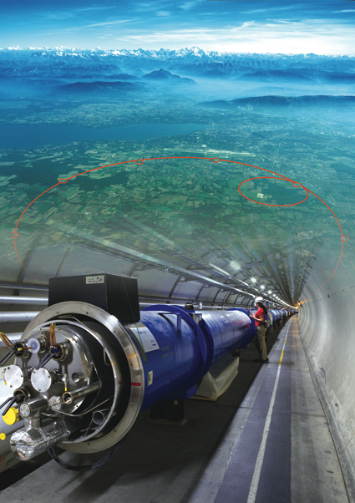
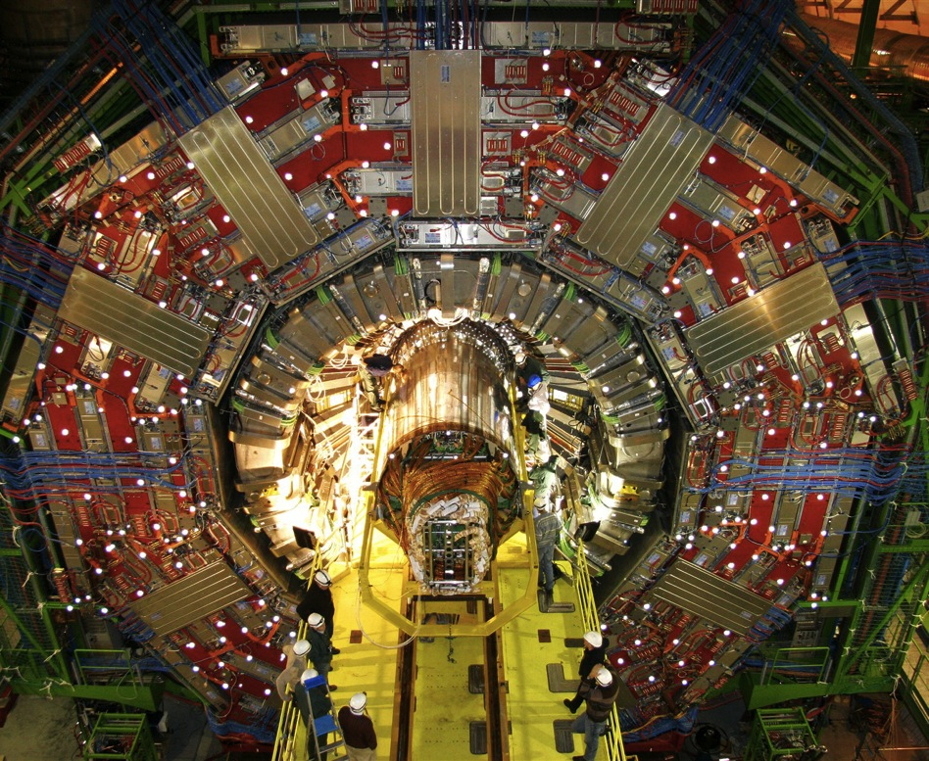
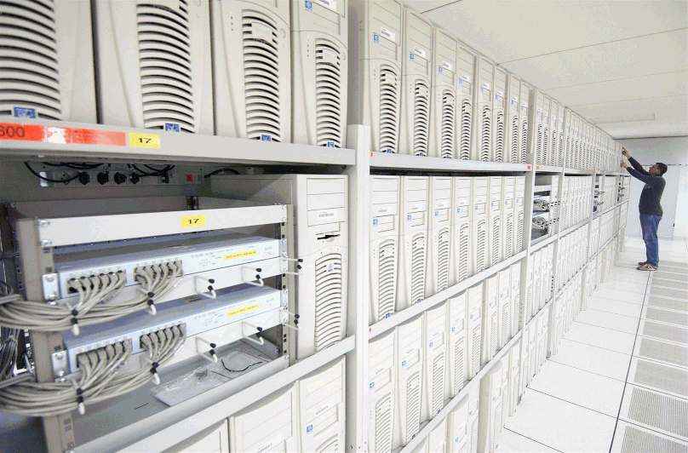
The instruments used
1. Particle accelerator :
Boost particles to high energies and make them collide
2. Detectors :
Gigantic instruments that observe and record the results of the collisions
(particle trajectories, energy, charge..)
3. Computers :
Collect, store, and send around the world the big quantity of data received from the detectors for data analysis.

Slide 13
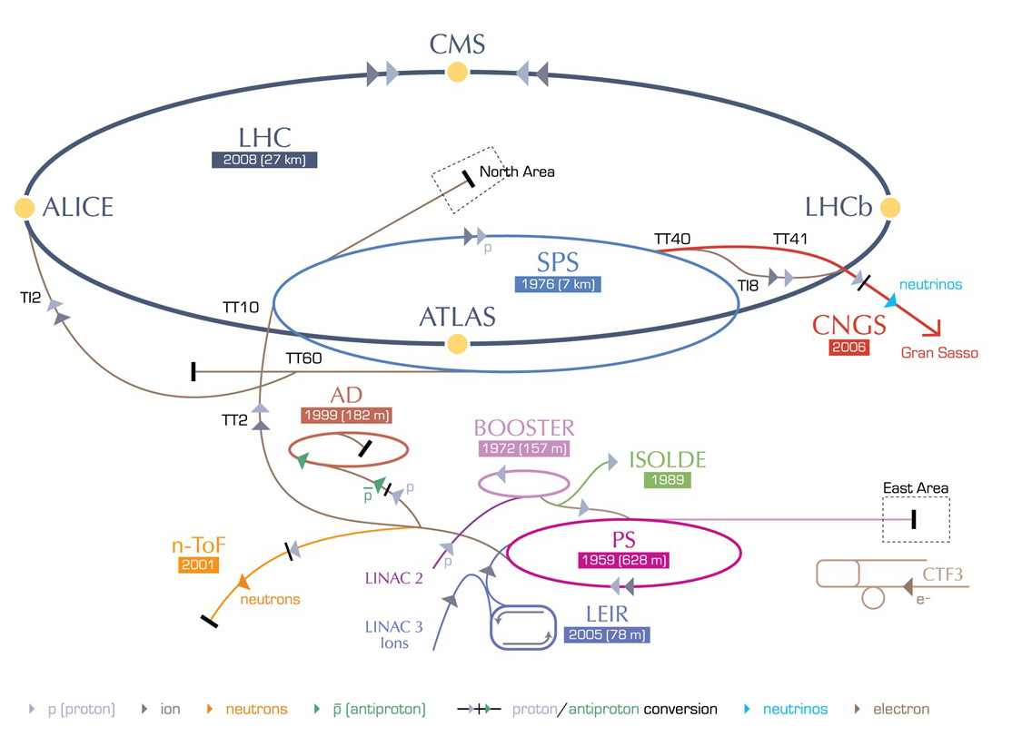
CERN accelerator complex

Slide 14
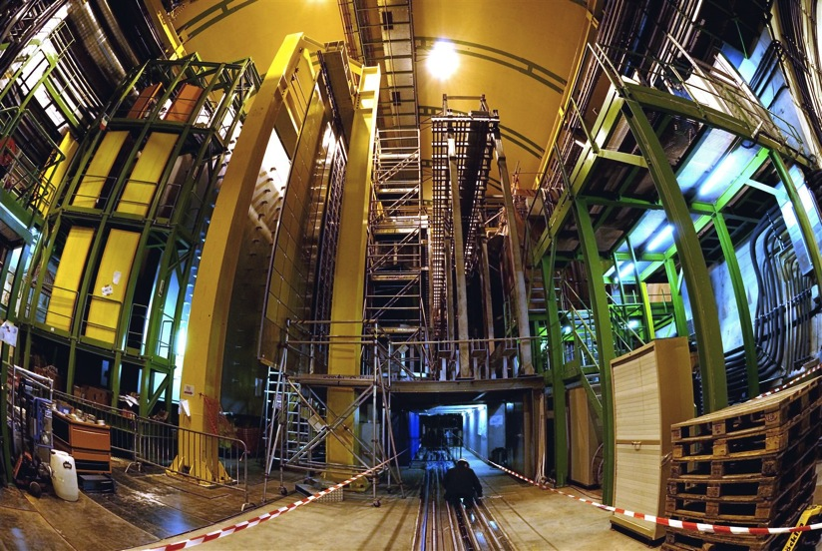
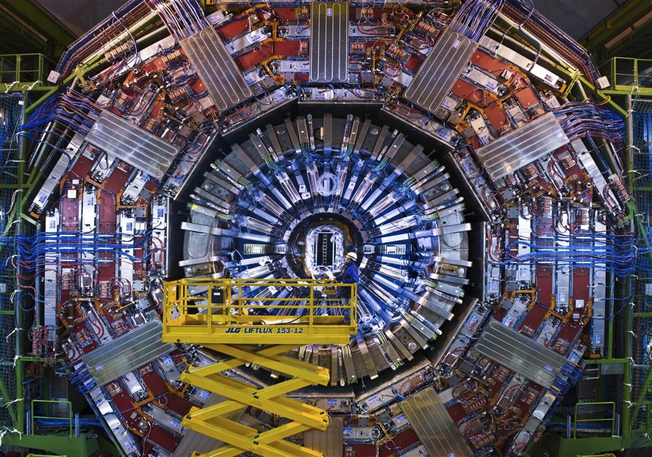
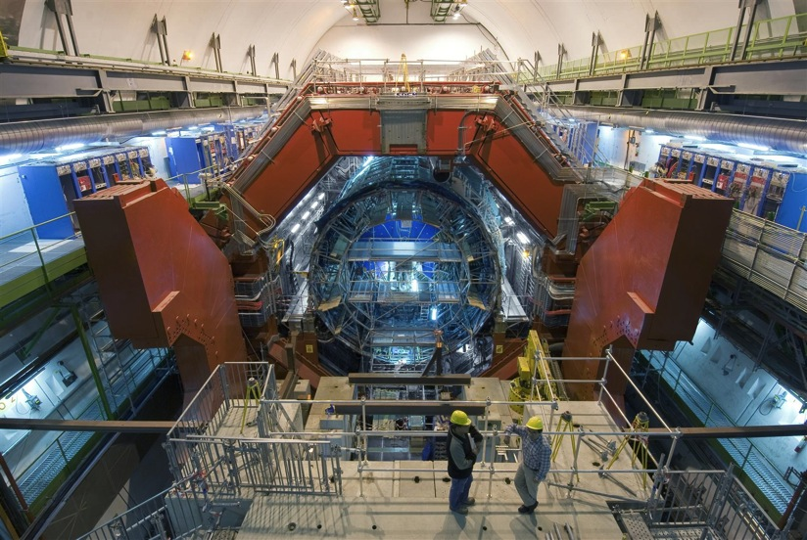
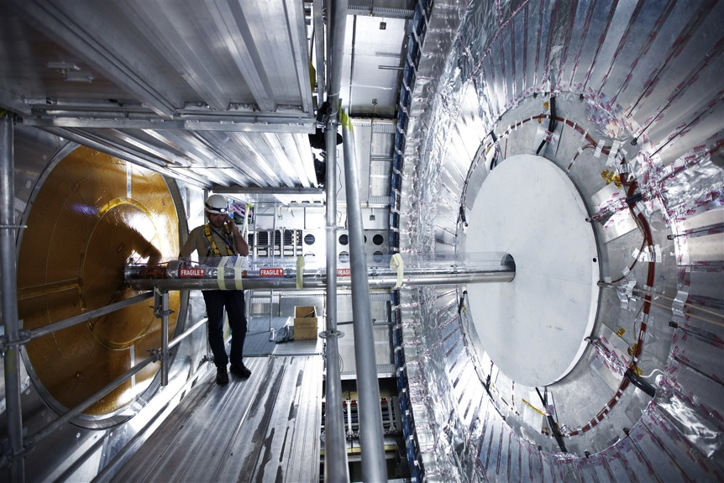
The most complex detectors
  Science cathedral 100 m underground
  Record
  600 millions of collisions every second
  100 millions of sensors
  Thousands of scientific collaborators

Slide 15



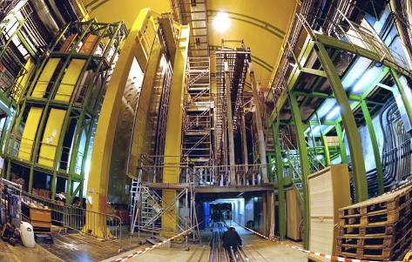
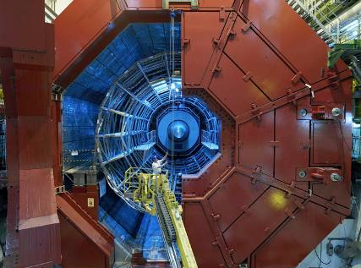


LHC experiments
LHC ring :
27 km long
CMS
LHCb
ALICE
ATLAS
France et CERN / Mai 2009
15
l'Université de Genève 450 ans / 1 avril 2009
Notes:
15

Slide 16
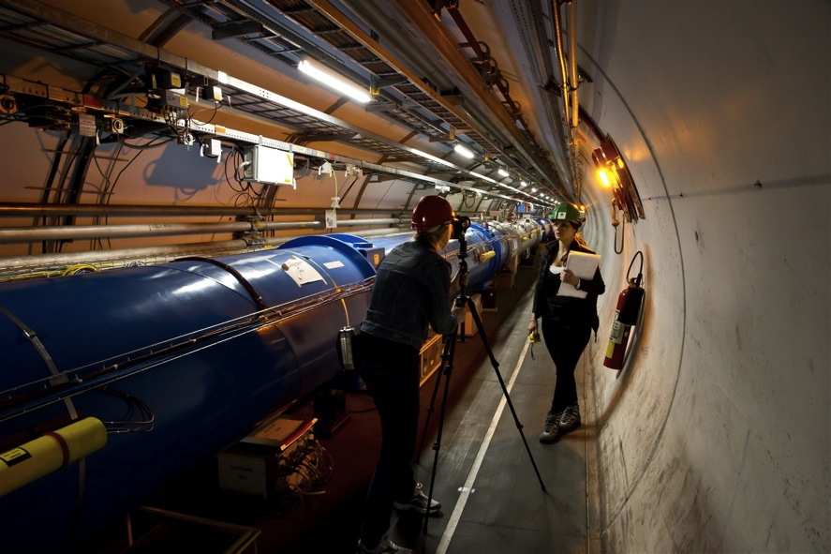
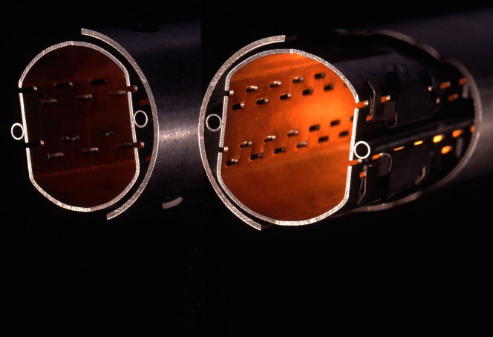
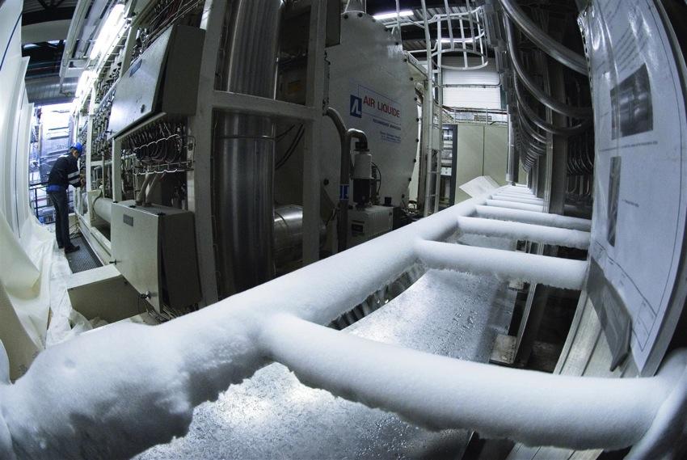
The most powerful particle accelerator
  27km tunnel
  Thousands of superconducting magnets
  Ultrahigh vacuum:
  10x stronger vacuum than on the Moon
  The coldest place in the universe:
  -271.3° C

Slide 17
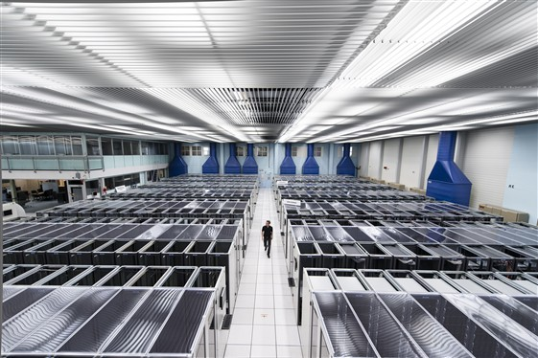
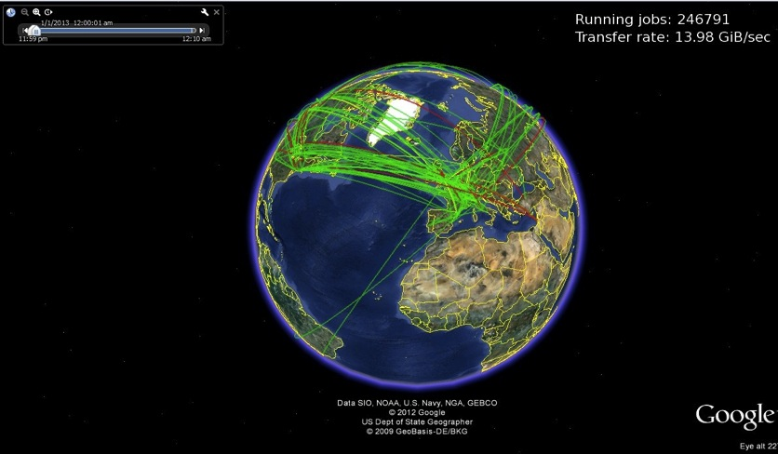
The Worldwide LHC Computing Grid
  25 millions Gb of data (25 Pb) collected every year
  (3 millions DVDs –
  850 years of movies)
  100 000 processors
  150 worldwide computing centres
Activity the 1st January 2013
246791 running jobs

Slide 18
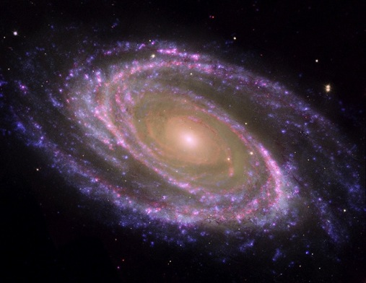
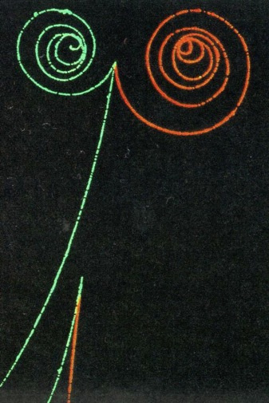
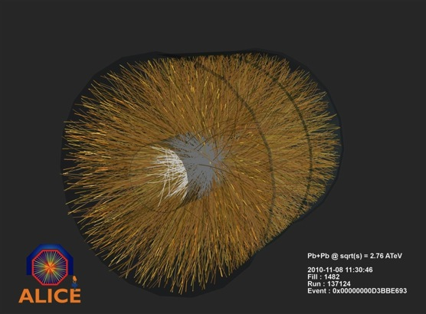
To answer some of the big questions
What are the constituents of the
universe (dark matter) ?
Where is the anti-matter ?
What is the primordial state of matter after the Big Bang ?
How have particles gained their mass ?

Slide 19
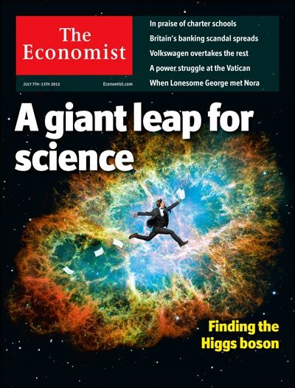
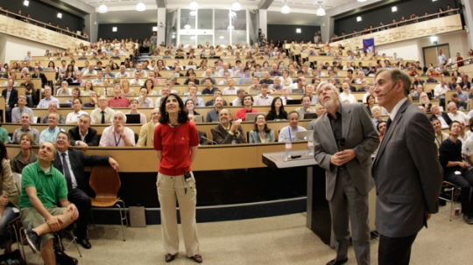
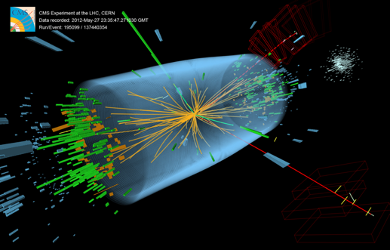
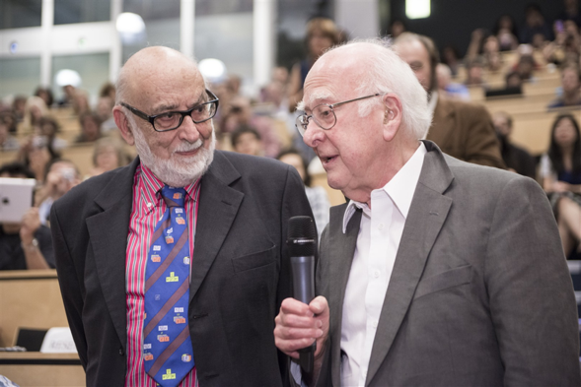
Discovery announced in 2012
François Englert et Peter Higgs

Slide 20
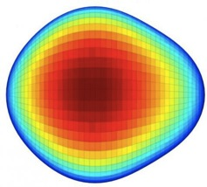
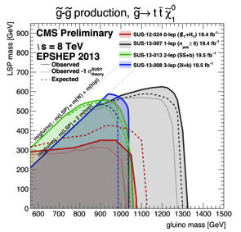











And many other results…
Standard Model
Extra dimensions, tiny black holes
Exotic nuclei
Antimatter
Supersymmmetry
Quark-gluon plasma
Etc…

Slide 21




Particle Physics and innovation
Interfacing between fundamental science and key technological developments
Technologies and Innovation
Accelerating particles beams
Detecting particles
Large-scale computing (Grid)
Notes:
21

Slide 22




Applications of CERN Research
The World Wide Web invented at CERN… freely available
Particle detectors… medical imaging, cancer treatment
Without fundamental research, there is are no applied studies
The computing Grid … climatology, cartography, medicine,…

Slide 23








Medical Applications: an Example of Particle Physics Spin-off
Combining Physics, Medical Imaging, Biology and Medicine to fight cancer
Hadron Therapy
Tumour = target
Accelerating particle beams
~30’000 accelerators worldwide
~17’000 used for medicine
Protons;
Light ions
X-rays
protons
>70’000 patients treated worldwide (30 facilities)
>21’000 patients treated in Europe (9 facilities)
Imaging
PET Scanner
New breast imaging.
Clinical trial in Portugal.
(ClearPEM)
Detecting particles
Normal
brain
Alzheimer’s disease
Notes:
23

Slide 24




Education Activities for every level
Students
Doctoral and technical students
Summer student programme
Short-term internship programme (scientific, technical, and administrative)
Programmes for pupils of all ages
Young Researchers
CERN School of High Energy Physics
CERN School of Computing
CERN Accelerator School
Scientists at CERN
Academic Training Programme
School Teachers
International and National Programmes

Slide 25

CERN Teacher Programme

Slide 26
Thank you for your attention
Any questions ?
Notes:
26

Slide 27

Safety Information for Visitors
Safety is our highest priority
We are confident that you have read the Safety Information provided prior
to the visit and ask that you take the time to read the document placed
in front of you once more before embarking on the site visit.
By taking part in the site visit you are deemed to have understood and accepted the Safety Information provided to you.
Please always follow the instructions given by your guide
and do not hesitate to ask if you have any questions.

Slide 28





LHC, the world’s most powerful accelerator
LHCb
CMS
ATLAS
ALICE
LHC ring:
27 km circumference
Notes:
28

